Slide 1
French Phonics Collection
SSC [r]
Artwork by: Chloé Motard
Date updated: 30/08/2022
Notes:
Artwork by Chloé Motard. All additional pictures selected are available under a Creative Commons license, no attribution required.

Slide 2
SSC [r]
phonétique
Introduction

Slide 3
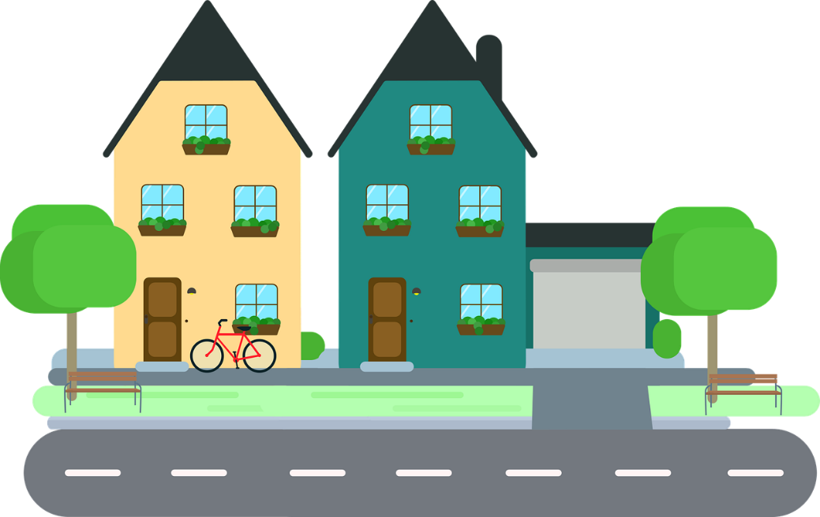
r
rue
Notes:
Timing: 1 minute
Aim: To introduce SSC [r]
Procedure: 1. Present the letter(s) and say the [r] sound first, on its own. Students repeat it with you. 2. Bring up the word ”rue” on its own, say it, students repeat it, so that they have the opportunity to focus all of their attention on the connection between the written word and its sound.
3. A possible gesture for this would be to look left and right and mime crossing a road. 4. Roll back the animations and work through 1-3 again, but this time, dropping your voice completely to listen carefully to the students saying the [r] sound, pronouncing ”rue” and, if using, doing the gesture.
Word frequency (1 is the most frequent word in French):
rue [598]
Source: Londsale, D., & Le Bras, Y. (2009). A Frequency Dictionary of French: Core vocabulary for learners London: Routledge.

Slide 4
r
rue
Notes:
With sound and no pictures to focus all attention on the sound-symbol correspondence.

Slide 5
r
rue
Notes:
Without sound to elicit pronunciation (without first hearing the teacher).
Teacher to elicit pronunciation by asking “Comment dit-on …”

Slide 6
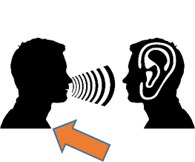
r
triste
frère
[brother]
moderne
rue
parler
[modern]
être
[to be]
Notes:
Timing: 2 minutes
Aim: To introduce SSC [r]
Procedure:
Introduce and elicit the pronunciation of the individual SSC [r] and then the source word again ‘rue’ (with gesture, if using). Then present and elicit the pronunciation of the five cluster words. The cluster words have been chosen for their high-frequency, from a range of word classes, with the SSC (where possible) positioned within a variety of syllables within the words (e.g. initial, 2nd, final etc.). Additionally, we have tried to use words that build cumulatively on previously taught SSCs (see the Phonics Teaching Sequence document) and do not include new SSCs. Where new SSCs are used, they are often consonants which have a similar symbol-sound correspondence in English.
Word frequency (1 is the most frequent word in French): rue [598]; frère [1043], triste [1843], moderne [1239], être [5], parler [106] Source: Londsale, D., & Le Bras, Y. (2009). A Frequency Dictionary of French: Core vocabulary for learners London: Routledge.

Slide 7
r
triste
frère
moderne
rue
parler
être
Notes:
With sound and no pictures to focus all attention on the sound-symbol correspondence.

Slide 8
r
triste
frère
moderne
rue
parler
être
Notes:
Without sound to elicit pronunciation (without first hearing the teacher).
Teacher to elicit pronunciation by asking “Comment dit-on …”

Slide 9
[r] en anglais vs français
écouter / parler
horrible | horrible
university | université
party | partie (part)
orientate | orienter
paragraph | paragraphe
interview | interview
[r] is a raspy sound pronounced in the back of the throat.
A
B
C
To pronounce [r], press your tongue towards the place you would pronounce English ‘g’, but don’t close your throat completely.
D
E
F
Notes:
Timing: 5 minutes
Aim: practising aural recognition and oral production of SSC [r]
Procedure:
Students say the English words, with their hands on their throats, paying particular attention to the pronunciation of [r]. They shouldn’t feel any vibration when pronouncing the [r].
Click on the letters to hear the French word. Pay attention to the pronunciation of the [r]. Before attempting to say the words, students should ‘warm up’ by saying the English letter ‘g’ a few times, feeling the vibration in their throats.
Students repeat the French word as many times as is necessary with their hands on their throats. They should feel a vibration when saying the [r].
Transcript:
horrible
université
partie
orienter
paragraphe
interview
Word frequency (1 is the most frequent word in French): horrible [3190], université [1192], partie [118], orienter [2124], paragraphe [2126], interview [3186]
Source: Londsale, D., & Le Bras, Y. (2009). A Frequency Dictionary of French: Core vocabulary for learners London: Routledge.

Slide 10
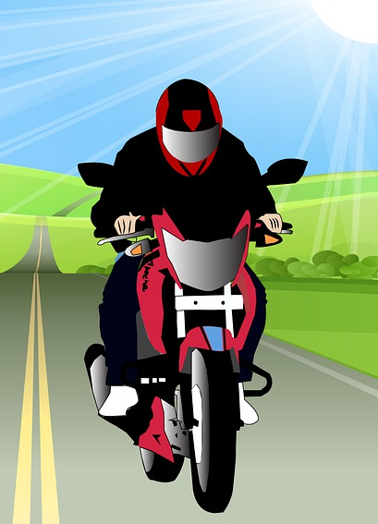
Des virelangues !
écouter / parler
Cinq gros rats grillent dans la grosse graisse grasse
[Five fat rats are roasting in the fatty, greasy fat]
1
2
3
La roue sur la rue roule; la rue sous la roue reste.
[The wheel on the road is rolling; the road under the wheel is resting.]
1
2
3
Notes:
Timing: 5 minutes
Aim: practising oral production of SSC [r]
Procedure:
1. Using their knowledge of the meanings of langue, ask students what they think the word virelangue might mean.
2. Click on ‘1’ to hear a tongue twister pronounced at a slow speed. Students repeat as many times a necessary.
3. If students feel confident, click on ‘2’ to hear a tongue twister pronounced at a medium speed, and repeat step 2.
4. At very advanced levels, students can try speed 3!
Transcript:
Cinq gros rats grillent dans la grosse graisse grasse.
La roue sur la rue roule; la rue sous la roue reste.

Slide 11
SSC [r]
phonétique
Consolidation [1]

Slide 12
r
rue
Notes:
Timing: 1 minute
Aim: To consolidate SSC [r]
Procedure: 1. Present the letter(s) and say the [r] sound first, on its own. Students repeat it with you. 2. Bring up the word ”rue” on its own, say it, students repeat it, so that they have the opportunity to focus all of their attention on the connection between the written word and its sound.
3. A possible gesture for this would be to look left and right and mime crossing a road. 4. Roll back the animations and work through 1-3 again, but this time, dropping your voice completely to listen carefully to the students saying the [r] sound, pronouncing ”rue” and, if using, doing the gesture.
Word frequency (1 is the most frequent word in French):
rue [598]
Source: Londsale, D., & Le Bras, Y. (2009). A Frequency Dictionary of French: Core vocabulary for learners London: Routledge.

Slide 13
Phonétique [r]
parler
It is a raspy sound pronounced in the back of the throat. Not like English ‘r’!
There is no equivalent sound in English.
Follow these steps to learn how to pronounce [r]:
1. Open your mouth.
2. Close your throat as if you’re about to gargle and say ‘k’ several times.
3. Start again but don’t close your throat completely.
4. Instead of ‘k’, practise saying “ra-ra-ra”.
Notes:
Timing: 2 minutes
Aim: To build familiarity with movement in the mouth and throat when saying SSC [r].
Procedure:
1. Click to reveal step by step process of pronouncing [r].
2. Students should practise for a minute.

Slide 14
[r] en anglais vs français
écouter / parler
comparison | comparaison
universe | univers
royal | royal
precaution | précaution
circle | cercle
consider | considère
[r] is a raspy sound pronounced in the back of the throat.
A
B
C
To pronounce [r], start as if to pronounce English ‘k’, but don’t close your throat completely.
D
E
F
Notes:
Timing: 5 minutes
Aim: Oral production of SSC [r]. Raising awareness of pronunciation differences between French and English [r].
Procedure:
1. Students say the English words, with their hands on their throats, paying particular attention to the pronunciation of [r]. They shouldn’t feel any vibration when pronouncing the [r].
2. Click on the letters to hear the French word said by a native speaker. Students repeat.
Transcript:
1. comparaison
2. univers
3. royal
4. précaution
5. cercle
6. considère
Word frequency (1 is the most frequent word in French): comparaison [2244], univers [2112], royal [2290], considerer [255], cercle [2258], précaution [2218]
Source: Londsale, D., & Le Bras, Y. (2009). A Frequency Dictionary of French: Core vocabulary for learners London: Routledge.

Slide 15
r
triste
frère
[brother]
moderne
rue
parler
[modern]
être
[to be]
Notes:
Timing: 2 minutes
Aim: To consolidate SSC [r]
Procedure:
Introduce and elicit the pronunciation of the individual SSC [r] and then the source word again ‘rue’ (with gesture, if using). Then present and elicit the pronunciation of the five cluster words. The cluster words have been chosen for their high-frequency, from a range of word classes, with the SSC (where possible) positioned within a variety of syllables within the words (e.g. initial, 2nd, final etc.). Additionally, we have tried to use words that build cumulatively on previously taught SSCs (see the Phonics Teaching Sequence document) and do not include new SSCs. Where new SSCs are used, they are often consonants which have a similar symbol-sound correspondence in English.
Word frequency (1 is the most frequent word in French): rue [598]; frère [1043], triste [1843], moderne [1239], être [5], parler [106] Source: Londsale, D., & Le Bras, Y. (2009). A Frequency Dictionary of French: Core vocabulary for learners London: Routledge.

Slide 16
Des virelangues !
lire / parler
Un rare reptile ressemble à son rival rose.
[A rare reptile looks like its pink rival]
a
b
c
Notes:
Timing: 4 minutes for 4 slides
Aim: Oral production of SSC [r].
Procedure:
1. Read the tongue twister.
2. Click to hear example pronunciation (a = slow; b = fast; c = very fast).
3. Click to reveal English translations.
4. Repeat on next slides (4 tongue twisters in total).
Transcript:
Un rare reptile ressemble à son rival rose.
Word frequency (1 is the most frequent word in French): rare [1233], reptile [>5000], ressembler [1398], rival [3758], rose [2671]
Source: Londsale, D., & Le Bras, Y. (2009). A Frequency Dictionary of French: Core vocabulary for learners London: Routledge.

Slide 17
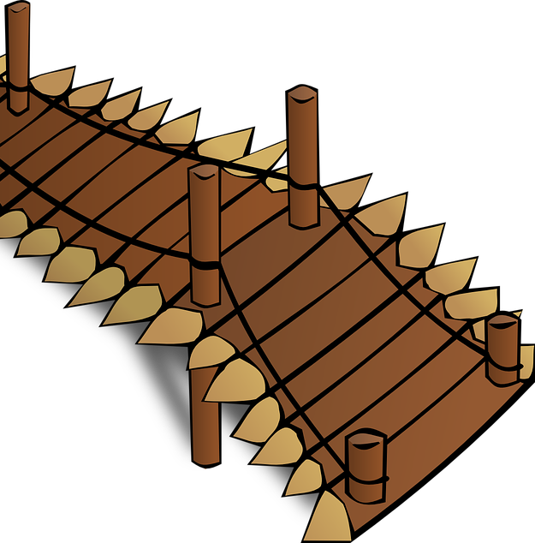
Des virelangues !
lire / parler
Une roche roule avec rage
le long de la rampe rustique.
[A rock rolls with rage
along the rustic ramp]
a
b
c
Notes:
Transcript:
Une roche roule avec rage le long de la rampe rustique.
Word frequency (1 is the most frequent word in French): roche [>5000], rouler [2599], rage [3035], rampe [>5000], rustique [>5000]
Source: Londsale, D., & Le Bras, Y. (2009). A Frequency Dictionary of French: Core vocabulary for learners London: Routledge.

Slide 18
Des virelangues !
lire / parler
Un repas de gaufres et de rillettes
est un vrai régal revigorant.
[A meal of waffles and rillettes
is a real invigorating treat]
rillettes = minced pork, a bit like pâté
a
b
c
Notes:
Transcript:
Un repas de gaufres et de rillettes est un vrai régal revigorant.
Word frequency (1 is the most frequent word in French): gaufre [>5000], rillette [>5000], régal [>5000], revigorant [>5000]
Source: Londsale, D., & Le Bras, Y. (2009). A Frequency Dictionary of French: Core vocabulary for learners London: Routledge.

Slide 19
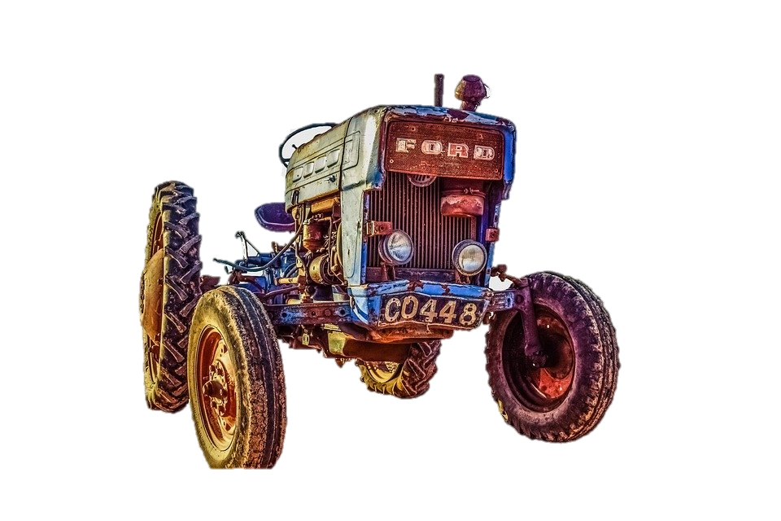
Des virelangues !
lire / parler
Un tracteur rouillé ne rajeunit
réellement pas !
[A rusty tractor doesn’t really
get any younger!]
This is a proverb meaning – it will only get worse with time!
a
b
c
Notes:
Transcript:
Un tracteur rouillé ne rajeunit réellement pas!
Note: the negative adverb in this proverb is normally jamais rather then pas.
Word frequency (1 is the most frequent word in French): tracteur [>5000], rouiller [>5000], rajeunir [>5000], réellement [1563]
Source: Londsale, D., & Le Bras, Y. (2009). A Frequency Dictionary of French: Core vocabulary for learners London: Routledge.

Slide 20
SSC [r]
phonétique
Consolidation [2]

Slide 21
r
rue
Notes:
Timing: 1 minute [2 slides]
Aim: To consolidate [delete as appropriate] SSC [r]
Procedure: 1. Present the letter(s) and say the [r] sound first, on its own. Students repeat it with you. 2. Bring up the word ”rue” on its own, say it, students repeat it, so that they have the opportunity to focus all of their attention on the connection between the written word and its sound.
3. A possible gesture for this would be to look left and right and mime crossing a road. 4. Roll back the animations and work through 1-3 again, but this time, dropping your voice completely to listen carefully to the students saying the [r] sound, pronouncing ”rue” and, if using, doing the gesture.
Word frequency (1 is the most frequent word in French):
rue [598]
Source: Londsale, D., & Le Bras, Y. (2009). A Frequency Dictionary of French: Core vocabulary for learners London: Routledge.

Slide 22
r
triste
frère
[brother]
moderne
rue
parler
[modern]
être
[to be]
Notes:
Aim: To consolidate SSC [r]
Procedure:
Introduce and elicit the pronunciation of the individual SSC [r] and then the source word again ‘rue’ (with gesture, if using). Then present and elicit the pronunciation of the five cluster words. The cluster words have been chosen for their high-frequency, from a range of word classes, with the SSC (where possible) positioned within a variety of syllables within the words (e.g. initial, 2nd, final etc.). Additionally, we have tried to use words that build cumulatively on previously taught SSCs (see the Phonics Teaching Sequence document) and do not include new SSCs. Where new SSCs are used, they are often consonants which have a similar symbol-sound correspondence in English.
Word frequency (1 is the most frequent word in French): rue [598]; frère [1043], triste [1843], moderne [1239], être [5], parler [106] Source: Londsale, D., & Le Bras, Y. (2009). A Frequency Dictionary of French: Core vocabulary for learners London: Routledge.

Slide 23
SSC [r]
phonétique
Consolidation [3]

Slide 24
r
rue
Notes:
Timing: 1 minute
Aim: To consolidate SSC [r]
Procedure: 1. Present the letter(s) and say the [r] sound first, on its own. Students repeat it with you. 2. Bring up the word ”rue” on its own, say it, students repeat it, so that they have the opportunity to focus all of their attention on the connection between the written word and its sound.
3. A possible gesture for this would be to look left and right and mime crossing a road. 4. Roll back the animations and work through 1-3 again, but this time, dropping your voice completely to listen carefully to the students saying the [r] sound, pronouncing ”rue” and, if using, doing the gesture.
Word frequency (1 is the most frequent word in French):
rue [598]
Source: Lonsdale, D., & Le Bras, Y. (2009). A Frequency Dictionary of French: Core vocabulary for learners London: Routledge.

Slide 25
r
triste
frère
[brother]
moderne
rue
parler
[modern]
être
[to be]
Notes:
Timing: 2 minutes
Aim: To consolidate SSC [r]
Procedure:
Introduce and elicit the pronunciation of the individual SSC [r] and then the source word again ‘rue’ (with gesture, if using). Then present and elicit the pronunciation of the five cluster words. The cluster words have been chosen for their high-frequency, from a range of word classes, with the SSC (where possible) positioned within a variety of syllables within the words (e.g. initial, 2nd, final etc.). Additionally, we have tried to use words that build cumulatively on previously taught SSCs (see the Phonics Teaching Sequence document) and do not include new SSCs. Where new SSCs are used, they are often consonants which have a similar symbol-sound correspondence in English.
Word frequency (1 is the most frequent word in French): rue [598]; frère [1043], triste [1843], moderne [1239], être [5], parler [106] Source: Lonsdale, D., & Le Bras, Y. (2009). A Frequency Dictionary of French: Core vocabulary for learners London: Routledge.

Slide 26
Phonétique [r]
info
Remember that it is a raspy sound pronounced in the back of the throat, and is not like the English ‘r’!
There is no equivalent sound in English.
Follow these steps to revise pronunciation of [r]:
1. Open your mouth.
2. Close your throat as if you’re about to gargle and say ‘k’ several times.
3. Start again but don’t close your throat completely.
4. Instead of ‘k’, practise saying “ra-ra-ra”.
Notes:
Timing: 2 minutes
Aim: To build familiarity with movement in the mouth and throat when saying SSC [r].
Procedure:
1. Click to reveal step by step process of pronouncing [r].
2. Students should practise for a minute.

Slide 27
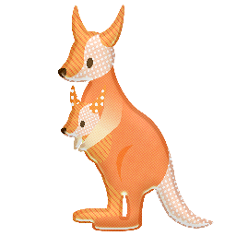
Phonétique: SSC [r]
Qui va avec chaque phrase?
lire/parler
Catherine
Arthur
Rosalie
Laurent
Beatrice
Rachid
Béatrice
1
Catherine
2
Laurent
3
…veut être
une vraie actrice.
…va travailler dur
dans l’usine*.
…roule en rond*
dans le vent.
Rosalie
4
Rachid
5
Arthur
6
…a nourri un wallaby en Australie.
…est sportif et
très rapide.
…fait un dessin
pur sur le mur*.
*usine = factory, rouler en rond = ride in circles, dessin = drawing, pur = pure, mur = wall
Notes:
Timing: 4 minutes
Aim: Consolidation of SSC [r]
Procedure:
Students read the phrases aloud in pairs and match them to each person.
Click on buttons to play the audio.
Students listen and check their answers.
Click to reveal answers.
Transcript:
Beatrice veut être une vrai actrice.
Catherine va travailler dur dans l’usine.
Laurent roule en rond dans le vent.
Rosalie a nourri un wallaby en Australie.
Rachid est sportif et très rapide.
Arthur fait un dessin pur sur le mur.
Word frequency of cognates used (1 is the most frequent word in French): wallaby [>5000], solide [1414], pur [1643]
Source: Lonsdale, D., & Le Bras, Y. (2009). A Frequency Dictionary of French: Core vocabulary for learners London: Routledge.
Word frequency (1 is the most frequent word in French): usine [1482], rouler [2599], rond [2268], dessin [2624], mur [1335]
Source: Lonsdale, D., & Le Bras, Y. (2009). A Frequency Dictionary of French: Core vocabulary for learners London: Routledge.

Slide 28
r
rue
Notes:
Timing: 1 minute
Aim: To consolidate SSC [r]
Procedure: 1. Present the letter(s) and say the [r] sound first, on its own. Students repeat it with you. 2. Bring up the word ”rue” on its own, say it, students repeat it, so that they have the opportunity to focus all of their attention on the connection between the written word and its sound.
3. A possible gesture for this would be to look left and right and mime crossing a road. 4. Roll back the animations and work through 1-3 again, but this time, dropping your voice completely to listen carefully to the students saying the [r] sound, pronouncing ”rue” and, if using, doing the gesture.
Word frequency (1 is the most frequent word in French):
rue [598]
Source: Lonsdale, D., & Le Bras, Y. (2009). A Frequency Dictionary of French: Core vocabulary for learners London: Routledge.

Slide 29
r
triste
frère
[brother]
moderne
rue
parler
[modern]
être
[to be]
Notes:
Timing: 2 minutes
Aim: To consolidate SSC [r]
Procedure:
Introduce and elicit the pronunciation of the individual SSC [r] and then the source word again ‘rue’ (with gesture, if using). Then present and elicit the pronunciation of the five cluster words. The cluster words have been chosen for their high-frequency, from a range of word classes, with the SSC (where possible) positioned within a variety of syllables within the words (e.g. initial, 2nd, final etc.). Additionally, we have tried to use words that build cumulatively on previously taught SSCs (see the Phonics Teaching Sequence document) and do not include new SSCs. Where new SSCs are used, they are often consonants which have a similar symbol-sound correspondence in English.
Word frequency (1 is the most frequent word in French): rue [598]; frère [1043], triste [1843], moderne [1239], être [5], parler [106] Source: Lonsdale, D., & Le Bras, Y. (2009). A Frequency Dictionary of French: Core vocabulary for learners London: Routledge.

Slide 30
Des virelangues !
lire / parler
Le poivron rouge donne de la fièvre à la pauvre pieuvre qui dort dans le havre.
[The red pepper gives a fever to the poor octopus that sleeps in the harbour.]
1
2
3
Notes:
Timing: 6 minutes for 3 slides
Aim: Oral production of SSC [r].
Procedure:
1. Read the tongue twister.
2. Click to hear example pronunciation (1 = slow; 2 = medium; 3 = fast).
3. Click to reveal English translations.
4. Repeat on next slides (3 tongue twisters in total).
Transcript:
Le poivron rouge donne de la fièvre à la pauvre pieuvre qui dort dans le havre.
Word frequency (1 is the most frequent word in French): poivron [>5000], fièvre [4105], pauvre [699], pieuvre [>5000], havre [>5000]
Source: Lonsdale, D., & Le Bras, Y. (2009). A Frequency Dictionary of French: Core vocabulary for learners London: Routledge.

Slide 31
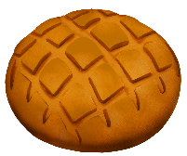
Des virelangues !
lire / parler
Trois gros rats gris dans trois gros trous ronds rongent trois gros croutons ronds.
[Three big grey rats in three big round holes gnaw on three big round croutons.]
1
2
3
Notes:
Slide 2 of 3
Transcript:
Trois gros rats gris dans trois gros trous ronds rongent trois gros croutons ronds.
Word frequency of cognates used (1 is the most frequent word in French): rat [4290], rond [2268], crouton [>5000]
Source: Lonsdale, D., & Le Bras, Y. (2009). A Frequency Dictionary of French: Core vocabulary for learners London: Routledge.
Word frequency (1 is the most frequent word in French): gris [2769], trou [2180], ronger [>5000]
Source: Lonsdale, D., & Le Bras, Y. (2009). A Frequency Dictionary of French: Core vocabulary for learners London: Routledge.

Slide 32
Des virelangues !
lire / parler
Le cricri de la crique crie son cri cru et critique car il craint que le crocodile ne le croque et ne le craque.
[The cricket in the creek cries its raw and critical cry because it fears that the crocodile will crunch and crack it.]
1
2
3
Notes:
Slide 3 of 3
Transcript:
Le cricri de la crique crie son cri cru et critique car il craint que le crocodile ne le croque et ne le craque.
Word frequency of cognates used (1 is the most frequent word in French): critique [909], crocodile [>5000]
Source: Lonsdale, D., & Le Bras, Y. (2009). A Frequency Dictionary of French: Core vocabulary for learners London: Routledge.
Word frequency (1 is the most frequent word in French): cri [2380], crique [>5000], crier [1950], cru [>5000], car [176], craindre [500], croquer [>5000], craquer [4893]
Source: Lonsdale, D., & Le Bras, Y. (2009). A Frequency Dictionary of French: Core vocabulary for learners London: Routledge.

