Slide 1
French Phonics Collection
SSC [i]
Artwork by: Chloé Motard
Date updated: 29/07/2022
Notes:
Artwork by Chloé Motard. All additional pictures selected are available under a Creative Commons license, no attribution required.

Slide 2
SSC [i]
phonétique
Introduction

Slide 3
i
midi
Notes:
Timing: 1 minute
Aim: To introduce/consolidate SSC [i]
Procedure: 1. Present the letter(s) and say the [i] sound first, on its own. Students repeat it with you. 2. Bring up the word ”midi” on its own, say it, students repeat it, so that they have the opportunity to focus all of their attention on the connection between the written word and its sound.
3. A possible gesture for this would be to draw a circle representing a clock face with one hand, with the other arm and hand pointing straight up (representing the hands on 12) within the circle. 4. Roll back the animations and work through 1-3 again, but this time, dropping your voice completely to listen carefully to the students saying the [i] sound, pronouncing ”midi” and, if using, doing the gesture.
Word frequency (1 is the most frequent word in French):
midi [2483].
Source: Londsale, D., & Le Bras, Y. (2009). A Frequency Dictionary of French: Core vocabulary for learners London: Routledge.

Slide 4
i
midi
Notes:
With sound and no pictures to focus all attention on the sound-symbol correspondence.

Slide 5
i
midi
Notes:
Without sound to elicit pronunciation (without first hearing the teacher).
Teacher to elicit pronunciation by asking “Comment dit-on …"

Slide 6
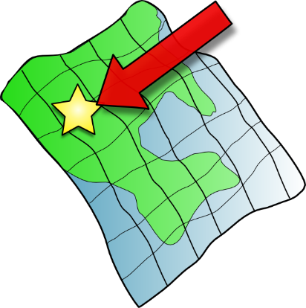
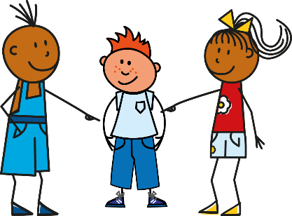
i
petit
lit
midi
ici
qui ?
il
?
Notes:
Timing: 2 minutes
Aim: To introduce/consolidate SSC [i]
Procedure:
1. Introduce and elicit the pronunciation of the individual SSC [i] and then the source word again ‘midi’ (with gesture, if using). 2. Then present and elicit the pronunciation of the five cluster words.
The cluster words have been chosen for their high-frequency, from a range of word classes, with the SSC (where possible) positioned within a variety of syllables within the words (e.g. initial, 2nd, final etc.). Additionally, we have tried to use words that build cumulatively on previously taught SSCs (see the Phonics Teaching Sequence document) and do not include new SSCs. Where new SSCs are used, they are often consonants which have a similar symbol-sound correspondence in English.
Word frequency (1 is the most frequent word in French): midi [2483]; petit [138]; lit [1837] ici [167]; il[13]; qui [14]. Source: Londsale, D., & Le Bras, Y. (2009). A Frequency Dictionary of French: Core vocabulary for learners London: Routledge.

Slide 7
i
petit
lit
midi
ici
qui ?
il
Notes:
With sound and no pictures to focus all attention on the sound-symbol correspondence.

Slide 8
i
petit
lit
midi
ici
qui ?
il
Notes:
Without sound to elicit pronunciation (without first hearing the teacher).
Teacher to elicit pronunciation by asking “Comment dit-on …"

Slide 9
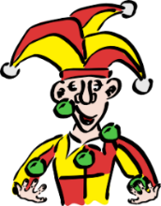
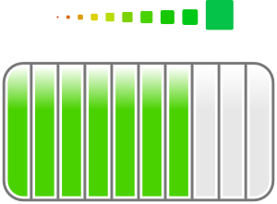
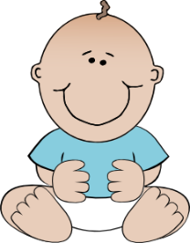
Phonétique
écouter
1
a) b) c)
innocent
3
a) b) c)
idée
2
a) b) c)
mari
4
a) b) c)
ville (town)
Notes:
Timing: 5 minutes
Aim: practicing aural recognition of SSC [i]
Procedure:
1. Click the numbers to play the audio. Tell students they are going to hear the letters ‘a’, ‘b’ and ‘c’ said in French.
2. Write 1-4 and choose if ‘a’, ‘b’ or ‘c’ is a word containing the SSC [i].
3. Click to reveal the answers.
Transcript:
a) innocent, b) méchant, c) amusant
a) jeune, b) mari, c) médecin
a) idée, b) étape, c) carré
a) égal, b) treize, c) ville
Word frequency (1 is the most frequent word in French): innocent [2059], méchant [3184], amusant [4695], jeune [152], mari [1589], médecin [827], idée [239], étape [1145], carré [3162], égal [1183], treize [3245], ville [260]
Source: Londsale, D., & Le Bras, Y. (2009). A Frequency Dictionary of French: Core vocabulary for learners London: Routledge.

Slide 10
Phonétique
parler
SFC
guide
20
climat
Paris
animal
minimal
secondes
guitare
discipline
rapide
machine
0
DÉBUT
Notes:
Timing: 3 minutes
Aim: practising production of SSC [i]
Procedure:
Start the timer.
Students tried to say as many words as they can correctly in twenty seconds. Student B takes note of any words pronounced the English way!
Students swap roles and the timer is restarted.
The person who has pronounced the greatest number of words correctly wins. If there is a tie, the student with the greatest amount of time remaining wins.
Click on the words to hear them said by a native speaker. Students repeat.
Go over the meaning of the words. These are all cognates or near-cognates, purposefully chosen for unlearning the connection between the SSC and the English sound. In some cases, the words may have an English translation which is a related but not direct equivalent (e.g. rapide - fast) so these should be clarified. Students will find it rewarding in the second lesson to be able to recognise nine new words! Explain that lots of words are shared between the languages and they will encounter more of these across the year.
Word frequency (1 is the most frequent word in French): guide [2392], climat [2006], minimal [3652], animal [1002], prime [2094], guitare [>5000], discipline [2120], rapide [672], Paris [n/a], machine [1294]
Source: Londsale, D., & Le Bras, Y. (2009). A Frequency Dictionary of French: Core vocabulary for learners London: Routledge.

Slide 11
SSC [i]
phonétique
Consolidation [1]

Slide 12
i
midi
Notes:
Timing: 1 minute
Aim: To introduce/consolidate SSC [i]
Procedure: 1. Present the letter(s) and say the [i] sound first, on its own. Students repeat it with you. 2. Bring up the word ”midi” on its own, say it, students repeat it, so that they have the opportunity to focus all of their attention on the connection between the written word and its sound.
3. A possible gesture for this would be to draw a circle representing a clock face with one hand, with the other arm and hand pointing straight up (representing the hands on 12) within the circle. 4. Roll back the animations and work through 1-3 again, but this time, dropping your voice completely to listen carefully to the students saying the [i] sound, pronouncing ”midi” and, if using, doing the gesture.
Word frequency (1 is the most frequent word in French):
midi [2483].
Source: Londsale, D., & Le Bras, Y. (2009). A Frequency Dictionary of French: Core vocabulary for learners London: Routledge.

Slide 13
i
midi
Notes:
With sound and no pictures to focus all attention on the sound-symbol correspondence.

Slide 14
i
midi
Notes:
Without sound to elicit pronunciation (without first hearing the teacher).
Teacher to elicit pronunciation by asking “Comment dit-on …"

Slide 15
i
petit
lit
midi
ici
qui ?
il
?
Notes:
Timing: 2 minutes
Aim: To introduce/consolidate SSC [i]
Procedure:
1. Introduce and elicit the pronunciation of the individual SSC [i] and then the source word again ‘midi’ (with gesture, if using). 2. Then present and elicit the pronunciation of the five cluster words.
The cluster words have been chosen for their high-frequency, from a range of word classes, with the SSC (where possible) positioned within a variety of syllables within the words (e.g. initial, 2nd, final etc.). Additionally, we have tried to use words that build cumulatively on previously taught SSCs (see the Phonics Teaching Sequence document) and do not include new SSCs. Where new SSCs are used, they are often consonants which have a similar symbol-sound correspondence in English.
Word frequency (1 is the most frequent word in French): midi [2483]; petit [138]; lit [1837] ici [167]; il[13]; qui [14]. Source: Londsale, D., & Le Bras, Y. (2009). A Frequency Dictionary of French: Core vocabulary for learners London: Routledge.

Slide 16
i
petit
lit
midi
ici
qui ?
il
Notes:
With sound and no pictures to focus all attention on the sound-symbol correspondence.

Slide 17
i
petit
lit
midi
ici
qui ?
il
Notes:
Without sound to elicit pronunciation (without first hearing the teacher).
Teacher to elicit pronunciation by asking “Comment dit-on …"

Slide 18
[i] ou [e] ?
écouter
Listen to the story. Which sounds do you hear? Choose [i], [e] or [i] et [e].
 |  | [i] [e] [i] et [e]
 |  | [i] [e] [i] et [e]
Tu passes une semaine triste ?
Tu fais une activité.
1
[i] et [e]
5
[i]
Voici une idée :
« Au revoir, les amis ! »
2
[i]
6
[i] et [e]
Tu regardes dehors…
« Je fais une promenade. »
3
[e]
7
[e]
Il fait beau en ce moment !
C’est une histoire sympathique.
4
[i] et [e]
8
[i]
Notes:
Timing: 10 minutes
Aim: to practise SSC recognition in context. Here the target SSC [i] is contrasted with [e], challenging students to dissociate the target SSC from its aural proximity to the letter ‘e’ in English.
Procedure:
Students write 1-8 and decide whether they hear [i], [e] or both in each sentence. For more of a challenge, students could listen again and note the words containing the SSCs, or the audio could be used for dictation, with students listening as many times as necessary to write the full sentence.
Click to bring up the answers. The answers are animated so that the SSCs appear first, followed by the full sentence, question by question.
Students can then translate the story. A suggested translation is given on the text slide. The use of ‘tu’ primes students for its contrast with ‘vous’ later in the lesson.
Transcript:
Tu passes une semaine triste ?
Voici une idée :
Tu regardes dehors…
Il fait beau en ce moment !
Tu fais une activité.
« Au revoir, les amis ! »
« Je fais une promenade. »
C’est une histoire sympathique.

Slide 19
[i] ou [e] ?
écouter
Translate the story into English:
 |  | [i] [e] [i] et [e]
 |  | [i] [e] [i] et [e]
Are you having a sad week?
Tu are doing an activity.
1
[i] et [e]
5
[i]
Here’s an idea:
« Goodbye, friends ! »
2
[i]
6
[i] et [e]
You look outside…
« I’m going for a walk. »
3
[e]
7
[e]
It’s nice weather at the moment!
4
[i] et [e]
8
It’s a nice story.
[i]
Notes:
Timing: 5 minutes
Aim: translation of known vocabulary in context
Procedure:
Suggested translation. In the absence of time phrases, students may be able to justify using the present simple or continuous in English. Note the freer translation of passer as ‘have’ in this context.
Click to bring up the English.
Transcript:
Tu passes une semaine triste ?
Voici une idée :
Tu regardes dehors…
Il fait beau en ce moment !
Tu fais une activité.
« Au revoir, les amis ! »
« Je fais une promenade. »
C’est une histoire sympathique.

Slide 20
i
petit
lit
midi
ici
qui ?
il
?
Notes:
Timing (slides 17-19): 3 minutes
Aim: To consolidate SSC [i]
Procedure:
1. Introduce and elicit the pronunciation of the individual SSC [i] and then the source word again ‘midi’ (with gesture, if using). 2. Then present and elicit the pronunciation of the five cluster words.
The cluster words have been chosen for their high-frequency, from a range of word classes, with the SSC (where possible) positioned within a variety of syllables within the words (e.g. initial, 2nd, final etc.). Additionally, we have tried to use words that build cumulatively on previously taught SSCs (see the Phonics Teaching Sequence document) and do not include new SSCs. Where new SSCs are used, they are often consonants which have a similar symbol-sound correspondence in English.
Word frequency (1 is the most frequent word in French): midi [2483]; petit [138]; lit [1837] ici [167]; il[13]; qui [14]. Source: Londsale, D., & Le Bras, Y. (2009). A Frequency Dictionary of French: Core vocabulary for learners London: Routledge.

Slide 21
i
petit
lit
midi
ici
qui ?
il
Notes:
With sound and no pictures to focus all attention on the sound-symbol correspondence.

Slide 22
i
petit
lit
midi
ici
qui ?
il
Notes:
Without sound to elicit pronunciation (without first hearing the teacher).
Teacher to elicit pronunciation by asking “Comment dit-on …”

Slide 23
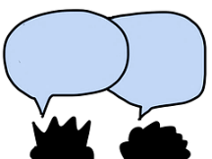
Phonétique
parler
action
ancien
60
fille
il
oui
animal
secondes
idée
petit
machine
rapide
livre
0
DÉBUT
Notes:
Timing: 1 minute
Aim: to practise pronunciation of this week’s target SSC [i]
Procedure:
Students take it in turns to try to pronounce correctly as many words as they can to a partner in one minute.
The two words at the top of the slide recall the SSCs of the previous week (‘-tion’ and ‘-ien’), though focusing on the ‘i’ sound within these this time.
Word frequency (1 is the most frequent word in French): fille [629], livre [358], ancien [392], il [13], oui [284], animal [1002], idée [239], machine [1294], petit [138], rapide [672], action [355]
Source: Londsale, D., & Le Bras, Y. (2009). A Frequency Dictionary of French: Core vocabulary for learners London: Routledge.

Slide 24
SSC [i]
phonétique
Consolidation [2]

Slide 25
i
midi
Notes:
Timing: 1 minute
Aim: To consolidate SSC [i]
Procedure: 1. Present the letter(s) and say the [i] sound first, on its own. Students repeat it with you. 2. Bring up the word ”midi” on its own, say it, students repeat it, so that they have the opportunity to focus all of their attention on the connection between the written word and its sound.
3. A possible gesture for this would be to draw a circle representing a clock face with one hand, with the other arm and hand pointing straight up (representing the hands on 12) within the circle. 4. Roll back the animations and work through 1-3 again, but this time, dropping your voice completely to listen carefully to the students saying the [i] sound, pronouncing ”midi” and, if using, doing the gesture.
Word frequency (1 is the most frequent word in French):
midi [2483].
Source: Londsale, D., & Le Bras, Y. (2009). A Frequency Dictionary of French: Core vocabulary for learners London: Routledge.

Slide 26
i
petit
lit
midi
ici
qui ?
il
?
Notes:
Timing: 1 minute
Aim: To consolidate SSC [i]
Procedure:
1. Introduce and elicit the pronunciation of the individual SSC [i] and then the source word again ‘midi’ (with gesture, if using). 2. Then present and elicit the pronunciation of the five cluster words.
The cluster words have been chosen for their high-frequency, from a range of word classes, with the SSC (where possible) positioned within a variety of syllables within the words (e.g. initial, 2nd, final etc.). Additionally, we have tried to use words that build cumulatively on previously taught SSCs (see the Phonics Teaching Sequence document) and do not include new SSCs. Where new SSCs are used, they are often consonants which have a similar symbol-sound correspondence in English.
Word frequency (1 is the most frequent word in French): midi [2483]; petit [138]; lit [1837] ici [167]; il[13]; qui [14]. Source: Londsale, D., & Le Bras, Y. (2009). A Frequency Dictionary of French: Core vocabulary for learners London: Routledge.

Slide 27
Phonétique
écouter / écrire
Say these words:
 |  | SSC [-ill-/ille] | SSC [i]
 | gentil
 | briller
 | grille
 | fils
 | billet
 | fillette
 | outil
 | subtil
fi !
[yuck]
fille
[girl]
1
[nice]
2
[to shine]
Attention!
The last letters of gentil and outil are SFCs. These are exceptions to the CRFL rule.
3
_
[railings]
4
[son]
Hint
SSC [-ill-/ille] sounds like SSC [i] followed by a ‘yih’ sound.
5
[ticket]
6
_
[little girl]
7
[tool]
8
[subtle]
Notes:
Timing: 5 minutes
Aim: aural recognition of SSCs [-ill-/ille] and [i]
Procedure:
1. Students try to say the words in the minimal pair, fi and fille. Click to hear the words said by a native speaker. Students repeat.
2. Click to bring up the hint.
3. Click the numbers to play the audio.
4. Students write 1-8 and choose [-ill-] or [i] for each.
5. Click to reveal the answers.
6. Click to highlight exceptions to the CRLF rule.
Transcript:
1. gentil
2. briller
3. grille
4. fils
5. billet
6. fillette
7. outil
8. subtil
Word frequency (1 is the most frequent word in French): gentil [2832] fils [735] outil [1725] briller [2904], billard [>5000], fillette [4737] grille [3341] subtil [4345]
Source: Londsale, D., & Le Bras, Y. (2009). A Frequency Dictionary of French: Core vocabulary for learners London: Routledge.

Slide 28
Phonétique
Quels mots sont différents ?
écouter / écrire
Il y a mille villes tranquilles comme Lille.
 |  | différent ?
 | famille [family]
 | ville [town]
 | coquillage [shell]
 | mille [thousand]
 | billes [marbles]
 | tranquille [quiet]
 | Lille [a French city]
 | camomille
1
These four words are different – the letter ‘l’ in [ille] is pronounced as normal.
There are not many of these exceptions, but some are important, high-frequency words.
You just have to learn them by heart!
2
3
4
5
6
7
8
Notes:
Timing: 5 minutes
Aim: To raise awareness of exceptions to the [-ill-/-ille] pronunciation rule
Procedure:
1. Explain to students that there are four important exceptions to the pronunciation rule they have practiced, and they are going to spot them in this exercise.
2. Click on the audio buttons to play the words.
3. Students tick in the column for the words in which they hear the difference.
4. Click to animate the answers (the words which are not exceptions disappear following the fifth click of the mouse).
5. Click once more to bring up the speech bubble explanation and the mnemonic. Students try to say the mnemonic. Teacher demonstrates, students repeat.
Transcript:
1. famille
2. ville
3. coquillage
4. mille
5. bille
6. tranquille
7. Lille
8. camomille
Word frequency (1 is the most frequent word in French): famille [172], ville [260], coquillage [>5000], mille [1008], bille [>5000], tranquille [2555], Lille [n/a], camomille [>5000]
Source: Londsale, D., & Le Bras, Y. (2009). A Frequency Dictionary of French: Core vocabulary for learners London: Routledge.

Slide 29
SSC [i]
phonétique
Consolidation [3]

Slide 30
Nasal or oral vowels?
écouter
 |  | nasal | oral + m/n
 | diminuer [decrease]
 | interroger [to interrogate]
 | grimper [to climb]
 | aimable [likeable]
 | contraindre [to force]
 | chimique [chemical]
 | minorité [minority]
 | crainte [fear]
 | vraiment [really]
 | centaine [hundred]
1
2
3
4
5
Remember!
[aim/im] and [ain/in] are nasal sounds before a consonant, and oral sounds before a vowel.
6
7
8
9
10
Notes:
Timing: 6 minutes
Aim: Aural recognition of nasal and non-nasal vowels [aim/im], [ain/in], [ai] and [i] in unknown words.
Procedure:
1. Practise saying SSCs [aim/im], [ain/in], [ai] and [i] aloud, in isolation. Students should notice a vibration in the nose when they produce the nasal sounds, but not when they produce the oral sounds.
2. Click the numbers to play the audio.
3. Students write 1-8 and decide if the letters in bold represent a ‘nasal’ or ‘non-nasal’ vowel sound.
4. Click to reveal the answers. The word appears first, followed by the ticks in the appropriate columns.
5. Click to bring up the reminder about spelling rules introduced last week (8.2.2.3) and demonstrate its applicability here.
Procedure:
1. Students listen to the words and tick the appropriate column.
2. Click to reveal the words one by one, together with the correct tick for each.
Transcript:
1. diminuer
2. interroger
3. grimper
4. aimable
5. contraindre
6. chimique
7. minorité
8. crainte
9. vraiment
10. centaine
Word frequency (1 is the most frequent word in French): diminuer [1507], interroger [1093], grimper [2646], aimable [4668], plaindre [137], chimique [2650,] minorité [>5000], crainte [1195], vraiment [361], centaine [1417]
Source: Londsale, D., & Le Bras, Y. (2009). A Frequency Dictionary of French: Core vocabulary for learners London: Routledge.

Slide 31
i
midi
Notes:
Timing: 1 minute
Aim: To consolidate SSC [i]
Procedure: 1. Present the letter(s) and say the [i] sound first, on its own. Students repeat it with you. 2. Bring up the word ”midi” on its own, say it, students repeat it, so that they have the opportunity to focus all of their attention on the connection between the written word and its sound.
3. A possible gesture for this would be to draw a circle representing a clock face with one hand, with the other arm and hand pointing straight up (representing the hands on 12) within the circle. 4. Roll back the animations and work through 1-3 again, but this time, dropping your voice completely to listen carefully to the students saying the [i] sound, pronouncing ”midi” and, if using, doing the gesture.
Word frequency (1 is the most frequent word in French):
midi [2483].
Source: Londsale, D., & Le Bras, Y. (2009). A Frequency Dictionary of French: Core vocabulary for learners London: Routledge.

Slide 32
i
petit
lit
midi
ici
qui ?
il
?
Notes:
Timing: 1 minute
Aim: To consolidate SSC [i]
Procedure:
1. Introduce and elicit the pronunciation of the individual SSC [i] and then the source word again ‘midi’ (with gesture, if using). 2. Then present and elicit the pronunciation of the five cluster words.
The cluster words have been chosen for their high-frequency, from a range of word classes, with the SSC (where possible) positioned within a variety of syllables within the words (e.g. initial, 2nd, final etc.). Additionally, we have tried to use words that build cumulatively on previously taught SSCs (see the Phonics Teaching Sequence document) and do not include new SSCs. Where new SSCs are used, they are often consonants which have a similar symbol-sound correspondence in English.
Word frequency (1 is the most frequent word in French): midi [2483]; petit [138]; lit [1837] ici [167]; il[13]; qui [14]. Source: Londsale, D., & Le Bras, Y. (2009). A Frequency Dictionary of French: Core vocabulary for learners London: Routledge.

Slide 33
[aim/im], [ain/in]
écouter / écrire
Normally, SSCs [aim/im] and [ain/in] are nasal vowels.
However, [aim/im] and [ain/in] sound different before a vowel.
Can you think of any examples in words you already know?
before a consonant: before a vowel:
important aimer
simple animal
prochain semaine
intéressant ordinateur
(important)
These sounds are nasal vowels [aim/im], [ain/in].
(to like)
These sounds are oral vowels [ai] / [i] + m / n.
(simple)
(animal)
(next)
(week)
(interesting)
(computer)
Notes:
Timing: 2 minutes
Aim: revising the spelling rules governing pronunciation changes in SSCs which are normally nasal vowels, and applying these to [aim/im] and [ain/in].
Procedure: 1. Cycle through the information on the slide using the animation sequence.

Slide 34
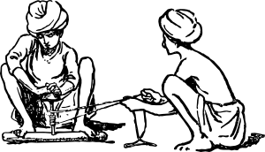
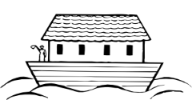
[nasal], [ai] ou [i] ?
lire / parler
 |  | [nasal] | [ai] + n | [i] + m/n
 | primitif [primitive]
 | intimider [to intimidate]
 | haine [hate]
j | crainte [fear]
 | timbre [to stamp]
 | prochainement [shortly, soon]
h | inondation [flood]
 | minimiser [to minimise]
 | capitaine [captain]
 | plaindre [to complain]
Lis les mots et décide si c’est une voyelle nasale ou une voyelle orale.
Puis, dis les mots !
1
2
3
4
5
6
nasal vowels
[aim/im], [ain/in]
7
8
oral vowels
[ai], [i]
9
10
Notes:
Timing: 5 minutes
Aim: applying awareness of the pronunciation rules governing SSCs [aim/ain], [ai] and [i] to the oral production of words containing these letter combinations.
Procedure
Student read the words and decide based on the presence of absence of a vowel after letter ‘m’ or ‘n’ whether a nasal is needed or not..
Click to check.
Now, students are challenged to pronounce the words correctly. Students should work in pairs and monitor each other for this.
Students try to say the words out loud. Teacher corrects.
Click the numbers to hear pronunciation
Transcript:
primitif
intimider
haine
crainte
timbre
prochainement
inondation
minimiser
capitaine
plaindre
Word frequency (1 is the most frequent word in French): primitif [3345], intimider [4777], haine [2277], crainte [1195], timbre [4138], prochainement [4417], inondation [4677], minimiser [4725], capitaine [2518], plaindre [1370]
Source: Londsale, D., & Le Bras, Y. (2009). A Frequency Dictionary of French: Core vocabulary for learners London: Routledge.
Word frequency of near-cognates used in task instructions (1 is the most frequent word in French): décider [165], voyelle [>5000], nasal [>5000], oral [4114]
Source: Londsale, D., & Le Bras, Y. (2009). A Frequency Dictionary of French: Core vocabulary for learners London: Routledge.

Slide 35
SSC [i]
phonétique
Consolidation [4]

Slide 36
i
midi
Notes:
Timing: 1 minute
Aim: To consolidate SSC [i]
Procedure: 1. Present the letter(s) and say the [i] sound first, on its own. Students repeat it with you. 2. Bring up the word ”midi” on its own, say it, students repeat it, so that they have the opportunity to focus all of their attention on the connection between the written word and its sound.
3. A possible gesture for this would be to draw a circle representing a clock face with one hand, with the other arm and hand pointing straight up (representing the hands on 12) within the circle. 4. Roll back the animations and work through 1-3 again, but this time, dropping your voice completely to listen carefully to the students saying the [i] sound, pronouncing ”midi” and, if using, doing the gesture.
Word frequency (1 is the most frequent word in French):
midi [2483].
Source: Londsale, D., & Le Bras, Y. (2009). A Frequency Dictionary of French: Core vocabulary for learners London: Routledge.

Slide 37
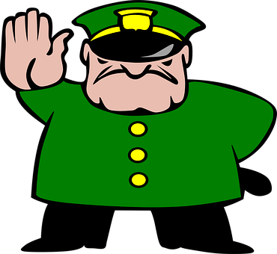
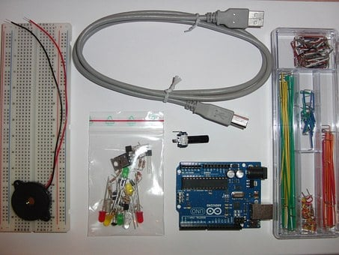
SSCs [i] in English and French
When you make these sounds, notice how your tongue is higher in French than in English.
phonétique
Below are three words that have the same meaning and spelling in English and French. They are cognates.
kit
film
strict
First, say the words aloud in English. Then, listen to the words in French and repeat.
Notice how the SSC [i] sounds different in English and French.
In English, the SSC [i] sounds like ‘ih’. But in French, it sounds like ‘ee’.
Notes:
Timing: 2 minutes
Aim: To draw attention to cross-linguistic differences in pronunciation of SSC [i].
Procedure:
1. Click to animate the explanation.
2. Students say the cognate words aloud in English and French. You can click on the words in orange to hear them read aloud in French by a native speaker.
3. Encourage students to compare the position of their tongue when saying the words in English and French. Because the French SSC [i] is a more ‘closed’ vowel than the English SSC [i], the position of the tongue should be higher in French than in English.
Transcript:
kit
film
strict
Word frequency of cognates used (1 is the most frequent word in French):
kit [>5000]
Source: Londsale, D., & Le Bras, Y. (2009). A Frequency Dictionary of French: Core vocabulary for learners London: Routledge.

Slide 38
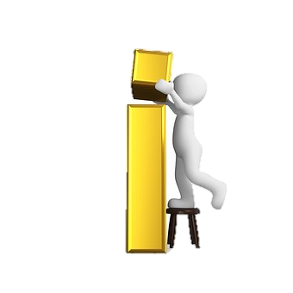
SSCs: [e] vs. [i]
Remember! In English, the SSC [i] sounds like ‘ih’. But in French, it sounds like ‘ee’.
écouter
Écoute ces mots et remplis les blancs avec la bonne SSC.
C’est quoi en anglais ?
 | French | English | [e] | [i]
 | mégabit | megabyte
 | rebelle | rebel
 | menu | menu
 | bip | beep
 | riche | rich
 | rejeté | rejected
 | fixé | fixed
 | degré | degree
1
_
2
_
3
_
4
_
5
_
6
_
7
_
8
_
Notes:
Timing: 5 minutes
Aim: Aural recognition of SSCs [e] and [i]; raising awareness of cross-linguistic differences in pronunciation between cognates and near-cognates; to ‘break’ the association between English SSC [i] and the sound ‘ih’ and to connect this sound with its nearest French equivalent, SSC [e].
Procedure:
1. Depending on the needs of the class, click to bring up the reminder about pronunciation.
2. Click the number button on the left to hear the French word read aloud.
3. Students fill in the gap with the correct SSC. Note that these words have specifically been chosen because they are near cognates.
4. Click to reveal the missing SSC and a tick in the correct column.
5. Click to reveal the next task instruction.
6. Students try to volunteer the English translation.
7. Students say the pairs of words, first in French and then in English.
Transcript:
1. mégabit
2. rebelle
3. menu
4. bip
5. riche
6. rejeté
7. fixé
8. degré
Word frequency of cognates used (1 is the most frequent word in French):
mégabit [>5000], rebelle [2621], menu [3470], bip [<5000], riche [599], rejeter [981], fixer [641], degré [1311]
Source: Londsale, D., & Le Bras, Y. (2009). A Frequency Dictionary of French: Core vocabulary for learners London: Routledge.

Slide 39
i
petit
lit
midi
ici
qui ?
il
?
Notes:
Timing: 1 minute
Aim: To consolidate SSC [i]
Procedure:
1. Introduce and elicit the pronunciation of the individual SSC [i] and then the source word again ‘midi’ (with gesture, if using). 2. Then present and elicit the pronunciation of the five cluster words.
The cluster words have been chosen for their high-frequency, from a range of word classes, with the SSC (where possible) positioned within a variety of syllables within the words (e.g. initial, 2nd, final etc.). Additionally, we have tried to use words that build cumulatively on previously taught SSCs (see the Phonics Teaching Sequence document) and do not include new SSCs. Where new SSCs are used, they are often consonants which have a similar symbol-sound correspondence in English.
Word frequency (1 is the most frequent word in French): midi [2483]; petit [138]; lit [1837] ici [167]; il[13]; qui [14]. Source: Londsale, D., & Le Bras, Y. (2009). A Frequency Dictionary of French: Core vocabulary for learners London: Routledge.

Slide 40
Mots qui finissent par –if
word patterns
This week, you have learnt several French words ending in –if.
These words contain the SSC [i].
actif (active)
négatif (negative)
positif (positive)
You may have noticed that these words are spelled similarly in English and French and have the same meaning. This is because they are cognates.
The only difference is the last syllable. It looks and sounds different.
In French it’s –if, but in English it’s –ive. How are these two endings pronounced?
Notes:
Timing: 2 minutes
Aim: To introduce the English ‘-ive’ ➜ French ‘-if’ word pattern and connect these with SSC [i].
Procedure:
1. Click to reveal the explanation.
2. Remind students that SSC [i] sounds different in English and French. Practice pronouncing the endings French ‘-if’ and English ‘-ive’, focusing on the [i].
3. Click on the French words to hear them said by a native speaker. Students repeat, and then say the English.
Transcript:
actif
négatif
positif

Slide 41
SSC [i]
phonétique
Consolidation [5]

Slide 42
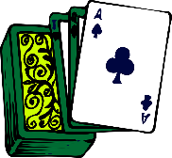
SSCs: [e] vs. [i]
Écoute ces mots et remplis les blancs avec la bonne SSC.
écouter
 | French | [e] | [i]
 | secours [aid]
 | menace [threat]
 | susciter [to provoke]
 | pari [bet]
 | regard [look]
 | bilan [outcome]
 | tenue [dress]
 | usine [factory]
1
8
_
2
_
3
_
4
_
5
_
6
_
7
_
8
_
Notes:
Timing: 5 minutes
Aim: To distinguish aurally between SSCs [e] and [i].
Procedure:
1. Click on the number button to listen to the word read aloud.
2. Students fill in the gap with the missing SSC.
3. Click to reveal the answers.
4. Students listen to and repeat the word.
Transcript:
secours
menace
susciter
pari
regard
bilan
tenue
usine
Word frequency (1 is the most frequent word in French): tenue [1899], regard [1206], menace [1607], secours [1857], susciter [1027], pari [1688], bilan [1758], usine [1482]
Source: Londsale, D., & Le Bras, Y. (2009). A Frequency Dictionary of French: Core vocabulary for learners London: Routledge.

Slide 43
SSC [i]
phonétique
Consolidation [6]

Slide 44
[y] et [i]
écouter
What do you notice about these words?
mite
[moth]
mythe
[myth]
SSC [y] is the same sound as SSC [i], which you already know.
SSC [y] is often found in cognate words (words which look like English or another language).
Notes:
Timing: 1 minute
Aim: Raising awareness of the identical sound in SSCs [y] and [i].
For a reminder of Year 7 SSC [i], see the two slides that follow.
Word frequency of unknown words (1 is the most frequent word in French): mite [>5000]
Source: Lonsdale, D., & Le Bras, Y. (2009). A Frequency Dictionary of French: Core vocabulary for learners London: Routledge.
Word frequency of cognates (1 is the most frequent word in French): mythe [2910]
Source: Lonsdale, D., & Le Bras, Y. (2009). A Frequency Dictionary of French: Core vocabulary for learners London: Routledge.

Slide 45
i
midi
Notes:
Timing: 1 minute
Aim: To consolidate SSC [i]
Procedure: 1. Present the letter(s) and say the [i] sound first, on its own. Students repeat it with you. 2. Bring up the word ”midi” on its own, say it, students repeat it, so that they have the opportunity to focus all of their attention on the connection between the written word and its sound.
3. A possible gesture for this would be to draw a circle representing a clock face with one hand, with the other arm and hand pointing straight up (representing the hands on 12) within the circle. 4. Roll back the animations and work through 1-3 again, but this time, dropping your voice completely to listen carefully to the students saying the [i] sound, pronouncing ”midi” and, if using, doing the gesture.
Word frequency (1 is the most frequent word in French):
midi [2483].
Source: Lonsdale, D., & Le Bras, Y. (2009). A Frequency Dictionary of French: Core vocabulary for learners London: Routledge.

Slide 46
i
petit
lit
midi
qui ?
ici
il
?
Notes:
Timing: 1 minute
Aim: To consolidate SSC [i]
Procedure:
1. Introduce and elicit the pronunciation of the individual SSC [i] and then the source word again ‘midi’ (with gesture, if using). 2. Then present and elicit the pronunciation of the five cluster words.
The cluster words have been chosen for their high-frequency, from a range of word classes, with the SSC (where possible) positioned within a variety of syllables within the words (e.g. initial, 2nd, final etc.). Additionally, we have tried to use words that build cumulatively on previously taught SSCs (see the Phonics Teaching Sequence document) and do not include new SSCs. Where new SSCs are used, they are often consonants which have a similar symbol-sound correspondence in English.
Word frequency (1 is the most frequent word in French): midi [2483]; petit [138]; lit [1837] ici [167]; il[13]; qui [14]. Source: Lonsdale, D., & Le Bras, Y. (2009). A Frequency Dictionary of French: Core vocabulary for learners London: Routledge.

Slide 47
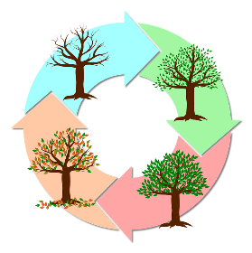
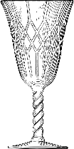
[y] et [i]
parler
Attention ! Some words look like English.
Use your French SSC knowledge to pronounce them correctly.
60
type
cultiver
analyser
cycle
[to grow]
[to analyse]
secondes
fragile
mystère
tisser
[mystery]
bijou
[to weave]
tragique
[jewel]
prime
héritage
[bonus]
[tragic]
hypothèse
cynique
mérite
typique
0
[hypothesis]
[cynical]
[merit]
[typical]
DÉBUT
Notes:
Timing: 3 minutes
Aim: To practise pronunciation of SSCs [y] and [i] in individual words.
Procedure:
1. Split students into pairs.
2. Click début to start the timer
3. Students take it in turns try to pronounce as many words accurately as possible
4. The listening partner checks pronunciation and tallies the total number of words pronounced correctly within 30 seconds. If a student pronounces [i] or [y] the ‘English’ way, they must repeat it three times before scoring the point and continuing.
5. When timer finishes, swap roles.
6. Students tally up the total number of words said correctly. The student who has said the greatest number of words is the winner.
7. Go through all the words together as a class to confirm pronunciation (click on words to hear them pronounced by a native speaker, students repeat.)
Word frequency of unknown words (1 is the most frequent word in French): bijou [4301], tisser [4320], prime [2094]
Source: Lonsdale, D., & Le Bras, Y. (2009). A Frequency Dictionary of French: Core vocabulary for learners London: Routledge.
Word frequency of cognate words (1 is the most frequent word in French): type [440], cycle [2462], mystère [2777], analyser [1209], cynique [3547], hypothèse [1669], typique [4178], mérite [2035], tragique [2042], cultiver [2061], fragile [2107], héritage [2193]
Source: Lonsdsale, D., & Le Bras, Y. (2009). A Frequency Dictionary of French: Core vocabulary for learners London: Routledge.

Slide 48
Des virelangues
lire / parler
Lily lit typiquement un livre
dans son lit.
Lily typically reads a book in bed.
Notes:
Timing: 2 minutes. This is slide 1/2.
Aim: To practise pronunciation of [i] and [y] in full sentences.
Procedure:
1. Students sound out the words in the tongue twister.
2. Click audio button to hear tongue twister read out by a native speaker.
3. Students try to reproduce the tongue twister at a similar speed, then at increasing speeds.
4. Students listen to the audio again. This time, the teacher pauses the audio at different points and asks students to say the last word that they heard.
Transcript:
Lily lit typiquement un livre dans son lit.
Word frequency of unknown words used (1 is the most frequent word in French): typiquement [>5000]
Source: Lonsdale, D., & Le Bras, Y. (2009). A Frequency Dictionary of French: Core vocabulary for learners London: Routledge.

Slide 49
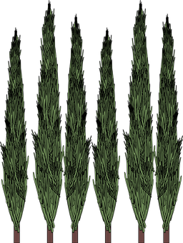
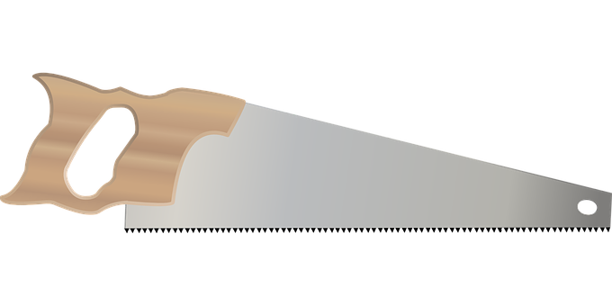
Des virelangues
lire / parler
Si six scies scient six cyprès,
six cents scies scient six cent cyprès.
If six saws saw six cypresses, six hundred saws saw six hundred cypresses
Notes:
This is slide 2/2.
NB: This tongue twister is very challenging! Students need to pay careful attention to the SSCs. They may need reassurance that the first 5 words are all supposed to sound the same!
Transcript:
Si six scies scient six cyprès, six cents six scies scient six cent six cyprès
Word frequency of unknown words used (1 is the most frequent word in French): scie [>5000], scier [>5000], cyprès [>5000], cent [704]
Source: Lonsdale, D., & Le Bras, Y. (2009). A Frequency Dictionary of French: Core vocabulary for learners London: Routledge.

Slide 50
SSC [i]
phonétique
Consolidation [7]

Slide 51
i
midi
Notes:
[7/8]
Aim: To consolidate SSC [i]
Procedure: 1. Present the letter(s) and say the [i] sound first, on its own. Students repeat it with you. 2. Bring up the word ”midi” on its own, say it, students repeat it, so that they have the opportunity to focus all of their attention on the connection between the written word and its sound.
3. A possible gesture for this would be to draw a circle representing a clock face with one hand, with the other arm and hand pointing straight up (representing the hands on 12) within the circle. 4. Roll back the animations and work through 1-3 again, but this time, dropping your voice completely to listen carefully to the students saying the [i] sound, pronouncing ”midi” and, if using, doing the gesture.
Word frequency (1 is the most frequent word in French):
midi [2483].
Source: Londsale, D., & Le Bras, Y. (2009). A Frequency Dictionary of French: Core vocabulary for learners London: Routledge.

Slide 52
i
petit
lit
midi
ici
qui ?
il
?
Notes:
[8/8]
Aim: To consolidate SSC [i]
Procedure:
1. Introduce and elicit the pronunciation of the individual SSC [i] and then the source word again ‘midi’ (with gesture, if using). 2. Then present and elicit the pronunciation of the five cluster words.
The cluster words have been chosen for their high-frequency, from a range of word classes, with the SSC (where possible) positioned within a variety of syllables within the words (e.g. initial, 2nd, final etc.). Additionally, we have tried to use words that build cumulatively on previously taught SSCs (see the Phonics Teaching Sequence document) and do not include new SSCs. Where new SSCs are used, they are often consonants which have a similar symbol-sound correspondence in English.
Word frequency (1 is the most frequent word in French): midi [2483]; petit [138]; lit [1837] ici [167]; il[13]; qui [14]. Source: Londsale, D., & Le Bras, Y. (2009). A Frequency Dictionary of French: Core vocabulary for learners London: Routledge.

Slide 53
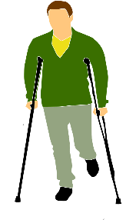
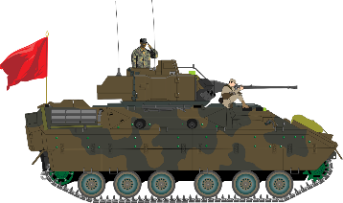
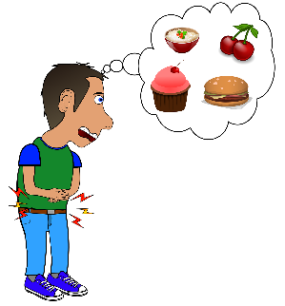
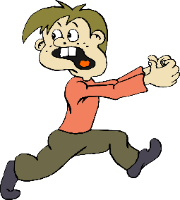
Les voyelles nasales
Are the vowels in bold nasal or non-nasal?
lire/parler
Remember that the nasal SSCs [aim/im] and [ain/in] become non-nasal sounds ([ai] + n/m and [i] + n/m) when they come before a vowel.
vainqueur [winner]
victime
[victim]
terrain
[land]
intervention
[intervention]
envahi
[invaded]
imposer
[to impose]
ministre
[minister]
aimant
[magnet]
capitaine
[captain]
These are the past participles of the verbs envahir (to invade) and fuir (to flee). Verbs like sortir and choisir form their past participles like this.
invasion
[invasion]
essaimer
[to swarm]
faim
[hunger]
fui
[fled]
Notes:
Timing: 5 minutes
Aim: Written recognition and oral production of nasal SSCs [aim/im] and [ain/in] and non-nasal SSCs [ai] and [i]; setting the scene for the topic of the lesson.
Procedure:
1. Use slides 2-9 to revise the sounds. Remind students that SSCs [aim/im] and [ain/in] sound identical, and that the spelling change m→n occurs when the sound appears before the letters ‘b’ and ‘p’.
2. Remind students that when [aim/im] and [ain/in] appear before a vowel, they are pronounced as non-nasal vowels + m/n. Victime could be used as an example to illustrate this.
3. Working in pairs, students use the rules to sound out the words and decide whether the sounds in bold are nasal or non-nasal.
4. Click to reveal the answers. Click on the images to hear the words said aloud by a native speaker.
5. Click to reveal a bubble drawing attention to the two words ending in -i which are past participles. This primes students for the new grammar point introduced later in the lesson.
Transcript:
vainqueur victime terrain intervention envahi imposer ministre
aimant capitaine invasion essaimer faim fui
Word frequency (1 is the most frequent word in French): vainqueur [3307], victime [697], terrain [867], intervention [intervention], envahi [envahir 2566], imposer [469], ministre [204], aimant [>5000], capitaine [2518], invasion [3911], essaimer [>5000], faim [1986], fui [fuir 1960]
Source: Londsale, D., & Le Bras, Y. (2009). A Frequency Dictionary of French: Core vocabulary for learners London: Routledge.

