Slide 1
French Phonics Collection
SSC [La liaison]
Artwork by: Chloé Motard
Date updated: 22/11/2022
Notes:
Artwork by Chloé Motard. All additional pictures selected are available under a Creative Commons license, no attribution required.

Slide 2
SSC [la liaison]
phonétique
Introduction

Slide 3
Liaison
écouter
C’est bon! That’s good!
The final –t in c’est is a Silent Final Consonant.
But …
C’est un chien. It’s a dog.
This time, the final consonant in c’est is not an SFC!
Because the -t is followed by a vowel, it is pronounced.
This pronunciation change is known as liaison.
Notes:
Timing: 2 minutes
Aim: Introduction to the –t liaison.

Slide 4
Liaison
écouter
c’est
it's, that’s
Notes:
Timing: 3 minutes for 6 slides
Aim: to introduce the concept of t-liaison before a vowel with c’est.
Procedure:
1. Listen and repeat.

Slide 5
Liaison
écouter
c’est un
it’s a, that’s a
Notes:
Timing: 3 minutes for 6 slides
Aim: to introduce the concept of t-liaison before a vowel with c’est.
Procedure:
Listen and repeat.
Highlight that this sounds like one word, rather than two

Slide 6
Liaison
écouter
C’est bon !
It’s good!
Notes:
Procedure:
1/ Listen and repeat.
2/ Ask students to translate the sentence.
3/ Reveal picture on a click, ask students to check their translations.
4/ Reveal English translation on click.

Slide 7
Liaison
écouter
C’est un chien !
It’s a dog!
Notes:
Procedure:
1/ Listen and repeat.
2/ Ask students to translate the sentence.
3/ Reveal picture on a click, ask students to check their translations.
4/ Reveal English translation on click.

Slide 8
Liaison
écouter
C’est triste.
It’s sad.
Notes:
Procedure:
1/ Listen and repeat.
2/ Ask students to translate the sentence.
3/ Reveal picture on a click, ask students to check their translations.
4/ Reveal English translation on click.

Slide 9
Liaison
écouter
C’est une règle.
It’s a ruler.
Notes:
Procedure:
1/ Listen and repeat.
2/ Ask students to translate the sentence.
3/ Reveal picture on a click, ask students to check their translations.
4/ Reveal English translation on click.

Slide 10
Liaison
écouter
C’est calme.
It’s quiet.
Notes:
Procedure:
1/ Listen and repeat.
2/ Ask students to translate the sentence.
3/ Reveal picture on a click, ask students to check their translations.
4/ Reveal English translation on click.

Slide 11
Liaison
écouter
C’est un portable.
It’s a mobile phone.
Notes:
Procedure:
1/ Listen and repeat.
2/ Ask students to translate the sentence.
3/ Reveal picture on a click, ask students to check their translations.
4/ Reveal English translation on click.

Slide 12
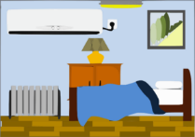
Liaison
écouter
1
C’est … grand / un pentagone !
What is Léa saying about these things?
Écoute!
2
C’est … calme / une chambre !
3
C’est … petit / un hexagone !
4
C’est … bon / un portable !
5
C’est … petite / une chose !
6
C’est … triste / un visage !
Notes:
Timing: 5 minutes
Aim: To detect the presence or absence of a t-liaison with c’est, and connect this with meaning.
Procedure:
Check students understand the task instructions. They have not encountered écoute before. Explain that this is the short form of écouter, which they met in week 1, and that they will encounter this in task instructions in the weeks to come.
Students write 1-6.
Click on a button to hear a form of ‘c’est’, followed by a beep.
Based on the presence or absence of a liaison, students decide what comes next. Remind them it is the presence or absence of a -t- sound that will give them this information – they won’t be able to tell the answer from the picture!
Click to check.
Full audio can be found on the next slide.
Transcript
1. C’est [grand].
2. C’est [une chambre].
3. C’est [petit].
4. C’est [un portable].
5. C’est [une chose].
6. C’est [triste].
Word frequency (1 is the most frequent word in French): pentagone [>5000], hexagone [>5000]
Source: Londsale, D., & Le Bras, Y. (2009). A Frequency Dictionary of French: Core vocabulary for learners London: Routledge.

Slide 13
Liaison
écouter
1
C’est … grand / un pentagone !
What is Léa saying about these things?
Écoute!
2
C’est … calme / une chambre !
3
C’est … petit / un hexagone !
4
C’est … bon / un portable !
5
C’est … petite / une chose !
6
C’est … triste / un visage !
Notes:
Full audio for the exercise on the previous slide.
Transcript
1. C’est grand.
2. C’est une chambre.
3. C’est petit.
4. C’est un portable.
5. C’est une chose.
6. C’est triste.

Slide 14
SSC [la liaison]
phonétique
Consolidation [1]

Slide 15
La liaison
écouter
You have met liaison before, with c’est
C’est un ordinateur.
Voici les règles. Here are the rulers.
The final –s in les is a Silent Final Consonant.
But …
Voici les ordinateurs. Here are the computers.
This time, the final consonant in les is not an SFC!
Because the -s is followed by a vowel, it is pronounced.
This pronunciation change is known as liaison.
Notes:
Timing: 2 minutes
Aim: Introduction to the –s liaison.
You may wish to ask students where they have seen this phenomenon before, before revealing the final info bubble on a click.

Slide 16
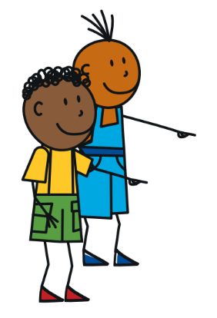
La liaison
écouter
les garçons
the boys
Notes:
Listen and repeat.

Slide 17
La liaison
écouter
les actrices
the female actors
Notes:
Timing: 3 minutes for 10 slides [audio missing]
Aim: to introduce the concept of s-liaison before a vowel after les.
Procedure:
Listen and repeat.
Highlight that this sounds like one word, rather than two

Slide 18
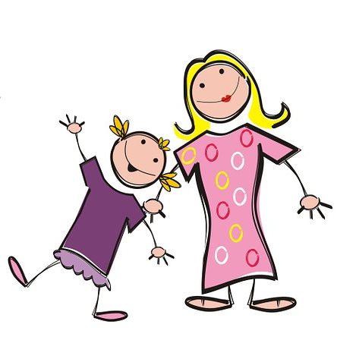
La liaison
La liaison
écouter
Les filles écoutent la radio.
The girls are listening to the radio.
Notes:
1. Listen and repeat.
2. Ask students to translate the sentence.
3. Reveal picture on a click, ask students to check their translations.
4. Reveal English translation on click.

Slide 19
La liaison
La liaison
écouter
Les amis écoutent la radio.
The friends are listening to the radio.
Notes:
1. Listen and repeat.
2. Ask students to translate the sentence.
3. Reveal picture on a click, ask students to check their translations.
4. Reveal English translation on click.

Slide 20
La liaison
La liaison
écouter
Les personnes parlent anglais.
The people speak English.
Notes:
1. Listen and repeat.
2. Ask students to translate the sentence.
3. Reveal picture on a click, ask students to check their translations.
4. Reveal English translation on click.

Slide 21
La liaison
La liaison
écouter
Les acteurs parlent anglais.
The actors speak English.
Notes:
1. Listen and repeat.
2. Ask students to translate the sentence.
3. Reveal picture on a click, ask students to check their translations.
4. Reveal English translation on click.

Slide 22
La liaison
La liaison
écouter
Voici les médecins.
Here are the doctors.
Notes:
1. Listen and repeat.
2. Ask students to translate the sentence.
3. Reveal picture on a click, ask students to check their translations.
4. Reveal English translation on click.

Slide 23
La liaison
La liaison
écouter
Voici les ordinateurs.
Here are the computers.
Notes:
1. Listen and repeat.
2. Ask students to translate the sentence.
3. Reveal picture on a click, ask students to check their translations.
4. Reveal English translation on click.

Slide 24
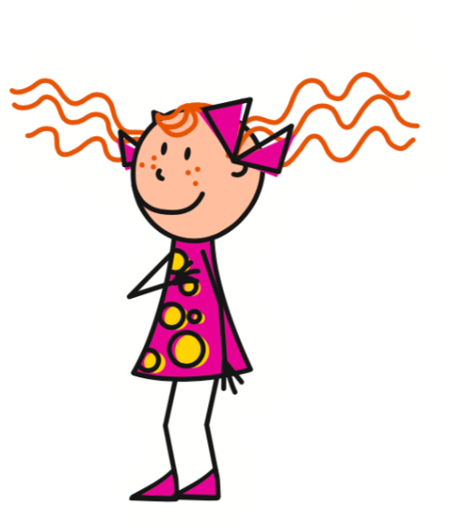
La liaison
La liaison
écouter
Elle a les livres.
She has the books.
Notes:
1. Listen and repeat.
2. Ask students to translate the sentence.
3. Reveal picture on a click, ask students to check their translations.
4. Reveal English translation on click.

Slide 25
La liaison
La liaison
écouter
Elle a les idées.
She has the ideas.
Notes:
1. Listen and repeat.
2. Ask students to translate the sentence.
3. Reveal picture on a click, ask students to check their translations.
4. Reveal English translation on click.

Slide 26
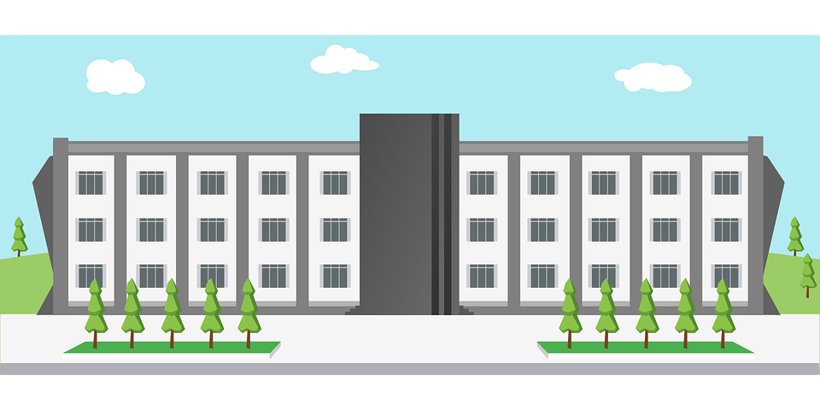
La liaison
écouter
Léa is giving you a tour of her school.
What is she showing you?
Écoute!
1
Voici les … garçons / ordinateurs.
2
Voici les … filles / acteurs.
3
Voici les … professeurs / actrices.
4
Voici les … ordinateurs / vélos.
5
Voici les … personnes / amies.
6
Voici les … livres / amis.
7
Voici les … chanteurs / actrices.
8
Voici les … règles / idées.
Notes:
Timing: 5 minutes
Aim: To detect the presence or absence of an s-liaison with les, and connect this with meaning.
Procedure:
Students write 1-8.
Click on a button to hear a form of ‘voici les’, followed by a beep.
Based on the presence or absence of a liaison, students decide what comes next. Remind them it is the presence or absence of a -s- sound that will give them this information.
Click to check.
Full audio can be found on the next slide.
Transcript
1. Voici les [garçons].
2. Voici les [acteurs].
3. Voici les [professeurs].
4. Voici les [ordinateurs].
5. Voici les [amies].
6. Voici les [livres].
7. Voici les [actrices].
8. Voici les [règles].

Slide 27
La liaison
écouter
Léa is giving you a tour of her school.
What is she showing you?
Écoute!
1
Voici les … garçons / ordinateurs.
2
Voici les … filles / acteurs.
3
Voici les … professeurs / actrices.
4
Voici les … ordinateurs / vélos.
5
Voici les … personnes / amies.
6
Voici les … livres / amis.
7
Voici les … chanteurs / actrices.
8
Voici les … règles / idées.
Notes:
Full audio for the exercise on the previous slide.
Transcript
1. Voici les garçons.
2. Voici les acteurs.
3. Voici les professeurs.
4. Voici les ordinateurs.
5. Voici les amies.
6. Voici les livres.
7. Voici les actrices.
8. Voici les règles.

Slide 28
SSC [la liaison]
phonétique
Consolidation [2]

Slide 29
Liaison
écouter
six
six
Notes:
Timing: 4.5 minutes for 9 slides
Aim: To introduce the concept of x-liaison before a vowel with numbers.
Procedure:
1. Listen and repeat.

Slide 30
Liaison
écouter
six semaines
six weeks
Notes:
Procedure:
Listen and repeat.
Ask students to translate the sentence.
Reveal picture on a click, ask students to check their translations.
Reveal English translation on click.

Slide 31
Liaison
écouter
six écoles
six schools
Notes:
Procedure:
Listen and repeat.
Ask students to translate the sentence.
Reveal picture on a click, ask students to check their translations.
Reveal English translation on click.

Slide 32
Liaison
écouter
dix
ten
Notes:
Timing: 1.5 minutes for 3 slides
Aim: To introduce the concept of x-liaison before a vowel with numbers.
Procedure:
1. Listen and repeat.

Slide 33
Liaison
écouter
dix magasins
ten shops
Notes:
Procedure:
Listen and repeat.
Ask students to translate the sentence.
Reveal picture on a click, ask students to check their translations.
Reveal English translation on click.

Slide 34
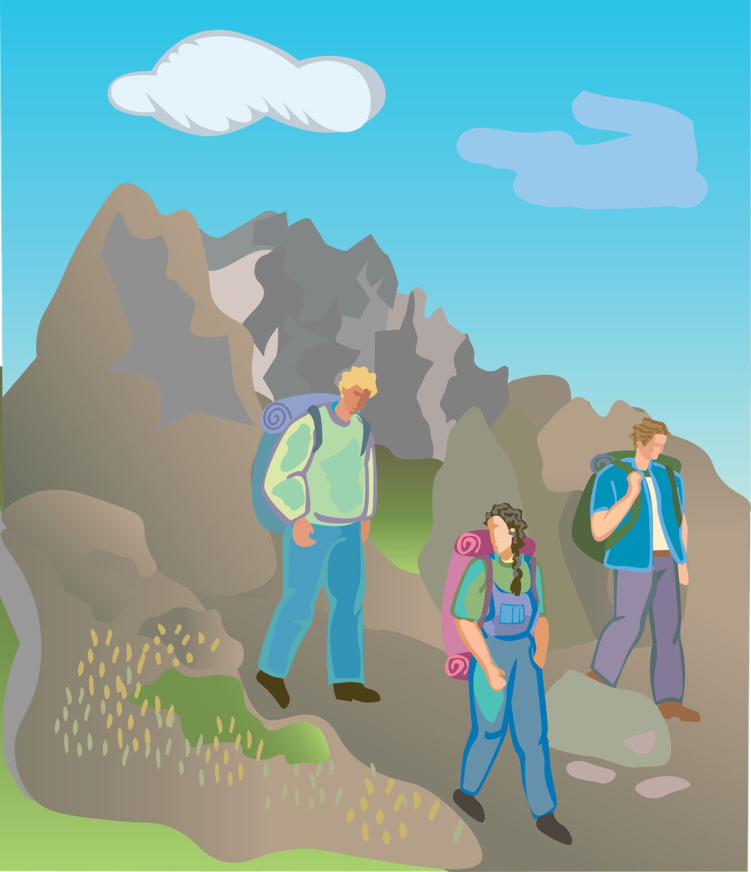
Liaison
écouter
dix activités
ten activities
Notes:
Procedure:
Listen and repeat.
Ask students to translate the sentence.
Reveal picture on a click, ask students to check their translations.
Reveal English translation on click.

Slide 35
Liaison
écouter
deux
two
Notes:
Timing: 1.5 minutes for 3 slides
Aim: To introduce the concept of x-liaison before a vowel with numbers.
Procedure:
1. Listen and repeat.

Slide 36
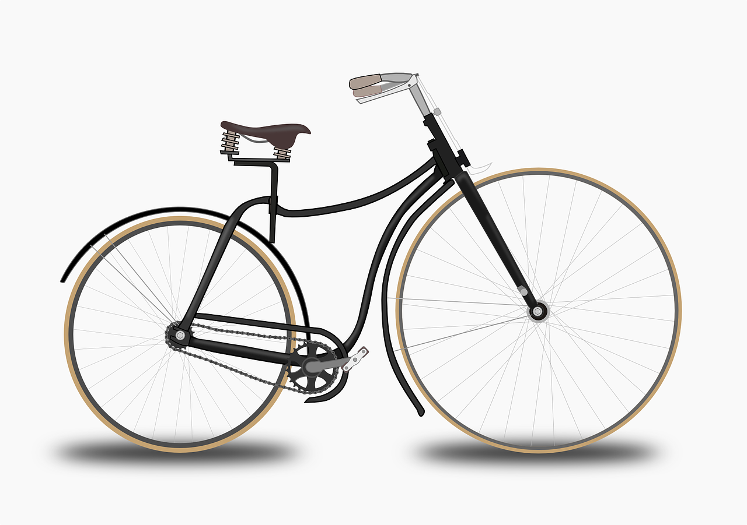
Liaison
écouter
deux vélos
two bikes
Notes:
Procedure:
Listen and repeat.
Ask students to translate the sentence.
Reveal picture on a click, ask students to check their translations.
Reveal English translation on click.

Slide 37
Liaison
écouter
deux ordinateurs
two computers
Notes:
Procedure:
Listen and repeat.
Ask students to translate the sentence.
Reveal picture on a click, ask students to check their translations.
Reveal English translation on click.

Slide 38
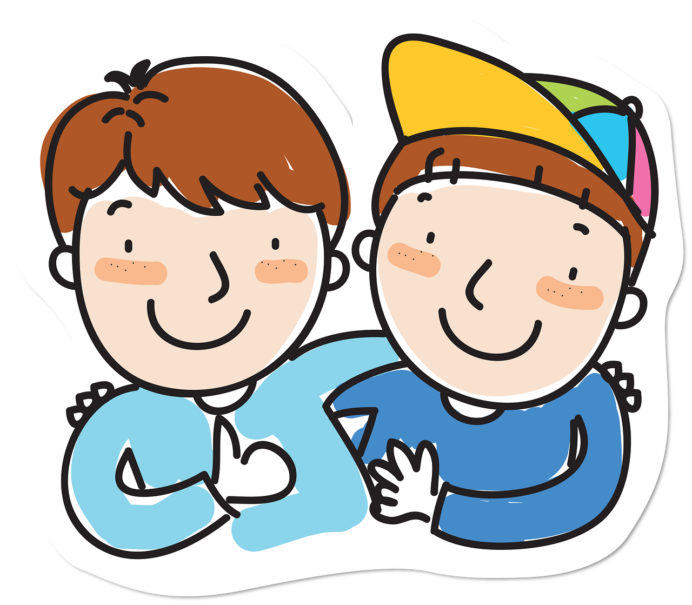
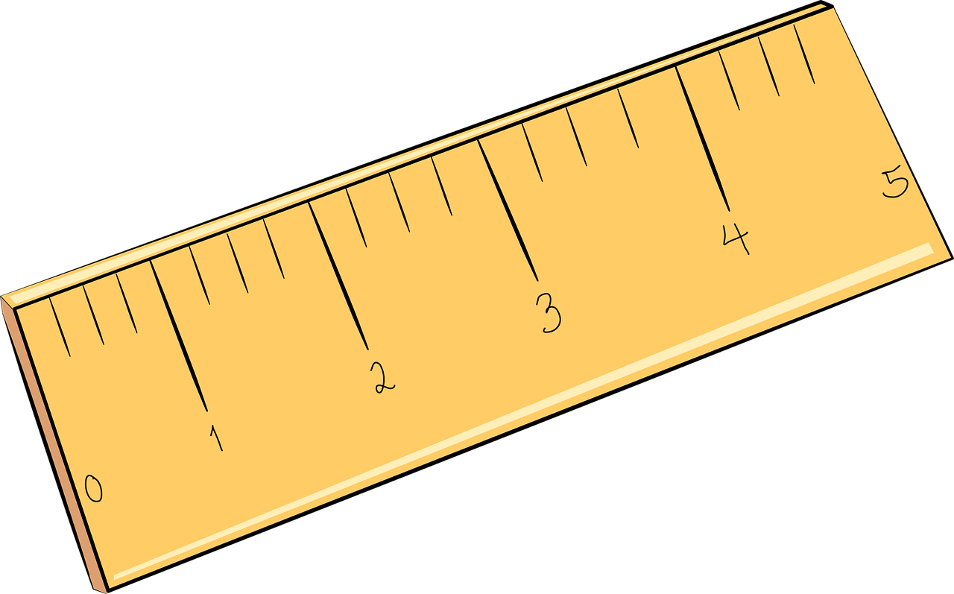
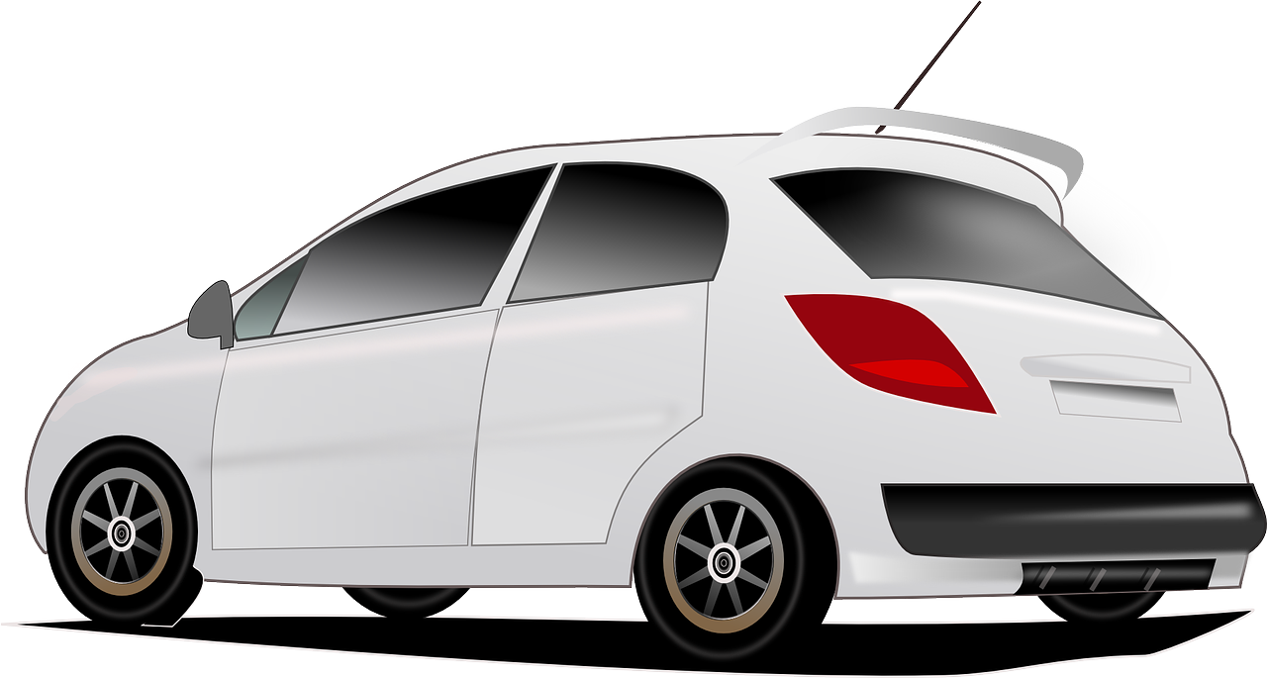
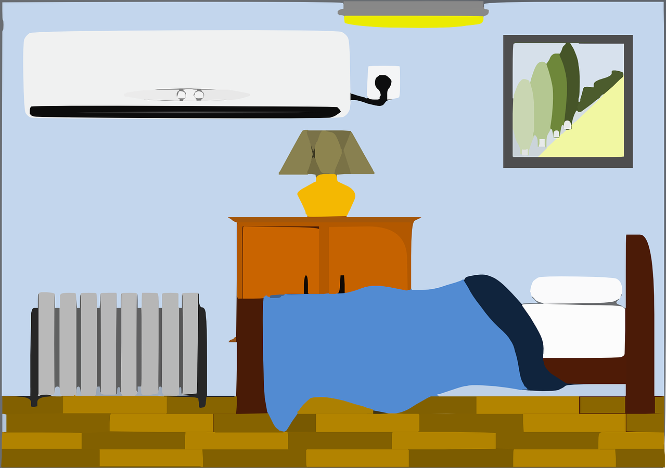
Liaison
écouter
Il y a quoi ? Écoute !
 | Il y a deux chiens / uniformes.
 | Il y a six portables / idées.
 | Il y a dix règles / ordinateurs.
 | Il y a deux chambres / amis.
 | Il y a six livres / acteurs.
 | Il y a dix vélos / activités.
 | Il y a deux voitures / écoles.
 | Il y a six chanteurs / exemples.
1
2
3
4
5
6
7
8
Notes:
Timing: 5 minutes
Aim: Aural recognition of the presence or absence of an x-liaison with numbers, and connect this with meaning.
Procedure:
1. Students write 1-8.
2. Click on a button to hear ‘il y a + number’, followed by a beep.
3. Based on the presence or absence of liaison, students decide which noun must comes next (the noun starting with a vowel, or that starting with a consonant. Remind them it is the presence or absence of a pronounced -x that will give them this information.
4. Click to reveal the answer and hear full audio.
5. Reset the task and ask students to read both versions of each sentence aloud, paying special attention to the –x and whether it enters into a liaison pattern or not.
Transcript
1. Il y a deux [chiens].
2. Il y a six [portables].
3. Il y a dix [ordinateurs].
4. Il y a deux [chambres].
5. Il y a six [acteurs].
6. Il y a dix [vélos].
7. Il y a deux [écoles].
8. Il y a six [exemples].

Slide 39
SSC [la liaison]
phonétique
Consolidation [3]

Slide 40
La liaison
La liaison
prononciation
Nous avons des chiens. We have dogs.
The final –s in avons is a Silent Final Consonant.
But …
Nous avons des chiens. We have dogs.
The final consonant in nous is not an SFC!
Because the -s is followed by a vowel, it is pronounced like the English ‘z’.
This pronunciation change is known as liaison.
Notes:
Timing: 2 minutes
Aim: To introduce the concept of liaison when –s appears before a vowel.
NB: Pronunciation practice of nous avons and vous avez appears in the slides that follow.

Slide 41
Avoir: nous and vous
avoir: nous and vous
parler
nous avons
we have
Notes:
Timing: 5 minutes for 14 slides.
Procedure:
1. Listen and repeat.
2. Highlight that nous avons sounds like one word, rather than two.

Slide 42
Avoir: nous and vous
parler
avoir: nous and vous
Avoir: nous and vous
vous avez
you (pl) have
Notes:
Procedure:
1. Listen and repeat.
2. Highlight that vous avez sounds like one word, rather than two.

Slide 43
Avoir: nous and vous
avoir: nous and vous
parler
Avoir: nous and vous
nous avons
we have
Notes:
Procedure:
1. Listen and repeat.
2. Highlight that nous avons sounds like one word, rather than two.

Slide 44
Avoir: nous and vous
avoir: nous and vous
parler
Avoir: nous and vous
vous avez
you (pl) have
Notes:
Procedure:
1. Listen and repeat.
2. Highlight that vous avez sounds like one word, rather than two.

Slide 45
Avoir: nous and vous
avoir: nous and vous
parler
Avoir: nous and vous
Nous avons deux sœurs.
We have two sisters.
Notes:
Note the SFC in the plural noun.
Procedure:
1. Listen and repeat.
2. Ask students to translate the sentence.
3. Reveal picture on a click, ask students to check their translations.
4. Reveal English translation on click.

Slide 46
Avoir: nous and vous
avoir: nous and vous
parler
Avoir: nous and vous
Vous avez des vélos.
You (pl) have bikes.
Notes:
Note the SFC in the plural noun.
Procedure:
1. Listen and repeat.
2. Ask students to translate the sentence.
3. Reveal picture on a click, ask students to check their translations.
4. Reveal English translation on click.

Slide 47
Avoir: nous and vous
avoir: nous and vous
parler
Avoir: nous and vous
Nous avons des rêves.
We have dreams.
Notes:
Note the SFC in the plural noun.
Procedure:
1. Listen and repeat.
2. Ask students to translate the sentence.
3. Reveal picture on a click, ask students to check their translations.
4. Reveal English translation on click.

Slide 48
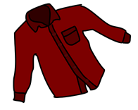
Avoir: nous and vous
avoir: nous and vous
parler
Avoir: nous and vous
Vous avez des chemises.
You (pl) have shirts.
Notes:
Listen and repeat.
Procedure:
1. Listen and repeat.
2. Ask students to translate the sentence.
3. Reveal picture on a click, ask students to check their translations.
4. Reveal English translation on click.

Slide 49
Avoir: nous and vous
avoir: nous and vous
parler
Avoir: nous and vous
Nous avons un problème.
We have a problem.
Notes:
An example with nous avons + un to further illustrate liaison before indefinite article.
NB: Teacher to explain to students that they may also hear ‘avons un(e)’ without the liaison, as both pronunciations are considered correct and pronunciation varies by individual speaker. The liaison is included here to provide maximal practice opportunities for students to recognise both variants.
Procedure:
1. Listen and repeat.
2. Ask students to translate the sentence.
3. Reveal picture on a click, ask students to check their translations.
4. Reveal English translation on click.

Slide 50
Avoir: nous and vous
avoir: nous and vous
parler
Avoir: nous and vous
Vous avez des enfants.
You (pl) have children.
Notes:
Note the SFC in the plural noun.
Procedure:
1. Listen and repeat.
2. Ask students to translate the sentence.
3. Reveal picture on a click, ask students to check their translations.
4. Reveal English translation on click.

Slide 51
Avoir: nous and vous
avoir: nous and vous
parler
Avoir: nous and vous
Nous avons une famille.
We have a family.
Notes:
An example with nous avons + une to further illustrate liaison before indefinite article.
NB: Teacher to explain to students that they may also hear ‘avons un(e)’ without the liaison, as both pronunciations are considered correct and pronunciation varies by individual speaker. The liaison is included here to provide maximal practice opportunities for students to recognise both variants.
Procedure:
1. Listen and repeat.
2. Ask students to translate the sentence.
3. Reveal picture on a click, ask students to check their translations.
4. Reveal English translation on click.

Slide 52
Avoir: nous and vous
avoir: nous and vous
parler
Avoir: nous and vous
Vous avez une maison.
You (pl) have a house.
Notes:
An example with vous avez + une to illustrate lack of liaison before indefinite article.
NB: Teacher to explain to students that they may also hear ‘avez un(e)’ without the liaison, as both pronunciations are considered correct and pronunciation varies by individual speaker. The liaison is included here to provide maximal practice opportunities for students to recognise both variants.
Procedure:
1. Listen and repeat.
2. Ask students to translate the sentence.
3. Reveal picture on a click, ask students to check their translations.
4. Reveal English translation on click.

Slide 53
Avoir: nous and vous
avoir: nous and vous
parler
Nous avons une solution.
We (pl) have a solution.
Notes:
An example with nous avez + une to illustrate lack of liaison before indefinite article.
NB: Teacher to explain to students that they may also hear ‘avons un(e)’ without the liaison, as both pronunciations are considered correct and pronunciation varies by individual speaker. The liaison is included here to provide maximal practice opportunities for students to recognise both variants.
Procedure:
1. Listen and repeat.
2. Ask students to translate the sentence.
3. Reveal picture on a click, ask students to check their translations.
4. Reveal English translation on click.

Slide 54
Avoir: nous and vous
avoir: nous and vous
parler
Vous avez une solution.
You (pl) have a solution.
Notes:
NB: Teacher to explain to students that they may also hear ‘avez un(e)’ without the liaison, as both pronunciations are considered correct and pronunciation varies by individual speaker. The liaison is included here to provide maximal practice opportunities for students to recognise both variants.
Procedure:
1. Listen and repeat.
2. Ask students to translate the sentence.
3. Reveal picture on a click, ask students to check their translations.
4. Reveal English translation on click.

Slide 55
Avoir: ils and elles
avoir: ils and elles
grammaire
Avoir: ils and elles
Avoir: nous and vous
To say one person has something, use il (m.) or elle (f.) with the correct form of avoir.
Il a des chiens. Elle a des chiens.
He has dogs. She has dogs.
To say ‘they’ + avoir (third person plural):
Ils ont des chiens. They (m. pl.) have dogs.
They (mixed pl.) have dogs.
Elles ont des chiens. They (f. pl.) have dogs.
Marc et Léa ont des chiens. Noura and Amir have dogs.
__
__
The final –t in ont
is a Silent Final Consonant.
The final consonant in ils and elles is not an SFC here! Because the -s is followed by a vowel, liaison occurs.
__
__
___________
Notes:
Timing: 2 minutes
Aim: To present the 3rd person plural forms of avoir.
Procedure
1. Teacher recaps the meaning of the pronouns ils and elles.
2. Teacher to remind students of the meaning of the pronouns ils and elles. Teacher to highlight that groups of named people (e.g. Noura and Amir) also need the 3rd person plural form.
3. Teacher to remind students of the meaning of the indefinite plural article des. The examples given illustrate its absence in English. Note the SFC in the plural chiens.
4. Teacher to point out that avoir is irregular in French. As with être, there is a different form for each pronoun.
5. Teacher to draw attention to the pronunciation (SFC on the verb, but not the pronoun). Explain that a liaison sometimes occurs when SFCs appear before a vowel, and that this can lead to a change in pronunciation in the consonant (here, like the English ‘z’.) Additional pronunciation practice of nous avons and vous avez appears in the slides that follow.

Slide 56
Avoir: ils and elles
avoir: ils and elles
parler
Avoir: nous and vous
ils ont
they (m or m/f) have
Notes:
Timing: 4 minutes for 12 slides
Procedure:
Listen and repeat.
Highlight that ils ont sounds like one word, rather than two.

Slide 57
Avoir: ils and elles
avoir: ils and elles
parler
Avoir: ils and elles
Avoir: nous and vous
elles ont
they (f) have
Notes:
Procedure:
Listen and repeat.
Highlight that elles ont sounds like one word, rather than two.

Slide 58
Avoir: ils and elles
avoir: ils and elles
parler
Avoir: ils and elles
Avoir: nous and vous
ils ont
they (m or m/f) have
Notes:
Procedure:
Listen and repeat.
Highlight that ils ont sounds like one word, rather than two.

Slide 59
Avoir: ils and elles
avoir: ils and elles
parler
Avoir: ils and elles
Avoir: nous and vous
elles ont
they (f) have
Notes:
Procedure:
Listen and repeat.
Highlight that elles ont sounds like one word, rather than two.

Slide 60
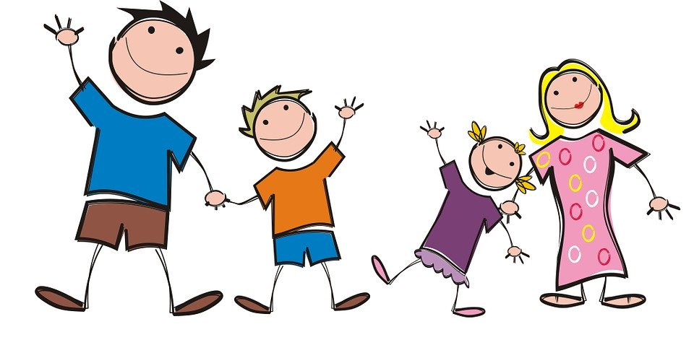
Avoir: ils and elles
avoir: ils and elles
parler
Avoir: ils and elles
Avoir: nous and vous
Ils ont deux sœurs.
They (m/f) have two sisters.
Notes:
Procedure:
1. Listen and repeat. Note the SFC in the plural noun.
2. Ask students to translate the sentence.
3. Reveal picture on a click, ask students to check their translations.
4. Reveal English translation on click.

Slide 61
Avoir: ils and elles
avoir: ils and elles
parler
Avoir: ils and elles
Avoir: nous and vous
Elles ont des vélos.
They (f) have bikes.
Notes:
Procedure:
Listen and repeat. Note SFC in plural noun.
Ask students to translate the sentence.
Reveal picture on a click, ask students to check their translations.
Reveal English translation on click.

Slide 62
Avoir: ils and elles
avoir: ils and elles
parler
Avoir: ils and elles
Avoir: nous and vous
Ils ont des rêves.
They (m/f) have dreams.
Notes:
Procedure:
1. Listen and repeat. Note SFC in plural noun
2. Ask students to translate the sentence.
3. Reveal picture on a click, ask students to check their translations.
4. Reveal English translation on click.

Slide 63
Avoir: ils and elles
avoir: ils and elles
parler
Avoir: ils and elles
Avoir: nous and vous
Elles ont des chemises.
They (f) have shirts.
Notes:
Procedure:
Listen and repeat. Note SFC in plural noun.
Ask students to translate the sentence.
Reveal picture on a click, ask students to check their translations.
Reveal English translation on click.

Slide 64
Avoir: ils and elles
avoir: ils and elles
parler
Avoir: ils and elles
Avoir: nous and vous
Ils ont un problème.
They (m) have a problem.
Here, there is a liaison between –t and the vowel which follows.
Notes:
Procedure:
1. Listen and repeat. Example with ils ont + un to illustrate –t liaison.
2. Ask students to translate the sentence.
3. Reveal picture on a click, ask students to check their translations.
4. Reveal English translation on click.

Slide 65
Avoir: ils and elles
avoir: ils and elles
parler
Avoir: ils and elles
Avoir: nous and vous
Elles ont une maison.
They (f) have a house.
Notes:
Procedure:
1. Listen and repeat. An example with elles ont + une to illustrate t- liaison.
2. Ask students to translate the sentence.
3. Reveal picture on a click, ask students to check their translations.
4. Reveal English translation on click.

Slide 66
Avoir: ils and elles
avoir: ils and elles
parler
Avoir: ils and elles
Avoir: nous and vous
Elles ont une famille.
They (f) have a family.
Notes:
Procedure:
1. Listen and repeat. An example with elles ont + une to illustrate t- liaison.
2. Ask students to translate the sentence.
3. Reveal picture on a click, ask students to check their translations.
4. Reveal English translation on click.

Slide 67
Avoir: ils and elles
avoir: ils and elles
parler
Avoir: ils and elles
Avoir: nous and vous
Ils ont un enfant.
They (m, m/f) have a child.
Notes:
Procedure:
1. Listen and repeat. An example with ils ont + un to illustrate -t liaison.
2. Ask students to translate the sentence.
3. Reveal picture on a click, ask students to check their translations.
4. Reveal English translation on click.

Slide 68
SSC [la liaison]
phonétique
Consolidation [4]

Slide 69
La liaison
La liaison
parler
Ils font le ménage. They are cleaning.
The final –t in font is a Silent Final Consonant.
But …
Ils font une visite à Paris. They are taking a trip to Paris.
Here, the final consonant in font is not an SFC!
Because the -t is followed by a vowel, it is pronounced.
As you know, this is an example of liaison.
Notes:
Timing: 2 minutes
Aim: Revisiting t-liaison (this was previously introduced with c’est + indefinite article only in week 1.1.3).
Pronunciation practice of font with and without liaison appears in the slides that follow.

Slide 70
Saying what people do
Saying what people do
parler
ils font
The final –t in font
is a Silent Final Consonant.
they (m or m/f) do, make
Notes:
Timing: 3 minutes for 10 slides.
Procedure:
1. Listen and repeat.
2. Highlight the SSC in font.
Transcript:
Ils font

Slide 71
Saying what people do
Saying what people do
parler
elles font
they (f) do, make
Notes:
Procedure:
1. Listen and repeat.
2. Highlight the SSC in font.
Transcript
Elles font

Slide 72
Saying what people do
Saying what people do
parler
Ils font la cuisine.
They (m/f) do/are doing the cooking.
Notes:
Procedure:
1. Listen and repeat.
2. Ask students to translate the sentence.
3. Reveal picture on a click, ask students to check their translations.
4. Reveal English translation on click.
Transcript
Ils font la cuisine

Slide 73
Saying what people do
Saying what people do
parler
Saying what people do
Ils font une fête
They (m/f) have/are having a party.
Notes:
Transcript
Ils font une fête

Slide 74
Saying what people do
Saying what people do
parler
Elles font des exercices de français.
They (f) are doing French exercises.
FAIRE
4. nous faisons
5. vous faites
6. ils/elles font
1. je fais
2. tu fais
3. il/elle fait
Notes:
Transcript: Elles font des exercices de français

Slide 75
Saying what people do
Saying what people do
parler
Elles font un effort.
They (f) make/are making an effort.
Notes:
Transcript:
Elles font un effort

Slide 76
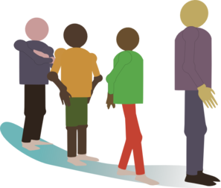
Saying what people do
Saying what people do
parler
Saying what people do
Ils font la queue.
They (m/f) queue / are queuing.
Notes:
Transcript:
Ils font la queue

Slide 77
Saying what people do
Saying what people do
parler
Saying what people do
Ils font un gâteau.
They (m/f) make/are making a cake.
Notes:
Transcript
Ils font un gâteau

Slide 78
Saying what people do
Saying what people do
parler
Saying what people do
Elles font les courses.
They (f) are doing grocery shopping.
Notes:
Transcript:
Elles font les courses

Slide 79
Saying what people do
Saying what people do
parler
Saying what people do
Elles font une promenade.
They (f) go/are going for a walk.
Notes:
Transcript:
Elles font une promenade

Slide 80
SSC [la liaison]
phonétique
Consolidation [5]

Slide 81
Saying what people have: nous and vous
La liaison
prononciation
Je vais dehors. I go outside.
The final –s in vais is a Silent Final Consonant.
But …
Je vais à Paris. I go to Paris.
Now, the final consonant in vais is not an SFC!
Because the -s is followed by a vowel, it is pronounced like the English ‘z’.
This pronunciation change is an example of liaison.
Notes:
Pronunciation practice of je vais appears in the slides that follow.

Slide 82
Saying where people go: je vais
prononcer
je vais à Lyon
I go/am going to Lyon
Notes:
Listen and repeat.
Highlight that vais à sounds like one word, rather than two.

Slide 83
Saying where people go: je vais
prononcer
je vais au parc
I go/am going to the park
Notes:
Listen and repeat.
Highlight that vais au sounds like one word, rather than two.

Slide 84
Saying where people go: je vais
prononcer
je vais à la poste
I go/am going to the post office
Notes:
Listen and repeat.
Highlight that vais à sounds like one word, rather than two.

Slide 85
Saying what people have: nous and vous
La liaison
prononciation
Tu vas dehors. You go outside.
The final –s in vas is a Silent Final Consonant.
But …
Tu vas à Londrès. I go to London.
Now, the final consonant in vas is not an SFC!
Because the -s is followed by a vowel, it is pronounced like the English ‘z’.
This is another example of liaison.
Notes:
Pronunciation practice of je vais appears in the slides that follow.

Slide 86
Saying where people go: tu vas
prononcer
tu vas à Lille
You go/are going to Lille
Notes:
Listen and repeat.
Highlight that vas à sounds like one word, rather than two.

Slide 87
Saying where people go: tu vas
prononcer
tu vas au collège
You go/are going to school
Notes:
Listen and repeat.
Highlight that vas au sounds like one word, rather than two.

Slide 88
Saying where people go: tu vas
prononcer
tu vas à la caisse
You go/are going to the checkout
Notes:
Listen and repeat.
Highlight that vas à sounds like one word, rather than two.

Slide 89
SSC [la liaison]
phonétique
Consolidation [6]

Slide 90
Saying ‘to (the)...’ in French
Saying ‘to (the)…’
grammaire
To say ‘to (the)... + noun’ in French, we use au or à la, according to whether the noun is masculine (au) or feminine (à la).
au parc
___
___
to the park
à la caisse
to the checkout
Because the -x in aux is followed by a vowel, it is pronounced like the English ‘z’.
This is a liaison.
If the noun begins with a vowel or h, we use à l’ for masculine and feminine:
___
à l’ île
to the island
___
à l’ aéroport
to the airport
___
à l’ hôtel
to the hotel
à l’ université
to the university
___
If the noun is plural, we use aux for both masculine and feminine nouns:
aux îles
___
to the islands
aux États-Unis
to the USA
___
Stephen Owen
Notes:
Timing: 3 minutes
Aim: To recap au/à la and introduce à l’/aux
Procedure:
Teacher to draw attention to the liaison in ‘aux États-Unis’ and ‘aux îles.’ This is practised further in the slides that follow.
Explain that because ‘États’ (states) is plural, the name of the country needs ‘aux’.

Slide 91
La liaison avec ‘aux’
La liaison avec ‘aux’
parler
La liaison avec ‘aux’
Il va aux hôtels.
He goes/is going to the hotels.
Notes:
Timing: 2 minutes for 4 slides.
Aim: Pronunciation practice with ‘aux’ + liaison.
Procedure:
1. Listen and repeat.
2. Ask students to translate the sentence.
3. Reveal picture on a click, ask students to check their translations.
4. Reveal English translation on click.

Slide 92
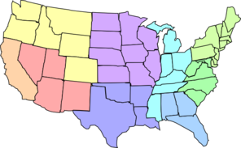
La liaison avec ‘aux’
La liaison avec ‘aux’
parler
La liaison avec ‘aux’
Je vais aux États-Unis.
I go/am going to the USA.

Slide 93
La liaison avec ‘aux’
La liaison avec ‘aux’
parler
La liaison avec ‘aux’
Elle va aux aéroports
She goes/is going to the airports.

Slide 94
La liaison avec ‘aux’
La liaison avec ‘aux’
parler
La liaison avec ‘aux’
Tu vas aux universités.
You go/are going to the universities.

Slide 95
SSC [la liaison]
phonétique
Consolidation [7]

Slide 96
Saying ‘to (the)...’ in French
Saying ‘to (the)…’
grammaire
To say ‘to (the)... + noun’ in French, we use au or à la, according to whether the noun is masculine (au) or feminine (à la).
au parc
___
___
to the park
à la caisse
to the checkout
Because the -x in aux is followed by a vowel, it is pronounced like the English ‘z’.
This is a liaison.
If the noun begins with a vowel or h, we use à l’ for masculine and feminine:
___
à l’ île
to the island
___
à l’ aéroport
to the airport
___
à l’ hôtel
to the hotel
à l’ université
to the university
___
If the noun is plural, we use aux for both masculine and feminine nouns:
aux îles
___
to the islands
aux États-Unis
to the USA
___
Stephen Owen
Notes:
Timing: 3 minutes
Aim: To recap au/à la and introduce à l’/aux
Procedure:
Teacher to draw attention to the liaison in ‘aux États-Unis’ and ‘aux îles.’ This is practised further in the slides that follow.
Explain that because ‘États’ (states) is plural, the name of the country needs ‘aux’.

Slide 97
Saying where we go / are going
Saying where we go
parler
Nous allons à Paris.
We are going to Paris.
Notes:
Timing: 5 minutes (4 slides)
Aim: Consolidate ‘nous’ form of aller and model the liaison within sentences using the preposition ‘à’.
Procedure:
1. Listen and repeat.
2. Ask students to translate the sentence.
3. Reveal picture on a click, ask students to check their translations.
4. Reveal English translation on click.

Slide 98
Saying where we go / are going
Saying where we go
parler
Nous allons à Londres.
We are going to London.

Slide 99
Saying where we go / are going
Saying where we go
parler
Nous allons au collège.
We are going to school.

Slide 100
Saying where we go / are going
Saying where we go
parler
Nous allons à la maison.
We are going home.
Since we are using aller
to talk about going somewhere,
the meaning of ‘à’ must be ‘to’.
In English, we of course say ‘home’ rather than ‘to the house’!

Slide 101
Saying where you go / are going
Saying where you go
parler
vous allez
you (pl) go / are going
Notes:
Timing: 30 seconds
Aim: Consolidate ‘vous’ form of aller and model the liaison.
Procedure:
Click the trigger button to play the audio.
Students listen and repeat
Highlight that vous allez sounds like one word, rather than two.

Slide 102
Saying where you go / are going
Saying where you go
parler
Vous allez à Londres.
You are going to London.
Notes:
Timing: 4 minutes (for four slides)
Aim: Consolidate ‘nous’ form of aller and model the liaison within sentences using the preposition ‘à’.
Procedure:
1. Listen and repeat.
2. Ask students to translate the sentence.
3. Reveal picture on a click, ask students to check their translations.
4. Reveal English translation on click.

Slide 103
Saying where you go / are going
Saying where you go
parler
Vous allez à Paris.
You are going to Paris.

Slide 104
Saying where you go / are going
Saying where you go
parler
Vous allez au magasin.
You are going to the shop.

Slide 105
Saying where you go / are going
Saying where you go
parler
Vous allez au magasin.
You are going to the shop.

Slide 106
SSC [la liaison]
phonétique
Consolidation [8]

Slide 107
Subject-verb inversion with ‘il’ and ‘elle’
grammaire
Subject-verb inversion (il/elle)
As you know, the verb and subject can swap places to make a question:
In questions with ‘il’/‘elle’, we pronounce the last letter of the verb as ‘t’.
Silent ‘t’
(SFC)
Elle revient de Paris.
She’s coming back from Paris.
Revient-elle de Paris ?
Is she coming back from Paris ?
Pronounce the ‘t’
The sound is always ‘t’, even if the verb ends with the letter ‘d’:
Prend-elle le train ?
Does she take the train?
Notes:
Timing: 1 minute
This slide reviews subject-verb inversion and presents the pronunciation change associated with questions in the third person.

Slide 108
Subject-verb inversion with ‘il’ and ‘elle’
grammaire
Subject-verb inversion (il/elle)
If the verb ends with a vowel, we need to add a ‘t’ before ‘il’/’elle’.
Now, we need two hyphens, to connect the verb, the ‘t’ and the subject.
Elle a une voiture.
She has a car.
A-t-elle une voiture ?
Does she have a car?
Il prépare le déjeuner.
He is preparing lunch.
Prépare-t-il le déjeuner ?
Is he preparing lunch?
Adding a ‘t’ makes this easier to pronounce.
Notes:
Timing: 1 minute
Introduce the need to add a ‘t’ if the verb ends with a vowel. This will be practised in the next slides.

Slide 109
Vocabulaire
Subject-verb inversion (il/elle)
écrire/écouter / parler
Subject-verb inversion with ‘il’ and ‘elle’
Va-t-il à l’hôtel aujourd’hui ?
Is he going to the hotel today?
Notes:
Timing 3 minutes for six slides
Aim: Pronunciation practice with vowels and inversion. For each slide, draw attention to the fact that there is always a ‘t’ sound between the verb and subject (regardless of whether a –t- is inserted or not; sometimes there is liaison).
Procedure:
1. Listen and repeat.
2. Ask students to translate the sentence. A time phrase is included so that it is clear which English tense (simple or continuous) is required.
3. Reveal picture on a click, ask students to check their translations.
4. Reveal English translation on click.

Slide 110
Vocabulaire
Subject-verb inversion (il/elle)
écrire/écouter / parler
Subject-verb inversion with ‘il’ and ‘elle’
Subject-verb inversion with ‘il’ and ‘elle’
Vocabulaire
Comprend-il la question ?
Does he understand the question?
Notes:
Pronunciation practice with vowels and inversion. (French to English)
NB: Teacher to flag the pronunciation of the –d in comprend, which is pronounced like a –t. All questions in the il/elle forms contain a ‘t’ sound of some kind between the verb and the pronoun.

Slide 111
Vocabulaire
Subject-verb inversion (il/elle)
écrire/écouter / parler
Subject-verb inversion with ‘il’ and ‘elle’
Subject-verb inversion with ‘il’ and ‘elle’
Vocabulaire
Donne-t-il un cadeau à Léa chaque année ?
Does he give a present to Léa every year?
Notes:
Pronunciation practice with vowels and inversion. (This slide and the 3 that follow: French to English)

Slide 112
Vocabulaire
Subject-verb inversion (il/elle)
écrire/écouter / parler
Subject-verb inversion with ‘il’ and ‘elle’
Subject-verb inversion with ‘il’ and ‘elle’
Vocabulaire
Est-il grand ?
Is he tall?
Notes:
Pronunciation practice with vowels and inversion. (French to English)

Slide 113
Vocabulaire
Subject-verb inversion (il/elle)
écrire/écouter / parler
Subject-verb inversion with ‘il’ and ‘elle’
Subject-verb inversion with ‘il’ and ‘elle’
Vocabulaire
Joue-t-elle à l’ordinateur en ce moment ?
Is she playing on the computer at the moment?
Notes:
Pronunciation practice with vowels and inversion. (French to English)

Slide 114
Vocabulaire
Subject-verb inversion (il/elle)
écrire/écouter / parler
Subject-verb inversion with ‘il’ and ‘elle’
Subject-verb inversion with ‘il’ and ‘elle’
Vocabulaire
Sort-elle en ville chaque week-end ?
Does she go out in town every weekend?
Notes:
Pronunciation practice with vowels and inversion. (French to English)

Slide 115
Questions with a named subject
grammaire
Questions with a named subject
We have seen how to form questions using subject pronouns (je, tu, il/elle).
If the subject is a name or a noun with an article, we repeat the subject.
The name/noun goes before the inverted verb and pronoun:
Paul devient professeur.
Paul is becoming a teacher.
Paul devient-il professeur?
Is Paul becoming a teacher?
La fille prend le train.
The girl takes the train.
La fille prend-elle le train ?
Does the girl take the train?
Notes:
Timing: 2 minutes
Introducing subject repetition in inversion questions with named subjects.

Slide 116
SSC [la liaison]
phonétique
Consolidation [9]

Slide 117
Vocabulaire
La liaison avec ‘ne…pas’
écouter / parler
La liaison avec ‘ne…pas’
Tu ne vas pas à l'école.
You don’t go / aren’t going to school.
Notes:
Timing: 3 minutes for 6 slides
Aim: Pronunciation practice with ‘ne…pas’ + liaison.
Procedure:
1. Listen and repeat.
2. Ask students to translate the sentence.
3. Reveal picture on a click, ask students to check their translations.
4. Reveal English translation on click.

Slide 118
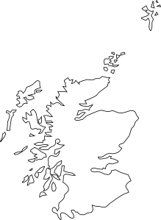
Vocabulaire
La liaison avec ‘ne…pas’
écouter / parler
La liaison avec ‘ne…pas’
La liaison avec ‘ne…pas’
Je n'habite pas en Écosse..
I don’t live / am not living in Scotland.

Slide 119
Vocabulaire
La liaison avec ‘ne…pas’
écouter / parler
La liaison avec ‘ne…pas’
Nous n'aimons pas écouter la radio.
We don’t like listening to the radio.

Slide 120
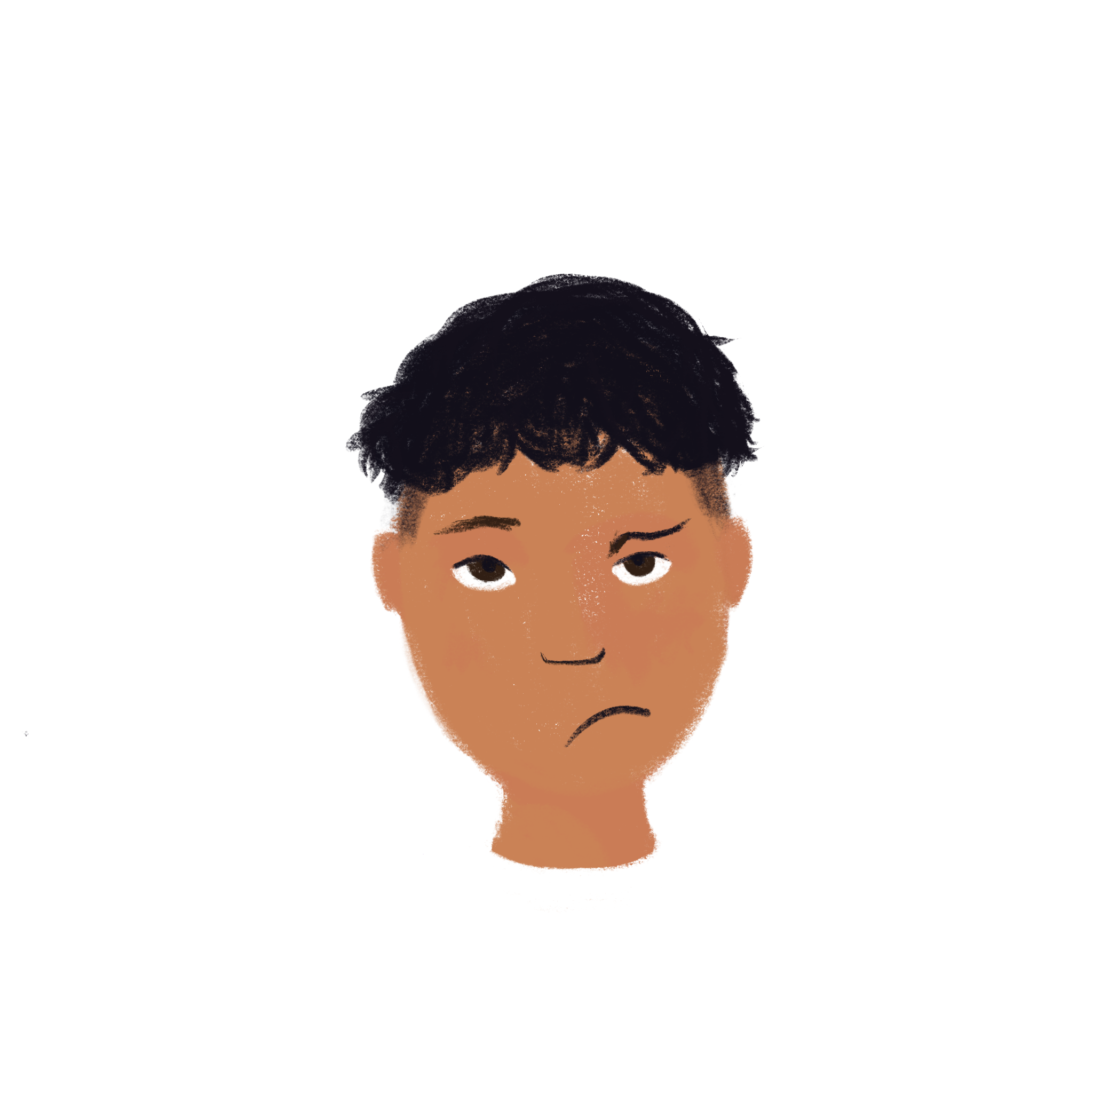
Vocabulaire
La liaison avec ‘ne…pas’
écouter / parler
La liaison avec ‘ne…pas’
La situation n'est pas amusante.
The situation isn’t funny.

Slide 121
Vocabulaire
La liaison avec ‘ne…pas’
écouter / parler
La liaison avec ‘ne…pas’
Elle ne fait pas attention.
She doesn’t pay / isn’t paying attention.

Slide 122
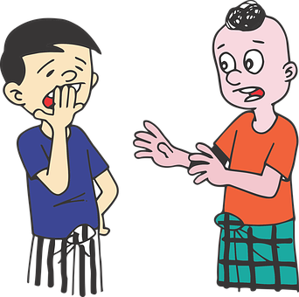
Vocabulaire
La liaison avec ‘ne…pas’
écouter / parler
La liaison avec ‘ne…pas’
Ce n'est pas intéressant.
It’s not interesting.

Slide 123
SSC [la liaison]
phonétique
Consolidation [10]

Slide 124
La liaison
grammaire
The plural articles ‘les’ and ‘des’ end with a Silent Final Consonant:
les vacances des parents
However, when we use them before a noun beginning with a vowel or ‘h’, the final ‘-s’ is pronounced like an English ‘z’. This is called liaison:
les affaires des hommes
The same thing happens with the numbers ‘deux’ and ‘trois’:
deux ordinateurs trois idées
Notes:
Timing: 2 minutes
Aim: to recap liaison with plural articles and numbers

Slide 125
La liaison
écouter / parler
J’aime les vacances.
I like the holidays.
Notes:
Timing: 3 minutes for 8 slides
Aim: practising pronunciation plural articles and numbers + liaison
Procedure:
1. Listen and repeat.
2. Ask students to translate the sentence.
3. Reveal picture on a click, ask students to check their translations.
4. Reveal English translation on click.

Slide 126
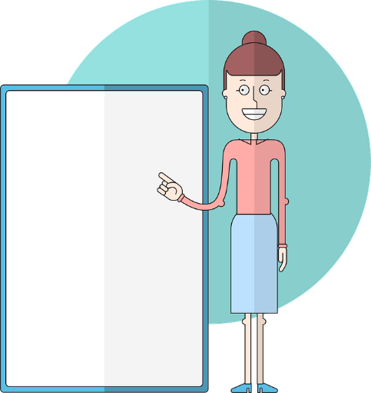
La liaison
écouter / parler
Tu montres les ordinateurs aux personnes.
You are showing the computers to the people.

Slide 127
La liaison
écouter / parler
Elles font des fêtes.
They have parties.

Slide 128
La liaison
écouter / parler
Ils font des affaires.
They are doing business.

Slide 129
La liaison
écouter / parler
Elle parle à deux femmes.
She is speaking to two women.

Slide 130
La liaison
écouter / parler
Il parle à deux hommes.
He is speaking to two men.

Slide 131
La liaison
écouter / parler
Il y a trois questions.
There are three questions.

Slide 132
La liaison
écouter / parler
Il y a trois exercices.
There are three exercises.

Slide 133
SSC [la liaison]
phonétique
Consolidation [11]

Slide 134
La liaison avec le h muet
parler
In French, [h-] is normally silent.
This means it follows the pronunciation rules of the vowel that comes after it.
Look at these sentences. How is the last letter in ‘c’est’ pronounced?
C’est triste !
C’est horrible !
C’est triste !
C’est horrible !
Liaison occurs when words ending with a Silent Final Consonant come before a word beginning with [h-].
Notes:
Timing: 2 minutes
Aim: To raise awareness of pronunciation patterns with SFC + [h-]

Slide 135
La liaison avec le h muet
parler / écouter
Dis les deux versions de chaque phrase. Attention à la consonne finale !
 |  | a | b
 | Il a des ... | hallucinations. | problèmes.
 | Tu fais un voyage dans ton … | hélicoptère ? | pays ?
 | Il y a deux … | hexagones. | questions.
 | Où passes-tu tes … | hivers ? | vacances ?
 | Je fais attention à mes … | horoscopes. | vêtements.
 | Voici les … | hologrammes. | réponses.
 | Désolé pour mon … | hostilité. | français.
 | Il y a trois … | hôtels. | cafés.
1
2
3
Écoute. Quel mot complète la phrase ? Écris a ou b.
4
5
6
7
8
Notes:
Timing: 10 minutes for 2 slides
Aim: practising oral production and aural recognition of liaison with SSC [h-] using cognates and known vocabulary.
Procedure:
Teacher can recap liaison before beginning the task, highlighting the different pronunciations of les, des, mon, mes, ton, tes, deux, trois before a vowel.
Students read the two versions of the sentences and decide which word needs a liaison and which does not. They then say each version of the sentence aloud.
Click to reveal the second part of the task
Click the numbers to play the audio. The last words in the sentences are obscured by beeps (the liaison is heard where present).
Students write 1-8 and choose ‘a’ or ‘b’ to complete the sentence, based on the presence or absence of liaison.
Answers and full audio (without beeps) are provided on the next slide.
Transcript:
Il a des [...].
Tu fais un voyage dans ton […] ?
Il y a deux […].
Où passes-tu tes […] ?
Je fais attention à mes […].
Voici les […].
Désolé pour mon […].
Il y a trois […].
Word frequency of cognates used (1 is the most frequent word in French): compléter [2034], hallucination [>5000], hélicoptère [2978], hexagone [>5000], hologramme [>5000], horoscope [>5000], hostilité [3436]
Source: Londsale, D., & Le Bras, Y. (2009). A Frequency Dictionary of French: Core vocabulary for learners London: Routledge.

Slide 136
La liaison avec le h muet
Réponses
parler / écouter
Dis les deux versions de chaque phrase. Attention à la consonne finale !
Écoute. Quel mot complète la phrase ? Écris a ou b.
 |  | a | b
 | Il a des ... | hallucinations. | problèmes.
 | Tu fais un voyage dans ton … | hélicoptère ? | pays ?
 | Il y a deux … | hexagones. | questions.
 | Où passes-tu tes … | hivers ? | vacances ?
 | Je fais attention à mes … | horoscopes. | vêtements.
 | Voici les … | hologrammes. | réponses.
 | Désolé pour mon … | hostilité. | français.
 | Il y a trois … | hôtels. | cafés.
1
2
3
4
5
6
7
8
Notes:
Procedure:
1. Click the numbers to play the full audio without beeps.
Transcript:
Il a des hallucinations.
Tu fais un voyage dans ton pays ?
Il y a deux hexagones.
Où passes-tu tes vacances ?
Je fais attention à mes vêtements.
Voici les hologrammes.
Désolé pour mon hostilité.
Il y a trois cafés.

Slide 137
SSC [la liaison]
phonétique
Consolidation [12]

Slide 138
Liaison with [h]
lire / parler
If a word normally ends with a Silent Final Consonant, the final consonant is pronounced before a word beginning with [h]. This is called liaison.
Dis les phrases à un(e) partenaire. Il y a une liaison, ou pas ?
Partenaire A
 |  | Liaison ? ( ü / û )
1. | Elles chantent en harmonie.
2. | Vous restez chez Marie ?
3. | Il est très content.
4. | Ils sont horribles.
1
2
3
4
Notes:
Timing: 4 minutes for 2 slides
Aim: practising oral production of liaison with SSC [h] using cognates and known vocabulary
Procedure:
1. Teacher can recap liaison before beginning the task.
2. Partner A reads the four sentences aloud, making the liaison where necessary.
3. Partner B notes if there is a liaison or not.
4. Click to reveal the answers.
5. Partners swap roles (see next slide).
Transcript:
1. Elles chantent en harmonie.
2. Vous restez chez Marie ?
3. Il est très content.
4. Ils sont horribles.
Word frequency of cognates used (1 is the most frequent word in French): liaison [1968], harmonie [4584], horrible [3190]
Source: Londsale, D., & Le Bras, Y. (2009). A Frequency Dictionary of French: Core vocabulary for learners London: Routledge.

Slide 139
Liaison with [h]
lire / parler
If a word normally ends with a Silent Final Consonant, the final consonant is pronounced before a word beginning with [h]. This is called liaison.
Dis les phrases à un(e) partenaire. Il y a une liaison, ou pas ?
Partenaire B
 |  | Liaison ? ( ü / û )
1. | Les bâtiments sont grands.
2. | Elles parlent en français.
3. | Je vais chez Hugo.
4. | Le climat est très humide.
5
6
7
8
Notes:
This is the continuation of the activity on the previous slide
Transcript:
5. Les bâtiments sont grands.
6. Elles parlent en français.
7. Je vais chez Hugo
8. Le climat est très humide.
Word frequency of cognates used (1 is the most frequent word in French): humide [4841]
Source: Londsale, D., & Le Bras, Y. (2009). A Frequency Dictionary of French: Core vocabulary for learners London: Routledge.

Slide 140
SSC [la liaison]
phonétique
Consolidation [13]

Slide 141
Saying ‘your’
Saying ‘your’
écouter / parler
Voici vos tâches.
Here are your tasks.
Notes:
Timing: 2 minutes [4 slides]
Aim: Practise pronunciation with vos + liaison
Procedure:
1. Listen and repeat.
2. Ask students to translate the sentence.
3. Reveal picture on a click, ask students to check their translations.
4. Reveal English translation on click.

Slide 142
Saying ‘your’
Saying ‘your’
écouter / parler
Vos élèves sont intelligents.
Your pupils are intelligent.

Slide 143
Saying ‘your’
Saying ‘your’
écouter / parler
J’aime vos cours.
I like your lessons.

Slide 144
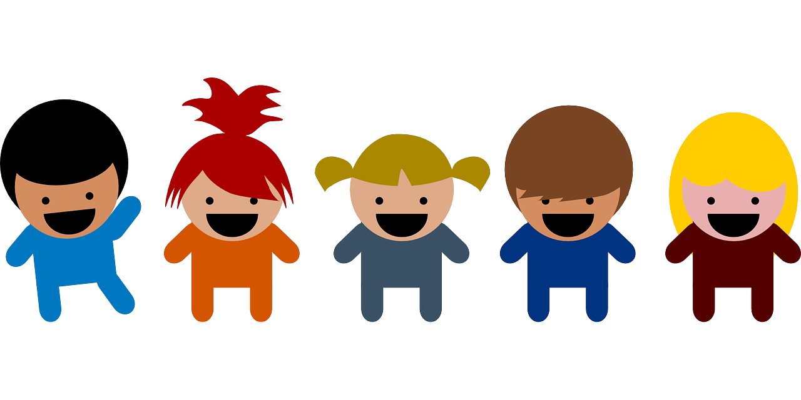
Saying ‘your’
Saying ‘your’
écouter / parler
Vos enfants sont gentils.
Your children are kind.

Slide 145
Saying ‘their’
Saying ‘their’
écouter / parler
Voici leurs vélos.
Here are their bikes.
Notes:
Timing: 2 minutes [4 slides]
Aim: To practise pronunciation with leurs + liaison
Procedure:
1. Listen and repeat.
2. Ask students to translate the sentence.
3. Reveal picture on a click, ask students to check their translations.
4. Reveal English translation on click.

Slide 146
Saying ‘their’
Saying ‘their’
écouter / parler
Leurs amis sont sympas.
Their friends are nice.

Slide 147
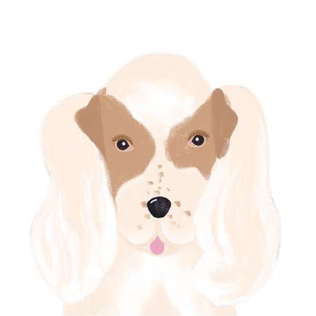
Saying ‘their’
Saying ‘their’
écouter / parler
Leurs chiens sont sages.
Their dogs are well-behaved.

Slide 148
Saying ‘their’
Saying ‘their’
écouter / parler
J’aime leurs idées.
I like their ideas.

