Slide 1
Phonics
SSC /au/
Y7 German
Term 2.2 - Week 2 - Lesson 41
Author name(s):
Rachel Hawkes / Ciaran Morris / Catherine /morris
Date updated: 26/04/20

Slide 2
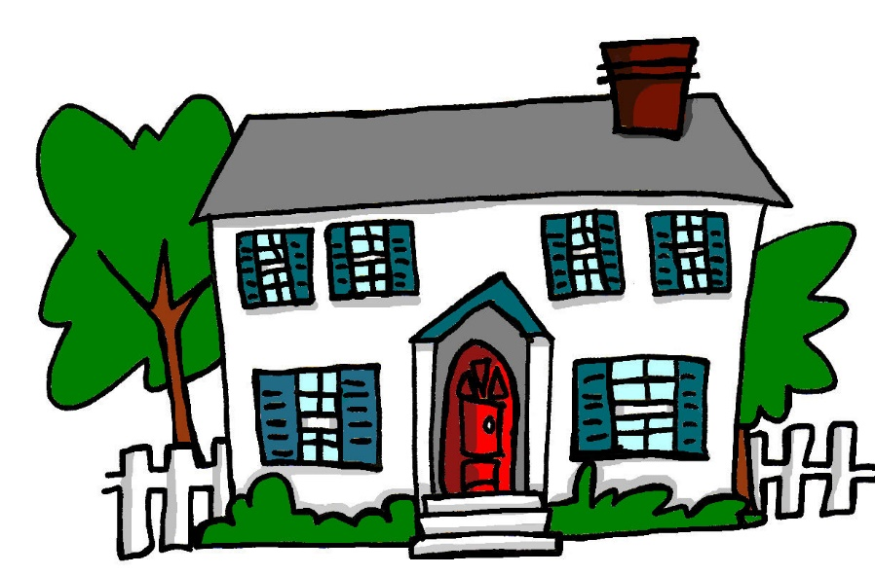
au
Haus
Steve Clarke / Rachel Hawkes
Notes:
Introduce and elicit the pronunciation of the individual SSC ‘au’ and then present and practise the pronunciation of the source word ‘Haus’.
A possible gesture for this would be to form a roof shape by touching your fingertips together, in front of you.

Slide 3
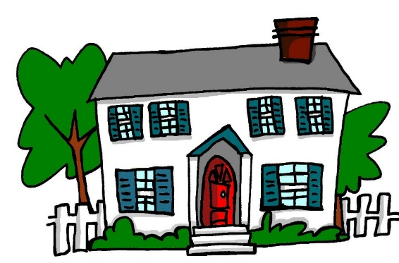
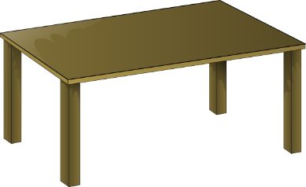
au
genau
auch
[exact(ly)]
Haus
[8:07:25]
glauben
auf
[to believe]
ausgehen
[to go out]
Rachel Hawkes
Notes:
Introduce and elicit the pronunciation of the individual SSC ‘au’ and then the source word again (with gesture, if using). Then present and elicit the pronunciation of the five cluster words. The cluster words have been chosen for their high-frequency, from a range of word classes, with the SSC (where possible) positioned within a variety of syllables within the words(e.g. initial, 2nd, final etc..) and additionally, we have tried to use words that build cumulatively on previously taught SSCs (see the Phonics Teaching Sequence document) and do not include new SSCs. Where new SSCs are used, they are often consonants which have a similar symbol-sound correspondence in English.
Word frequency rankings (1 is the most common word in German): Haus [159]; genau [183] auch [16]; glauben [143]; ausgehen [493]; auf [17]. Source: Jones, R.L. & Tschirner, E. (2006). A frequency dictionary of German: core vocabulary for learners. Routledge

Slide 4
au
genau
auch
Haus
glauben
auf
ausgehen
Rachel Hawkes
Notes:
Without pictures to focus on the SSC alone.

Slide 5
au
genau
auch
Haus
glauben
auf
ausgehen
Rachel Hawkes
Notes:
Without sound to elicit the pronunciation.

Slide 6
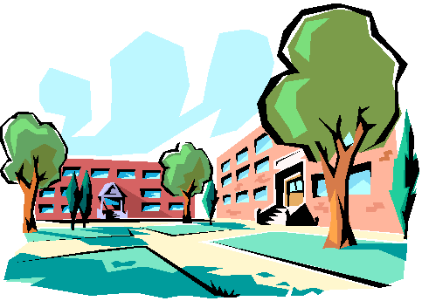
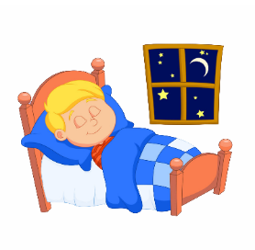
Hörst du ‘au’ oder ‘äu’?
Hören / Schreiben
 |  | au | äu
auf Deutsch
A | E
B | F
C | G
D | H
D
häufig
[to believe]
1
F
genau
2
[exact(ly)]
H
Träume
[to go out]
3
[8:07:25]
B
ausgehen
4
G
auf
5
A
Bäume
6
E
glauben
7
C
Gebäude
8
Notes:
Phonics: au/äu contrast Mäuse [3757]; Bäume [994] häufig [432]; träumen [1907]; Häuser [159]; Gebäude[1202]. Haus [159]; genau [183] auch [16]; glauben [143]; ausgehen [493]; auf [17].
Teachers click each number for the audio. Students write 1-8 in books, and write ‘au’ or ‘äu’. On 2nd listening, they should try to write the words. Then, to prompt meaning recall, students match the letters of the pictures to the words 1-8. Teach can elicit answers: Teacher: Was ist Nummer eins? Student: häufig. D This requires students both to pronounce the German word and produce the alphabet letter in German.

Slide 7
‘AU’ oder ÄU oder beide?
1
Was hörst du? ‘AU’, ‘ÄU’ oder ‘AU’ und ‘ÄU’?
1
AU
Er kann laufen.
He can run.
Notes:
This is a second phonics activity using whole sentences. The students must listen to determine which SSC(s) is/are used in the sentence- only au, only äu, or both. Note: If timing is too tight, it would be possible to omit this task.
The sentences are:
Er kann laufen
Träumst du von Bäumen?
Die Mäuse sind zu Hause
Ich gehe ins Baumhaus.
Ich glaube das auch.
1] Click on number 1 to hear the audio. 2] Students write au, äu OR au und äu. 3] Click to reveal the answer. 4] Click to show the full German sentence. 5] Elicit the English translation from students, and reveal the English translation.

Slide 8
1
Er kann l__fen.
au
1
Notes:
Now the same sentences are presented, but with gaps. Teacher prompts students (chorally) to say the full sentence, and then clicks to show the missing SSC. If desired, the audio can be played to hear the SSC(s) again.

Slide 9
‘AU’ oder ÄU oder beide?
2
Was hörst du? ‘AU’, ‘ÄU’ oder ‘AU’ und ‘ÄU’?
2
ÄU
Träumst du von Bäumen?
Do you dream / are you dreaming about trees?
Notes:
Repeat as for Number 1.

Slide 10
2
Tr__mst du von B__men?
äu
äu
2
Notes:
Repeat as for Number 1

Slide 11
‘AU’ oder ÄU oder beide?
3
Was hörst du? ‘AU’, ‘ÄU’ oder ‘AU’ und ‘ÄU’?
AU und ÄU
3
Die Mäuse sind zu Hause.
The mice are at home.
Notes:
Repeat steps as for Number 1.

Slide 12
3
Die M__se sind zu H__se.
äu
au
3
Notes:
Repeat steps as for Number 1.

Slide 13
‘AU’ oder ÄU oder beide?
4
Was hörst du? ‘AU’, ‘ÄU’ oder ‘AU’ und ‘ÄU’?
4
AU
Ich gehe ins Baumhaus.
I go / am going to the treehouse.
Notes:
Repeat as for Number 1.

Slide 14
‘AU’ oder ÄU oder beide?
4
Ich gehe ins B__mh__s.
au
au
4
Notes:
Repeat as for Number 1.

Slide 15
‘AU’ oder ÄU oder beide?
5
Was hörst du? ‘AU’, ‘ÄU’ oder ‘AU’ und ‘ÄU’?
5
AU
Ich glaube das auch.
I believe that, also/too.
Notes:
Repeat as for Number 1.

Slide 16
5
Ich gl__be das __ch.
au
au
5
Notes:
Repeat as for Number 1.

