Slide 1
Revisiting phonics, vocabulary and grammar
CPD 8 / TRG 4
Stephen Owen / Victoria Hobson / Rachel Hawkes
Date updated: 19/5/2020
Notes:
This is the presentation for CPD 8/TRG 4 of 2020: Revisiting PVG and meaningful practice.

Slide 2

Aims of the session
The core objectives are that teachers:
1. are more familiar with the range of NCELP Year 7 resources for phonics, vocabulary and grammar;
2. understand and are considering ways to deepen and extend vocabulary learning;
3. revisit the grammar rationale and develop knowledge of task design principles.
Notes:
This slide lists the core objectives of the session.

Slide 3
Vocabulary
Stephen Owen

Slide 4
Vocabulary activities
NCELP SOW assumes approx. 30 minutes prior learning of each week’s vocabulary, before the lesson takes place.
The vocabulary activities at the start of lessons aim to re-visit the new words the students have learnt at home, to strengthen the new knowledge.
Subsequent grammar input activities that week use the new vocabulary, thereby deepening knowledge.
Productive tasks then combine the target grammar feature and new vocabulary.
Lessons also systematically recycle previously taught vocabulary (from several weeks earlier). Where possible, activities integrate new and previously taught vocabulary. Otherwise, separate tasks ensure that all necessary vocabulary taught in previous weeks is revisited.
Notes:
This slide explains the types of activity featured, and how it is intended that they should be used.

Slide 5
Vocabulario: Semana 1
60
 | Word | English meaning
1 | dónde | where
2 | estar | to be [location]
3 | estoy | I am
4 | estás | you are
5 | está | he / she / it is
6 | en | in
7 | Inglaterra | England
8 | España | Spain
9 | norte | north
10 | sur | south
Segundos
This task is made more challenging by being done against the clock.
0
INICIO
Notes:
Term 1.1 Week 1
Vocabulary practice slide
The pre-learning vocabulary homework includes a lot of audio input to support students to make secure and accurate sound-writing connections. This is particularly important in the early stages of the course, when students have not been taught all of the sound-spelling correspondences. Given this pre-lesson focus on the sounds of the words, though, we can expect students often to start the lesson either working by themselves or in pairs, reading out the words and studying their English meaning (1 minute), to refresh their knowledge of the new vocabulary.
This task builds in challenges, as in subsequent rounds, the English meanings are removed and students try to recall them, looking at the Spanish (1 minute).
Then the Spanish meanings are removed and they to recall them, looking at the English (1 minute)
Further rounds of learning can be facilitated by one student turning away from the board, and his/her partner asking him/her the meanings. This activity can work from L2 → L1 or L1 → L2.
The example here is the vocabulary for Spanish Term 1, Week 1. This is before the vocabulary pre-learning homework routine has been established, so this activity is positioned later on in the sequence, rather than at the start of the lesson.
Vocabulary for Week 1:
dónde [161]; estar [21]; estoy; estás; está; en [5]; Inglaterra [proper noun - N/A]; España [proper noun - N/A]; el [1]; norte [624]; sur [661]

Slide 6















Vocabulaire
jouer
écouter
chanter
manger
étudier
la radio
le fruit
l’histoire
Nouns are presented with the corresponding form of the definite article.
ils
elles
Notes:
Whilst students are expected to pre-learn vocabulary for 30 minutes before each week’s first lesson, vocabulary is often presented again, like this, with pictures or English first, to elicit what students might know/remember, followed immediately by a presentation of the French word to reinforce the developing knowledge.
Teacher resource notes Year 7 French 1.2.6
Students should be familiar with this vocabulary, as it will have been practised in the vocabulary learning homework from the week before. This slide is, therefore, a whole class check on whether students have done their homework.
Draw students’ attention to the SFC of ils and elles and reinforce pronunciation of the words if necessary.
Additional notes on article use in vocabulary presentation (and on Quizlet):
As soon as students have been taught both definite and indefinite articles, all nouns are listed for teaching (e.g., in Quizlet) with the definite article. This is why there is some change of practice over time.
For example, in French, le/la only are taught first, then un/une, so any nouns taught that start with vowels are listed with the indefinite article. Once l’ has been taught, then l’ is used to list nouns, with a (m) or (f) in the English translation.
With Spanish, the indefinite article is taught first, so all nouns are listed with the indefinite article until the week when definite articles are taught. Thereafter all nouns are listed with the definite article.
German – definite articles are taught first. All nouns are always listed with the definite article, right from the start.

Slide 7
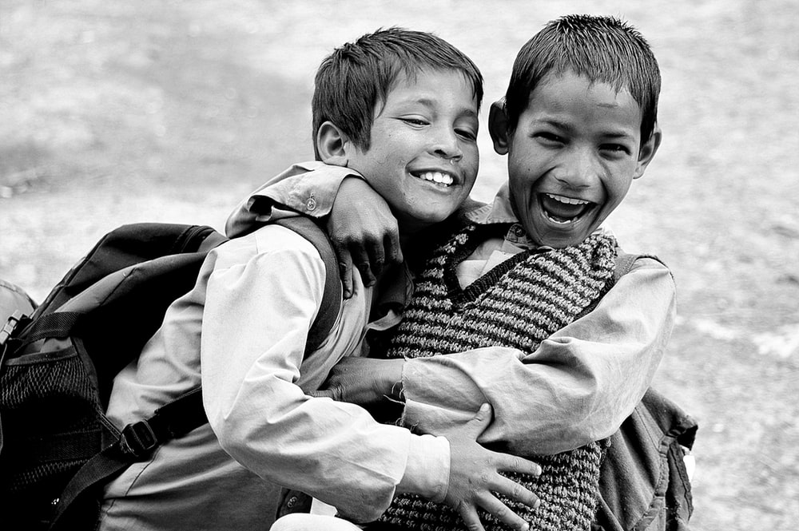
Vocabulario
This activity practises recognising the regular gender marking of nouns.
amigo
un
una
Notes:
Term 1.1 Week 5
In the previous week, students were introduced to the singular indefinite article (un/una) and a set of nouns with regular gender marking. The nouns taught in this week also have regular gender marking, so students should be able to judge accurately whether they take ‘un’ or ‘una’. This is an example of short vocabulary activities that are linked to a particular grammar feature, in such a way that the knowledge of both is promoted.
Week 5 vocabulary frequency rankings: amigo [210]; periódico [1026]; caballo [907]; teléfono [866]; planta [768]; botella [1878]; revista [920]; pregunta [507]; palabra [192]; tarea [995]; también [49]. Source: Davies, M. & Davies, K. (2018). A frequency dictionary of Spanish: Core vocabulary for learners (2nd ed.). Routledge: London
Image retrieved from https://unsplash.com/ (freely usable images)

Slide 8


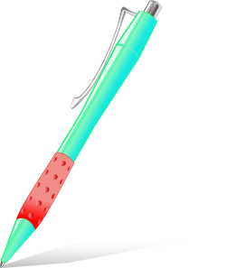

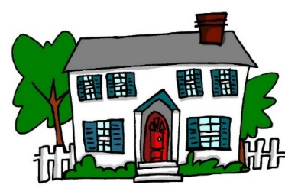
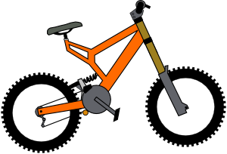




Vocabulario
un
una
Notes:
Term 1.1 Week 4
Having different ways to elicit the same knowledge is important.
This gender-focused task has students predicting which pacman will eat the object depending on the noun’s gender. It’s easy to increase the challenge for individual students by requiring them to produce the noun, too.

Slide 9

Vocabulario
revista
teléfono
periódico
amigo
también
tarea
[also; too]
pregunta
botella
English translations are used where no unambiguous pictures exist.
planta
palabra
caballo
Notes:
Term 1.1 Week 5
Early in the 2-lesson sequence for any one week, there are usually some quick tasks to re-activate the emergent vocabulary knowledge that has resulted from the 30-minute pre-lesson learning. These are necessary because:
first, time will have elapsed between the learning homework and the lesson, allowing forgetting; second, students have different memory capacities;
third, students do not all complete their homework to the same high standard.
This task, whilst it is a recognition task, has the additional requirement that students say the Spanish words aloud, which supports the development of their sound-spelling knowledge too.
Click for speech bubble: It’s also important to highlight that when teaching focuses on the teaching of high-frequency vocabulary, that vocabulary is often includes conjunctions, prepositions, high-frequency verbs etc., and these often don’t lend themselves to unambiguous pictorial representation. Think for example of the verb ‘to use’ and how tricky it would be to find a picture to show that meaning, clearly. So, where this is the case, we use English.

Slide 10
Vocabulario
una amiga
bailar
¿quién?
hablar
música
escuchar
comprar
temprano
tarde
llegar
bien
con
to arrive
Again, unambiguous English translations are provided.
Notes:
Term 1.1 Week 6
For variety, it’s important to find new formats and layouts. This task does the same as the previous one, in that it is a recognition task, which requires students to produce their Spanish answer orally, but it looks quite different.
Click for speech bubble: Again, unambiguous English translations are provided.

Slide 11
←palabras en español
tarde
hablar
C
A
B
amiga
D
F
¿quién?
E
comprar
con
buy
with
G
H
who?
I
A game-like memory challenge is introduced in this activity.
female friend
J
late
K
to speak
L
palabras en inglés →
Notes:
Term 1.1 Week 6
Click for speech bubble, first.
So, this activity has triggers that reveal the word meanings, and then cover them again on a further click, compelling students to remember their position, as they search for the matching pairs.
Using the letters actively – if they have been taught by now - elicits the Spanish letter names, too.

Slide 12

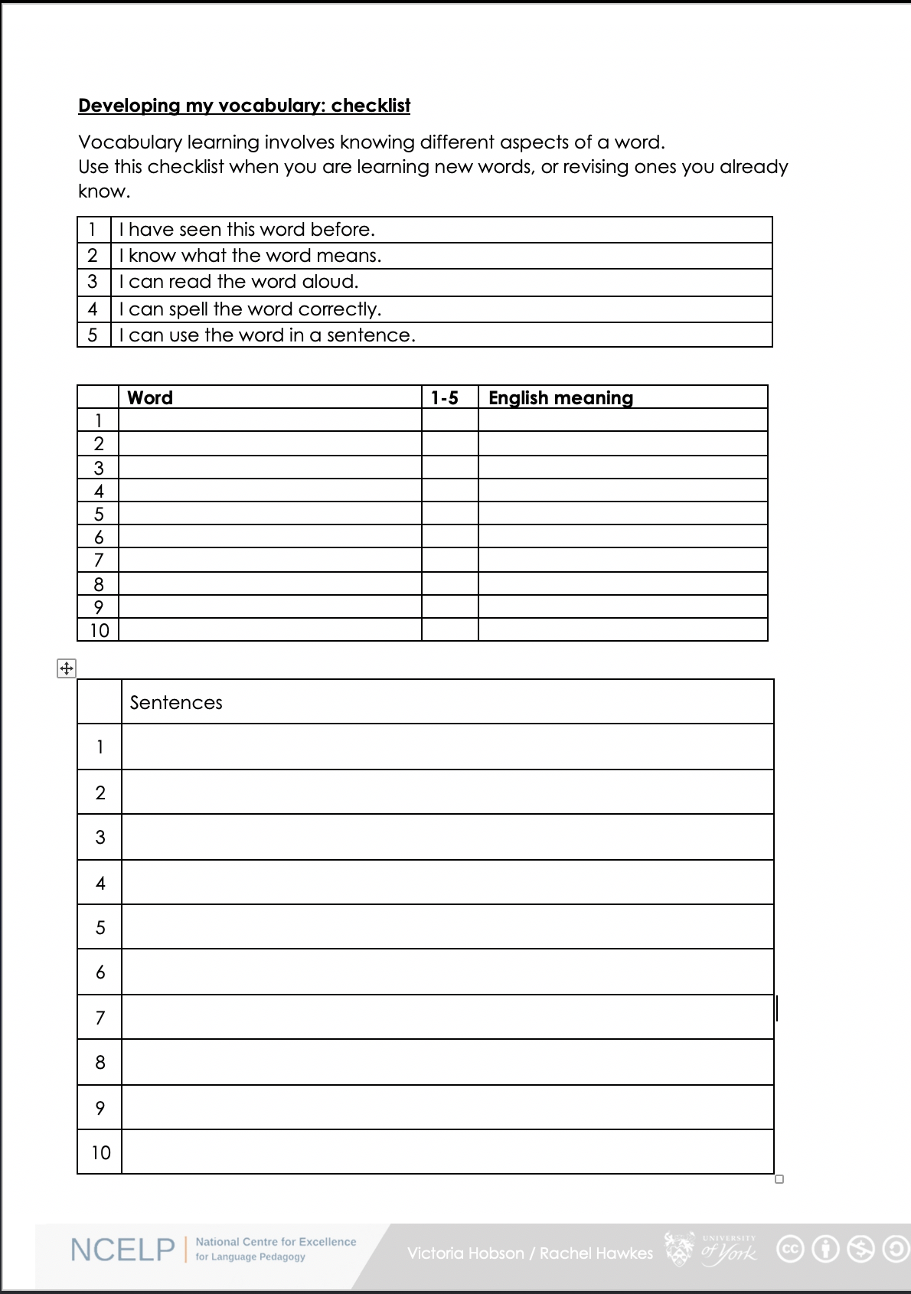
Was denkst du?
1. I have seen this word before.
2. I know what the word means.
3. I can read the word aloud.
4. I can spell the word correctly.
5. I can use the word in a sentence.
6. For nouns, I know the gender and the correct word for ‘the’
This checklist gets students thinking about how well they know a word.
Notes:
Term 1.1 Week 2
Click through all the animations, first.
So, this is a checklist we introduce early in Year 7 Term 1, and then bring back periodically to prompt students to reflect on how well they know a particular set of words. The downloadable template is blank, but teachers can quickly populate it with a vocabulary set and/or a set of English sentence prompts for students to translate, to put their vocabulary and grammar knowledge to the test.
A word template is available on the NCELP resource portal.
https://resources.ncelp.org/concern/resources/gf06g264k?locale=en

Slide 13





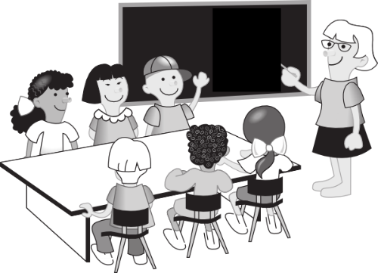


Starter - genders and spellings
A
d__ P___
E
f_____
60
r______
B
F
d__ M___
Sekunden
s______
C
This activity challenges students to recall the genders and spellings of words, rather than simply matching them.
D
d__ K___
G
0
d__ T__
ANFANG
Notes:
Term 1.1 Week 2
Click for speech bubble: This starter slide for the 2nd lesson in a week revisits the week’s words, but challenging students to remember genders and spellings, with the additional challenge of a time limit.
Students are likely to be clear about the meanings these pictures represent from the previous lesson, but teachers make it clear to students that they can ask about any they are not sure about, for example: ‘Was ist ‘E’ auf Englisch? As with many such vocabulary tasks, this one also offers the opportunity for them to re-visit some alphabet letters from last week.
sagen [46] sagt [46] der Tag [108] der Mann [131] das Paar [284] die Klasse [619] richtig [211] falsch [638] nicht [12]
Notes:
ja [27], nein [120], and oder [30] will be incorporated in the next exercise
Was? [39] will be revisited in the activity on Question words

Slide 14
Game of cards
I
J
K
L
the human being
the problem
the table
the school
M
a woman
the example
the board
a friend (male)
N
In giving the coordinates of the squares for this game, later letters of the alphabet are practised too.
an animal
a question
the place
a colour
O
Notes:
Term 1.1 Week 6
This vocabulary practice slide elicits previously taught nouns with either definite or indefinite articles, testing gender and article knowledge, as well the knowledge of the nouns themselves.
Click for speech bubble: Alphabet letters give coordinates to practise several more letters, too, if they are also being taught at this stage.
This can be a whole class activity, for example in two halves, teams A and B.
Students nominate any ‘card’ giving coordinates e.g. ‘M-I’
Teacher clicks the card to reveal the English prompt for 2 seconds and then again to hide the card.
NB: take care to click only when you see the ‘hand’ icon, rather than the arrow pointer, which would move the slide on!
Student tries to name the item, giving the correct article. e.g. das Problem.
If correct, the card is left uncovered. If the response is incorrect, the item is re-covered, and play continues with Team B.
This same slide could be used for many other varieties of vocabulary retrieval, e.g. individual written production using mini whiteboards.

Slide 15
Question-forming
Wer
der Tag
Was
das Tier
Wo
der Mann
der Gast
?
Was
ist
Wie
Wer
die Farbe
die Flasche
Wo
Wie
der Mensch
das Ding
This activity provides practice in question formation, and translation of the resulting questions by a partner.
Notes:
Term 1.1 Week 5
This is a pair task. In pairs, students take turns to create a question using a question and a noun from each set. Once a word has been used it is crossed out. Note that not all question words can go with all nouns, e.g. ‘wer’ only makes sense with living things.
Rather than answering the questions, students translate their partner’s question into English.
They can do this orally or write down their questions.
For higher challenge, suggest that only the student creating the questions has sight of the sheet.
This ensures that the listener relies only on the aural input for understanding.
All the words have been introduced during previous weeks in the NCELP SOW.

Slide 16
Was ist die Ausnahme?
Some of the items are audio only, ensuring that practice occurs in the different modalities.
1
sein / bist / hast / ist
2
___ Frage / ___ Tisch / ___ Nummer / ___ Farbe
3
A
B
C
D
4
ein Fenster / ein Wort / ein Paar / ein Freund
5
A
B
C
D
6
groß – rot – kalt - sagt
der Lehrer – der Freund – das Heft – die Frau
7
A
B
C
D
8
Notes:
Term 1.1 Week 6
This is a plenary ‘odd one out’ task, which revisits some of the grammar, vocabulary, and phonics introduced over the previous few weeks.
Click animation (up to the speech bubble): So, there are a mixture of different elements of knowledge tested here, but also different modalities involved, which deepens the quality of the processing involved.
The first question tests knowledge of the verb sein, the second is about gender knowledge, and the third the difference in sound between ‘ei’ and long ‘e’.
1. Sein / bist / hast / ist (not a form of sein)
2. die/eine Frage / der/ein Tisch / die/eine Nummer / die/eine Farbe (der/ein Tisch – it’s masculine)
3. frei / allein / Idee / klein (audio – long ‘e’ not ‘ei)
Then click quickly through the remainder of the animations:
4. Ein Fenster / Ein Wort / Ein Paar / Ein Freund (masculine)
5. Geben / Welt / Leben / sehen (audio – short ‘e’ not long ‘e’)
7. groß / rot / kalt / sagt (verb not adjective)
9. Der Lehrer / Der Freund / Das Heft / Die Frau (thing not person)
10. Wasser / klar / haben / Paar (audio – long ‘a’ not long ‘a’)

Slide 17
Vokabeln
m
das Zim__er
W
w
das __ asser
nicht __ahr?
a
h__ben
e
c
a
der Fr__und
ko__hen
der Fußb__ll
H
das __aus
r
s
das Wo__t
das Hau__tier
t
die Wel__
W
e
r
m
a
c
h
t
w
a
s
?
Notes:
Term 1.2 Week 2
I mentioned that previous sets of vocabulary are systematically revisited in lessons, too, after three and nine weeks. So, from the 10th week of teaching onwards, two sets of vocabulary are being revisited, in addition to the new-to-be-learned set - a total of thirty words ‘in play’ in any given week.
We make every attempt to weave the revisited words together with the new words into the listening, reading, speaking and writing tasks for that week. We also make use of other, stand alone tasks, like this one.
This starter task revises nine items of vocabulary from a previous week and two items from the new week. By working out which letters are missing and putting them in order into the spaces below, they create the question ‘Wer macht was?’, which is the context for this week’s lessons, so the activity does the task of ‘sharing the context learning objective’ with students, as well as revisiting key vocabulary. Teachers then also elicit the English translation of this question from students to ensure that they are all clear about its meaning.
Week 5 vocabulary
haben [7] hat [7] wer? [173] der Lehrer [433] der Fußball [1497] der Freund [326] das Wasser [297] die Welt [190] das Wort [243] nicht wahr? [14/662] das Haustier [>5000] das Haus [159]
Note that 6 of these words were built into this week‘s lessons, as well.
Term 1.2, Week 2 vocabulary
arbeiten [200] putzen [2851] kochen [1005] sitzen [261] das Auto [490] zu Hause [6/159] der Garten [959] der Boden [445] die Liste [1975] das Zimmer [609]
Source: Jones, R.L. & Tschirner, E. (2006). A frequency dictionary of German: core vocabulary for learners. Routledge

Slide 18


Vokabeln
lesen und schreiben
?
A. Was machst du in England?
B. Nicht falsch.
C. Wo bist du?
D. Was ist das? →
E. Was machst du in der Schule?
F. Wo ist das Klassenzimmer?
G. Nicht richtig.
H. Das ist ein Tag.
I. Was machst du mit einer Gitarre?
J. Du redest …
K. Er ist keine Frau.
L. Was machst du im Unterricht?
 |  |  |  |  |  |  |  | W | O | H | N | E | N
 |  |  |  |  |  |  | R | I | C | H | T | I | G
I | M | - | K | L | A | S | S | E | N | Z | I | M | M | E | R
 |  |  |  |  |  |  |  | D | A | S | - | P | A | A | R
 |  |  |  |  |  |  | L | E | R | N | E | N
 |  |  | I | N | - | D | E | R |  | S | C | H | U | L | E
 |  |  | F | A | L | S | C | H
 |  |  |  |  |  |  | M | O | N | T | A | G
 |  |  |  | S | P | I | E | L | E | N
 | M | I | T | - | F | R | E | U | N | D | E | N
 |  | D | E | R | - | M | A | N | N
 | D | I | E | - | A | U | F | G | A | B | E
Notes:
Term 1.2 Week 3
A similar, more developed variant of the previous task recycles vocabulary not only in the answers, but in the target language question prompts, too.
Then click through the animations on this and the next slide, which provides the answers.
This has just been a quick run through a sample of the different vocabulary activity types that are in the Y7 resources. There are more than this, but now we need to move on to look at other aspects of vocabulary teaching.
(No need to read out the notes below, but I’ve left them in for teachers to see).
Starter
This starter task revises 12 items of vocabulary (shown in bold below) drawn from 1.1.2 and 1.1.7 (the two weeks students were set to revisit last week). A further 7 items of vocabulary (shown in italics below) feature in the clues and are therefore revised receptively.
By working out the answers to the clues and spelling out the words correctly, students create the word ‘Wiederholung’, which is the focus for this activity. So the activity does the task of ‘sharing the context learning objective’ with students. Students should have pre-learned the verb ‘wiederholen’ as part of their audio and Quizlet homework, so teacher should explain that this is the noun form.
Note: The clues relate to the words directly to their right.
Individual letters appear on clicks. This allows teachers to elicit both full words from the students (‘Was ist A?’ ‘A ist wohnen’) as well as spelling (‘Wie schreibt man ‘wohnen’?’ ‘W-O-H-N-E-N)
Note: a more complex version of this task, in which only the first letter of each word is given, can be found on the next slide.
T1.1 Week 2
sagen [46] sagt [46] was? [39] der Tag [108] der Mann [131] das Paar [284] die Klasse [619] richtig [211] falsch [638] nicht [12] oder [30] ja [27] nein [120]
T1.2 Week 2
wohnen [380] schreiben [245] spielen [197] reden [356] lernen [203] machen [49] Montag [794] die Aufgabe [317] im Klassenzimmer [609/619] im Unterricht [1107] in der Schule [208] mit Freunden [13/327] er [20] sie [10]

Slide 19
Vokabeln
lesen und schreiben
?
A. Was machst du in England?
B. Nicht falsch.
C. Wo bist du?
D. Was ist das? →
E. Was machst du in der Schule?
F. Wo ist das Klassenzimmer?
G. Nicht richtig.
H. Das ist ein Tag.
I. Was machst du mit einer Gitarre?
J. Du redest …
K. Er ist keine Frau.
L. Was machst du im Unterricht?
 |  |  |  |  |  |  |  | W | O | H | N | E | N
 |  |  |  |  |  |  | R | I | C | H | T | I | G
I | M | - | K | L | A | S | S | E | N | Z | I | M | M | E | R
 |  |  |  |  |  |  |  | D | A | S | - | P | A | A | R
 |  |  |  |  |  |  | L | E | R | N | E | N
 |  |  | I | N | - | D | E | R |  | S | C | H | U | L | E
 |  |  | F | A | L | S | C | H
 |  |  |  |  |  |  | M | O | N | T | A | G
 |  |  |  | S | P | I | E | L | E | N
 | M | I | T | - | F | R | E | U | N | D | E | N
 |  | D | E | R | - | M | A | N | N
 | D | I | E | - | A | U | F | G | A | B | E
Notes:
Term 1.2 Week 3
ANSWER SLIDE (which provides additional alphabet practice)
1. Teacher asks question / gives clue in German as per A – L on slide.
2. Student(s) volunteer(s) the answer (e.g. wohnen).
3. Teacher asks ‘wie schreibt man das?’
4. Students in chorus (slowly and steadily) respond to spell out the answer: W – O – H – N – E – N.
5. As students spell the word, teacher reveals each letter on a click.
This will enable the teacher to pick up on any of the trickier letters, and do some remedial practice in the moment.

Slide 20
Vocabulary activities [2]
Using word reference resources
Word patterns
Compound nouns (German)
Cognates
Words with multiple meanings
Lexical profiling tool
Notes:
This slide introduces the additional elements of vocabulary learning that we are going to address in remainder of this session.

Slide 21
Using word reference resources
This sequence of slides offers students help with the following:
1. Understanding the role of dictionaries and translation resources
2. Developing skills in using these resources
3. Avoiding some of the pitfalls!
Notes:
This sequence of slides aims to raise students’ awareness of the role of dictionaries or translation sites when looking up the meaning of unknown words when translating from the target language, and to find the correct target language word for the desired meaning when translating from English.
It also attempts to help students to deal with the common pitfalls encountered by newcomers to dictionary use, by giving practice opportunities in the basic thought and decision-making processes required.
The following version of the sequence is adapted for the Year 7 French scheme of work, and is featured in the lessons for 3.1.2 (text exploitation week). Similar sequences feature in 2.2.4 German and in 3.1.1 Spanish, all of which are on the resource portal.

Slide 22
Challenge 1
Could you guess the meanings of these French words? (if you had not met them):
effort
effort
this is a cognate – it means the same in both languages
(though it sounds very different!)
histoire
history
not quite a full cognate, but its spelling gives you a clue!
blanc
white
not ‘blank’, as you may have thought!
to eat
not ‘manger’, as you may have thought!
manger
These are known as
‘false friends’ (faux amis), because they actually mislead you!
faisons
we do
you need to know it – you cannot really hope to guess!
So, guessing the meaning would only be a reliable strategy for two of the above five words!
Notes:
Term 2.2 Week 3
This resource aims to raise students’ awareness of the importance of using dictionaries or translation sites to research the meaning of unknown words when translating from the target language, and to find the correct target language word for the desired meaning when translating from the English.
It also attempts to help students to deal with the common pitfalls encountered by newcomers to dictionary use, by giving practice opportunities in the basic thought and decision-making processes required.
This slide aims to raise students’ awareness of the importance of looking up words rather than guessing their meaning, even though sometimes meanings can be worked out (e.g. for cognates and near-cognates). It also points out the problem of ‘false friends’ (faux amis) in French.
The words used are drawn from this week’s vocabulary sets:
2.2.3 - frapper [745], ressembler [1398], cœur [568], temps [65], blanc [708], noir [572], pourquoi [193] si [34]
2.1.4 – faisons [25], faites [25], font [25], quoi [297], attention [482], effort [388], exercice [1290], fête [1490], rien [168]
1.2.6 - chanter [1820], écouter [429], étudier [960], jouer [219], manger [1338], ils [13], elles [38], fruit [896], histoire [263], radio [1526]
Teachers should ask, for each category below, which other words students can think of in each category, from this week’s words:
E.g.
Cognates - radio, fruit, attention, exercice (one letter different)
Near cognates - ressembler - to resemble, be like, étudier - to study, chanter - to sing (like chant… - false friend or does it help?)
Words you need to know that cannot be guessed - frapper, cœur , temps, noir, pourquoi, si, faites, font, quoi, fête, rien, écouter, jouer, ils, elles

Slide 23
Challenge 2
A paper dictionary (i.e., a real book!) has two sections:
for a French dictionary, these are French to English and English to French.
In which section of the dictionary would you look for the words below?
heart
ils
French to English
English to French
black
with
font
rapidement
we
mais
Notes:
This slide explains the fact that there are two ‘sides’ to a paper dictionary, something which often causes beginner dictionary users problems. Students are challenged to allocate the words in the centre – a mix of English and French words – to one side or the other. Though this should not be too difficult a task, it ‘trains’ the student in the correct first step to be taken upon consulting a paper dictionary (the ‘from’ and ‘to’ languages settings also being a consideration, of course, with online dictionaries and translation websites).
The answers are animated, and the words ‘fly’ to the correct side.
Further words are used from this week’s sets:
heart 🡪 cœur [568], ils [13], black 🡪 noir [572], font [25]

Slide 24
Challenge 3
In a paper dictionary, words are listed in alphabetical order.
Put these English words into the order in which they would appear in the dictionary:
before
bold
because
ball
befriend
1
2
3
4
5
So, we had to go as far as the fourth letter to sort words 3 and 4 into alphabetical order!
Notes:
Alphabetical ordering is something which can also cause beginner dictionary users problems – particularly when they are required to look beyond the initial letter. This slide therefore attempts to provide some practice in this skill, essential for the second step in locating the word to be looked up in the dictionary. It is necessary to look as far as the fourth letter to sort two of the words!
The answers are animated, and the words ‘fly’ into their correct position in the order.

Slide 25
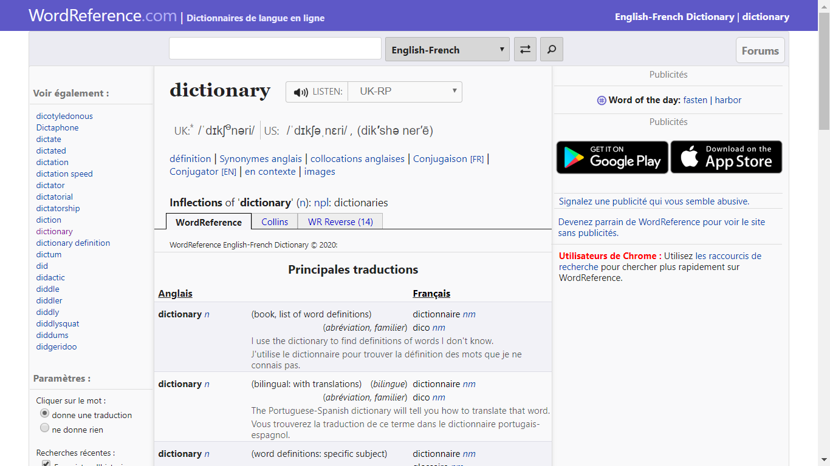
Online dictionary
  You can play the audio of the word, too!
These days, you don’t have to use a paper dictionary: online dictionaries are available. A good one for French is WordReference
It looks like this:
  You type the word you want to look up here (make sure it is in the right language!)
  You swap between the
  English to French and French to English sections, here.
Notes:
Having practised two of the skills required for paper dictionary use, the students are now introduced to our choice of online dictionary for French. It is recommended that they bookmark this on their own devices.

Slide 26
Challenge 4
As well as finding the word, we also need to know what type of word it is, in the context in which we need to use it.
Match the words on the left below with their type (in orange)on the right.
Sometimes, the same word can be both a noun and a verb –
E.g., the English word ‘lead’ - something you use to walk the dog, and something you do when others follow you!
noir
adjective
article (determiner)
fête
avec
adverb
verb
le
elles
pronoun
preposition
rapidement
faites
conjunction
noun
mais
Notes:
This slide prompts learners to consider the part of speech of a word, an essential part of wider word knowledge, which informs the correct grammatical usage of that word. The activity challenges students to match some English words with their part of speech.
Explain to students that some words can be both a noun or a verb – as in the animated example of ‘lead’ – which has implications when searching for the correct translation of a given word in a particular context!
The answers are animated on the next slide; this slide should be displayed whilst students attempt the task.
Further words are revisited from this week’s sets:
fête [1490] faites [25]

Slide 27
Challenge 4 - answers
fête
noun
noir
adjective
faites
verb
rapidement
adverb
le
article (determiner)
elles
pronoun
avec
preposition
mais
conjunction
Types of word are called ‘parts of speech’.
This describes how a word works in a sentence.
Notes:
The answers to the activity on the previous slide are animated on this one. The term ‘parts of speech’ is explained. It describes how a word works in a sentence.

Slide 28
Challenge 5
Dictionaries give the type of word (part of speech) using abbreviations after the word itself. The part of speech is often in italics and sometimes in a different colour.
Find the abbreviations used in WordReference for each part of speech.
nm or nf
noun
adj
adjective
vtr or vi
verb
adv
adverb
def art or indef art
article (a type of determiner)
pron
pronoun
prep
preposition
conj
conjunction
Similar abbreviations are used in paper dictionaries too.
Notes:
Students are now challenged to find the abbreviations used on the recommended French dictionary site for the parts of speech listed; the answers are animated. A similar exercise could be done with any paper bilingual dictionaries in use.

Slide 29
L’homme qui te ressemble
Challenge 6
  The dictionary has different possible meanings of a word, with examples. The third meaning listed for repousser in WordReference is the right one for the context of the poem!
J’ai frappé à ta porte
J’ai frappé à ton cœur
Pour avoir (un) bon lit
Pour avoir (un) bon feu
Pourquoi me repousser ?
Ouvre-moi, mon frère !...
Pourquoi me demander
Si je suis d’Afrique
Si je suis d’Amérique
Si je suis d’Asie
Si je suis d’Europe ?
Ouvre-moi, mon frère !...
Look up the orange words in a dictionary (or using WordReference) and list their English meaning and part of speech.
ton adj poss your
feu nm fire
repousser vtr reject
mon adj poss my
Notes:
Translation resources - Challenge 6
Many of the words in this text have been previously introduced and learnt (this was one factor in the choice of this text for this point in the scheme of work); others are introduced as part of the new vocabulary set for this week. However, a third group of words does not fall into either of the above categories: they have not been covered before and are not part of the set to be learnt this week. Four words are thus highlighted for students to look up, practising the skills introduced earlier in this sequence. It is pointed out that the dictionary user has to work his/her way down the examples of usage provided, in order to find the correct translation of a word for the context; in this case, the third meaning given in WordReference for repousser is the correct one.
N.B. The possessive forms mon and ton are not dealt with as a grammar point at this stage; we are only aiming for students to understand their meaning here. Possessive adjectives form part of the scheme of work grammar for Year 8 in the NCELP French scheme of work (as they require complex gender and number relations between the possessor and the possessed).

Slide 30
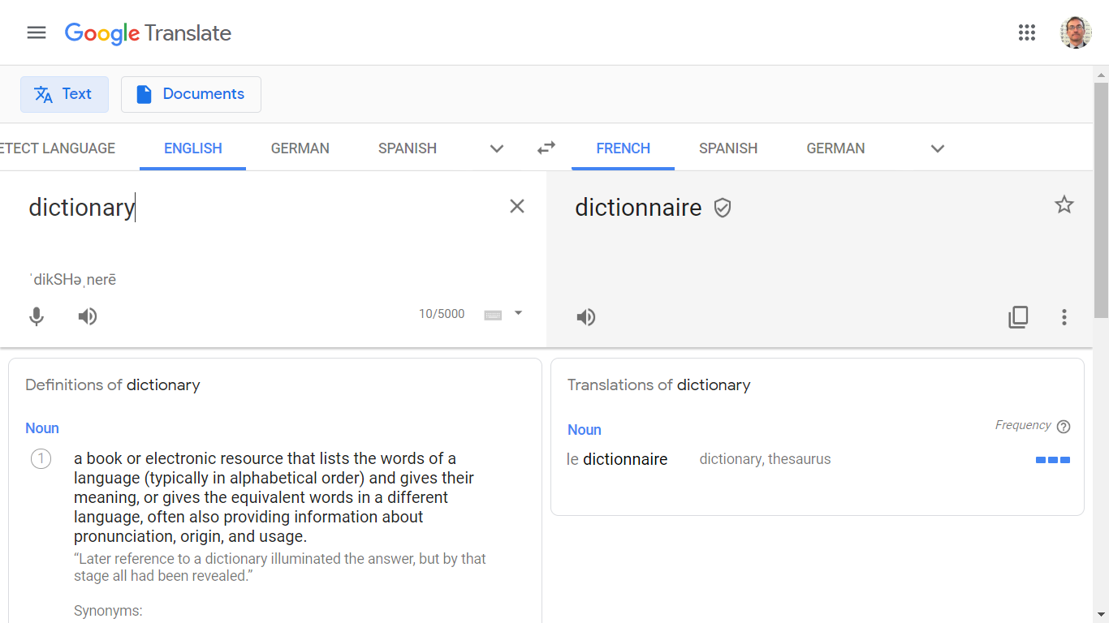
Translation websites
  You can reverse the direction of translation (English to French or French to English) here
Some people like to use translation websites, such as Google Translate.
It looks like this:
  You select the ‘from’ and ‘to’ languages here
  You type the word you want to look up here (make sure it is in the right language!)
Notes:
This slide introduces translation websites (using the example of Google Translate) – a popular alternative to dictionaries for many students. These sites are extremely simple to use, but are often very basic in the amount of information offered, at least initially.
The relative lack of exemplification of correct word usage can lead to a mis-translation of the intended concept being adopted by the student.
The next slide will invite students to consider the benefits offered by the dictionary, as compared with these sites.

Slide 31
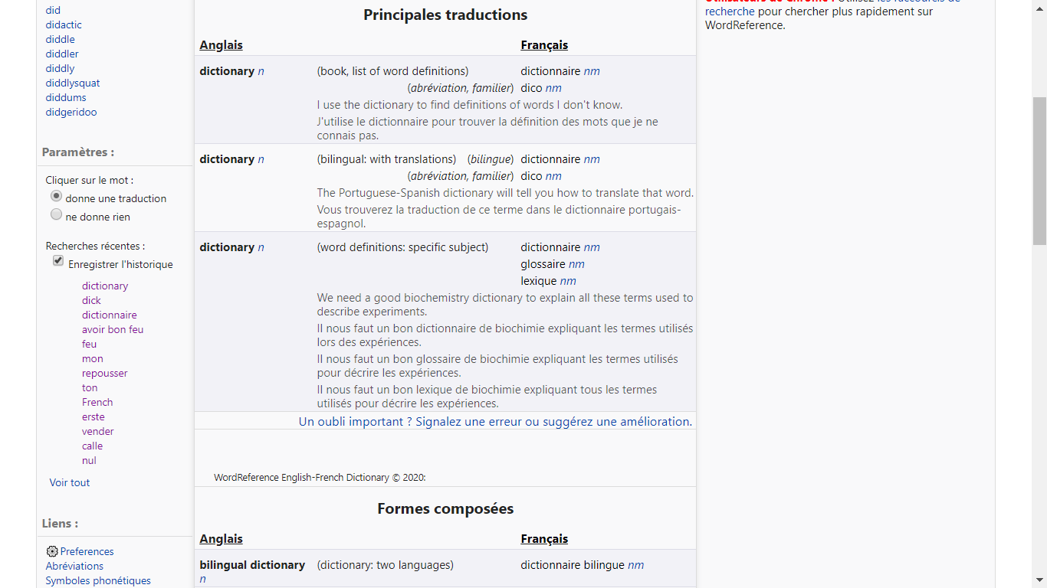
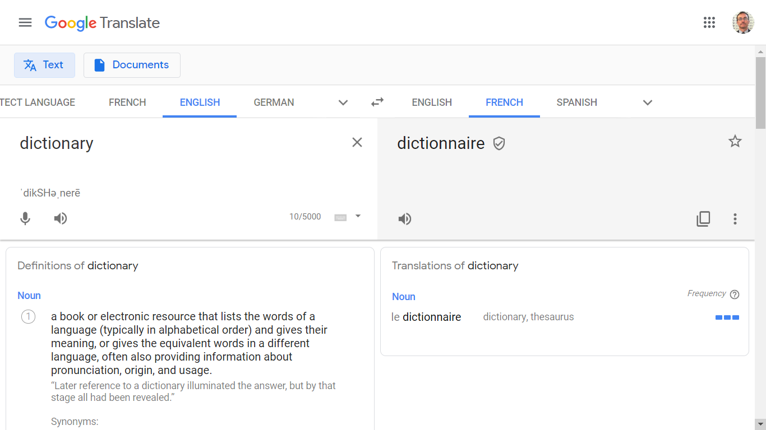
Comparing options
Compare below the amount of information about correct French usage given by the online dictionary (on the left) and the translation website (on the right).
Which is likely to be the most useful?
Notes:
This slide invites students to consider the benefits offered by the dictionary, as compared with translation sites. As can be seen from the screenshots, the dictionary often provides greater detail and, in particular, exemplification of correct word usage in a variety of contexts, thus better enabling the student to select the correct word to express the meaning desired.

Slide 32
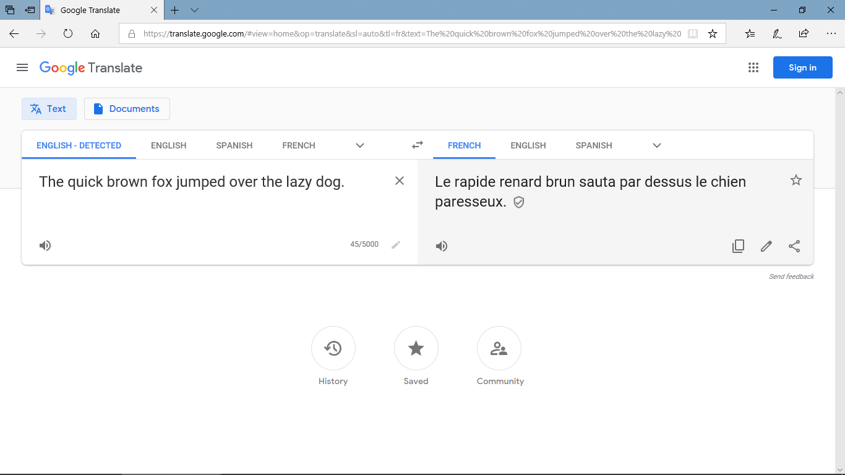
Watch what happens as you go round a few languages translating this well-known sentence. First, from the English into French:
Students haven’t learnt any past tense yet, but it’s worth pointing out that google translate often selects the simple past in French and German, when this is seldom / never (!) the appropriate choice for students for their own production.

Slide 33
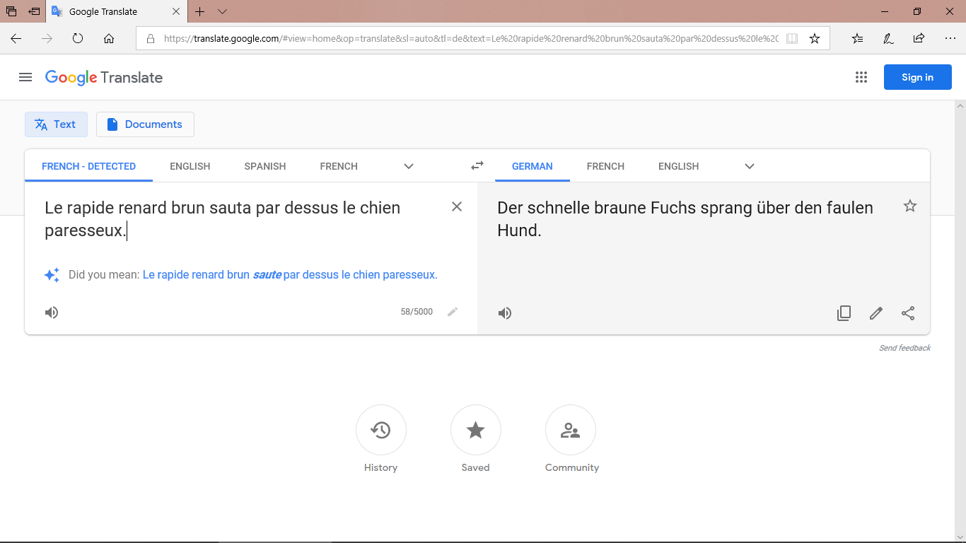
Then from the French into German:
The past simple in German, too!
Notes:
Obviously, as a story narrative the past simple is appropriate but the point here is that if students type in ‘We went to the café’ in German they will also get the past simple: ‘Wir gingen ins Café’, instead of ‘Wir sind ins Café gegangen’.

Slide 34

Then the German into Spanish:

Slide 35
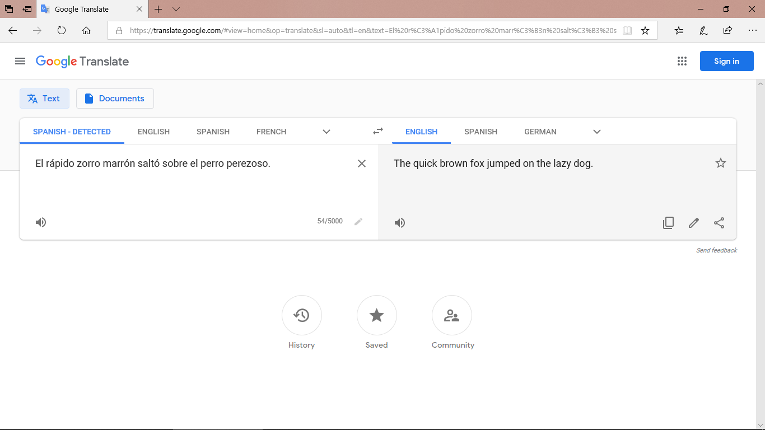
... and finally from the Spanish back into English:
So we have gone from:
‘The quick brown fox jumped over the lazy dog.’
to:
The quick brown fox jumped on the lazy dog.
Quite a difference for the dog!
Sometimes these small errors make a big difference to the intended meaning (e.g., whether or not there was a fox-dog fight!)

Slide 36
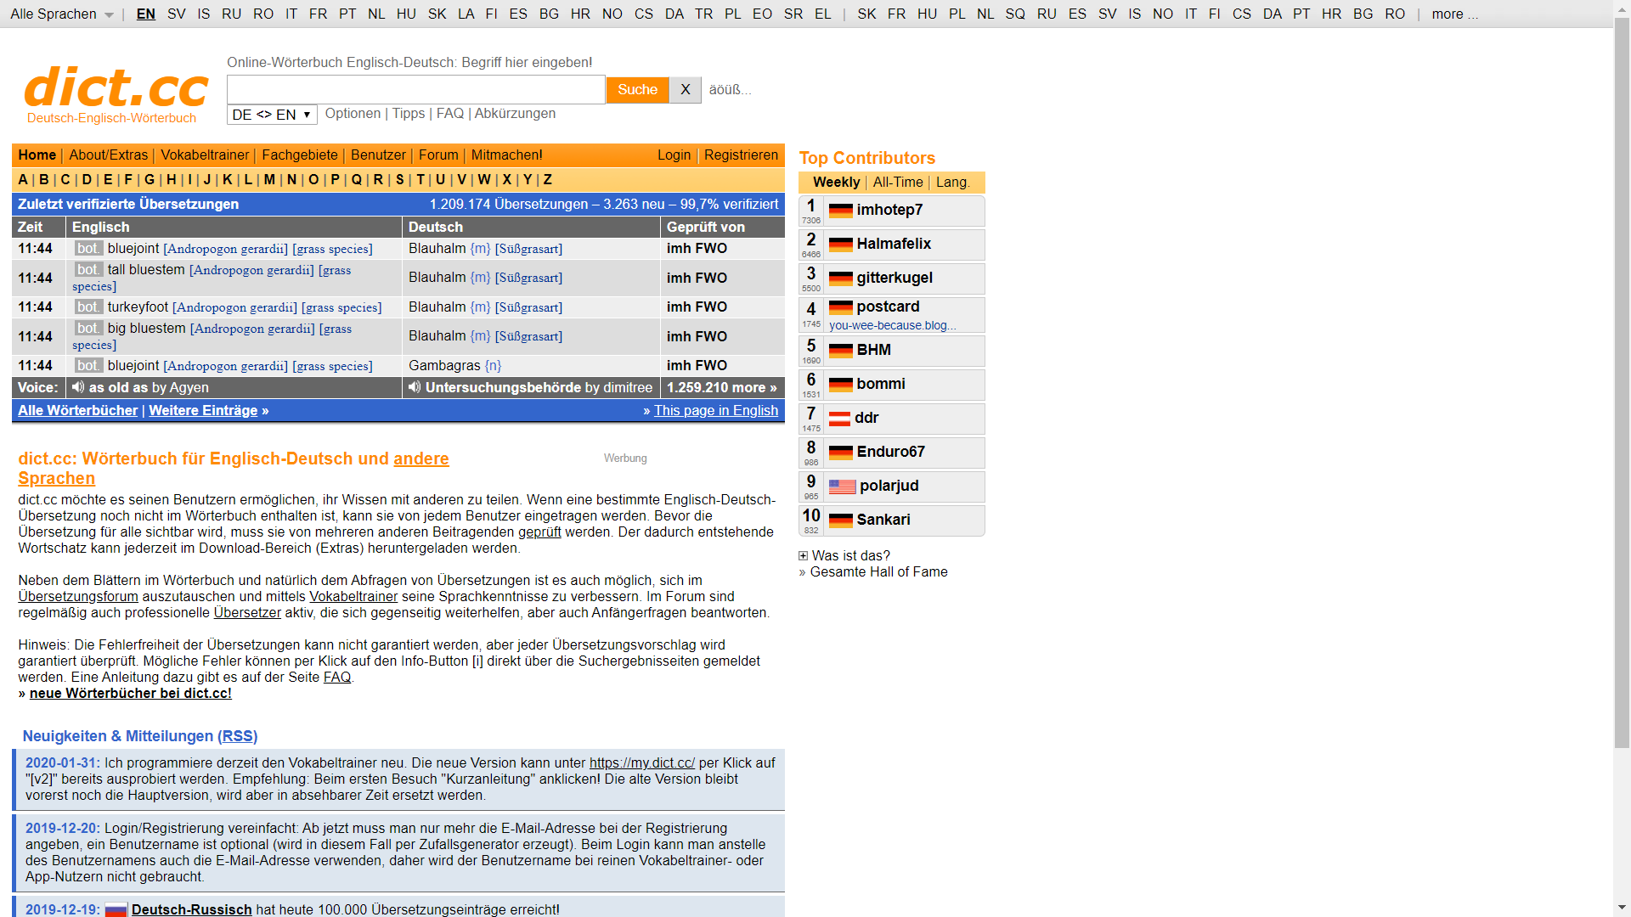
Online dictionary
These days, you don’t have to use a paper dictionary: online dictionaries are available. A good one for German is dict.cc
It looks like this:
  You type the word you want to look up here (make sure it is in the right language!)
  You swap between the
  English to German and German to English sections, here.
Notes:
Two slides from the German version of this sequence are now included. Having practised two of the skills required for paper dictionary use, the students are now introduced in this slide to our choice of online dictionary for German. It is recommended that they bookmark this on their own devices.

Slide 37
2.2.4
The context of this week’s German lessons is:
Asking and answering questions about what you do out of school.
Look up the following in German in a dictionary (paper or online) to increase the range of vocabulary you can use to talk about this topic:
1) an activity verb (e.g. to run)
2) the name of an activity (e.g. table tennis)
3) the name of something you use in that activity (e.g. a racket)
4) the name of the place where you go for that activity (e.g. the club)
5) an adverb of time, saying when you usually do the activity (e.g. on Saturdays)
Notes:
Term 2.2 Week 4
This slide links the theme of dictionary use with the lesson context for Term 2.2, Week 4 in the Year 7 German scheme of work.
The lessons are about Asking and answering questions about what you do out of school.
The task given to students is a realistic one: to look up an example of their choice of each stated type of German word that could be useful within this context:
1) an activity verb (e.g. to run)
2) the name of an activity (e.g. table tennis)
3) the name of something you use in that activity (e.g. a racket)
4) the name of the place where you go for that activity (e.g. the swimming pool)
5) an adverb of time, saying when you usually do the activity (e.g. on Saturday).

Slide 38

Vocabulary activities [2]
Using word reference resources
Word patterns
Compound nouns (German)
Cognates
Words with multiple meanings
Lexical profiling tool
Notes:
This slide introduces the additional elements of vocabulary learning that we are going to address in remainder of this session.

Slide 39
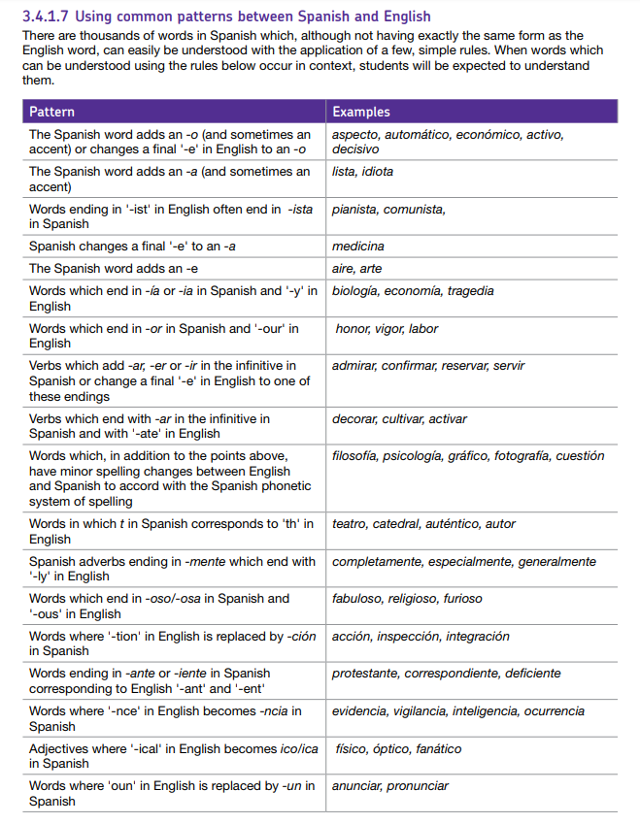
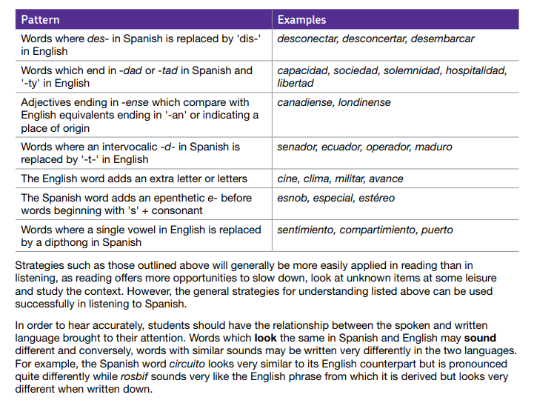
Common word patterns
“When words that can be understood using these rules occur in context, students will be expected to understand them.”
AQA Specification section 3.4.1.17
https://resources.ncelp.org/concern/resources/bc386j21m?locale=en
Notes:
The following activities have been created using the common patterns between Spanish and English detailed in the AQA specification.
The activities provide opportunities to:
- make connections and understand patterns between Spanish and English
- practise those links by translating Spanish → English and English → Spanish
consolidate their SSC (phonics) knowledge by reading the words / sentences aloud
reinforce their knowledge of spelling and pronunciation rules (e.g. single vs double consonants in writing and syllable stress in speaking)
Note that we include just a couple of examples here. In total, there are 12 sets of similar activity sequences, 11 word patterns and a final revisiting set to bring together all of the patterns. On this slide you’ll see a link to the full set of activities on the NCELP portal.
The idea is that each pattern is given 10 minutes in tutor time (so NOT taking time out of L2 lessons!) each week, so that this set of 12 represents a term’s worth of activities.
They are written so that non-linguist tutors can deliver them.

Slide 40
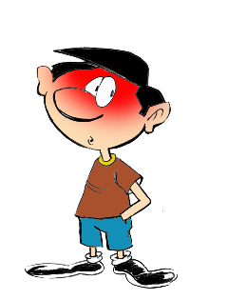

English → Spanish → English
1
-id at the end of the word often changes to -ido
The boy is timid
El chico es tímido
What would the following words be in Spanish?
solid
rapid
valid
Choose one and write a sentence in Spanish.
Translate these sentences.
1. El ácido es rojo.
2. The acid is a liquid.
Notice that you also add a tilde (accent) on the first vowel, i.e., tímido
Rachel Hawkes
Notes:
Working with Spanish-English words patterns
Word frequency: tímido [3607]; ácido [2932]; líquido [1382]; sólido [2420]; rápido [879]; válido [3114]
Further words with the same pattern: estúpido [2596]; espléndido [3964]; rígido [3421]
Source: Davies, M. & Davies, K. (2018). A frequency dictionary of Spanish: Core vocabulary for learners (2nd ed.). London: Routledge.

Slide 41
ANSWERS
1
El ácido es rojo.
The acid is a liquid.
solid
rapid
valid
The acid is red.
El ácido es un líquido.
sólido
rápido
válido
Pronounce the words. Normally, you stress the penultimate syllable, but the ‘tilde’ tells you to stress a different syllable.

Slide 42
Word patterns
12
Here is a selection of words with the word patterns you have seen this term:
secretario
físico
demostrar
cantidad
delicioso
estúpido
científico
contrario
existencia
separar
fenómeno
generoso
industria
necesidad
relación
influencia
básico
condición
categoría
espléndido
Work out the meaning. Pronounce the words.
Choose two words and write sentences in Spanish.
Notes:
All words are within the 2000 most frequently occurring words in Spanish.
Source: Davies, M. & Davies, K. (2018). A frequency dictionary of Spanish: Core vocabulary for learners (2nd ed.). London: Routledge.

Slide 43
ANSWERS
12
cognate pattern | Spanish word 1 | English | Spanish word 2 | English
id → ido | estúpido |  | espléndido
ous → oso | delicioso |  | generoso
tion → ción | relación |  | condición
ary → ario | contrario |  | secretario
ph → f | físico |  | fenómeno
ty → dad | necesidad |  | cantidad
y → ia / ía | industria |  | categoría
ence/ance → encia / ancia | existencia |  | influencia
ate → ar | separar |  | demostrar
ic → ico | científico |  | básico
stupid
splendid
delicious
generous
relationship
condition
contrary
secretary
physical
phenomenon
necessity
quantity
industry
category
existence
influence
separate
demonstrate
scientific
basic

Slide 44

English → French → English
1
Words ending in –c, -k and –cal
often change to -que in French
The grandfather likes classical music
Le grandpère aime
la musique classique.
What would the following words be in French?
economic
bank
historical
Choose one and write a sentence in French.
Translate these sentences.
Le problème est logique.
It is a dramatic film.
Notes:
Note: we are in the process of creating a set of French and German word pattern activities. This is a sample. They are not yet on the portal, as they are not yet finished.
This sequence of French word patterns slides can be used after the first half-term of Y7, once definite and indefinite articles and post-nominal position and agreement of adjectives has been taught.
Word frequencies of the word pattern vocabulary: musique [1139]; classique [1845]; logique [1107]; dramatique [2918]; économique [261]; banque [774]; historique [902]
Further words with the same pattern: politique [128] unique [402] publique [554] technique [592] pratique [842] critique [909] scientifique [950] république [1028] physique [1146] démocratique [1380] catholique [1578] statistique [1901] tragique [2042]
risque [647] paquet [2413] attaque [1655]
Source: Londsale, D., & Le Bras, Y. (2009). A Frequency Dictionary of French: Core vocabulary for learners London: Routledge.
Note: Some of these words have exactly the same form in French and English - unique, technique, physique, so are orthographical cognates. But note that technique also means technical, and physique means physical, and also physics.

Slide 45
ANSWERS
1
Le problème est logique.
It is a dramatic film.
economic
bank
historical
The problem is logical.
C’est un film dramatique.
économique
la banque
historique
Note the addition of the accent.
Pronounce the words.

Slide 46
English → German → English
1
Note that ‘c’ is almost always ‘k’ in German, too.
Words ending in –ical
often change to -isch in German.
The music is classical.
Die Musik ist klassisch.
What would the following words be in German?
biological
geographical
practical
electrical
Choose one and write a sentence in German.
Translate these sentences.
1. Die Kirche ist sehr historisch.
2. That is typical (for* England)!
*for = für
Notes:
Word frequency: klassisch [912] historisch [752] typisch [1076] biologisch [1619] geographisch [1682] praktisch [478] elektrisch [1519] katholisch [1937] demokratisch [1958]
Other -isch adjectives, that do not have the exact English-German pattern, but can be more easily recognised, once students know the pattern: elektronisch [1595] medizinisch [1774] literarisch [2007] musikalisch [2264] künstlerisch [1601]
It is also worth considering that this is how many adjectives of nationality are created in German:
amerikanisch [522] englisch [628] französisch [644] italienisch [1440] britisch [1415] spanisch [1867] türkisch [1910] russisch [1037] österreichisch [1180] bayrisch [1991] chinesisch [3280]
Source: Jones, R.L. & Tschirner, E. (2006). A frequency dictionary of German: core vocabulary for learners. Routledge

Slide 47
ANSWERS
1
Die Kirche ist sehr historisch.
That is typical (for England)!
biological
geographical
practical
electrical
The church is very historical.
Das ist typisch (für England)!
biologisch
geographisch
praktisch
elektrisch
Note that ‘c’ becomes ‘k’.
Pronounce the words.

Slide 48
Vocabulary activities [2]
Using word reference resources
Word patterns
Compound nouns (German)
Cognates
Words with multiple meanings
Lexical profiling tool
Vocabulary activities

Slide 49
German compound nouns
Separate unfamiliar words to try to understand them.
German often combines two (or more!) nouns to make one word, a compound noun.
Beispiel:
der Urlaub →
der Campingurlaub
___ Camping + ___ Urlaub →
das
der
der
camping holiday →
?
___ Campingurlaub
The gender of the new noun is the gender of the final noun.
Sometimes, extra letters join the two nouns to make the new noun easier to say:
-s-, -es-, -e-, -n-, -en-, -(e)r-
What is the definite article (‘the’) for these compound nouns?
holiday money →
Urlaub + Geld →
das
____ Urlaubsgeld
daily newspaper →
Tag + -es- + Zeitung →
die
____ Tageszeitung
market place →
Markt + Platz →
der
____ Marktplatz
So, German has some very long words. For example…
das Rindfleischetikettierungsüberwachungsaufgabenübertragungsgesetz
Notes:
Term 2.2 Week 3
Developing vocabulary knowledge
One of the most fascinating things about German is its habit of joining nouns to make new words, new meanings.
This is the first formal introduction to compound nouns in German. It is taken from a lesson in the second half of term 2.
In Term 1.1 Week 7 students previously learnt the prefix ‘Lieblings-’ and the way it combines with other nouns:
Lieblingsband, Lieblingsbuch, Lieblingsfilm, Lieblingslehrerin, Lieblingslied, Lieblingssäanger, Lieblingssängerin
die Band [<4034] das Buch [295] der Film [524] die Lehrerin [2696] das Lied [1726] der Sänger [3916] die Sängerin [3916] Lieblings- [>4034]
This slide looks busy but the animations break the content into very small steps.
It is designed to work interactively, with the teacher eliciting responses from students at every stage to gauge their understanding.
The main knowledge is that:
1] German combines nouns to make single, new words.
2] The gender of the new word is the gender of the final noun
3] Some additional letters can be required (the rules for these are complex and have many exceptions so will not be explicitly taught so students will not automatically be able to produce accurate new compound nouns themselves)
4] However, they will vastly increase their receptive vocabulary and often be able to comprehend compound nous, even if only one part is known, by using the surrounding context in addition.
They should be encouraged, when faced with apparently unfamiliar, to try to separate them, as they may find they know both nouns, individually.
The final item is for fun, and teachers may omit, if preferred.
The information point is that German places no limits on the number of nouns that can be combined, which leads to some very long German words.
This particular example has 63 letters.
Word for word in English it means ‘beef-meat labelling monitoring tasks legislative law’
Or, slightly more freely translated, it means: ‘legislative law for the monitoring of beef labelling’

Slide 50
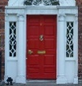

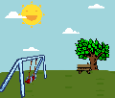


Vocabulary Development-Compound Nouns
3 Lieblingsurlaube.
Separate the words. Was ist das auf Englisch?
1 Schreib den Artikel (der, die, das, die).
Schreib das Wort auf Englisch, auch.
Sometimes the English is NOT a word-for-word translation, and could also be one word:
das Haustier → house animal → pet!
Try exercise 2. The pictures may help.
Winterurlaub
Aktivurlaub
Rucksackurlaub
Familienurlaub
Tagesurlaub
Bootsurlaub
Strandurlaub
1 ____ Lieblingsnummer
2 ____ Deutschunterricht
3 ____ Frühzug
4 ____ Sprachschule
5 ____ Wochentag
winter holiday
die
favourite number
der
German lesson
activity holiday / active holiday
der
early train
backpacking holiday
die
language school
family holiday
der
week day
day’s holiday
boating holiday
beach holiday
2 Schreib den Artikel (der, die, das, die).
Schreib das Wort auf Englisch, auch.
4 Urlaubssachen
Separate the words. Was ist das auf Englisch?
die
____ Haustür
____ Liebespaar
____ Spielplatz
____ Grünblau
____ Schlafzimmer
front door
____ Urlaubstag
____ Urlaubsideen
____ Urlaubsort
____ Urlaubshotel
____ Urlaubsgeld
der
holiday day
das
(romantic)couple
die
holiday ideas
der
playground
der
holiday place / location
das
greeny blue
das
holiday hotel
das
bedroom
das
holiday money
Notes:
Vocabulary development - compound nouns
Note: This task also includes three words from the revisited sets for this week: der Zug [613] der Platz [344] grün [556]
In tasks 1 and 2, all words have been previously taught within the SOW, although some featured as verbs - e.g. lieben (Liebe as phonics source word), schlafen.
Lieblings- [>4037] Nummer [1048] Deutsch [105] Unterricht [1107] früh [322] Sprache [1791] Schule [208] Woche [209] Tag [108] Haus [159] Tür [400] Liebe [843] lieben [816] Paar [284] Spiel [500] Platz [344] grün [556] blau [1016] schlafen [787] Zimmer [609]
There is a clear overlap with word families work, here, though the focus is on compound nouns. Subsequent lessons will explore links between word classes: how verbs become nouns, nouns become verbs etc..
Task 1:
We first practise the application of gender knowledge of previously taught nouns, combining them to make new compound nouns, which students should then also know the meaning of, without reference to a dictionary. This reinforces the importance of gender knowledge, which is a theme running right through this SOW!
Task 2:
Using previously-taught words, students are again asked to provide the gender and the English meaning.
This time, however, the English meanings are less transparent, and require further thinking.
This represents a very important opportunity for developing vocabulary depth - many high-frequency words have multiple meanings. Students have been taught these words previously in one context.
The way they are combined here is often with a slightly different meaning.
Task 3:
This task moves us into the theme of holidays.
Second, we practise segmentation of some compound nouns, all starting or ending with the word Urlaub.
Some of these will feature previously taught language, some will contain cognates, and finally, others with have unfamiliar words.
With the unfamiliar words, it is not expected that students guess the meaning.
They are to segment the word, and then look up the unfamiliar part to try to work out its meaning.
Note: in good online dictionaries many compound nouns will be listed. However, typically school paper dictionaries may not, and either way, it is helpful for students to recognise the usefulness of breaking compound nouns down into their component nouns, as a comprehension strategy.
Ask the students why they don’t need to work out the articles in Task 3 (answer - they will all be ‘der’ like ‘der Urlaub’).
der Urlaub [1192] is in this week’s vocabulary set.
Winter [1288] is a cognate and was met in the Christmas lesson sequence; aktiv [861] a near cognate; Rucksack [3915] cognate and previously met; Familie [310] previously taught; Tag [108] is known but the -es may confuse at first; Boot [1927] not yet met - will need looking up; Strand [2047] not yet met - will need looking up.
Task 4
This task continues the focus on holidays, but this time, Urlaub- is the first word, meaning that the genders need to be worked out, as well as the English meanings.
All words were previously taught, except the cognate Hotel.
Tag [108], Idee [641] Ort [383] Hotel - cognate [1129] Geld [249]
Note: Not all tasks need to be completed in one lesson. Teachers to differentiate for their own classes.

Slide 51
Vocabulary activities [2]
Using word reference resources
Word patterns
Compound nouns (German)
Cognates
Words with multiple meanings
Lexical profiling tool

Slide 52
Cognates
This slide shows the first part of a list of high-frequency words that follow patterns between Spanish and English word forms (and are thus near-cognates). The full list is available here.
Pattern | Word | Frequency ranking | Translation | Word class
1. The Spanish word adds an -o (and sometimes an accent) or changes a final '-e' in English to an –o NB an accent is also sometimes added
 | caso | 153 | case, occasion | nm
 | humano | 243 | human | adj
 | artículo | 458 | article, product, item | nm
 | minuto | 478 | minute | nm
 | resto | 522 | rest, remainder, leftover | nm
 | elemento | 537 | element | nm
 | período | 686 | period, time | nm
 | médico | 692 | medical | adj
 | cubano | 703 | Cuban | adj
 | modelo | 705 | model, pattern | nc
 | futuro | 718 | future | nm
Notes:
This slide shows the first part of a list of high-frequency words that follow patterns between Spanish and English word forms, as set out in section 3.4.1.17 of the AQA GCSE Spanish specification. The words on these lists are not already on the AQA GCSE Spanish vocabulary list, but are highly frequent (among the 2000 most frequent words in Spanish).
The varying length of lists gives teachers a sense of which patterns students are most likely to encounter between their L1 and L2 and could therefore be particularly useful for them (see, for example, lists 1, 6, 8, 9, 12, 14, 20, which have at least 15 words). Such word lists could be used to design activities in which students are encouraged to notice patterns in the language they read or hear and how these relate to equivalents in English.
Part of speech (word class) key: adj: adjectives; adv: adverbs; conj: conjunctions; nm/nf: nouns (masculine/feminine); prep: prepositions; v: verbs
Source of frequency rankings, translations and word class data: Davies, M., & Davies, K. (2018). A frequency dictionary of Spanish: Core vocabulary for learners (2nd ed.). London: Routledge
NB Some words occur in more than one list.

Slide 53
Cognates
A lists of true cognates (the first part of which is shown below) exists for French here:
Word | Frequency ranking | Translation | Word class
cause | 127 | cause | nf
question | 144 | question | nf
possible | 175 | possible | adj
simple | 212 | simple | adj
condition | 281 | condition | nf
international | 282 | international | adj
programme | 340 | program | nm
action | 355 | action | nf
minute | 375 | minute | nf
position | 383 | position | nf
effort | 388 | effort | nm
dollar | 432 | dollar | nm
commission | 461 | commission | nf
population | 509 | population | nf
nature | 542 | nature | nf
charger | 544 | to load, charge | v
organisation | 570 | organisation | nf
double | 574 | double | nm, adj
nation | 576 | nation | nf
technique | 592 | technique, technics, technical | nf, adj
Notes:
Cognates are referred to in the AQA specification as "words which have the same form and essentially the same meaning in French and in English (eg innocent, justice, muscle, rectangle). When such words occur in context, students can be expected to understand them in English and French. (AQA GCSE French specification, p.17). Below is a list of the cognates that are not already on the AQA French vocabulary list and are among the 2000 most frequently occurring words.
Word class key: adj: adjectives; adv: adverbs; conj: conjunctions; nm/nf: nouns (masculine/feminine); prep: prepositions; v: verbs
Source of frequency rankings, translations and word class data: Lonsdale, D. & Le Bras, Y. (2009). A frequency dictionary of French: Core vocabulary for learners. London: Routledge

Slide 54
Cognates
... and a similar list for German is here (again, only the first part is shown below;
see ‘2. Cognates’ tab of Excel sheet):
Word | Frequency ranking | Translation | Word class
Hand | 179 | hand | fn
Problem | 189 | problem | nn
System | 348 | system | nn
international | 371 | international | adj
Moment | 385 | moment | mn
Situation | 428 | situation | fn
Information | 467 | information | fn
modern | 504 | modern | adj
Bank | 509 | bank | fn
Film | 524 | film | mn
September | 560 | September | mn
Chance | 566 | chance | fn
Internet | 588 | internet | nn
normal | 651 | normal | adj
Computer | 739 | computer | mn
Dollar | 740 | dollar | mn
aha | 747 | aha, I see | interj
Professor | 765 | professor | mn
Westen, West | 767 | west | mn
Plan | 987 | plan | mn
national | 1007 | national | adj
November | 1009 | November | mn
Position | 1010 | position | fn
Team | 1051 | team | nn
okay | 1062 | okay | adj
Material | 1068 | material | nn
Rest | 1070 | rest, remains | mn
Wind | 1080 | wind | mn
Notes:
Cognates are referred to in the AQA specification as "which have exactly the same form, and essentially the same meaning, in German and in English (eg Museum, Hand, Name). When such words occur in context, students can be expected to understand them in English and German." (AQA GCSE German specification, p.15). Below is a list of the cognates that are not already on the AQA German vocabulary list and are among the 2000 most frequently occurring words.
Source of frequency rankings, translations and word class data: Jones, R., & Tschirner, L. (2006). A frequency dictionary of German: Core vocabulary for learners. Oxford: Routledge

Slide 55
Vocabulary activities [2]
Using word reference resources
Word patterns
Compound nouns (German)
Cognates
Words with multiple meanings
Lexical profiling tool

Slide 56
Words with multiple meanings
A number of words in the scheme of work have multiple meanings.
We have added a new tab called ‘Multiple senses’ to the SOW
This sheet documents when each meaning is introduced
Meanings are introduced cumulatively, so previously taught meanings are included in each new English translation.
Link to research suggesting that teaching meanings separately and cumulatively helps.
(Verspoor & Lowie, 2003, Making sense of polysemous words. Language Learning, 53, 547-586)
Notes:
Talk through these bullets.
The next slide shows what this tab looks like on the Spanish SOW

Slide 57
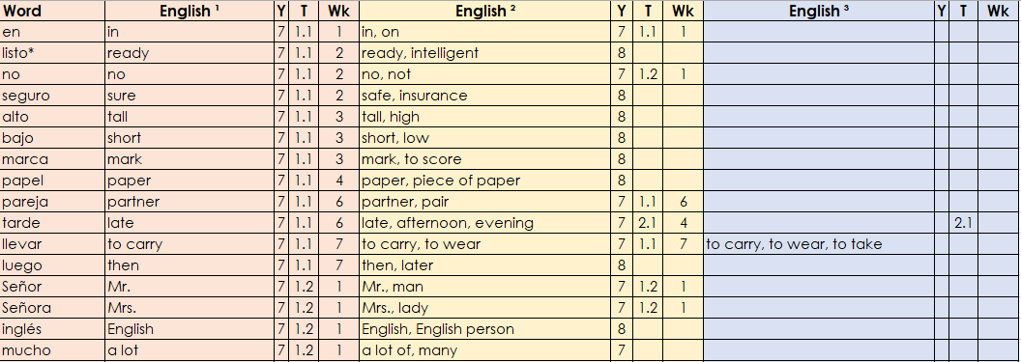
Words with multiple meanings
Notes:
This is not the full list, just a portion to give a flavour.
In total there are 41 words with multiple meanings in the Y7 Spanish SOW.

Slide 58
Vocabulary activities [2]
Using word reference resources
Word patterns
Compound nouns (German)
Cognates
Words with multiple meanings
Lexical profiling tool

Slide 59
Lexical profiling
with the ‘Top-2000’ and the NCELP SOW
Natalie Finlayson
CPD 8
Notes:
Say this in the screencast:
In advance of this part of the session it would be useful if you download the lexical profiling program and an NCELP folder for the language of your choice. You will see the links further down on the CPD page. The folders contain the NCELP lists for each week, and two sample texts - one GCSE-level one for demo-ing with the NCELP lists, one Harry Potter chapter for demo-ing with the 2000-lists.

Slide 60
What is lexical profiling?
Lexical profiling is the process of analysing words in a text to determine how suitable these are for a specific purpose.
Here are some questions that teachers might ask when assessing the suitability of L2 texts for use in their classes:
What percentage of the words in this text are high-frequency words?
Does this text contain any low-frequency words which I will need to gloss or replace?
How many of the words in this text have students learned so far?
These questions can be answered quickly and accurately using lexical profiling methods.

Slide 61





How to do lexical profiling
Lexical profiling can be performed manually.
This involves reading a text and cross-referencing words in it with frequency values or syllabi by hand.
The process is very time consuming, and the risk of human error is high.
Alternatively, lexical profiling can be carried out using electronic tools, such as AntProfiler-NCELP (Anthony 2020).
The process is instant and gives accurate results.

Slide 62
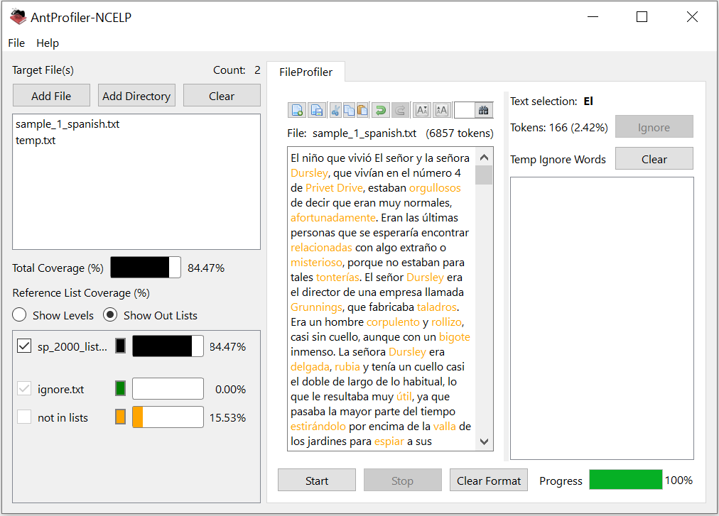
Lexical profiling (frequency)
This is what lexical profiling using AntProfiler-NCELP with a 2000-band frequency list looks like.
The total coverage value tells you the percentage of words in the text which appear in the top 2000.
Words in black have a frequency of 1-2000. Words in orange have a frequency value of >2000.
Teachers can edit texts directly in the program by removing, glossing or replacing highlighted words and, checking the edits for suitability.

Slide 63
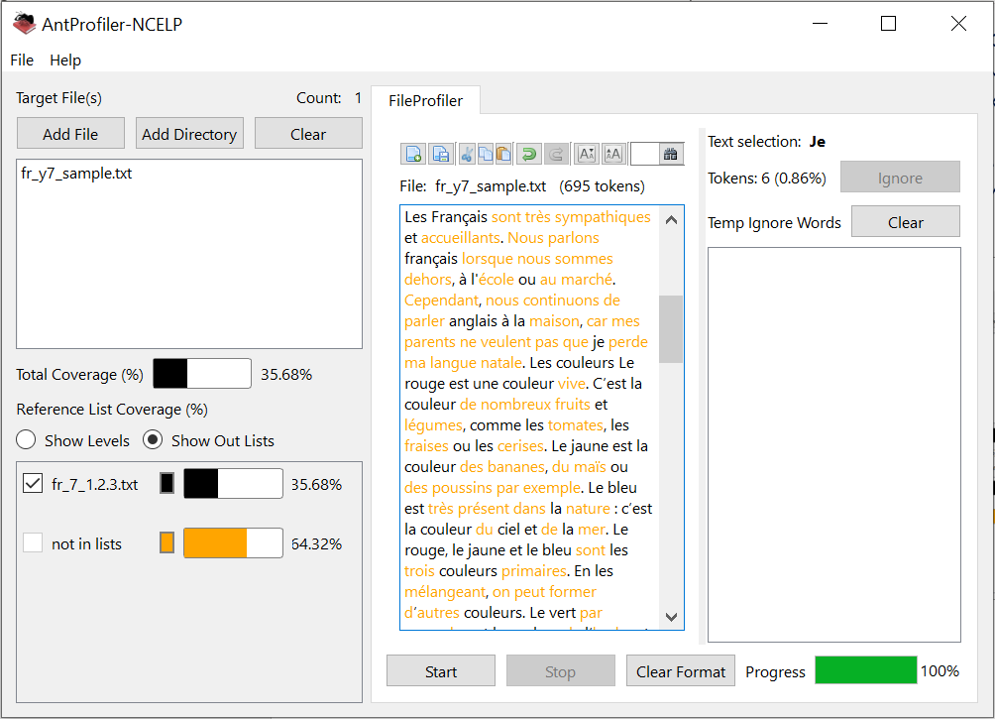
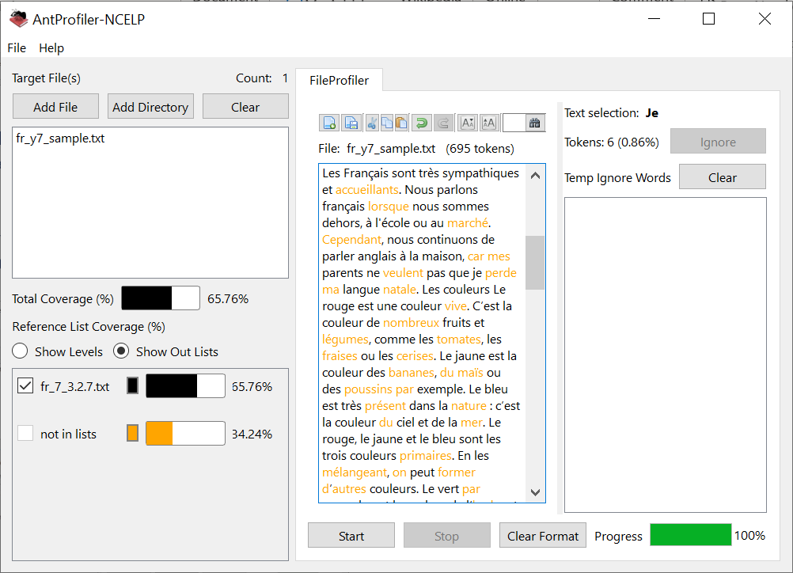
Lexical profiling (NCELP SOW)
If you are adopting the NCELP scheme of work, you might be interested to know how suitable a text is for inclusion in a given NCELP week.
Using special SOW-compatible wordlists created by NCELP, AntProfiler-NCELP can perform bespoke lexical profiling for NCELP-led syllabi.
On the top right, you can see the results of profiling a text using the wordlist for French Y7 SOW 1.2.3.
On the bottom right, you can see the results of profiling the same text using the wordlist for French Y7 SOW 3.2.7.

Slide 64
Lexical profiling demo
We now invite you to try this out for yourself, using the ‘how to’ guide and files provided by NCELP!
This demonstration will take around 15 minutes.
References
Anthony, L. (2020). AntProfiler-NCELP 1.0.0 [Computer Software]. Tokyo, Japan: Waseda University.
Davies, M., & Davies, K. (2018). A frequency dictionary of Spanish: Core vocabulary for
learners (2nd ed.). London: Routledge
Jones, R., & Tschirner, L. (2006). A frequency dictionary of German: Core vocabulary for
learners. Oxford: Routledge
Lonsdale, D. & Le Bras. Y. (2009). A frequency dictionary of French: Core vocabulary for
learners. Oxford: Routledge
Notes:
Once you have opened the profiler, a really good activity to show the usefulness of all this would be to use the 2000-profiler to adapt a paragraph of the Harry Potter text to make it suitable for a GCSE exam. Or, to adapt a paragraph of a GCSE text for use in Y7 Week 3.2.7! Time yourself - how long does it take you to get the text to 100% coverage of ‘known’ words?!
In case anyone asks, the program is currently only compatible with Windows. We are considering whether it makes sense to create a Mac-compatible version - watch this space.

Slide 65
Vocabulary activities [2]
Using word reference resources
Word patterns
Compound nouns (German)
Cognates
Words with multiple meanings
Lexical profiling tool

Slide 66
Reflection
1. Pre-learning of vocabulary prior to each week
2. Systematic revisiting of vocabulary every week
3. Integrating new and previously-taught vocabulary in lesson teaching
4. Making use of word reference resources
5. Learning about and using word patterns
6. Teaching about compound nouns (German)
7. Working with cognates
8. Teaching of words with multiple meanings
9. Lexical profiling (teacher tool)
Notes:
As we come to the end of the vocabulary part of this CPD session, it’s a useful time to reflect on the approaches we’ve considered for developing vocabulary knowledge in this session.
To summarise, they include:
1. Pre-learning of vocabulary prior to each week
2. Systematic revisiting of vocabulary every week, after 3 and 9 weeks.
3. Integrating new and previously-taught vocabulary in lesson teaching, and across all modes and modalities.
4. Making use of word reference resources
5. Learning about and using word patterns
6. Teaching about compound nouns (German)
7. Working with cognates
8. Teaching of words with multiple meanings
9. Lexical profiling (teacher tool)
Think about 2 or maximum 3 of these.
Make a note of one idea that you think is strong practice, and one aspect that you are interested in developing further in your department. If you are doing this CPD on your own, make sure you find a way to share these ideas with others in your department.
In addition, note down the way ways in which you and your department plan the teaching of vocabulary, revisit it systematically across the year, and/or develop its knowledge.

Slide 67
Session summary
The core objectives are that teachers:
1. are more familiar with the range of NCELP Year 7 resources for phonics, vocabulary and grammar;
2. understand and are considering ways to deepen and extend vocabulary learning;
3. revisit the grammar rationale and develop knowledge of task design principles.
Notes:
This is a summary of the objectives from the whole of CPD 8, which has three parts: phonics, vocabulary and grammar.
We hope that you have found it useful to see a sample of NCELP vocabulary resources created so far for Year 7 and reflect on the principles in action.
If you would like to access Part 3 - grammar, click the next link on the NCELP CPD page.

