Slide 1
Revisiting phonics, vocabulary and grammar
CPD 8 / TRG 4
Stephen Owen / Victoria Hobson / Rachel Hawkes
Date updated: 18/5/2020
Notes:
This is the presentation for CPD 8/TRG 4 of 2020: Revisiting PVG and meaningful practice.

Slide 2
Aims of the session
The core objectives are that teachers:
1. are more familiar with the range of NCELP Year 7 resources for phonics, vocabulary and grammar;
2. understand and are considering ways to deepen and extend vocabulary learning;
3. revisit the grammar rationale and develop knowledge of task design principles.
Notes:
This slide lists the core objectives of the session.

Slide 3
Phonics
Rachel Hawkes

Slide 4
Phonics activities
The NCELP SOW assumes an average of 10 minutes of phonics-related learning per lesson.
Initial activities present the SSCs (first cycle) in source and cluster words, and then revisit them (second and subsequent cycles) to strengthen the new knowledge.
Subsequent activities embed the SSCs into tasks, thereby deepening knowledge, for example, by requiring students to apply the SSC knowledge to unknown words, receptively and/or productively.
The scheme of work systematically recycles previously-taught SSCs.
Notes:
This slide explains the types of activity featured, and how it is intended that they should be used. Note: For time reasons, we have not included examples of source and cluster slides, as hub teachers will already be familiar with these from earlier phonics CPD. Here we focus on showcasing examples of different follow up tasks and activities that have been developed and incorporated into the Y7 lesson resources. We have had to include only a sample of the types of tasks available! There are, of course, many more on the portal.

Slide 5
Pairwork ‘tennis’
Variant spellings corresponding to this sound are featured in this set of words.
donner
60
écrire
bébé
Secondes
et
aller
0
parler
DÉBUT
Notes:
Term1.1 Week 5 (SSC ‘É-ER-ET’)
Pairwork ‘tennis’ – pupils say the words alternately out loud with a partner, building up speed, over 1 minute’s intensive practice. They call in any order they like, pupils are not allowed to repeat the one they said in their last turn. Teacher can circulate to listen into their SSC knowledge. Click on Début to start a one minute timer on the screen.

Slide 6
Lis en français !
lire / parler
3
peux
2
4
euh !
mieux
1
bleu
This read aloud task can focus on previously-taught OR unknown words OR a combination.
9
heureux
8
vieux
sérieux
5
dangereux
yeux
7
6
Notes:
Term 1.1 Week 2 (after students have been taught SFC (Silent Final Consonant) and SSC ‘EU’.
Word cloud
Partner A reads out words 1-5 in French and Partner B says the English back - partner A agrees or disagrees. Swap roles - partner B reads words 6-9.
Students should then choose any of the words at random to read out, their partner saying the number of the word and then giving the English - this should be out of order, so they cannot just rely on the order here. They should do six words each, alternating: A says French, B gives the number and then the English. B says French, A gives the number and then the English.
No timer this time. Some of these will be unfamiliar words and pupils will need to slow down to decode them more carefully.
NB: Pupils have learnt the SSC SFC (Silent final consonant) – here they get a reminder of the silent –X at the end of words.
Word frequency rankings (1 is the most common word in French): bleu [1216]; euh [889]; peux [pouvoir - 20] mieux [217]; sérieux [412]; yeux [œil-474]; dangereux [713]; vieux [671]; heureux[764] Source: Londsale, D., & Le Bras, Y. (2009). A Frequency Dictionary of French: Core vocabulary for learners London: Routledge.

Slide 7
Escucha.
Marca ‘GA’, ‘GO’ o ‘GU’.
Escucha otra vez.
Escribe la palabra.
escuchar
 | GA | GO | GU
¿Cómo se dice en inglés?
go
1
conmi___
with me
This transcription task type can also focus on previously-taught OR unknown words.
There is the opportunity for differentiation: recognise, transcribe, translate
se___ro
gu
sure, safe
2
go
3
___l
goal
ga
4
__to
cat
pre___ntar
5
gu
to ask
se___ndo
second
6
gu
ami__
7
ga
(female) friend
Students may learn some of these high-frequency words ‘Incidentally’ (without really aiming to learn them).
__nar
8
ga
to win
go
9
lar__
long
lu___r
10
ga
place
Notes:
Term 1.2 Week 4 These are high-frequency words that some students will acquire incidentally. They are not counted within the core expected learning of 360 words in Y7, so the additional challenge of translating into English shouldn’t be seen as a test, but as an additional opportunity to explore word meanings.

Slide 8
Make a word. Translate it!
cui
hablar / escuchar
This is an example of a multi-modal task, requiring students to listen, read, write, and speak to each other.
cui
¡Hola! Soy CUI.
Soy CUE.
Soy CUA.
tro
dar
rpo
dro
es ____ la
cue
dado
cua
cue
cua
Notes:
Term 1.1 Week 6
Starter task to recap this week’s SSCs.
The 3 SSCs lost the rest of their words! Students work in pairs to put the words back together.
Student A chooses an SSC and says it aloud to their partner CUE, CUA or CUI. Student B has to listen and write that SSC, then complete it with one of the fragments found in the middle of the slide to make a word.
Students then swap roles.
Then ask students to translate the words that they wrote (together each pair should be able to produce the six words in English)
Exclamation marks were not included with ‘cui’ and ‘dado’ to avoid giving away the answer. Note: these words are phonics source and/or cluster words. They have not been pre-learnt as vocabulary homework, but have been met and practised as part of the SSC (sound-symbol correspondence) learning.

Slide 9
Hören und schreiben
Wo ist das Fenster?
Das ist richtig.
Was denkst du?
Das ist falsch.
Die Flasche ist da.
Ist die Tafel hier oder da?
1
2
3
4
This multi-modal transcription task requires students to write full sentences, combining a number of SSCs.
5
6
Notes:
Term 1.1 Week 2
Transcription exercise
Play the audio recording of the sentences. Click the number to repeat the sentence as many times as needed.
Students write the sentences down.
Discuss the answers. For each item ask a student to read what they have written. Play the recording again and then show the written version.
A lot of the activities so far have used isolated words. This activity puts the vocabulary they have learnt in context. It also focuses the students’ attention on spelling of the words. This leads into the next activity where we discuss the various aspects of ‘knowing a word’.

Slide 10
İPilla al intruso!
hablar / escuchar / escribir
Persona A
✄
Persona B
 | hola / hasta luego / amigo |  | hermano / abuelo / hijo
 | hablar / estudiar / estar |  | hermosa / hermana / escuela
 | hermano / español / helado |  | hacer / usar / estudiar
 | hay / alto / arte |  | iglesia / hospital / escuela
 | once / ocho / hola |  | usar / hablar / hacer
A
A
B
B
- - - - - - - - - - - - - - - - - - - - - - - - - - - - - - - - -
C
C
Odd one out read aloud tasks are another useful format for SSC practice of individual words.
D
D
E
E
Notes:
Term 2.1 Week 3
Student worksheets to print (these are available in Word format). Do not display in class.
Pairs take it in turns to say their set of words to their partner who has to listen for the odd one out and write it down in Spanish.
All the vocabulary used here has been seen in previously taught vocabulary sets or phonics practice. Note: Explain to students that the task’s focus is the silent ‘h’. Otherwise, they may think that the odd one out might be the meaning rather than the spelling of words. They may need to write down ALL three words before they can determine which is the odd one out.

Slide 11
Phonétique
écouter
Mets les mots en ordre. Écris ‘1’ ou ‘2’.
e/an
on
__ cent 100
__ son sound
1
2
a
__ en in/by/to
__ on we/one
2
1
b
__ dans in
__ don gift
2
1
c
__ pan part
__ pont bridge
d
1
2
__ sans without
__ sont (they) are
e
1
2
__ fan fan
__ font (they) do/make
f
2
1
Notes:
Term 2.2 Week 4 (This is a week when SSC ‘EN/AN’ is revisited and contrasted with ‘ON’)
This phonics activity requires students to listen for the SCCs, and note the order in which they are presented each time in words which are minimal pairs. Minimal pairs of words differ by one phoneme, i.e., an SSC which changes the meaning. Through this activity, students learn the importance of connecting SSCs with meaning.
The students only need to note the order of presentation of each SSC – i.e. 1 or 2 – not the source word itself (there could be more than one answer, since multiple graphemes correspond in French to the same phoneme). The answers are animated and appear on successive mouse clicks, together with the words which were spoken on the recordings. Click on the letters to play the audio. To elicit answers, teachers point at a word and ask: “1 ou 2 ?”.
Transcript
cent.... son
on... en
don... dans
pan... pont
sans... sont
font... fan

Slide 12
Pirates!
1
c
Minimal pairs of unknown words are used to focus students’ attention on the SSCs.
w
Riese
leider
Riese
One of the chests contains buried treasure. All the others contain poison!
Listen carefully to the secret code and follow the arrows to find the treasure.
Reise
Lieder
Reise
h
z
Wien
Biene
Feile
v
Wein
Beine
viele
Riese
k
Riese
Biene
Feile
leider
i
Reise
Beine
viele
Lieder
Reise
Riese
leider
Feile
leider
Riese
r
Reise
Lieder
viele
Lieder
Reise
Riese
y
j
q
Reise
Notes:
Term 1.1 Week 7 (and also Term 3.1 Week 4, with different routes)
The game makes use of minimal pairs of unknown words (unknown words are used so that pupils focus on the sound - spelling relationships. Definitions are given on a later slide).
Starting on the red square, pupils listen to the words and decide whether they hear /ei/ or /ie/. They follow the arrows indicated by their choice to finish at one of the chests. There is only one correct route per slide, so pupils must correctly identify all words to find the treasure. The order of /ei/ and /ie/ changes (i.e. sometimes /ei/ is on the white square and sometimes on the blue) so the pupils must read the spellings.
Pupils can follow the slide on the projector, or the slide can be printed so they can trace the route with a pen/finger.
Teacher asks ‘Wo bist du?’ Pupils respond ‘Z, W’ etc. to practise the alphabet. Teacher clicks on the chests they say to reveal treasure (or not!)
Audio plays on clicking play. Pupils will probably need to hear the audio at least three times.
Note: Each treasure chest is triggered to reveal what is underneath. You see a hand icon appear when you mouse over it – click and the chest disappears. Each slide only has one treasure chest – the rest reveal skulls.
Transcript:
Wien, Biene, Feile, Lieder, Reise
Treasure is located in chest W.

Slide 13
¿r o rr?
escuchar
Pairing two similar SSC for practice can provide powerful learning opportunities.
Escucha y escribe la letra. ¿Es ‘r’ o ‘rr’?
Escucha otra vez. Escribe la palabra en español.
r
abrir
rr
correo
1
6
r
dar
r
seria
2
7
rr
correcto
rr
cerrar
3
8
rr
perro
rr
correr
4
9
r
pero
r
caro
5
10
Notes:
Term 2.1 Week 2
Play each sound twice. Those that quickly understand the SSC on the first hearing can then write the word.
For 8), students might write ‘serrar’ and this should not be treated as ‘wrong’, but as an opportunity to explore the different ways of pronouncing ‘ce’ in different regions.
TRANSCRIPT
abrir
dar
correcto
perro
pero
correo
seria
cerrar
correr
caro

Slide 14
escuchar
This second task shows progression in challenge, as students listen to whole sentences and tally the SSC.
Escucha las frases. Marca cada vez que hay una ‘r’
y una ‘rr.’ Luego, escribe las palabras o la frase en español.
r | rr | Frase / Palabras
1
Estudiar arte es importante.
2
La señora es seria pero es interesante.
3
Tienes cuatro correctas.
El perro es grande y está en Inglaterra.
4
Notes:
Term 2.1 Week 2
TRANSCRIPT
Estudiar arte es importante.
La señora es seria, pero es interesante.
Tienes cuatro correctas.
El perro es grande y está en Inglaterra.
Students should tally every time they hear ‘r’ and ‘rr.’
There are then two levels of differentiation available.
Students write the words containing the target SSCs in Spanish.
Higher ability students may be able to transcribe the whole sentence.
The vocabulary used here is all known to students, taken from previously learnt vocab sets.

Slide 15
Phonétique 1
écrire
Here, vocabulary revisiting is combined with SSC revision.
En français, quel mot a la SSC é (-er, -et) ?
ou
[nothing]
ch______
anter
r______
ien
Notes:
Term 2.2 Week 3
This exercise revises the SSC [é (-er, -et)] at the same time as practising this week’s new and revisited vocabulary.
For each pair of words/pictures, give students some time to write down the words in French. This practices written production of the vocabulary and spelling of the SSC. Pronunciation can be checked when eliciting answers with the class. The answers are animated to show the word with the SSC [é (-er, -et)] first, followed by the other word.

Slide 16
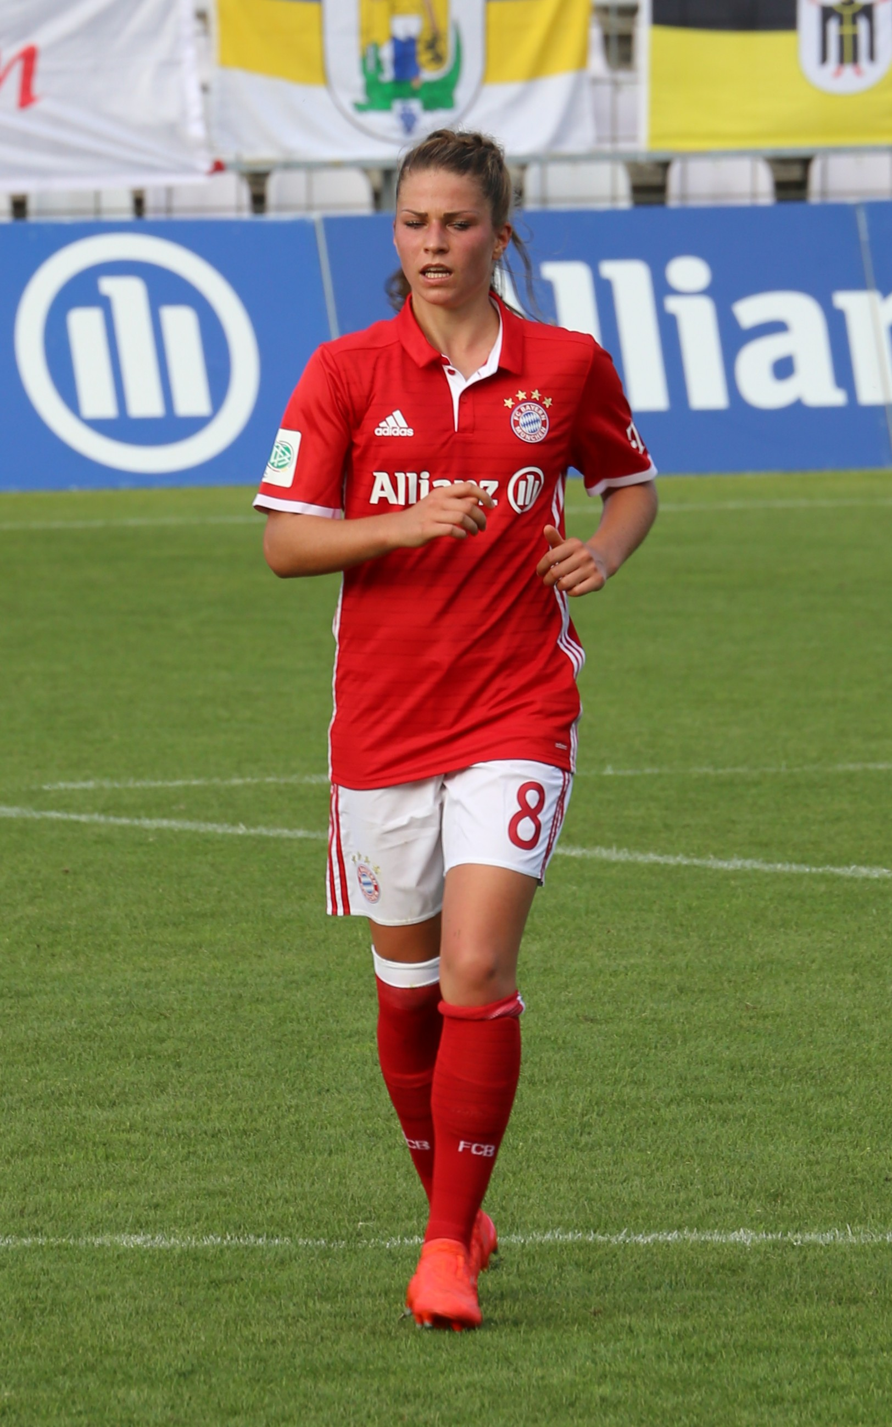
Phonetik
sprechen
Ich heiße Melanie Leupolz. Ich spiele für Deutschland Fußball aber ich spiele heute mit neun Freunden Schlagzeug!
This read aloud text features one SSC but brings together many others, doubles as vocabulary revision and also includes some cultural knowledge.
Notes:
Term 2.2 Week 4 Read aloud task focusing on this week’s SSC. Melanie Leupolz does play football for the German national team and Bayern München. However, the drum playing with nine friends is poetic licence, and includes all of the words from this week’s sequence that contain the SSC EU!
Rufus46 / CC BY-SA (https://creativecommons.org/licenses/by-sa/3.0)
Click the speech bubble to hear the recording. Transcript:
Ich heiße Melanie Leupolz. Ich spiele Fußball für Deutschland aber ich spiele heute mit neun Freunden Schlagzeug!

Slide 17
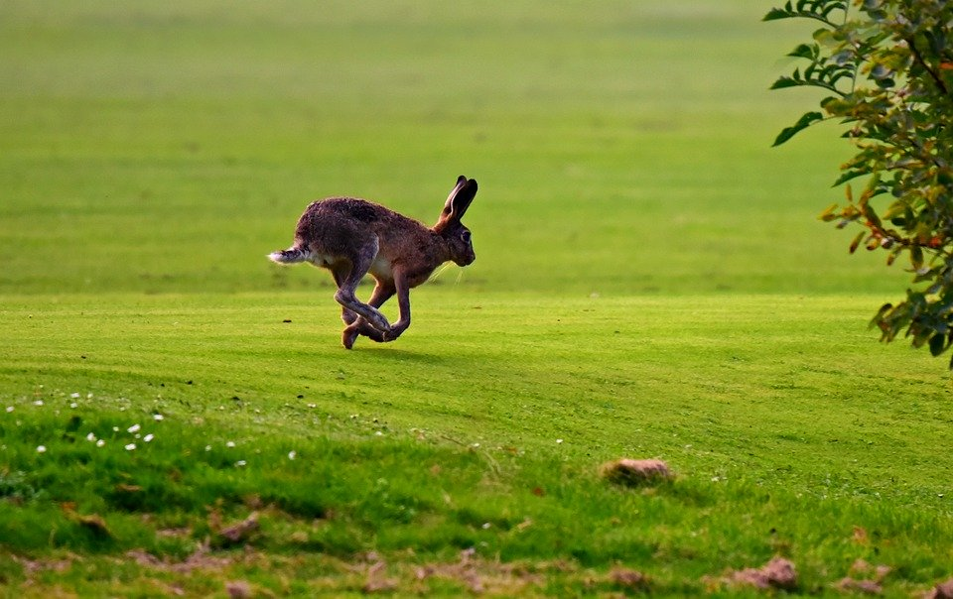
Zungenbrecher
Phonetik
Auf dem Rasen rasen Hasen, atmen rasselnd durch die Nasen.
Tongue twisters are a useful source of read aloud practice that include unknown words, compelling students to apply their SSC knowledge.
Notes:
Term 2.2 Week 5 (long and short vowels, revisited)
Opportunity to practise long and short ‘a’ sounds, but note that ‘atmen’ does not follow the standard rules owing to its Sanskrit origins. Auf dem Rasen rasen Hasen, atmen rasselnd durch die Nasen.
There are two recordings of this tongue twister – one slower, one faster.
Frequency: der Rasen [>4029]; rasen [>4029]; atmen [2454]; durch [56]; rasselnd[>4029] die Nase [1530]
Translation: On the lawn hares are racing, breathing raspingly?noisily? through their noses
Images from www.pixabay.com
https://creativecommons.org/licenses/by-nd/2.0/legalcode

Slide 18
Remember there are different ways to pronounce ‘z’.
In most of Spain, ‘z’ is pronounced like the ‘th’ in English (as you just heard).
In the Canary Islands and Latin America, this ‘z’ is often pronounced like an ‘s’.
Compare:
Phonics tasks can also draw attention to sociolinguistic differences, and develop students’ awareness of language diversity.
naturaleza
(mainland Spain)
1
naturaleza
(Canaries & Latin America)
2
Notes:
Term 3.1 Week 1 (SSC ‘Z’ - revisited)
Click on the orange number to hear the word.
In this slide students are reminded of the two possible pronunciations of ’z’ in the Spanish speaking world (as discussed in 1.2 Week 1). In this case, a word from the vocabulary to be revisited this week is being used.

Slide 19
Escucha.
¿Dónde está la persona?
Escucha otra vez y escribe la frase. ¿Qué significa?
 | España | Latinoamérica / Canarias
Frase | ¿Qué significa?
1
Hay pájaros azules en los árboles de la zona.
There are blue birds in the trees of the area.
2
Debo organizar los zapatos.
I must organise the shoes.
3
La plaza está a la izquierda.
The square is on the left.
Debes empezar un dibujo de la naturaleza.
You must start a drawing of nature.
4
Tiene diez ideas en la cabeza.
S/he has ten ideas in the head.
5
Notes:
Term 3.1 Week 1 (SSC ‘Z’ - revisited)
Transcript:
Hay pájaros azules en los árboles de la zona;
Debo organizar los zapatos;
La plaza está a la izquierda;
Debes empezar un dibujo de la naturaleza;
Tiene diez ideas en la cabeza;
All of the phonics source and cluster words have been used, here, plus some of the vocabulary to be revisited this week has been used: T2.2 Week 2: deber [71]; debo; debes; organizar [1053] T2.1 Week 3: naturaleza [712]; pájaro [1607]; azul [811]; árbol [748]
Image with creative commons public domain licence
https://mycsres.com/freesheet/spanish-speaking-world-map-18.html.html

Slide 20
Session summary
The core objectives are that teachers:
1. are more familiar with the range of NCELP Year 7 resources for phonics, vocabulary and grammar;
2. understand and are considering ways to deepen and extend vocabulary learning;
3. revisit the grammar rationale and develop knowledge of task design principles.
Notes:
This was the first part in a three-part CPD session. Part 2 - vocabulary can be accessed from a link on the NCELP CPD page.

