Slide 1
Phonics
SSC [s; ss] revisited
Y7 German
Term 3.2 - Week 5
Stephen Owen / Rachel Hawkes
Date updated: 22/05/2020
Notes:
Learning outcomes (lesson 1)
Introduction of expressing future versus present meaning using present tense with appropriate time adverbials.
Revisiting SSC [s; ss] with known words from this week’s new vocabulary set and those revisited this week.
Frequency rankings of vocabulary introduced this week (1 is the most common word in German):
Dorf [684] Großstadt [74/188] Jahr [53] Monat [306] Schwimmbad [>4034/1579] See [1167] Strand [2047] nächste [249] nächstes [249] nächsten [249] nächstes Jahr [249/53] nächsten Monat [249/306] nächste Woche [249/211]
Two compound nouns, and a previous SSC cluster word:
Wasserpark [299/1940] Freizeitpark [1156/1940] Meer [979]
Frequency rankings of vocabulary revisited this week (1 is the most common word in German):
Week 3.1.6 dauern [698] erreichen¹ [305] fahren² [169] schaffen¹ [320] suchen [293] viel, viele [60] das Land¹ [146] Schottland [>4034] Schweiz [>4034] Stunde¹ [262] Wien [>4034] dort [134] normalerweise [1898]
Week 2.2.3 fahren¹ [169] geben [57] helfen [406] mir [64]vergessen [595] laufen [248] schlafen [787] Zeitung [572] Geld [249] Urlaub [1192] fast [223]
Source: Jones, R.L. & Tschirner, E. (2006). A frequency dictionary of German: core vocabulary for learners. Routledge

Slide 2
Wiederholung - s, ss, ß
Phonetik
Before a vowel, German 's' sounds like the English ‘z’.
E.g., sagen, sehr, sein, sie, sitzen, gesund, super, Reise.
Elsewhere, the German ‘s’, as well as all instances of ‘ss’ and ‘ß’ are pronounced like an English ‘s’.
E.g., eins, hast, das, groß, lassen, Haus, Wasser, heißen.
Use 'ss’ when the preceding vowel in a word is short, e.g., essen. Write 'ß’ after a long vowel e.g., 'Fuß', or two vowels together e.g. 'weiß‘.
Remember: sch-, sp-, st- are pronounced in their own way at the start of a word,
e.g. schwimmen, springen, stehen
Notes:
Timing (total for phonics activities on Slides 2-9): 15 minutes
These notes remind students when to pronounce ‘s’ as a ‘z’ and when as an ‘s’. They also explain the use of the ß (called Eszett or scharfes S) instead of ss. There is also a reminder of the pronunciation of ‘sch-’, ‘sp-’ and ‘st-’ at the start of a word.

Slide 3
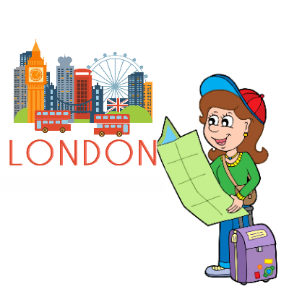
Phonetik
s
Gesetz
Seite
sollen
54
reisen
Satz
Subjekt
Verb
Objekt
langsam
Ich habe Hunger.
Notes:
Elicit again the pronunciation of the individual SSC ‘S’ and then the source word again (with gesture, if using). Then elicit the pronunciation of the five cluster words. The cluster words have been chosen for their high-frequency, from a range of word classes, with the SSC (where possible) positioned within a variety of syllables within the words (e.g. initial, 2nd, final etc.).
Word frequency rankings (1 is the most common word in German): sollen [63]; Gesetz [552] Seite[217]; reisen [978]; langsam [604]; Satz [582]. Source: Jones, R.L. & Tschirner, E. (2006). A frequency dictionary of German: core vocabulary for learners. Routledge

Slide 4
Phonetik
s
Phonetik
Gesetz
Seite
sollen
reisen
Satz
langsam
Notes:
Without pictures to focus solely on the SSC and cluster words.

Slide 5
Phonetik
s
Gesetz
Seite
sollen
reisen
Satz
langsam
Notes:
Without sound to elicit pronunciation from students.

Slide 6
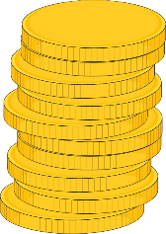
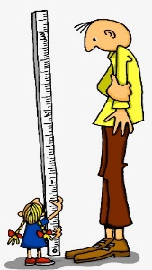
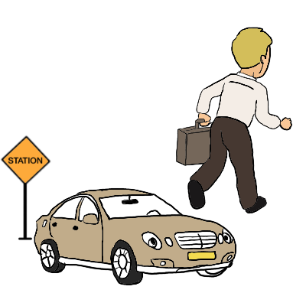
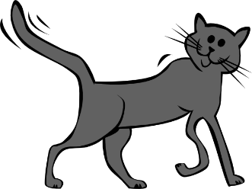
Phonetik
ß
Fußball
ein bisschen
groß
heißen
lassen
Misky
damals
1919
2019
Notes:
Elicit again the pronunciation of the individual SSC ‘ß’ and then the source word again (with gesture, if using). Then elicit the pronunciation of the five cluster words. The cluster words have been chosen for their high-frequency, from a range of word classes, with the SSC (where possible) positioned within a variety of syllables within the words (e.g. initial, 2nd, final etc.).
Word frequency rankings (1 is the most common word in German): groß [74]; Fußball [1497] ein bisschen [194]; heißen [123]; damals [271]; lassen [82]. Source: Jones, R.L. & Tschirner, E. (2006). A frequency dictionary of German: core vocabulary for learners. Routledge

Slide 7
Phonetik
ß
Fußball
ein bisschen
groß
heißen
lassen
damals
Notes:
Without pictures to focus on SSC and source words alone.

Slide 8
Phonetik
ß
Fußball
ein bisschen
groß
heißen
lassen
Notes:
Without sound to elicit pronunciation from students.

Slide 9
Phonetik
suchen
Großstadt
normalerweise
vergessen
der See
suchen
normalerweise
Großstadt
der Wasserpark
vergessen
nächste
der Wasserpark
fast
nächste
fast
der See
Notes:
Students must decide whether the sounds in the words match to the bee (buzz) or the snake (hiss). Teachers can elicit the sound [zzzz] or [ssss] first from the students, then the full word. Answers are animated one by one to move to the correct image.
This is a reprise of the task from 2.1.4, but this time the words are taken from the introduced and revisited vocabulary sets for the current week.
Word frequencies:
Großstadt [74/188] See [1167] nächste [249] Wasserpark [299/1940] suchen [293] normalerweise [1898] vergessen [595] fast [223]
Source: Jones, R.L. & Tschirner, E. (2006). A frequency dictionary of German: core vocabulary for learners. Routledge
Bee pic from pixabay.com
Snake pic from publicdomainvectors.org

Slide 10
Snap?
Ja
oder
nein?
Süden
selbst
besser
so
als
Spaß
Wechsel
Sommer
lustig
Seite
letztes
küssen
Gesicht
heiß
setzen
besuchen
Notes:
Timing (total for phonics activities on Slides 19-20): 10 minutes
Students identify if the sounds highlighted in yellow are a match, ‘snap’ (like the card game) by pronouncing the words aloud and comparing them. Play FOUR times with class and give students a few seconds to pronounce in pairs and decide, before taking the class answer each time. The answers are animated. Then pairs can play against each other – one student choosing and pronouncing two words and the other student deciding whether they make a matching snap pair or not. The words have been selected from the forthcoming Year 8 vocabulary lists, and are thus ‘unknown words’ for the students at present. This makes the task one of pure phonics decoding, rather than allowing existing word knowledge to play a part.
Word frequency rankings:
der Süden [1534], selbst [98], besser [231], so [21], als [25], der Spaß [666], der Wechsel [1945], der Sommer [704], lustig [2262], die Seite [217], letztes [147], küssen [2625], heiß [920], setzen [228], besuchen [703], das Gesicht [365]
Source: Jones, R.L. & Tschirner, E. (2006). A frequency dictionary of German: core vocabulary for learners. Routledge
Bee pic from pixabay.com
Snake pic from publicdomainvectors.org

Slide 11
Was passt nicht in die Reihe?
Phonetik
1.
Süden
als
Gesicht
2.
lustig
selbst
besuchen
3.
Spaß
Seite
küssen
4.
so
heiß
Wechsel
5.
Sommer
besser
gesund
Notes:
Odd One Out Students should be encouraged to practise pronouncing these words out loud, individually or in pairs, to decide which is the odd one out in each row (Reihe). Students have met this task type before and the instruction ‘Was passt nicht?’ Teachers can elicit the instruction meaning from students. Answers are animated to shade the odd one out. Words are from the forthcoming Year 8 scheme of work (with the exception of ‘gesund’, learnt in 2.1.4), as used on the previous slide. There is no need to focus on meaning, though teachers might be interested to see if students can anticipate the meanings, e.g. besser, Sommer, Süden.

