Slide 1
Saying what people have
Singular indefinite article (un/una)
SSCs [l],[ll]
Y7 Spanish
Term 1.1 - Week 4 - Lesson 7
Nick Avery / Victoria Hobson
Date updated: 30/06/21
Notes:
Learning outcomes (lesson 1):
Introduction of SSC [l] and [ll]
Introduction of [singular indefinite article]
Word frequency (1 is the most frequent word in Spanish):
7.1.1.4 (introduce) tener [19]; tengo; tiene; tienes; moneda [1577]; cama [609]; casa [106]; cámara [903]; bicicleta [3684]; libro [230]; barco [1384]; bolígrafo [>5000]; gato [1728]; ¿qué? [50]; nuevo [94]; un/a [6]; lee [leer-209]; frase [1036]; letra [977]; papel [393]
7.1.1.1 (revisit) estar [21]; estoy; estás; está; norte [624]; sur [661]; Inglaterra [N/A]; España [N/A]; ¿dónde? [161] en [5]; hola [1245]; hasta luego [luego-150]
Source: Davies, M. & Davies, K. (2018). A frequency dictionary of Spanish: Core vocabulary for learners (2nd ed.). Routledge: London

Slide 2
l
libro
Notes:
Timing: 1 minute
Aim: To introduce/consolidate SSC [l]
Procedure: 1. Present the letter(s) and say the [l] sound first, on its own. Students repeat it with you. 2. Bring up the word ”libro” on its own, say it, students repeat it, so that they have the opportunity to focus all of their attention on the connection between the written word and its sound.
3. A possible gesture for this would be to open an imaginary book. 4. Roll back the animations and work through 1-3 again, but this time, dropping your voice completely to listen carefully to the students saying the [l] sound, pronouncing ”libro” and, if using, doing the gesture.
Word frequency (1 is the most frequent word in Spanish):
libro [230] Source: Davies, M. & Davies, K. (2018). A frequency dictionary of Spanish: Core vocabulary for learners (2nd ed.). Routledge: London

Slide 3
l
salir
palabra
lista
libro
luz
luego
[then]
Notes:
Timing: 2 minutes
Aim: To introduce/consolidate SSC [l]
Procedure:
Introduce and elicit the pronunciation of the individual SSC [l] and then the source word again ‘libro’ (with gesture, if using).
Then present and elicit the pronunciation of the five cluster words.
The cluster words have been chosen for their high-frequency, from a range of word classes, with the SSC (where possible) positioned within a variety of syllables within the words (e.g. initial, 2nd, final etc.). Additionally, we have tried to use words that build cumulatively on previously taught SSCs (see the Phonics Teaching Sequence document) and do not include new SSCs. Where new SSCs are used, they are often consonants which have a similar symbol-sound correspondence in English.
Word frequency (1 is the most frequent word in Spanish): libro [230]; salir [114]; lista [1189]; luego [150]; palabra [192]; luz [278] Source: Davies, M. & Davies, K. (2018). A frequency dictionary of Spanish: Core vocabulary for learners (2nd ed.). Routledge: London

Slide 4
l
salir
palabra
lista
libro
luz
luego
Notes:
Without the images, students focus this time again closely on the SSC and the cluster words.

Slide 5
l
salir
palabra
lista
libro
luz
luego
Notes:
Without the images or sound, students have to pronounce the words themselves.

Slide 6
ll
llamar
Notes:
Timing: 1 minute
Aim: To introduce/consolidate SSC [ll]
Procedure: 1. Present the letter(s) and say the [ll] sound first, on its own. Students repeat it with you. 2. Bring up the word ”llamar” on its own, say it, students repeat it, so that they have the opportunity to focus all of their attention on the connection between the written word and its sound.
3. A possible gesture for this would be to bring an imaginary phone to your ear. 4. Roll back the animations and work through 1-3 again, but this time, dropping your voice completely to listen carefully to the students saying the [ll] sound, pronouncing ”llamar” and, if using, doing the gesture.
Word frequency (1 is the most frequent word in Spanish): llamar [122] Source: Davies, M. & Davies, K. (2018). A frequency dictionary of Spanish: Core vocabulary for learners (2nd ed.). Routledge: London

Slide 7
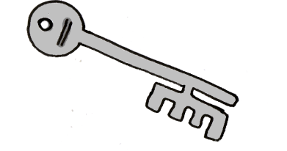
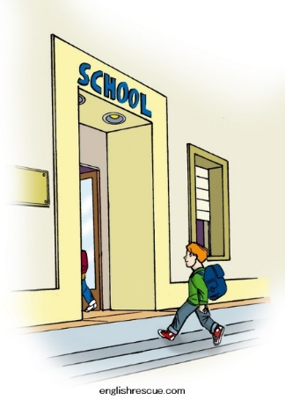
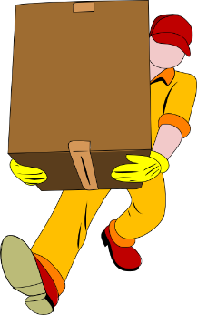
ll
llegar
llave
© www.englishrescue.com
llamar
llevar
amarillo
ella
Notes:
Timing: 2 minutes
Aim: To introduce/consolidate SSC [ll]
Procedure:
Introduce and elicit the pronunciation of the individual SSC [ll] and then the source word again ‘llamar’ (with gesture, if using).
Then present and elicit the pronunciation of the five cluster words.
The cluster words have been chosen for their high-frequency, from a range of word classes, with the SSC (where possible) positioned within a variety of syllables within the words (e.g. initial, 2nd, final etc.). Additionally, we have tried to use words that build cumulatively on previously taught SSCs (see the Phonics Teaching Sequence document) and do not include new SSCs. Where new SSCs are used, they are often consonants which have a similar symbol-sound correspondence in English.
Word frequency (1 is the most frequent word in Spanish): llamar [122]; llegar [75]; llevar [101]; llave [1853]; amarillo [1381] Source: Davies, M. & Davies, K. (2018). A frequency dictionary of Spanish: Core vocabulary for learners (2nd ed.). Routledge: London

Slide 8
ll
llegar
llave
llamar
llevar
amarillo
ella
Notes:
Without the images, students focus this time again closely on the SSC and the cluster words.

Slide 9
ll
llegar
llave
llamar
llevar
amarillo
ella
Notes:
Without the images or sound, students have to pronounce the words themselves.

Slide 10
Fonética
leer / hablar
60
ella
salir
llamar
Segundos
llevar
lista
amarillo
luz
0
palabra
INICIO
Notes:
Phonics practice activity (we recommend doing either this or the next activity)
Timing: 1 minute
Aim: to gain confidence and fluency in saying words with [l] and [ll]
Procedure:
1. Pupils say the words alternately out loud with a partner, building up speed, over 1 minute’s intensive practice.
2. Pupils call in any order they like, but are not allowed to repeat the one they said in their last turn. 3. Teacher can circulate to listen into their SSC knowledge.
Click on INICIO to start a one minute timer on the screen.
Word frequency (1 is the most frequent word in Spanish): salir [114]; lista [1189]; palabra [192]; luz [278]; llamar [122]; llevar [101]; ella [72]; amarillo [1381]
Source: Davies, M. & Davies, K. (2018). A frequency dictionary of Spanish: Core vocabulary for learners (2nd ed.). Routledge: London

Slide 11
Fonética
leer / hablar
60
ella
salir
llamar
Segundos
llevar
lista
amarillo
0
palabra
luz
INICIO
Notes:
OPTIONAL
Phonics practice activity: alphabetical read aloud
Timing: 1 minute
Aim: to gain confidence and fluency in saying words with [l] and [ll]
Procedure:
1. Individually (but all at once) pupils read out the words but in alphabetical order. They keep going for one minute.
2. Teacher can circulate to listen into their SSC knowledge.
Word frequency (1 is the most frequent word in Spanish): salir [114]; lista [1189]; palabra [192]; luz [278]; llamar [122]; llevar [101]; ella [72]; amarillo [1381]
Source: Davies, M. & Davies, K. (2018). A frequency dictionary of Spanish: Core vocabulary for learners (2nd ed.). Routledge: London

Slide 12
Gender in Spanish
Gender in Spanish
Things, as well as people, have a gender in Spanish. This means that they are either masculine or feminine:
Masculine
Feminine
un
elefante
an elephant
una
llave
a key
un
lugar
an idea
a place
una
idea
a world
a house
un
mundo
una
casa
To say a (or an) in Spanish before a noun, you use un or una, depending on whether the noun is masculine or feminine.
Notes:
Grammar explanation slide
These example nouns are all taken from the SSC source/cluster words from weeks 1-3. Students should already familiar with these from their phonics learning.

Slide 13
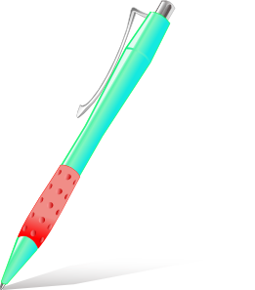
Vocabulario
Masculine nouns (un = a, an)
un
gato
un
barco
un
bolígrafo
un
libro
Notes:
Vocabulary presentation slide
Timing: 2 minutes (slideds 13-14)
Notes:
Presentation of to the active nouns in the tasks that follow. Here, all the masculine nouns are introduced.
All nouns to be taught this week have regular gender marking (i.e. -o ending with masc nouns; -a ending with feminine nouns). This makes the gender recognition easier for students’ first encounter with the concept of gender of nouns. You could point this out to students, but also so that this is not always the case. Some nouns have other endings (e.g. elefante).
Word frequency (1 is the most frequent word in Spanish): barco [1384]; bolígrafo [>5000 –in AQA]; gato [1728]; libro [230]
Source: Davies, M. & Davies, K. (2018). A frequency dictionary of Spanish: Core vocabulary for learners (2nd ed.). Routledge: London

Slide 14
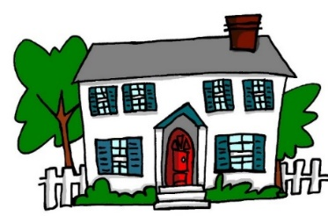
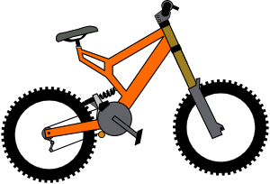
Vocabulario
Feminine nouns (una = a, an)
una
casa
una
cama
una
cámara
You can also just say ‘bici’!
una
bicicleta
una
moneda
Notes:
Vocabulary presentation slide
Word frequency (1 is the most frequent word in Spanish):
moneda [1577]; cama [609]; casa [106]; cámara [903]; bicicleta [3684]
Source: Davies, M. & Davies, K. (2018). A frequency dictionary of Spanish: Core vocabulary for learners (2nd ed.). Routledge: London

Slide 15
Vocabulario
un
una
Notes:
Vocabulary practice activity (with reference to indefinite articles)
Timing: 2 minutes
Procedure:
Ask students to predict which pacman will eat the object depending on the noun’s gender.
Pupils may need to say the word aloud first, then decide if it is ‘un’ or ‘una’

Slide 16
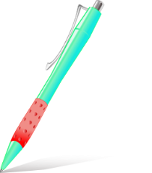
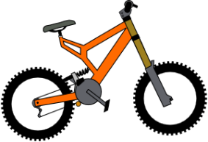
Vocabulary introduction
İPilla al intruso!
Vocabulario
1.
4.
un
un
una
una
una
un
2.
5.
un
una
un
una
un
un
3.
6.
der
una
una
un
una
una
un
Notes:
Vocabulary practice activity (with reference to indefinite articles)
Timing: 3 minutes
Procedure: Pupils find the odd one out by identifying the gender of each noun.

Slide 17
De vacaciones
leer
You are going on holiday to Spain. The tour guide sent you some useful information, but it got jammed in the printer! What does it say? Choose the correct noun.
1 | Una | libro | cámara | es esencial.
2 | Un | barco | bicicleta | está en Bilbao.
3 | Un | cámara | bolígrafo | es muy importante.
4 | Una | bicicleta | barco | es útil.
5 | Una | cama | libro | es importante.
6 | Una | gato | casa | está en el centro.
7 | Una | libro | moneda | es indispensable.
8 | Un | libro | cama | es necesario.
Notes:
Grammar practice activity (reading)
Timing: 7 minutes
Aim: To practice recognising gender marking on nouns
Procedure:
1. Students select the correct word to complete the sentence, depending on the indefinite article given.
Notes:
1. Although in some cases the adjective agreement is an additional clue, this grammar point has not been taught yet so it is unlikely that students will use this to work out the answer.
2. The language at the end of each sentence is included to recycle some of the grammar (es for attribute, está for location) covered in previous weeks. A number of (near-) cognates (e.g. esencial, importante, indispensable) are included as these are likely to be easily recognised and understood.
Word frequency (1 is the most frequent word in Spanish): moneda [1577]; cama [609]; casa [106]; cámara [903]; bicicleta [3684]; libro [230]; barco [1384]; bolígrafo [>5000]; gato [1728];
Source: Davies, M. & Davies, K. (2018). A frequency dictionary of Spanish: Core vocabulary for learners (2nd ed.). Routledge: London

Slide 18
¡Cluedo!
escuchar
Lire
¿Qué es, y dónde está?
(What is it and where is it?)
You’re listening to some clues in a Cluedo game but your friend is distracting you! Which things are mentioned? Circle the correct ones.
Es un / una | gato / bicicleta. | Está en un / una | barco / casa.
Es un / una | bolígrafo / moneda. | Está en un / una | cama / libro.
Es un / una | libro / cámara. | Está en un / una | barco / bicicleta.
Es un / una | barco / casa. | Está en un / una | libro / moneda.
Es un / una | bolígrafo / casa. | Está en un / una | barco / cama.
1
2
3
4
5
Notes:
Grammar practice activity (listening)
Timing: 8 minutes
Aim: to practice focusing on the indefinite article to determine the gender of noun it refers to
Procedure:
1. Focus students’ attention on the title (¿Qué es, y dónde está?). Some may have heard the word before (‘qué será será’, ‘¿qué pasa?’). Ensure that the meaning of this question word in the title is clear and elicit the translation of title. 2. Students write 1-5.
3. Students listen and write the two correct nouns each time.
4. After finishing, focus on meaning and ask students if any of these sound a bit odd/unexpected!
Note:
They may also circle the indefinite article, but this isn’t essential; they will have to pay attention to it, in any case, to work out which noun is correct.
Transcript:
Es un [gato]. Está en un [barco]
Es una [moneda]. Está en un [libro]
Es una [cámara]. Está en una [bicicleta]
Es un [barco]. Está en una [moneda]
Es una [casa]. Está en una [cama].
Word frequency (1 is the most frequent word in Spanish): moneda [1577]; cama [609]; casa [106]; cámara [903]; bicicleta [3684]; libro [230]; barco [1384]; bolígrafo [>5000]; gato [1728];
Source: Davies, M. & Davies, K. (2018). A frequency dictionary of Spanish: Core vocabulary for learners (2nd ed.). Routledge: London

Slide 19
Partner A
Say the start of the sentence in Spanish to your partner.
hablar / escuchar
Choose the word for ‘a’ carefully (either un or una), depending on your picture.
Note: un is for masculine nouns and una is for feminine nouns. Do not say the noun!
E.g. ‘Es una…’
Partner B
Listen carefully to the sentence starter (‘Es un…’ or ‘Es una…’).
Tick which picture is being described.
Choose between a masculine noun and a feminine noun.
E.g.
Notes:
Paired speaking/listening activity
Timing: 10-12 mins (slides 19-22)
Aim: to practise producing and understanding indefinite articles in the oral modality; to practice retrieving the gender of nouns from memory
Procedure:
1. Use this slide to give instructions and model the activity
2. Partner A gives their sentence (Es un/una…..without saying the noun!)
3. Partner B ticks the correct noun on their sheet.
4. Students then swap roles.
See next slide for the prompt cards/listening grid.

Slide 20
Partner A
Es _____
2) Es _____
3) Es _____
4) Es _____
5) Es _____
Partner B
2)
3)
4)
5)
Notes:
DO NOT DISPLAY DURING ACTIVITY
Student A prompt cards and Student B answer grid.
Example for item 1:
Partner A would say:
Es una…
Partner B would tick the picture of the bed.

Slide 21
hablar / escuchar
Now swap roles!
Partner B
Say the start of the sentence in Spanish to your partner. Choose the word for ‘a’ carefully (either un or una), depending on your picture. Remember: un is for masculine nouns and una is for feminine nouns.
Partner A
Listen carefully to your partner. Tick the picture being described. Choose between a masculine noun and a feminine noun.
Notes:
Students swap roles. The activity continues in exactly the same way as described on slide 19.

Slide 22
Partner B
Es _____
2) Es _____
3) Es _____
4) Es _____
5) Es _____
Partner A
2)
3)
4)
5)
Notes:
DO NOT DISPLAY DURING ACTIVITY
Student B prompt cards and Student A answer grid.
Partner B would say:
Es una.
Partner B would tick the picture of the house etc.

Slide 23
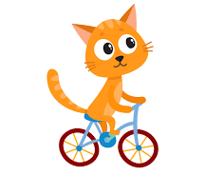
¡A escribir!
escribir
¿Dónde está Snapcat?
You see Snapcat everywhere you go on holiday! Write descriptions in Spanish of where he is in each picture. Choose the word for a carefully.
Está en una bicicleta.
Está en una cama.
Está en un barco.
Está en una casa.
Está en un libro.
Notes:
OPTIONAL
Writing activity
Timing: 6 mins
Aim: To practise the use of the singular indefinite article in written production
Procedure:
1. When giving the instructions, if students need help with the sentence content, give them the English (He is on a bike, He is in a bed, etc.). Remind students that en is for both ‘on’ and ‘in’ and that ‘está’ is used to say ‘it is’ for location.
2. Students write the 5 sentences
Word frequency (1 is the most frequent word in Spanish): moneda [1577]; cama [609]; casa [106]; cámara [903]; bicicleta [3684]; libro [230]; barco [1384]; bolígrafo [>5000]; gato [1728]
Source: Davies, M. & Davies, K. (2018). A frequency dictionary of Spanish: Core vocabulary for learners (2nd ed.). Routledge: London

Slide 24
Saying what people have [2]
TENER – tengo / tienes / tiene
yes-no questions [revisited]
SSC [l]/[ll] (cont.)
Y7 Spanish
Term 1.1 - Week 4 - Lesson 8
Nick Avery / Victoria Hobson
Date updated: 30/06/21
Notes:
Learning outcomes (lesson 2):
Consolidation of SSC [l]/[ll]
Introduction of TENER – tengo / tienes / tiene Consolidation of yes/no questions with raised intonation
Word frequency (1 is the most frequent word in Spanish):
7.1.1.4 (introduce) tener [19]; tengo; tiene; tienes; moneda [1577]; cama [609]; casa [106]; cámara [903]; bicicleta [3684]; libro [230]; barco [1384]; bolígrafo [>5000]; gato [1728]; ¿qué? [50]; nuevo [94]; un/a [6]; lee [leer-209]; frase [1036]; letra [977]; papel [393]
7.1.1.1 (revisit) estar [21]; estoy; estás; está; norte [624]; sur [661]; Inglaterra [N/A]; España [N/A]; ¿dónde? [161] en [5]; hola [1245]; hasta luego [luego-150]
Source: Davies, M. & Davies, K. (2018). A frequency dictionary of Spanish: Core vocabulary for learners (2nd ed.). Routledge: London

Slide 25
Fonética
leer / escribir
palabra
lista
llave
libro
llamar
© www.englishrescue.com
llegar
Notes:
Timing: 3 minutes
Aim: to correctly use SSCs [l] and [ll]
Procedure:
1. This can be done as a whole-class activity, or individually/in pairs.
2. The target SSC (L/ LL) is obscured in each word.
3. The teacher can say the word and ask students to write the missing letter(s).
4. To challenge students more, ask students to try to remember which source/cluster words with L and LL don’t appear here (e.g. amarillo, llevar, ella, luz, salir, luego), making sure to check their spelling and to also have students say them aloud.
5. Check understanding of the meanings of the words
Word frequency (1 is the most frequent word in Spanish): llamar [122]; llegar [75]; llave [1853]; libro [230]; lista [1189]; palabra [192]
Source: Davies, M. & Davies, K. (2018). A frequency dictionary of Spanish: Core vocabulary for learners (2nd ed.). Routledge: London

Slide 26
Vocabulario
leer / hablar
60
 | Word | English meaning
1 | una moneda | a coin
2 | una cama | a bed
3 | una casa | a house
4 | una cámara | a camara
5 | una bicicleta | a bike
6 | un libro | a book
7 | un barco | a boat
8 | un bolígrafo | a pen
9 | un gato | a cat
10 | nuevo | new
Segundos
0
INICIO
Notes:
Vocabulario
Timing: 1-4 minutes Aim: To reactivate and strengthen vocabulary knowledge. Procedure: Round 1: Look at the Spanish, recall the English meanings, saying them aloud. [1 minute] Round 2: Look at the English, recall the Spanish meanings, saying them aloud. [1 minute] Repeat for two further minutes, to speed up recall.
Vocabulary for week 4:
tener [19]; tengo; tiene; tienes; moneda [1577]; cama [609]; casa [106]; cámara [903]; bicicleta [3684]; radio [933]; barco [1384]; bolígrafo [>5000]; gato [1728]; ¿qué? [50]; nuevo [94]; un/a [6]
Note: Students may be able to do this activity very quickly as they have had input on the nouns from the indefinite article grammar point.

Slide 27
hablar
Vocabulario
un gato
un barco
un bolígrafo
una casa
una cama
una cámara
una moneda
una bicicleta
Notes:
OPTIONAL
Teachers may wish to use this slide to reinforce the vocabulary for Week 4, depending on how fresh the words are in students’ minds from the indefinite article work. Alternatively, progress straight on to the tener grammar explanation. Return to vocab recap at a later point should you wish.
Timing: 3 minutes
Aim: to reinforce the nouns taught this week
Procedure:
Pictures appear in order: teacher says them, students repeat.
Words remain only - students pronounce chorally without teacher support
Question icons elicit the English meanings, one by one.
Pictures slowly appear eliciting Spanish (on next series of slides.)
Transcript:
Word frequency (1 is the most frequent word in Spanish): moneda [1577]; cama [609]; casa [106]; cámara [903]; bicicleta [3684]; barco [1384]; bolígrafo [>5000]; gato [1728]
Source: Davies, M. & Davies, K. (2018). A frequency dictionary of Spanish: Core vocabulary for learners (2nd ed.). Routledge: London

Slide 28
Hablar 2
hablar
una cámara
Notes:
OPTIONAL – vocabulary recall activity
Timing: 3 mins (slides 28-35)
Aim: to prompt recall of the new vocabulary items
Procedure:
1. Click to make each square disappear until the complete picture of the noun is left.
2. Students say the Spanish word aloud

Slide 29
Hablar 3
hablar
un gato
hablar
hablar
hablar

Slide 30
Hablar 4
hablar
una casa

Slide 31
Hablar 5
hablar
una bicicleta

Slide 32
Hablar 6
hablar
un bolígrafo

Slide 33
Hablar 7
hablar
un barco

Slide 34
Hablar 8
hablar
una moneda

Slide 35
Hablar 9
hablar
una cama

Slide 36
Tener – tengo / tienes
In Spanish, the verb tener means to have.
Tengo
I have
Tienes
you have
Tengo una idea.
I have an idea.
Tienes una casa.
You have a house.
Notes:
Grammar presentation slide
1. Click to reveal each new part of the explanation
2. Ask students for the English translation of Spanish sentences (using the orange question mark as a prompt)
3. This week we introduce the vocabulary item ‘papel’ [393]. This could be used with the new verb ‘tengo’ or ‘tienes’. (¿Tienes papel? Sí/no).

Slide 37
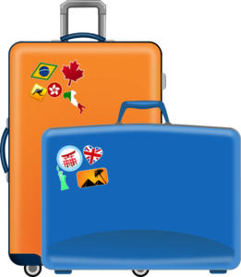
escuchar
En la maleta…Mrs Organised is going on holiday with Mr Organised. She is talking about the contents of their suitcases. Who has what?
Tick ‘I have’ or ‘you have’.
I have
you have
 |  | Object | Description
1
boat
fantastic
2
bicycle
white
3
cat
mad (now)
4
book
famous
5
coin
new
6
bed
high
7
pen
famous
8
camera
new
Notes:
Grammar practice activity (listening)
Timing: 10 mins (an optional final part of the activity is provided on the next slide)
Aim: to practise distinguishing between ‘tengo’ and ‘tienes’ and their meanings; to recall the meanings of the new vocabulary
Procedure:
1. Students write 1-8 and 4-column copy the grid into their books
2. They listen to each item. The first time they only tick ‘I have’ or ‘you have’ (this is the key grammatical information).
3. The second time they listen they focus on the the lexical item and its description, completing this information in English in the right-hand columns.
4. Check answers (these will appear in the order described above)
4. Ask students if there are any surprising items in their suitcases (gato, barco)!
Notes:
1. In checking the descriptions, students might be encouraged to notice adjective agreement (from the previous week). This point may only need to be noted in passing, or teachers may wish to make more of the explanation as a teaching point, depending on the profile of the group.
2. See if students can distinguish the temporary state in item 3 (“está loco”) from the general attributes (‘es famoso’, ‘es blanco’ in the others)
3. To focus on sound-spelling correspondences, students could also listen again and transcribe the sentences.
4. Students have so far seen ‘alto’ as ‘tall’. Here, it refers to an object, so the translation would be ‘high’. Try to elicit this from them.
Transcript:
Tengo un barco. Es fantástico.
Tienes una bicicleta. Es blanca.
Tienes un gato. Está loco.
Tengo un libro. Es famoso.
Tengo una moneda. Es nueva.
Tienes una cama. Es alta.
Tengo un bolígrafo. Es famoso.
Tienes una cámara. Es nueva.
Word frequency (1 is the most frequent word in Spanish): moneda [1577]; cama [609]; cámara [903]; bicicleta [3684]; barco [1384]; bolígrafo [>5000]; gato [1728], libro [230], blanco [372], alto¹ [231], nuevo [94], famoso [997], loco [846], fantástico [2501]
Source: Davies, M. & Davies, K. (2018). A frequency dictionary of Spanish: Core vocabulary for learners (2nd ed.). Routledge: London

Slide 38
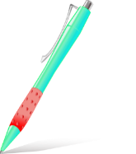
¿Quién es?
Sara
Manolo
Carla
Pepe
Paloma
Juan
Notes:
OPTIONAL
To reinforce understanding of the vocabulary, students can then use their answers from the listening to work out the first names of the couple.
Procedure
Students look at the pictures and compare them with their answers.
They decide which two people must have been spoken about. ANSWERS: Paloma y Juan
Note:
1. ‘Quién’ has not been formally introduced yet, but students should be able to guess here what it means.

Slide 39
leer
The children of Mr & Mrs Organised are also going on holiday. Their daughter is speaking. Lee las frases. Write who has what in the correct column.
 |  | Daughter (‘I’) | Her brother (‘you’)
1 | Tengo una moneda y un bolígrafo.
 | Tienes una bicicleta y una cámara.
2 | Tienes una casa y un gato.
 | Tengo una cámara y una moneda.
3 | Tienes una cama y un libro.
 | Tengo un gato y una cámara.
4 | Tengo un libro y un bolígrafo.
 | Tienes un barco y una casa.
5 | Tienes una cama y un barco.
 | Tengo una bicicleta y una casa.
6 | Tienes un gato y un libro.
 | Tengo un libro y una moneda.
coin
pen
bike
camera
camera
coin
house
cat
cat
camera
bed
book
book
pen
boat
house
bike
house
bed
boat
book
coin
cat
book
Notes:
Grammar practice activity (reading)
Timing: 7 minutes
Aim: to practise distinguishing between two forms of ‘tener’ and to recall the meaning of vocabulary items
Procedure:
1. Students could use their ex books to write their responses. Students do not need to copy out the whole table.
Students read the sentences and write, underneath each person, the things that s/he has.
Note:
1. We are gradually starting to incorporate the target language into task instructions. Here we use lee [leer-209] and frase [1036]. Make sure that this is clear to students.
Word frequency (1 is the most frequent word in Spanish): moneda [1577]; cama [609]; casa [106]; cámara [903]; bicicleta [3684]; libro [230]; barco [1384]; bolígrafo [>5000]; gato
Source: Davies, M. & Davies, K. (2018). A frequency dictionary of Spanish: Core vocabulary for learners (2nd ed.). Routledge: London

Slide 40
Escribir
Partner A
escribir / hablar /escuchar
Tengo
una casa
una cama
una moneda
Partner A
Hablar
Tengo una casa, una cama y una moneda.
Partner B
Escuchar
I have
or you have ???
Notes:
Writing / speaking / listening activity
Procedure:
1. Explain that students must write the four sentences from their card in Spanish. The pictures dictate what the students must write. The worked example can be used to model this to students. The sentences could be done in students’ ex. Books
2. For partner A, the sentences to write in Spanish are items 1,2,5,7 (see prompt cards on next slide).
For partner B, the sentences to write in Spanish are items : 3,4,6,8 (see prompt cards on next slide). This should be clear to the students from the modelling.
3. Students should take it in turns to say the sentences they have just written to their partner. They may do this in numerical order (or for a greater challenge, in random order).
The partner listens carefully and writes in English in the correct box ‘I have’ or ‘you have’.
4. The answers can be checked on the next slide.

Slide 41
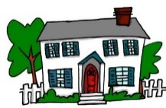
Partner A
Partner B
1)
2)
1)
2)
………………………… boat / pen / coin | ………………………. house / book / bike
 | ………………………. bed / camera / cat
 | ………………………. boat / coin / camera
……………………….. cat / pen / book | ……………………….. house / boat / bed
.............................. pen / house / camera
…………………… camera / coin / bike
I have
you have
3)
4)
3)
4)
you have
I have
5)
6)
5)
6)
you have
you have
7)
8)
7)
8)
I have
I have
Notes:
These are the student prompt cards and answer grid (see accompanying Word doc for printable version).
Students can either write on the dotted line on the printed card itself or in their exercise books. Writing in exercise books would mean that the cards could be used again.
Note:
1. If students are instructed to go in numerical order, then the listening task for the partner is made easier because students will only be attending to the verb and this will lessen the cognitive load and fully focus attention on the choice between tengo / tienes. Tip for stronger students: If students are given a hint that they do not have to follow the numerical order on cards, then the partner will also have to listen to the lexical items to make sure that the verb is written in the correct box. Teachers should use their judgement here, depending on the level of the class.
2. The English answers appear if teachers wish to lead a quick check that both pairs’ cards are correct.

Slide 42
Tener: I have & s/he has
We have learnt the verb tener means to have.
Tengo
I have
Tienes
you have
Tiene
he / she / it has
Tiene un libro.
S/he has a book.
Tiene una casa.
S/he has a house.
Notes:
Grammar presentation slide
Having seen 1st and 2nd person singular, now explain 3rd person singular to students.

Slide 43
escuchar
¡Regalos!
Grandma needs to buy a present for her two grandsons.
She is talking to the younger one about what he and his brother already have. Listen and complete the table in English.
Younger grandson (‘you have’) | Older grandson (‘he has’)
a boat
a house
1
2
a cat
a bike
3
a pen
a book
4
a coin
a camera
5
a bed
a dictionary
Notes:
Grammar practice activity (listening)
Timing: 8 mins
Aim: to practise distinguishing between ‘tienes’ and ‘tiene’ and their meanings; to recall the meanings of vocabulary items
Procedure:
1. Students write 1-5.
2. They listen to the items and write the word in English in the correct column.
3. Play all of the audio again another time.
4. Check answers
Note: ‘regalo’ will be taught in Term 1.2, Week 7. Check its meaning is understood here.
Transcript:
Tiene una casa y tienes un barco
Tienes un gato y tiene una bicicleta.
Tiene un libro y tienes un bolígrafo.
Tiene una cámara y tienes una moneda.
Tienes una cama y tiene un diccionario.
Word frequency (1 is the most frequent word in Spanish): moneda [1577]; cama [609]; casa [106]; cámara [903]; bicicleta [3684]; libro [230]; barco [1384]; bolígrafo [>5000]; gato [1728], diccionario [3844]
Source: Davies, M. & Davies, K. (2018). A frequency dictionary of Spanish: Core vocabulary for learners (2nd ed.). Routledge: London

Slide 44
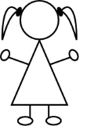
leer
Pepe is talking to a friend (‘you’)about what each of them has. Pepe also mentions what his sister Paula (‘she’) has. Write the item in English that each person has.
 |  | Pepe |  | Paula
1 | Tiene un barco. Tengo una cámara.
2 | Tengo una bicicleta. Tienes un libro.
3 | Tiene una casa. Tengo un barco.
4 | Tengo una moneda. Tiene un bolígrafo.
5 | Tengo un gato. Tienes una cama.
6 | Tiene una bicicleta. Tengo una cama.
‘you have’
‘she has’
‘I have’
a camera
a boat
a bike
a book
a boat
a house
a coin
a pen
a cat
a bed
a bed
a bike
Notes:
Timing: 6 mins
Aim: to distinguish between the three previously taught forms of ‘tener’
Procedure:
1. Students write 1-6 on the left-hand margin, with 3 column headers (I have, you have, she has)
2. They read the sentences and write the vocabulary item in English in the correct column.
3. Check answers and give feedback
Notes:
1. By now, students will be very familiar with the vocabulary plus the three singular parts of tener, which have up to now featured in pairs. In this activity, all sentences have ‘tengo’, but not all have ‘tiene’ – some have ‘tienes’ instead. In this way, students have to pay close attention to both the verb form and the item.
Word frequency (1 is the most frequent word in Spanish): moneda [1577]; cama [609]; casa [106]; cámara [903]; bicicleta [3684]; libro [230]; barco [1384]; bolígrafo [>5000]; gato [1728]
Source: Davies, M. & Davies, K. (2018). A frequency dictionary of Spanish: Core vocabulary for learners (2nd ed.). Routledge: London

Slide 45
Partner A
hablar / escuchar
Say the sentences in Spanish to your partner, according to your picture. Choose the verb carefully.
Remember: tengo – I have, tienes – you have, tiene – s/he has
Partner B
Listen carefully to your partner’s sentence. Write the correct verb in English next to the picture being described.
Notes:
Instruction slide for paired/speaking listening activity (slides 45-7)
Timing: 10 mins
Procedure:
Student A looks at prompt cards and says the sentence in Spanish.
Student B looks for the corresponding sentence on their card, then writes the missing person and verb (e.g. I have).
Students then swap roles
Notes:
1. All three persons of tener in the singular are practised in the activity as students have now had plenty of input practice across the different combinations of pairs.
2. It may be advisable to re-familiarise students’ memory with the subject pronoun pictures for ‘I’, ‘you’ and ‘he’ before the activity (bottom of this slide).

Slide 46
Partner A
1)
2)
3)
4)
5)
Partner B
………………….a house
………………….a bike
…………………..a pen
………………….a boat
……………….a camera
S/he has
‘he’
I have
‘I’
You have
‘she’
S/he has
‘you’
I have
‘I’
Notes:
Prompt cards and answer cards (see accompanying Word doc for printable version).
Alternatively students could write the answers in their ex books and the cards used again.
Partner A says their sentence to partner B in Spanish. Partner B listens carefully and then writes the verb accordingly.
Additional note:
1. Partner B’s items are not on the page in numerical order. This forces Partner B to attend to the meaning of the noun and the verb form at the same time. If felt to be too challenging, the items can be edited to follow the same order as Partner A’s items 1-5.

Slide 47
Now swap roles!
Partner B
Say the sentences in Spanish to your partner, according to your picture. Choose the verb carefully.
Remember: tengo – I have, tienes – you have, tiene – s/he has
Partner A
Listen carefully to the sentence that your partner says.
Write the verb in English (e.g. you have) next to the picture being described.

Slide 48
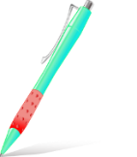
Partner B
1)
2)
3)
4)
5)
Partner A
………………….a cat
………………….a book
…………………..a pen
………………….a coin
……………….a bed
You have
‘you’
You have
‘he’
‘I’
S/he has
‘I’
I have
‘she’
S/he has
‘you’
‘I’
Notes:
Prompt cards and answer cards (see accompanying Word doc for printable version).
Alternatively students could write the answers in their ex books and the cards used again.
Partner B says their sentence to partner A in Spanish. Partner A listens carefully and then writes the verb accordingly.
Additional note:
1. Partner A’s items are not on the page in numerical order. This forces Partner A to attend to the meaning of the noun and the verb form at the same time. If felt to be too challenging, the items can be edited to follow the same order as Partner B’s items 1-5.

Slide 49
Writing 1
escribir
Tiene una bicicleta.
Notes:
Plenary style writing activity (slides 49-54)
Timing: 3 minutes
Aim: to practise producing the target verb forms and vocabulary items in writing
Procedure: ask students to write the correct sentence, as indicated by the images.
Note: all three persons of tener in the singular are practised here, since students have had lots of input practice across the different combinations of pairs.

Slide 50
Writing 2
escribir
Tengo un libro.

Slide 51
Writing 3
escribir
Tengo un gato.

Slide 52
Writing 4
escribir
¿Tienes una moneda?
Notes:
Note: the question symbol should prompt students to recall yes-no questions from week 3. They just need to remember here to write with the upside down question mark and to maintain the same word order as in normal statements.
Elicit the translation to draw students attention to the difference between English (which requires auxiliary ‘do’) and Spanish (which just uses the main verb).

Slide 53
Writing 5
escribir
¿Tiene un barco?
Notes:
Note: the question symbol should prompt students to recall yes-no questions from week 3. They just need to remember here to write with the upside down question mark and to maintain the same word order as in normal statements.
Elicit the translation to draw students attention to the difference between English (which requires auxiliary ‘does’) and Spanish (which just uses the main verb).

Slide 54
Writing 6
escribir
¿Tienes una cámara?
Notes:
Note: the question symbol should prompt students to recall yes-no questions from week 3. They just need to remember here to write with the upside down question mark and to maintain the same word order as in normal statements.
Elicit the translation to draw students attention to the difference between English (which requires auxiliary ‘do’) and Spanish (which just uses the main verb).

Slide 55
Alphabet 1
Letras
A
B
C
D
E
F
G
H
I
J
K
L
M
N
Ñ
O
P
Q
R
S
T
U
V
W
X
Y
Z
Notes:
Alphabet
Audio – click on the letter for audio.
This is also an opportunity to teach the new vocabulary item ‘letra’ [977].
We usually use the ‘drill instructor’ chant/song to learn the alphabet. Teacher will lead first but after some practice, individuals can take on this role, or class can be split into two halves etc. Have fun with it.

Slide 56
Alphabet 2
 | A | B | C | D | E | F | G | H | I | J | K
P | a | l | x | i | t | e | p | b | m | y | j
Q | b | m | y | j | u | f | q | c | n | z | k
R | c | n | z | k | v | g | r | d | o | a | l
S | d | o | a | l | w | h | s | e | p | b | m
T | e | p | b | m | x | i | t | f | q | c | n
U | f | r | c | n | y | j | u | g | r | d | o
V | g | s | d | o | z | k | v | h | s | e | p
W | h | t | e | p | a | l | w | i | t | f | q
X | i | u | f | q | b | m | x | j | u | g | r
Y | j | v | g | r | c | n | y | k | v | h | s
Z | k | w | h | s | d | o | z | l | w | i | t
Notes:
Pair work for alphabet practice.
Make small grids for the pupils to stick into their books. Pupil A chooses grid coordinates (e.g. C, X) and pupil B has to say which letter those coordinates meet at (e.g. f).

Slide 57
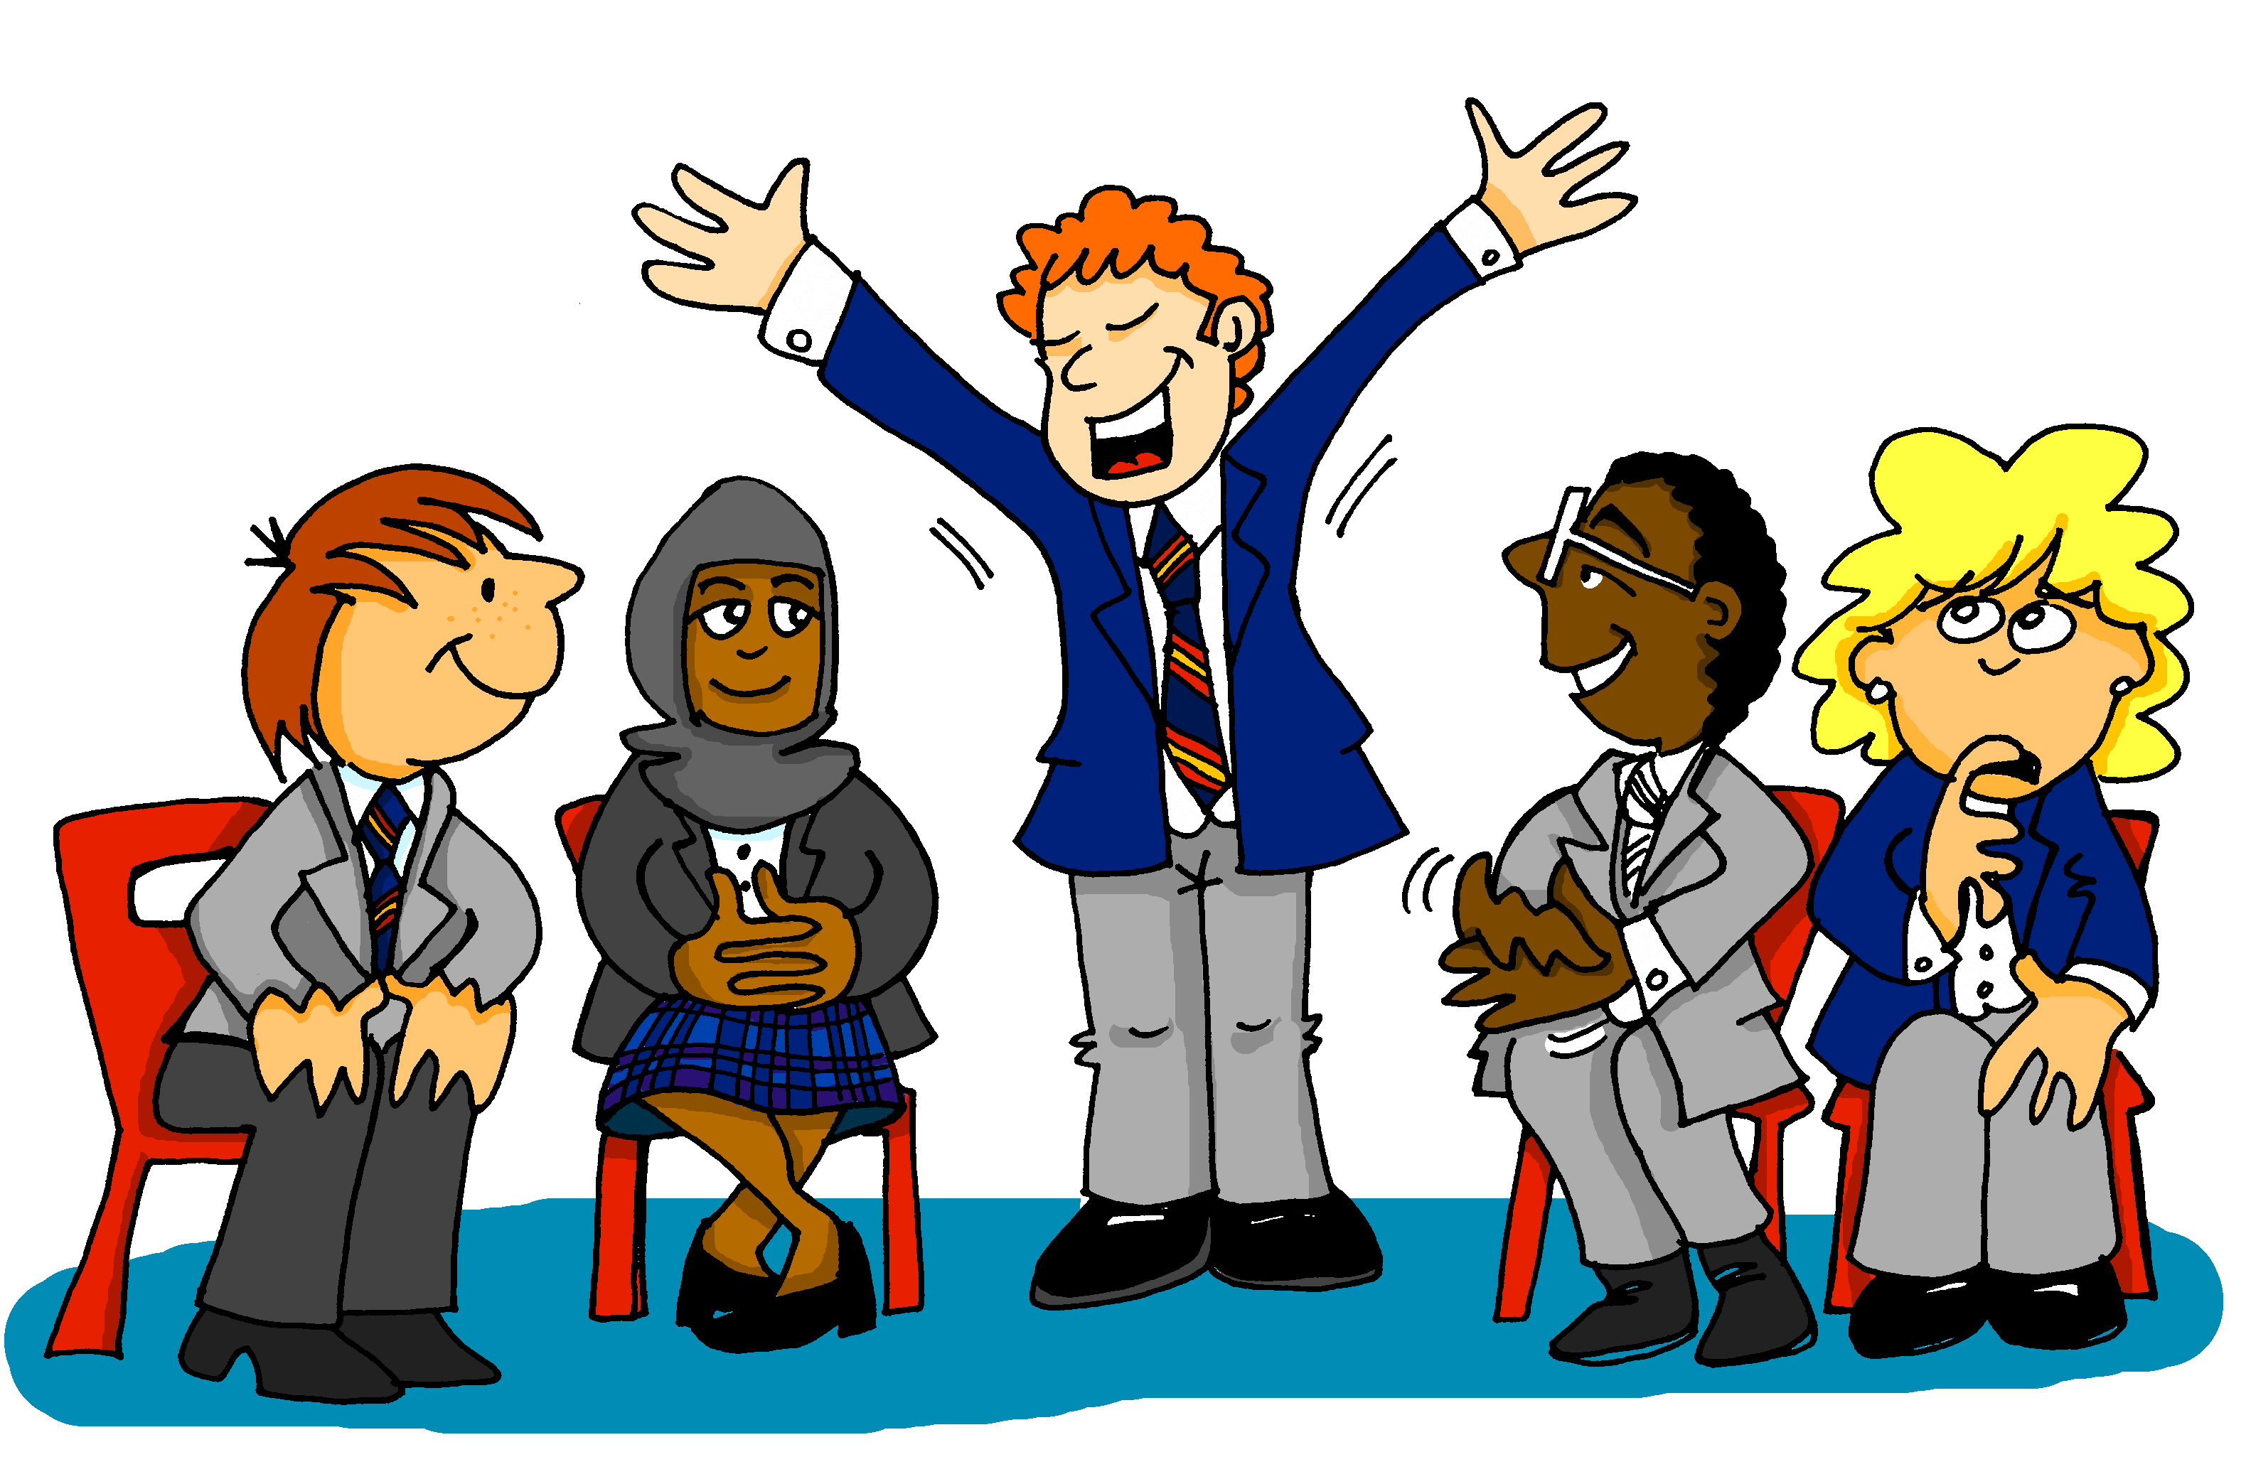
SPELLING BEE
Listen and write!
Notes:
Pupils may want to put themselves forward for the Spelling Bee where they have to spell words aloud within a time limit. Teacher may repeat the word only once. This should encourage the pupils to repeat the word for themselves and retain it in their heads until the spelling becomes clearer – a good strategy for later listening work. The rest of the class members must write down what they think is the correct spelling and mark the speller right or wrong. There is a list of words on the next slide which you can use for this – or you may wish to choose your own.
Time allowing, it would be good to put students into pairs to practise. Student A calls in English, Student B faces away from the board, translates the word into Spanish (saying the article, for nouns, but not spelling the article) and spells the word. Then they swap roles.

Slide 58
Spelling Bee 2
estar | to be | being [location /state]
está | is [location / state]
¿dónde? | where?
en | in, on
estoy | I am
yo | I
¿cómo? | how?
hoy | today
nervioso | nervous
tranquilo | calm
serio | serious
raro | strange
tonto | silly
blanco | white
muy | very
Notes:
The first 15 words from the Spelling Bee, Stage 1. Students have learnt these words already, but this is the first time they will have practised spelling them out loud using the Spanish alphabet.

Slide 59
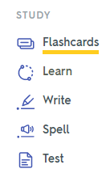
Word
 |  | English meaning
1 | tienes | you have (singular)
2 | tiene | s/he has, it has
3 | tener | to have, having
4 | tengo | i have
5 | ¿qué? | what?
6 | un | a (masculine)
7 | una | a (feminine)
8 | una moneda | a coin
9 | una cama | a bed
10 | una casa | a house
11 | una cámara | a camera
12 | una bicicleta | a bicycle
13 | un libro | a book
Notes:
Introduce Quizlet to the class. Go to www.quizlet.com and demonstrate the different stages.
If you click the Q icon, it takes you directly to this Term 1.1 Week 4 vocabulary list.
Departments may have their own Quizlet accounts and may wish to import the NCELP vocabulary sets into their school account.
Explain the key principles of vocabulary learning:
1] Choice of vocabulary – high-frequency words and their usefulness (teachers can share the frequency of the words on the NCELP SOW, for students’ interest).
2] Levels of word knowledge (see NCELP template, here: 1. I have seen this word before.
2. I know what the word means.
3. I can read the word aloud.
4. I can spell the word correctly.
5. I can use the word in a sentence.
It takes time to build up to this level of word knowledge. 3] Practice of different kinds – listen and translate L2 → L1, read and translate L2 → L1, listen and say L1→ L2, read and write L1 → L2 (all sorts of different combinations of modes/modalities strengthen retention and recall of new words
4] Memories fade and regular retrieval and re-visiting are needed to maintain word knowledge (mention recycling but also structured re-visiting after 3 weeks and after 9 weeks). 5] Usefulness of priming (learning vocabulary ahead of the lesson – helps students to be in a position to use language more readily in the lesson itself) – from now on, vocabulary learning will be set as pre-learning for the next lesson.

Slide 60
Gaming Grammar
Gaming Grammar
Gaming Grammar mini-game Indefinite articles: gender in the ‘Article agreement’ menu practices aspects of this week’s lesson further.
Notes:
This slide links to Gaming Grammar login screen. The appropriate mission can then be selected from the menu page.
Students will progress through the game at their own rate; teachers should use the teacher interface to check progress. This will help to inform future lesson planning.

Slide 61
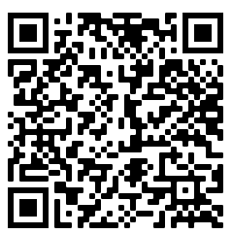
Deberes
Vocabulary Learning Homework (Term 1.1, Week 5)
Audio file
Audio file QR code:
Student worksheet
Quizlet link
In addition, revisit: Term 1.1 Week 2

