Slide 1
Travel activities in France
Infinitive used as a noun
SSC [qu]
Y9 French
Term 1.2 - Week 1 - Lesson 15
Catherine Salkeld / Natalie Finlayson / Amber Dudley
Artwork by: Chloé Motard
Date updated: 08/08/2022
Notes:
Artwork by Chloé Motard. All additional pictures selected are available under a Creative Commons license, no attribution required.
Native speaker feedback provided by Sarah Brichory.
With thanks to Rachel Hawkes and Emma Marsden for their input on the lesson material.
Learning outcomes (lesson 1):
Consolidation of SSC [qu]
Introduction of infinitive used as nouns
Word frequency (1 is the most frequent word in French):
9.1.2.1(introduce) empêcher [306], pratiquer [1268], risquer [322], région [241], historique [902], respecter [673], utile [1003], fantastique [4107], château [3510], essentiel [675]
9.1.1.4 (revisit) devons, devez, doivent [39], il faut [13/falloir 68], peuvent [20], savent^{1,2} [67], veulent [57], entreprise [298], attitude [834], collègue [1099], directeur2 [640], stage [4007], actif, active [1289], négatif, négative [1502], positif, positive [949], sportif, sportive [2670]
8.3.1.6 (revisit) attendre [155], descendre [1705], (en) bas [7/468], histoire² [263], règle² [488], piste [1902], roman [1262], texte [631] dépendre (de) [313], entendre [159], répondre (à) [200]
Source: Lonsdale, D., & Le Bras, Y. (2009). A Frequency Dictionary of French: Core vocabulary for learners London: Routledge.
The frequency rankings for words that occur in this PowerPoint which have been previously introduced in NCELP resources are given in the NCELP SOW and in the resources that first introduced and formally re-visited those words.
For any other words that occur incidentally in this PowerPoint, frequency rankings will be provided in the notes field wherever possible.
The additional English meanings of the following words have been added to Quizlet since the creation of this resource: région – region, area

Slide 2
qu
?
question
Notes:
Timing: 1 minute
Aim: To introduce/consolidate SSC [qu]
Procedure: 1. Present the letter(s) and say the [qu] sound first, on its own. Students repeat it with you. 2. Bring up the word ”question” on its own, say it, students repeat it, so that they have the opportunity to focus all of their attention on the connection between the written word and its sound.
3. A possible gesture for this would be to raise one’s eyebrows and look intently, as if querying something. 4. Roll back the animations and work through 1-3 again, but this time, dropping your voice completely to listen carefully to the students saying the [qu] sound, pronouncing ”question” and, if using, doing the gesture.
Word frequency (1 is the most frequent word in French):
question [144].
Source: Londsale, D., & Le Bras, Y. (2009). A Frequency Dictionary of French: Core vocabulary for learners London: Routledge.

Slide 3
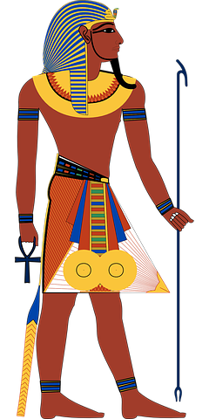
Mots qui finissent par -que
écouter / écrire
This week you are learning two French words ending with -que.
fantastique (fantastic)
historique (historic)
Notice that they are spelled similarly in English and French and have the same meaning. They are cognates.
The only spelling difference is the word ending.
In French it’s -que, in English it’s -c. How are these endings pronounced?
Notes:
Timing: 2 minutes
Aim: To introduce the English ‘-c’ ➜ French ‘-que’ word pattern and connect this with SSC [qu].
Procedure:
1. Click to reveal the explanation.
2. Remind students that SSC [i] sounds different in English and French. Practise pronouncing the endings French ‘-ique’ and English ‘-ic’, focusing on the [i] pronunciation (pronounced differently in French and English) and the [qu] spelling and pronunciation (pronounced the same way in French and English).
3. Click on the French words to hear them said by a native speaker. Students repeat, and then say the English.
Transcript:
fantastique
historique

Slide 4
Mots qui finissent par -que
French words ending in -que often end in -c, -ck or -k in English.
écouter / écrire
C’est quoi en anglais ?
Use your knowledge
of French words ending in -que to predict the English.
 | French | English
 | catholique | catholic
 | risque | risk
 | marque | mark
 | rythmique | rhythmic
 | critique | critic
 | scientifique | scientific
 | attaque | attack
 | plastique | plastic
1
2
3
4
5
6
7
8
Notes:
Timing: 5 minutes
Aim: Oral production of words containing SSC [qu]; application of English-French word patterns.
Procedure:
1. Students translate the French words into English, applying the knowledge of French-English word patterns covered in the last slide.
2. Click on the audio button to hear the words pronounced by a native speaker.
3. Students repeat and then say the English translation aloud, focusing on the pronunciation of –(i)c/-(i)que.
4. Click to bring up the bubble with information about the range of English spelling variations equivalent to the French -que.
Transcript:
catholique
risque
marque
rythmique
critique
scientifique
attaque
plastique
Word frequency of cognates used (1 is the most frequent word in French):
catholique [1578], risque [640], marque [1344], rythmique [>5000], ], critique [909], scientifique [950], attaque [1655], plastique [2191]
Source: Londsale, D., & Le Bras, Y. (2009). A Frequency Dictionary of French: Core vocabulary for learners London: Routledge.

Slide 5
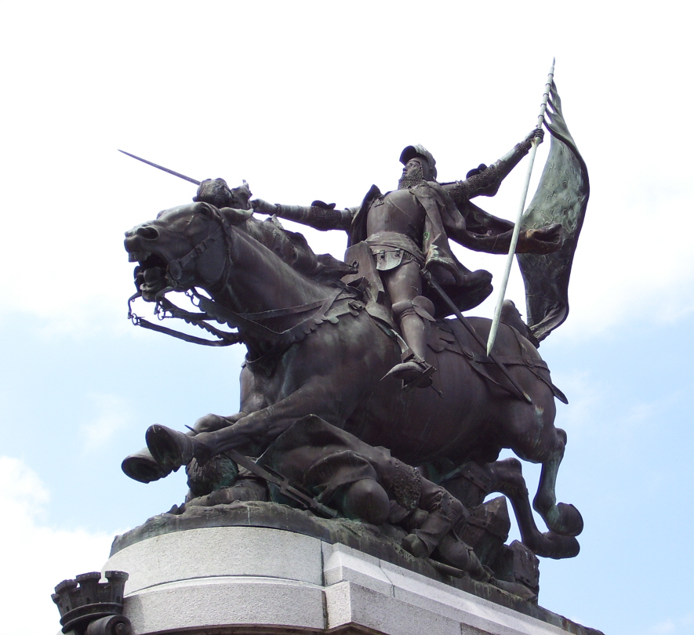
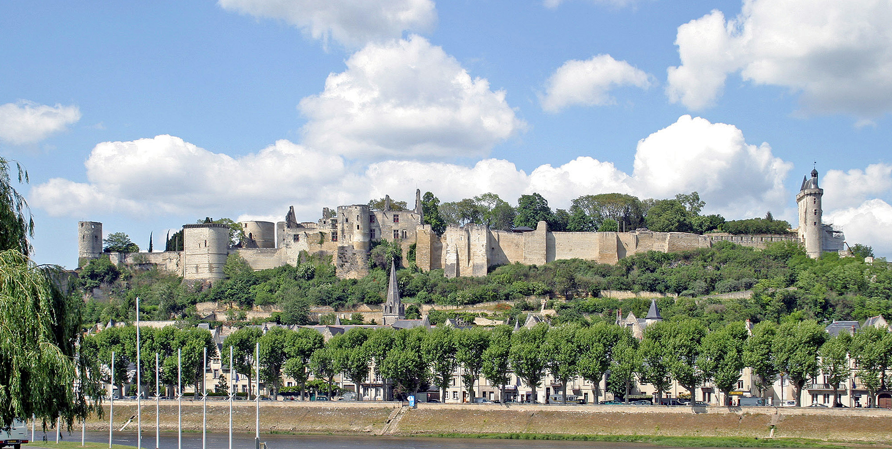
Jeanne d’Arc à Chinon
Remplis les blancs avec les nouveaux mots.
écouter / lire
La région du Val de Loire, c’est fantastique pour pratiquer le français ! Visiter le château de Chinon, c’est essentiel ! C’est très historique. En 1429, Jeanne d’Arc voyage à Chinon pour parler avec le prochain roi*. Il doit respecter Jeanne parce qu’elle peut être utile dans la guerre contre l’Angleterre. Elle veut empêcher la victoire des Anglais. Elle sait aider la France sans risquer sa vie.
 | useful | utile
 | historic | historique
 | to prevent, preventing | empêcher
 | essential | essentiel
 | region | la région
 | castle, palace | le château
 | to risk, risking | risquer
 | to practise, practising | pratiquer
 | fantastic | fantastique
 | to respect, respecting | respecter
1
1
2
3
2
4
3
5
6
4
5
7
6
8
9
7
8
10
9
10
*le roi = king
Notes:
Timing: 8 minutes
Aim: Aural comprehension of this week’s new vocabulary; using the new vocabulary items in context; reading comprehension.
Note: Students in Y8 pre-learn vocabulary on Quizlet, additionally completing several tasks. This activity provides an additional step; listening and understanding the new vocabulary and using it in context.
Procedure: 1. Click to hear the word in French. 2. Students write down the meaning in English. 3. Click to check answers.
4. Click to play the audio again.
5. Students transcribe the French.
6. Click to check answers.
7. Students use the words to fill in the gaps in the text.
8. Click to check answers. Transcript: utile
historique
empêcher
essentiel
la region
le château
risquer
pratiquer
fantastique
respecter
Word frequency of cognates (1 is the most frequent word in French): victoire [1373]
Source: Londsale, D., & Le Bras, Y. (2009). A Frequency Dictionary of French: Core vocabulary for learners London: Routledge.
00 4009 Ruine der Burg Chinon by W. Bulach is licensed under CC BY-SA 4.0

Slide 6
L’infinitif
grammaire
The infinitive is the long form of the verb. It always ends in -er, -re, or -ir.
You know these types of infinitives: -er, like regarder; -re, like prendre, lire, entendre; -ir, like venir, sortir, chosir ; irregular (aller, avoir, boire, être, faire).
To find out the meaning of a verb in the short form, we need to look up the infinitive in a dictionary.
To form it, remove the short form ending and add the infinitive ending.
Amir regarde→
regard- →
regarder →
to watch / watching
Amir écrit→
écri- →
écrire →
to write / writing
Amir choisit→
chois- →
choisir →
to choose / choosing
Notes:
Timing: 3 minutes
Aim: to recap definition of an infinitive; to recap infinitive forms.
Procedure:
1. Click to reveal explanations.
2. Ask students to list any other examples of infinitives they can think of that fit each verb group.

Slide 7
C'est un infinitif ?
écouter /parler
Est-ce que tu entends la forme ‘il/elle’ ou un infinitif ? Dis l’autre forme.
Q | il/elle | infinitive | R | Q | il/elle | infinitive | R
 |  |  | dit |  |  |  | marche
 |  |  | manger |  |  |  | décrire
 |  |  | choisir |  |  |  | sort
 |  |  | apprend |  |  |  | dormir
 |  |  | réussit |  |  |  | entendre
 |  |  | comprendre |  |  |  | revenir
 |  |  | répond |  |  |  | être
 |  |  | devient |  |  |  | va
1
dire
9
marche
2
mange
10
décrit
3
choisit
11
sortir
4
apprendre
12
dort
5
réussir
13
entend
6
comprend
14
revient
7
répondre
15
est
8
devenir
16
aller
Notes:
Timing: 7 minutes
Aim: Recognition and oral production of short and long forms of known verbs.
Procedure:
1. Click on a number to hear a verb.
2. Students tick whether they hear the short (il/elle) form or the long form.
3. Click to reveal the answers.
4. Students say the other form of each verb.
5. Click to reveal the answers.
Transcript:
1) dit
2) manger
3) choisir
4) apprend
5) réussit
6) comprendre
7) répond
8) devient
9) marche
10) décrire
11) sort
12) dormir
13) entendre
14) revenir
15) être
16) Va
Word frequency of cognates (1 is the most frequent word in French): forme [369], infinitif [>5000]
Source: Londsale, D., & Le Bras, Y. (2009). A Frequency Dictionary of French: Core vocabulary for learners London: Routledge.

Slide 8
C'est un infinitif ?
lire / écrire
C’est la forme ‘je’ ou l’infinitif ? Écris l’autre forme.
Q | (je) | infinitive | other form
1. compte (count) |  |  | compter
2. prescrire (prescribe) |  |  | prescris
3. polir (polish) |  |  | polis
4. détruire (destroy) |  |  | détruis
5. éviter (avoid) |  |  | évite
6. surprends (surprise) |  |  | surprendre
7. préviens (warn) |  |  | prévenir
8. mords (bite) |  |  | mordre
(like écrire)
(like choisir)
(like lire)
(like prendre)
(like venir)
(like entendre)
Notes:
Timing: 5 minutes
Aim: Written recognition and written production of short forms and infinitives of unknown verbs
Procedure:
1. Students tick whether each verb is in the short (je) form or the long form.
2. Click to reveal answers.
3. Students write the other form of each verb. The anchor verbs are provided to help with –ir and –re verbs.
4. Click to reveal the answers.
Word frequency of unknown words (1 is the most frequent word in French): compter [140], prescrire [3666], polir [>5000], détruire [928], éviter [396], surprendre [1053], prévenir [1207], mordre [4292]
Source: Londsale, D., & Le Bras, Y. (2009). A Frequency Dictionary of French: Core vocabulary for learners London: Routledge.

Slide 9
L’usage de l’infinitif
grammaire
When the sentence starts with an infinitive, the activity is often followed by a comma + ‘c’est’. This is different from English.
An infinitive (long form) can be used as the subject of a sentence to express an activity. It works like a noun and is often the first word in the sentence:
Conduire dans la neige, c’est difficile.
We normally translate this using the English verb in the –ing form:
Driving in the snow is difficult.
A verb in short form at the start of a sentence normally indicates a question about what someone or something is doing:
Conduit-il dans la neige ? Is he driving in the snow ?
Where else have you seen a verb at the start of a sentence?
Remember!
In inversion questions, the verb and subject swap places: Prend-il le train ?
If the verbs ends with a vowel, we add “t” before “il/elle”: Prépare-t-il le déjeuner ?
Notes:
Timing: 3 minutes
Aim: To introduce the use of the infinitive as a noun; to present two different circumstances in which verbs appear at the beginning of sentences.
Procedure:
1. Click to reveal explanations and examples.
2. Ensure understanding of the use of the infinitive to express the idea of an activity (rather than an action).
3. Explain that the c’est after the comma refers back to the activity described by the noun phrase starting with the infinitive.

Slide 10
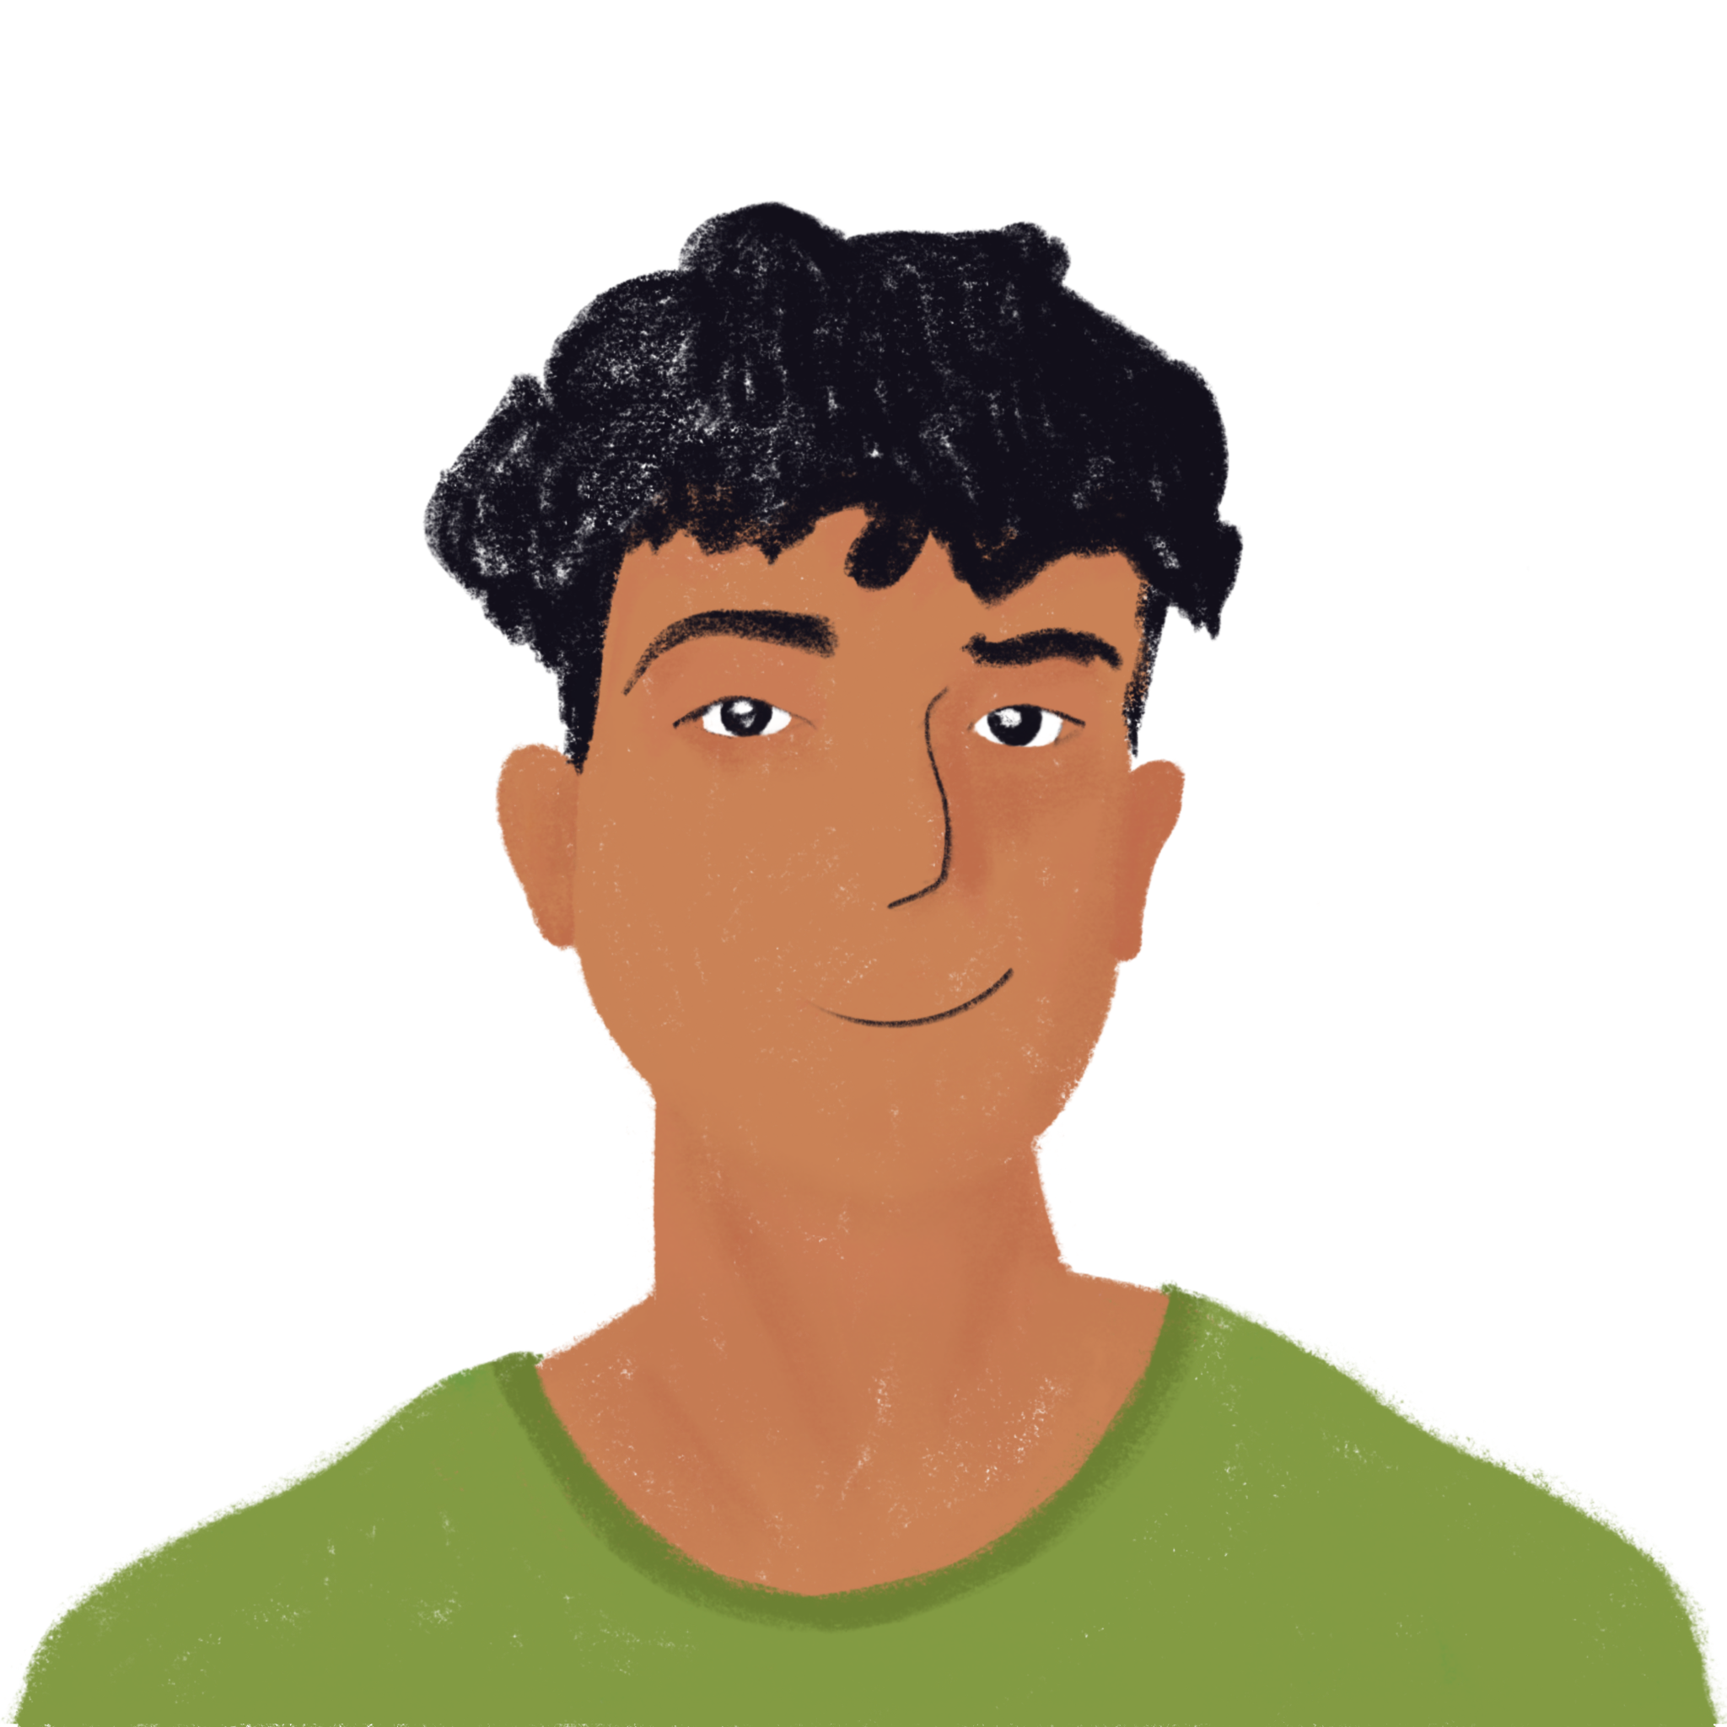
Amir pense aux vacances
le moniteur de ski = ski instructor
lire
Is Amir asking about the ski instructor’s actions or about an activity ? Write -il, -t-il, ou [-] and ‘action’ or ‘activity’.
Salut Océane ! Je veux faire du ski avec ta famille. Tu as dit beaucoup sur le moniteur de ski* dans tes messages sur le voyage scolaire. Conduit-il l’autobus ? Conduire dans la neige, c’est difficile ? Parler français sur les pistes, c’est possible ? Parle-t-il français ? Dit-il beaucoup de choses en français ? Avoir des conversations ensemble, c’est amusant ? Organise-t-il des activités ? Aller en ville, c’est facile ? Sortir sans tes parents, c’est possible ? Regarder un film au cinéma, c’est cher ? Je vais attendre ta réponse… -Amir
action
activity
activity
1
2
action
action
3
activity
4
5
6
action
activity
activity
7
activity
8
9
10
Notes:
Timing: 10 minutes. This is slide 1/2.
Aim: Written recognition of contrast between long and short forms of verbs at the beginning of sentences and connecting these with meaning (activities vs actions).
Procedure:
1. Explain to students that they are going to use the form of the verb at the start of the sentence to decide whether Amir is asking a question about the ski instructor (short form) or an activity (long form). Students may need a reminder of when to use -t-il.
2. Students read the text and choose il, -t-il, or [-].
3. Students classify each verb as ‘action’ (short form) or ‘activity’ (long form).
4. Click to check answers.
5. Students translate the ten questions into English. (Click back to remove action/activity bubbles so whole text is visible.)
6. Check with suggested answers on next slide.

Slide 11
Amir pense aux vacances
lire
Does he drive the bus?
Is driving in the snow difficult?
Is it possible to speak French on the ski slopes?
Does he speak French?
Does he say a lot of things in French?
Is having conversations together fun?
Does he organise activities?
Is it easy to go into town?
Is it possible to go out without your parents?
Is watching a film at the cinema expensive?
Notes:
This is slide 2/2.
SUGGESTED TRANSLATIONS

Slide 12
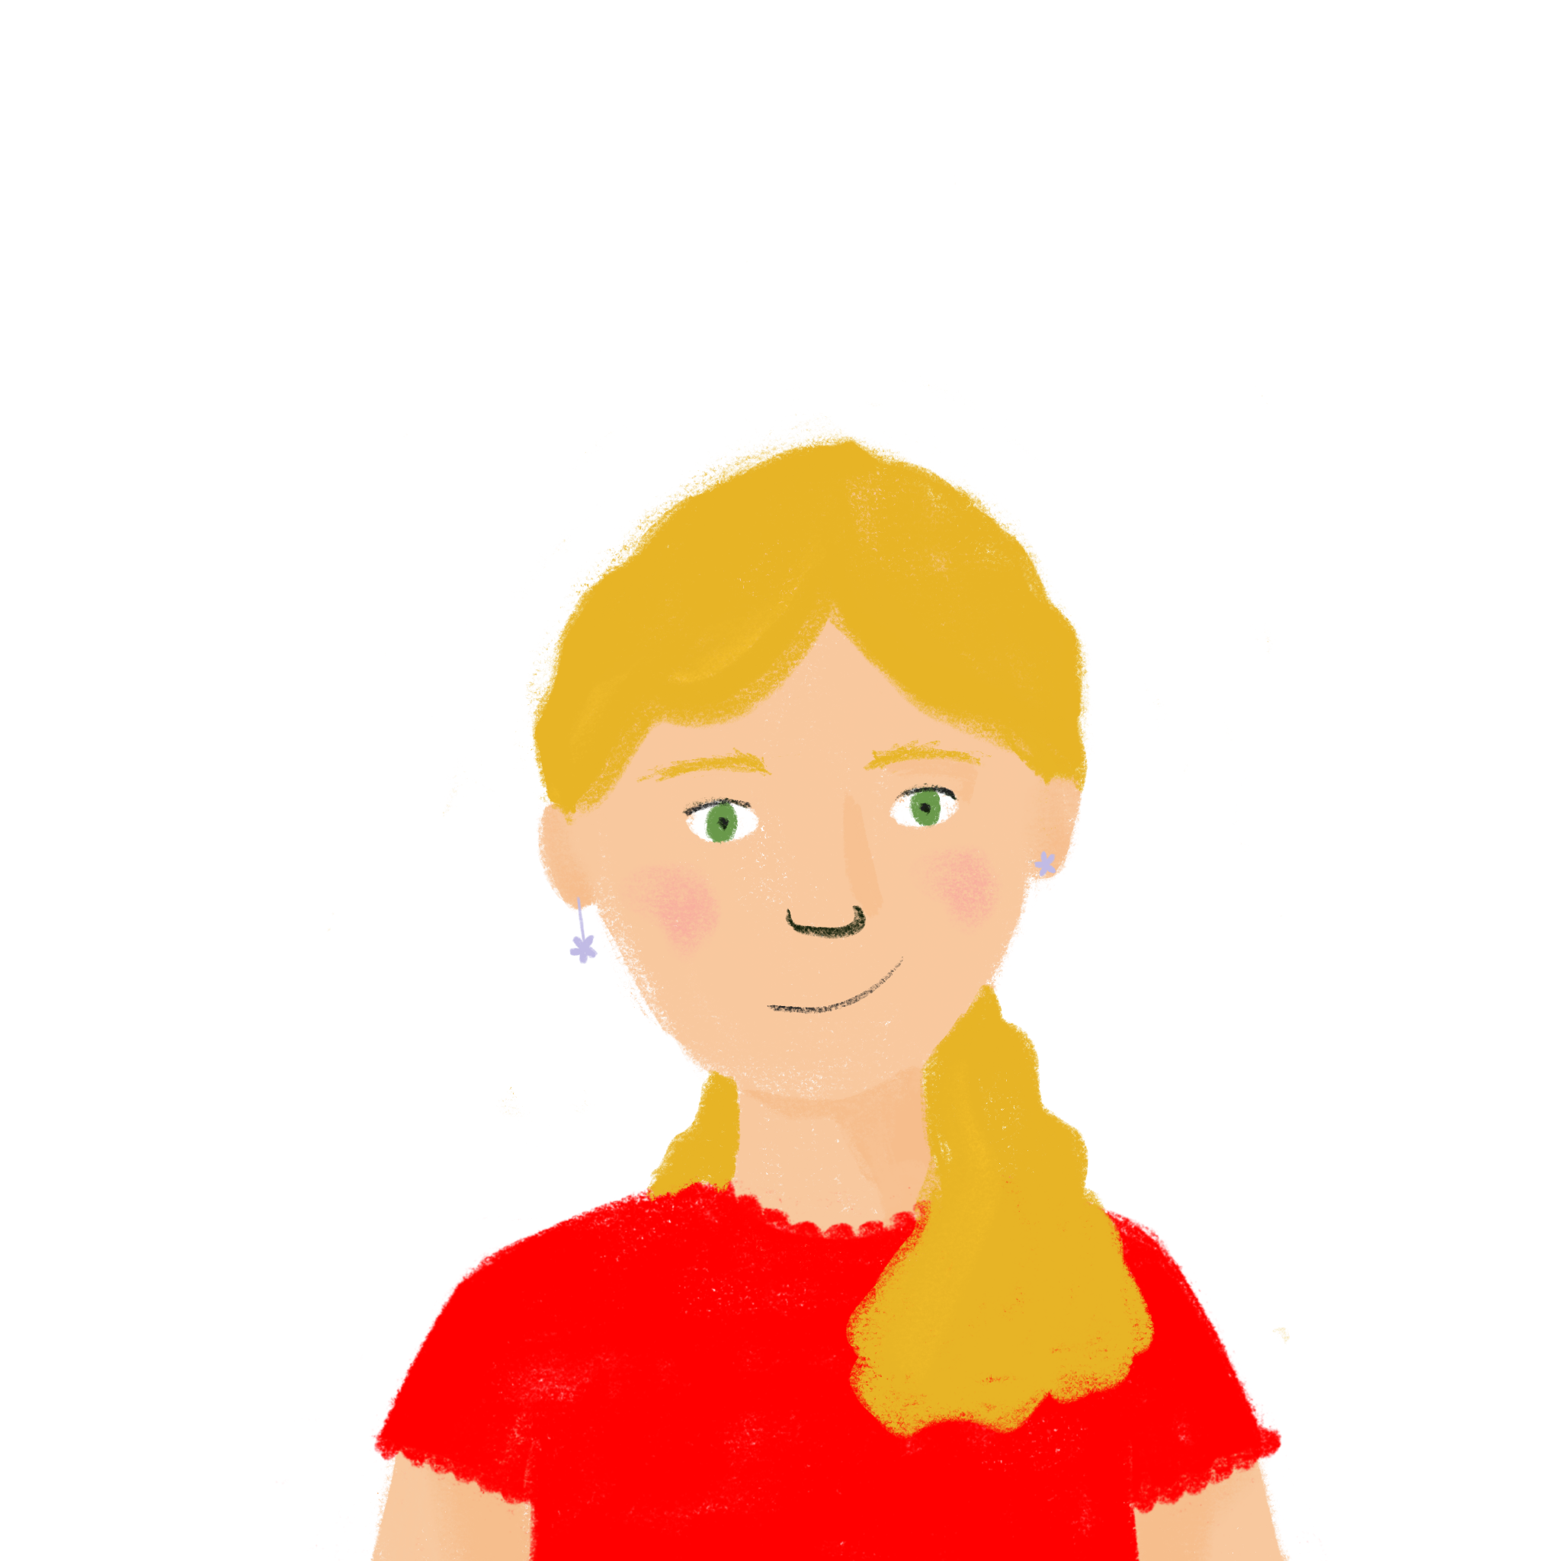
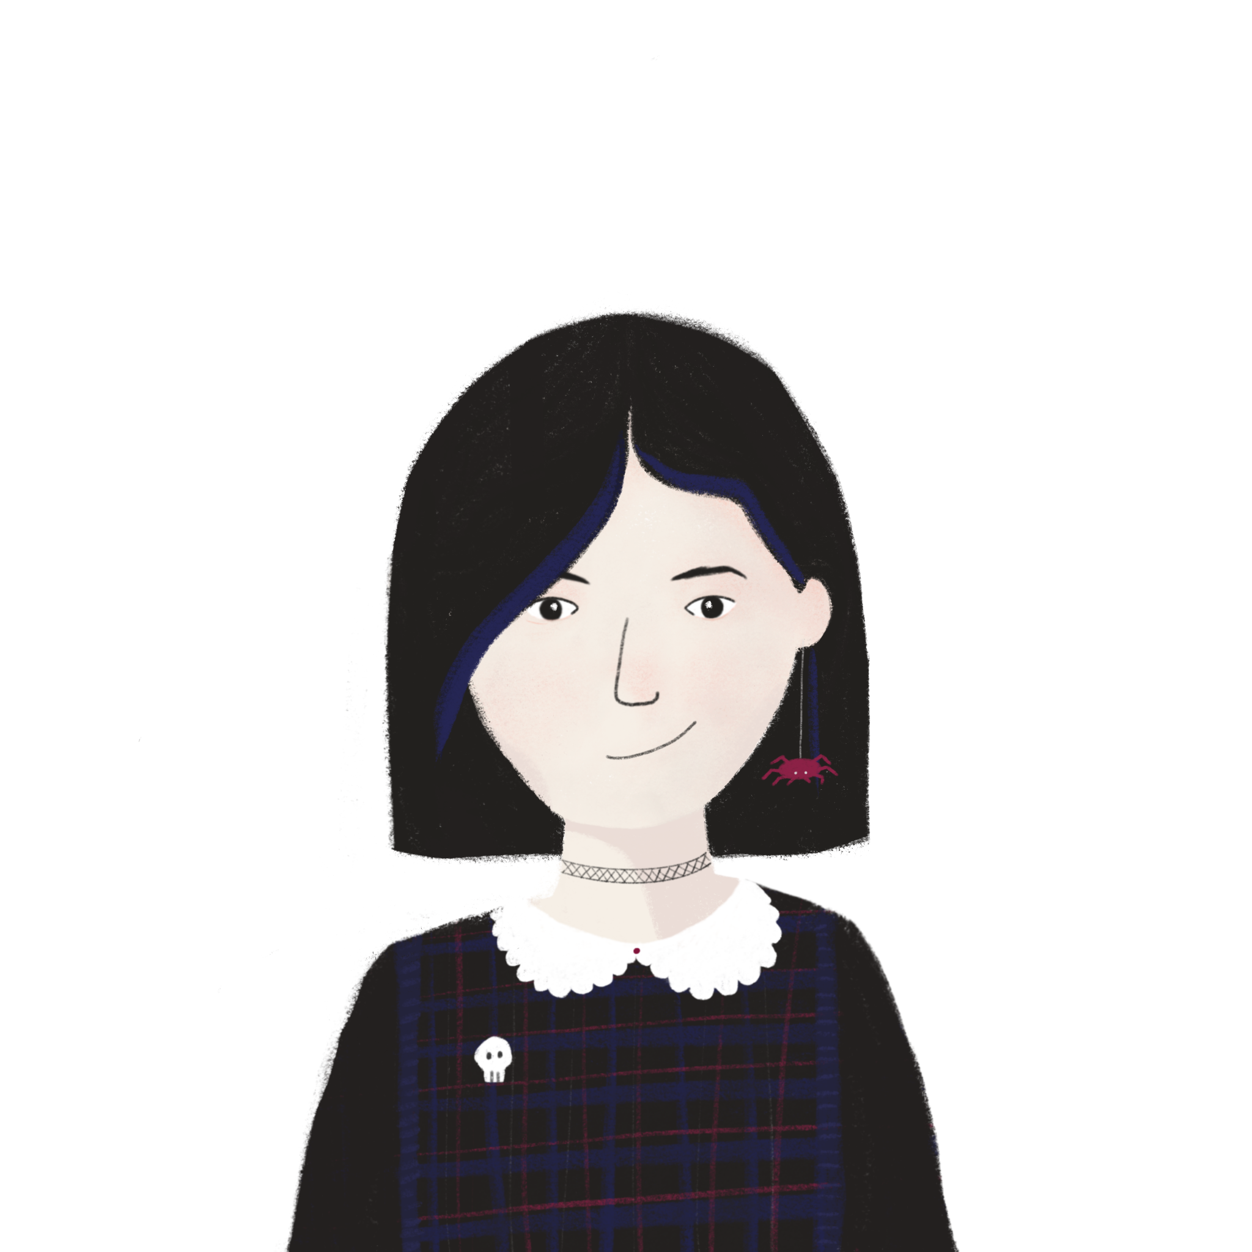
Finis la phrase !
parler
Boire…
…-t-il de l’eau ? / …de l’eau est important.
…de l’eau est important.
Notes:
Timing: 6 minutes. This is slide 1/4.
Aim: Oral recognition and production of short and long forms of known verbs.
Procedure:
1. Print the rolecards from slide 17.
2. Model the task with the example on slide 16.
3. Display slide 18.
4. Partner A reads the verb from their rolecard.
5. Partner B looks at the board and chooses the correct ending for the sentence.
6. Repeat for each sentence.
7. Display slide 19 and partners swop roles.
Transcript:
Word frequency (1 is the most frequent word in French):
Source: Londsale, D., & Le Bras, Y. (2009). A Frequency Dictionary of French: Core vocabulary for learners London: Routledge.

Slide 13
Finis la phrase !
parler
Partenaire A Say these verbs to start sentences. Your partner will choose the end of the sentence from the board. 1) Parler… 2) Achète… 3) Descendre … 4) Lit … 5) Écrit … 6) Répondre … | Partenaire B Say these verbs to start sentences. Your partner will choose the end of the sentence from the board. 1) Visiter … 2) Dépend … 3) Entendre … 4) A … 5) Connaître … 6) Travaille …
Partenaire A Say these verbs to start sentences. Your partner will choose the end of the sentence from the board. 1) Parler… 2) Achète… 3) Descendre … 4) Lit … 5) Écrit … 6) Répondre … | Partenaire B Say these verbs to start sentences. Your partner will choose the end of the sentence from the board. 1) Visiter … 2) Dépend … 3) Entendre … 4) A … 5) Connaître … 6) Travaille …
Partenaire A Say these verbs to start sentences. Your partner will choose the end of the sentence from the board. 1) Parler… 2) Achète … 3) Descendre … 4) Lit … 5) Écrit … 6) Répondre … | Partenaire B Say these verbs to start sentences. Your partner will choose the end of the sentence from the board. 1) Visiter … 2) Dépend … 3) Entendre … 4) A … 5) Connaître … 6) Travaille …
Notes:
ROLECARDS FOR PRINTING

Slide 14
Finis la phrase ! (B)
parler
Partenaire B
Listen to the verb your partner says and choose the correct ending for each sentence.
1 | …-t-il allemand ? | …allemand, c’est utile.
2 | …-t-il le produit ? | …le produit, c’est cher ?
3 | -t-il les pistes rouges ? | …les pistes rouges, c’est facile ?
4 | -il des romans en anglais ? | …des romans en anglais, c’est difficile ?
5 | -il des histoires sur le ski ? | …des histoires sur le ski, c’est amusant.
6 | -il aux questions sur le stage? | …aux questions sur le stage, c’est essentiel.

Slide 15
Finis la phrase ! (A)
parler
Partenaire A
Listen to the verb your partner says and choose the correct ending for each sentence.
1 | …-t-il les bâtiments historiques ? | …les bâtiments historiques, c’est amusant.
2 | …-il du directeur de l’entreprise ? | …du directeur de l’entreprise, c’est essentiel.
3 | -t-il les annonces sur les pistes ? | …les annonces sur les pistes, c’est important.
4 | …-t-il une attitude positive ? | …une attitude positive, c’est important
5 | …-t-il la communauté ? | …la communauté, c’est utile.
6 | -t-il avec des collègues actifs ? | …avec des collègues actifs, c’est amusant.

Slide 16
Travel activities in France
Uses of infinitives
SSC [qu]
Y9 French
Term 1.2 - Week 1 - Lesson 16
Catherine Salkeld / Natalie Finlayson / Amber Dudley
Artwork by: Chloé Motard
Date updated: 08/08/2022
Notes:
Artwork by Chloé Motard. All additional pictures selected are available under a Creative Commons license, no attribution required.
Native speaker feedback provided by Sarah Brichory.
With thanks to Rachel Hawkes and Emma Marsden for their input on the lesson material.
Learning outcomes (lesson 2):
Revision of SSC [qu]
Practice of infinitive used as nouns
Word frequency (1 is the most frequent word in French):
9.1.2.1(introduce) empêcher [306], pratiquer [1268], risquer [322], région [241], historique [902], respecter [673], utile [1003], fantastique [4107], château [3510], essentiel [675]
9.1.1.4 (revisit) devons, devez, doivent [39], il faut [13/falloir 68], peuvent [20], savent^{1,2} [67], veulent [57], entreprise [298], attitude [834], collègue [1099], directeur2 [640], stage [4007], actif, active [1289], négatif, négative [1502], positif, positive [949], sportif, sportive [2670]
8.3.1.6 (revisit) attendre [155], descendre [1705], (en) bas [7/468], histoire² [263], règle² [488], piste [1902], roman [1262], texte [631] dépendre (de) [313], entendre [159], répondre (à) [200]
Source: Lonsdale, D., & Le Bras, Y. (2009). A Frequency Dictionary of French: Core vocabulary for learners London: Routledge.
The frequency rankings for words that occur in this PowerPoint which have been previously introduced in NCELP resources are given in the NCELP SOW and in the resources that first introduced and formally re-visited those words.
For any other words that occur incidentally in this PowerPoint, frequency rankings will be provided in the notes field wherever possible.
The additional English meanings of the following words have been added to Quizlet since the creation of this resource: région – region, area

Slide 17
qu
quatre
musique
?
question
expliquer
unique
[to explain]
manquer
[unique; only]
[to miss/be missing]
Notes:
Timing: 2 minutes
Aim: To introduce/consolidate SSC [qu]
Procedure:
1. Introduce and elicit the pronunciation of the individual SSC [qu] and then the source word again ‘question’ (with gesture, if using). 2. Then present and elicit the pronunciation of the five cluster words.
The cluster words have been chosen for their high-frequency, from a range of word classes, with the SSC (where possible) positioned within a variety of syllables within the words (e.g. initial, 2nd, final etc.). Additionally, we have tried to use words that build cumulatively on previously taught SSCs (see the Phonics Teaching Sequence document) and do not include new SSCs. Where new SSCs are used, they are often consonants which have a similar symbol-sound correspondence in English.
Word frequency (1 is the most frequent word in French): quarte [283]; musique [1139] expliquer [252]; manquer [583]; unique [402]; question [144]. Source: Londsale, D., & Le Bras, Y. (2009). A Frequency Dictionary of French: Core vocabulary for learners London: Routledge.

Slide 18
Mots qui finissent par -que
écouter / écrire
As you know, we can translate the French word ending -que with the English word endings -c, -ck and –k.
We can also translate French word ending -ique with the English ending -ical:
magique (magic OR magical)
historique (historic OR historical)
Note: fantastic (great) and fantastiscal (strange, unreal) have different meanings.
fantastique (fantastic OR fantastical)
The only difference in these cognates is the word ending.
In French it’s -ique, but in English it’s -ical. How are these endings pronounced?
Notes:
Timing: 2 minutes
Aim: To revise and expand knowledge of the French word ending –que and its English equivalent equivalents; to introduce the English ‘-ical’ ➜ French ‘-ique’ word pattern and connect these with SSCs [i] and [qu].
1. Click to reveal the explanation.
2. Remind students that SSC [i] sounds different in English and French. Practise pronouncing the endings French ‘-ique’ and English ‘-ical’, focusing on the [i] pronunciation and the [qu] spelling.
3. Click on the French word to hear it said by a native speaker. Students repeat, and then say the English.
Transcript:
fantastique
historique
magique
Word frequency (1 is the most frequent word in French): magique [3530]
Source: Londsale, D., & Le Bras, Y. (2009). A Frequency Dictionary of French: Core vocabulary for learners London: Routledge.

Slide 19
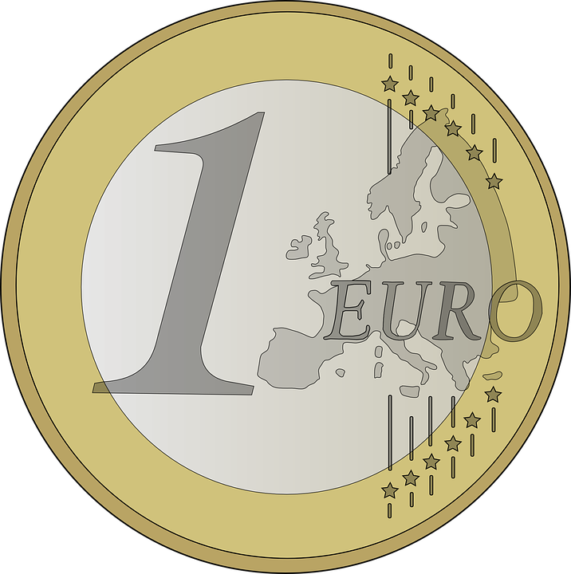
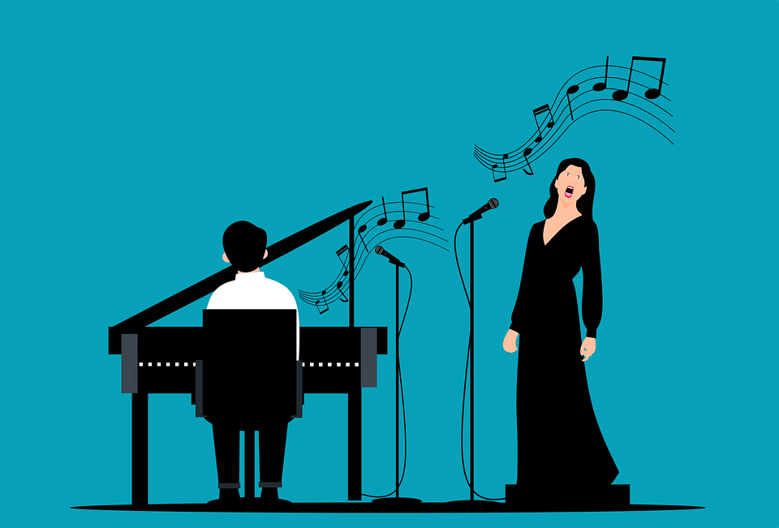
Mots qui finissent par -ique
écrire / parler
C’est quoi en français ?
 | English | French
 | statistical | statistique
 | political | politique
 | physical | physique
 | economical | économique
 | technical | technique
 | logical | logique
 | typical | typique
 | classical music | musique classique
1
2
3
4
5
6
7
8
Notes:
Timing: 5 minutes
Aim: Oral production of words containing SSC [qu]; application of English-French word patterns.
Procedure:
1. Students translate the English words into French, applying the knowledge of French-English word patterns covered on the previous slide.
2. Click to reveal answers.
3. Click on the audio button to hear the words pronounced by a native speaker.
4. Students repeat and then say the English translation aloud, focusing on the pronunciation of –ic(al)/-ique.
Transcript:
statistique
politique
physique
économique
technique
logique
typique
musique classique
Word frequency of cognates used (1 is the most frequent word in French):
statistique [1901], politique [128], physique [1146], économique [261], technique [592], logique [1107], typique [4178], classique [1845],
Source: Londsale, D., & Le Bras, Y. (2009). A Frequency Dictionary of French: Core vocabulary for learners London: Routledge.

Slide 20
Vocabulaire
Vocabulaire
parler
A
B
C
D
E
[to respect, respecting]
[useful]
[to prevent, preventing]
[essential]
[fantastic]
F
G
H
I
J
[to practise, practising]
[to risk, risking]
[castle, palace]
[historic]
[region]
Notes:
Timing: 5 minutes
Aim: To revise in oral modality 10 items of vocabulary, within a limited time frame.
Procedure:
1. Write A-J in books. (or treat as a whole class oral activity)
2. Click / press enter to flash an English word. It will disappear after 3 seconds.
3. Students try to say the French equivalent before the 3 seconds is up.
Answers:
a. respecter
b. utile
c. fantastique
d. empêcher
e. essentiel
f. historique
g. la région
h. pratiquer
i. risquer
j. le château

Slide 21
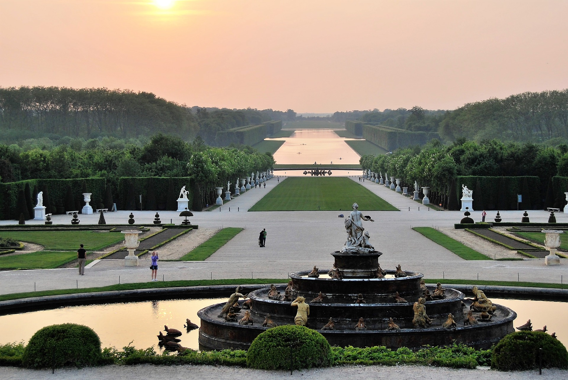
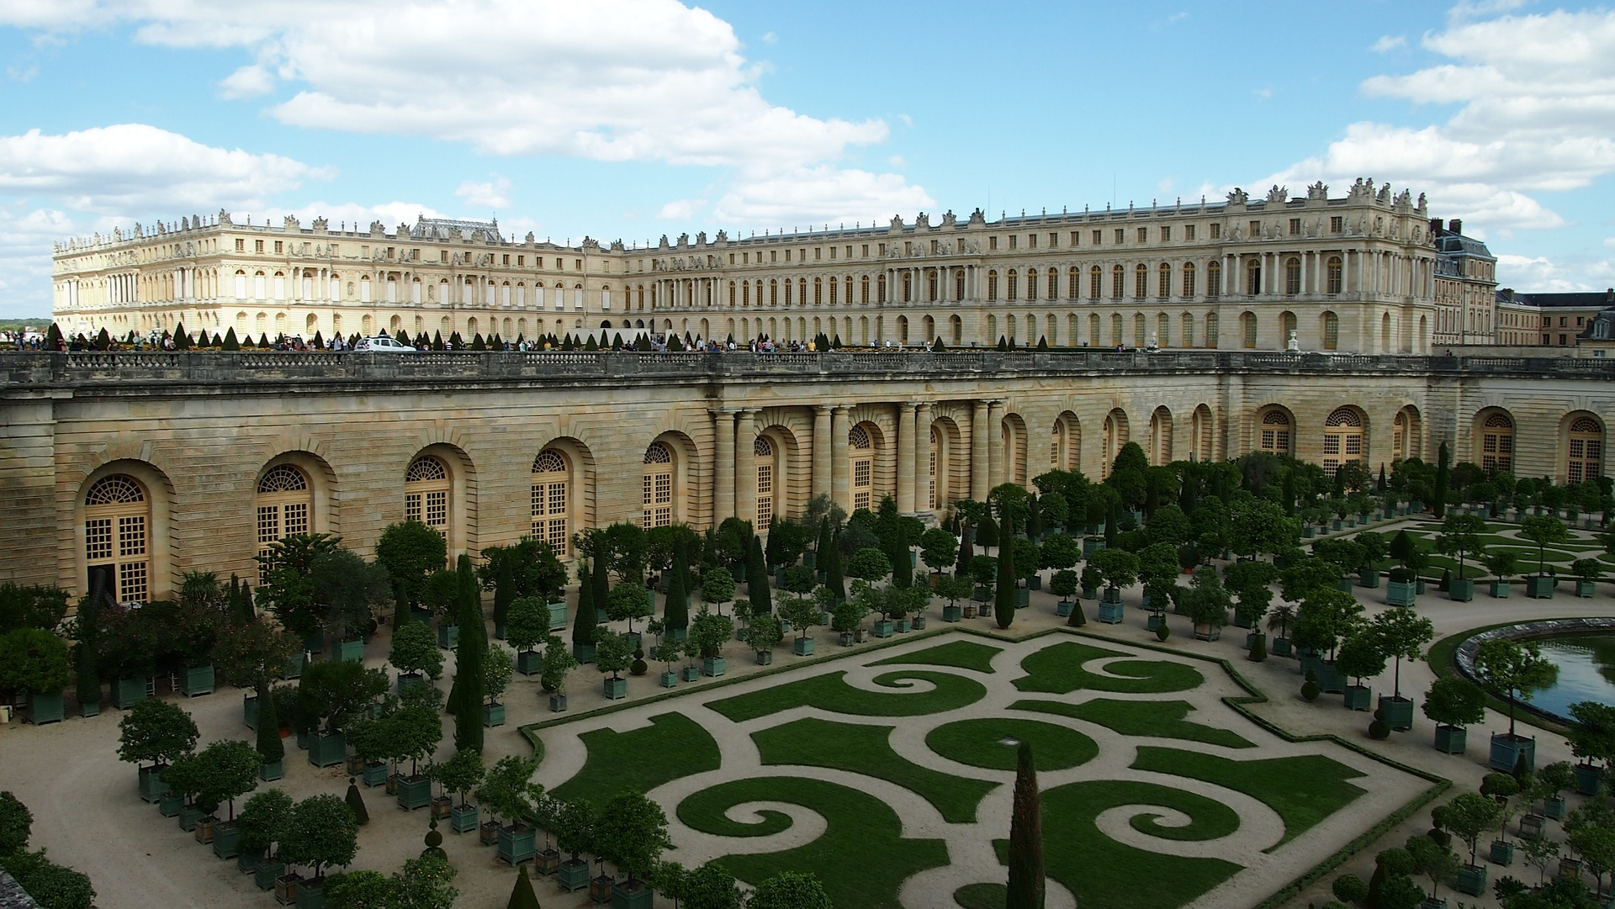
Versailles
*Le RER est un train pour la région de Paris.
écrire
Léa écrit un article pour le journal scolaire d’Amir. Traduis les mots en français.
Versailles est dans la même région que Paris. À Versailles il y a un beau château. Respecter l’architecture et la culture est essentiel. Il ne faut pas risquer des accidents dans ce bâtiment historique. Il y a un grand jardin pour pratiquer la photographie. Le transport ne va pas empêcher le voyage. Le RER* est utile pour visiter ce lieu fantastique.
1) region
2) palace
3) Respecting
When we use an infinitive as a noun, we use masculine forms of adjectives to describe it.
4) essential (m)
5) risk
6) historic
7) practise
8) prevent
9) useful
10) fantastic
Notes:
Timing: 5 minutes
Aim: Written production of new vocabulary.
Procedure:
1. Students write 1-11. and translate each word into French.
2. Click to reveal answers.
3. Oral summary of the full passage.
Word frequency of cognates used (1 is the most frequent word in French): photographie [3279], transport [935], architecture [4182]
Source: Lonsdale, D., & Le Bras, Y. (2009). A Frequency Dictionary of French: Core vocabulary for learners London: Routledge.

Slide 22
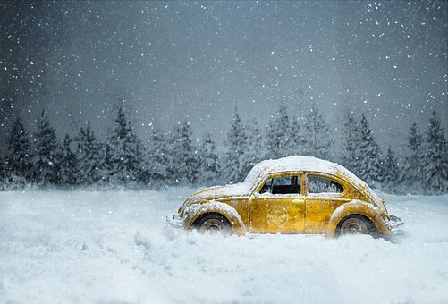
Uses of infinitives: modal verbs
grammaire
You know another use of the infinitive in French - after a modal verb.
The English translation of the infinitive changes depending on whether it is being used as a noun or after a modal:
Conduire dans la neige, c'est difficile.
Driving in the snow is difficult.
Il doit conduire dans la neige.
He must/has to drive in the snow.
At the beginning of a sentence to express a noun (-ing form in English)
After a modal verb
Notes:
Timing: 2 minutes
Aim: Consolidating use of infinitive after a modal verb; drawing attention to different English equivalents of French infinitives.
Procedure:
1. Click to show explanations.
2. Ensure understanding of the idea that one verb form in French (infinitive) has more than one English equivalent.

Slide 23
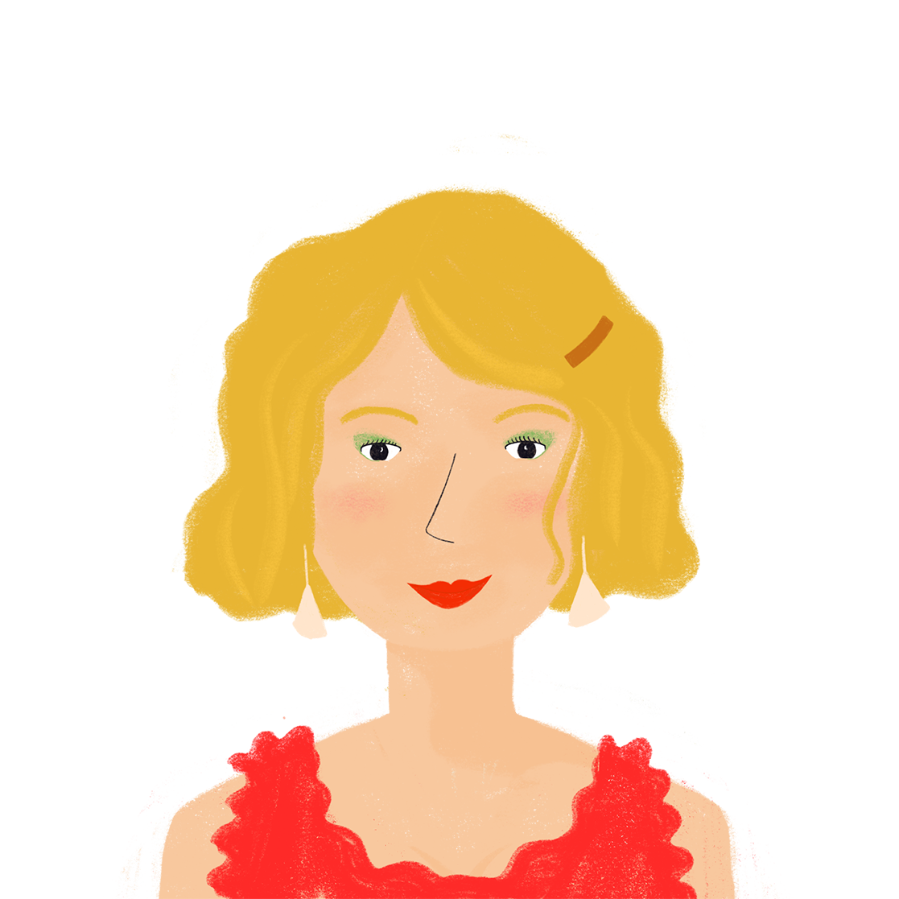
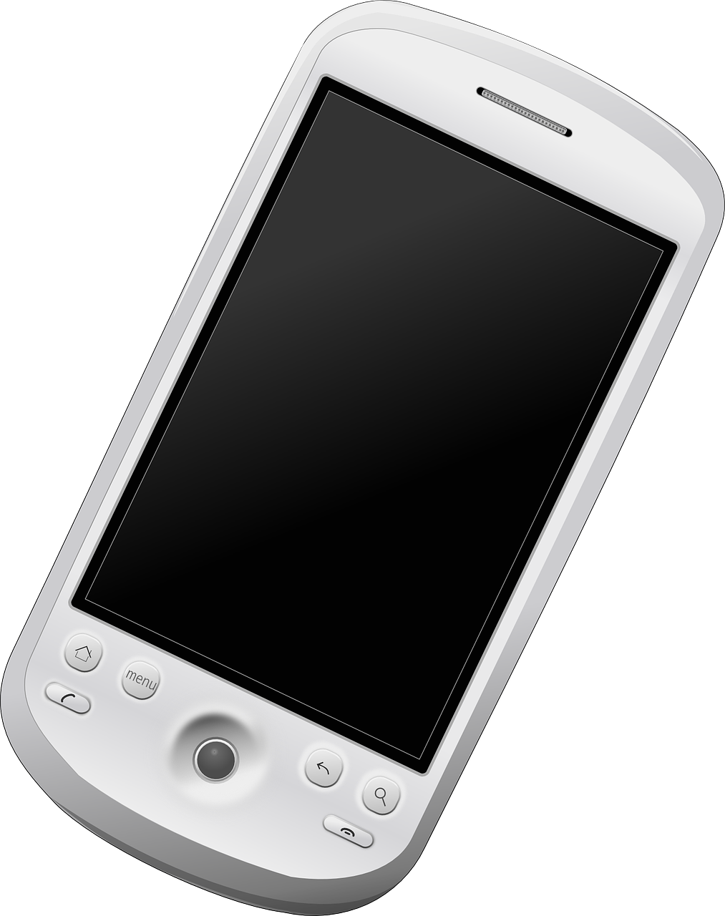
Un message d’Amandine
lire
Amir veut faire un voyage avec la famille d’Océane, mais sa mère a des doutes ! Amandine écrit à Amir. Traduis les verbes en anglais.
Nous devons 1) parler avec les parents d’Océane. Bien 2) organiser le voyage, c’est très important. Pourquoi veulent-ils 3) aller à la Vallée d’Aoste ? Peuvent-ils 4) envoyer un texte sur la région ? 5) Lire beaucoup d’information, c’est utile. Savent-ils 6) faire du ski ? 7) Descendre les pistes rouges, ce n’est pas facile. Ils doivent 8) être prudents. Sont-ils sportifs ? Il ne faut pas 9) risquer d’accidents ! Vous devez 10) respecter les règles et 11) attendez Océane en bas de chaque piste !
We must speak with Océane’s parents. Organising the trip well is very important. Why do they want to go to Vallée d’Aoste? Can they send a text about the region? Reading a lot of information is useful. Do they know how to ski ? Going down the red ski slopes isn’t easy. They have to be careful. Are they sporty? You mustn’t
risk accidents! You must respect the rules and wait for Océane at the bottom of every ski run.
1
2
3
4
5
6
7
8
9
10
11
Notes:
Timing: 8 minutes
Aim: Written recognition of uses of infinitives in French (as a noun and after an infinitive) and translating these into English.
Procedure:
1. Students write 1-10 and translate the infinitives into English, using the -ing form where the infinitive is used as a noun, and the bare infinitive (without ‘to’) where it appears after a modal.
2. Click to reveal answers, eliciting reasons for choosing that form in English.
Word frequency of cognates used (1 is the most frequent word in French): doute [362], ski [4571]
Source: Lonsdale, D., & Le Bras, Y. (2009). A Frequency Dictionary of French: Core vocabulary for learners London: Routledge.

Slide 24
Uses of infinitives: aimer and aller
grammaire
You know two other uses of the infinitive in French - after ‘aimer’ and ‘aller’.
The English translation of the infinitive depends on the context.
Conduire dans la neige, c'est difficile.
Driving in the snow is difficult.
Il va conduire dans la neige.
He is going to drive in the snow.
Il aime conduire dans la neige.
He likes driving/to drive in the snow.
At the beginning of a sentence to express a noun (-ing form in English)
After the present tense of aller to describe a future action (‘to’ form in English)
After ‘aimer’ (-ing form or ‘to’ form in English)
Notes:
Timing: 2 minutes
Aim: Consolidating use of infinitive after aller to talk about future intention and aimer to talk about preferences; drawing attention to different English equivalents of French infinitives.
Procedure:
1. Click to show explanations.
2. Ensure understanding of the idea that one verb form in French is equivalent to a range of verb forms in English.

Slide 25
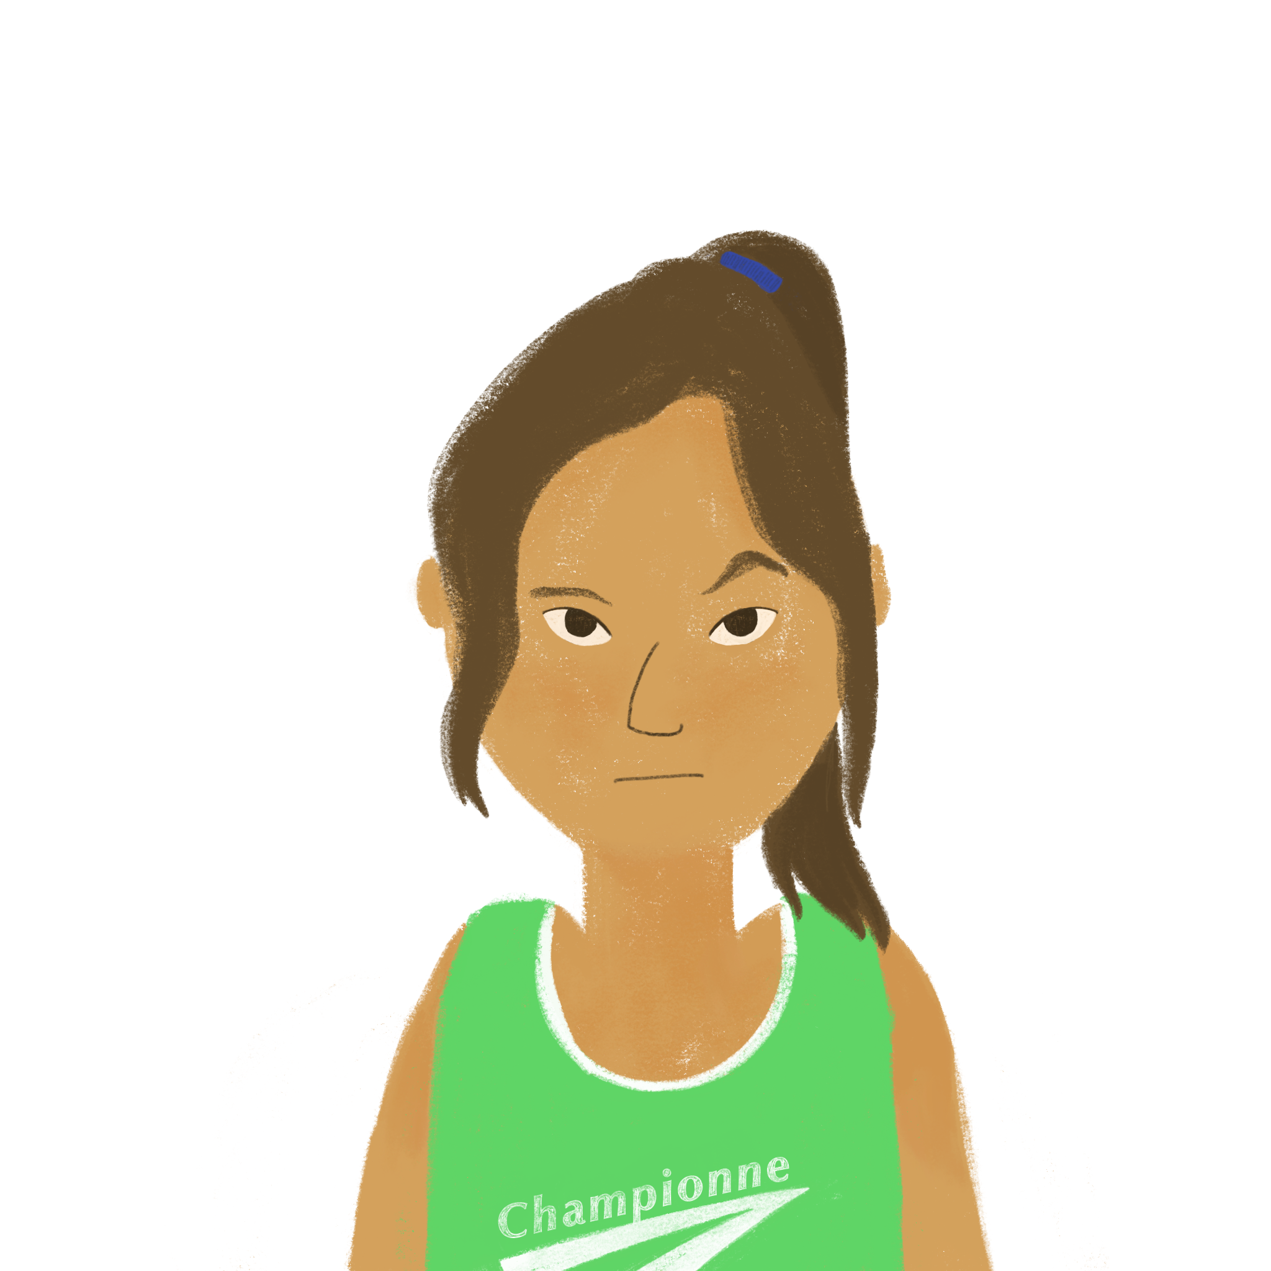
Amir et Océane parle du voyage
écouter
1
speaking to / to speak to
your mum?
Are you going to speak to
2
asking/to ask
a lot of things!
Yes, but she likes
asking/to ask
Notes:
Timing: 8 minutes (slide 1/5)
Aim: Aural recognition of infinitives and connecting these with meaning; contrasting English translations of aller + infinitive (to + infinitive) and aimer + infinitive (to + infinitive or –ing form).
Procedure:
1. Click the buttons to play the audio.
2. Students note whether the infinitive they hear translates as –ing form, to + infinitive or either.
3. Click to reveal answers
Transcript [audio currently missing]:
1. Vas-tu parler à ta mère ?
2. Oui, mais elle aime demander beaucoup de choses !
3. Va-t-elle empêcher le voyage ?
4. Tu ne peux pas pratiquer sur les pistes rouges sans mon aide.
5. Mes parents ne vont pas aller sur des pistes difficiles.
6. Descendre les pistes rouges seul, ce n’est pas possible !
7. Tu vas aider toute la famille !
8. Et je sais traduire de l’italien !
9. Mes parents n’aiment pas apprendre les langues.
10. Parler italien, c’est difficile pour ta famille !

Slide 26
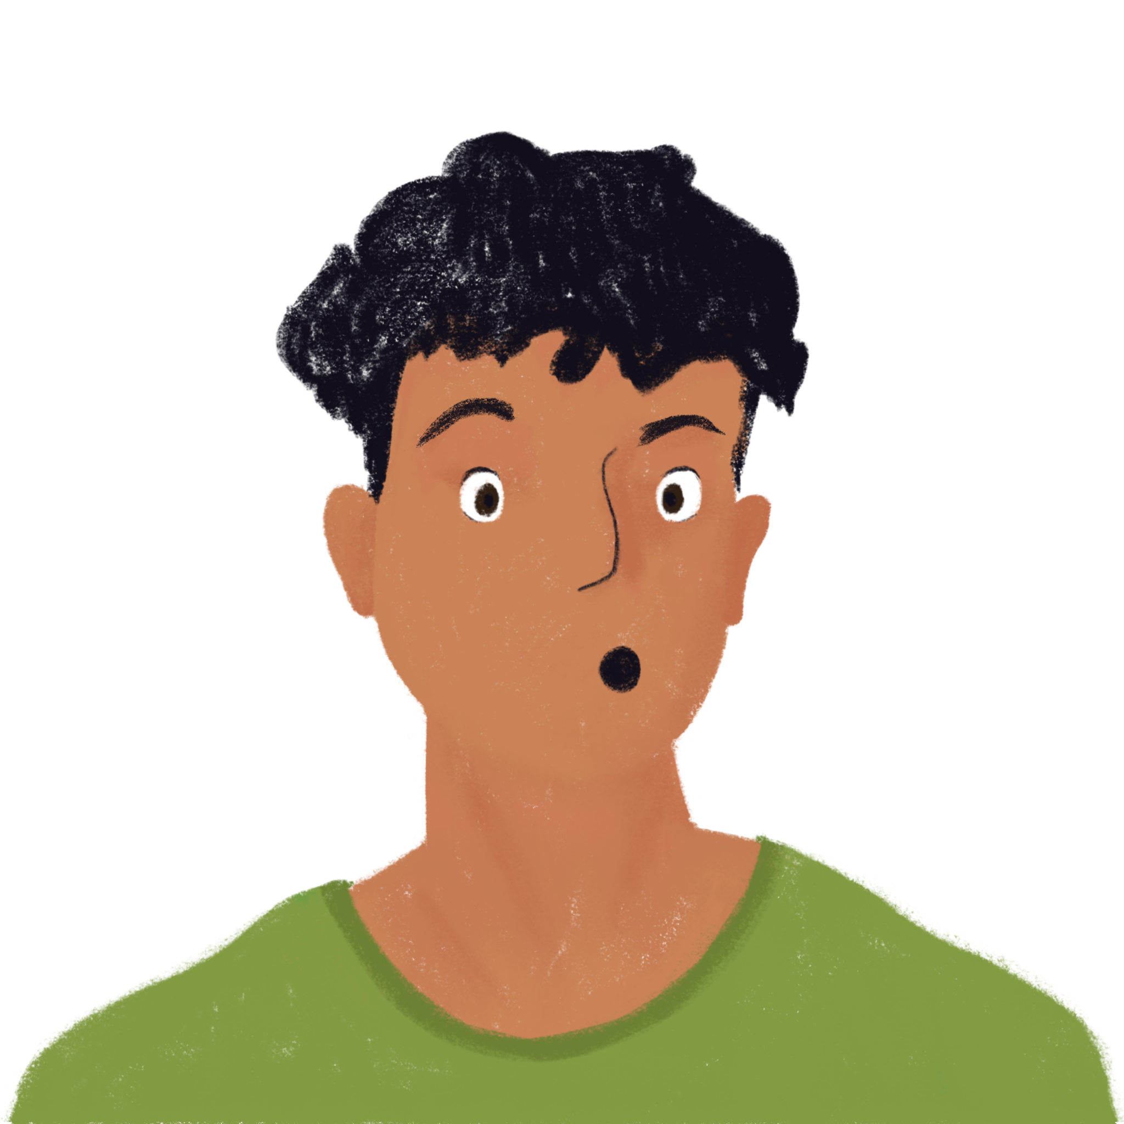
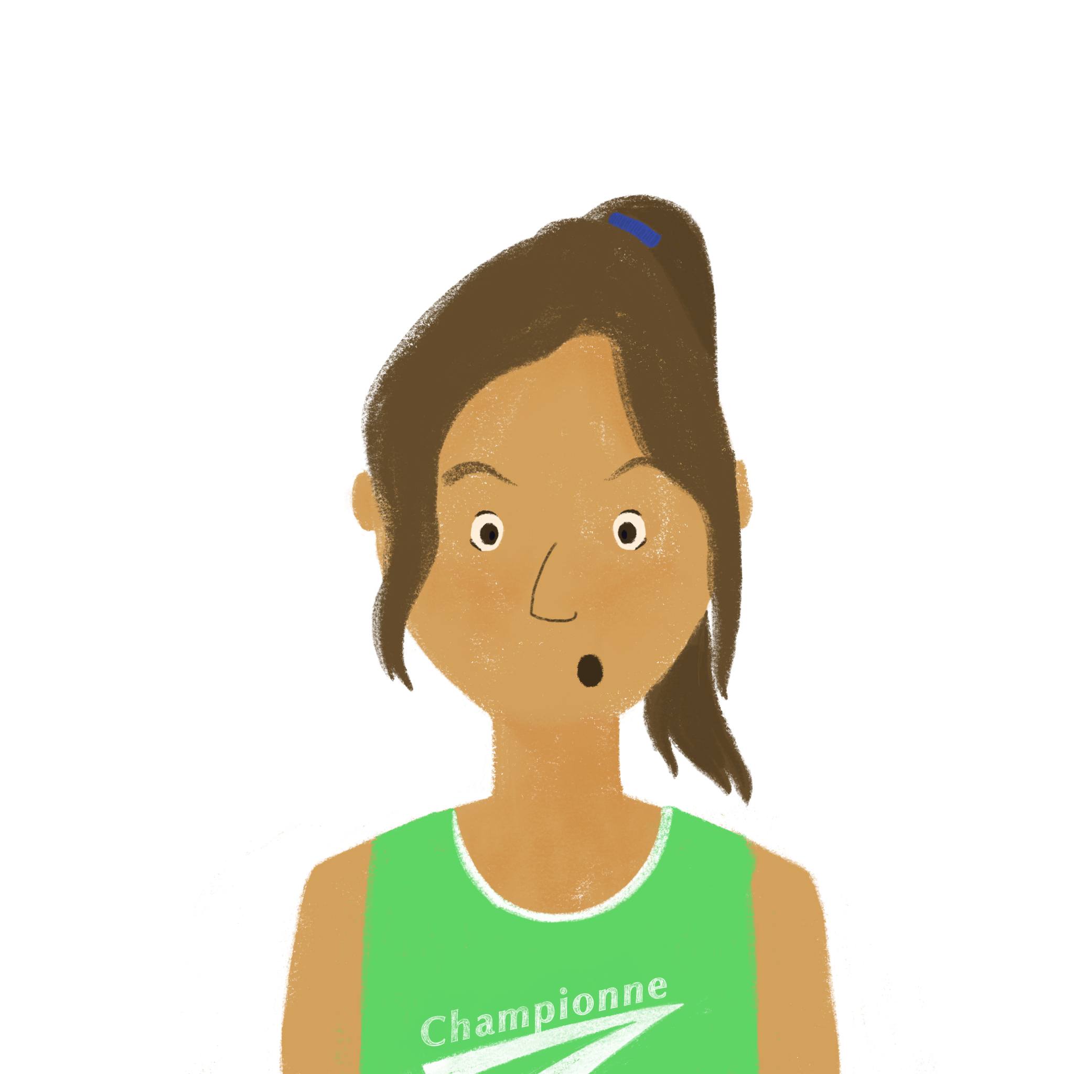
Amir et Océane parle du voyage
écouter
3
preventing / to prevent
the trip?
Is she going to prevent
4
practising/ practise
on the red ski slopes without my help.
You can’t practise
Notes:
Slide 2/5

Slide 27
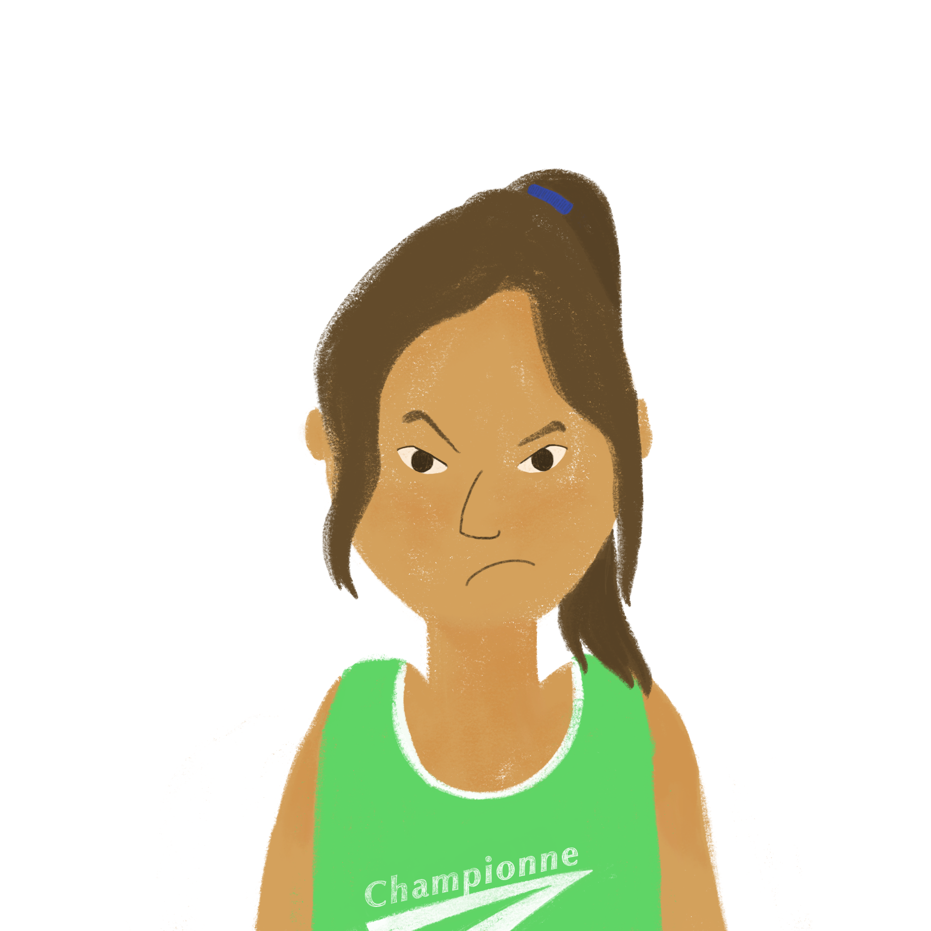
Amir et Océane parle du voyage
écouter
5
going/to go
to the difficult ski slopes.
My parents aren’t going
to go
6
going down/to go down
the red ski slopes alone is not possible!
Going down
Notes:
Slide 3/5

Slide 28
Amir et Océane parle du voyage
écouter
7
helping/to help
the whole family!
You are going to help
8
translating/translate
from Italian!
And I know how to translate
Notes:
Slide 4/5

Slide 29
Amir et Océane parle du voyage
écouter
9
learning/ to learn
languages.
My parents don’t like
learning
10
speaking/to speak
Italian is
difficult for your family!
Speaking
Notes:
Slide 5/5

Slide 30
pour/sans + infinitif
grammaire
You know two more uses of the infinitive in French.
Use the infinitive after pour to say why someone is doing something:
Je vais à la piscince pour faire de l'exercice. I’m going to the swimming to do some exercise.
Use the infinitive after sans to mean “without doing something”:
Il regarde un film sans écouter.
He’s watching a film without listening.
Notes:
Timing: 2 minutes
Aim: Recap of pour and sans + infinitive
Procedure:
1. Click through the explanations and examples, ensuring understanding.

Slide 31
Un message à Abdel
Traduis les expressions en français.
parler
Je vais en vacances au ski avec la famille d’Océane pour aider avec les pistes difficiles. Elle veut aller sur les pistes rouges pour pratiquer. Mais ma mère a une attitude négative ! Tu viens parfois avec ma famille pour apprendre. Tu sais faire du ski sans faire des choses dangereuses. Si tu descends les pistes sans respecter les règles, c’est différent. Descendre les pistes rouges sans risquer des accidents, c’est possible ! Il y a des moniteurs de ski pour empêcher des accidents !
Ma mère dit: “La famille ne peut pas aller en Italie sans parler italien !”
Océane lit mon cahier d’italien pour apprendre un peu. Ma mère ne va pas dire “oui” sans penser à tous les problèmes possibles.
C’est difficile ! - Amir
1) to help
2) to practise
3) to learn
4) without doing
5) without respecting
6) Going down
7) without risking
8) to prevent
9) without speaking
10) to learn
11) without thinking
le moniteur de ski = ski instructor
Notes:
Timing: 8 minutes
Aim: scaffolded oral translation; read-aloud of unfamiliar text; improving fluency of production
Procedure:
1. Students take it in turns to read sentences aloud, translating the English phrases into French as they go.
2. Click to reveal the answers.
Word frequency of cognates (1 is the most frequent word in French): expression [952]
Source: Londsale, D., & Le Bras, Y. (2009). A Frequency Dictionary of French: Core vocabulary for learners London: Routledge.

Slide 32
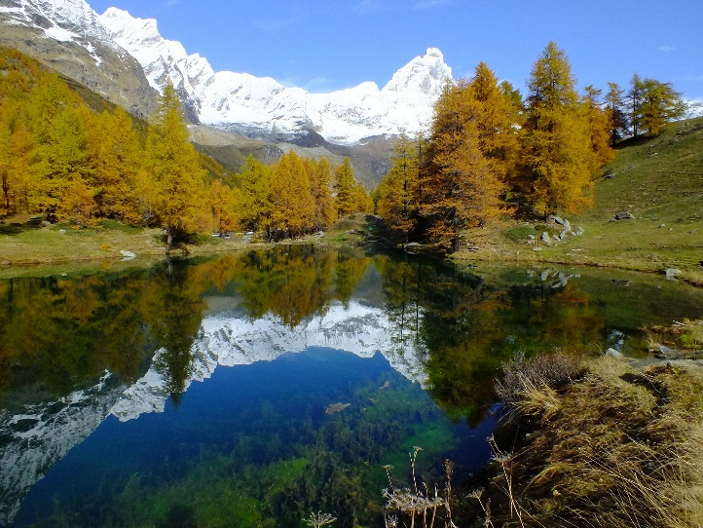
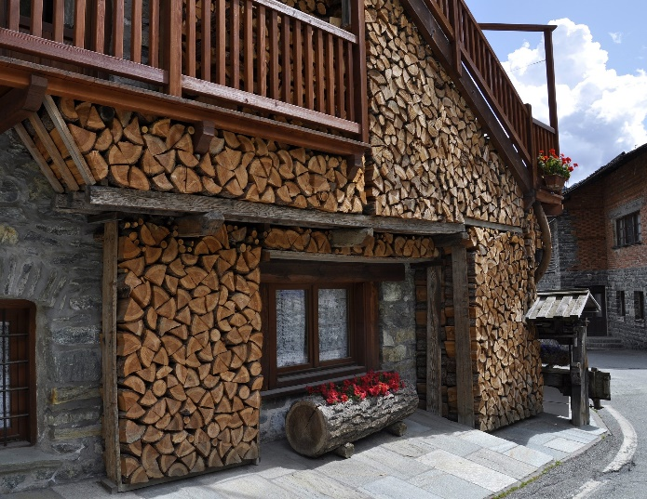
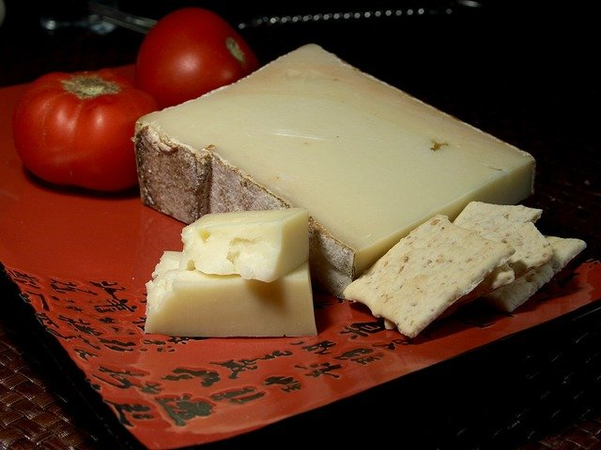
La Vallée d’Aoste
Le père d’Océane envoie un texte sur la Vallée d’Aoste à Amandine.
Find the 14 infinitives and translate them.
lire
visiting
go
look at
visit
do
Visiter la Vallée d’Aoste est une expérience fantastique ! On peut faire du ski et regarder les montagnes, mais on peut visiter d’autres endroits pour faire beaucoup d’autres choses ! Parler français, c’est possible, mais on peut aussi pratiquer l’italien. Dormir dans un chalet, c’est typique, mais on peut choisir un hôtel si on préfère être plus confortable. Si on aime apprendre de l’histoire, explorer l’architecture romaine est important. Aussi, on peut prendre des photos des châteaux. Finalement, manger les fromages locaux est essentiel !
speaking
practise
sleeping
choose
to be/being
to learn/learning
exploring
take
eating
Notes:
OPTIONAL EXTENSION to bring together the different uses of infinitives in French, and their translations into English (can be set for homework)
Timing: 10 minutes
Aim: Written recognition of different uses of the French infinitive. French-English translation. Raising awareness about English language.
Procedure:
1. Students read the text and list the fourteen infinitives. Pratiquer and explorer have not been learned, but they are cognates and should be recognisable as verbs form the –ER ending.
2. Click to reveal the location of the verbs.
3. Students translate the verbs using the most suitable verb form in English according to the context.
4. Click to reveal the answers. Translate orally for each section, discussing the choice of verb form and the reasons for it.
Word frequency of cognates used(1 is the most frequent word in French): vallée [2856], fantastique [4107], ski [4571], pratiquer [1268], chalet [>5000], typique [4178], confortable [3964], explorer [3204], architecture [4182], romain [3144], photo [1412], château [3510], finalement [843]
Source: Londsale, D., & Le Bras, Y. (2009). A Frequency Dictionary of French: Core vocabulary for learners London: Routledge.

Slide 33
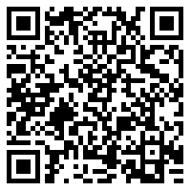
Devoirs
Vocabulary Learning Homework (Y9, Term 1.2, Week 2)
Audio file
Audio file QR code:
Student worksheet
Quizlet link
In addition, revisit: Year 9 Term 1.1 Week 6
Year 8 Term 3.2 Week 1
Notes:
The answer sheet for the 9.1.2.2 vocabulary learning homework is here: https://resources.ncelp.org/concern/resources/7h149r38z?locale=en

