Slide 1
Vocabulary
Y7 German
Term 3.2 - Week 1
Rachel Hawkes / Natalie Finlayson
Date updated: 21/05.20
Notes:
Revision of HABEN and SEIN [all persons taught so far: ich, du, er/sie/es, wir, sie]
No new vocabulary or revisited vocabulary this week. Vocabulary will recycle language previously taught across the whole year.

Slide 2
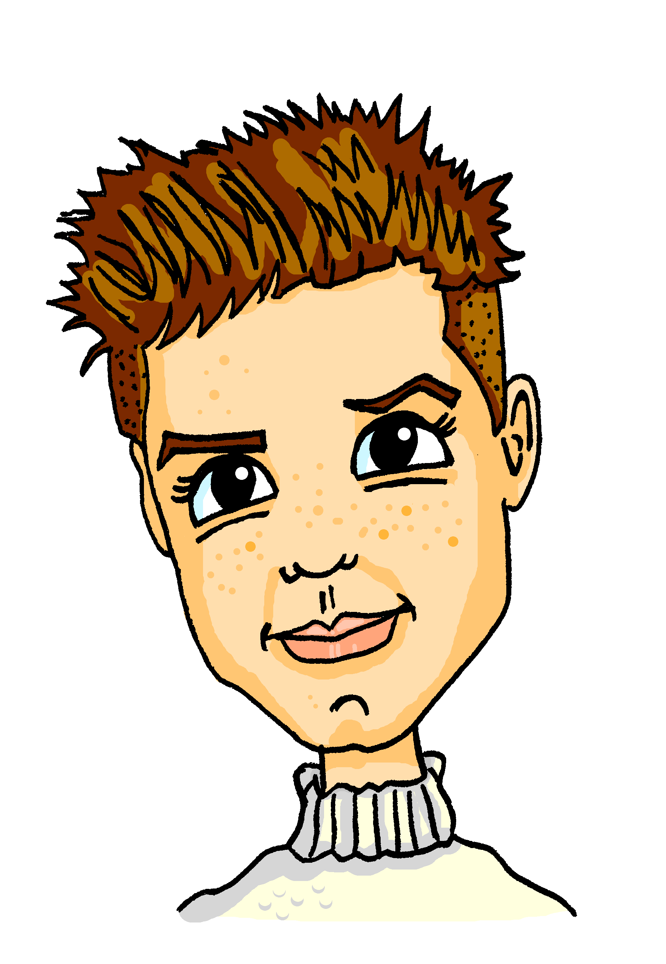
Vokabeln
hören / schreiben
Mia and Alastair spielen ein Wortspiel, Konnekt 6. Alastair sagt sechs Wörter. Mia sagt das Thema.
Was ist das Thema?
reisen | Sprache
zu Hause | Jobs
im Klassenzimmer | Lieblingssachen
Familie | Wann?
1
Familie
5
Sprache
2
Jobs
6
im Klassenzimmer
3
zu Hause
7
reisen
4
Lieblings-sachen
8
Wann?
Notes:
Vokabeln This listening activity revisits 48 words from Y7. For each question, students listen to a list of six words and identify the category that best fits. Note: To ensure that students think about the meaning of all the words, the selection begins with the less obvious words and finishes with the most transparent. Students may find it useful to try to note down as many of the words as they can, so that they have a little more time to process meaning and consider the categories. However, transcription is not the main aim of the task so the speed of delivery will reflect this. Teachers to ensure that all of the category words are still known.
The first one can be done as a worked example with students. Transcript (minus the category words): 1/ Familie [310] - das Kind [106], wohnen [380] wichtig [177], die Eltern [351], mit [13], die Geschwister [3090] 2/ Jobs [1090] - der Arzt [614], arbeiten [200], die Lehrerin [2696], das Geld [249], der Sänger [3916], der Schauspieler [2202]
3/ zu Hause [6/159] - der Boden [445], die Tür [400], bleiben [112], kochen [1005], die Nummer [1048], der Garten [959] 4/ Lieblingssachen [>4034/251] - mögen [151], der Sport [845], dein [225], die Musik [469], die Farbe [929], der Tag [108] 5/ Sprache [367] - das Wort [243], Tschüs! [<4034], wiederholen [1044], türkisch [1908], das Beispiel [89], der Grund [230] 6/ Im Klassenzimmer - der Unterricht [1107], die Aufgabe [317], schreiben [245], schwierig [471], die Tafel [3660], das Fenster [634], 7/ reisen [978] – nehmen [139], dauern [696], die Stunde [262] das Fahrrad [1596], der Zug [613], Österreich [N/A] 8/ Wann? [583] - schließlich [307], danach [437], immer [68], der Nachmittag [1426], das Wochenende [764], die Nacht [335]
Note: To encourage listening to the final list, teachers could ask students to predict any of the words that they might be in this category (Wann?) before listening.

Slide 3
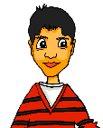
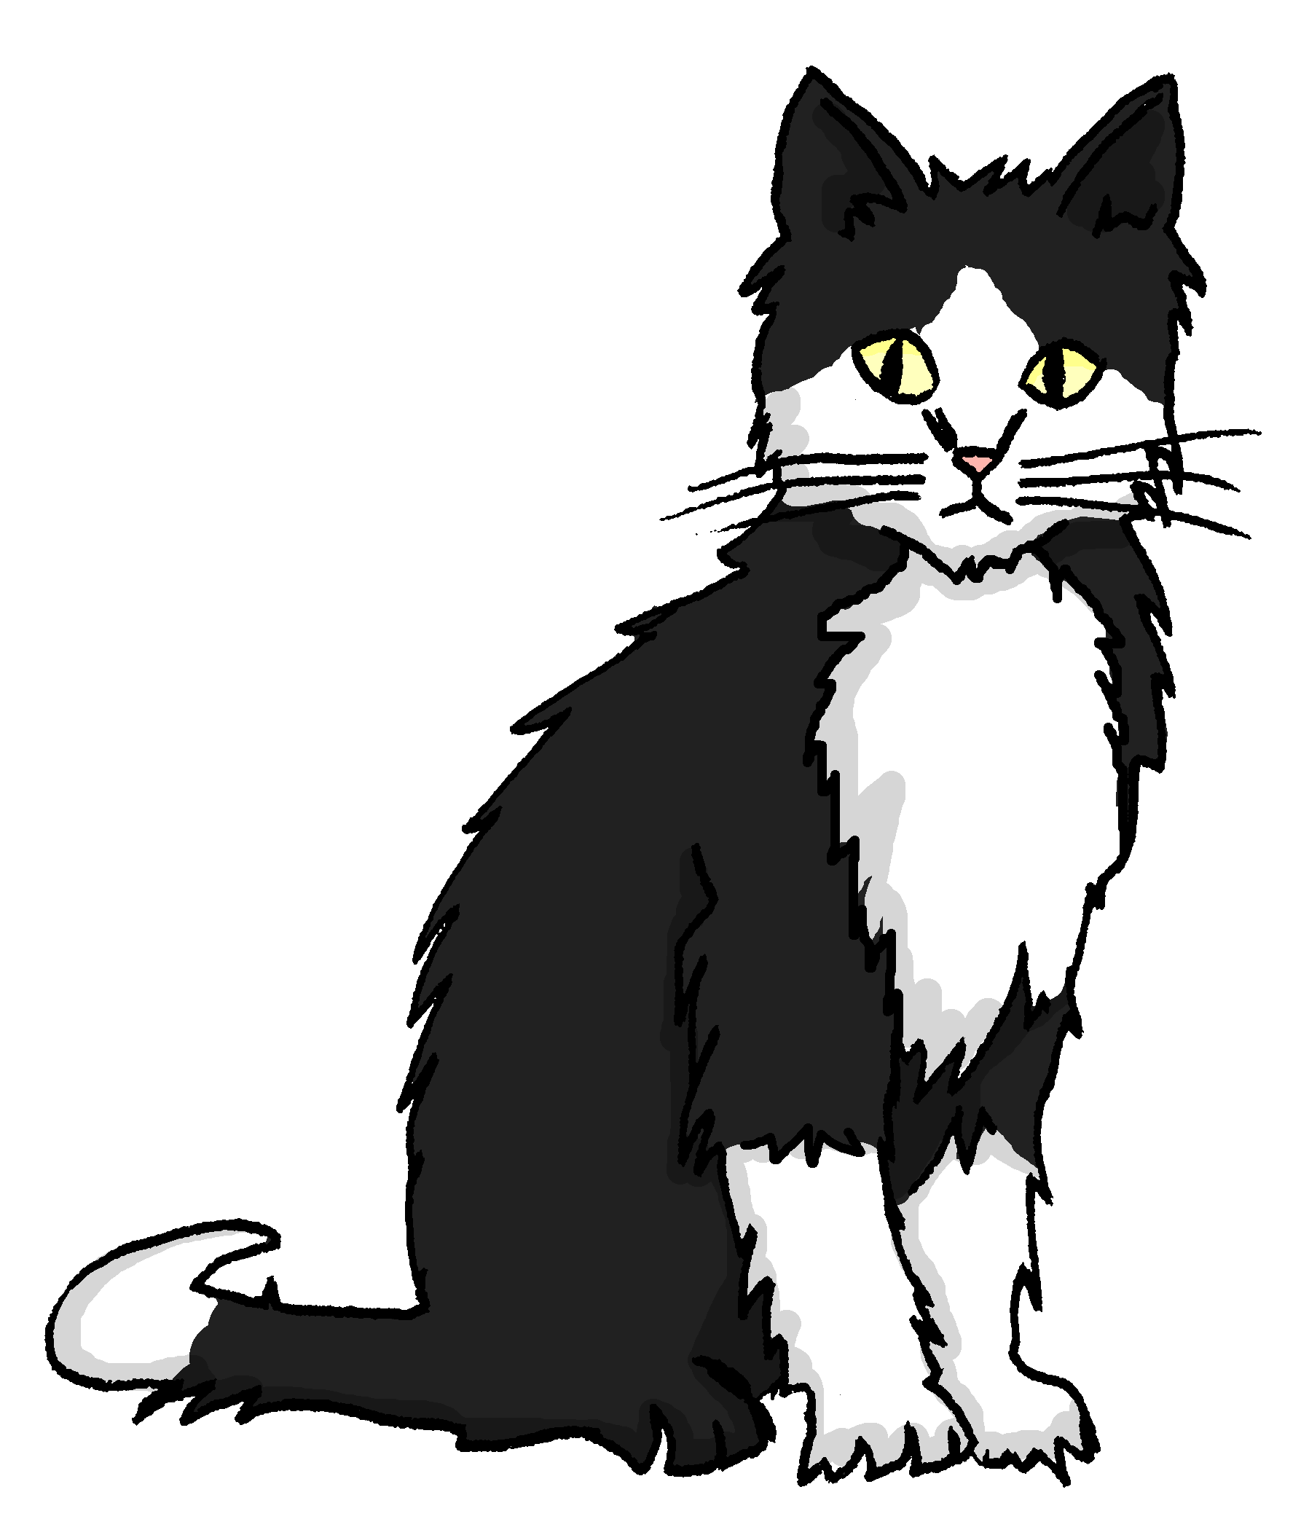
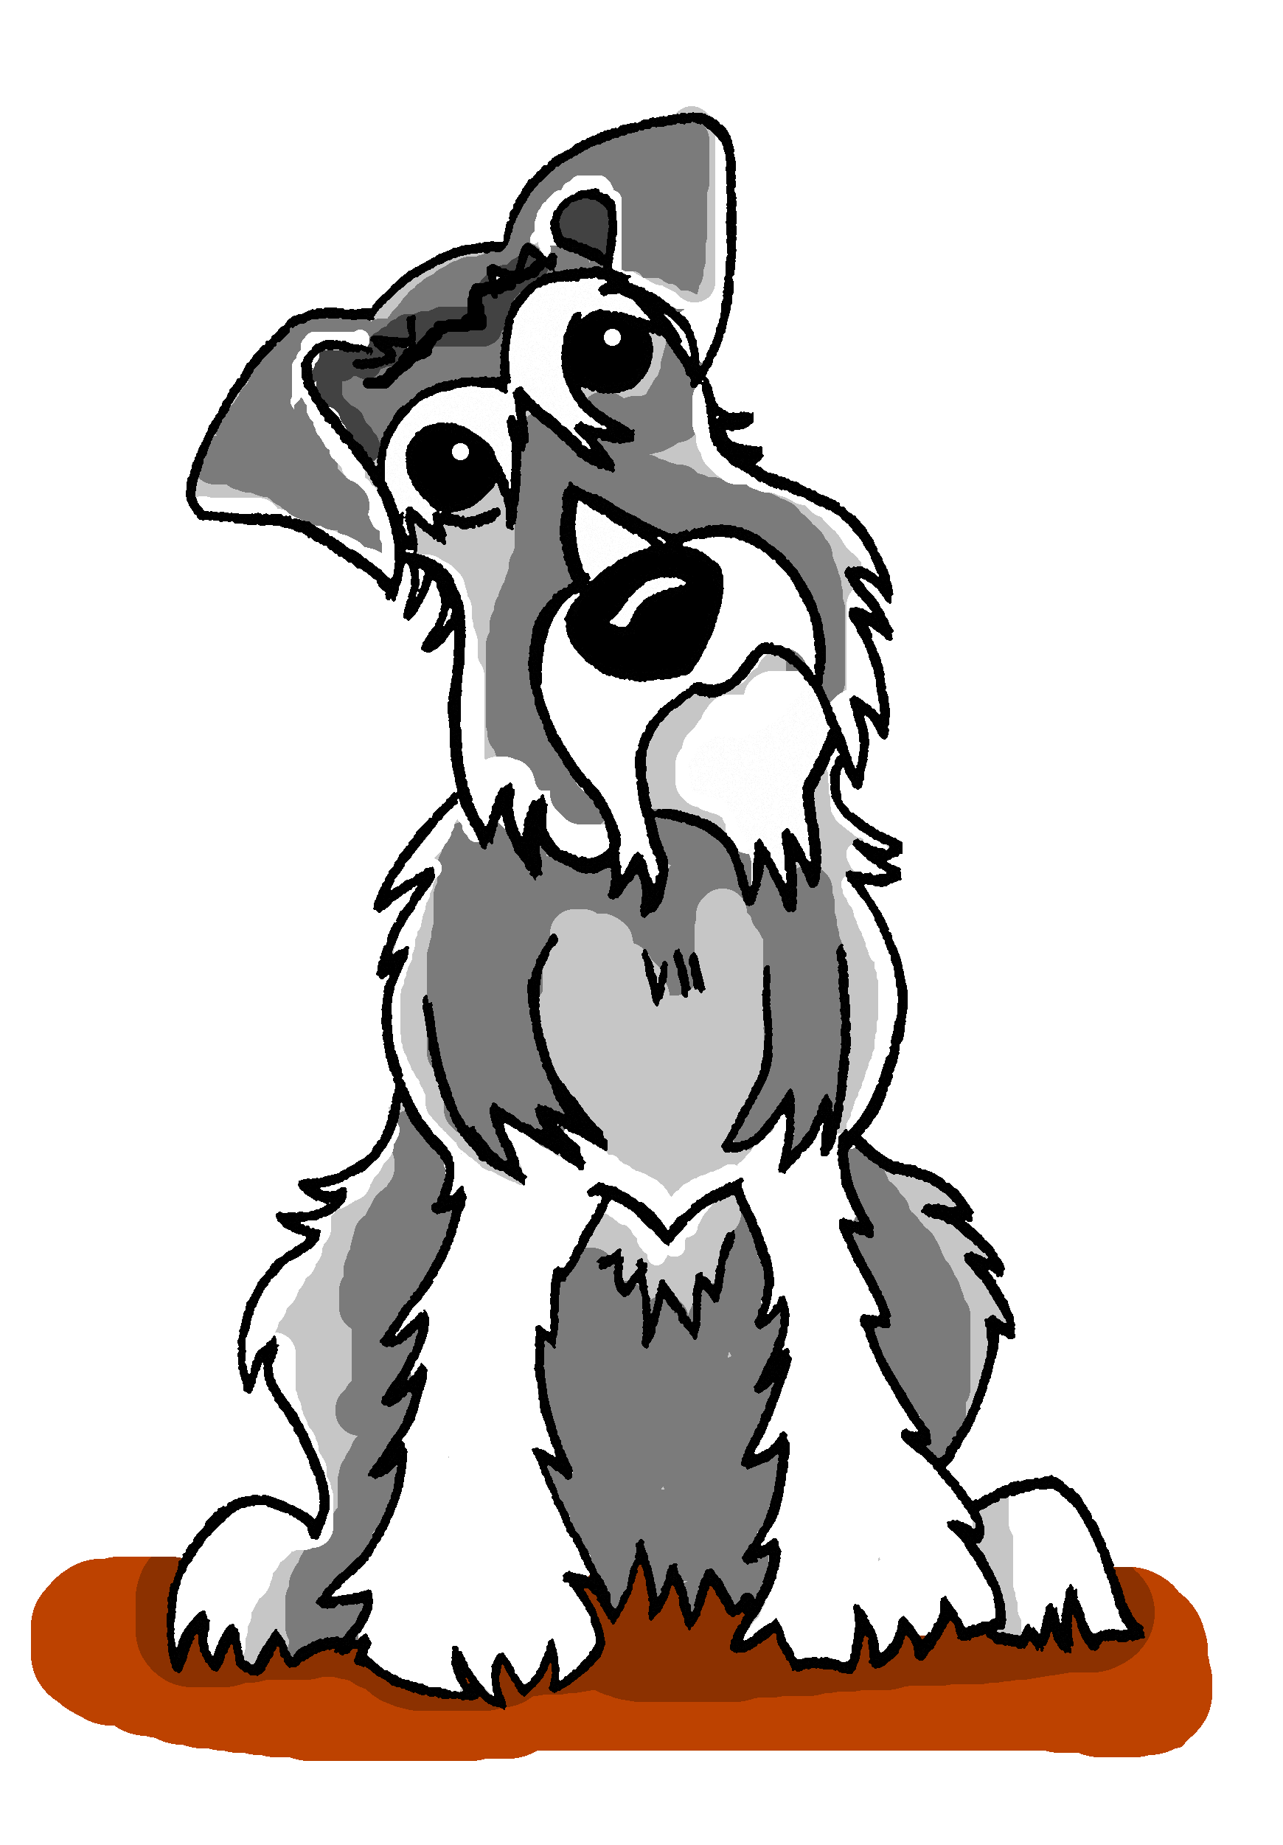
Vokabeln
lesen / schreiben
[On Saturdays] spielen wir [often] im Park Fußball.
Sie gehen [rarely] in die Stadt.
[Always] hilft sie Mia mit den Hausaufgaben.
Am Wochenende läuft sie [never].
Mieze sitzt [sometimes] auf dem Sofa, aber [now] trinkt sie Wasser.
Heute [afternoon] liegt Einstein im Garten, und schläft.
[Every day] macht Wolfang viele Fotos, und [on Monday] zeigt er sie.
[Usually] vergisst sie alles, aber [today] lässt sie nichts zu Hause.
1
Samstags
oft
2
kaum
3
Immer
4
nie
5
manchmal
jetzt
6
Nachmittag
7
Jeden Tag
am Montag
8
Normalerweise
heute
Notes:
This vocabulary task revisits previously taught adverb and adverbial time phrases that will be needed for the present tense revision activities that follow in this lesson.
Task instructions 1. Write 1-8 and each adverb / adverbial phrase in German. 2. Translate orally into English with a partner. 3. Teacher elicits adverb answers from students. 4. Teacher elicits oral translations, drawing students’ attention to their own use of present simple and present continuous in each sentence, reminding students that there is only one present tense in German. 5. Teacher elicits the pattern of usage from students, i.e., regular repeated actions = present simple, whereas actions occurring now, at the moment = present continuous It is usually the adverb which helps us choose the English tense to use when translating.
Note: the use of present continuous in English is far more nuanced than this, and there are often instances when both tenses are possible (as here in number 1, where both ‘She always helps me with homework’, and ‘she’s always helping me with homework’ are valid translations). The important thing from an English speaking learner of German’s perspective is that that both of these just have one form in German!
Suggested (most probable) translations: 1. We often play football in the park on Saturdays. 2. I seldom go into town. 3. She always helps me with homework. 4. He never runs at the weekend. 5. Mieze sometimes sits on the sofa but now she is drinking water. 6. This afternoon Einstein is lying in the garden, and sleeping. [NB: heute Nachmittag has not been explicitly taught together with the meaning ‘this afternoon’. Teachers can encourage further learning by eliciting ‘this morning’ and ‘this evening’ from the class.] 7. Wolfgang takes lots of photos every day and on Monday he is showing them. 8. Usually I forget everything, but today I’m leaving nothing at home. It might also be useful to ask students go give examples of WO1 and WO2 phrases, to provide further opportunities to recognise these structures.
The words with frequency rankings and the lesson when first taught:
jeden Tag [88/108] Week 1.2.3 jetzt [62] Week 2.1.1 heute [121] Week 2.2.4 normalerweise [1898] Week 3.1.6 immer [68] Week 2.1.6 oft [215] Week 1.2.3 manchmal [394] Week 1.2.3 kaum [259] Week 1.2.3 nie [196] Week 1.2.3 am Montag [19/794] Week 1.1.7 samstags [1306] Week 3.1.1 (am) Nachmittag [19/1426] Week 2.2.4 All other vocabulary has also been previously taught.

