Slide 1
Grammar
Present tense weak verbs: 1st person singular vs 1st person plural
Y7 German
Term 2.1 - Week 6
Author name(s): Natalie Finlayson / Rachel Hawkes
Date updated: 26/04/20

Slide 2
Talking about yourself and others (wir)
Grammatik
As you know, regular verbs have endings which match the subject pronoun.
To say wir (we) + regular verb:
The wir form of the verb is the same as the infinitive form that you find in the dictionary. ☺
Ich gehe jeden Tage in die Schule.
Du bleibst kaum zu Hause.
Sie heißt Sara.
___
___
___
Wir gehen jeden Tag in die Schule.
We go to school every day.
Wir bleiben kaum zu Hause.
We rarely stay at home.
Wir heißen Sara und Max.
We are called Sara and Max.
___
___
___
Notes:
It’s important to celebrate simplicity when it occurs! The fact that the wir form is the same as the infinitive is just one such moment. Hence the ☺.

Slide 3
Mein Freund Mehmet und ich
lesen
Wolfgang schreibt Oma eine Email. Was macht er allein? Was macht er mit Mehmet?
Schreib ich oder wir.
Hallo Oma,
Ich habe einen neuen Freund! Er heißt Mehmet und wir haben viel gemeinsam!
Ich gehe jeden Tag früh in die Schule. Ich habe um 8.00 Tanzunterricht. Mehmet kommt um 8.30. Wir sitzen im Klassenzimmer und reden.
Wir haben um 9.00 Unterricht. Wir mögen Kunst und Naturwissenschaften. Ich mag auch Sport.
Wir spielen nach der Schule oft Musik. Mehmet spielt Schlagzeug und ich spiele Gitarre. Wir gehen manchmal schwimmen. Wir machen auch natürlich immer Hausaufgaben …
___
___
___
___
___
___
___
___
___
___
___
___
Notes:
Students have previously met all vocabulary in this task, with the exception of near-cognates allein [259] and natürlich [n/a], and um [47] used to introduce times. Students should be able to infer meaning from context when completing the exercise, but teacher should check and clarify during the feedback stage.
Adverbs containing lexical clues (beide / zusammen) are avoided here, so that students focus on the verb endings.
Answers revealed on individual clicks.

Slide 4
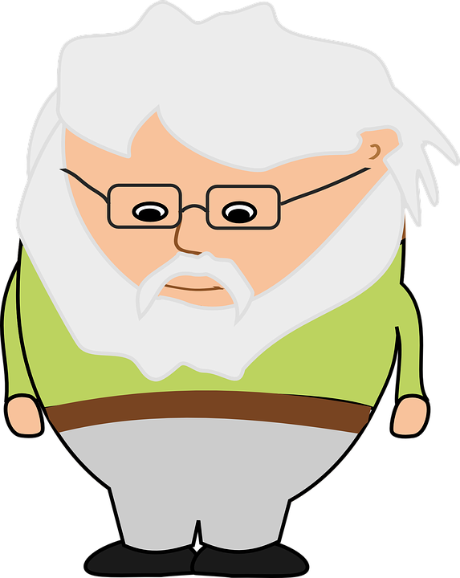
Meine Woche
hören
Wolfgang redet mit Opa am Telefon. Wie macht er die Aktivitäten? Mit Mehmet oder allein?
 | allein | zusammen
1
2
3
4
5
6
7
Notes:
In this exercise, students link verb endings with meaning (doing things alone, or together with someone else).
At more advanced levels, the teacher may prefer to ask students to write complete sentences, with the adverb in the correct position and a subject that makes sense.
Audio (with subject and adverb obscured) plays on number clicks.
[Mehmet und ich] hören [zusammen] Musik.
[Wir] schwimmen oft [zusammen].
[Ich] spiele [allein] Computer.
[Ich] bleibe [allein] zu Hause.
[Wir] hören [zusammen] Musik.
[Mehmet und ich] lernen [zusammen] Englisch.
[Ich] liege [allein] im Garten.

Slide 5
Meine Woche (Antworten)
hören
Wolfgang redet mit Opa am Telefon. Wie macht er die Aktivitäten? Mit Mehmet oder allein?
 | allein | zusammen
1
2
3
4
5
6
7
Notes:
Answers (with subject and adverb included) play on number clicks.
Mehmet und ich hören zusammen Musik.
Wir schwimmen oft zusammen.
Ich spiele allein Computer.
Ich bleibe allein zu Hause.
Wir hören zusammen Musik.
Mehmet und ich lernen zusammen Englisch.
Ich liege allein im Garten.

Slide 6
Zusammen oder allein?
schreiben
Und was machst du mit Freunden zusammen? Was machst du allein? Finde Verben im Wörterbuch und schreib Sätze mit ich und wir!
Beispiel: Wir sitzen zusammen im Garten.
Ich lese allein im Zimmer.
1. Ich … 4. Wir …
2. Wir … 5. Ich …
3. Ich … 6. Wir …
Zusammen and allein are adverbs. Use them after the verb.
Notes:
This free production exercise allows for dictionary practice. First, ask students to use the dictionary to find the meaning of the example sentences given.
Them encourage students to find German translations for things they do alone and with friends. Students know that if they are using the wir form, verbs may be used as they are found in the dictionary. If they are using the ich form, they must change the ending appropriately.
Teacher can elicit some examples from the class by asking students ‘Was machst du mit Freunden zusammen?’ ‘Was machst du allein?’
Note: Students are safe to use the vast majority of verbs that they find in the dictionary, as strong verbs don’t change their stems in the ‘ich’ or ‘wir’ forms. They will be learning about strong verbs in the 2nd half of the spring term (Term 2.2 Week 3). Whilst students should be encouraged to use a dictionary for the verbs, teachers will probably want to insist that they draw on their own, known vocabulary for the remainder of the sentence.

Slide 7
Talking about what you and others are like
Grammatik
As you know, the verb sein has irregular forms which match the subject pronoun.
To say wir + sein:
The wir form of sein is the same as the sie (they) form.
Ich bin Einzelkind.
Du bist nett.
Sie ist Sängerin.
___
___
___
When using sein + noun to talk about yourself or others, no indefinite article is needed:
Ich bin Einzelkind.
This is different from English:
I am an only child.
Wir sind Einzelkinder.
We are only children.
Wir sind nett.
We are nice.
Wir sind Sänger.
We are singers.
___
___
___
Sie sind Einzelkinder.
They are only children.
Sie sind nett.
They are nice.
___
___
Notes:
Teacher to draw extra attention to the note on sein + no definite article in the bubble. Ask students what other structures this may refer to: Ich bin Student, Lehrer(-in), other job titles

Slide 8
Was haben wir gemeinsam?
lesen
Wolfgang und Mehmet simsen. Wolfgangs Handy ist kaputt!
Was haben Wolfgang und Mehmet gemeinsam? Schreib beide (both) oder (-).
Mehmet: Ich denke, wir haben viel gemeinsam, nicht wahr?
Mehmet: Das ist toll! Wir wohnen auch beide in Berlin. Ich bin (-) aber Einzelkind.
Mehmet: Wir sind beide praktisch. Und wir haben beide Angst vor Katzen!
Mehmet: Ich gehe (-) aber in die Moschee.
___
___
___
___
___
Wolf: Ich gehe (-) manchmal in die Kirche. Sind wir beide nicht auch Zwillinge?!
Wolf: Ja! Wir lesen beide Krimis und hören beide auch Rockmusik.
___
___
Wolf: Haha, ja! Ich mag (-) Mias Katze nicht.
___
Wolf: Und ich bin
(-) Zwilling.
___
___
___
Notes:
In this exercise, students link verb endings with meaning (having things in common with someone, or not).
Teacher to draw attention to the verb simsen in the rubric. What kind of word is it? Students should be able to tell from the –en ending that it is a verb. They may be able to work out the meaning of simsen (to text) by recognising SMS and tying it into the context.
Note: Teachers need to make really clear to students that when the verb is singular (ich form) you cannot use ‘beide’ (both) so that’s when they would record (-). It will be clear once they get the hang of it, but will need clear explanation at the outset.
Teacher to draw attention to new work Krimis, presented with lesen. Teacher to ask students what kind of text this might be, and point to the importance of crime novels/films in German-speaking culture.
On individual clicks, the crack obscuring each pronoun appears at the same time as the adverbs (beide or (-)) it indicates.

Slide 9
Was haben wir gemeinsam?
Beide and auch are adverbs.
They come after the verb.
Remember
kein(e) + noun = ‘not a’
sprechen und schreiben
Einzelkind sein?
in die Moschee gehen?
“Bist du Einzelkind?”
“Ja, ich bin Einzelkind. Und du?”
“Ja, ich bin auch Einzelkind.”
Wir sind beide Einzelkinder.
“Bist du Einzelkind?”
“Nein, ich bin kein Einzelkind. Und du?”
“Nein, ich bin auch kein Einzelkind.”
Wir sind beide keine Einzelkinder.
“Gehst du in die Moschee?”
“Ja, ich gehe in die Moschee. Und du?
“Nein, ich gehe nicht in die Moschee. Ich gehe in die Kirche.”
Ich gehe in die Moschee und Sara geht in die Kirche.
Notes:
Model questions, answers and sentences for the spoken and written exercise to come, which brings together the ich, er/sie and wir forms of all verbs studied so far.
Teacher to elicit questions, answers and written responses in each case, drawing attention to the following points:
- difference in meaning/usage between auch and beide;
- word order rule with Ich bin auch Einzelkind and Wir sind beide Einzelkinder. Which parts of speech are these? Where do they go in the sentence?
- use of kein(e) + noun to mean not a
NB: NCELP suggest that, having taught kein early on, it is important to include as much practice of the structure, in varied contexts and with varied lexis, as possible. However, if the teacher prefers to avoid this complexity introduced by kein + noun at this time, the task may by edited by substituting the sein + noun items for noun + adjective items (e.g. Bist du groß? Ja, ich bin groß / nein, ich bin nicht groß.)

Slide 10
Was haben wir gemeinsam?
sprechen und schreiben
1. Einzelkind sein? _________________________________________________________________________
2. in die Moschee gehen? ________________________________________________________________
3. Sänger(-in) sein? _______________________________________________________________________
4. Rockmusik hören? ______________________________________________________________________
5. streng sein? ____________________________________________________________________________
6. Kunst mögen? _________________________________________________________________________
7. schwimmen gehen? ___________________________________________________________________
8. Deutsch verstehen? ___________________________________________________________________
Notes:
Teacher to elicit some model answers from the class by saying ‘Was hast du mit deinem Partner gemeinsam?’

Slide 11
Present simple or continuous?
Grammatik
English has two present tense forms.
I play the drums every week. I am playing the drums right now.
German has one present tense only. The BE + -ing form does not exist.
Ich spiele jede Woche Schlagzeug. Ich spiele jetzt Schlagzeug.
Present simple - normally; routine
Ich spiele =
I play AND
I am playing
Present continuous (BE + -ing) - ongoing; current
Adverbs of time tell us which English tense to choose.
In German, the present simple is used with all adverbs.
Notes:
In this and the slides that follow, we continue to emphasise that one German present tense is equivalent to two English present tenses.
Here, the metalanguage (present simple, present continuous and adverbs) used to talk about verbs in this and subsequent sequences is described and explained.
Teacher to highlight the distinction between present simple for routine actions and present continuous for current/ongoing actions.
Teacher to stress the fact that the BE + -ing form is an English construction only. Sein cannot be used with a verb this way.

Slide 12
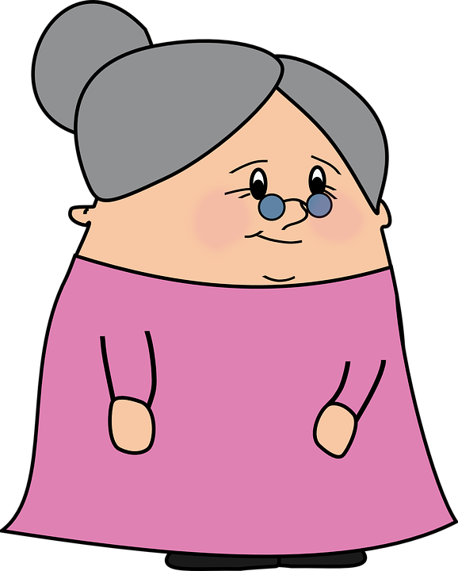
Present simple or continuous?
Grammatik
Wolfgang and Mia are staying with Oma this week. She makes notes about their routine.
1.1 Choose the correct adverb.
A
Wolfgang is playing tennis at the moment/every week.
B
Mia wears a uniform at the moment/every week.
C
Mia is having lunch at the moment/every week.
D
Wolfgang is doing his homework at the moment/every week.
E
Mia goes for a walk at the moment/every week.
Notes:
Awareness-raising exercise in English to teach students to connect temporal adverbs with tense.
Teacher to ask students to explain how they knew the answer. By looking at the verb form in present tense, we can tell whether an action happens routinely (present simple) or is happening currently (present continuous). This tells us which adverb to use.
Explain that as there is only one verb form in German, the verb does not give us this information.

Slide 13
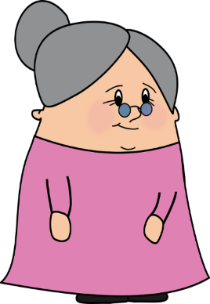
Present simple or continuous?
Speaking exercise
hören
Oma calls Opa to tell him about Wolfgang and Mia.
Choose present simple or continuous.
A
Wolfgang does/is doing his homework.
B
Wolfgang and Mia go/are going to school.
C
Mia plays/is playing the drums.
D
Wolfgang and Mia plays/are playing on the Computer.
E
Mia swims/is swimming.
Notes:
Answers revealed on clicks.
Transcript
A. Wolfgang macht jetzt Hausaufgaben.
B. Wolfgang und Mia gehen jetzt in die Schule.
C. Mia spielt jede Woche Schlagzeug.
D. Wolfgang und Mia spielen jetzt zusammen Computer.
E. Mia schwimmt jede Woche.

Slide 14
Present simple or continuous?
Speaking exercise
hören
Oma calls Opa to tell him about Wolfgang and Mia.
Choose present simple or continuous.
A
Wolfgang does/is doing his homework.
B
Wolfgang and Mia go/are going to school.
C
Mia plays/is playing the drums.
D
Wolfgang and Mia plays/are playing on the Computer.
E
Mia swims/is swimming.
Notes:
Answers revealed on clicks.
Transcript
A. Wolfgang macht jetzt Hausaufgaben.
B. Wolfgang und Mia gehen jetzt in die Schule.
C. Mia spielt jede Woche Schlagzeug.
D. Wolfgang und Mia spielen jetzt zusammen Computer.
E. Mia schwimmt jede Woche.

