Slide 1
Making the case for change: championing challenge and calming concerns
Presenter: Rachel Hawkes
Date updated: 30/05/21
Notes:
Images from www.pixabay.com – no attribution required.
This introductory session examines the key drivers of curriculum planning and the core components of language learning, providing answers to the question, “What does an excellent languages curriculum look like?”

Slide 2
Aims for the session
to understand the rationale for a new approach to curriculum design
identifying issues
setting out potential solutions

Slide 3
Identifying issues [1/3]
1st language - 17,000 hours of exposure by age of four
2nd language in classroom - 450 hours approx. over five years
in time-poor classroom context, every moment of practice counts
(Roffwarg et al., 1966, cited in Collins & Muñoz, 2016)
Notes:
In their home language, children are exposed to more than 17,000 hours of exposure by the age of four (Roffwarg et al., 1966, cited in Collins & Muñoz, 2016). However, in the secondary foreign language classroom in England, learners typically have around 450 hours of learning over five years. At this rate, it would take 189 years for learners to have the equivalent hours of input as infants in the initial stages of learning their home language! Clearly, in time-poor classroom contexts, it is crucial to make every moment of practice count. It is important to identify what learners should practise and how best they should do it.

Slide 4
Identifying issues [2/3]
Notes:
As busy teachers, we make 1000s of decisions in one day, 100s in one lesson. The role is demanding. In each lesson our focus needs to be on the students moment-by-moment, to respond to what and how they are learning what we teach. Every lesson is different in that respect, and it requires all of our attention and skill. We rely on the planning of our SOW, our published lesson materials, and/or our individual lesson resources to be all there ready in advance. We buy published courses because we know that those producing them have had the time to plan the course in detail, that they have taken every care to ensure that it covers the national curriculum programmes of study, or at KS4, the requirements of the GCSE. Of course, we reserve the right to adapt and supplement (or sometimes ignore) material from a text book or other course, to meet the needs of our classes. We completely get the fact that a text book is just a tool, that there is not enough space on the pages to have all the practice steps that we need for our learners. Many of us like to innovate and create, too. We tend to put in additional vocabulary practice stages, more revisiting activities at the start and ends of lessons, or create scaffolded versions to tasks to support lower proficiency learners or additional tasks to increase the challenge for our higher proficiency learners. We also like to innovate and add in songs, more culture, or games etc..
But one thing we rarely have the opportunity to do is step back and look at things with different eyes. If we do that we can sometimes see things we hadn’t previously noticed. This is sometimes revealing so we’re going to start with that, here.

Slide 5
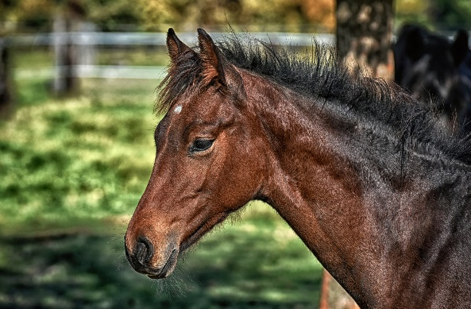
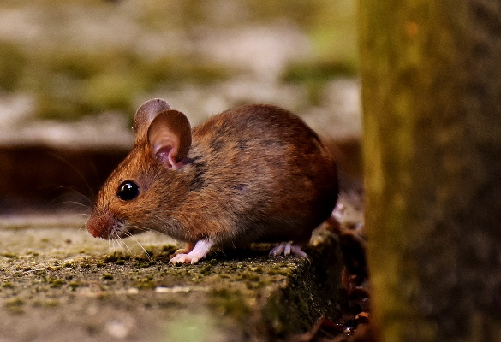
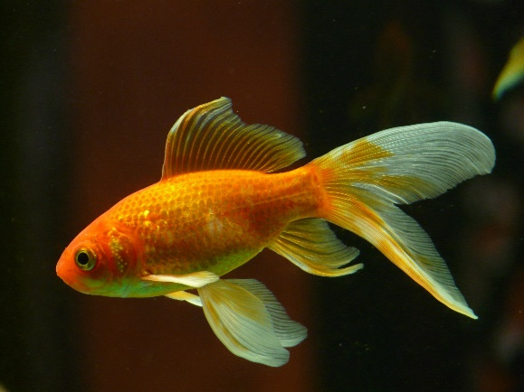
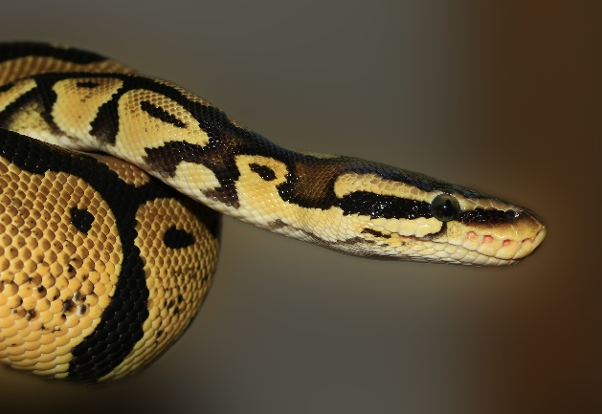
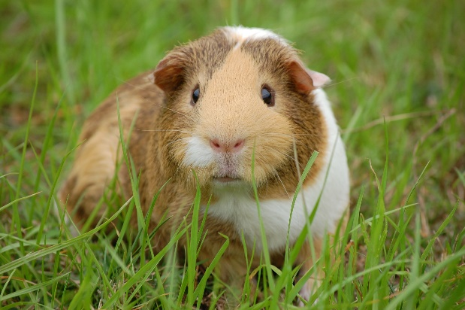
¿Tienes mascotas? Tengo…
un gato
un perro
un caballo
un ratón
no tengo mascotas
un pez
una serpiente
una cobaya
Notes:
So let’s take a unit from Y7 Spanish on pets, for example, as exists in many Y7 SOW and published resources. We might create a slide like this to give stronger visual support to what is in the text book.
What might we do with this slide? 1. Present the vocabulary (use animations to build up to independent oral recall of the vocabulary items for a few minutes) - 2. Typically we might then do a listening - e.g. listen and put the pets in order.
E.g
¿Tienes mascotas?
Sí. Tengo un gato.
¿Tienes mascotas?
Sí. Tengo una serpiente.
¿Tienes mascotas?
Sí. Tengo una cobaya.
Let’s pause for a moment to consider what content we are teaching here. What is the aim of the teaching?
Insert polling questions (multiple choice): Are we teaching knowledge of: a. individual vocabulary ítems? b. two parts of the verb tener? c. knowledge of gender through the singular indefinite article? 3. Which grammar is meant to be in the spotlight here? the indef articles and tener… So - if we keep the articles with the noun, the chances are that students will retain the noun word, but might forget the gender. Gender is non-salient for English speakers - we are not sensitive to it because we don’t have grammatical gender in English. 4. The use of tener (orally and in the listening) doesn’t vary - Tienes…? Tengo… Tengo… It’s not necessary for it to be in the listening at all, for students to do the task. Students will focus on what they need in order to do the task, i.e., the meaning of the noun. So, from this teaching so far, we are likely to be in the process of learning some vocabulary, but we are unlikely to retain the meaning of tienes / tengo this way. Most learners are not well-placed to learn the genders of these nouns this way. Other things make this selection of vocabulary tricky:
1. pez, serpiente and ratón do not fit the regular pattern so don’t help students establish the knowledge that nouns ending in -o/-a are generally masculine/feminine 2. caballo and cobaya sound very similar and tend to cause confusion in the early stages as students’ phonics knowledge is emergent and they can’t easily differentiate these two words in the oral modality.
3. word frequency - only gato [1728] and perro [888], caballo [907] are within 2000.
ratón [3415]; pez [3579]; serpiente [3662]; cobaya [>5000] mascota [>5000] Source: Davies, M. & Davies, K. (2018). A Frequency Dictionary of Spanish: Core vocabulary for learners (2nd ed.) London: Routledge

Slide 6
The indefinite article In Spanish, the words for ‘a’ change according to whether the noun is masculine or feminine.
masculine | un perro | a dog
feminine | una tortuga | a tortoise
Copy the sentences and put in the correct word for ‘a’.
1 Tengo _______ gato. (m) | 4 ¿Tienes _____ pez? (m)
2 ¿Tienes _____ cobaya? (f) | 5 Tengo ____ hermanastro. (m)
3 Tengo _______ hermana. (f) | 6 Tiene _____ serpiente. (f)
Notes:
We might think that this is ok. We’re just focusing on the nouns themselves and then later we can focus on the grammar. How is this done in a text book? Or, how do we as teachers then ensure that students practise the grammar?
Often grammar is practised in written grammar exercises, and usually students have a model to follow and refer to. Sometimes the practice is oral, led by the class teacher, with moment-by-moment feedback. Do these sorts of practice tasks meet our criteria / expectations for meaningful practice?
meaning- and form-focused?
involving an element of struggle?
multi-modal?
1. Do we need to know the meaning of any of the words to do the task? 2. Do we need to remember that ‘a’ for masculine words = ‘un’ and for feminine words = ‘una’? 3. Do we have to listen and understand, read and understand, speak and understand or write and understand the meaning in these 6 sentences.
What are the chances that that this is the best way, in a time-poor classroom context, to:
practise the knowledge of indefinite articles
develop noun gender sensitivity/awareness
remember that every noun has gender in Spanish
know that the vast majority of nouns ending in ‘o’ are masculine and in ‘a’ are feminine (if the selection of nouns had only focused on those ending is -o/-a, then the gender information in brackets could have been omitted)
So, it’s quite likely that we might say, ‘yes, I don’t tend to do those sorts of mechanical practice tasks anyway’. We might say, ‘Instead, I…. do a lot of oral work to embed the grammar’, but that probably looks a lot like the previous oral practice slide, the design of which practises the vocabulary but not the grammar very effectively…

Slide 7
After about 15 hours of teaching…
Notes:
Of course teachers don’t just use the textbook. Many complement it with other materials and this is such an example that a member of the NCELP team has seen in a **personal** capacity recently (not in an NCELP school).
This explicit information was given to pupils after about 15 hours of teaching
There is a great deal of complexity involved in this explicit grammar explanation, all in one go – definites, indefinites, plurals, singulars, masculine, feminine.
In Spanish one can usually know the gender of nouns in Spanish from the end of the noun itself (a is feminine, o is masculine), but this salient pattern hasn’t been described at all in this worksheet!

Slide 8
Notes:
Then pupils had to produce these articles. They did not know what the nouns mean. And most of these are irregular!!!! and there is no way of knowing what the gender is. If any analytical learner had suspected a pattern, attempts to pick out that pattern would soon be abandoned.

Slide 9
The indefinite article In Spanish, the words for ‘a’ change according to whether the noun is masculine or feminine.
Remove this table and replace with brief explanation that highlights the pattern –o/-a.
Change the nouns so they all have the –o/-a pattern.
masculine | un perro | a dog
feminine | una tortuga | a tortoise
Choice of nouns should reflect frequency of use.
Ensure they have to connect the un with –o and the una with –a.
Add something so that they have to know what the words mean.
Copy the sentences and put in the correct word for ‘a’.
Remove the (m) and (f) gender cues.
1 Tengo _______ gato. (m) | 4 ¿Tienes _____ pez? (m)
2 ¿Tienes _____ cobaya? (f) | 5 Tengo ____ hermanastro. (m)
3 Tengo _______ hermana. (f) | 6 Tiene _____ serpiente. (f)
Include the need to practise understanding the verbs, too.
Make sure they listen, read, then speak, write – all modalities involved.
Notes:
I recently asked some NCELP project teachers to improve this slide. These were their main responses.

Slide 10
The indefinite article
In Spanish, the words for ‘a’ change according to whether the noun is masculine or feminine.
This is grammatical, not biological gender! A house is not female, it is a feminine noun.
masculine | un perro | a dog
feminine | una casa | a house
Many Spanish masculine nouns end in -o, and many feminine nouns end in -a.
Mia writes what she has and what her friend Elena has. Her drink spills, smudging her list.
Write the correct words for ‘a’. Then write two lists in English, one for Mia, one for Elena.
1 Tiene _______ libro.
2 Tiene _______ cámara.
3 Tengo _______ gato.
4 Tiene _______ planta.
5 Tengo _______ bolsa.
6 Tengo _______ moneda.
Mia (I have …)
Elena (she has …)
un
una
a cat
a book
un
a bag
a camera
una
una
a coin
a plant
una
Notes:
So, how could we improve the task on the previous slide. Obviously, it’s always a bit false working in a vacuum, creating a one-off task, but it’s also helpful to go a step further than critiquing an existing task. So… Our context is that this is the introduction to gender of nouns and the indefinite article… We have to assume that students have already met at least two parts of the verb TENER, too.
Improvements could include:
1] Remove the gender information (m) / (f) from the task – to make the students have to notice the form of the noun. 2] Ensure that the nouns we use consolidate the pattern of a lot of nouns in Spanish (ends in ‘o’ = (m), ends in ‘a’ = (f) so, leave out ‘pez’ and ‘serpiente’ and instead use…. ‘libro’ / ‘casa’ 3) Consider the usefulness (i.e. frequency) of the words we include – ‘cobaya’ clearly fits the pattern for gender, but is it a useful word? Why not use grammar tasks to work with useful vocabulary, too? [This is a prompt again to think outside ‘topic’ lines – the original version of the task is topic-based – pets/family – we could keep the broad theme, potentially, but still include higher-frequency words] 4] Three parts of TENER are used but are completely superfluous to the task. If we’re not going to focus on them, we might as well get rid of them. OR, we make them a focus. It’s trickier to make a focus of three persons at once, so suggest we contrast I and s/he, and add a comprehension step.

Slide 11
Identifying issues [2/3]
Classroom-based language learning is time-limited
Our assumptions about current course design may need revisiting because:
many tasks may practise vocabulary only
listening and reading tasks that focus on processing grammar are typically missing (e.g. gender, verb endings)
grammar-focused tasks may be a written, mechanical add-on (i.e. it is possible to complete them without processing the language for meaning)
We can adapt tasks to increase the chances of student learning
Notes:
Let’s summarise. So far, we have acknowledged that our learners learn language in a time-limited context, so that every minute counts.
Then, we are exploring the idea that our current, very natural assumptions about published courses may need revising because: i. many tasks may only practise vocabulary ii. listening and reading that compel learners to process the grammar are missing iii. grammar-focused tasks (typically written) are often mechanical. Finally, as we’ve also just seen, we can adapt some text book tasks to make the grammar salient and increase the chances of students learning it. But this is only part of the issue.

Slide 12
Identifying issues [3/3]
If topics come first…
then learning the patterns will be secondary (and not as strong)
then students will learn some rare vocab that is not as useful
then learning is less secure and intrinsic motivation lower
Notes:
Can all the issues can be solved by re-designing the tasks to include a better grammar focus? One of the issues we saw (and then changed in the re-designed slide) was the choice of vocabulary. We swapped out some of the animals (those which didn’t have a helpful, regular pattern for students to grasp hold of and embed) for other items. These items – plant, book, coin were more suited to learning the dominant gender pattern - ends in –o = masculine, ends in –a = feminine. However, what has consequently been de-emphasised is the topic of pets. This has taken a backseat, been backgrounded, if you like, in order for the regular pattern in the language to be foregrounded. Why? Because it makes the patterns more salient, easier to learn. For most learners in most situations this gives most likelihood of students learning the pattern, and therefore (to re-use Ofsted’s criteria) be more likely to end up ‘knowing more’ and being ‘able to do more’.
This one example of the pets is indicative of the wider issue. There is a tension between organising teaching (at the initial stages, at least) principally around topics (meaning the topics are king – they come first and other elements come after), and presenting students with the clearest, most learnable patterns that will give them maximum confidence in creating their own sentences. The fundamental issue : when topics are the main organising principle of curriculum design this leads to compromises in terms of progression and language development

Slide 13
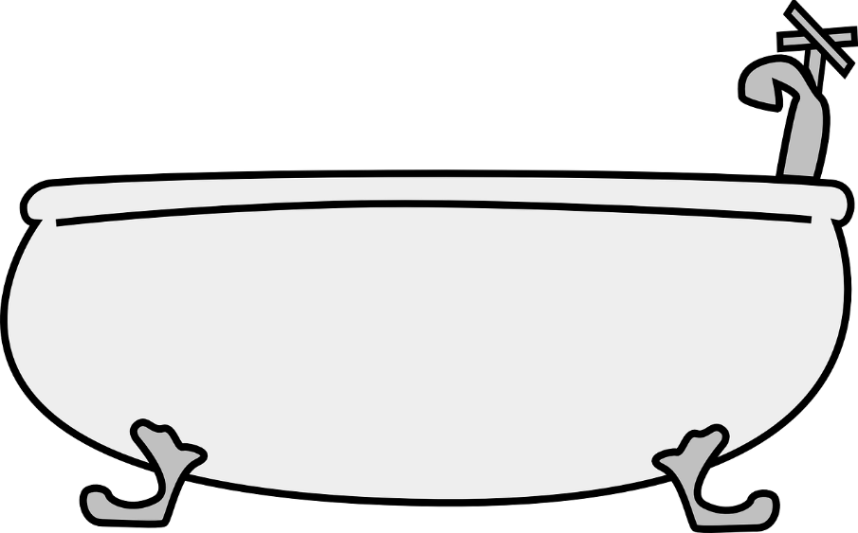
Concern: Does this mean that we get rid of themes and topics???!!!
Notes:
No! It means that they don’t come first as the primary organising principle of the curriculum. Themes and topics will still emerge when you set out to teach the most frequent, most used (therefore most useful) language. Let’s see a few examples just to reassured ourselves that this is true!

Slide 14
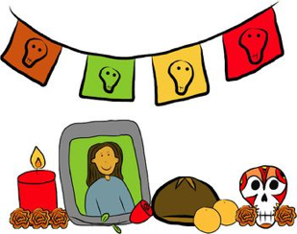
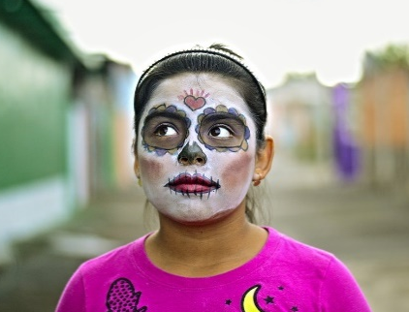
Una tradición mexicana: el Día de Muertos
leer / escuchar
Lee y escucha el texto sobre el Día de Muertos:
1
5
‘Pan de muerto’ es un tipo de pan tradicional en este día.
México tiene muchas tradiciones, pero su tradición del Día de Muertos es especialmente conocida. Es una costumbre única y muy importante para su comunidad porque es una forma de pensar en los muertos. Para los mexicanos, los muertos vienen a la tierra este día.
Nadia es mexicana y celebra el Día de Muertos con su familia. Por la mañana se levanta temprano para ayudar a su abuela: preparan pan* de muerto y un poco de fruta para el altar. Su altar tiene varios* niveles. Los niveles del altar son las diferentes partes del mundo: el primer nivel es la tierra y el segundo nivel es el cielo*. Nadia pone allí fotos de su abuelo y se sienta al lado de su abuela. Se queda unas horas en casa con su familia y se acuerda de su abuelo muerto.
Por la tarde se pone ropa divertida, se pinta de blanco y negro y va a la calle con su hermano. En su barrio hay un festival con música fuerte y luces de colores. ¡Es muy divertido!
2
6
3
7
4
*el pan = bread; *el cielo = sky, heaven; *varios = various
Notes:
Length of text: 175 words Frequency data: 95.59% words in the most frequent 2000 (removing proper nouns México, Nadia, and true cognates festival and altar). Only word not in most frequent 2000 is divertido, which occurs twice (and has, in any case, been taught).
Timing: 8 minutes
Aims:
to reinforce understanding of the difference between ‘se’ and ‘su’.
to help students to connect the spoken and written forms of the language more securely.
to consolidate vocabulary and grammar knowledge by eliciting suggested changes to the text.
Procedure:
Students read the text and write ‘se’ or ‘su’ for each space.
Click on the audio button to play the text. Read and listen.
Note: There is a full version of the audio top right with a player. Alternatively, the audio is in 6 sections with a pause just after the words 1-5 below, to facilitate easy stop/start.
To support segmentation, stop the audio and ask students to say: a) the next word b) the previous word
In addition, to develop understanding, vocabulary and grammar knowledge, pause at key points and ask students to suggest an alternative word that could replace the next word. This is a chance to draw on previously taught grammar and vocabulary knowledge.
Es una costumbre única y muy importante para su... (students volunteer other possible nouns – e.g., gente, historia, país).
y celebra el Día de Muertos con su…..(students volunteer other possible nouns – e.g., padre, madre, primo etc.).
de su abuelo y se... (students volunteer verbs in third person singular that fit after ‘se’ – e.g., se acuerda de..., se queda, se prepara (para), etc)
en casa con su familia y se ... (students volunteer other possible verbs that fit after ‘se’ – e.g., se saca (fotos), se mira en el espejo, se presenta a otra gente).
Por la tarde se…… (students are prompted other possible verbs that fit after ‘se’)
va a la calle con su…. (students volunteer other possible nouns)
Notes:
1. The word for ‘bread’ (‘pan’) will be introduced in the next week’s vocabulary set.
Transcript
México tiene muchas tradiciones, pero su tradición del Día de Muertos es especialmente conocida. Es una costumbre única y muy importante para su comunidad porque es una forma de pensar en los muertos. Para los mexicanos, los muertos vienen a la tierra este día.
Nadia es mexicana y celebra el Día de Muertos con su familia. Por la mañana se levanta temprano para ayudar a su abuela: preparan pan* de muerto y un poco de fruta para el altar. Sualtar tiene varios niveles. Los niveles del altar son las diferentes partes del mundo: el primer nivel es la tierra y el segundo nivel es el cielo. Nadia pone allí fotos de su abuelo y se sienta al lado de su abuela. Se queda unas horas en casa con su familia y se acuerda de su abuelo muerto.
Por la tarde se pone ropa divertida, sepinta de blanco y negro y va a la calle con su hermano. En su barrio hay un festival con música fuerte y luces de colores. ¡Es muy divertido!
Frequency of unknown words and cognates:
pan [1342]; cielo [620]; varios [386]
Photos:
Photo of the child by Christian Newman, from Unsplash.
Photo of ‘Pan de muertos’ by Alejandro Ávila Cortez, from Pixabay.

Slide 15
Mehmets und Heidis Ferien
lesen
Welches Verb passt?
besucht
gesprochen
gemacht
gesehen
getroffen
gewohnt
Mehmet hat Urlaub
in der Schweiz gemacht. Er hat in einem Ferienhaus gewohnt und hat jeden Tag den See besucht! Er hat auch viel Fu$ß$ball gespielt und den Wasserpark besucht! Hier haben wir nicht viel gemacht! Nächstes Jahr will ich nach Frankreich reisen.
Ja! Und das is nicht alles: Heidi hat in Spanien Urlaub gemacht. Sie hat bei Freunden gewohnt und hat viel Spanisch gesprochen. Sie hat die Großstadt von Madrid besucht. Wir haben Freunde getroffen und einen Film im Kino gesehen! Das ist nicht fair! Wann reisen wir?
1
2
7
3
8
4
9
5
10
6
11
12
Notes:
Y8.1.1.2
Timing: 10 minutes
Aim: To strengthen knowledge of weak and strong past participles.
Procedure:
1. Write 1-12. Model sentence one and answer one with students. 2. Students read each sentence and think about a past participle that fits the meaning. They write it down in German. 3. Check the answers, eliciting full sentence answers from students.
4. The audio (optional) is available upon clicking each speech bubble.
Note: For students who may need more support, the past participles are listed on the screen. To reveal them click on the question: Welches Verb passt?
Transcript (optional)
(Wolfgang)
Mehmet hat Urlaub in der Schweiz gemacht. Er hat in einem Ferienhaus gewohnt und hat jeden Tag den See besucht! Er hat auch viel Fu$ß$ball gespielt und den Wasserpark besucht! Hier haben wir nicht viel gemacht! Nächstes Jahr will ich nach Frankreich reisen.
(Mia)
Ja! Und das is nicht alles! Heidi hat in Spanien Urlaub gemacht. Sie hat bei Freunden gewohnt und hat viel Spanisch gesprochen. Sie hat die Großstadt Madrid besucht. Wir haben Freunde getroffen und einen Film im Kino gesehen! Das ist nicht fair! Wann reisen wir?

Slide 16
Léa parle des écoles en France
Léa parle des écoles en France
écouter / écrire / parler
Léa donne une présentation en classe sur le système scolaire en France.
Écoute et prends des notes.
Les différentes écoles en France.
Présentation de Léa.
Notes:
Y7 T2
Timing: 10 minutes
Aim: Dictagloss – Reconstruct a text from notes
Procedure:
Students write 1-10 in their notebooks with plenty of space for each point.
Students listen to the presentation and take notes about each point.
Play the presentation again if necessary. How many times depends on the class and ability level and is up to the teacher’s judgment.
Based on the notes students reconstruct the monologue (could be done in pairs/groups of four).
Students summarise the text in English and discuss any differences between school in France and England.
Transcript: L’école primaire est pour les élèves de six à onze ans.
On ne va pas à l’école le mercredi après-midi.
Le collège est pour les élèves de onze à quinze ans.
On ne porte pas d’uniforme.
Le déjeuner est très important. Chaque jour, on mange les repas à table dans la cantine.
Les professeurs donnent des notes sur vingt aux élèves.
Pour réussir un examen, un élève doit avoir une note de dix sur vingt (au minimum).
Si on a une mauvaise note à la fin de l’année*, on doit redoubler.
Le lycée est pour les élèves de quinze à dix-huit ans.
Au lycée, on prépare le baccalauréat. Si on réussit, on peut aller à l’université.
Word frequency of cognates used (1 is the most frequent word in French): note [1161], système [289], présentation [1723]
Source: Londsale, D., & Le Bras, Y. (2009). A Frequency Dictionary of French: Core vocabulary for learners London: Routledge.

Slide 17
Léa parle des écoles en France
écouter
Léa parle des écoles en France
1
L’école primaire est pour les élèves de six à onze ans.
2
On ne va pas à l’école le mercredi après-midi.
3
Le collège est pour les élèves de onze à quinze ans.
4
On ne porte pas d’uniforme.
5
Le déjeuner est très important. Chaque jour, on mange les repas à table à la cantine.
Notes:
Transcript dictagloss for checking.
Word frequency of (near-)cognates used:
primaire [2527]; table [1019]; cantine [>5000]
Source: Londsale, D., & Le Bras, Y. (2009). A Frequency Dictionary of French: Core vocabulary for learners London: Routledge.

Slide 18
Léa parle des écoles en France
écouter
Léa parle des écoles en France
* at the end of the year.
6
Les professeurs donnent des notes sur vingt aux élèves.
7
Pour réussir un examen, un élève doit avoir une note de dix sur vingt (au minimum).
‘Redoubler’ means to repeat a year. This happens if you are not ready to move up to the next academic year.
8
Si on a une mauvaise note à la fin de l’année*, on doit redoubler.
9
Le lycée est pour les élèves de quinze à dix-huit ans.
10
Au lycée, on prépare le baccalauréat. Si on réussit, on peut aller à l’université.
The ‘baccalauréat’ is the high school leaving qualification you need to get if you want to study at university. You take it at around age 18.
Notes:
Transcript dictagloss for checking.
Word frequency of (near-)cognates used:
minimum [1410], redoubler [>5000]; baccalauréat [>5000], cantine [>5000]
Source: Londsale, D., & Le Bras, Y. (2009). A Frequency Dictionary of French: Core vocabulary for learners London: Routledge.

Slide 19
Teachertap – 294 MFL teachers
Notes:
Teacher Tapp - https://teachertapp.co.uk/ is an app headed by Laura McInerneny and Becky Allen, where teachers answer 3 questions at 3.30 each working day. Then they get access to the previous' day's survey results - currently it has 8000+ teachers using the app.
Well over half of the respondents were either ambivalent about the topics they taught or said that they did not inspire them.
In addition, NALA carried out a survey and found that teachers were very dissatisfied with the topic based emphasis of the curriculum.
Whilst, as we have seen, the GCSE exams themselves do not necessarily draw on this very topic-specific vocabulary to an extreme extent, the washback effect of the subject content and the topic-driven choices in the awarding bodies’ lists are clearly having an effect on textbooks and pedagogy.
In fact, a very wide range of topics can be covered and we show a few examples now.
These are actually texts for teaching, but either in the notes underneath the slides and bubbles on the slides we provide some information about the frequency of the words used to show how this kind of thing could be accommodated in actual exams.

Slide 20
Aims for the session
to understand the rationale for a new approach to curriculum design
identifying issues
setting out potential solutions

Slide 21
Exploring alternatives
If we don’t foreground topics, what kind of SOW is possible?
A scheme of work driven by the language itself
More logical sequencing
Cohesion of different aspects of language (phonics, vocabulary, grammar)
Broader contexts for teaching
Notes:
So what’s the alternative? What could a SOW be like if topics didn’t come first? What would take their place as the ‘driver’ of the curriculum?
Without topics in the foreground, there is no need to make the language ‘fit’ a pre-selected topic. The language itself becomes the starting point for curriculum design. We can think about the structures and patterns that are likely to be most useful and learnable for our students.
This also allows us to sequence the teaching more logically. We can group grammar features that are naturally used together and bring them together for practice. For example, when we introduce forms of the verb ‘tener’, it seems logical to incorporate practice with indefinite articles (un/una), as people often use these features together to talk about possessions.
Without topics coming first, we can also think more about the cohesion between the different aspects of language that we plan to teach. For example, if our grammar focus is indefinite articles, which need to agree in gender with nouns, our selection of vocabulary might include nouns with regular gender marking patterns (-o for masculine, -a for feminine), and we can get students to make connections between vocabulary and grammar here.
The topics and contexts are still there, but with language taking precedence they can be made broader. For example, rather than a lesson on hobbies, we could have a lesson on ‘things that people do’ at different times and in different places.
Additional notes:
Re logical sequencing – in a topic-driven course reflexive pronouns are likely to be taught very early (je m’appelle, me llamo…). However, this is actually a complex grammar feature (word order is different from English, pronoun requires agreement with verb ending, and English often just omits it!). So if we think about the language itself, some traditional early topics probably aren’t optimal for a complete beginner in terms of language complexity.

Slide 22
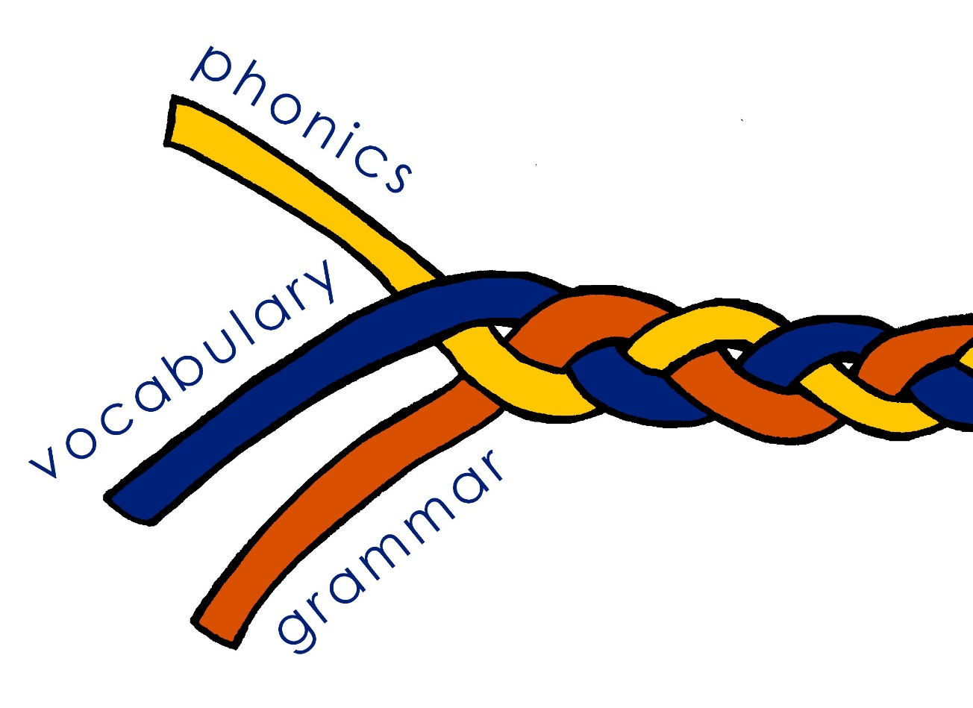
TSC review: Essential language knowledge (for beginner language learners)
Pupils need to gain systematic knowledge of the vocabulary, grammar, and sound and spelling systems (phonics) of their new language, and how these are used by speakers of the language. They need to reinforce this knowledge with extensive planned practice and use it in order to build the skills needed for communication. (MFL Pedagogy Review, p.3)
Notes:
The Pedagogy Review draws attention to three core strands of essential knowledge: vocabulary, a chosen set of words in the language; grammar – a set of features that are the essential building blocks needed to put language together to make meaningful sentences and phonics, which is the set of sound-symbol correspondences that represent the relationship between how the language sounds and how it is written.
The metaphor of the braid here indicates that the knowledge is stronger because of the interconnections between the strands. The fact that they are closely intertwined suggests that each strand is important and affects the other. The loose ends recognise that the language learning process is always unfinished, and the knowledge is vulnerable to decay, just as the braid is prone to unravelling. These themes will recur later in the session.

Slide 23
Grammar
practice with ‘pairs’ of features (not whole paradigms)
compels thinking about form and meaning
brief explanation followed by input practice, then scaffolded production
revisiting leads to freer production activities
promotes true manipulation of language, where possible
Notes:
On the last slide I mentioned three language components: phonics, vocabulary and grammar.
There will be sessions on each of these as part of NCELP’s series of talks at Bath Spa, but I’d like to outline a few of principles for each of these :
The first is to plan a SOW where pairs of grammar features are practised. For example, two verb endings with contrasing meanings (or functions) can be juxtaposed. Practising a whole new set of features together, e.g., a full range of verb endings, is unlikely to be effective, as it is beyond what most learners can pay attention to at any one time.
The practice itself should require attention to form and meaning. We might need to strip out other language in order to make attention to the grammar essential for task completion.
After a brief explanation, students are given plenty of practice, initially in reading and listening, with the new features before scaffolded production.
When features are revisited, they can be used more freely.
There is an emphasis on true manipulation of language (as opposed to chunks) as this gives students the best chance of being able to communicate meaning themselves.

Slide 24
Vocabulary
using frequency to inform vocabulary selection
mixed word classes – allowing for sentence creation
word selection to support grammar practice
teaching one new meaning at a time (e.g., rico – rich, tasty)
systematic revisiting
Notes:
Up until now we’ve had to rely on intuition about which words might be useful to learn. However, there is now data available from corpora (large electronic collections of oral and written language) on the frequency with which words occur in the language. As high-frequency words can be used across contexts (rather than for a single topic), they are particularly useful in a time-limited teaching context.
The current GCSE proposals suggest teaching 90% of words that are among the 2000 most frequent in the language – on the next slide I will show a graph illustrating the potential implications of this for text comprehension.
Other principles for vocabulary teaching include:
combining different word classes in a each vocabulary set. This offers greater potential for sentence building than, say, a list of nouns used to fill a slot after a verb.
choosing words that are closely related to the grammar being practised – again, this is the cohesion between different language components that I mentioned on the last slide.
teaching each meaning of a word separately to avoid unnecessary difficulty. High-frequency words often have more than one meaning – e.g. rico for rich and tasty.
systematically revisiting previously taught words. This is the crucial factor leading to long-term retention.

Slide 25
Usefulness of words
The usefulness of the most frequent 1,000-1,300 words!
How many words in a text do you know if you know very high frequency words?
◆ General conversation  More formal speech – e.g. lectures  Written language
worked cited in Milton, J. (2009) Measuring second language vocabulary acquisition (p. 58). Multilingual Matters.
Notes:
To illustrate my first point about the usefulness of high-frequency words, here is a graph based on data about the English language.
The findings come from 100s of millions of words collected from a wide range of contexts.
You will see that the x axis along the bottom is ‘words by frequency’ – so, 1,000 means the most frequent 1000 words in a language.
The y axis is called ‘coverage’ – this is the amount of words in a text you will understand if you know the 1,000 or 2,000 most frequent words etc.
The top grey line is the estimation for general conversation – very high frequency vocabulary is the most important for this
The middle line is the estimation for more formal speech – the media, educational contexts,
The bottom line is the estimation for written language – you tend to get rarer words being used in written texts – though this massively varies according to context and genre (type of text)
I want to highlight three things about this visual:
First – you will see that knowing just the most frequent 200 words gives you a massive boost – you can see a really, really steep curve here – knowing these words gives you access to between 50% and 75% of any input you hear or read
Second – If you know somewhere around 1,700 of the most frequent words you can probably understand between 70% and 92% of things you read and hear.
Third - This very clear value of knowing really high frequency words tends to almost completely plateau after about the 1,700 to 2,000 most frequent words; but this plateauing starts even earlier, at between 1,000 and 1,500 most frequent words. So, after knowing about the 1,500 most frequent words, how much you understand depends on whether you happen to know those other, rarer words. We need to know A LOT of words to be able to be sure that we will understand any more of a text.

Slide 26
Concern: Aren’t high frequency words just mainly the function words?

Slide 27
Common concerns
47.5% nouns
25.1% verbs
16.3% adjectives
1) Aren’t high-frequency words just the ‘function’ words?
How are they going to be able to talk about anything meaningful?
majority of words in top 2000 are nouns, verbs and adjectives
a much smaller proportion (<5% of the total) is made up of prepositions, conjunctions and articles
Source: Davies, M. & Davies, K. (2018). A frequency dictionary of Spanish: Core vocabulary for learners (2nd ed.). Routledge: London
Notes:
People have rightly asked questions about frequency data informing vocabulary selection.
One of these is whether learning the most frequent words actually allows you talk to about anything meaningful.
The answer is ‘yes’!
In the Spanish frequency dictionary published by Routledge, most words in the top 2000 are nouns, verbs and adjectives – typically the ‘content’ words – whereas fewer than 8% are prepositions, conjunctions and articles (usually considered the ‘function’ words).

Slide 28
Concern: Does this mean teaching completely different words from those we are teaching now?

Slide 29
Common concerns
2) Does this mean teaching completely different words to those typically taught now?
Some of our intuitions about ‘useful’ language seem right!
But there are also useful words that haven’t been regularly taught before (especially words that are not topic-specific)
Notes:
Another question is just how different vocabulary selection would be in a frequency-informed SOW compared to a traditional one.
Obviously this would depend on each individual SOW, but a look at texts and word lists being used by exam boards suggests that the words being used in assessments are a mix of both high- and low-frequency words. I’ll show a specific example on the next slide.

Slide 30
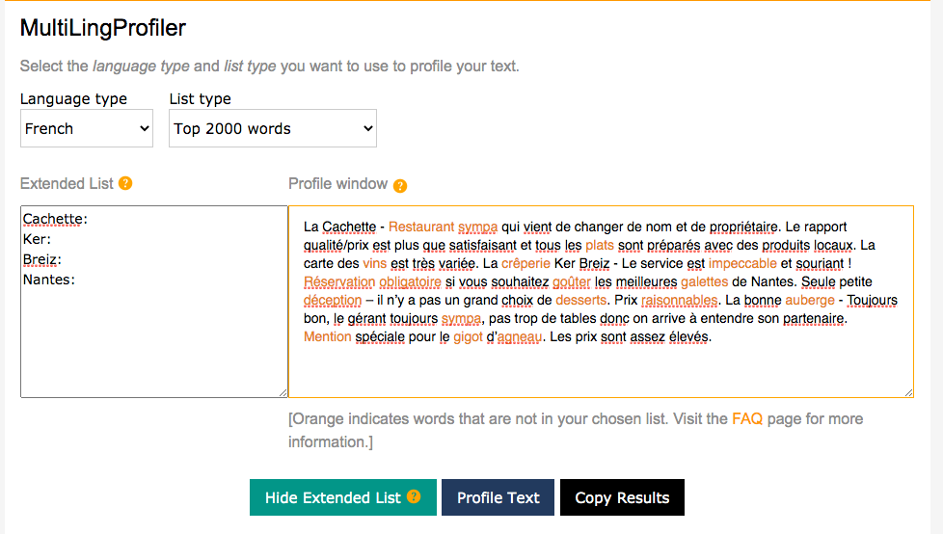
AQA French GCSE 2018 Reading Higher Tier
Percentage of words in most frequent 2,000 = 83%
Notes:
This screenshot shows the output from the MultiLingProfiler, a tool developed by NCELP that allows you to measure the percentage of words in a text that are within the 2000 most frequent words in the language. We profiled an AQA GCSE French reading paper from 2018.
All words that are orange are those that are outside of the 1-2000 range. NCELP profiled a number of texts and this was the one with the highest percentage of words not in the top 2000. Even so, coverage is 79% before proper nouns removed. When you add those to the list (because proper nouns are not included in the frequency dictionary), then the text has 83% already in the most frequent 2,000.
So we aren’t really looking at using such different vocabulary. It seems that quite a lot of the vocabulary already being taught and assessed is highly frequent, supporting our intuitions. It is just that we now have data to confirm it and can spot the examples of low-frequency vocabulary where we might reconsider the usefulness of a word.

Slide 31
Adapted text following profiling
With changes and glossing 91%
La Cachette - Restaurant sympa accueillant qui vient de changer de nom et de propriétaire. Le rapport qualité/prix est plus que satisfaisant et tous les plats sont préparés avec des produits locaux. La carte des vins est très variée. La crêperie Ker Breiz - Le service est impeccable excellent et souriant ! Réservation obligatoire Il faut réserver si vous souhaitez goûter manger les meilleures galettes de Nantes. Seule petite déception critique – il n’y a pas un grand choix de desserts. Prix raisonnables Pas trop cher. La bonne auberge - Toujours bon, le gérant toujours sympa heureux de vous voir, pas trop de tables donc on arrive à entendre son partenaire. Mention spéciale pour le gigot d’agneau. Les prix sont assez élevés.
Glossed: vins, galettes, gigot d’agneau, plats
Plus: desserts, restaurant, crêperie, mention (if no cognates can be added)
Notes:
With a few small changes to the text we can increase the proportion of words within the top 2000 to over 90% leading to a greater likelihood of text comprehension.

Slide 32
Concern: Don’t high frequency words depend on which corpus you use?

Slide 33
Common concerns
3) Don’t the most highly frequent words depend on which corpus you use?
comparisons of different corpora suggest significant overlap
E.g. German web 2013 (deTenTen13) shares 81% of the 2000 most frequent words in Jones & Tschirner (2019).
Notes:
Another question is whether the 2000 most frequent words vary according to the corpus used.
We have done some work at NCELP comparing corpora to explore this. We found a large overlap of 81% between the 2000 most frequent words in two general corpora of German (deTenTen13 and Jones & Tschirner). Similar comparisons have been done for English, French and Spanish, again pointing towards a considerable overlap, even when making comparisons with specialised corpora (like legal or political texts).

Slide 34
Concern: Shouldn’t they be learning more words not fewer?

Slide 35
Common concerns
4) Are 1200 and 1700 enough words? Shouldn’t students be learning way more words than this?
Can pass a GCSE with…(receptive knowledge)
852 words by year 11 (Milton, 2006)
564 words by year 11 (David, 2008)
NCELP curriculum design suggests:
With systematic revisiting & active practice over 5 years (approx. 450 hours):
approx. 364 words per year * 5 years (minus one term in year 11)
= 1699 words, if all are retained and can be both understood and produced
Notes:
Another concern raised is whether the proposed 1200 at foundation tier and 1700 tier is enough, and whether students should actually be taught more words.
A couple of studies have been done on the average vocabulary size of a student at GCSE level, and have found that students can pass a GCSE with only 500-800 words known receptively (the number of words in their productive vocabulary would be smaller). So we do need to think about what is realistically possible to learn securely, given existing constraints on curriculum time, and also what would be fair to assess on that basis.
In our own schemes of work, we envisage that 364 words could be taught per year, with 1699 words that could be understood and produced, following a programme of systematic revisiting and active practice.

Slide 36
Phonics
explicit teaching of the key sound-spelling correspondences (SSCs)
improves ability to accurately sound out unknown words
positively associated with motivation and confidence in spoken and written production
supports errorless learning (accurate representation of the language from first exposure)
Notes:
The final component is phonics teaching: explicit teaching of the relationships between the letters of written words and their sounds.
Research has found that this improves students’ phonological decoding ability (their ability to sound out unknown words).
There are also many related benefits in terms of motivation and confidence in oral and written production.
And this also supports errorless learning – avoiding inaccurate representations regarding how the how new language sounds and is spelt.

Slide 37
Summing up
Full SOW evaluation doc here!
https://resources.ncelp.org/concern/resources/p2676v62m?locale=en
Five questions for SOW evaluation:
What is ‘driving’ the choice of the language and order of teaching?
When is each grammar feature taught and why then – what is the rationale for the sequencing?
Is the vocabulary highly frequent? How is the frequency known?
Is there explicit phonics teaching? Which SSC are taught and why?
How often is each language feature re-visited? Is it practised in both comprehension and production?
Notes:
In this part of the presentation I’ve spoken about potential solutions. We can’t claim to present all of them here, not least because there is no single one-size-fits-all scheme of work. Different SOWs may be successful with different learners in different contexts. But to be confident in the planning, here are some key questions that we can ask:
Firstly, what is driving the choice of language and the order in which it is taught? Is it the usefulness of the language itself, or are we compromising (students’ ability to make progress in language learning) by making the language ‘fit’ a certain topic?
Secondly, when is each grammar feature taught? Why then? Here we might think about things like cross-linguistic complexity (does the feature exist in English? If so, does it work in the same way?).
Thirdly, how frequent is the vocabulary and what is our source? One published source of frequency data is the Routledge series of frequency dictionaries.
Fourthly, is there explicit phonics teaching – which SSC are taught and why?
Finally, how often do we revisit each language feature? And when we revisit them, do we give opportunities for that revisiting to happen in comprehension and production?

Slide 38
Explore one SOW in detail
Think of a SOW you are currently using
How is it laid out? in columns?
What headings does each column have?
What detail is included – about the language content?
Notes:
We are going to walk through the Y8 French Scheme of Work. All the SOW share the same design features. Before we start, it will be useful for us all to visualise a scheme of work, think about one that we know well. How is it laid out? In columns? What are the headings? What detail does it have? As you conjure up one of the SOW you are currently using, type the features that you see into the chat.

Slide 39
Tabs in the NCELP SOW
The grammar tracking tab is a week-by-week overview of the grammar spine, listing the new and revisited grammar features.
Notes:
NCELP SOW are written in excel. If you look at the bottom of the SOW Excel document you can see a number of useful tabs. We are going to explore the five main tabs:
Y8 Grammar tracking
Y8 SOW
Y8 Resources
Y8 Vocabulary List
Y8 multiple senses

Slide 40
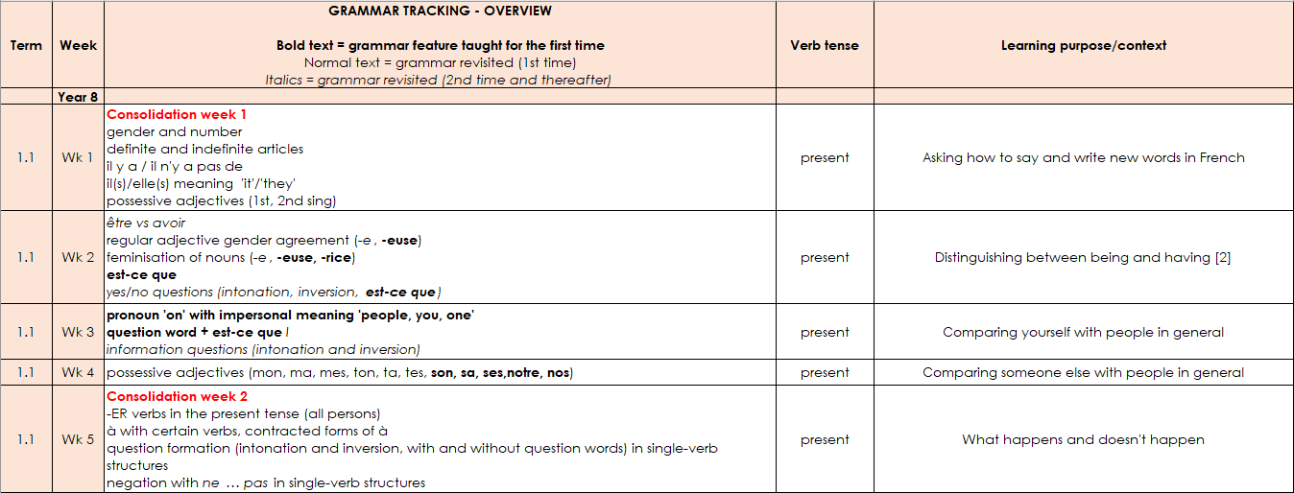
Grammar tracking tab
This columns denote the focus tense for that week.
This column gives the learning context.
A consolidation week revises vocabulary from Y7 and grammar features from either Y7 or Y8.
New grammar features are in bold type.
Features for 1st time revisiting are in normal type.
2nd and subsequent revisits are in italics.
Extended text exploitation weeks are in blue type.

Slide 41
Tabs in the NCELP SOW
The Y8 SOW tab is the detailed planning document for each week, with grammar, vocabulary, sounds of the language, and lesson overviews.

Slide 42
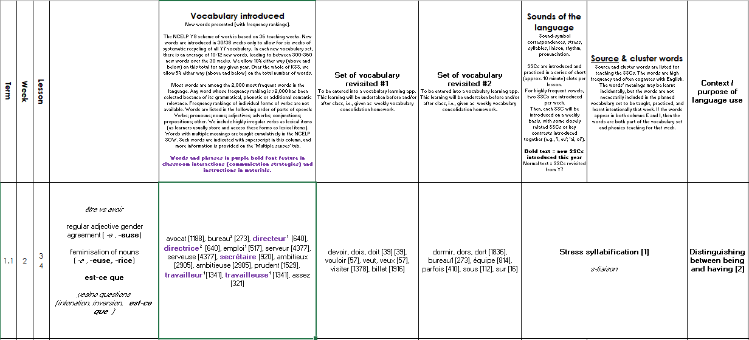
Y8 SOW
Sounds of the language practice in every lesson.
Systematic revisiting of vocabulary every 3 weeks and 9 weeks.
new | revisit | revisit
The grammar column reproduces the
information from the grammar tracking tab.
Additional notes detailing the content of each lesson.
Notes:
This is what the layout of the Y8 French SoW looks like – this is from week two of the first term.
Starts with grammar introduced – here est-ce que – in addition it references the grammar to be revisited, regular adjective gender agreement and the feminisation of nouns. Revisited for the second or subsequent time are yes/no and intonation questions (in italics).
Then we see new vocabulary introduced as well as vocabulary to be revisited – we revisit two sets of vocabulary every lesson from three and nine weeks ago - you can see that the sets differ a little in the number of words in each – the vocabulary is integrated as much as possible, but there are also stand-alone vocabulary tasks, where needed.
Then the sounds of the language - in this week we are doing stress syllabification and a 2nd revisiting of s-liaison.
There is still a context – no traditional topic but a context for language use, here it is ‘Distinguishing between being and having’. This particular week is a typical SOW week. In addition, at regular intervals there are weeks set aside for some revision and consolidation, assessment (in term 2 and 3) and also for work on “rich” texts or authentic text exploitation, as we saw on the grammar tracking tab.

Slide 43
Tabs in the NCELP SOW
The RESOURCES tab is a page of individual links to each SOW resource.

Slide 44
Resources
Notes:
Each hyperlink takes you to the resource on the portal. You can choose the full lessons or you can download the PVG elements separately – the quizlet links for vocabulary introduced and also the vocabulary learning homework sheets

Slide 45
Tabs in the NCELP SOW
The NCELP Y8 vocabulary list contains all French words taught in Y8, with English meanings, parts of speech and frequency information.

Slide 46
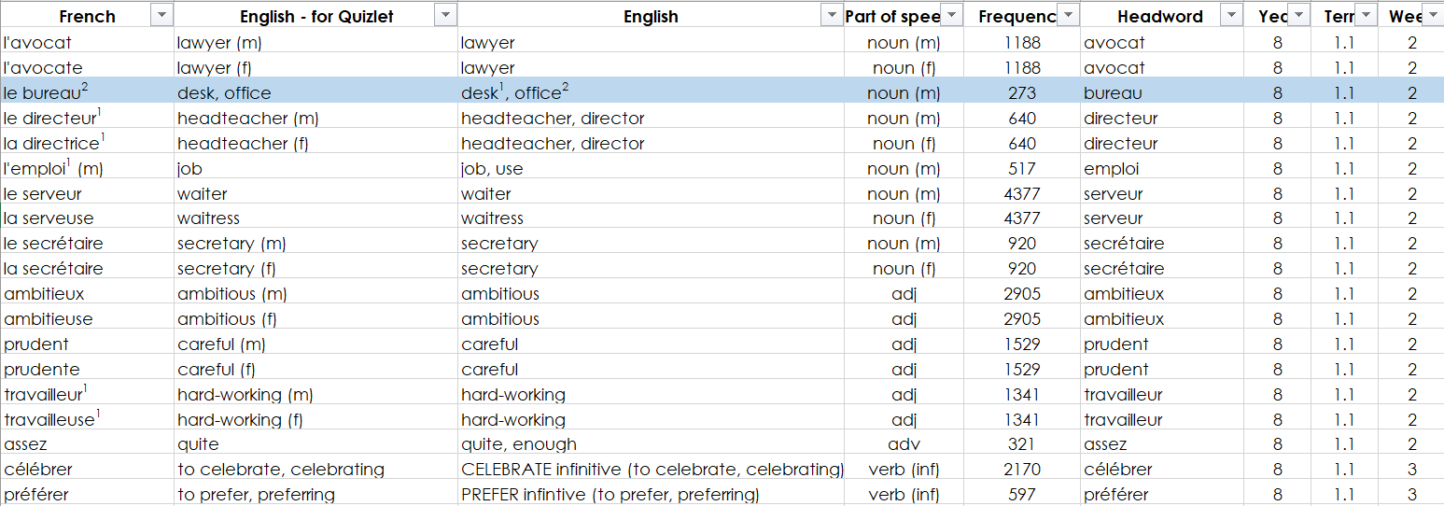
Y8 NCELP vocabulary list
Source of frequency information:
Londsale, D., & Le Bras, Y. (2009). A Frequency Dictionary of French: Core vocabulary for learners London: Routledge.
Frequency ranking of all words is provided, here.

Slide 47
Concern: How can I change things now without changing everything?!

Slide 48
Curriculum design take-aways
Phonics - working with unknown words
Vocabulary - shortcut to systematic revisiting
Grammar - input practice before production

Slide 49
Aims for the session
to understand the rationale for a new approach to curriculum design
identifying issues
setting out potential solutions
Questions?

Slide 50
References
Londsale, D., & Le Bras, Y. (2009). A Frequency Dictionary of French: Core vocabulary for learners London: Routledge.
Ofsted, (2019a). Inspecting the curriculum, May 2019, 190024, www.gov.uk/government/organisations/ofsted.
Ofsted, (2019b). School Inspection Handbook, September 2019, 190024, www.gov.uk/government/organisations/ofsted. Roffwarg, H. P., Muzio, J. N., & Dement, W. C. (1966). Ontogenetic development of the human sleep dream cycle. Science, 152, 604–618. Teaching School Council, (2016). Modern Foreign Languages Pedagogy Review.

