Slide 1
TRG 7
Computer Assisted Language Learning (CALL)
Date
Presenter(s)
Notes:
Please read the CALL TRG 7 Presenter Notes and Timings document first.
This is a session about how digital technologies can support language learning. We will consider a range of areas but there will be a focus on vocabulary learning, particularly outside the classroom in order to see how we might best support students to learn and retain vocabulary in the long-term, whilst operating within a time-limited teaching context.
Handout 1 Oral Homework
Handout 2. The positive relationship between out-of-school exposure and vocabulary knowledge. Peters et al. (2019)
Handout 3. Vocabulary Learning Homework Example Worksheets in French, German and Spanish (includes links to guided audio)
Handout 4. Quizlet Guide

Slide 2
Updates, Sharing and Feedback
David Shanks
Notes:
You are encouraged to set aside time for updates, good practice sharing and feedback in TRGs. Aim to pull together the different strands of your collaborative work to date.
Some lead schools have shared videos of good practice seen on their visits to Hub schools to excellent effect. Equally, STs describing good things you have seen on observations or strategies/resources that have worked for you in your lessons is also recommended. You may consider asking someone from a hub school to be ready to present briefly on their NCELP-informed classroom practice as lead schools did at residential 2. Alternatively, quick contributions from all hub schools could be a useful format.
Equally, you can gauge and note any emerging challenges for feedback to NCELP. Do focus on the successes of which there are many – particularly to set the tone at the beginning of your session!

Slide 3
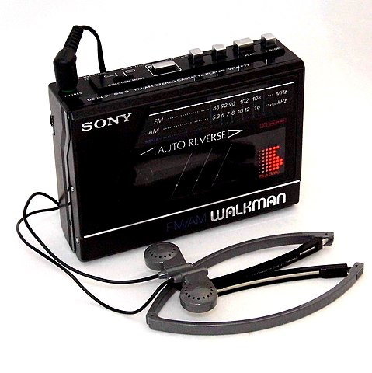
What links the following?
Is technology a silver bullet for language learning?
The Guardian, 2014
France bans mobile phones in schools
…The government has banned mobile phones in schools for all pupils up to the age of 15.
BBC, 2018
Image attributions in slide notes
David Shanks
Notes:
Starter – the images are all inventions that came about as a result of the technological developments of the time but that were also met with initial negativity, scepticism and even fear. This is a way to try and encourage anyone strongly against tech to keep an open mind.
The written word / writing things down – Socrates was against writing things down as written words would only be a semblance of the truth and “create forgetfulness in learners’ souls”. We only know this because Plato wrote it down!
Mirrors – people used to think they captured your soul in the glass, some tribes would smash mirrors left by anthropologists
Trains – some thought that if humans travelled at high speeds they would die in a gruesome ways such bodies melting or blood vaporising
Cassette recorders – the 1980s campaign told us that “home taping is killing music”
Is tech a silver bullet or something to be banned? Edutech utopianism Vs strong “anti-tech’ views – a false dichotomy? We all probably have quite firmly established views on tech in MFL and sit somewhere on a continuum. For any technophiles – is what you do effective and what is the pedagogical rationale? For any “technophobes” – could you make use of tech to enhance students’ learning? A balanced approach is optimal, one that leverages technology effectively for language learning whilst avoiding pitfalls of poorly implemented and unplanned use of tech. Context is key (tech infrastructure, student access, teacher tech knowledge as we will come back to later).
Image attributions, clockwise from top left:
1. Emoji One, Emojione 1F4DD, CC BY-SA 4.0. https://commons.wikimedia.org/wiki/File:Emojione_1F4DD.svg
2. Pixabay License. Free for commercial use. No attribution required. https://pixabay.com/photos/people-woman-frame-camera-shutter-2574337/ https://pixabay.com/service/license/
3. Trougnouf (Benoit Brummer), Steam locomotive Haine-Saint-Pierre No. 1378-1922 in Baasrode-Noord train station, Dendermonde (DSCF0566), CC BY-SA 4.0. https://commons.wikimedia.org/wiki/File:Steam_locomotive_Haine-Saint-Pierre_No._1378-1922_in_Baasrode-Noord_train_station,_Dendermonde_(DSCF0566).jpg
4. Joe Haupt from USA, Vintage Sony Walkman, FM-AM Stereo Cassette Player, Model WM-F77, Made In Japan, Circa 1986 (44032204520), CC BY-SA 2.0. https://commons.wikimedia.org/wiki/File:Vintage_Sony_Walkman,_FM-AM_Stereo_Cassette_Player,_Model_WM-F77,_Made_In_Japan,_Circa_1986_(44032204520).jpg

Slide 4
Session Outline
Models for the use of educational technology
CALL benefits and trends
Practical examples of CALL, linked to NCELP work:
Oral Homework
Guided Learning Audio Homework (prototype)
Quizlet (hands on time)
Duolingo
David Shanks
Notes:
The main message is for use to be reflective and think a bit more deeply about any technology we might use, particularly in relation to NCELP principles.
As such, this will not be a “resource-a-minute session” and instead a smaller number of CALL resources considered.
There will be many other CALL resources full of great potential out there and some being used effectively by teachers. There will be a chance for these to come through in TRG discussions and be shared.

Slide 5
The Bigger Picture
Technology is nothing more and nothing less than the application of technical knowledge for practical purposes
When used effectively:
It improves and streamlines processes, facilitating the completion of tasks more effectively and easily.
It allows us to do things that would be inconceivable without the use of technology. (Picardo, 2017)
David Shanks
Notes:
A reminder as to why we use technology in the first place. Not because we feel we should or it’s trendy but because it can make things more efficient and presents us with new (useful!) opportunities. The caveat is in bold – when tech is not used effectively it can potentially be damaging and waste valuable learning time.

Slide 6
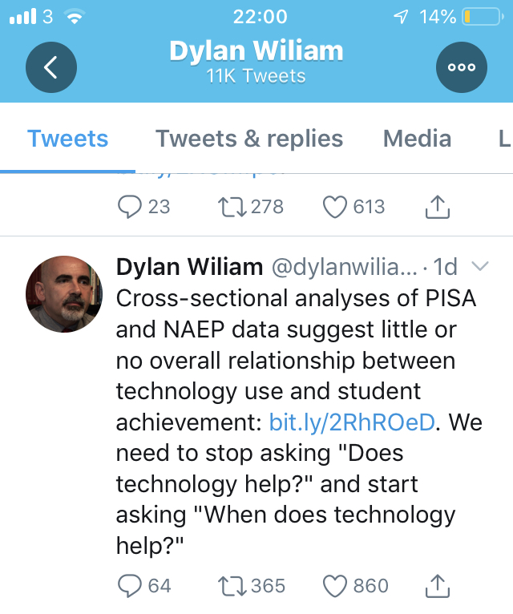
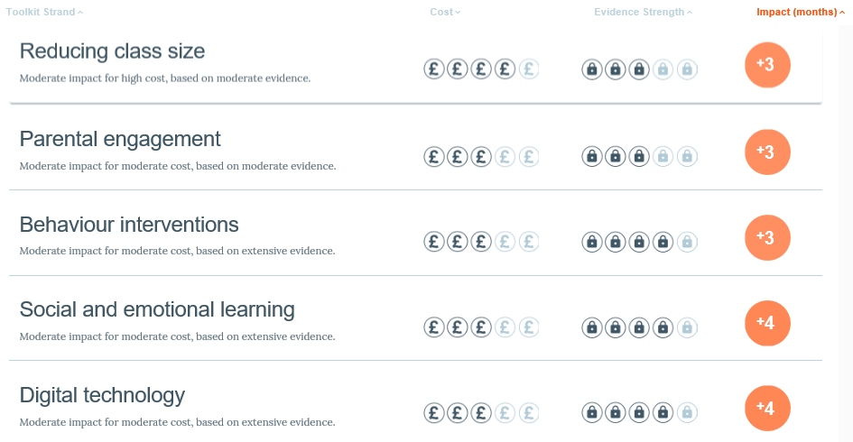
The Bigger Picture - Debate
Reboot Foundation (2019)
Education Endowment Foundation (2019)
David Shanks
Notes:
NB The animated reveal will show the rest of Dylan Wiliam’s tweet and the main message we would like to get across: We need to stop asking “does technology help?” and start asking “when does technology help?”
This slide is to show that technology in education produces a lot of debate and even 2 meta analyses, from the outside, paint a contradictory picture.
EEF(2019) would indicate that Digital Technology has a more positive impact on learning than reducing class sizes. Ask teachers if they agree!
You should remind teachers of the nature of meta analyses – they give a useful overall, simplified picture but are based on a range of studies that may differ from one another in their findings. Anything that looks at the top-most level will lose the detail from the various contexts of different research. Context is key as we will come back to later.

Slide 7
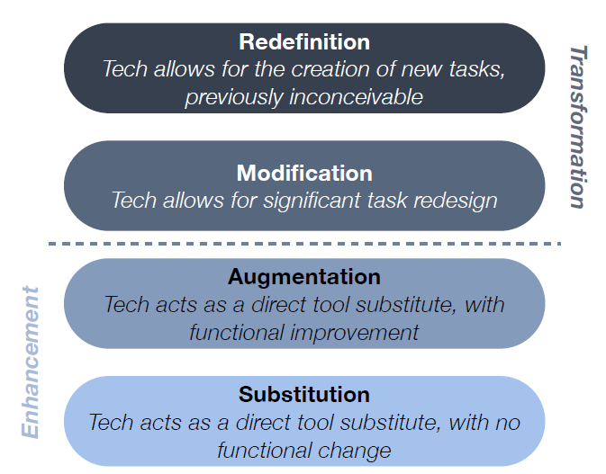
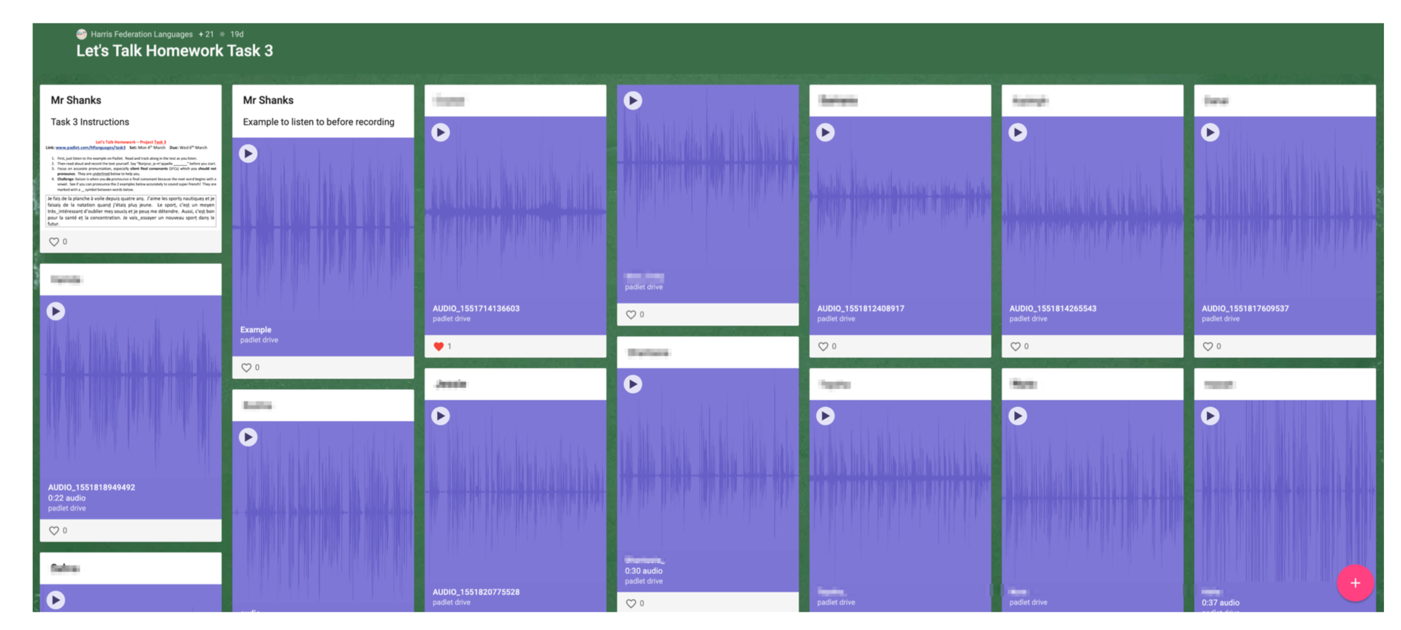
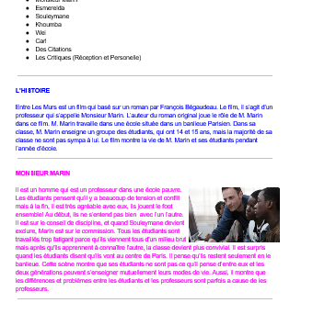
The SAMR Model
Access out of class
(Puentedura, 2010)
David Shanks
Notes:
Introduce the SAMR model. The model should not be seen as a strait jacket to categorise the use of technology, but used to convey the idea that it is desirable to move from the bottom of the model (substitution) towards the top (redefinition) as far as is possible. In short, what does the use of technology bring to the table that couldn’t be achieved without technology?
Ask teachers to think of examples of technology use in education and consider where they might fit on the model.
Example 1 – outside of school Language Perfect World Cup competition in which 30 students answered 106,150 MFL questions in 10 days – a new task (Redefinition)
Example 2 – Entre Les Murs digital brochure produced collaboratively by (KS5) students in Google Docs. Students worked as a magazine editing team outside of class – each wrote a section of the brochure (e.g. synopsis, critical reception, key quotes, character profiles). 2 more able students were the editor and proof reader. (Modification)
Example 3 – Use of padlet.com to have students record oral homework and post to the class bulletin board shown (Redefinition)
Access out of class is common to all these examples and this is something technology can strongly support in MFL – important in light of time poor context and research e.g. The positive relationship between out-of-school exposure and vocabulary knowledge. Peters et al. (2019). The capacity of modern technology to support the oral modality is also significant.

Slide 8
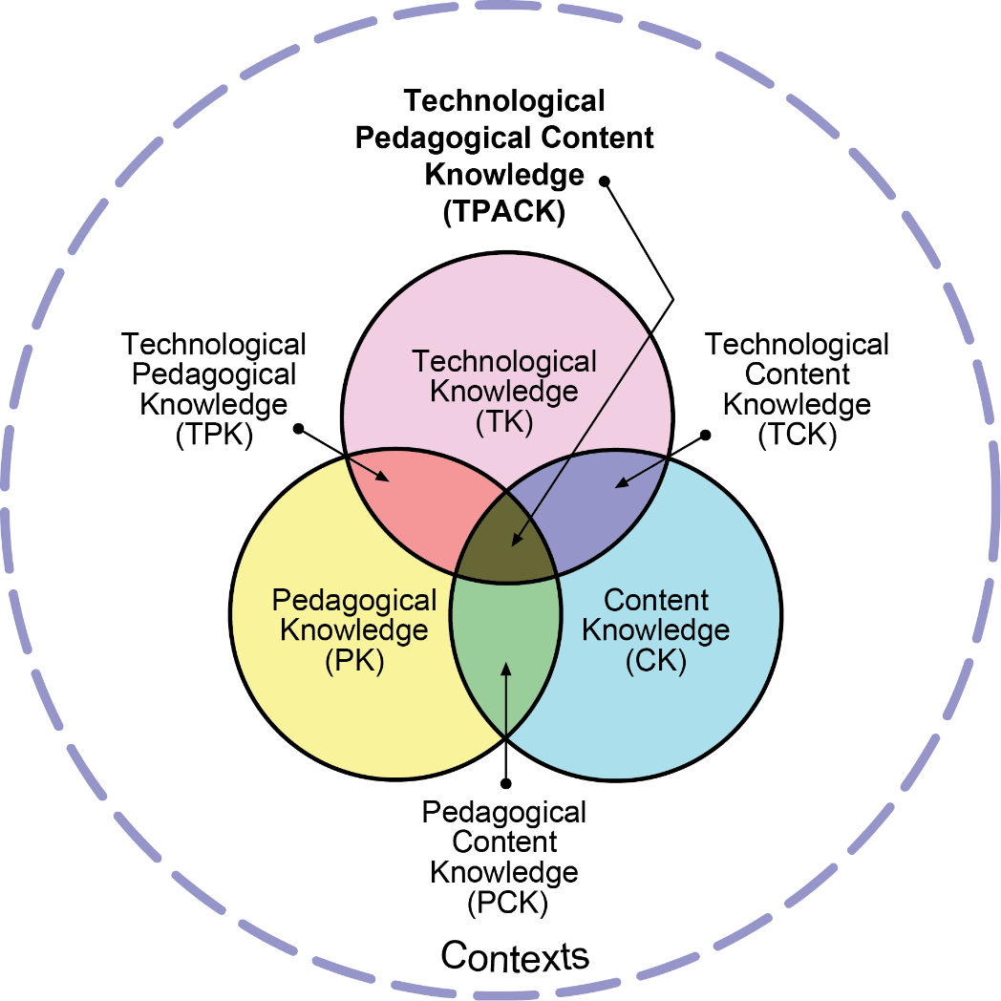
The TPACK Model
Think–pair-share:
What key messages do you take from this model for the use of technology in education?
And in the context of our NCELP work?
(TPACK.org, 2012)
David Shanks
Notes:
Aim to elicit the following possible key messages:
Teachers knowing how to use the tech on a practical, technical & admin level is important (and the training/upskilling implications for teachers and students)
Knowing the tech alone is not sufficient.
Importance of how the technology interacts with the pedagogical approach and the content (NCELP’s PVGMP in our context).
Examples related to NCELP pedagogy – does the technology focus on a solid verb lexicon or higher frequency words? How is the role of decoding supported? Does it trap the form (Gaming Grammar)
Pedagogical and Content Knowledge can lead us to informed decisions about what, if any, tech to use and when.
Importance of local contexts in determining how successful the use of technology is - accessibility of resources, funding, tech infrastructure, software/hardware, teacher tech expertise, GDPR requirements, school policy, school-wide learning or homework platforms in use

Slide 9
Some Benefits of CALL
Increased motivation, differentiation, interaction with L2 and native speakers, positive association with attainment (BECTA, 2004)
Automated, immediate feedback
Complex competencies broken down – short term goals
Evidence of achievement or progress - metacognition (familiar, mastered, %, ●●● )
Gamification and competition can increase motivation
Restructuring / retesting the same content in new ways
Increasing ability to work across modes and modalities (SSC, audio in/out, multimedia)
Out of class learning – very significant in a time-poor context
Points 2-5 in particular may overlap with learning preferences of some boys in MFL
David Shanks
Notes:
Bullet 2. A great timesaver for teachers and also powerful for students’ metacognition – students can get live feedback on each individual question rather than the potentially long time delay between answering and feedback from the teacher
Bullet 4. some platforms will tell you which words or content you have seen/are familiar with/ have mastered, give you a percentage completed counter or traffic lights etc. This helps students with metacognition – their awareness of their own learning and progress
Bullet 9. e.g. immediate feedback, short-term goals, evidence of progress and competition may align with the learning preferences of some boys (without having an adverse affect on the learning preferences of some girls and also potentially benefitting some girls)

Slide 10
Trends in CALL
Proliferation of Open Educational Resources
Blending Formal and Informal Learning
Data-driven Technology (learning analytics, adaptive learning)
Mobile Learning
Immersive Technology
90% of households in the UK have internet access (Ofcom, 2018)
Proliferation of Internet-connected mobile devices: 80% of 8-11s making use of tablets (Ofcom, 2016)
Mobile device recording capabilities, increasing connectivity speeds
Be acutely aware of digital equity. Have alternative provisions.
David Shanks
Notes:
Proliferation of Open Educational Resources – many educational resources are now open source / free and increasingly accessible
Blending Formal and Informal Learning – learning no longer just takes place in the formal “bricks and mortar” classroom. Opportunities for remote, connected learning.
Data-driven Technology (learning analytics, adaptive learning) – algorithms will track your performance e.g. Quizlet will re-quiz you on word you got wrong, Duolingo will adapt questions based upon your previous answers
Mobile Learning
Immersive Technology – tools like augmented reality and virtual reality. Not commonplace for language learning yet, but immersive games of the future could require you, for example, to speak in L2 to navigate a game

Slide 11
However…
When NASA first started sending up astronauts, they quickly discovered that ballpoint pens would not work in zero gravity. To combat the problem, NASA scientists spent a decade and $12 billion to develop a pen that writes in zero gravity, upside down, underwater, on almost any surface, and at temperatures ranging from below freezing to 300 degrees Celsius.
The Russians used a pencil.
David Shanks
Notes:
Play the “whip” effect animation and ask teachers what the message of this slide is.
Answer: This “joke” is actually a myth, but it provides an apt reminder to not get lost in the technology, keep it simple, and only use the technology when there are advantages or, in our case, a clear pedagogical rationale
An aside – adding animations can waste a lot of teacher time in preparing resources, but the “whip” entrance effect can be used to good effect to increase students focus as the words arrive. The speed can be changed so you might invite students to translate silently in their heads as words arrive slowly, then increase the speed on a following slide and ask students to translate aloud in pairs, then you could go faster still and mix up the order of language.

Slide 12
Pedagogy above all else
As computer technology is constantly developing, it is clear that the effectiveness of CALL cannot reside in the medium itself, as it is always changing; rather, effectiveness must be judged in how these technologies are put to use in ways that are consistent with theoretical and pedagogical development and education.
(Smith, 2015)
CALL is not just about the technology, app, platform or website being used, it is “a dynamic complex in which technology, theory, and pedagogy are inseparably interwoven.”
(Garrett, 2009)
David Shanks
Notes:
These 2 quotes remind us to be considered and reflective in our use of technology and that we should have good pedagogy as the starting point (NCELP’s mission!)

Slide 13
From the Pedagogy Review:
…a planned approach to teaching vocabulary, grammar and phonics…should be supplemented by additional, attractive resources, including ICT…
ICT has also been shown to be very effective in the field of vocabulary, provided that it is used as an aid to teaching rather than a replacement for it. This all requires very careful planning.
[Students] should have opportunities to interact with native speakers, both in person and through video links.
Question for MFL leaders from PR: how is ICT being used to reinforce and support teaching?
David Shanks
Notes:
Refer back to ICT references from the Pedagogy Review

Slide 14
Group Task
Write down all the technology you use for MFL on the flipchart paper
Tally underneath each technology the number of teachers using it
Critically discuss the effectiveness of each tool in light of NCELP pedagogy – think phonics, vocabulary, grammar, meaningful practice
Also consider motivation, gender, admin, accessibility, compatibility, past or envisaged issues and solutions
David Shanks
Notes:
Flipchart/A3 paper needed.
Join group discussions or circulate and encourage reflective discussions focussing on bullets 3 & 4 rather than just gathering a list of resources.

Slide 15
Practical Examples
Computer Assisted Language Learning (CALL)

Slide 16
[5 easy wins for MFL Teachers]
The B key
Reduce audio playback speed (VLC Player, Youtube)
A DIY visualizer – use a flattening app e.g. MS Office Lens
Windows snip tool
Have students set their phone in the L2 as a homework
David Shanks
Notes:
An optional slide of super fast tricks for MFL teachers you can relay – these are less specifically related to NCELP principles but teachers tend to find these useful!
Blanking the screen can be a useful signal to students for attention and also reduce split attention. Good also for follow-up activities or Q & A with the support of language or prompt on the board removed.
2. Students often underperform on listening tasks and the stress of “missing the answer” can be reduced by slowing down the audio. Slower audio and a higher success rate in a task are likely preferable to presenting more authentic speeds and a dent in motivation.
3. Use an app such as Microsoft Office Lens (or even a simple photo on your mobile) to email yourself a picture of student work to project on the board. Excellent for showcasing success, modelling and peer assessment. This could be done live in lesson or from book before a lesson and then built into subsequent lesson slides.
4. Type “snip” in windows search and launch “Snipping Tool”. Select the exact content you want a picture of. This saves valuable teacher time on formatting and cropping images and is great for grabbing authentic materials from website for example.
5. An easy way to expose students to L2 outside the classroom and zero-prep on your behalf. As a homework task, ask students to change the language on their phone/device and ask them to record all the vocabulary they worked out the meaning of in an L2-L1 vocabulary list. Students can often infer meaning from the tech context and generally enjoy the task.

Slide 17
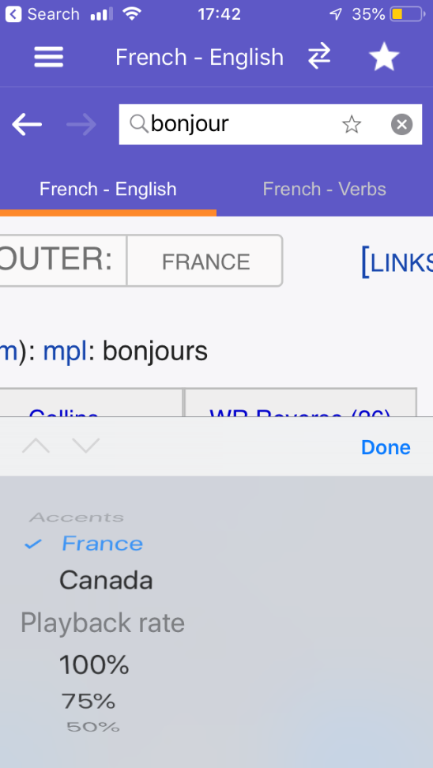
Supporting Phonics / SSC
www.wordreference.com mobile app (free)
David Shanks
Notes:
It can be useful to inform students that dictionary apps such as Wordreference can speak out words to model pronunciation (link to phonics, independent learning and motivation)
Click the embedded video on the right to play through an example. If time allows, ask teachers if they have any experience of other dictionary tools or good practice to share with the group from their contexts.

Slide 18
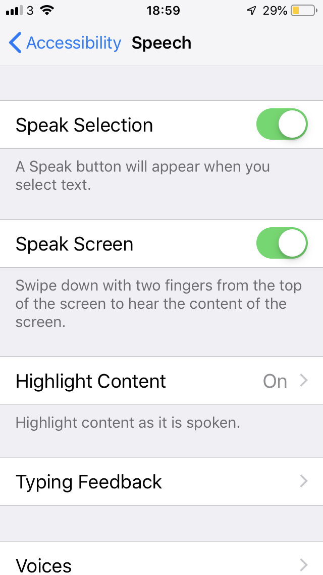
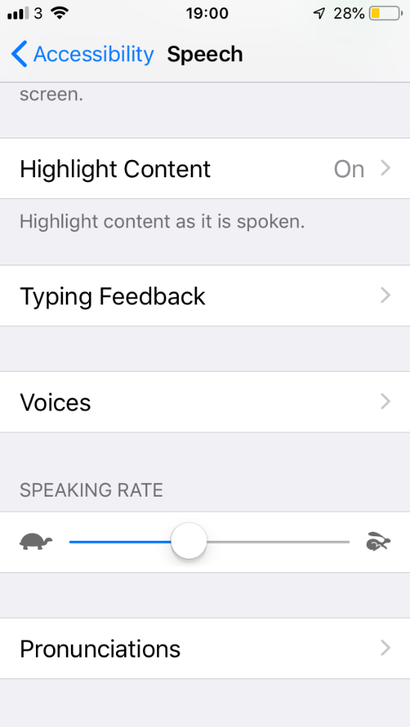
Supporting Phonics / SSC
MS Powerpoint/Word
OS native functionality (iOS)
David Shanks
Notes:
This is a built in function of iphones. By setting the speech settings as shown, L2 text can be read aloud by the phone.
Play the video on the right to hear the text read aloud. Using the microphone button to the left of the space bar, speech can also be transformed to text. The text that appears comes from the sentence being read aloud by the phone user.
Most operating systems now have increasingly accurate dictation functions in all languages e.g. The new Office 365 Powerpoint and Word.

Slide 19
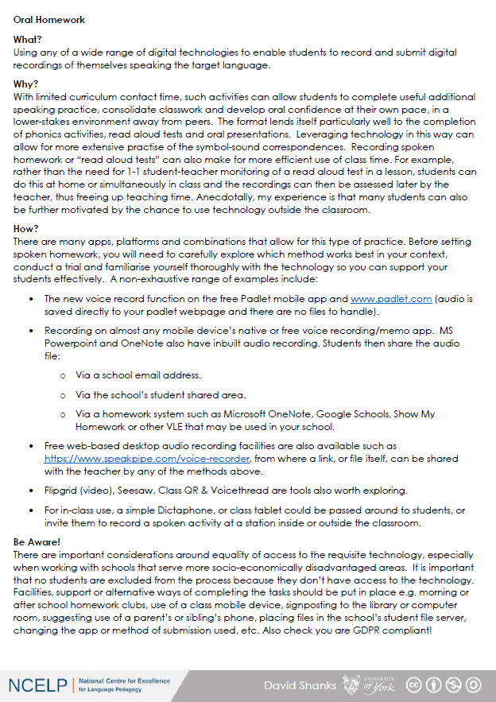
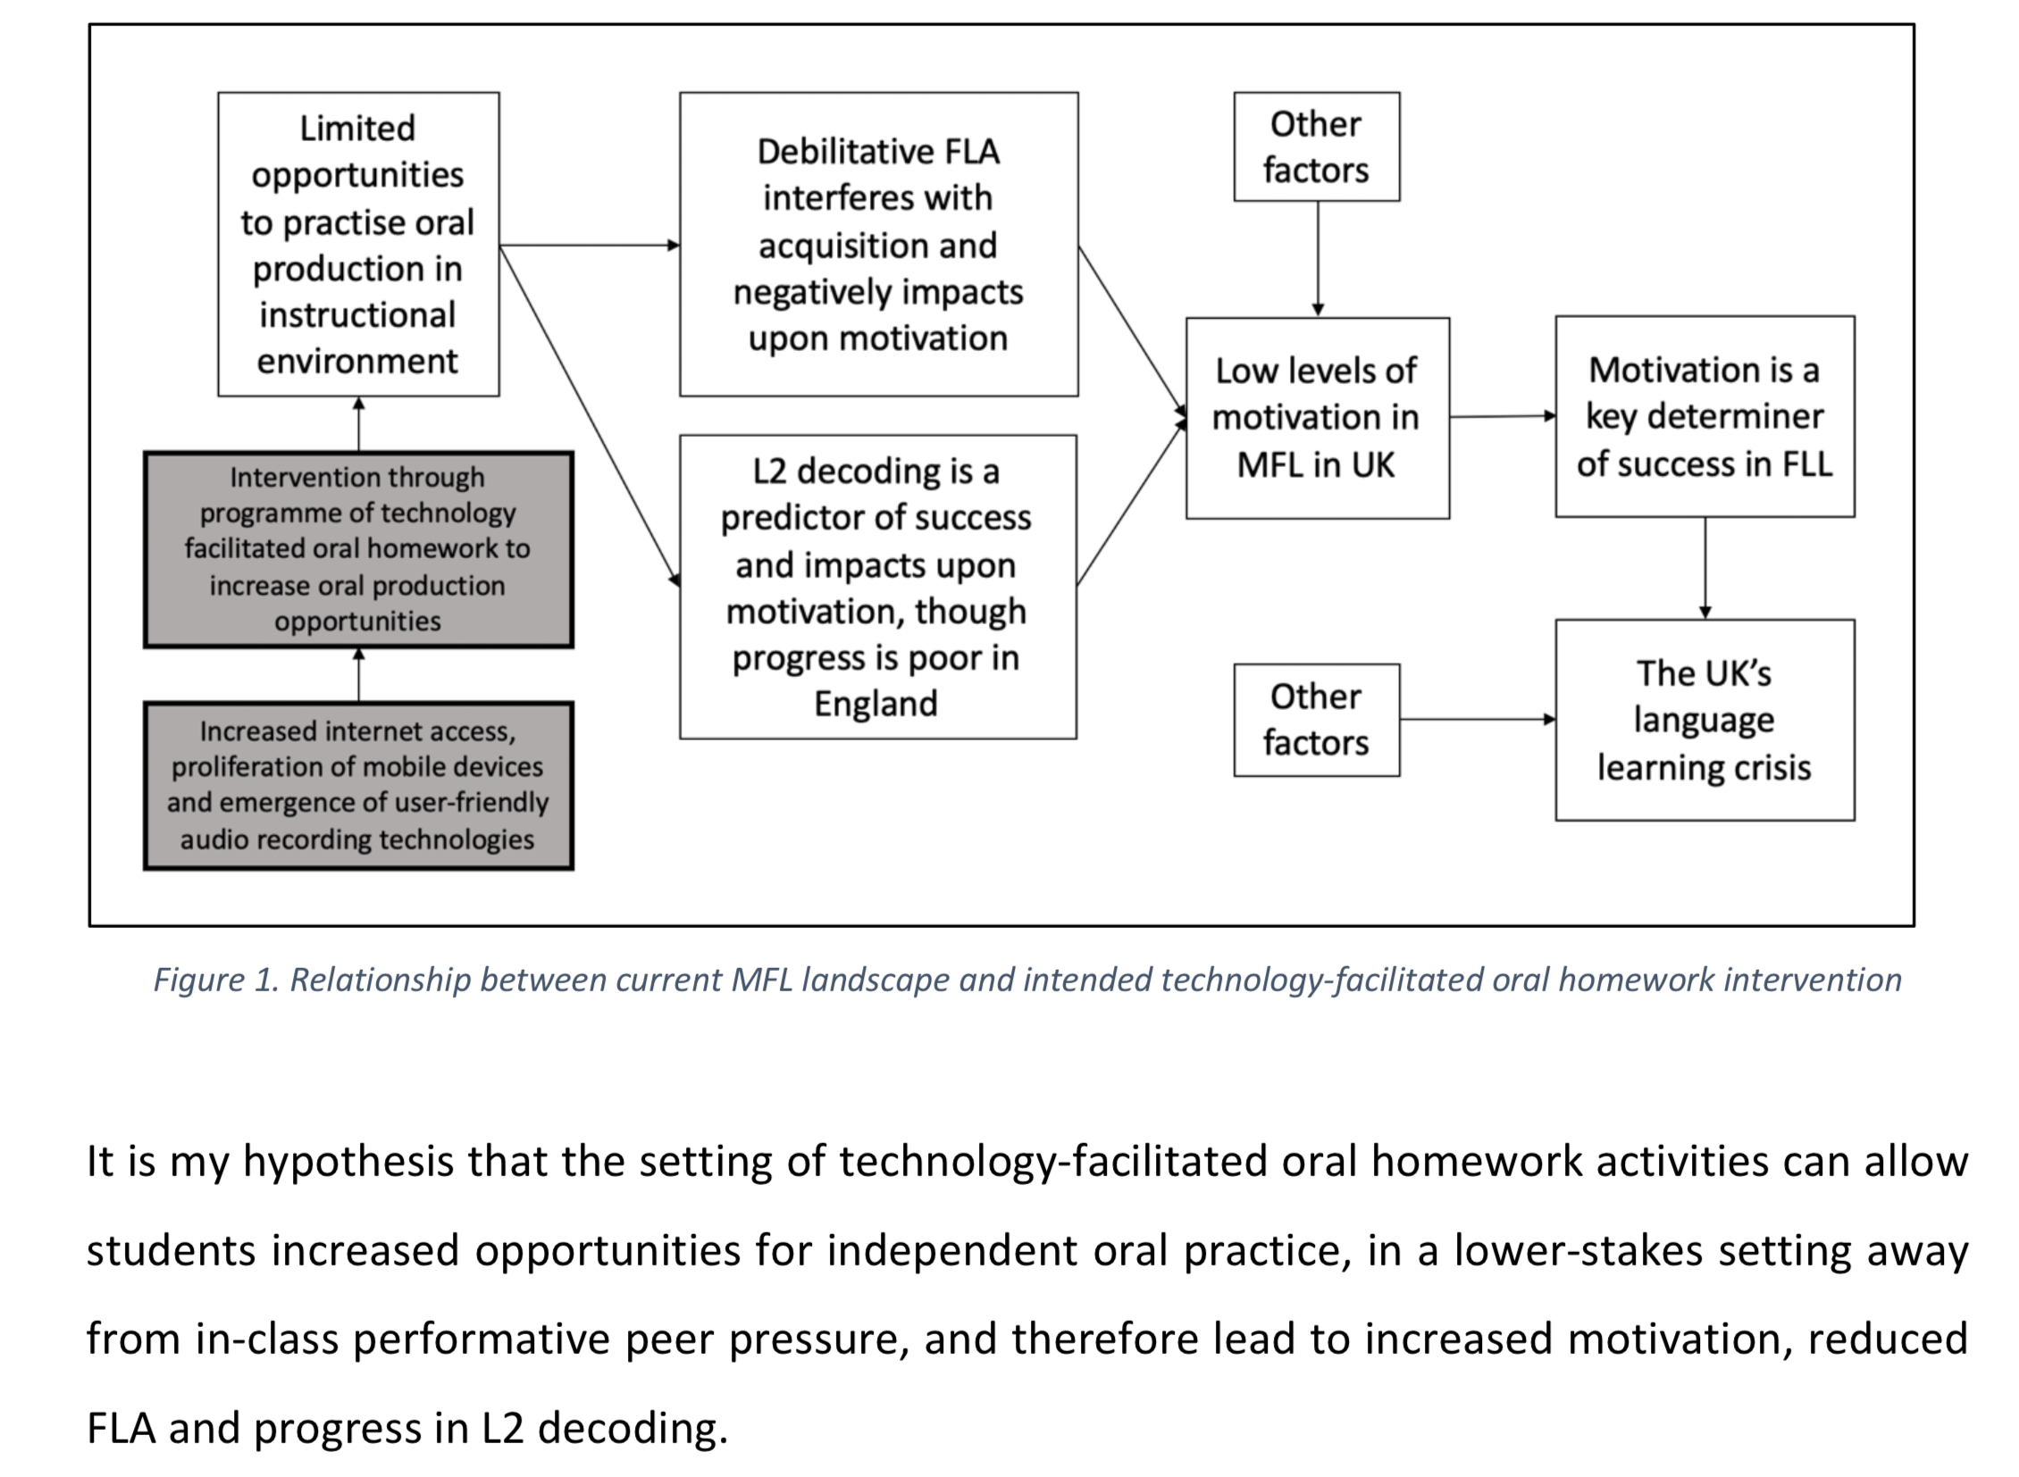
Oral Homework
(MA dissertation, 2019)
David Shanks
Notes:
Handout 1 - Oral Homework
Allow time to read Handout 1 (this was shared previously but a refresher useful)
Ask if anyone is currently using oral homework or has past experience
The diagram is from David Shanks’ MA dissertation and outlines a hypothesis around why technology-facilitated oral homework could be a powerful tool. This was a small scale case study with year 9 students. FLA = Foreign Language Anxiety.

Slide 20
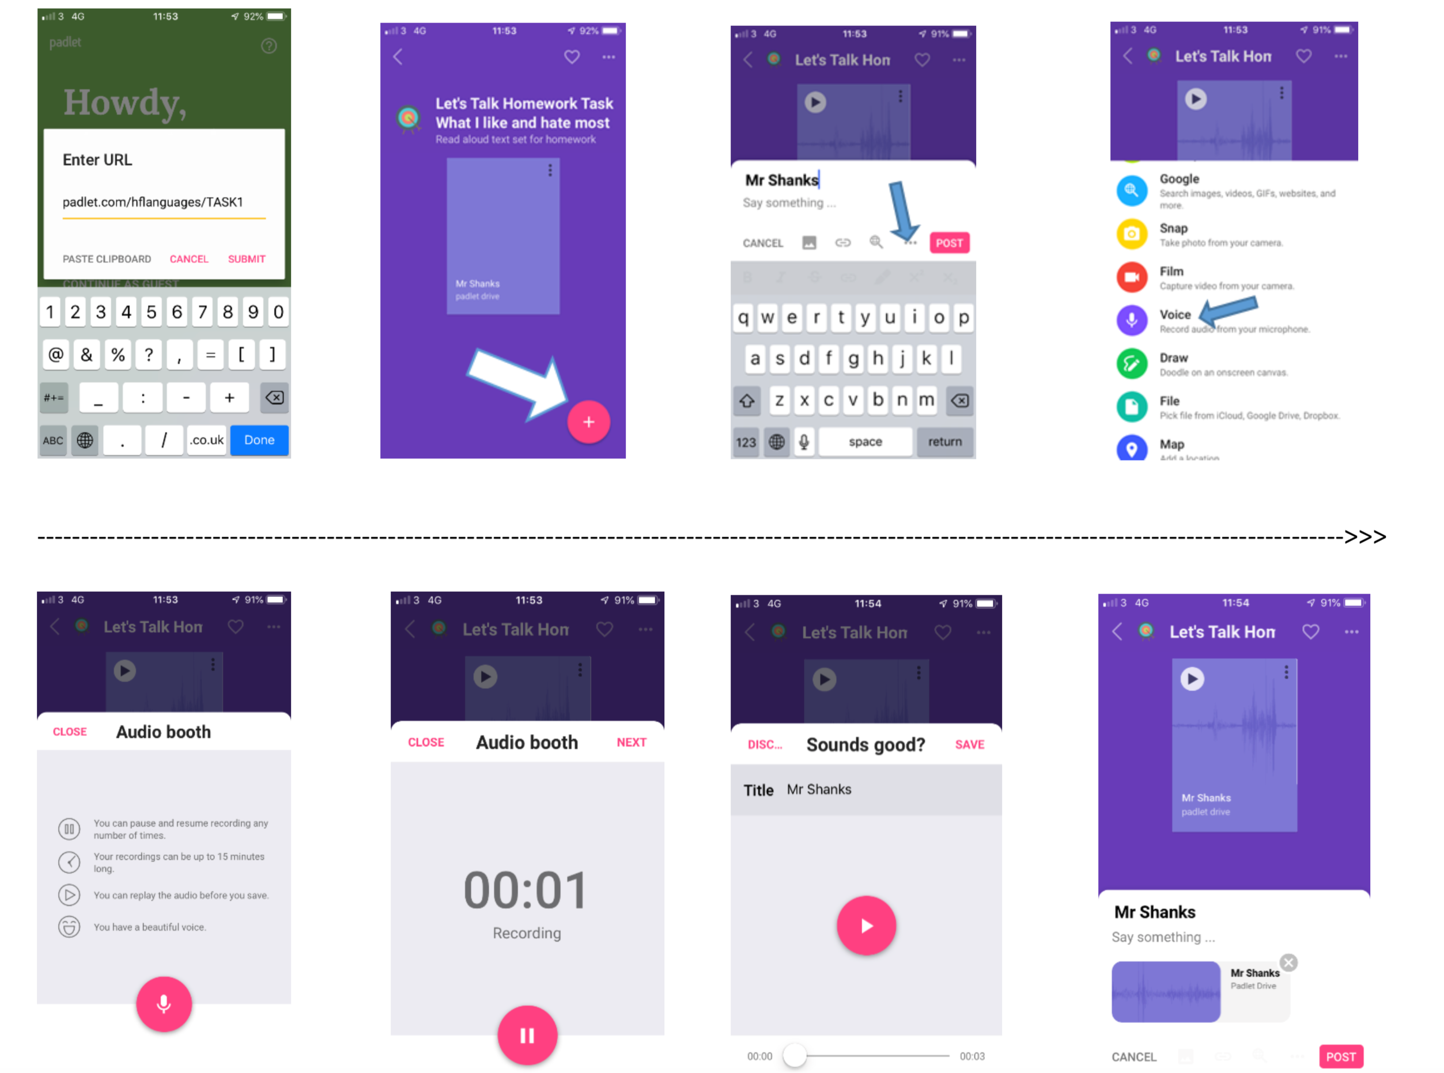
Case Study (Padlet.com)
David Shanks
Notes:
Screenshot from Padlet showing what a student sees when recording an audio file on the free mobile app.
NB: The free version of padlet now comes with just 3 padlets only allows 10MB files. The premium plan for teachers is called “Padlet Backpack” and has unlimited students accounts, costing $99 per year. More info here: https://padlet.com/premium
As per Handout 1 Oral Homework, there are many ways and tools that could be used to organise the submission of oral homework. One lead school is using their Google Classroom and students email attachements. Some additional options are outlined below:
Show My Homework – if your school has a subscription to this popular homework platform, it is possible for students to send you attachments for tasks you create
Flipgrid – is free for educators and allows students to submit videos directly to their teacher. If you/students don’t want to use video, students can cover the camera lens and submit the audio only. More info here: https://info.flipgrid.com/
Showbie – this digital classroom platform allows voice notes of up to 1 minute on the basic free plan. More info on the free version and paying plans here: https://www.showbie.com/plans/
Microsoft ClassNote / OneNote / Teams – if your school uses Office 365, audio can be submitted, for example, through a class OneNote. The latest Word and Powerpoint versions also allow you to insert audio.

Slide 21
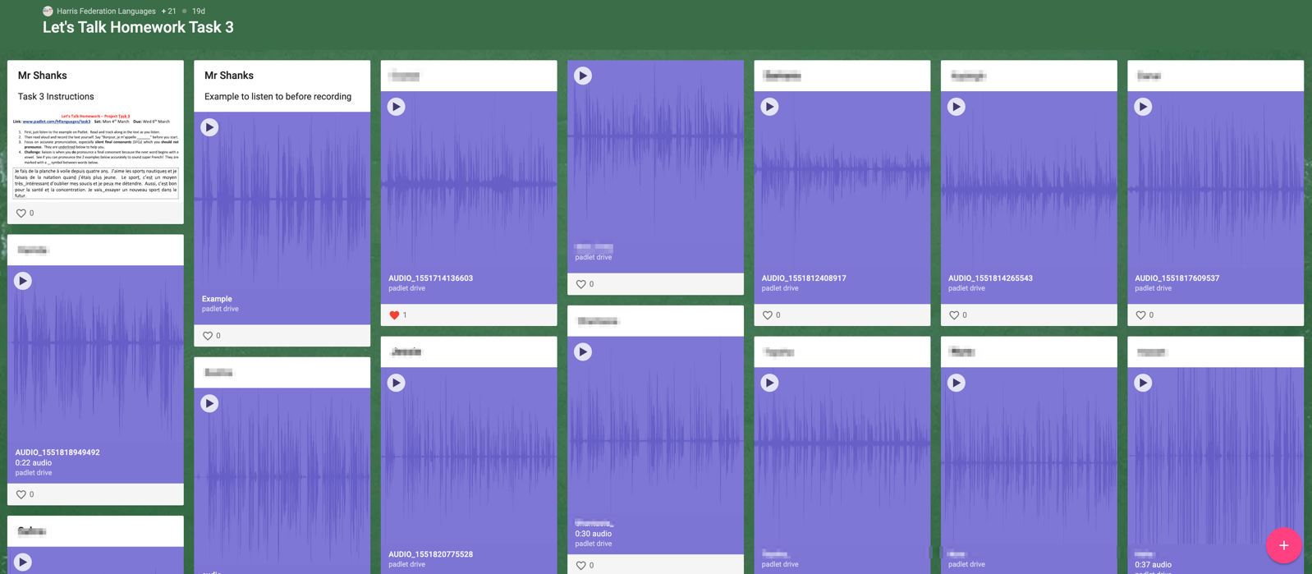
Case Study (Padlet.com)
David Shanks
Notes:
This is the bulletin boards to which audio files are posted and are available to the whole group.
The top left post is the homework task set and the first recording from Mr Shanks is a model audio response

Slide 22
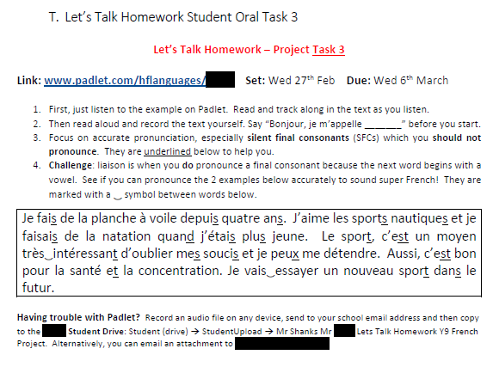
Oral Homework Tasks
What other types of oral homework could you envisage?
David Shanks
Notes:
2 example oral homework task types from the dissertation case study
On the left, a read aloud text (which students had encountered as a translation exam question previously). Note the phonics focus on SFCs and liaison with added underlining support
On the right, a GCSE style describe the picture task. A model was supplied and included SFC markers but this is of course optional.
Ask teachers what other kinds of Oral Homework task they could envisage setting. Analyse these in terms of NCELP pedagogy principles.

Slide 23
Case Study Findings
Case study found a strong pedagogical rationale for oral homework:
“Oral homework has the potential to open the door to increased motivation, reduced FLA, improved decoding/pronunciation, greater self-efficacy and more self-regulated learners”
When I speak French I feel like I'm not pronouncing it properly, and I get really anxious that people will judge me and the teacher will probably say I didn't do it correctly. (Student A)
[Motivation specifically for speaking has] increased definitely, and I've noticed a couple of students who have been a lot more forthcoming with speaking in lessons (Teacher)
I first say it in front of my sister to see how I sound then I try and record, and if I don't like how I sound I'll delete it, and just keep on doing that until I'm actually happy with what I recorded. (Student B)
…for the tongue twisters I had to record like ten different times. (Student C)
David Shanks
Notes:
Focus group feedback from the 2019 MA dissertation research
Note in bullets 4 & 5 - students were self-regulating, assessing their own performance and striving to improve it without instruction from the teacher to do so – this is an encouraging finding!

Slide 24
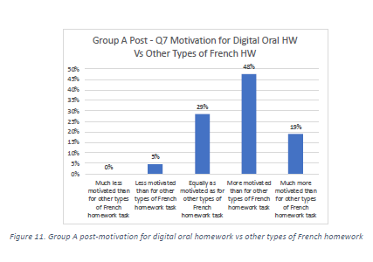
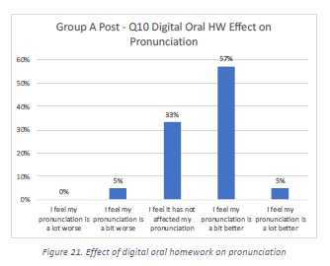
Case Study Findings
David Shanks
Notes:
Majority of students were more motivated for this type of technology-facilitated oral homework than for other types of French homework
Majority of students felt their pronunciation was a bit or a lot better following the intervention of oral homework.
Worth noting that this was a short case study of 5 oral homework tasks. A more systematic use of oral homework, with increased feedback components over time could have an increased impact.

Slide 25
The positive relationship between out-of-school exposure and vocabulary knowledge. Peters et al. (2019)
Given the limited classroom time available, researchers have repeatedly advocated contact with the foreign language outside the classroom to increase learners’ vocabulary size.
Even after eight years of instruction, many learners were not familiar with the 2,000 most frequent words in French, which meant that they could do little with the language in terms of reading, listening, speaking, or writing.
In spite of the beneficial effects of instruction, formal instruction of 2–4 hours per week was not enough to make large learning gains for the learners in this study because the learners needed large amounts of language input to develop a large vocabulary size.
These findings confirm the knowledge shared by many language teachers, namely, that foreign language learners need to be guided in engaging with the foreign language outside of the language classroom.
The researchers propose a principled approach to foreign language vocabulary teaching, in which a vocabulary learning plan is included in foreign language curricula.
David Shanks
Notes:
Handout 2. The positive relationship between out-of-school exposure and vocabulary knowledge. Peters et al. (2019)
Allow time for teacher to read and take key messages.
This is a reminder of the importance of vocabulary acquisition and ties it to the need for planned, guided vocabulary learning outside of the classroom on the understanding 2-4 hours per week is not sufficient.
This sets a context for the next suggestion of Guided Audio Learning Homework.

Slide 26
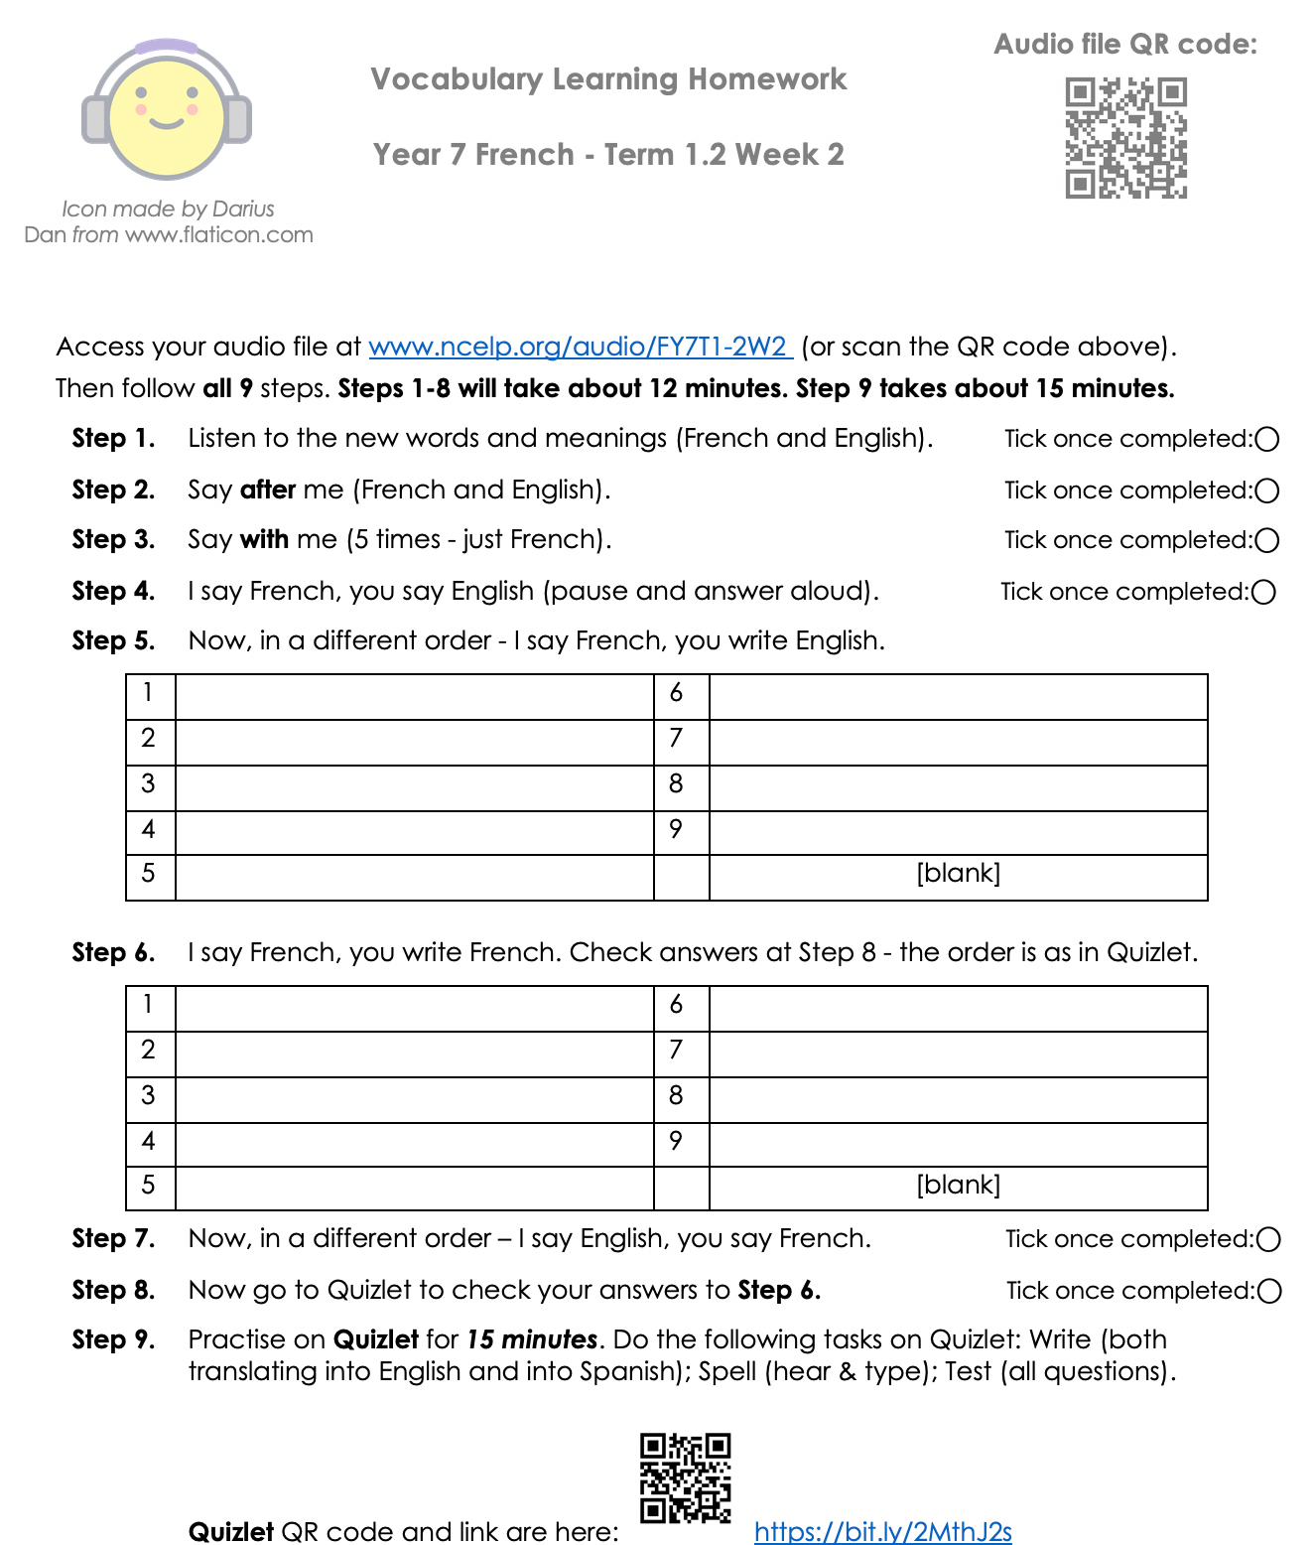
Vocabulary Learning Homework
“foreign language learners need to be guided in engaging with the foreign language outside of the language classroom” Peters et al. (2019)
Listen (French and English)
Say after me (French and English).
Say with me (5 times - just French).
I say French - you say English.
Out of order - I say French, you write English.
Listen to French, write down French.
Say English - students say French (out of order).
Now go to Quizlet to check Step 6
and for more practice
Year 7 Term 1.2 Week 2 audio examples
www.ncelp.org/audio/FY7T1-2W2 (FR)
www.ncelp.org/audio/SY7T1-2W2 (SP)
www.ncelp.org/audio/GY7T1-2W2 (GER)
This is a prototype – your thoughts and feedback?
Leigh McClelland, Cam Academy Trust
Notes:
Handout 3. Vocabulary Learning Homework Examples - Student Worksheets for Year 7 Term 1.2 Week 2 in French, German and Spanish
Slides 27-32 have vocabulary learning homework examples in French German and Spanish. Talk through the process in a language of your choice and give teachers time to digest each of the steps on the example handouts.
Draw teachers attention to how the Guided Audio Learning Homework compensates for some of the features missing from textbooks, Quizlet or other CALL tools e.g. forcing students to say vocabulary out loud and steps 4/5/6 that focus on rendering word-for-word meaning and require students to translate the aural form without any written prompts into written/oral form. The new AQA question type in which students have to write down the questions word for word is one that students find tricky.
Invite teachers to access the audio file either through the link or QR code reader on Handout 3 on a mobile device, alternatively they can go direct to the links on this slide (Year 7 Term 1.2 Week 2 audio examples in all 3 languages).
Vocabulary Learning Homework tasks are being created to accompany the SOW, and uploaded now weekly to the portal to support flipped pre-learning. Invite and record feedback from teachers.

Slide 27
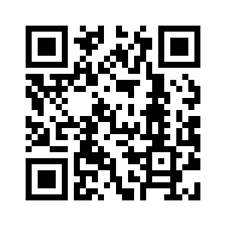
Year 7 French - Term 1.2, week 2
Vocabulary Learning homework
Audio file : http://www.ncelp.org/audio/FY7T1-2W2
Audio file QR code:
Student worksheet:
https://resources.ncelp.org/concern/resources/fb494855q?locale=en

Slide 29
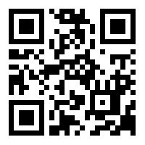
Year 7 German – Term 1.2, Week 2
Vocabulary Learning Homework
Audio file : [www.ncelp.org/audio/GY7T1-2W2]
Audio file QR code:
Student worksheet: [https://resources.ncelp.org/concern/resources/sx61dm39d?locale=en]
Notes:
Term 1.2, Week 2 Vocabulary, as audio learning homework. This may be the first time students have been given this style of homework. There is a screen shot of the student worksheet on the following page, to enable teachers to talk through in more detail.
Icon made by Darius from www.flaticon.com (freely usable image).

Slide 30
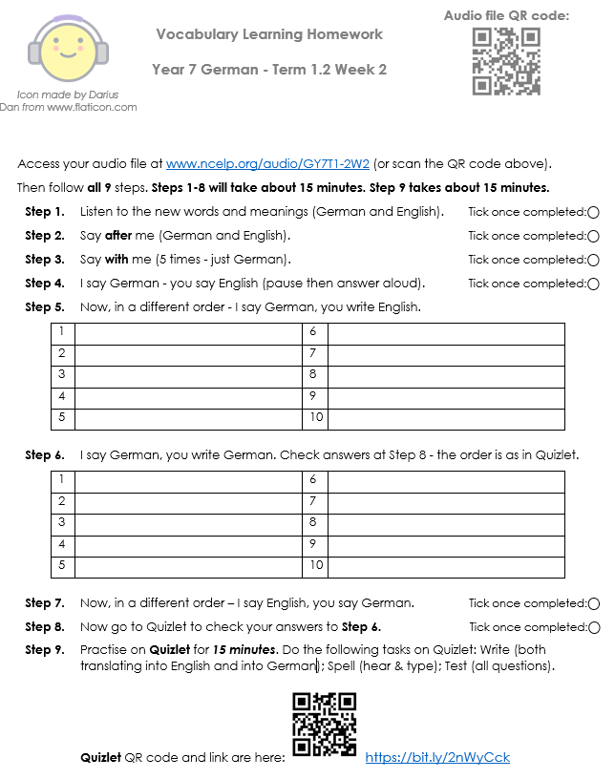

Slide 31
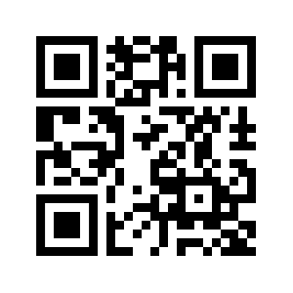
Year 7 Spanish - Term 1.2, week 2
Vocabulary Learning Homework
Audio file : www.ncelp.org/audio/SY7T1-2W2
Audio file QR code:
Student worksheet: https://resources.ncelp.org/concern/resources/th83kz43m?locale=en

Slide 32
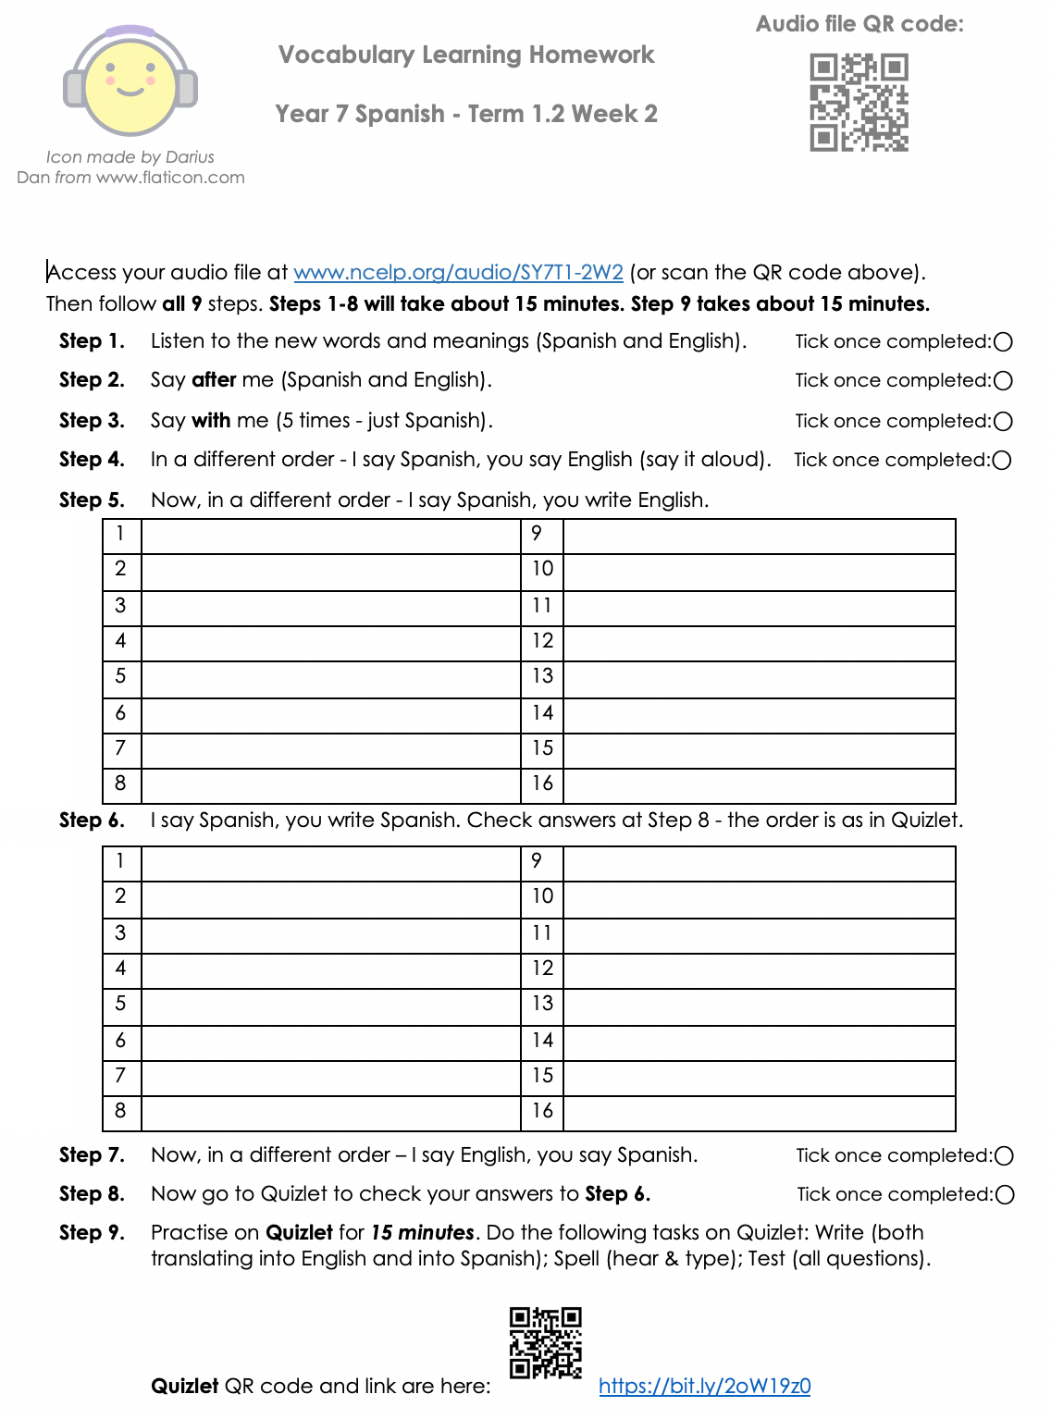

Slide 33
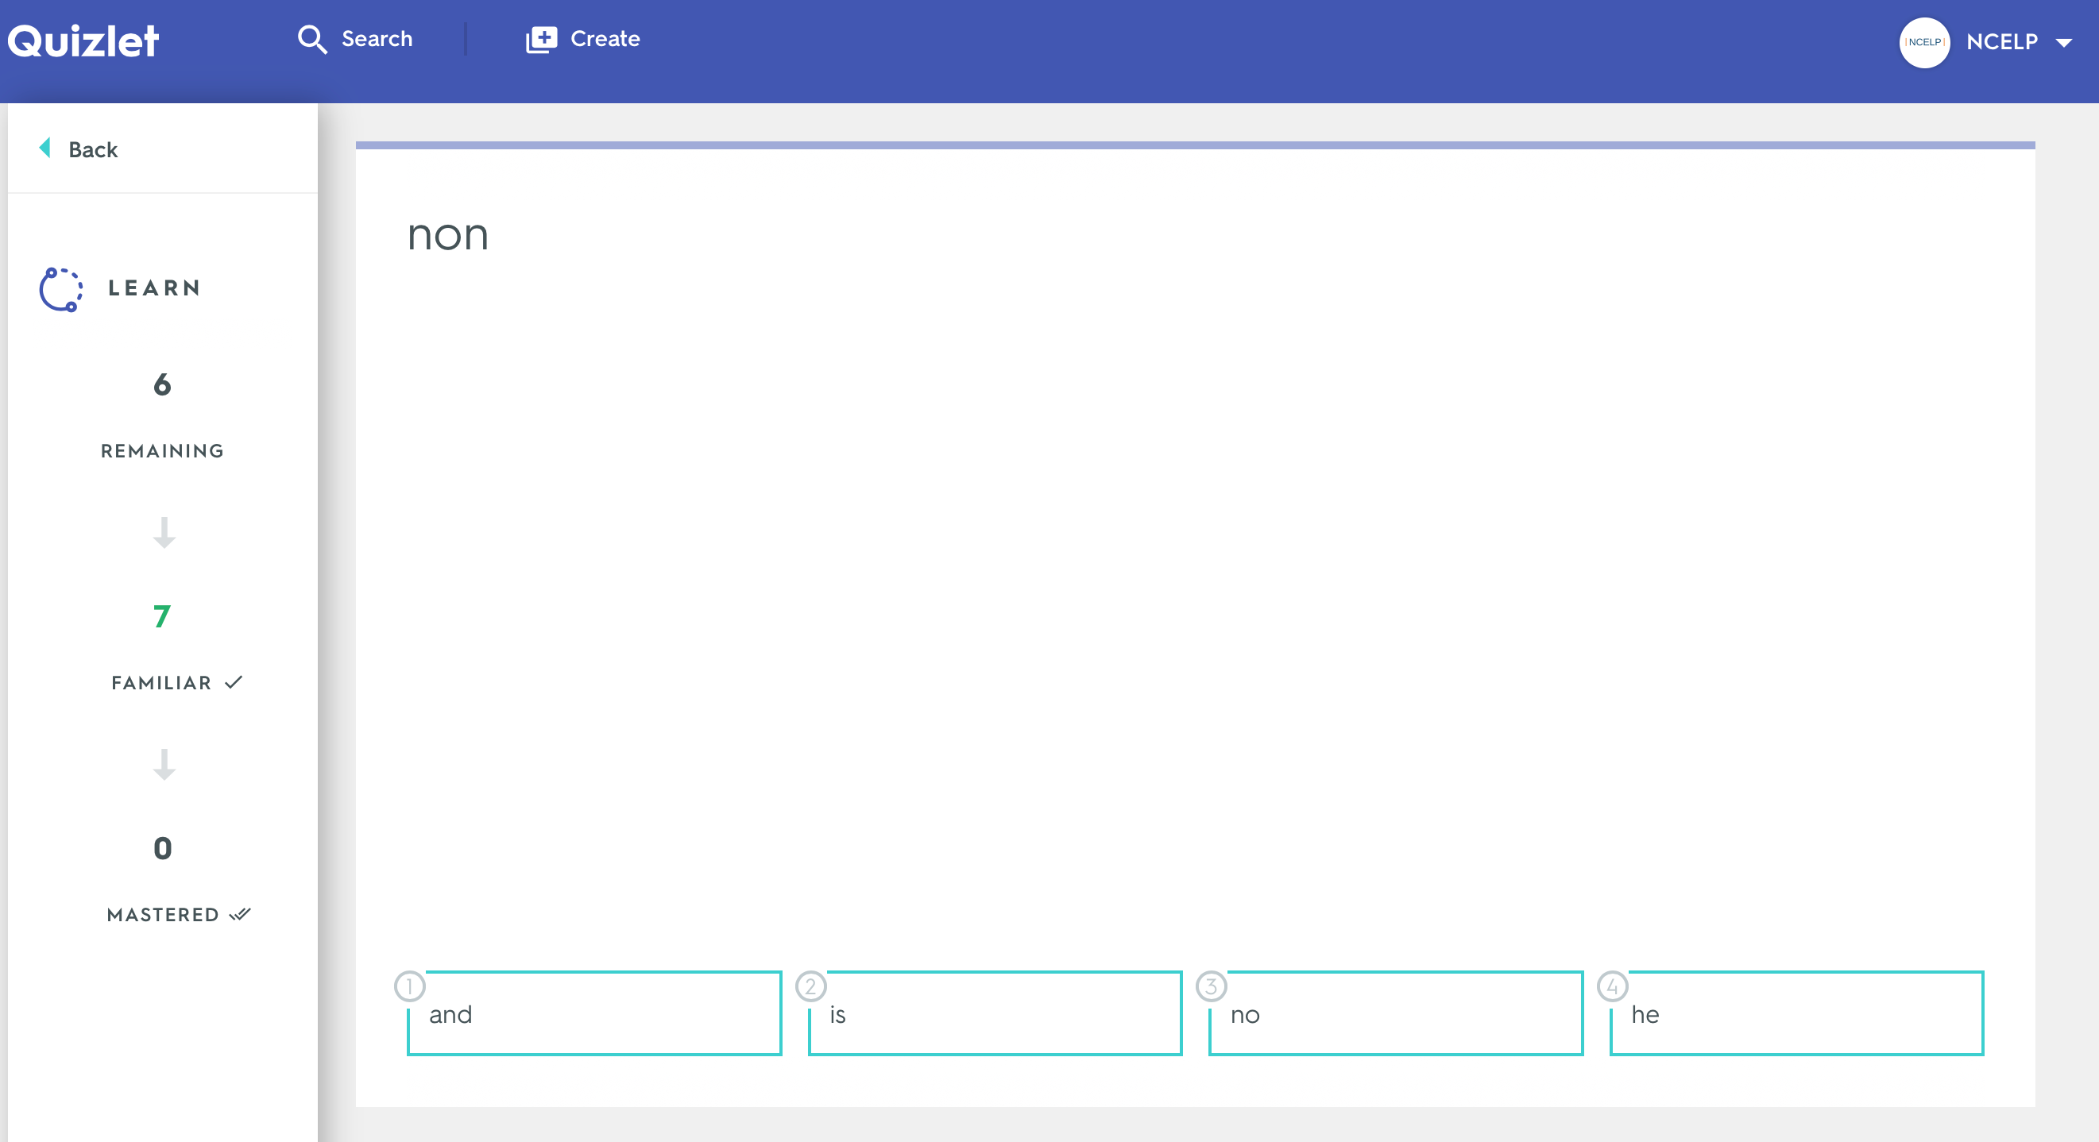
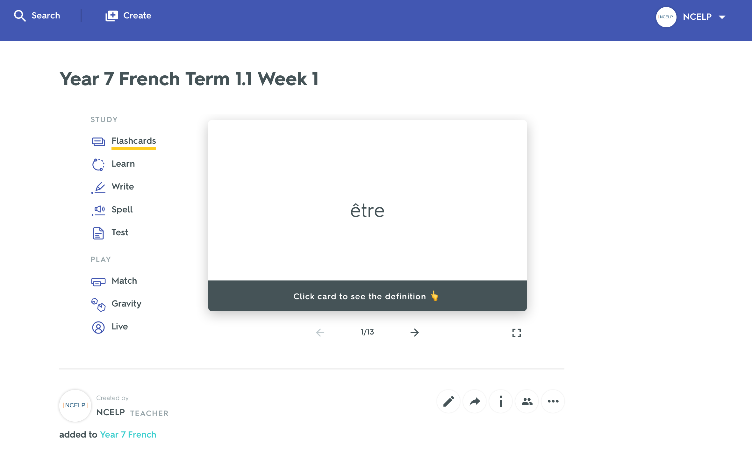
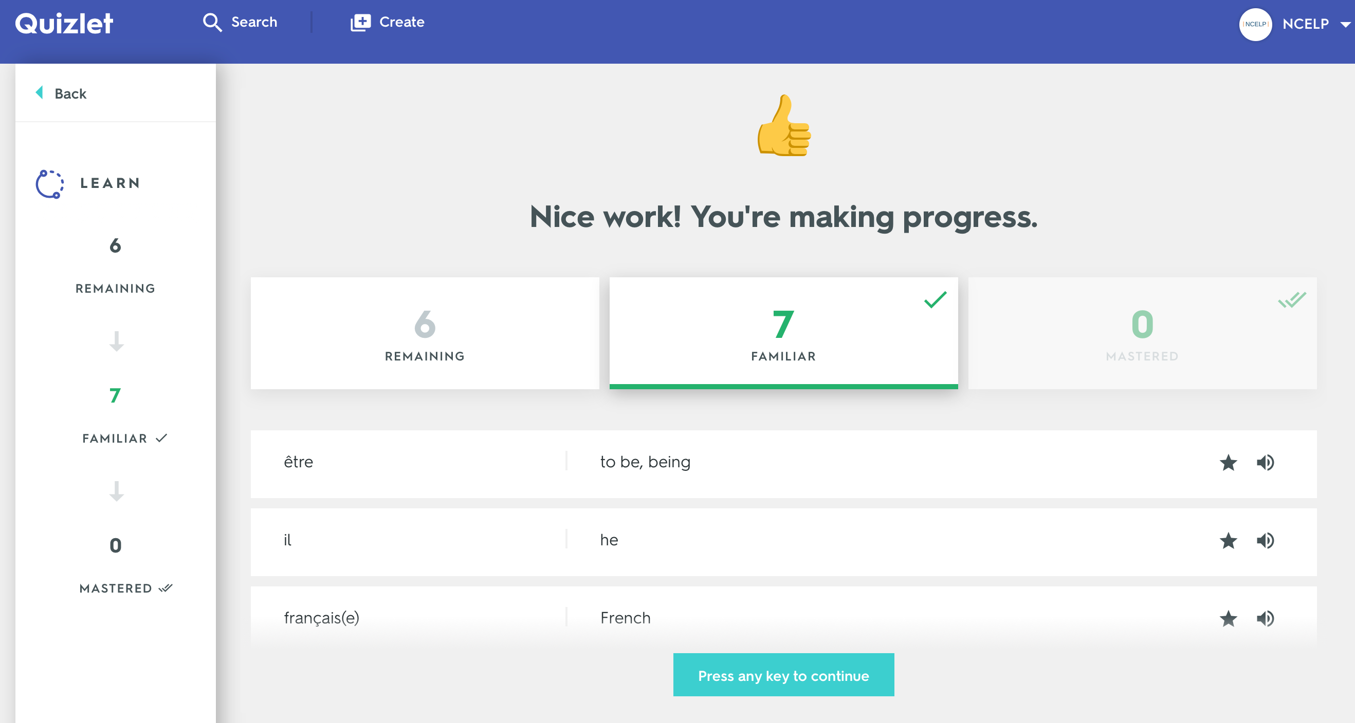
Quizlet Digital Flashcards
David Shanks
Notes:
Handout 4. Quizlet Guide (PowerPoint also available for projection to TRG)
Introduce Quizlet briefly and ask who is familiar with it / using it regularly. Spread any knowledgeable Quizlet users out across the room to support others during the hands-on work.
This section requires teachers to be at computers, ideally desktops or laptops, for hands on familiarisation with the (many) features of Quizlet.
Ensure you make arrangements in advance to access a computer room / have laptops / ask teachers by email in advance to bring a laptop and provide wifi login details. Mobile device versions of Quizlet are available but are more limited than the desktop version.
It is also important to familiarise yourself with Quizlet in advance so you can support teachers and answer questions. Any advice and tips you can add from personal experience will be useful.
You could run this (40 minute) section in a number of ways according to your level of familiarity and confidence with Quizlet e.g.
Demo the main features of Quizlet front-of-class on the website itself through your own account, then give Handout 4 Quizlet Guide for teachers to work through at machines
Give Handout 4 Quizlet Guide for teachers to work through themselves
Present selected slides from the Handout 4 Quizlet Guide PowerPoint at the front, then let teachers familiarise themselves
The end of the Quizlet guide has a list of differentiated specific tasks that teachers can attempt to complete.

Slide 34
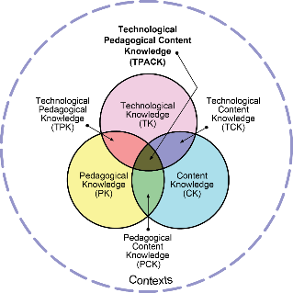
Quizlet Digital Flashcards
Demo / hands-on time
David Shanks
Notes:
Recall the TPACK model and the need for us to think of how technology integrates with pedagogy and content.
Teacher Technological Knowledge of any digital tools used is also important for effective use of technology.

Slide 35
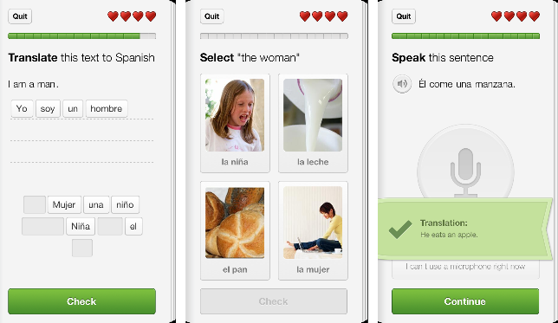
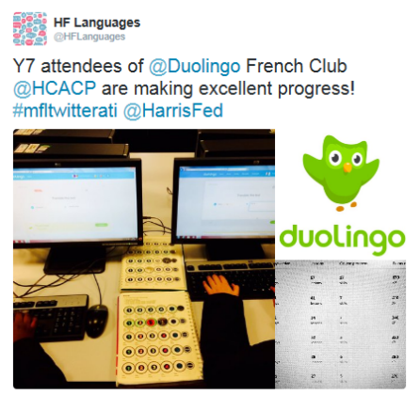
Duolingo.com
Free mobile and web-based language learning platform
Strong gamification and recycling structure (Duolingo nags!)
Variety of translation, reading, listening and speaking activities.
Clean and intuitive environment/user interface
schools.duolingo.com dashboard for managing students and setting tasks
Excellent for signposting students (independent learning, open-ended HW)
Duolingo Clubs/Competitions can be a great initiative for raising profile of MFL
Often updated and developed: Chatbots, Stories, Podcasts
Big limitation = fixed content determined by Duolingo course structure
A free ALL Webinar and goodies available here:
www.all-london.org.uk/site/index.php/webinar-david-shanks-duolingo
David Shanks
Notes:
[optional slide]
You and many teachers may already be familiar with Duolingo. Ask the room of their experiences.

Slide 36
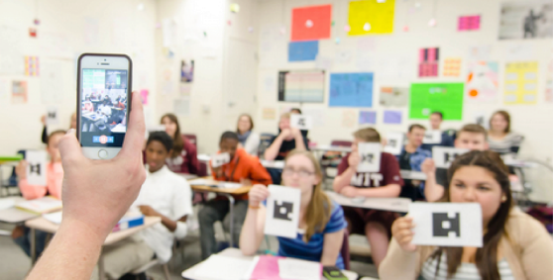
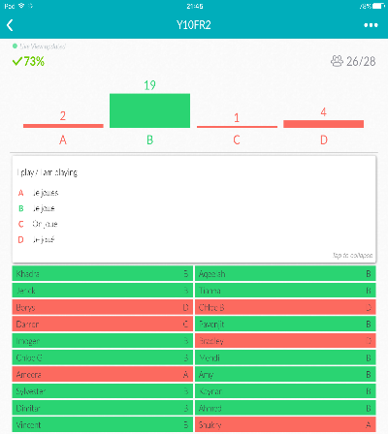
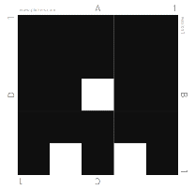
Plickers.com
Free, in-lesson, student response system without student devices
Students respond to teacher’s multiple choice questions using a simplified QR card/paper
Real-time formative feedback - responses graphed and detail saved to spreadsheet
Excellent for regular low stakes testing (Top infinitives? Question words?), auto tracking
Generates a lot of engagement!
Drawbacks: initial setup, creating questions, multiple choice format only, multiple classes
David Shanks
Notes:
[optional slide]
This slide gives an overview of the Plickers formative assessment student response system.
For a better understanding of how to use it practically, see this tutorial: https://www.youtube.com/watch?v=Qpx56rjCVjQ&safe=active

Slide 37
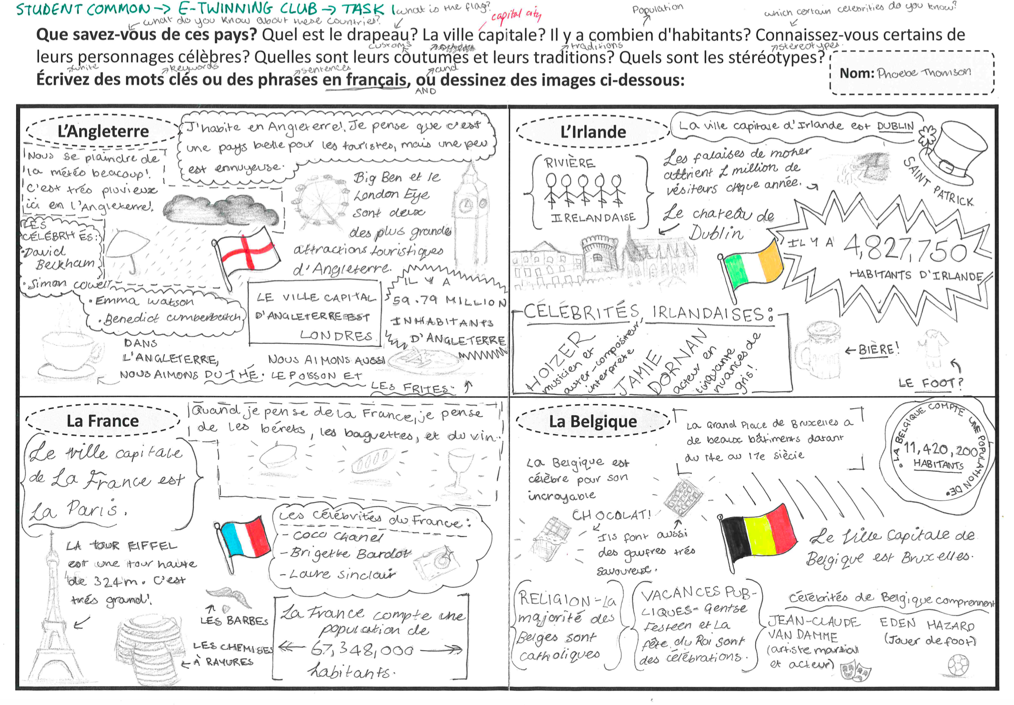
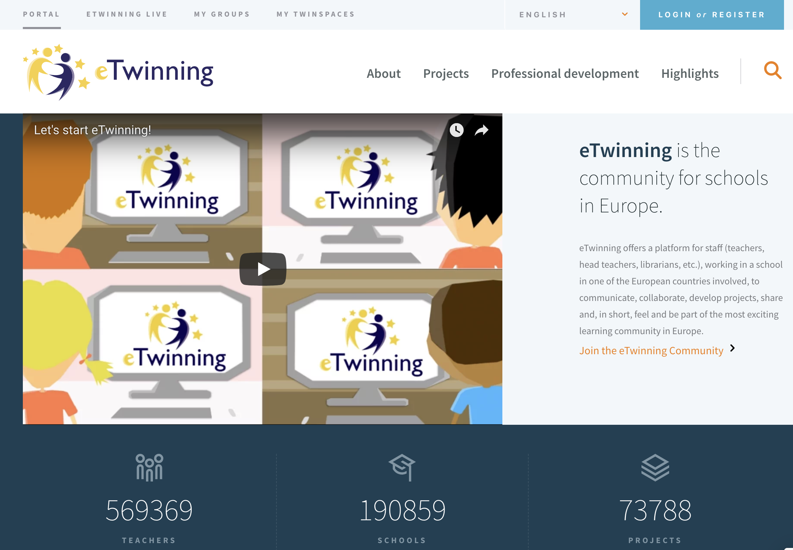
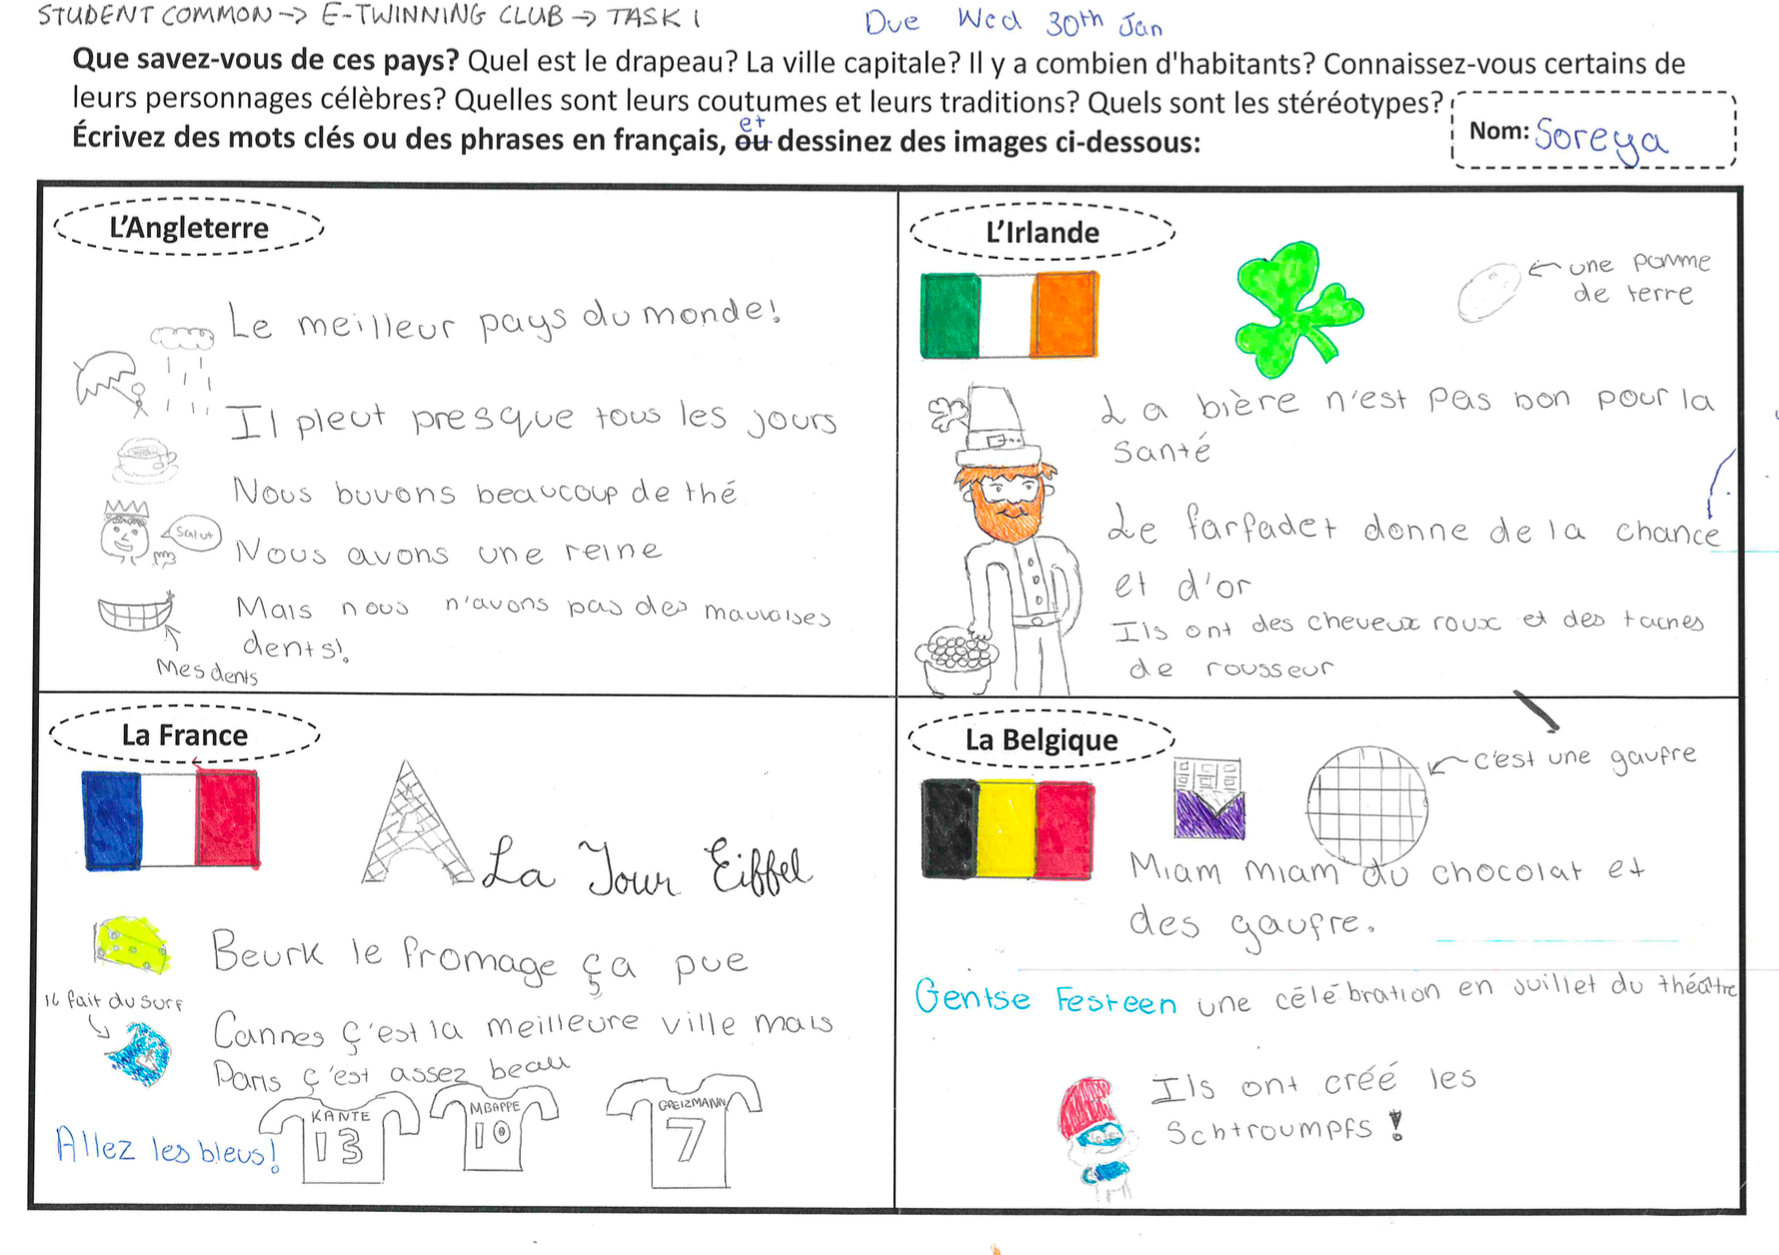
Computer Mediated Communication (CMC)
www.etwinning.net
David Shanks
Notes:
[optional slide]
One benefit of CALL mentioned was the opportunity to interact with speakers of the L2.
eTwinning provides a digital platform for interaction and many free CPD opportunities for teachers (see www.etwinning.net)
See example images of a stereotypes task set up through eTwinning between students in England, Ireland, France and Belgium
Ask teachers how they are using technology to establish links/interaction in L2.

Slide 38
Summary
Does technology help? When does technology help?
Manifold potential benefits of CALL, when used effectively
The primacy of pedagogy
SAMR – what does technology bring to the table?
TPACK – the interplay between tech, (NCELP) pedagogy and content
Oral Homework, Guided Audio Learning Homework, Quizlet, Duolingo
Harnessing CALL for vocabulary acquisition and out of lesson work
Digital equity
Now commit – what are your CALL next steps in your context? Be S.M.A.R.T.
David Shanks
Notes:
We need to get beyond the false dichotomy of “is tech good or bad?” and ask instead, when can we use technology to our advantage? This also implies the teacher is involved in assessing and reflecting upon how the use of technology affects learning
Recap the main benefits of CALL covered (or quiz teachers on what they remember). Remind that these benefits are always with the caveat of tech being put to considered, effective use – poorly used tech (especially in valuable lesson time) can negatively impact on learning
Linked to previous point, pedagogy should come first – how does the use of tech improve learning, the use of learning time or how can it extend learning time (e.g. outside the classroom)
Substitution, Augmentation, Modification, Redefinition (Puentedura, 2010). A nice model for reflecting on any use of tech (though not a strait jacket/exact science). Key point = what does technology bring to the table?
TPACK allows us to consider the interplay between teachers knowledge of Technology, (NCELP!) Pedagogy, Content and the Context. Key message = tech knowledge is important but not isolated (so don’t use an app purely because it’s shiny and whizz-bang)
Remind teachers of the main tech ideas focussed on in the session: Oral Homework, Guided Audio Learning Homework, Quizlet, Duolingo
CALL can be a powerful ally in supporting vocabulary acquisition (remember our 2000 word target!) in our time-poor contexts, by increasing out of lesson learning opportunities
Digital equity – we need to be mindful of access to tech for students and support this e.g. through computer rooms, homework clubs, library facilities, pre/post school access windows, supporting students with tech issues and having a plan B for when the tech doesn’t work
Invite teacher to right down their CALL next steps with one or more SMART targets (Specific, Measurable, Attainable, Relevant, Time-bound)

Slide 39
References
Adams-Becker, S., Rodriguez, J. C., Estrada, V., & Davis, A. (2016). Innovating Language Education: An NMC Horizon Project Strategic Brief. Retrieved from https://www.nmc.org/publication/2016-nmc-strategic-brief-innovating-language-education/
Education Endowment Foundation. (2019). Digital Technology - Sutton Trust-Education Endowment Foundation Teaching and Learning Toolkit. Retrieved from https://educationendowmentfoundation.org.uk/evidence-summaries/teaching-learning-toolkit/
Garrett, N. (2009). Computer‐assisted language learning trends and issues revisited: Integrating innovation. The modern language journal, 93, 719-740.
Peters, E., Noreillie, A., Heylen, K., Bulté, B., & Desmet, P. (2019). The positive relationship between out-of-school exposure and vocabulary knowledge. OASIS Summary of Peters et al. (2019) in Language Learning. https://oasis-database.org
Picardo, J. (2017). Using Technology in the Classroom. London: Bloomsbury.
Puentedura, R. (2010). SAMR and TPCK: Intro to advanced practice. Retrieved from http://hippasus.com/resources/sweden2010/SAMR_TPCK_IntroToAdvancedPractice.pdf
Reboot Foundation. (2019). Does Educational Technology Help Students Learn? An analysis of the connection between digital devices and learning. Retrieved from https://reboot-foundation.org/does-educational-technology-help-students-learn/
Smith, B. (2015). Technology in language learning: An overview. Routledge.
TPACK. (2012). TPACK Explained: The Seven Components of TPACK. Retrieved from http://tpack.org
Williams, M. (2014). Is technology a silver bullet for language teaching and learning? The Guardian. Retrieved from https://www.theguardian.com/teacher-network/teacher-blog/2014/may/12/technology-language-teaching-learning-pedagogy
David Shanks

