Slide 1
Vokabeln
Y7 German - Term 1.2 - Week 2 - Lesson 17/8
Elinor Parks / Rachel Hawkes
Notes:
arbeiten [200] putzen [2851] kochen [1005] sitzen [261] das Auto [490] zu Hause [6/159] der Garten [959] der Boden [445] die Liste [1975] das Zimmer [609]

Slide 2
m
das Zim__er
W
w
das __ asser
nicht __ahr?
a
h__ben
e
c
a
der Fr__und
ko__hen
der Fußb__ll
H
das __aus
r
s
das Wo__t
das Hau__tier
t
die Wel__
W
e
r
m
a
c
h
t
w
a
s
?
Notes:
Additional idea for register starter: Students offer a noun in German. It can be any noun but the gender must be different from the one said just before, and students must try not to repeat (in a class of 32 students, they are likely to repeat after around 16-20 items!)
Starter: This starter task revises nine items of Week 5 vocabulary and two items from this week. By working out which letters are missing and putting them in order into the spaces below, they create the question ‘Wer macht was?’, which is the context for this week’s lessons, so the activity does the task of ‘sharing the context learning objective’ with students. Elicit the English translation of this question from students to ensure that they are all clear about its meaning.
Week 5 vocabulary haben [7] hat [7] wer? [173] der Lehrer [433] der Fußball [1497] der Freund [326] das Wasser [297] die Welt [190] das Wort [243] nicht wahr? [14/662] das Haustier [>5000] das Haus [159] Note that 6 of these words were built into this week‘s lessons, as well. Term 1.2, Week 2 vocabulary arbeiten [200] putzen [2851] kochen [1005] sitzen [261] das Auto [490] zu Hause [6/159] der Garten [959] der Boden [445] die Liste [1975] das Zimmer [609]
Source: Jones, R.L. & Tschirner, E. (2006). A frequency dictionary of German: core vocabulary for learners. Routledge

Slide 3
to be
to say
finden
to play
to know
machen
putzen
wissen
to work
to clean
sagen
to find
to do
arbeiten
sein
spielen
Notes:
Vocabulary recap
Here we revise 8 infinitive verbs that Y7 has encountered (some have been taught as phonics cluster words).
sein [3]; machen [49] sagen [46]; finden [110]; wissen [79] spielen [197] putzen [2851] arbeiten [200]
5/8 are in the most common 25 German verbs.
The English verbs appear. Learners need to match them to one of the German verbs, by saying the German verb.
Teacher can ask Wie sagt man ‘XXX’ auf Deutsch ? as each English verb appears.
These are the 27 verbs that Y7 has encountered since the start of the course: Verbs taught:
sein [3]; haben [7]; sagen [46]; wohnen [380] schreiben [245] spielen [197] reden [356] lernen [203] machen [49] arbeiten [200] putzen [2851] kochen [1005] sitzen [261] Phonics source/cluster verbs encountered: fahren [169]; geben [57]; denken [124]; sehen [81]; helfen [406]; antworten [804]; gewinnen [410]; liegen [118]; ziehen [266]; holen [640]; wollen [65]; kommen [61]; finden [110]; wissen [79]

Slide 4
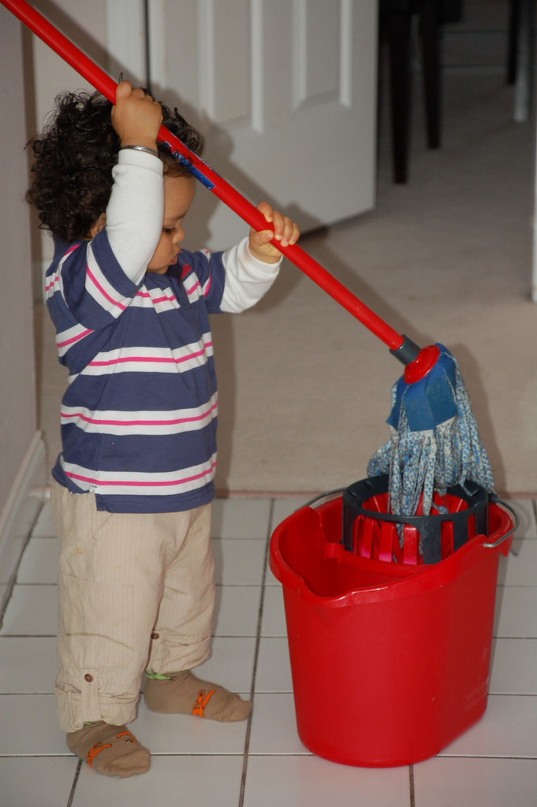
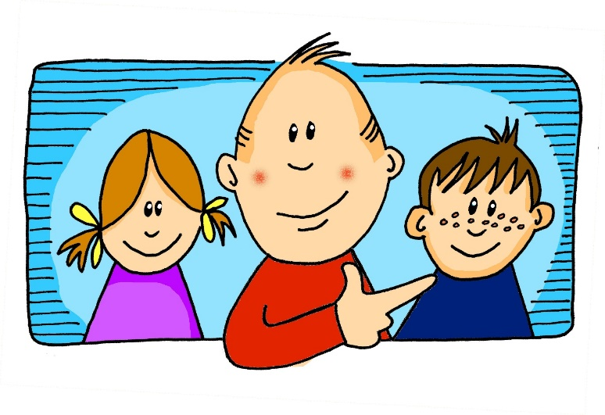
Was macht er?
Er putzt den Boden.
Notes:
Hardeep Singh from Vancouver, Canada [CC BY 2.0 (https://creativecommons.org/licenses/by/2.0)]
Nine slides to practise the key vocabulary from this week and to prime for the information gap production task that follows. Teacher elicits the language orally from students (or on mini whiteboards, if preferred)

Slide 5
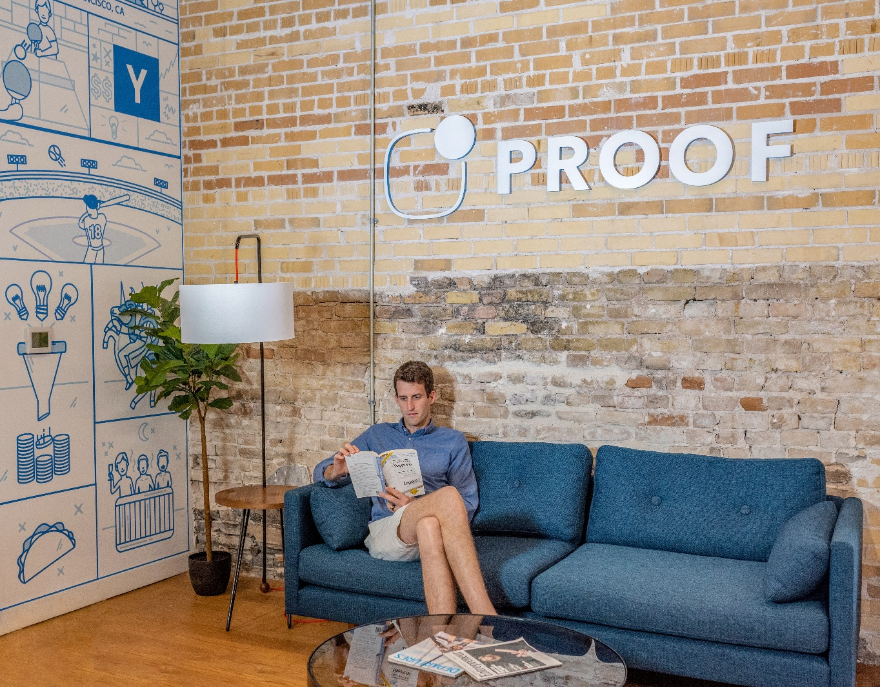
Was machst du?
Ich sitze zu Hause.
Notes:
Photo by Austin Distel on Unsplash

Slide 6
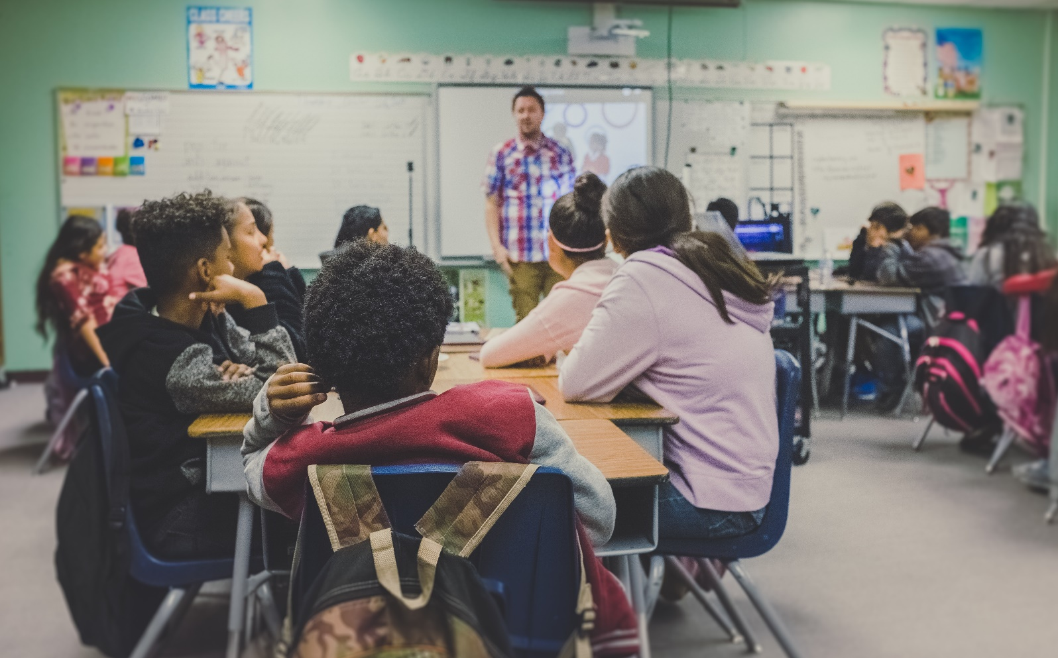
Was macht sie?
Sie sitzt im Klassenzimmer.
Notes:
Photo by Austin Distel on Unsplash

Slide 7
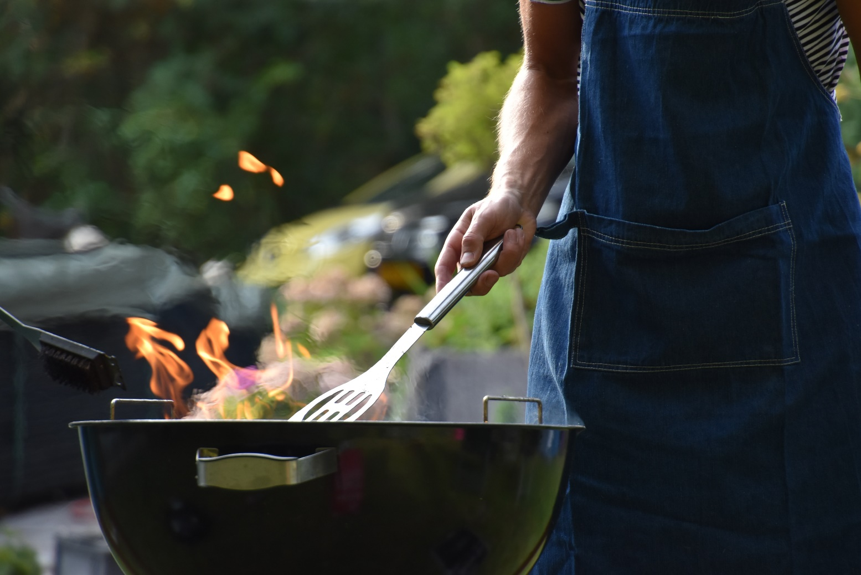
Was macht er?
Er kocht im Garten.
Notes:
Photo by Vincent Keiman on Unsplash

Slide 8
Was machst du?
Ich arbeite zu Hause.
Notes:
Photo by Thought Catalog on Unsplash

Slide 9
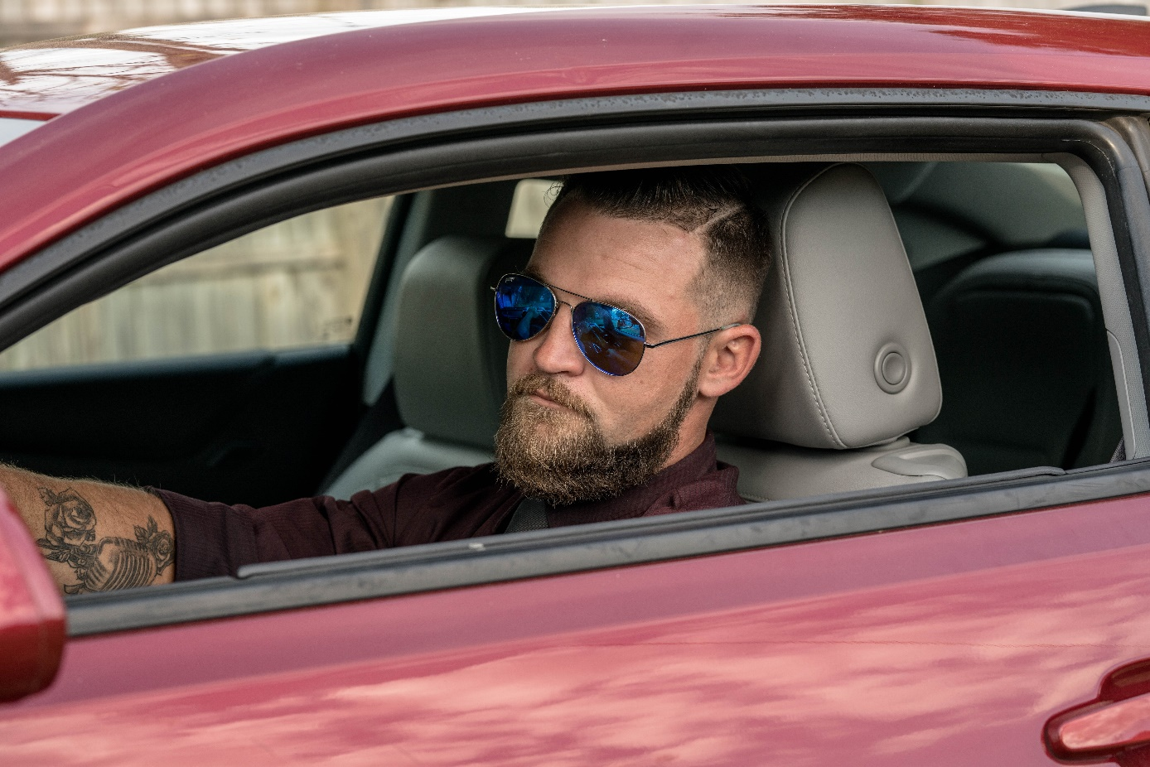
Was macht er?
Er sitzt im Auto.
Notes:
Photo by Blake Barlow on Unsplash

Slide 10
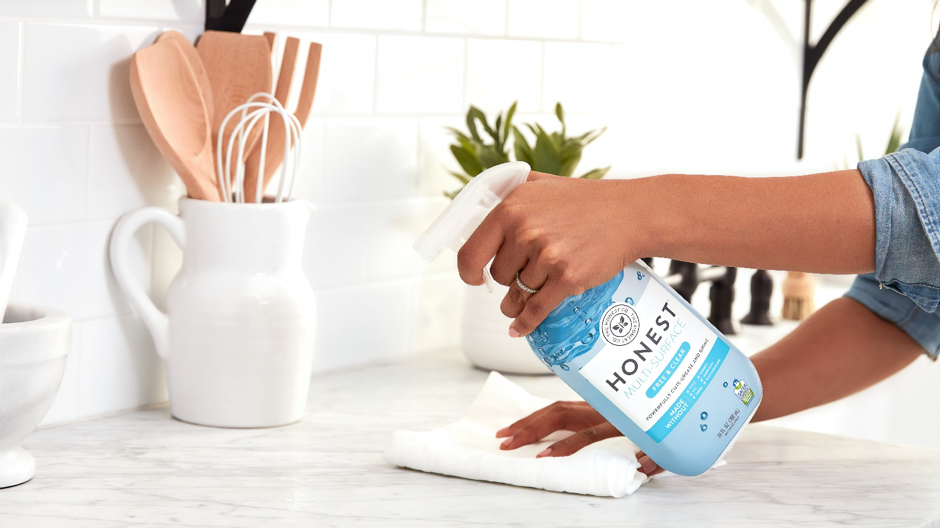
Was macht sie?
Sie putzt das Zimmer.
Notes:
Photo by The Honest Company on Unsplash

Slide 11
Was machst du?
Ich mache Sport.
Notes:
Photo by Thought Catalog on Unsplash

Slide 12
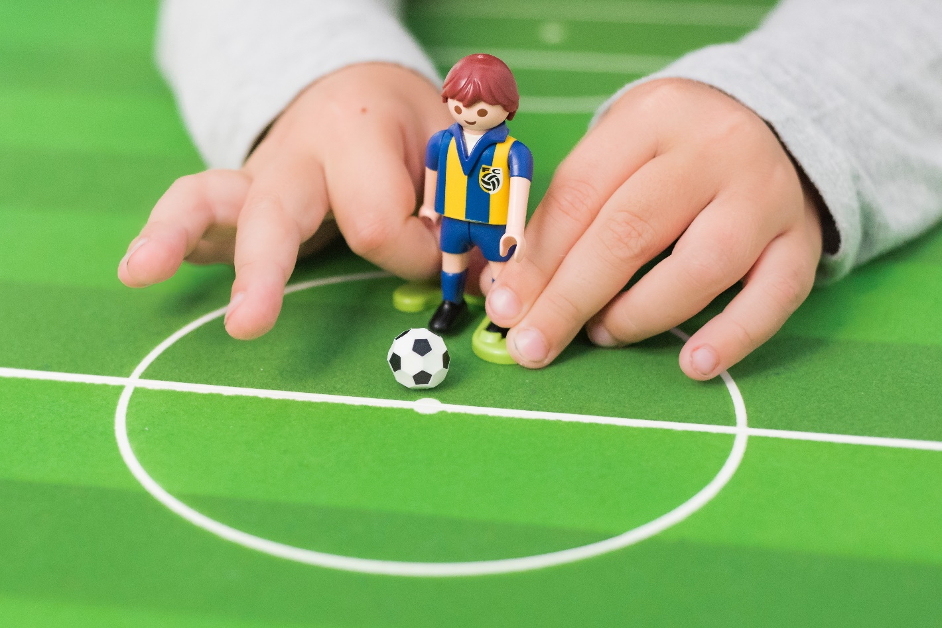
Was machst du?
Ich spiele Fußball.
Notes:
Photo by Click and Boo on Unsplash

Slide 13
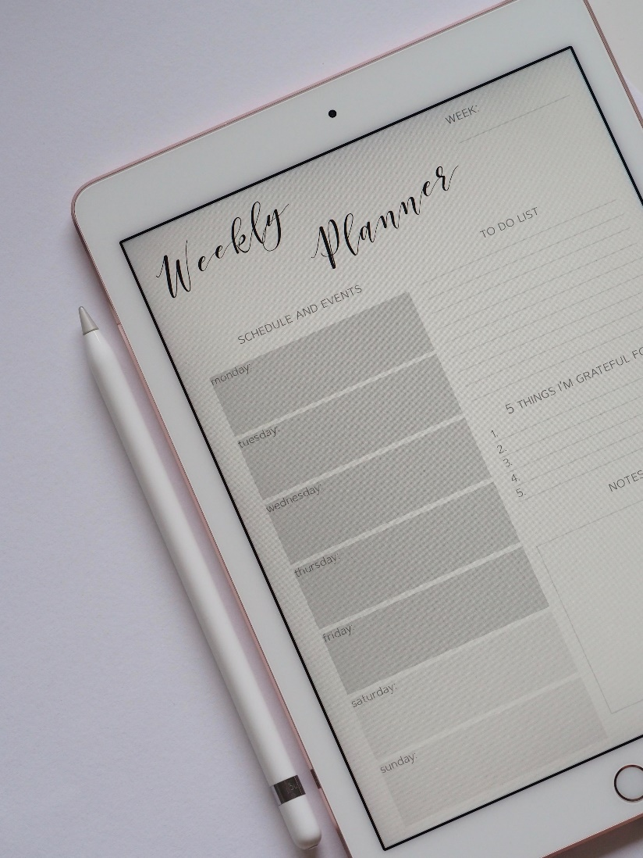
Was macht sie?
Sie schreibt eine Liste.
Notes:
Photo by Plush Design Studio on Unsplash

Slide 14
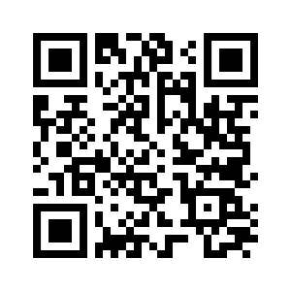
Vocabulary Learning Homework
Year 7 German – Term 1.2, Week 3
Audio file : [www.ncelp.org/audio/GY7T1-2W3 ]
Audio file QR code:
Student worksheet: [https://resources.ncelp.org/concern/resources/nz805z797?locale=en]
In addition, revisit: Term 1.1 Week 7: https://quizlet.com/_7655pv
Term 1.1 Week 1: https://quizlet.com/_6zlc6u
Notes:
Icon made by Darius from www.flaticon.com (freely usable image).
Term 1.2, Week 3 vocabulary
tanzen [2011] gehen [69] hören [1557] jeden Tag [88/108] einmal die Woche [136 / 209] nie [196] kaum [259] manchmal [394] sehr [70] oft [215])
Term 1.1, Week 7 Lieblings- [>4034] das Buch [295] der Film [524] der Sänger [3916] die Sängerin [3916] die Lehrerin [2696] das Lied [1726] die Band [<4034]; leider [642]
Term 1.1, Week 1 sein [3] ist [3] das Heft [3598] das Fenster [634] der Tisch [494] die Tafel [3660] die Flasche [1762] wo? [94] hier [71] da [35] der, die, das [1]

