Slide 1
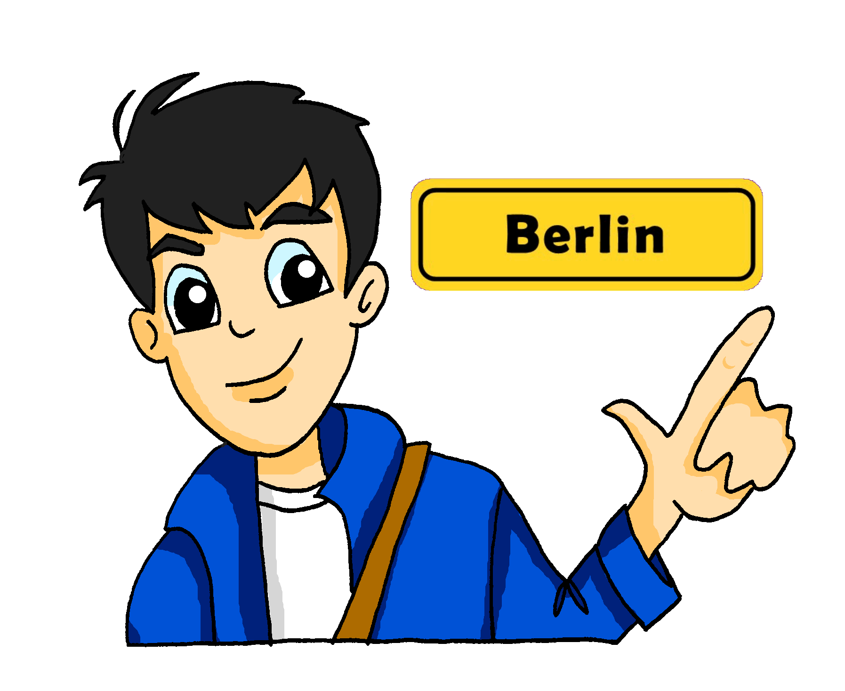
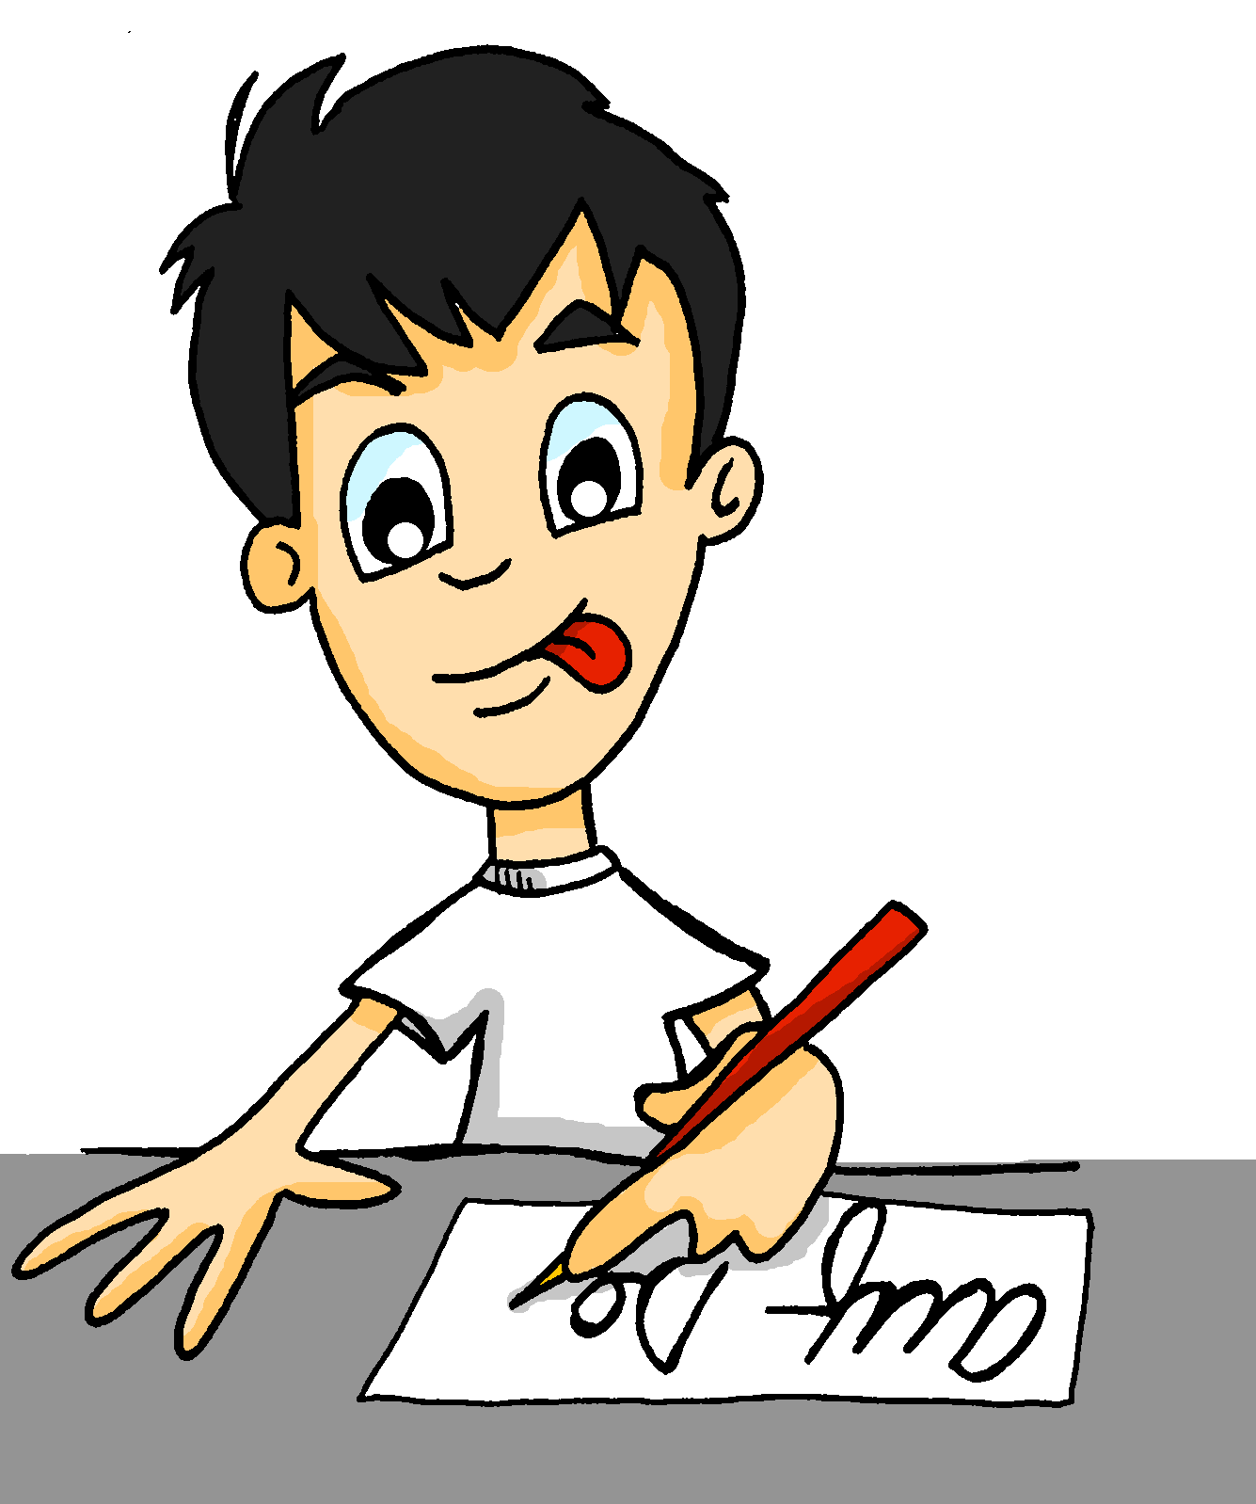
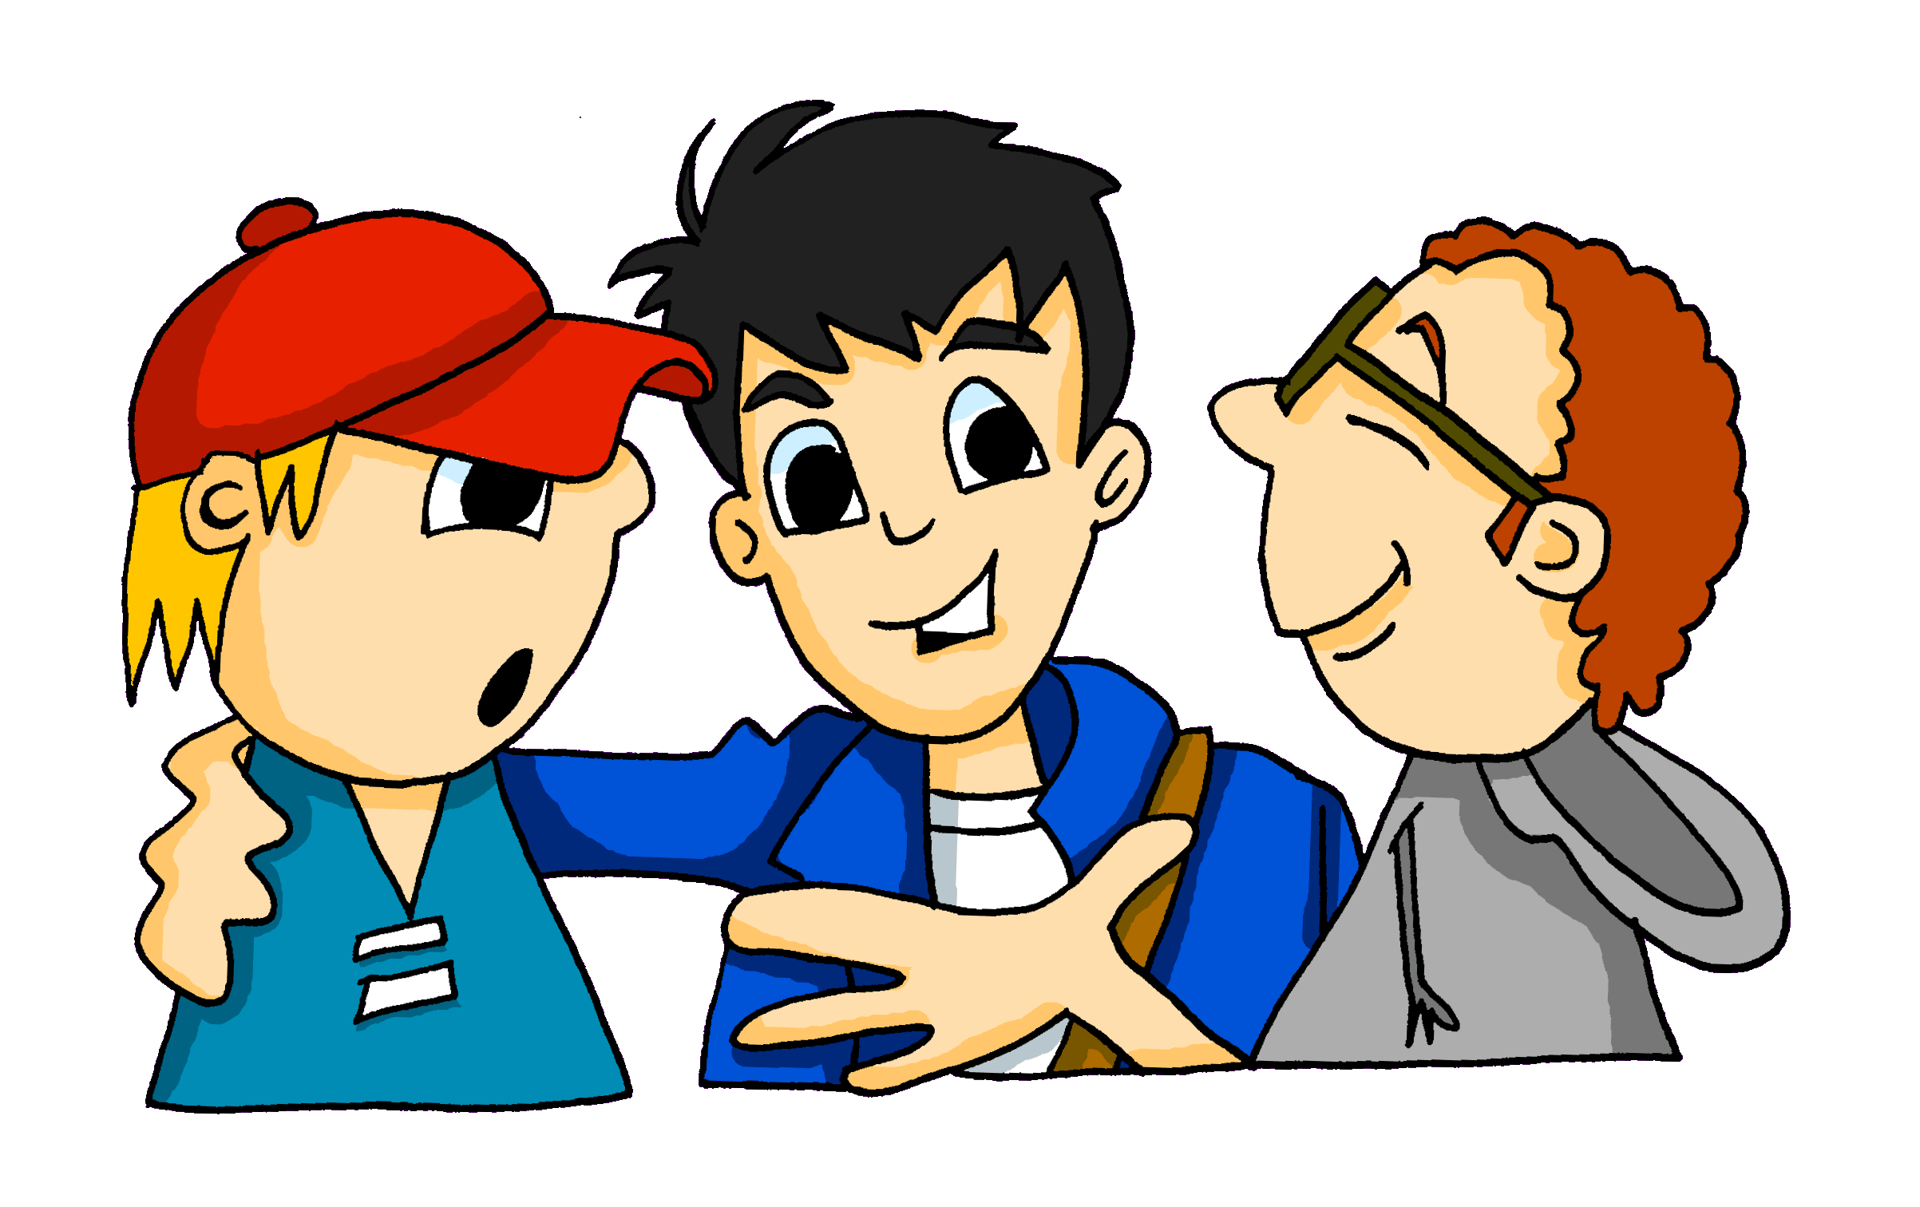
Leigh McClelland / Rachel Hawkes
Notes:
Cards to print and cut up – 3 sets per page, easy to slice into 3 and then students can cut up their own. Photocopy onto paper, in b/w is fine. It is not essential that students create pieces/cards of exactly the same size – they can tear the paper to create their six cards, avoiding the need for giving out scissors.

