Slide 1
Talking about things that are important to you
Revisit subject and object pronouns
Develop SSC fluency
Y8 German
Term 3.2 - Week 7- Lesson 71
Author name(s): Stephen Owen / Rachel Hawkes
Artwork: Steve Clarke
Date updated: 20/12/21
Notes:
Artwork by Steve Clarke. All additional pictures selected are available under a Creative Commons license, no attribution required.
Native-speaker teacher feedback provided by Stephanie Cross.
Learning outcomes (lesson 1): Revisit pronouns, present, past (perfect) and future tenses. Develop SSC fluency
Word frequency (1 is the most frequent word in German):
9.3.2.7 (revisit) ihn [92] ein bisschen [n/a] beide [117] viel [56] man [32] beginnen [251] denken [128] dürfen, darf [143] glauben [156] leben [98] mögen, mag [168] schaffen [285] ziehen [193] Auto [361] Dorf [959] Geschäft [765] Jahr [53] Mädchen [602] Museum [1078] Theater [1086] Tier [614] Arzt [622] Bruder [730] Junge [548] Markt [476] Urlaub [1570] Vater [232] Bibliothek [2366] Eltern [404] Familie [329] Farbe [1079] Fremdsprache [3770] Geschwister [3929] Großstadt [3084] Idee [451] Kirche [892] Mutter [218] Schwester [974] Stadt [204] Tür [375] Uniform [3857] Monat [316] blau [948] dein [233] dunkel [706] gelb [1446] gesund [1275] glücklich [1070] grün [682] hässlich [3542] ihr [27] mein [51] nächster, nächste, nächstes [237] praktisch [840] rot [477] schön [188] sein [30] wahr [737] dann [41] ganz [69] genug [498] nie [186] über [47] ein, eine [5] null [1680] eins [774] zwei [70] drei [106] vier [200] fünf [274] sechs [428] sieben [611] acht [645] neun [1053] Angst vor [n/a] ich verstehe nicht [n/a] in Ordnung [n/a]
Source: Jones, R.L & Tschirner, E. (2019). A frequency dictionary of German: Core vocabulary for learners. London: Routledge.
The frequency rankings for words that occur in this PowerPoint which have been previously introduced in NCELP resources are given in the NCELP SOW and in the resources that first introduced and formally re-visited those words.
For any other words that occur incidentally in this PowerPoint, frequency rankings will be provided in the notes field wherever possible.

Slide 2
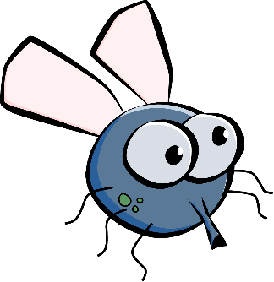
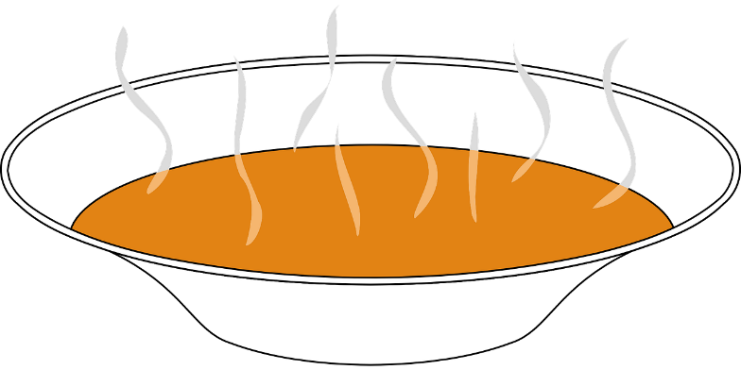
Phonetik
Lies den Witz* laut vor. Wie heißt das auf Englisch?
lesen / sprechen
10
Herr Ober*, da sitzt eine Fliege in meiner Suppe!
Das ist schon in Ordnung, meine Dame, das kostet nichts extra.
Sekunden
0
der Witz – joke
der Ober – waiter
LOS!
Notes:
Timing: 5 minutes (for two slides) Aim: To develop SSC fluency when reading aloud a mixture of known and unknown words at sentence level, building up speed of oral production through task repetition. Procedure: 1. Teacher ensures students recognise the premise and format of the ‘waiter, waiter’ joke, noting that this is a genre of humour that is shared across many cultures.
2. In pairs, students read the joke aloud, aiming for appropriate intonation and emotion in their ‘performance’, as fits the scenario.
3. Teacher ensures that the meaning is clear.
4. Click to reveal the 10-second timer. Students read the joke together two-three times, aiming to increase the speed and confidence of their oral production.
5. At the most beneficial moment for learners, click each speech bubble to hear an audio version of the joke. 6. Repeat with the second joke on the next slide.
Note: the use of schon here has the role of modal particle, rather than the meaning ‘already’, which students have learnt. Teachers may like to prompt students to think of a filling word that might serve the same purpose, e.g. That’s quite alright, madam. Equally, the sentence would also translate well without the addition, i.e. That’s alright, madam.
Transcript: Herr Ober, da sitzt eine Fliege in meiner Suppe! Das ist schon in Ordnung, meine Dame, das kostet nichts extra.
Word frequency of cognates and unknown words (1 is the most frequent word in German): Fliege [3994] Ober [>5009] Suppe [>5009] Witz [2228] Source: Jones, R.L. & Tschirner, E. (2019). A frequency dictionary of German: core vocabulary for learners. Routledge

Slide 3
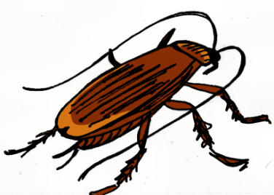
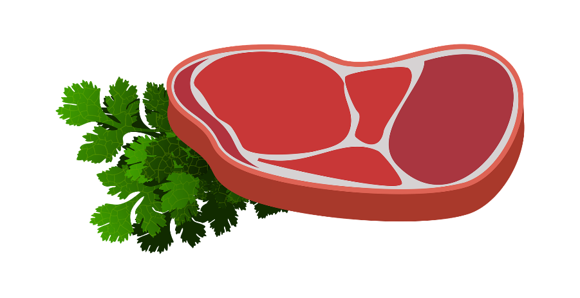
Phonetik
Lies den Witz laut vor. Wie heißt das auf Englisch?
lesen / sprechen
10
Herr Ober, da ist eine Fliege in meiner Suppe!
Nein, nein, meine Dame, das ist eine Kakerlake*, die Fliege ist auf dem Steak.
Sekunden
0
die Kakerlake – cockroach
LOS!
Notes:
Transcript: Herr Ober, da ist eine Fliege in meiner Suppe! Nein, nein, meine Dame, das ist eine Kakerlake, die Fliege ist auf dem Steak.
Word frequency of cognates and unknown words (1 is the most frequent word in German): Fliege [3994] Kakerlake [>5009] Ober [>5009] Steak [5009] Suppe [>5009] Witz [2228] Source: Jones, R.L. & Tschirner, E. (2019). A frequency dictionary of German: core vocabulary for learners. Routledge

Slide 4
Kategorien
A: Lies die drei Wörter. B: Hör zu. Welche Kategorie?
hören / sprechen
1
Eltern, Bruder, Vater
Familie
1
dunkel, rot, blau
Farbe
2
vier, null, sieben
Nummer
2
Kirche, Geschäft, Bibliothek
Dorf
3
Arzt, praktisch, Uniform
Arbeit
3
Mutter, Mädchen, Schwester
Frauen
4
Woche, Monat, 2020
Jahr
4
Touristen, ziehen, Großstadt
London
meine Meinung
5
Theater, Museum, Markt
Stadt
5
Idee, glauben, denken
6
Englisch, Französisch, Deutsch
Fremdsprache
6
glücklich, Urlaub, beginnen
Juli
London | Juli | Frauen
Farbe | meine Meinung | Dorf
Arbeit | Stadt | Nummer
Familie | Fremdsprache | Jahr
Notes:
Vokabeln Timing: 8 minutes
Aim: To revisit 48 previously taught words, 38 from this week’s vocabulary set, in oral modality, receptive mode.
Procedure:
1. Explain the task. At this point, advise student B to note down the six possible categories, then turn away from the board.
2. Click to bring up the text for student A.
3. Student A reads the first list of three words to student B who responds by saying the category. 4. Student A continues until all six sets of words have been said. 5. Student B turns back to double check his/her answers.
6. Students then swap roles.
7. Teachers can use this slide to bring the activity to a close by eliciting the meanings of the target words in English.

Slide 5
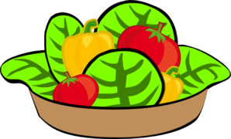
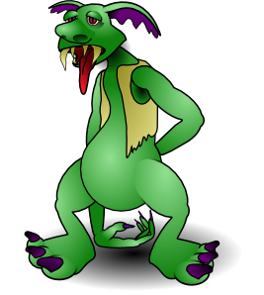
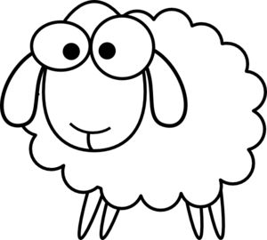
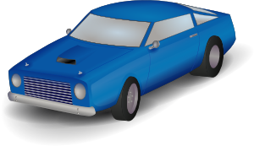
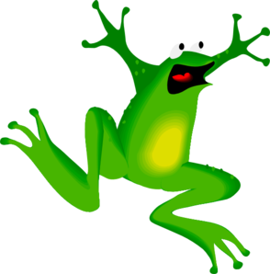
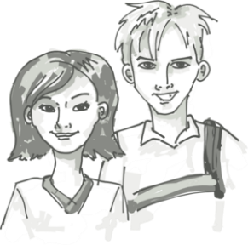
Vokabeln
Welche Nummer ist das? Wie sagt man das auf Deutsch?
sprechen
1 | 2 | 3 | 4
5 | 6 | 7 | 8
9 | 10 | 11 | 12
20
[boy]
[healthy]
[animal]
[ugly]
Sekunden
[true]
[green]
[car]
[door]
0
[yellow]
[fear of]
[siblings]
[beautiful]
LOS!
Notes:
Timing: 5 minutes Aim: To revisit a further 12 words (plus numbers 1-12) from this week’s vocabulary set in oral modality, productive mode. Using the timer in a specific round is a spur to increase the speed of processing. Procedure: 1. Round 1: Teacher says the German, students say number in German, the word in English, then the word in German again, chorally. E.g. Teacher: grün Students: sechs – green – grün Teacher to remind students to give the definite article with nouns.
2. Round 2: Teacher says the number, students say the German, chorally.
3. Round 3: In pairs. Student A mouths a German word, Student B says it aloud. Continue for 20-second timer. Swap roles.
4. Round 4: Students say all words out loud, in number order, with 20-second timer.
Answers 1. der Junge 2. gesund 3. das Tier 4. hässlich 5. wahr 6. grün 7. das Auto 8. die Tür 9. gelb 10. Angst vor 11. die Geschwister 12. schön

Slide 6
der, die, das → ein, eine, ein
sprechen
Ich sage, du sagst
60
the market
a holiday
a town
the library
the week
a shop
the month
a girl
the year
a market
the holiday
the town
a library
a week
the shop
a month
the girl
a year
Sekunden
0
LOS!
Notes:
Vokabeln: Pairwork ‘tennis’: Timing: 2 minutes
Aim: To practise connecting nouns, their gender and their definite and indefinite articles in R1(nom) in oral modality, productive mode.
Procedure: 1. Partner A says item 1 in German. B says the corresponding article plus noun in German. 2. B continues by saying his/her next item in German. A says the corresponding article plus noun in German. Pattern of interaction is thus A B B A A B B etc.. Teacher can circulate to listen into their SSC knowledge.

Slide 7
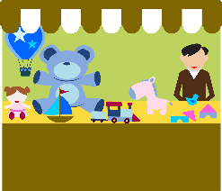
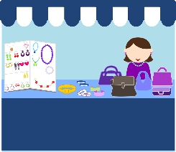
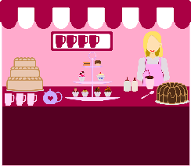
Subject pronouns (it) and (them)
Grammatik
The ending of the word for ‘it’ is the same as the ending of the word for ‘the’.
The subject of a sentence is the person or thing doing a verb.
Often, the subject of a sentence is a noun:
Sometimes, the noun is replaced by a pronoun:
In German, subject pronouns tell us the grammatical gender of the subject.
er - masculine: ____ Urlaub ist ganz toll! ____ ist ganz toll! ____ is totally great.
sie - feminine: ____ Uniform ist hässlich. ____ ist hässlich. ____ is ugly.
es - neuter: ____ Geschäft ist dunkel. ____ ist dunkel. ____ is dark.
sie - plural: ____ Mäuse sind glücklich. ____ sind glücklich. _____ are happy.
Der Markt hat viel Platz.
Er hat viel Platz.
Der
Er
It
Die
Sie
It
Das
Es
It
Die
Sie
They
Remember: sie is ‘they’ for all nouns.
Notes:
Timing: 2 minutes
Aim: To revisit the knowledge that German has three words for ‘it’ and one for ‘them’ when the pronoun is the subject of the sentence.
Procedure:
Click through animations and pause to elicit the English or German words that are hidden or missing.
Teacher to emphasise that ‘es’ is only for neuter words.
Teacher to emphasise that the pronoun endings (er, sie, es) mirror the endings of the definite article (der, die, das).
Teacher can reinforce this, as necessary, by pointing to objects in the classroom and describing them using the subject pronoun, e.g. Er (der Tisch) ist groß. Sie (die Tafel) ist hier/da. Es (das Buch) ist rot.

Slide 8
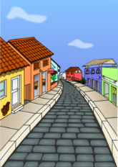
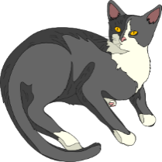
Wie sind die Dinge?
lesen / schreiben
Schreib Sätze. Beispiel: Das Dorf ist…
Es ist groß, aber sie ist klein.
Er war schön, aber es war schlecht.
Es ist glücklicher als sie.
1
[town]
[village]
Das Dorf ist groß, aber die Stadt ist klein.
2020
2
[year]
[holiday]
Der Urlaub war schön, aber das Jahr war schlecht.
3
[girl]
[cat]
Das Mädchen ist glücklicher als die Katze.
Notes:
Timing: 8 minutes (for two slides) Aim: To connect pronouns with nouns by matching pairs of pronouns with pairs of known nouns in written modality. Procedure: 1. Students read the sentences, which each contain two different pronouns.
2. Students decide to which noun each adjective refers, and write a sentence using definite article + noun as the subject. This will help students connect pronouns with definite articles, and also provides some written vocabulary revision.
3. Teacher elicits full sentence responses orally and answers are revealed on clicks.
Note: additional words from this week’s vocabulary set are included in these sentences. Teachers can prompt student recall of the meanings of these words as they come up. These are the words: Dorf, Stadt, Urlaub, schön, Jahr, Mädchen, glücklich, Idee, Monat, dunkel, Auto, praktisch.

Slide 9
Wie sind die Dinge?
lesen / schreiben
Sie ist falsch, aber er ist richtig.
Er ist so dunkel wie sie.
Beide sind praktisch, aber es ist schneller in der Stadt.
4
[idea]
[text]
Die Idee ist falsch, aber der Text ist richtig.
Dezember
5
[night]
[month]
Der Monat ist so dunkel wie die Nacht.
6
[train and car]
[car]
Der Zug und das Auto sind praktisch, aber das Auto ist schneller in der Stadt.
Notes:
Teachers to elicit the meaning of ‘beide’ explicitly.

Slide 10
Singular object pronouns (him, her, it, them)
Grammatik
As you know, subject pronouns show the gender of nouns.
After most verbs, the masculine subject pronoun changes to ihn. This is the object pronoun.
The plural pronoun (sie) also stays the same as the object.
Die Lieder sind toll!
Sie sind toll!
Ich mag sie.
Die Farbe ist schön!
Sie ist schön!
Der Unterricht ist super!
Er ist super.
___
Das Lied ist toll!
Es ist toll!
___
___
Der Unterricht ist super!
Ich mag ihn.
I like it.
Die Farbe ist schön!
Ich mag sie.
I like it.
Das Lied ist toll!
Ich mag es.
I like it.
___
___
___
The feminine and neuter object pronouns stay the same.
‘Sie (die Lieder) are great’, so here, ‘sie’ is the sentence subject
‘sie (die Lieder)’
are what are liked, so here,
‘sie’ is the sentence object
Notes:
Timing: 2 minutes
Aim: To revisit the change for masculine pronouns from er (R1: subject pronoun) to ihn (R2: object pronoun), with all other subject (R1) and object (R2) pronouns remaining identical.
Procedure:
Click through animations and pause to elicit the pronouns that are hidden.

Slide 11
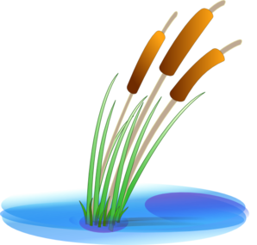
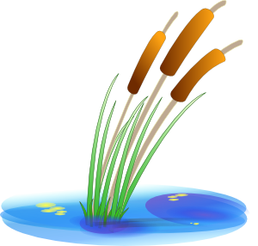
Was ist das?
hören
Choose the right words to cross the river.
Be careful! Some of the rocks are wobbly.
1
2
3
4
5
6
Kirche
Theater
Stadt
Farbe
Monat
Urlaub
Auto
Markt
Museum
Geschäft
Dorf
Idee
Notes:
Timing: 5 minutes Aim: Aural recognition of object pronouns, linked to association with the genders of known nouns.
Procedure: 1. Click numbers to hear audio.
2. Students pick which word on a rock is being referred to.
3. Click on rock to find out if the answer is right or wrong (wrong answers fall into the water).
4. Continue to the next audio until you have crossed the river!
Transcript: 1. Hast du es gesehen?
2. Ihre Mutter mag ihn. 3. Wann wirst du sie besuchen?
4. Magst du es?
5. Ich werde ihn mögen!
6. Wir haben sie gekauft.

Slide 12
Was?!
hören / sprechen
Partnerarbeit
Person A sagt den Satz. Person B hört zu. Was war das? Objekt 1 oder 2? Und auf Englisch?
Objekt 1 | Objekt 2 | Englisch
das Steak | die Kakerlake | ate the cockroach!
Beispiel:
Ich habe sie gegessen.
Person B
Person A
Ichhabesiegegessen.
You ate the cockroach!
Notes:
Timing: 3 minutes Aim: To model the speaking/listening activity. Procedure: Click through the animations carefully to show the steps for the activity.
Note: the speaking partner reads the sentence, but has to separate the words to pronounce/intone the sentence correctly. The listening partner needs to hear and understand the pronoun to identify which of the objects is the referent. S/he then writes down the detail and tells his/her partner what s/he has just (unknowingly) said. The humorous/unlikely nature of the items should appeal to students and given them an additional motivation to listen carefully.
Word frequency of cognates and unknown words (1 is the most frequent word in German): Kakerlake [>5009] Steak [5009]
Source: Jones, R.L. & Tschirner, E. (2019). A frequency dictionary of German: core vocabulary for learners. Routledge

Slide 13
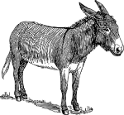
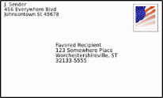
Was?!
Partnerarbeit
hören / sprechen
Person A sagt den Satz. Person B hört zu. Was war das? Objekt 1 oder 2? Und auf Englisch?
Person A: Runde 1
Runde 2
Objekt 1 | Objekt 2 | Englisch
Ichdarfesessen.
das Heft | der Esel | can’t find donkey!
das Schloss | die Stadt | will visit the castle
Ichmagihn.
Ichziehees.
der Freund | die Königin | are calling the Queen!
das Problem | die Frage | don’t understand the problem
Ichwerdesiekaufen.
Ichhabeüberihngesprochen.
das Buch | der Brief | wrote the letter
der Hund | die Spinne | bought the spider!
Ichhabesiegeschafft.
Notes:
DO NOT DISPLAY (SHOWS ANSWERS) Timing: 10 minutes Aim: To practise connecting pronouns to known and unknown nouns in oral modality, and at sentence level in past, present and future tenses. Procedure: 1. The speaking partner reads the sentence, but has to separate the words to pronounce/intone the sentence correctly. 2. The listening partner identifies which of the objects is the referent. S/he then writes down the detail of the utterance and tells his/her partner what s/he has just (unwittingly) said. 3. Repeat stages 1-2 for A’s six items. Then swap roles.
Word frequency of cognates and unknown words (1 is the most frequent word in German):
Esel [>5009] Königin [>5009] Spinne [>5009]
Source: Jones, R.L. & Tschirner, E. (2019). A frequency dictionary of German: core vocabulary for learners. Routledge

Slide 14
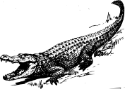
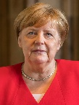
Was?!
Partnerarbeit
hören / sprechen
Person B sagt den Satz. Person A hört zu. Was war das? Objekt 1 oder 2? Und auf Englisch?
Person B: Runde 1
Runde 2
Objekt 1 | Objekt 2 | Englisch
Ichkannihnnichtfinden.
das Krokodil | der Keks | can eat the crocodile!
das Eis | der Drache | like the dragon!
Ichwerdeesbesuchen.
Ichrufesiean.
die Katze | das Pferd | are pulling the kitten!
das Handy | die Schlange | will buy the snake!
Ichversteheesnicht.
Ichhabeihngeschrieben.
Donald Trump | Angela Merkel | spoke about Donald Trump
die Aufgabe | der Marathon | completed the task
Ichhabesiegekauft.
Notes:
DO NOT DISPLAY (SHOWS ANSWERS) Timing: 10 minutes Aim: To practise connecting pronouns to known and unknown nouns in oral modality, and at sentence level in past, present and future tenses. Procedure: 1. The speaking partner reads the sentence, but has to separate the words to pronounce/intone the sentence correctly. 2. The listening partner identifies which of the objects is the referent. S/he then writes down the detail of the utterance and tells his/her partner what s/he has just (unwittingly) said. 3. Repeat stages 1-2 for A’s six items. Then swap roles.
Word frequency of cognates and unknown words (1 is the most frequent word in German): Krokodil [>5009] Drache [>5009] Kätzchen [>5009] Pferd [1504] Schlange [3601] Marathon [>5009]
Source: Jones, R.L. & Tschirner, E. (2019). A frequency dictionary of German: core vocabulary for learners. Routledge
Photo of Angela Merkel: Raimond Spekking / CC BY-SA 4.0 (via Wikimedia Commons) (Photo of Donald Trump is in public domain)

Slide 15
Talking about things that are important to you
Revisit direct and indirect object pronouns
Revisit [ei] and [ie]
Y8 German
Term 3.2 - Week 7- Lesson 72
Author name(s): Heike Krüsemann / Rachel Hawkes
Artwork: Steve Clarke
Date updated: 20/12/21
Notes:
Artwork by Steve Clarke. All additional pictures selected are available under a Creative Commons license, no attribution required.
Native-speaker teacher feedback provided by Stephanie Cross.
Learning outcomes (lesson 2): Revisit pronouns, present, past (perfect) and future tenses. Revisit [ei] and [ie]
Word frequency (1 is the most frequent word in German):
9.3.2.7 (revisit) ihn [92] ein bisschen [n/a] beide [117] viel [56] man [32] beginnen [251] denken [128] dürfen, darf [143] glauben [156] leben [98] mögen, mag [168] schaffen [285] ziehen [193] Auto [361] Dorf [959] Geschäft [765] Jahr [53] Mädchen [602] Museum [1078] Theater [1086] Tier [614] Arzt [622] Bruder [730] Junge [548] Markt [476] Urlaub [1570] Vater [232] Bibliothek [2366] Eltern [404] Familie [329] Farbe [1079] Fremdsprache [3770] Geschwister [3929] Großstadt [3084] Idee [451] Kirche [892] Mutter [218] Schwester [974] Stadt [204] Tür [375] Uniform [3857] Monat [316] blau [948] dein [233] dunkel [706] gelb [1446] gesund [1275] glücklich [1070] grün [682] hässlich [3542] ihr [27] mein [51] nächster, nächste, nächstes [237] praktisch [840] rot [477] schön [188] sein [30] wahr [737] dann [41] ganz [69] genug [498] nie [186] über [47] ein, eine [5] null [1680] eins [774] zwei [70] drei [106] vier [200] fünf [274] sechs [428] sieben [611] acht [645] neun [1053] Angst vor [n/a] ich verstehe nicht [n/a] in Ordnung [n/a]
Source: Jones, R.L & Tschirner, E. (2019). A frequency dictionary of German: Core vocabulary for learners. London: Routledge.
The frequency rankings for words that occur in this PowerPoint which have been previously introduced in NCELP resources are given in the NCELP SOW and in the resources that first introduced and formally re-visited those words.
For any other words that occur incidentally in this PowerPoint, frequency rankings will be provided in the notes field wherever possible.

Slide 16
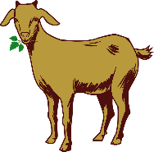
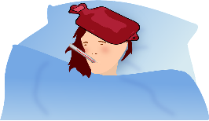
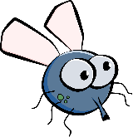
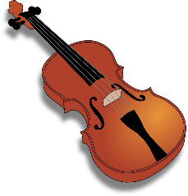
Phonetik
Partner A: Schreib fünf Wörter.
lesen / sprechen
Du sollst sie nicht zeigen!
Partner B: Sag alle Wörter.
Versuch, die fünf Wörter zu sagen.
40
die Ziege
die Wiese
das Fieber
die Liebe
die Fliege
das Schwein
Sekunden
die Freiheit
die Zeit
die Geige
die Allergie
die Beine
die Leiber*
der Haifisch
0
die Leiber – bodies
die Biene
der Frieden
der Wein
LOS!
Notes:
Timing: 3 minutes Aim: To revisit SSC [ei] and [ie] in a read aloud task. Procedure: 1. Partner A writes down 5 of the words on the slide. 2. Partner B, without seeing A’s list, says all the words on the slide as quickly as possible, trying to match all of Partner A’s list before the 40 seconds is up. Note: Partner A should listen very carefully to B’s pronunciation. S/he doesn’t need to cross a word off if the [ei] and [ie] are pronounced wrongly! 3. Swap roles. 4. Note: this activity can be repeated a couple of times.
Word frequency of cognates and unknown words (1 is the most frequent word in German): Allergie [>5009] Bein [884] Biene [>5009] Fieber [4774] Fliege [3994] Freiheit [814] Frieden [1696] Geige [>5009] Haifisch [>5009] Leib [3274] Liebe [844] Schwein [2975] Wein [1736] Wiese [2963] Ziege [>5009]
Source: Jones, R.L. & Tschirner, E. (2019). A frequency dictionary of German: core vocabulary for learners. Routledge

Slide 17
der, die, das → mein(e), dein(e), sein(e), ihr(e)
sprechen
Ich sage, du sagst
60
the mother
her brother
the sister
his friends
the siblings
your parents
the (female)friend
her father
the family
his mother
the brother
your sister
the friends
my siblings
the parents
his (female)friend
the father
my family
Sekunden
0
LOS!
Notes:
Vokabeln: Pairwork ‘tennis’: Timing: 3 mindddutesin
Aim: To practise connecting nouns, their definite articles and correct possessive adjectives. This revisits 10 items of vocabulary from this week’s set.
Procedure: 1. Partner A says item 1 in German. B says the corresponding article plus noun in German. 2. B continues by saying his/her next item in German. A says the corresponding article plus noun in German. 3. Teacher to circulate to monitor and listen to students’ SSC knowledge. 4. To bring the activity to a close, the teacher may wish to elicit a few of the items in German from students, either chorally or individually. Pattern of interaction is thus A B B A A B B etc..

Slide 18
Pronomen
Grammatik
As you know, we use pronouns to replace nouns that we do not need to repeat.
After most verbs, use direct object pronouns:
The subject case is also called Row 1 or nominative.
Remember: The object case is also called Row 2 or accusative.
SUBJECT
VERB
OBJECT
Ich
mag
dich.
I like you.
Du
magst
mich.
You like me.
Er
mag
sie.
He likes her/it (feminine).
Sie
mag
ihn.
She likes him/it (masculine).
Wir
mögen
es.
We like it (neuter).
Sie
mögen
sie.
They like them (all noun genders).
Notes:
Timing: 3 minutes Aim: To revisit knowledge of direct object pronouns. Procedure: 1. Click to animate the explanation.
2. Ensure students’ understanding at each stage.

Slide 19
Pronomen [R3 – Dativ]
Grammatik
After certain verbs or prepositions, use indirect object pronouns instead:
Sometimes these R3 (dative) pronouns mean ‘to me’, ‘to you’ etc., but they can just mean ‘me’, ‘you’, ‘him’, ‘her’ ‘it’.
SUBJECT
VERB
OBJECT
Ich
glaube
dir.
I believe you.
Du
glaubst
mir.
You believe me.
Sie
glaubt
ihm.
She believes him/it (masculine).
Er
glaubt
ihr.
He believes her/it (feminine).
Wir
glauben
ihm.
We believe it (neuter).
Sie
glauben
ihnen.
They believe them (all nouns).
Notes:
Timing: 3 minutes Aim: To revisit Row 3 (dative) pronouns dir, mir, ihm, ihr, ihm, ihnen. Procedure: 1. Click to animate the explanation.
2. Ensure students’ understanding at each stage.

Slide 20
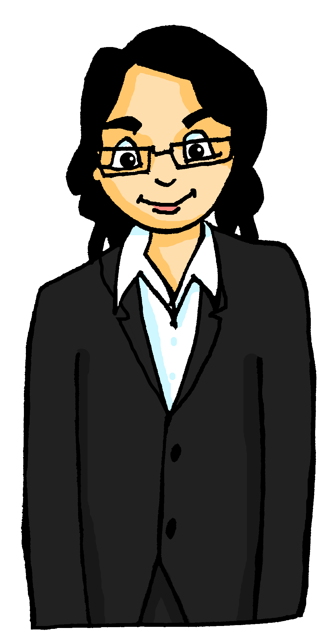
Im Radio
Listeners phone in to say what they like and what they’re scared of. But reception is bad!
hören
Hör zu. Schreib 1 – 8 und mag oder habe Angst vor.
 |  | ich mag | ich habe Angst vor
 | Ich habe Angst vor ihnen.
 | Ich mag sie.
 | Ich mag sie.
 | Ich habe Angst vor ihr.
 | Ich habe Angst vor ihnen.
 | Ich mag ihn.
 | Ich habe Angst vor ihnen.
 | Ich mag es.
Clowns
Mias Mutter
Spinnen
unsere Schuldirektorin
Ratten
der Zahnarzt
Schlangen
das Kind
1
2
3
4
5
6
7
8
Notes:
Timing: 7 minutes Aim: To differentiate aurally between R2 (acc.) and R3 (dat.) pronouns, deciding whether the sentence has (a) a direct object (“Ich mag”/accusative) and the missing meaning must be ‘I like’; or (b) an indirect object (“ich habe Angst vor”/dative) and the missing meaning must be ‘I am scared of’. Procedure: 1. Explain the activity, ensuring students know to listen out for the pronoun in order to decide whether to write ‘ich mag’ or ‘ich habe Angst vor’.
2. Depending on the level of the teaching group, consider making clear which pronouns are possible for each item – e.g. clowns = plural, so the choice will be between ‘sie’ and ‘ihnen’, etc.
3. Click sound button for item 1 to play recording.
4. Click again to reveal the tick for the right answer .
5. Click again to reveal the text.
6. Repeat for items 2 and 3. For items 4 - 8 play the audio for all items, checking the answers at the end.
Transcript:
1. Clowns? Ich [habe Angst vor] ihnen. 2. Mias Mutter? Ich [mag] sie. 3. Spinnen? Ich [mag] sie. 4. Unsere Schuldirektorin? Ich [habe Angst vor] ihr. 5. Ratten? Ich [habe Angst vor] ihnen. 6. der Zahnarzt? Ich [mag] ihn. 7. Schlangen? Ich [habe Angst vor] ihnen. 8. das Kind? Ich [mag] es.
Word frequency (1 is the most frequent word in German): Clown [>5009] Spinne [>5009] Ratte [4924] Zahn [1871] Schlange [3601] Source: Jones, R.L. & Tschirner, E. (2019). A frequency dictionary of German: core vocabulary for learners. Routledge

Slide 21
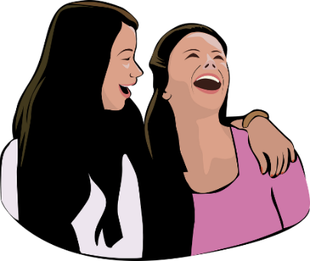
Meine Nachbarin [1/2]
Schreib 1 – 8. Wähle die richtige Antwort aus.
lesen
Meine Nachbarin liebt Vieles – und hat vor Vielem Angst!
Meine Nachbarin liebt viele Sachen, aber sie hat auch viel Angst. Zum Beispiel hat sie Angst vor ihrem Hund und vor ihrer Katze! Allerdings* mag sie die Nase und das rechte Ohr von ihrem Hund und sie liebt auch das linke Ohr und den Schwanz* von ihrer Katze! Lustig, nicht wahr? Vor dem Meerschweinchen* und der Maus von ihrer Tochter aber hat sie große Angst. Sie mag keine Post*, …
 |  | Antwort 1 | Antwort 2
 | Sie hat Angst vor ihm. | Hund | Katze
 | Sie liebt sie. | Nase | Ohr
 | Sie liebt es. | Ohr | Schwanz
 | Sie hat Angst vor ihr. | Meerschweinchen | Maus
1
2
allerdings – though der Schwanz – tail die Post – mail
das Meerschweinchen – guinea pig
3
4
Notes:
Timing: 7 minutes (two slides)
Aim: to practise written comprehension of object and indirect object pronouns in the context of a longer text. Procedure: 1. Based on the reading text, students decide which of the two noun objects the pronoun refers to. Draw their attention to the gender of the singular nouns. The items are in the order in which the answers appear in the reading text.
2. Click to reveal the first item, and the two possible answers.
3. Based on the pronoun, students select either Antwort 1 or Antwort 2.
4. Click again for the answer.
5. Repeat for items 2-4 on this slide, and items 5-8 on the next slide.
Answers: 1. Sie hat Angst vor ihm (Hund/Katze).
2. Sie liebt sie (Nase/rechtes Ohr von ihrem Hund).
3. Sie liebt es (das linke Ohr/den Schwanz von ihrer Katze).
4. Sie hat große Angst vor ihr (Meerschweinchen/Maus)
Word frequency of unknown words and cognates (1 is the most frequent word in German): allerdings [225] Meerschweinchen [>5009] Post [1926] [2788] Schwanz [>5009]
Source: Jones, R.L. & Tschirner, E. (2019). A frequency dictionary of German: core vocabulary for learners. Routledge

Slide 22
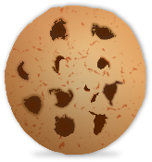
Meine Nachbarin [2/2]
lesen
der Briefträger – postman
… und sie hat nicht nur Angst vor Briefen, sondern* auch vor dem Briefträger*! Sie liebt meine Familie und mich und die Familie nebenan*, aber sie hat Angst vor meinem Baby – und auch vor der Babysitterin! Meine Nachbarin ist trotzdem* sehr nett, und sie liebt Kaffee und Kekse – wie ich auch. Doch leider kann ich keinen Kaffee mit ihr trinken – ich habe Angst vor Tassen*. Schade! ;-)
nebenan – next door
 |  | Antwort 1 | Antwort 2
 | Sie hat Angst vor ihm. | Briefen | Briefträger
 | Sie liebt uns. | meine Familie | Familie nebenan
 | Sie hat Angst vor ihm. | Baby | Babysitterin
 | Sie liebt ihn. | Kaffee | Kekse
5
6
7
sondern – but die Tasse – cup trotzdem – nevertheless
8
Notes:
Continuation of the previous activity. Answers:
5. Sie hat Angst vor ihm (Briefträger, Briefen)
6. Sie liebt uns (meine Familie und mich/die Familie nebenan).
7. Sie hat Angst vor ihm (Baby/Babysitterin).
8. Sie liebt ihn (Kaffee/ Kekse).
Word frequency (1 is the most frequent word in German):
Briefträger [>5009] nebenan [4567] trotzdem [463] schade [2788] Tasse [3518] Source: Jones, R.L. & Tschirner, E. (2019). A frequency dictionary of German: core vocabulary for learners. Routledge

Slide 23
Pronomen ‘I’, ‘me’ and ‘you’
Grammatik
Compare:
vor + dem → vorm
The subject case is also called Row 1 or nominative.
Do you have fear of flying?
Hast du Angst vorm Fliegen?
Ja, ich habe Angst vorm Fliegen.
Yes, I have fear of flying.
The object case is also called Row 2 or accusative.
Was macht dich glücklich?
What makes you happy?
Sport macht mich glücklich.
Sport makes me happy.
Indirect objects (R3 or dative) can mean ‘to me, you,…’
Was ist dir wichtig?
What is important to you?
Musik ist mir wichtig.
Music is important to me.
What is different about the word order?
What is different about the word order?
Notes:
Timing: 3 minutes Aim: To revisit knowledge of subject, direct object and indirect object pronouns for the first and second person singular.
Procedure: 1. Click to animate the explanation.
2. Ensure students’ understanding at each stage.

Slide 24
10 Tipps für ein glückliches Leben
lesen
etwas Nettes – something nice
Lies den Text. Was macht uns glücklich und warum? Schreib eine Liste.
What? | Why/How?
Set goals | setting short and long term goals is positive
Acceptance | there are some things you should just accept
Feelings | keep positive – laugh and say something nice
Love | you should love yourself as you are
Helping | it does us good to help others, esp. in a team
What? | Why/How?
Giving | gives a warm feeling doing things for others
Contact | good to spend more time with the right people
Sport | healthy body healthy mind
Be in the moment | maybe with meditation music? lots of apps for that
Learning | thinking actively makes you happy
1. Geben Es gibt uns ein ganz warmes Gefühl, Dinge für andere Leute zu tun. 2. Kontakt Es tut gut, mehr Zeit mit den richtigen Menschen zu verbringen. 3. Sport Welche Sportart gefällt dir? Im gesunden Körper lebt ein gesunder Geist*. 4. Im hier und jetzt sein (vielleicht durch Meditationsmusik? Es gibt viele gute Apps dafür*.) 5. Lernen Aktiv denken macht glücklich.
6. Ziele setzen Es ist positiv, Ziele für heute, nächste Woche, nächsten Monat und nächstes Jahr zu setzen. 7. Akzeptanz Einige Dinge soll man einfach annehmen. 8. Gefühle Immer positiv bleiben. Man kann immer lachen und etwas Nettes* sagen. 9. Lieben Du sollst dich selbst lieben, so wie du bist. 10. Helfen Es tut gut, anderen Personen zu helfen, besonders wenn man im Team zusammen arbeitet.
der Geist – mind
dafür – for it
Notes:
Timing: 8 minutes Aim: To practise comprehension of a longer text that brings together a number of grammar features and vocabulary taught over the course of years 7 and 8. Procedure: 1. Ensure students understand the title, the overall purpose of the text (i.e., to inform about things that make us happy), and the task.
2. Students put two headings ‘What?’ and ‘Why/How?’ and write 1-10 in the margin.
3. They note in English the 10 tips for a happy life and the reason/way each one makes us happy.
4. Extension: Students rank them in order of importance for themselves personally.
5. Teacher elicits feedback from students as appropriate to the group, i.e. either sequentially, or asking students to report the one they think is most/least important etc.
Word frequency of unknown words and cognates (1 is the most frequent word in German): Akzeptanz [>5009] dafür [175] Geist [1426] Meditation [>5009] Source: Jones, R.L. & Tschirner, E. (2019). A frequency dictionary of German: core vocabulary for learners. Routledge

Slide 25
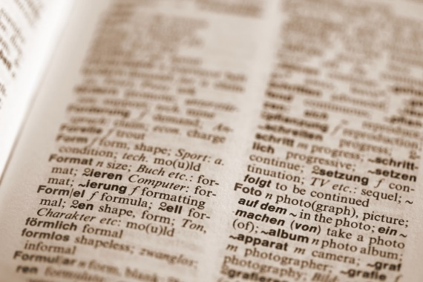
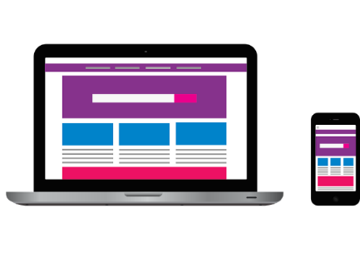
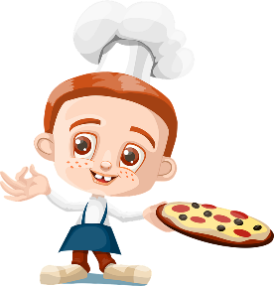
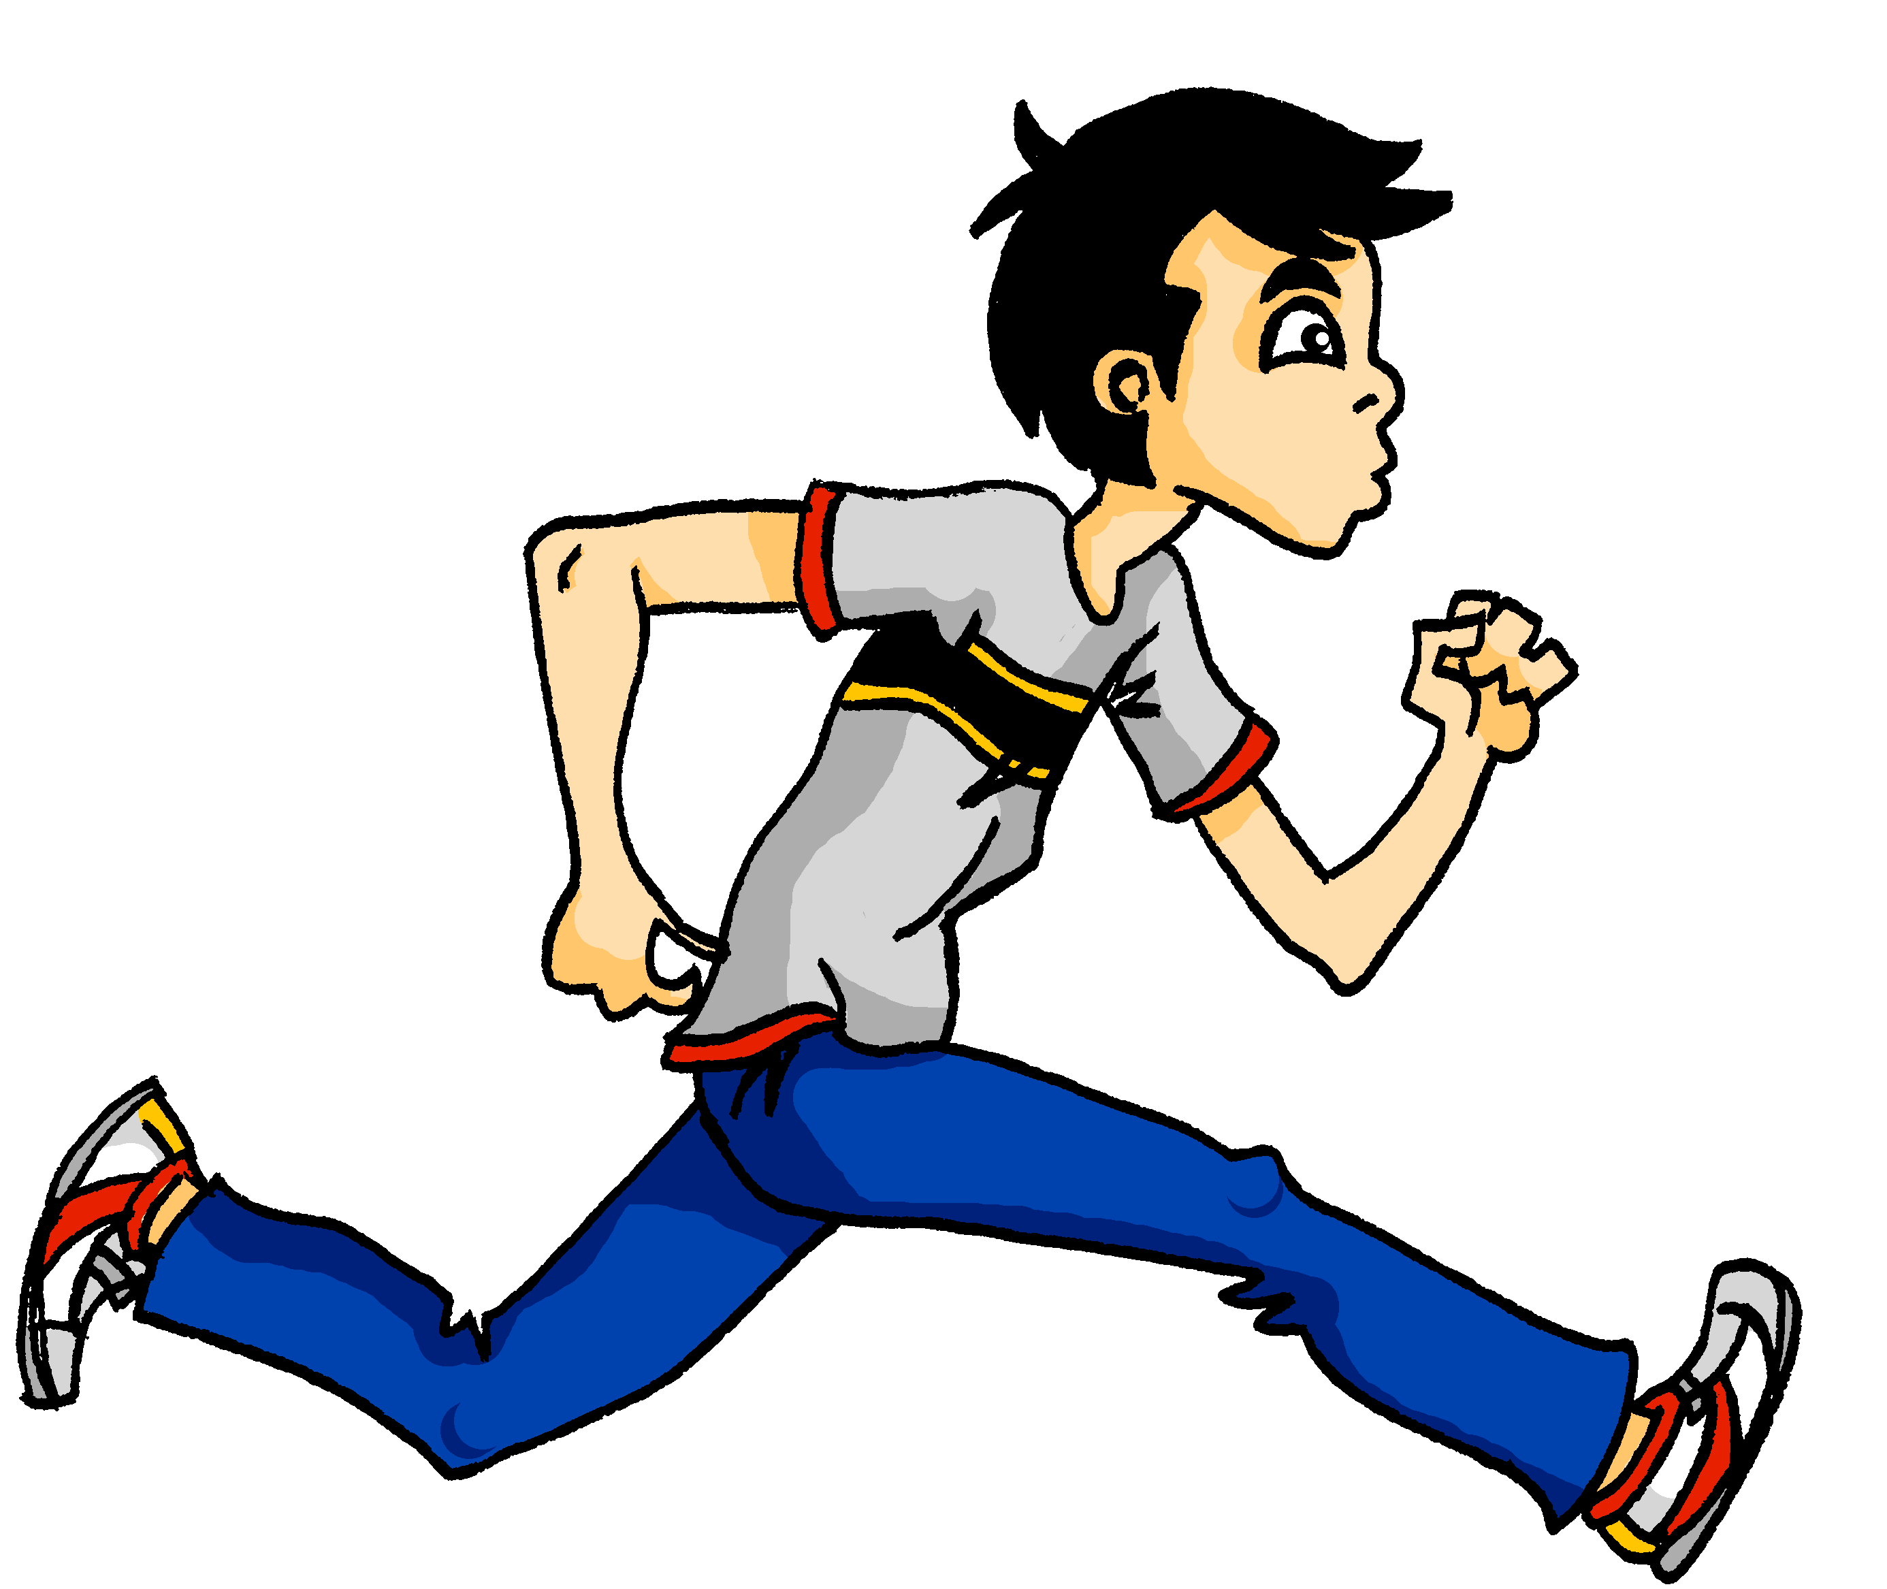
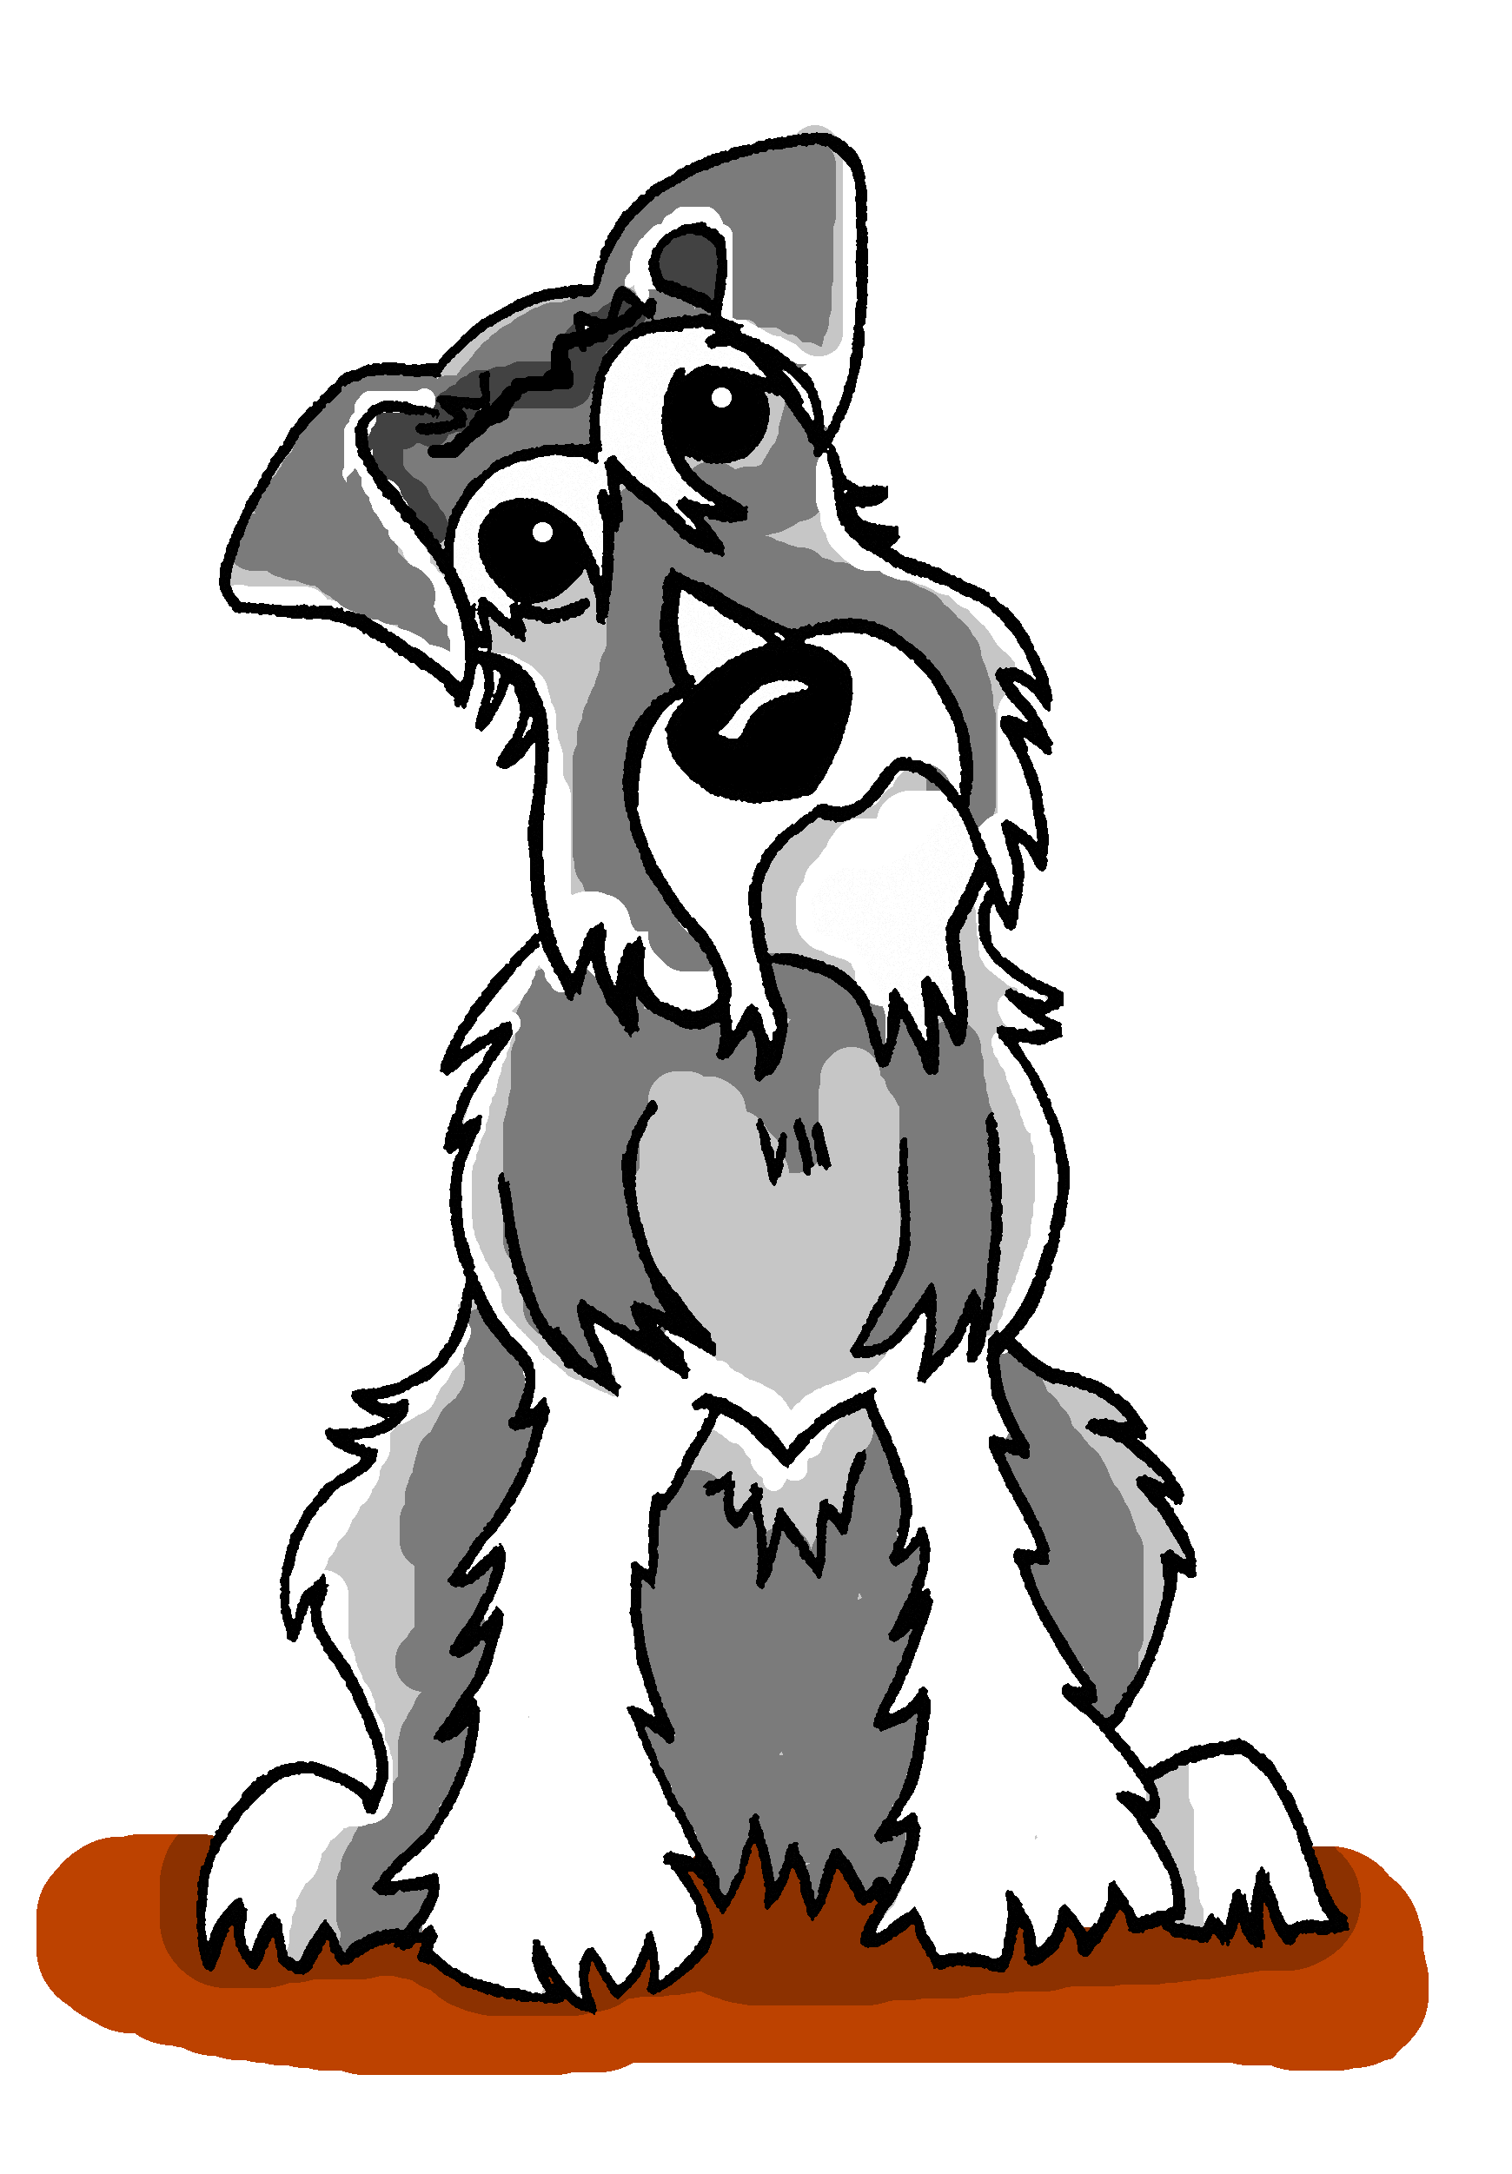
Was ist dir wichtig?
Wie heißt das auf Deutsch?
lesen
zum Beispiel:
Essen
Schreib ein Ranking.
total wichtig!
WLAN*
Kochen
Liebe
Sport
Frieden
Freunde
Familie
Gesundheit
Geben
But note: Familie is a singular idea in German:
Meine Familie ist mir wichtig.
Plural items need a plural verb!
Meine Freunde sind mir wichtig.
Musik
nicht so wichtig
Laufen
den Hund streicheln
Notes:
Timing: 7 minutes Aim: To prepare for a speaking task by ranking nine things that are important to them, using reference resources where necessary. Procedure: 1. Explain that the task is for each student to think of 9 things that are important them.
2. There are some ideas on this slide, but students could come up with their own ideas.
3. Students look up words in online or hard copy dictionaries.
4. Student fill in the diamond shape: the top field is very important, the bottom field is not so important.
Variation: Rather than individually, students could work in groups where they have to agree on concepts and rank order.
Differentiation: If working in groups, students could use target language to negotiate rankings, e.g.
“Familie ist mir nicht so wichtig. Und dir?”
“Waaas? Familie ist mir sehr wichtig!”
Word frequency of unknown words (1 is the most frequent word in German): streicheln [4377] Frieden [1696] Gesundheit [1851] WLAN [>5000] Source: Jones, R.L. & Tschirner, E. (2019). A frequency dictionary of German: core vocabulary for learners. Routledge

Slide 26
Partnerarbeit
Stelle und beantworte diese drei Fragen. Wiederhole mit zwei anderen Personen.
sprechen
Person A:
1. Was macht dich glücklich? 2. Was ist dir wichtig? 3. Hast du Angst vor …
What makes you happy?
What is important to you?
Are you scared of…?
Person B:
1. Singen macht mich glücklich. 2. Sport ist mir wichtig. 3. Ich habe Angst vor… Clowns.
1. Was macht dich glücklich? 2. Was ist dir wichtig? 3. Hast du Angst vor …
What makes you happy?
What is important to you?
Are you scared of…?
Notes:
Timing: 6 minutes Aim: Oral practice of the previously learnt/revised content.
Procedure: 1. Teacher elicits the German forms of the three questions from all students. The animations are set so that this can be done twice before the start of the task. 2. Each student asks one other student the three questions on the slide, and notes the answers.
3. Swap roles.
4. Time allowing, students could either ask a certain number of people (e.g. five), or ask as many other people as they can within the time limit (five minutes).

Slide 27
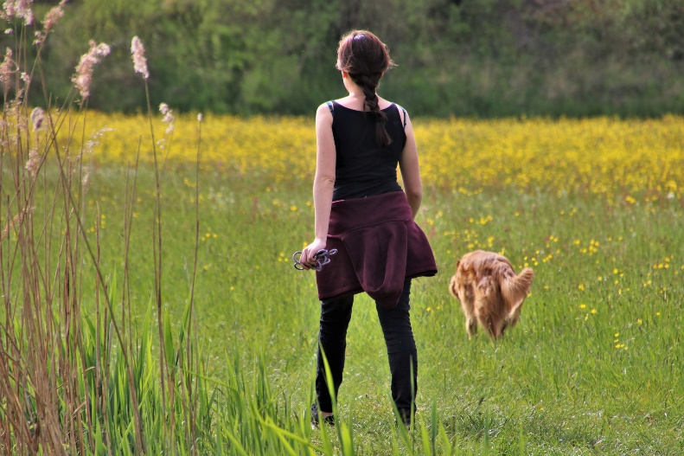
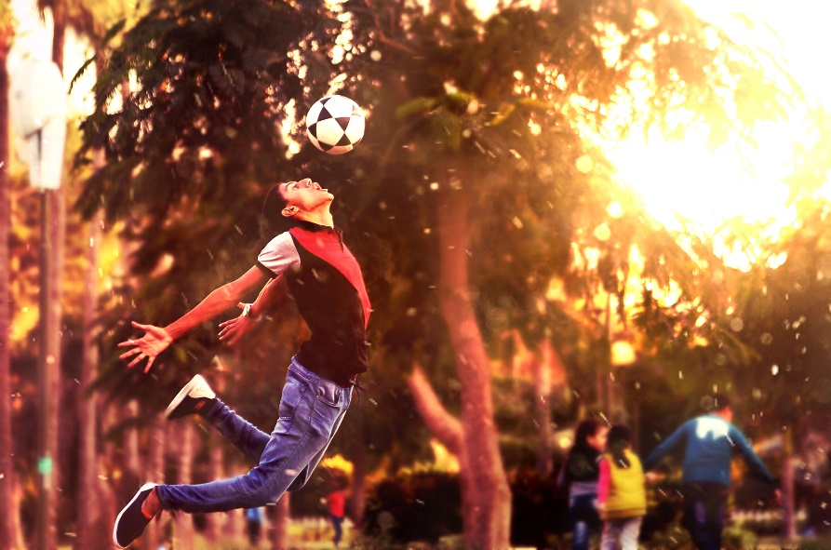
Viel Spaß in den Sommerferien!
Tschüs!
Notes:
Emoji One / CC BY-SA (https://creativecommons.org/licenses/by-sa/4.0)

Slide 28
10 Tipps für ein glückliches Leben
lesen
etwas Nettes – something nice
Lies den Text. Was macht uns glücklich und warum? Schreib eine Liste.
1. Geben Es gibt uns ein ganz warmes Gefühl, Dinge für andere Leute zu tun. 2. Kontakt Es tut gut, mehr Zeit mit den richtigen Menschen zu verbringen. 3. Sport Welche Sportart gefällt dir? Im gesunden Körper lebt ein gesunder Geist*. 4. Im hier und jetzt sein (vielleicht durch Meditationsmusik? Es gibt viele gute Apps dafür*.) 5. Lernen Aktiv denken macht glücklich.
6. Ziele setzen Es ist positiv, Ziele für heute, nächste Woche, nächsten Monat und nächstes Jahr zu setzen. 7. Akzeptanz Einige Dinge soll man einfach annehmen. 8. Gefühle Immer positiv bleiben. Man kann immer lachen und etwas Nettes* sagen. 9. Lieben Du sollst dich selbst lieben, so wie du bist. 10. Helfen Es tut gut, anderen Personen zu helfen, besonders wenn man im Team zusammen arbeitet.
der Geist – mind
dafür – for it
Notes:
TEXT only in case teachers want to print it.
Word frequency of unknown words and cognates (1 is the most frequent word in German): Akzeptanz [>5009] dafür [175] Geist [1426] Meditation [>5009] Source: Jones, R.L. & Tschirner, E. (2019). A frequency dictionary of German: core vocabulary for learners. Routledge

