Slide 1
Phonics
SSC /er/
Y7 German
Term 2.1 - Week 5 - Lesson 37
Author name(s): Inge Alferink / Rachel Hawkes
Date updated: 26/04/20

Slide 2
Transcript
er
schwer
wer?
er
Herz
lernen
erst
st
Notes:
Introduce and elicit the pronunciation of the individual SSC ‘er’ and then the source word again (with gesture, if using). Then present and elicit the pronunciation of the five cluster words. The cluster words have been chosen for their high-frequency, from a range of word classes, with the SSC (where possible) positioned within a variety of syllables within the words(e.g. initial, 2nd, final etc..) and additionally, we have tried to use words that build cumulatively on previously taught SSCs (see the Phonics Teaching Sequence document) and do not include new SSCs. Where new SSCs are used, they are often consonants which have a similar symbol-sound correspondence in English.
Note: Students have already been taught er, wer, lernen, erst (from der/die/das Erste), so only Herz and schwer are new to them.
Note: The difference between the two versions of [-er] depends on the stress. Essentially, where the ‘er’ falls on the stressed syllable it sounds one way, stronger/longer, and where it falls on the unstressed syllable, it’s obviously much less pronounced, similar to the sound or ‘er’ in the English word ‘Butter’.
Word frequency rankings (1 is the most common word in German): er [20]; schwer [256] wer? [173]; Herz [699]; erst [126]; lernen [203]. Source: Jones, R.L. & Tschirner, E. (2006). A frequency dictionary of German: core vocabulary for learners. Routledge

Slide 3
Transcript
er
schwer
wer?
er
Herz
lernen
erst
Notes:
Without pictures to focus on the SSC alone.

Slide 4
Transcript
er
schwer
wer?
er
Herz
lernen
erst
Notes:
Without sound to elicit the pronunciation

Slide 5
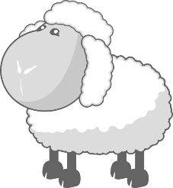
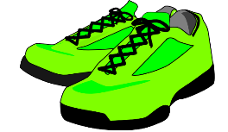
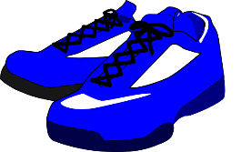
phonics
er
Eltern
aber
wieder
anders
oder
?
hundert
Notes:
Introduce and elicit the pronunciation of the individual SSC ‘er’ and then the source word again (with gesture, if using). Then present and elicit the pronunciation of the five cluster words. The cluster words have been chosen for their high-frequency, from a range of word classes, with the SSC (where possible) positioned within a variety of syllables within the words(e.g. initial, 2nd, final etc..) and additionally, we have tried to use words that build cumulatively on previously taught SSCs (see the Phonics Teaching Sequence document) and do not include new SSCs. Where new SSCs are used, they are often consonants which have a similar symbol-sound correspondence in English.
Word frequency rankings (1 is the most common word in German): wieder [75]; Eltern [351] aber [32]; anders [306]; hundert [945]; oder [30]. Source: Jones, R.L. & Tschirner, E. (2006). A frequency dictionary of German: core vocabulary for learners. Routledge

Slide 6
phonics
er
Eltern
aber
wieder
anders
oder
hundert
Notes:
Without pictures to focus on the SSC alone.

Slide 7
phonics
er
Eltern
aber
wieder
anders
oder
hundert
Notes:
Without sound to elicit the pronunciation.

Slide 8
Wie viele? Stressed and unstressed -er
hören
Der Herr versteht kein Deutsch.
1
Der Herr versteht kein Deutsch.
2
Er lernt nichts.
Er lernt nichts.
Die Eltern putzen das Fenster
3
Die Eltern putzen das Fenster
4
Die Mutter ist groß, aber das Kind ist klein.
Die Mutter ist groß, aber das Kind ist klein.
5
Wer hat leider kein Herz?
Wer hat leider kein Herz?
6
Der Fußballspieler gewinnt wieder hundert Trophäen.
Der Fußballspieler gewinnt wieder hundert Trophäen.
Notes:
Phonic practice
How many stressed and unstressed –er can you hear in the sentences?
Sentences 1 and 2 only contain stressed -er
Sentences 2 and 3 only contain unstressed –er
Sentences 5 and 6 contain both stressed and unstressed –er
Stressed -er underlined in the answers

