Slide 1
Separable verbs
Grammatik
The we and they/you (polite) forms of the verb are the same as the infinitive:
Wir
stehen
früh
auf.
We get / are getting up early.
sie / Sie
stehen
früh
auf.
They/you (polite) get / are getting up early.
Remember that sie (they) and Sie (you – formal) sound the same!
It is the context that tells you the correct meaning.
Notes:
Timing: 3 minutes Aim: To introduce two plural separable verb forms. Procedure: 1. Cycle through the information on the slide using the animation sequence. Word frequency (1 is the most frequent word in German):
aufstehen [653] Source: Jones, R.L. & Tschirner, E. (2006). A frequency dictionary of German: core vocabulary for learners. Routledge
Source: Gm Y8 2.2.2

Slide 2
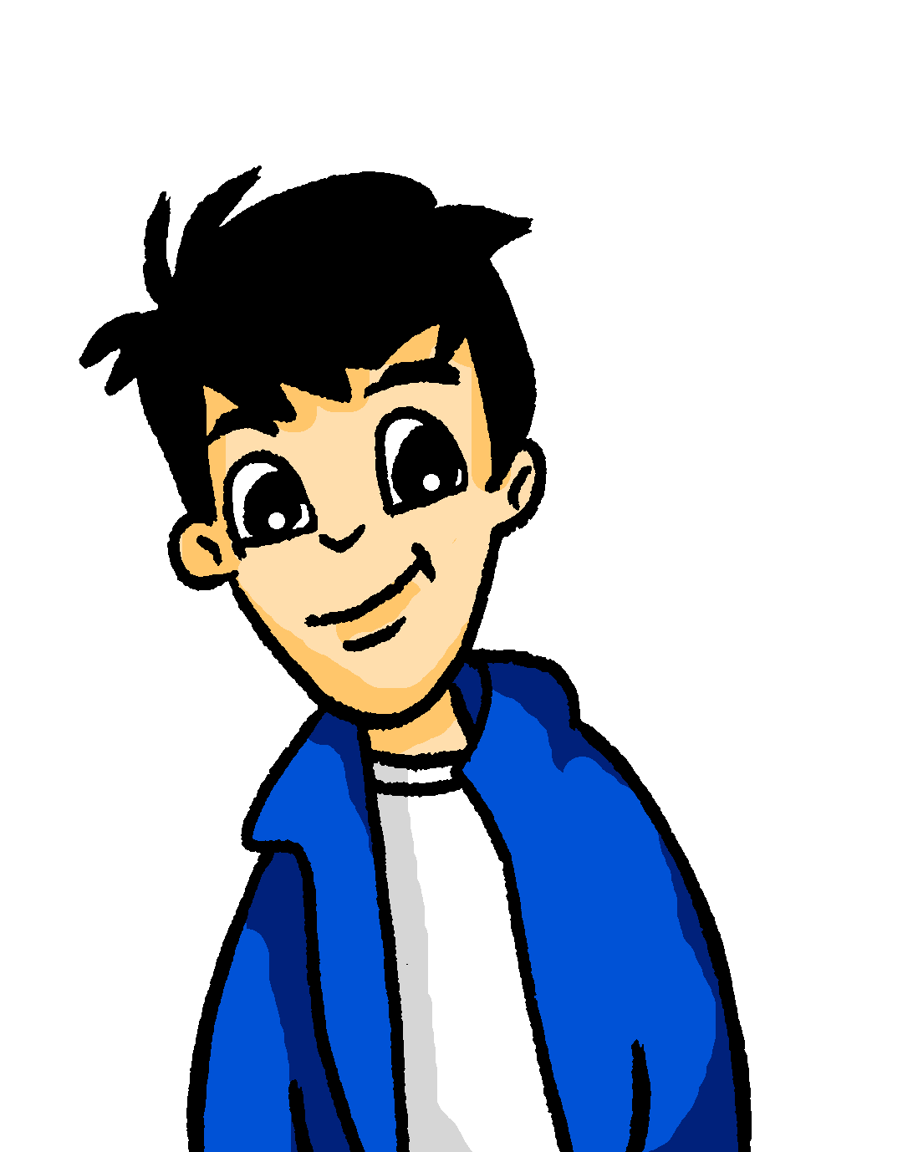
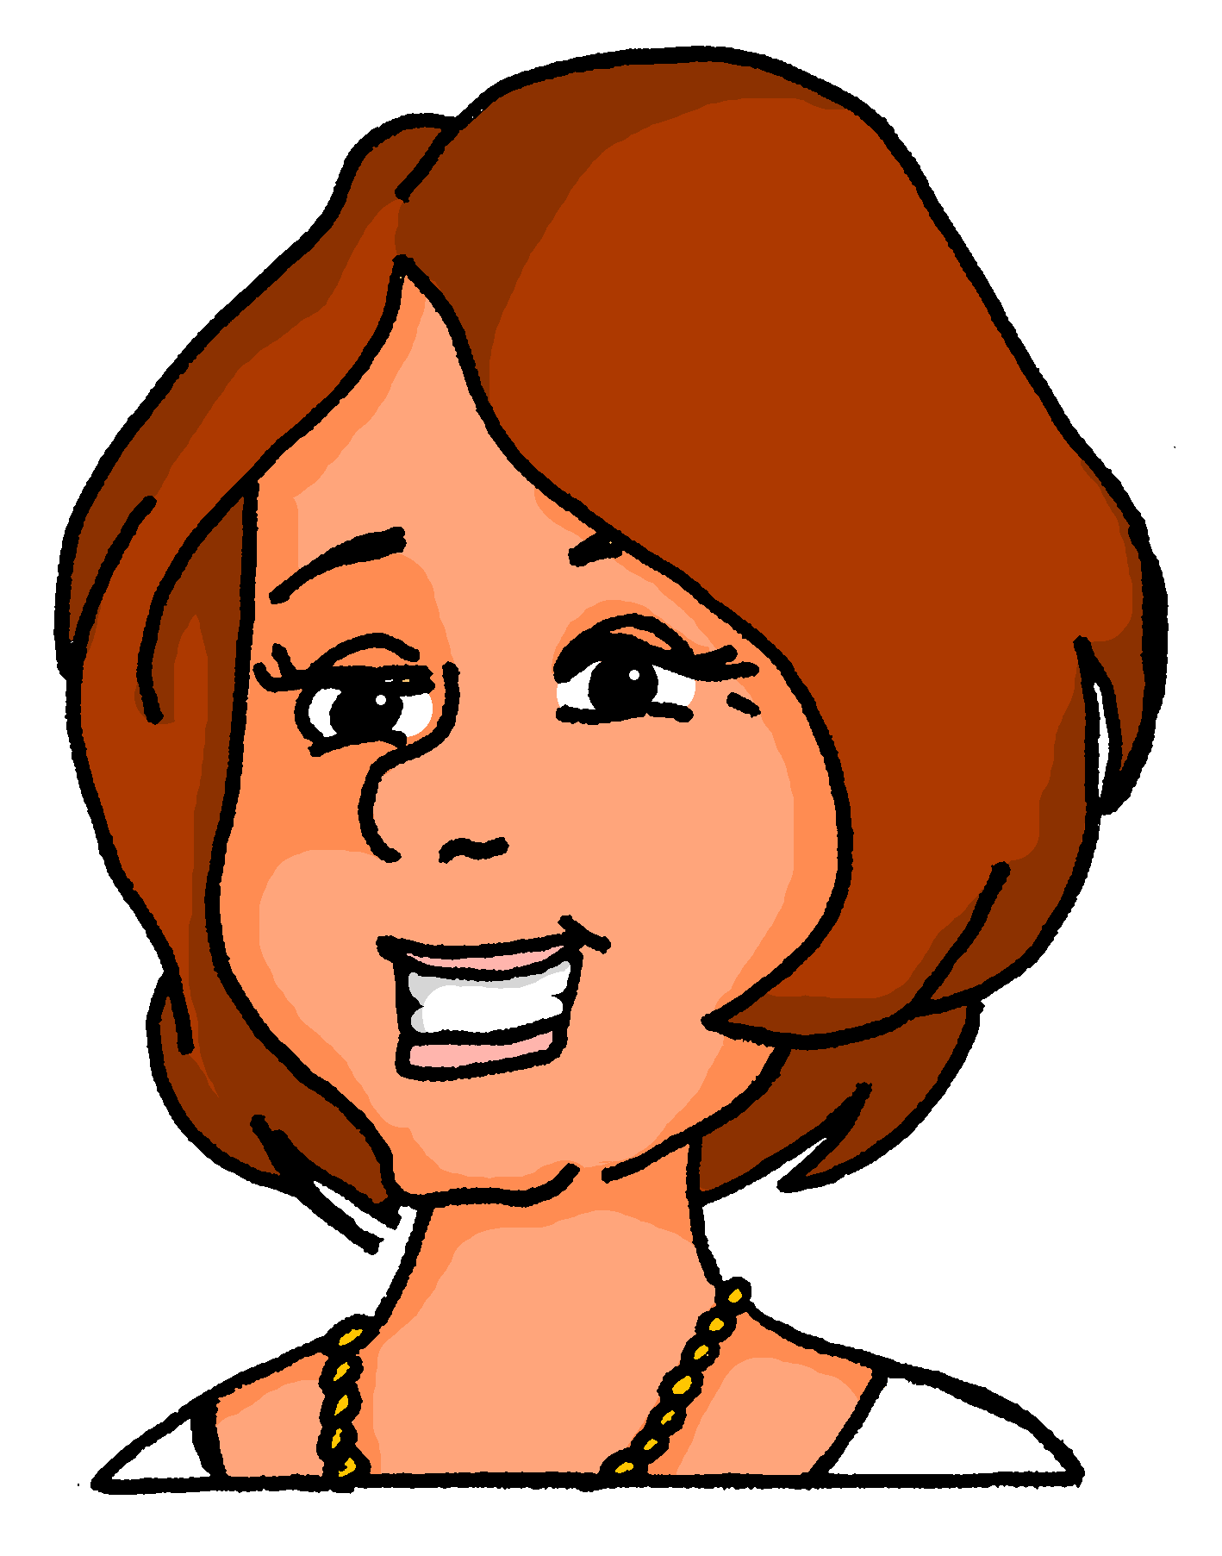
Sie oder sie?
hören / schreiben
Wolfgang redet mit Frau Nowak. Hör zu und schau das Bild an. Fragt er „Sie” (you, polite) oder „sie”(they)? Schreib die Frage auf Deutsch und auf Englisch.
1
Fliegen Sie gern?
Do you like flying?
Notes:
Timing: 5 minutes (8 slides) Aim: To practise distinguishing between ‘Sie’ and ‘sie’. Procedure: 1. Click on the numbered audio buttons to play the questions.
2. Click to reveal which referent ‘Frau Nowak’ or ‘Katja und Heidi’ is being addressed. 3. Students then transcribe the German sentence heard, also writing its meaning in English, taking care to use the correct form of Sie (you, formal) /sie (they).
4. Click to reveal first the German sentence, then the English translation.
Transcript: 1. Fliegen Sie gern?

Slide 3
Sie oder sie?
hören / schreiben
Wolfgang redet mit Frau Nowak. Hör zu und schau das Bild an. Fragt er „Sie” (you, polite) oder „sie”(they)? Schreib die Frage auf Deutsch und auf Englisch.
2
Stehen Sie früh auf?
Do you get up early?
Notes:
As for previous slide.
Transcript: 2. Stehen Sie früh auf? Word frequency (1 is the most frequent word in German):
8.2.2.1 (introduce) aufstehen [966]
Source: Jones, R.L. & Tschirner, E. (2019). A frequency dictionary of German: core vocabulary for learners. Routledge

Slide 4
Sie oder sie?
hören / schreiben
Wolfgang redet mit Frau Nowak. Hör zu und schau das Bild an. Fragt er „Sie” (you, polite) oder „sie”(they)? Schreib die Frage auf Deutsch und auf Englisch.
3
Arbeiten sie viel?
Do they work much?
Notes:
As for previous slide.
Transcript: 3. Arbeiten sie viel?

Slide 5
Sie oder sie?
hören / schreiben
Wolfgang redet mit Frau Nowak. Hör zu und schau das Bild an. Fragt er „Sie” (you, polite) oder „sie”(they)? Schreib die Frage auf Deutsch und auf Englisch.
4
Was essen sie gern?
What do they like eating?
Notes:
As for previous slide.
Transcript: 4. Was essen sie gern?

Slide 6
Sie oder sie?
hören / schreiben
Wolfgang redet mit Frau Nowak. Hör zu und schau das Bild an. Fragt er „Sie” (you, polite) oder „sie”(they)? Schreib die Frage auf Deutsch und auf Englisch.
5
Schauen Sie gern Filme an?
Do you like watching films?
Notes:
As for previous slide.
Transcript:
5. Schauen Sie gern Filme an? Word frequency (1 is the most frequent word in German):
8.2.2.1 (introduce) anschauen [949]
Source: Jones, R.L. & Tschirner, E. (2019). A frequency dictionary of German: core vocabulary for learners. Routledge

Slide 7
Sie oder sie?
hören / schreiben
Wolfgang redet mit Frau Nowak. Hör zu und schau das Bild an. Fragt er „Sie” (you, polite) oder „sie”(they)? Schreib die Frage auf Deutsch und auf Englisch.
6
Lesen sie Geschichten?
Do they read stories?
Notes:
As for previous slide.
Transcript: 6. Lesen sie Geschichten?

Slide 8
Sie oder sie?
hören / schreiben
Wolfgang redet mit Frau Nowak. Hör zu und schau das Bild an. Fragt er „Sie” (you, polite) oder „sie”(they)? Schreib die Frage auf Deutsch und auf Englisch.
7
Fahren Sie oft mit dem Schiff?
Do you often travel by boat?
Notes:
As for previous slide.
Transcript: 7. Fahren Sie oft mit dem Schiff?

Slide 9
Sie oder sie?
hören / schreiben
Wolfgang redet mit Frau Nowak. Hör zu und schau das Bild an. Fragt er „Sie” (you, polite) oder „sie”(they)? Schreib die Frage auf Deutsch und auf Englisch.
8
Nehmen sie die Bahn?
Are they taking the train?
Notes:
As for previous slide.
Transcript:
8. Nehmen sie die Bahn?

Slide 10
Regular –ER verbs
To say ‘s/he’ + verb in French, the verb is in the short form, often ending in -e.
Il joue.
He plays.
Elle joue.
She plays.
NB! These endings all sound the same!
To say ‘they’ + verb, the verb ends with -ent.
For either a group of boys or a mixed group.
Ils jouent.
They play.
For a group of girls only.
Elles jouent.
They play.
Notes:
Timing: 1 minute
Aim: to reinforce that 3rd person singular and plural both sound the same, and likewise for the subject pronoun, ahead of the listening activity to follow.
Procedure:
1. Click to reinforce the teaching point that these endings all sound the same.
Source: Fr Y7 1.2.6

Slide 11
écouter / écrire
C’est qui ?
écouter / écrire
il ou ils ?
elle ou elles ?
Écoute, regarde et écris en français.
Exemple
ils regardent
Notes:
Timing: 5 minutes for the next six slides
Aim: This is an example of a bimodal task which connects the spoken form with the written form simultaneously, as in this case listening alone does not indicate singular or plural. It is useful to practise bimodal tasks in this case because students practise the idea that you can only tell which verb ending to use in writing when you know whether the person is singular or plural – so, here the students get a visual cue (the picture) and this tells them what the written verb ending would be (the oral verb ending doesn’t help!). This teaches students about ‘ambiguity’ in language, and how sentences fit together. In this case, to know ‘who did the verb’ for 3rd person verbs (il and ils), you usually need other prompts to know whether singular or plural is being referred to.
Procedure:
1. Use this slide to model the task instructions.
2. Click to bring up the image and again for the audio. Students will hear a verb (e.g., ils regardent). At the same time a circle will appear around the picture to indicate whether it is 3rd person singular or 3rd person plural.
3. Once they have heard the audio and seen whether it is singular or plural, students write the correct form.
4. Click to reveal the correct written form.
Transcript:
ils regardent
Note: Teachers need to mouse click on the ‘Exemple’ box, which triggers the audio to play the word ‘exemple’
If this step is missed, the first verb may not play in full.

Slide 12
écouter / écrire
C’est qui ?
écouter / écrire
ils chantent
Notes:
Transcript:
ils chantent

Slide 13
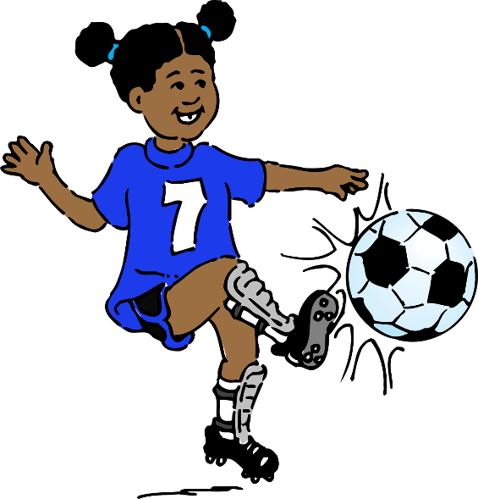
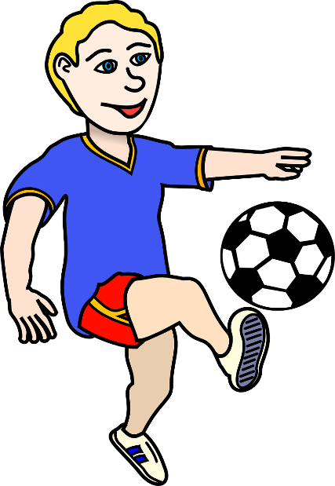
écouter / écrire
C’est qui ?
écouter / écrire
il joue
Notes:
Transcript:
il joue

Slide 14
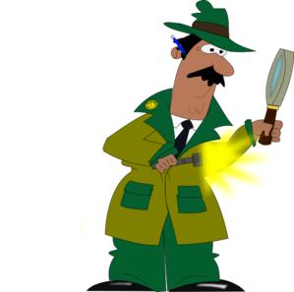
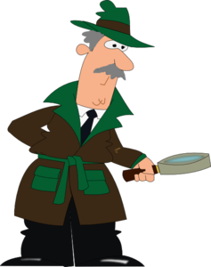
écouter / écrire
C’est qui ?
écouter / écrire
il trouve
Notes:
Transcript:
il trouve

Slide 15
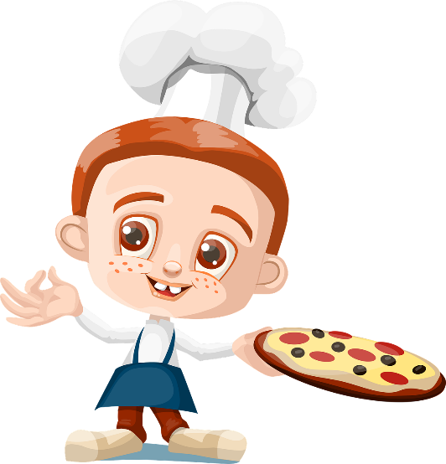
écouter / écrire
C’est qui ?
écouter / écrire
ils préparent
Notes:
Transcript:
ils préparent

Slide 16
écouter / écrire
C’est qui ?
écouter / écrire
elle mange
Notes:
Transcript:
elle mange

Slide 17
écouter / écrire
C’est qui ?
écouter / écrire
elle écoute

Slide 18
Exemple :
écouter / écrire
parler
Listen to the
sentence. Use the start of the sentence to work out how to complete the end of the sentence.
Tick the correct one
Write the correct ending
Write the correct subject pronoun
Write the correct verb
E.G.
 | Le garçon | aim_____ | le sport; |  |  | au foot.
 | Les garçons
e
il
joue
E.G.
 | La fille | rest_____ | à la maison; |  |  | la télé.
 | Les filles
ent
elles
regardent
Notes:
Timing: 8 minutes (for this and the next two slides)
Aim: to focus on verb form by having to choose between 3rd person singular or plural, depending on the subject of the verb by using full nouns when listening.
Procedure:
1. Use this slide to model the requirements of the task. Really emphasise the importance of listening carefully to the subject of the verb – is it singular or plural? Elicit from students what will be heard when the subject is singular and what is heard when it is plural – the subtle difference between ’le’ and ‘les’ (or ‘la’ and ‘les’) really makes a difference to meaning. This is key to students succeeding in the task
2. Click the E.G. trigger to play the audio.
3. Students tick the subject of the verb then use this to help write the correct verb ending (3rd person singular or third person plural).
4. Students continue to transcribe the verb from the second part of the sentence, focusing on the achieving the correct subject pronoun and verb form.
5. On completion of the task, teachers could take the opportunity to do some further sentence level comprehension by asking students to give the meanings in English of the complete sentences.
Transcript:
E.G
Le garçon aime le sport; il joue au foot.
E.G
Les filles restent à la maison; elles regardent la télé.
Note: The two part nature of the task sets up differentiation. All students should be able to complete the first part of the sentence at least – hearing the difference between ‘le’ and ‘les’; and the difference between ‘la’ and ‘les’ and then writing the verb ending accordingly: ‘e’ or ‘ent’.
The second part offers a greater level of challenge. Teachers could consider asking students to mark their work in two sets, to allow students to feel successful and give the teacher an indication of how students did with the two aspects of the task.
Source: Fr Y7 1.2.6

Slide 19
Grammaire
écouter / écrire
Tick the correct one
Write the ending
Write the pronoun
Write the correct verb
 | Le garçon | aim_____ | la télé; |  |  | des films.
 | Les garçons
 | La fille | aim_____ | la musique; |  |  | avec la radio.
 | Les filles
 | Les médecins | travaill____ | en Angleterre; |  |  | anglais.
 | Le médecin
 | Le chanteur | aim_____ | la musique; |  |  | la radio.
 | Les chanteurs
e
il
regarde
1
ent
2
elles
chantent
ent
ils
parlent
3
4
e
il
écoute
Notes:
Transcript
1) Le garçon aime la télé; il regarde des films.
2) Les filles aiment la musique; elles chantent avec la radio.
3) Les médecins travaillent en Angleterre; ils parlent anglais.
4) Le chanteur aime la musique; il écoute la radio.

Slide 20
Grammaire
écouter / écrire
Tick the correct one
Write the ending
Write the pronoun
Write the correct verb
 | Le professeur | travaill____ | dans la salle de classe; |  |  | les devoirs.
 | Les professeurs
 | Les chiens | march____ | dehors; |  |  | dans le parc.
 | Le chien
 | Les mères | prépar___ | le déjeuner; |  |  | du fruit.
 | La mère
 | Le garçon | écout____ | le professeur; |  |  | un uniforme.
 | Les garçons
ent
ils
préparent
5
e
il
joue
6
ent
elles
mangent
7
e
il
porte
8
Notes:
NOTE: This section is without audio. Teachers read out the sentence here. This facilitates the ‘idea for extension’
Transcript
5) Les professeurs travaillent dans la salle de classe; ils préparent les devoirs.
6) Le chien marche dehors; il joue dans le parc.
7) Les mères préparent le déjeuner; elles mangent du fruit.
8) Le garçon écoute le professeur; il porte un uniforme.
Idea for extension: rather than saying the whole sentence in full , stop after the first verb and do not reveal the second part of the sentence. Then, ask the students to PREDICT what will come next. Students will use the first part of the sentence and the final words to work it out. They could give answers orally or they could write down what they think will come next.
THEN, continue the sentence and the students read their own work to check whether they predicted correctly. Click to reveal the French so that they can check how they spelled the verb (-ent or –e).
Word frequency (1 is the most frequent word in French): parc [1240]
Source: Londsale, D., & Le Bras, Y. (2009). A Frequency Dictionary of French: Core vocabulary for learners London: Routledge.

