Slide 1
Defining and Assessing Language Content: Effects on Curriculum Design
4 July 2022
Session presenter: Prof. Emma Marsden,
Dept of Education, University of York.
Director, National Centre for Excellence for Language Pedagogy (NCELP)
Notes:
Aims of learning a language have not changed – open minds and expose learners to new ideas and cultures - the content to get there in the early stages has been defined more clearly
Busting a couple of myths along the way

Slide 2
1/ New GCSE content defines the vocabulary
Aim to reduce the gap between what is taught / learned and what was being tested
50% of words on awarding organisations’ current lists have never been used in an exam
averaged across AQA, Edexcel, 3 langs, F & H, 4yrs
21% of words on current lists have only ever been used once
Only 10% of words on current list are used in every single paper
Notes:
50% (51% at foundation and 49% at higher; 46% for AQA and 55% for Edexcel) of words on awarding boards’ current lists have never been used in an exam
21% (20% at foundation and 21% at higher; 22% for AQA and 19% for Edexcel) of the words on current lists have only ever been used once
Only 10% (10% for foundation and 10% for higher;10% for AQA and 9% for Edexcel) of the word families from the current lists are used in every single paper

Slide 3
How many words can be learnt?
450 hours available !
Average of 10 words per week (including productive knowledge)
-> 360 words per year * 5 years =>
1,700 words, for highest achievers
Milton (2006) found 852 words known by average year 11 = 4 words learned per lesson
See Milton (2015) for a recommendation to learn a list of 1,500
Notes:
Currently 50 hours at primary – perhaps 250-300 words might be brought from primary – and ideally the curriculum would be continuous – but at the moment it is not on a wide scale for all children
Taking account of a term in year 11 where new words are unlikely to be learnt.
productive knowledge, not just receptive (Nation, Laufer, Meara, Webb)
polysemy (multiple meanings)
‘extreme’ irregulars, as lexical items (Clashen; Gor; Marslen-Wilson; Verríssimo)
some multi-word units (Crossley; Myles, Mitchell & Hopper; Siyanova-Chanturia)
some mid-low frequency words e.g., culturally important
systematic revisiting
spaced repetition (e.g., Webb 2007)

Slide 4
Words needed to create three exams
Tier of GCSE | Word families used to create THREE exams
Foundation | 1,173
Higher | 1,542
Median of range across awarding organisations & languages
2015 GCSE minimum word lists, AQA:
Spanish: 1,566 word families
French: 1,300 word families
German: 1,632 word families
Notes:
But if we look across Awarding organizations there was disparity in this – simply in terms of how much language was in the body of language being tested
Word families used to create ONE exam
609
753

Slide 5
2/ Vocabulary more ‘reusable’ (i.e., high frequency)
Over 4 years of exams, approx. 45% of word families have been low frequency;
60% of these low frequency words are not on the current word lists
Lower frequency words twice as likely to change, year on year, as high frequency
The deeper a topic goes, the less likely those words will be met in other topics
need to re-do same topics (‘at doctors’, ‘in restaurant’) to get enough usage of low freq words
2026 ->better circumlocution?: use known high frequency words to describe unknown words
Notes:
Putting all exams together over 4 years, approximately 45% (44% for foundation and 45% for higher; 45% for AQA and 44% for Edexcel) of the word families used are low frequency words; 60% (58% at foundation and 62% at higher; 65% for AQA and 55% for Edexcel) of these are not on the word lists
The lists ‘cover’ (predict) approximately 78% (80% at foundation and 77% at higher; 74% for AQA and 83% for Edexcel) of all running words in a typical paper [These are based on PREDICTED PROBABILITIES, not raw counts, so they have been normed for list length].

Slide 6
Why should 85% be high frequency words?
Greater transparency & systematicity in choosing the language content
The 2,000 most common words in a language generally cover…
80 – 87 % of an average written text (Meara, 1995; Nation, 2001; Nation & Waring, 1997).
90+ % of words in informal conversation (Nation, 2001)
Massive corpora French 23 million; Spanish 2 billion; German 20 million
show that very most frequent words change very little, over time or context
Notes:
The frequency information that is recommended in the subject content is based on these massive FL corpora mentioned in this slide.
About 80-85% of the most frequent words are the same – no matter which large, general corpus you use

Slide 7
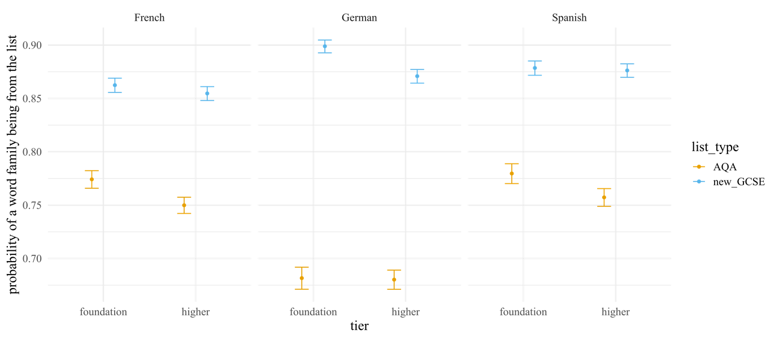
A 85% high frequency list predicts more of the content of current exams compared to the current word lists
Predicted probability of a word family in corpus of exams being from each word list
Notes:
This is based on the corpus of all the four papers to date.
The pattern is almost the same for an average paper – a single, typical paper.

Slide 8
Does this ‘constrained’ lexicon mean that students would be less well prepared for an A level exam?
No.
A new GCSE list has an average of 13% fewer word families than a current list,
but provides 34% more coverage of the word families in typical A level exam
(averaging across AQA and Edexcel).

Slide 9
Communicative contexts and themes emerge from language
Talking about people’s lives
Asking about future intentions
Talking about the environment

Slide 10
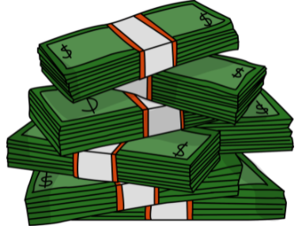
El pasado de Medellín
escuchar / escribir / leer
Escucha y completa el texto.
Medellín es una ciudad en Colombia que hace veinte años era muy peligrosa. Un grupo de criminales, el Cartel de Medellín, organizaba redes de narcotráfico* y prácticamente controlaba la ciudad. El narcotráfico era un muy _______ _________ (el Cartel ganaba hasta sesenta millones de dólares al día), así que era posible ganar mucho dinero en muy ________ _________. Sin embargo, era una ___________ _________ y el grupo usaba la violencia* muy a menudo. Mataba a policías en la calle y secuestraba* a ___________ _____________. A pesar de estas acciones, el jefe del cartel, Pablo Escobar, era una persona popular en los _________ _________. Él ayudaba a la población en lugares donde el gobierno no estaba. Por eso mucha gente de estas comunidades lo consideraba una _______ _________.
buen
negocio
poco
tiempo
actividad
ilegal
personas
importantes
barrios
pobres
gran
persona
*el narcotráfico = drug trafficking
*la violencia = violence
*secuestrar = to kidnap, kidnapping
Notes:
Timing: 10 minutes
Aims:
to learn about the past of a Spanish-speaking city
to accurately transcribe the missing words
to consolidate understanding of pre-nominal adjectives
to demonstrate understanding of key information in the text
Procedure:
Students write 1-6 down the left hand side of their books.
Explain to students that they will hear six pairs of missing words.
They listen to the text and write the missing pairs of words.
Check answers and give feedback. Elicit oral translations in English of the words in the gaps.
Ask students which pairs of words have an adjective before the noun (ANSWER: buen negocio, poco tiempo, gran persona).
Ask which pairs of words have an adjective after the noun (ANSWER: actividad illegal, personas importantes, barrios pobres).
To check comprehension of the text on this slide, the questions below could be asked. These could be written on the board by the teacher or distributed on a handout (word doc available with this resource). The answers can be checked orally in English afterwards, with reference to the Spanish text displayed on the board.
Comprehension questions:
Who was effectively in charge of Medellín twenty years ago? (The Cartel de Medellín)
How much could the Cartel de Medellín earn in a day? (Up to 60 million dollars)
What is said about violence? What examples are given? (The group used violence frequently. It killed police officers and kidnapped important people)
Why was Pablo Escobar considered to be a great person? (Because he helped the population in poor neighbourhoods where the government wasn’t present)
Notes: it is assumed that students will be able to understand ‘prácticamente’ given that the word ‘práctico’ has been taught, as well as the meaning of the affix –mente.
Based on the text length (142 words), 2% of the text is 2.6 words. In the new GCSE, a maximum of 2% of words in a text may be glossed. This is rounded up to the nearest single figure (3) here.
One additional cognate (dólar) is included as it has been used in previous phonics activities.
An additional way in which the text could be exploited would be to ask students to identify instances of ‘era’ and their meanings (e.g. ‘[it] was’ for the city, ‘[he] was’ for Escobar).
Image credits: Image retrieved from https://pixabay.com/es/illustrations/pablo-escobar-gr%c3%a1ficos-dise%c3%b1o-4439780/ (image free to use)
Sources and additional information:
Source of information regarding income: Pablo Escobar: The Life and Crimes of the Most Notorious Colombian Drug Lord By J.D. Rockefeller
Frequency of glossed words:
narcotráfico [3549]; secuestrar [>5000]; violencia [1100]
Frequency of cognates:
criminal [2884; controlar [994]; dólar [677]; ilegal [2912]

Slide 11
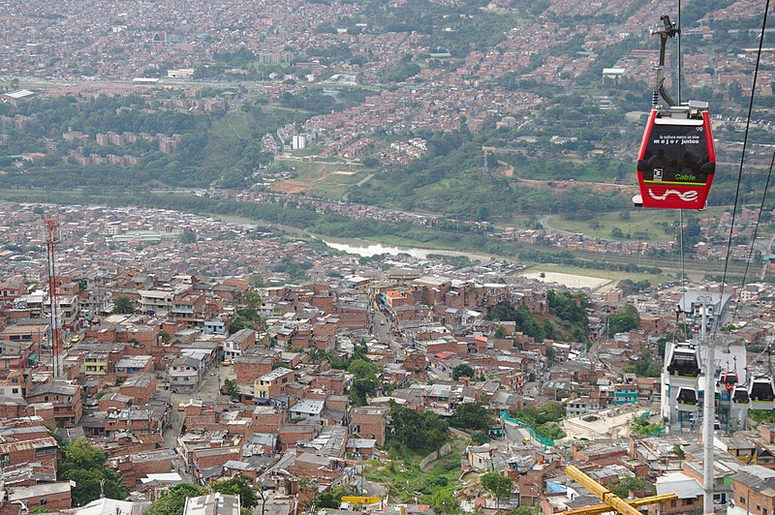
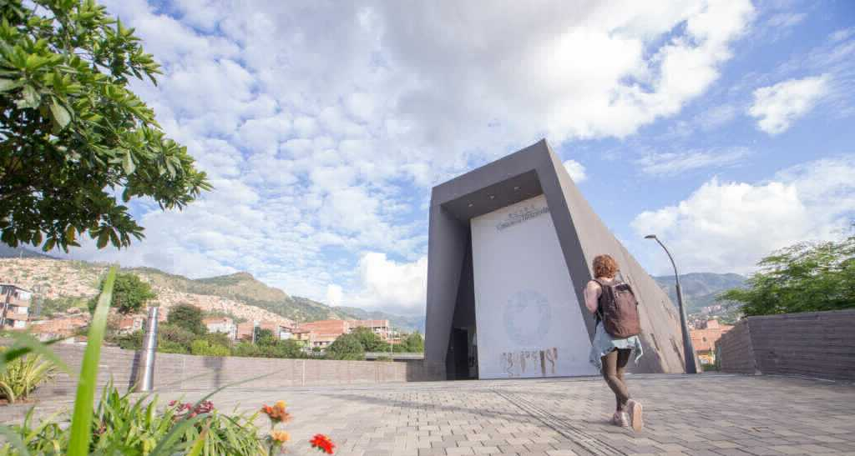
El Medellín de hoy
*la violencia = violence
leer
Escobar murió en el año 1993. Hoy en día Medellín es mucho más __________. En general la gente puede vivir tranquilamente. La zona urbana es bastante agradable, con museos, plazas y parques. Medellín es la ________ ciudad de Colombia que tiene su _________ metro y una red de “metrocables” (un tipo de transporte que conecta las partes altas de la ciudad con las partes bajas). En 2012, incluso ganó un premio a nivel ____________ por estos proyectos de transporte público.
Al _________ tiempo, la ciudad no olvida su pasado ________. En 2006 el gobierno abrió un museo, la “Casa de la Memoria”, para acordarse de la violencia y promover el diálogo. La idea: aprender del pasado para crear un futuro _______.
seguro
única
propio
El metrocable
mundial
mismo
oscuro
La Casa de la Memoria
mejor
Opciones:
propio | única | mundial | oscuro | seguro | mismo
Notes:
Timing: 8 minutes
Aims:
to learn about present day life in a Spanish-speaking city
to correctly identify the missing words in the gaps
to understand key information in the text
Procedure:
Ask students to read the text and identify which word should go in which gap.
Teachers may wish to challenge higher achieving students by not showing them the answer options initially.
Reveal each answer and give feedback. Check understanding of the text via oral translation of each sentence into English.
Notes: students may be interested to know that Escobar died in 1993 during a military attack by the Colombian armed forces. To give an indication of Escobar’s popularity, around 25,000 people attended his funeral (https://faroutmagazine.co.uk/how-pablo-escobar-became-symbol-of-resistance-popular-culture/).
Students were taught the spelling change o > u in the word ‘murió’ in Y9 T2 but it may be worth recapping this.
Frequency of unknown words:
tranquilamente [4526] (not glossed as students have learnt ‘tranquilo’ and the affix –mente); violencia [1100]; conectar [1973]
Images free to use from wikicommons and from the Museo Casa de la Memoria website.
https://commons.wikimedia.org/wiki/File:Metrocable_and_Comuna_1_in_Medell%C3%ADn_01.jpg
https://www.museocasadelamemoria.gov.co/en/elmuseo/acerca-de-nosotros/

Slide 12
3/ “Inferencing skills” still encouraged
Has been a very heavy reliance on inferencing
But successful inferencing more likely for higher proficiency -> existing knowledge helpful
strategies more effective the more proficient learners are (Plonsky, 2011)
(e.g., Albrechtsen et al., 2008; Bengeleil & Paribakht, 2004; Fraser, 1999; H. C. M. Hu & Nassaji, 2012; Huckin & Bloch, 1993; Nassaji, 2003; Pulido, 2007; Qian, 2005; Sternberg, 1987; Wesche & Paribakht, 2009).
Some inferencing still needed by most students, as most won’t know all the words on list
av. receptive knowledge 564 - 852 words (David, 2008; Milton, 2006)
New GCSE includes a ‘test of inferencing’, but identifiable and short: students must infer plausible meaning of words not on the list, when words are embedded in sentences that have all other words on the list
Dudley & Marsden (in progress). Using word lists for high-stakes exams: Topic-driven versus frequency-informed.
Notes:
Inferencing = guessing meaning, using the context and own knowledge
Strategies, such as use the context to work it out, ask someone, use a dictionary, guess from your world knowledge
Other contextual factors: the relevance of the unknown word for comprehension, and the proportion of unknown words in the text
for an exam oriented to ‘communication’, we would expect around 85%
approx. 80% in written texts, and 90% in spoken of running words to be high frequency.

Slide 13
Hanoucca
Example of inferencing task
Use the words you know to choose the general meaning of the words in bold.
Pour la communauté juive, la fête importante de décembre est Hanoucca. C’est une fête de lumières et on utilise des bougies pour célébrer. La fête est de huit jours, et on allume une bougie le premier jour, deux bougies la deuxième jour … Les bougies sont un symbole de la bonté de Dieu. Dans une vieille histoire juive, une petite bouteille d’huile a nourri une lampe pendant huit jours, beaucoup plus de temps que normalement. On mange des beignets comme un symbole de l’huile. Les enfants jouent avec des toupies qui contiennent une phrase religieuse. Hanoucca est plus familial et spirituel que religieux.
huile : a type of wood / plant / liquid / shoe
beignet : a type of drink / chair / cup / food
toupie : a type of toy / book / hat / sweet
Notes:
To ‘really’ understand a text, you need to know 98% of the words in it
To ‘just about’ understand a text, you need to know at least 90% of words in it
See research by Nation, Laufer, and colleagues
Here is a text about Hanoucca
Followed by some practice at inferencing the meaning of words by using the words that we know they have already met several times and have been tested on
At this stage, lexical inferencing becomes possible because we are confident that they have a critical mass of vocabulary to start doing this.
Timing: 5 minutes Aim: to practise lexical inferencing; the written comprehension of known words to arrive at a general understanding of one unknown word in a sentence context. In addition, to revise previously learnt vocabulary in new contexts. Procedure: 1. Ensure that students understand the task (as this is the first time they are doing this type of activity). Students need to know that they are aiming to understand the general meaning, rather than specific meaning (though they may in some cases also arrive at this).
2. Students read each text and decide which of the four options is most likely, depending on their understanding of the surrounding words.
3. Click to reveal answers.
4. Proceed to the next slide for the comprehension part of the activity.
Word frequency of unknown words used (1 is the most frequent word in French):
lumière [1059], allumer [3169], bougie [>5000], deuxième [427], bonté [>5000], huile [2340], beignet [>5000], toupie [>5000]
Word frequency of cognates used (1 is the most frequent word in French): Hanoucca [>5000], bouteille [2979], lampe [4699], normal [833], familial [1622], spirituel [3047]
Source: Lonsdale, D., & Le Bras, Y. (2009). A Frequency Dictionary of French: Core vocabulary for learners London: Routledge.

Slide 14
4/ Unprepared use of language
Unprepared conversation after read aloud and after picture stimuli
Reducing existing reliance on rote-learning of complex, unanalysed chunks for speaking and writing, which is still happening

Slide 15
Over-preparation for current ‘general conversation’…
Extract of letter home to parents, 15 June 2022, from high-performing state secondary school

Slide 16
reliance on rote-learning still happening… extracts from twitter June 2022
@MikeElliottMFL
“I would avoid going to any parks this weekend. Judging from last week’s GCSE Speaking Exams, they’re going to be full of Year 11 students. Playing football. With their friends.”
[…]
“You might be ok, most of mine are going to the cinema then restaurant and eating pizza and chips”
@mfl_swavesey, Replying to @MikeElliottMFL
“They also listened to a lot of Taylor Swift because it is interesting”

Slide 17
But the key, going forward: How to reward genuinely unprepared speech …
New GCSE rewards for ‘clear and comprehensible’ speech
Only 20% of whole GCSE can be for accuracy (including read aloud, writing, listening, reading
reduced emphasis on accuracy for oral production?
confidence to manipulate language creatively when speaking

Slide 18
Further resources from NCELP
https://resources.ncelp.org/
Culture collections
Phonics collection
Schemes of Work: fully resourced, adaptable, incl. communication!
Sample GCSE word lists
Notes:
You can see many more NCELP resources for 13-14 year olds, after 200 hours of instruction, that cover topics such as secularism in France, the Berlin Wall and divided Germany, the ‘polite you’.
One teacher has shared with us some humorous versions of well known fairy tales that they have written with the high frequency words.

Slide 19
CPD
Free to teachers in state schools
5 remote learning sessions of 2.5 hours
Peer and instructor support
Self-study version available
Register here: www.ncelp.org/cpd
Notes:
As much as possible, participants are assigned to courses regionally - led by an NCELP Specialist Teacher near them, with other participants from their region.
This offers the potential to make the most of local networking and peer support, both online and potentially also face-to-face. A self-study version of the course (with similar certification) for anyone who is unable to access a ‘live’ place will be available shortly.
---------
If this CPD deck is delivered by others, please use this feedback survey, and paste into the chat:
Google Form: https://forms.gle/Y2ztbpRTrkKZRjcp9

Slide 20
Join the mailing list, email: enquiries@ncelp.org for regular bulletins about resources arriving on the portal
To get monthly alerts to summaries of new research, sign up in 10 seconds at
https://oasis-database.org/

Slide 21
Spare slides

Slide 22
Having a word list is not very unusual
Word lists for proficiency tests:
Japanese Language Proficiency Test until 2010 (Japan Educational Exchanges and Services, 2009)
~A2: 1,500 words / ~B1: 3,750 words
German-Zertifikat Proficiency Test (Goethe-Institut, 2016a, 2016b, 2016c)
A2: 1,300 words / B1: 2,400 words
Word lists for curricula:
France, Ministry of National Education (éduscol, 2020) lists 1,500 most frequent words in French for French primary school children (6-11 years)
China, Ministry of Education (2017) lists 1,500 words for English for 16 years olds (after 9 yrs of English)
Hungarian National Core Curriculum for English (Krizsán, 2003): 1,200 active vocabulary for 13-14 year olds
Guidelines about number of words:
Japanese Ministry of Education (MEXT, 2008, 2009, 2016, 2017, 2018) English: Junior high school students: 1,200 words; High school students: 1,800 words
Notes:
The size of the word lists seem to be not too far out from other countries and languages.
You can see here the languages highlighted in red and the numbers that are most relevant to our age and level of learners in green – the numbers in the new subject content are not much lower even than contexts in which the magic global English is being learned.

Slide 23
Key differences in 2022 Subject Content. [1/4]
The lexicon is specified:
1,200 word families [Foundation],1700 [Higher],
85% from most common 2000 word families,
30 multiword units (of up to five words)
20 cultural / geographical terms
All tasks fully accomplishable using only language from the defined vocabulary and grammar lists
Full credit given for successful production of language beyond content
Is it very unusual to have a word list?
Notes:
A word family, in this instance, is defined a a word and its inflected forms
Such as wash, washes, washed – but not washer, or unwashed – so inflectional morphology, but not derivational morphology, as that is harder for learners

Slide 24
Key difference in 2022 Subject Content [2/4]
Vocabulary in Reading only:
Glossing allowed: up to 2% of words in a text can be glossed
Use of cognates more constrained: ‘same/very similar’ spelling and meaning
Derivational morphology now clearly defined, based on ‘bang for buck’
Notes:
Glossing allowed: up to 2% of words in a text can be glossed
Use of cognates more constrained: same spelling and meaning (or 1 letter different, +/- accent, for words of six letters or more) up to 2% of a text
Derivational morphology now clearly defined, based on ‘bang for buck’, and is for reading only: derived or base forms of words (where the base or derived form is on the list), following patterns specified in the grammar annexes, can be included
Content is not defined by whether or not a text is ‘authentic’: no requirement to include literary, authentic texts but they can be
A ‘test of inferencing’ will be identifiable, defined, and short: students must infer plausible meaning of words not on the list, when words are embedded in sentences that have all other words on the list

Slide 25
Key difference in 2022 Subject Content [3/4]
Grammar content simplified, clarified, and sequenced:
Much greater transparency about what can be tested
(e.g., interrogative types laid out)
Some features cut completely (e.g., subjunctive)
Some features moved from Foundation to Higher
(e.g. depuis +present; inflectional future)
Some features divided into sub-components: some can be tested at foundation, and some only at higher
reflexive use of verbs
present tense irregular verbs
Notes:
Making the content more explicit could help awarding organisations and Ofqual to ensure accountability for test content

Slide 26
Key difference in 2022 Subject Content [3/4]
Grammar content:
Some features removed completely (e.g., subjunctive)
Some features given tolerance in production at foundation (e.g., minor spelling changes in present tense stems), and are then credit bearing at Higher
Some moved from ‘grammar’ to ‘vocabulary’ (e.g., adverbs, pronouns)
Notes:
All grammar can be tested in reception and production
Except for derivational morphology - only in Reading

Slide 27
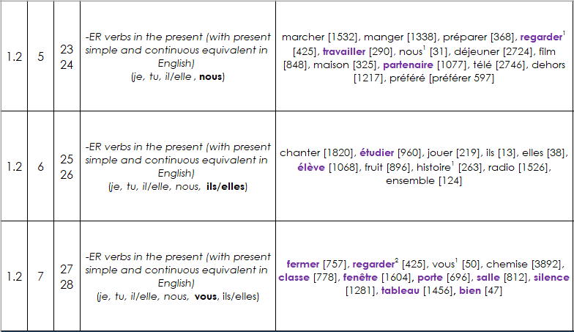
2. Design
Planning systematic vocabulary and grammatical growth
lesson | word families grow | number of words grows
grammatical growth: word families gradually get larger as new features are introduced
Notes:
In this extract from the Year 7 NCELP scheme of work, you can see that students learn a set of –ER verbs in Term 1.2 Week 5. However, they cannot yet use these verbs in the second or third person plural, because these forms are introduced in the weeks that follow. They also cannot use the verbs in any tenses other than the present.
--------
You will see this embedded in one function of the MultiLingProfiler a weekly NCELP syllabus list. These word lists are cumulative, growing along with students’ learning. These lists also differ from most lists in that they make no assumptions about students’ ability to produce all forms of a known headword, and so profile for grammatical as well as semantic knowledge. There is a different list for each week in the NCELP scheme of work, each building on progress in the last.
So, the profiling tool has to recognise students’ grammar progress as well as headword knowledge, and reflect this in results.

Slide 28
Key difference in 2022 Subject Content [4/4]
No longer just ‘isolated skills’ of L, R, S, W
Addition of sound-spelling correspondences (phonics)
Students demonstrate ability in:
transcription (dictation)
decoding (reading aloud + show comprehension in unprepared conversation)

Slide 29
How to sequence a curriculum, if not with phrases from topics on ‘my routine’, ‘school’, ‘jobs’?
Challenges of specific language drives initial curriculum choices
But can maintain focus on communicative contexts & functions
Themes and context of use emerge from the language…
Notes:
High frequency words in small semantically-related sets with a small number of other words deemed to be useful for communication for this group of learners
Mixed parts of speech (v, n, adj, …) -> create sentences from lesson 1
Rather driven by choice of topic-inspired phrases, be driven by challenges of language, which then leads to themes and functions/notions
Avoiding at the start to foreground input that can mislead learners trying to ‘crack the code’
(VanPatten, Marsden & Chen/Kasprowicz/McManus)
Instead of starting with je m’appelle
je m’ is not ‘I am called’ or ‘my name is’
-> Use Je suis … and Tu es … for the same function
--------------------------
Mitchell & Myles research on chunks
Analytic ability – Kasprowicz & Marsden; Roehr-Brackin
Levelling the playing field – aptitude*treatment research

Slide 30
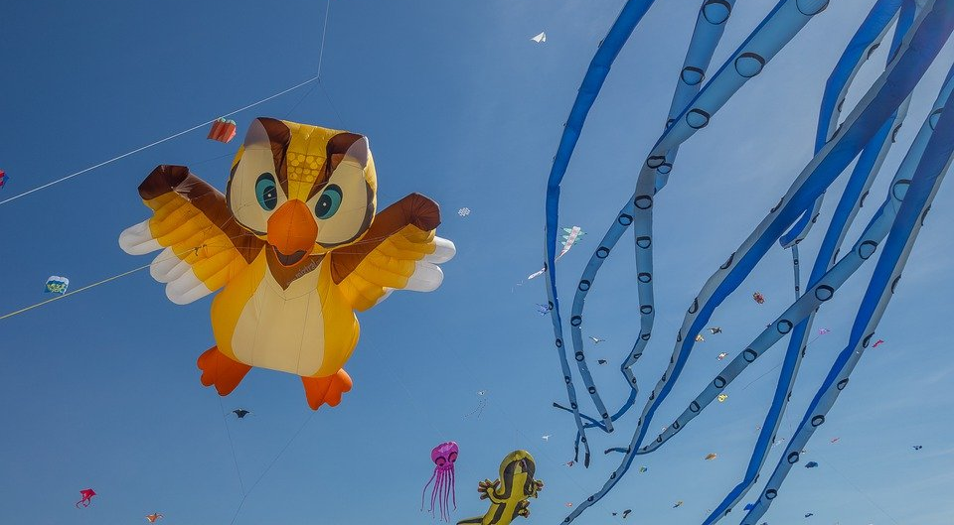
Le festival de Dieppe
lire
*le plus grand =
the biggest
*le cerf-volant = kite
*le son = sound
Comment dit-on les mots orange en anglais ?
What noun does this word look like?
What adjective does this word look like?
What noun does this word look like?
Le festival de Dieppe est le plus grand* festival de cerfs-volants* au monde.
On trouve le festival sur la plage.
Les visiteurs viennent de beaucoup de pays pour regarder des cerfs-volants traditionnels, de l'art et des acrobates. Un aspect important du festival est qu’on peut visiter sans acheter de billet. Il est gratuit !
Il y a beaucoup d'activités pour les enfants et le festival encourage l'imagination. Cet événement culturel célèbre les relations internationales. Pendant le dernier week-end du festival, on regarde les cerfs-volants illuminés pendant un show son* et lumière. Je pense à visiter le festival. Tu veut voyager au festival avec ma famille ?
visitors
What does this sentence tell you about the festival?
acrobats
traditional
The start of this word looks like the English
free
What adjective does this look like?
This word has the same stem as the previous one you worked out. What might it mean?
event
illuminated
light
What words that you already know could you use instead of the words in orange?
Answer the question at the end.
Notes:
Here is a text about a kite-festival in Dieppe with lots of language awareness activities to help learners understand cognates
Then drawing on their current lexicons – which we know what they are precisely as they have been tracked so carefully - to replace the words
Then giving their reaction to the content of the text by answering a question about whether they would like to go to the festival
----------
Timing: 5 minutes
Aim: Developing inferencing skills by using surrounding context to work out meaning of unknown words; word substitution with known words.
Procedure:
1. Students try to work out the meaning of the highlighted words based on context (text and images) and similarity to English words.
2. If students need some help, click to bring up a clue
3. Click gain to reveal the translations.
4. Click to bring up the extension. Students think of known words that could replace the orange words to make a sensible sentence.
Some suggested answers:
visiteurs -> gens, enfants, personnes … any relevant noun to describe people
traditionnels -> grands, nouveaux… any relevant adjective to describe kites
acrobates -> artistes, chanteurs … any relevant noun to describe performers
événement -> lieu, festival … (note that any relevant masculine noun works here but ‘cet’ would need to change to agree)
illuminés -> verts, bons … any relevant adjective to describe kites
lumière -> musique, film … any relevant noun to describe a show

Slide 31
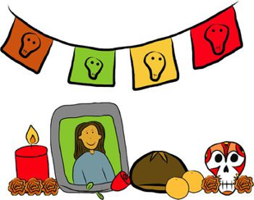
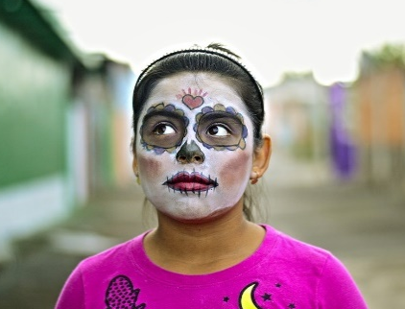
Una tradición mexicana: el Día de Muertos
leer / escuchar
Lee y escucha el texto sobre el Día de Muertos:
1
5
‘Pan de muerto’ es un tipo de pan tradicional en este día.
México tiene muchas tradiciones, pero su tradición del Día de Muertos es especialmente conocida. Es una costumbre única y muy importante para su comunidad porque es una forma de pensar en los muertos. Para los mexicanos, los muertos vienen a la tierra este día.
Nadia es mexicana y celebra el Día de Muertos con su familia. Por la mañana se levanta temprano para ayudar a su abuela: preparan pan* de muerto y un poco de fruta para el altar. Su altar tiene varios* niveles. Los niveles del altar son las diferentes partes del mundo: el primer nivel es la tierra y el segundo nivel es el cielo*. Nadia pone allí fotos de su abuelo y se sienta al lado de su abuela. Se queda unas horas en casa con su familia y se acuerda de su abuelo muerto.
Por la tarde se pone ropa divertida, se pinta de blanco y negro y va a la calle con su hermano. En su barrio hay un festival con música fuerte y luces de colores. ¡Es muy divertido!
2
6
3
7
4
*el pan = bread; *el cielo = sky, heaven; *varios = various
Notes:
This was a bimodal reading and listening task – where learners are asked to follow the text whilst they listen; every so often the audio stops and they have to say the next word or the previous one, or replace the next word with something else
This was informed by evidence that bimodal input helps learners to segment the input into words and helps their comprehension.
-------------
Timing: 8 minutes
Aims:
to reinforce understanding of the difference between ‘se’ and ‘su’.
to help students to connect the spoken and written forms of the language more securely.
to consolidate vocabulary and grammar knowledge by eliciting suggested changes to the text.
Procedure:
Students read the text and write ‘se’ or ‘su’ for each space.
Click on the audio button to play the text. Read and listen.
Note: There is a full version of the audio top right with a player. Alternatively, the audio is in 6 sections with a pause just after the words 1-5 below, to facilitate easy stop/start.
To support segmentation, stop the audio and ask students to say: a) the next word b) the previous word
In addition, to develop understanding, vocabulary and grammar knowledge, pause at key points and ask students to suggest an alternative word that could replace the next word. This is a chance to draw on previously taught grammar and vocabulary knowledge.
Es una costumbre única y muy importante para su... (students volunteer other possible nouns – e.g., gente, historia, país).
y celebra el Día de Muertos con su…..(students volunteer other possible nouns – e.g., padre, madre, primo etc.).
de su abuelo y se... (students volunteer verbs in third person singular that fit after ‘se’ – e.g., se acuerda de..., se queda, se prepara (para), etc)
en casa con su familia y se ... (students volunteer other possible verbs that fit after ‘se’ – e.g., se saca (fotos), se mira en el espejo, se presenta a otra gente).
Por la tarde se…… (students are prompted other possible verbs that fit after ‘se’)
va a la calle con su…. (students volunteer other possible nouns)
Notes:
1. The word for ‘bread’ (‘pan’) will be introduced in the next week’s vocabulary set.
Transcript
México tiene muchas tradiciones, pero su tradición del Día de Muertos es especialmente conocida. Es una costumbre única y muy importante para su comunidad porque es una forma de pensar en los muertos. Para los mexicanos, los muertos vienen a la tierra este día.
Nadia es mexicana y celebra el Día de Muertos con su familia. Por la mañana se levanta temprano para ayudar a su abuela: preparan pan* de muerto y un poco de fruta para el altar. Sualtar tiene varios niveles. Los niveles del altar son las diferentes partes del mundo: el primer nivel es la tierra y el segundo nivel es el cielo. Nadia pone allí fotos de su abuelo y se sienta al lado de su abuela. Se queda unas horas en casa con su familia y se acuerda de su abuelo muerto.
Por la tarde se pone ropa divertida, sepinta de blanco y negro y va a la calle con su hermano. En su barrio hay un festival con música fuerte y luces de colores. ¡Es muy divertido!
Frequency of unknown words and cognates:
pan [1342]; cielo [620]; varios [386]
Photos:
Photo of the child by Christian Newman, from Unsplash.
Photo of ‘Pan de muertos’ by Alejandro Ávila Cortez, from Pixabay.

Slide 32
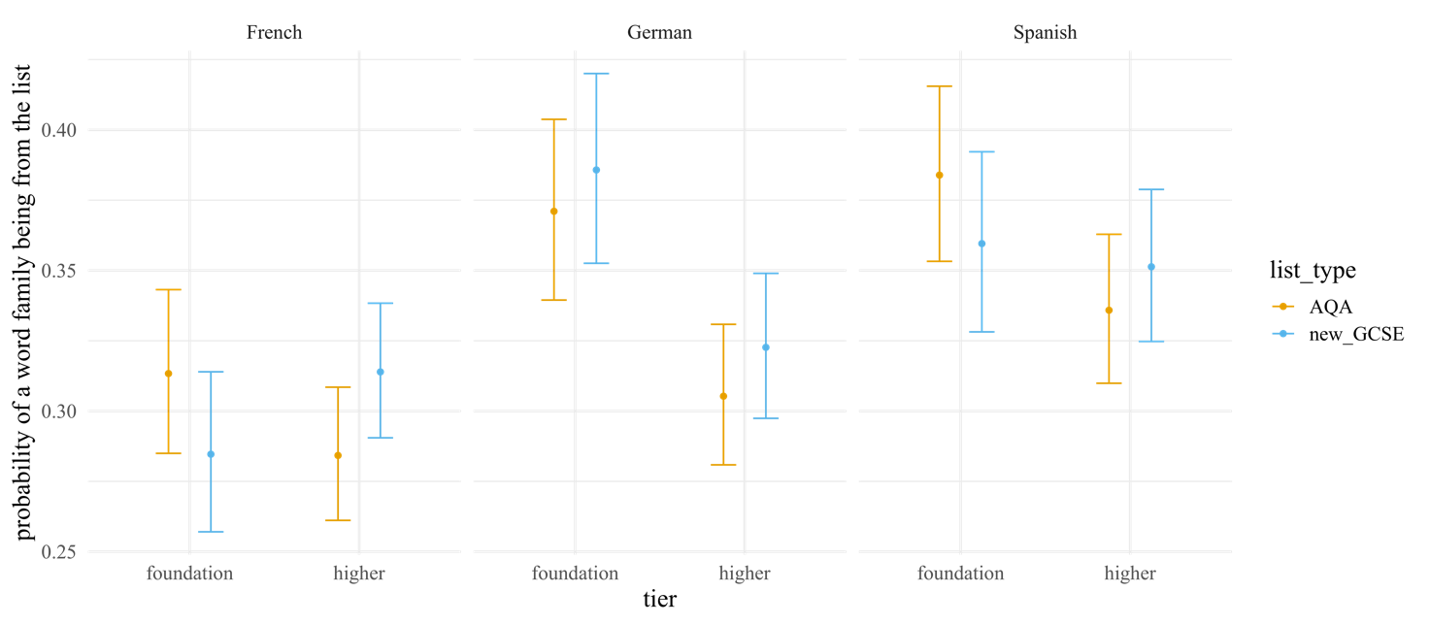
A frequency-informed list is equally useful even for words only used once in current GCSEs
For all current AQA lists and all Higher Edexcel lists
Predicted probability of a word family only used once so far being from each word lists
Notes:
For exams held to date including 2018, 2019, 2020, sample
The models did not reveal any differences in coverage between the AQA and new GCSE lists in terms of word families used only once for any of the three languages.
For Edexcel papers, for German and Spanish, the Edexcel lists provided greater coverage than the new GCSE lists, but only at foundation (OR: German: 34%, 95% CI [12%, 62%], p = .002; Spanish: 29%, 95% CI [5%, 57%], p = .014), and not at higher.

