Slide 1
Comparing how people do things
comparative forms of adverbs
meilleur(e) vs mieux
SSC [um/un] revisited
Y8 French
Term 3.1 - Week 2 - Lesson 51
Catherine Salkeld / Stephen Owen / Catherine Morris Artwork by: Chloé Motard
Date updated: 25/06/21
Notes:
Artwork by Chloé Motard. All additional pictures selected are available under a Creative Commons license, no attribution required.
Native teacher feedback provided by Sarah Brichory.
Learning outcomes (lesson 1):
Revisit SSC [um/un]
Introduction of comparative forms of adverbs
Introduction of irregular comparative adverb mieux and contrast with adjective meilleur(e)
Word frequency (1 is the most frequent word in French):
8.3.1.3 (introduce) décision [370], soin [1109], dur [1029], facilement [1194], lentement [2637], mal¹ [277], mieux [217], vite [711]
8.2.2.2 (revisit) finir [583], nourrir [1261], chat [3138], dimanche [1235], heure [99], jeudi [1112], lundi [1091], mardi [1044], mercredi [1168], minute [375], vendredi [1086]
8.1.2.6 (revisit) carte¹ [955], côté [123], foot(ball) [2602], guitare [>5000], instrument [1650], pétanque [>5000] piano [4967], droit [1293], gauche [607], loin [341], près [225]
Source: Londsale, D., & Le Bras, Y. (2009). A Frequency Dictionary of French: Core vocabulary for learners London: Routledge.
The frequency rankings for words that occur in this PowerPoint which have been previously introduced in NCELP resources are given in the NCELP SOW and in the resources that first introduced and formally re-visited those words.
For any other words that occur incidentally in this PowerPoint, frequency rankings will be provided in the notes field wherever possible.

Slide 2
um/un
1
un
Notes:
Timing: 2 minutes for two SSC slides
Aim: To consolidate SSC [um/un]
Procedure: 1. Present the letter(s) and say the [um/un] sound first, on its own. Students repeat it with you. 2. Bring up the word ”un” on its own, say it, students repeat it, so that they have the opportunity to focus all of their attention on the connection between the written word and its sound.
3. A possible gesture for this would be to hold up one finger. 4. Roll back the animations and work through 1-3 again, but this time, dropping your voice completely to listen carefully to the students saying the [um/ un] sound, pronouncing ”un” and, if using, doing the gesture.
Word frequency (1 is the most frequent word in French):
un [3]
Source: Londsale, D., & Le Bras, Y. (2009). A Frequency Dictionary of French: Core vocabulary for learners London: Routledge.

Slide 3
um/un
lundi
parfum
1
aucun
un
commun
[none]
chacun
[common]
[each]
Notes:
Aim: To consolidate SSC [um/un]
Procedure:
Introduce and elicit the pronunciation of the individual SSC [um/un] and then the source word again ‘un’ (with gesture, if using). Then present and elicit the pronunciation of the five cluster words. The cluster words have been chosen for their high-frequency, from a range of word classes, with the SSC (where possible) positioned within a variety of syllables within the words (e.g. initial, 2nd, final etc.). Additionally, we have tried to use words that build cumulatively on previously taught SSCs (see the Phonics Teaching Sequence document) and do not include new SSCs. Where new SSCs are used, they are often consonants which have a similar symbol-sound correspondence in English.
Word frequency (1 is the most frequent word in French): un [3]; aucun [63] chacun [323]; commun [780]; lundi [1091]; parfum [4477]. Source: Londsale, D., & Le Bras, Y. (2009). A Frequency Dictionary of French: Core vocabulary for learners London: Routledge.

Slide 4
Nasal or oral vowels?
Remember!
[um/un] are nasal sounds before a consonant or at the end of a word, and oral sounds before a vowel.
écouter
 |  | nasal | oral + m/n
 | lunette [glasses]
 | humble
 | unique
 | commun [common]
 | fortune
 | union
 | opportun [timely]
 | légumes [vegetables]
nasal vowel
[um/un]
1
2
3
4
oral vowel
[u] + m/n
5
6
7
8
Notes:
Timing: 5 minutes
Aim: Aural recognition of nasal [um/un] and oral [u] vowels in unknown words.
Procedure:
1. Practice saying SSCs [um/un] and [u] aloud, in isolation. Students should notice a vibration in the nose when they produce the nasal sounds, but not when they produce the oral sounds.
2. Click the numbers to play the audio.
3. Students write 1-10 and decide if the letters in bold represent a nasal or non-nasal vowel sound.
4. Click to reveal the answers.
5. Click to bring up the reminder.
6. Click to hear the words again. Students repeat.
Transcript:
1. lunette
2. humble
3. unique
4. commun
5. fortune
6. union
7. opportun
8. légumes
Word frequency of unknown words used (1 is the most frequent word in French): lunette [4207], commun [780], opportun [4485], légume [3117]
Source: Londsale, D., & Le Bras, Y. (2009). A Frequency Dictionary of French: Core vocabulary for learners London: Routledge.
Word frequency of cognates used (1 is the most frequent word in French): humble [4680], unique [402], fortune [2371], union [729]
Source: Londsale, D., & Le Bras, Y. (2009). A Frequency Dictionary of French: Core vocabulary for learners London: Routledge.

Slide 5
Vocabulaire
écouter
 | en français | en anglais
 | Nous prenons lentement une bonne décision. | We are slowly making a good decision.
 | Mes frères prennent mieux soin du chien que mes sœurs. | My brothers take better care of the dog than my sisters.
 | Si vous prenez le train, vous allez facilement arriver. | If you take the train, you will arrive easily.
 | Je préfère travailler dur à travailler vite et mal. | I prefer to work hard than to work quickly and badly.
1
_________
_________
_________
2
___________
______
____
3
_______
_____________
4
__
__
__
Notes:
Timing: 5 minutes
Aim: Oral recognition of new vocabulary at sentence level. NB: a more complex version of this activity, in which students are asked to recognise and transcribe full sentences, is found on the next slide.
Procedure:
Click numbers to hear phrases in French.
If students want more of a challenge, have them turn away from the board and transcribe the full sentence rather than just the gaps
Students transcribe the missing words and translate orally into English.
Click to reveal French and then English for each sentence.
Transcript:
1. Nous prenons lentement une bonne décision.
2. Mes frères prennent mieux soin du chien que mes sœurs.
3. Si vous prenez le train, vous allez facilement arriver.
4. Je préfère travailler dur à travailler vite et mal.
Word frequency of cognates used (1 is the most frequent word in French): pizza [>5000]
Source: Londsale, D., & Le Bras, Y. (2009). A Frequency Dictionary of French: Core vocabulary for learners London: Routledge.

Slide 6
Vocabulaire
écouter
 | en français | en anglais
 | Nous prenons lentement une bonne décision. | We are slowly making a good decision.
 | Mes frères prennent mieux soin du chien que mes sœurs. | My brothers take better care of the dog than my sisters.
 | Si vous prenez le train, vous allez facilement arriver. | If you take the train you will arrive easily.
 | Je préfère travailler dur à travailler vite et mal. | I prefer to work hard than to work quickly and badly.
1
2
3
4
Notes:
Timing: 8 minutes
NB: a less complex version of this activity, in which students are asked to recognise and transcribe target words only, is found on the previous slide.
Aim: Oral recognition of new vocabulary at sentence level.
Procedure:
1. Click numbers to hear phrases in French.
2. Students transcribe the sentences and translate into English.
3. Click to reveal French and then English for each sentence.
Transcript:
1. Nous prenons lentement une bonne décision.
2. Mes frères prennent mieux soin du chien que mes sœurs.
3. Si vous prenez le train, vous allez facilement arriver.
4. Je préfère travailler dur à travailler vite et mal.
Word frequency of cognates used (1 is the most frequent word in French): pizza [>5000]
Source: Londsale, D., & Le Bras, Y. (2009). A Frequency Dictionary of French: Core vocabulary for learners London: Routledge.

Slide 7
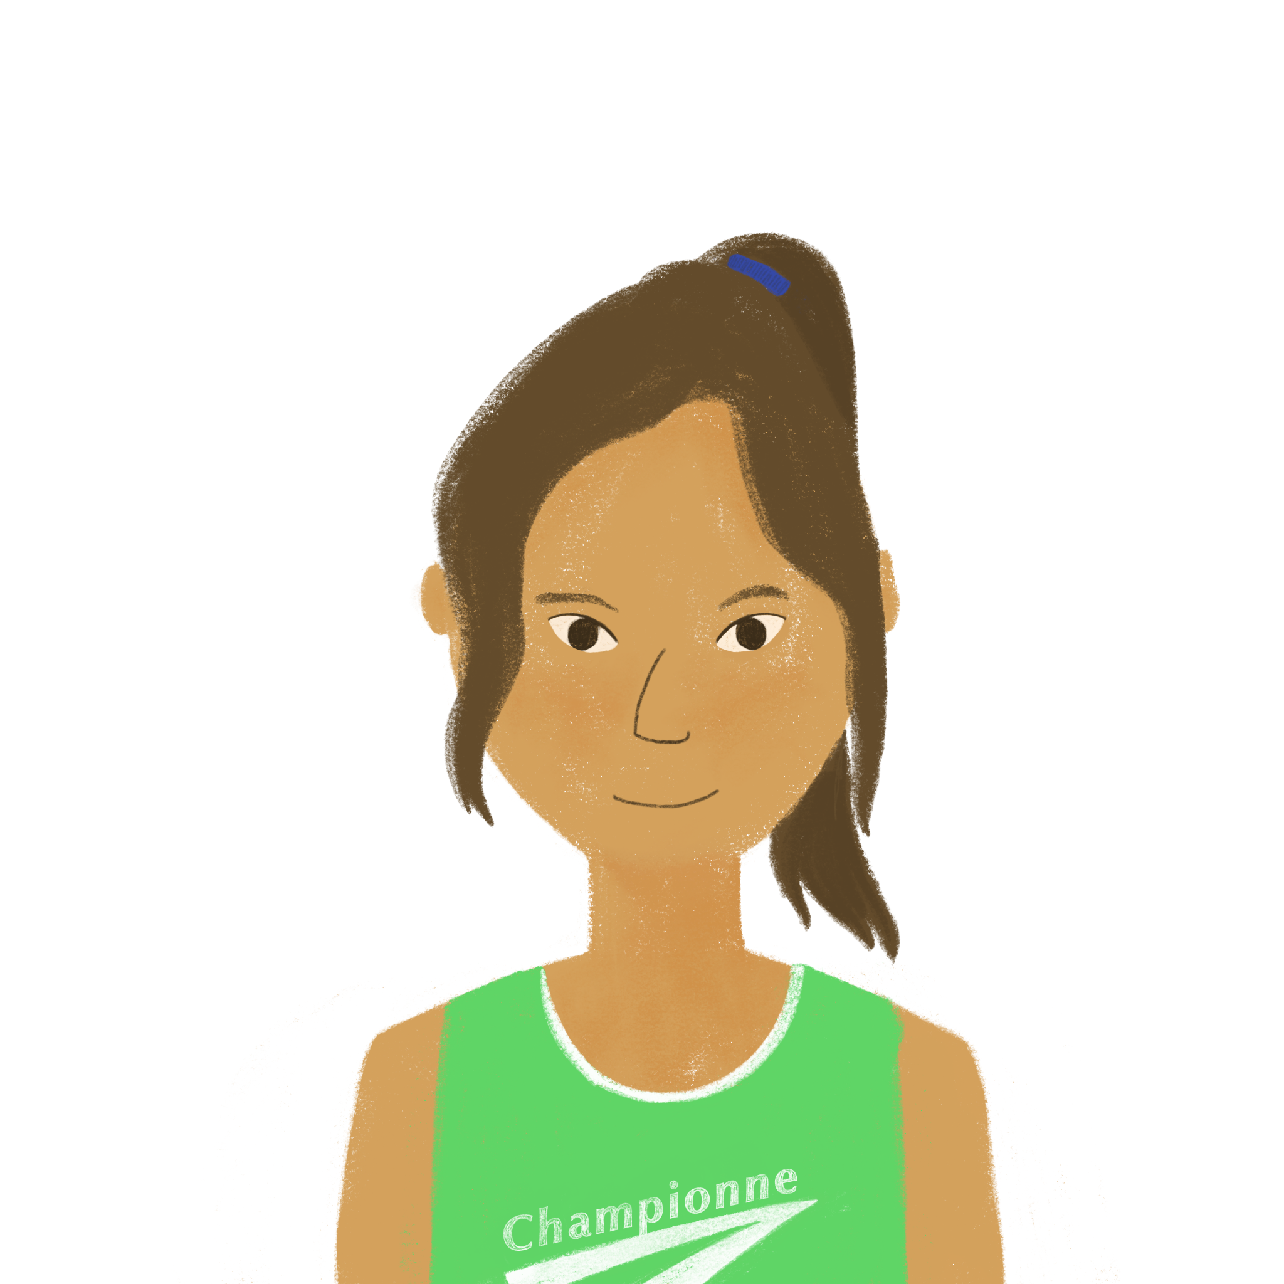
Les adverbes
grammaire
Adverbs describe verbs. They tell us when, where and how things happen.
Here are some adverbs you already know:
lentement vite facilement souvent
slowly quickly easily often
Add plus (more) or moins (less) before adverbs to compare how things happen:
Amir apprend vite, mais Océane apprend plus vite.
Amir learns quickly, but Océane learns more quickly.
Océane lit souvent, et Amir lit moins souvent.
Océane reads often, and Amir reads less often.
Notes:
Timing: 3 minutes
Aim: Revision of adverb definition; introduction to comparative forms of adverbs.
Procedure:
1. Click through the explanations, ensuring understanding.

Slide 8
C’est quel enfant ?
décrire* = to describe
lire
Romain décrit* les enfants. Que dit-il ? Lis les phrases et réponds aux questions.
1 | Léa marche vite, et Océane marche plus vite. | Who walks more quickly?
2 | Amir lit lentement, et Noura lit plus lentement. | Who reads less slowly?
3 | Sophie pense vite, et Léa pense plus vite. | Who thinks less quickly?
4 | Amir voyage souvent, et Abdel voyage plus souvent. | Who travels more often?
5 | Sophie apprend facilement, et Léa apprend moins facilement. | Who learns less easily?
6 | Océane étudie souvent, et Amir étudie moins souvent. | Who studies less often?
7 | Abdel écrit vite, et Amir écrit moins vite. | Who writes more quickly?
8 | Noura joue souvent, et Amir joue moins souvent. | Who plays more often?
Océane
Amir
Sophie
Abdel
Léa
Amir
Abdel
Noura
Notes:
Timing: 7 minutes
Aim: Written recognition of comparative forms of adverb and connecting these with meaning.
Procedure:
1. Students read sentences and choose the correct name to answer the questions. They will have to read very carefully, because the comparative form used in the question is not always the same as that used in the statement (i.e. the English question may ask about less + adverb while the French sentence uses the construction is plus + adverb).
2. Click to reveal answers.
Word frequency of unknown words used (1 is the most frequent word in French): décrire [1176]
Source: Londsale, D., & Le Bras, Y. (2009). A Frequency Dictionary of French: Core vocabulary for learners London: Routledge.

Slide 9
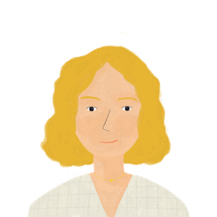
C’est qui / quoi ?
décrire* = to describe
écouter
Aurélie décrit* sa famille et ses affaires. Que dit-elle ? Écoute et réponds aux questions.
 | Who learns languages more easily? | Amir | Abdel
 | Who reads more quickly? | Léa | Sophie
 | Who speaks less slowly? | Amandine | Noura
 | What travels less quickly? | the car | the train
 | Who passes exams more easily? | Léa | Sophie
 | What eats more quickly? | the dog | the cat
 | Who works less slowly? | Noura | Amir
 | Who understands English less easily? | Abdel | Amir
1
2
3
4
5
6
7
8
Notes:
Timing: 7 minutes
Aim: Aural recognition of comparative forms of adverb and connecting these with meaning.
Procedure:
1. Click on the buttons to play audio, allowing time to read the question before listening to each sentence. Students will have to read very carefully, because the comparative form used in the question is not always the same as that used in the statement (i.e. the English question may ask about less + adverb while the French sentence uses the construction is plus + adverb).
2. Students choose the correct name to answer the question.
3. Click to reveal answers.
Transcript:
1. Amir apprend les langues facilement, et Abdel apprend les langues plus facilement.
2. Léa lit vite, et Sophie lit plus vite.
3. Amandine parle lentement, et Noura parle plus lentement.
4. La voiture voyage vite, et le train voyage plus vite.
5. Léa réussit les examens facilement, et Sophie réussit les examens plus facilement.
6. Le chat mange vite, et le chien mange plus vite.
7. Noura travaille lentement, et Amir travaille plus lentement.
8. Amir comprend l’anglais facilement, et Abdel comprend l’anglais plus facilement.
Word frequency of unknown words used (1 is the most frequent word in French): décrire [1176]
Source: Londsale, D., & Le Bras, Y. (2009). A Frequency Dictionary of French: Core vocabulary for learners London: Routledge.

Slide 10
Meilleur(e) ou mieux ?
grammaire
As you know, adjectives describe nouns (what something is like):
Cette musique est bonne. Cette musique est meilleure.
This music is good. This music is better.
Bien and mieux are the adverbial forms of bon and meilleur.
Adverbs describe verbs (how something is done/happens):
Je joue bien aux cartes. Tu joues mieux aux cartes.
I play cards well. You play cards better.
Meilleur is the comparative form of bon.
Mieux is the comparative form of bien.
Notes:
Timing: 2 minutes
Aim: To present the adverbial forms of bon and meilleur.
Procedure: 1. Cycle through the information on the slide using the animation sequence.
NB: To reduce cognitive load for these young learners, a very simple interpretation of the exception to the rule is provided here. If students ask for further clarification of the exception, teacher can mention that C’est bon is normally only encountered when describing the sensory aspects of a noun (e.g. taste). C’est bien implies a moral/intellectual judgement.
Word frequency of cognates used (1 is the most frequent word in French): jazz [>5000], classique [1845]
Source: Londsale, D., & Le Bras, Y. (2009). A Frequency Dictionary of French: Core vocabulary for learners London: Routledge.

Slide 11
Saying ‘better’
grammaire
The English word ‘better’ can be an adjective or an adverb – you cannot tell from it whether a noun or verb is being described. The French translation ‘mieux’ or ‘meilleur’ gives us this information.
 |  | this cheese (is) | she sings | could be either
1. | This cheese is better.
2. | She sings better.
3. | Elle chante mieux.
4. | Ce fromage est meilleur.
__________
_______
_________
_________
Use bon and meilleur(e) to describe nouns. Use bien and mieux to describe verbs.
Exception: General opinions with ‘c’est’ are normally followed by bien/mieux:
Le jazz, c'est bien, mais le classique, c'est mieux. Jazz is good, but classical is better.
Notes:
Timing: 2 minutes
Aim: To present cross-linguistic differences between the English word ‘better’, and the two French equivalents mieux and meilleur.

Slide 12
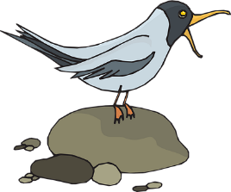
Adjectif ou adverbe ?
Réponses:
*la voix = voice
lire
1. Qui prend des notes, Sara ou Sandrine ?
- Sandrine prend des notes parce que son ordinateur est / elle écrit meilleur.
2. Tu veux chanter ?
- Non, tu peux chanter. Ta voix* est / tu chantes meilleure.
3. Tu préfères quel footballeur ?
- Je préfère Messi parce qu’il joue / il est mieux.
4. Tu prends le bus ou le train ?
- Je prends le train puisqu’il est / il voyage meilleur.
5. Il choisit l’histoire ou les maths ?
- Il choisit l’histoire. Il travaille / la professeure est mieux dans cette classe.
Choisis les mots corrects!
!!!
Notes:
Timing: 5 minutes
Aim: Written recognition of comparative forms meilleur(e) and mieux and connecting these with meaning.
Procedure: 1. Students read the mini dialogues, and complete the responses with an appropriate justification, using their knowledge of the functions of meilleur(e) and mieux to inform their choices.
2. Answers revealed on clicks.
3. Elicit oral translations.
Word frequency of unknown words used (1 is the most frequent word in French): voix [414], footballeur [>5000]
Source: Londsale, D., & Le Bras, Y. (2009). A Frequency Dictionary of French: Core vocabulary for learners London: Routledge.

Slide 13
Meilleur(e) ou mieux ?
écrire
Comment dit-on ‘better’? Écris mieux ou meilleur(e).
J’aime le pain français, mais ce pain anglais est __________.
Il parle bien italien, mais tu parles __________ italien.
En général, il ne réussit pas les examens, mais il étudie __________ maintenant.
Normalement, je préfère le café, mais ce thé est __________.
Tu as plus de livres en anglais parce que tu comprends __________ la langue.
J’aime le film, mais le livre est __________.
On voyage avec Coralie parce qu’elle a une __________ voiture.
Tu apprends plus parce que tu écoutes __________ la professeure.
meilleur
mieux
mieux
meilleur
mieux
meilleur
meilleure
mieux
Notes:
Timing: 5 minutes
Aim: Written production of mieux and meilleur(e).
Procedure:
1. Students read the sentences, taking note of whether the gap is preceded by, and, therefore, describes, a verb phrase or a noun phrase. Remind students that where the gap is sandwiched between a verb and noun (items 2, 6 and 8), it is the idea before the gap that gives them the answer. Draw attention to the pre-nominal use in 7, and clarify that the gap still refers to the noun phrase here.
2. Students complete each sentence by writing mieux or meilleur(e). Remind them that meilleur must agree with the gender of the noun.
3. Click to reveal answers.

Slide 14
On fait des comparaisons
[speaks Spanish less easily]
parler
Antoine
Christophe
Antoine parle espagnol mais Christophe parle moins facilement espagnol.
Notes:
Timing: 7 minutes (slide 1/8)
Aim: Oral production of sentences containing comparative forms of adverbs.
Procedure:
1. Students work in pairs and take turns to say a sentence with mais that compares the two pictures on each slide, using the English prompt at the top of the slide to guide them.
2. Click to reveal suggested answers.
Word frequency of unknown words used (1 is the most frequent word in French): comparaison [2244]
Source: Londsale, D., & Le Bras, Y. (2009). A Frequency Dictionary of French: Core vocabulary for learners London: Routledge.

Slide 15
On fait des comparaisons
[sings better]
parler
Simon
Étienne
Simon chante, mais Étienne chante mieux.
Notes:
Slide 2/8

Slide 16
On fait des comparaisons
[sleeps worse]
parler
Marcel
Gaspard
Marcel dort mal, mais Gérard dort plus mal.
Notes:
Slide 3/8

Slide 17
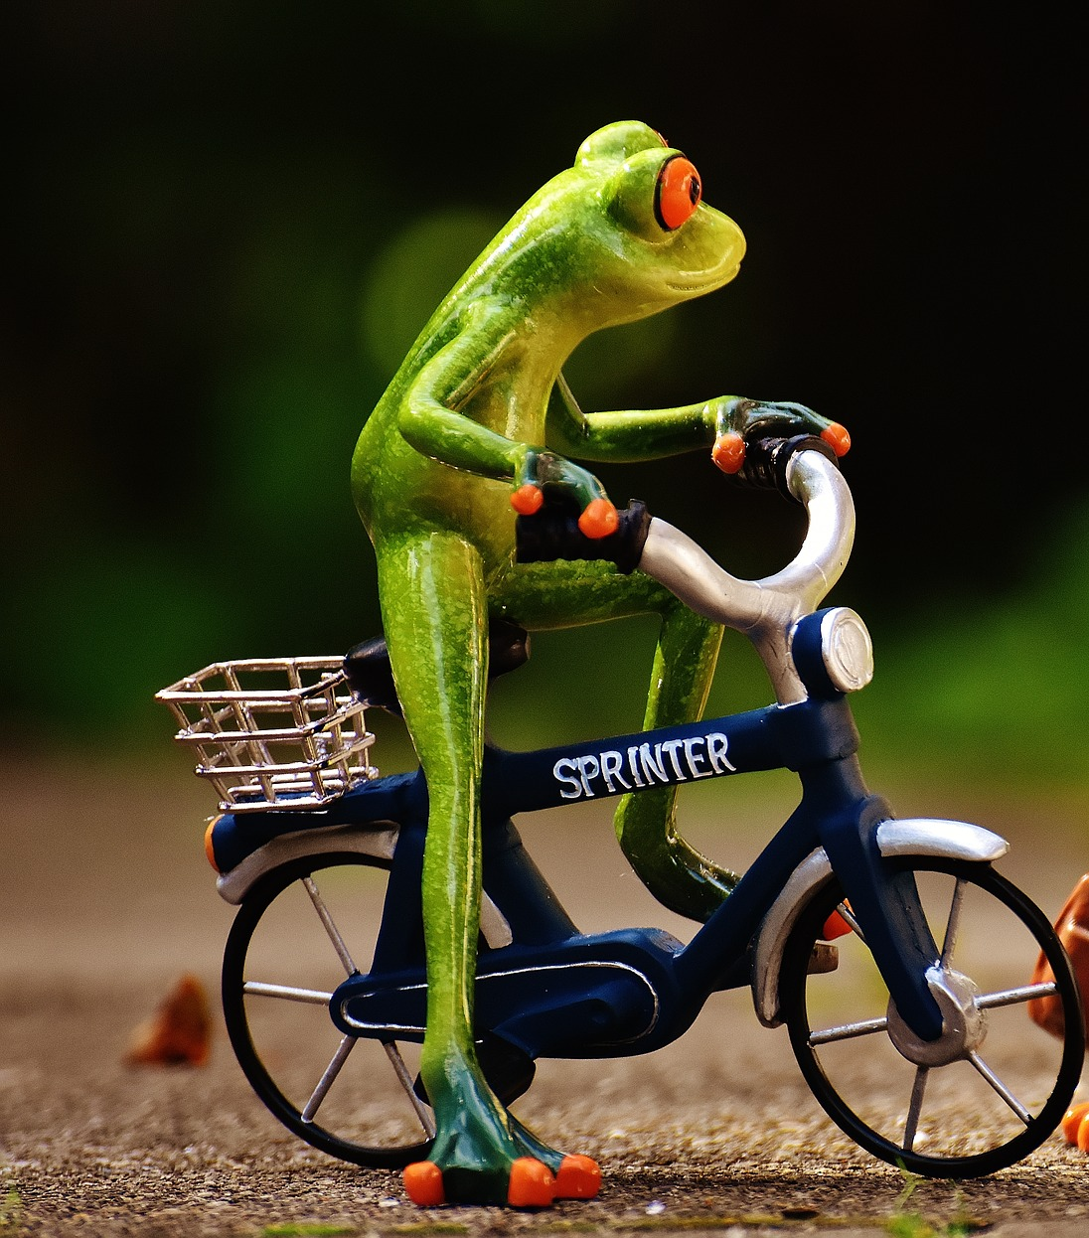
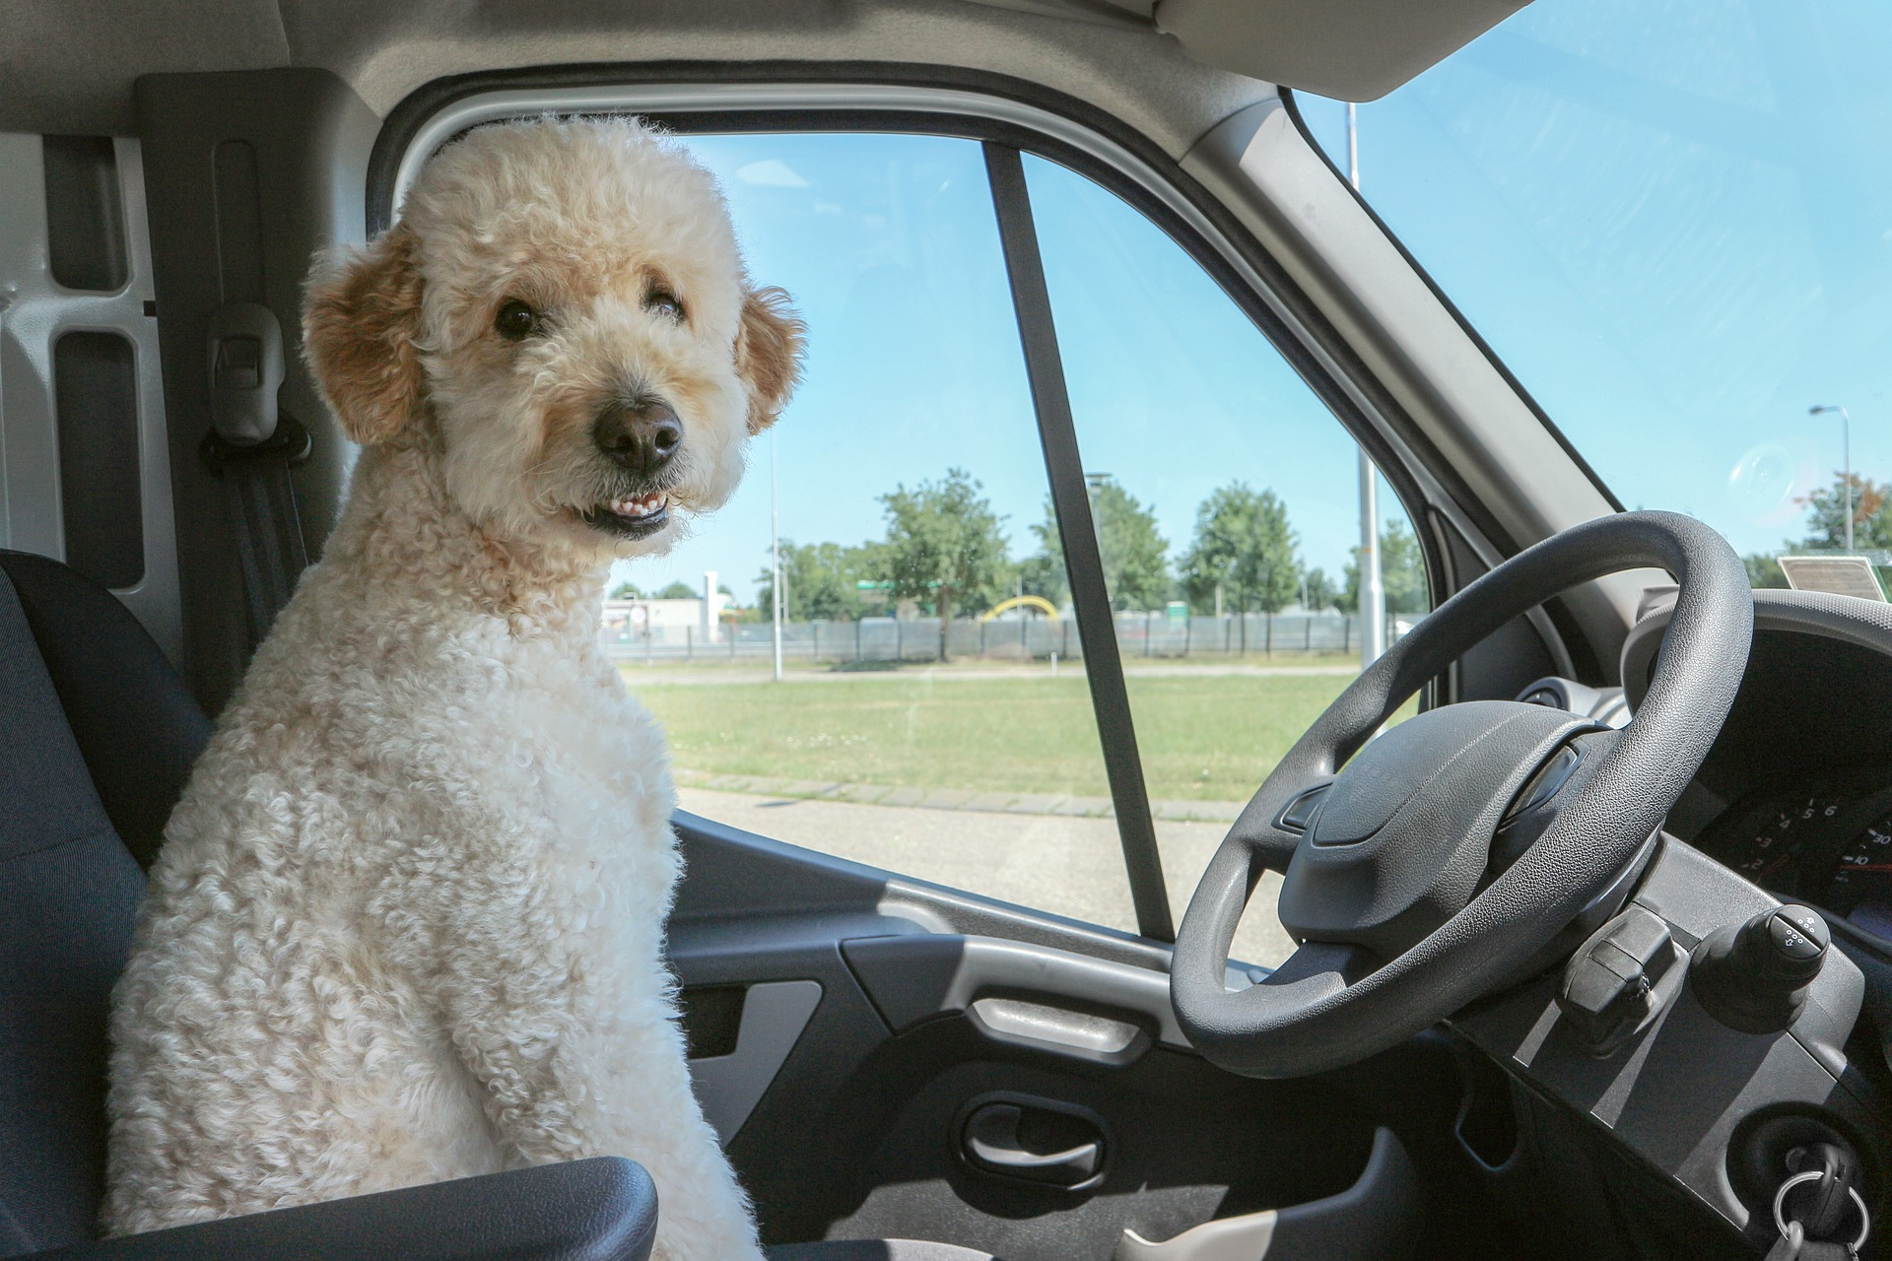
On fait des comparaisons
[travels more quickly]
parler
Frédérique
Alizée
Frédérique voyage vite, mais Alizée voyage plus vite.
Notes:
Slide 4/8

Slide 18
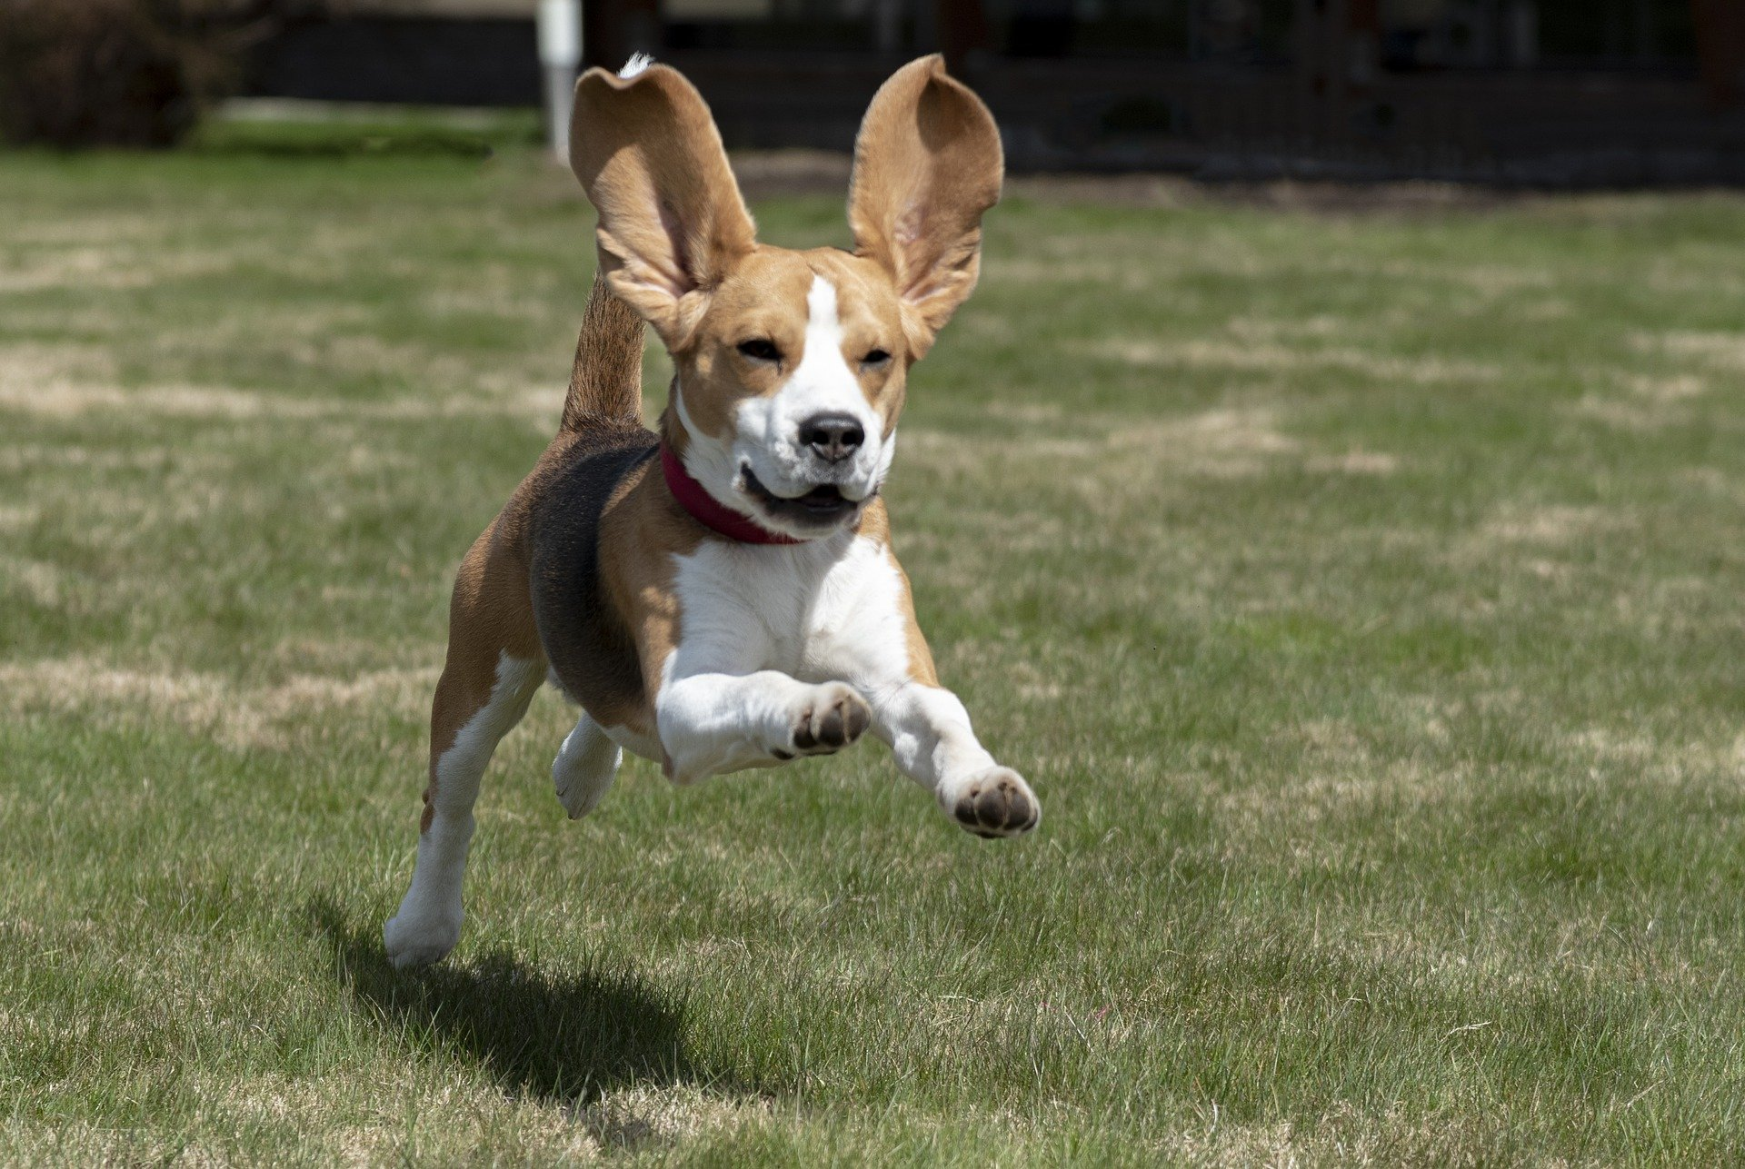
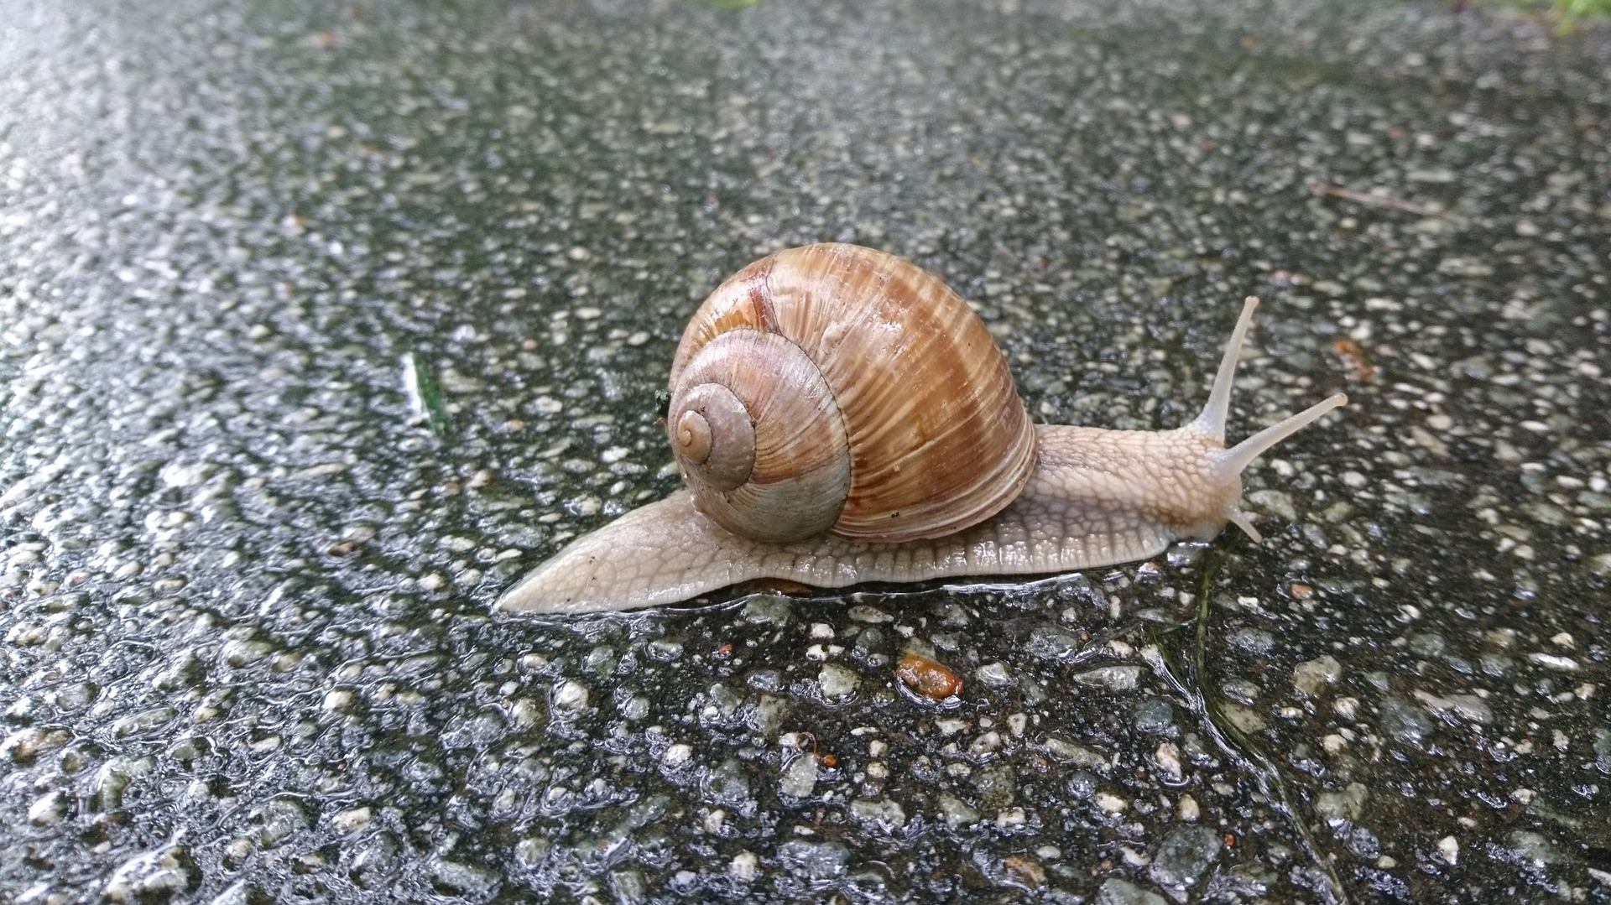
On fait des comparaisons
[arrives less quickly]
parler
Cyril
Élodie
Cyril arrive vite, mais Élodie arrive moins vite.
Notes:
Slide 5/8

Slide 19
On fait des comparaisons
[finishes less easily]
parler
Patrick
Olivier
Patrick finit facilement, mais Olivier finit moins facilement.
Notes:
Slide 6/8

Slide 20
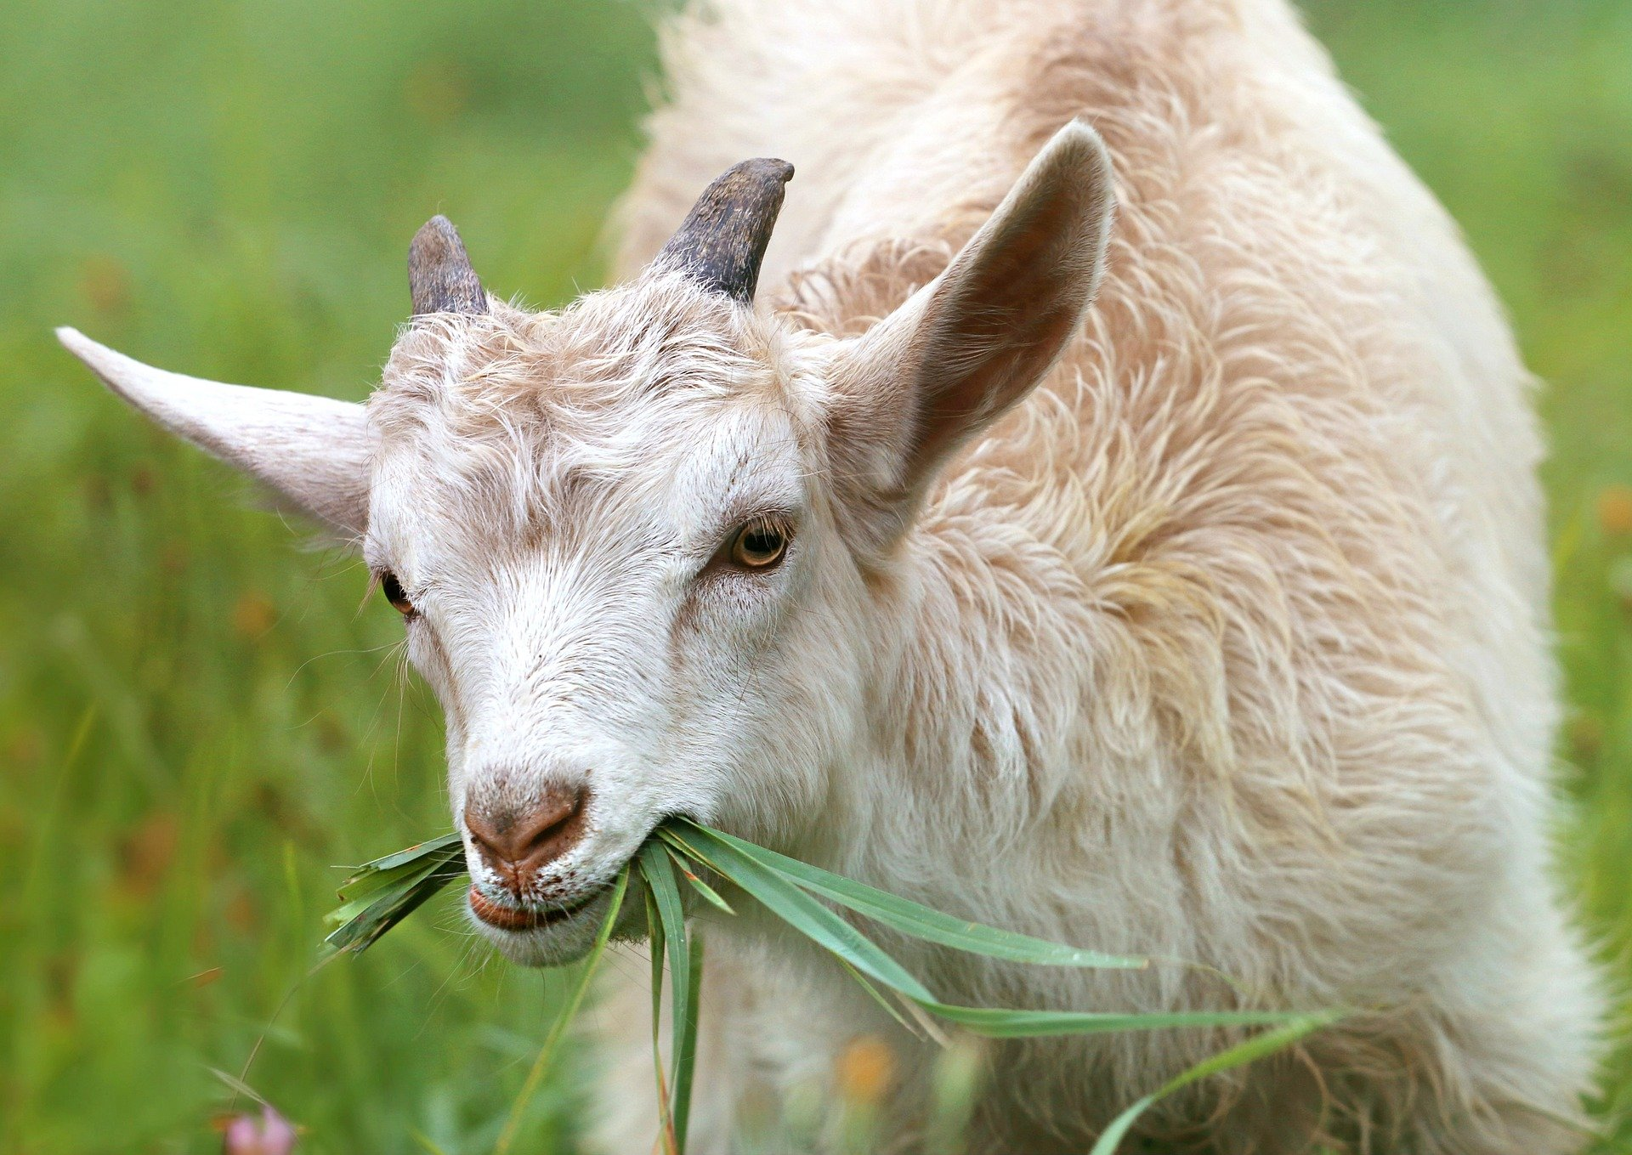
On fait des comparaisons
[eats less slowly]
parler
Nolwenn
Audrey
Nolwenn mange lentement, mais Audrey mange moins lentement.
Notes:
Slide 7/8

Slide 21
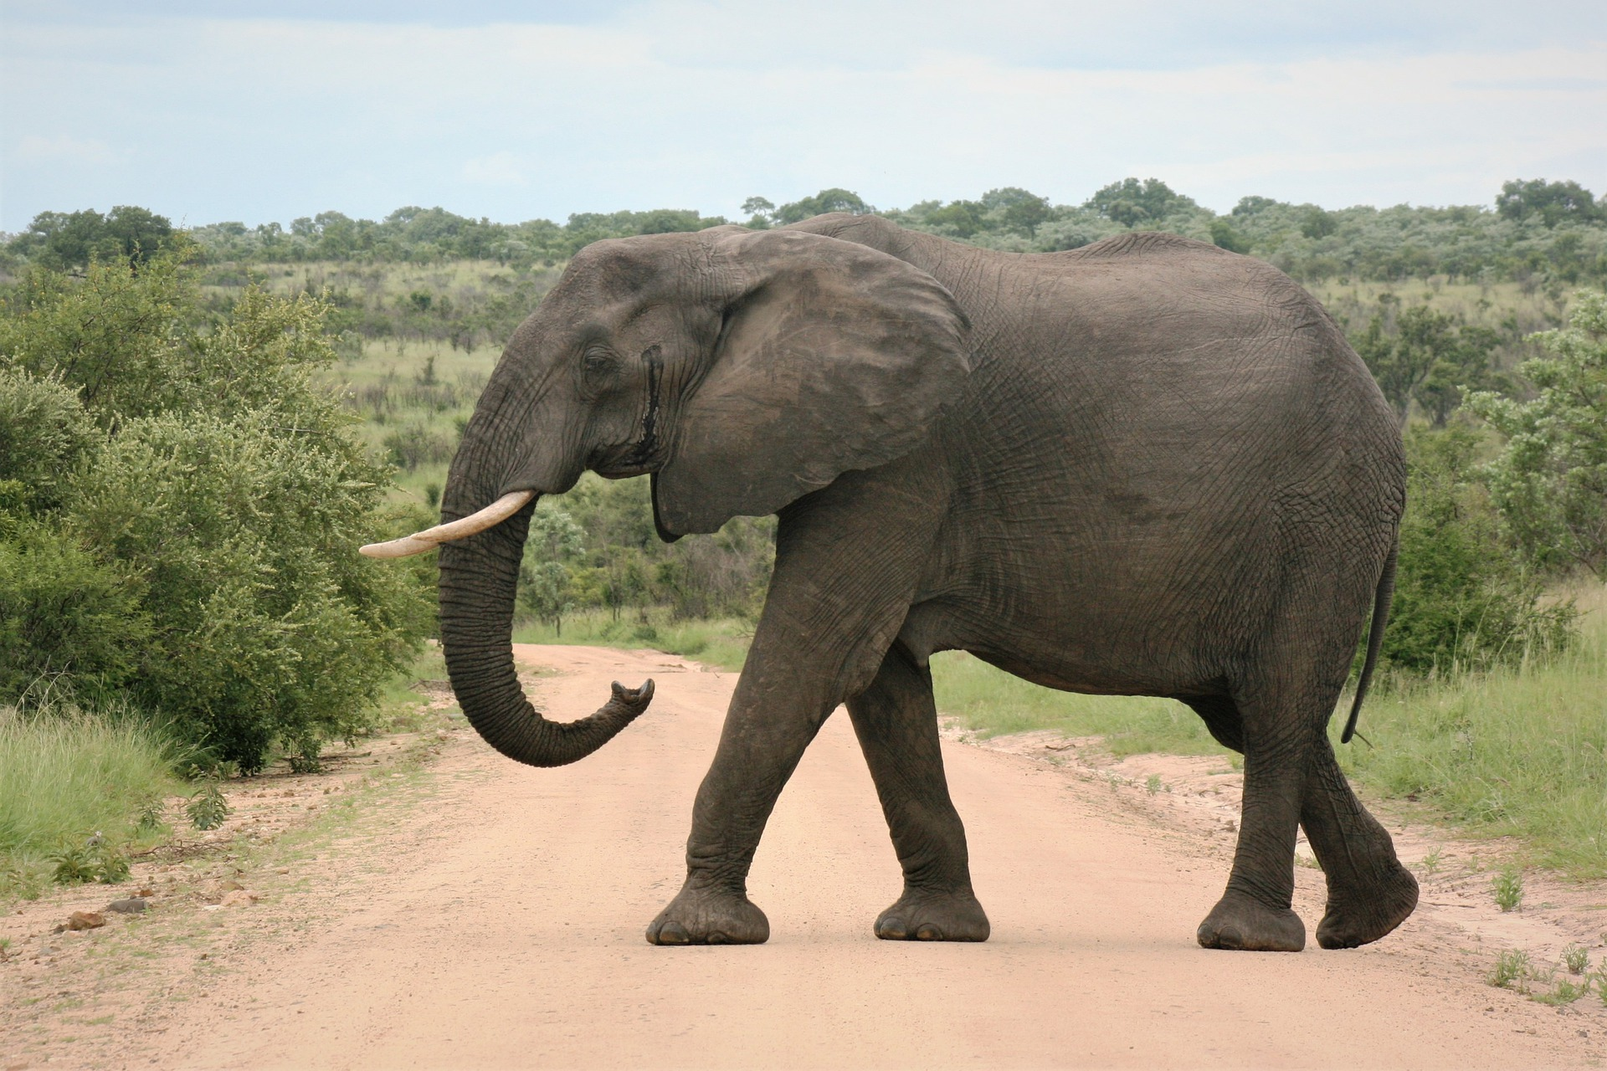
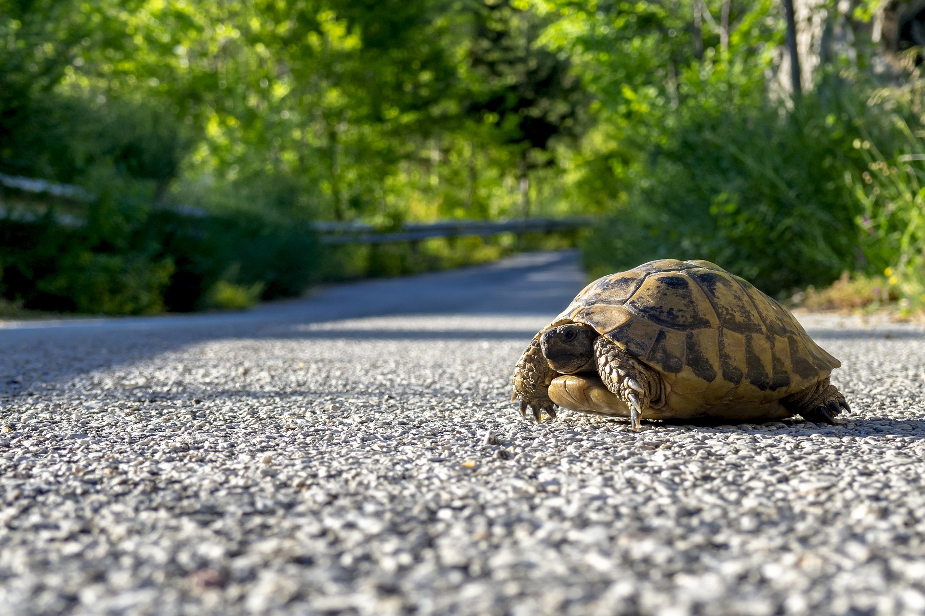
On fait des comparaisons
[crosses the road more slowly]
parler
Joséphine
Richard
Joséphine traverse la rue lentement, mais Richard traverse la rue plus lentement.
Notes:
Slide 8/8

Slide 22
Comparing how people do things
comparative forms of adjectives (plus…que, moins…que, aussi…que)
SSC [um/un] before a vowel
Y8 French
Term 3.1 - Week 2 - Lesson 53
Catherine Salkeld / Stephen Owen / Catherine Morris Artwork by: Chloé Motard
Date updated: 25/06/21
Notes:
Artwork by Chloé Motard. All additional pictures selected are available under a Creative Commons license, no attribution required.
Native teacher feedback provided by Sarah Brichory.
Learning outcomes (lesson 2):
Introduction of SSC [um/un] before a vowel
Consolidation of comparative structures with adverbs
Introduction of comparative structures with adverbs
Word frequency (1 is the most frequent word in French):
8.3.1.3 (introduce) décision [370], soin [1109], dur [1029], facilement [1194], lentement [2637], mal¹ [277], mieux [217], vite [711]
8.2.2.2 (revisit) finir [583], nourrir [1261], chat [3138], dimanche [1235], heure [99], jeudi [1112], lundi [1091], mardi [1044], mercredi [1168], minute [375], vendredi [1086]
8.1.2.6 (revisit) carte¹ [955], côté [123], foot(ball) [2602], guitare [>5000], instrument [1650], pétanque [>5000] piano [4967], droit [1293], gauche [607], loin [341], près [225]
Source: Londsale, D., & Le Bras, Y. (2009). A Frequency Dictionary of French: Core vocabulary for learners London: Routledge.
The frequency rankings for words that occur in this PowerPoint which have been previously introduced in NCELP resources are given in the NCELP SOW and in the resources that first introduced and formally re-visited those words.
For any other words that occur incidentally in this PowerPoint, frequency rankings will be provided in the notes field wherever possible.

Slide 23
u
tu
Notes:
Timing: 2 minutes for two SSC slides
Aim: To consolidate SSC [u]
Procedure: 1. Present the letter(s) and say the [u] sound first, on its own. Students repeat it with you. 2. Bring up the word ”tu” on its own, say it, students repeat it, so that they have the opportunity to focus all of their attention on the connection between the written word and its sound.
3. A possible gesture for this would be to point to someone else as though addressing him/her ‘you’. 4. Roll back the animations and work through 1-3 again, but this time, dropping your voice completely to listen carefully to the students saying the [u] sound, pronouncing ”tu” and, if using, doing the gesture.
Word frequency (1 is the most frequent word in French):
tu [112]
Source: Londsale, D., & Le Bras, Y. (2009). A Frequency Dictionary of French: Core vocabulary for learners London: Routledge.

Slide 24
u
Salut !
vue
amusant
tu
utiliser
[to use]
sur
[on]
Notes:
Aim: To consolidate SSC [u]
Procedure:
1. Introduce and elicit the pronunciation of the individual SSC [u] and then the source word again ‘tu’ (with gesture, if using). 2. Then present and elicit the pronunciation of the five cluster words.
The cluster words have been chosen for their high-frequency, from a range of word classes, with the SSC (where possible) positioned within a variety of syllables within the words (e.g. initial, 2nd, final etc.). Additionally, we have tried to use words that build cumulatively on previously taught SSCs (see the Phonics Teaching Sequence document) and do not include new SSCs. Where new SSCs are used, they are often consonants which have a similar symbol-sound correspondence in English.
Word frequency (1 is the most frequent word in French): tu [112]; salut ! [2205] vue [191]; sur [16]; amusant [4695]; utiliser [345]. Source: Londsale, D., & Le Bras, Y. (2009). A Frequency Dictionary of French: Core vocabulary for learners London: Routledge.

Slide 25
[um], [un]
écouter / écrire
Normally, SSCs [um] and [un] are nasal vowels.
However, [um] and [un] sound different before a vowel.
Can you think of any examples in words you already know?
before a consonant/end of word: before a vowel:
un absolument
chacun numéro
lundi université
instrument
(one)
These sounds are nasal vowels [um], [un].
(absolutely)
These sounds are oral vowels [u] + m / n.
(everyone)
(number)
(Monday)
(university)
(instrument)
Notes:
Timing: 2 minutes
Aim: revising the spelling rules governing pronunciation changes in SSCs which are normally nasal vowels and applying these to [um] and [un].
Procedure: 1. Cycle through the information on the slide using the animation sequence.

Slide 26
[nasal] ou [u] ?
lire / parler
Lis les mots et décide si c’est une voyelle nasale ou une voyelle orale.
Puis, dis les mots !
 |  | [nasal] | [u]
 | lumière [light]
 | punir [to punish]
 | jungle
j | humour
 | emprunter [to borrow]
 | aluminium
h | humaine
 | quelqu’un [someone]
1
2
3
nasal vowel
[um/un]
4
5
6
oral vowel
[u]
7
8
Notes:
Timing: 5 minutes
Aim: applying awareness of the pronunciation rules governing SSCs [um/un] and [u] to the oral production of words containing these letter combinations.
Procedure
1. Students read the words and decide based on the presence of absence of a vowel after letter ‘m’ or ‘n’ whether a nasal pronunciation is needed or not..
2. Click to check.
3. Now, students are challenged to pronounce the words correctly. Students should work in pairs and monitor each other for this.
4. Students try to say the words out loud. Teacher corrects.
5. Click the numbers to hear pronunciation
Transcript:
1. lumière
2. punir
3. jungle
4. humour
5. emprunter
6. aluminium
7. humaine
8. quelqu’un
Word frequency of unknown words (1 is the most frequent word in French): lumière [1059], punir [2149], emprunter [1123], quelqu’un [772]
Source: Londsale, D., & Le Bras, Y. (2009). A Frequency Dictionary of French: Core vocabulary for learners London: Routledge.
Word frequency of near-cognates used in task instructions (1 is the most frequent word in French): décider [165], voyelle [>5000], nasal [>5000], oral [4114], jungle [4891], humour [3950], aluminium [>5000] humain [286]
Source: Londsale, D., & Le Bras, Y. (2009). A Frequency Dictionary of French: Core vocabulary for learners London: Routledge.

Slide 27
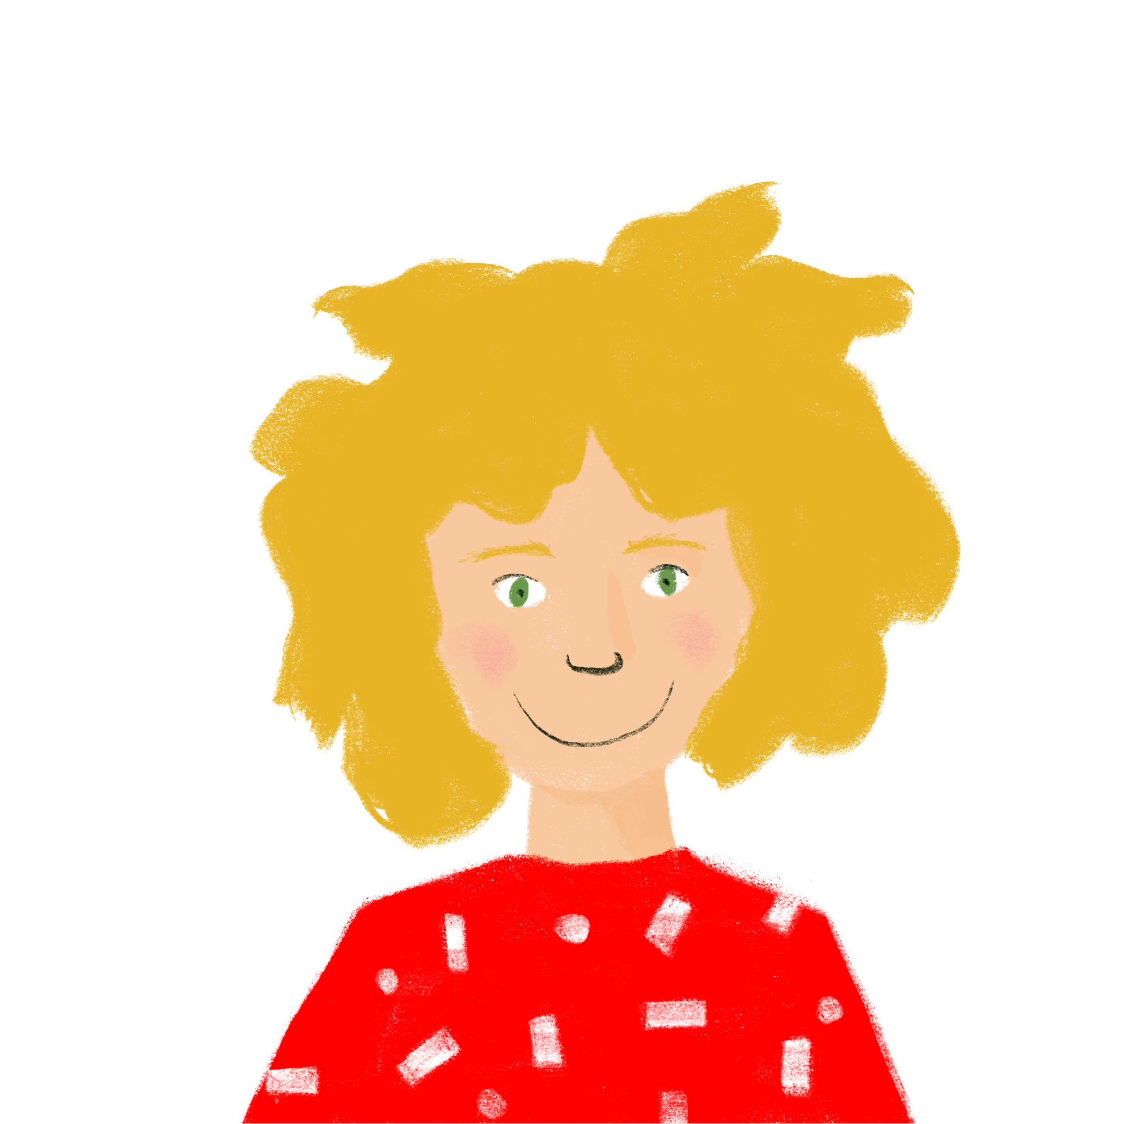
Une langue difficile
lire / écrire
Abdel pense à apprendre l’allemand. Léa écrit un message pour décrire ses expériences avec la langue. Remplis les blancs.
Could any of the words make sense in more than one place?
Can you think of any other words that could fill the gaps?
Salut Abdel! C’est _______1_______ difficile. L’allemand, c’est ________2_______, mais tu apprends ________3_______. Je parle anglais assez bien, mais tu parles ________4_______. Parfois je travaille ________5_______ et j’étudie ________6_______, mais tu étudies avec ________7_______. Tu peux comprendre ________8_______ une nouvelle langue.
- Léa
une décision
dur
facilement
mieux
care
hard
lentement
easily
better
mal
slowly
badly
soin
a decision
quickly
vite
Notes:
Timing: 8 minutes
Aim: Written production of new vocabulary in context.
Procedure:
1. Students fill gaps with the words provided.
2. Click to reveal answers.
3. Optional extension 1: Discuss whether some words could make sense in different places.
4. Optional extension 2: Elicit other known words that could fill the gaps.

Slide 28
Comparing adjectives
grammaire
Remember, the three ways to compare two things/people are:
plus ... que more ... than
moins ... que less ... than
aussi ... que as ... as
For example:
La ville est plus grande que le village.
The town is bigger [more big] than the village.
Le village est moins grand que la ville.
The village is less big than the town.
Le village est aussi grand que la ville.
The village is as big as the town.
Remember!
The comparative forms of bon (good) and mauvais (bad) are meilleur (better) and pire (worse).
Notes:
Timing: 2 minutes
Aim: to prime for the introduction of comparative structure with adverbs by revising comparative structures with adjectives (introduced in 8.3.1.1).
Procedure: 1. Cycle through the information on the slide using the animation sequence.
Word frequency of cognates used (1 is the most frequent word in French):
village [1295]
Source: Londsale, D., & Le Bras, Y. (2009). A Frequency Dictionary of French: Core vocabulary for learners London: Routledge.

Slide 29
Comparing adverbs
grammaire
The comparative form of bien (well) is mieux (better):
Il chante mieux que son ami.
He sings better than his friend
Mal (badly) does not have a special form.
Il chante plus mal que son ami.
He sings worse than his friend.
We can compare adverbs in the same way:
Léa travaille plus vite qu’Amir.
Léa works quicker [more quickly] than Amir.
Amir travaille moins vite que Léa.
Amir works less quickly than Léa.
Léa travaille aussi vite que Noura.
Léa works as quickly as Noura.
Notes:
Timing: 2 minutes
Aim: To demonstrate use of plus…que, moins … que and aussi …que as applied to adverbs.
Procedure: 1. Cycle through the information on the slide using the animation sequence.

Slide 30
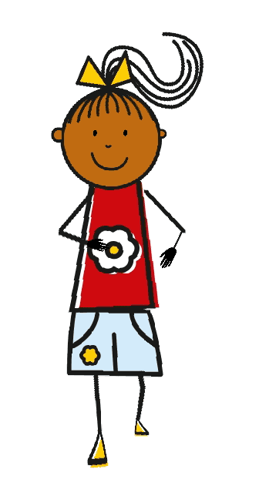
Qui est Pauline ?
écouter
1
A
B
C
Notes:
Timing: 6 minutes (slide 1/6)
Aim: Aural comprehensive of sentences with adverbs in comparative structures.
Procedure:
1. Click to play audio.
2. Students choose which person is referred to in the question. Clarify that in the case of a structure with aussi… que… comparison, the answer could be either (option B).
3. Click to reveal answer.
Transcript:
Pauline marche plus lentement que Marie.

Slide 31
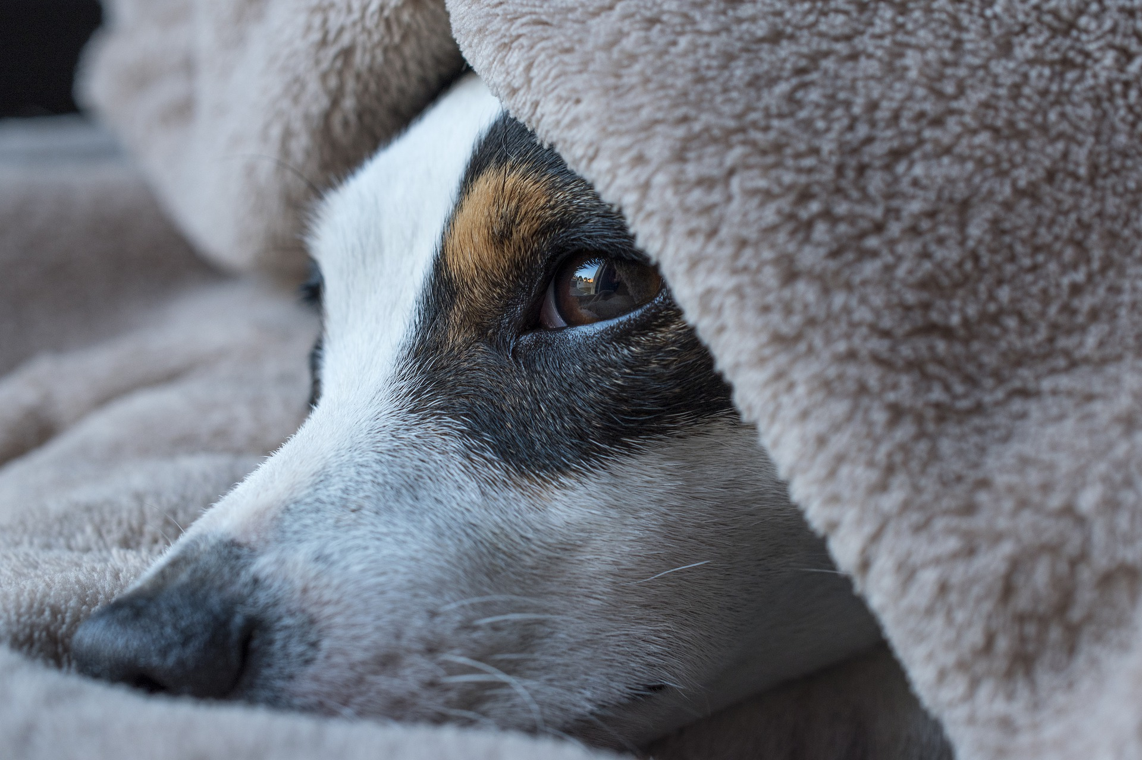
Qui est Jacques ?
écouter
2
A
B
C
Notes:
Slide 2/6
Transcript:
Jacques dort moins facilement que Pierre.

Slide 32
Qui est Denise ?
écouter
3
Bonjour
A
B
C
Notes:
Slide 3/6
Transcript:
Denise écrit mieux que Belle.

Slide 33
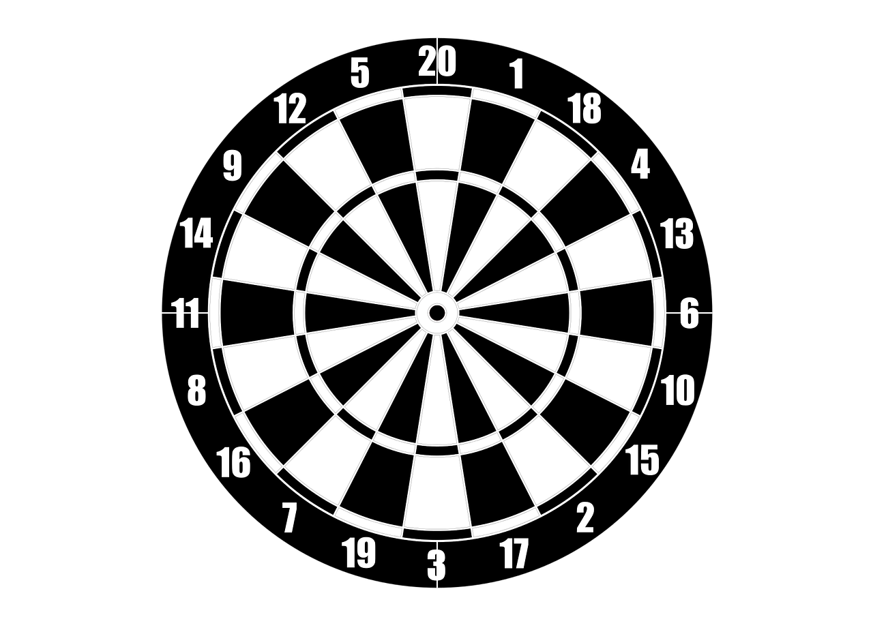
Qui est Paul ?
écouter
4
A
B
C
Notes:
Slide 4/6
Transcript:
Robert gagne plus facilement que Paul.

Slide 34
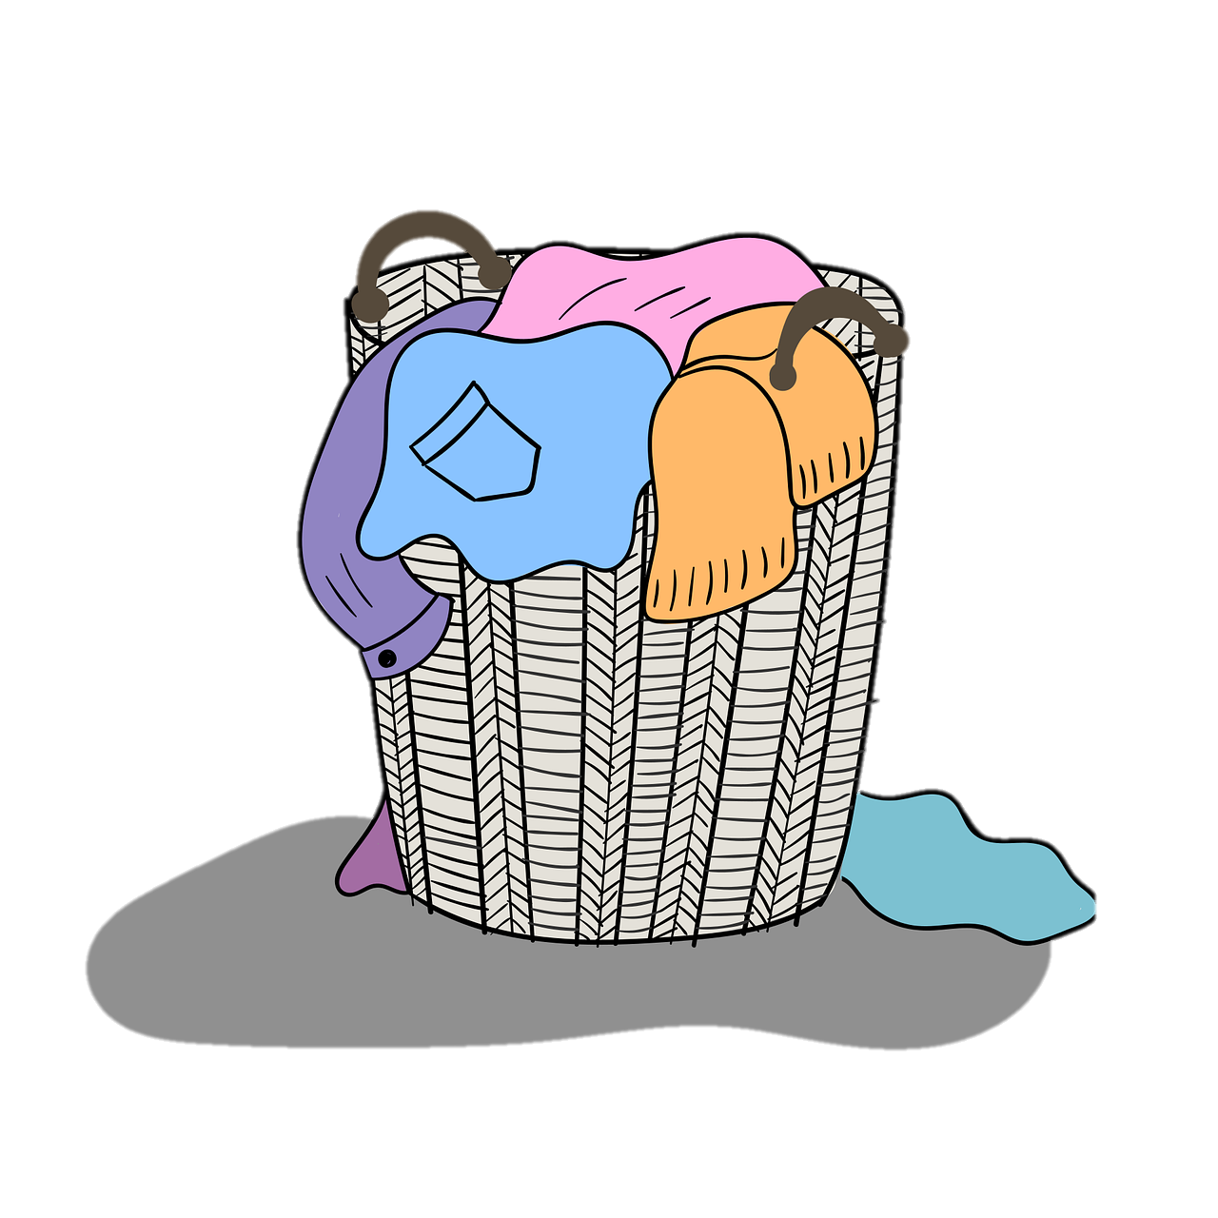
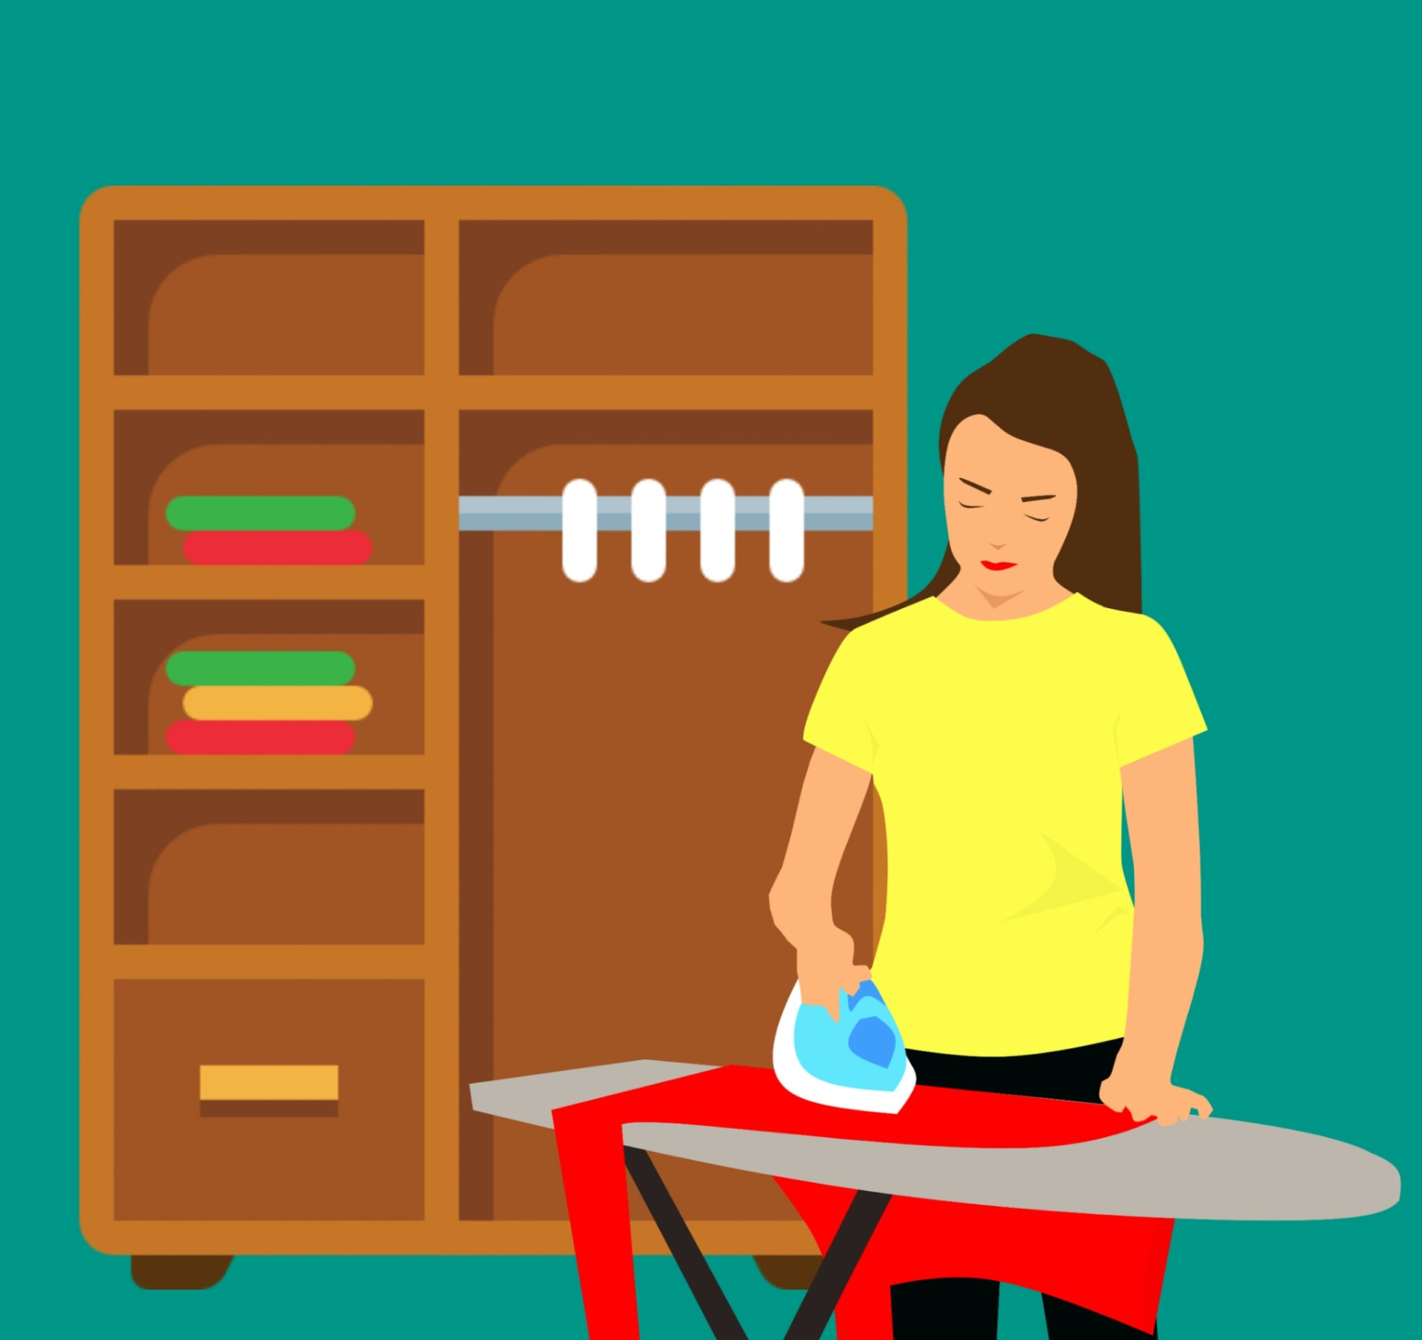
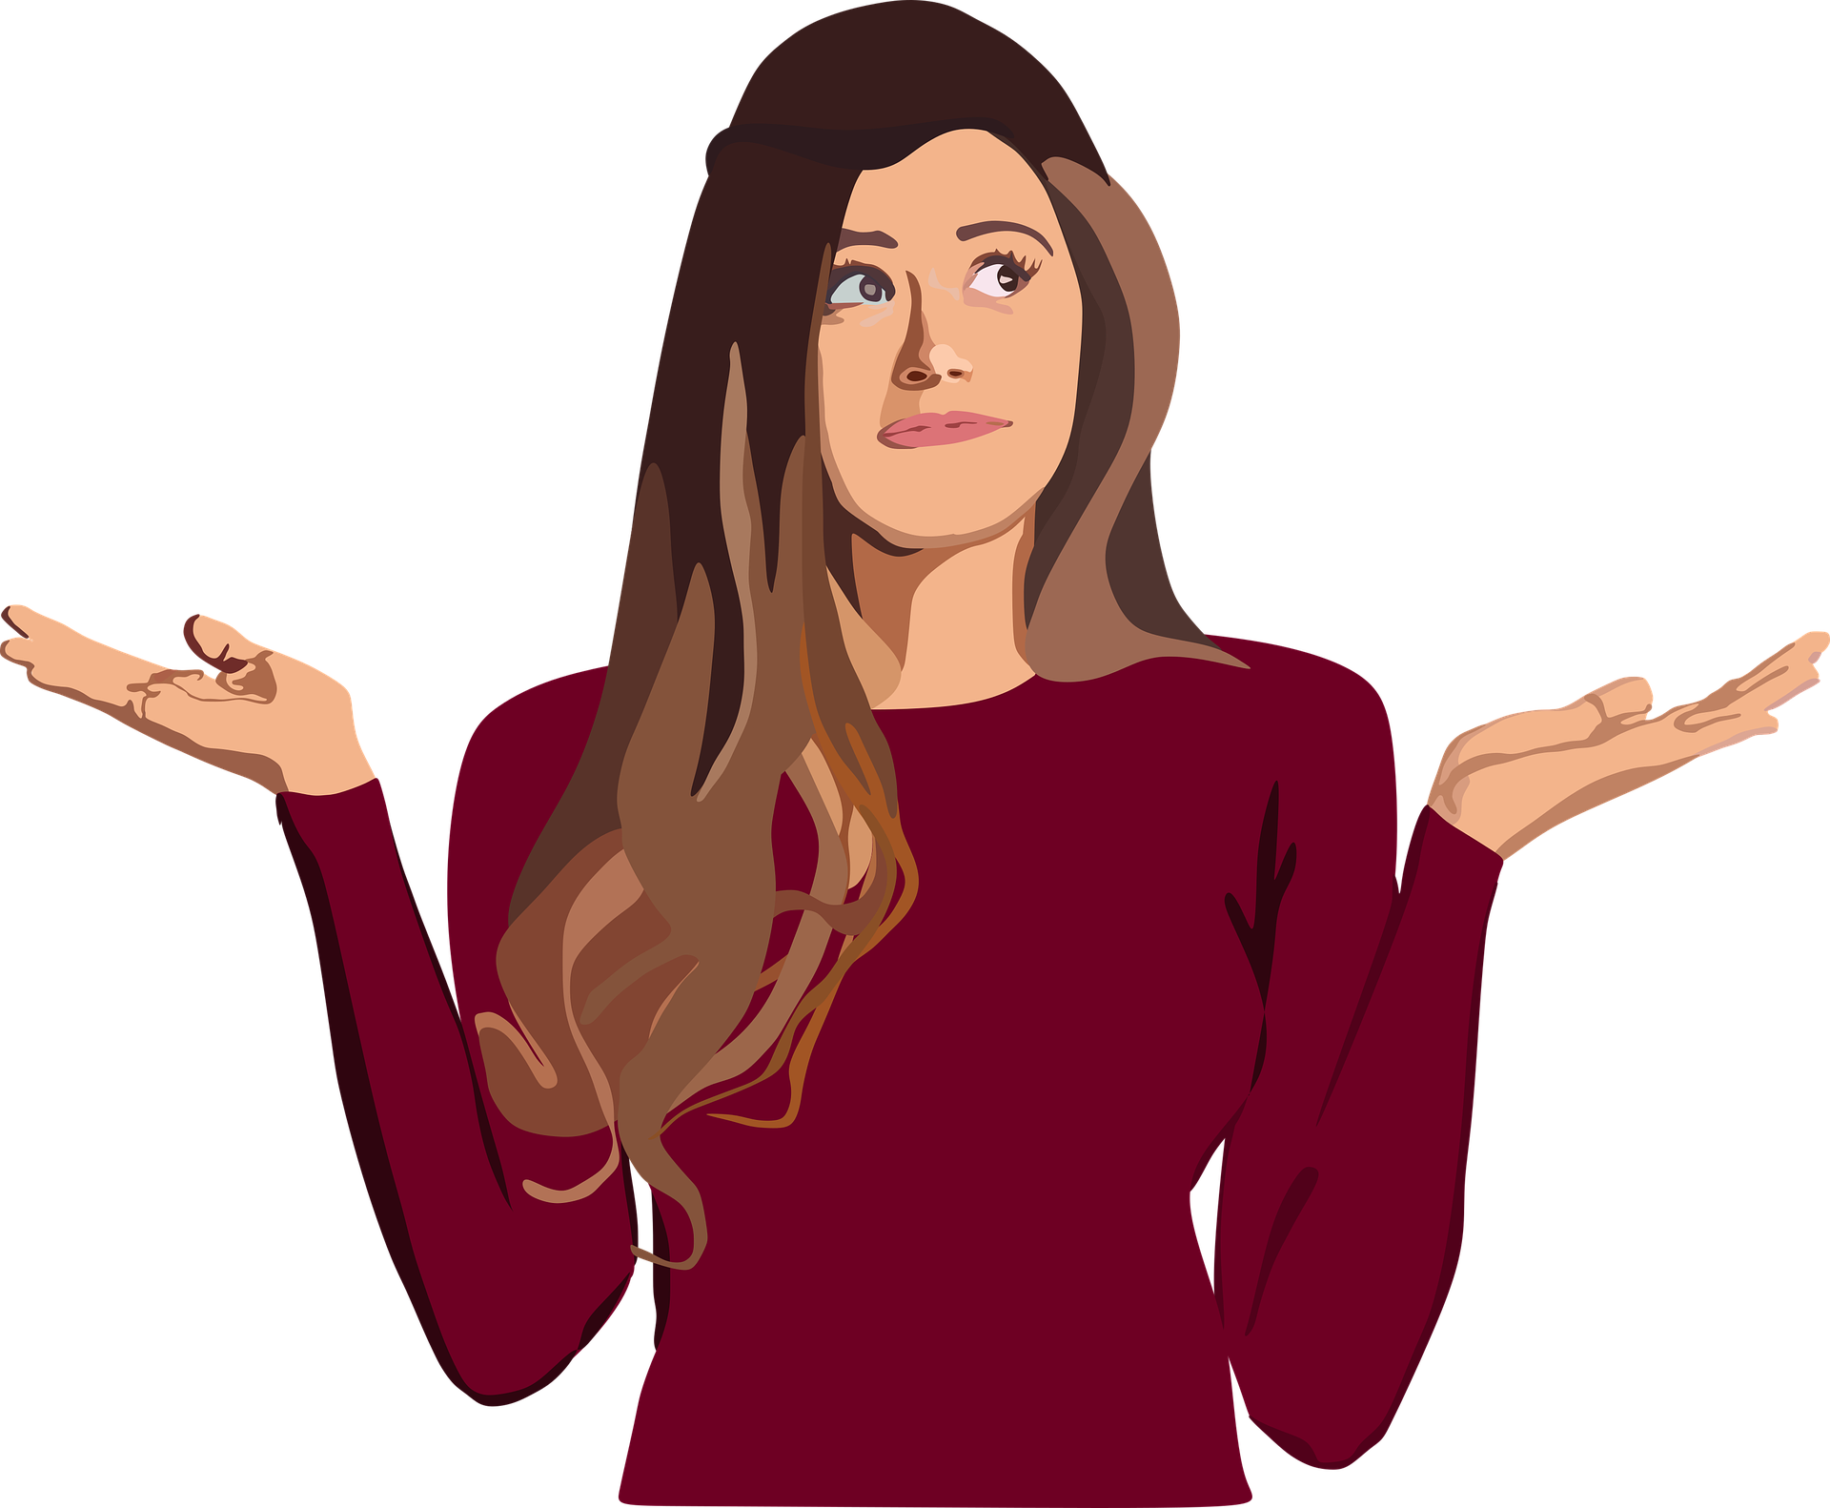
Qui est Sandrine ?
écouter
5
A
B
C
Notes:
Slide 5/6
Transcript:
Anne organise ses vêtements mieux que Sandrine.

Slide 35
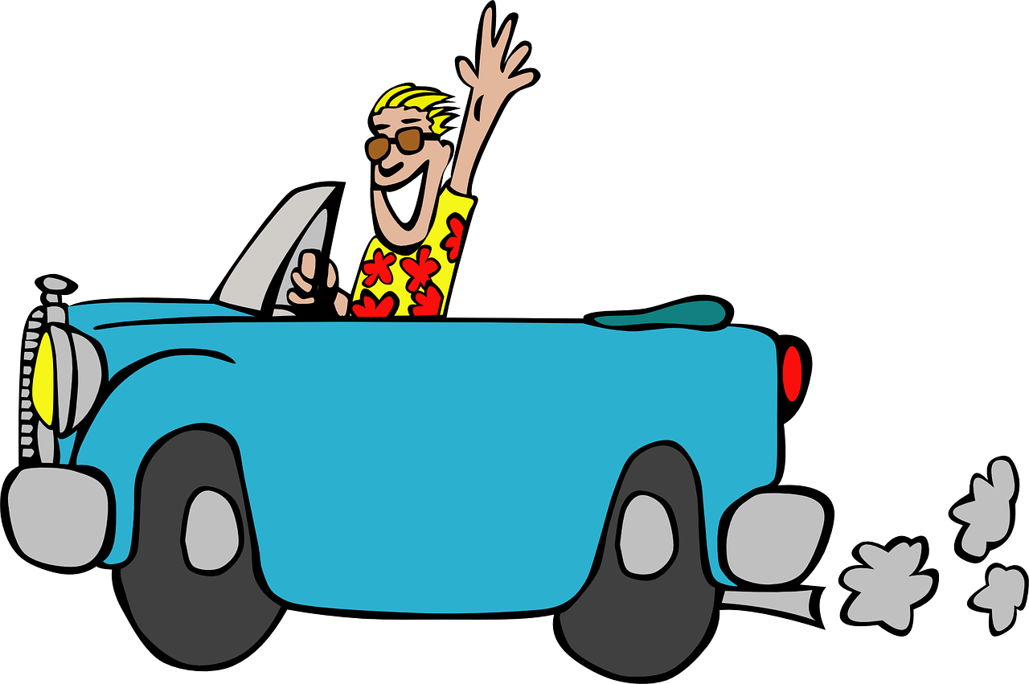
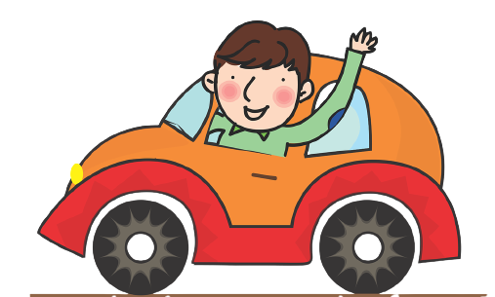
Qui est Alain ?
*il conduit = he drives
écouter
6
A
B
C
Notes:
Slide 6/6
Transcript:
Alain conduit* moins vite que Thomas.
Word frequency of unknown words used (1 is the most frequent word in French): conduire [487]
Source: Lonsdale, D., & Le Bras, Y. (2009). A Frequency Dictionary of French: Core vocabulary for learners London: Routledge.

Slide 36
Amandine et sa famille
lire
Amandine parle des membres de sa famille. Finis ses phrases. C’est A, B ou les deux?
 |  | A | B
1 | Est-ce qu’Abdel travaille plus vite … | qu’Amir | aujourd’hui
2 | Léa apprend bien … | ses leçons | que Sophie
3 | Amir écrit facilement ... | que Noura | en anglais
4 | Noura parle plus lentement ... | en français | qu’Amir
5 | Abdel joue souvent ... | qu’Amir | au foot
6 | Amir prend des décisions plus facilement ... | qu’Abdel | à l’école
7 | Noura lit souvent ... | à la maison | que Léa
8 | Abdel voyage plus souvent ... | que Léa | le week-end
Notes:
Timing: 5 minutes
Aim: Written comprehension in distinguishing between comparative and non-comparative adverbial statements.
Procedure:
1. Students read the first part of each sentence and then choose the possible endings – A, B or A+B, depending on whether a comparison is cued by ‘que’.
2. Click to reveal the answers. 3. Elicit the English meanings of the sentences.
Word frequency of cognates used (1 is the most frequent word in French): membre [390]
Source: Lonsdale, D., & Le Bras, Y. (2009). A Frequency Dictionary of French: Core vocabulary for learners London: Routledge.

Slide 37
Les comparaisons
écrire
Michelle
Lucie
Michelle lit plus vite que Lucie.
Notes:
Timing: 8 minutes (slide 1/8)
Aim: Written production of adverbs in sentences with comparative structures.
Procedure:
Students write a sentence to compare the two pictures on each slide. Tell students to begin their sentence with the person the arrow is pointing to.
If there is one, click for prompt in English.
Click to reveal suggested answers.
Word frequency of cognates used (1 is the most frequent word in French): comparaison [2244]
Source: Lonsdale, D., & Le Bras, Y. (2009). A Frequency Dictionary of French: Core vocabulary for learners London: Routledge.

Slide 38
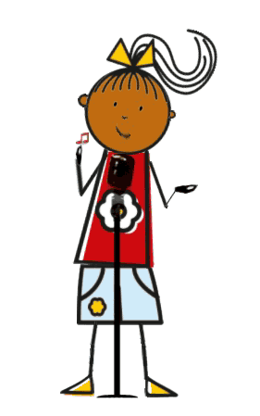
Les comparaisons
écrire
Françoise
Isabelle
Isabelle chante mieux que Françoise.
Notes:
Slide 2/8

Slide 39
Les comparaisons
écrire
Odile
Yvette
[studies]
Yvette étudie plus vite qu’Odile.
Notes:
Slide 3/8

Slide 40
Les comparaisons
écrire
Stéphanie
Charlotte
[sings, quickly]
Charlotte chante aussi vite que Stéphanie.
Notes:
Slide 4/8

Slide 41
Les comparaisons
*danser = to dance
écrire
Victoire
Ariane
[dances]
que -> qu’ before a vowel
Victoire danse plus vite qu’Ariane.
Notes:
Slide 5/8
Word frequency of cognates used (1 is the most frequent word in French): danser [2934]
Source: Lonsdale, D., & Le Bras, Y. (2009). A Frequency Dictionary of French: Core vocabulary for learners London: Routledge.

Slide 42
Les comparaisons
écrire
Babette
Justine
[walks]
Babette marche plus lentement que Justine.
Notes:
Slide 6/8

Slide 43
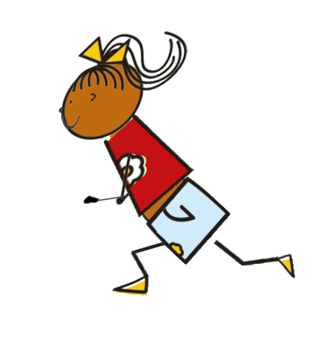
Les comparaisons
écrire
Adrienne
Sabine
[arrives]
Adrienne arrive plus lentement que Sabine.
Notes:
Slide 7/8

Slide 44
Les comparaisons
*trottiner = to jog
écrire
Christine
Géraldine
[jogs, slowly]
Christine trottine aussi lentement que Géraldine.
Notes:
Slide 8/8

Slide 45
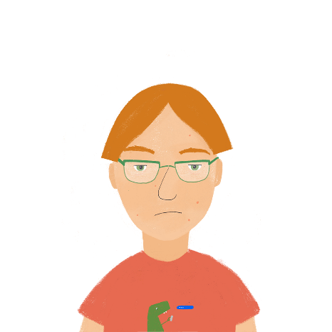
Comment sont-ils?
parler / écouter
Partnenaire A: Décris les personnes (et l’animal!) dans l’ordre. Sont-ils plus ou moins travailleurs ?
Partenaire B: Écoute les descriptions et écris les noms dans l’ordre !
Léa dort moins souvent qu’Antoine.
Abdel dort moins souvent que Léa.
Antoine dort plus souvent que Léa.
2. Abdel
1. Léa
3. Antoine
< sleeps less often----------------------sleeps more often>
Notes:
Timing: 7 minutes. This is slide 1/3.
Aim: Picture description task to practise oral production of comparative adverbial forms.
Procedure:
1. Use this slide (which presents a shortened version of the activity on the next two slides) to model the task. Explain to students that they are going to describe the order in which the characters lie on the scale to a partner using comparative adverbs. Their partner must write down the names in the appropriate order.
2. Starting with Léa (labelled 1), ask students to produce a sentence describing how the character relates to the others on the scale. There are several possible solutions here, e.g. Léa dort plus souvent qu’Abel and Léa dort moins souvent qu’Antoine.
3. Suggested sentences for each character appear on clicks.
4. Partner B turns away from the board. Partner A describes where everyone lies on the scale in the order, starting with the person labelled as number 1 (to stop them doing it linearly!).
5. Partner B tries to put the names in order by listening alone. When complete, s/he turns round to check.
6. Partners swap roles and do the same with the alternative version on the following slide.
Word frequency of near-cognates used in task instructions (1 is the most frequent word in French): décrire [1176], ordre [197], description [2779]
Source: Londsale, D., & Le Bras, Y. (2009). A Frequency Dictionary of French: Core vocabulary for learners London: Routledge.

Slide 46
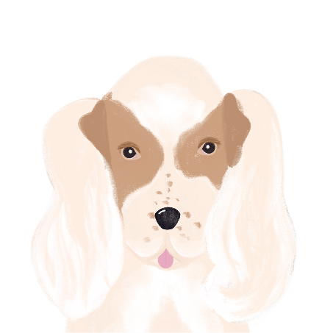
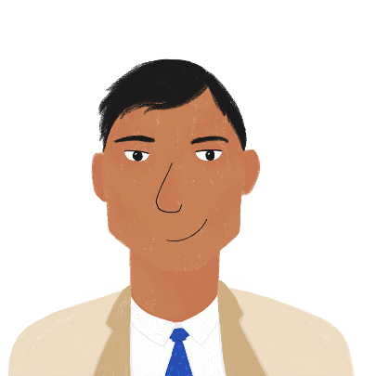
Comment sont-ils?
parler / écouter
Partnenaire A: Décris les personnes (et l’animal!) dans l’ordre. Sont-ils plus ou moins travailleurs ?
Partenaire B: Écoute les descriptions et écris les noms dans l’ordre !
4. Apollon
2. Antoine
3. Léa
1. Abel
5. Bilal
< works less hard----------------------------------------------- works harder>
Notes:
This is slide 2/3.
Do not display until Partner B has turned away from the board!

Slide 47
Comment sont-ils?
parler
Partnenaire B: Décris les personnes (l’animal!) dans l’ordre. Marchent-ils plus ou moins vite ?
Partenaire A: Écoute les descriptions et écris les noms dans l’ordre !
4. Léa
2. Antoine
3. Abdel
1. Apollon
5. Bilal
<walks more slowly-------------------------------------------- walks more quickly>
Notes:
This is slide 3/3.
This is Partner B’s version of the activity on the previous slide. Do not display until Partner A has turned away from the board!

Slide 48
Devoirs
Vocabulary Learning Homework (Revisit Y8, Term 3.1, Week 2)
Quizlet link: Y8 Term 3.1 Week 2
Quizlet QR code:
In addition, revisit: Y8 Term 2.2 Week 2
Y8 Term 1.2 Week 6
Notes:
The answer sheet for the Y8, Term 3.1, Week 2 vocabulary learning HW is here: https://resources.ncelp.org/concern/resources/2j62s565w?locale=en

