Slide 1
Es war einmal…
Present tense: 2nd person plural
[a] and [ä] revisited
Y9 German
Term 1.1 - Week 2 - Lesson 3
Inge Alferink/ Rachel Hawkes
Artwork: Steve Clarke
Date updated: 7/7/21
Notes:
Artwork by Steve Clarke. All additional pictures selected are available under a Creative Commons license, no attribution required.
Native-speaker teacher feedback provided by Stephanie Cross.
Learning outcomes (lesson 1):
Introduction of present tense weak verbs: 2nd person plural.
Introduction of seid and habt
Revisit verbs + R3 (dative) – i.e. verbs that take indirect objects Revisit SSC [a] and [ä]
Word frequency (1 is the most frequent word in German):
9.1.1.1 (introduce) ihr⁴ [27] dienen [684] erwarten [387] feiern [869] sammeln [1219] ihr seid [27/4] Ende [183] Dienst [1558] Feuer [1576] Gast [576] Holz [2221] woher [1494]
8.3.2.4 (revisit) fassen [1144] führen [162] scheinen [275] versprechen [1056] warten [364] mancher, manche, manches [433] Arm [527] Blatt [1270] König [1087] Sohn [596] Tochter [694] lieb [897] tot [513] warm [1281] wohl [261] gar [165]
8.3.1.1 (revisit) hängen [590] schützen [996] verdienen [835] Angriff [1489] Daten [574] Euro [207] Gesetz [578] Milliarde [453] Million [209] Unternehmen [236] Wand [828] an² [19] gegen [104] laut [835]
Source: Jones, R.L & Tschirner, E. (2019). A frequency dictionary of German: Core vocabulary for learners. London: Routledge.
The frequency rankings for words that occur in this PowerPoint which have been previously introduced in NCELP resources are given in the NCELP SOW and in the resources that first introduced and formally re-visited those words.
For any other words that occur incidentally in this PowerPoint, frequency rankings will be provided in the notes field wherever possible.

Slide 2
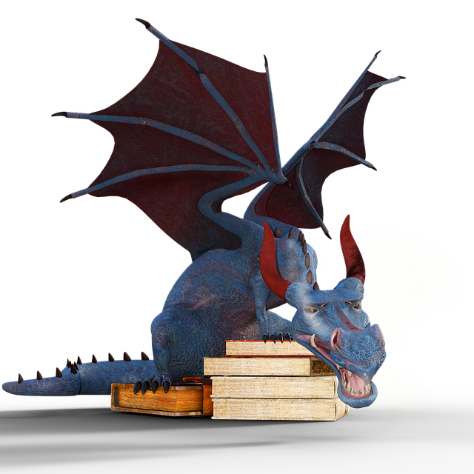
Vokabeln
lesen
das Holz
wohl
das Ende
feiern
warm
der Gast
dienen
ihr
ENDE
lieb
sammeln
erwarten
der Dienst
Der Drache* spuckt* Wörter aus. Schreib die Wörter auf Englisch.
woher
tot
das Feuer
*der Drache – dragon *spucken – to spit
Notes:
Timing: 5 minutes Aim: to practise written receptive recall of this week’s vocabulary set and some items from one of the revisiting sets. The smoke animations restrict the time and compel students to process the words for meaning more quickly. Procedure: 1. Click the mouse ONCE to start the animated sequence and let it run – wait for words to slowly disappear and the next one to appear.
2. Students write the English meanings of the German words before the word disappears. 3. The word ENDE signals the end of the task.
4. The answers are displayed on the next slide.
Word frequency (1 is the most frequent word in German): ihr4 [27] dienen [684] erwarten [387] feiern [869] sammeln [1219] Ende [183] Dienst [1558] Feuer [1576] Gast [576] Holz [2221] woher [1494] lieb [897] tot [513] warm [1281] wohl [261]
Source: Jones, R.L. & Tschirner, E. (2019). A frequency dictionary of German: core vocabulary for learners. Routledge

Slide 3
Vokabeln
das Ende
wohl
das Holz
lesen
end
well
wood
dienen
der Gast
ihr
feiern
to serve, serving
you (pl. fam.), (to) her, their
guest
to celebrate, celebrating
sammeln
lieb
der Dienst
warm
to collect, collecting
dear, kind
warm
service, duty
woher
erwarten
tot
das Feuer
to expect, expecting
where…from
fire
dead
Notes:
ANSWERS Note: this slide has not been animated to facilitate a quick visual check of the answers. If desired, teachers could add animations to facilitate an oral elicitation of the German meanings from students.

Slide 4
Phonetik
Hör zu. Ist der Buchstabe [a] oder [ä]? Schreibe die Wörter. Wie heißen sie auf Englisch?
hören / schreiben
 | [a] | [ä] | Deutsch | Englisch
 |  |  | Blätter | leaves
 |  |  | Arme | arms
 |  |  | Angriffe | attacks
 |  |  | Gäste | guests
 |  |  | Pläne | plans
 |  |  | Äpfel | apples
 |  |  | Wälder | forests
 |  |  | Fälle | cases
1
2
3
4
5
6
7
8
Notes:
Timing: 7 minutes Aim: to distinguish between [a] and [ä] in the aural modality. Transcribe unknown plurals. Procedure: 1. Click audio button 1. Students listen and indicate whether they hear [a] or [ä].
2. Click for tick to appear in correct column.
3. Click audio again and students transcribe the word they hear. Hopefully when looking at what they have written, students will recognise the plurals of previously taught singular nouns.
4. Click to reveal answer – German transcription.
5. Students then write the English meaning.
6. Click to reveal answer – an image will appear at the same time.
7. Repeat for 2 – 4. For 5 – 8, depending on level of the class, possibly only play the audio once, students tick [a] / [ä] and transcribe at the same time.
8. When all times 1 – 8 have been ‘done’, students read the words aloud with a partner.
Word frequency (1 is the most frequent word in German):
Apfel [3491] Fall [188] Plan [955] Source: Jones, R.L. & Tschirner, E. (2019). A frequency dictionary of German: core vocabulary for learners. Routledge

Slide 5
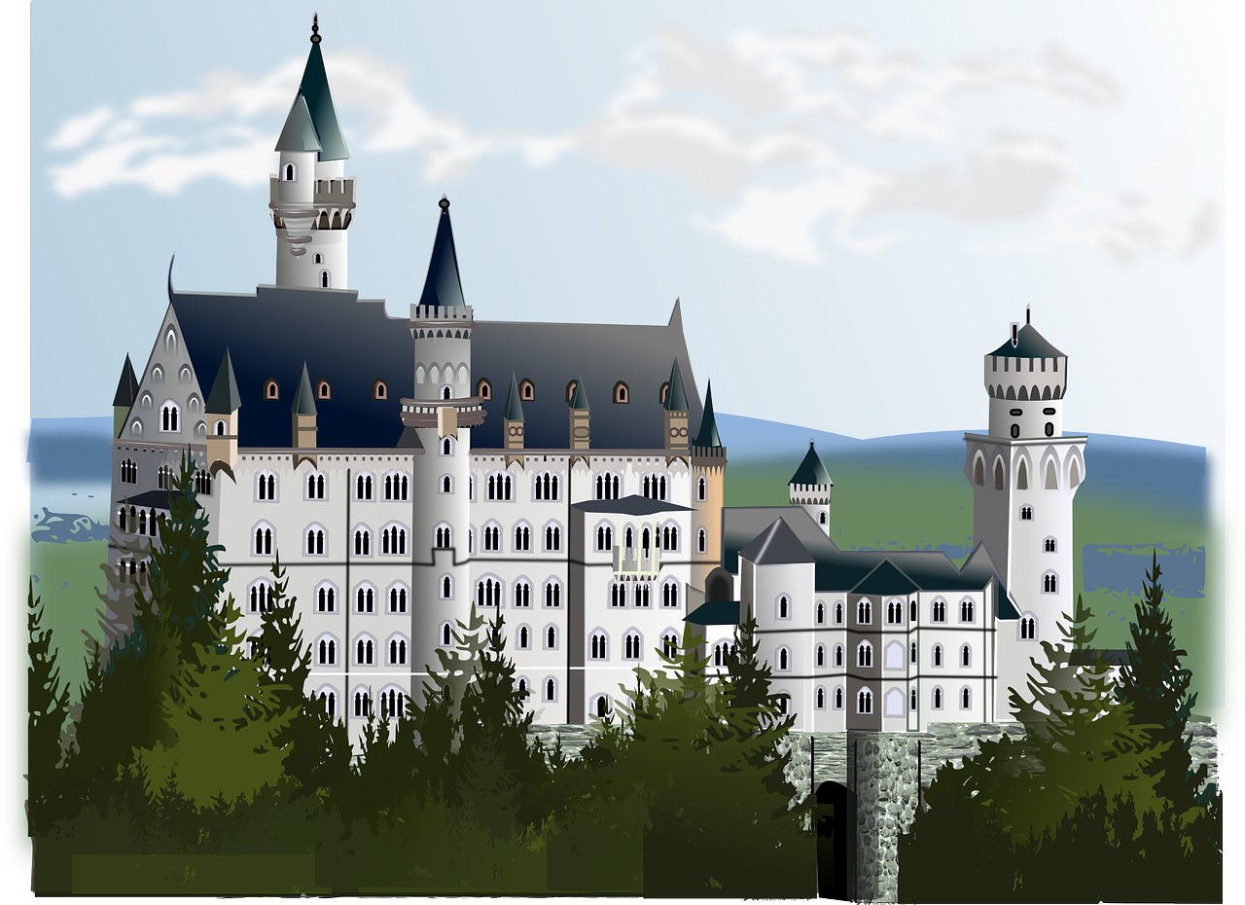
Es war einmal…
hören / schreiben
Hör zu und schreib die Geschichte.
König Konrad der Erste lebt in einem großen Schloss mit seinen drei Töchtern und seinen zwei Söhnen.
1
2
Leider ist das Schloss sehr alt und die Familie hat kein Geld mehr.
3
Laut Frau Müller, der Putzfrau, sind ihre Millionen weg.
4
Jetzt erwarten sie aber einen besonderen Gast.
Sie bereiten das Schloss vor. Der König will feiern und Geld vom unbekannten Gast erhalten.
5
weg – gone, vanished
Notes:
Timing: 10 minutes Aim: to practise comprehension and production of language and structures in a longer context.
Procedure: 1. Elicit the meaning of the title ‘Es war einmal’ – students have previously learnt these words and should be able to translate literally – it was once – then suggest that this is how a fairy tale would typically start in German and elicit ‘once upon a time’ as the idiomatic translation for this phrase. 2. Click on the ear to play the audio for the whole text or click on the numbers to hear the text broken up into smaller pieces.
3. Make notes and rewrite the story as accurately as possible.
4. Click to reveal the text and check the writing.
Transcript: König Konrad der Erste lebt in einem großen Schloss mit seinen drei Töchtern und seinen zwei Söhnen. Leider ist das Schloss sehr alt und die Familie hat kein Geld mehr. Laut Frau Müller, der Putzfrau, sind ihre Millionen weg. Jetzt erwarten sie aber einen besonderen Gast. Sie bereiten das Schloss vor. Der König will feiern und Geld vom unbekannten Gast erhalten.
Word frequency (1 is the most frequent word in German): weg [965] Source: Jones, R.L. & Tschirner, E. (2019). A frequency dictionary of German: core vocabulary for learners. Routledge

Slide 6
Present tense – 2nd person plural ihr
Wer ist dieser Gast?!!!
Grammatik
As you know, regular verbs have endings which match the subject.
Ich verdiene eine Milliarde Euro.
I earn a billion euros.
___
Du führst mein Unternehmen.
You lead/are leading my company.
___
Sie schützt meine Daten.
She protects/is protecting my data.
___
Wir erwarten einen Angriff gegen mich.
___
We expect/are expecting an attack against me.
To mean you (plural, familiar) use ihr and verb ending –t:
Ihr hängt die Bilder an die Wand.
You (all) hang/are hanging the pictures on the wall.
_
Ihr sammelt Holz für das Feuer.
You (all) collect/are collecting wood for the fire.
_
Ihr wartet, aber er kommt nicht!
You (all) wait/are waiting but he isn't coming!
_
Notes:
Timing: 3 minutes Aim: to introduce the ihr form ending of the present tense. In addition, relating to the story opening on the previous slide, to build anticipation about the awaited mystery guest! Procedure: 1. Click through the animations to present the information on the slide.
2. Elicit meanings from students, where appropriate.

Slide 7
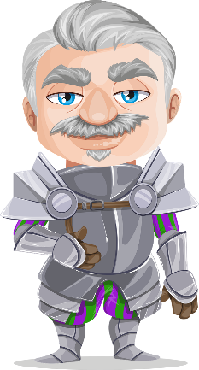
Sie bereiten das Schloss vor
hören
König Konrad der Erste hat eine Aufgabenliste. Wer macht was? Du oder ihr?
der Apfel – apple
 |  | du | ihr | Aufgabe auf Englisch
 | Du kaufst Obst und Gemüse auf dem Markt. |  |  | buy fruit and veg at the market
 | Ihr holt Fleisch vom Nachbarn. |  |  | fetch meat from the neighbour
 | Ihr sammelt Holz für das Feuer. |  |  | collect wood for the fire
 | Du bereitest das Gästezimmer vor. |  |  | prepare the guest room
 | Ihr kocht das Abendessen. |  |  | cook dinner
 | Du holst Wasser. |  |  | fetch water
 | Ihr führt die Tiere auf das Feld. |  |  | lead the animals to the field
 | Du kletterst auf den großen Apfelbaum. |  |  | climb the big apple tree
1
2
3
4
5
6
7
8
Notes:
Timing: 8 minutes Aim: to practise attending to the verb endings for 2nd person plural (Ihr) in contrast with 2nd person singular (du). Procedure: 1. Click on the mouse to play the audio.
2. For each sentence, students write du or ihr, depending on the verb ending –st or –t. 3. Students listen again and write the chore in English.
3. Click to reveal and check answers.
Transcript: 1. [Du] kaufst Obst und Gemüse auf dem Markt.
2. [Ihr] holt Fleisch vom Nachbarn.
3. [Ihr] sammelt Holz für das Feuer.
4. [Du] bereitest das Gästezimmer vor.
5. [Ihr] kocht das Abendessen.
6. [Du] holst Wasser.
7. [Ihr] führt die Tiere auf das Feld.
8. [Du] kletterst auf den großen Apfelbaum. Word frequency (1 is the most frequent word in German): Apfel [3490] Source: Jones, R.L. & Tschirner, E. (2019). A frequency dictionary of German: core vocabulary for learners. Routledge

Slide 8
Verbs with indirect objects – R3 (Dative)
Grammatik
Use R2 (accusative) after most verbs for the object of the sentence:
Row 2 (acc.) words for the are: den (m.), die (f.), das (nt), die (pl.)
SUBJECT
VERB
OBJECT
Wir
fragen
den Gast.
We ask / are asking the guest.
You also know that certain verbs use indirect object pronouns instead:
Ihr
antwortet
dem Gast.
You (all) answer / are answering the guest.
Row 3 (dat.) words for the are: dem (m.), der (f.), dem (nt), den (pl.)
The verb fragen is always followed by Row 2 (accusative – or direct object); antworten is always followed by Row 3 (dative – or indirect object).
As you have seen, verbs with indirect objects often have the meaning of giving something to someone: e.g. thanks, help, an answer, congratulations, a service.
Notes:
Timing: 2 minutes Aim: to recap the knowledge that some verbs take dative objects. Procedure: 1. Click through the animations to present the information on the slide.
2. Elicit meanings from students, where appropriate.

Slide 9
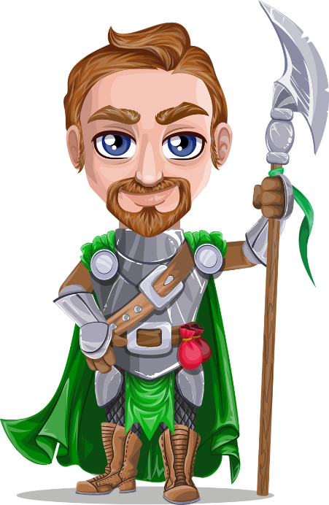
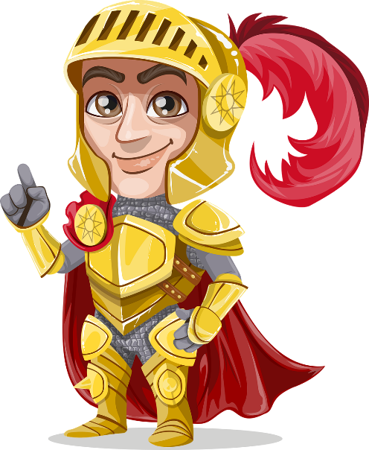
R2 oder R3 Verben
Grammatik
Ist das Verb R2 oder R3?
R3 Verben
R2 Verben
antworten
fragen
Ihr antwortet dem Freund!
Wir erwarten die Sängerin!
Du suchst den Drachen!
Ich frage den Papa!
danken
Ich helfe der Lehrerin!
Ihr dient dem König!
Wir gratulieren dem Zauberer*!
Wir danken der Frau!
Wir holen den Gast!
Ihr schützt das Schloss!
erwarten
dienen
suchen
helfen
schützen
gratulieren
holen
gratulieren
schützen
antworten
erwarten
fragen
holen
suchen
danken
dienen
helfen
der Zauberer – wizard
Notes:
Timing: 2 minutes Aim: to recap knowledge of 10 verbs in terms of the grammatical case they take. This prepares students for the reading task that follows. Procedure: 1. Click for verb to appear. 2. Click for verb in sentence context that indicates the case by the article that follows. 3. Students use the sentence to help them categorise the verb. Teacher can elicit ‘R2’ or ‘R3’ from students, chorally. 4. Click again for the sentence to disappear and the verb to appear in the correct column. 5. Continue until all 10 verbs have been correctly categorised. Note: This could be framed as a girls against boys competition, with the King’s daughters (Töchter) on the left and the (Söhne) on the right. Alternatively, just the class in two halves, left and right, works well.
Word frequency (1 is the most frequent word in German): Zauberer [>5009] gratulieren [>5009] Source: Jones, R.L. & Tschirner, E. (2019). A frequency dictionary of German: core vocabulary for learners. Routledge

Slide 10
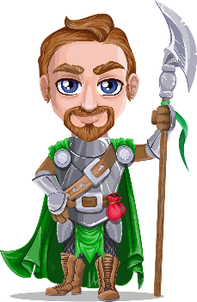
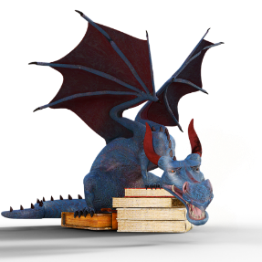
Wer macht was? Wir oder ihr?
lesen
Schreibe wir oder ihr und das richtige Verb. Ist das Objekt direkt oder indirekt?
5
1
Wir gratulieren / fragen den Sohn.
Wir danken / suchen den König.
2
6
Ihr holt / helft dem Drachen.
Ihr dankt / erwartet den Gast.
7
3
Ihr ruft / dient dem König.
Ihr ruft / antwortet den Sohn.
8
Wir schützen / dienen das Gesetz.
4
Wir fragen / helfen der Tochter.
Notes:
Timing: 7 minutes Aim: to practise attending to the verb endings for 2nd person plural (Ihr) in contrast with 1st person plural (wir). In addition, to differentiate between R2 and R3 verbs.
Scenario: The servants argue about the tasks and write each other notes. Unfortunately, some of them got burned by their pet dragon.
Procedure: 1. Students read the messages. They decide whether it is wir or ihr, and which verb it is. 2. Teacher to ensure that students know that the only way they can choose the correct verb is to look at the article of the noun object and recognise it as R2 (acc.) or R3 (dat.) 3. They note the sentence meaning in English.
4. Click to reveal and check pronoun answers and elicit the English meanings orally.
English translations: 1. We are looking for the king. 2. You (all) are helping the dragon. 3. You (all) are calling the son. 4. We are helping the daughter. 5. We are asking the son. 6. You (all) are expecting the guest. 7. You (all) are serving the king. 8. We are protecting the law. Word frequency (1 is the most frequent word in German): gratulieren [>5009] Source: Jones, R.L. & Tschirner, E. (2019). A frequency dictionary of German: core vocabulary for learners. Routledge

Slide 11
Habt und seid
Grammatik
As you know, the verb sein (to be) is irregular:
Haben also has two irregular forms (du and er/sie/es):
sein
ich bin
du bist
er/sie/es ist
wir sind
ihr seid
Sie sind
sie sind
haben
ich habe
du hast
er/sie/es hat
wir haben
ihr habt
Sie haben
sie haben
___ _____
___ _____
___ ______
___ ______
___/___/__ ______
___/___/__ ______
___ _______
___ _______
___ _______
you (all) are
___ _______
you (all) have
___ _______
___ _______
___ _______
___ _______
Notes:
Timing: 1 minute Aim: to recap the verbs forms of sein and haben in the present tense and present ihr seid and ihr habt. Note: Students also revisited sein forms last week. Procedure: 1. Click to present the information.
2. Elicit the previously taught forms of sein in the present tense, and their meanings and present ihr seid. 3. Elicit the previously taught forms of haben in the present tense, and their meanings and present ihr habt.

Slide 12
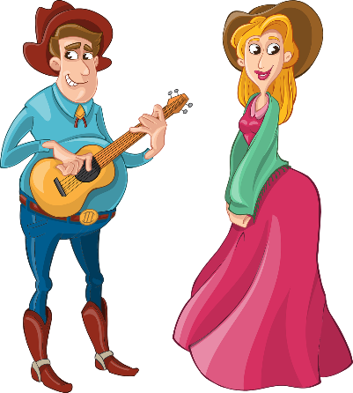
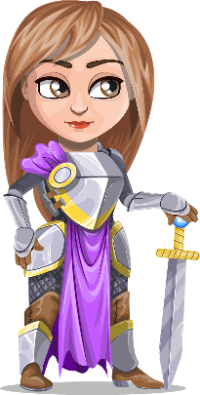
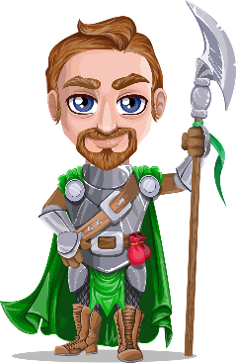
Seid ihr fertig*!?!
König Konrad stellt Fragen. Was machen seine Töchter, seine Söhne und seine Diener*?
hören
seid/ habt | auf Englisch
seid | Are you finished already?
habt | Do you have enough wood for the fire?
seid | You are very kind.
habt | You already have the meat.
habt | Where do you have these leaves from?
habt | Do you have tired arms?
seid | Are you ill or something?
seid | Are you not on duty today?
fertig – ready, finished
1
2
3
4
5
6
7
der Diener – servant
8
Notes:
Timing: 5 minutes Aim: to practise aural comprehension of seid and habt and this week’s vocabulary in context. The King is keen to know how preparations for receiving the guest are going.
Procedure: 1. Click on the numbers to hear each question. The verb is missing. 2. Students write seid or habt and the question meaning.
2. Click to reveal and check answers.
Transcript: 1. Also, wie geht‘s? Ihr scheint müde. [Seid] ihr schon fertig?
2. [Habt] ihr genug Holz für das Feuer? 3. Danke. Ihr [seid] sehr lieb. Ok… 4. Ihr [habt] schon das Fleisch, nicht wahr? 5. Woher [habt] ihr diese Blätter? 6. [Habt] ihr müde Arme? 7. [Seid] ihr krank oder was? 8. [Seid] ihr heute nicht im Dienst?!
Word frequency (1 is the most frequent word in German): fertig [717 (2011 list)] Diener [4476] Source: Jones, R.L. & Tschirner, E. (2019). A frequency dictionary of German: core vocabulary for learners. Routledge

Slide 13
Es war einmal
Verbs with direct and indirect objects
[o] and [ö] revisited
Y9 German
Term 1.1 - Week 2 - Lesson 4
Inge Alferink / Heike Krüsemann / Rachel Hawkes
Artwork: Steve Clarke
Date updated: 7/7/21
Notes:
Artwork by Steve Clarke. All additional pictures selected are available under a Creative Commons license, no attribution required.
Native teacher feedback provided by Stephanie Cross.
Learning outcomes (lesson 2):
Revisiting du / Sie
Revisiting verbs with direct and indirect objects Revisit SSC [o] and [ö]
Word frequency (1 is the most frequent word in German):
9.1.1.1 (introduce) ihr⁴ [27] dienen [684] erwarten [387] feiern [869] sammeln [1219] ihr seid [27/4] Ende [183] Dienst [1558] Feuer [1576] Gast [576] Holz [2221] woher [1494]
8.3.2.4 (revisit) fassen [1144] führen [162] scheinen [275] versprechen [1056] warten [364] mancher, manche, manches [433] Arm [527] Blatt [1270] König [1087] Sohn [596] Tochter [694] lieb [897] tot [513] warm [1281] wohl [261] gar [165]
8.3.1.1 (revisit) hängen [590] schützen [996] verdienen [835] Angriff [1489] Daten [574] Euro [207] Gesetz [578] Milliarde [453] Million [209] Unternehmen [236] Wand [828] an² [19] gegen [104] laut [835]

Slide 14
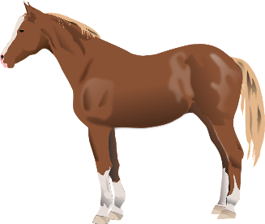
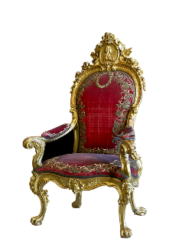
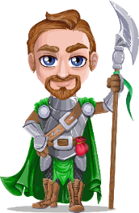
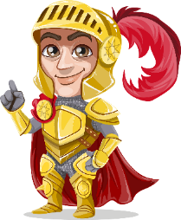
Phonetik
Hör zu. Schreibe [o] oder [ö].
hören / schreiben
2
H ö lzer
3
1
_
R ö sser
_
Fr ö sche
_
4
5
6
H o nig
_
Thr o n
_
K ö nige
_
8
10
7
9
Kr o nen
R o be
S ö hne
_
T ö chter
_
_
_
Notes:
Timing: 7 minutes Aim: to differentiate aurally between [o] and [ö] in unknown words and to encounter the plural forms of four words which appear on this week’s list in the singular form. Procedure: 1. Click to hear the audio for each item.
2. Students write the whole word with the missing SSC.
3. Click to reveal the missing SSC. 4. Elicit the pronunciation from students. Note: to increase the challenge teachers could remove the written prompts and students could write the whole words independently.
Transcript: 1. Frösche 2. Hölzer 3. Rösser 4. Honig 5. Könige 6. Thron 7. Robe 8. Söhne 9. Kronen 10. Töchter Word frequency of unknown words (1 is the most frequent word in German): Frosch [4962] Honig [>5009] Ross [>5009] Robe [>5009] Krone [3743] Thron [>5009] Source: Jones, R.L. & Tschirner, E. (2019). A frequency dictionary of German: core vocabulary for learners. Routledge

Slide 15
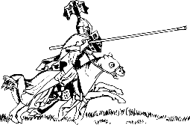
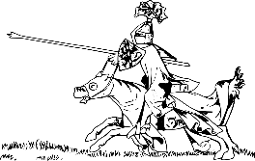
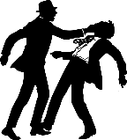
Phonetik
hören / schreiben
Person A liest die Wörter, Person B schreibt auf. Dann tauscht die Rollen.
6 Wörter – Person A liest:
6 Wörter – Person B liest:
1. Lanzen
1. Töpfe
2. Throne
2. Kronen
3. Rösser
3. Waffen
4. Kämpfe
4. Stäbe
5. Gewänder
5. Wassergräben
6. Schlösser
6. Köpfe
Notes:
Timing: 5 minutes Aim: to read aloud to practise spoken production of a, ä, o, ö. Procedure: 1. Partner B turns away from the board.
2. Click to make the words and images appear for Person A to read out. Person B writes down what Person A says.
3. When all 6 words have been read and transcribed, Person B turns back to the board, and together with Person A, checks their spelling.
4. Students work out meaning of the words using the images as clues – they may need help with this.
5. Swap roles and follow procedure 1 – 5 for the second set of six words.
Word frequency of unknown words (1 is the most frequent word in German): Lanze [>5009] Thron [>5009] [4962] Ross [>5009] Kampf [867] Gewand [>5009] Topf [4136] Krone [3743] Waffe [1625] Stab [>5009] Wassergraben [>5009]

Slide 16
Vokabeln: Beispiel
lesen
Ein deutsches Wort im Kreis A ist auch im Kreis B (auf Englisch). Welches Wort? Sag das Wort, wenn du es findest!
A
B
warm
daughter
der Beruf
room
neighbour
der Arm
führen
modern
die Sachen
music
traditionell
lady
wohin
voice, vote
der Nachbar
well
Notes:
Timing: 6 minutes (two slides) Aim: to practise written comprehension of new and revisited vocabulary. The time element facilitates automisation and fluency.
Procedure: 1. The circle on the left has eight German words. One of the words has a translation in the English circle on the left. Students try to find the word as quickly as possible. And shout out the word when they have found it.
2. When the correct word is found click the mouse to change the English words to the next set.
3. The German words change after every four rounds. This change is signalled with a colour change on both circles.
4. Play until all cards have been done.
There are a number of ways to do this game:
Whole class (live – In person): First one to spot and shout out the correct answer gets a point
Whole class (synchronous online): First one to spot and type the word in the chat gets a point
Individual (asynchronous online): Use the timed version (English circle changes after 8 seconds). Can they spot the word before it changes?
Pairs (live – In person): Same as live whole class, but in pairs. Would need a tablet for each pair.

Slide 17
Vokabeln
Lesen / Sprechen
to protect,
protecting
to celebrate,
celebrating
end
fire
against
wall (inside)
billion
warten
guest
der Traum
to protect
to expect
ihr
wood
scheinen
service, duty
das Gesetz
dienen
relatively
thousand
on, at
wall (inside)
to expect
euro
wall (inside)
guest
to grasp, grab
to lead
erwarten
billion
according to
enterprise, company
wood
to hang, be hanging
euro
to promise, promising
training
tausend
enterprise, company
relativ
verdienen
relatively
hängen
der Angriff
to lead
to protect
gegen
euro
you, her, to her, their
euro
to wait
to protect
service, duty
feiern
according to
die Milliarde
dream
die Ausbildung
to collect, collecting
on, at
to expect, expecting
der Euro
to expect, expecting
das Ende
to wait, waiting
guest
to collect
dream
to wait, waiting
to protect
you, her, to her, their
to promise
wall (inside)
attack
wood
per
thousand
according to
to serve, serving
you, her, to her, their
enterprise, company
billion
free time
dream
fassen
to hang, be hanging
sammeln
wenn
to expect
to serve, serving
woher
to expect
das Unternehmen
verdienen
you, her, to her, their
euro
you, her, to her, their
to celebrate
well
data
against
to grab, grasp
wall (inside)
die Daten
against
to hang,
be hanging
führen
training
das Gesetz
wall (inside)
law
law
schützen
wood
to appear, seem
where …from
to celebrate, celebrating
to celebrate, celebrating
to earn
attack
career
against
law
service, duty
million
million
guest
euro
if, when
to serve, serving
fire
you, her, to her, their
to protect
das Unternehmen
where…from
law
to lead
on, at
verdienen
die Karriere
service, duty
to celebrate, celebrating
euro
to lead
to promise, promising
to serve , serving
to appear, seem
fire
law
der Angriff
attack
million
relatively
if, when
according to
you, her, to her, their
der Gast
relatively
end
to expect, expecting
to earn
free time
to hang, be hanging
against
data
to earn
to celebrate, celebrating
free time
führen
if, when
to serve, serving
training
where … from
data
to collecting,
collecting
das Holz
wall (inside)
to promise, promising
der Euro
wood
die Million
an
end
on, at
die Milliarde
das Feuer
law
million
der Angriff
you, her, to her, their
to appear, seem
million
guest
to expect, expecting
career
guest
to grab, grasp
free time
to hang, be hanging
to collect, collecting
fassen
relatively
to promise, promising
according to
to collect, collecting
to earn
to protect
fire
euro
enterprise, company
service, duty
dream
to grab, grasp
free time
career
die Wand
thousand
end
to appear, seem
to serve
if, when
to grasp, grab
die Million
data
woher
to protect
to wait, waiting
relativ
to appear, seem
to grab, grasp
versprechen
euro
der Dienst
to protect
free time
free time
if, when
law
training
wood

Slide 18
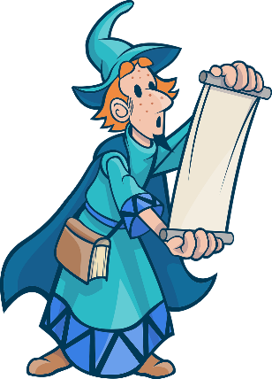
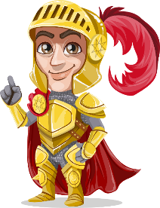
Pronomen – so many ‘yous’!
Grammatik
You have already met three words for you in German: du (sing.), Sie (formal), and man(one/people). Now add ihr (plural) to your list:
Du sammelst Gemüse aus dem Garten, Georg!
___
Sie warten bitte ein paar Stunden, Herr König!
___
du
Sie
Du erwartest zu viel, Papa.
___
du
ihr
Ihr habt vielleicht Recht. Mmm...
___
Man is always singular. Use it with the same verb form as er, sie, es.
Gut! Man ist jetzt optimistisch!
___
Man
Notes:
Timing: 2 minutes Aim: to recap the three forms of ‘you’ that students have been taught (du, Sie and man), and to introduce ihr.
Procedure: 1. Click to bring up bubble explaining the four ways of saying you.
2. Click again to bring up reminder bubble further explaining ‘man’.
3. Elicit an oral explanation from students about when to use ‘du’ (you, singular, informal – someone you know) and ‘Sie’ (you, singular/plural, formal – someone older that you don’t know (well), and man (generally speaking. ‘one’/’people’. Use what’s on the slide to elicit/explain the different ways of using you and why: King to servant – du, servant to King – Sie, King’s children to King – du, King to children – ihr, man – ‘one’/’people/ – to no one in particular.
4. Click to bring up speech bubble of King to servant. Elicit verb form.
5. Click to bring up verb.
6. Repeat for rest of slide.
Word frequency (1 is the most frequent word in German):
optimistisch [4686] Source: Jones, R.L. & Tschirner, E. (2019). A frequency dictionary of German: core vocabulary for learners. Routledge

Slide 19
Wir wollen
König Konrad ist nicht glücklich. Der Diener* ist auch unglücklich. Beide Seiten schreiben, was sie wollen. Wer schreibt was? König Konrad oder der Diener.
lesen
Sie…
Du…
__
1. Du machst das Schloss warm.
__
5. Sie hängen jeden Morgen eine Aufgabenliste an die Wand.
__
2. Du dienst dem König und seiner Familie.
__
6. Du bereitest das Gästezimmer vor.
__
3. Sie versprechen jede Woche einen freien Tag.
Du hast jeden Tag zwölf Stunden Dienst.
__
__
4. Sie informieren uns besser.
8. Sie erwarten ein bisschen weniger.
__
der Diener – servant
darauf – on it/ to it/ for it
Notes:
Timing: 8 minutes (two slides)
Aim: to practise written comprehension of the contrast between du and sie.
The king and the servant have both written their demands. Whose list does each demand go on?
Procedure: 1. Learners use the verb ending only to identify whether the speaker is the servant (using Sie) or the King (using du). They write du or sie for 1 – 8.
2. Click to reveal answers one by one. 3. Students then complete a table in English listing the four demands of the King and those of the servant. Note: Students could complete the table in English without the additional step of first checking the pronouns, if appropriate.
Word frequency (1 is the most frequent word in German):
darauf [195] Diener [4476] Source: Jones, R.L. & Tschirner, E. (2019). A frequency dictionary of German: core vocabulary for learners. Routledge

Slide 20
Antworten
Du…
Sie…
lesen
You make the castle warm. | You promise one free day each week.
You serve the King and his family. | You inform us better/keep us better informed.
You prepare the guest rooms. | You hang a task list on the wall every morning .
You are on duty for 12 hours every day. | You expect a bit less.
der Diener – servant
darauf – on it/ to it/ for it
Notes:
ANSWERS

Slide 21
Order of objects in a sentence
Grammatik
You know the usual word order in sentences with one object :
DIRECT OBJECT
SUBJECT
VERB
Ihr
gebt
das Geld.
You (all) give the money.
INDIRECT OBJECT
If it helps, think: We give help to the man.
SUBJECT
VERB
Wir
helfen
dem Mann.
We help the man.
With two object nouns together, the indirect object always comes first.
INDIRECT OBJECT
DIRECT OBJECT
Compare: 1. We give the man the money. 2. We give the money to the man.
SUBJECT
VERB
Ihr
gebt
dem Mann
das Geld.
You (all) give (to) the man the money.
Notes:
Timing: 2 minutes Aim: to introduce the order of two object nouns in a sentence, indirect before direct object. Procedure: 1. Click through the animations and present the information.
2. Elicit the English translations, where appropriate.

Slide 22
Wir wollen...
Ich habe eine laaaaange Liste!
hören
Wer sagt es?
Diener oder Königstochter? Wer bekommt was vom König?
Hier muss ich etwas sagen!
der Diener – servant die Köchin – cook (f.)
 | Diener | Königstochter | Wer bekommt das?
 |  |  | Diener | Köchin
 |  |  | Sohn | Tochter
 |  |  | Putzfrau | Sohn
 |  |  | Kindern | Familie
 |  |  | Köchin | Arbeitern
 |  |  | Diener | Tochter
 |  |  | Familie | Diener
 |  |  | Königin | Krankenhaus
1
2
3
4
5
6
7
8
Notes:
Timing: 8 minutes
One of the king’s daughters gets involved in helping the servants. She and one of the servants list the demands. The daughter is family and will use du while the servant will use Sie. Aim: to practise aural comprehension of the contrast between du and Sie; to practise aural connection of the R3 (dat.) article with the corresponding noun.
Procedure: 1. Click to hear the audio. 2. Students first listen for the verb and pronoun to identify who is speaking. Note: the pronoun is not removed here as this has been the focus for previous practice. 3. Students listen again, as required, to identify who, from the two options provided, is the recipient of the action mentioned. They will need to listen out for the R3 (dat.) article and match it to the corresponding noun. 4. It may be helpful to do item-by-item feedback for the first few questions. Click to reveal the answers and ensure understanding.
Transcript: 1. Du kaufst dem [Diener] eine Uniform. 2. Sie helfen der [Tochter] bei den Hausaufgaben. 3. Sie schreiben dem [Sohn] eine Liste. 4. Du baust den [Kindern] eine Schule. 5. Du gibst der [Köchin] zwei Tage die Woche frei von Dienst. 6. Sie versprechen dem [Diener] eine neue Küche. 7. Du sagst der [Familie] die Wahrheit. 8. Du schenkst dem [Krankenhaus] Euros und Obst. Word frequency (1 is the most frequent word in German): Diener [4476] Koch [3784] Arbeiter [2404] Krankenhaus [1529] Source: Jones, R.L. & Tschirner, E. (2019). A frequency dictionary of German: core vocabulary for learners. Routledge

Slide 23
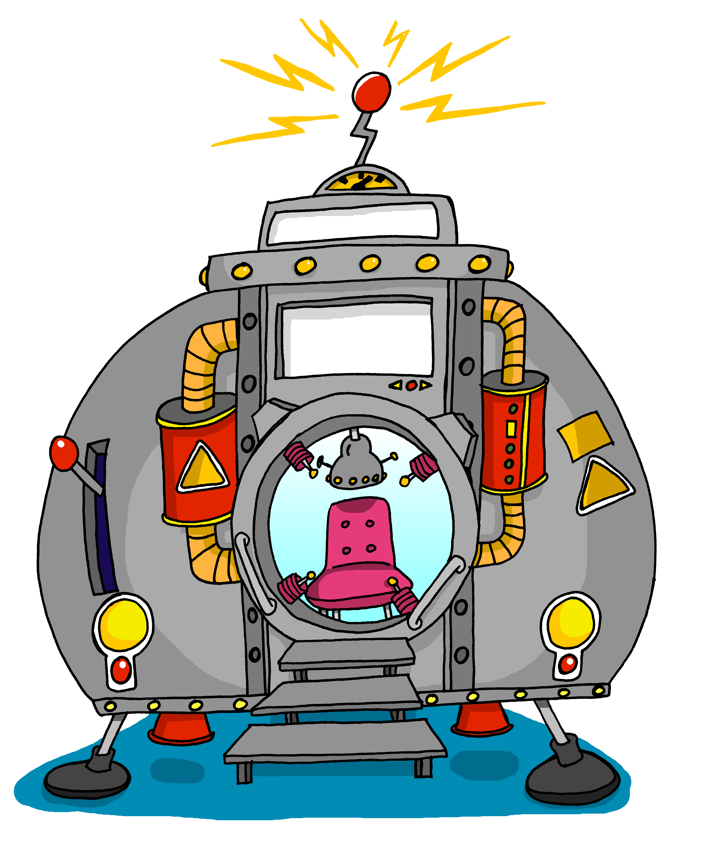
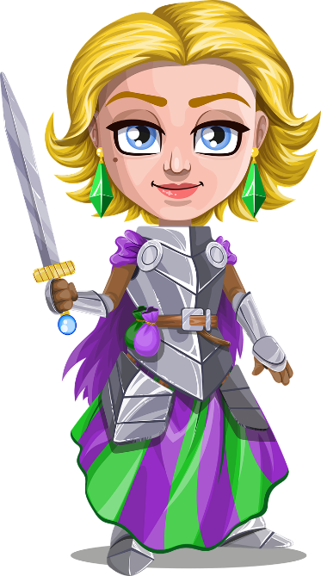
Der Gast kommt an [1/2]
Person A liest vor*,
Person B übersetzt* ins Englische.
lesen / sprechen
Alle sind glücklich: Der Gast kommt an! Er steigt aus einer Zeitmaschine! Woher kommt er? Aus der Zukunft*! Aber was?! Der Gast ist eine Dame! Es ist die dritte Königstochter – sie ist nicht tot! UND sie ist reich!
All are happy:
The guest arrives!
He climbs out of a time machine!
Where does he come from? From the future!
But what?! The guest is a lady!
It is the third king’s daughter –
she is not dead! AND she is rich!
* vorlesen – read aloud; übersetzen – translate;
* die Zukunft – future
die Zeitmaschine
Notes:
Timing: 5 minutes (2 slides) Aim: to practise read aloud and written comprehension of vocabulary and structures in a longer context. Procedure: 1. Student A reads the text aloud, sentence by sentence.
2. After each sentence, Student B provides an oral translation into English of the narrative.
3. Click to provide a written English translation.
4. Move onto the next slide to swap roles.
Word frequency of unknown words and cognates (1 is the most frequent word in German):
Maschine [1237] Zukunft [469] Source: Jones, R.L. & Tschirner, E. (2019). A frequency dictionary of German: core vocabulary for learners. Routledge

Slide 24
Der Gast kommt an [2/2]
Jetzt tauscht* die Rollen.
lesen / sprechen
tauschen – change
Sie hat eine Milliarde Euro! Jetzt kann man das Schloss reparieren, Feuer machen, schöne Bilder an die Wand hängen und: feiern! Der König kann es nicht fassen*. Und sie sind glücklich bis zum Lebensende.
She has a billion euros.
Now people can repair the castle,
make a fire, hang beautiful pictures
on the wall,
and celebrate!
The king cannot grasp it.
And they are happy till the end of their lives.
*fassen also means to grasp in the sense of to understand.
die Zeitmaschine
Notes:
Word frequency of unknown words and cognates (1 is the most frequent word in German):
reparieren [>5009] tauschen [3648] Source: Jones, R.L. & Tschirner, E. (2019). A frequency dictionary of German: core vocabulary for learners. Routledge

Slide 25
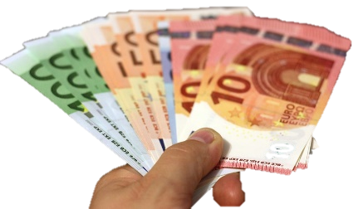
Eine Geschichte erzählen
sprechen
Person A beginnt, zu lesen. Welches Wort ist richtig?
Person A: Es war einmal ein… Sohn / Tochter und eine kleine…
Schloss / Wohnung am Ende von der…
Unternehmen / Firma. Sie erwarten nichts vom…
sind / ist modern – und so sind sie glücklich bis zum Lebensende! ☺
Person B: Königin / König. Er/Sie hat einen… Katze / Hund. Sie wohnen zusammen in einer…
Dorf / Straße. Sie machen beide Dienst in einem…
Staat / Königin. Sie verdienen eigene Euros! Manche sagen, sie…
der Staat – state
Notes:
Timing: 7 minutes (two slides) Aim: to complete a paired read aloud story narration, completing each sentence based on the article heard. Procedure: 1. Hand out the story halves. (Do not click to reveal the text on this slide at this stage).
2. Person A starts the sentence off and Student B completes the sentence, based on the article heard.
2. Student B continues and Student A completes the next sentence. 3. Narration continues to the end of the story. 4. Click to reveal both halves of the story. 5. Answers are revealed on subsequent clicks. 6. Students then translate the story orally in pairs. A suggested English translation is on the next slide.
Word frequency of unknown words and cognates (1 is the most frequent word in German):
Staat [337] Source: Jones, R.L. & Tschirner, E. (2019). A frequency dictionary of German: core vocabulary for learners. Routledge

Slide 26
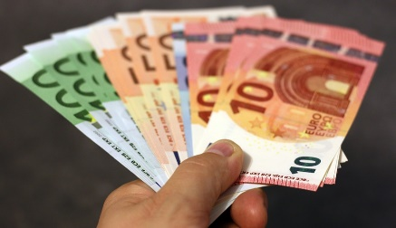
Auf Englisch
sprechen
1. Once upon a time there was a King.
2. He has a kind son and a small cat.
3. They live together in a flat at the end of the street.
4. They both do shifts in a company.
5. They expect nothing from the state, they earn their own euros!
6. Some say they are modern – and so they are happy till the end of their lives! ☺
Notes:
ANSWERS Click for English translation to appear sentence by sentence.

Slide 27
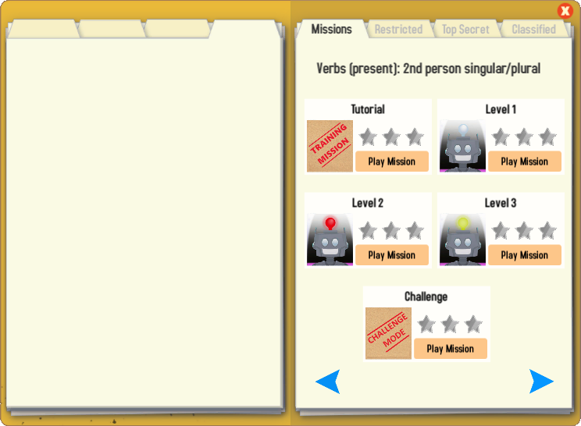
Gaming Grammar
Try the following Gaming Grammar missions to practise:
Notes:
Y9 T1.1 W2

Slide 28
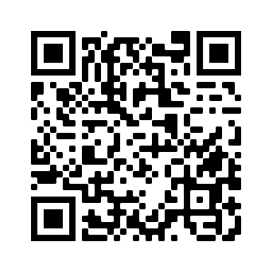
Hausaufgaben
Vocabulary Learning Homework (Term 1.1, Week 3)
Student worksheet
Quizlet link
Quizlet QR code:
Notes:
Use this slide to set the homework. Link to the student worksheet answers: https://resources.ncelp.org/concern/parent/p8418p212/file_sets/jw827c61n

