Slide 1
Vocabulary
Y7 French
Term 1.1 - Week 7
Victoria Hobson / Stephen Owen / Emma Marsden
Date updated: 23/02/20

Slide 2
faire
[to do, make | doing, making]
fait
[does, makes | is doing, is making]
Notes:
The verb ‘faire’, the focus of this week’s grammar, is now presented in its infinitive and short forms, over the next six slides.
Learners can listen and repeat.

Slide 3
faire
[to do, make | making, doing]
fait
[does, makes | is doing, is making]

Slide 4
fait
[does, makes | is doing, is making]
Zara fait le lit.
[Zara makes | is making the bed.]

Slide 5
faire
[to do, make | doing, making]
Faire le lit, c’est bon
[Making the bed is good.]

Slide 6
fait
[does, makes | is doing, making]
Zara ___ le lit.
fait
[Zara makes | is making the bed.]

Slide 7
faire
[to do, make |doing, making]
Faire
_____ le lit, c’est bon.
[Making the bed is good.]

Slide 8
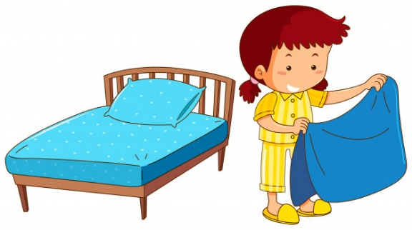
exercise
faire le lit
faire le modèle
faire le ménage
faire la cuisine
faire une activité
faire les courses
faire les devoirs
Notes:
These images draw students’ attention to the two translations of ‘make’ and ‘do’.
To ensure that English meanings are transparent and that students are fully aware of when they use ‘do’ and ‘make’ in English, it is worth eliciting English translations explicitly, here.
Teachers can then use this slide to introduce the vocabulary in a listen and repeat style, if not already pre-learnt.
Reading and writing activities follow which practise the verb faire in first and third person singular. NB this teaching point does not offer a listening and speaking opportunity because of the same pronunciation of the forms for both meanings.

Slide 9
Les devoirs
New learning Term 1.2 Week 1
Re-visit Week 4

