Slide 1
Comparing what you usually do with your summer plans for this year
Future vs present meaning [present tense 1st singular / plural plus adverbial time phrases]
SSCs [s-], [ß, ss -s] [revisited]
Y7 German
Term 3.2 - Week 5 - Lesson 67
Author name(s): Stephen Owen / Rachel Hawkes
Artwork: Steve Clarke
Date updated: 20/12//21
Notes:
Artwork by Steve Clarke. All additional pictures selected are available under a Creative Commons license, no attribution required.
Learning outcomes (lesson 1):
Introduction of expressing future versus present meaning using present tense with appropriate time adverbials.
Consolidation of SSCs [s], [ss] with known words from this week’s new vocabulary set and those revisited this week.
Word frequency (1 is the most frequent word in German):
7.3.2.5 (introduce) Dorf [959] Großstadt [204] Jahr [51] Jahre [51] Monat [303] Schwimmbad [>5009] See [1317] Strand [1966] nächste, nächstes, nächsten [235] nächste Woche [n/a] nächsten Monat [n/a] nächstes Jahr [n/a]
7.3.1.6 (revisit) dauern [744] erreichen [309] fahren2 [2138] schaffen1 [285] suchen [293] viel, viele [56] das Land1 [134] Schottland [>5009] Schweiz [763] Stunde1 [276] Wien [n/a] dort [134] normalerweise [2062] 7.2.2.3 (revisit) fahren1 [215] geben [49] helfen [338] laufen [252] schlafen [679] vergessen [584] mir [63] Geld [235] Urlaub [1570] Zeitung [670] fast [202]
Source: Jones, R.L & Tschirner, E. (2019). A frequency dictionary of German: Core vocabulary for learners. London: Routledge.
The frequency rankings for words that occur in this PowerPoint which have been previously introduced in NCELP resources are given in the NCELP SOW and in the resources that first introduced and formally re-visited those words.
For any other words that occur incidentally in this PowerPoint, frequency rankings will be provided in the notes field wherever possible.

Slide 2
Wiederholung - s, ss, ß
Phonetik
Before a vowel, German 's' sounds like the English ‘z’.
E.g., sagen, sehr, sein, sie, sitzen, gesund, super, Reise.
Elsewhere, the German ‘s’, as well as all instances of ‘ss’ and ‘ß’ are pronounced like an English ‘s’.
E.g., eins, hast, das, groß, lassen, Haus, Wasser, heißen.
Use 'ss’ when the preceding vowel in a word is short, e.g., essen. Write 'ß’ after a long vowel e.g., 'Fuß', or two vowels together e.g. 'weiß‘.
Remember: sch-, sp-, st- are pronounced in their own way at the start of a word,
e.g. schwimmen, springen, stehen
Notes:
Timing: 3 minutes
Aim: To remind students when to pronounce ‘s’ as a ‘z’ and when as an ‘s’. Additionally, to explain the use of the ß (called Eszett or scharfes S) instead of ss.
Note: There is also a reminder of the pronunciation of ‘sch-’, ‘sp-’ and ‘st-’ at the start of a word.
Procedure: 1. Cycle through the information on the slide using the animation sequence.

Slide 3
s
sollen
Notes:
Timing: 1 minute
Aim: To introduce/consolidate SSC [s]
Procedure: 1. Present the letter(s) and say the [s] sound first, on its own. Students repeat it with you. 2. Bring up the word ”sollen” on its own, say it, students repeat it, so that they have the opportunity to focus all of their attention on the connection between the written word and its sound.
3. A possible gesture for this would be to mime telling someone what s/he should do, by wagging your finger, and looking serious.
4. Roll back the animations and work through 1-3 again, but this time, dropping your voice completely to listen carefully to the students saying the [s] sound, pronouncing ”sollen” and, if using, doing the gesture. Word frequency (1 is the most frequent word in German): sollen [63]
Source: Jones, R.L. & Tschirner, E. (2006). A frequency dictionary of German: core vocabulary for learners. Routledge

Slide 4
s
sollen
Notes:
With sound and no pictures to focus all attention on the sound-symbol correspondence.

Slide 5
s
sollen
Notes:
Without sound to elicit pronunciation (without first hearing the teacher).
Teacher to elicit pronunciation by asking “Wie sagt man…”

Slide 6
s
Gesetz
Seite
sollen
54
reisen
Satz
Subjekt
Verb
Objekt
langsam
Ich habe Hunger.
Notes:
Timing: 2 minutes
Aim: To introduce/consolidate SSC [s]
Procedure:
Introduce and elicit the pronunciation of the individual SSC [s] and then the source word again ‘sollen’ (with gesture, if using).
Then present and elicit the pronunciation of the five cluster words.
The cluster words have been chosen for their high-frequency, from a range of word classes, with the SSC (where possible) positioned within a variety of syllables within the words (e.g. initial, 2nd, final etc.). Additionally, we have tried to use words that build cumulatively on previously taught SSCs (see the Phonics Teaching Sequence document) and do not include new SSCs. Where new SSCs are used, they are often consonants which have a similar symbol-sound correspondence in English.
Word frequency (1 is the most frequent word in German): sollen [63]; Gesetz [552] Seite[217]; reisen [978]; langsam [604]; Satz [582]. Source: Jones, R.L. & Tschirner, E. (2006). A frequency dictionary of German: core vocabulary for learners. Routledge

Slide 7
s
Gesetz
Seite
sollen
reisen
Satz
langsam
Notes:
With sound and no pictures to focus all attention on the sound-symbol correspondence.

Slide 8
s
Gesetz
Seite
sollen
reisen
Satz
langsam
Notes:
Without sound to elicit pronunciation (without first hearing the teacher).
Teacher to elicit pronunciation by asking “Wie sagt man…”

Slide 9
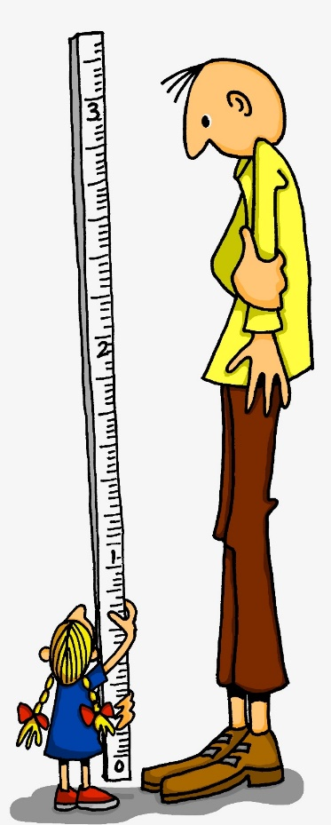
ß
groß
Notes:
Timing: 1 minute
Aim: To introduce/consolidate SSC [ß]
Procedure: 1. Present the letter(s) and say the [ß] sound first, on its own. Students repeat it with you. 2. Bring up the word ”groß” on its own, say it, students repeat it, so that they have the opportunity to focus all of their attention on the connection between the written word and its sound.
3. A possible gesture for this would be to stretch your hand up high above your head, forming your hand into a right angle to indicate that you are measuring something/one very tall.
4. Roll back the animations and work through 1-3 again, but this time, dropping your voice completely to listen carefully to the students saying the [ß] sound, pronouncing ”groß” and, if using, doing the gesture. Word frequency (1 is the most frequent word in German): groß [74] Source: Jones, R.L. & Tschirner, E. (2006). A frequency dictionary of German: core vocabulary for learners. Routledge

Slide 10
ß
groß
Notes:
With sound and no pictures to focus all attention on the sound-symbol correspondence.

Slide 11
ß
groß
Notes:
Without sound to elicit pronunciation (without first hearing the teacher).
Teacher to elicit pronunciation by asking “Wie sagt man…”

Slide 12
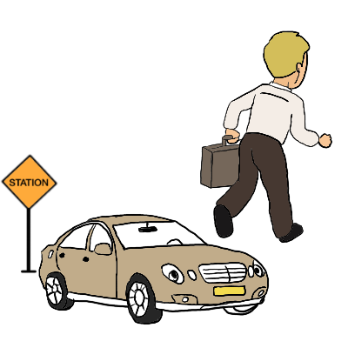
ß
Fußball
ein bisschen
groß
heißen
lassen
Misky
damals
1919
2019
Notes:
Timing: 2 minutes
Aim: To introduce/consolidate SSC [ß]
Procedure:
Introduce and elicit the pronunciation of the individual SSC [ß] and then the source word again ‘groß’ (with gesture, if using).
Then present and elicit the pronunciation of the five cluster words.
The cluster words have been chosen for their high-frequency, from a range of word classes, with the SSC (where possible) positioned within a variety of syllables within the words (e.g. initial, 2nd, final etc.). Additionally, we have tried to use words that build cumulatively on previously taught SSCs (see the Phonics Teaching Sequence document) and do not include new SSCs. Where new SSCs are used, they are often consonants which have a similar symbol-sound correspondence in English.
Word frequency (1 is the most frequent word in German): groß [74]; Fußball [1497] ein bisschen [194]; heißen [123]; damals [271]; lassen [82]. Source: Jones, R.L. & Tschirner, E. (2006). A frequency dictionary of German: core vocabulary for learners. Routledge

Slide 13
ß
Fußball
ein bisschen
groß
heißen
lassen
damals
Notes:
With sound and no pictures to focus all attention on the sound-symbol correspondence.

Slide 14
ß
Fußball
ein bisschen
groß
heißen
lassen
damals
Notes:
Without sound to elicit pronunciation (without first hearing the teacher).
Teacher to elicit pronunciation by asking “Wie sagt man…”

Slide 15
Phonetik
Großstadt
vergessen
suchen
suchen
normalerweise
der See
normalerweise
Großstadt
der Wasserpark
vergessen
nächste
der Wasserpark
fast
nächste
fast
der See
Notes:
Timing: 3 minutes
Aim: To practise spoken production of ‘s-’ and ‘ß’ (called Eszett or scharfes S) ‘ss’ and -s.
Procedure: 1. Students must decide whether the sounds in the words match to the bee (buzz) or the snake (hiss). 2. Teachers can elicit the sound [zzzz] or [ssss] first from the students, then the full word. 3. Answers are animated one by one to move to the correct image.
Word frequencies:
Großstadt [74/188] See [1167] nächste [249] Wasserpark [299/1940] suchen [293] normalerweise [1898] vergessen [595] fast [223]
Source: Jones, R.L. & Tschirner, E. (2011). A frequency dictionary of German: core vocabulary for learners. Routledge
Bee picture from pixabay.com
Snake picture from publicdomainvectors.org

Slide 16
Vokabeln
Wasserpark
Freizeitpark
Schwimmbad
Strand
Großstadt
Dorf
Jahr
Monat
Meer
See
die
der
das
Notes:
Timing: 5 minutes
Aim: To practise connecting nouns with gender.
Note: The words are the nouns from this week’s vocabulary set, plus three from previous weeks. We continue to emphasise the importance of knowing the gender of a word in German.
Procedure: 1. Ask students to predict which ‘Pacman’ will eat the word, based on the word’s gender.
2. Click to make the word ‘fly’ to the correct ‘Pacman’.
Note: Students should get the gender of Wasserpark and Freizeitpark from their knowledge of ‚der Park‘ and their knowledge about compound nouns. Teachers should seek to elicit the meanings ‚water park / aqua park‘ and ‚theme park‘ from students. Wasser was previously taught, Freizeit will be taught in Y8, as a compound ‚frei‘ (a previous SSC source word) and Zeit, a new noun. Meer may not be remembered, but is included here, to help students note the meaning difference between ‚See‘ (here taught as lake), and ‚Meer‘ (sea). Teachers should not expect students to know the gender. This word will be taught formally in Y8, too.

Slide 17
Adverbial time phrases
Grammatik
It sounds a bit like the English word!
In German, the adjective nächst means ‘next’.
Its ending changes according to the gender of the noun that follows:
der Monat
nächsten Monat
(next month)
die Woche
nächste Woche
(next week)
Note: all these adverbial time phrases use Row 2 (accusative) endings.
das Jahr
nächstes Jahr
(next year)
Previously, you learnt:
der Tag
jeden Tag
(every day)
What are…?
die Woche
jede Woche
(every week)
das Jahr
jedes Jahr
(every year)
Notes:
Timing: 2 minutes
Aim: To explain how to form three useful future time adverbials using the German adjective nächst.
Note: Individual elements are animated to prompt students to produce the English translations for each phrase. The explanation then links back to the time phrase ‘jeden Tag’ that students learnt early on in Y7, and prompts them to apply the emerging pattern to feminine and neuter nouns. This time the animations prompt students to produce the German for each adverbial phrase. In last week’s sequence (3.2.4) students were introduced to the use of ‘jeder, jede, jedes’ in Row 1 (nominative) and Row 2 (accusative). Here, there is a call out to tell students that in many adverbial time phrases, Row 2 (accusative) forms are used. Students will be explicitly taught pre-nominal adjectival agreement in Y8. Here, this very specific, but highly-frequent use of Row 2 (accusative) forms is presented as a pattern commonly applying to adverbial time phrases. Early in Y8, students will meet letzt(er,e,es), too.
Procedure:
1. Cycle through the information on the slide using the animation sequence.

Slide 18
Expressing future intention with present
Grammatik
In German, as in English, we can use the present tense with an adverbial time phrase to say what we are doing in the future:
Use Word Order 2 because the sentences start with an adverbial time phrase.
Nächsten Monat reise ich in die Schweiz.
Next month I am travelling to Switzerland.
Nächste Woche gehe ich in die Stadt.
Next week I am going into town.
Nächstes Jahr arbeiten wir im Geschäft.
Next year we are working in the shop.
Notes:
Timing: 2 minutes
Aim: To explain the use of the present tense with a future time adverbial to express future plans, as in the corresponding English construction.
Note: A reminder that Word Order 2 (first met in 3.1.1 with adverbs of time) is required here is provided. Sentences are animated to allow teachers to elicit the English meanings from students. The referential exercises which follow will practise all of these elements in reading and listening tasks.
Procedure:
1. Cycle through the information on the slide using the animation sequence.

Slide 19
Was planen sie? Und wann?
lesen
Wolfgang schreibt eine Email an Mehmet.
Wann ist das?
 |  | Woche | Monat | Jahr
1 | Nächstes Jahr fahre ich nach Schottland.
2 | Nächsten Monat helfe ich im Geschäft.
3 | Nächste Woche fahren wir in den Urlaub.
4 | Nächsten Monat arbeite ich im Dorf.
5 | Nächste Woche gehen wir ins Schwimmbad.
6 | Nächstes Jahr schlafe ich auf dem Strand!
7 | Nächste Woche laufen wir am* See.
8 | Nächsten Monat suchen wir ein Haus.
*am (an + dem) = at the
Notes:
Timing: 4 minutes
Aim: To practise distinguishing time expresssions from the adjective ending on nächst in each sentence.
Procedure:
Click to bring up the slide rubric in German in two stages.
Students look at the adjective ending on nächst in each sentence, and tick the appropriate column. The first one could be done as an example with them.
Click to bring up first the correct tick, then reveal the obscured word for each sentence. The questions could be done one by one, revealing the correct answer after each, or as a block.

Slide 20
Ich oder wir?
hören
Sie reden jetzt am Telefon. Ist das “ich”, oder “wir”?
 |  | ich | wir
 | Nächstes Jahr fahren wir nach Wien.
 | Nächsten Monat arbeite ich am Schwimmbad.
 | Nächste Woche gehen wir in den Wasserpark.
 | Nächsten Monat helfen wir im Dorf.
 | Nächste Woche gehe ich in den Freizeitpark.
 | Nächstes Jahr fahren wir im Winter in den Urlaub.
 | Nächste Woche spiele ich in der Großstadt Fußball .
 | Nächsten Monat gebe ich eine Party.
Remember: the “wir” form of the verb is the same as the infinitive!
1
2
3
4
5
6
7
8
Notes:
Timing: 4 minutes
Aim: To practise distinguishing between first person singular and plural verb forms.
Procedure:
1. Click first to bring up the slide rubric, then again to bring up a callout reminding students that the wir form of the verb is the same as the infinitive.
2. Click on the numbered buttons to play each sentence. Students listen and tick the appropriate column.
3. Click first to bring up the correct tick, then reveal the sentence in written form, for each item.
Transcript:
1. Nächstes Jahr fahren [wir] nach Wien.
2. Nächsten Monat arbeite [ich] am Schwimmbad.
3. Nächste Woche gehen [wir] in den Wasserpark.
4. Nächsten Monat helfen [wir] im Dorf.
5. Nächste Woche gehe [ich] in den Freizeitpark.
6. Nächstes Jahr fahren [wir] im Winter in den Urlaub.
7. Nächste Woche spiele [ich] in der Großstadt Fußball.
8. Nächsten Monat gebe [ich] eine Party.

Slide 21
Sag die Sätze auf Deutsch und dann auf Englisch!
lesen
Make sure you use the continuous present tense for future meaning!
1 | Nächstes Jahr fahren wir nach Wien.
2 | Nächsten Monat arbeite ich am Schwimmbad.
3 | Nächste Woche gehen wir in den Wasserpark.
4 | Nächsten Monat helfen wir im Dorf.
5 | Nächste Woche gehe ich in den Freizeitpark.
6 | Nächstes Jahr fahren wir im Winter in den Urlaub.
7 | Nächste Woche spiele ich in der Großstadt Fußball.
8 | Nächsten Monat gebe ich eine Party.
Notes:
Timing: 6 minutes
Aim: To practise written comprehension of the futuristic present and its translation into English.
Note: This requires recall of the vocabulary used, much of which is taken from this week’s vocabulary set and those of the revisited weeks. Students’ attention is focused on the fact that the corresponding English construction uses the present continuous form of the verb.
Procedure:
Allow students to view the sentences and think about their translation in English (the slide is not animated).
They work in pairs reading a sentence aloud, which their partner translates.
The next slide reveals the answers.

Slide 22
Antworten
1 | Nächstes Jahr fahren wir nach Wien.
2 | Nächsten Monat arbeite ich am Schwimmbad.
3 | Nächste Woche gehen wir in den Wasserpark.
4 | Nächsten Monat helfen wir im Dorf.
5 | Nächste Woche gehe ich in den Freizeitpark.
6 | Nächstes Jahr fahren wir im Winter in den Urlaub.
7 | Nächste Woche spiele ich in der Großstadt Fußball.
8 | Nächsten Monat gebe ich eine Party.
Antworten
Next year we’re going to Vienna.
Next month I’m working at the swimming pool.
Next week we’re going to the aqua park.
Next month we’re helping in the village.
Next week I’m going to the theme park.
Next year we’re going on holiday in the winter.
Next week I’m playing football in the city.
Next month I’m giving a party.
Notes:
Timing: 2 minutes
Aim: To reveal the answers to the activity on the previous slide.
Procedure:
Click to bring up the suggested English translations one by one.

Slide 23
Was planst du?
sprechen / schreiben
Schreib deine Pläne für nächste Woche, nächsten Monat, nächstes Jahr! Benutz die Vokabeln. Partnerarbeit: Sag deine Sätze.
machen
meine Hausaugaben
spielen
Fußball mit Freunden
fahren
eine Party
nach London
gehen
geben
in die Stadt
Jetzt schreib deine eigene* Sätze!
*eigen- - own
Notes:
Timing: 15 minutes
Aim: To provide productive practice with the grammar features covered in this lesson.
Note: This writing/speaking task requires students first to write, then say aloud to their partner, sentences similar to those encountered in the reading and listening exercises this lesson. Useful verbs and possible complements are provided giving the parameters for structured practice in the first instance. The verbs are given in the infinitive, so students need to put them into the first person singular form, adding one of the time adverbials and remembering to use Word Order 2. Upon the next mouse click, students are challenged to create some similar sentences using vocabulary of their choice, as an extension task.
Procedure:
1. Use the prompts on the slide as a stimulus to elicit some example sentences from students.
2. Click to bring up the next instruction: students write their own sentences.
3. They then read their sentences to their partner.
Word frequency (1 is the most frequent word in German):
eigen [166]
Source: Jones, R.L & Tschirner, E. (2011). A frequency dictionary of German: Core vocabulary for learners. London: Routledge.

Slide 24
Comparing what you usually do with your summer plans for this year
Future vs present meaning [present tense 1st singular / plural plus adverbial time phrases]
SSCs [s-], [ß, ss -s] [revisited]
Y7 German
Term 3.2 - Week 5 - Lesson 68
Author name(s): Stephen Owen / Rachel Hawkes
Artwork: Steve Clarke
Date updated: 20/12/21
Notes:
Artwork by Steve Clarke. All additional pictures selected are available under a Creative Commons license, no attribution required.
Learning outcomes (lesson 2):
Consolidation of expressing future versus present meaning using present tense with appropriate time adverbials.
Consolidation of SSCs [s-], [ß, ss -s] with known words from this week’s new vocabulary set and those revisited this week.
Word frequency (1 is the most frequent word in German):
7.3.2.5 (introduce) Dorf [959] Großstadt [204] Jahr [51] Jahre [51] Monat [303] Schwimmbad [>5009] See [1317] Strand [1966] nächste, nächstes, nächsten [235] nächste Woche [n/a] nächsten Monat [n/a] nächstes Jahr [n/a]
7.3.1.6 (revisit) dauern [744] erreichen [309] fahren2 [2138] schaffen1 [285] suchen [293] viel, viele [56] das Land1 [134] Schottland [>5009] Schweiz [763] Stunde1 [276] Wien [n/a] dort [134] normalerweise [2062] 7.2.2.3 (revisit) fahren1 [215] geben [49] helfen [338] laufen [252] schlafen [679] vergessen [584] mir [63] Geld [235] Urlaub [1570] Zeitung [670] fast [202]
Source: Jones, R.L & Tschirner, E. (2019). A frequency dictionary of German: Core vocabulary for learners. London: Routledge.
The frequency rankings for words that occur in this PowerPoint which have been previously introduced in NCELP resources are given in the NCELP SOW and in the resources that first introduced and formally re-visited those words.
For any other words that occur incidentally in this PowerPoint, frequency rankings will be provided in the notes field wherever possible.

Slide 25
Snap?
Ja
oder
nein?
Süden
selbst
besser
so
als
Spaß
Wechsel
Sommer
lustig
Seite
letztes
küssen
Gesicht
heiß
setzen
besuchen
Notes:
Timing: 6 minutes
Aim: To practise distinguishing SSCs [s] and [ss] ([ß]).
Note: Students identify if the sounds highlighted in yellow are a match, ‘snap’ (like the card game) by pronouncing the words aloud and comparing them.
Procedure:
1. Play FOUR times with class and give students a few seconds to pronounce in pairs and decide, before taking the class answer each time. The answers are animated. 2. Then pairs can play against each other – one student choosing and pronouncing two words and the other student deciding whether they make a matching snap pair or not. Note: The words have been selected from the forthcoming Year 8 vocabulary lists, and are thus ‘unknown words’ for the students at present. This makes the task one of decoding (applying SSC knowledge), rather than allowing existing word knowledge to play a part.
Word frequency rankings:
der Süden [1534], selbst [98], besser [231], so [21], als [25], der Spaß [666], der Wechsel [1945], der Sommer [704], lustig [2262], die Seite [217], letztes [147], küssen [2625], heiß [920], setzen [228], besuchen [703], das Gesicht [365]
Source: Jones, R.L. & Tschirner, E. (2011). A frequency dictionary of German: core vocabulary for learners. Routledge.

Slide 26
Was passt nicht in die Reihe?
Phonetik
1.
Süden
als
Gesicht
2.
lustig
selbst
besuchen
3.
Spaß
Seite
küssen
4.
so
heiß
Wechsel
5.
Sommer
besser
gesund
Notes:
Timing: 5 minutes
Aim: To practice distinguishing SSCs [s] and [ss] ([ß]).
Note: Students have met this task type before and the instruction ‘Was passt nicht?’
Procedure:
1. Teachers can elicit the instruction meaning from students.
2. Students should be encouraged to practise pronouncing these words out loud, individually or in pairs, to decide which is the odd one out in each row (Reihe). 3. Answers are animated to shade the odd one out upon clicking the mouse.
Note: Words are from the forthcoming Year 8 scheme of work (with the exception of ‘gesund’, learnt in 2.1.4), as used on the previous slide. There is no need to focus on meaning, though teachers might be interested to see if students can anticipate the meanings, e.g. besser, Sommer, Süden.
Word frequency (1 is the most frequent word in German): besser [201] Sommer [771] Süden [1771] Spaß [1045] als [22] Gesicht [346] lustig [1973] selbst [101] besuchen [820] Seite [197] küssen [2644] so [28] heiß [1195] Wechsel [2525]
Source: Jones, R.L. & Tschirner, E. (2011). A frequency dictionary of German: core vocabulary for learners. Routledge.

Slide 27
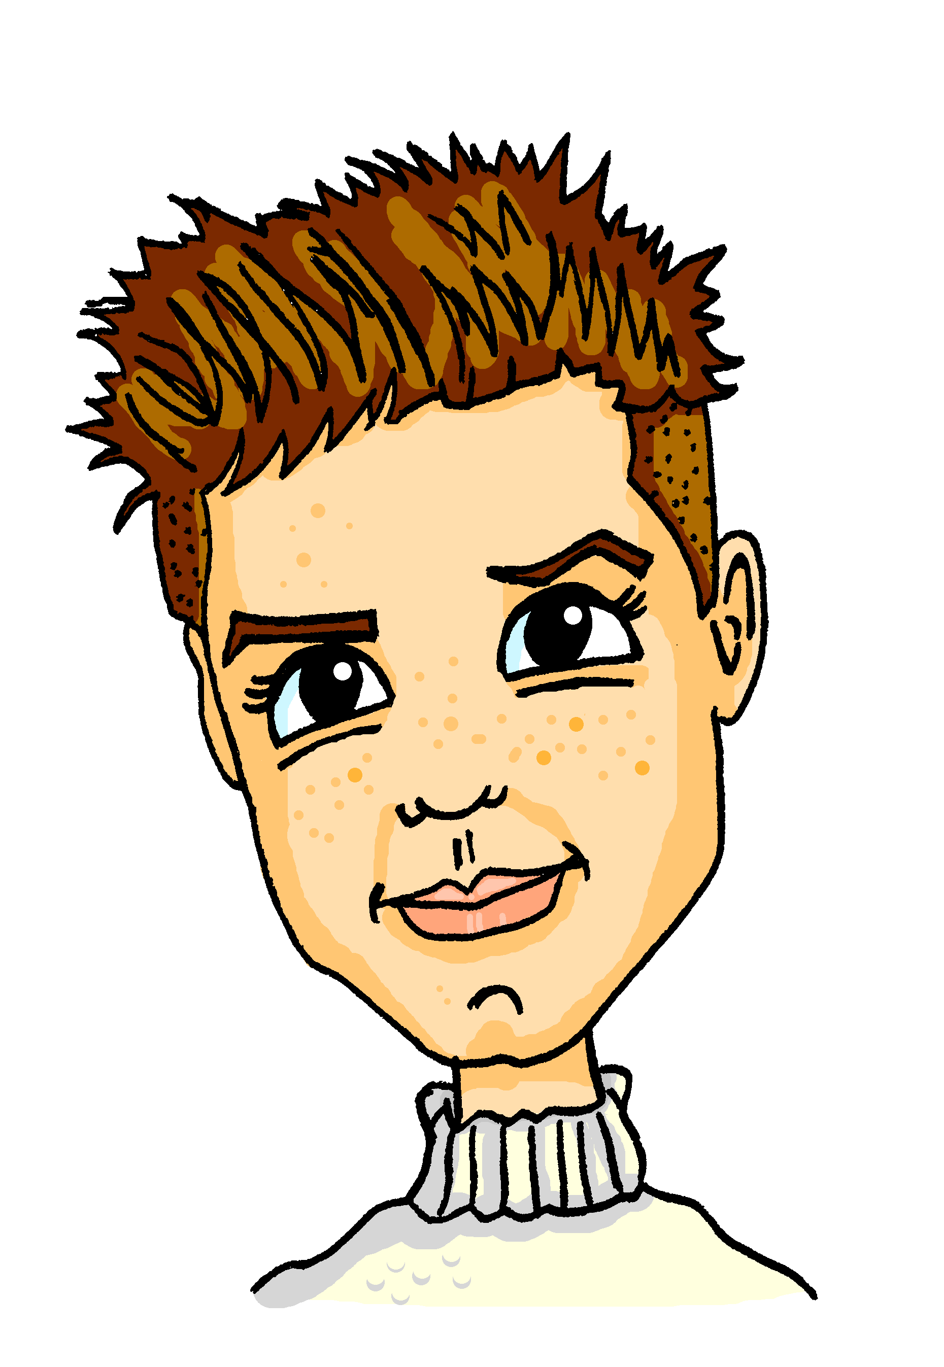
Eine Reise nächste Woche
lesen
Alastair schreibt Mia und Wolfgang über seine Reise nächste Woche eine Email. Schreib die Verben 1-12.
Nächste Woche [1] fahre ich nach London. Ich [2] nehme früh den Zug. Die Reise [3] dauert drei Stunden. Normalerweise [4] lese ich die Zeitung im Zug. London [5] erreiche ich in zwei Stunden. Dort [6] muss ich einen Bus [7] nehmen. Mein Freund [8]will am Samstagabend eine Party [9] geben, und ich muss damit* [10] helfen. Wir [11] haben fast genug Geld! Wir müssen nichts [12] vergessen!
lese | haben | fahre | nehmen | geben | vergessen
nehme | dauert | helfen | will | erreiche | muss
*damit - with it
Notes:
Timing: 5 minutes
Aim: To revisit written comprehension of some of the vocabulary from 3.1.6, together with most words from 2.2.3, the two sets revisited this week.
Note: This version is less challenging than the one on the following slide, as the verbs are already conjugated.
The task focuses upon the verbs in particular. The text is the account of an imaginary journey to London next week.
Procedure:
Students read the text and select the correct verb from the options shown at the bottom of the screen to fill each gap.
Click to reveal the answers one by one.

Slide 28
Eine Reise nächste Woche
lesen
Alastair schreibt Mia und Wolfgang über seine Reise nächste Woche eine Email. Schreib die Verben 1-12.
Nächste Woche [1] fahre ich nach London. Ich [2] nehme früh den Zug. Die Reise [3] dauert drei Stunden. Normalerweise [4] lese ich die Zeitung im Zug. London [5] erreiche ich in zwei Stunden. Dort [6] muss ich einen Bus [7] nehmen. Mein Freund [8]will am Samstagabend eine Party [9] geben, und ich muss damit* [10] helfen. Wir [11] haben fast genug Geld! Wir müssen nichts [12] vergessen!
lesen | haben | fahren | nehmen | geben | vergessen
nehmen | dauern | helfen | wollen | erreichen | müssen
*damit - with it
Notes:
Timing: 5 minutes
Aim: To revisit written comprehension of some of the vocabulary from 3.1.6, together with most words from 2.2.3, the two sets revisited this week.
Note: This version is more challenging than the version on the previous slide, with the verbs given in infinitive form. The task focuses upon the verbs in particular. The text is the account of an imaginary journey to London next week.
Procedure:
Students read the text and select the correct verb from the options shown at the bottom of the screen to fill each gap.
Click to reveal the answers one by one.

Slide 29
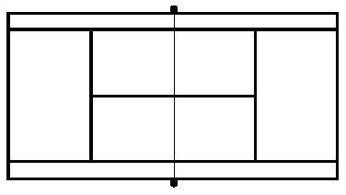
Eine Reise nächste Woche. Partnerarbeit. Sag den Text auf Englisch.
Wie sagt man ‘XXX’ auf Englisch?
Notes:
Timing: 5 minutes
Aim: Translation practice.
Procedure:
1. Students translate the Eine Reise text on the previous slide into English, sentence by sentence, taking it in turns, as quickly as they can. 2. If they get stuck on a word, they should use the well-practised routine ‘Wie sagt man… auf Englisch?’ to elicit support from their peers or the teacher.

Slide 30
Normalerweise oder nächstes Jahr?
lesen
Was machen sie im Urlaub?
Circle the correct form of the present tense to use in English,
in order to translate the German verb in bold.
1 | Nächstes Jahr fahren wir in die Schweiz. | go / are going
2 | Normalerweise fahren wir in die Alpen. | go / are going
3 | Normalerweise nehmen wir den Zug. | are taking / take
4 | Nächstes Jahr nehmen wir das Auto. | take / are taking
5 | Normalerweise gehen wir in den Freizeitpark. | go / are going
6 | Nächstes Jahr gehen wir in den Wasserpark. | are going / go
7 | Nächstes Jahr spielen wir Fußball. | play / are playing
8 | Normalerweise spielen wir Tennis. | are playing / play
Notes:
Timing: 3 minutes
Aim: To practise cross-linguistic knowledge of the two English meanings for the German present tense.
Procedure:
Students select the correct form of the present tense to use in the English.
Click to reveal the answers one by one.

Slide 31
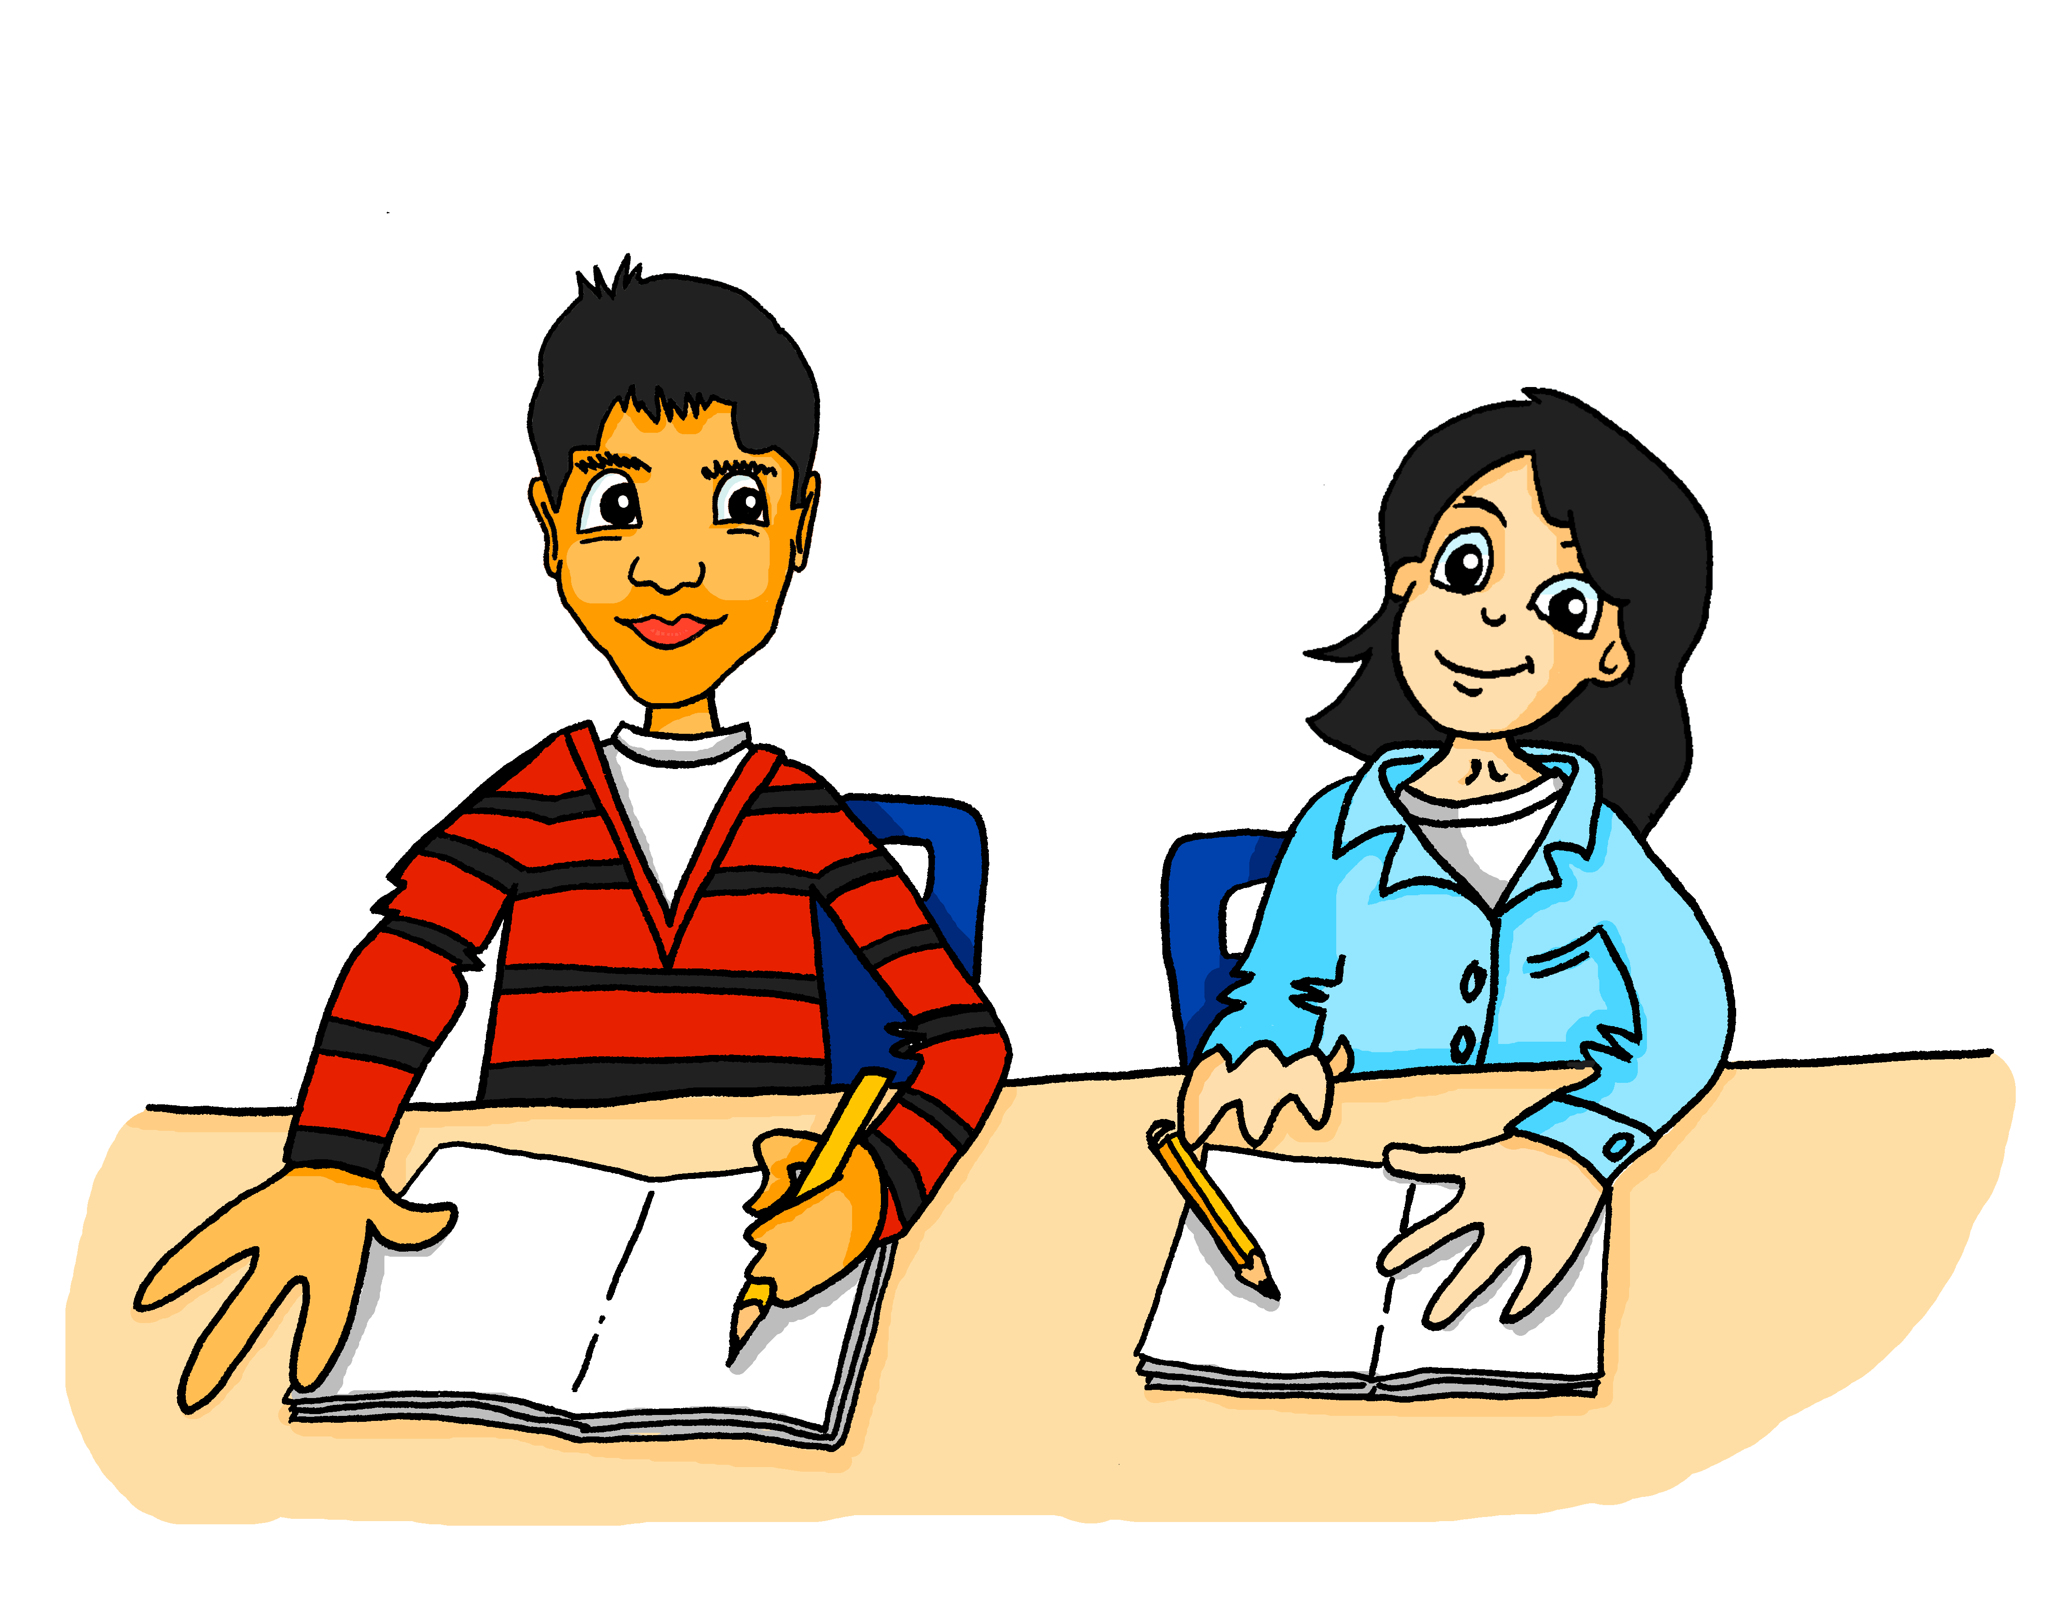
Mehmet und Mia reden über Urlaubspläne
hören / lesen
Echt? Das ist ja super! Normalerweise fahren wir nach Österreich. Wir machen viel Sport und wir besuchen* die Großstädte Wien und Salzburg.
Nächstes Jahr reisen wir aber nach Schottland! Alastair sagt, sein Land ist so schön!
Nächstes Jahr fahren wir in den Urlaub in die Schweiz. Wir nehmen den Zug. Die Reise dauert zehn Stunden! Normalerweise suchen wir ein Hotel für* eine Woche, aber nächstes Jahr bleiben wir zwei Wochen! Im Sommer mag ich besonders* Schwimmen und Rad fahren!
1
2
3
4
5
*für - for | * besonders - especially | *besuchen - to visit
Notes:
Timing: 5 minutes
Aim: To practice connecting written and aural language in a segmentation task. Additionally to practise vocabulary by suggesting alternative words at key points.
Note: The second (Mia) passage provides additional revisiting of vocabulary.
Procedure:
Click on the action buttons 1-5 to play Mehmet’s speech. When the text stops, teachers elicit the next word to practise segmentation.
The teacher also elicits alternative answers as suggested below.
Continue to the end of Mehmet’s speech.
Play Mia’s response by clicking on the speech bubble.
This time students translate the text orally into English.
Transcript:
Mehmet: 1. Nächstes Jahr fahren wir in den Urlaub ... [a different location] 2. in die Schweiz. Wir nehmen den Zug. Die Reise dauert [a different length of journey] 3. zehn Stunden! Normalerweise suchen wir ein Hotel für* eine Woche, aber nächstes Jahr bleiben wir [a different length of holiday time] 4. zwei Wochen! Im Sommer mag ich besonders* Schwimmen [an additional holiday activity]
5. und Rad fahren!
Mia: Echt? Das ist ja super! Normalerweise fahren wir nach Österreich. Wir machen immer viel Sport und wir besuchen die Großstädte Wien und Salzburg.
Nächstes Jahr reisen wir aber nach Schottland! Alastair sagt, sein Land ist so schön!
Word frequency rankings:
für [17], besuchen [820], besonders [270]
Source: Jones, R.L. & Tschirner, E. (2011). A frequency dictionary of German: core vocabulary for learners. Routledge.

Slide 32
Deine Urlaubspläne
schreiben
Schreib 50-60 Wörter über deine Urlaubspläne für nächstes Jahr. (It can be imaginary!).
Wo? Wie? Wie lange dauert das? Was machst du, und wann?
Contrast this with what you normally do every year, as Mehmet and Mia did in their conversation on the previous slide.
Use the vocabulary you have learned and revised this lesson.
Use a dictionary, for up to five new words, if you want to.
Notes:
Timing: 10 minutes
Aim: To practise written production of the language this week in a freer task, to communicate about future holiday plans and compare these with usual holiday activities.
Procedure:
1. Students write freely, following the prompts on the slide.

Slide 33
Deine Urlaubspläne
sprechen
Sag deine Urlaubspläne!
Now read your text in German to your partner, who will make notes on what you say in English. Make notes in English on what your partner says in his/her text, as below below:
What your partner normally does | What your partner is doing next year
Notes:
Timing: 6 minutes
Aim: To practise reading aloud, as well as listening and note-taking.
Procedure:
1. Students take turns in reading out their text; partners note down key details in English in the table.

Slide 34
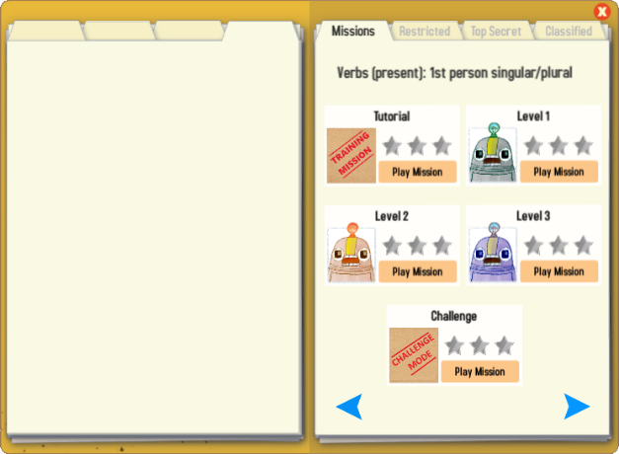
Gaming Grammar
Try the following Gaming Grammar missions to practise:

Slide 35
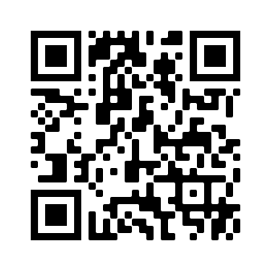
Hausaufgaben
Vocabulary Learning Homework (Term 3.2, Week 6)
Audio file
Audio file QR code:
Student worksheet
Quizlet link
In addition, revisit: Term 3.2 Week 3
Term 2.2 Week 4
Notes:
Use this slide to set the homework.

