Slide 1
Phonics
SSC /ch/
Y7 German
Term 1.2 - Week 4 - Lesson 21
Natalie Finlayson / Rachel Hawkes
25/11/19

Slide 2
ch
[x]
Buch
Notes:
The Buch/ich slides from last week (1.2.3) are included here to cycle through once more as an introduction to this week’s clusters.
This slide and those that follow alternate between Buch and ich to focus on the physical production of the two /ch/ sounds.
Teacher to highlight that Buch is formed at the at the back – ask students to feel the vibration in their throats.
Introduce and elicit the pronunciation of the individual SSC ‘ch’ and then present and practise the pronunciation of the source word ‘Buch’.
A possible gesture for this would mime opening the pages of a book with both hands.

Slide 3
ch
[ç]
ich
Notes:
Teacher to highlight that ich is formed at front, with a closed throat - ask students to feel the air on the soft palette.
Introduce and elicit the pronunciation of the individual SSC ‘ch’ and then present and practise the pronunciation of the source word ‘ich’.
A possible gesture for this would be to make an exaggerated gesture of pointing to yourself.

Slide 4
ch
[x]
Buch
Notes:
Teacher to highlight that Buch is formed at the at the back – ask students to feel the vibration in their throats.
Without pictures to focus on the SSC alone.

Slide 5
ch
[ç]
ich
Notes:
Teacher to highlight that ich is formed at front, with a closed throat - ask students to feel the air on the soft palette.
Without pictures to focus on the SSC alone.

Slide 6
ch
[x]
Notes:
Teacher to highlight that Buch is formed at the at the back – ask students to feel the vibration in their throats.
Without sound to elicit the pronunciation.

Slide 7
ch
[ç]
ich
Notes:
Teacher to highlight that ich is formed at front, with a closed throat - ask students to feel the air on the soft palette.
Without sound to elicit the pronunciation.

Slide 8
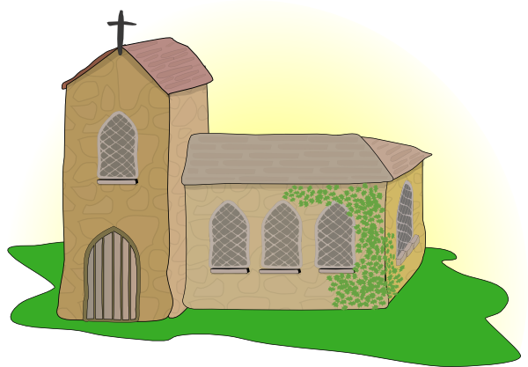
ch
Licht
Kirche
ich
nicht
endlich
[finally]
manchmal
[sometimes]
Notes:
Introduce and elicit the pronunciation of the individual SSC ‘ch’ and then the source word again (with gesture, if using). Then present and elicit the pronunciation of the five cluster words. The cluster words have been chosen for their high-frequency, from a range of word classes, with the SSC positioned within a variety of syllables within the words (e.g. initial, 2nd, final etc.). Additionally, we have tried to use words that build cumulatively on previously taught SSCs (see the Phonics Teaching Sequence document) and do not include new SSCs. Where new SSCs are used, they are often consonants which have a similar symbol-sound correspondence in English.
Word frequency rankings (1 is the most common word in German): ich [8]; Licht [503] Kirche [519]; endlich [496]; manchmal [394]; nicht [12]. Source: Jones, R.L. & Tschirner, E. (2006). A frequency dictionary of German: core vocabulary for learners. Routledge

Slide 9
ch
Licht
Kirche
ich
nicht
endlich
manchmal
Notes:
Without pictures to focus on the SSC alone.

Slide 10
ch
Licht
Kirche
ich
nicht
endlich
[finally]
manchmal
[sometimes]
Notes:
Without sound to elicit the pronunciation.

Slide 11
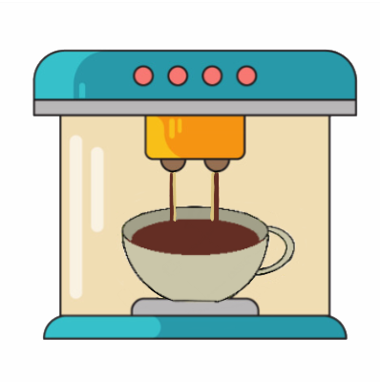
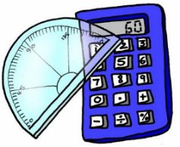
ch
machen
nochmal
Buch
acht
Nacht
Fach
Notes:
Introduce and elicit the pronunciation of the individual SSC ‘ch’ and then the source word again (with gesture, if using). Then present and elicit the pronunciation of the five cluster words. The cluster words have been chosen for their high-frequency, from a range of word classes, with the SSC positioned within a variety of syllables within the words (e.g. initial, 2nd, final etc.). Additionally, we have tried to use words that build cumulatively on previously taught SSCs (see the Phonics Teaching Sequence document) and do not include new SSCs. Where new SSCs are used, they are often consonants which have a similar symbol-sound correspondence in English.
Word frequency rankings (1 is the most common word in German): Buch [195]; machen [49] nochmal [773]; acht [458]; Fach [698]; Nacht [335]. Source: Jones, R.L. & Tschirner, E. (2006). A frequency dictionary of German: core vocabulary for learners. Routledge

Slide 12
ch
machen
nochmal
Buch
acht
Nacht
Fach
Notes:
Without pictures to focus on the SSC alone.

Slide 13
ch
machen
nochmal
Buch
acht
Nacht
Fach
Notes:
Without sound to elicit the pronunciation.

Slide 14
Soft or hard /ch/?
Phonetik
The German /ch/ can be soft or hard.
It is hard after these sounds:
/a/ (machen, acht, Sachen)
/o/ (die Woche, kochen, nochmal)
/u/ (das Buch)
/au/ (auch)
It is soft after other sounds: (manchmal, nicht, richtig).
Notes:
Students have encountered all words used as examples here with the exception of auch [16].
Note: hard and soft here refer to the physiological differences in sound production, i.e. whether the air is forced through the soft palette (‘soft’) or from a place lower in the throat (‘hard’).

Slide 15
Phonetik
Soft or hard /ch/?
lesen / sprechen
Consider the words below. Is the /ch/ is soft or hard?
 | soft | hard |  | soft | hard
leicht (light, easy) |  |  | ziemlich (quite, fairly)
brauchen (to need) |  |  | ein bisschen (a bit)
danach (afterwards) |  |  | die Fremdsprache (foreign language)
schlecht (bad) |  |  | lachen (to laugh)
Notes:
Here, students practise sounding out new words and recognising the different versions of the SSC that result from the different mouth positions.
First, students read the words and decide based on spelling with the /ch/ is soft or hard. The teacher then reads the words out loud. Students check their answers based on what they hear.
Answers revealed on clicks. Teacher elicits oral pronunciation of the words. The words are comprised of previously studied SSCs and transferable consonants with the exception of /au/ brauchen and /sp/ in Fremdsprache.
Unknown words have been chosen so that students must focus on the sound. The words are all highly frequent and will be introduced over the coming weeks. leicht [285]; danach [437]; brauchen [201]; ziemlich [443]; schlecht [332]; lachen [561]; Fremdsprache [1791]

