Slide 1
Myth-busting and meaning making: important ideas for classroom-based language teaching
The Language Show 2021
Presenter: Rachel Hawkes Date updated: 06/11/21
Notes:
Hello. My name is Rachel Hawkes. I’m currently seconded from my school for four days a week to work as co-director at NCELP, and in this presentation I'm going to talk about some important ideas for classroom-based language teaching after nearly three years of work with NCELP (the National Centre for Excellence for Language Pedagogy).
I’ve called this session myth-busting and meaning making because there is a lot of talk out there at the moment. Some of it seems worth unpacking a bit, because at the end of the day most of us are deeply committed to getting classroom language learning right for our students. And I think that to do that, we need to be really clear about what we say.

Slide 2
Myth-busting and meaning making
Phonics
1. Phonics is not in the National Curriculum, (is it?)
Notes:
So, this is something I’ve heard fairly recently. Phonics isn’t in the national curriculum. The bracketed tag question at the end is mine. So I’m not sure where this idea comes from but…

Slide 3
National Curriculum PoS KS2 and KS3
Phonics
Pupils should be taught to:
…link the spelling, sound and meaning of words
develop accurate pronunciation and intonation so that others understand when they are reading aloud
…transcribe words and short sentences that they hear with increasing accuracy
speak coherently and confidently, with increasingly accurate pronunciation and intonation
GCSE specifications in MFL must require students to:
…undertake dictation exercises from short spoken extracts, with credit for accurate spelling.
read aloud, using clear and comprehensible pronunciation, short sentences from the written form of the language and demonstrate understanding of them (for example by answering questions)
KS2
KS3
KS4
Proposed GCSE subject content March 21
Notes:
This is where I see phonics in the National Curriculum. It seems to state clearly that pupils should (not may!) be taught to: [animation] …link the spelling, sound and meaning of words
[animation] develop accurate pronunciation and intonation so that others understand when they are reading aloud [animation] …transcribe words and short sentences that they hear with increasing accuracy
[animation] speak coherently and confidently, with increasingly accurate pronunciation and intonation
This is phonics knowledge. They are writ large in our national curriculum. What it doesn’t say is ‘teach explicit phonics’. That’s because the teaching of phonics knowledge is curriculum, not pedagogy. How it’s done though is pedagogy. Of course, curriculum content has pedagogical implications when teachers have to work out the optimum ways to teach the knowledge. I am not that wedded to one particular method. I use the one I use because a) I tried it out first in the classroom and it works and b) I later learnt about some compelling research that reinforced my view that teaching phonics explicitly is beneficial, and also gave me some ideas about how we could make our phonics teaching better in the department. However, I stand to be convinced by anyone who is 100% happy with their students’ ability to: i) pronounce unknown words they read aloud and ii) transcribe words they hear with increasing accuracy As teachers this is the part we have to be confident about because this is part of the defined curriculum knowledge as set out in the NC PoS. It is further supported by the recommendations of the Pedagogy Review, by the recent Ofsted languages research report, and by the proposed Subject Content for GCSE, where we have this: [animation]
To ensure that we are confident that we are teaching students this knowledge to the best of our ability, in a well-planned and sequenced way, within the considerable time constraints that current languages teaching allocations represent, it seems fair enough to expect us as subject specialists to be informed about the research that exists in this field, to be aware of the different methods put forward for the teaching of phonics, and to evaluate these for ourselves as far as we can, in our classrooms.

Slide 4
Why teach phonics? [1/3]
Teaching phonics in L1 (first language)
Reading comprehension: ‘discovering’ the meaning of words you already know orally
‘Simple View of Reading’ (Hoover & Gough, 1990):
Reading comprehension = decoding x language comprehension
Lots of research in Anglophone countries showing benefits of teaching phonics or early reading (and spelling)
Teaching phonics in L2 (second / ‘foreign’ language)
Written and spoken forms encountered simultaneously!
Notes:
And here we’re talking about ‘why teach it explicitly’ and many thanks here to Dr Robert Woore who has considerable experience of phonics research in UK languages classrooms and who advises and informs NCELP thinking on phonics teaching. ANIMATION
Let’s look then at the importance of phonological decoding. So, in L1, in a first language setting, children meet meet unfamiliar written forms, sound them out using their phonics knowledge, and thus discover (i.e., recognise) their meaning. So we can say that reading comprehension and discovering the meaning of words orally is a key part of the rationale for phonics teaching in a first language setting.
ANIMATION
But, what about teaching phonics in L2? Of course, if we think of our own classrooms, as in many other instructed contexts around the world, so classroom foreign language contexts around the world, learners start to encounter the written language pretty much at the same time as they start to learn the language itself.
If you think of a learner encountering the French word <chat>. Even if they could sound that out, even if they have secure phonic knowledge and can pronounce ‘chat’. If they don’t know ‘chat’ orally, then sounding that word out is not going to help them in terms of understanding or comprehension.

Slide 5
Why teach phonics? [2/3]
Many L2 learners do try to sound out words they don’t know when reading (Erler & Macaro, 2011)
The ability to decode accurately in L2 may additionally support:
vocabulary learning (Hamada & Koda, 2008, 2011; Li, 2019; Li & Woore, in progress)
learner autonomy
grammar learning (Erler, 2003) → je / j’ai parle/ parlé
motivation (Erler & Macaro, 2011)
Speaking; listening; writing (Macaro, 2007)
Notes:
And on that basis, some people might argue that there’s no point in teaching phonics in a foreign language. But we would strongly disagree with that view for several reasons.
Firstly, in a large-scale study by Erler and Macaro looking at MFL learners in England learning French, they found that many learners did actually say that they try to sound out words they don’t know in written texts. There may be some words which they do know, it’s possible that there are some words that they know orally, and that by sounding them out they could discover the meaning. But that will only work obviously if they have the secure phonic knowledge to sound the word out accurately. Otherwise that strategy will misfire.
Beyond thinking about reading comprehension, there is evidence that accurate decoding in a foreign language may have a positive impact on various other aspects of language learning.
So, vocabulary learning being a key one and learner autonomy and those are linked because a learner who is able to sound out a word accurately and obtain an accurate phonological form for that word, is then less dependent on other spoken models.
Grammar learning. Erler pointed out that if a learner is sounding out the word <je> and <j’ai> and is doing that inaccurately, those two words may sound the same to that learner, making them very difficult to distinguish between. The same with say a present tense and a past participle <parle> versus <parlé>, for some learners if they’re decoding inaccurately, those two words may sound the same, so making it very difficult then for them to distinguish between these two key grammatical forms.
A link has been found between ability to decode accurately and motivation for studying the language and intention to continue studying that language.
Speaking obviously, children often speak from the basis of written models.
Listening because the link between spoken and written forms can help learners to segment the speech stream, which is one of the key challenges of listening comprehension.
And finally writing. Again Macaro did a study of beginner learners’ writing strategies in French in an MFL context and found that when copying down from the board for example, they would as part of that process of copying them down sound words out inaccurately and then would reflect that inaccurate pronunciation in what they wrote down. So, they would not copy what was on the board, but it would be mediated by their decoding and it would lead to errors.
So, we can see here, that the rationale for teaching phonics in an L2 may be different but is nonetheless a really strong one we would argue.

Slide 6
Why teach phonics? [3/3]
Research in UK MFL classrooms (mainly L2 French) suggests that without explicit instruction:
students are not very good at phonological decoding (reading aloud);
they seem to make little progress in this area;
English spelling-sound links remain stubbornly entrenched;
students may know that words should sound different to English, but not know how they should sound.
Sources: Erler, 2003, 2004; Erler & Macaro, 2012; Porter, 2014, forthcoming; Woore, 2009, 2010, 2011, 2014, 2018
Notes:
We’ve done quite a bit of research in MFL classrooms looking at progress in phonological decoding over time and I would say that there’s fairly strong evidence that in the absence of explicit instruction, so if they’re not taught phonics, on the whole students are not very good at phonological decoding and reading aloud. That’s obviously not to say that no students are any good at it and nobody makes any progress, but thinking about the average classroom, many learners are not very good at it, they don’t seem to make a great deal of progress over the course of Key Stage 3 and somehow they seem to just carry on reading many words as if they were English words, pronouncing them using the heuristic of English SSCs.
Of course, that’s not surprising because think how much MFL exposure they get per week compared to the vast amount of English texts that they are exposed to in a given week. So those English SSCs are continuously being reinforced.
What we also have found is that if you push students, saying come on how do you think this French word should sound, in many cases they do know when they stop to think about it that it should not be pronounced like English but they don’t have that secure phonic knowledge to know how it should be pronounced so they may come up with all kinds of different pronunciations which are incorrect but at least they’re not English. So that’s why we’ve got this analogy, it’s a bit like pin the tail on the donkey, as though they’ve got a blindfold on and they’re trying to think well how should I say this?

Slide 7
Research evidence
Summary: Is teaching L2 phonics effective?
“The research evidence on this question remains limited in quantity, and the studies that do exist have various methodological limitations. However, consistently positive effects of phonics instruction on L2 decoding have been found across various phases of formal education (primary school, secondary school and university): it appears that L2 learners who are taught phonics are more likely to develop more accurate SSC knowledge than those who are not. Experimental evidence is also emerging of an impact on L2 vocabulary learning.” (Woore, forthcoming)
Remember also the evidence on L2 learners’ outcomes in the absence of phonics instruction!
Notes:
Robert Woore at the University of Oxford is currently understanding a meta-review of around 20 phonics studies. It is not yet published but here is a summary of the findings of the analysis.

Slide 8
Target SSC in French
silent final consonant
a
i/y
eu
e
au/eau/closed o/ô
ou
u
silent final e
é (-er, -ez)
en/an/em/am
on/om
ain/in/aim/im
è/ê/ai
oi/oy
ch
ç (and soft 'c')
qu
j
-tion
-ien
s-liaison
t-liaison
n-liaison
x-liaison
h
um/un
-gn-
r
open eu/œu
open o
-s-
th
-ill-/-ille
-aill-/ail
-eille-/-eil
-euill-/-euil/-ueill-/-ueil/-œill-/-œil
-ouill-/ouil
Notes:
These are the SSC listed in the proposed GCSE Subject Content for French. As I mentioned, in my trust we have taught phonics explicitly since the early noughties. However, in the last three years we have developed our practice in the light of NCELP’s work in this area. Many things are the same. However, we now: i) stagger the roll out of phonics more evenly across the year ii) revisit systematically iii) plan practice activities that use unknown words iv) make use of minimal pairs (use words that only differ by one phoneme) v) assess phonics knowledge

Slide 9
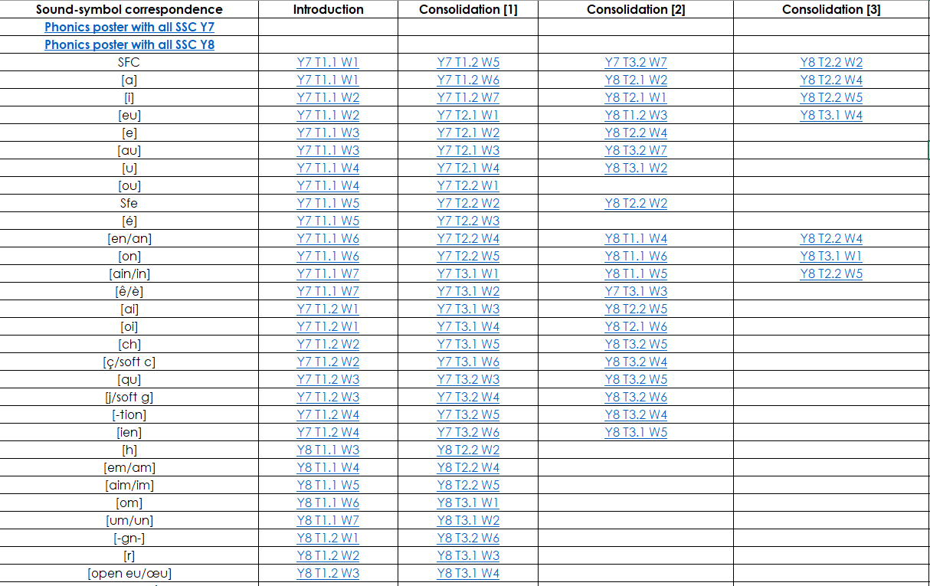
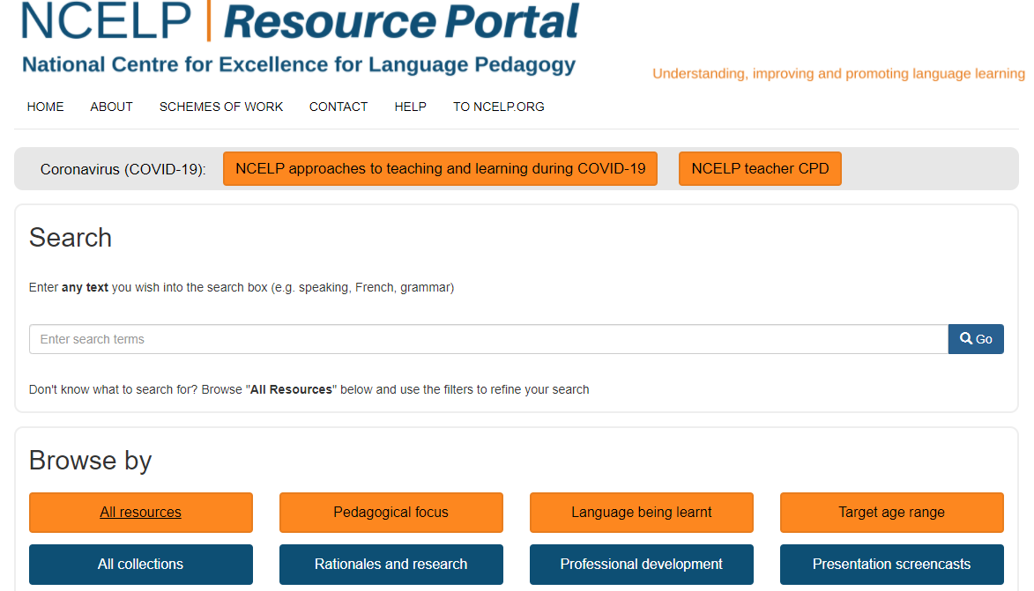
French phonics
phonétique
https://resources.ncelp.org/
Notes:
NCELP plans the initial teaching, practice and spaced revisiting of phonics with all of the identified sound-symbol correspondences into its SOW at KS3. Its assessments also test them. All of these materials are available in phonics collections, easily accessed from the homepage of the resource portal.

Slide 10
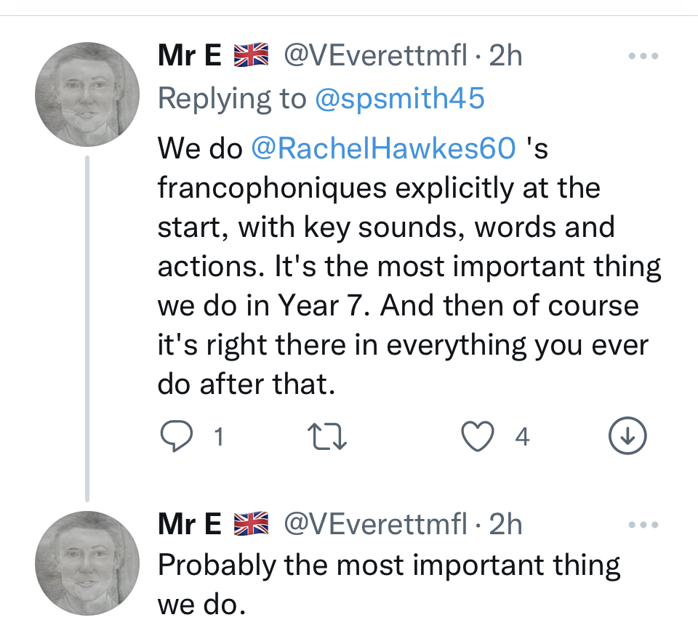
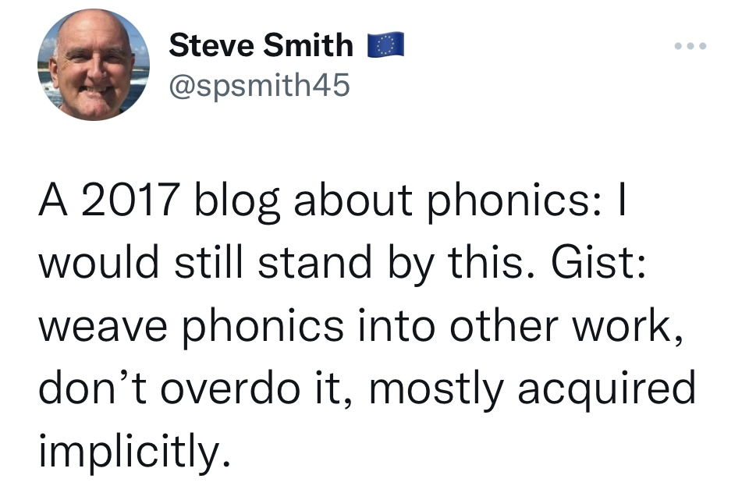
Myth-busting and meaning making
Phonics
2. All of this systematic planning isn’t needed, (is it?)
Notes:
But surely all of this systematic planning isn’t needed, is it? We can just draw attention to phonics as and when they come up in the classroom, incidentally. Or, on the other hand, starting with explicit phonics is the most important thing to go in Y7. There are loud voices on Twitter and busy teachers who are searching for definitive answers may be inclined to follow the strength of the voice. But I think that we need to accept as teachers that we have to evaluate critically what we are presented with. We need to ask questions, and get answers – the answers might not be categorical but they will inform our practice. So there’s what we have shared in terms of the policy documents, what we have to deliver in terms of knowledge, then the research, then of course there are various different views of experienced teachers and retired colleagues out there, which are also important to hear, particularly if they are backed up by classroom experience, and then there are the end points – the exams that conclude a phase of study, the GCSE. Currently of course we’re waiting to have the final subject content confirmed, but I’d think it would feel a bit surprising if phonics were suddenly absent from the final version, given the strength of its representation in the KS2 and 3 NC, the pedagogy review and recent Ofsted research report. So on that basis, we need to start weighing our current practice against all that and make pedagogy decisions.

Slide 11
French phonics
phonétique
Notes:
I’m not sure I’d be confident that this would be as good for my students’ learning.

Slide 12
SSC [e] ou [ê/è] ?
phonétique
Je suis avec mon chat, Pacha
As you have already learned, some French words containing an unaccented ‘e’ are not pronounced like je.
Some sound like ê/è, such as in avec [with].
Listen to the difference here between the ‘e’ in je and the ‘e’ in avec.
Notes:
I just have time for one example and I chose it because when I was reviewing the resource it struck me as a really good example of something that I wouldn’t just have come up with on the spur of the moment, if I’d noticed in a lesson that pupils were struggling with these two sounds.
So, I am fairly confident in saying that my students would be better served by this sets of slides than my spontaneously drawing their attention to the issue and casting around in the moment for a few examples to help them practise.
Timing: 1 minute
Aim: Raising awareness of different sounds represented by the SSC [e].
Procedure:
Explain that an e without an accent is not always pronounced like je, giving the example of avec.
Listen to the audio, and students repeat the sentence, emphasizing the pronunciation of je and avec.
Transcript:
Je suis avec mon chat, Pacha

Slide 13
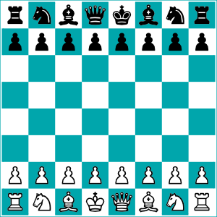
SSC [e] ou [ê/è] ?
Listen carefully to the pronunciation. Do you hear [e] or [ê/è]?
écouter
1
tunnel
2
chenille
[e] | [ê/è]
[e] | [ê/è]
3
melon
4
*échecs
[e] | [ê/è]
[e] | [ê/è]
*échecs = chess
Notes:
Timing: 8 minutes. Slide 1/3.
Aim: to practise aural recognition of SSCs [e/ê/è].
NB: unknown words
Procedure:
1. Click numbers to hear a word.
2. Students tick whether they hear the [e] or [ê/è] sound.
3. Click to reveal answers.
4. Listen again, this time drawing attention to the e sounds. Students repeat.
5. Students say the words one more time, emphasizing the correct e sound.
Transcript:
tunnel
chenille
melon
échecs
Word frequency of unknown words used (1 is the most frequent word in French):
chenille [>5000], échecs [>5000]
Source: Lonsdale, D., & Le Bras, Y. (2009). A Frequency Dictionary of French: Core vocabulary for learners London: Routledge.
Word frequency of cognates used (1 is the most frequent word in French): tunnel [3386], melon [>5000]
Source: Lonsdale, D., & Le Bras, Y. (2009). A Frequency Dictionary of French: Core vocabulary for learners London: Routledge.

Slide 14
SSC [e] ou [ê/è] ?
Listen carefully to the pronunciation. Do you hear [e] or [ê/è]?
écouter
1
renard
2
cheval
[e] | [ê/è]
[e] | [ê/è]
3
*bec
4
carrousel
[e] | [ê/è]
[e] | [ê/è]
*bec = beak
Notes:
Slide 2/3
Transcript:
renard
cheval
bec
carrousel
Word frequency of unknown words used (1 is the most frequent word in French): renard [>5000], cheval [2220], bec [>5000]
Source: Lonsdale, D., & Le Bras, Y. (2009). A Frequency Dictionary of French: Core vocabulary for learners London: Routledge.
Word frequency of cognates used (1 is the most frequent word in French): carrousel [>5000]
Source: Lonsdale, D., & Le Bras, Y. (2009). A Frequency Dictionary of French: Core vocabulary for learners London: Routledge.

Slide 15
SSC [e] ou [ê/è] ?
Have you noticed any spelling patterns which could help you identify whether to use the [e] or [ê/è] sound?
Listen carefully to the pronunciation. Do you hear [e] or [ê/è]?
écouter
caramel
chaussette
1
2
[e] | [ê/è]
[e] | [ê/è]
peluche
3
*vitesse
4
[e] | [ê/è]
[e] | [ê/è]
*vitesse = speed
Notes:
Slide 3/3
Differentiation option for higher level students: Do you notice any patterns emerging for words containing an e which is not pronounced like je?
Point out there is a rule in French for this: This pronunciation comes before double consonants e.g. –ette, and when it is a closed syllable (a syllable ending in a consonant sound), e.g. caramel, bec. Can use following slide for add-on activity.
Transcript:
caramel
chaussette
vitesse
peluche
Word frequency of unknown words used (1 is the most frequent word in French): chaussette [>5000], vitesse [1065], peluche [>5000]
Source: Lonsdale, D., & Le Bras, Y. (2009). A Frequency Dictionary of French: Core vocabulary for learners London: Routledge.
Word frequency of cognates used (1 is the most frequent word in French): caramel [>5000]
Source: Lonsdale, D., & Le Bras, Y. (2009). A Frequency Dictionary of French: Core vocabulary for learners London: Routledge.

Slide 16
SSC [e] ou [ê/è] ?
phonétique
In French, the e is usually pronounced as in avec [ê/è] when:
It comes before a double consonant, such as vitesse [speed]
It comes before a ‘c’ or ‘l’ in the last syllable, such as bec [beak]
Following this guide, decide whether the unaccented e makes the [e] or [ê/è] sound, and say the words. Check by listening to the native speaker.
1
assiette [plate]
repos [rest]
vaisselle [crockery]
verre [glass]
culturel [cultural]
première [first]
2
3
4
5
6
Notes:
[Optional] Timing: 3 minutes
Aim: Differentiation: additional slide for higher level students: Raising awareness of differences between different ‘e’ sounds.
Procedure:
In French, the e is usually pronounced as in avec [ê/è] when:
It comes before a double consonant, such as vitesse [speed]
It comes before a ‘c’ or ‘l’ in the last syllable, such as bec [beak]
Students say the words, applying the rule.
Listen to the native speaker to check.
Transcript:
assiette
verre
repos
culturel
vaisselle
première
Word frequency of unknown words used (1 is the most frequent word in French):
assiette [3756], verre [2174], repos [2731], vaisselle [>5000], première [56]
Source: Lonsdale, D., & Le Bras, Y. (2009). A Frequency Dictionary of French: Core vocabulary for learners London: Routledge.
Word frequency of cognates used (1 is the most frequent word in French): culturel [1495]
Source: Lonsdale, D., & Le Bras, Y. (2009). A Frequency Dictionary of French: Core vocabulary for learners London: Routledge.

Slide 17
Myth-busting and meaning making
Phonics
Phonics knowledge is a requirement of the national curriculum PoS, (regardless of how it is developed).
There is classroom and research evidence to support the explicit teaching of phonics.
Phonics knowledge appears to benefit several aspects of language learning, including (excitingly!) vocabulary learning.
Notes:
Let’s conclude then on phonics.
We can say that the teaching of phonics contributes to meaning making in several ways, too: i) students are able to read known and unknown words off the page more accurately ii) this can aid comprehension (in a similar way to how helpful I always used to find it as a learner, when my teacher read the words aloud – it suddenly seemed to make them so much easier to understand). iii) it supports autonomous learning (in class - students are able to work in pairs more effectively in the classroom (e.g., testing each other on vocabulary, providing a good source of peer input in the target language, for a whole range of activities, but also at home – students are able to sound out words accurately for themselves and are less likely to learn mispronunciations )

Slide 18
Myth-busting and meaning making
Vocabulary
Vocabulary to be taught should be informed by frequency of occurrence in the language, and special attention should be paid to common verbs in the early stages... A consequence of not attending to frequency of occurrence in vocabulary choice is pupils realising that they cannot say or understand basic things in the language.
Anon. 2016. Modern Foreign Languages Pedagogy Review. A review of modern foreign languages teaching practice in key stage 3 and key stage 4. (Chair: Ian Bauckham). Teaching Schools Council.
Notes:
Let’s move on.

Slide 19
Myth-busting and meaning making
Vocabulary
3. If we choose to teach high frequency words, there are no topics, (are there?)

Slide 20
High frequency words
free-time activities?
travel and tourism?
many high frequency words are content rich
many words in the top 2000 fit into a range of topics
important to connect new words in the L2 with more than one topic
global issues?
el bosque [1444]
la forêt [1274]
der Wald [1028]
social issues?
home, town, neighbourhood and region ?
Notes:
So, some facts about high frequency words.
[Cue animation]
Many (the majority, actually) of the words in a list of the 2000 most frequent are content rich and applicable in range of cultural and thematic contexts. For that reason, if can be tricky to stick them in one particular topic-based list.
[Cue animation]
For example, in which of the current GCSE topics would you put la forêt [1274], el bosque [] or der Wald []?
I think you could argue for its place on any one of these topic-based lists, and, ideally, by the end of Y11, we’d probably want to see it on all five.
The meaning of ‘forest’ and the associations that come to mind vary depending on the context in which it is encountered, and we would want students to be able to recall the word to talk about environmental issues just as readily as to talk about holidays in Switzerland.
This is the central idea behind NCELP’s work on vocabulary and topics. Rather than assigning words to topics, we assign topics to words. Each content word is likely to have several topics, rather than just one.
At the beginning of the language learning process is when topics need to be at their most general, which is why the early Y7 NCELP resources are the most different from existing textbooks. Once students have built up a bunch of language themes can and do emerge and of course by the start of KS4 students will have more than 1000 words, many of which are content-rich. How do we know that the words in a list of the most frequent 2000 are content rich?

Slide 21
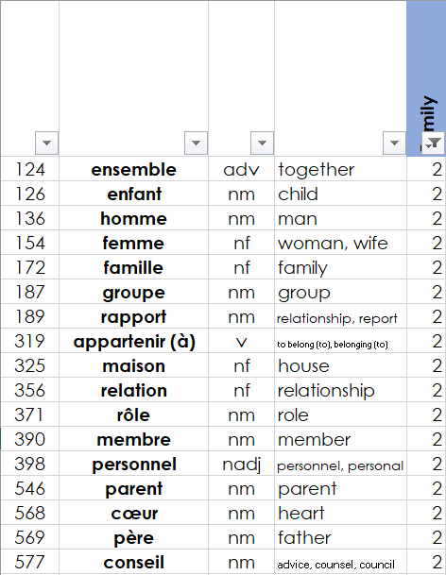
Vocabulary and cultural themes
Assigning ‘topics to words’
Family
Words are semantically tagged using a rating scale approach to determining whether the individual meanings of words fall into the sphere of certain semantic themes or not (Chung and Nation, 2004).
Notes:
Here is a snapshot of the French wordlist that we use at NCELP. As you can see, the words are listed in frequency order – those are the numbers on the left. Along the top, you can see some of the topic headings we identified as relevant to GCSE-level learners – there are 51 in total.
The numbers that you can see in the boxes are semantic tags that 3 NCELP colleagues have assigned to each word. This was a time consuming process, with every word in the top 2000 reviewed and assessed as to whether it belonged to each of the 51 categories. If there is a number two in the box, that means that two people agreed that this word belonged to the topic represented in that column, suggesting that there is a strong semantic connection to the word.
So, to find words that belong to each topic we can simply filter the column by semantic tag. Here is an example with the topic of family. If we filter by all of the words that have a ‘2’ attached to them, that gives us a nice set of words in the top 2000 that have a clear connection to this headword. The process is not exhaustive and is subjective (according to each rater’s life experiences and belief systems). And of course you could filter at level 1 or level 3, not filtering at level 2 shows you words that perhaps a larger majority of the population would generally agree belongs that category, which suits our purposes for beginner level quite well.
(The more raters you have, of course, the higher your cut-off number can be, and the more reflective of the general population your list becomes. But it’s worth bearing in mind that this is a subjective process, and cannot, of course, predict every word that every student is going to associate with every theme.)

Slide 22
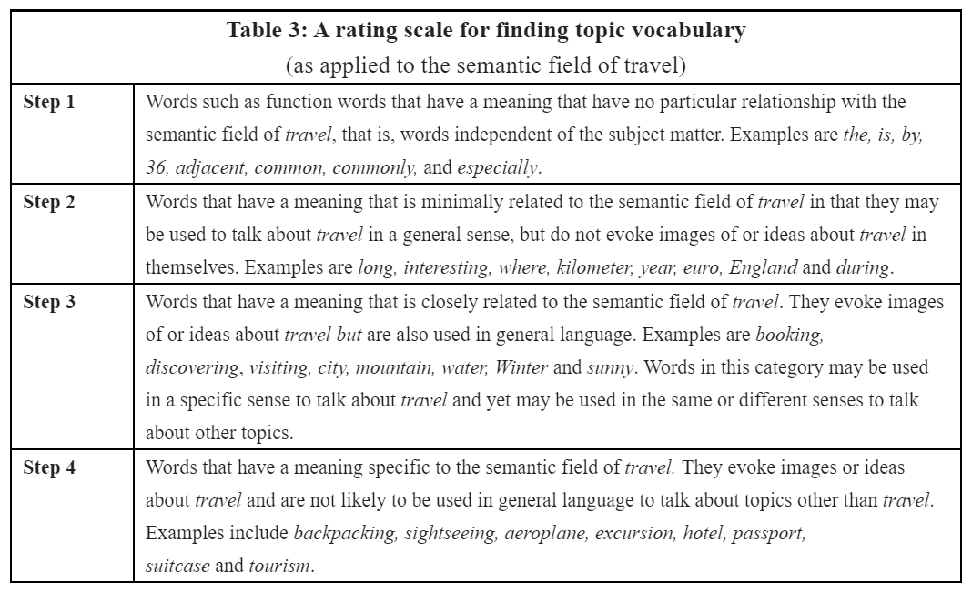
Vocabulary and cultural themes
Assigning ‘topics to words’
(Adapted from Chung and Nation, 2004)
Notes:
CL notes:
So, if you would like to try this at home after this session, this is the rating scale we used. It's adapted from the work of Chung and Nation who originally used the method to identify technical vocabulary for more advanced learners, and we just tweaked the wording slightly to make it applicable to beginner and intermediate level topics. And it’s a really interesting exercise in terms of reviewing any vocabulary lists you are currently using.
More details on the rating system and some tips can be found in the notes under this slide.
…………………………………………………………………………………………………………………………………………………………………………………………..
Participant notes:
So, if you would like to try this at home after this session, this is the rating scale we used. It's adapted from the work of Chung and Nation who originally used the method to identify technical vocabulary for more advanced learners, and we just tweaked the wording slightly to make it applicable to beginner and intermediate level topics.
We were working at step three, so only tagging words that had meanings closely related to the topic heading. Words at steps one and two that don't get tagged are things like function words that don't have any particular relationship to the topic at all, and words that are related to the theme but in a more general sense – for example, ‘long,’ ‘interesting’ and ‘kilometre’ are all words you would use to talk about travel, but they don’t necessarily scream ‘travel’ when you see them in isolated contexts as they are also used to talk about all sorts of other things. When performing semantic tagging, you’re looking specifically for words that make you recall the theme, by prompting images or memories related to it.
It took our raters about three days to get through the top 2000 list, but it is a process that is really worth doing with any vocabulary lists you are using (though you may wish to spread the work over a few weeks or months, perhaps!)

Slide 23
Myth-busting and meaning making
Vocabulary
4. High frequency words are just function words, (aren’t they?)

Slide 24
High frequency words
1231 high frequency French words
1248 high frequency Spanish words
1318 high frequency German words
had strong connections with one or more semantic themes relevant to GCSE
Some of the remaining words are content words with no strong connection to a theme relevant at GCSE. These are not taught.
Many are highly important, useful words which can be used to talk about a range of topics and it is important that these are practised and revisited just as often as the topic words.
Notes:
So, using the rating method for a list of all of the 2000 most frequent words, we found that:
[Cue animation]
Around 60-65% of the words in the top 2000 have strong connections with one or more of the cultural themes that we considered to be relevant to GCSE-level learners.
It is not the case that all high frequency words in a language are function words with no semantic richness. Some of them are, of course – some of the very highest frequency words are conjunctions and prepositions – but the vast majority are culturally, socially, personally-rich content words.
[Cue animation]
Some the words in the top 2000 aren’t assigned to topics not because not because they are function words, but because they are content words that don't belong to topics that are that considered suitable for GCSE (for example, legal words like juridique). Such words aren’t included in the NCELP vocabulary list, and don’t feature in NCELP lessons or SOW.
[Cue animation]
But many of the other words that aren't included in the figures that you see here are still important, useful words, despite not having a clear link to a particular theme. They might be highly descriptive words that can be used to talk generally about a range of topics, such as ‘must’ or ‘usual’ or ‘normally’. It is important that words like these are given just as much focus, in practice and revisiting, as the more overtly ‘topicky’ words.

Slide 25
Populating a vocabulary strand
“Vocabulary selection should be informed by frequency of occurrence” (TSC 2016)
Other factors: complexity, (tiering), usefulness for target group (teacher input), frequency in other corpora* (written & spoken), topics
*Other corpora consulted: French Web 2017 (frTenTen17), French corpus of 88, 000 SMS (88milSMS), frWaC, Corpus d'Etude pour le Français Contemporain (CEFC), German Web 2013 (deTenTen13), deWaC, Datenbank für Gesprochenes Deutsch, Spanish Web 2018 (esTenTen18), esWaC, Corpus Oral de Referencia de la Lengua Española Contemporánea (CORLEC)
Notes:
However, of course, factors other than frequency must be considered when choosing words for a vocabulary list for a specific target group – in this case, teenagers learning languages in the UK.
As part of our word list evaluation process, [cue animation] we assigned each word in the top 2000 a tier based on complexity of usage, [cue animation] we considered the opinions of schoolteachers and test writers regarding the usefulness of the words for their cohorts, [cue animation] looked at the frequency of the words in corpora of spoken and informal language and, [cue animation] as discussed, ranked the applicability of the words for topics and themes relevant to school-age learners.

Slide 26
Myth-busting and meaning making
Vocabulary
5. The current GCSE is not broken, (is it?)
Eduqas Exam Report, GCSE summer 2019
“Vocabulary and verbs were the main stumbling blocks.”
Notes:
So on the one hand we are hearing people saying the current GCSE is not broken. Whilst the indications we get from examiners’ reports suggest a different picture. And we don’t have anything like the government aspiration of 75% students taking a language at GCSE.
Change is always hard, and harder still when we feel it is not necessary. However…

Slide 27
The connection between what is taught and tested
On average*, 49% of the words on the current word lists have never been used over four years of L & R exams, *across tiers (foundation, higher), AOs (AQA, Edexcel), and languages (French, Spanish, and German)
On average*, 21% of the words on the current word lists have been used only once over four L & R exams, * across tiers (foundation, higher), AOs (AQA, Edexcel), and languages (French, Spanish, and German)
Average number of words used in every paper (excl. sample):
Foundation: 178 (214), Higher: 221 (268)
of which about 20% are not on current wordlists
Lower frequency words change at a much greater rate year on year than the high frequency words
Notes:
It is broken, and a large part of what is broken is the connection between what is taught and tested.
Some of this we might have suspected as teachers, as we are the ones that pour over the exam papers as soon as we can, and we are the ones that try to convince our demoralised students that it will still be a good idea to do A level after they come out of the higher listening exam. And we are the ones that feel dreadful that we have taught our socks off and still there are many words on the papers that students don’t know because we didn’t know to teach them. What is broken is the connection between learning effort and learning outcome. Sure that is enough for us to consider the need to embrace change.
Of course, without the tools to analyse all of the words in in all the papers across all of the awarding organisations, we had no way of knowing for sure.
But NCELP has recently done this analysis, and found that:
About half of the words that are on the current GCSE word lists have not appeared in any GCSE exam from the current specification
Just think about that for a moment – these lists feed textbook creation. I know that first-hand. In any case we could never fit in all the words that were on them, but knowing now that even if we could have fitted them all in, almost 50% has not been used in any of the four years of exams.
Just over 20% of the words on the list have have been used just once. Also, though not shown here, of the words that have only ever been used once over the four exams, 42% are on the word list, meaning that 58% of them are not.
There is a relatively low number of words that definitely will appear every year and 1 in 5 of them are not on the current lists (as the subject content states that some words must be tested off the list)
The lower frequency words change year on year much more often than the high frequency words – this is to some extent inevitable – but it adds an extra layer of unpredictability – not only are the words low frequency so they are less likely to have turned up in books or in lessons, trips abroad, they are also not likely to turn up again in another exam.
The awarding bodies are currently required to test words off the list. This, plus the fact that the use of the words on the list is not obligatory has led to this very high degree of unpredictability for teachers and pupils and therefore an emphasis on the skill of lexical inferencing – working out words from the words around them - an important component of language competence, particularly once you reach intermediate proficiencies and beyond. This should of course be tested, too, but whilst also recognising that to do lexical inferencing, a really solid grasp of the core vocabulary is needed first. It is about balance, and fairness.
So, whilst some low frequency words are of course useful and needed, a word list would allow us to identify these words, making the connection a bit more reliable between what is being taught and what is tested. So a defined word list, where important high and low frequency words are identified has much to recommend it.
How can we say that the randomness of word selection in current exams isn’t demoralising for students? And therefore the reverse. How can we claim that having a defined word list won’t serve to strengthen the connection between effort and outcome for our students, and be motivating.

Slide 28
Myth-busting and meaning making
Vocabulary
6. The proposed GCSE is not a good preparation for A level, (is it?)
Notes:
My source for this myth was a TES article, where the author writes: “What kind of preparation is this (referring to the proposed GCSE subject content) for study beyond GCSE or use of the language in any real-world context?”
https://www.tes.com/news/why-proposed-changes-mfl-get-it-all-wrong John Claughton

Slide 29
How much coverage do word lists have of current A level exams?
Preparing students for A level
Comparing the coverage given by:
→ Current GCSE word lists
→ A list with an equivalent number of words based solely on frequency
→ Lists following revised new GCSE Subject Content parameters
Notes:
OK, so I want to thank Dr Amber Dudley at NCELP for her work, here. To approach this question objectively, she set out to compare the coverage of different word lists for the current A level exams. By coverage we mean the % words that students would know in the texts and transcripts from all the A level exams put together (from the current specifications) if they had learnt the words on a particular word list. And here she compared 3 different lists:
→ Current GCSE word lists
→ A list with an equivalent number of words based solely on frequency (literally frequency in order, ranked top to bottom)
→ Lists following revised new GCSE Subject Content parameters (i.e. we created a draft list of GCSE words according to the proposed new subject content)

Slide 30
Averages – Across Languages and AOs (AQA & Edexcel)
 | Number (%) of word families on A level papers that are on …
Word families from A level papers that have been used in… | GCSE word list (n = 1810) | High frequency* word list (n = 1810) | A new GCSE word list (n = 1582)
… every paper (2018, 2019, 2020, sample 1, sample 2) (196 different word families) | 148 (76%) | 184 (94%) | 179 (91%)
… every actual exam (2018, 2019, 2020 – excluding samples) (259 different word families) | 181 (70%) | 240 (92%) | 231 (89%)
… only one individual paper ever (1500 different word families) | 317 (21%) | 466 (31%) | 394 (26%)
… a typical exam paper (averaged across the four exam papers) (894 word families) | 391 (44%) | 565 (63%) | 523 (59%)
… all papers combined to make ‘one big A level text’ (2349 different word families) | 766 (33%) | 1133 (48%) | 1020 (43%)
On average, a new GCSE list has 13% fewer words, but provides 34% more coverage of a typical A level text.
Notes:
New GCSE word lists: give more coverage that existing GCSE words lists.
**The ‘new GCSE’ Higher word list has 13% fewer words, but provides 34% more coverage in a typical exam paper**
These analyses were carried out separately by year, by language and by awarding organisation, and for those that are interested in those individual, very detailed results, the slides will shortly be available on the NCELP resource portal. However, I’ve cut to the chase here with a slide that averages across languages and across awarding bodies.
The headline is that a draft new GCSE word list gives more coverage than current GCSE word lists. On average the lists have about 13% fewer words, but provide 34% more coverage.
There are 1582 words in the new GCSE word list column because this is an average across the three languages, and it’s not 1700 because a new GCSE word list will list some parts of word families (e.g., parts of highly irregular verbs such as etre/avoir as separate words).
…………………………………………………………………………………………………………………………………………………….
We also must remember that the current GCSE assumes knowledge of other words too (from KS3) so the exams use words every year in their exams which were not on the list. This makes up the difference between the NCELP lists and the current GCSE word lists, making the comparison fair: with the same number of words essentially on both lists, the frequency informed list provides better preparation for the words used on current A levels.

Slide 31
Myth-busting and meaning making
Vocabulary
A frequency-informed approach to vocabulary selection connects more topics to words, not fewer.
This is likely to help students now with the current GCSE, as current exams already test words across different topics, and this is problematic for many students.
The current GCSE text books match the GCSE word lists and are therefore what we teach, but they don’t match the content of the exams. A defined vocabulary list would address this.
A word list designed within the parameters of the proposed new GCSE content gives more coverage of current A level exams than the current GCSE word lists do.
Notes:
So, to conclude this section on vocabulary…

Slide 32
Myth-busting and meaning making
Grammar
7. You don’t need grammar to communicate (do you?)
Notes:
And now, finally, grammar. This is a direct quote from a session I recently attended.
Again, the tag question is mine.

Slide 33
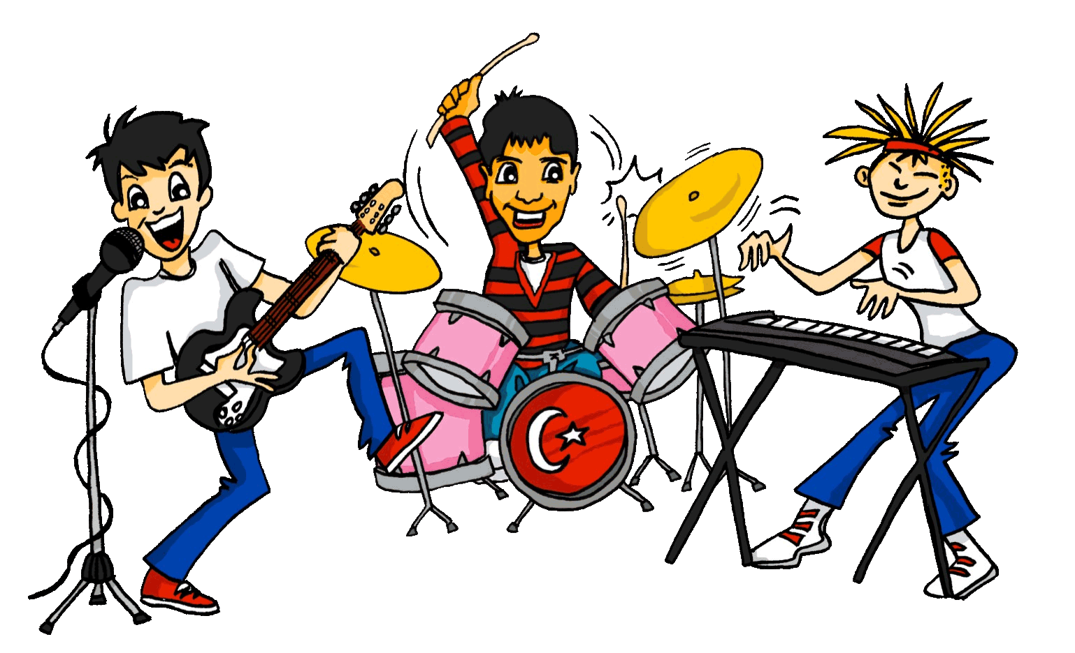
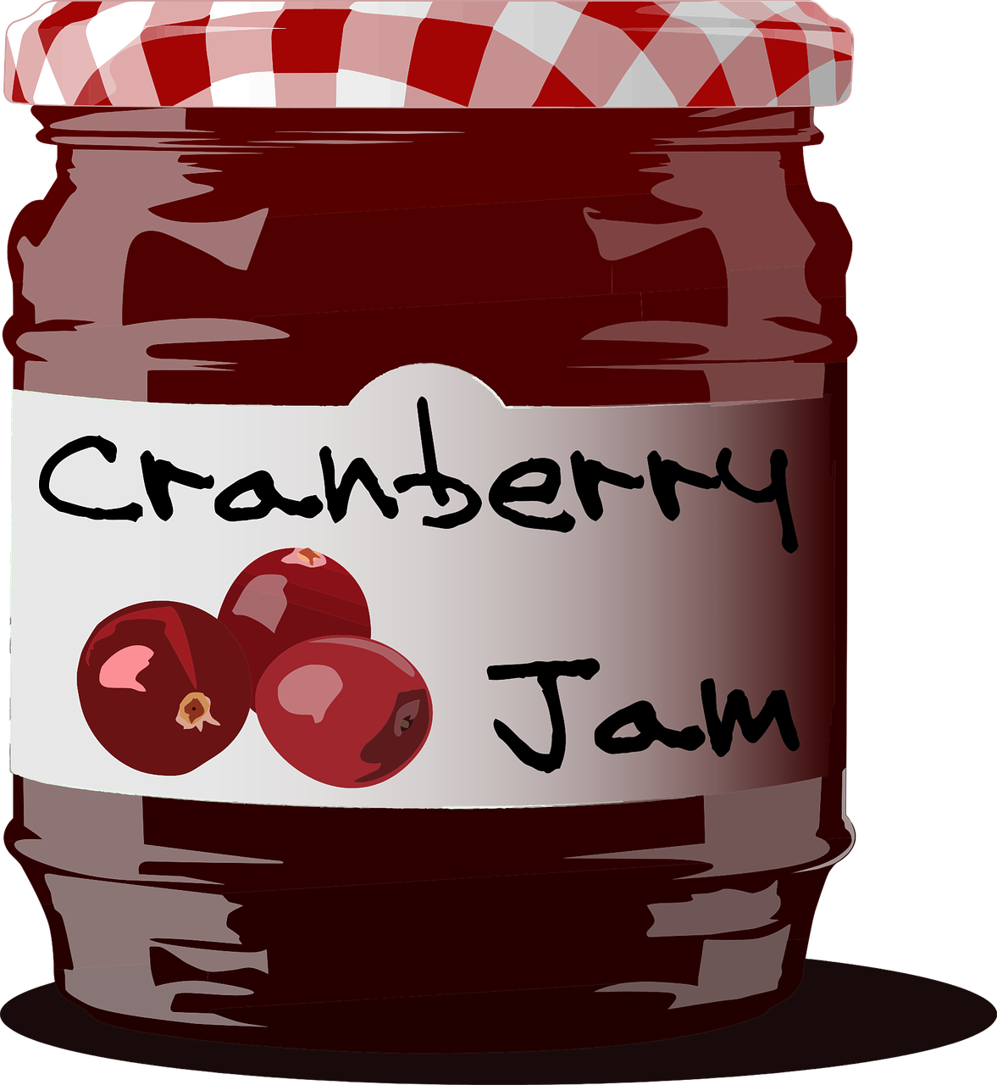
Grammar
"Only by putting words in sentences are we able to make sense of them… Grammar is the study of how sentences mean, and how the bits of sentences mean. And that is why it helps."
Crystal, 2016, p.29
Notes:
Why grammar? Why explicit grammar? Why explicit grammar in a particular way or with particular features in the teaching?
Let’s start with a David Crystal definition of grammar’s importance. Words without sentences lack elements of meaning, are likely to be ambiguous, or the communication unclear. Crystal gives example of jam - two nouns, one verb – meanings completely different. Using grammar (both to understand and to create meaning) is about communicating meaning clearly, then. When we think about grammar, and grammatical accuracy, we’re often implicitly thinking about production, and then with 2nd language learning, inevitably about mistakes. But actually knowing grammar well is just as much, if not more, about understanding meaning clearly.
………………………………………………………………………………………………………………………………………
David Crystal: “Nobody would ever doubt the importance of ‘meaning’ in educational practice. Meaning is why we communicate – to understand each other, enjoy each other’s company, build social rapport, obtain emotional support. We need to follow and interpret what other people do when they talk or write, and make ourselves clear and effective when we carry out these tasks ourselves. It’s sometimes thought that meaning is nothing to do with grammar, that it is just a matter of vocabulary. When we say we’re going to ‘look the meaning of a word up in a dictionary’ we give that impression. But it’s a misleading impression. A word on its own conveys little meaning.

Slide 34
Myth-busting and meaning making
Grammar
8. But we don’t need grammar from the start, (do we?)
Notes:
This question for me is about equality of opportunity.
So, we often associate the ability to treat language as an object (i.e. analyse it, spot patterns, know language rules, and use technical language to describe linguistic phenomena.
with older learners. In fact, this knowledge is developing rapidly during middle childhood (age 7 – 11). This has some implications for how we see classroom language learning at KS2. There has been a tendency to see language learning at primary as more about memory than analysis. But there are some studies that show marked gains for young learners who engage in explicit, rule-based, analytic learning.

Slide 35
Equality of opportunity
Language analytical ability predicts foreign language proficiency in young learners (8-9 years). Roehr-Brackin & Tellier (2019)
Metalinguistic instruction is related to greater mastery in use of grammatical knowledge. White & Ranta (2002)
Metalinguistic ability can be improved through instruction, leading to less variation in performance (i.e. between learners with higher / lower levels of innate language analytical ability). White & Ranta (2002); Roehr-Brackin & Tellier (2018)
Short bursts of listening and reading practice with primary age learners (9-11), which focus attention on the meaning of grammatical forms, can help grammar learning. Kasprowicz & Marsden (2017)
Notes:
Two award winning articles have shown how important "analytic ability" is for foreign language learning
(Roehr-Brackin in Studies in Second Langauge Acquisition, and Kasprowicz & Marsden in The MLJ). The age of learners in both these studies was primary age (8 – 9, 9-11), so primary age learners who were taught grammar features explicitly, the outcomes showing that pupils at this age can learn grammatical patterns and that analytic ability predicts proficiency. i.e. the better pupils are at pattern spotting, language rules, grammar essentially, the more language proficient they will be.
As I said, it seems to me to be about equality of opportunity, and at the appropriate time, i.e., when there is evidence that pupils can benefit from explicit grammar teaching.
In a nutshell:
If we don't help learners work out the language system, we can't help level the playing field for those who don't naturally analyse language;
those who are 'naturally gifted' with analytic ability will have a huge advantage if we don't help the others.
Kasprowicz, R.E. & Marsden, E. (2017). Towards ecological validity in research into input-based practice: Form spotting can be as beneficial as form-meaning practice. Applied Linguistics (Advance Access), 1-27. http://dx.doi.org/10.1093/applin/amw051

Slide 36
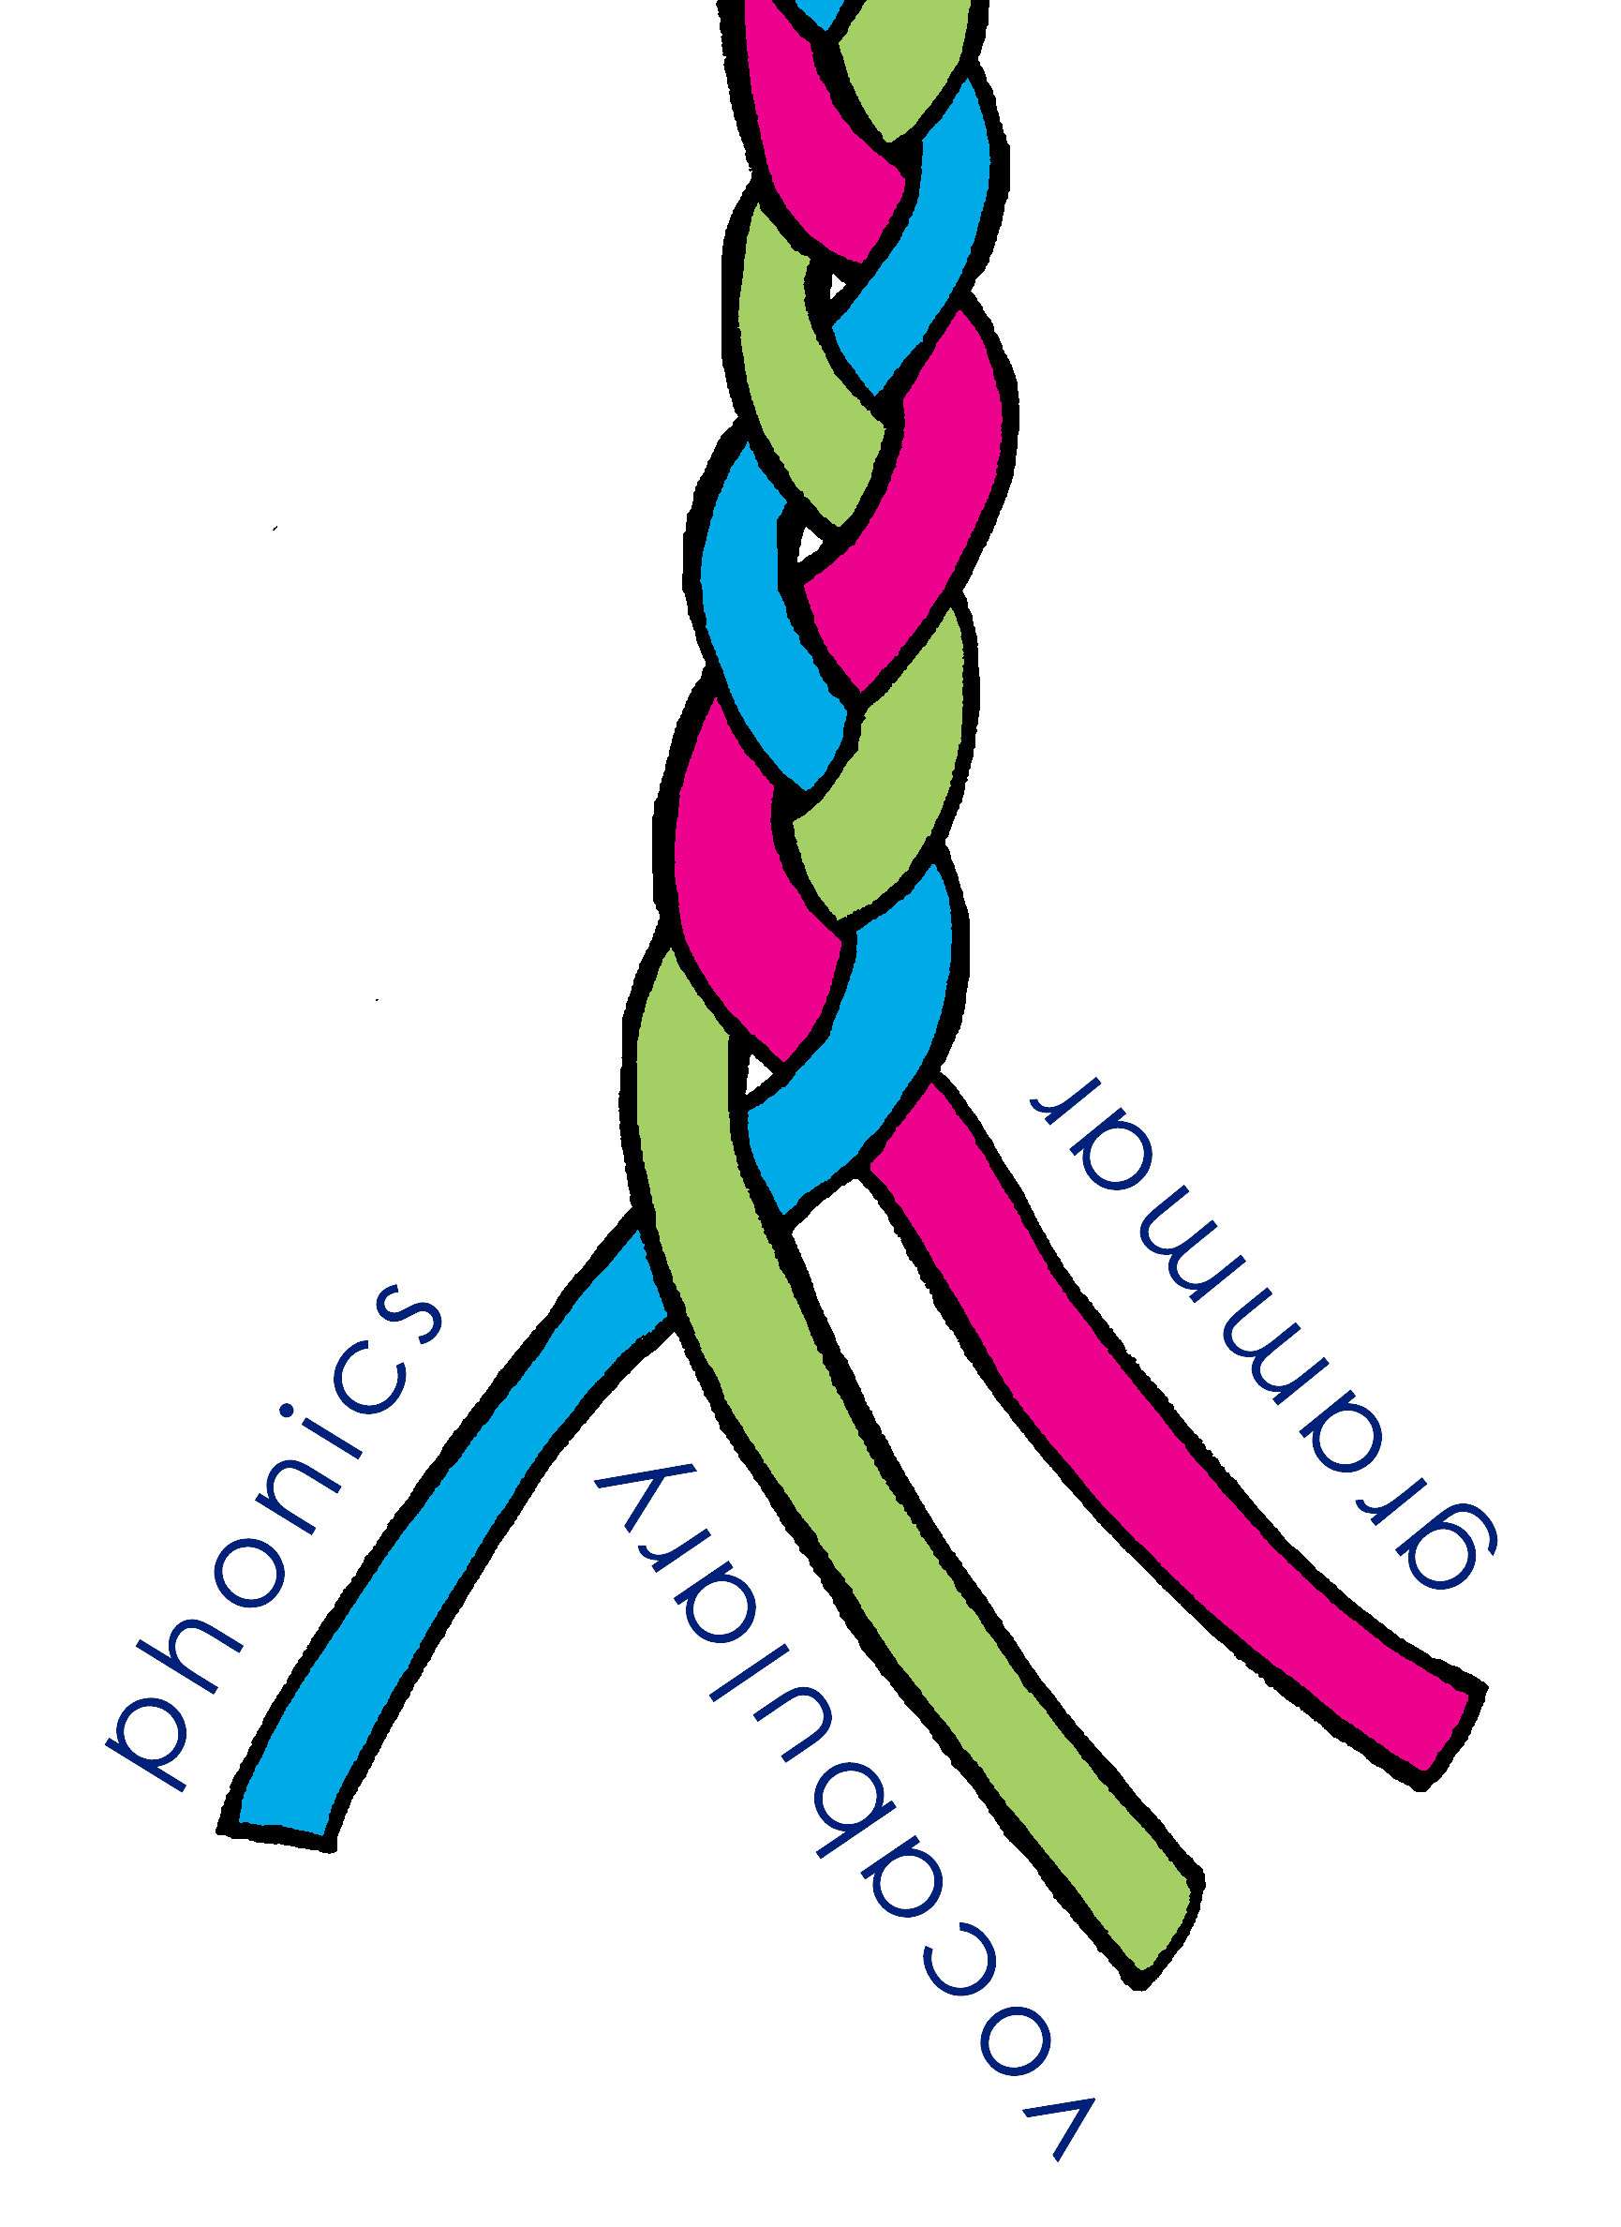
New primary SOW for French and Spanish (German from September 2022)
Time allocation (realistic yet optimal)
60 minutes per week in total
30-minute lesson
five mini follow ups (four x five minutes, one x 10 minutes)
Structure (4-year, 2-year rolling)
one structure that fits both!
The three strands
phonics and grammar repeat in Y3 & 4 and then again in Y5 & 6
vocabulary varies (so that lesson contexts are different)
Notes:
So in terms of the principles guiding a redesign of the curriculum… (and this is important as the designated language lead in every primary school is now the one that the Ofsted inspector will want to talk to about curriculum design).
So this slide outlines the main thinking behind the structure of the SOW.
1. Time allocation
Cutting to the chase a bit now, one of the developments from the French primary project was a consideration of overall structure and time allocation. As you saw in a previous meeting the recommendations for time settle on a (non-statutory) suggestion of 60 teaching time at KS2. With our primary partners in the project, it was clear this wasn’t always in place, and in some cases it was clear it wasn’t realistic to put 60 minutes teaching in. In any case it is not optimal to have this long as a single teaching slot as it leaves no room for the way languages are learned (frequent revisiting). So, we came up with a model that met the recommendation for overall time allocation, whilst being more realistic to achieve in terms of timetabling. Of course, this is a principle. There are variations possible within it, by stretching/ cutting the material appropriately.
2. Structure The one big request from primaries within the trust was to have a SOW that could also be a 2-year rolling programme. Other primaries of course wanted to retain the 4-year consecutive model, so we needed to come up with one structure that fits both. 3. The three knowledge strands phonics, vocabulary and grammar The answer to the structural issue was to hold phonics and grammar constant across the two years and vary the vocabulary. This means that the two years 3 & 4 can be taught in either order, and the same for Y5 & 6.

Slide 37
New primary SOW for French and Spanish (German from September 2022)
Different
Same
Phonics
Phonics spread out
Revisited systematically
Unknown words included for practice
Vocabulary
words counted (around 450 over 4 years)
frequency-informed word selection
spaced revisiting schedule for all words
Grammar
clearer links with primary English
knowledge about language and language analysis
explicit explanation
plenty of input practice before production
Phonics
SSC taught in source words, with gestures, and practised with cluster words
Read aloud and transcription practice
Vocabulary
many concrete nouns retained as appropriate to this cohort
activity types (songs, poems, games)
Grammar
features are the same (nouns – gender and number, articles, adjectives; verbs – high-frequency irregulars and present tense regular verbs)
activity types (description and interaction)
www.rachelhawkes.com
Notes:
In my trust we have re-designed the SOW for KS2 and we are sharing the resources as they are created to my website.
A big thanks and shout out to Paula Vázquez-Valero who is lead author on the Spanish material, and Marie-Odile Guillou who is working with me on the French. I know that quite a few schools use the existing French and Spanish SOW and resources on the site, and I will be leaving those exactly as they are, for people to continue using, if they wish. However, I’m being asked why we have re-designed and what the key differences are, so I’ve done a summary slide here, because the principles tie in very much with some of the big ideas that we have looked at in this session.
So on the left you can see the key elements that have changed within each of the core language knowledge strands, and on the right you’ll see the elements of practice that are retained from previous resources. Essentially… (click through animations)
There is an hour’s worth of teaching material provided for each week. It is laid out as a 30-minute lesson and a supplementary follow up sequence with 5 short 5 minute activities. These are designed to be used by the classroom teacher. There are two versions of each week’s resources, one is fully audio’d by a native French/Spanish speaker. The other just has audio for the listening tasks.

Slide 38
Feedback on the new SOW
I am absolutely loving this scheme of work and I already see children speaking the language after just the first week. How amazing is that? After the first lesson, my class is saying the register every day in Spanish in the morning and afternoon. They say everything they can because they enjoy it. They say to my tiny ‘Hola’, Hello, good morning, I am present/ here. I am in class. It’s just fantastic. I can see the benefits of this scheme already. Thank you again.
We've just finished our fourth lesson of the new scheme and the children are really getting into it. It is so good that they are having to listen and respond with many of the activities. This is so key to making a language useable and responsive- love it.
www.rachelhawkes.com
Notes:
If you are interested in being on my primary mailing list, so that you will get updates when there are updates to the resources, and also in case you might like to be involved in a large-scale primary languages research project that is going to be led by Rowena Kasprowicz from the University of Reading, which is starting its school-based phase next September and will be exploring the learning outcomes of learners who are being taught with these SOW, then drop an email to www.rachelhawkes.com and I will put you on the list.

Slide 39
Myth-busting and meaning making: important ideas for classroom-based language teaching
The Language Show 2021
https://ncelp.org/professional-development/
Presenter: Rachel Hawkes Date updated: 06/11/21
Notes:
So I hope that whatever your teaching or learning context, there’s been something of interest and use to you in this session. As I say, each of the ideas we explored in this session really needs a longer exposition, so I really would recommend that you apply to do the NCELP CPD course (it’s 5 x twilight online sessions). The first cohort starts in January. You still have time to sign up now for that start.
And get in touch.

