Slide 1
Practice:
Making It Meaningful,
Making It Varied,
Making It Frequent
Professor Emma Marsden

Slide 2
Pedagogy Review
Plan opportunities for pupils to practise and use new language, so that language knowledge is embedded and retained.
Plan practice tasks and activities that are incremental, develop automatization and lead to confident communication.
Provide opportunities for pupils to use their new language for meaningful communication beyond the classroom.
Design and use tasks where manipulation of language is needed to fill a genuine information gap.
Exploit meaningful contexts that arise spontaneously in the classroom for the introduction of new language, and/or the recycling of known language.

Slide 3
What’s In Store?
Where does practice sit in the learning process?
What counts as practice?
How frequent does practice need to be?
How important is ‘meaningful production’?
What are the challenges of delivering practice?
Transfer Appropriate Processing
Skill Specificity
‘Trapping the form’ in meaningful production
Tensions between complexity, accuracy & fluency

Slide 4
Putting Classroom FL Learning In Context
In your home language:
17,520 hours exposure by age 4
= PRACTICE in understanding, interacting, meaning-making
(Roffwarg et al., 1966, cited in Collins & Muñoz, 2016)
Foreign language:
432 hours in KS3 and KS4, combined…
Our expectations are VERY high
short cuts, anyone?

Slide 5
What’s In Store?
Where does practice sit in the learning process?
What counts as practice?
How frequent does practice need to be?
How important is ‘meaningful production’?
What are the challenges of delivering practice?
Transfer Appropriate Processing
Skill Specificity
‘Trapping the form’ in meaningful production
Tensions between complexity, accuracy & fluency

Slide 6
Skill acquisition theory (information processing theory)
Where Does Practice Sit In The Instructed Learning Process?
Practice requires less awareness
Less error, faster and there is LESS VARIABILITY in speed.
Declarative knowledge may be lost.
Practice with control, with awareness.
Errors happen, speed is variable.
proceduralisation
automatisation
Declarative knowledge
Procedural knowledge
Automatised knowledge

Slide 7
Shifting View of “What” We Are Practicing
Moving away from a view of what needs “practice” as”
practising a task (writing a letter, ordering a meal)
practising a function (expressing an opinion, describing the weather, telling the time)
practising reading as though isolated from the knowledge needed
Towards a view of practising knowledge that has been established…
By strengthening & consolidating knowledge of the phonics, the vocabulary, the grammar
…in the context of understanding or expressing a meaning.

Slide 8
Establishing Declarative Knowledge of
Phonics, Vocabulary, Grammar
“SEAR”
Short
Explicit,
As-Accurate-and-All-Encompassing-As-Possible-At-Present,
Revisited
In multiple forms: oral, aural, written for recognition & recall
Limited role if not with meaningful practice
Marsden, 2006; Sanz & Morgan-Short, 2005

Slide 9
Proceduralisation: A New Knowledge Type
PRACTICE!
Declarative knowledge is ‘chunked’ -> becomes more accessible
Precursor to automatisation
hearing and reading benefit production without practising production!
VanPatten & colleagues; Marsden & colleagues
But … production necessary for certain sounds & grammar features e.g., where there are L1-L2 differences
Production practice helps production more than comprehension practice,
but not always necessary
Shintani & Ellis (2015); DeKeyser & colleagues

Slide 10
‘Visually enhancing the input’ so learners notice the form to establish declarative knowledge or to help proceduralisation? (colouring or bolding or underlining)
unclear / small / negligible benefits of visual enhancement
Many studies showing little effect on attention!
Alanen, 1995; Izumi, 2002; Jourdenais, 1998; Kubota, 2000; Leow, 2001; Leow, Egi, Nuevo, & Tsai, 2003; Loewen & Inceoglu, 2016; Lyddon, 2011; Park, Choi, & Lee, 2012; Park & Nassif, 2014; Winke, 2013; Wong, 2003
Some studies did find increased attention on the target form
but no increase in comprehension or learning
-> we should not expect visual enhancement to establish or consolidate specific grammar or words

Slide 11
What’s In Store?
✓
Where does practice sit in the learning process?
What counts as practice?
How frequent does practice need to be?
How important is ‘meaningful production’?
What are the challenges of delivering practice?
Transfer Appropriate Processing
Skill Specificity
‘Trapping the form’ in meaningful production
Tensions between complexity, accuracy & fluency

Slide 12
What Counts as Practice?
a wide array of “activities in the second language engaged systematically, deliberately, with the goal of developing knowledge of and skills in the second language” (DeKeyser, 2007b, p. 8)
meaningful practice “is better at driving the brain processes that result in successful recall” (Anderson, 2005, p. 198)

Slide 13
What Counts as Practice?
In the input
written
Spoken
In production
written
spoken
Accessing meaning from rich texts
Suzanne Graham, CPD in autumn / spring
+ corrective feedback!
+ corrective feedback!

Slide 14
Simply repeat! Keep topic (lexicon) the same
What Counts as Practice?
Simple repetition helps oral fluency
The 4/3/2 task:
Learners who repeated a speech on the same topic improved their fluency more than the group who spoke on different topics
reduced length of pauses,
increased syllables-per-minute,
longer stretches of speech without a pause
De Jong and Perfetti (2011)

Slide 15
Don’t repeat! Change the topic (lexicon)
What Counts as Practice?
“learners who engaged in repeated practice of the same grammatical structure (wh-questions) but with different lexical items became faster with shorter pauses during communicative interaction”
Sato & McDonough (in press) Studies in Second Language Acquisition

Slide 16
Practising one structure … on different topics
What Counts as Practice?
Varying the topic around the grammar
Producing wh-questions
Teacher holds the information (information gap)
Biography: Determine the identity of a famous person
Interview: Obtain information about the instructor’s life
Picture difference: Spot the difference between teachers’ picture and pupils’ picture
Truth or lie? Teacher telling truth or lying
Note: same grammar feature practised in DIFFERENT contexts
Sato & McDonough (in press, SSLA)

Slide 17
Variation helps build a system
What Counts as Practice?
Carefully planned variety in input helps build a system
Helps learners “segment” (extract, isolate) grammar & lexicon
Vary lexicon so learners extract ‘ons’ from lots of verbs!
(Note: different to presenting a full paradigm of verb endings on one verb)
Vary grammar so learners extract the lexicon
je m’appelle ALONGSIDE j’appelle (mon chien Scratch)
me lavo ALONGSIDE lavo (a mi niña)

Slide 18
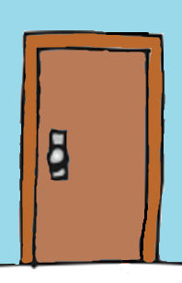
What Counts as Practice?
Practice in extracting a grammar system through listening
You are looking for your mobile phone. You think you left it in a bathroom!
The door is locked, so you check to see if you can go in. But the house is noisy, and you can’t hear all of the reply. Can you go in?
*noise* je baigne *noise*
Je peux entrer?
Non!
Oui!

Slide 19
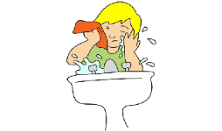
What Counts as Practice?
Go to the other bathroom! Can you go in?
*noise* je me lave *noise*
Je peux entrer?
Oui!
Non!

Slide 20
Integrating ‘skills’ (connecting multiple representations)
What Counts as Practice?
Why? To Establish connections in memory, for the SAME knowledge, between different kinds of representations (oral, aural, written). Examples…
Phonics!
Dictation and its more meaningful variants
- Dictogloss
- Transcription
- Aural -> written translations
- Zero-error dictation (pupils can ask questions after each sentence)
- Arabyan’s (1990) dictee dialogue
- Error spotting (L2 oral -> L2 reading & writing)
Multi-modal presentation (listening while reading)
Think: ‘Unusual combinations?’

Slide 21
Oral corrective feedback: 100s of studies
What Counts as Practice?
Prompts
force “uptake” (learner self-corrects)
drive recall
timely
consolidate knowledge
Reformulations / recasts (implicit feedback)
“utterances that repeat a learners’ incorrect utterance, making only the changes necessary to produce a correct utterance, without changing the meaning” (from Nicholas et al. 2001, p. 733 cited in Mackey 2005, p. 7)
RISKIER!
More dependent on context
Vulnerable to learner individual differences
Depends on how the recast is done

Slide 22
What’s In Store?
✓
Where does practice sit in the learning process?
What counts as practice?
How frequent does practice need to be?
How important is ‘meaningful production’?
What are the challenges of delivering practice?
Transfer Appropriate Processing
Skill Specificity
‘Trapping the form’ in meaningful production
Tensions between complexity, accuracy & fluency
✓

Slide 23
Do we understand, precisely, how frequent practice needs to be? Important for planning ‘re-visiting’ in SoWs
Relevance check!
small number of classroom-based studies
mixed results
adult learners (university students)
methodological variation between studies
More than 7 days better than less than 7 days At delayed post-test | 7 days similar to less than 7 days At post- and delayed post-test
Bird (2010) 14 days vs. 3 days. 10 practice sessions Practice = error correction Test = error correction Test after 60 day days Rogers (2015) 7 days vs. 2.25 days. 5 practice sessions. practice = reading Test = judge grammaticality Test after 42 days | Suzuki & DeKeyser (2015) 7 days vs. 1 day. 2 practice sessions. Practice = Picture comp & description Test = Rule application & oral sentence completion Suzuki (2017) 7 days vs. 3.5 days Kasprowicz & Marsden (2019) 4 practice sessions 7 days vs. 3 days

Slide 24
What Do We Know About Frequency Of Practice?
Frequent practice on same knowledge is important (e.g. about 4-8 encounters of words)
Sleep is important for consolidating new language
A few days / weeks / months can ALL be useful
Some spacing = some difficulty at recall => helpful
Too much spacing = too difficult! => memory faded
Too little spacing = too easy! => not helpful
“Optimum” difficulty at recall??!
…The Goldilocks of practice?
Teacher judgements
Gaskell & colleagues, Suzuki & DeKeyser; Rogers; Bird;

Slide 25
Might seem vague, BUT important professional identity building …
How Frequent?
We can challenge bold, overly precise claims:
“it has to be every week”
“no, it has to be twice a week!”
“NO! study for longer but once a fortnight is best”
It depends! On…. when you test,
what you test,
who you test.

Slide 26
What’s In Store?
✓
Where does practice sit in the learning process?
What counts as practice?
How frequent does practice need to be?
How important is ‘meaningful practice’, especially production?
What are the challenges of delivering practice?
Transfer Appropriate Processing
Skill Specificity
‘Trapping the form’ in meaningful production
Tensions between complexity, accuracy & fluency
✓
✓

Slide 27
Importance of Meaningful Production
“Output Hypothesis” = producing output helps because learners have to
notice ‘the gap’ (what they can’t say) and will then notice or find out how to do it
try out new language (I’ll try to say it like this and see if it is understood)
reflect metalinguistically
(Swain, 1995)

Slide 28
Importance of Meaningful Production
Benefits of output over input? (1)
By early teens, we use gestures, contexts, expected behaviours, guess work to get meaning
can make many subtleties in language INPUT redundant
But when producing language, we need to express something as accurately and efficiently as possible

Slide 29
Importance of Meaningful Production
Benefits of output over input? (2)
When listening or reading, we can pretend to understand
But when speaking or writing, we cannot ‘pretend’ we are producing something!

Slide 30
Importance of Meaningful Production
Benefits of output over input? (3)
Research into ‘immersion learning’ found that input alone was not enough to lead to accurate and fluent production of the language
Practice in producing language is necessary
(work by Canadian researchers: Swain, Lightbown, Spada, Collins)

Slide 31
Importance of Meaningful Production: In Interaction
How does interaction help language learning?
“Interactional modification” (‘can you repeat that?’ ‘what does x mean?’) allows you to understand something better
Understanding something helps you learn it
So, “interactional modification” helps learning
Long’s Interaction Hypothesis (1985 & 1996)

Slide 32
Examples of ‘Interaction’
Asking & answering questions to get & give meaning
Can be
Real time (online, face to face)
Offline (email, leaving and receiving oral messages)
Importance of errors -> interactional modification
‘Surprisal effect’ of a miscommunication!
helps establish new knowledge or recall stored knowledge

Slide 33
Examples of Meaningful ‘Interaction’
3 main benefits of interaction:
Negotiation for meaning
Provision of feedback
Production of modified output
All these help attention and memory systems
establish declarative knowledge and proceduralisation

Slide 34
Importance of Meaningful Practice
Practice through interaction: Does interaction help comprehension? YES! Two approaches compared:
Group 1: read a simplified script with repetition and paraphrasing, simple grammar & vocab
Group 2: learners listened to a version of the same script but which had not been simplified, but they were encouraged to stop the reader and ask questions and seek assistance (negotiation for meaning)
The interaction group comprehended much more than the simplified input group
Pica, Young & Doughty (1987)

Slide 35
Importance of Meaningful Interaction
Information-gaps in whole class work
teacher-fronted,
all one-way tasks - teacher held the information
students’ asked questions to obtain that information
E.g., ‘would I lie to you?’ (truth or lie)
from Sato & McDonough (in press)

Slide 36
Importance of Meaningful Production
Meta-analysis: role of interaction in vocabulary teaching
32 studies, 1,964 learners
having interaction helped more than no interaction
Vos et al (2018)
Other meta-analyses showing some kind of interaction helps Keck et al. (2006) Mackey and Goo (2007) (larger group of studies)

Slide 37
What’s In Store?
✓
Where does practice sit in the learning process?
What counts as practice?
How frequent does practice need to be?
How important is ‘meaningful production’?
What are the challenges of delivering practice?
a) Transfer Appropriate Processing
b) Skill Specificity
c) ‘Trapping the form’ in meaningful production
d) Tensions between complexity, accuracy & fluency
✓
✓
✓

Slide 38
Challenge a) Transfer appropriate processing
What Are The Challenges of Delivery Practice?
“we can better remember what we have learned if the cognitive processes that are active during learning are similar to those that are active during retrieval”
(Lightbown, 2008, p. 27)

Slide 39
Challenge a) Transfer appropriate processing
What Are The Challenges of Delivery Practice?
a skill learned in a certain context is best transferred to performance in a similar context
(Morris et al., 1977).
Example study:
“isolated-training” = computerized word-naming
“games context-training” = providing learners with the target words in a story
“isolated training” better on an individual words test on computer
“context-training group” better on a reading passage test
Martin-Chang and Levy (2005, 2006)

Slide 40
Challenge b) Skill Specificity
What Are The Challenges of Delivery Practice?
Practice must be skill-specific
(DeKeyser 2015)
in order for declarative knowledge to be usable in a particular mode or modality (speaking, writing, listening, or reading), the knowledge must be practiced in activities involving those modes & modalities
comprehension practice led to proceduralization of comprehension production practice led to proceduralization of production
DeKeyser (1997); Li & DeKeyser (2017)

Slide 41
What Are The Challenges of Delivery Practice?
How does this ‘practice specificity’ sit with the Pedagogy Review’s recommendation on skill integration?
Benefits of practice can be specific to skill, task, context
=> practice should be contextualized
embedded in meaningful encounters
Reconciling need to practice ‘separate skills and tasks’ with the need to “integrate skills” in MFL Pedagogy Review?
establish knowledge in first place in all modalities & modes
oral, aural, symbol for recall, symbol for production
so knowledge is accessible in different forms
practice in retrieving knowledge can then be contextualised and specific

Slide 42
Challenge c) Making language “task essential” = trapping the form!
What Are The Challenges of Delivery Practice?
Need to “trap the form” in production
Make correct use “task-essential” for expressing meaning
THIS IS HARD! ONE OF NCELP’S MAJOR UNDERTAKINGS
Very occasionally, not possible
“Task useful”

Slide 43
What Are The Challenges of Delivery Practice?
Making language essential in input practice can be easy…
An example with English relative clauses
A) The man that follows the dog wears a hat
B) The man that the dog follows wears a hat
Xiaoran Niu (PhD student, Dept of Education)

Slide 44
c) So THE CORE CHALLENGE: Trapping the form in MEANINGFUL production Avoiding the MECHANICAL!
What Are The Challenges of Delivery Practice?
Activities that elicit specific language for production practice, but that
are not mechanical
avoid superficial pattern rehearsal
Need to engage meaning or force challenging recall

Slide 45
What Are The Challenges of Delivery Practice?
in input, easy…
It’s very noisy in the restaurant. Listen to the words you hear, then tick which word must have come first …
(Dudo que… / Se que … ) coma comida muy sana.
(Es posible que... / Digo que …) canta muy bien.
(Es verdad que … / Es probable que …) sean arrogantes.
in production, less easy…
“in tasks not specifically designed to elicit the subjunctive, its frequency in learner output is likely to be low”
McManus, Tracey-Ventura, Mitchell, Richard, Romero de Mills (2014). Exploring the acquisition of the French subjunctive In LeClerq, Edmonds & Hilton (Eds) Measuring L2 proficiency: Perspectives from SLA . Multilingual Matters. pp167-190

Slide 46
What Are The Challenges of Delivery Practice?
Trapping the form in meaningful production less easy!
Making learners produce a subjunctive
La casa de Bill Gates. Bill Gates has a luxurious life. Below are some statements about his home. Finish each sentence using the phrases given. Note: some are facts, others we don’t know!
Es verdad que su casa … grande
Es probable que su casa ... aire acondicionado
Not all subjunctive or all indicative.
Farley, A. (2004). The relative effects of processing instruction and meaning-based output instruction.. In B. VanPatten (Ed.), Processing instruction: Theory, research, & commentary. New Jersey: Lawrence Erlbaum.

Slide 47
Trapping the form in meaningful production less easy! Making learners produce a subjunctive
What Are The Challenges of Delivery Practice?
Isabel and Javier are discussing where they will go on holiday. Isabel wants to express her wishes about where they might go:
“Quiero que ---------- en Italia, en España o en México.”
[viagemos we travel subjunctive]
[I want that we travel in Italy, Spain or Mexico.]
Adapted from Aarnes Gudmestad. (2006) Selected Proceedings of the 7th Conference on the Acquisition of Spanish and Portuguese as First and Second Languages, ed. Carol A. Klee and Timothy L. Face, 170-184. Somerville, MA: Cascadilla Proceedings Project.

Slide 48
How to make gender obligatory?
What Are The Challenges of Delivery Practice?
Little difference to communication!
The noun expresses meaning – we don’t need gender for meaningful production!
Is it even possible to make it essential in the input?

Slide 49
What Are The Challenges of Delivery Practice?
German articles agree with the gender of the noun
Can gender in articles be made non-redundant?
Which animal being talked about?
Die schhhhhhhh heißt Tweety
(the schhhhhhhh is called Tweety)

Slide 50
How to make gender obligatory?
What Are The Challenges of Delivery Practice?
Doesn’t make a difference to communication!
The noun expresses meaning – we don’t need gender!
but… it does act as glue (links an adjective to its noun) and speeds up processing
gender marking is used to predict!
Research by Lew-Williams, Fernald, Hopp, Huettig
Ongoing PhDs: Sophie Thompson, Xioaran Niu on instruction using prediction

Slide 51
Gender helps anticipate upcoming language

Slide 52
Gender helps anticipate upcoming language

Slide 53
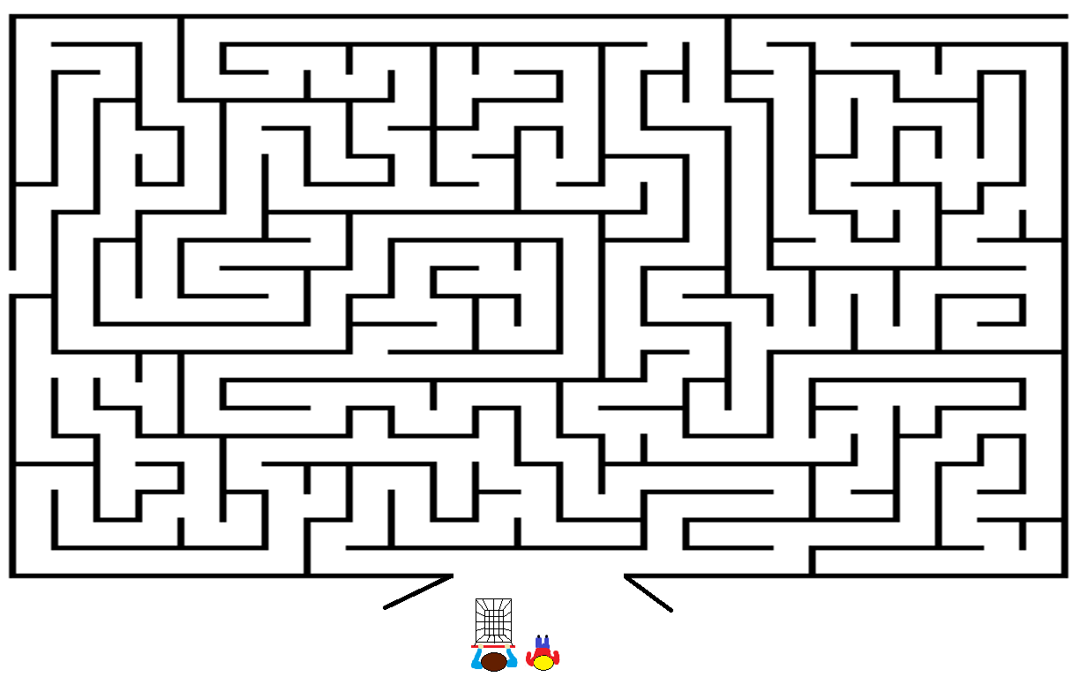
Using anticipation to make gender ‘task essential’!
You are at the supermarket with your dad.
Fetch the items your dad asks for.
It’s quite noisy in the supermarket,
so it’s hard to hear what your dad is saying.
Two items will appear each time.
Decide which item your dad asked for and race to fetch it.
Watch out!
If you fetch the wrong item you will get a time penalty!

Slide 54
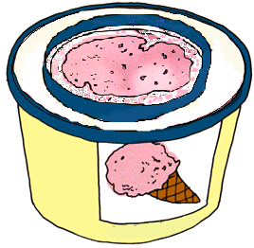
Using anticipation to make gender task essential!
Hmmm,
le chocolat ou la glace.
Trouves le ……..…,
s’il te plait.

Slide 55
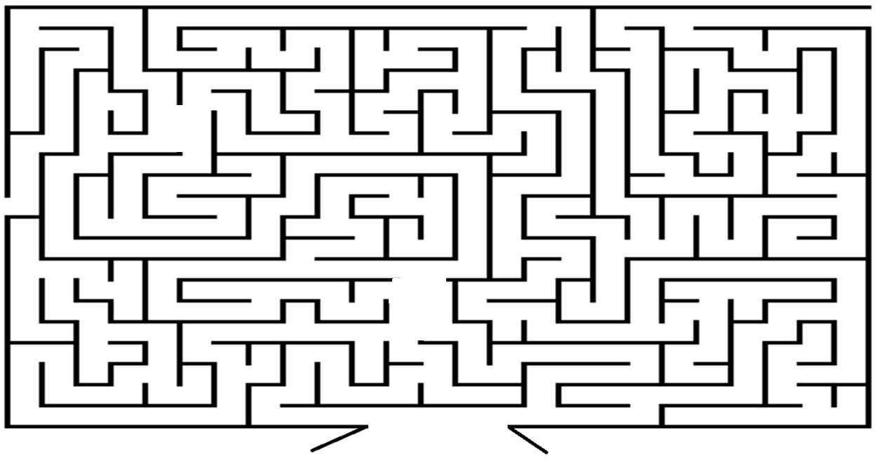
+1
Correct 1

Slide 56
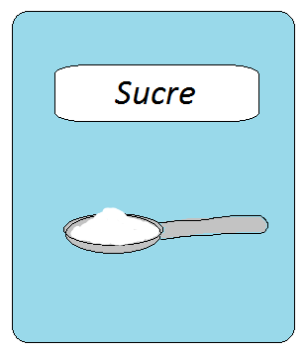
Hmmm,
le sucre ou la baguette.
Trouves la …..…,
s’il te plait.

Slide 57
+1
Correct 2

Slide 58
Challenges of Meaningful Practice
d) Tensions between complexity, accuracy & fluency
‘Error tolerance’ in the Pedagogy Review
Limited attentional capacity, so can’t perform on all tasks with the same complexity, accuracy & fluency
“Cognitive overload!”
So what for my practice?
Expect different performances in oral and written
Be ‘error tolerant’ (expect errors in some tasks/stages)
‘Planning’ can increase lexical and grammatical complexity and fluency of production
Research by Foster & Skehan (2008), Robinson, Revesz, Gilabert, Pallotti

Slide 59
Summary: Introduction to “Practice”
Declarative knowledge necessary, but is not enough
Declarative knowledge prior to class as much as possible
“SEAR”: Short, Explicit, As Accurate As Possible At Present, Revisited (and in Multiple Modalities)
Check it briefly before the practice
Practice is needed to “proceduralise” and “automatise”
Reduce cognitive overload in early stages
Frequent enough to prevent forgetting
Spaced enough so recall is challenging for your learners, for that language feature
Space in planned ways to ensure re-visiting happens

Slide 60
Summary: Introduction to “Practice”
Genuine information gaps to force recall
Meaningful interaction is so important
Making the target feature essential to get or give meaning
Manage expectations
a LOT of practice is needed
oral production < written production
errors happen as part of proceduralisation

Slide 61
Questions & Short Discussion

Slide 62
References/Bibliography
Bird, S. (2010). Effects of distributed practice on the acquisition of second language English syntax. Applied Psycholinguistics, 31, 635–650.
Cepeda, N.J., Vul, E., Rohrer, D., Wixted, J.T., & Pashler, H. (2008). Spacing effects in learning a temporal ridgeline of optimal retention. Psychological Science, 19, 1095–1102.
Collins, L., Halter, R.H., Lightbown, P., & Spada, N. (1999). Time and the distribution of time in L2 instruction. TESOL Quarterly, 33, 655–680.
Collins, L., & White, J. (2011). An intensive look at intensity and language learning. TESOL Quarterly, 45, 106–133.
DeKeyser, R. (2000). The robustness of critical period effects in second language acquisition. Studies in Second Language Acquisition, 22, 499–533.
DeKeyser, R. (2007). Conclusion: The future of practice. In, R. DeKeyser (Ed.), Practice in a second language (pp. 287–304). Cambridge: Cambridge University Press .
DeKeyser, R. (2012). Interactions between individual differences, treatments, and structures in SLA. Language Learning, 62(Suppl. 2), 189–200.
DeKeyser, R. (2015). Skill acquisition theory. In B. VanPatten & J. Williams (Eds.), Theories in second language acquisition: An introduction (pp. 94-112). London: Routledge.
DeKeyser, R., & Criado, R. (2012). Automatization, skill acquisition, and practice in second language acquisition. In C.A. Chapelle (Ed.), The encyclopedia of applied linguistics. Oxford, UK: Blackwell Publishing.
DeKeyser, R., & Prieto-Botana, G. (2015). The effectiveness of processing instruction in L2 grammar acquisition: A narrative review. Applied Linguistics, 36, 290–305.

Slide 63
References/Bibliography
DeKeyser, R. (2017). Knowledge and skill in ISLA. In S. Loewen and M. Sato (Eds.), Routledge Handbook of Instructed Second Language Acquisition (pp. 15–32). London: Routledge.
DeKeyser, R. M., & Sokalski, K. J. (1996). The differential role of comprehension and production practice. Language Learning, 46, 613–642.
Donovan, J.J., & Radosevich, D.J. (1999). A meta-analytic review of the distribution of practice effect: Now you see it, now you don’t. Journal of Applied Psychology, 84, 795–805.
Ellis, N. C., & Sagarra, N. (2011). Learned attention in adult language acquisition: A replication and generalization study and meta-analysis. Studies in Second Language Acquisition, 33, 589-624.
Foster & Skehan, 2008 The Influence of Planning and Task Type on Second Language Performance. Studies in Second Language Acquisition. 18, 3 (299-323)
Kasprowicz, R. , & Marsden, E. (under review). Distribution of practice effects for the learning of foreign language verb morphology in the young learner classroom. The Modern Language Journal.
Li, M., & DeKeyser, R. (2017). Perception practice, production practice, and musical ability in L2 Mandarin tone-word learning. Studies in Second Language Acquisition, 39, 593-620.
MacWhinney, B. (2012). The logic of the unified model. In Gass, S.M. & Mackey, A. (eds). The Routledge handbook of second language acquisition (pp. 211-227). New York, NY: Routledge.
McManus, K., & Marsden, E. (2019). Signatures of automaticity during practice: Explicit instruction about L1 processing routines can improve L2 grammatical processing. Applied Psycholinguistics, 40, 205-234.
Roffwarg, H. P., Muzio, J. N., & Dement, W. C. (1966). Ontogenetic development of the human sleep dream cycle. Science, 152, 604–618.

Slide 64
References/Bibliography
Rogers, J. (2015). Learning second language syntax under massed and distributed conditions. TESOL Quarterly, 4 , 91–97.
Rogers, J. (2017). The spacing effect and its relevance to second language acquisition. Applied Linguistics, 38, 906–911.
Sanz, C., & Morgan–Short, K. (2004). Positive evidence versus explicit rule presentation and explicit negative feedback: A computer–assisted study. Language Learning, 54, 35–78.
Serrano, R., & Muñoz, C. (2007). Same hours, different time distribution: Any difference in EFL? System, 35, 305–321.
Spada, N., Lightbown, P., & White, J. (2005). The importance of form/meaning mappings in explicit form-focused instruction. In A. Housen & M. Pierrard (Eds.), Investigations in instructed second language acquisition (pp. 199-234). Berlin: DeGruyter
Suzuki, Y. (2017). The optimal distribution of practice for the acquisition of L2 morphology: A conceptual replication and extension. Language Learning, 67(3), 512-545.
Suzuki, Y., (2017). The optimal distribution of practice for the acquisition of L2 morphology: A conceptual replication and extension. Language Learning, 67, 512–545.
Suzuki, Y., & DeKeyser, R. (2017a). Effects of distributed practice on the proceduralization of morphology. Language Teaching Research, 21, 166–188.
Suzuki, Y., & DeKeyser, R. (2017b). Exploratory research on second language practice distribution: An aptitude × treatment interaction. Applied Psycholinguistics, 38, 27–56.

