Slide 1
“J’ai cherché” par Amir Hammad, Johan Errami et Nazim Khaled
Text exploitation
SSCs [y] and [i] [revisited]
Y9 French
Term 2.1 - Week 4 - Lesson 33
Amber Dudley / Catherine Morris / Catherine Salkeld
Artwork by: Chloé Motard
Date updated: 04/12/2021
Notes:
Artwork by Chloé Motard. All additional pictures selected are available under a Creative Commons license, no attribution required.
Native-speaker teacher feedback provided by Sarah Brichory.
With thanks to Rachel Hawkes and Emma Marsden for their input on the lesson material.
Learning outcomes (lesson 1):
Consolidation of SSCs [y] and [i]
Text exploitation 3: ‘J’ai cherché’
Identifying the type of text and situating the text in time
Word frequency (1 is the most frequent word in French):
9.2.1.4 (introduce) blesser [2024], jeter [1202], laisser [196], amour [967], envie [1237], mer [921], prix¹ [310], reconnaissance¹ [1432], sens¹ [243], tellement [869]
9.1.2.6 (revisit) faim [1986], soif [4689], peur [755], tort [1652], heure2 [99], midi [2483], minuit [3453], quarante [2436], cinquante [2273], soixante [3151], alors2 [81] revisit: chaud, froid, mal, raison
9.1.1.6 (revisit) connaître, connais [133], savoir2 [67], chanson [2142], chemin [859], endroit [650], gens [236], groupe [187], québécois [1970], canadien [611], Canada [n/a], Québec [n/a]
Source: Lonsdale, D., & Le Bras, Y. (2009). A Frequency Dictionary of French: Core vocabulary for learners London: Routledge.
The frequency rankings for words that occur in this PowerPoint which have been previously introduced in NCELP resources are given in the NCELP SOW and in the resources that first introduced and formally re-visited those words.
For any other words that occur incidentally in this PowerPoint, frequency rankings will be provided in the notes field wherever possible.

Slide 2
y
y
Notes:
Timing: 1 minute
Aim: To consolidate SSC [y]
Procedure: 1. Present the letter(s) and say the [y] sound first, on its own. Students repeat it with you. 2. Bring up the word ”y” on its own, say it, students repeat it, so that they have the opportunity to focus all of their attention on the connection between the written word and its sound.
3. A possible gesture for this would be [to point over ‘there’]. 4. Roll back the animations and work through 1-3 again, but this time, dropping your voice completely to listen carefully to the students saying the [y] sound, pronouncing ”y” and, if using, doing the gesture.
Word frequency (1 is the most frequent word in French):
y [36]
Source: Lonsdale, D., & Le Bras, Y. (2009). A Frequency Dictionary of French: Core vocabulary for learners London: Routledge.

Slide 3
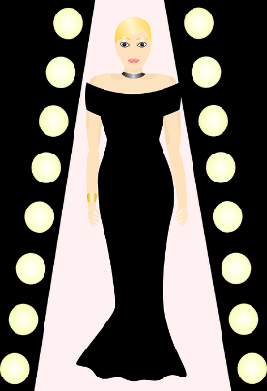
y
rythme
système
style
y
analyser
[to analyse]
physique
Notes:
Timing: 1 minute
Aim: To consolidate SSC [y]
Procedure:
1. Introduce and elicit the pronunciation of the individual SSC [y] and then the source word again ‘y’ (with gesture, if using). 2. Then present and elicit the pronunciation of the five cluster words.
The cluster words have been chosen for their high-frequency, from a range of word classes, with the SSC (where possible) positioned within a variety of syllables within the words (e.g. initial, 2nd, final etc.). Additionally, we have tried to use words that build cumulatively on previously taught SSCs (see the Phonics Teaching Sequence document) and do not include new SSCs. Where new SSCs are used, they are often consonants which have a similar symbol-sound correspondence in English.
Word frequency (1 is the most frequent word in French): système [289]; style [1999] physique [1146]; analyser [1209]; rythme [1662] Source: Lonsdale, D., & Le Bras, Y. (2009). A Frequency Dictionary of French: Core vocabulary for learners London: Routledge.

Slide 4
[y] et [i]
écouter
What do you notice about these words?
mite
[moth]
mythe
[myth]
SSC [y] is the same sound as SSC [i], which you already know.
SSC [y] is often found in cognate words (words which look like English or another language).
Notes:
Timing: 1 minute
Aim: Raising awareness of the identical sound in SSCs [y] and [i].
For a reminder of Year 7 SSC [i], see the two slides that follow.
Word frequency of unknown words (1 is the most frequent word in French): mite [>5000]
Source: Lonsdale, D., & Le Bras, Y. (2009). A Frequency Dictionary of French: Core vocabulary for learners London: Routledge.
Word frequency of cognates (1 is the most frequent word in French): mythe [2910]
Source: Lonsdale, D., & Le Bras, Y. (2009). A Frequency Dictionary of French: Core vocabulary for learners London: Routledge.

Slide 5
i
midi
Notes:
Timing: 1 minute
Aim: To consolidate SSC [i]
Procedure: 1. Present the letter(s) and say the [i] sound first, on its own. Students repeat it with you. 2. Bring up the word ”midi” on its own, say it, students repeat it, so that they have the opportunity to focus all of their attention on the connection between the written word and its sound.
3. A possible gesture for this would be to draw a circle representing a clock face with one hand, with the other arm and hand pointing straight up (representing the hands on 12) within the circle. 4. Roll back the animations and work through 1-3 again, but this time, dropping your voice completely to listen carefully to the students saying the [i] sound, pronouncing ”midi” and, if using, doing the gesture.
Word frequency (1 is the most frequent word in French):
midi [2483].
Source: Lonsdale, D., & Le Bras, Y. (2009). A Frequency Dictionary of French: Core vocabulary for learners London: Routledge.

Slide 6
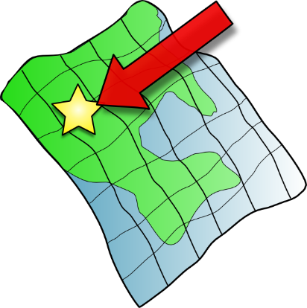
i
petit
lit
midi
qui ?
ici
il
?
Notes:
Timing: 1 minute
Aim: To consolidate SSC [i]
Procedure:
1. Introduce and elicit the pronunciation of the individual SSC [i] and then the source word again ‘midi’ (with gesture, if using). 2. Then present and elicit the pronunciation of the five cluster words.
The cluster words have been chosen for their high-frequency, from a range of word classes, with the SSC (where possible) positioned within a variety of syllables within the words (e.g. initial, 2nd, final etc.). Additionally, we have tried to use words that build cumulatively on previously taught SSCs (see the Phonics Teaching Sequence document) and do not include new SSCs. Where new SSCs are used, they are often consonants which have a similar symbol-sound correspondence in English.
Word frequency (1 is the most frequent word in French): midi [2483]; petit [138]; lit [1837] ici [167]; il[13]; qui [14]. Source: Lonsdale, D., & Le Bras, Y. (2009). A Frequency Dictionary of French: Core vocabulary for learners London: Routledge.

Slide 7
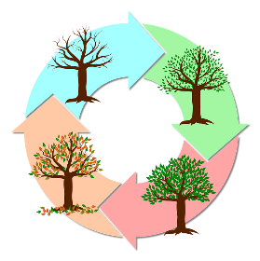
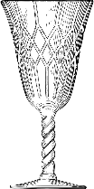
[y] et [i]
parler
Attention ! Some words look like English.
Use your French SSC knowledge to pronounce them correctly.
60
type
cultiver
analyser
cycle
[to grow]
[to analyse]
secondes
fragile
mystère
tisser
[mystery]
bijou
[to weave]
tragique
[jewel]
prime
héritage
[bonus]
[tragic]
hypothèse
cynique
mérite
typique
0
[hypothesis]
[cynical]
[merit]
[typical]
DÉBUT
Notes:
Timing: 3 minutes
Aim: To practise pronunciation of SSCs [y] and [i] in individual words.
Procedure:
1. Split students into pairs.
2. Click début to start the timer
3. Students take it in turns try to pronounce as many words accurately as possible
4. The listening partner checks pronunciation and tallies the total number of words pronounced correctly within 30 seconds. If a student pronounces [i] or [y] the ‘English’ way, they must repeat it three times before scoring the point and continuing.
5. When timer finishes, swap roles.
6. Students tally up the total number of words said correctly. The student who has said the greatest number of words is the winner.
7. Go through all the words together as a class to confirm pronunciation (click on words to hear them pronounced by a native speaker, students repeat.)
Word frequency of unknown words (1 is the most frequent word in French): bijou [4301], tisser [4320], prime [2094]
Source: Lonsdale, D., & Le Bras, Y. (2009). A Frequency Dictionary of French: Core vocabulary for learners London: Routledge.
Word frequency of cognate words (1 is the most frequent word in French): type [440], cycle [2462], mystère [2777], analyser [1209], cynique [3547], hypothèse [1669], typique [4178], mérite [2035], tragique [2042], cultiver [2061], fragile [2107], héritage [2193]
Source: Lonsdsale, D., & Le Bras, Y. (2009). A Frequency Dictionary of French: Core vocabulary for learners London: Routledge.

Slide 8
Des virelangues
lire / parler
Lily lit typiquement un livre
dans son lit.
Lily typically reads a book in bed.
Notes:
Timing: 2 minutes. This is slide 1/2.
Aim: To practise pronunciation of [i] and [y] in full sentences.
Procedure:
1. Students sound out the words in the tongue twister.
2. Click audio button to hear tongue twister read out by a native speaker.
3. Students try to reproduce the tongue twister at a similar speed, then at increasing speeds.
4. Students listen to the audio again. This time, the teacher pauses the audio at different points and asks students to say the last word that they heard.
Transcript:
Lily lit typiquement un livre dans son lit.
Word frequency of unknown words used (1 is the most frequent word in French): typiquement [>5000]
Source: Lonsdale, D., & Le Bras, Y. (2009). A Frequency Dictionary of French: Core vocabulary for learners London: Routledge.

Slide 9
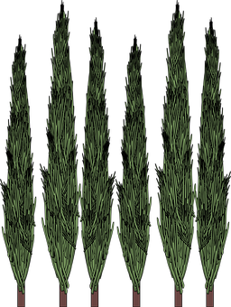
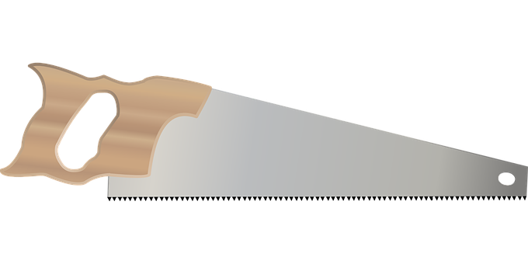
Des virelangues
lire / parler
Si six scies scient six cyprès,
six cents scies scient six cent cyprès.
If six saws saw six cypresses, six hundred saws saw six hundred cypresses
Notes:
This is slide 2/2.
NB: This tongue twister is very challenging! Students need to pay careful attention to the SSCs. They may need reassurance that the first 5 words are all supposed to sound the same!
Transcript:
Si six scies scient six cyprès, six cents six scies scient six cent six cyprès
Word frequency of unknown words used (1 is the most frequent word in French): scie [>5000], scier [>5000], cyprès [>5000], cent [704]
Source: Lonsdale, D., & Le Bras, Y. (2009). A Frequency Dictionary of French: Core vocabulary for learners London: Routledge.

Slide 10
Vocabulaire
lire
Écoute le mot, écris le mot, traduis le mot, et dis le mot !
 | en français | en anglais
 | blesser | to hurt
 | jeter | to throw
 | laisser | to leave
 | l'amour (m) | love
 | l'envie (f) | desire
1
2
 | en français | en anglais
 | la mer | sea
 | le prix | price
 | la reconnaissance | recognition
 | le sens | sense, meaning
 | tellement | so much, so many
3
6
4
7
5
8
9
10
Notes:
Timing: 5 minutes
Aim: Recognition of this week’s new vocabulary in the oral and written modalities.
Procedure: 1. Click to hear the words in French. 2. Students write down the English meaning. 3. Click to reveal answers and transcriptions, one by one.
4. Click to cover the English.
5. Teacher now points at the French words in a random order.
6. Students say the English.
Transcript:
blesser
jeter
laisser
l'amour
l'envie
la mer
le prix
la reconnaissance
le sens
tellement

Slide 11
On va étudier quel type de texte ?
écouter
Which sounds do the words in bold have in common?
J'ai cherché un sens, un point de repère
Partagé en deux hémisphères
Comme une erreur de l'univers
J'ai jeté tellement de bouteilles à la mer
Tu m'as comme donné l'envie d'être moi
Donné un sens à mes pourquoi
Tu as tué la peur qui dormait là
Qui dormait là dans mes bras
1
A.
2
SSC [è/ê] and SSC [r]
(with SFe and SFC)
3
A.
4
5
B.
SSC [oi]
6
7
C.
SSC [a]/[à]
(with SFC)
8
C’est: a) un poème b) une histoire c) une chanson d) un article
Notes:
Timing: 5 minutes
Aim: To identify a text type from a sound pattern feature (rhyme); to revise several SSCs; to create anticipation by introducing students to the text type.
Procedure:
1. Tell students that they are going to see two sections of the text and guess what type of text it is from the structure (rather than the meaning, at this stage).
2. Click the audio button next to a line to hear it read out by a native speaker. Have students focus on the last word in each line.
3. Once students have identified a rhyme scheme, reveal the pattern on clicks and ask them to consider which SSCs create it.
4. Click to reveal more information about the SSCs.
5. Encourage students to say the words in bold aloud. Note the [e] in l'univers and la mer is pronounced like SSC [è/ê] here.
6. Students consider the multi-choice options at the bottom of the slide, and discuss what type of text they think it is. Though of course they are most likely to select un poème or une chanson, this is an exercise in predictions and there are no right or wrong answers at this stage.
Transcript:
J'ai cherché un sens, un point de repère
Partagé en deux hémisphères
Comme une erreur de l'univers
J'ai jeté tellement de bouteilles à la mer
Tu m'as comme donné l'envie d'être moi
Donné un sens à mes pourquoi
Tu as tué la peur qui dormait là
Qui dormait là dans mes bras
Word frequency of cognates used (1 is the most frequent word in French): type [440]
Source: Lonsdale, D., & Le Bras, Y. (2009). A Frequency Dictionary of French: Core vocabulary for learners London: Routledge.
NB: The frequency values of all unknown words in the text are provided on slide 16.

Slide 12
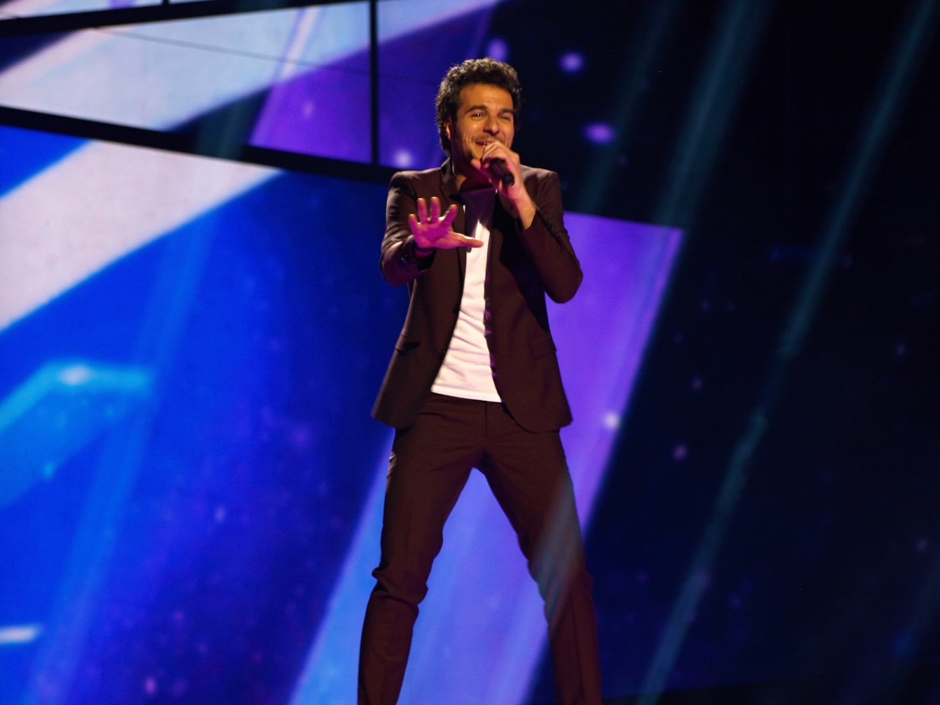
Qui est Amir ?
lire
Remember:
il/elle est + profession = he/she is a [profession]
(no indefinite article in French)
c’est un(e) + job = he/she is a… [profession]
(with indefinite article – usually when there’s an adjective or other detail added)
Quel est l’emploi d’Amir Haddad ?
Il est poète.
Il est comédien.
Il est chanteur.
Amir Haddad, c’est un chanteur franco-israélien. C’est le candidat français de l’Eurovision 2016.
Notes:
Timing: 2 minutes
Aim: To present the singer; to briefly revise the absence of an article with professions in French following ‘il/elle est’.
Procedure:
1. Students look at the picture and briefly discuss the likely career of Amir Haddad. Draw attention to the lack of article before each profession. Though they are likely to conclude chanteur from the picture and the text presented to them on the previous slide, this is still a prediction.
2. Click to reveal the answer and accompanying text which primes for the activity on the next slide.
Word frequency of cognates used (1 is the most frequent word in French): franco [>5000], israélien [1468], candidat [1328], comédien [4253]
Source: Lonsdale, D., & Le Bras, Y. (2009). A Frequency Dictionary of French: Core vocabulary for learners London: Routledge.
Image source: https://eurovisionary.com/?attachment_id=145948 is licensed under CC BY-SA 4.0

Slide 13
Qui connaît l’Eurovision ?
la télé
lire
le chanteur
Quels mots associez-vous à l’Eurovision ?
la culture
la France
drôle
international
chanter
la chanson
la musique
mai
l’événement
célébrer
gagner
la chanteuse
l’Angleterre
L’Eurovision, c’est une compétition annuelle de la chanson.
Chaque pays de l’Europe choisit un candidat pour représenter sa culture.
Notes:
Timing: 4 minutes
Aim: To bring together known vocabulary items that can be used to talk about an international music event; to create anticipation by introducing students to the context of the text.
Procedure:
1. Give students 2 minutes to note down as many French vocabulary items as they can that they associate with Eurovision. If students aren’t familiar with Eurovision, bring up the French description of the event, which should provide enough information to complete the activity.
2. Elicit examples of vocabulary items from students. Some examples appear on clicks, but there are many others.
Word frequency of cognates used (1 is the most frequent word in French): associer [1422], annuel [1684], compétition [2651], Europe [n/a], candidat [1328], représenter [293]
Source: Lonsdale, D., & Le Bras, Y. (2009). A Frequency Dictionary of French: Core vocabulary for learners London: Routledge.
Image source: https://upload.wikimedia.org/wikipedia/en/thumb/e/e1/Eurovision_Song_Contest.svg/1600px-Eurovision_Song_Contest.svg.png

Slide 14
Décris la chanson (1/2)
écouter / parler
Comment est la chanson ? Attention ! Il faut utiliser les adjectifs féminins.
Notes:
Timing: 8 minutes. This is slide 1/2.
Aim: To watch/listen to the music video for “J’ai cherché”; oral production of adjectives in the feminine form.
N.B. Watching the video (in addition to reading the text) is strongly recommended to make students aware that although the lyrics seem sad, the song itself sounds upbeat.
Procedure:
1. Students watch the video. The video is embedded into the PowerPoint and can be found here: https://www.youtube.com/watch?v=kQysGibXphE. Reassure students that they are not expected to understand the whole text at this stage! They should be able to form ideas about the song largely from the melody and lyrics. NB: there is a recurring English refrain which will also give them ideas.
2. Students work in pairs to describe the song using known adjectives. Remind them that the adjective following une chanson must be in feminine form. Teacher may wish to start this activity with a recap of the six feminine adjective agreement patterns learned so far (rule 1: add –e; rule 2: no change with adjectives ending in mute –e; rule 3: -x ➜ -se; rule 4: -l ➜ -lle; rule 5: -n ➜ -nne; rule 6 -f ➜ -ve).
3. Elicit adjectives from students. Some ideas are offered on the next slide. If using, draw attention to the different agreement patterns represented.
Word frequency of cognates used (1 is the most frequent word in French): adjectif [>5000], féminin [2381]
Source: Lonsdale, D., & Le Bras, Y. (2009). A Frequency Dictionary of French: Core vocabulary for learners London: Routledge.

Slide 15
Décris la chanson (2/2)
écouter / parler
romantique ?
dangereuse ?
internationale ?
intelligente ?
C’est une chanson…
heureuse ?
positive ?
moderne ?
en français ?
négative ?
en anglais ?
triste ?
belle ?
amusante ?
Notes:
This is slide 2/2.
Word frequency of cognates used (1 is the most frequent word in French): romantique [4884]
Source: Lonsdale, D., & Le Bras, Y. (2009). A Frequency Dictionary of French: Core vocabulary for learners London: Routledge.

Slide 16
La forme du texte
*le couplet = verse *le refrain = chorus
lire
Il y a combien de verbes différents au passé composé ? Écris la traduction et la forme infinitive de chaque verbe.
J'ai cherché un sens à mon existence
J'y ai laissé mon innocence
J'ai fini le cœur sans défense
J'ai cherché l'amour et la reconnaissance
J'ai payé le prix du silence
Je me blesse et je recommence
Tu m'as comme donné l'envie d'être moi
Donné un sens à mes pourquoi
Tu as tué la peur qui dormait là
Qui dormait là dans mes bras
You're the one that's making me strong
I'll be looking, looking for you
Like the melody of my song
J'ai cherché un sens, un point de repère
Partagé en deux hémisphères
Comme une erreur de l'univers
J'ai jeté tellement de bouteilles à la mer
J'ai bu tant de liqueurs amères
Que j'en ai les lèvres de pierre
[REFRAIN]
Au gré de nos blessures
Et de nos désinvoltures
C'est quand on n'y croit plus du tout
Qu'on trouve un paradis perdu en nous
[REFRAIN]
couplet
couplet
refrain
couplet
Notes:
Timing: 8 minutes. This is slide 1/2.
Aim: To present the full text for the first time; to present the structure of a song; to situate the text in time (past tense); to recognise verbs in the perfect tense form.
NB: It may be helpful to print copies of this slide so that students have the full text at their disposal for the remainder of the lesson.
Procedure:
1. Click to bring up the parts of the song one by one. Clarify that [REFRAIN] indicates a repeat of the bilingual text in the bottom left of the screen.
2. Ask students to focus on the first verse, and to look at the beginning of each line. What to the verb phrases (pronoun + verb) tell us about when the song is is set (past, present or future?) Take the opportunity to recap the structure of the perfect tense (present tense form of avoir + past participle).
3. Click to reveal the task instruction.
4. On clicks, the eight past participle forms that students are expected to recognise at this stage are revealed on clicks. Ai payé is included on account of its regular form and its cognate meaning. Ai fini is not included as students have not yet encountered past participle forms of verbs like choisir. Some students may identify it as a perfect tense form on account of the presence of avoir and an unfamiliar form of finir. This is explained on the next slide.
5. Full answers (including infinitive forms and English translation) are provided on the next slide.
Word frequency of unknown words (1 is the most frequent word in French): y [36], me [61], moi [131], peur [755], là [109], fini [finir 534], amour [967], dormait [dormir 1836], bouteille [2979], liqueur [>5000], amère [>5000], tant [181], lèvre [2979], pierre [1767], gré [2676], blessure [4681], désinvolture [>5000], croire [135], refrain [>5000], couplet [>5000], traduction [2826]
Source: Lonsdale, D., & Le Bras, Y. (2009). A Frequency Dictionary of French: Core vocabulary for learners London: Routledge.
Word frequency of cognates (1 is the most frequent word in French): payer [537], existence [1153], innocence [4300], défense [938], répéter [630], point [97], repère [4373], univers [2112], hémisphère [>5000], paradis [2952], forme [369], infinitif [>5000], verbe [>5000]
Source: Lonsdale, D., & Le Bras, Y. (2009). A Frequency Dictionary of French: Core vocabulary for learners London: Routledge.

Slide 17
Au passé composé
lire
Il y a combien de verbes différents au passé composé ?
 | l’infinitif | la forme passée | en anglais
1 | chercher | ai cherché | (I) have looked, looked for
2 | laisser | ai laissé | (I) have left, left
3 | payer | ai payé | (I) have paid, paid
4 | donner | as donné | (you) have given, gave
5 | tuer | as tué | (you) have killed, killed
6 | jeter | ai jeté | (I) have thrown, threw
7 | boire | ai bu | (I) have drunk, drank
8
Don’t worry ! You haven’t learnt the perfect tense forms of verbs like choisir yet!
Il y un autre :
J'ai fini
L’infinitif, c’est comment?
finir
Notes:
This is slide 2/2.

Slide 18
Le premier couplet*
*le couplet = verse
*y = there
*me = myself
lire / écouter
Écoute les phrases du premier couplet et remplis les blancs. Puis, traduis le couplet en anglais.
1
J'ai cherché un sens à mon existence
J’y* ai laissé mon innocence
J'ai fini le cœur sans défense
J'ai cherché l'amour et la reconnaissance
J'ai payé le prix du silence
Je me* blesse et je recommence
Les mots en orange sont des « cognates » ! Ces mots ont le même sens en anglais et en français.
2
3
4
5
6
Notes:
Timing: 8 minutes. This is slide 1/2.
Aim: Aural recognition of some of this week’s new words in context; to use knowledge of known vocabulary items and cognates to translate the first verse of the text.
Procedure:
1. Students listen to each line of the first verse of the song and transcribe the missing word(s).
2. Click to reveal the answers.
3. Click to reveal a call-out with a definition for the word ‘cognate’. Check students recognise the English meanings of the words in orange.
4. Draw students’ attention to the verb phrase je recommence. They have not encounter recommencer, but they know commencer and have encountered the re- prefix with remettre. Ask students what they think a likely translation of this verb is (to restart/start again).
5. Elicit oral or written translations for the six sentences. Alert students to the fact that the tense changes in the last line. Depending on the needs of the class, students can attempt full translations from this slide, or use the gapped version provided on the following slide.
Transcript:
J'ai cherché un sens à mon existence
J'y ai laissé mon innocence
J'ai fini le cœur sans défense
J'ai cherché l'amour et la reconnaissance
J'ai payé le prix du silence
Je me blesse et je recommence
Word frequency of unknown words used (1 is the most frequent word in French): couplet [>5000]
Source: Lonsdale, D., & Le Bras, Y. (2009). A Frequency Dictionary of French: Core vocabulary for learners London: Routledge.
NB: The frequency values of all unknown words in the text are provided on slide 16.

Slide 19
Le premier couplet*
*le couplet = verse
*y = there
*me = myself
lire / écouter
Écoute les phrases du premier couplet et remplis les blancs. Puis, traduis le couplet en anglais.
J'ai cherché un sens à mon existence
J’y* ai laissé mon innocence
J'ai fini le cœur sans défense
J'ai cherché l'amour et la reconnaissance
J'ai payé le prix du silence
Je me* blesse et je recommence
I searched for a meaning to my existence
I left my innocence there
I ended up [finished] with a defenseless heart
I looked for love and recognition
I paid the price of silence
I hurt myself and start again
_______________________
_________________
_________________
______________________________
______________
______________
A more natural way to say this in English is ‘I get hurt’
Notes:
This is slide 2/2.
Suggested translations appear on clicks.

Slide 20
“J’ai cherché” par Amir Hammad, Johan Errami et Nazim Khaled
Text exploitation 3
SSCs [y] and [oy] [revisited]
Y9 French
Term 2.1 - Week 4 - Lesson 33
Amber Dudley / Catherine Salkeld / Natalie Finlayson
Artwork by: Chloé Motard
Date updated: 04/12/2021
Notes:
Artwork by Chloé Motard. All additional pictures selected are available under a Creative Commons license, no attribution required.
Native-speaker teacher feedback provided by Sarah Brichory.
Learning outcomes (lesson 2):
Consolidation of SSCs [y] and [oy]
Text exploitation 3: J’ai cherché
Dictionary skills
Understanding the details of the text
Being creative with the text
Word frequency (1 is the most frequent word in French):
9.2.1.4 (introduce) blesser [2024], jeter [1202], laisser [196], amour [967], envie [1237], mer [921], prix¹ [310], reconnaissance¹ [1432], sens¹ [243], tellement [869]
9.1.2.6 (revisit) faim [1986], soif [4689], peur [755], tort [1652], heure2 [99], midi [2483], minuit [3453], quarante [2436], cinquante [2273], soixante [3151], alors2 [81] revisit: chaud, froid, mal, raison
9.1.1.6 (revisit) connaître, connais [133], savoir2 [67], chanson [2142], chemin [859], endroit [650], gens [236], groupe [187], québécois [1970], canadien [611], Canada [n/a], Québec [n/a]
Source: Lonsdale, D., & Le Bras, Y. (2009). A Frequency Dictionary of French: Core vocabulary for learners London: Routledge.
The frequency rankings for words that occur in this PowerPoint which have been previously introduced in NCELP resources are given in the NCELP SOW and in the resources that first introduced and formally re-visited those words.
For any other words that occur incidentally in this PowerPoint, frequency rankings will be provided in the notes field wherever possible.

Slide 21
oy
nettoyer
voyage
[journey]
royal
envoyer
moyen
employé
[average]
[employee]
Notes:
Timing: 1 minute
Aim: To consolidate SSC [oy]
Procedure:
1. Introduce and elicit the pronunciation of the individual SSC [oy] and then the source word again ‘envoyer’ (with gesture, if using). 2. Then present and elicit the pronunciation of the five cluster words.
The cluster words have been chosen for their high-frequency, from a range of word classes, with the SSC (where possible) positioned within a variety of syllables within the words (e.g. initial, 2nd, final etc.). Additionally, we have tried to use words that build cumulatively on previously taught SSCs (see the Phonics Teaching Sequence document) and do not include new SSCs. Where new SSCs are used, they are often consonants which have a similar symbol-sound correspondence in English.
Word frequency (1 is the most frequent word in French): envoyer [526]; royal [2290]; nettoyer [3887]; employé [1485]; voyage [904]; moyen [186] Source: Lonsdale, D., & Le Bras, Y. (2009). A Frequency Dictionary of French: Core vocabulary for learners London: Routledge.

Slide 22
oy
envoyer
Notes:
Timing: 1 minute
Aim: To consolidate SSC [oy]
Procedure: 1. Present the letter(s) and say the [oy] sound first, on its own. Students repeat it with you. 2. Bring up the word ”envoyer” on its own, say it, students repeat it, so that they have the opportunity to focus all of their attention on the connection between the written word and its sound.
3. A possible gesture for this would be [sending a letter]. 4. Roll back the animations and work through 1-3 again, but this time, dropping your voice completely to listen carefully to the students saying the [oy] sound, pronouncing ”envoyer” and, if using, doing the gesture.
Word frequency (1 is the most frequent word in French):
enyoyer [526]
Source: Lonsdale, D., & Le Bras, Y. (2009). A Frequency Dictionary of French: Core vocabulary for learners London: Routledge.

Slide 23
Phonétique
écouter
Écoute. Les mots ont-ils la SSC [oy] ou [y] ?
Q | mot | en anglais | [oy] | [y]
 | joyau | [jewel]
 | c y cliste | [cyclist]
 | r y thme | [rhythm]
 | voyelle | [vowel]
 | l y cée | [sixth form]
 | g y mnase | [gymnasium]
 | incroyable | [incredible]
 | citoyen | [citizen]
1
_
2
_
Notice that all the words containing [y] are cognates (look like English).
3
_
4
_
5
_
6
_
7
_
8
_
Notes:
Timing: 5 minutes
Aim: Aural recognition of SSCs [oy] and [y] in single words; connecting SSC [y] with cognate words
Procedure:
1. Click to play the audio.
2. Students tick whether they hear [oy] or [y].
3. Click to reveal the answers.
4. Note that it is the near-cognates that contain SSC [y].
Transcript:
1. joyau
2. cycliste
3 rythme
4. voyelle
5. lycée
6. gymnase
7. incroyable
8. citoyen
Word frequency of unknown words used (1 is the most frequent word in French):
joyau [>5000], voyelle [>5000], incroyable [2231], citoyen [1081]
Word frequency of near-cognates used (1 is the most frequent word in French): rythme [1662], cycliste [>5000], mystère [2777], gymnase [>5000],
Source: Lonsdale, D., & Le Bras, Y. (2009). A Frequency Dictionary of French: Core vocabulary for learners London: Routledge.

Slide 24
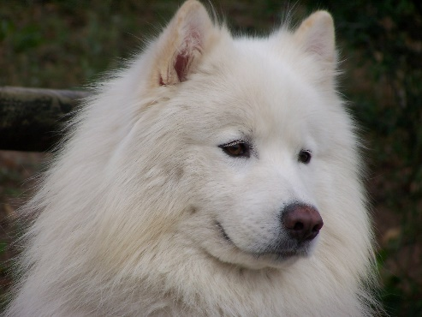
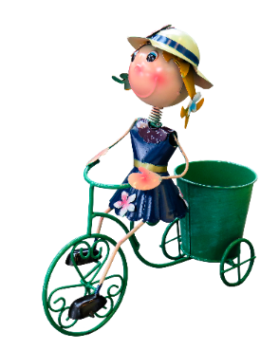
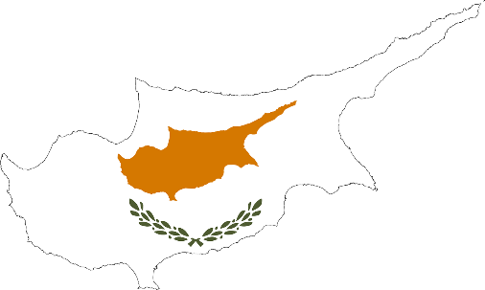
Des virelangues !
écouter / parler
Le samoyède syrien aime aboyer sur le python royal.
[The Syrian Samoyed likes to bark at the royal python.]
Sylvie la cycliste joyeuse voyage à Chypre.
[Sylvie the joyful cyclist travels to Cyprus.]
Notes:
Timing: 4 minutes. This is slide 1/2.
Aim: oral production of SSCs [oy] and [y] in longer contexts; fluency production
Procedure:
1. Click on play button to hear a tongue twister said aloud by a native speaker. Students read along.
2. Students repeat as many times a necessary.
3. If students feel confident, they can try to speed up – compete to see who can say a correct the sentence correctly fastest.
Transcript:
Le samoyède syrien aime aboyer au python royal.
Sylvie la cycliste joyeuse voyage en Chypre.
Word frequency of unknown words used (1 is the most frequent word in French):
samoyède [>5000], aboyer [>5000], Chypre [>5000]
Word frequency of cognates used (1 is the most frequent word in French):
syrien [4453], python [>5000], royal [2290], cycliste [>5000] , joyeux [3987]
Source: Lonsdale, D., & Le Bras, Y. (2009). A Frequency Dictionary of French: Core vocabulary for learners London: Routledge.

Slide 25
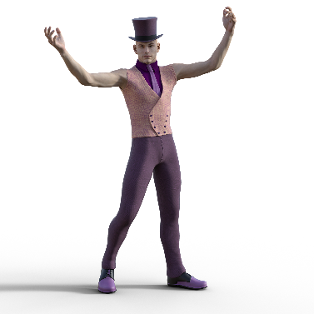
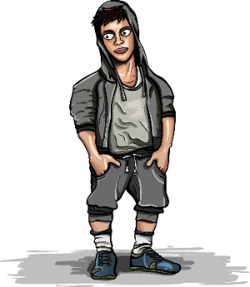
Des virelangues !
écouter / parler
Le lycéen flamboyant aime le rythme de l’hymne calypso.
[The flamboyant sixth-former likes the rhythm of the calypso carol.]
Le voyou moyen doit nettoyer les pylônes du royaume.
[The average hooligan has to clean the pylons of the kingdom.]
Notes:
This is slide 2/2.
Transcript:
Le lycéen flamboyant aime le rythme de l’hymne calypso.
Le voyou moyen doit nettoyer les pylônes du royaume.
Word frequency of unknown words used (1 is the most frequent word in French):
lycéen [>5000], hymne [4862], voyou [>5000], moyen [186], nettoyer [3887], royaume [2620]
Word frequency of cognates used (1 is the most frequent word in French):
flamboyant [>5000], rythme [1662], calypso [>5000], pylône [>5000]
Source: Lonsdale, D., & Le Bras, Y. (2009). A Frequency Dictionary of French: Core vocabulary for learners London: Routledge.

Slide 26
Mots croisés
écrire / parler
la pierre = stone
Remember to say the word for ‘the’! Trouve le mot mystère !
 |  |  |  |  |  |  |  |  |  |  |  |  |  |  | 10
 |  |  |  |  | ? |  |  |  |  |  | 1 | T | E | L | L | E | M | E | N | T
 |  |  |  |  | L |  |  |  |  |  |  |  |  |  | A
 |  | 9 | L | ‘ | A | M | O | U | R |  |  |  | 8 |  | I
 |  |  |  |  |  |  |  |  |  |  | 2 |  | L |  | S
 | 4 | L | E |  | P | R | I | X |  |  | L |  | E |  | S |  | 7
 |  |  |  |  | I |  |  |  |  |  | ‘ |  |  |  | E |  | L
 |  |  |  |  | E |  |  | 5 | B | L | E | S | S | E | R |  | A
6 | J | E | T | E | R |  |  |  |  |  | N |  | E
 |  |  |  |  | R |  |  |  |  |  | V |  | N |  |  |  | M
3 | L | A |  | R | E | C | O | N | N | A | I | S | S | A | N | C | E
 |  |  |  |  |  |  |  |  |  |  | E |  |  |  |  |  | R
10 DOWN
to leave
3 ACROSS
recognition
6 ACROSS
to throw
7 DOWN
sea
2 DOWN
desire
5 ACROSS
to hurt
8 DOWN
sense; meaning
9 ACROSS
love
4 ACROSS
price
1 ACROSS
so much, so many
les lèvres de pierre
lips of stone
les lèvres de Pierre
Peter’s lips !
Notes:
Timing: 5 minutes
Aim: Written and spoken recall of this week’s new vocabulary.
Procedure:
1. Explain to students that they are going to find the mystery word (indicated by ‘?’) by completing the rest of the crossword. Tell them that the mystery word is one of the unknown words appearing in the song, also a popular French boy’s name.
2. Click to reveal a clue in the form of an English word.
3. Students say aloud (or write down) the translation to complete the crossword. Tell students to include the article.
4. Click to reveal the answer.
5. Click again to reveal a new word.
6. Repeat steps 1-3 for ten words in total.
7. Click to reveal the translation of pierre and then its context in the song. The version with capital ‘P’ is included for interest only – students maybe be interested to know that Pierre is the French form of the name ‘Peter’.
Word frequency of cognate words (1 is the most frequent word in French): mystère [2777]

Slide 27
Quelle est la catégorie ?
lire
What connects the following lists of words?
1. | avoir faim | avoir soif | avoir peur
2. | l’heure | le midi | le minuit
3. | quarante | cinquante | soixante
4. | québécois | canadien | français
5. | les États-Unis | le Canada | le Québec
6. | un groupe | une équipe | des gens
feelings
time
numbers
nationalities
in North America
more than 1 person
Notes:
Timing: 3 minutes
Aim: Semantic categorisation of items from this week’s revisited vocabulary sets.
Procedure:
Students use knowledge of meaning to identify a connecting theme.
Click to reveal the answers.
Word frequency of cognates used (1 is the most frequent word in French): catégorie [1402]
Source: Lonsdale, D., & Le Bras, Y. (2009). A Frequency Dictionary of French: Core vocabulary for learners London: Routledge.

Slide 28
Trouve l’intrus !
lire
Which word is the odd one out? Think about grammar categories.
1. | alors | ensuite | avoir tort
2. | connaître | connais | savoir
3. | une chanson | un endroit | un chemin
4. | québécois | le Québec | canadienne
5. | blesser | jeter | la mer
6. | laisser | une chanson | un chemin
not an adverb
not an infinitive
not a masculine noun
not an adjective
not a verb
not a noun
Notes:
Timing: 3 minutes
Aim: Grammatical categorisation of items from this week’s revisited vocabulary sets
Procedure:
Tell the students to use grammar knowledge to identify the odd one out.
Click to reveal the answers.
Check understanding of meaning.
Word frequency of unknown words used (1 is the most frequent word in French): catégorie [>5000]
Source: Lonsdale, D., & Le Bras, Y. (2009). A Frequency Dictionary of French: Core vocabulary for learners London: Routledge.

Slide 29
Trouver le sens d'un nouveau mot
lire
You can swap direction: English → French or French to English
Type in the word here
Check the language combination
More information about the word (type of word, gender, plural form) is given here
Notes:
Timing: 1 minute
Aim: To consolidate knowledge of (online) dictionary use. For an introduction to using WordReference.com, see 7.3.2.7.
Procedure:
1. Show students the key features of online dictionaries, such as WordReference.com.
2. Click to reveal call-outs.
3. If possible, do a live demonstration using le repère as an example.

Slide 30
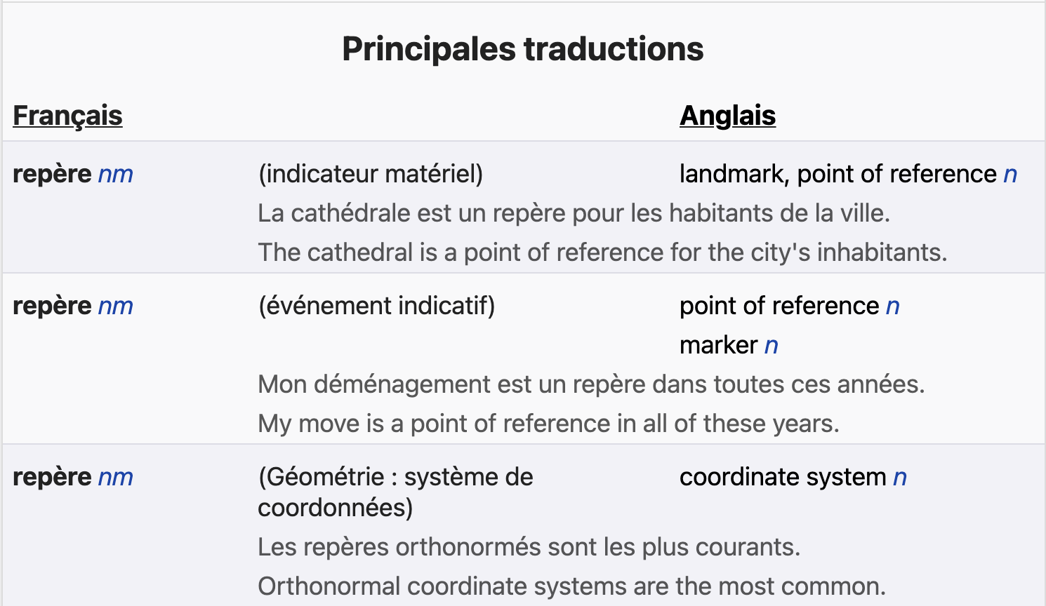
Trouver le sens d'un nouveau mot
lire
Sometimes, the dictionary gives us more than one translation.
Which word makes the most sense in this line of the song?
Use the context to help you to choose the right one.
« J'ai cherché un sens, un point de repère. »
le repère = point of reference
Notes:
Timing: 1 minute
Aim: To demonstrate how to use context to choose the correct translation from multiple definitions.
Procedure:
1. Click to reveal tips on how to choose the correct translation from multiple definitions in a dictionary..
2. Click to reveal the most likely translation of le repère in the song.
Word frequency of unknown words used (1 is the most frequent word in French): repère [4373]
Source: Lonsdale, D., & Le Bras, Y. (2009). A Frequency Dictionary of French: Core vocabulary for learners London: Routledge.
Word frequency of cognates used (1 is the most frequent word in French): point [97]
Source: Lonsdale, D., & Le Bras, Y. (2009). A Frequency Dictionary of French: Core vocabulary for learners London: Routledge.

Slide 31
On traduit
lire
Chercher les mots en orange dans un dictionnaire.
J'ai cherché un sens, un point de repère
Partagé en deux hémisphères
Comme une erreur de l'univers
J'ai jeté tellement de bouteilles à la mer.
Tu m'as comme donné l'envie d'être moi
Donné un sens à mes pourquoi
Tu as tué la peur qui dormait là
Qui dormait là dans mes bras.
I searched for a meaning, a point of reference
Split into / between two hemispheres
Like a mistake of the universe
I threw so many bottles into the sea.
It’s like you gave me the desire to be me
Gave a meaning to my ‘whys’
You killed the fear that was sleeping there
That was sleeping there in my arms.
split, torn
_______________________
Amir, est-il content ?
__________________
bottles
______________________
_____________________
me
Et maintenant ? Qui est ‘tu’ ?
_____________________
fear
___________
_____________
__________
Notes:
Timing: 10 minutes
Aim: To apply dictionary skills introduced on the two previous slides to unknown words in context; to understand the detail of the text; scaffolded French – English translation; to think about the emotions conveyed by the songwriter.
Procedure:
1. Students begin by looking up the words in orange in the dictionary, using the skills practised in the two previous slides. Encourage them to use the surrounding context in the line to inform their choice of definition.
2. Suggested translations appear and then disappear again on clicks.
3. Students fill the gaps to complete the English translation. Note that partial translations are provided to avoid drawing attention to complex grammar features that the students have not yet encountered, such as direct object pronouns (tu m'as comme donné), the imperfect tense (dormait) and relative pronouns (qui).
4. Suggested translations appear on clicks.
5. At the end of each section, click to reveal a question in French about the feelings the singer is describing in each verse. Encourage students to discuss this in French, using je pense qu’il est + adjective.
6. Do his feelings change? How do they know? Encourage more advanced students to discuss this in French using parce que to introduce their justifications, e.g. je pense qu’il est content maintenant parce qu’il dit que tu as/une personne a tué la peur .
Word frequency of unknown words used (1 is the most frequent word in French): orange [3912], dictionnaire [4094]
Source: Lonsdale, D., & Le Bras, Y. (2009). A Frequency Dictionary of French: Core vocabulary for learners London: Routledge.

Slide 32
Dans le bon ordre…
lire
Mets ces phrases dans l’ordre de la chanson.
5 | Despite everything, the singer finds happiness.
2 | The singer felt as though he was broken in two.
3 | The singer threw a lot of bottles into the sea.
1 | The singer looked for love and meaning to his life.
4 | The singer drank a lot of alcohol.
Notes:
Timing: 6 minutes
Aim: To understand the detail of the text.
Procedure:
1. Print song lyrics from Word handout for students
2. Students read through the song again and put the English sentences in the right order. Students will need help deconstructing the final verse as it contains a lot of complex structures. Encourage them to focus on vocabulary they recognise – understanding of the phrase On trouve un paradis will suffice to allow them to complete this activity.
3. Click to reveal answers.
Word frequency of cognates used (1 is the most frequent word in French): ordre [197]
Source: Lonsdale, D., & Le Bras, Y. (2009). A Frequency Dictionary of French: Core vocabulary for learners London: Routledge.

Slide 33
La forme du texte
*le couplet = verse *le refrain = chorus
lire
J'ai cherché un sens à mon existence
J'y ai laissé mon innocence
J'ai fini le cœur sans défense
J'ai cherché l'amour et la reconnaissance
J'ai payé le prix du silence
Je me blesse et je recommence
Tu m'as comme donné l'envie d'être moi
Donné un sens à mes pourquoi
Tu as tué la peur qui dormait là
Qui dormait là dans mes bras
You're the one that's making me strong
I'll be looking, looking for you
Like the melody of my song
J'ai cherché un sens, un point de repère
Partagé en deux hémisphères
Comme une erreur de l'univers
J'ai jeté tellement de bouteilles à la mer
J'ai bu tant de liqueurs amères
Que j'en ai les lèvres de pierre
[REFRAIN]
Au gré de nos blessures
Et de nos désinvoltures
C'est quand on n'y croit plus du tout
Qu'on trouve un paradis perdu en nous
[REFRAIN]
couplet
couplet
refrain
couplet
Notes:
Aim: To show the text of the song again to help with the questions on page 32.
The full song text can be printed as a handout (in additional Word file).

Slide 34
Prends des notes !
écrire
Voici six phrases de la chanson. Écoute et prends des notes.
1
J'ai cherché un sens à mon existence
2
J’y ai laissé mon innocence
3
J'ai cherché l'amour et la reconnaissance
4
J'ai payé le prix du silence
5
Comme une erreur de l'univers
6
J'ai jeté tellement de bouteilles à la mer
Notes:
Production activity for lower-level groups.
Timing: 10 minutes
Aim: To reconstruct a text from notes as part of a dictagloss.
Procedure:
Students write 1-6 in their exercise books with plenty of space for each point.
Students listen to different lines of the song and take notes about each point.
Play each line again if necessary. How many times depends on the class and ability level and is up to the teacher’s judgement.
Based on the notes students reconstruct the lines from the song (could be done in pairs/groups of four).
Students summarise the lyrics in English and discuss what they think of the song.
Click to reveal a transcription of each line.
Transcript:
J'ai cherché un sens à mon existence.
J’y ai laissé mon innocence.
J'ai cherché l'amour et la reconnaissance.
J'ai payé le prix du silence.
Comme une erreur de l'univers
J'ai jeté tellement de bouteilles à la mer.
Word frequency of cognates used (1 is the most frequent word in French): existence [1153], innocence [4300], ligne [342]
Source: Lonsdale, D., & Le Bras, Y. (2009). A Frequency Dictionary of French: Core vocabulary for learners London: Routledge.

Slide 35
À ton tour !
écrire
Écris un nouveau couplet. Tu vas commencer tes phrases avec je ou tu ?
Try to include a rhyming pattern in your verse if possible!
Groupe de mots qui riment
la mer, la frontière, le partenaire, la guerre, le verre, l’hiver, le père, hier
le prix, l’envie, le produit, la pluie, la maladie, samedi, lundi, la vie
la reconnaissance, le sens, la science, la chance, blanche (f), dimanche
Tip: It’s easy to rhyme French verbs because they have similar endings in the infinitive (-er, -ir, - re) and the past ( -é)!
Notes:
Production activity for higher-level groups.
Timing: 10 minutes
Aim: To respond creatively to the text; written production of novel sentences using known vocabulary.
Procedure:
1. Students think about what might happen next, or another part of the story Amir might want to share. They write a new verse of six lines (and a rhyme scheme, though not essential).
2. Encourage students to use this week’s new vocabulary (highlighted in orange). Known words that rhyme with this week’s new vocabulary are provided on the slide. For lower-level sets trying this activity, the teacher may wish to add some examples of verbs in the past tense to the table.
3. Suggest that students could mimic the style of the song, starting each line with je or tu (or a different pronoun!) followed by the correct form of a verb in the perfect tense.
4. Students can use dictionaries and do research online to inform their writing.
Word frequency of unknown words used (1 is the most frequent word in French): tour [523]
Source: Lonsdale, D., & Le Bras, Y. (2009). A Frequency Dictionary of French: Core vocabulary for learners London: Routledge.
Word frequency of cognates used (1 is the most frequent word in French): couplet [>5000], ligne [342]
Source: Lonsdale, D., & Le Bras, Y. (2009). A Frequency Dictionary of French: Core vocabulary for learners London: Routledge.

Slide 36
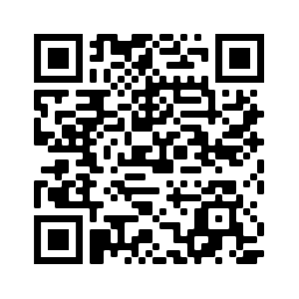
Devoirs
Vocabulary Learning Homework (Y9, Term 2.1, Week 5)
Quizlet link: Y9 Term 2.1 Week 5 (Y7/8 Mashup 7)
Quizlet QR code:
Notes:
The answer sheet for the 9.2.1.5 vocabulary learning homework is here: https://resources.ncelp.org/concern/resources/bc386k78z?locale=en

