Slide 1
An Introduction to NCELP Online Conference Friday 20 November 2020
David Shanks – NCELP Subject Specialist
Emma Marsden – NCELP Director
Rachel Hawkes – NCELP Co-Director
ncelp.org
resources.ncelp.org

Slide 2
Opening Session
Overview of today’s conference
What is NCELP?
What resources are freely available to you
Alignment between the new Ofsted framework & NCELP
Next steps
Notes:
This session introduces NCELP, explaining the project's aims and the main pillars of pedagogy and details our activities since its inception. It will also demonstrate how the NCELP schemes of work align with the new Ofsted framework and provide an overview of the conference day ahead.

Slide 3
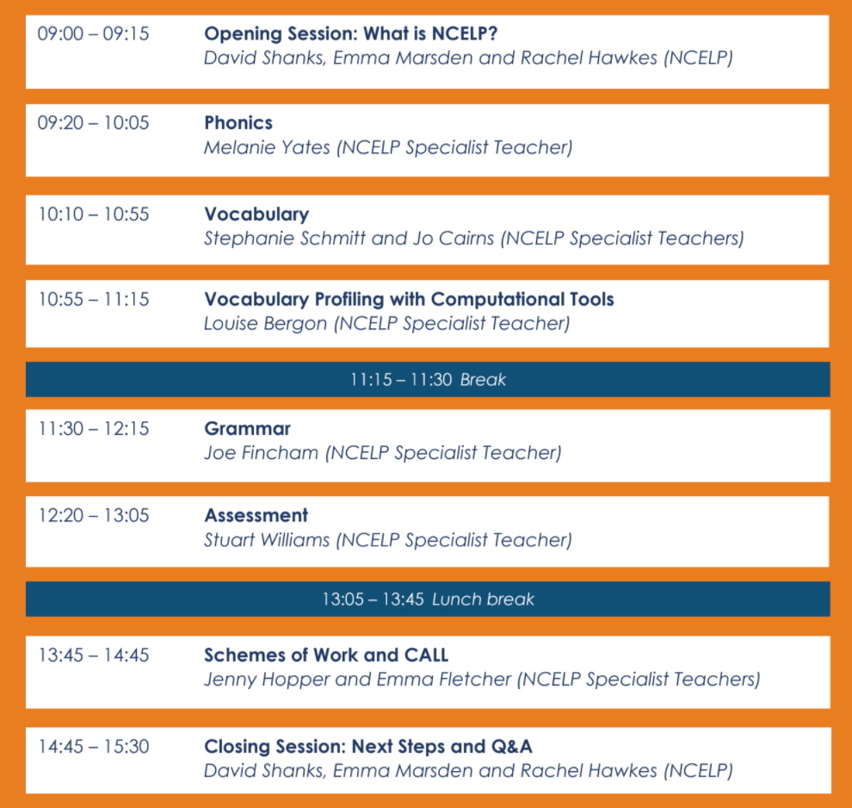
Today’s Conference
Sessions are best viewed together
(but we understand!)
Session recordings will be available
5 mins Q&A at end of each session
Use Zoom’s Q&A feature for questions on content
Use Zoom’s Chat feature for technical issues
“View options” > “Exit full screen”
Closing session Q&A, follow-up FAQ
A huge thank you to our presenters

Slide 4
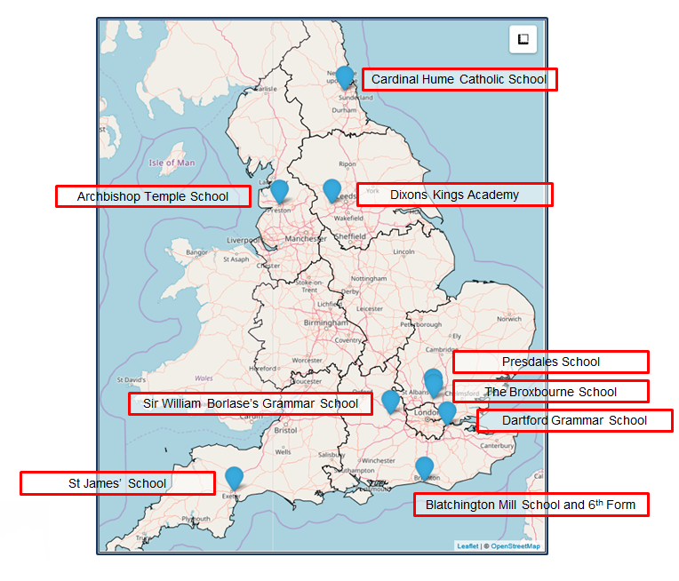
What is NCELP?
Notes:
NCELP comprises a Centre, based at the University of York, and the network of 9 Lead Schools and their hubs shown here. As our strapline says, our business is to understand, improve, and promote the learning of foreign languages.
The Centre itself, after a recent small expansion, now has the equivalent of about 12 members of staff who create a wide range of resources, develop and deliver CPD, maintain the resource portal, communicate research findings, monitor progress, address feedback, and provide technical and administrative support.

Slide 5
NCELP beginnings
Teaching Schools Council Report, Nov 2016
DfE Invitation to Tender for Centre for Excellence, June 2018
Awarded, Sept 2018
Began, Dec 2018.
9 Lead Schools each with 2 Specialist Teachers & 4 Hub Schools
Currently funded until December 2021
Teaching Schools Council (2016), MFL Pedagogy Review.
Notes:
So, how did NCELP come about?
In November 2016, the Teaching Schools Council published the report of the MFL Pedagogy Review.
On the back of the report, the DfE issued a public invitation to tender for a Centre for Excellence, which was awarded in September 2018 and started work that December.
The Centre’s core work has, to date, focused on collaborating with 9 Lead Schools, each with two specialist teachers, some of whom who will hear today. Each Lead school works with four Hub schools.
Our current funding is until December 2021.
The Review made several recommendations and NCELP was funded to help deliver those that relate to pedagogy

Slide 6
NCELP aims to…
Connect classroom practice and research
Develop pedagogy, with resources to deliver it
Improve intrinsic motivation and increase GCSE uptake
Notes:
NCELP’s overarching purposes are:
1 to link research and practice more closely than has previously been the case.
2 to develop research-informed pedagogy and a full suite of supporting resources
3 in order to improve intrinsic motivation and increase numbers at KS4.

Slide 7
1. Connecting research and practice
Interest from teachers & researchers
But difficult due to…
Lack of time
Limited funding
Problems with accessibility of research:
conceptual remoteness
contextual remoteness
Kasprowicz & Marsden, 2017
Notes:
Let’s take the core purposes one by one. To date, it has been a challenge to link research and practice. But there is enthusiasm and interest in making better connections between research and practice. This has been reflected in comments from teachers we have talked to. So, the difficulties we face are not due to a lack of interest but rather …
CLICK a lack of time and
funding for access to high-quality research journals, something that is not supported by school CPD budgets.
CLICK
There are also challenges in accessing research
a) conceptually, due to the terminology and ideas in published research and
b) in working out how to use findings from contexts that can, all too often, differ from our own (such as university learners of Spanish in the States).
So, NCELP aims help improve this situation.

Slide 8
2. Developing languages pedagogy
Generalisable - from teacher to teacher, classroom to classroom
Knowledge-based pedagogy (phonics, vocabulary, grammar)
Practice-rich, meaningful
Focus on high frequency vocabulary
Topics de-emphasised
Notes:
CLICK
NCELP aims to articulate a pedagogy that works ‘on the whole’, that is: for as many teachers and pupils as possible for as much of the time as possible, with the aim of making language teaching less reliant on personal charisma and craft knowledge of individual teachers.
The NCELP pedagogy stresses the importance of establishing a body of phonics, vocabulary and grammar knowledge and sets out to define what that body could look like.
It emphasises practice that doesn’t lose the connection with the meaning of language
And it emphasises the importance of getting a really reliable knowledge of vocabulary that is ‘most useful’, which is the most frequently needed for understanding and producing language.
As a result of these characteristics, it becomes necessary to move away from shaping the curriculum around discrete topics, and this is particularly clear in the early stages.

Slide 9
3. Pedagogy itself improving motivation
Enhancing achievement and ‘perceived ease’ of learning
Increasing the likelihood of success
Teaching students explicitly to ‘sound out’ words
Taylor & Marsden (2014) OASIS summary
Graham (2004) OASIS summary
Erler & Macaro (2012) OASIS summary
Notes:
NCELP is set on developing pedagogy to improve intrinsic motivation.
Research has suggested that this is possible:
feeling good about achievement and perceiving the subject is learnable has been found to predict whether or not a student chooses to do the subject
learners are more motivated by learning when they feel they can succeed and ‘know’ or do something
learners are more motivated when they feel they can read out loud
Today, we hope you will see how NCELP pedagogy aims to give learners a solid knowledge base and gradually build their capacity to use it faster and more easily.

Slide 10
The NCELP Pillars
Pupils need to gain systematic knowledge of the vocabulary, grammar, and sound and spelling systems (phonics) of their new language, and how these are used by speakers of the language.
They need to reinforce this knowledge with extensive planned practice and use in order to build the skills needed for communication.
+ meaningful practice
Teaching Schools Council (2016), MFL Pedagogy Review.
Notes:
You will see today how NCELP schemes of work and the accompanying resources help pupils to gain
CLICK
knowledge of the vocabulary, grammar, and sound and spelling systems (phonics).
CLICK
You will see activities that aim to reinforce this knowledge, with extensive planned practice and use.
All this is with the ultimate aim, which surely all language educators share, of promoting language proficiency for understanding and communicating about cultures and societies and also of sowing a lasting interest in language itself.
Image by Steve Clarke

Slide 11
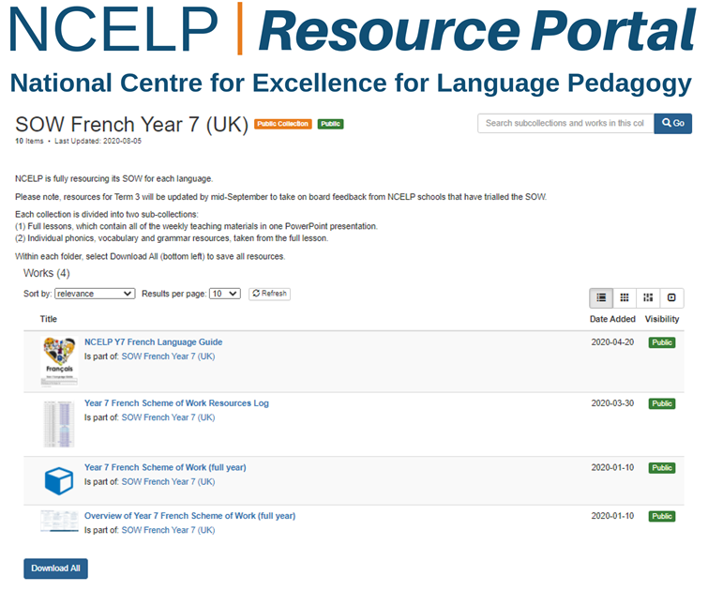
Notes:
For each of the key strands of knowledge building, we have collated some of the research that has informed our thinking,
For phonics, for vocabulary and for grammar
All these can be found on the resources portal, including detailed schemes of work, which contain links to the accompanying resources for each week.

Slide 12
NCELP in Numbers
378 lessons fully resourced
1,450 resources freely available on the Resources Portal
48,000 estimated downloads from NCELP Resources Portal
680 hours of CPD sessions delivered (+ 33 presentations beyond the NCELP network)
9 batteries of tests (=30 individual tests)
312 videoed versions of NCELP lessons (and counting) on Oak Academy
187 Quizlet sets of vocabulary for learning homeworks
6 ‘Language Guides’ (independent student booklets, with phonics, vocab & grammar for term/year)
581 Accessible Summaries of research freely available on OASIS oasis-database.org
Notes:
So, here is a snapshot of what we – NCELP and our network of teachers has been up to over the last 20 months.
The team and NCELP teachers have produced
378 Lessons
And 1,450 resources,
The portal has had about 48,000 downloads (based on 16,120 ‘unique user per month’ downloads as of 10 Nov, assuming each individual user makes an average of 3 downloads per month)
The network has delivered 680 Hours of CPD sessions (+60 more before the end of December!)
We have created 9 language test batteries (=30 individual tests)
Made available 312 OAK Video lessons
Produced 187 Quizlet sets
And 6 language guides (Independent Student Work Booklets)
And made available 581 accessible summaries of research, available from OASIS
That is the end of that brief tour, and I now hand over to Rachel Hawkes who will talk about how our core work aligns with Ofsted’s recent framework.
----------------------
Tests:
Achievement tests
p v g, fr sp g, yr 7 term 2 = 9
P v g fr sp g, yr 7, term 3 = 9
Applying knowledge tests
l s r w, fr sp g, y7 term 2 = 12
=30 individual tests
Not including
Pvg, fr sp g, yr 8 term 2 = 9 (available in Jan 2021)
Aptitude/analytic ability tests for KS2/3

Slide 13
New Ofsted framework and NCELP
Ofsted - Intent
NCELP curriculum planning
Learning is carefully planned to support progression for the vast majority of learners at KS3* within a low exposure foreign language setting.
Progression is determined by the functions of grammar, and the frequency and usefulness of vocabulary and phonics, and avoids introducing too much language too fast.
‘End points’ denote planned progression to the end of KS3 and KS4:
Phonics – confidence in understanding and producing the key SSC by the end of KS3.
Vocabulary – 360 words approx. per year at KS3
Grammar – high-frequency grammar functions taught and revisited several times over KS3 and KS4, in particular features for persons, subjects, tenses and aspect and a range of key syntax (word order and relations between words).
NC or curriculum of similar breadth and ambition
careful thinking about what students will know and be able to do at the end points
Note: intent means ‘everything up to the point of implementation.’
Notes:
An example of logical progression would be not to introduce AVOIR first with ages, which introduces an aspect of cross-linguistic difference that continues to trip students up. Instead, AVOIR is introduces with high-frequency nouns and thoroughly practised and embedded with its meaning of ‘HAVE’ before more idiomatic, less straightforward uses of the verb are encountered.

Slide 14
Ofsted - Intent
NCELP curriculum planning
curriculum sequencing to build knowledge and skills towards the identified end points
subject content that has been identified as most useful
logical progression, systematic and sufficiently explicit teaching to enable all pupils to acquire the intended knowledge and skills (p.44, Ofsted, 2019b).
In general, across KS3, this means:
Phonics – paced, explicit teaching of new sound-symbol correspondences (SSC) initially in Y7, followed by integrated revisiting and consolidation throughout KS3
Vocabulary – teaching of ten new words, on average, per week (assuming a curriculum model of two lessons per week), in sets of words from different parts of speech, including the most common verbs, and selected on the basis of word frequency and additionally informed to support grammar features, learner choice, context appropriateness
Grammar – part paradigms are introduced and built up gradually over time

Slide 15
Ofsted - Implementation
NCELP pedagogy
The most important factors are that teachers:
have expert knowledge of the subject(s) and courses they teach…
enable students to understand key concepts, presenting information clearly and encourage appropriate discussion
check learners’ understanding effectively, and identify and correct misunderstandings.
ensure that students embed key concepts in their long-term memory and apply them fluently.
use assessment well, for example to help learners embed and use knowledge fluently or to check understanding and inform teaching…
select resources and materials – in a way that does not create unnecessary workload for staff – that … support the intent of a coherently planned curriculum, sequenced towards cumulatively sufficient knowledge and skills for future learning and employment
The pedagogy is research-informed and practice-informed (and engagement with it therefore strengthens subject teachers’ specialist knowledge).
Systematic and explicit teaching / clear presentation (of PVG)
Long-term retention and retrieval (revisiting within a week, about a month, about a term, about a year)
Effective checking of learning, understanding
often item-by-item initially in presentation and input practice tasks, then several items
careful selection of TL ensures meanings are consistently clear
L1 translations often provided, where images and gestures are insufficient
NCELP provides resources to support its SOW, which can be adapted or adopted

Slide 16
Ofsted - Impact
NCELP
learners develop detailed knowledge and skills across the curriculum and, as a result, achieve well. Learners are ready for the next stage of education, employment or training.
Judgements about impact will come from the following sources:
the progress that students make in terms of knowing more, remembering more and being able to do more
discussions with students about what they remember from the content they have studied
at KS4, relevant outcomes in national tests will be considered
Assessment of learner progress is continuous
Every lesson students are prompted to apply (PVG) knowledge to understand and to produce language (without recourse to written prompts)
‘Achievement tests’ assess PVG knowledge, ‘Applying your knowledge’ tests more holistic progress
For handout, audio presentation, and more, see:
https://resources.ncelp.org/catalog?utf8=%E2%9C%93&search_field=all_fields&q=ofsted

Slide 17
NCELP’s next steps
Complete resourcing for Y8 (Jan 2021)
SOW development Y9 (Jan – Feb 2021)
Dissemination activities (ongoing)
GCSE Review Panel

Slide 18
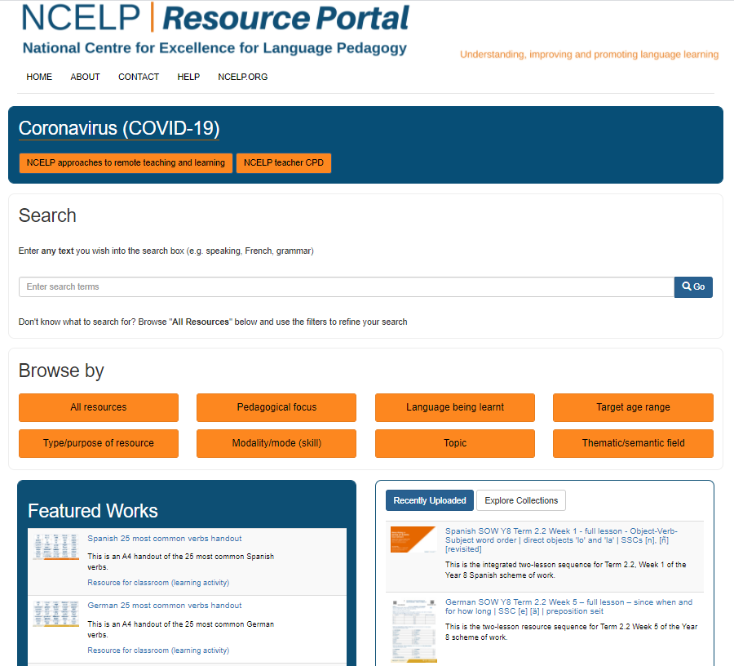
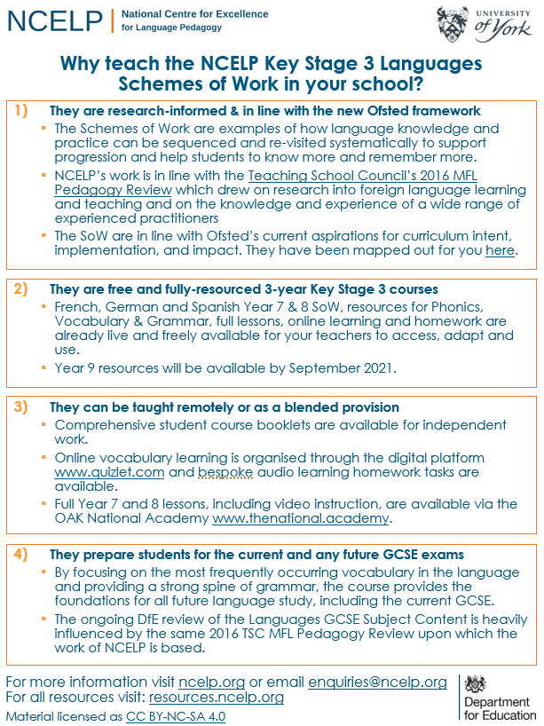
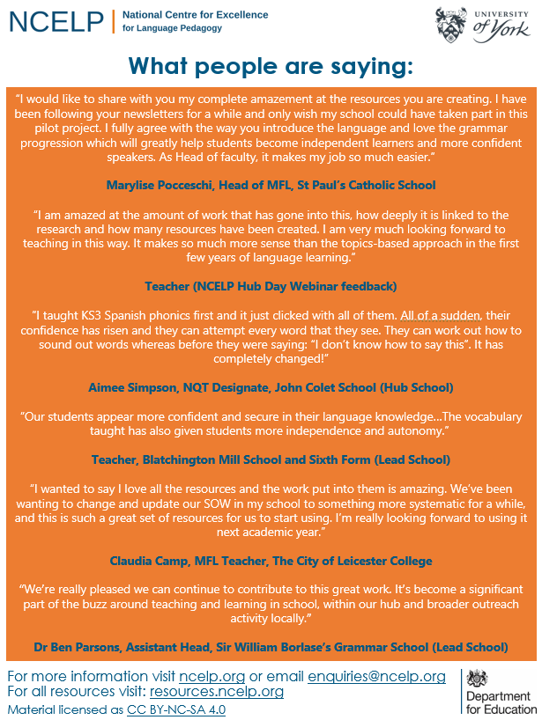
Your next steps?
Enjoy today and ask questions!
Reflect upon what NCELP could offer your context. Have follow up discussions in your school with colleagues and line managers. Share today’s session recordings?
Explore the NCELP Resource Portal – SoW, Resources and CPD sessions including screencasts?
Explore www.thenational.academy video lessons?
Succinct A4 overview flyer available (for SLT!)?
Join the NCELP mailing list for regular bulletins of new research-informed resources arriving on the portal?
Sign up to get monthly alerts to summaries of new research, from OASIS at https://oasis-database.org?
Get in touch with enquiries@ncelp.org for any questions!

Slide 20
Over to our Lead School Specialist Teachers

Slide 21
END

