Slide 1
Statements vs. Questions
‘You’. 2nd person singular

Slide 2
Asking questions: You (singular)
In English, to ask a ‘yes/no’ question we can use the phrase ‘Do you…’ followed by the verb e.g., Do you eat pizza? -> ‘Yes’. Do you play football? -> ‘No’
In French, we swap round the verb and the subject pronoun (e.g., ‘tu’ - you) to change a statement into a question, like this:
Statement
Tu aimes la pizza.
You like pizza.
Question
Aimes-tu
la pizza?
Do you like pizza?
Victoria Hobson / Emma Marsden
Notes:
So, here you will again see the sequence: brief explicit grammar description, focusing on the function of the grammar.
Followed by a reading, then listening, then writing and speaking

Slide 3
ANSWERS
Lire
You have recently introduced your French friend to your brother. She just emailed him but your brother needs help to understand parts of it. Read and decide if the sentence is a statement (write S), or a question (write Q).
Remember that the verb and subject swap round when it is a question. There is no punctuation to help you, such as full stops or questions marks.
Q
Q
1 | Es-tu content |  | 7 | Restes-tu ici
2 | As-tu un frère |  | 8 | Tu joues au tennis
3 | Tu donnes beaucoup |  | 9 | Tu travailles tard
4 | Viens-tu à la maison |  | 10 | Tu aides les parents
5 | Tu dis la vérité |  | 11 | Sors-tu avec les amis
6 | Tu prends le train |  | 12 | Apprends-tu l’anglais
Q
S
S
S
Q
S
S
Q
S
Q
Victoria Hobson / Emma Marsden
Notes:
We have chosen reading first here because this allows them more time than a listening for the pupils to process the forms.
Immediate feedback to the whole class can be given for the first few items, to make sure that all the pupils in the class have ‘got the idea’. Then, perhaps move on to the pupils just responding without immediate class fronted feedback and go through the answers at the end. The teacher can make a judgement about when to stop giving immediate feedback
Punctuation has been removed here so that students have no other clue apart from the verb. You could explain that people sometimes forget punctuation, especially when they are sending a quick message such as a text. So, it can be important to use word order to understand whether it is a question or not.
Verb frequency rankings (1 is the most common word in French): être (5); avoir (8); donner (46); venir (88); dire (37); prendre (43); rester (100);(jouer (219); travailler (290); aider (413); sortir (309); apprendre (327).
Source: Londsale, D., & Le Bras, Y. (2009). A Frequency Dictionary of French: Core vocabulary for learners London: Routledge.

Slide 4
Lire
You have recently introduced your French friend to your brother. She just emailed him but your brother needs help to understand parts of it. Read and decide if the sentence is a statement (write S), or a question (write Q).
Remember that the verb and subject swap round when it is a question. There is no punctuation to help you, such as full stops or questions marks.
1 | Es-tu content |  | 7 | Restes-tu ici
2 | As-tu un frère |  | 8 | Tu joues au tennis
3 | Tu donnes beaucoup |  | 9 | Tu travailles tard
4 | Viens-tu à la maison |  | 10 | Tu aides les parents
5 | Tu dis la vérité |  | 11 | Sors-tu avec les amis
6 | Tu prends le train |  | 12 | Apprends-tu l’anglais
Victoria Hobson / Emma Marsden
Notes:
Students could easily work from the board, writing 1-12 in their books and noting S or Q for each. Alternatively, these two slides are printable student versions.
To print, select 2 slides to a page (Slides 4 & 5), so that each pupil has an A5 response sheet.
NB. Note to teachers: The instructions here about which slides to print are relevant for when viewing these ppts for just the teaching resource itself (not this version of the ppts which are embedded in the much larger set for the CPD itself)

Slide 5
Lire
You have recently introduced your French friend to your brother. She just emailed him but your brother needs help to understand it. Read and decide if the sentence is a statement (write S), or a question (write Q).
Remember that the verb and subject swap round when it is a question. There is no punctuation to help you, such as full stops or questions marks.
1 | Es-tu content |  | 7 | Restes-tu ici
2 | As-tu un frère |  | 8 | Tu joues au tennis
3 | Tu donnes beaucoup |  | 9 | Tu travailles tard
4 | Viens-tu à la maison |  | 10 | Tu aides les parents
5 | Tu dis la vérité |  | 11 | Sors-tu avec les amis
6 | Tu prends le train |  | 12 | Apprends-tu l’anglais
Victoria Hobson / Emma Marsden
Notes:
Printable student copy. To print, select 2 slides to a page (Slides 4 & 5), so that each pupil has an A5 response sheet.
NB. Note to teachers: The instructions here about which slides to print are relevant for when viewing these ppts for just the teaching resource itself (not this version of the ppts which are embedded in the much larger set for the CPD itself)

Slide 6
ANSWERS
Écouter
Your French friend has left a voicemail for your brother. He needs help to understand it! Listen. Decide if each utterance is a fact (write F); something she already knows about your brother, or a question (write Q); something she wants to know.
Remember that the verb and subject pronoun swap round when it is a question.
Q
Q
1
7
There are no other cues to help you. The intonation on the voicemail is flat, like a computerized voice!
F
F
2
8
3
Q
F
9
Q
F
4
10
F
Q
5
11
Q
F
6
12
Victoria Hobson / Emma Marsden
Notes:
NB these sentences have been recorded without intonation, to remove additional cues that would otherwise help students identify between a statement and a question, so as to retain their focus on the initial verb. Click on each orange number to trigger the audio. Each utterance is heard twice. Click again to repeat, as required.
Transcript
Joues-tu au foot?
Tu demandes la raison.
Vas-tu en ville?
As-tu un animal?
Tu aimes le chocolat.
Parles-tu français?
Comprends-tu la question?
Tu manges des fruits.
Tu sors ce weekend.
Tu prépares le dîner.
Veux-tu sortir?
Tu penses que c’est vrai.
Verb frequency rankings (1 is the most common word in French): jouer (219); demander (80); aller (53); avoir (8); aimer (242); parler (106); comprendre (95); manger (1338); sortir (309); préparer (368); penser (116); être (5).
Source: Londsale, D., & Le Bras, Y. (2009). A Frequency Dictionary of French: Core vocabulary for learners London: Routledge.
Image: pixabay (no attribution required) https://pixabay.com/vectors/robot-mustache-science-mechanical-161367/

Slide 7
Écouter
Your French friend has left a voicemail for your brother. He needs help to understand it! Listen. Decide if each utterance is a fact (write F); something she already knows about your brother, or a question (write Q); something she wants to know.
Remember that the verb and subject pronoun swap round when it is a question.
There are no other cues to help you. The intonation on the voicemail is flat, like a computerized voice!
1 |  | 7
2 |  | 8
3 |  | 9
4 |  | 10
5 |  | 11
6 |  | 12
Victoria Hobson / Emma Marsden
Notes:
Students could easily work from the board, writing 1-12 in their books and noting F or Q for each. Alternatively, these two slides are printable student versions.
Printable student copy. To print, select 2 slides to a page (Slides 7 & 8) to give an A5 answer sheet to each pupil.
Or just ask pupils to write 1-10 in their exercise books.

Slide 8
Écouter
Your French friend has left a voicemail for your brother. He needs help to understand it! Listen. Decide if each utterance is a fact (write F); something she already knows about your brother, or a question (write Q); something she wants to know.
Remember that the verb and subject pronoun swap round when it is a question.
There are no other cues to help you. The intonation on the voicemail is flat, like a computerized voice!
1 |  | 7
2 |  | 8
3 |  | 9
4 |  | 10
5 |  | 11
6 |  | 12
Victoria Hobson / Emma Marsden
Notes:
Printable student copy. To print, select 2 slides to a page (Slides 7 & 8) to give an A5 answer sheet to each pupil.
Or just ask pupils to write 1-10 in their exercise books.

Slide 9
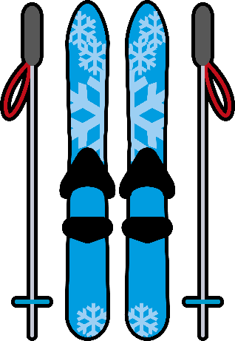
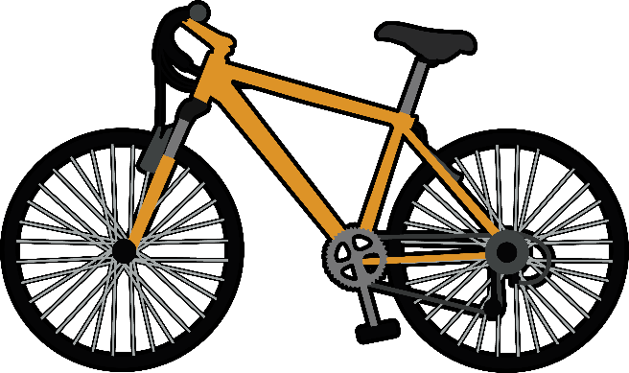
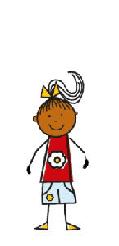
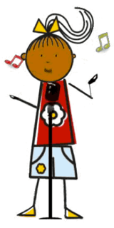
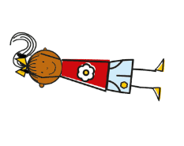
jouer au basket
jouer au football
jouer du piano
faire du ski
faire du vélo
chanter
dessiner
nager
sauter
Victoria Hobson / Emma Marsden
Notes:
Vocab help
This slide can be used as a quick knowledge check in advance of the production activities to reinforce the meanings of the verbs. This can be done with teacher-led mini whiteboard work and then / or as a printed vocab help sheet for those who will need it during the speaking and the writing. This depends on how familiar the students already are with this selection of verbs.
If using as a printed help sheet, pupils should first try to say what they can and leave blanks, e.g. for any of the lexical verbs they don't know. This shows them what they don't know, a learning process known as "noticing the gap". The aim is to 'force recall', by not giving them all the language that they can then just manipulate mechanically. They have to 'pull out' the language from their memories.
Teachers may decide that some learners will need the prompts on this slide.
Verb frequency rankings (1 is the most common word in French): jouer (219); faire (25); chanter (1820); dessiner (2086); nager (>5000); sauter (2114).
Source: Londsale, D., & Le Bras, Y. (2009). A Frequency Dictionary of French: Core vocabulary for learners London: Routledge.

Slide 10
Tu chantes.
Victoria Hobson / Emma Marsden / Rowena Kasprowicz / Juliet Park
Notes:
EMBEDDING and CONSOLIDATION.
This series of slides: a) revises the key activities, b) enables learners to spot questions and statements, c) makes the intonation difference between statements and questions clear, d) and enables learners to practise making statements and asking questions in the second person singular.
Slides 10 to 21 recap of the main verbs and formation of the partitive article, with embedded sound.
Point out that the learners can now hear the difference in intonation for statements and questions. Point out that we also raise our voices when we ask questions in English.
NB. For now, just focus on the idea of “not raising intonation when it is a statement”. There are other practice opportunities to practise making questions simply by raising intonation but keeping the word order the same. The focus here in this series of activities is just on making pupils attend to the word order.
When using slides 9 to 21 with the whole class, learners could first simply repeat the sentences, making sure they get the intonation correct.
In a second time through these slides, they could be asked to mime the action if it is a statement; but if it is a question, they could nod or shake their head to answer the question. Clearly, now, the question marks and the intonation give away more clues than just the word order alone! But they have already had practise in using just the word order, so now we are adding the other cues back in, to help for when they produce questions.
Slide 22 includes picture prompts and learners should be selected to read out the examples with the correct intonation and the correct word order.
Slide 23 encourages learners to think about recalling the correct verb with gapfills. As well as a speaking task, this could also be handed out A5 size as a written activity or learners could write the answers on mini whiteboards.
Slide 24 requires learners to work totally from picture recall. As well as a speaking task, this could also be handed out A5 size as a written activity. A sentence grid is provided for learners to record their answers here.
Slide 27 tests the learners’ ability to apply the statement vs question formation with other activities that have not yet been revised. This could be done as a speaking activity and/or a writing activity. Some pupils may need support with vocabulary here.
This session could then lead to pairwork activities: “Bingo” and “All Activities”

Slide 11
Tu joues au football.
Victoria Hobson / Emma Marsden / Rowena Kasprowicz / Juliet Park

Slide 12
Joues-tu du piano?
Victoria Hobson / Emma Marsden / Rowena Kasprowicz / Juliet Park

Slide 13
Tu fais du ski.
Victoria Hobson / Emma Marsden / Rowena Kasprowicz / Juliet Park

Slide 14
Dessines-tu?
Victoria Hobson / Emma Marsden / Rowena Kasprowicz / Juliet Park

Slide 15
Sautes-tu?
Victoria Hobson / Emma Marsden / Rowena Kasprowicz / Juliet Park

Slide 16
Nages-tu?
Victoria Hobson / Emma Marsden / Rowena Kasprowicz / Juliet Park

Slide 17
Joues-tu au basket?
Victoria Hobson / Emma Marsden / Rowena Kasprowicz / Juliet Park

Slide 18
Fais-tu du vélo?
Victoria Hobson / Emma Marsden / Rowena Kasprowicz / Juliet Park

Slide 19
Tu dessines.
Victoria Hobson / Emma Marsden / Rowena Kasprowicz / Juliet Park

Slide 20
Tu sautes.
Victoria Hobson / Emma Marsden / Rowena Kasprowicz / Juliet Park

Slide 21
Tu .
Tu joues au .
Joues-tu au ?
Joues-tu du ?
Fais-tu du ?
Tu fais du .
Tu .
-tu?.
Tu .
-tu?
Tu
-tu ?
1
7
2
8
3
9
4
10
5
11
6
12
Victoria Hobson / Emma Marsden / Rowena Kasprowicz / Juliet Park
Notes:
Picture recall
Slide 22 includes picture prompts and learners should be selected to read out the examples with the correct intonation and the correct word order.
NB: The items 7 – 12 appear on one mouse click, to avoid information overload on the slide.

Slide 22
Tu .
Tu ____ au .
_____-tu au ?
_____-tu du ?
____-tu du ?
Tu ___ du .
Tu .
-tu?
-tu?
___ ?
-__?
__
Victoria Hobson / Emma Marsden / Rowena Kasprowicz / Juliet Park
Notes:
Partial recall
Slide 23 encourages learners to think about recalling the correct verb with gap-fills. As well as a speaking task, this could also be handed out A5 size as a written activity or learners could write the answers on mini whiteboards.

Slide 23
1
.
.
.
.
.
7
2
8
3
4
9
5
10
6
Victoria Hobson / Emma Marsden / Rowena Kasprowicz / Juliet Park
Notes:
Total recall
Slide 24 requires learners to work totally from picture recall. As well as a speaking activity, this could also be used as a writing activity to allow students to practise the whole constructions of statements and questions.

Slide 24
1
.
.
.
.
.
7
2
8
3
4
9
5
10
6
Victoria Hobson / Emma Marsden / Rowena Kasprowicz / Juliet Park
Notes:
Printable student worksheet for writing (or speaking) activity, if needed. [Usually, learners would write in their books using the projected image from the board.] Select 2 slides to a page. (Slides 25&26)

Slide 25
1
.
.
.
.
.
7
2
8
3
4
9
5
10
6
Victoria Hobson / Emma Marsden / Rowena Kasprowicz / Juliet Park
Notes:
Printable student worksheet for writing (or speaking) activity, if needed. [Usually, learners would write in their books using the projected image from the board.] Select 2 slides to a page. (Slides 25&26)

Slide 26
1
2
3
4
5
6
7
8
9
10
Victoria Hobson / Emma Marsden / Rowena Kasprowicz / Juliet Park
Notes:
Response grid for student sentences, if needed.

Slide 27
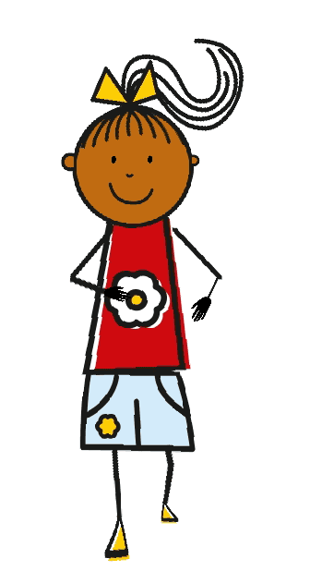
A
B
C
D
E
Victoria Hobson / Emma Marsden / Rowena Kasprowicz / Juliet Park
Notes:
Example of an activity that could be seen as in ‘extending phase’ : Providing examples of meaningful practice, with new vocabulary and little or no support.
EXTENSION with other vocabulary.
This slide challenges the learners’ ability to apply the statement vs question formation with other activities that have not yet been revised.
Note, some learners may need to see some vocabulary first.
Remember, the focus here is on word order, so if pupils don’t shorten the verb from the infinitive to the 2nd person singular, you can gently correct it but don’t get distracted from the main purpose of this activity. There are other opportunities to work more on verb endings, but in this activity, try to focus on whether or not the word order and intonation express a question or a statement.
This session could then lead to pairwork activities (“Bingo” and “All Activities”).

Slide 28
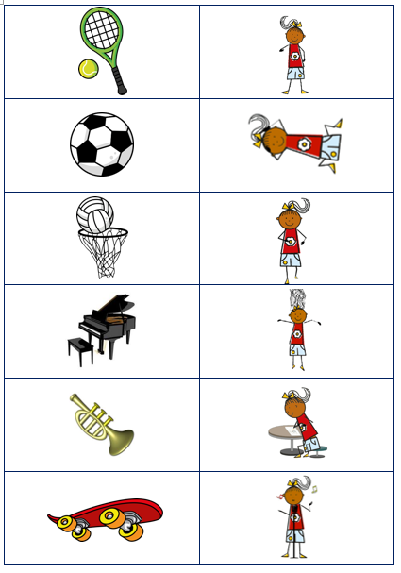
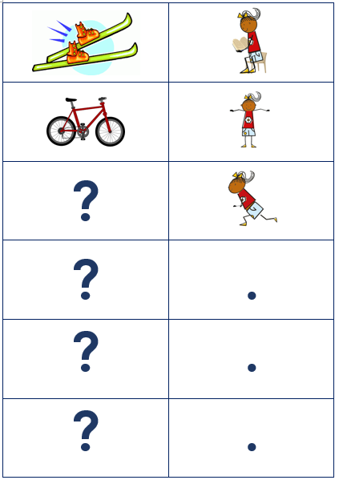
Pair Work
Bingo cards (see next slide)
All activities cards →
Victoria Hobson / Emma Marsden / Rowena Kasprowicz / Juliet Park
Notes:
BINGO, forcing learners to produce and notice word order to indicate questions.
Hand out Bingo cards to learners in pairs, one receives the Partner A cards and one receives the Partner B cards. Each learner should first of all fill in appropriate sentences for each picture in the top grid, taking note of whether it is a question (question mark) or a statement (tick). Once the learners have filled in the cards, they should take it in turns to read at random one of the statements from the eight pictures. Using the bottom grid, the partner should listen to each utterance, work out which picture is being referred to and then add a tick or a question mark. They should take it in turns to do this and once all eight utterances have been read out they should check their answers to see if they have added the correct symbol.
ALL ACTIVITIES, forcing learners to produce and notice word order to indicate questions
Learners could then be given the All Activities cards which contain all images plus full stops and question mark. Students could put the punctuation symbols upside down into one pile and turn the activity cards upside down into another. Each learner should take it in turns to select a card from each pile and either read the activity as a statement or a question! Their partner has to answer ‘oui’ or ’non’ if it is a question. But if it is a statement, they do not need to answer.
You could ask them to use robotic voices when they make their statements or questions, so that their partner really has to listen out for the word order, and can’t use intonation as a clue at all.
They should replace the punctuation cards underneath the pack each time.

Slide 29
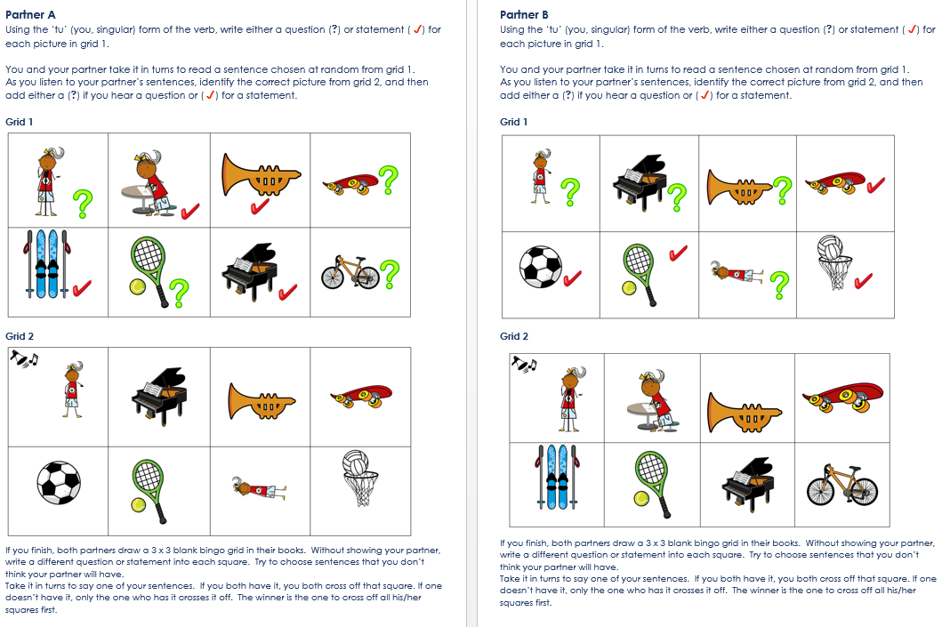
Notes:
Screen shot of the Bingo game

Slide 30
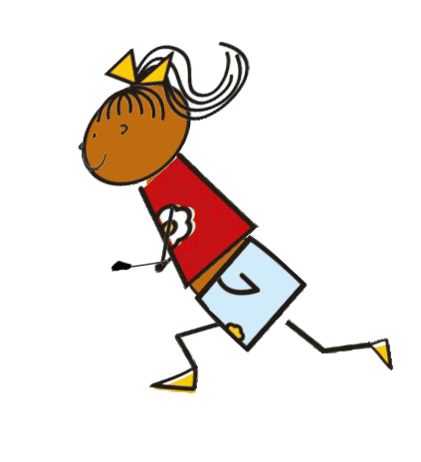
jouer au basket
jouer au football
jouer au tennis
jouer de la trompette
jouer du piano
faire du skate
faire du vélo
faire du ski
chanter
marcher
dessiner
courir
nager
sauter
Victoria Hobson / Emma Marsden / Rowena Kasprowicz / Juliet Park
Notes:
Vocab help sheet
Some students may need reference to the infinitives during the pair work activities.
Verb frequency rankings (1 is the most common word in French): jouer (219); faire (25); chanter (1820); marcher (1532); dessiner (2086); courir (1447); nager (>5000); sauter (2114).
Source: Londsale, D., & Le Bras, Y. (2009). A Frequency Dictionary of French: Core vocabulary for learners London: Routledge.

