Slide 1
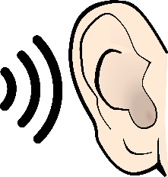
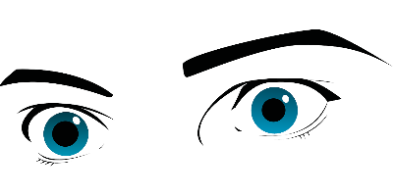
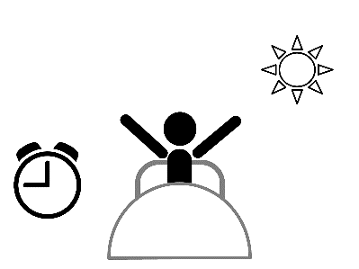
Vokabeln
Hör zu. Schreib den richtigen Buchstaben – A, B, C …
hören
1
D
A
B
C
D
E
2
B
3
E
4
G
[to take]
[to hear]
[to call]
[to see]
[to stop]
5
C
6
A
F
G
H
I
J
7
J
8
N
9
K
[to watch]
[to phone]
[to accept]
[to catch]
[to stand]
10
F
11
M
K
L
M
N
H
12
13
L
[to start]
[to look, appear]
[to look]
[to get up]
14
I
Notes:
Timing: 3 minutes
Aim: aural recognition of key verbs from this week’s vocabulary set, and their connection with verbs that have the same stem, but no separable prefix.
Procedure:
1. Click on the numbers to play each vocabulary item
2. Students match the audio to the correct picture by writing the letter.
3. Elicit the answers/alphabet practice by asking ‘Nummer 1 – welcher Buchstabe ist das?’ Students respond with the German letter name.
Transcript:
1. sehen 2. hören 3. aufhören 4. anrufen 5. rufen 6. nehmen 7. stehen 8. aufstehen 9. anfangen 10. anschauen 11. schauen 12. annehmen 13. aussehen 14. fangen Word frequency (1 is the most frequent word in German): 8.2.2.1 (introduce) annehmen [523] anschauen [949] aufhören [995] aufstehen [966] aussehen [277] fangen [2044] rufen [531] schauen [510] previously taught: nehmen [142] hören [146] anfangen [497] stehen [85] sehen [79] Source: Jones, R.L. & Tschirner, E. (2019). A frequency dictionary of German: core vocabulary for learners. Routledge

Slide 2
Fonética
escuchar / escribir
Text
Notes:
Timing:
Aim:
Procedure:
1.
2.
3.
4.
5.
Transcript:
Word frequency (1 is the most frequent word in Spanish):
Source: Davies, M. & Davies, K. (2018). A frequency dictionary of Spanish: Core vocabulary for learners (2nd ed.). Routledge: London

Slide 3
Vocabulaire
écouter
Text
Notes:
Timing:
Aim:
Procedure:
1.
2.
3.
4.
5.
Transcript:
Word frequency (1 is the most frequent word in French):
Source: Londsale, D., & Le Bras, Y. (2009). A Frequency Dictionary of French: Core vocabulary for learners London: Routledge.

