Slide 1
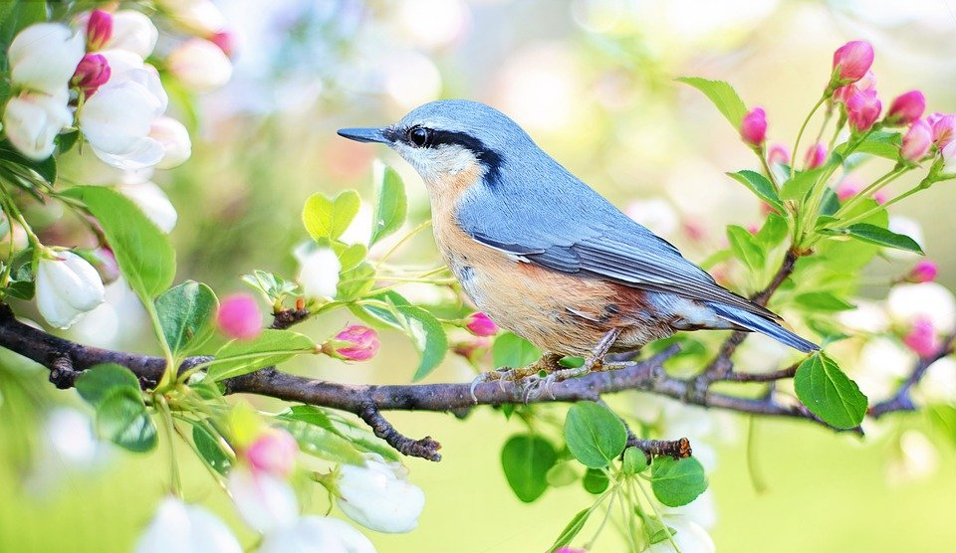
Trouve l’image !
écouter
 | 1 | 2 | 3 | 4
A
B
C
D
audio:
active (m.)
headteacher, manager (m.)
they can, they are able to
?
?
?
?
positive (m.)
1A
2A
3A
4A
you
_{(plural/formal)} must, have to
work experience
company
they must, they have to
?
?
?
?
1B
2B
3B
4B
attitude
swimming pool
colleague (m.)
sporty (m)
?
?
?
?
1C
2C
3C
4C
negative (m)
they want (to)
they know (how to)
we must, we have to
?
?
?
?
1D
2D
3D
4D
Notes:
Timing: 4 minutes
Aim: Aural recognition of new vocabulary at word level.
Procedure:
1. Students volunteer (in French) a letter/number combination relating to a square on the grid.
2. Click the corresponding audio button on the right-hand side.
3. The whole class say the English translation in chorus. Click the blue box to reveal the answer.
4. If the majority of the class says the correct answer, click the yellow box to reveal part of the underlying image.
5. Students guess what the image represents as more is revealed.
Transcript:
1a - positif
2a - actif
3a - le directeur
4a – ils/elles peuvent
1b - vous devez
2b - le stage
3b - l’entreprise
4b – ils/elles doivent
1c - l’attitude
2c – la piscine [audio missing]
3c - le collègue
4c - sportif
1d - négatif
2d – ils/elles veulent
3d – ils/elles savent
4d - nous devons
Answer: oiseau

