Slide 1
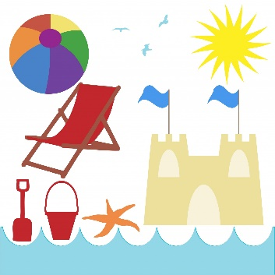
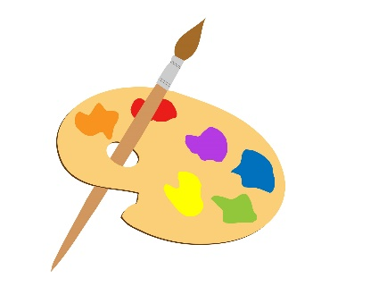
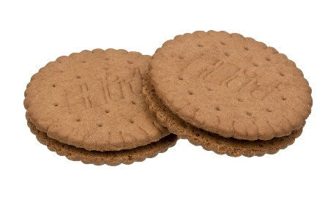
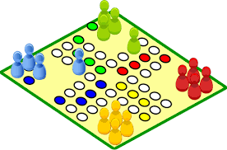
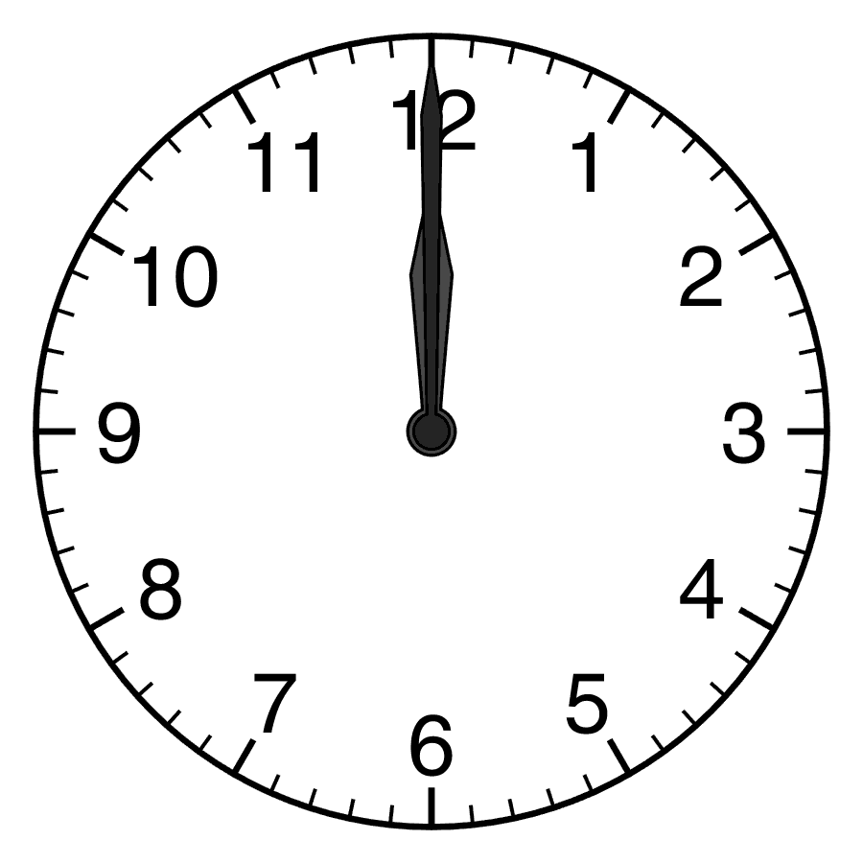
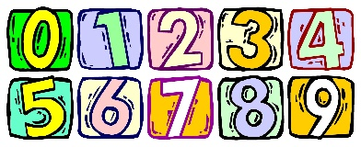
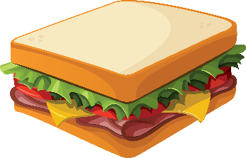
Wie schreibt man das?
schreiben
A
B
C
D
[holiday]
E
F
G
H
[art]
I
J
K
L
[hour]
[number]
[the 1st]
Notes:
Vokabeln Timing: 5 minutes
Aim: To revise in productive mode/written modality 12 items of vocabulary, within a limited time frame.
Procedure:
1. Write A-L in books.
2. Click / press enter to flash a picture. It will disappear after 3 seconds. Note that the pictures do not appear in alphabetical order to increase the challenge.
3. Write down the German word before the picture has faded away. 4. Ensure that gender/definite articles are known for any words that are nouns.
Word frequencies: Butterbrot [3561/1757] Erste [91] Geschenk [2610] Jacke [>4034] Keks [>4034] Kunst [468] Lehrerin [2696] Nummer [1048] Spiel [500] Stunde [262] Urlaub [1192] Welt [190]
ANSWERS
die Jacke
das Geschenk
C. die Lehrerin
D. der Urlaub
E. die Kunst
F. der Keks
G. die Welt
H. das Spiel
I. die Stunde
J. die Nummer
K. das Butterbrot
L. der/die/das Erste

Slide 2
Vocabulaire
écrire
A
B
C
D
[Miss, Mrs, Ms, Madam]
[again]
[other]
[team]
E
F
G
H
[Sir, Mr]
[to become]
[town]
[match]
I
J
K
L
[to continue]
[to leave]
[early]
[late]
Notes:
Vocabulaire Timing: 5 minutes
Aim: To revise in productive mode/written modality 12 items of vocabulary, within a limited time frame.
Procedure:
1. Write A-L in books.
2. Click / press enter to flash a picture. It will disappear after 3 seconds. Note that the pictures do not appear in alphabetical order to increase the challenge.
3. Write down the French word before the picture has faded away. 4. Ensure that gender/definite articles are known for any words that are nouns.
Word frequencies: continuer [113], devenir [162], partir [163], match [1906], madame [294], monsieur [79], encore¹ [51], en retard [7/1278], tôt [513], autre [28] équipe [814], ville [260],
ANSWERS
A. madame
B. encore
C. autre
D. équipe
E. monsieur
F. ville
G. match
H. devenir
I. tôt
J. continuer
K. en retard
L. partir

Slide 3
Vocabulario
escribir
A
B
C
D
[Miss, Mrs, Ms, Madam]
[again]
[other]
[team]
E
F
G
H
[Sir, Mr]
[to become]
[town]
[match]
I
J
K
L
[to continue]
[to leave]
[early]
[late]
Notes:
Vocabulario Timing: 5 minutes
Aim: To revise in productive mode/written modality 12 items of vocabulary, within a limited time frame.
Procedure:
1. Write A-L in books.
2. Click / press enter to flash a picture. It will disappear after 3 seconds. Note that the pictures do not appear in alphabetical order to increase the challenge.
3. Write down the Spanish word before the picture has faded away. 4. Ensure that gender/definite articles are known for any words that are nouns.
Word frequencies:
ANSWERS

