Slide 1
What people can/must/want to do to improve their lifestyle
Modal verbs müssen,dürfen,wollen;
revision of können and the 2-verb rule
SSC [ü] [revisited]
Y7 German
Term 3.2 - Week 3 - Lesson 63
Author name(s): Stephen Owen / Rachel Hawkes
Artwork: Steve Clarke
Date updated: 20/12/21
Notes:
Artwork by Steve Clarke. All additional pictures selected are available under a Creative Commons license, no attribution required.
Learning outcomes (lesson 1):
Consolidation of SSC [ü], present in two of the infinitives introduced this week.
Consolidation of modal verb können and the 2-verb rule. Introduction of müssen, dürfen and wollen.
Word frequency (1 is the most frequent word in German):
7.3.2.3 (introduce) dürfen, darf, darfst [143] müssen, muss, musst [43] wollen, will, willst [57] man [32] genug [498] glücklich [1070] krank [1321] ruhig [991] traurig [1752]
7.3.1.3 (revisit) fallen [332] springen [1431] Geschäft [765] Kino [2020] Konzert [2350] Markt [476] Museum [1078] Party [2809] Stadt [204] Straße [391] angenehm [2214] auf¹ ² [16] in [3]
7.2.2.1 (revisit) schwimmen [1863] wir sind [4] beide [117] wir [26] Einzelkind [>5009] Moschee [>5009] Schlagzeug [>5009] gemeinsam [295] türkisch [1531] immer [64] zusammen [553] Angst vor [n/a]
Additional known vocabulary or cognates to recycle:
können [23] gesund [1275]
Source: Jones, R.L & Tschirner, E. (2019). A frequency dictionary of German: Core vocabulary for learners. London: Routledge.
The frequency rankings for words that occur in this PowerPoint which have been previously introduced in NCELP resources are given in the NCELP SOW and in the resources that first introduced and formally re-visited those words.
For any other words that occur incidentally in this PowerPoint, frequency rankings will be provided in the notes field wherever possible.

Slide 2
SSC?
hören
05:30!!!
Notes:
Note: we are assuming that teachers will remove the [ü] from the title slide before the lesson, so as not to give away the answer!
Timing: 2 minutes
Aim: Students listen in pairs to work out the sound we are revisiting – first pair to put hands up have a go – must say all words correctly and work out the sound.
Procedure:
1. Click the image to play the audio.
2. Students guess the SSC.
3. The following slides reveal and practice the SSC.
ANSWERS:
grün
früh
fünf

Slide 3
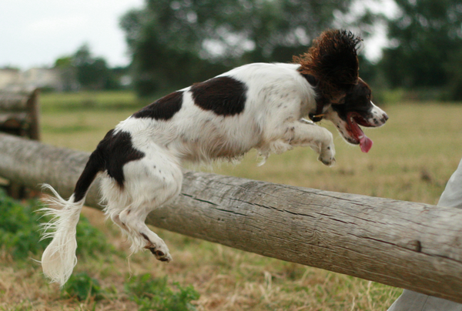
ü
fühlen
grün
Tür
Küche
über
früh
05:30!!!
Notes:
Timing: 2 minutes
Aim: To introduce/consolidate [] SSC [ü]
Procedure:
Introduce and elicit the pronunciation of the individual SSC [ü] and then the source word again ‘Tür’ (with gesture, if using).
Then present and elicit the pronunciation of the five cluster words.
The cluster words have been chosen for their high-frequency, from a range of word classes, with the SSC (where possible) positioned within a variety of syllables within the words (e.g. initial, 2nd, final etc.). Additionally, we have tried to use words that build cumulatively on previously taught SSCs (see the Phonics Teaching Sequence document) and do not include new SSCs. Where new SSCs are used, they are often consonants which have a similar symbol-sound correspondence in English.
Word frequency (1 is the most frequent word in German): Tür [400]; fühlen [419] grün [556]; Küche [960]; früh [322]; über [48]. Source: Jones, R.L. & Tschirner, E. (2006). A frequency dictionary of German: core vocabulary for learners. Routledge

Slide 4
ü
fühlen
grün
Tür
Küche
über
früh
Notes:
With sound and no pictures to focus all attention on the sound-symbol correspondence.

Slide 5
ü
fühlen
grün
Tür
Küche
über
früh
Notes:
Without sound to elicit pronunciation (without first hearing the teacher).
Teacher to elicit pronunciation by asking “Wie sagt man…”

Slide 6
ü
Rücken
wünschen
[to wish]
fünf
Stück
Glück
[luck/happiness]
müssen
[to have to/must]
Notes:
Timing: 2 minutes
Aim: To introduce/consolidate SSC [ü]
Procedure:
Introduce and elicit the pronunciation of the individual SSC [ü] and then the source word again ‘fünf’ (with gesture, if using).
Then present and elicit the pronunciation of the five cluster words.
The cluster words have been chosen for their high-frequency, from a range of word classes, with the SSC (where possible) positioned within a variety of syllables within the words (e.g. initial, 2nd, final etc.). Additionally, we have tried to use words that build cumulatively on previously taught SSCs (see the Phonics Teaching Sequence document) and do not include new SSCs. Where new SSCs are used, they are often consonants which have a similar symbol-sound correspondence in English.
Word frequency (1 is the most frequent word in German): fünf [272]; Rücken [914] wünschen [684]; Glück [763]; müssen [45]; Stück [417].
Source: Jones, R.L. & Tschirner, E. (2006). A frequency dictionary of German: core vocabulary for learners. Routledge

Slide 7
ü
Rücken
wünschen
fünf
Stück
Glück
müssen
Notes:
With sound and no pictures to focus all attention on the sound-symbol correspondence.

Slide 8
ü
Rücken
wünschen
fünf
Stück
Glück
müssen
Notes:
Without sound to elicit pronunciation (without first hearing the teacher).
Teacher to elicit pronunciation by asking “Wie sagt man…”

Slide 9
U oder Ü?
sprechen
das Buch
60
fühlen
grün
gut
die Nummer
Sekunden
die Küche
über
früh
der Zug
0
die Kunst
LOS!
Notes:
Timing: 2 minutes
Aim: To practise spoken production of words containing the [u] and [ü] SSC, building up speed, over 1 minute’s intensive practice.
Procedure:
1. Click on ‘LOS!’ to start a one-minute timer on the screen.
2. Pupils call in any order they like but are not allowed to repeat the one they said in their last turn. 3. Teacher can circulate to listen into their SSC knowledge. Alternative: 1. Student A selects three words and write them down in order. 2. Student B has to work out, just by saying the words, which three words have been chosen, and then the correct order, within the time limit. Note: Student B responses can vary the challenge. 1. Student B repeats back any words that Student A correctly guesses each time. (more straightforward) OR 2. Student B allows Student A to say three words each ‘go’ and indicates how many of these three words are in his/her selection each other. (more challenging).

Slide 10
U oder Ü?
hören
 | U | Ü
1
2
3
4
5
6
1
2
3
4
5
6
Notes:
Timing: 5 minutes (both slides)
Aim: To practise distinguishing aurally between [u] and [ü].
Procedure:
1. Click on the number to play the audio.
2. Students tick the appropriate column.
3. Click to reveal the answers one by one.
4. Activity continues on next slide.
Transcript:
1. das Museum
2. dürfen
3. ruhig
4. früh
5. genug
6. glücklich
Differentiation: In addition, students could be asked to transcribe the full words.

Slide 11
U oder Ü? [2]
hören
 | U | Ü
1
2
3
4
5
6
7
8
9
10
11
12
Notes:
This slide continues the activity on the previous slide.
Transcript:
7. türkisch
8. zusammen
9. gesund
10. müssen
11. sie muss
12. du musst

Slide 12
Vokabeln
H
I
J
K
a cinema
the concert
the museum
a shop
X
an only child
the mosque
the drums
a town
Y
Notes:
Timing: 5 minutes
Aim: To practise recall of nouns from the two revision weeks (3.1.3 and 2.2.1), with either definite or indefinite articles.
Note: This is an important area of grammar to revisit regularly. Alphabet letters give coordinates to practise several difficult letter names.
Procedure:
1. This can be a whole class activity. Teams A/B (class halves) 2. Students nominate any ‘card’ giving coordinates e.g. ‘X-I’ 3. Teacher clicks the card to reveal the English prompt for 2 seconds and then again to hide the card.
4. Student tries to name the item, giving the correct article.
5. If unable to do so, item is re-covered, play continues with Team B.
Note: The slide could be used for many other varieties of vocabulary retrieval, e.g. individual written production using mini whiteboards.
Frequency rankings of vocabulary revisited this week (1 is the most common word in German):
Week 3.1.3 fallen [278] springen [1468] das Geschäft [663] das Kino [1825] das Konzert [1721] das Museum [1360] die Stadt [186] angenehm [1748] in [4], auf [17]
Week 2.2.1 wir sind [3] schwimmen [1832] Angst vor [465/55] Einzelkind [263/106] die Moschee [>4034] das Schlagzeug [>4034] türkisch [1908] beide [130] gemeinsam [346] zusammen [553] immer [68]
Source: Jones, R.L. & Tschirner, E. (2011). A frequency dictionary of German: core vocabulary for learners. Routledge

Slide 13
Vokabeln
springen
to jump
Notes:
Timing: 5 minutes (all 9 slides)
Aim: To practise recall of the verbs, adjectives and adverbs from the two revision weeks (3.1.3 and 2.2.1).
Procedure:
1. Use image and English prompt to elicit vocabulary from students.
2. Reveal answer - clicking on the English term causes it to spin and then be replaced with the German equivalent.
Frequency rankings of vocabulary revisited this week (1 is the most common word in German):
Week 3.1.3 fallen [278] springen [1468] das Geschäft [663] das Kino [1825] das Konzert [1721] das Museum [1360] die Stadt [186] angenehm [1748] in [4], auf [17]
Week 2.2.1 wir sind [3] schwimmen [1832] Angst vor [465/55] Einzelkind [263/106] die Moschee [>4034] das Schlagzeug [>4034] türkisch [1908] beide [130] gemeinsam [346] zusammen [553] immer [68]
Source: Jones, R.L. & Tschirner, E. (2011). A frequency dictionary of German: core vocabulary for learners. Routledge

Slide 14
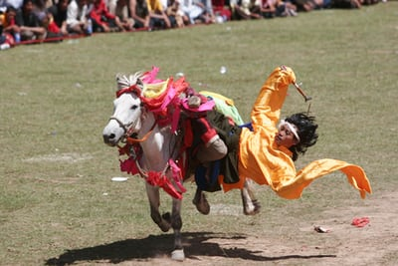
Vokabeln
to fall
fallen
Notes:
As for previous slide.

Slide 15
Vokabeln
angenehm
pleasant
Notes:
As for previous slide.

Slide 16
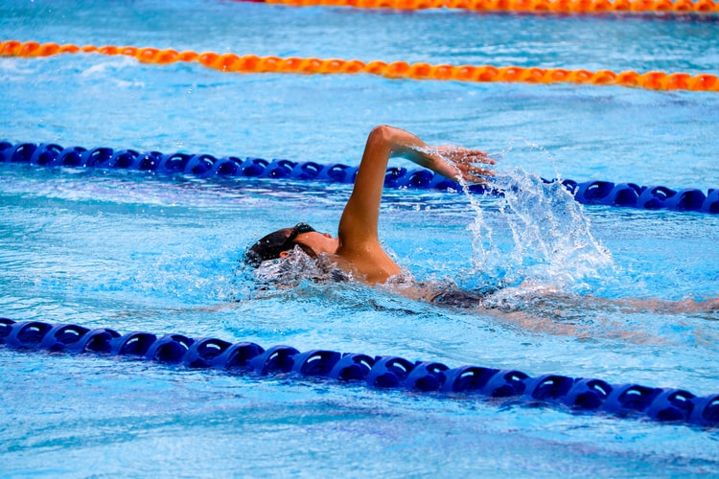
Vokabeln
to swim
schwimmen
Notes:
As for previous slide.

Slide 17
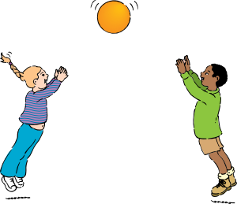
Vokabeln
both
beide
Notes:
As for previous slide.

Slide 18
Vokabeln
zusammen
together
Notes:
As for previous slide.

Slide 19
Vokabeln
immer
always
Notes:
As for previous slide.

Slide 20
Vokabeln
türkisch
Turkish
Notes:
As for previous slide.
Teacher could point out that the word türkisch contains this week’s revisited SSC [ü].

Slide 21
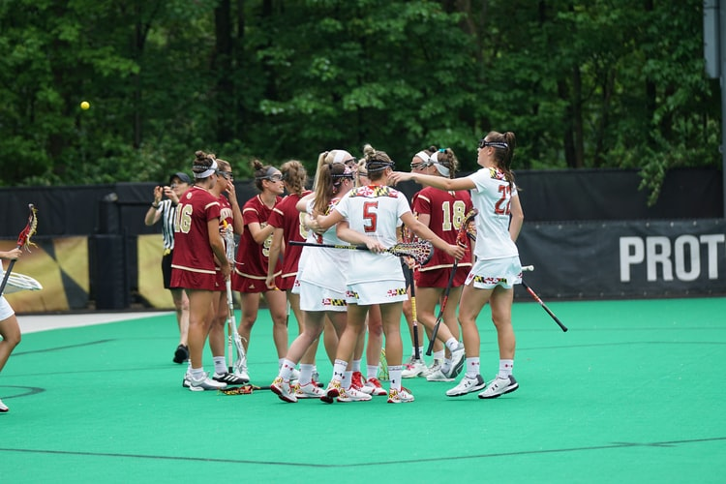
Vokabeln
gemeinsam
in common
Notes:
As for previous slide.

Slide 22
More modal verbs
Grammatik
Remember: to say what someone can do, use the modal verb können with a 2nd verb in the infinitive at the end of the sentence:
Ich kann Deutsch sprechen.
Note: as for können, the verb forms for I and s/he are the same → muss, darf, will How is this different from other German verbs you know?
I can speak German.
How is the word order different from English?
Du kannst Gitarre spielen.
You can play guitar.
Er kann gut tanzen.
He can dance well.
She can eat fruit.
Sie kann Obst essen.
Here are three more modal verbs:
müssen [to have to, must] – ich muss, du musst, er muss, sie muss
dürfen [to be allowed, may] – ich darf, du darfst, er darf, sie darf
wollen [to want] – ich will, du willst, er will, sie will
Notes:
Timing: 3 minutes
Aim: To introduce this week’s modal verbs, recapping on the conjugation pattern of können and the two-verb rule.
Procedure:
1. Cycle through the information on the slide using the animation sequence.
Note: In the recap of können, teachers can seek to elicit the German from students for the English examples.

Slide 23
Mehmet redet mit Mia.
Ist das Mehmet (→ ICH) oder Mia (→ DU)?
hören
 | Mehmet [I] | Mia [You]
1
Mehmet
2
3
4
Mia
5
6
7
8
Notes:
Timing: 4 minutes
Aim: To practise aural comprehension of the first and second person singular forms of the modals in sentence utterances.
Procedure:
1. Click on the numbered buttons to play the audio.
2. Students tick the appropriate column.
3. Click to reveal the answers one by one.
Transcript: 1) [beep] musst viel lernen. (du) 2) [beep] will sehr gut spielen. (ich) 3) [beep] darf zu Hause bleiben. (ich) 4) [beep] willst jeden Tag laufen. (du) 5) [beep] darfst in die Stadt gehen. (du) 6) [beep] kannst nicht so gut singen. (du) 7) [beep] muss Mathematik lernen. (ich) 8) [beep] kann später mit Freunden reden. (ich)

Slide 24
Das gute Leben*
lesen
Mehmet schreibt eine Email an Wolfgang.
Der Computer ist nochmal kaputt! Schreibt er ‘sie’ (Mia) oder ‘du’ (Wolfgang)?
 |  | sie [she] | du [you]
1 | kannst Sport machen.
2 | will glücklich sein.
3 | muss gesund essen.
4 | darf Sport machen.
5 | willst keine Angst haben.
6 | kann mit Freunden reden.
7 | musst genug Wasser trinken.
8 | darfst früh ins Bett gehen.
*das gute Leben = the good life
Notes:
Timing: 5 minutes
Aim: To practise written comprehension of the 3rd person singular [sie] and 2nd person singular [du] forms of können, müssen, wollen and dürfen. This is slide 1 of 2.
Procedure:
1. The rubrics and task themselves are animated step by step to support teacher explanation.
2. Click to reveal the sentences, minus the subject pronoun in each case.
3. Students tick the appropriate column. The first one can be modelled with the whole class.
4. Answer ticks are animated to appear one by one.

Slide 25
Wie sagt man das auf Englisch?
lesen
Schreib die Sätze auf Englisch.
 |  | Englisch
1 | Du kannst Sport machen.
2 | Sie will glücklich sein.
3 | Sie muss gesund essen.
4 | Sie darf Sport machen.
5 | Du willst keine Angst haben.
6 | Sie kann mit Freunden reden.
7 | Du musst genug Wasser trinken.
8 | Du darfst früh ins Bett gehen.
You can do sport.
She wants to be happy.
She must eat healthily.
She is allowed to do sport.
You want to have no fear.
She can talk to friends.
You must drink enough water.
You are allowed to go to bed early.
Notes:
Timing: 8 minutes
Aim: To practise written comprehension of present tense modal sentences in German, together with active recall of the vocabulary.
This is slide 2 of 2.
Procedure:
1. Students translate each sentence into English.
Note: These are the same sentences as featured in Part 1 of the task.
2. Click to bring up the suggested translations one by one.

Slide 26
The 2-verb rule and negation
Grammatik
As you know, when using modals with another infinitive verb, this second verb goes to
the end of the sentence:
Ich muss singen.
I must sing.
To make sentences like this negative, use nicht before the infinitive verb:
Ich muss nicht singen.
I don’t have to sing.
To use modals with singular nouns, put the noun before the infinitive verb:
Er will einen Film sehen.
How is the word order different from English?
Er will keinen Film sehen.
He wants to see a film.
He doesn’t want to see a film.
She is allowed to wear trousers.
Sie darf eine Hose tragen.
She isn’t allowed to wear trousers.
Sie darf keine Hose tragen.
Du musst ein Handy benutzen.
You must use a mobile.
Du musst kein Handy benutzen.
You don’t have to use a mobile.
To negate sentences with modals and nouns, use keinen, keine, kein:
Notes:
Timing: 3 minutes
Aim: To revisit the use of nicht in negative 2-verb structures and kein (and its inflected forms) in sentences with nouns following the modal.
Note: This distinction was originally introduced and practised with können in 2.2.2. Here, it is applied to the other modals introduced this week.
This slide contains animated text that is hidden when viewing the slides in edit mode. Put the presentation into slide show mode to review this slide.
Procedure:
1. Cycle through the information on the slide using the animation sequence.

Slide 27
Wie sagt man das auf Englisch?
lesen
Positiv oder negativ?
 |  | Englisch
1 | Ich muss eine Straße finden.
2 | Du musst keinen Boden putzen.
3 | Du darfst auf kein Konzert gehen.
4 | Sie darf viele Sprachen lernen.
5 | Ich will in eine Moschee gehen.
6 | Sie will kein Enzelkind sein.
7 | Er darf eine Stunde stehen.
8 | Du willst kein Schlagzeug spielen.
I must / mustn’t find a street.
You must / don’t have to clean any floor.
You may / may not go to any concert.
She may / may not learn lots of languages.
I want / don’t want to go to a mosque.
She wants / doesn’t want to be an only child.
He is / isn’t allowed to stand for an hour.
You want / don’t want to play (any) drums.
Notes:
Timing: 5 minutes
Aim: To practise written comprehension of ‘ein/eine/ein’ and ‘kein/keine/kein’ in two-verb sentences.
Note: Three persons of dürfen, müssen and wollen are used, for variety, but the English translations are provided to allow students to focus solely on the difference in form and meaning of ‘ein’ versus ’kein’ and the equivalent structure in English, which is very different. Students have already been taught ‘nicht’ with verbs and ‘kein’ with nouns and practised differentiating between them. However, this is a point of significant cross-linguistic difficulty, and is therefore being revisited here, with different lexis reflecting this week’s vocabulary sets, and other previously taught vocabulary.
Procedure:
1. Students should write 1-8 in their books and record the correct form of the verb phrase (positive or negative polarity) for each. 2. Answers are revealed on separate mouse clicks.

Slide 28
What people can/must/want to do to improve their lifestyle
Further practice with modal verbs müssen, dürfen, wollen, können
Introduction of the pronoun man
SSC [r] [revisited]
Y7 German
Term 3.2 - Week 3 - Lesson 64
Author name(s): Stephen Owen / Rachel Hawkes
Artwork: Steve Clarke
Date updated: 20/12/21
Notes:
Artwork by Steve Clarke. All additional pictures selected are available under a Creative Commons license, no attribution required.
Learning outcomes (lesson 2):
Consolidation of SSCs [ü], [r].
Consolidation of modal verbs (können, müssen, dürfen and wollen) and the 2-verb rule.
Introduction of dürfen versus können.
Introduction of the pronoun man.
Word frequency (1 is the most frequent word in German):
7.3.2.3 (introduce) dürfen, darf, darfst [143] müssen, muss, musst [43] wollen, will, willst [57] man [32] genug [498] glücklich [1070] krank [1321] ruhig [991] traurig [1752]
7.3.1.3 (revisit) fallen [332] springen [1431] Geschäft [765] Kino [2020] Konzert [2350] Markt [476] Museum [1078] Party [2809] Stadt [204] Straße [391] angenehm [2214] auf¹ ² [16] in [3]
7.2.2.1 (revisit) schwimmen [1863] wir sind [4] beide [117] wir [26] Einzelkind [>5009] Moschee [>5009] Schlagzeug [>5009] gemeinsam [295] türkisch [1531] immer [64] zusammen [553] Angst vor [n/a]
Additional known vocabulary or cognates to recycle:
können [23] gesund [1275]
Source: Jones, R.L & Tschirner, E. (2019). A frequency dictionary of German: Core vocabulary for learners. London: Routledge.
The frequency rankings for words that occur in this PowerPoint which have been previously introduced in NCELP resources are given in the NCELP SOW and in the resources that first introduced and formally re-visited those words.
For any other words that occur incidentally in this PowerPoint, frequency rankings will be provided in the notes field wherever possible.

Slide 29
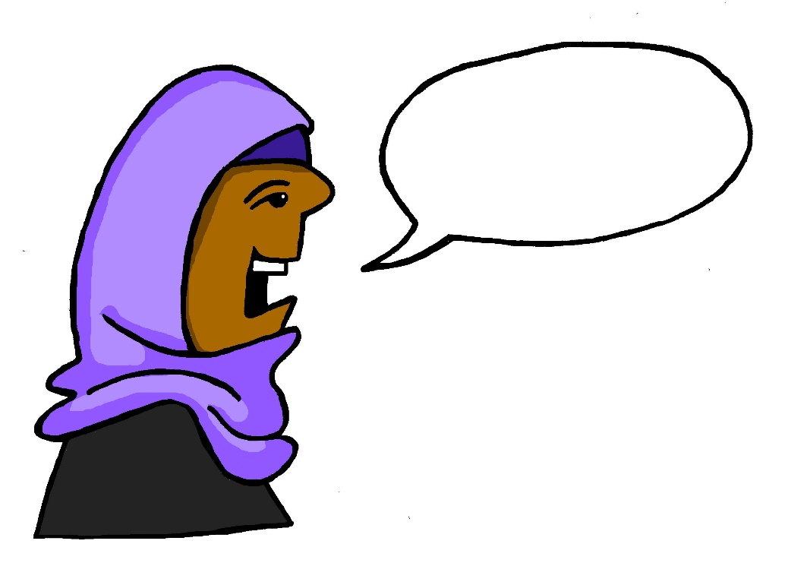
r
reden
Notes:
Timing: 1 minute
Aim: To introduce/consolidate SSC [r]
Procedure: 1. Present the letter(s) and say the [r] sound first, on its own. Students repeat it with you. 2. Bring up the word ”reden” on its own, say it, students repeat it, so that they have the opportunity to focus all of their attention on the connection between the written word and its sound.
3. A possible gesture for this would be to mime talking between your right hand and your left hand.
4. Roll back the animations and work through 1-3 again, but this time, dropping your voice completely to listen carefully to the students saying the [r] sound, pronouncing ”reden” and, if using, doing the gesture. Word frequency (1 is the most frequent word in German): reden [356]
Source: Jones, R.L. & Tschirner, E. (2006). A frequency dictionary of German: core vocabulary for learners. Routledge

Slide 30
r
reden
Notes:
With sound and no pictures to focus all attention on the sound-symbol correspondence.

Slide 31
r
reden
Notes:
Without sound to elicit pronunciation (without first hearing the teacher).
Teacher to elicit pronunciation by asking “Wie sagt man…”

Slide 32
r
Regel
rot
reden
warum?
Beruf
Reise
Notes:
Timing: 2 minutes
Aim: To introduce/consolidate SSC [r]
Procedure:
Introduce and elicit the pronunciation of the individual SSC [r] and then the source word again ‘reden’ (with gesture, if using).
Then present and elicit the pronunciation of the five cluster words.
The cluster words have been chosen for their high-frequency, from a range of word classes, with the SSC (where possible) positioned within a variety of syllables within the words (e.g. initial, 2nd, final etc.). Additionally, we have tried to use words that build cumulatively on previously taught SSCs (see the Phonics Teaching Sequence document) and do not include new SSCs. Where new SSCs are used, they are often consonants which have a similar symbol-sound correspondence in English.
Word frequency (1 is the most frequent word in German): reden [356]; Regel [484] rot[381]; warum? [246]; Reise [786]; Beruf [477 Source: Jones, R.L. & Tschirner, E. (2006). A frequency dictionary of German: core vocabulary for learners. Routledge

Slide 33
r
Regel
rot
reden
warum?
Beruf
Reise
Notes:
With sound and no pictures to focus all attention on the sound-symbol correspondence.

Slide 34
r
Regel
rot
reden
warum?
Beruf
Reise
Notes:
Without sound to elicit pronunciation (without first hearing the teacher).
Teacher to elicit pronunciation by asking “Wie sagt man…”

Slide 35
Welcher R?
hören
 | ‘r’ as in ‘Regel’ | ‘r’ as in ‘Wort’
1
2
3
4
5
6
1
2
3
4
5
6
Notes:
Timing: 3 minutes
Aim: To practise distinguishing between the sounds of the ‘r’ at the beginning of a word or syllable and the post-vocalic ‘r.
Note: Words from the new and revisited vocabulary sets for this week are used.
Procedure:
1. Click on the number to play the audio.
2. Students tick the appropriate column.
3. Click to reveal the answers one by one.
Transcript:
1. dürfen
2. die Straße
3. ruhig
4. der Markt
5. springen
6. die Party

Slide 36
Vokabeln: Wo bin ich?
*treffen = to meet
hören
Mia telefoniert mit Alastair. Sie spielen ein Wortspiel auf Deutsch, „Wo bin ich?”
im Klassenzimmer | im Geschäft | im Bus | im Kino
im Krankenhaus | im Museum | in der Stadt | im Konzert
 | im Kino
 | im Bus
 | im Klassenzimmer
 | im Konzert
 | im Krankenhaus
 | im Museum
 | im Geschäft
 | in der Stadt
Ich will einen Film sehen.
1
2
Ich muss elf Stunden sitzen.
3
Ich darf hier nicht springen.
4
Ich muss zwei Stunden Schlagzeug spielen.
5
Ich darf nicht stehen, ich muss ruhig im Bett liegen.
6
Ich darf nicht laut sprechen.
7
Ich will ein T-Shirt kaufen.
8
Ich kann meine Freunde hier treffen.
Notes:
Timing: 4 minutes
Aim: To practise aural recall of revisited vocabulary in 2-verb modal sentences.
Note: Scenario - Alastair is now back in Scotland but is still in touch with his friends, Wolfgang and Mia. Here they are playing a word game. Mia is giving verbal clues and Alastair is guessing where she is.
Procedure:
1. Click each number to hear the audio.
2. Students choose the place that matches each sentence. Note: Some answers are possible for more than one location. Encourage students to listen to them all, noting possible answers, before coming to a conclusion.
3. Answers are revealed one by one on mouse clicks, along with a written version of the audio sentence.
4. Teachers may want to draw attention to the ‘im’ and ‘in der’ and elicit its meaning and grammatical structure (taught in 3.1.3 and revisited since in 3.1.6).
Transcript: 1. Ich will einen Film sehen. [im Kino] 2. Ich muss elf Stunden sitzen. [im Bus} 3. Ich darf nicht springen. [im Klassenzimmer] 4. Ich muss zwei Stunden Schlagzeug spielen. [im Konzert] 5. Ich darf nicht stehen, ich muss ruhig im Bett liegen. [im Krankenhaus]* This is a compound noun, made up of two known words, ‘krank’ and ‘Haus’. Teachers to elicit the English meaning of this new noun [hospital] from students, in whole class feedback. 6. Ich darf nicht laut sprechen. [im Museum] 7. Ich will ein T-Shirt kaufen. [im Geschäft] 8. Ich kann meine Freunde hier treffen.* [in der Stadt]

Slide 37
Can I, or may !?
Grammatik
In English, we use can with two different meanings:
Can you swim?
= Are you able to swim?
Can I go out tonight?
= Am I allowed to go out tonight?
May is sometimes often used in English to express this second meaning:
(asking permission)
May I go out tonight?
In German, we use dürfen for this second meaning of to be allowed or may:
Darf ich in die Stadt gehen?
May I go into town?
Du darfst ein Handy haben.
You are allowed to have a mobile phone.
Er darf nicht zu Hause bleiben.
He is not allowed to stay at home.
Notes:
Timing: 3 minutes
Aim: To clarify the difference between ‘can’ and ‘may’ in English, to support students’ differentiation of können and dürfen.
Note: The following slide provides practice in selecting the correct German verb for the intended meaning of ‘can’.
Procedure:
1. Cycle through the information on the slide using the animation sequence.

Slide 38
Dürfen oder können?
lesen
Mehmet schreibt noch eine Email an Wolfgang.
Der Computer ist nochmal kaputt! Schreibt er ‘darf/darfst’ (may) oder ‘kann/kannst’ (can)?
 |  | darf / darfst | kann / kannst
1 | Darf ich ins Kino gehen?
2 | Kann er gut Fussball spielen?
3 | Darfst du ein Eis essen?
4 | Kannst du schwimmen?
5 | Sie kann sehr gut singen.
6 | Sie darf keine Hose in der Schule tragen.
7 | Ich kann nicht sehr gut tanzen.
8 | Er darf nicht auf das Konzert gehen.
Notes:
Timing: 3 minutes
Aim: To practise written comprehension of dürfen and können.
Procedure:
1. The rubrics and task themselves are animated step by step to support teacher explanation.
2. Click to reveal the sentences, minus the verb in each case.
3. Students tick the appropriate column. The first one can be modelled with the whole class.
4. Answer ticks are animated to appear one by one, and alternate clicks reveal the verb in the sentence itself.

Slide 39
Wie sagt man das auf Englisch?
lesen
Schreib die Sätze auf Englisch.
 |  | Englisch
1 | Darf ich ins Kino gehen?
2 | Kann er gut Fussball spielen?
3 | Darfst du ein Eis essen?
4 | Kannst du schwimmen?
5 | Sie kann sehr gut singen.
6 | Sie darf keine Hose in der Schule tragen.
7 | Ich kann nicht sehr gut tanzen.
8 | Er darf nicht auf das Konzert gehen.
May I go to the cinema?
Can he play football well?
Are you allowed to eat an ice cream?
Can you swim?
She can sing very well.
She isn’t allowed to wear trousers in school.
I can’t dance very well.
He isn’t allowed to go to the concert.
Notes:
Timing: 7 minutes
Aim: To practise further written comprehension of sentences with können and dürfen, drawing attention to the difference in syntax between German and English, and additionally recalling this week’s and revisited vocabulary.
Procedure:
1. Students translate each sentence into English.
Note: These are the same sentences as featured in Part 1 of the task.
2. Click to bring up the suggested translations one by one.

Slide 40
Wolfgang redet mit Mia [1]
lesen
d_ _ S _ _ _ _ !
die Stadt!
Ach, er muss positiv denken! Er kann ja Musik hören, oder seine Hausaufgaben machen…
Mehmet ist traurig.
Er ist krank und er darf nicht auf das Konzert gehen!
Notes:
Timing: 4 minutes (two slides)
Aim: To provide additional comprehension practice of modal 2-verb structures and this week’s vocabulary.
Procedure:
1. Students should read the dialogue aloud with a partner, before clicking on the speech bubbles to hear the audio.
2. Teachers elicit the English meaning from students, orally, or in written form.

Slide 41
Wolfgang redet mit Mia [2]
lesen
d_ _ S _ _ _ _ !
die Stadt!
Mia, du denkst immer so positiv! Willst du vielleicht mit Mehmet reden?
Ja, natürlich! Das kann ich später machen.
Notes:
As for previous slide.

Slide 42
The pronoun man in German
Grammatik
The pronoun man is used to talk about people in general in German.
We use it to mean ‘you’ for people in general (or ‘one’):
Ich will Sport machen.
I want to do sport.
Du willst Sport machen.
You want to do sport.
He wants to do sport.
Er will Sport machen.
Sie will Sport machen.
She wants to do sport.
Man will Sport machen.
You (people in general) want / one wants to do sport.
The verb form with man is the same as for er and sie (third person singular).
Notes:
Timing: 3 minutes
Aim: To present the use of the pronoun man.
Procedure:
1. Cycle through the information on the slide using the animation sequence.

Slide 43
Mehmet ist krank!
der Rat = advice
hören
Der Arzt redet mit Mehmet und gibt Rat*.
Tick ‘you’ if the advice is to Mehmet; tick ‘one’ if it is about people in general.
 |  | you ... [du] | one ... [man]
 | Du musst positiv bleiben.
 | Man kann Sport machen.
 | Man muss genug schlafen.
 | Du darfst oft mit Freunden reden.
 | Man muss gesund essen.
 | Du musst genug Wasser trinken.
 | Du darfst nicht zu spät am Computer spielen.
 | Man darf immer früh ins Bett gehen.
1
2
3
4
5
6
7
8
Notes:
Timing: 5 minutes
Aim: To practise distinguishing between the second person (du) and third person (man) singular forms of the modals in sentence utterances.
Note: This task models the use of man to talk about people in general, and incorporates most of the vocabulary needed for the writing task which follows.
Procedure:
1. Click on numbered buttons to play audio.
2. Students tick the appropriate column.
3. The answers are animated to appear one by one upon clicking the mouse, then with the final click the rectangle obscuring the full sentences disappears, allowing the task to be used as a translation into English (oral or written).
Transcript: 1) [Du] musst positiv denken.
2) [Man] kann Sport machen.
3) [Man] muss genug schlafen.
4) [Du] darfst oft mit Freunden reden.
5) [Man] muss gesund essen.
6) [Du] musst genug Wasser trinken.
7) [Du] darfst nicht zu spät am Computer spielen.
8) [Man] darf immer früh ins Bett gehen.

Slide 44
Das gute Leben!
schreiben
Was muss man machen? Write sentences in German about what you can/must/may/are not allowed to do in order to live healthily!
man kann...
-Fleisch essen
-positiv denken
man darf...
man muss...
-Sport machen
-genug Wasser trinken
man darf... nicht...
-Angst haben
-gesund essen
-zu spät ins Bett gehen
-früh ins Bett gehen
-oft mit Freunden reden
Notes:
Timing: 5 minutes
Aim: To practise written production of 2-verb modal sentences about how to live a healthy life.
Procedure:
1. Students match up each of the modal verb phrases from the left-hand side with an appropriate complement from the right-hand side, to create sentences about healthy living.
2. Discuss students’ answers (the slide is not animated, since each verb phrase could go with alternative complements (sometimes to comic effect!).

Slide 45
Das gute Leben!
sprechen
Was muss man machen? Say sentences about living healthily in German to your partner, and get their reaction!
A
B
-Fleisch essen
-positiv denken
-positiv bleiben
man kann...
Ja, das ist richtig.
-genug Wasser trinken
-Sport machen
-Fleisch essen
man muss...
-Sport machen
Nein, das ist falsch.
-gesund essen
-Angst haben
man muss keinen/keine/kein...
-gesund essen
-Angst haben
Das ist (k)eine gute Idee!
-zu spät ins Bett gehen
-zu spät ins Bett gehen
man muss... nicht...
Das ist wichtig.
-früh ins Bett gehen
-früh ins Bett gehen
-oft mit Freunden reden
Das ist nicht wichtig.
-oft mit Freunden reden
Notes:
Timing: 5 minutes
Aim: To practise oral production of 2-verb modal statements about healthy lifestyles, and short, appropriate reactions.
Procedure:
1. Student A creates spoken sentences about healthy living, using the sentence complements in A and selecting from memory an appropriate modal verb phrase to begin each.
2. Student B expresses his/her reaction to each sentence, using the expressions in B.

Slide 46
Schreib die Sätze auf Deutsch.
schreiben
1) Am I allowed to sing?
2) He has to be quiet.
3) She wants be happy.
4) You don’t want to be ill.
5) You don’t have to be sad.
6) I am not allowed a mobile phone.
Darf ich singen?
Er muss ruhig sein.
Sie will glücklich sein.
Du willst nicht krank sein.
Du musst nicht traurig sein.
Ich darf kein Handy haben.
Notes:
Timing: 5 minutes
Aim: To practise full sentence written production of the vocabulary and structures from this week in a more challenging writing task.
Procedure:
1. Students translate the sentences into German.
2. Click to reveal the suggested translations one by one.

Slide 47
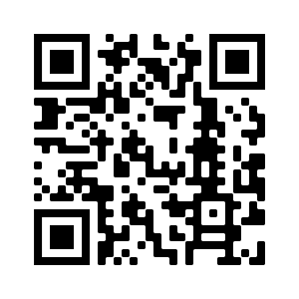
Hausaufgaben
Vocabulary Learning Homework (Term 3.2, Week 4)
Audio file
Audio file QR code:
Student worksheet
Quizlet link
In addition, revisit: Term 3.1 Week 4
Term 2.2 Week 2
Notes:
Use this slide to set the homework.

