Slide 1
Phonics
Year 7 French
Term 1.1 - Week 5
Stephen Owen / Rachel Hawkes
Date updated: 09/02/20
Notes:
Phonics learning aims for Term 1.1, Week 5:
‘SFe’; ‘é’.
All pictures selected are available under a Creative Commons license; no attribution required.

Slide 2
SFE
Silent final -e
timide
Stephen Owen & Rachel Hawkes
Notes:
A possible gesture for this source word would be to cower and cover one’s face slightly, simulating shyness.

Slide 3
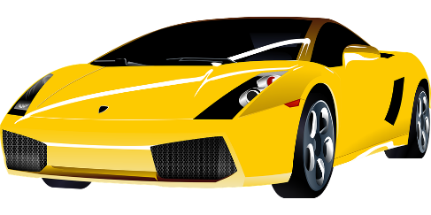
SFE
monde
moderne
[silent final –e]
[shy]
centre
timide
douze
vie
[life]
Stephen Owen & Rachel Hawkes
Notes:
Introduce and elicit the pronunciation of the individual SSC ‘SFE’ and then the source word ‘timide’ again (with gesture, if using). Then present and elicit the pronunciation of the five cluster words.
Word frequency rankings (1 is the most common word in French): monde [77]; moderne [1239] centre [491]; vie [132]; douze [1664]; timide [3835]. Source: Londsale, D., & Le Bras, Y. (2009). A Frequency Dictionary of French: Core vocabulary for learners London: Routledge.

Slide 4
SFE
monde
moderne
[silent final –e]
centre
timide
douze
vie
Stephen Owen & Rachel Hawkes

Slide 5
é
[é / -er / et]
écrire
Stephen Owen / Rachel Hawkes
Notes:
Introduce and elicit the pronunciation of the individual SSC ‘é’ and then present and practise the pronunciation of the source word ‘écrire’. A possible gesture for this source word would be to mime the act of writing (onto the palm of the other hand perhaps)

Slide 6
é
écrire
[é / -er / et]
Stephen Owen / Rachel Hawkes
Notes:
Introduce and elicit the pronunciation of the individual SSC ‘é’ and then present and practise the pronunciation of the source word ‘écrire’. A possible gesture for this source word would be to mime the act of writing (onto the palm of the other hand perhaps)

Slide 7
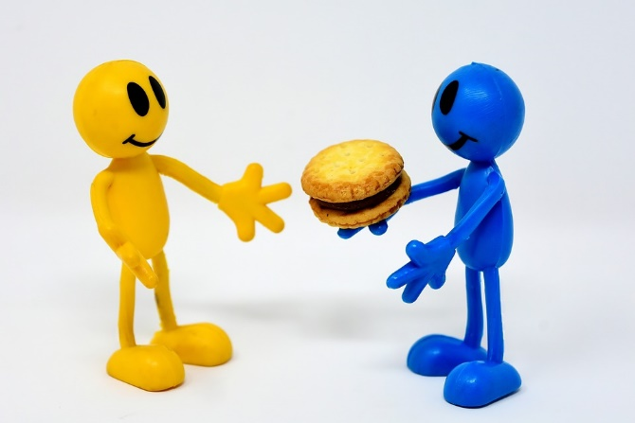
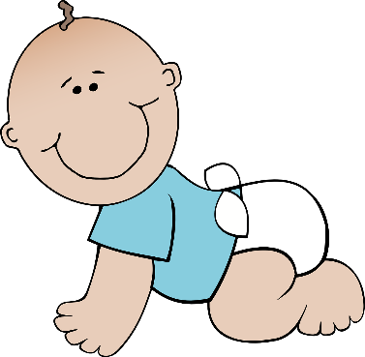
é
bébé
donner
[é / -er / et]
parler
aller
écrire
et
[and]
Stephen Owen / Rachel Hawkes
Notes:
Recap individual SSC ‘é’ and then the source word again (with gesture, if using). Then present and elicit the pronunciation of the five cluster words. The cluster words have been chosen for their high-frequency, from a range of word classes, with the SSC (where possible) positioned within a variety of syllables within the words(e.g. initial, 2nd, final etc..) and additionally, we have tried to use words that build cumulatively on previously taught SSCs (see the Phonics Teaching Sequence document) and do not include new SSCs. Where new SSCs are used, they are often consonants which have a similar symbol-sound correspondence in English. Word frequency rankings (1 is the most common word in French): écrire [382]; bébé [>5000]; aller [55] donner [46]; et [6]; parler [106] Source: Londsale, D., & Le Bras, Y. (2009). A Frequency Dictionary of French: Core vocabulary for learners London: Routledge.

Slide 8
é
donner
bébé
[é / -er / et]
parler
aller
écrire
et
Stephen Owen / Rachel Hawkes
Notes:
Recap individual SSC ‘é’ and then the source word again (with gesture, if using). Then present and elicit the pronunciation of the five cluster words. The cluster words have been chosen for their high-frequency, from a range of word classes, with the SSC (where possible) positioned within a variety of syllables within the words(e.g. initial, 2nd, final etc..) and additionally, we have tried to use words that build cumulatively on previously taught SSCs (see the Phonics Teaching Sequence document) and do not include new SSCs. Where new SSCs are used, they are often consonants which have a similar symbol-sound correspondence in English. Word frequency rankings (1 is the most common word in French): écrire [382]; bébé [>5000]; aller [55] donner [46]; et [6]; parler [106] Source: Londsale, D., & Le Bras, Y. (2009). A Frequency Dictionary of French: Core vocabulary for learners London: Routledge.

Slide 9
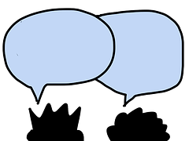
donner
60
écrire
bébé
Secondes
et
aller
0
parler
DÉBUT
Sandra Underwood
Notes:
Pairwork ‘tennis’ – pupils say the words alternately out loud with a partner, building up speed, over 1 minute’s intensive practice. They call in any order they like, pupils are not allowed to repeat the one they said in their last turn. Teacher can circulate to listen into their SSC knowledge. Click on Début to start a one minute timer on the screen.

Slide 10
donner
60
écrire
bébé
Secondes
et
aller
0
parler
DÉBUT
Sandra Underwood
Notes:
Alphabetical read aloud Individually (but all at once) pupils read out the words but in alphabetical order. They keep going for one minute.
Teacher can circulate to listen into their SSC knowledge.

