Slide 1
Talking about how people celebrate
Construction rule for dates
SSCs [a], [i], [aim/im]
Y8 French
Term 1.1 - Week 5 - Lesson 9
Kirsten Somerville / Natalie Finlayson / Cath Morris
Artwork by: Chloé Motard
Date updated: 09/07/21
Notes:
Learning outcomes (lesson 1):
Introduction of SSC [aim/im]
Introduction of construction rule for dates
Word frequency (1 is the most frequent word in French):
8.1.1.5 (introduce) célébrer [2170], préférer [597], avril [1022], date [660], événement [573], février [1136], janvier [939], juin [931], mars [868], mai [943], tradition [1371], premier, première [56], vingt [1273], trente [1646], on [29]
7.3.2.6 (revisit) aider [413], chercher [336], partager [527], peut [20], peux [20], pouvoir [20], sais [67], sait [67], savoir¹ [67], plan [164], désolé [désoler - 2081], peut-être [190]
7.3.1.5 (revisit) café¹ [1886], cinéma [1623], plage [2693], rue [598], devant [198], derrière [805], entre [55]
Source: Londsale, D., & Le Bras, Y. (2009). A Frequency Dictionary of French: Core vocabulary for learners London: Routledge.

Slide 2
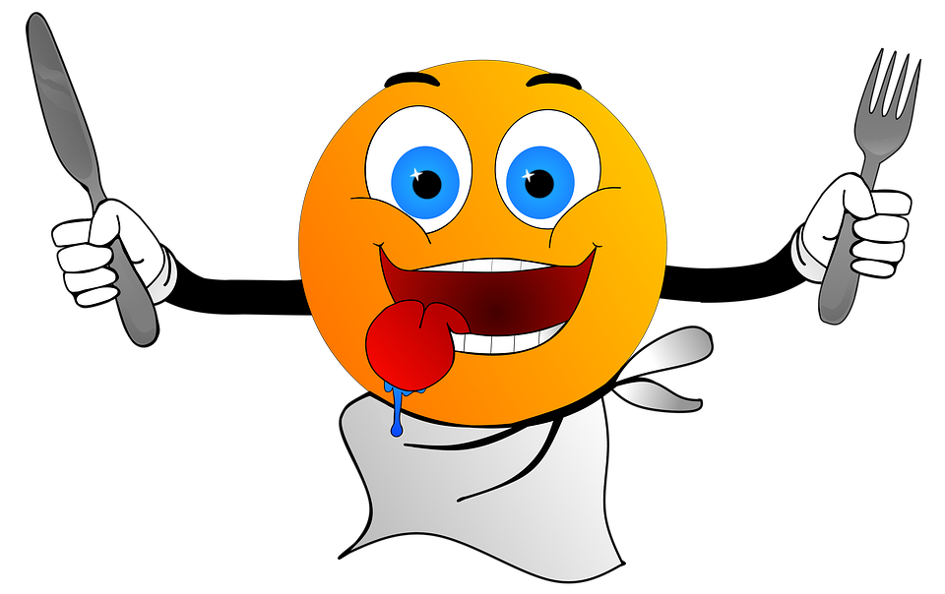
aim/im
faim
Notes:
Timing: 1 minute
Aim: To introduce SSC [aim/im]
Procedure: 1. Present the letter(s) and say the [aim/im] sound first, on its own. Students repeat it with you. 2. Bring up the word ”faim” on its own, say it, students repeat it, so that they have the opportunity to focus all of their attention on the connection between the written word and its sound.
3. A possible gesture for this would be to rub your tummy as if hungry. 4. Roll back the animations and work through 1-3 again, but this time, dropping your voice completely to listen carefully to the students saying the [-(a)im] sound, pronouncing ”faim” and, if using, doing the gesture.
Word frequency (1 is the most frequent word in French):
faim [1986]
Source: Londsale, D., & Le Bras, Y. (2009). A Frequency Dictionary of French: Core vocabulary for learners London: Routledge.

Slide 3
aim/im
faim
Notes:
With sound and no pictures to focus all attention on the sound-symbol correspondence.

Slide 4
aim/im
faim
Notes:
Without sound to elicit pronunciation (without first hearing the teacher).
Teacher to elicit pronunciation by asking “Comment dit-on …”

Slide 5
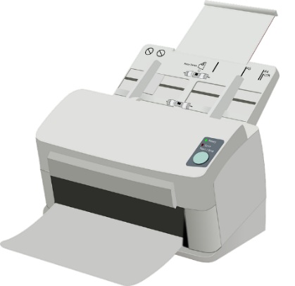
aim/im
grimper
imprimer
faim
simple
impossible
[simple]
[impossible]
important
[important]
Notes:
Timing: 2 minutes
Aim: To introduce SSC [aim/im]
Procedure:
Introduce and elicit the pronunciation of the individual SSC [aim/im] and then the source word again ‘faim’ (with gesture, if using). Then present and elicit the pronunciation of the five cluster words. The cluster words have been chosen for their high-frequency, from a range of word classes, with the SSC (where possible) positioned within a variety of syllables within the words (e.g. initial, 2nd, final etc.). Additionally, we have tried to use words that build cumulatively on previously taught SSCs (see the Phonics Teaching Sequence document) and do not include new SSCs. Where new SSCs are used, they are often consonants which have a similar symbol-sound correspondence in English.
Word frequency (1 is the most frequent word in French): faim [1986]; simple [212]; important [215]; grimper [2646]; imprimer [3092]; impossible [3092]. Source: Londsale, D., & Le Bras, Y. (2009). A Frequency Dictionary of French: Core vocabulary for learners London: Routledge.

Slide 6
aim/im
grimper
imprimer
faim
simple
impossible
important
Notes:
With sound and no pictures to focus all attention on the sound-symbol correspondence.

Slide 7
aim/im
grimper
imprimer
faim
simple
impossible
important
Notes:
Without sound to elicit pronunciation (without first hearing the teacher).
Teacher to elicit pronunciation by asking “Comment dit-on …”

Slide 8
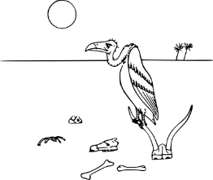
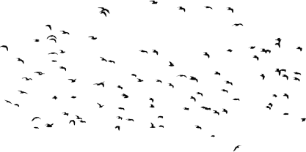
Phonétique
If there is an [m] after either of these vowels, it makes an identical nasal sound.
écouter
C’est quelle SSC ?
1
la n ai ssance
_
[ai]
[aim/im]
[i]
2
impoli
_
3
communautaire
impoli
_
4
la naissance
l’identité
l’ identité
_
la faim
5
la faim
_
6
l’importance
l’importance
l’unité
_
communautaire
7
l’un i té
l’essaim
[swarm]
_
8
l’essaim
_
Notes:
Timing: 5 minutes
Timing: 5 minutes
Aim: aural recognition of SSCs [ai], [i] and [em/am]; raising awareness of the fact that although SSCs [ai] and [i] sound different, [aim] and [im] sound identical.
Procedure:
1. Students sketch the Venn diagram in their books.
2. Click on the numbers to hear the words said aloud.
3. Students decide whether the missing sound is [ai], [aim/im] or [i] and write the word in full in the correct section of the diagram.
4. Click to reveal missing sounds. As the missing letters are revealed, the words pop up in the appropriate places in the Venn diagram. Displaying the words in this way should help students visualise the crossover. On their own, letters [ai] and [i] represent different SSCs. When followed by an ‘m’, [ai] and [i] enter into an identical nasal sound.
5. Click to reveal pronunciation rule: [ai]/[i] + m = nasal [aim/im].
Transcript:
1. la naissance
2. important
3. communautaire
4. l’identité
5. la faim
6. importance
7. l’unité
8. l’essaim
Word frequency (1 is the most frequent word in French): naissance [1305], impoli [>5000], communautaire [1811], identité [1437], faim [1986], importance [715], unité [571], essaim [<5000]
Source: Londsale, D., & Le Bras, Y. (2009). A Frequency Dictionary of French: Core vocabulary for learners London: Routledge.

Slide 9
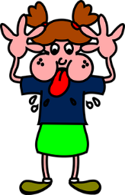
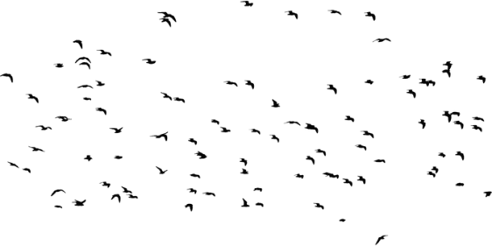
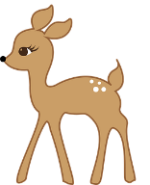
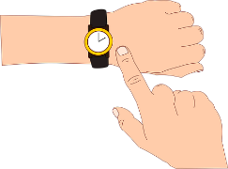
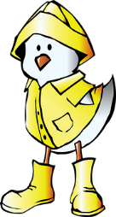
Phonétique
timbre
parler
impoli
[postage stamp]
essaim
45
[rude]
daim
[swarm]
impatient
[deer]
[impatient]
impression
secondes
simplement
[impression]
[simply]
imperméable
impact
0
[raincoat]
[impact]
DÉBUT
Notes:
Timing: 3 minutes. This is slide 1/3.
Aim: To correctly pronounce unknown words containing [aim/im] in decreasing amounts of time, helping automisation of SSC production.
Procedure:
Students pair up, and take turns trying to say all the words in 30 seconds (run the timer twice). It will be tempting to follow instinct and add an ‘m’! Students should monitor each other to listen out for this, ad apply a three-second ‘pause’ penalty for any incorrectly pronounced words. The student who says the most words correctly in the allotted time wins.
Click on the words to hear them pronounced by a native speaker. Students repeat.
Move on to the next slide.
Word frequency (1 is the most frequent word in French): daim [>5000], essaim [>5000], impoli [>5000], impatient [4530], simplement [615], impact [2032], imperméable [>5000], denim [>5000], impression [825]
Source: Londsale, D., & Le Bras, Y. (2009). A Frequency Dictionary of French:], Core vocabulary for learners London: Routledge.

Slide 10
Phonétique
timbre
parler
Phonétique
impoli
[postage stamp]
essaim
30
[rude]
daim
[swarm]
impatient
[deer]
[impatient]
impression
secondes
simplement
[impression]
[simply]
imperméable
impact
0
[impact]
DÉBUT
[raincoat]
[impact]
Notes:
This is slide 2/3.
As previous but with 15 fewer seconds on the timer.

Slide 11
Phonétique
timbre
parler
Phonétique
impoli
[postage stamp]
essaim
15
[rude]
daim
[swarm]
impatient
[deer]
[impatient]
impression
secondes
simplement
[impression]
[simply]
imperméable
impact
0
[raincoat]
[impact]
DÉBUT
Notes:
This is slide 3/3.
As previous but with 15 fewer seconds on the timer again.

Slide 12
Vocabulaire
parler
March
mars
February
février
thirty
trente
June
juin
first (f)
première
célébrer
to celebrate, celebrating
event
l’événement
sixteen
seize
everyone, you, one
on
fifteen
quinze
May
mai
fourteen
quatorze
thirteen
treize
twenty
vingt
to prefer, preferring
préférer
first (m)
premier
date
la date
April
avril
tradition
la tradition
January
janvier
Notes:
Timing: 4 minutes
Aim: oral recall of vocabulary.
Procedure:
1. Students sketch a 5x4 grid.
2. Working in pairs, they take turns to choose a word to translate orally into French.
3. Students should work as quickly as they can without repeating a word the other has already said. If their partner agrees the given translation is correct, the speaking student ‘claims’ the relevant square on the grid by putting their initials in it. If they cannot translate a word, or translate it incorrectly, they do not claim a square and the game moves on.
4. Click to reveal translations one by one.
5. Students count up the number of squares they have claimed. The student with the most squares wins.

Slide 13
préférer
vs
[to prefer]
The é in the stem changes to è in all forms except nous and vous.
préfère
[prefers]
préférons
[prefer]
Notes:
Timing: 4 minutes for sequence of eight slides
Aim: to introduce the verb préférer more explicitly. Both long form (infinitive) and short form (3rd person singular) are introduced in order to familiarise students with various forms of the same verb.
Procedure
Bring up the word préférer on its own, say it, students repeat it, and remind them of the phonics.
Try to elicit the meaning from the students. Students have had explicit teaching that the present tense in French communicates two different present tense meanings in English. This reinforces that learning. Emphasise the two meanings for the short form, reminding students that French only has one form and does not have a direct equivalent of the grammar for ‘is + ing’, the continuous form (as covered in previous weeks).
Bring up the picture, and, if using gestures, a possible gesture would be to mime pointing at two things as if choosing between them
Then bring up the English translations. Emphasise the two meanings for the infinitive.
Bring up the first short form préfère , say it, students repeat it. Draw attention to different pronunciation of [è] vs [e].
Bring up the second short form préférons, say it, students repeat it. Draw attention to different pronunciation of [è] vs [e].
Try to elicit the meaning from the students. Emphasise the two meanings for the short forms.
Bring up the info bubble to introduce the stem-change. NB: This is not a grammar point that students are expected to produce at this stage and will not feature in any NCELP tests. It is showcased here for awareness and passive understanding only.

Slide 14
préférer
[to prefer]
préfère
[prefers]
préférons
[prefer]
Notes:
Cycle through the long and short forms again.

Slide 15
préfère
[prefers]
Elle préfère la plage à la montagne.
[She prefers the beach to the mountain.]
Notes:
Introduce the first short form in a sentence.

Slide 16
préférons
[prefer]
Nous préférons la plage à la montagne.
[We prefer the beach to the mountain.]
Notes:
Introduce the second short form in a sentence.

Slide 17
préférer
[to prefer]
Elle doit préférer la plage à la montagne !
[She should prefer the beach to the mountain!]
Notes:
Introduce the long form in a sentence.

Slide 18
préfère
[prefers]
Elle la plage à la montagne.
préfère
[She prefers the beach to the mountain.]
Notes:
Cycle through the first short form in context again.

Slide 19
préférons
[prefer]
préférons
Nous la plage à la montagne.
[We prefer the beach to the mountain.]
Notes:
Cycle through the second short form in context again.

Slide 20
préférer
[to prefer]
préférer
Elle doit la plage à la montagne !
[She should prefer the beach to the mountain!]
Notes:
Cycle through the long form in context again.

Slide 21
Les dates
grammaire
In English, we use ordinal numbers like ‘first’, ‘second’ and ‘third’ in dates:
The fourteenth of February
14th February
In French, we simply add le before a number to make it into a date:
‘of’ is not translated.
14 février
Le quatorze février
Le can be translated as ‘the’ or ‘on the’, depending on the context.
The only exception is the first day of the month, which has a special form:
Le premier janvier
1er janvier
Notes:
Timing: 2 minutes
Aim: introducing date formation with le + number

Slide 22
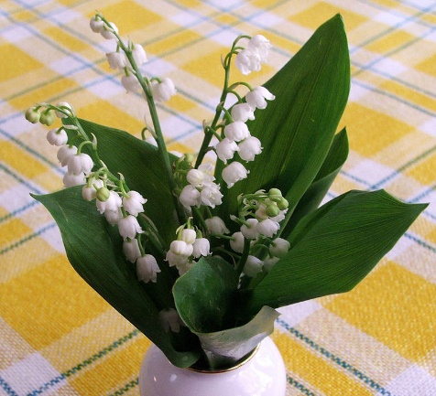
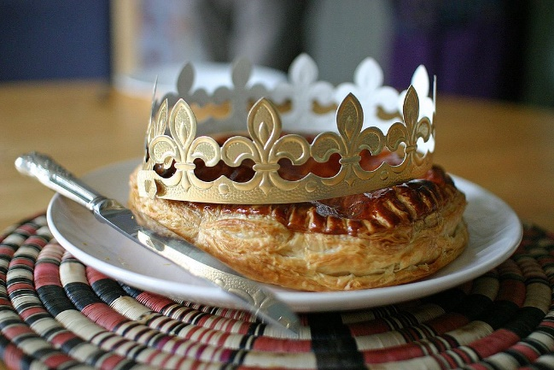
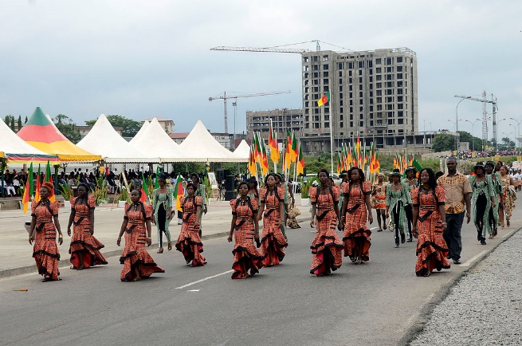
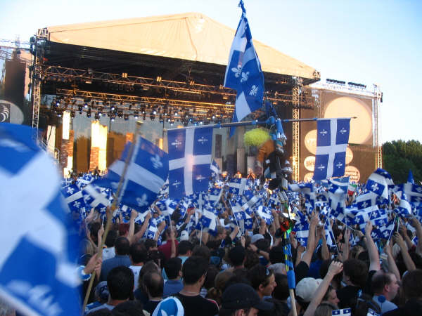
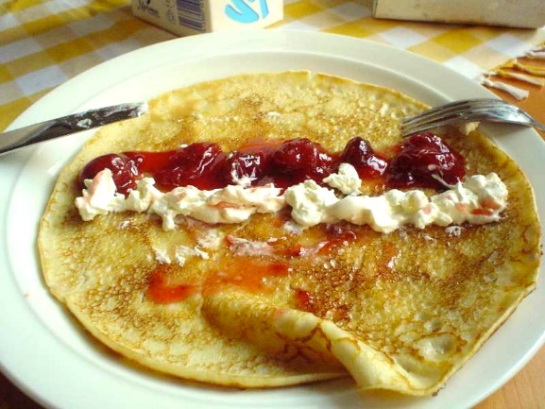
Les dates
écouter
La fête du Travail
L’Épiphanie
La Journée internationale des femmes
1
2
3
le premier mai
le six janvier
le huit mars
La Fête nationale du Québec
La Chandeleur
Le Jour de la Terre
4
5
6
le vingt-quatre juin
le deux février
le vingt-deux avril
Notes:
Timing: 5 minutes
Aim: aural comprehension of this week’s new vocabulary in dates
Procedure:
1. Click the numbers to play the audio.
2. Students write 1-8 and the date they hear.
3. Click to reveal the answers.
4. Teachers may wish to provide some background to the cultural events.
Transcript:
le premier mai
le six janvier
le huit mars
le vingt-quatre juin
le deux février
le vingt-deux avril
Image attribution:
Par Steph Gray le 15 janvier 2011 CC BY-SA 2.0, https://commons.wikimedia.org/w/index.php?curid=54689390
CC BY-SA 3.0, https://commons.wikimedia.org/w/index.php?curid=190999
Par Mbiele Happi — Travail personnel, CC BY-SA 4.0, https://commons.wikimedia.org/w/index.php?curid=45034581
Par John McConnell — from [2]: Earth flag created solely from public domain sources and released into the public domain by Derrick Coetzee., Domaine public, https://commons.wikimedia.org/w/index.php?curid=114292
Par Jüppsche — Ripuarian Wikipedia, CC BY-SA 3.0, https://commons.wikimedia.org/w/index.php?curid=765582
Domaine public, https://commons.wikimedia.org/w/index.php?curid=1889121

Slide 23
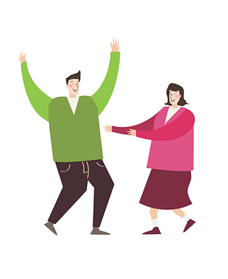
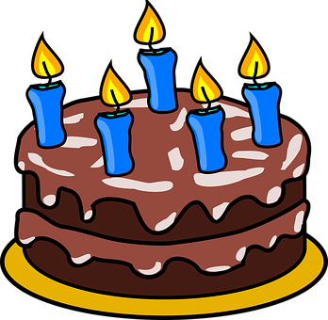
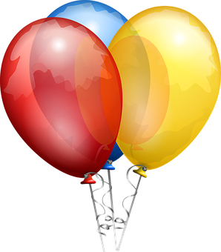
Les dates
lire
Que signifie « le » en anglais ?
 | the | on the
Le 25 mars c’est un jour spécial .
Il part en vacances le 1er mai.
Aujourd’hui, c’est le 22 mars.
Le 31 avril n’existe pas.
Nous voyageons le 3 janvier.
Mon jour préferé c’est le 27 juin.
La fête est le 18 mars.
Notes:
Timing: 4 minutes
Aim: Raising awareness of cross-linguistic differences in article use; written recognition of the two English meanings of le with dates (‘the’ and ‘on the’).
Procedure:
1. Students read the sentences and decide in each case whether ‘le’ translates as ‘the’ or ‘on the’ in English.
2. Click to reveal answers one by one.
3. Aural translation of full sentences.
Word frequency of near-cognates used (1 is the most frequent word in French): spécial [726], exister [269], signifier [586]
Source: Londsale, D., & Le Bras, Y. (2009). A Frequency Dictionary of French: Core vocabulary for learners London: Routledge.

Slide 24
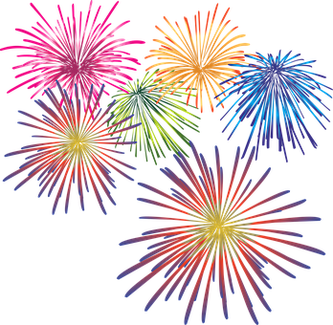
Des dates importantes
écrire
Réécris les dates en mots.
1/1 est le Jour de l’an
le premier janvier
[New Year’s Day]
Notes:
Timing: 5 minutes. This is slide 1/6.
Aim: Written production of dates.
Procedure:
1. Students write the dates in bold in words.
2. Click to bring up answer.
3. Click again to reveal translation and accompanying information in English.
Word frequency of unknown words used (1 is the most frequent word in French):
réécrire [>5000]
Source: Londsale, D., & Le Bras, Y. (2009). A Frequency Dictionary of French: Core vocabulary for learners London: Routledge.

Slide 25
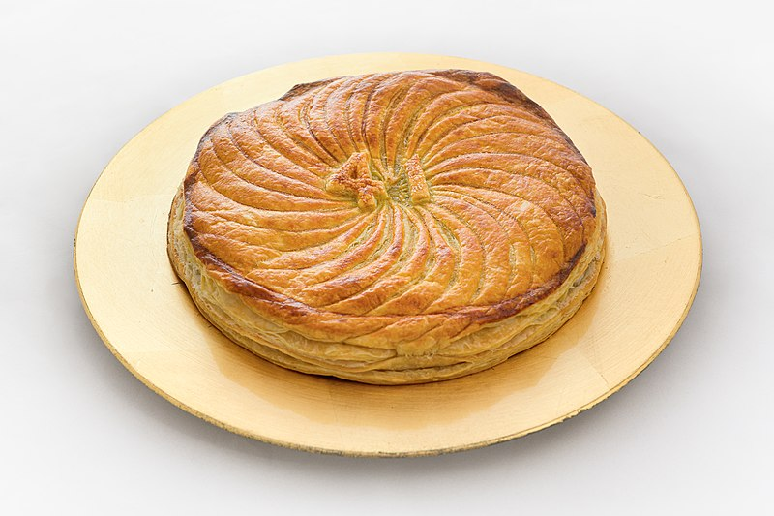
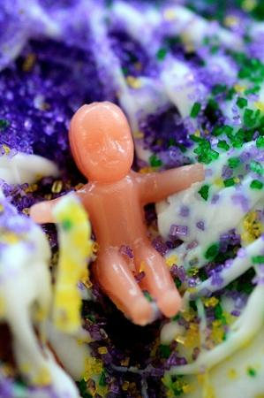
Des dates importantes
écrire
6/1 est le jour de l’Epiphanie : le Jour des Rois
le six janvier
[Epiphany: Feast of the Kings]
It is traditional in French to eat a special cake
called “une galette des rois” [king cake] on this day.
Whoever finds the trinket known as a “fève” in their slice is named King or Queen for the day!
Notes:
Galette des rois image by Benh LIEU SONG (Flickr) - https://www.flickr.com/photos/blieusong/50904846883/, CC BY-SA 4.0, https://commons.wikimedia.org/w/index.php?curid=99562836
Fève image by Hlane13 - Own work, CC BY-SA 3.0, https://commons.wikimedia.org/w/index.php?curid=32609044

Slide 26
Des dates importantes
écrire
2/2 est le jour de la Chandeleur
le deux février
[Candlemas]
Pancakes are traditionally eaten on this day and people take candles to church to be blessed.

Slide 27
Des dates importantes
écrire
1/4 est la fête du poisson d'avril
le premier avril
[April Fool’s Day]
A traditional prank for April Fool’s day in France is to stick a paper fish to your friend’s back without them noticing!

Slide 28
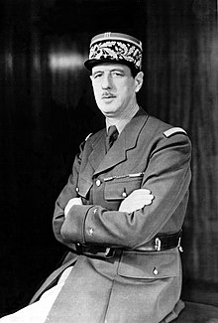
Des dates importantes
écrire
8/5 est le Jour de la Victoire 1945
le huit mai
[WWII Victory Day 1945]
Notes:
Charles de Gaulle image by Office of War Information, Overseas Picture Division. [1]The image prefix (LC-USW3) at the Library of Congress image page matches that of pictures from the OWI collection (see prefix list here. - This image is available from the United States Library of Congress&#039;s Prints and Photographs divisionunder the digital ID cph.3b42159.This tag does not indicate the copyright status of the attached work. A normal copyright tag is still required. See Commons:Licensing for more information., Public Domain, https://commons.wikimedia.org/w/index.php?curid=1778410

Slide 29
Des dates importantes
écrire
21/6 est la Fête de la Musique
le vingt-et-un juin
[Music Festival]
A celebration of the longest day of the year. Professional and amateur musicians line the streets of Paris and towns all over France to entertain crowds throughout the day and night.

Slide 30
C’est quelle date ? (A)
parler
1/5
20/6
6/1
18/5
La fête du travail
La fête des pères
La fête des
secrétaires
La fête des musées
Notes:
Timing: 8 minutes
Aim: Aural recognition of vocabulary; oral production of dates.
Procedure:
1. Students work in pairs. Print and distribute the rolecards of slide 32.
2. Student B faces the board, student A turns away. Student A reads out the start of the sentence and student B finishes by guessing the picture it represents and saying the date. Student A writes down the dates and turns back to face the board.
3. Click to reveal answers.
4. Students swap roles. Display slide 32 and repeat steps 2-3.
NB: students have not yet learned the nominal form le travail but should be able to infer its meaning from their knowledge of the short form of travailler and the adjective travailleur.
Word frequency of unknown words used (1 is the most frequent word in French):
travail [153] musée [2216]
Source: Londsale, D., & Le Bras, Y. (2009). A Frequency Dictionary of French: Core vocabulary for learners London: Routledge.

Slide 31
C’est quelle date ? (B)
parler
21/6
8/6
30/5
14/2
La fête de la musique
La fête des amis
La fête des mères
la Saint-Valentin

Slide 32
Rolecards for printing
parler
Student A:
La fête du travail, c’est…
La fête des musées, c’est…
La fête des pères, c’est…
La fête des secrétaires, c’est …
Student B:
La Saint-Valentin, c’est…
La fête des mères, c’est…
La fête des amis, c’est…
La fête de la musique, c’est…
Student A:
La fête du travail, c’est…
La fête des musées, c’est…
La fête des pères, c’est…
La fête des secrétaires, c’est …
Student B:
La Saint-Valentin, c’est…
La fête des mères, c’est…
La fête des amis, c’est…
La fête de la musique, c’est…
Notes:
Rolecards – do not display on screen

Slide 33
Une date importante
Can you fit the following words into the conversation?
April, thirteen, January, thirty, first (f), June, March, fourteen, sixteen, February, fifteen
écrire
*l’anniversaire (m) = birthday
Quelle est la date aujourd'hui ?
____
Euh … c’est le premier mai. Pourquoi ?
______
__
I prefer
first (m)
C’est mon anniversaire* !
to celebrate, celebrating
date
On doit célébrer ! Il y a un événement au centre ville ce soir dans vingt minutes.
everyone, you, one
twenty
__
_______
________
____
event
May
Je préfère rester à la maison.
C'est une tradition dans ma famille.
tradition
__________
_______
Notes:
Timing: 7 minutes
Aim: written recall and usage of new vocabulary in context.
Procedure:
1. Students use the English words at the side to fill the gaps in the conversation.
2. Click to reveal answers one by one.
3. Draw students’ attention to the use of the 24hr clock in French.
4. Word substitution extension: students think about where they could use the other new words in the vocabulary set in this text.
Word frequency of unknown words used (1 is the most frequent word in French): anniversaire [2043]
Source: Londsale, D., & Le Bras, Y. (2009). A Frequency Dictionary of French: Core vocabulary for learners London: Routledge.
Word frequency of cognates used (1 is the most frequent word in French): minute [375]
Source: Londsale, D., & Le Bras, Y. (2009). A Frequency Dictionary of French: Core vocabulary for learners London: Routledge.

Slide 34
Talking about how people celebrate
pronoun 'on' with impersonal meaning ‘people/you/one’
SSCs [aim/im], [ain/in]
Y8 French
Term 1.1 - Week 5 - Lesson 9
Kirsten Somerville / Natalie Finlayson / Cath Morris
Artwork by: Chloé Motard
Date updated: 09/07/21
Notes:
Learning outcomes (lesson 2):
Consolidation of SSCs [aim/im] and [ain/in]
Introduction of pronoun 'on' with impersonal meaning ‘people/you/one’
Word frequency (1 is the most frequent word in French):
8.1.1.5 (introduce) célébrer [2170], préférer [597], avril [1022], date [660], événement [573], février [1136], janvier [939], juin [931], mars [868], mai [943], tradition [1371], premier, première [56], vingt [1273], trente [1646], on [29]
7.3.2.6 (revisit) aider [413], chercher [336], partager [527], peut [20], peux [20], pouvoir [20], sais [67], sait [67], savoir¹ [67], plan [164], désolé [désoler - 2081], peut-être [190]
7.3.1.5 (revisit) café¹ [1886], cinéma [1623], plage [2693], rue [598], devant [198], derrière [805], entre [55]
Source: Londsale, D., & Le Bras, Y. (2009). A Frequency Dictionary of French: Core vocabulary for learners London: Routledge.

Slide 35
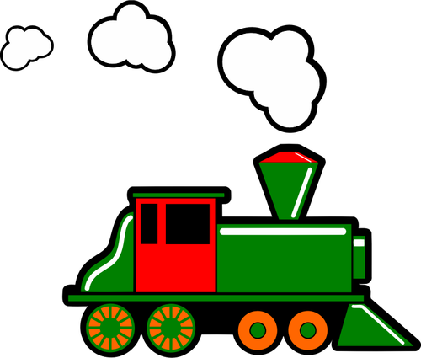
ain/in
train
Notes:
Timing: 1 minute
Aim: To consolidate SSC [ain/in]
Procedure: 1. Present the letter(s) and say the [ain/in] sound first, on its own. Students repeat it with you. 2. Bring up the word ”train” on its own, say it, students repeat it, so that they have the opportunity to focus all of their attention on the connection between the written word and its sound.
3. A possible gesture for this would be to move both arms simultaneously forwards and back in a circular motion, simulating the motion of train wheel connecting rods.
4. Roll back the animations and work through 1-3 again, but this time, dropping your voice completely to listen carefully to the students saying the [ain/in] sound, pronouncing ”train” and, if using, doing the gesture.
Word frequency (1 is the most frequent word in French):
train [232]. Source: Londsale, D., & Le Bras, Y. (2009). A Frequency Dictionary of French: Core vocabulary for learners London: Routledge.

Slide 36
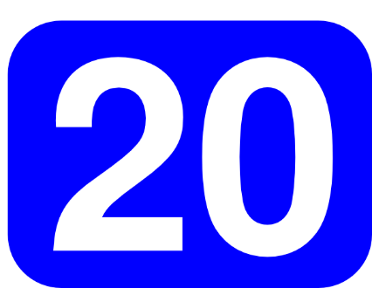
ain/in
fin
matin
[end]
vingt
train
main
maintenant
[now]
Notes:
Timing: 1 minute
Aim: To consolidate SSC [ain/in]
Procedure:
1. Introduce and elicit the pronunciation of the individual SSC [ain/in] and then the source word again ‘train’ (with gesture, if using). 2. Then present and elicit the pronunciation of the five cluster words.
The cluster words have been chosen for their high-frequency, from a range of word classes, with the SSC (where possible) positioned within a variety of syllables within the words (e.g. initial, 2nd, final etc.). Additionally, we have tried to use words that build cumulatively on previously taught SSCs (see the Phonics Teaching Sequence document) and do not include new SSCs. Where new SSCs are used, they are often consonants which have a similar symbol-sound correspondence in English.
Word frequency (1 is the most frequent word in French): fin [111]; matin [442] vingt[1273]; maintenant [192]; main [418]; train [232]. Source: Londsale, D., & Le Bras, Y. (2009). A Frequency Dictionary of French: Core vocabulary for learners London: Routledge.

Slide 37
[ain/in] et [aim/in]
écouter
What do you notice about these words?
Even though these words are spelled differently, they sound exactly the same!
[end]
fin
faim
SSC [aim/im] is the same sound as SSC [ain/in], which you already know.
When this nasal sound appears in front of the letters p or b, it is spelled [aim/im] instead of [ain/in].
maintenant [now], vingt [twenty] BUT grimper [to climb], un timbre [a stamp]
Notes:
Timing: 2 minutes
Aim: Raising awareness of the identical sound in SSCs [ain/in], an [aim/im]
For a reminder of Year 7 SSC [ain/in], see the two slides that follow.

Slide 38
Rendez-vous arrangé !
écouter
Les mots riment-ils ?
 |  | match | no match
 | faim - pin
 | timbre - ombre
 | sain - sang
 | vin - main
 | dinde - Inde
 | emporter - importer
 | pince - mince
 | pain - dans
1
hunger & pine?
2
stamp & shadow?
3
healthy & blood?
4
wine & hand?
5
turkey & India?
6
to take & to import?
7
pliers & thin?
8
bread & in ?
Notes:
Timing: 5 minutes
Aim: To practise distinguishing between [(a)in] / [(a)im] and other nasal vowel sounds using minimal pairs
Procedure:
1. Explain the ‘blind date’ theme and that we are looking for words that match in sound (i.e. rhyme).
2. Click on the audio to play the pairs of words.
3. Students listen to the pairs of words and determine whether the vowel sounds match or not, ticking the appropriate column.
4. Click to reveal the pair of words for each question, then again to reveal the correct tick placement.
Transcript:
1) faim – pin
2) timbre – ombre
3) sain – sang
4) vin – main
5) dinde – Inde
6) emporter – importer
7) pince - mince
8) pain - dans
Word frequency (1 is the most frequent word in French): faim [1986], pin [>5000], timbre [>5000], ombre [>5000], sain [1763], sang [1126], vin [2309], main [418], dinde [>5000], Inde [n/a], emporter [1128], importer [354] pince [>5000], mince [3570], pain [2802], dans [11]
Source: Londsale, D., & Le Bras, Y. (2009). A Frequency Dictionary of French: Core vocabulary for learners London: Routledge.

Slide 39
The pronoun ‘on’
grammaire
Subject pronouns (like ‘I’, ‘you’ and ‘they’) tell us who is doing something.
In French, the subject pronoun on is used to talk about what people in general do. We can translate it as ‘people’, ‘you’ or ‘one’.
‘One’ sounds very formal in English and is rarely used in everyday conversation. ‘On’ is commonly used in French.
On uses the same verb endings as il / elle:
On célèbre le carnaval en février.
People celebrate carnival in February.
On doit porter un uniforme au collège.
You have to wear a uniform at school.
‘You’ doesn’t refer to a specific person here – it’s impersonal.
Notes:
Timing: 3 minutes
Aim: introducing the pronoun on with impersonal meaning ‘people, you, one’

Slide 40
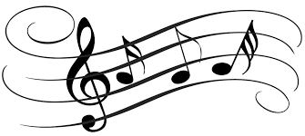
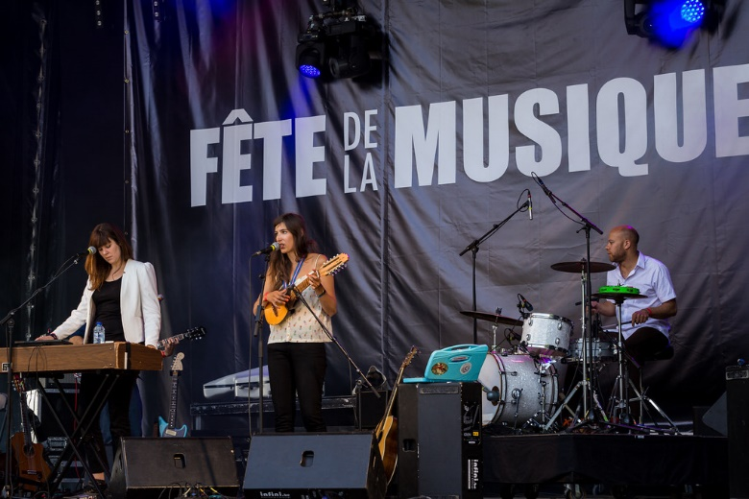
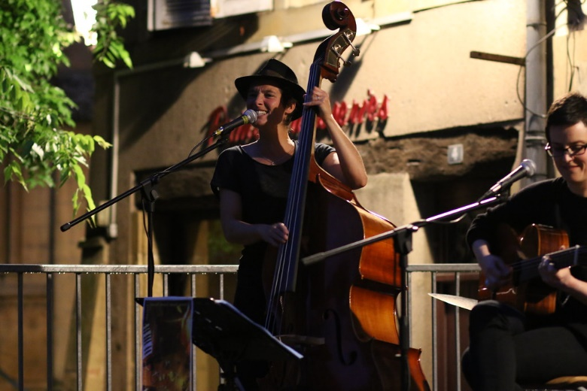
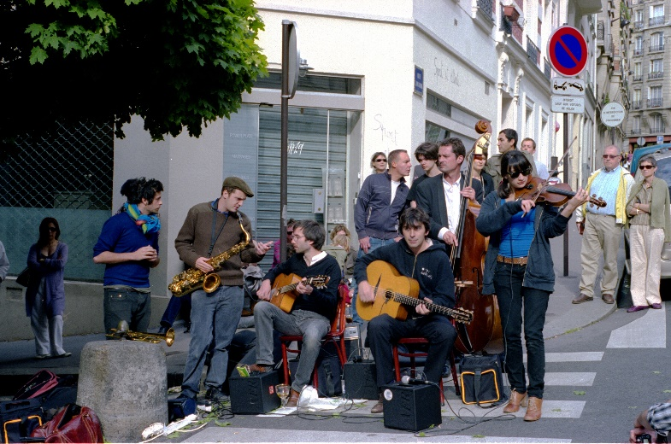
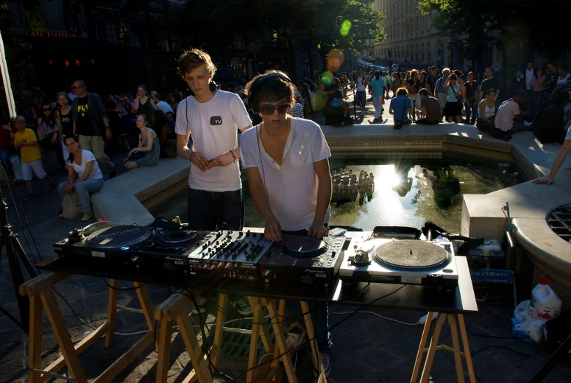
La Fête de la Musique
lire
Que fait Léa (je) ? Que font les personnes en général (on) ?
Le 21 juin en France, c’est la Fête de la Musique. Des musiciens amateurs et professionnels jouent dans la rue, et je vais dehors pour écouter. Je sors avec mes amis. Pour trouver un concert, on peut aller en ville, ou juste devant la maison. On fait une grande fête avec le public. Parfois, on prend des instruments. L’ambiance est fantastique. Mais j’ ai un problème aussi. On part souvent en retard, et je dois fermer la fenêtre pour dormir !
[1]
[2]
[3]
[4]
[5]
[6]
[7]
[8]
Notes:
Timing: 10 minutes
Aim: practising written recognition of the on form of a range of irregular verbs, and its impersonal meaning
Procedure:
1. Students write two columns in their books, headed ‘people in general’ and ‘just Léa’. Using the verb forms to help them, they write (in English) who does what.
2. Click to reveal pronouns.
3. Suggested solutions appear on the next slide.
Word frequency of cognates used (1 is the most frequent word in French): général [147], musicien [3100], amateur [2760], professionnel [1000], concert [1697], juste [304], public [285], instrument [1650], ambiance [4025], fantastique [4107]
Source: Londsale, D., & Le Bras, Y. (2009). A Frequency Dictionary of French: Core vocabulary for learners London: Routledge.
Image attribution:
"20140622 Fête de la musique - Cinquantenaire (Bruxelles) - Clare Louise" by Philippe Clabots (#PhilippeCPhoto) is licensed under CC BY-NC-SA 2.0
"Babayaga à la fête de la Musique 2016" by ciegalo is licensed under CC BY-NC-SA 2.0
Image by Alain Bachellier is licensed under CC BY-NC-SA 2.0

Slide 41
La Fête de la Musique
lire
Que fait Léa (je) ? Que font les personnes en général (on) ?
Le 21 juin en France, c’est la Fête de la Musique. Des musiciens amateurs et professionnels jouent dans la rue, et je vais dehors pour écouter. Je sors avec mes amis. Pour trouver un concert, on peut aller en ville, ou juste devant la maison. On fait une grande fête avec le public. Parfois, on prend des instruments. L’ambiance est fantastique. Mais j’ai un problème aussi. On part souvent en retard, et je dois fermer la fenêtre pour dormir !
Léa
goes outside to listen (to music)
goes out with friends
has a problem
has to close the window to sleep!
People in general
can go into town
have a big party
sometimes take instruments
often leave late
Notes:
Suggested answers appear on clicks.

Slide 42
Le carnaval
*les fleurs = flowers
*le citron = lemon
écouter
Que fait Amir avec la famille (nous) ? Que font les personnes en général (on) ?
1
2
3
4
5
6
7
8
Amir’s family
People in general
think about next year’s theme
watch the parade
walk into town
share (out) flowers
listen to music
don’t eat fruit
visit Menton for the lemon festival
create sculptures with fruit
Réponses:
1
2
3
4
5
6
7
8
Notes:
Timing: 10 minutes
Aim: practising written recognition of the the on form of regular –ER verbs, and its impersonal meaning
Procedure:
1. Students write two columns in their books, headed ‘people in general’ and ‘just Amir’s family’.
2. Click on the numbers at the top of the screen to hear audio with the pronouns (on and nous) obscured.
3. Using the verb forms to guide them, students write (in English) who does what.
4. Click to reveal answers. Full audio can be played at the bottom of the screen.
5. Transcript of audio on next slide
Transcript:
1. Le carnaval de Nice est un grand événement en février (ou mars). [On] regarde la parade.
2. Il y a un thème différent chaque année. [Nous] pensons au thème de l’année prochaine.
3. [On] partage des fleurs* à la « bataille de fleurs ». C’est une tradition unique à Nice
4. [Nous] marchons en ville
5. Et [nous] écoutons la musique.
6. En février, [nous] visitons la ville de Menton aussi, pour la fête du citron
7. [On] ne mange pas les fruits
8. [on] crée des sculptures avec !
Word frequency of cognates used (1 is the most frequent word in French): général [147], carnaval [>5000], parade [>5000], thème [1720], fleur [2305], bataille [1303], unique [402], groupe [187], citron [>5000], sculpture [>5000]
Source: Londsale, D., & Le Bras, Y. (2009). A Frequency Dictionary of French: Core vocabulary for learners London: Routledge.

Slide 43
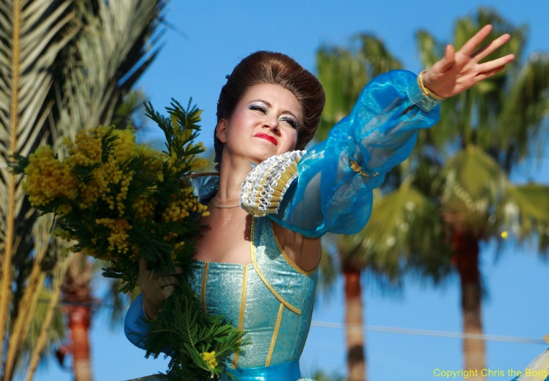
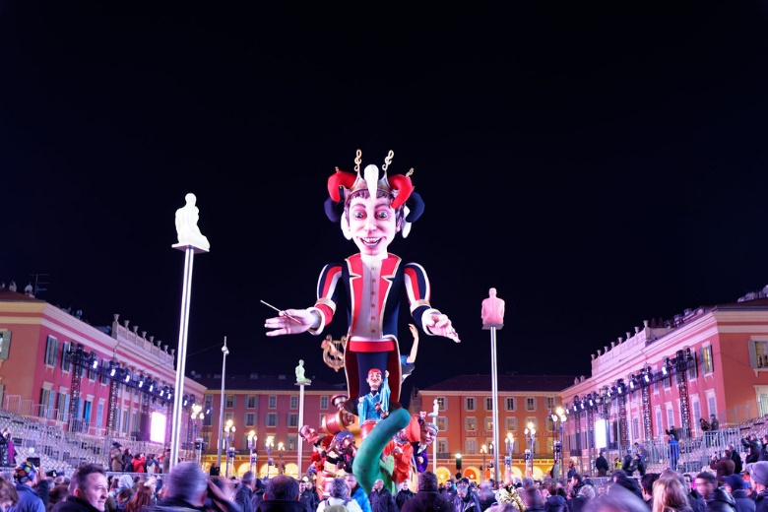
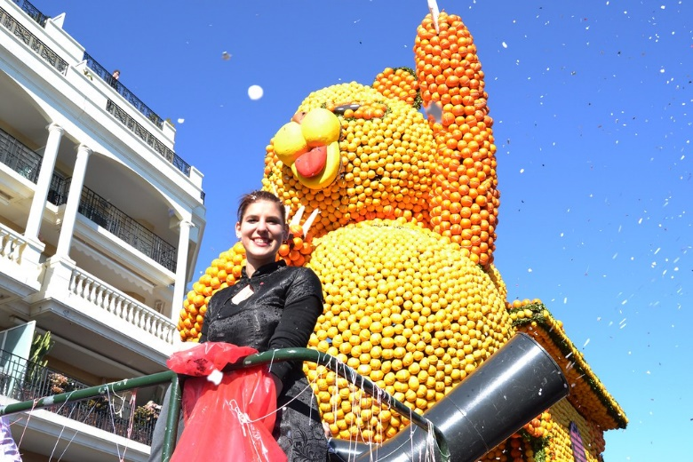
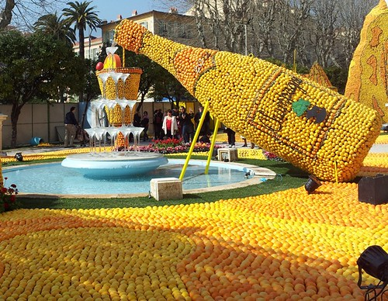
Le carnaval
*les fleurs = flowers
*le citron = lemon
écouter
Que fait Amir avec la famille (nous) ? Que font les personnes en général (on) ?
Le carnaval de Nice est un grand événement en février (ou mars). On regarde la parade. Il y a un thème différent chaque année, et nous pensons au thème de l’année prochaine. On partage des fleurs* à la « bataille de fleurs ». C’est une tradition unique à Nice. Nous marchons en ville, et nous écoutons la musique. En février, nous visitons la ville de Menton aussi, pour la fête du citron*. On ne mange pas les fruits… on crée des sculptures avec !
Notes:
Full text to read through
Image attribution:
"Attend!" by Chris the Borg is licensed under CC BY-SA 2.0
"Corso illuminé Nice Carnaval 17/02/2015" by christopher.royer is licensed under CC BY-NC-SA 2.0
"DSC_0474" by Leona Lorraine is licensed under CC BY-ND 2.0
"Champagne" by Cappuccino & Baguette is licensed under CC BY-NC-ND 2.0
gh and opportunity to comment on pictures.

Slide 44
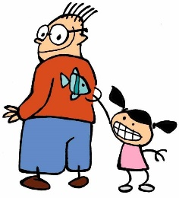
Le premier avril
écrire
En France, le premier avril a des traditions différentes de l’Angleterre.
Tu cherches des informations sur Internet. Complète les phrases avec on.
En France, ce n’est pas « April Fools’ » – on dit « poisson* d’avril ».
On crée des poissons en papier.
On donne un poisson à un ami.
Mais on ne montre pas le poisson à l’ami.
On fait des farces*, comme en Angleterre.
Un exemple : en 1986, on rapporte que Paris donne la tour Eiffel à Disneyland !
On ne comprend pas l’origine de la tradition, mais il y a des théories.
On change la date de la nouvelle année en 1564 – le premier avril est la date originale.
(dire)
(créer)
*le poisson = fish
*la farce = practical joke, prank
*rapporter = to report
(donner)
(ne pas montrer)
(faire)
(rapporter*)
(ne pas comprendre)
(changer)
Notes:
Timing: 8 minutes
Aim: written production of the on form of regular and irregular verbs
Procedure:
1. Write 1-8 and the on form of the verb in brackets.
2. Click to reveal answers.
3. If time permits, ask students to summarise the text in English. If there is less time, assign pairs of students a sentence each to translate, and share the information as a class. Suggested answers can be found on the next slide.
Word frequency of cognates used (1 is the most frequent word in French): information [317], internet [>5000], compléter [2034], poisson [1616], papier [951], farce [4285], origine [709], théorie [1773], original [1814], rapporter [922]
Source: Londsale, D., & Le Bras, Y. (2009). A Frequency Dictionary of French: Core vocabulary for learners London: Routledge.
Image attribution:
“Poisson d'avril > April Fools Day” by Ian Thomas is licensed under CC BY-SA 2.0 https://www.flickr.com/photos/44745854@N03/16380857943/in/photostream/

Slide 45
Le premier avril
*le poisson = fish
*la farce = practical joke, prank
écrire
En France, le premier avril a des traditions différentes de l’Angleterre.
Tu cherches des informations sur Internet. Complète les phrases avec on.
In France, people say “poisson d’avril » (April Fish) instead of ‘April Fool’s’.
They create paper fish.
They give a fish to a friend.
But they don’t show the fish to the friend.
French people play practical jokes, like in England.
For example, in 1986, it was said that Paris gave the Eiffel Tower to Disneyland!
The origin of this tradition is not understood, but there are theories.
The date of new year was changed in 1564 – the 1st of April was the original date.
Notes:
Suggested translations of the sentences on the previous slide.
Note the various different translations of ‘on’ (‘people’, ‘they’, ‘French people’, passive construction).

Slide 46
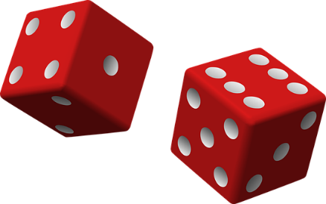
On célèbre comment ?
parler
dehors
à Pâques (Easter)
à Noël (Christmas)
au nouvel an (New Year)
à Halloween
à son anniversaire (birthday)
à la fin du semestre (end of term)
jouer
manger
célébrer
porter
regarder
chanter
des feux d’artifice*
ensemble
la parade
des vêtements rouges
des chocolats
la télé
des jeux de société*
beaucoup
des costumes
des films
des fruits
le feu d’artifice* = firework
les jeux de société* = board games
du jazz
des personnes
Notes:
Timing: 10 minutes
Aim: Oral production of sentences with on + verb in 3rd person singular to talk about what people in general do to celebrate.
Procedure:
1. Students take turns to roll two dice. The first roll determines the festival they must describe, and the second determines the verb they must use.
2. Students form a sentence with on, and finish it with one of the words on the right (or another appropriate noun or adjective).
e.g. 1 - à Pâques … 2 - on mange … des chocolats/ensemble/
Word frequency of unknown words used (1 is the most frequent word in French): feu [786], artifice [>5000], jeu [291], société [295], fin [111]
Source: Londsale, D., & Le Bras, Y. (2009). A Frequency Dictionary of French: Core vocabulary for learners London: Routledge.
Word frequency of cognates used (1 is the most frequent word in French): jazz [>5000], parade [>5000], chocolat [4556], costume [4419]
Source: Londsale, D., & Le Bras, Y. (2009). A Frequency Dictionary of French: Core vocabulary for learners London: Routledge.

Slide 47
Gaming Grammar
Gaming Grammar
Relevant mini game(s):
Verbs (present): 1st person singular/plural (Verb agreement (present))
Verbs (present): 2nd person singular/plural (Verb agreement (present))
Verbs (present): 3rd person singular/plural (Verb agreement (present))
Notes:
This slide links to Gaming Grammar login screen. The appropriate mission can then be selected from the menu page.
Students will progress through the game at their own rate; teachers should use the teacher interface to check progress. This will help to inform future lesson planning.

Slide 48
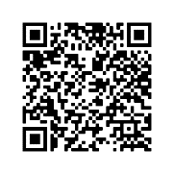
Devoirs
Vocabulary Learning Homework (Y8, Term 1.1, Week 6)
Audio file
Audio file QR code:
Student worksheet
Quizlet link
In addition, revisit: Y7 Term 3.2 Week 7
Y7 Term 3.1 Week 6
Notes:
The answer sheet for the Y8 vocabulary learning HW is here: https://resources.ncelp.org/concern/resources/0c483k04d?locale=en

