Slide 1
Talking about jobs
feminine noun formation rules 1, 2 and 3
(-eur ➜ -rice)
SSC [h]
Y8 French
Term 1.1 - Week 3 - Lesson 5
Stephen Owen / Catherine Morris / Natalie Finlayson
Artwork by: Chloé Motard
Date updated: 11/10/21
Notes:
Learning outcomes (lesson 1):
Introducing SSC [h]
Revisiting feminine noun formation rules 1 and 2
Introducing feminine noun formation rule 3
Word frequency (1 is the most frequent word in French):
8.1.1.2 (revisit) avocat [1188], bureau² [273], directeur¹ [640], emploi¹ [517], facteur [1264], secrétaire [920], ambitieux [2905], prudent [1529], travailleur, travailleuse [1341], assez [321]
7.3.2.5 (revisit) devoir [39], dois [39], doit [39], veut [57], veux [57], vouloir [57], visiter [1378], billet [1916]
7.3.1.4 (revisit) dormir [1836], dors [1836], dort [1836], bureau¹ [273], équipe [814], parfois [410], sous [112], sur [16]
Source: Londsale, D., & Le Bras, Y. (2009). A Frequency Dictionary of French: Core vocabulary for learners London: Routledge.

Slide 2
h
heure
Notes:
Timing: 1 minute
Aim: To introduce SSC [h]
Procedure: 1. Present the letter(s) and the [h] first, on its own. As there is no sound, put a finger to your lips instead. 2. Bring up the word ”heure” on its own, say it, students repeat it, so that they have the opportunity to focus all of their attention on the connection between the written word and its sound.
3. A possible gesture for this would be to tap a watch/wrist. 4. Roll back the animations and work through 1-3 again, but this time, dropping your voice completely to listen carefully to the students saying the [h] sound, pronouncing ”heure” and, if using, doing the gesture.
Word frequency (1 is the most frequent word in French):
heure [99]
Source: Londsale, D., & Le Bras, Y. (2009). A Frequency Dictionary of French: Core vocabulary for learners London: Routledge.

Slide 3
h
heure
Notes:
With sound and no pictures to focus all attention on the sound-symbol correspondence.

Slide 4
h
heure
Notes:
Without sound to elicit pronunciation (without first hearing the teacher).
Teacher to elicit pronunciation by asking “Comment dit-on …”

Slide 5
h
hôtel
huit
8
hôpital
hiver
heure
[winter]
histoire
[history, story]
Notes:
Timing: 2 minutes
Aim: To introduce SSC [h]
Procedure:
Introduce and elicit the pronunciation of the individual SSC [h] and then the source word again ‘heure’ (with gesture, if using). Then present and elicit the pronunciation of the five cluster words. The cluster words have been chosen for their high-frequency, from a range of word classes, with the SSC (where possible) positioned within a variety of syllables within the words (e.g. initial, 2nd, final etc.). Additionally, we have tried to use words that build cumulatively on previously taught SSCs (see the Phonics Teaching Sequence document) and do not include new SSCs. Where new SSCs are used, they are often consonants which have a similar symbol-sound correspondence in English.
Word frequency (1 is the most frequent word in French): histoire [263]; huit [877]; hôpital [1308]; hôtel [1774]; hiver [1586]; heure [99]. Source: Londsale, D., & Le Bras, Y. (2009). A Frequency Dictionary of French: Core vocabulary for learners London: Routledge.

Slide 6
h
hôtel
huit
hôpital
hiver
heure
histoire
Notes:
With sound and no pictures to focus all attention on the sound-symbol correspondence.

Slide 7
h
hôtel
huit
hôpital
hiver
heure
histoire
Notes:
Without sound to elicit pronunciation (without first hearing the teacher).
Teacher to elicit pronunciation by asking “Comment dit-on …”

Slide 8
Phonétique
parler
Remember! Although you will recognise these words from English, the h- is silent in French!
60
humanité
horreur
herbe
horizon
[grass]
secondes
honnête
ha ha
héros
hostile
historique
[hero]
0
honorable
hélicoptère
DÉBUT
Notes:
Timing: 5 minutes. This is slide 1/3.
Aim: To correctly pronounce unknown words containing [h-] in decreasing amounts of time, helping automisation of SSC production. Awareness raising of cross-linguistic pronunciation differences. The words chosen are cognates which otherwise contain sounds that are equivalent (or very similar) to English SSCs, as well as known SSCs, so that students can focus fully on [h-] (allowances are made for English pronunciation of [r], which is covered later in year 8).
Procedure:
1. Students pair up.
2. Teacher starts timer.
3. Student A tries to say the words without pronouncing [h-].
4. Student B listens and makes speaker pause for 3 seconds every time an English pronunciation creeps in!
5. Swap roles.
6. The student who says the most words correctly is the winner!
7. Click on the word to hear pronunciation by a native speaker. Students repeat.
8. Check understanding of words.
9. Move onto the next slide.
Transcript and word frequency (1 is the most frequent word in French): horreur [2565], herbe [3562], humanité [1525], honnête [2405], ha ha [>5000], horizon [2502], héros [1883], historique [902], hostile [3091], honorable [893], hélicoptère [2978]
Source: Londsale, D., & Le Bras, Y. (2009). A Frequency Dictionary of French: Core vocabulary for learners London: Routledge.

Slide 9
Phonétique
parler
Remember! Although you will recognise these words from English, the h- is silent in French!
45
humanité
horreur
herbe
horizon
[grass]
secondes
honnête
ha ha
héros
hostile
historique
[hero]
0
honorable
hélicoptère
DÉBUT
Notes:
This is slide 2/3.
As previous but with 15 fewer seconds on the timer.

Slide 10
Phonétique
parler
Remember! Although you will recognise these words from English, the h- is silent in French!
30
humanité
horreur
herbe
horizon
[grass]
secondes
honnête
ha ha
héros
hostile
historique
[hero]
0
honorable
hélicoptère
DÉBUT
Notes:
This is slide 3/3.
As previous but with 15 fewer seconds on the timer again.

Slide 11
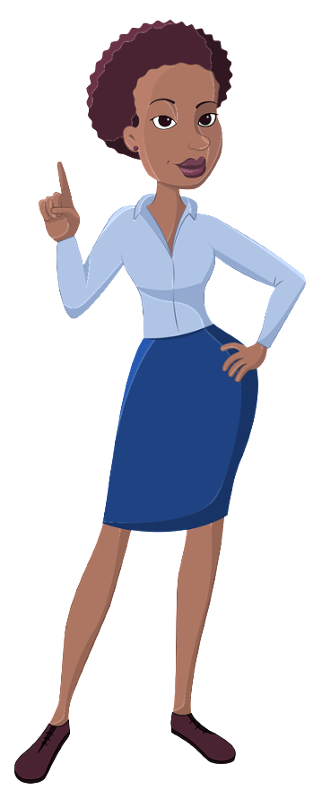
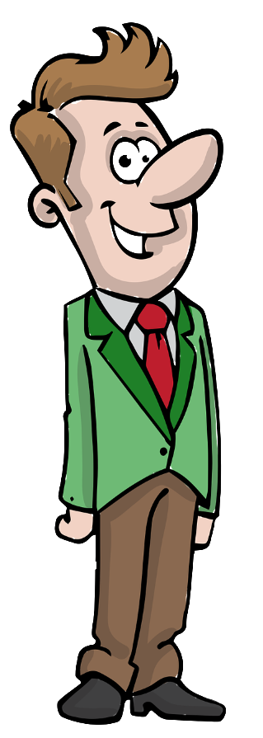
Emplois et adjectifs
écouter
C’est qui ?
Écoute. C’est quelle lettre?
1
hard-working
hard-working
careful
careful
2
3
4
5
A
B
C
D
E
F
G
H
Réponses:
3
1
5
2
4
Notes:
Timing: 3 minutes
Aim: To practise recognition of the masculine and feminine forms or nouns and adjectives in this week’s vocabulary set.
Procedure:
1. Go over the vocabulary, which students should have pre-learned. Click on a picture to hear the word pronounced by a native speaker. Students repeat. Pay close attention to the end of the words which show the gender.
2. Click on a number to hear a recording. Students listen and follow the pathway specified in each according to the masculine or feminine nouns mentioned.
3. The answers are animated and appear on clicks.
Transcript:
1. directrice, travailleur, une secretaire (answer: C)
2. directeur, prudente, ambitieux (answer: E)
3. directrice, travailleuse, avocate (answer: B)
4. directeur, prudent, facteur (answer: H)
5. directrice, travailleur, un secretaire (answer: D)

Slide 12
C’est à vous !
écouter / parler
C’est qui ?
Travaille avec un(e) partenaire.
Écoute et parle.
C’est quelle lettre?
hard-working
hard-working
careful
careful
A
B
C
D
E
F
G
H
Notes:
Timing: 5 minutes
Aim: To practise production (spoken modality) of the masculine and feminine forms presented on the previous slide.
Procedure:
Check students understand the task instructions. See if they can work out the idiomatic usage of à toi/à vous, meaning ‘your turn’.
Students take turns to narrate a pathway as for the previous listening exercise. Students can choose their pathways, or teachers can give out rolecards with letters on so that students do not ‘play it safe’/pick similar pathways each time!
Partners try to name the correct destination point.

Slide 13
La féminisation des professions
grammaire
You already know two ways to turn a masculine noun into a feminine noun:
masculin féminin
1. add –e: un avocat une avocate
2. change the article only: un médecin une médecin
un secrétaire une secrétaire
Here is another way:
3. change –eur to –rice un acteur une actrice
Attention!
You know one exception to this rule.
le chanteur
la chanteuse
If the masculine form already ends in –e, it does not change for the feminine!
Exception: Although it ends in –eur, professeur now follows the pattern of avocat: professeur → professeure. Until recently, it did not change for the feminine! In fact, many feminine forms of job titles are very new.
Notes:
Timing: 3 minutes
Aim: To revise known ways of making a masculine noun (e.g. job title) feminine, and to add two new patterns (-eur to –rice, and –eur to –euse).
If students seem interested in the info box that appears on a final click, expand on the recent [2019] decision by the Académie Française to allow the feminisation of job titles: https://www.bbc.co.uk/news/world-europe-47414140

Slide 14
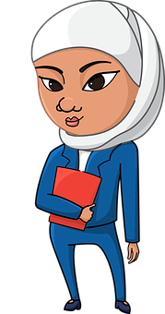
C’est qui ?
écouter
1
Notes:
Timing: 5 minutes. This is slide 1/7.
Aim: aural recognition of masculine and feminine noun forms (rules 1-3).
Procedure:
1. Click on the numbers to hear a short sentence about either the male or female person with the article obscured.
2. Students point to the left or right of the screen to indicate which person they think they sentence is about.
3. Click to reveal answer.
4. Click on the picture to hear the full audio (including the article).
Transcript:
Voici [la] directrice de l’école.

Slide 15
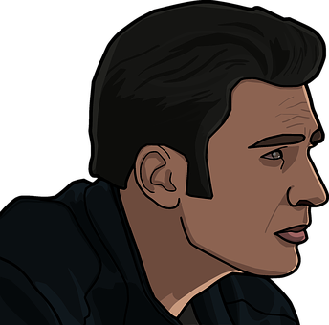
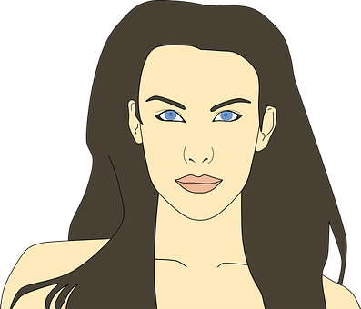
C’est qui ?
écouter
2
Notes:
This is slide 2/7.
Transcript:
Voici [un] acteur du nouveau film.

Slide 16
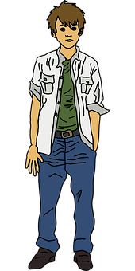
C’est qui ?
écouter
3
Notes:
This is slide 3/7.
Transcript:
Voici [un] étudiant de l’université.

Slide 17
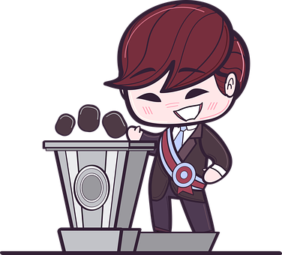
C’est qui ?
écouter
4
Notes:
This is slide 4/7.
Transcript:
Voici [la] présidente du pays.
Word frequency (1 is the most frequent word in French): présidente [president 268]
Source: Londsale, D., & Le Bras, Y. (2009). A Frequency Dictionary of French: Core vocabulary for learners London: Routledge.

Slide 18
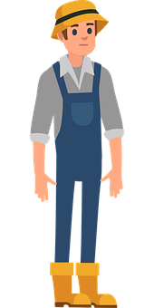
C’est qui ?
écouter
5
Notes:
This is slide 5/7.
Transcript:
Voici [une] agricultrice de la ferme locale.
Word frequency (1 is the most frequent word in French): agricultrice [agriculteur 2306], ferme [1024], local [622]
Source: Londsale, D., & Le Bras, Y. (2009). A Frequency Dictionary of French: Core vocabulary for learners London: Routledge.

Slide 19
C’est qui ?
écouter
6
Notes:
This is slide 6/7.
Transcript:
Voici [une] avocate calme.

Slide 20
C’est qui ?
écouter
7
Notes:
This is slide 7/7.
Transcript:
Voici [un] réalisateur du Hollywood.
Word frequency (1 is the most frequent word in French): réalisateur [4333]
Source: Londsale, D., & Le Bras, Y. (2009). A Frequency Dictionary of French: Core vocabulary for learners London: Routledge.

Slide 21
Au centre-ville
lire
Qui a quel emploi ? C’est un homme ou une femme ?
La factrice organise des lettres.
Le/La journaliste écrit des articles pour la rédactrice (editor).
Le présentateur lit les nouvelles chaque jour.
Le/La médecin aide des personnes malades.
Le coiffeur (hairdresser) prépare l'actrice pour la scène.
__
__
__
__
__
__
The presenter is a man.
True / False / Unknown
A woman helps sick people.
True / False / Unknown
A woman prepares the actor for the scene.
True / False / Unknown
A woman writes the articles.
True / False / Unknown
A man organises the letters.
True / False / Unknown
The actor is male.
True / False / Unknown
The editor is a woman.
True / False / Unknown
Notes:
Timing: 8 minutes
Aim: Written recognition of masculine and feminine noun forms.
Procedure:
1. Students read the sentence and fill gaps with le or le based on the form of the noun they see (NB: some answers could be either!)
2. Click to bring up a true/false question. Students answer based on the gender of the noun.
3. Click to reveal answer and definite articles.
4. Click to bring up the next question.
5. Repeat steps 2-5 for three more questions.
Word frequency of unknown words used (1 is the most frequent word in French): coiffeur [>5000], rédacteur [4260]
Source: Londsale, D., & Le Bras, Y. (2009). A Frequency Dictionary of French: Core vocabulary for learners London: Routledge.
Word frequency of cognates used (1 is the most frequent word in French): organiser [701], journaliste [1337], article [604], patronne [patron 1701], présentateur [>5000], scène [794]
Source: Londsale, D., & Le Bras, Y. (2009). A Frequency Dictionary of French: Core vocabulary for learners London: Routledge.

Slide 22
La féminisation des noms
écrire / parler
Quel est le masculin ?
1
2
un ingénieur
un dessinateur
___________
_____________
une ingénieure
une dessinatrice
3
4
un instituteur
un gérant
__________
_______
une institutrice
une gérante
Notes:
Timing: 8 minutes. This is slide 1/2.
Aim: To consolidate knowledge of noun feminisation patterns through practice in switching between feminine forms (as given) and the corresponding masculine forms of job titles. This activity continues on the following slide.
Procedure:
1. Elicit masculine forms of the nouns shown in the feminine from the students, either immediately or after a pause for thought. NB: to avoid confusion with the feminine forms ending in –e, only job titles which differ in the feminine form have been selected for this activity.
2. Click to animate the answers.
3. Clarify the meanings of these unknown words.
3. Students close their books and repeat the activity orally, helping automisation of the process.
Word frequency of unknown vocabulary used (1 is the most frequent word in French):
ingénieur [2848], dessinateur [>5000], instituteur [4630], gérant [>5000]
Source: Londsale, D., & Le Bras, Y. (2009). A Frequency Dictionary of French: Core vocabulary for learners London: Routledge.

Slide 23
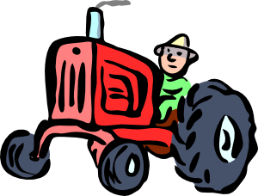
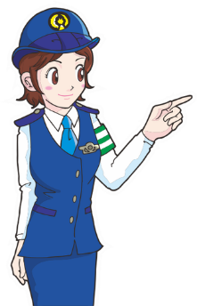
La féminisation des noms
écrire / parler
Quel est le masculin ?
5
6
un écrivain
un agriculteur
_________
___________
une agricultrice
une écrivaine
7
8
un conducteur
un inspecteur
_____________
____________
une conductrice
une inspectrice
Notes:
This is slide 1/2.
Word frequency of unknown vocabulary used (1 is the most frequent word in French):
agriculteur [2306], écrivain [1738], conducteur [3072], inspecteur [2694]
Source: Londsale, D., & Le Bras, Y. (2009). A Frequency Dictionary of French: Core vocabulary for learners London: Routledge.

Slide 24
Est-ce que tu veux être…
écrire / parler
teacher | actor | lawyer | headteacher | secretary | postman/woman
Salut Léa ! Est-ce que tu veux être professeure ?
Hein… non, je ne veux pas être professeure.
Je veux être directrice !
Notes:
Timing: 10 minutes. This is slide 1/2.
Aim: written and spoken production of est-ce que questions and statements with masculine and feminine jobs.
Procedure:
1. Students sketch a table as shown on the slide. The job titles given here are suggestions only – you may want to add more, fewer or different job titles depending on the level and interests of the class. Ensure that the feminine forms of any jobs added to the table are formed by adding -e, -rice or a feminine article only, and ensure students are aware of the forms.
2. Tell students they are going to work in mixed-gender groups of 4-6 (or this could be a whole-class activity). They need to ask one another which jobs they might like to do in the future using the construction Est-ce que tu veux être + masculine or feminine noun, depending on who they are talking to.
3. Students respond in full sentences (use this slide to model the dialogue).
4. Students tally up the total number of ‘yes’ responses for each job to see which profession is most popular in the class.
5. Display the writing follow-up on slide 25. Students write sentences about their classmates in the 3rd person, e.g. Matthew veut être facteur.

Slide 25
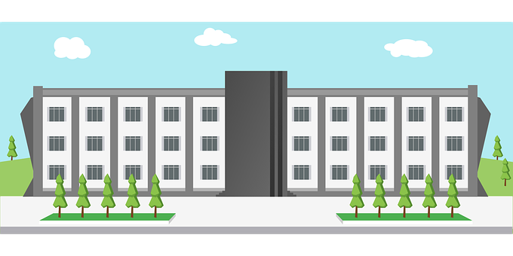
Grammaire
écrire / parler
Qui veut être quoi ?
Exemple : Léa veut être directrice.
Notes:
This is slide 2/2.

Slide 26
Talking about jobs
feminine adjective agreement rules 1, 2 and 3 (-x ➜ -se)
SSC [h]
Y8 French
Term 1.1 - Week 3 - Lesson 6
Stephen Owen / Catherine Morris / Robert Woore
Artwork by: Chloé Motard
Date updated: 11/10/21
Notes:
Learning outcomes (lesson 2):
Consolidating SSC [h]
Revisiting adjective agreement rules 1 and 2
Introducing adjective agreement rule 3
Word frequency (1 is the most frequent word in French):
8.1.1.2 (revisit) avocat [1188], bureau² [273], directeur¹ [640], emploi¹ [517], facteur [1264], secrétaire [920], ambitieux [2905], prudent [1529], travailleur, travailleuse [1341], assez [321]
7.3.2.5 (revisit) devoir [39], dois [39], doit [39], veut [57], veux [57], vouloir [57], visiter [1378], billet [1916]
7.3.1.4 (revisit) dormir [1836], dors [1836], dort [1836], bureau¹ [273], équipe [814], parfois [410], sous [112], sur [16]
Source: Londsale, D., & Le Bras, Y. (2009). A Frequency Dictionary of French: Core vocabulary for learners London: Routledge.

Slide 27
La liaison avec le h muet
parler
In French, [h-] is normally silent.
This means it follows the pronunciation rules of the vowel that comes after it.
Look at these sentences. How is the last letter in ‘c’est’ pronounced?
C’est triste !
C’est horrible !
C’est triste !
C’est horrible !
Liaison occurs when words ending with a Silent Final Consonant come before a word beginning with [h-].
Notes:
Timing: 2 minutes
Aim: To raise awareness of pronunciation patterns with SFC + [h-]

Slide 28
La liaison avec le h muet
parler / écouter
Dis les deux versions de chaque phrase. Attention à la consonne finale !
 |  | a | b
 | Il a des ... | hallucinations. | problèmes.
 | Tu fais un voyage dans ton … | hélicoptère ? | pays ?
 | Il y a deux … | hexagones. | questions.
 | Où passes-tu tes … | hivers ? | vacances ?
 | Je fais attention à mes … | horoscopes. | vêtements.
 | Voici les … | hologrammes. | réponses.
 | Désolé pour mon … | hostilité. | français.
 | Il y a trois … | hôtels. | cafés.
1
2
3
Écoute. Quel mot complète la phrase ? Écris a ou b.
4
5
6
7
8
Notes:
Timing: 10 minutes for 2 slides
Aim: practising oral production and aural recognition of liaison with SSC [h-] using cognates and known vocabulary.
Procedure:
Teacher can recap liaison before beginning the task, highlighting the different pronunciations of les, des, mon, mes, ton, tes, deux, trois before a vowel.
Students read the two versions of the sentences and decide which word needs a liaison and which does not. They then say each version of the sentence aloud.
Click to reveal the second part of the task
Click the numbers to play the audio. The last words in the sentences are obscured by beeps (the liaison is heard where present).
Students write 1-8 and choose ‘a’ or ‘b’ to complete the sentence, based on the presence or absence of liaison.
Answers and full audio (without beeps) are provided on the next slide.
Transcript:
Il a des [...].
Tu fais un voyage dans ton […] ?
Il y a deux […].
Où passes-tu tes […] ?
Je fais attention à mes […].
Voici les […].
Désolé pour mon […].
Il y a trois […].
Word frequency of cognates used (1 is the most frequent word in French): compléter [2034], hallucination [>5000], hélicoptère [2978], hexagone [>5000], hologramme [>5000], horoscope [>5000], hostilité [3436]
Source: Londsale, D., & Le Bras, Y. (2009). A Frequency Dictionary of French: Core vocabulary for learners London: Routledge.

Slide 29
La liaison avec le h muet
Réponses
parler / écouter
Dis les deux versions de chaque phrase. Attention à la consonne finale !
Écoute. Quel mot complète la phrase ? Écris a ou b.
 |  | a | b
 | Il a des ... | hallucinations. | problèmes.
 | Tu fais un voyage dans ton … | hélicoptère ? | pays ?
 | Il y a deux … | hexagones. | questions.
 | Où passes-tu tes … | hivers ? | vacances ?
 | Je fais attention à mes … | horoscopes. | vêtements.
 | Voici les … | hologrammes. | réponses.
 | Désolé pour mon … | hostilité. | français.
 | Il y a trois … | hôtels. | cafés.
1
2
3
4
5
6
7
8
Notes:
Procedure:
1. Click the numbers to play the full audio without beeps.
Transcript:
Il a des hallucinations.
Tu fais un voyage dans ton pays ?
Il y a deux hexagones.
Où passes-tu tes vacances ?
Je fais attention à mes vêtements.
Voici les hologrammes.
Désolé pour mon hostilité.
Il y a trois cafés.

Slide 30
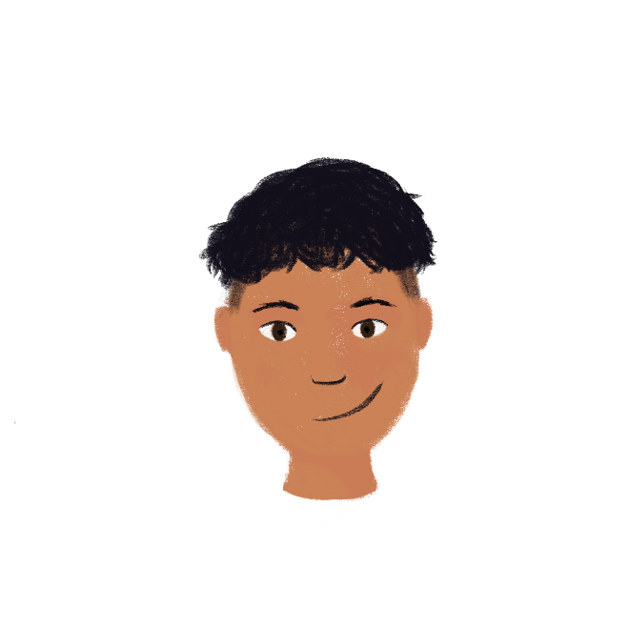
La famille d’Amir
lire
Amir parle de sa famille. C’est quel mot?
Je vais parler de ma famille. Bilal, c’est mon père. Il est homme d'affaires.
Il travaille souvent dehors! Il doit visiter chaque magasin en ville!
Amandine, c’est ma mère. Elle est avocate et elle travaille dans un bureau. Parfois, elle travaille en équipe et elle est assez ambitieuse.
Ma tante Aïcha est secrétaire. Elle aime ça. Il y a un billet de concert pour une chanteuse célèbre sur son bureau!
Mon oncle Ammar est directeur d’une école. Il est prudent.
Ma sœur Noura veut être professeure! Elle veut aussi travailler dans une école. Elle est travailleuse et elle ne dort pas en classe! Amir
1____
2_______
3______
4____
5_______
6________
7___________
8__
parfois - célèbre – billet – directeur – dort – bureau – travailleuse – doit
Notes:
Timing: 5 minutes
Aim: To revisit the vocabulary from this week’s sets in a reading exercise. A more challenging version is on the next slide.
Procedure:
Check students understand the surrounding context. They know the words homme and affaires. What does Amir’s dad do for a living?
Students read the text and determine which word shown at the bottom goes in each gap.
Click on the mouse to animate the answers.

Slide 31
La famille d’Amir
lire / écrire
Amir parle de sa famille. C’est quel mot?
Je vais parler de ma famille. Bilal, c’est mon père. Il est homme d'affaires.
Il travaille souvent dehors! Il doit visiter chaque magasin en ville!
Amandine, c’est ma mère. Elle est avocate et elle travaille dans un bureau. Parfois, elle travaille en équipe et elle est assez ambitieuse.
Ma tante Aïcha est secrétaire. Elle aime ça. Il y a un billet de concert pour une chanteuse célèbre sur son bureau!
Mon oncle Ammar est directeur d’une école. Il est prudent.
Ma sœur Noura veut être professeure! Elle aussi veut travailler dans une école. Elle est travailleuse et elle ne dort pas en classe! Amir
1____
2_______
3______
4____
5_______
6________
7___________
8__
c______ – b_____ – v______ – d________ – d___ – p______ – b_____ – tr___________
Notes:
A more challenging version of the previous slide, in that only the first letter of each missing word is given at the bottom of the slide.

Slide 32
La féminisation des adjectifs
grammaire
You already know various ways to make a masculine adjective feminine:
masculin féminin
add –e: grand grande
no change: calme calme
irregular forms: beau belle
vieux vieille
Here is another rule:
3. change –x to –se heureux heureuse
ambitieux ambitieuse
Exception: travailleur travailleuse
Rule: if the masculine form already ends in –e, it does not change for the feminine!
Attention!
You know one exception to this rule.
travailleur (m.)
travailleuse (f.)
Notes:
Timing: 3 minutes (both slides)
Aim: To revise ways of making a masculine adjective feminine using previously-met vocabulary.
Procedure:
1. Animate the explanation.
2. Ensure students’ understanding at each stage.

Slide 33
C’est qui ?
lire
1 | L’actrice est heureuse. | acteur | actrice
2 | Le professeur est travailleur. | professeur | professeure
3 | Le directeur est ambitieux. | directrice | directeur
4 | La factrice est assez prudente. | facteur | factrice
5 | L’étudiant est intelligent. | étudiant | étudiante
6 | L’avocat est vieux. | avocate | avocat
7 | La professeure est ambitieuse. | professeur | professeure
8 | Le chanteur est travailleuse. | chanteuse | chanteur
_________
_____________
_____________
__________
_____________
_________
_____________
__________
Notes:
Timing: 6 minutes
Aim: Written recognition of masculine and feminine adjectives and connecting these with masculine and feminine nouns.
Procedure:
1. Students read the sentences and decide whether a male of female person is being described, based on the form of the adjective they see. They will have to apply their knowledge of noun forms learned in lesson one to complete the task as the articles are not given with the nouns/
2. Click to reveal answers one by one.
3. Oral translation of sentences.

Slide 34
De qui parlent-ils ?
*le serveur = waiter
écouter
Réponses:
 | directeur | directrice
 | homme | femme
 | Amir | Noura
 | professeur | professeure
 | professeur | professeure
 | directeur | directrice
 | tu | elle
 | serveur | serveuse
 | un médecin | une médecin
 | avocat | avocate
1
Le père de Léa et la mère d’Amir parlent au téléphone.
De qui parlent-ils ? Écoute.
2
3
4
5
6
7
8
9
10
Notes:
Timing: 8 minutes. This is slide 1/2.
Aim: To practise recognition (listening modality) of masculine and feminine adjective forms.
Procedure:
1. Students listen to the sentences. They select the correct noun (job title) option, according to the gender of the adjective heard in each case (the nouns and articles are bleeped out).
2. Click to animate the answers.
3. The full audio, with nouns included so that students can hear full sentences, can be found on the next slide.
Transcript:
1. L’école a [beep] prudente ?
2. Oui, c’est [beep] intéressante.
3. [beep] est content ?
4. Oui, [beep] est travailleur aussi. C’est bon. Et Léa ?
5. Ouais … elle a [beep] intelligente.
6. Mais elle a [beep] méchant !
7. Oooh … c’est triste. [beep] n’es pas heureux, hein ?
8. Bah, je suis malade. [beep] de restaurant n’est pas prudent.
9. Tu as [beep] travailleuse ?
10. Non, mais j’ai [beep] ambitieux!
Word frequency of unknown words used (1 is the most frequent word in French): serveur [4377]
Source: Londsale, D., & Le Bras, Y. (2009). A Frequency Dictionary of French: Core vocabulary for learners London: Routledge.

Slide 35
De qui parlent-ils ?
*le serveur = waiter
écouter
Réponses:
 | directeur | directrice
 | homme | femme
 | Amir | Noura
 | professeur | professeure
 | professeur | professeure
 | directeur | directrice
 | tu | elle
 | serveur | serveuse
 | un médecin | une médecin
 | avocat | avocate
1
Écoute encore. Que comprends-tu ?
Écris cinq phrases en anglais !
2
3
4
Une solution
Amir has a careful, interesting, female headteacher and a hard-working teacher. He is happy. Léa has an intelligent teacher and a mean male headteacher. Léa’s dad is ill because the waiter at the restaurant was careless. He doesn’t have a hard-working doctor but he has an ambitious lawyer.
5
6
7
8
9
10
Notes:
This is slide 2/2.
Aim: Written summary of a spoken dialogue.
Procedure:
1. Click on the numbers to hear sentences in French.
2. Students have 5 seconds after each item to make notes in French or English.
3. Students have 4 minutes to write a written summary of what they have heard in English. Encourage students to group their notes logically, e.g. – what is Amir’s school like? What is Léa’s school like? What happened to Léa’s dad?
4. A suggested summary appears on a click.
Transcript:
1. L’école a une directrice prudente ?
2. Oui, c’est une femme intéressante.
3. Amir il-est content ?
4. Oui, le professeur est travailleur aussi. C’est bon. Et Léa ?
5. Ouais … elle a une professeure intelligente.?
6. Mais elle a un directeur méchant !
7. Oooh … c’est triste. Tu n’es pas heureux, hein ?
8. Bah, je suis malade. Le serveur de restaurant n’est pas prudent.
9. Tu as une médecin travailleuse ?
10. Non, mais j’ai un avocat ambitieux!

Slide 36
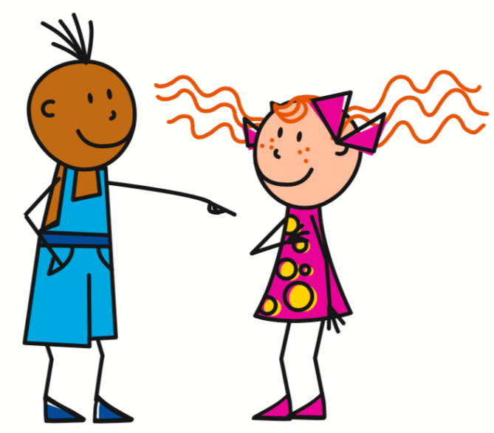
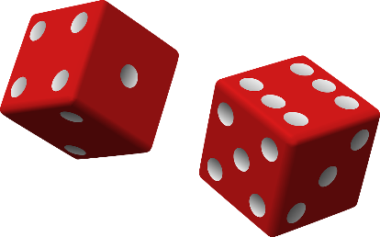
Nous sommes comment ?
écrire
Exemple:
Score 1
2=
Phrase possible:
Score 2
3=être
Tu es une avocate intelligente.
Score 3
6=noun (f.)
Score 4
4=adjectives that add –e in feminine
Notes:
Timing: 8 minutes
Aim: Semi-structured writing task consolidating the main grammar points and vocabulary presented this week. The slide following this one should be displayed during the activity.
Procedure:
1. Students roll 4 dice. The score on the first represents the person; the second represents the verb (avoir or être); the third represents the gender of the noun to be used; the fourth represents the type of adjective – all according to the table on the slide following this one, which should be displayed during the activity.
2. Students create a sentence of their own in writing according to the parameters indicated by the scores on the dice.
3. Complete five sentences at least.

Slide 37
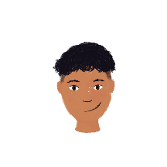
Nous sommes comment ?
écrire
1
1
1
1
adjectives that add –e in feminine
2
2
être
2
noun (m.)
2
3
/
3
3
3
adjectives that add
–euse in feminine
4
4
4
4
5
5
avoir
5
noun (f.)
5
adjectives with irregular feminine forms
6
+
6
6
6
Notes:
Display this slide during the activity.

Slide 38
Une interview
parler
Pose des questions sur la famille ou les amis d’un(e) partenaire.
intelligent
happy
calm
careful
nice
strict
well-behaved
hard-working
short
English
young
mean
funny
ambitious
interesting
sad
tall
Notes:
Timing: 8 minutes
Aim: semi-structured oral production of adjectives following feminine agreement patterns 1-3; oral production of est-ce que questions.
Procedure:
1. Tell students they are going to choose one female person they know and one male person they know, and answer questions about what those people are like.
2. Students work in pairs. Student A asks Tu parles de qui ? Student B answers with the name of the person they are going to describe first. To clarify the gender of the person, Student A can ask C’est un homme/une femme/un garçon/une fille ?
3. Student A then asks six questions about Student B’s first person, using the adjectives on this slide as prompts. This slide lists all the regular adjectives students have learned to describe people so far. Explain to students that the adjectives are grouped by agreement pattern. Student A must pick two adjectives from each column, and agree them accordingly, e.g. Est-ce qu’il est intelligent ? Est-ce qu’elle est heureuse ?
4. Student B responds in a full sentence, e.g. Oui, il est intelligent. Non, elle n’est pas heureuse. At higher levels, encourage students to add their answers by adding mais/et and offering an alternative adjective.
5. Students swap roles. Repeat steps 2-4.
6. Repeat steps 2-5 for each student’s second person, taking care to agree the adjectives appropriately.
Word frequency of cognates used (1 is the most frequent word in French):
interview [3186], poser [218]
Source: Londsale, D., & Le Bras, Y. (2009). A Frequency Dictionary of French: Core vocabulary for learners London: Routledge.

Slide 39
Devoirs
Vocabulary Learning Homework (Y8, Term 1.1, Week 4)
Audio file
Audio file QR code:
Student worksheet
Quizlet link
In addition, revisit: Y7 Term 3.2 Week 6
Y7 Term 3.1 Week 5
Notes:
The answer sheet for the Y8 vocabulary learning HW is here: https://resources.ncelp.org/concern/resources/4j03d022r?locale=en

