Slide 1
Describing what people do
Using –er and –ir verbs in the infinitive and third person singular
SSCs [ga], [go], [gu] [revisited]
Y7 Spanish
Term 3.1 - Week 4 - Lesson 55
St. James’ Hub Teachers / Victoria Hobson / Nick Avery / Rachel Hawkes
Artwork: Mark Davies
Date updated: 16.08.21
Notes:
Artwork by Mark Davies. All additional pictures selected are available under a Creative Commons license, no attribution required.
Learning outcomes (lesson 1):
Consolidation of SSCs [ga], [go], [gu] ('hard G')
Introduction of -er and –ir verbs in the infinitive and third person singular
Word frequency (1 is the most frequent word in Spanish):
7.3.1.4 (introduce) beber [1085]; comer [347]; leer [209]; vivir [142]; hombre [97]; ejercicio [1162]; fruta [1925]; carne [860]; rico² [398]; agua [204]; nunca [158]; a veces [vez-59]
7.2.2.5 (revisit) somos [7-ser]; feliz [908]; moreno [3304]; claro [1923]; oscuro [802]; aburrido [3917]; loco [846]
Source: Davies, M. & Davies, K. (2018). A frequency dictionary of Spanish: Core vocabulary for learners (2nd ed.). Routledge: London
The frequency rankings for words that occur in this PowerPoint which have been previously introduced in NCELP resources are given in the NCELP SOW and in the resources that first introduced and formally re-visited those words.
For any other words that occur incidentally in this PowerPoint, frequency rankings will be provided in the notes field wherever possible.

Slide 2
ga
regalo
jugar
gato
ganar
amiga
lugar
[place]
Nick Avery
Notes:
Introduce and elicit the pronunciation of the individual SSC ‘ga’ and then the source word again (with gesture, if using). Then present and elicit the pronunciation of the five cluster words.
The cluster words have been chosen for their high-frequency, from a range of word classes, with the SSC (where possible) positioned within a variety of syllables within the words (e.g. initial, 2nd, final etc.). Additionally, we have tried to use words that build cumulatively on previously taught SSCs (see the Phonics Teaching Sequence document) and do not include new SSCs. Where new SSCs are used, they are often consonants which have a similar symbol-sound correspondence in English.

Slide 3
ga
regalo
jugar
gato
ganar
amiga
lugar
Nick Avery
Notes:
Without the images, students focus this time again closely on the SSC and the cluster words.

Slide 4
ga
regalo
jugar
gato
ganar
amiga
lugar
Nick Avery
Notes:
Without the images or sound, students have to pronounce the words themselves.

Slide 5
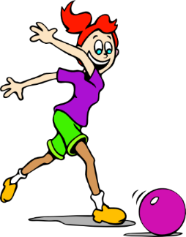
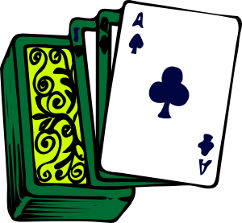
go
domingo
largo
SUNDAY
gol
juego (n)
conmigo
[with me]
algo
[something]
Nick Avery
Notes:
Introduce and elicit the pronunciation of the individual SSC ‘go’ and then the source word again (with gesture, if using). Then present and elicit the pronunciation of the five cluster words.
The cluster words have been chosen for their high-frequency, from a range of word classes, with the SSC (where possible) positioned within a variety of syllables within the words (e.g. initial, 2nd, final etc.). Additionally, we have tried to use words that build cumulatively on previously taught SSCs (see the Phonics Teaching Sequence document) and do not include new SSCs. Where new SSCs are used, they are often consonants which have a similar symbol-sound correspondence in English.

Slide 6
go
domingo
largo
gol
juego (n)
conmigo
algo
Nick Avery
Notes:
Without the images, students focus this time again closely on the SSC and the cluster words.

Slide 7
go
domingo
largo
gol
juego (n)
conmigo
algo
Nick Avery
Notes:
Without the images or sound, students have to pronounce the words themselves.

Slide 8
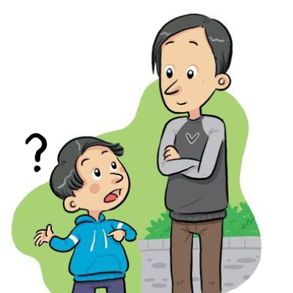
gu
¡mucho gusto!
segundo
preguntar
Nick Avery
Notes:
Introduce and elicit the pronunciation of the individual SSC ‘gu’ and then the source word again (with gesture, if using). Then present and elicit the pronunciation of the five cluster words.
The cluster words have been chosen for their high-frequency, from a range of word classes, with the SSC (where possible) positioned within a variety of syllables within the words (e.g. initial, 2nd, final etc.). Additionally, we have tried to use words that build cumulatively on previously taught SSCs (see the Phonics Teaching Sequence document) and do not include new SSCs. Where new SSCs are used, they are often consonants which have a similar symbol-sound correspondence in English.

Slide 9
gu
¡mucho gusto!
segundo
preguntar
Nick Avery
Notes:
Without the images, students focus this time again closely on the SSC and the cluster words.

Slide 10
gu
¡mucho gusto!
segundo
preguntar
Nick Avery
Notes:
Without the images or sound, students have to pronounce the words themselves.

Slide 11
İTres segundos!
hablar / escuchar
jugar
domingo
amiga
largo
seguro
regalo
conmigo
preguntar
gato
juego
segundo
lugar
gol
ganar
algo
Notes:
Timing: 3 minutes
Aim: to revise SSCs [ga], [go] and [gu]
Procedure:
1. This is a paired read aloud task. Teachers will need to print one sheet per pair, and then distribute to the students before explaining the activity.
2. Each student uses a different colour to play. Student A says one of the words and student B has 3 seconds to locate it and circle/highlight with their colour. If the student takes longer than 3 seconds student A can steal the point.
Teachers may need to think about student pairings to ensure friendly competition.
Notes:
Slides 11-12 (answers on slide 13) provide a few activities for further phonics practice. Teachers can do them all or select the most appropriate for their classes. In addition to previously taught source and cluster words, this set of words includes previously taught vocabulary items with the target SSC ‘ga’: jugar (2.2.2), amiga (1.1.6), lugar (2.1.3), regalo (1.2.7)

Slide 12
İUn minuto!
hablar
jugar
domingo
60
amiga
largo
seguro
regalo
conmigo
preguntar
Segundos
gato
juego
segundo
lugar
gol
0
ganar
algo
INICIO
Notes:
Timing: 4 minutes
Aim: to revise SSCs [ga], [go] and [gu]
Procedure:
This is a choral alphabetical read aloud – the teacher sets the 60-second timer going (click on ‘inicio’). Individually (but all together at once) students read out the words in alphabetical order. They keep going for one minute. Challenge – translate into English orally with partner. Teachers can circulate to listen to students’ SSC knowledge and recall of English.
As the final activity, students should write the English for as many of the words as they can to reinforce their meanings. Students could have a minute individually then team up with a partner to see if they can achieve translations for all 15 words. The answers are provided on slide 13.

Slide 13
¿Qué significan las palabras?
jugar
?
conmigo
?
to play, playing
with me
amiga
?
?
female friend
juego
game
regalo
?
present
gol
goal
?
gato
cat
?
algo
?
something
place
lugar
?
preguntar
?
to ask, asking
to win, winning
ganar
?
seguro
sure, certain
?
domingo
?
Sunday
second
segundo
?
largo
long
?
Notes:
Timing: 2 minutes
Aim: to revise the meaning of the words used in these phonics activities on the previous slides.
Procedure:
1. Click on the box with ‘?’ to reveal the answer for each word. In this way, answers can be volunteered in any order.

Slide 14
Vocabulario
escuchar / escribir
Escucha y completa las frases. Escribe las palabras en español.
Quiere estar moreno.
Estar feliz es importante.
No quiero estar aburrido.
Estar loco no es bueno.
El cielo parece estar oscuro.
El río está claro.
1
2
3
4
5
6
Notes:
Timing: 5 minutes (for slides 14 and 15)
Aim: to revise vocabulary from the 2.2.5 set; to practise transcription of individual words.
Procedure:
Students listen to identify the missing word and write it in Spanish.
Play the recording by clicking on the number button. The words are revealed in numerical order by clicking.
As part of the feedback, students could be asked to translate the whole sentences. This activity and answers appear on the next slide.
Transcript
Quiere estar moreno.
Estar feliz es importante.
No quiero estar aburrido.
Estar loco no es bueno.
El cielo parece estar oscuro.
El río está claro.
Notes:
Note that ‘cielo’ hasn’t been previously taught as a vocabulary item, but has featured in earlier lesson material with a gloss.
Vocabulary revisited here is from term 2.2, week 5 (as per SoW revisiting cycle): feliz [908]; moreno [3304]; claro [1923]; oscuro [802]; aburrido [3917]; loco [846].

Slide 15
Vocabulario
Escribe las frases en inglés.
Quiere estar moreno.
Estar feliz es importante.
No quiere estar aburrido.
Estar loco no es bueno.
El cielo parece estar oscuro.
El río debe estar claro.
He wants to be tanned.
Being/feeling happy is important.
He doesn’t want to be bored.
Being/acting crazy is not good.
The sky seems to be dark.
The river must/has to be clear.
Notes:
Aim: to check understanding of the sentences on the last slide.
Procedure:
Answers are revealed on a mouse click. Note that in items 1 and 3, the answer has to be ‘he’ (rather than s/he) because the adjective is the masculine form.
This slide could then be used as a recap of students’ prior learning about the infinitive form. On a mouse click, ‘estar’ is highlighted. Students could be asked if they can remember the name for this part of the verb. Ask students what they can remember about its function. They may say things like:
The infinitive form of a verb is the form you see in a dictionary.
In English, this is often written ‘to + verb’.
In Spanish, the infinitive of the verb often ends in –ar (they may name some they can readily remember).
You can also begin a sentence with the infinitive.
The infinitive often describes the general meaning of the verb.
3. If students do not manage to remember this information, it is all recapped in the grammar explanation to come.
4. Point out that this infinitive ends in –ar, then ask students is they can remember any other infinitives that end in –ar. There is no need at this point to open up a discussion about regular and irregular verbs. The infinitive ‘estar’ is being used here as a platform to open a discussion about the function of the infinitive only, not conjugated forms.
Notes:
Vocabulary revisited here is from term 2.2, week 5 (as per SoW revisiting cycle): feliz [908]; moreno [3304]; claro [1923]; oscuro [802]; aburrido [3917]; loco [846].

Slide 16
-er and -ir verbs: infinitive and 3rd person singular
Remember, the infinitive form of a verb is the form you see in a dictionary. It describes the general meaning of a verb.
In Spanish, infinitives often end in –ar, but also end in –er and –ir.
For example:
Es importante leer.
It’s important to read.
You can also begin a sentence with the infinitive:
Escribir es importante.
Writing is important.
Notes:
Timing: 1 minute
Aim: to introduce ‘-er’ and ‘-ir’ verbs as infinitive.
Procedure:
Teachers explain to students that they are now going to learn more about infinitives that end in –er and –ir. Students may say that they know some ‘–er’ infinitives (of irregular verbs) that they have previously met, for example, ser, tener, querer, poder, hacer.
If students do name these infinitives, explain that today students will be learning about regular -er verbs which follow a pattern and move onto the explanations in this and the next slide to exemplify this.
Notes:
We use ‘leer’ and ‘escribir’ as examples as these two verbs have already been used extensively in task instructions.
Because -er and -ir verbs behave alike in most cases, the scheme of work only separates them for teaching when they behave differently (e.g., in the 1st person plural).

Slide 17
-er and -ir verbs: infinitive and 3rd person singular
To mean ‘s/he’ or ‘it’ with an –er or –ir verb, remove –er/–ir and then add –e to the stem.
Escrib
Escribe
(escribir)
S/he writes
In English, we say ‘he’ or ‘she’ to say who does the action.
In Spanish, the verb ending tells us this. There is usually no need for the word ‘s/he’.
Le
Lee
(leer)
S/he reads
Escucha la pronuncación de ‘leer’ y ‘lee’.
1
leer
2
lee
Notes:
Timing: 2 minutes
Aim: to introduce present tense 3rd person singular endings of ‘-er’ and ‘-ir’ verbs
Procedure:
Click to go through the slide step by step.
Audio recordings are included to model the pronunciation of ‘leer’ and ‘lee’, whose vowel sounds sometimes cause difficulty.
There is also a call out explaining how in Spanish the verb ending tells us who is performing the action often without a subject pronoun being used, unlike English.

Slide 18
comer
[to eat | eating]
come
[s/he eats | it eats]
Notes:
Timing: 2 minutes (for slides 18-23)
Aim: to introduce the verb ‘comer’ more explicitly.
Procedure:
Bring up the word ‘comer’ on its own, say it, students repeat it, and teachers remind them of the phonics. Teachers should draw attention to [co].
Elicit the meaning from the students. If using gestures, a possible gesture would be to put their hand to your mouth, as if eating a sandwich.
Click to bring up the English translations. It is worth emphasising the two meanings for the infinitive.
Click to bring up the short form ‘come’, say it, students repeat it. Teachers should draw attention to [co].
Elicit the meaning from the students and emphasise the two meanings for the short form.
Notes:
Students should know the meaning of this verb already, as it was set as (audio and Quizlet) homework. It is re-presented here in the infinitive and short form to deepen students’ knowledge and model the use of both forms in sentences.
‘Comer’ is one of the NCELP 15 prototypical verbs in Spanish. Prototypical verbs are common verbs that illustrate the typical characteristics of a class of verb. All 15 prototypical verbs will be introduced early on using the same format. Both long form (infinitive) and short form (3rd person singular) are introduced in order to familiarise students with various forms of the same verb.

Slide 19
comer
[to eat | eating]
come
[s/he eats | it eats]
Notes:
Procedure:
1. Cycle through the long and short form again.

Slide 20
come
[s/he eats | it eats]
Lucía come fruta.
[Lucía eats fruit.]
Notes:
Aim: Introduce the short form in a sentence.
Procedure:
Teachers click through the word, example and translation on this slide.

Slide 21
comer
[to eat | eating]
Quiere comer fruta.
[S/he wants to eat fruit.]
Notes:
Aim: Introduce the long form in a sentence.
Procedure:
1. Teachers click to show the verb, the example and the translation.

Slide 22
come
[s/he eats]
Lucía come fruta.
[Lucía eats fruit.]
Notes:
Cycle through the short form in context again.

Slide 23
comer
[to eat | eating]
Quiere comer fruta.
[S/he wants to eat fruit.]
Notes:
Cycle through the long form in context again.

Slide 24
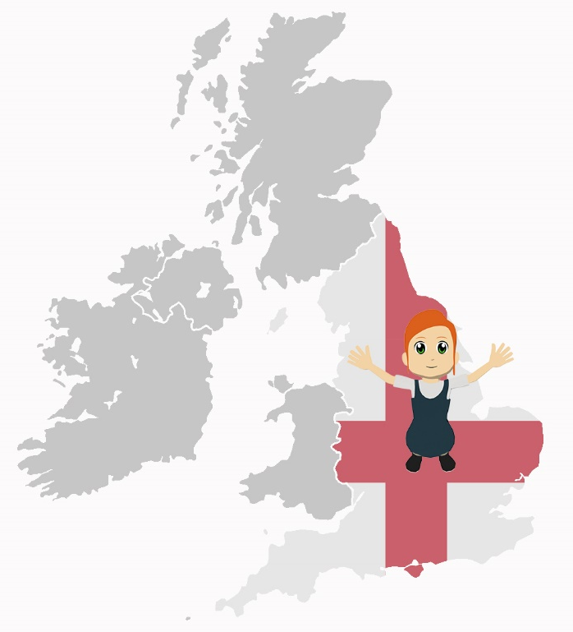
vivir
[to live | living]
vive
[s/he lives | it lives]
Notes:
Timing: 2 minutes (for slides 24-29)
Aim: Introducing the verb ‘vivir’ more explicitly.
Bring up the word ‘vivir’ on its own, say it, students repeat it, and remind them of the phonics. It is worth drawing attention to SSC [v].
Try to elicit the meaning from the students.
Bring up the English translations and emphasise the two meanings for the infinitive.
Bring up the short form ‘vive’, say it, students repeat it. Teachers should draw attention to [v]
Elicit the meaning from the students and emphasise the two meanings for the short form.
Notes:
Because ‘-er’ and ‘-ir’ verbs behave alike in most cases, we will only separate them for teaching when they behave differently (e.g., in the 1st person plural - see Y8 SoW).
Students should know the meaning of this verb already, as it was set as (audio and Quizlet) homework. It is re-presented here in the infinitive and short form to deepen students’ knowledge and model the use of both forms in sentences.
‘Vivir’ is one of the NCELP 15 prototypical verbs in Spanish. Prototypical verbs are common verbs that illustrate the typical characteristics of a class of verb. All 15 prototypical verbs will be introduced early on using the same format. Both long form (infinitive) and short form (3rd person singular) are introduced in order to familiarise students with various forms of the same verb.

Slide 25
vivir
[to live | living]
vive
[s/he lives | it lives]
Notes:
Cycle through the long and short form again.

Slide 26
vive
[s/he lives]
Paula vive en Francia.
[Paula lives in France.]
Notes:
Aim: Introduce the short form in a sentence.
Procedure:
1. Teachers click to go through the verb, the example sentence and the translation

Slide 27
vivir
[to live | living]
Quiere vivir en Francia.
[S/he wants to live in France.]
Notes:
Aim: Introduce the long form in a sentence.
Procedure:
1. Teachers click to go through the verb, the example sentence and the translation

Slide 28
vive
[s/he lives]
Paula vive en Francia.
[Paula lives in France.]
Notes:
Cycle through the short form in context again.

Slide 29
vivir
[to live | living]
Quiere vivir en Francia.
[S/he wants to live in France.]
Notes:
Cycle through the long form in context again.

Slide 30
Vocabulario
vivir
comer
beber
leer
Notes:
Timing: 3 minutes
Aim: to practise the verbs from this week’s vocabulary set. Two more verbs are presented here: beber and leer.
Procedure:
Use the animation sequence to introduce the Spanish and elicit the meanings in English from the students. Teachers should clarify meanings in English so that students have a correct understanding of the picture.
Play a game of ‘What’s missing?’ Students give the Spanish each time. This can be done in pairs or as a whole class. The animation sequence moves from one verb missing, to two then three in a variety of combinations then all four.
Notes:
The additional items of vocabulary from this week’s vocabulary set will be practised in lesson two.

Slide 31
Problemas con Siri
escuchar
 | the action in general | someone does the action
Siri doesn’t seem to be working on your phone! Can you work out what it’s talking about?
Escucha los mensajes.
Marca la opción correcta.
1
2
3
4
5
6
7
8
Notes:
Timing: 5 minutes
Aim: listening activity that aims to help learners understand the difference in meaning between the infinitive and the third person singular.
Procedure:
Teachers tell students to pay careful attention to the verb that they hear.
Teachers click the number button in the table to play the recording.
Answers are revealed one by one by clicking.
Teacher can ask students to translate the text extracts to ensure comprehension of meaning.
Transcript
[‘pling’ sound] Lee frases interesantes.
[‘pling’ sound] Vivir cerca del pueblo.
[‘pling’ sound] Bebe coca cola.
[‘pling’ sound] Come comida.
[‘pling’ sound] Leer juntos.
[‘pling’ sound] Vive lejos de aquí.
[‘pling’ sound] Comer mucho.
[‘pling’ sound] Beber limonada.
Notes:
The vocabulary other than the verbs in this activity is either already known to students or is a cognate.

Slide 32
İEscribe!
leer / escribir
es importante
es bueno
es aburrido
leer juntos
es normal
es interesante
es excelente
es tonto
es fantástico
Notes:
Timing: 12 minutes (for slides 32-39)
Aim: to practise using infinitives and 3rd person singular ‘-er’ and ‘-ir’ verbs to create sentences.
Procedure:
This reading and writing activity could be done on mini-whiteboards or in students’ exercise books. It uses the infinitive sentences and verbs from the previous activity.
Students have to complete the sentence starter in orange with their own creations. Having students write on mini-whiteboards allows the teacher to see all the different student responses (to see if they have selected a correct sentence finisher i.e. distinguished correctly between the infinitive and 3rd person singular) and then select and share with the group for translation into English.
Teachers could write their own answers on their own whiteboard. Students can see if any of their responses appear. Teachers could present this as an ‘ESP’ exercise to see if great minds think alike, between teacher and students, or student and students.
Notes:
This offers lots of scope for differentiation. Higher ability students will naturally arrive at more complex/creative sentences. Examples are given but students will come up with other sentences, too.
Revisited words:
bueno (1.2.4); aburrido (2.2.5); tonto (1.1.2); interesante (1.2.6); importante (1.1.6)

Slide 33
İEscribe!
leer / escribir
es bueno
es caro
es excelente
comer mucho
es normal
es feo
por la noche es malo
puede ser algo bueno
Notes:
Revisited words:
Caro (1.2.4)
Bueno (1.2.4)
Malo (1.2.4)
Noche (2.1.4)
Puede (2.2.2)
Ser (1.1.3)
Feo (1.2.4)
Algo – phonics word

Slide 34
İEscribe!
leer / escribir
tarde
temprano
mucho
comida
fruta
come
carne
solo
un plato rico
en la escuela
fuera de la casa
debajo del árbol
Notes:
‘Fruta’, ‘carne’ and ‘rico’ will be introduced formally in lesson 2 this week.
Revisited words:
Mucho (1.2.1)
Comida (2.2.1)
Solo (2.2.1)
Plato (1.2.6)
Fuera (2.2.4)
Casa (1.1.4)
Debajo (2.2.4)
Árbol (2.1.3)
Escuela (1.2.5)
Temprano, tarde (1.1.6)

Slide 35
İEscribe!
leer / escribir
por la mañana
Coca-Cola
mucho
limonada
bebe
delante de la tienda
con amigos
cinco botellas de agua
solo
en clase
Notes:
‘Agua’ will be introduced formally in lesson 2. ‘Limonada’ is a near-cognate that has been included in receptive tasks in earlier lessons.
Revisited words
Delante – 2.2.4
Tienda – 1.2.5
Cinco – 1.2.2
Botella – 1.1.5
De – 1.2.6
Amigo – 1.1.5
Solo – 2.2.1
Clase – 1.2.3
Mañana – 2.1.4

Slide 36
İEscribe!
leer / escribir
es bonito
es barato
es aburrido
vivir cerca del pueblo
es bueno
es interesante
es malo
es fantástico
es excelente
es una buena idea
es caro
es importante
Notes:
Revisited words
Bonito – 1.2.4
Barato – 1.2.4
Aburrido – 2.2.5
Bueno – 1.2.4
Interesante – 1.2.6
Malo – 1.2.4
Caro – 1.2.4
Importante – 1.1.6
Idea – phonics word

Slide 37
İEscribe!
leer / escribir
mucho
en la escuela
libros famosos
lee
revistas interesantes
frases en español
el periódico cada día
por la tarde
en la cama
Notes:
Revisited words
Mucho – 1.2.1
Libro – 1.1.4
Importante – 1.1.6
Revista – 1.1.5
famoso – 1.2.4
Frase – 1.1.4
Espanol – 1.2.1
Periódico – 1.1.5
Cada – 3.1.1
Tarde – 2.1.4
Cama – 1.1.4

Slide 38
İEscribe!
en una isla
leer / escribir
fuera del centro
en el sur de Francia
delante de la plaza
detrás del banco
vive
lejos de aquí
cerca del mercado
con amigos
en España
en una casa antigua
en una ciudad grande
en el campo
en el norte
solo/a
en un pueblo pequeño
Notes:
Revisited words
Isla – 1.2.6
Fuera – 2.2.4
Centro – 1.2.5
Sur, norte – 1.1.1
Francia – 3.1.1
Delante – 2.2.4
Plaza – 1.2.5
Detrás -2.2.4
Banco – 1.2.5
Cerca – 1.2.5
Mercado – 1.2.5
Lejos – 1.2.5
Aquí – 1.2.3
Con –1.1.6
Amigo – 1.1.5
España -1.1.1
Casa – 1.1.4
Antigua – 1.2.4
Ciudad – 1.2.5
Grande – 1.2.6
Solo – 2.2.1
Campo – 2.2.1
Pueblo – 1.2.6
Pequeño – 1.2.4

Slide 39
İEscribe!
leer / escribir
es bueno
es malo
es barato
beber limonada
es caro
por la tarde es normal
es excelente
es fantástico
Notes:
Revisited words
Bueno – 1.2.4
Malo – 1.2.4
Barato – 1.2.4
Caro – 1.2.4
Tarde – 2.1.4

Slide 40
İEscribe!
escribir
1) Eating at night is bad. Comer por la noche es malo.
2) He eats a lot in the afternoon. Come mucho por la tarde.
3) Reading at school is important. Leer en la escuela es importante.
4) She reads famous books. Lee libros famosos.
5) Living in the centre is excellent. Vivir en el centro es excelente.
6) She drinks a bottle of Coca-Cola. Bebe una botella de Coca Cola.
Notes:
OPTIONAL
Timing: 5 minutes
Aim: to practise written production of infinitives or 3rd person singular of ‘-er’ and ‘-ir’ verbs at sentence level.
Procedure:
There are 3 sentences that require the infinitive and 3 that require the third person singular. Students write the translations.
Answers are revealed by clicking on the dark blue shape. This is to allow teachers to nominate students to respond, but give nominated students the flexibility to offer the answer they feel most confident about (out of order).

Slide 41
Describing what people do
Using –er and –ir verbs in the infinitive and third person
SSCs [ga], [go], [gu] [revisited]
Y7 Spanish
Term 3.1 - Week 4 - Lesson 56
St. James’ Hub Teachers / Victoria Hobson / Nick Avery / Rachel Hawkes
Artwork: Mark Davies
Date updated: 16/08/21
Notes:
Artwork by Mark Davies. All additional pictures selected are available under a Creative Commons license, no attribution required.
Learning outcomes (lesson 2):
Consolidation of SSCs [ga], [go], [gu] ('hard G')
Consolidation of -er and –ir verbs in the infinitive and third person
Word frequency (1 is the most frequent word in Spanish):
7.3.1.4 (introduce) beber [1085]; comer [347]; leer [209]; vivir [142]; hombre [97]; ejercicio [1162]; fruta [1925]; carne [860]; rico² [398]; agua [204]; nunca [158]; a veces [vez-59]
7.2.2.5 (revisit) somos [7-ser]; feliz [908]; moreno [3304]; claro [1923]; oscuro [802]; aburrido [3917]; loco [846]
Source: Davies, M. & Davies, K. (2018). A frequency dictionary of Spanish: Core vocabulary for learners (2nd ed.). Routledge: London
The frequency rankings for words that occur in this PowerPoint which have been previously introduced in NCELP resources are given in the NCELP SOW and in the resources that first introduced and formally re-visited those words.
For any other words that occur incidentally in this PowerPoint, frequency rankings will be provided in the notes field wherever possible.

Slide 42
¿GA, GO o GU?
escuchar
Escucha.
Escucha otra vez.
Marca ‘GA’, ‘GO’ o ‘GU’.
Escribe las palabras.
 | GA | GO | GU
¿Cómo se dice en inglés?
1
gol
gana
goal
wins
segundo
lugar
second
place
2
3
jugar
domingos
playing
Sunday
4
regalo
pregunta
present
asks
algo
something
5
gato
cat
Notes:
Timing: 5 minutes
Aim: listening exercise to practise recognising the SSCs [ga], [go], and [gu].
Procedure:
1. Click the number button to play the recording. Students draw the grid and then listen. They tick the boxes for the SSCs that they hear in the sentence. Tell students that there will be more than one SSC per sentence.
2. Then click to go through the answers.
3. Click to reveal a second part to the activity, requiring students to write the words including the [ga], [go], or [gu] SSCs that they hear in Spanish. Then click to go through the answers.
4. Finally students translate those Spanish words into English, this could be either written or done orally, with the answers revealed by clicking.
Transcript
1) ¡Gol! Gana el Barça.
2) En segundo lugar es el Real Madrid.
3) Jugar los domingos es fantástico.
4) ¿Cual es el regalo?, pregunta Daniel.
5) Tener un gato es algo muy especial.
Notes:
Answers are animated to support differentiation. Some students will simply focus on listening out for the correct SSC the first time they listen, while others will be able to also write the words with the target SSCs as they go.
Students could be asked to give the English meaning of the whole sentence.

Slide 43
¿GA, GO o GU?
hablar
İGol! Gana el Barça.
1
Goal! Barca wins!
Notes:
OPTIONAL
Timing: 2 minutes (for slides 43-47)
Aim: Further practice with [ga], [go] and [gu] SSCs
Procedure:
Here, for further sentence level practice, the same sentences appear with target SSCs missing. Students have to read the sentence aloud in chorus, recalling the missing SSCs as they read aloud. The missing SSCs are revealed by clicking.
Students can be asked if they can give the whole translation of the sentence in English.
Audio is also included here for reinforcement of the pronunciation, if needed, by clicking on the number button.
Repeat the process for each slide.
Note: alternatively, the audio can be played first so that students transcribe the missing SSCs.

Slide 44
¿GA, GO o GU?
hablar
En segundo lugar es el Real Madrid.
2
In second place is Real Madrid.

Slide 45
¿GA, GO o GU?
hablar
Jugar los domingos es fantástico.
3
Playing on Sundays is fantastic.

Slide 46
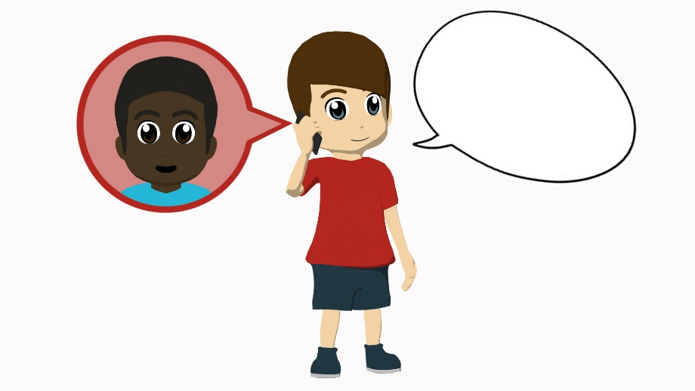
¿GA, GO o GU?
hablar
¿Cuál es el regalo?, pregunta Daniel.
4
“Which is the present?” asks Daniel.

Slide 47
¿GA, GO o GU?
hablar
Tener un gato es algo muy especial.
5
Having a cat is something very special.

Slide 48
vocabulario
Spanish adverbs may come at the start of the sentence.
Nunca come carne.
S/he never eats meat.
Solo come carne.
S/he only eats meat.
 | Word | English meaning
1 | beber | to drink, drinking
2 | comer | to eat, eating
3 | leer | to read, reading
4 | vivir | to live, living
5 | nunca | never
6 | el ejercicio | exercise
7 | la fruta | fruit
8 | la carne | meat
9 | rico | rich, tasty
10 | el agua (f) | water
11 | el hombre | man
12 | a veces | sometimes
vocabulario
60
Segundos
‘Agua’ is a feminine noun, but the article is ‘el’.
This is because ‘agua’ starts with a stressed ‘a’ sound. (Saying ‘a’ twice in a row would be hard!)
0
INICIO
Notes:
Timing: 6 minutes
Aim: to practise with vocabulary from this week’s vocabulary set.
Procedure:
Pupils either work by themselves or in pairs, reading out the words and studying their English meaning (1 minute). Teachers click on the ‘inicio’ button to start the 1 minute timer or can use their own timing device.
Then the English meanings are removed by clicking and students try to recall them, looking at the Spanish (1 minute).
Then the Spanish meanings are removed by clicking and students try to recall them, looking at the English (1 minute)
Further rounds of learning can be facilitated by one pupil turning away from the board, and his/her partner asking him/her the meanings. This activity can work from L2 → L1 or L1 → L2.
After the activity, clicking shows two callouts explaining adverb use in Spanish and ‘el’ agua.
Notes:
Students will need to know that agua is a feminine noun but requires 'el‘. The explanation for this is revealed in a call out.
Word frequency (1 is the most frequent word in Spanish): beber [1085]; comer [347]; leer [209]; vivir [142]; hombre [97]; ejercicio [1162]; fruta [1925]; carne [860]; rico¹ [398]; agua [204]; nunca [158]; a veces [vez-59]
Source: Davies, M. & Davies, K. (2018). A frequency dictionary of Spanish: Core vocabulary for learners (2nd ed.). Routledge: London

Slide 49
Limpia la pizarra
1. to drink / drinking
2. to eat / eating
3. to read / reading
4. to live / living
5. man
6. exercise
7. fruit
8. meat
9. tasty
10. water
11. never
12. sometimes
Notes:
Timing: 3 minutes
Aim: further productive vocabulary practice (from English into Spanish)
Procedure:
Students need to translate the words on the board.
Click on the word when translated correctly and it will disappear.
Turn this into a game – one side of the class plays against the other to see who can get the fastest time. The teacher chooses students to answer. Students need to say the number of the word they are translating.
Notes:
Students have learnt ‘limpiar’ in week 2.2.3. In the title of this activity they will encounter the word in a new context, thus aiding consolidation. Clarify the meaning of ‘pizarra’, if needed.
Word frequency (1 is the most frequent word in Spanish): beber [1085]; comer [347]; leer [209]; vivir [142]; hombre [97]; ejercicio [1162]; fruta [1925]; carne [860]; rico [398]; agua [204]; nunca [158]; a veces [vez-59]
Source: Davies, M. & Davies, K. (2018). A frequency dictionary of Spanish: Core vocabulary for learners (2nd ed.). Routledge: London

Slide 50
hacer
[to do | make]
hace
[s/he does | makes]
Notes:
Timing: 2 minutes (for slides 50-55)
Aim: to consolidate the verb ‘hacer’ more explicitly.
Procedure:
Bring up the word ‘hacer’ on its own, say it, students repeat it, and remind them of the phonics. Draw attention to [ce].
Try to elicit the meaning from the students.
Bring up the English translations and emphasise the two meanings for the infinitive.
Bring up the short form ‘hace’, say it, students repeat it. Draw attention to [ce].
Try to elicit the meaning from the students and emphasise the two meanings for the short form.
Notes:
‘Hacer’ is already known to students (see 2.1.4 in SoW) and behaves like a regular –er verb in the 3rd person singular. It is re-presented here in the infinitive and short form to reactivate students’ knowledge and model the use of both forms in sentences. It also reminds students of this week’s learning focus: infinitive and third person singular –er and –ir verbs.
‘Hacer’ is one of the 25 most frequently used verbs in Spanish. All 25 most frequent verbs will be introduced early on using the same format. Both long form (infinitive) and short form (3rd person singular) are introduced in order to familiarise students with various forms of the same verb.

Slide 51
hacer
[to do | make]
hace
[s/he does | makes]
Notes:
Cycle through the long and short form again.

Slide 52
hace
[s/he does | makes]
Diego hace ejercicio.
[Diego does exercise.]
Notes:
Aim: Introduce the short form in a sentence.
Procedure:
1. Click to go through the verb, the example sentence and translation

Slide 53
hacer
[to do | make]
Quiere hacer ejercicio.
[S/he wants to do exercise.]
Notes:
Aim: Introduce the short form in a sentence.
Procedure:
1. Click to go through the verb, the example sentence and translation

Slide 54
hace
[s/he does | makes]
Diego hace ejercicio.
[Diego does exercise.]
Notes:
Cycle through the short form in context again.

Slide 55
hacer
[to do | make]
Quiere hacer ejercicio.
[S/he wants to do exercise.]
Notes:
Cycle through the long form in context again.

Slide 56
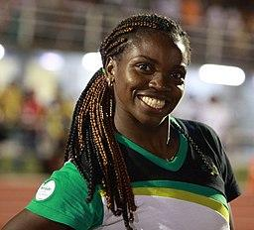
leer
En una revista hablan sobre los hábitos de unas personas famosas.
leer
Some of the verbs are referring to the Colombian athlete Caterine Ibargüen. Which ones are they?
 |  | The action in general | Referring to the athlete
1 | Beber agua es importante.
2 | Vivir fuera de la ciudad es interesante.
3 | Lee periódicos en línea* y es práctico.
4 | Vive entre dos montañas y es perfecto.
5 | Hace ejercicio cada día con otros hombres.
6 | Nunca bebe Coca Cola por la noche.
7 | Comer fruta es bueno.
8 | Leer revistas puede ser informativo.
9 | Hacer deporte es difícil.
10 | A veces come carne. ¡Es una comida rica!
Caterine Ibargüen is a Colombian Olympic gold-winning triple jumper, and was World Athlete of the Year in 2019.
* online
Notes:
Timing: 8 minutes
Aim: reading practice consolidating the difference in meaning between infinitive and 3rd person singular of ‘-er’ (including ‘hacer’) and ‘-ir’ verbs.
Procedure:
Students decide if the sentence refers to the athlete, or a general action.
Click to show the answers in numerical order.
Notes:
The title has been written using previously taught language, except for ‘sobre’. Teachers can clarify the meaning of this word if needed.
Several near-cognates have been included: práctico [2141], perfecto [1115] and informativo [4002]. The main reason for the inclusion of a range of adjectives is to avoid an incongruence between infinitive sentences, which often end in ‘es + adjective’, and the sentences with 3rd person singular. The risk would otherwise be that students rely on this part of the sentence, rather than the verb, to decide on the answer.
Image free from Selecciónantioquia from https://commons.wikimedia.org/wiki/File:Caterine_Ibarg%C3%BCen_-_Atletismo_(3)_(cropped).JPG. This file is free to use under the Creative Commons Attribution-Share Alike 3.0 Unported license.

Slide 57
escuchar / leer
You are listening to a podcast that talks about lifestyle in general and gives info about the athlete you have just read about.
Not all of it has downloaded. Which ending is needed?
escuchar / leer
…un plato rico es caro.
…un plato rico y es caro.
…en el centro y es muy práctico.
…en el centro es muy práctico.
…libros cada día y es interesante.
…libros cada día es interesante.
…la cama es tonto.
…la cama y es tonto.
…agua y es bueno.
…agua es bueno.
…en el este de España es fantástico.
…en el este de España y es perfecto.
…carne roja es malo.
…carne roja y es malo.
…revistas en línea es barato.
…revistas en línea y es barato.
…limonada, pero no es importante.
…limonada no es importante.
…los deberes por la tarde y es normal.
…los deberes por la tarde es normal.
1
6
2
7
3
8
4
9
5
10
Notes:
Timing: 8 minutes
Aim: to help learners understand the difference in meaning between 3rd person singular and the infinitive form whilst recapping ‘es’ in infinitive sentences through listening and reading. Similar sentence types to the preceding reading activity are used.
Procedure:
Teachers click the number button to play the verb (either the infinitive or the 3rd person singular).
Students listen to the verb and decide how the sentence must carry on.
Teachers should stress the importance of reading each of the two options carefully before selecting their answer.
Answers are shown in order by clicking, and teachers can ask students to translate the sentence, supplying the verb that was on the recording.
Transcript
Come
Vivir
Leer
Hace
Bebe
Vive
Comer
Lee
Beber
Hacer
Notes:
The near-cognate ‘práctico’ [2141] was included as an additional adjective.

Slide 58
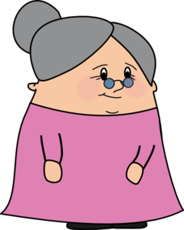
¿Cómo ser feliz?
hablar / escuchar
A friend needs advice! You are telling Agony Aunt ‘Tía Dolores’ about your friend Daniel, who is not happy. You tell her what Daniel does and what you think would be good for him to do.
Student A: tell Tía Dolores what Daniel does and what it’s good for him to do.
Student B: you are Tía Dolores. Listen and write in English:
what Daniel does.
what your friend thinks it’s good for Daniel to do.
Then swap roles. Your cards are different.
Notes:
Timing: 10-12 minutes (for slides 58-62)
Aim: speaking / listening activity to consolidate the use of the infinitive and 3rd person singular
Procedure
Print out the speaking cards downloadable with this powerpoint (these cards are shown on slides 59 and 60, which should not be shown during the activity)
Click through this explanation slide to explain how the activity works. Students use their cards to say what Daniel does (using 3rd person singular), and what is good for him to do (using the infinitive). Student B writes these in English, and then the roles are swapped.
The answers to this activity are shown on slides 61 and 62
Notes:
Since it is not essential to correctly use the infinitive and 3rd person singular to complete the task, the listener should be encouraged to correct the speaker if s/he notices mistakes in use of –er/ –ir infinitive vs –e ending for 3rd person singular.

Slide 59
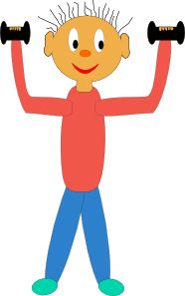
hablar / escuchar
Persona A
hablar / escuchar
What Daniel does. |  |  |  | What it’s good for Daniel to do. (“Es bueno…”)
[never] |  | [sometimes] |  | [every day] |  | [at school]
[red meat] |  |  | [alone] |  |  |  | [with friends]
Notes:
Student A speaking cards (these are also available in Word format)
Do not show during the activity

Slide 60
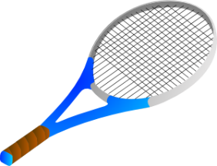
hablar / escuchar
Persona B
hablar / escuchar
What Daniel does. |  |  |  | What it’s good for Daniel to do. (“Es bueno…”)
[never] |  | [sometimes] |  | [at school] |  | [every day]
[big dishes] | [in England] |  |  | [small dishes] | [in Spain]
Notes:
Student B speaking cards (these are also available in Word format)
Do not show during the activity

Slide 61
hablar / escuchar
Student B answers
hablar / escuchar
Daniel does it | It’s good to… (talking in general)
Never does homework | Do homework everyday
Sometimes does exercise | Do exercise at school
Eats red meat | Eat fruit
Drinks Coca Cola | Drink water
Lives alone | Live with friends

Slide 62
hablar / escuchar
Student A answers
hablar / escuchar
Daniel does it | It’s good to… (talking in general)
Never does sport | Do sport at school
Reads sometimes | Read everyday
Eat big dishes | Eat small dishes
Lives in England | Live in Spain
Drinks lemonade | Drink water

Slide 63
Deberes
Vocabulary Learning Homework (Term 3.1, Week 5)
Audio file
Audio file QR code:
Student worksheet
Quizlet link
In addition, revisit: Term 3.1, Week 2
Term 2.2, Week 2
Notes:
Note that vocabulary from 3.1, Week 2, consists of 10 words from the poem ‘hombre sin cabeza’. This aims to support consolidation of the words encountered in that poem. Some of these words are core vocabulary items from other weeks of the Y7 scheme of work (e.g. usar), while others have not yet been taught (e.g. besar).

