Slide 1
Phonics
SSCs [revisited]
Y7 German
Term 3.1 - Week 2
Natalie Finlayson / Rachel Hawkes
Date updated: 19/04/20
Notes:
Learning outcomes (lesson 1)
Consolidation of a selection of SSCs

Slide 2
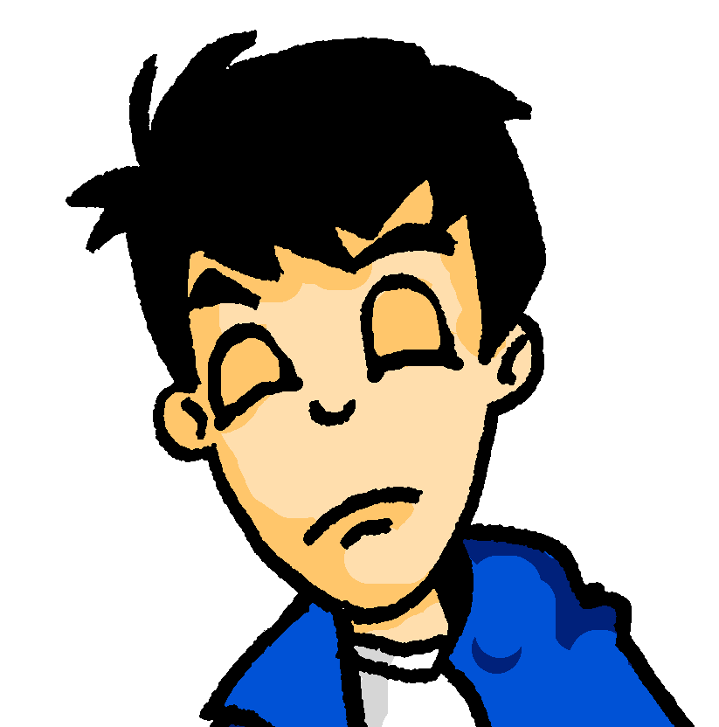
Samstagnachmittag
lesen und hören
Es ist Samstagnachmittag und Wolfgang schläft. Er träumt von …
Kirschen
Kirchen
Notes:
In slides 4-11, students encounter a range of known SSCs contrasted in minimal pairs. By correctly identifying the word they hear, they complete the story of Wolfgang and Heidi’s very different Saturday afternoons. The activity aims to show how a single SSC can change the meaning of a full sentence! Point out to students how differently the story would unfold if they had heard the other SSC instead!
The following SSCs are revisited in this activity: [sch], [ch], short [i], short [e], [ei], [ie], [ü], [u], [äu], [v] and [w].
Students are also encouraged to write short summaries of each slide in English. A range of vocabulary and key grammar points from across terms 1 and 2 are revisited.
Procedure for each slide:
1/ Teacher clicks on the loudspeaker to play the audio.
2/ Students hear one of the options and circle a) or b) to complete the sentence.
3/ Students write a one sentence summary in English (at more advanced levels, the teacher might wish to ask for the summary in German).
4/ The answer is revealed on a click.
5/ Teacher elicits example translations from one or two students.
6/ Teacher elicits oral pronunciation of the other word using “Wie sagt man …” to create the alternative scenario!
Here, SSCs [ch] and [sch] are contrasted.
Teacher to draw attention to compound ‘Samstagnachmittag’ and help students break it down.
Students have encountered träumen [1907] as an SSC cluster word, but not as a vocabulary item. Teacher to remind students of its meaning. Students have not yet met preposition von [11]. Teacher to explain its use here to of mean of.
Frequencies of unknown vocabulary: Kirsche [4034]
Transcript
Kirschen

Slide 3
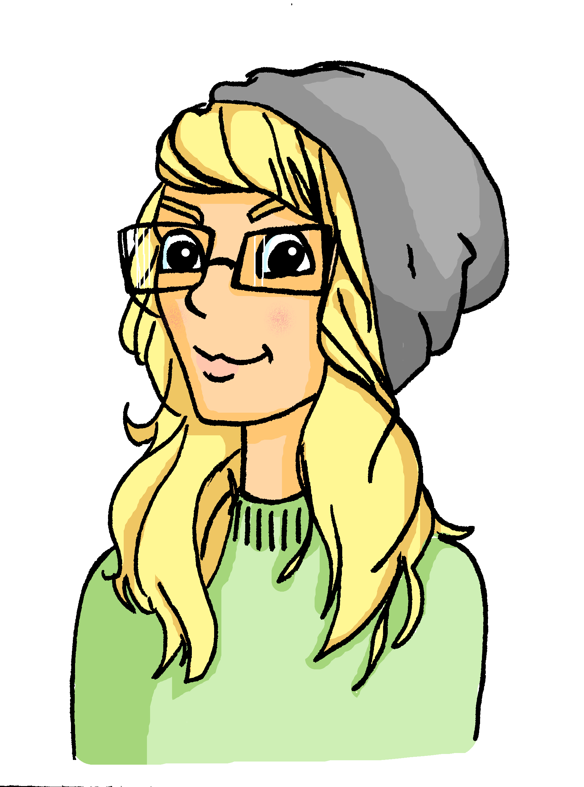
Samstagnachmittag
lesen und hören
Heidi schläft nicht. Am Wochenende ist sie sehr aktiv. Heidi mag Kunst. Sie malt eine(n) …
a) Stirn
b) Stern
Notes:
Here, SSCs short [e] and short [i] are contrasted.
Teacher to draw attention to use of word order 2 in the second sentence, which starts with a time phrase. Before eliciting the English translation, remind students that the time phrase normally appears at the end of the sentence in English.
Students have not yet met the cognate aktiv [859]. Teacher to elicit pronunciation of this word, asking students to draw on their knowledge of SSC [v].
Students have not yet encountered malen [1851]. Teacher to draw attention to the third person form malt, and ask students what the infinitive ‘to paint’ must be.
Frequencies of unknown vocabulary: Stirn [1943], Stern [1446]
Transcript
Stirn

Slide 4
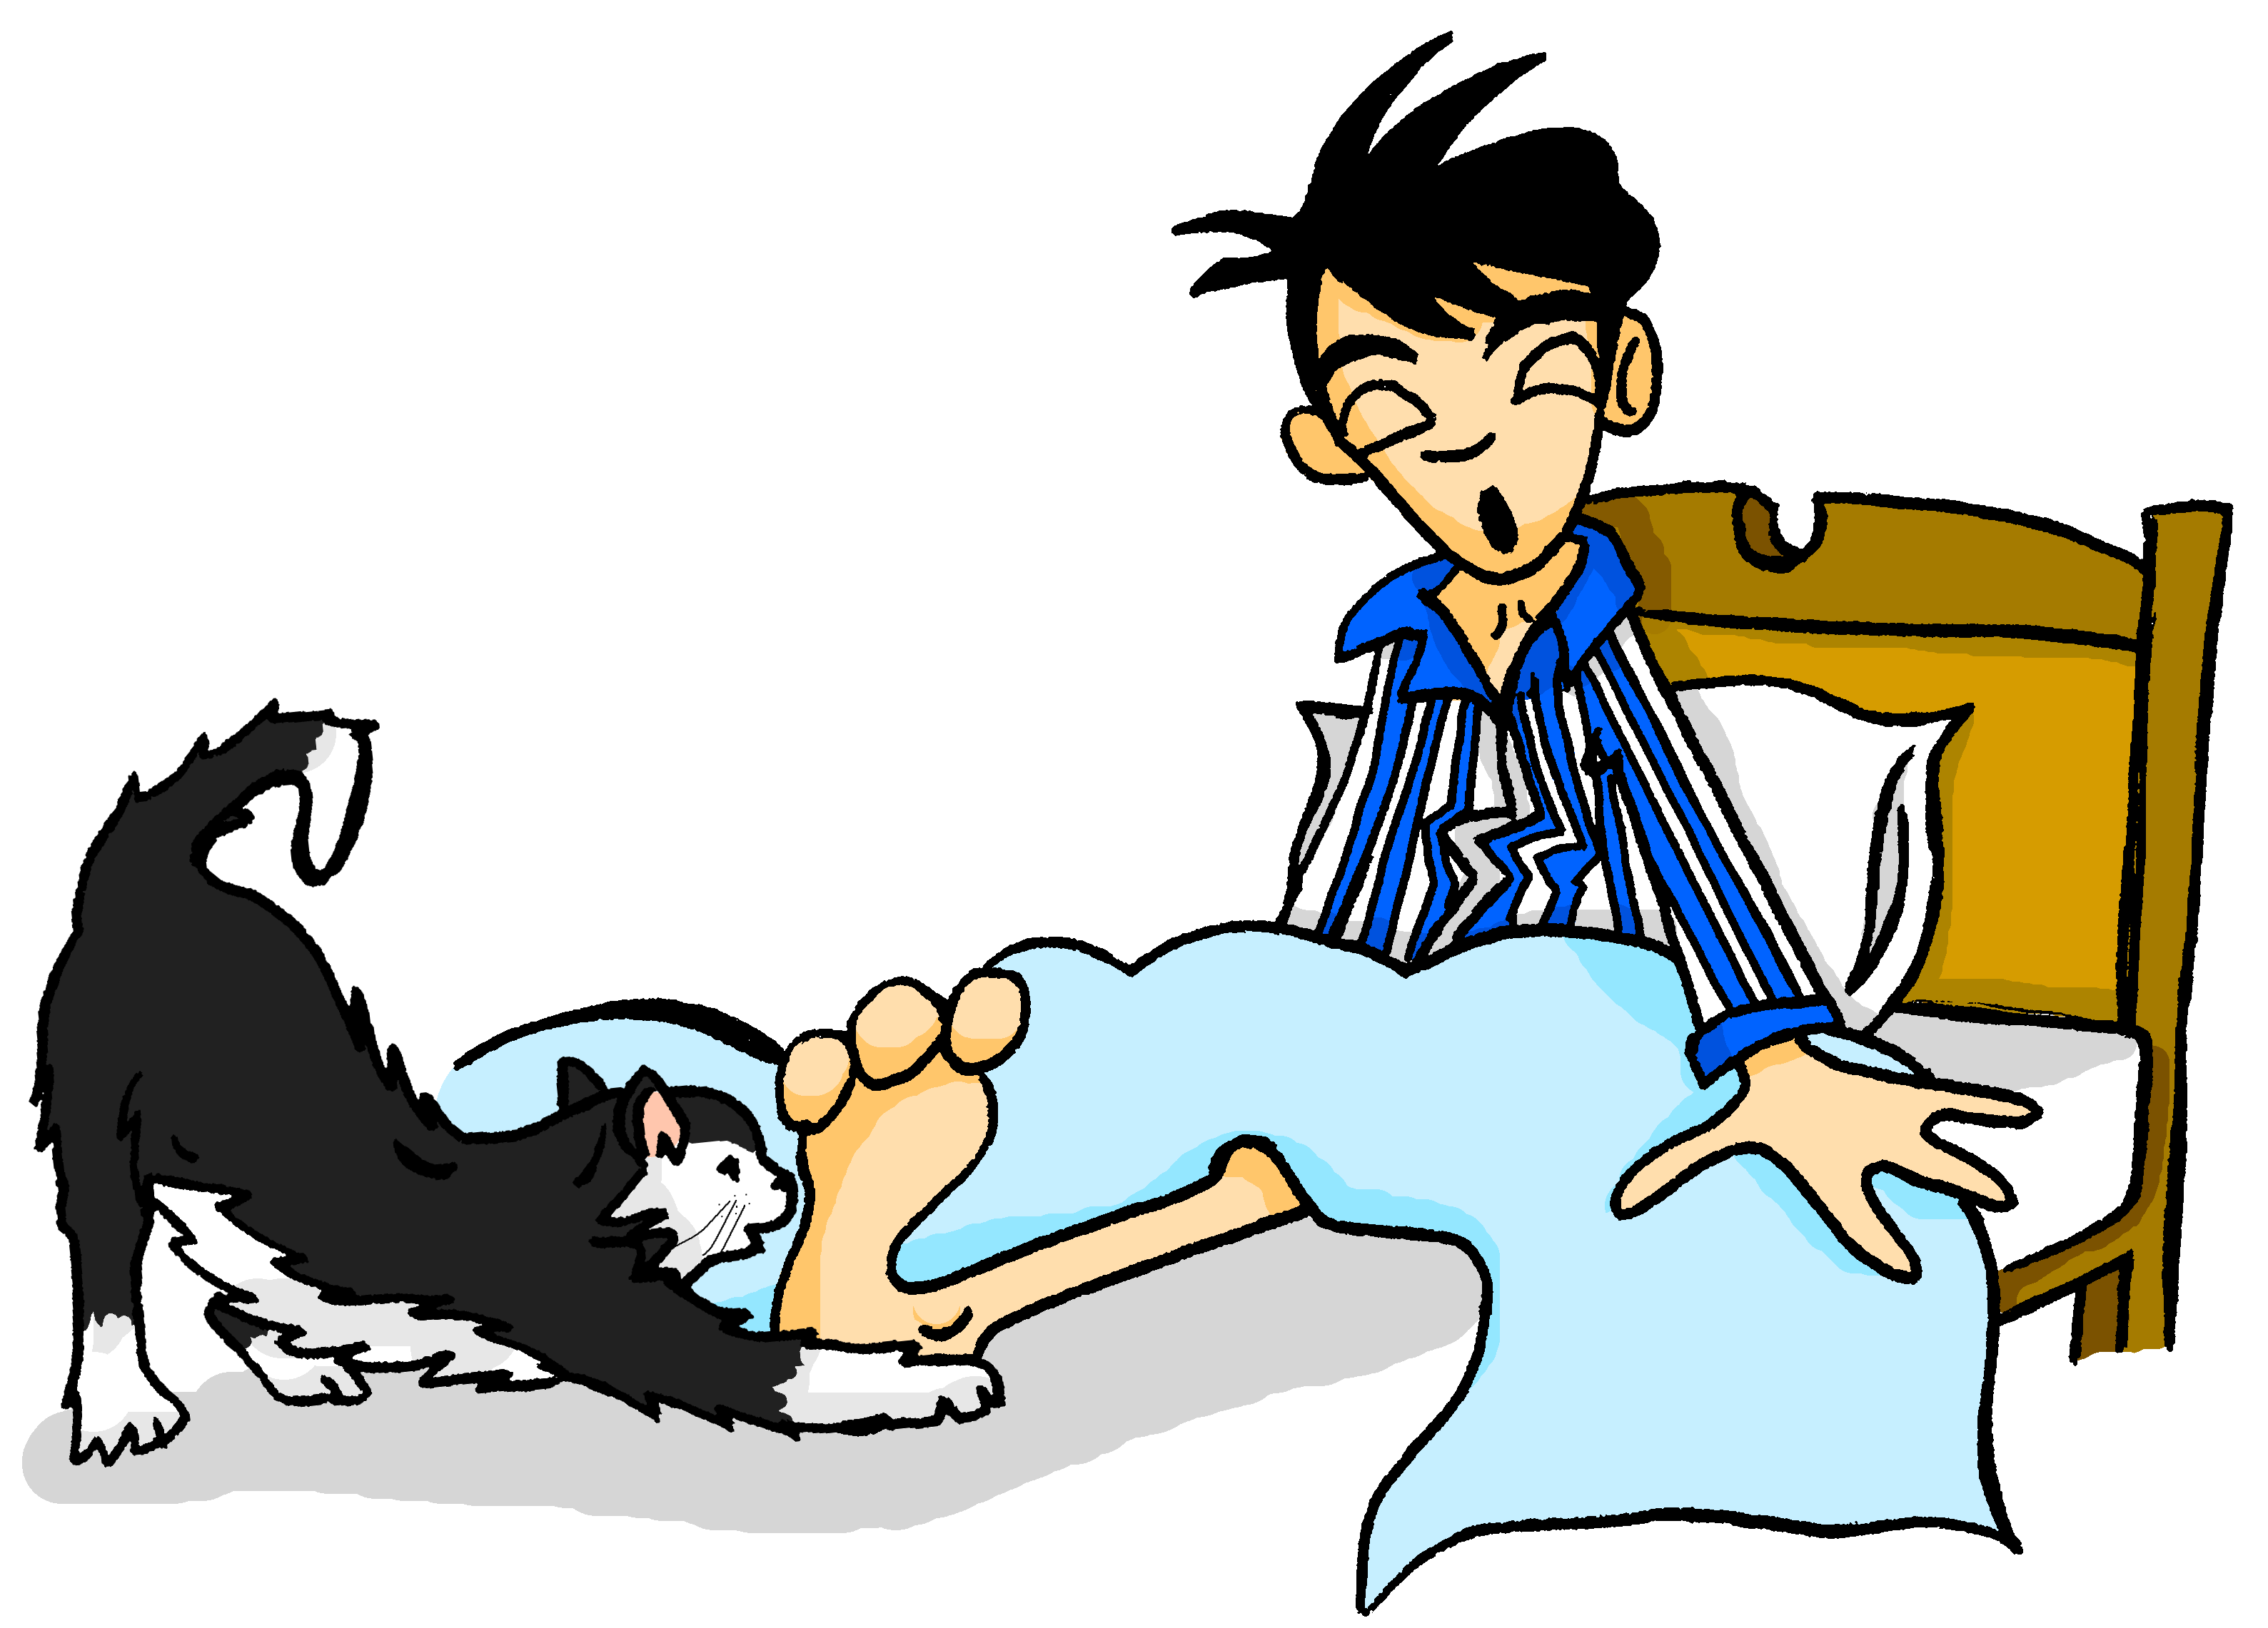
Samstagnachmittag
lesen und hören
Mieze ist auch sehr aktiv. Sie spielt mit Wolfgangs …
a) Beinen
b) Bienen
Notes:
Here, SSCs [ei] and [ei] are contrasted.
Frequencies of unknown vocabulary: Bein [937], Biene [>4034]
Transcript
Beinen

Slide 5
Samstagnachmittag
lesen und hören
Heidi chillt jetzt ein bisschen. Sie liest ein Buch, aber es ist langweilig.
Sie findet ________ nicht so interessant.
a) Kisten
b) Küsten
Notes:
Here, SSCs short [i] and [ü] are contrasted.
Teacher to draw attention to strong verb stem in liest, eliciting the infinitive form and meaning from students.
Students met cognate chillen [>4034] in week 3.1.1.
Students should also be asked to suggest the singular for these plural nouns and their gender. The 3rd plural rule they learnt [1.2.7] - die → (e)n.
Frequencies of unknown vocabulary: Kiste [1943], Küste [1446]
Transcript
Kisten

Slide 6
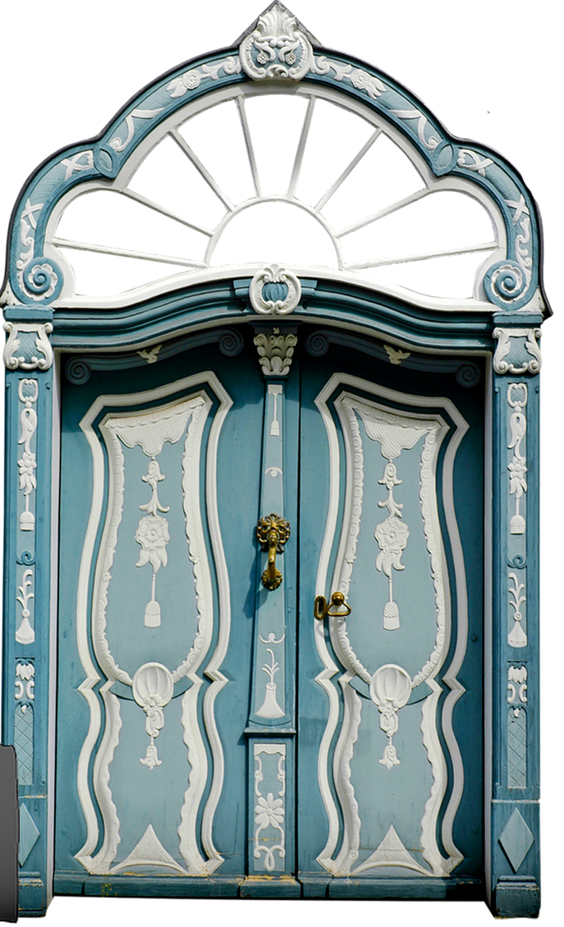
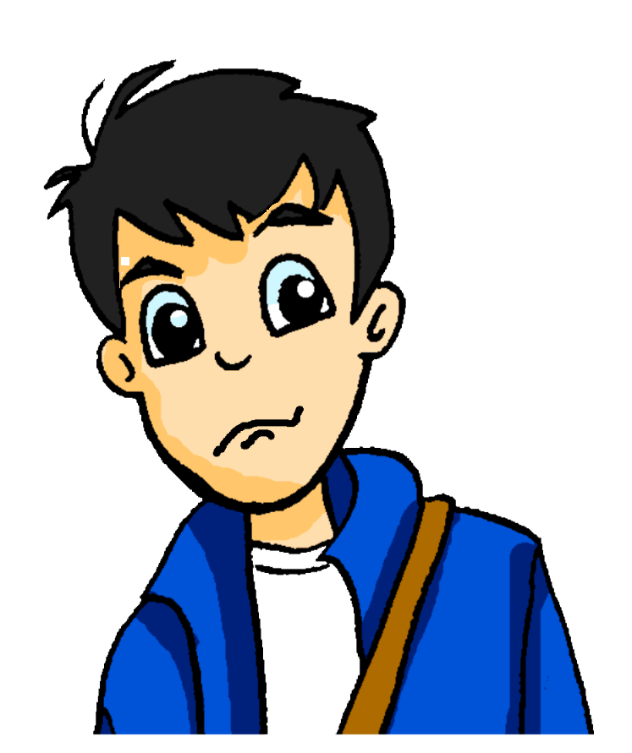
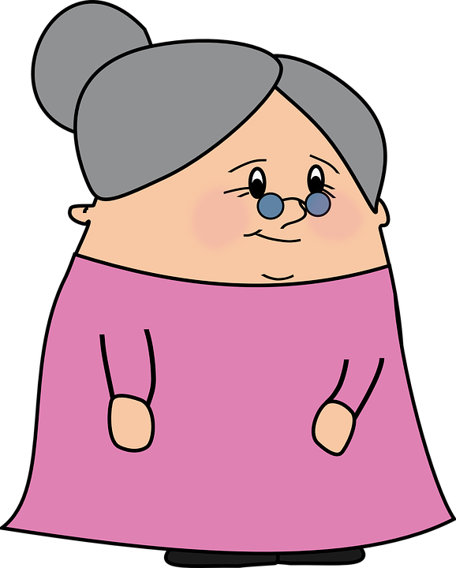
Samstagnachmittag
lesen und hören
Wolfgang hat ein bisschen Angst. Es wird spät, und er hat heute Nachmittag ein Date!
Er sieht Oma im Wohnzimmer. Sie surft im Internet. Sie fragt: „Wolfgang! Wie findest du die …“
a) Tour
b) Tür
Notes:
Here, SSCs [u] and [ü] are contrasted.
Teacher to draw attention to the strong verb stems in sieht and wird, eliciting the infinitive form and meaning from students.
Teacher to students how they might translate ‘es wird spät’ - ‘it is getting late’ in English, rather than becoming
Teacher to point out cross-linguistic differences in punctuation conventions (speech marks)
Students have not yet met the cognate surfen [>4034]. Teacher to elicit pronunciation of this word, asking students to draw on their knowledge of SSC [s-].
Frequencies of unknown vocabulary: Tour [2474]
Transcript
Tür

Slide 7
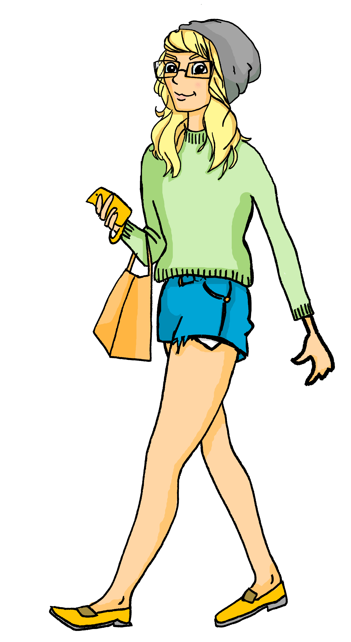
Samstagnachmittag
lesen und hören
Heidi geht ganz relaxt in den Park. Wolfgang kommt in zehn Minuten.
Sie bleibt ein Moment stehen, und sieht einen/eine …
a) Berg
b) Burg
Notes:
Here, SSCs short [e] and [u] are contrasted.
Students have not yet met cognates relaxen [>4034] or Moment [383]. They have met cognate Minute [360] as an SSC cluster word.
Frequencies of unknown vocabulary: Berg [1134], Burg [2984]
Transcript
Burg

Slide 8
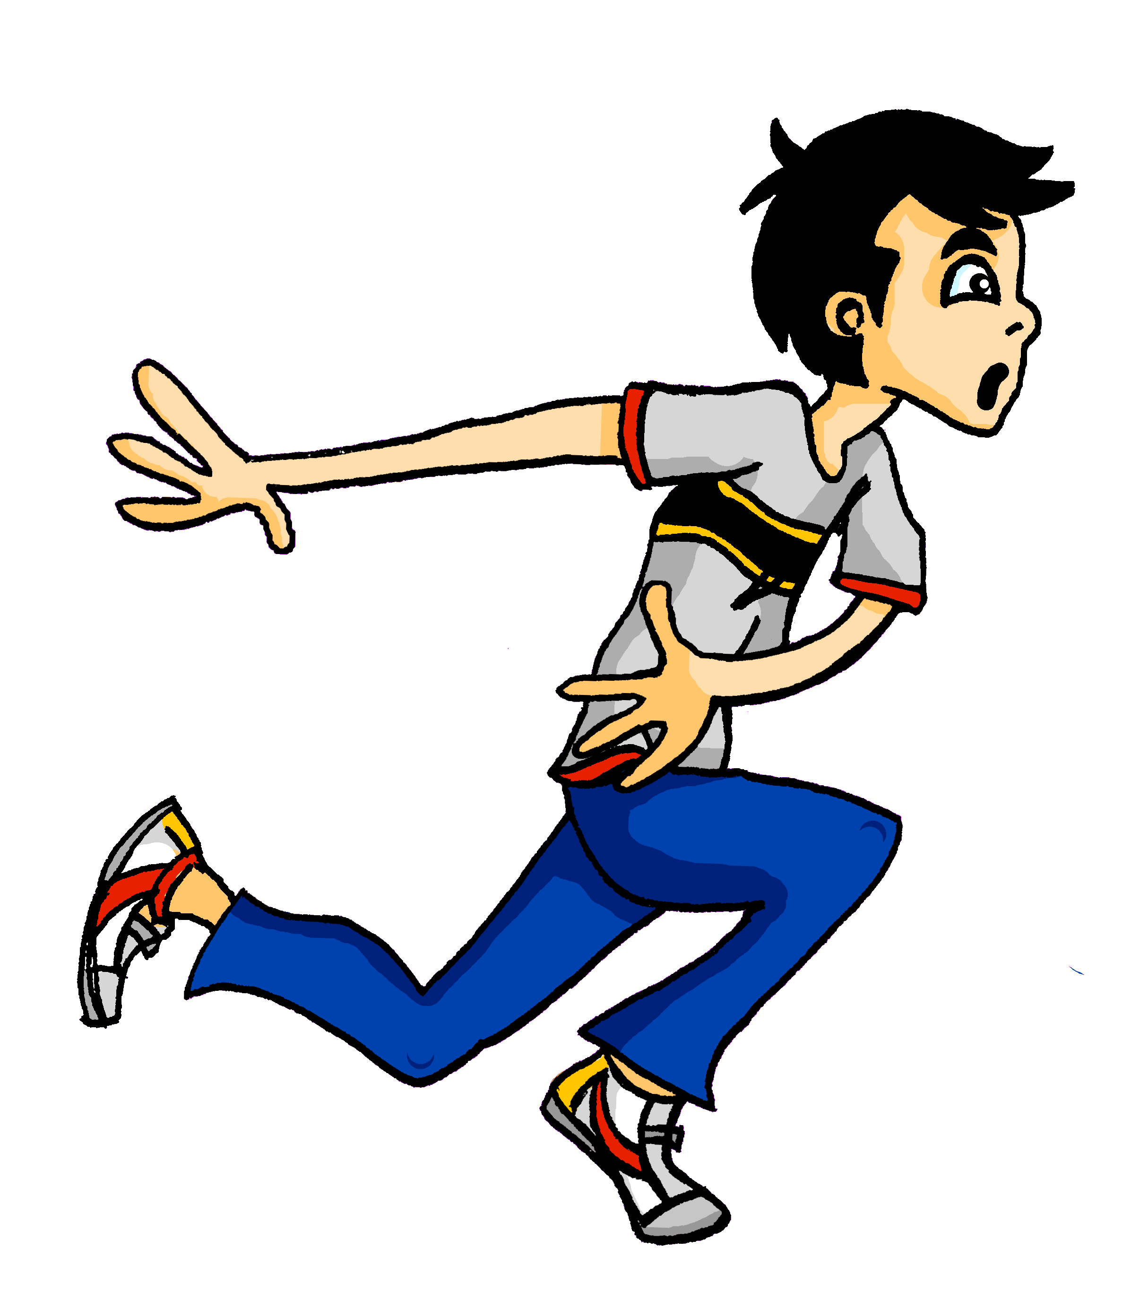
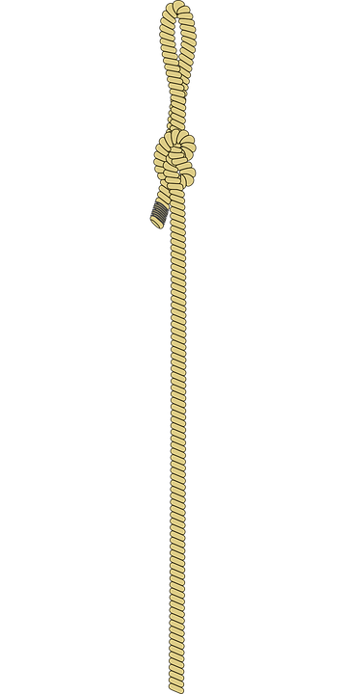
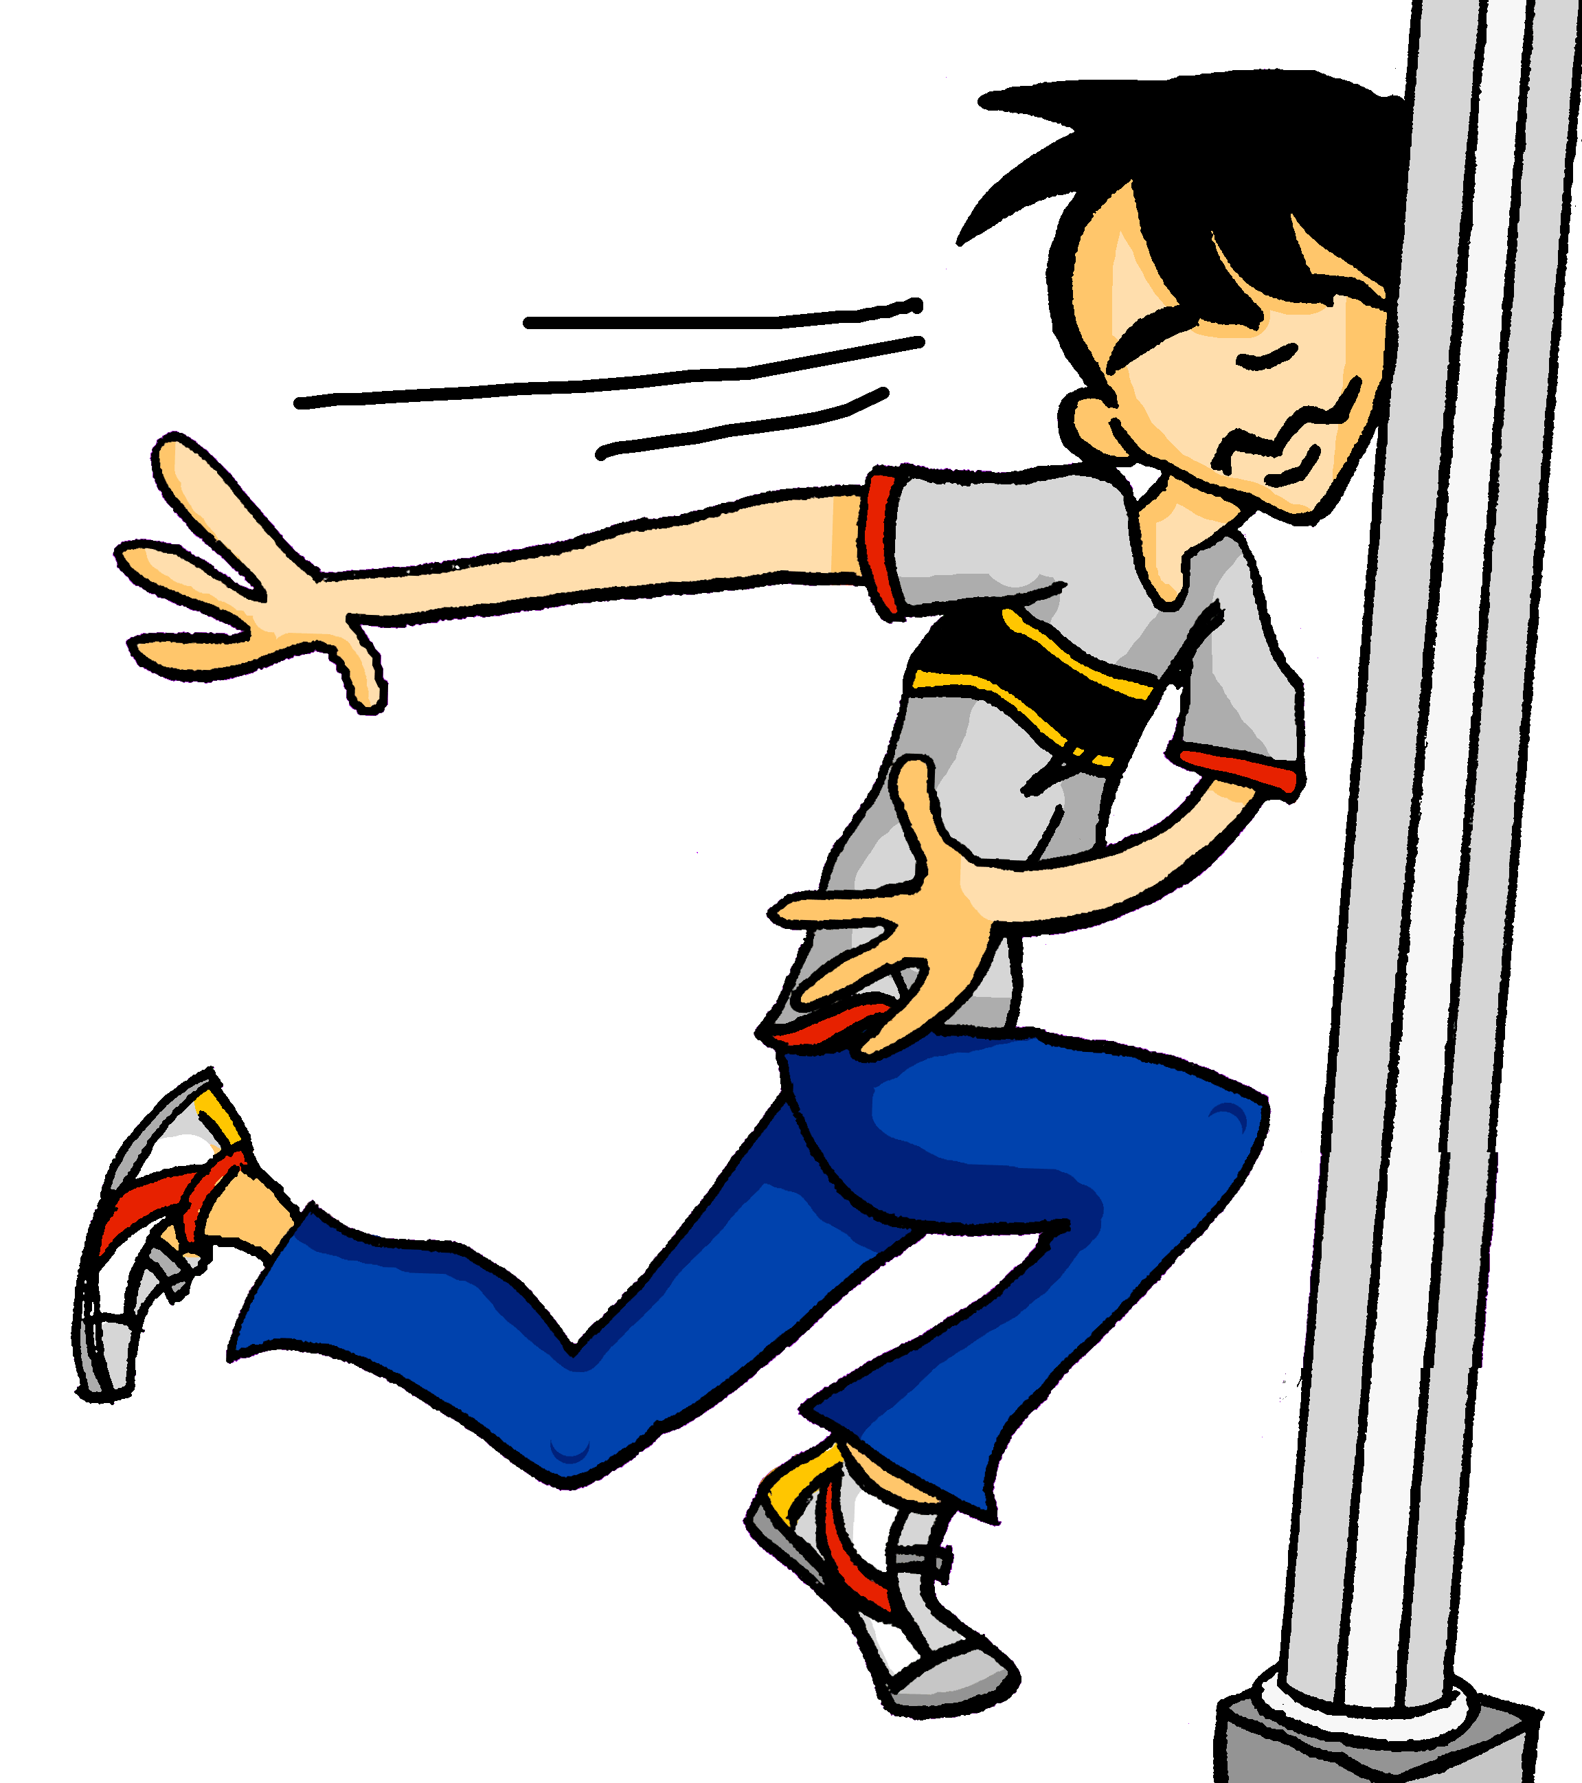
Samstagnachmittag
lesen und hören
Wolfgang ist im Stress. Er läuft in den Park. Leider sieht er nicht die …
a) Seile
b) Säule
Notes:
Here, SSCs [ei] and [äu] are contrasted.
Teacher to draw attention to the strong verb stem in läuft, eliciting the infinitive form and meaning from students. Students have not yet been taught ‘in’ and its use with/without movement, but this will be taught next week. The use of ‘den’ here will not be a barrier to understanding, as students know its meaning.
Students have not yet met the cognate Stress [2566]. They will need some guidance with pronunciation, as they have not yet encountered SSC [st-]. This is the SSC for next week.
Frequencies of unknown vocabulary: Seil [>4034], Säule [3778]
Transcript
Säule

Slide 9
Samstagnachmittag
lesen und hören
Jetzt hat Heidi ein bisschen Angst. Wo ist Wolfgang?
Sie telefoniert mit Wolfgang. Er sagt: „Jaaa … ich brauche eine …“
a) Weile
b) viele
Notes:
Here, SSCs [w] and [ei] are contrasted with SSCs [v] and [ie].
Teacher to draw attention to use of word order 2 in the first sentence, which starts with a time phrase. Before eliciting the English translation, remind students that the time phrase normally appears at the end of the sentence in English.
Students have not yet met cognate telefonieren [3352].
As no pictures are provided here, teacher to elicit meaning by asking students what English word Weile sounds like.
Frequencies of unknown vocabulary: Weile [1807]
Transcript
Weile

Slide 10
Heidis Shoppingliste
Was braucht Heide? Ordne die Dinge zu!
Zahnbürste
_
Pilze
Osterhase
_
_
s/z
s
z
Seife
_
Sonnenschutz
_
_
Salz
_
_
_
_
Säge
_
Zelt
_
Zitrone
_
Notes:
This phonics exercise contrasts two SSCs which were not revisited above - [s] and [z].
Students sketch the Venn-diagram in their answer books, listen to the pronunciation of these unknown words, and assign each to the appropriate part of the diagram.
Audio plays on clicking the images.
Answers are revealed (clockwise) on clicks, starting with Zahnbürste and finishing with Pilze
Frequency values of words used: Zahnbürste [2449/>4034], Osterhase [>4034], Sonnenschutz [953/1094], Säge [>4034], Zitrone [>4034], Zelt [2969], Salz [2437], Seife [>4034], Pilz [>4034]

Slide 11
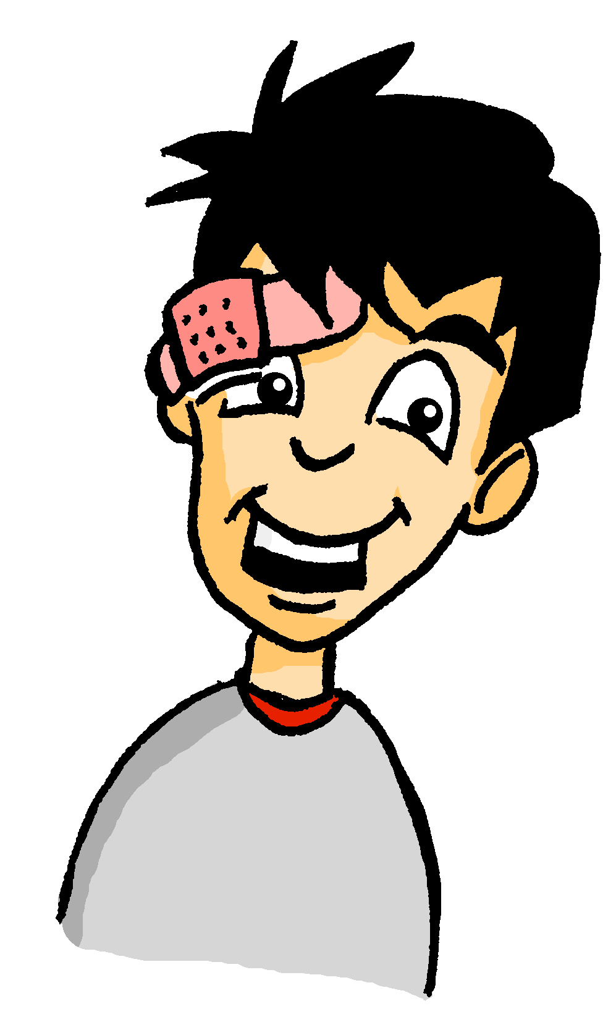
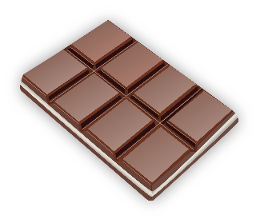
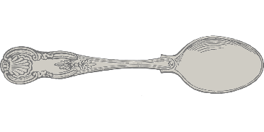
Wolfgangs Shoppingliste
Schokolade
_
_
Und was braucht Wolfgang? Ordne die Dinge zu!
Löffel
_
Brötchen
_
o/ö
o
ö
Knöpfe
_
Kopfhörer
_
_
Socken
_
Tomaten
_
Sonnenbrille
_
Olivenöl
_
_
Notes:
This phonics exercise contrasts for SSCs which were not revisited above - long [o], short [o], long [ö] and short [ö].
Students sketch the Venn-diagram in their answer books, listen to the pronunciation of these unknown words, and assign each to the appropriate part of the diagram.
Audio plays on clicking the images.
Answers are revealed (clockwise) on clicks, starting with Schokolade and finishing with Löffel.
During the feedback, teacher could break down the word Kopfhörer, asking students which noun and verb they recognise in the compound.
Frequency values of words used: Schokolade [>4034], Socke [>4034], Knopf [>4034], Tomate [>4034], Olivenöl [>4034], Sonnenbrille [953/3423], Löffel[>4034], Kopfhörer [279/1557], Brötchen [>4034]

