Slide 1
The National Centre for Excellence for Language Pedagogy (NCELP) Linking research on language learning and teaching with classroom practice
Presentation to the Association for Language Learning’s Initial Teacher Education and Training SIG.
2 July 2019. York St. John University.
Professor Emma Marsden, Director NCELP
University of York
Notes:
NCELP – soft C as in Centre

Slide 2
Today’s talk
Reasons for NCELP’s beginnings
What is NCELP and what is it doing?
Approach to pedagogy
Phonics
Vocabulary
Grammar
Meaningful practice
Where next for NCELP & research into FL pedagogy?

Slide 3
Part 1: Some of the reasons behind NCELP’s beginnings

Slide 4
The logic that is driving NCELP’s activities: Promoting intrinsic motivation
Improve pedagogy (something that is within our powers)
Helps language development
Gives learners sense of progression, improves self-efficacy
Increases intrinsic motivation
Increases numbers studying languages at GCSE

Slide 5
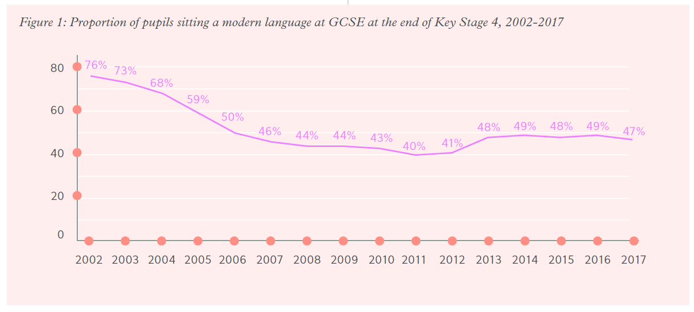
Percentage of pupils sitting a FL GCSE, 2002-2017
Just one third 16-year olds achieves at least a Grade 4 (= low pass grade C)
In 1/3 state schools, the majority drop a language aged 13 (starting GCSEs one year earlier)
Tinsley & Doležal (2018). Language Trends Survey using data from DfE SFR01.2018 tables S2a and b, S7b, S8b, S9b and LA6

Slide 6
School inspectors’ report (2015): ‘Key Stage 3: The Wasted Years’
”Achievement was not good enough in just under half of the MFL classes observed, two-fifths of the history classes and one third of the geography classes. It is no surprise, therefore, that there is low take-up in these subjects at GCSE. Some pupils told inspectors that they were not taking these EBacc subjects at Key Stage 4 because they did not enjoy them or had found them difficult at Key Stage 3, particularly MFL. A small number made an explicit link between their choices and the quality of teaching that they had received at Key Stage 3. This is a serious concern given the government’s ambition for all pupils starting Year 7 in September 2015 to take the EBacc subjects when they reach their GCSEs in 2020.”
Premise: poor motivation is due, in part, to poor pedagogy

Slide 7
Some evidence about links between pedagogy and motivation
Perceptions of ‘ease’ and sense of ‘achievement following effort’ lead to increased motivation
Graham (2004)
Just telling learners “FLs are useful” does not influence uptake;
perceptions of lessons, ‘ease of learning’ and personal relevance count the most
Taylor & Marsden (2014) OASIS summary
Not being able to ‘sound out’ words is de-motivating
Erler & Macaro (2012) OASIS summary

Slide 8
Articulating a generalizable pedagogy
“teacher cognition” exists and can change
Classroom practice is not all ‘implicit’ or ‘natural’
It has a knowledge base
Research-informed reflection links to professional enrichment
A role for research in articulating & changing pedagogy
But research is difficult to:
Get hold of (paywalls!)
Get time to read!
Get training to understand!
Borg, 2010 & 2015; Kasprowicz & Marsden, 2017
Contra Medgyes, 2017

Slide 9
But teachers and teacher educators overwhelming told us they wanted to know about research
(Marsden& Kasprowicz, 2017)

Slide 10
research-led, teacher-informed, co-delivered professional development and resources.
Specialist Teachers deliver training to four hub schools. Via Monthly Teacher Research Groups, lesson observation & discussion, resource creation, annual Hub conference
NCELP delivers monthly half days CPD on research & resource to Specialist Teachers
NCELP residential for Specialist Teachers
Part 2:
What is NCELP and what is it doing?

Slide 11
NCELP’s beginnings
Teaching Schools Council Report, Nov 2016
Review chaired by Ian Bauckham
DfE Invitation to Tender for Centre for Excellence, June 2018
Awarded, September 2018
Centre began, December 2018

Slide 12
NCELP team
Research and CPD specialists
Prof Suzanne Graham (University of Reading) KS2-3 transition, literature, meaningful practice Dr Rowena Kasprowicz (University of Reading) KS2 knowledge about language, grammar René Koglbauer (University of Newcastle) School FL policy, leadership training, CALL David Shanks (Harris Federation) School FL policy, CALL, differentiation Dr Robert Woore (University of Oxford) Teaching and learning phonics, reading, vocabulary
Director: Prof Emma Marsden (University of York)
Co-Director: Dr Rachel Hawkes (Comberton Academy Trust)
Resource developers
Dr Inge Alferink Nick Avery
CPD providers
Victoria Hobson Stephen Owen
Management and administration
Ann Mannion, Heather Bradley, Wendy Burns
Tech team for Gaming Grammar
Andy Wood Dr Nick Sephton
Tech team, Resource Portal
Dr Frank Feng Dr Sebastian Pelucha

Slide 13
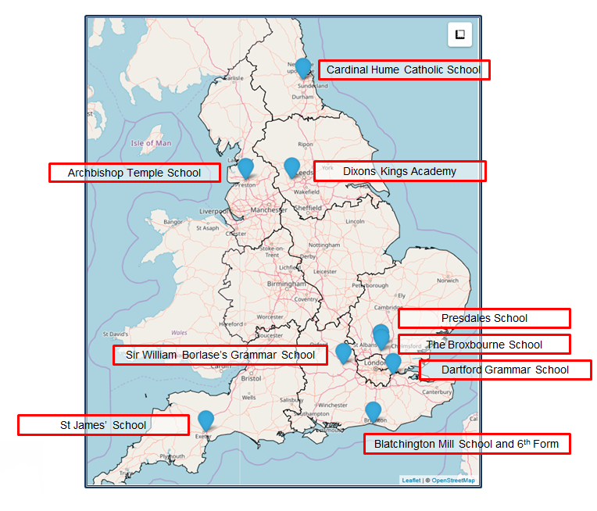
The Nine Lead Schools
Working with 9 Hubs:
9 Lead Schools each with 4 hub schools
Dartford Grammar School, Dartford
Dixons Kings Academy, Bradford
Presdales School, Ware, Hertfordshire
Sir William Borlase’s Grammar School, Marlow
St James’ School, Exeter
The Broxbourne School, Broxbourne, Hertfordshire
Archbishop Temple School, Preston
Blatchington Mill School and Sixth Form, Hove
Cardinal Hume Catholic School, Gateshead

Slide 14
Part 3: Approaches to pedagogy

Slide 15
Putting classroom FL learning in context…
In your home language:
17,520 hours exposure by age 4
(Roffwarg et al., 1966, cited in Collins & Muñoz, 2016)
Infants hear 2,000 -15,000 words a DAY! (varies with SES)
(Weisleder & Fernald, 2013)
Have 3,000 - 5,000 spoken words before learn to read
= PRACTICE in understanding, interacting, meaning-making
Foreign language in England:
429 hours in KS3 + KS4 combined (ages 11-16)
Learn 4-10 words an hour
Our expectations are VERY high
Conscious learners -> Skill acquisition theory.
General cognitive models of learning
(little reliance on innate linguistic or statistical learning)
short cuts, anyone?!
DeKeyser, 2015 & 2017

Slide 16
Changing conceptualisations: “skills” and “knowledge”
Knowledge Knowledge is what you ‘know and know how to do’
Skills Skill is a performance built on what a person knows … the practice of applying the ‘known’.
Yet, conceptualisations of skills as Reading, Listening, Speaking, Writing can drive:
lesson structure, schemes of work, text book units, and tests

Slide 17
What do we want to teach?
What does it mean to be competent in a language?
Bachman (1990)
Canale & Swain (1980)
Organisational Competence
Grammatical Competence
Textual Competence
Pragmatic Competence
Illocutionary Competence
Sociolinguistic Competence
Morphology
Syntax
Vocab
Phonology/
Graphology
Cohesion
Rhetoric
Functions of language
Register/
Genre / Dialect
NCELP: defining this body of knowledge and providing planned and meaningful practice.

Slide 18
NCELP pedagogy
Pupils need to gain systematic knowledge of the vocabulary, grammar, and sound and spelling systems (phonics) of their new language, and how these are used by speakers of the language. They need to reinforce this knowledge with extensive planned practice and use it in order to build the skills needed for communication. (MFL Pedagogy Review, p.3)
Phonics
Vocabulary
Grammar
Meaningful practice

Slide 19
PHONICS
selection and order of SSC (symbol-sound correspondences)
high-frequency ‘source’ words
staged roll out with more intensive practice activities (and systematic revisiting)
much more time for French
Erler, L. and Macaro, E. (2012) ‘Decoding Ability in French as a Foreign Language and Language Learning Motivation’. The Modern Language Journal, 95(4): 496-518.
Porter, A.M. (2014) An early start to French literacy: Learning the spoken and written word simultaneously in English primary schools. PhD thesis, University of Southampton.
Woore, R. (2007) ‘“Weisse Maus in Meinem Haus”: Using Poems and Learner Strategies to Help Learners Decode the Sounds of the L2’. Language Learning Journal, vol. 35, no. 2, pp. 175-188.
Woore, R. (2009) ‘Beginners’ progress in decoding L2 French: some longitudinal evidence from English Modern Foreign Languages classrooms’. Language Learning Journal, vol. 37, no. 1, pp. 3-18.
Woore, R. (2010) ‘Thinking aloud about L2 decoding: an exploration into the strategies used by beginner learners when pronouncing unfamiliar French words’. Language Learning Journal, vol. 38, no. 1, pp. 3-17.
Woore, R. (2011) Investigating and developing beginner learners’ decoding proficiency in second language French: an evaluation of two programmes of instruction. Unpublished PhD thesis, University of Oxford.
Woore, R. (2014) ‘Beginner learners’ progress in decoding L2 French: transfer effects in typologically similar L1-L2 writing systems’. Writing Systems Research, volume 4(2): 167-189.
Woore, R (2018) ‘Learners’ pronunciations of familiar and unfamiliar French words: what can they tell us about phonological decoding in an L2?’ The Language Learning Journal, 46(4):456-69.
Woore, R., Graham, S., Porter, A., Courtney, L. and Savory, C. (2018) Foreign Language Education: Unlocking Reading (FLEUR) - A study into the teaching of reading to beginner learners of French in secondary school. https://ora.ox.ac.uk/objects/uuid:4b0cb239-72f0-49e4-8f32-3672625884f0

Slide 20
Why teach phonics in a FOREIGN language? (no ready-made sound system to map to symbols!!)
without explicit phonics teaching, decoding (letters to sounds) limited (Woore, 2008)
decoding associated positively with motivation
helps access new written and spoken language autonomously and accurately
supports vocabulary learning
https://resources.ncelp.org/
Research on current FL phonics teaching in England by Robert Woore, Alison Porter

Slide 21
SFC
a
i
eu
e
au
 |  |  |  |  | Francophoniques
dans
je
X
animal
midi
deux
gauche
u
ou
SFE
a
en/an
on
nous
timide
écrire
enfant
Non!
tu
X
ain/in
ê/è
ai
oi
ch
c
train
tête
vrai
voir
chercher
ici
qu
j
tion
ien
un
question
jour
Attention!
bien
un
X

Slide 22
Vocabulary in FL
“Vocabulary to be taught should be informed by frequency of occurrence in the language, and special attention should be paid to common verbs in the early stages... A consequence of not attending to frequency of occurrence in vocabulary choice is pupils realising that they cannot say or understand basic things in the language.”
TSC 2016. Modern Foreign Languages Pedagogy Review. A review of modern foreign languages teaching practice in key stage 3 and key stage 4. (Chair: Ian Bauckham). Teaching Schools Council.
Research by Milton, Meara, Marsden & David, Hacker, Woore on lexical learning in early stages

Slide 23
VOCABULARY
the frequency principle
the verb lexicon
mixed word class vocabulary sets
developing depth (e.g. through information gaps)
Davies, M, & Davies, K.H. (2018). A Frequency Dictionary of Spanish: Core Vocabulary for Learners. Routledge. Häcker, M. (2008). Eleven pets and 20 ways to express one's opinion: the vocabulary learners of German acquire at English secondary schools, The Language Learning Journal, 36:2, 215-226. Jones, R.L. & Tschirner, E. (2006). A frequency dictionary of German: core vocabulary for learners. Routledge. Lonsdale, D. & Le Bras, Y. (2009) A Frequency dictionary for French. Routledge. Marsden, E., & David, A. (2008). Vocabulary use during conversation: a cross-sectional study of development from year 9 to year 13 among learners of Spanish and French. Language Learning Journal, 36(2), 181-198.
Milton, J. (2006). Language Lite? Learning French Vocabulary in School. Journal of French Language Studies, 16,187-205. Milton, J. (2009). Measuring second language vocabulary acquisition. Multilingual Matters Milton, J. (2013). Measuring the contribution of vocabulary knowledge to proficiency in the four skills. Eurosla Monographs Series 2, 57-78. http://www.eurosla.org/monographs/EM02/Milton.pdf
Schmitt, N. (2008). Review Article. Instructed second language vocabulary learning. Language Teaching Research, 12(3), 329–363. https://doi.org/10.1177/1362168808089921 Swan, M. (2008). Talking Sense about Learning Strategies, RELC, Vol 39(2), 262-273.

Slide 24
vocabulary learning and expectations in England
vocabulary knowledge (breadth alone, not even depth or fluency/automaticity) is most important predictor of outcomes
across modes (production & comprehension) and modalities (oral & written).
pre-intermediate learners tend to ‘know’ about 2,000 words
= expected vocabulary size at CEFR Threshold B1 level
1772 words on the AQA Spanish Higher Minimal Core Vocabulary list
excludes cognates and exams MUST test other words.
only about half on board’s list are in most frequent 2,000 words in Spanish language
So, to get top marks, learners actually need nearer 3,000 words
Estimates of how many words pupils have on average at GCSE have been around 1,000 – 2,000
NCELP is helping teachers to determine:
Which words learners need to know; How can words be effectively taught and retained

Slide 25
Mixing word classes – reducing the need to ‘slot and fill’
En la ciudad [in town]
 | Word | Frequency ranking | Part of speech
1 | la plaza | 806 | noun
2 | la iglesia | 437 | noun
3 | el teatro | 605 | noun
4 | ser | 7 | verb
5 | grande | 66 | adjective
6 | pequeño/a | 202 | adjective
7 | estar | 21 | verb
8 | cerca (de) | 1042 | adverb
9 | lejos (de) | 833 | adverb
10 | el museo | 1114 | noun

Slide 26
The ‘grammar debate’ (Should we? How?)
Reason 1) Aims for expressing self-identity, communication, and engaging with culture
rote-learned formulae can be quick win – “il faut que je puisse”
Reason 2) (Mis?) interpretation of communicative teaching and functional syllabuses
hiding a thread of grammar & vocabulary progression, behind ‘topics’
Reason 3) Little access to findings from research on grammar pedagogy
Reason 4) Little top-down direction about ‘what & how’ of grammar pedagogy
“many teachers tend to be uncertain about the place of grammar and its relationship to communication … teachers’ insecurity and confusion about grammar teaching led to them adopting diverse and idiosyncratic policy interpretations and practices”
(Dobson, 2018) (drawing on and citing Liviero 2017 & McClelland, 2018).

Slide 27
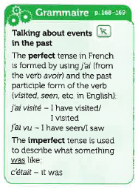
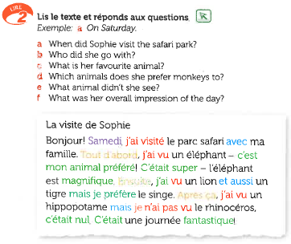
Allez 1 (p. 46)

Slide 28
After 29 weeks = 43 hours of French instruction
plus a few hours at primary school for some children
Pupils were shown two written sentences, with open slots for “friend’s name” and “number of years”
Pupils told:
“This means ‘My best friend is called X. I have known her for Y years’.
Write it down and learn it with the other phrases for the test next week”

Slide 29
After about 15 hours of teaching…

Slide 31
Then, the final task, just add ‘s’…

Slide 32
Grammar in FL
Key recommendations from Pedagogy Review
Provide an explicit but succinct description of the grammatical feature to be taught
Provide practice of the grammar point in ‘input language’ (reading / listening)
Provide practice in productive use of the features being taught
Practice productive use in free writing and speech in a range of contexts
Utilise standard grammatical terminology
Build on knowledge developed at key stage 2

Slide 33
GRAMMAR
verb paradigms (staging / minimal pairs)
input processing
output activities (trapping the forms)
DeKeyser, R. (2005). What makes second-language grammar learning difficult? A review of issues. Language Learning, 55, 1-25. https://doi.org/10.1111/j.0023-8333.2005.00294.x
DeKeyser, R. (2015). Skill acquisition theory. In B. VanPatten & J. Williams (Eds.), Theories in second language acquisition: An introduction (pp. 94–112). London, UK: Routledge.
DeKeyser, R., & Prieto Botana, G. (2015). The effectiveness of processing instruction in L2 grammar acquisition: A narrative review. Applied Linguistics, 36, 290–305. Ellis, N. (2006). Selective attention, and transfer phenomena in L2 acquisition: Contingency, cue competition, salience, interference, overshadowing, blocking, and perceptual learning. Applied Linguistics, 27(2), 164-194. Lichtman, K. (2016). Age and learning environment: Are children implicit second language learners? Journal of Child Language, 43, 707-730. https://doi.org/10.1017/S0305000915000598 Marsden, E. (2006). Exploring input processing in the classroom: An experimental comparison of processing instruction and enriched input. Language Learning, 56, 507–566. Norris, J. & Ortega, L. (2001). Does type of instruction make a difference? Substantive findings from a meta-analytic review. Language Learning, 51, 157-213. https://doi.org/10.1111/j.1467-1770.2001.tb00017.x VanPatten, B. (2002). Processing instruction: An update. Language Learning, 52(4), 755-803.

Slide 34
Practice of the grammar point in ‘input language’
Example: French 1st person present versus past tense with avoir (je vs. j’ai)
Listen to these people talking about what they normally do at the weekend and what they did last weekend. You will hear each sentence twice.
You will hear the whole sentence but the only clue is whether you hear “je” (something happens regularly) or “j’ai” (past).
1. Normalement Le weekend dernier 2. Normalement Le weekend dernier 3. Normalement Le weekend dernier
4. Normalement Le weekend dernier 5. Normalement Le weekend dernier
Removed temporal adverb
and
kept main verb constant
(no phonemic difference between present tense and past participle, e.g. fais vs. fait)
→ Use presence/absence of auxiliary and connect to meaning to identify the tense
(Marsden, 2006)
Notes:
Here is an example of withholding ‘clues’ that can take learner attention away from grammatical structure and enable them to get at the meaning through other means – e.g. the time phrase as in this example
Can be applied to a very wide range of grammatical systems, both morphology and syntax, including S V inversion, verb 2nd

Slide 35
Meaningful practice
Planned (SoW!)
Revisited (SoW!)
Making language ‘task essential’
connect grammar in input & production to function
making listening essential during pairwork
Practice in different modalities and modes
Integrating ‘skills’ (dictogloss)
Using, adapting and creating challenging texts, e.g. literature
Notes:
NCELP have also created production activities that TRAP the form – make it essential.
This draws on a huge body of research about task design to help teachers design tasks that really try to coerce (elicit) certain forms. The aim is to avoid mechanical repetition that doesn’t require active choice of grammar or vocabulary, and that doesn’t force recall of specific grammar.
We are also selecting and developing classroom-ready ‘challenging texts’.

Slide 36
https://ncelp.org/

Slide 37
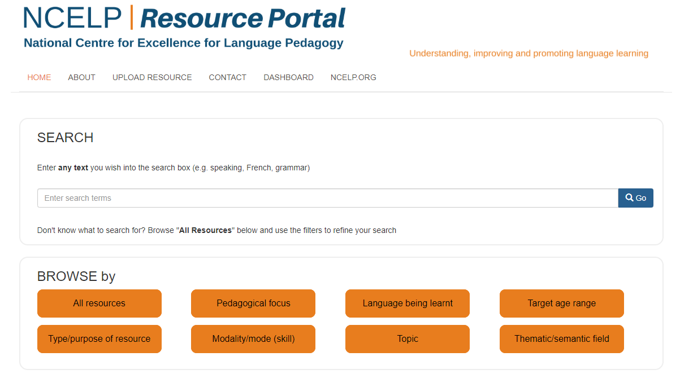
https://resources/ncelp.org/
Notes:
Fully searchable and has all of the CPD ppts that have been delivered, all of the rationale documents mentioned, and all of the resources.
This is all freely accessible to any teacher, any school, not just those involved in the project.

Slide 38
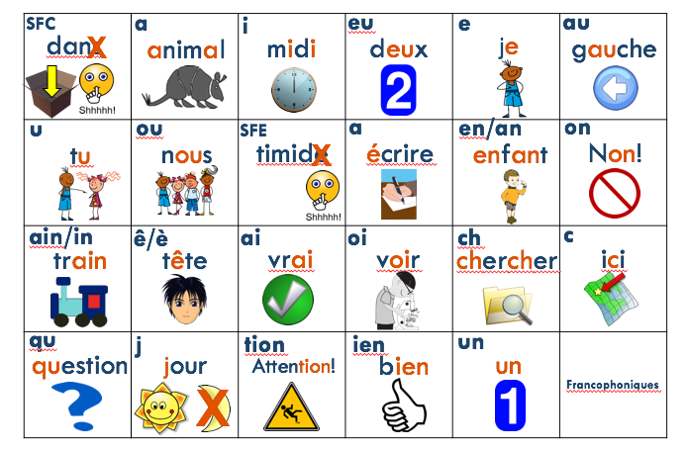
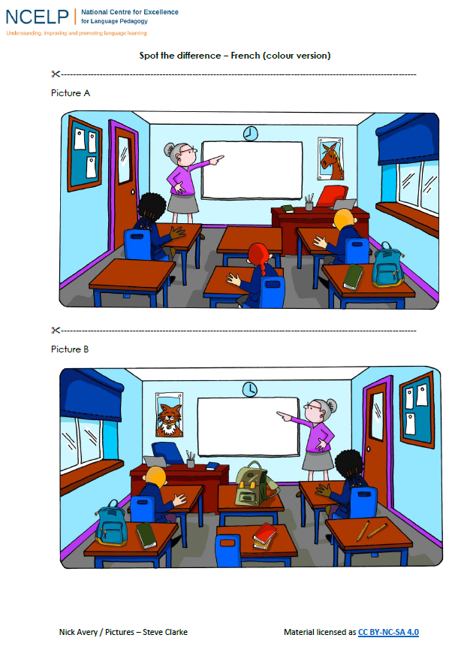
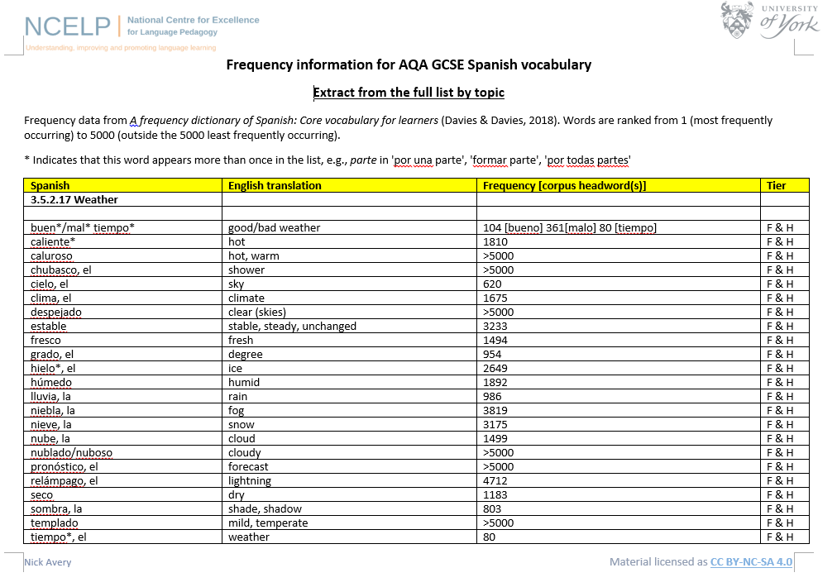
Notes:
Many of the resources that are on our database are linked to summaries of relevant research. Of course, the summaries do not provide a direct link – they provide an opportunity for teachers to reflect on some of the evidence informing the resources.

Slide 39
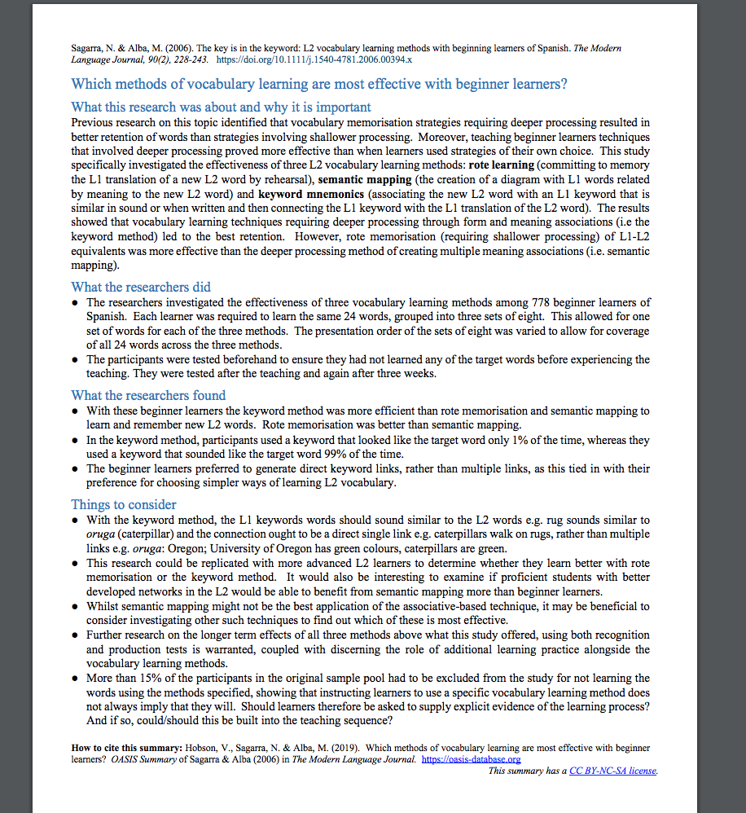
OASIS: https://oasis-database.org
Open Accessible Summaries in Language Studies
Want to be alerted about NEW summaries every month?
Sign up in 10 seconds at https://tinyurl.com/oasisalerts
One page, non-technical, openly accessible summaries of high quality peer-reviewed, international research
among many others
Notes:
OASIS is a searchable database (continually growing) of one page summaries of research studies. They are interesting and quick to read. You can read 5 in the time it takes to drink a big mug of tea!
3 journals make it obligatory for every article to have a summary – so that’s 90 articles are year reaching a wider audience that used to just be shared with academics, essentially.
Many other journals support the initiative – asking their authors to write summaries.

Slide 40
Next steps for NCELP:
Summer 2019
Schemes of Work
Full day hubs, each with 10 extra schools
Autumn term 2019
Autumn Residential (Oxford)
Motivations to learn
Online grammar digital game, with individualized feedback
Using rich and challenging texts – literature
Use of the target language
Technology for learning vocabulary, especially for differentiation
Spring term 2020
Error correction
KS2-3 transition
Knowledge of grammar brought from primary school

Slide 41
Research needed
Current DfE success criteria:
Effects on uptake (motivation)
Developing teacher confidence following engagement with research
Teacher’s perceptions of usefulness of NCELP resources
What words do children really need to know?
Our understanding of which words are useful currently has to be based on word frequencies taken from first language (largely adult) corpora
(formality, register appropriate?)
Drawing on knowledge of English brought from primary school
Establishing a ‘test to teach to’ (Ofqual) for oral production
Data on learning of phonics, vocab. & grammar

Slide 42
References (for those without links to OASIS summaries)
Bachman, L. (1990) Communicative language ability in Bachman, L. Fundamental Considerations in Language Testing, Cambridge University Press, chapter 4, pp. 81-109
Canale, M. & Swain, M. (1980). Theoretical bases of communicative approaches to second language teaching and testing. Applied Linguistics, 1, 1-44.
Collins, L., & Muñoz, C. (2016). The foreign language classroom:Current perspectives and future considerations. The Modern Language Journal, 100(1), 133-147.
DeKeyser, R. (2015). Skill acquisition theory. In B. VanPatten & J. Williams (Eds.), Theories in second language acquisition: An introduction (pp. 94-112). London: Routledge.
DeKeyser, R. (2017). Knowledge and skill in ISLA. In S. Loewen and M. Sato (Eds.), Routledge Handbook of Instructed Second Language Acquisition (pp. 15–32). London: Routledge.
Graham, S. J. (2004) Giving up on modern foreign languages? Students' perceptions of learning French. The Modern Language Journal, 88 (2). pp. 171-191
Maley, A. 2016. ‘“More research is needed”—a mantra too far?’. Humanising Language Teaching 18/3. Available at http://www.hltmag.co.uk/jun16/mart01. htm#C12 (accessed on 15 May 2017).
Medgyes, P., 2017. The (ir)relevance of academic research for the language teacher. ELT Journal, 71(4), pp.491-498.
Roffwarg, H. P., Muzio, J. N., & Dement, W. C. (1966). Ontogenetic development of the human sleep dream cycle. Science, 152, 604–618.
Weisleder, A & Fernald, A. (2013) Talking to children matters: Early language experience strengthens processing and builds vocabulary. Psychological Science 24 i11, 2143-2152

Slide 43
Foreign languages at GCSE … for all ?
Regional and socio-economic inequality of language learning
Improving social mobility through education:
“Unlocking talent; Fulfilling potential” (Government policy paper, Dec 2017)
“Ensure that disadvantaged pupils can access the core academic subjects that unlock opportunity … In particular, we will make it our mission to improve access to high quality modern foreign languages subject teaching, particularly for disadvantaged pupils, drawing on the findings of the Teaching Schools Council review by Ian Bauckham – building expert hubs to share best practice, targeted in disadvantaged areas.”
Tinsley, T. & Doležal, N. (2018). Language Trends Survey
Teaching and Learning Council (2016) Modern Foreign Language Pedagogy Review
Notes:
Another key driver behind the DfE investment in MFLs is the ambition of 75% EBacc [suite of subjects that includes an FL] take-up by 2022, on route to 90% by 2025. To reach this, we will be introducing targeted support for schools to encourage take-up and increase the supply of EBacc subject teachers where it is most needed, spreading access to these core enabling subjects to the pupils and areas that have been denied these opportunities for too long”

