Slide 1
Talking about what you did and have done
adverb placement in the perfect tense
SSCs [th], [ch] and [qu]
Y8 French
Term 3.2 - Week 5 - Lesson 67
Amber Dudley / Catherine Morris / Catherine Salkeld
Artwork by: Chloé Motard
Date updated: 09/07/21
Notes:
Artwork by Chloé Motard. All additional pictures selected are available under a Creative Commons license, no attribution required.
Native speaker feedback provided by Sarah Brichory.
With thanks to Rachel Hawkes and Emma Marsden for their input on the lesson material.
Learning outcomes (lesson 1):
Consolidation of SSCs [th], [ch] and [qu]
Consolidation of adverb placement in the present tense
Introduction of adverb placement in the perfect tense
Word frequency (1 is the most frequent word in French):
8.3.2.5 (revisit) commencer [139], bibliothèque [2511], expliquer [252], emprunter [1268], quitter [507], cours [169], fois [49], tâche [887], déjà¹ [58], enfin [349], toujours [103]
8.3.1.5 (revisit) décrire [1176], traduire [1125], communauté [558], culture [913], expérience [679], information [317], produit [373], programme [340], tout¹, tous¹ [24]
8.2.2.2 (revisit) finir [583], nourrir [1261], chat [3138], dimanche [1235], heure [99], jeudi [1112], lundi [1091], mardi [1044], mercredi [1168], minute [375], vendredi [1086]
Source: Londsale, D., & Le Bras, Y. (2009). A Frequency Dictionary of French: Core vocabulary for learners London: Routledge.
The frequency rankings for words that occur in this PowerPoint which have been previously introduced in NCELP resources are given in the NCELP SOW and in the resources that first introduced and formally re-visited those words.
For any other words that occur incidentally in this PowerPoint, frequency rankings will be provided in the notes field wherever possible.

Slide 2
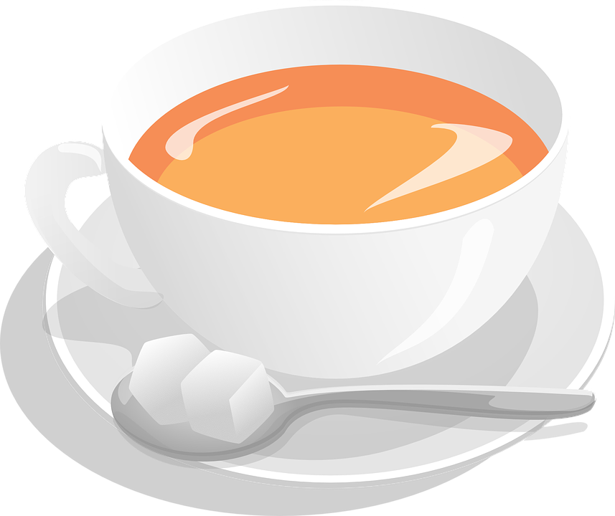
th
thé
Notes:
Timing: 1 minute [2 slides]
Aim: To consolidate SSC [th]
Procedure: 1. Present the letter(s) and say the [th] sound first, on its own. Students repeat it with you. 2. Bring up the word ”thé” on its own, say it, students repeat it, so that they have the opportunity to focus all of their attention on the connection between the written word and its sound.
3. A possible gesture for this would be to mime drinking tea. 4. Roll back the animations and work through 1-3 again, but this time, dropping your voice completely to listen carefully to the students saying the [th] sound, pronouncing ”thé” and, if using, doing the gesture.
Word frequency (1 is the most frequent word in French):
thé [3517]
Source: Londsale, D., & Le Bras, Y. (2009). A Frequency Dictionary of French: Core vocabulary for learners London: Routledge.

Slide 3
th
théâtre
bibliothèque
sympathique
thé
maths
[nice]
méthode
[method]
Notes:
Aim: To consolidate SSC [th]
Procedure:
Introduce and elicit the pronunciation of the individual SSC [th] and then the source word again ‘thé’ (with gesture, if using). Then present and elicit the pronunciation of the five cluster words. The cluster words have been chosen for their high-frequency, from a range of word classes, with the SSC (where possible) positioned within a variety of syllables within the words (e.g. initial, 2nd, final etc.). Additionally, we have tried to use words that build cumulatively on previously taught SSCs (see the Phonics Teaching Sequence document) and do not include new SSCs. Where new SSCs are used, they are often consonants which have a similar symbol-sound correspondence in English.
Word frequency (1 is the most frequent word in French): thé [3517]; méthode [1149]; théâtre [1701]; bibliothèque [2511]; maths [3438]; sympathique [4164]. Source: Londsale, D., & Le Bras, Y. (2009). A Frequency Dictionary of French: Core vocabulary for learners London: Routledge.

Slide 4
ch
chercher
Notes:
Timing: 1 minute [2 slides]
Aim: To consolidate SSC [ch]
Procedure: 1. Present the letter(s) and say the [ch] sound first, on its own. Students repeat it with you. 2. Bring up the word ”chercher” on its own, say it, students repeat it, so that they have the opportunity to focus all of their attention on the connection between the written word and its sound.
3. A possible gesture for this would be to mime looking for something everywhere. 4. Roll back the animations and work through 1-3 again, but this time, dropping your voice completely to listen carefully to the students saying the [ch] sound, pronouncing ”chercher” and, if using, doing the gesture.
Word frequency (1 is the most frequent word in French):
chercher [336]. Source: Londsale, D., & Le Bras, Y. (2009). A Frequency Dictionary of French: Core vocabulary for learners London: Routledge.

Slide 5
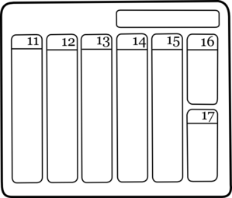
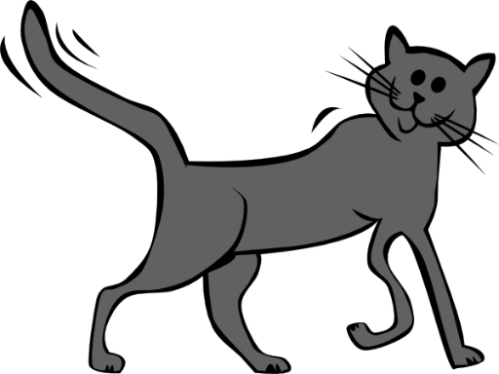
ch
dimanche
chanter
chercher
bouche
chat
champ
[field]
Notes:
Aim: To consolidate SSC [ch]
Procedure:
1. Introduce and elicit the pronunciation of the individual SSC [ch] and then the source word again ‘chercher’ (with gesture, if using). 2. Then present and elicit the pronunciation of the five cluster words.
The cluster words have been chosen for their high-frequency, from a range of word classes, with the SSC (where possible) positioned within a variety of syllables within the words (e.g. initial, 2nd, final etc.). Additionally, we have tried to use words that build cumulatively on previously taught SSCs (see the Phonics Teaching Sequence document) and do not include new SSCs. Where new SSCs are used, they are often consonants which have a similar symbol-sound correspondence in English.
Word frequency (1 is the most frequent word in French): dimanche [1235]; chanter [1820] bouche [1838]; champ [847]; chat [3138]; chercher [336]. Source: Londsale, D., & Le Bras, Y. (2009). A Frequency Dictionary of French: Core vocabulary for learners London: Routledge.

Slide 6
qu
?
question
Notes:
Timing: 1 minute [2 slides]
Aim: To consolidate SSC [qu]
Procedure: 1. Present the letter(s) and say the [qu] sound first, on its own. Students repeat it with you. 2. Bring up the word ”question” on its own, say it, students repeat it, so that they have the opportunity to focus all of their attention on the connection between the written word and its sound.
3. A possible gesture for this would be to raise one’s eyebrows and look intently, as if querying something. 4. Roll back the animations and work through 1-3 again, but this time, dropping your voice completely to listen carefully to the students saying the [qu] sound, pronouncing ”question” and, if using, doing the gesture.
Word frequency (1 is the most frequent word in French):
question [144].
Source: Londsale, D., & Le Bras, Y. (2009). A Frequency Dictionary of French: Core vocabulary for learners London: Routledge.

Slide 7
qu
quatre
musique
?
question
expliquer
unique
[to explain]
manquer
[unique; only]
[to miss/be missing]
Notes:
Aim: To consolidate SSC [qu]
Procedure:
1. Introduce and elicit the pronunciation of the individual SSC [qu] and then the source word again ‘question’ (with gesture, if using). 2. Then present and elicit the pronunciation of the five cluster words.
The cluster words have been chosen for their high-frequency, from a range of word classes, with the SSC (where possible) positioned within a variety of syllables within the words (e.g. initial, 2nd, final etc.). Additionally, we have tried to use words that build cumulatively on previously taught SSCs (see the Phonics Teaching Sequence document) and do not include new SSCs. Where new SSCs are used, they are often consonants which have a similar symbol-sound correspondence in English.
Word frequency (1 is the most frequent word in French): quarte [283]; musique [1139] expliquer [252]; manquer [583]; unique [402]; question [144]. Source: Londsale, D., & Le Bras, Y. (2009). A Frequency Dictionary of French: Core vocabulary for learners London: Routledge.

Slide 8
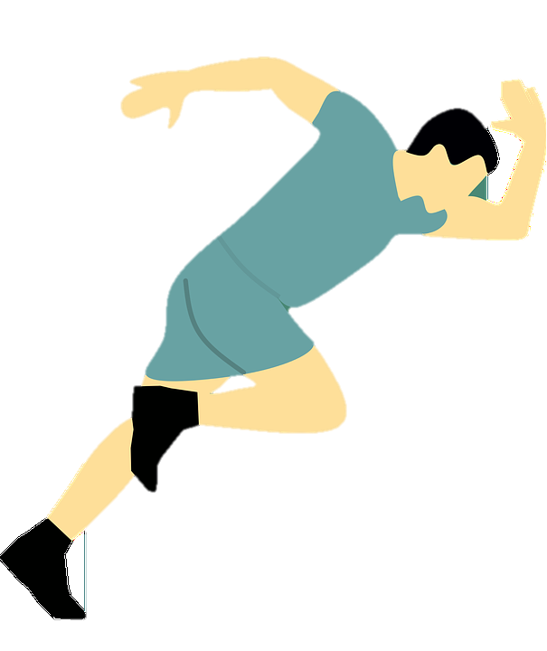
Des groupes consonantiques
écouter / écrire
Coche chaque fois que tu entends une des SSCs [th], [ch] ou [qu].
 | th | ch | qu | phrase
 |  |  |  | Mathieu est athlète.
 |  |  |  | Il cherche des marathons au Québec…
 |  |  |  | …parce qu’il est enthousiaste.
 |  |  |  | Son chat, Thibaut, mâche du thon québécois.
 |  |  |  | Son chien, Véronique, est chez Monique.
1
Mathieu is an athlete.
Ma__ieu est a__lète.
He looks for/is looking for marathons in Quebec…
Il __er__e des mara__ons au __ébec…
2
3
…because he is enthusiastic.
…parce __’il est en__ousiaste.
His cat, Thibaut, chews/is chewing tuna from Quebec.
4
Son __at, __ibaut, mâ__e du __on __ébecois.
Son __ien, Véroni__e, est __ez Moni__e.
His dog, Véronique, is at Monique’s place.
5
Notes:
Timing: 7 minutes
Aim: Aural recognition of SSCs [th], [ch], [qu] in longer contexts. Raising awareness of cross-linguistic differences in the pronunciation of these consonant clusters through use of cognate words.
Procedure:
1. Click on the buttons to play the audio.
2. Students listen and tick or transcribe the target SSCs.
3. Click to reveal answers (with more advanced classes, skip this step and move to step 4 to challenge students to translate the sentences through listening alone).
4. Students use the answers to try to translate the sentences into English, noticing the cognate words that they have transcribed.
5. Click to reveal answers.
6. Ask students to identify other SSCs in the sentence that sound identical to [th] and [qu] ([t] and hard [c] in enthousiaste and Québec).
Transcript:
1. Mathieu est athlète.
2. Il cherche des marathons au Québec…
3. …parce qu’il est enthousiaste.
4. Son chat, Thibault, mâche du thon québécois.
5. Son chien, Véronique, est chez Monique.
Word frequency of cognates used (1 is the most frequent word in French):
athlète [4722], marathon [>5000], enthousiaste [4287], groupe [187], consonantique [<5000]
Word frequency of unknown words used (1 is the most frequent word in French):
mâcher [>5000], thon [>5000]
Source: Lonsdale, D., & Le Bras, Y. (2009). A Frequency Dictionary of French: Core vocabulary for learners London: Routledge.

Slide 9
Vocabulaire
écouter
Écoute. Écris les lettres a, b, c dans l'ordre de la liste.
 | to feed | library | to start, to begin
 | already | finally, at last | always
 | task, chore | time | lesson
 | to borrow, borrowing | to explain, explaining | to leave, leaving (somewhere)
1
a)
b)
c)
c, b, a
2
a)
b)
c)
c, a, b
3
a)
b)
c)
b, c, a
4
a)
b)
c)
a, c, b
Notes:
Timing: 4 minutes Aim: Aural comprehension of this week’s new vocabulary.
Procedure:
1. Give students a few seconds to read the words and try to recall the French before beginning each item. 2. Click the numbers to play the audio.
3. Students write 1-4 in their books and then write a, b and c in the order of the French words they hear.
4. Click to reveal the answers.
Transcript [RECORDING IN PROCESS]:
commencer … la bibliothèque … nourrir
toujours… déjà … enfin
la fois … le cours … la tâche
emprunter … quitter … expliquer
Word frequency of cognates used (1 is the most frequent word in French): ordre [197], dictée [>5000]
Source: Londsale, D., & Le Bras, Y. (2009). A Frequency Dictionary of French: Core vocabulary for learners London: Routledge.

Slide 10
Adverb placement
grammaire
As you know, adverbs that tell us exactly when or where something happens normally come at the beginning or end of sentences:
Hier, j’ai commencé la tâche. I started the task yesterday. Il quitte la salle en ce moment. He’s leaving the room at the moment.
Adverbs that tell us how or how frequently something happens normally come in the middle of a sentence, after the verb in short form:
Il parle souvent de son chien. He often talks about his dog.
In the perfect tense, avoir is in short form. So, adverbs that tell us how or how frequently something happens normally come between the form of avoir and the past participle:
Il a déjà quitté la salle. He already left the room.
In English, this kind of adverb comes before the verb in short form.
The short form of avoir and the past participle make a sandwich around adverbs like souvent and déjà.
Notes:
Timing: 3 minutes
Aim: To introduce adverb placement rules in the perfect tense.
Procedure:
1. Click to animate the explanation.

Slide 11
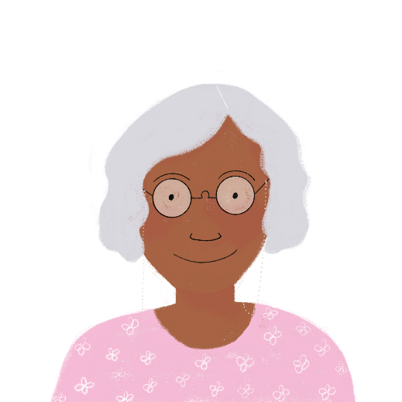
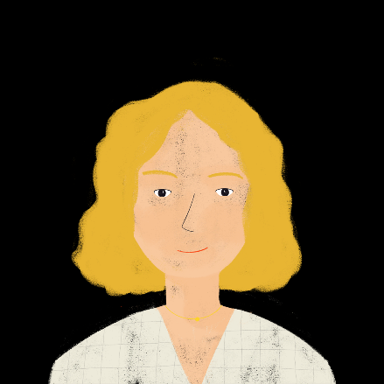
À la réunion parents-professeurs
*le progrès = progress
*la traductrice = translator (f.)
lire
Ces phrases sont-elles au présent ou au passé ? Où est l’adverbe ? Complète.
1. Léa est heureuse. Elle dit souvent que le cours d’anglais est bien.
?
2. Merci, c’est gentil. Elle a bien fait son travail cette année.
?
3. Est-ce qu’elle a toujours fait ses devoirs ?
?
4. Oui, elle fait toujours un grand effort.
?
5. Très bien ! Elle a vite fait de grands progrès*, je pense.
?
6. Oui, c’est vrai ! Elle a déjà dit qu’elle veut peut-être devenir traductrice* un jour.
?
Notes:
Timing: 4 minutes
Aim: Written recognition of adverb placement and connecting this with tense (present or perfect tense).
Procedure:
1. Check that students understand the context. Ask them to infer the meaning of la réunion parents-professeurs.
2. Tell students that they need to look at the position of the adverb in orange (either before or after the verb in short form) to decide whether each sentence is in the present or perfect tense. Remind them that the 3rd person singular forms fait and dit are identical to the past participles, so these do not provide clues.
3. Students write 1-6, read the sentences, and decide whether each sentences covers the auxiliary a or not.
4. Click to reveal answers.
Word frequency of cognates used (1 is the most frequent word in French): réunion [971], présent [216], progrès [919], adverbe [>5000], completer [2034],
Source: Londsale, D., & Le Bras, Y. (2009). A Frequency Dictionary of French: Core vocabulary for learners London: Routledge.

Slide 12
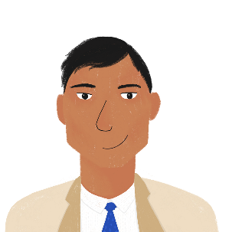
Bilal parle de ses enfants
lire
Que dit-il ? Choisis le bon adverbe.
la semaine dernière
bien
Les vacances scolaires ont commencé .
Nous avons voyagé à l’étranger .
Mais nous restons en France .
Amir et Océane passent souvent des jours ensemble.
Ils regardent un film en espagnol .
Ils parlent l’espagnol.
Noura a quitté sa chambre.
Elle a travaillé sur son ordinateur.
la semaine dernière
l’année dernière
beaucoup
l’année dernière
cette année
cette année
toujours
souvent
maintenant
souvent
en ce moment
enfin
en ce moment
bien
bien
aujourd’hui
enfin
hier
enfin
beaucoup
beaucoup
lundi dernier
Notes:
Timing: 8 minutes. This is slide 1/2.
Aim: Written recognition of adverb type based on its position in a sentence in the present or perfect tense.
Procedure:
1. Students choose which adverb fits the gap, using their knowledge of adverb positioning (at the end or in the middle of sentences) to inform their choices.
2. Click to reveal answers.
3. Move to slide 12 for the comprehension element.
Word frequency of cognates used (1 is the most frequent word in French): adverbe [>5000]
Source: Londsale, D., & Le Bras, Y. (2009). A Frequency Dictionary of French: Core vocabulary for learners London: Routledge.

Slide 13
Bilal parle de ses enfants
lire
Lis ces phrases anglaises et décide si c’est une activité que les enfants font à présent ou qu’ils ont déjà fait.
 | à présent | dans le passé
1. starting their school holidays
2. staying in France
3. travelling abroad
4. speaking Spanish well
5. watching a film in Spanish
6. working on the computer
7. leaving the room
8. spending days with Océane
Notes:
This is slide 2/2.
Aim: Written comprehension of the sentences on the previous slide.
Procedure:
1. Students read the English sentences in English and decide, based on the information on the previous slide, whether these events happened in the present or the past. NB: the sentences are in a different order so that students must understand all vocabulary to complete the task. 2. Click to reveal the answers.
Word frequency of cognates used (1 is the most frequent word in French): présent [216], decider [165]
Source: Londsale, D., & Le Bras, Y. (2009). A Frequency Dictionary of French: Core vocabulary for learners London: Routledge.

Slide 14
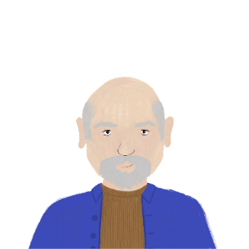
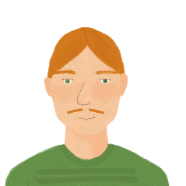
En vacances !
Romain décrit ses vacances. Quels adverbes remplissent les blancs ?
écouter
1. Salut Romain ! Vous prenez des vacances ? Vous avez déjà quitté Paris ?
5. Léa et Antoine ont enfin visité le musée de Bordeaux ?
___
___
2. En fait, nous avons quitté Paris
la semaine dernière. Nous sommes à Bordeaux.
6. Oui ! Et ils ont vite expliqué l’histoire de la ville à Aurélie !
___________________
__
3. Vous avez toujours passé les vacances en France ?
7. En fait, Léa a emprunté un livre sur l’histoire de la ville
le mois dernier.
______
______________
4. Non … nous avons voyagé en Belgique l’année dernière.
8. Je sais ! Elle a parlé de ce livre hier ! À bientôt – nous sortons !
________________
__
la semaine dernière | souvent | enfin | aujourd’hui | hier | déjà | facilement | l’année dernière | lundi dernier | mal | samedi dernier | toujours | le mois dernier | vite
1
2
3
4
5
6
7
8
9
Notes:
Timing: 8 minutes
Aim: Text segmentation exercise to focus on placement of adverbs in the perfect tense only. The text has been divided into nine segments, with the audio clipped immediately before each adverb. Students read and listen to the conversation simultaneously, anticipating which of the adverbs provided at the bottom could fill the gap based on position in the sentence, and context.
Procedure:
1. Click on ‘1’ to hear the first part of the text read aloud. The audio stops before the first gap.
2. After each segment (bar the last) ask students, ‘Quel adverbe peut remplir le blanc ?’.
3. Take suggestions from the class. Highlight to students that there isn’t a single correct answer; several adverbs may be syntactically and semantically correct. Click to reveal suggested answer.
4, Repeat steps 1-3 for each segment.
5. Oral translation of full dialogue.
Transcript:
Salut Romain ! Vous prenez des vacances ? Vous avez …
[déjà] quitté Paris ? En fait, nous avons quitté Paris …
[la semaine dernière]. Nous sommes à Bordeaux. Vous avez …
[toujours] passé les vacances en France ? Non … nous avons voyagé en Belgique …
[l’année dernière]. Léa et Antoine ont …
[enfin] visité le musée de Bordeaux ? Oui ! Et ils ont …
[vite] expliqué l’histoire de la ville à Aurélie ! En fait, Léa a emprunté un livre sur l’histoire de la ville …
[le mois dernier]. Je sais ! Elle a parlé de ce livre …
[hier] ! À bientôt – nous sortons !
Word frequency of cognates used (1 is the most frequent word in French): adverbe [>5000]
Source: Londsale, D., & Le Bras, Y. (2009). A Frequency Dictionary of French: Core vocabulary for learners London: Routledge.

Slide 15
Amandine parle à Aurélie !
Réécris les phrases avec l’adverbe en orange.
écrire
1. Amir parle à Léa. [toujours]
5. Alors, Léa a expliqué les devoirs à Amir. [bien]
2. Léa a commencé ses devoirs. [hier]
6. Les amis de Noura ont emprunté tous les cahiers d’Amir. [déjà]
3. Amir fait ses devoirs. [en ce moment]
7. Je dois partir ! Nous quittons la maison. [enfin]
4. Amir a parlé à Léa d’un problème avec ses devoirs. [la semaine dernière]
8. Vous sortez ? [aujourd’hui]
Notes:
Timing: 8 minutes. This is slide 1/2.
Aim: Written production of sentences in the present and perfect tenses using adverbs of specified and unspecified time.
Procedure:
1. Check students understand task instructions. They have not yet encountered the verb réécrire but should use their knowledge of écrire and the re- prefix in English to infer the meaning.
2. Students write numbers 1-8 in their books.
3. Students rewrite the sentences, putting the time phrases in the brackets in the correct position.
4. Answers are on the next slide.
Word frequency of unknown words used (1 is the most frequent word in French): réécrire [>5000]
Source: Londsale, D., & Le Bras, Y. (2009). A Frequency Dictionary of French: Core vocabulary for learners London: Routledge.
Word frequency of cognates used (1 is the most frequent word in French): orange [3912]; adverbe [>5000]
Source: Londsale, D., & Le Bras, Y. (2009). A Frequency Dictionary of French: Core vocabulary for learners London: Routledge.

Slide 16
Amandine parle à Aurélie !
écrire
1. Amir parle toujours à Léa.
5. Alors, Léa a bien expliqué les devoirs à Amir.
2. Léa a commencé ses devoirs hier.
Hier, Léa a commencé ses devoirs.
6. Les amis de Noura ont déjà emprunté tous les cahiers d’Amir.
3. Amir fait ses devoirs en ce moment.
En ce moment, Amir fait ses devoirs.
7. Je dois partir ! Nous quittons enfin la maison.
4. Amir a parlé à Léa d’un problème avec ses devoirs la semaine dernière.
La semaine dernière Amir a parlé à Léa d’un problème avec ses devoirs.
8. Vous sortez aujourd’hui ?
Notes:
This is slide 2/2.

Slide 17
Noura et ses livres
parler
Dis ces phrases. Utilise l’adverbe en orange.
1. Noura passe beaucoup de temps dans sa chambre. en ce moment
Noura passe beaucoup de temps dans sa chambre en ce moment.
2. Elle a quitté sa chambre une fois. hier
Elle a quitté sa chambre une fois hier.
3. Mais elle visite la bibliothèque. souvent
Mais elle visite souvent la bibliothèque.
4. Elle a aimé la bibliothèque. toujours
Elle a toujours aimé la bibliothèque.
Notes:
Timing: 6 minutes. This is slide 1/2.
Aim: Oral production to practise adverb placement in the present and perfect tenses.
Procedure:
Students read the sentences aloud and insert the adverb (in orange) in the right place.
Sentences are presented one-by-one.
Click to reveal the answers. Note: for sentences 1 and 2, the adverb can also go at the beginning of the sentence.
Click again to reveal the next sentence.
See next slide for four more sentences.
Word frequency of cognates used (1 is the most frequent word in French): adverbe [>5000], orange [3912]
Source: Londsale, D., & Le Bras, Y. (2009). A Frequency Dictionary of French: Core vocabulary for learners London: Routledge.

Slide 18
Noura et ses livres
parler
5. Elle a emprunté plusieurs livres. déjà
Elle a déjà emprunté plusieurs livres.
6. Elle lit des livres en anglais. toujours
Elle lit toujours des livres en anglais.
7. Elle a commencé un livre en allemand. samedi dernier
Elle a commencé un livre en allemand samedi dernier.
8. Maintenant, elle comprend l’allemand. un peu
Maintenant, elle comprend un peu l’allemand.
Notes:
This is slide 2/2.
Note: for sentence 7, the adverb can also go at the beginning of the sentence.

Slide 19
Talking about what you did and have done
perfect tense events with past simple and present perfect equivalent in English
SSCs [th], [ch] and [qu]
Y8 French
Term 3.2 - Week 5 - Lesson 68
Amber Dudley / Catherine Morris / Catherine Salkeld
Artwork by: Chloé Motard
Date updated: 06/11/21
Notes:
Artwork by Chloé Motard. All additional pictures selected are available under a Creative Commons license, no attribution required.
Native speaker feedback provided by Sarah Brichory.
With thanks to Rachel Hawkes and Emma Marsden for their input on the lesson material.
Learning outcomes (lesson 2):
Consolidation of SSCs [th], [ch] and [qu]
Consolidation of specified time expressions with past simple equivalent in English
Introduction of unspecified time expressions with present perfect and past simple equivalent in English
Word frequency (1 is the most frequent word in French):
8.3.2.4 (introduce) commencer [139], bibliothèque [2511], expliquer [252], emprunter [1268], quitter [507], cours [169], fois [49], tâche [887], déjà¹ [58], enfin [349], toujours [103]
8.3.1.5 (revisit) décrire [1176], traduire [1125], communauté [558], culture [913], expérience [679], information [317], produit [373], programme [340], tout¹, tous¹ [24]
8.2.2.2 (revisit) finir [583], nourrir [1261], chat [3138], dimanche [1235], heure [99], jeudi [1112], lundi [1091], mardi [1044], mercredi [1168], minute [375], vendredi [1086]
Source: Londsale, D., & Le Bras, Y. (2009). A Frequency Dictionary of French: Core vocabulary for learners London: Routledge.
The frequency rankings for words that occur in this PowerPoint which have been previously introduced in NCELP resources are given in the NCELP SOW and in the resources that first introduced and formally re-visited those words.
For any other words that occur incidentally in this PowerPoint, frequency rankings will be provided in the notes field wherever possible.

Slide 20
Phonétique
écouter / écrire
Personne A lit la phrase. Personne B coche chaque fois qu’il/elle entend [th, [ch] ou [qu].
Charles va chez Thérèse chaque dimanche.
1
2
3
 | th | ch | qu | en anglais
1 |  |  |  | Charles goes to Thérèse’s place every Sunday.
2
3
4
Notes:
Timing: 8 minutes. This is slide 1/7.
Aim: Oral production and aural recognition of SSCs [th], [ch], [qu].
Procedure:
1. Students prepare for the activity by sketching the grid pictured on this slide. Use the sentence on this slide as an example to model steps 2-6 below.
2. Students work in pairs. Student A faces the board. Student B turns away.
3. Student A reads the sentence from the board. Student B has their back to the board and ticks the SSCs they hear.
4. Student B turns back to the board to check the answer, revealed on clicks.
5. Students use their knowledge of cognates to guess the English meaning of the sentence, revealed on a further click. At more advanced levels, the listening student could try to do this as part of step 3.
6. Both students practice saying the sentences at increasing speeds to increase fluency of production. Click on the numbers 1-3 to hear the sentences read aloud at different speeds. Students listen and repeat.
7. Repeat steps 2-7 for the remaining sentences.

Slide 21
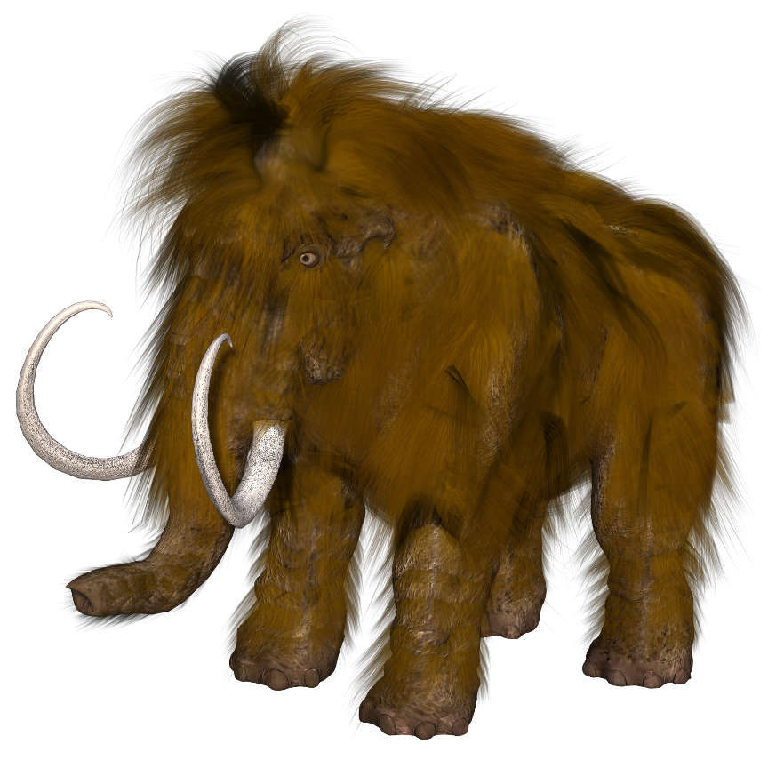
Phonétique
écouter / écrire
Michel le mammouth explique qu’il vient de Belgique.
Michel the mammoth explains that he comes from Belgium.
1
2
3
Notes:
This is slide 2/7
Word frequency of cognates used (1 is the most frequent word in French):
mammouth [<5000]
Source: Lonsdale, D., & Le Bras, Y. (2009). A Frequency Dictionary of French: Core vocabulary for learners London: Routledge.

Slide 22
Phonétique
écouter / écrire
Frédérique choisit la musique catholique.
Frédérique chooses Catholic music.
1
2
3
Notes:
This is slide 3/7
Word frequency of cognates used (1 is the most frequent word in French):
catholique [1578]
Source: Lonsdale, D., & Le Bras, Y. (2009). A Frequency Dictionary of French: Core vocabulary for learners London: Routledge.

Slide 23
Phonétique
écouter / écrire
Les quatre chats sympathiques cherchent quatre chaises chaudes.
The four nice cats are looking for four warm chairs.
1
2
3
Notes:
This is slide 4/7
Word frequency of unknown words used (1 is the most frequent word in French):
chaise [3419]
Source: Lonsdale, D., & Le Bras, Y. (2009). A Frequency Dictionary of French: Core vocabulary for learners London: Routledge.

Slide 24
Phonétique
écouter / écrire
Les dimanches, Agathe va au théâtre, aux champs, et à la bibliothèque.
On Sundays, Agathe goes to the theatre, to the fields, and to the library.
1
2
3
Notes:
This is slide 5/7
Word frequency of cognates used (1 is the most frequent word in French):
théâtre [1701]
Word frequency of unknown words used (1 is the most frequent word in French):
champ [847]
Source: Lonsdale, D., & Le Bras, Y. (2009). A Frequency Dictionary of French: Core vocabulary for learners London: Routledge.

Slide 25
Phonétique
écouter / écrire
Le chef fait des recherches sur le thé à la menthe.
The boss is doing research on mint tea.
1
2
3
Notes:
This is slide 6/7
Word frequency of unknown words used (1 is the most frequent word in French):
chef [386], recherche [357], menthe [>5000]
Source: Lonsdale, D., & Le Bras, Y. (2009). A Frequency Dictionary of French: Core vocabulary for learners London: Routledge.

Slide 26
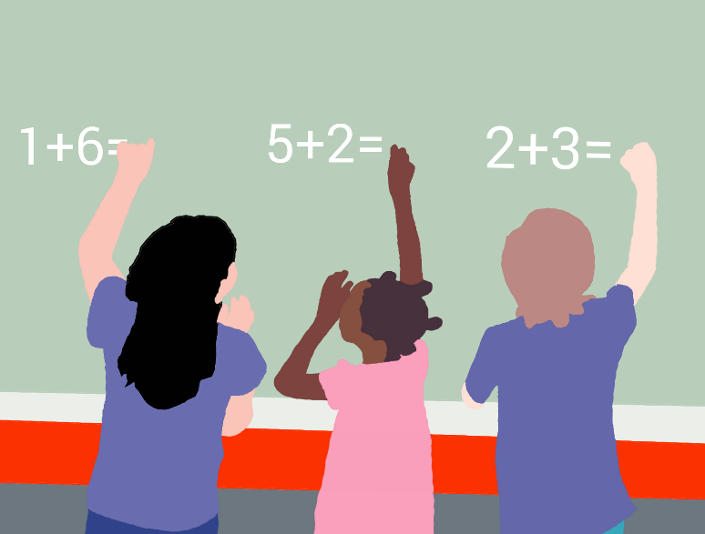
Phonétique
écouter / écrire
Dominique a des questions sur les méthodes chinoises de maths.
Dominique has some questions about Chinese maths methods.
1
2
3
Notes:
This is slide 7/7
Word frequency of cognates used (1 is the most frequent word in French):
méthode [1149], chinois [1914]
Source: Lonsdale, D., & Le Bras, Y. (2009). A Frequency Dictionary of French: Core vocabulary for learners London: Routledge.

Slide 27
Salut Amir !
écrire
Lis la lettre de Léa à Amir et remplis les blancs.
Salut Amir !
Nous faisons toujours les mêmes tâches au collège. Mais aujourd’hui le professeur veut commencer un nouveau cours. On va parler d’un livre. Je dois expliquer l’histoire à toute la classe parce que j’ai déjà regardé le film de ce livre plusieurs fois. Je pense que Sophie va emprunter un livre de
la bibliothèque. Elle lit beaucoup. Je dois sortir ! Mes parents vont enfin quitter la maison dans deux minutes!
À bientôt,
Léa
always
tasks
start
lesson
explain
already
times
borrow
library
at last
leaving
Notes:
Timing: 5 minutes Aim: Written production of this week’s new vocabulary in context.
Procedure:
1. Students read the paragraph and translate the English words using this week’s vocabulary.
2. Answers revealed on click.
3. Oral translation of paragraph.

Slide 28
Present perfect vs. simple past
grammaire
The French perfect tense has two equivalent tenses in English:
J’ai expliqué la tâche. I explained the task (simple past) I have explained the task (present perfect)
When we know the specific year, month, day or time, we use the simple past.
J’ai expliqué la tâche hier. I explained the task yesterday.
When we don’t, we can use either the present perfect or the simple past.
J’ai expliqué la tâche. I have explained the task. I explained the task.
In French, we use the same tense for both situations.
One past tense in French
Two past tenses in English
Notes:
Timing: 3 minutes
Aim: To explain that two English past tenses (simple past and present perfect) have one equivalent in French (perfect tense). To present the forms and uses of the simple past and the present perfect in English.
Procedure:
1. Click to animate the explanation.
2. Highlight that the perfect tense has two possible equivalents in English and that the English tense depends on whether we know if something happened at a specific point in time or not.

Slide 29
Adverbs of time
lire
These adverbs are always used with the past simple in English.
These adverbs can be used with past simple or present perfect in English.
Translate the adverbs on the right into French.
Decide whether the adverbs give information about a specified or an unspecified time.
already
yesterday
last month
often
at a specified time | at an unspecified time
le mois dernier | déjà
lundi dernier | toujours
hier | enfin
le 30 octobre | souvent
la semaine dernière | plusieurs fois
always
on 30th October
Both types of adverb are used with the perfect tense in French.
last Monday
several times
at last, finally
last week
Notes:
Timing: 5 minutes
Aim: Written production of adverbs. To practise distinguishing between adverbs of specified and unspecified, and connecting their uses with English and French past tenses.
Procedure:
1. Students sketch the grid.
2. Students translate the adverbs on the right into French.
3. Students then sort the adverbs into the two columns.
4. Whole class correction. Click to highlight the English adverb. Teacher elicits the French translation and asks students in which column it belongs.
5. Click to reveal answer.
6. Repeat steps 4-5 for the other adverbs.
7. Click to reveal bubbles connecting the adverbs in each column with English and French past tenses, drawing particular attention to the fact that this distinction does not exist in French.

Slide 30
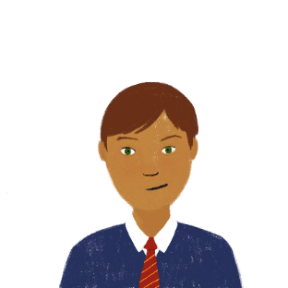
Present simple or continuous?
Sam au collège français !
lire
Sam parle de l’anniversaire de Léa ! Traduis les phrases. Attention ! On peut utiliser quelle(s) forme(s) du passé en anglais ? Le « simple past » seulement ou les deux ?
 |  | present perfect | simple past
1 | Léa a toujours célébré son anniversaire.
2 | Léa a voyagé à Londres l'année dernière !
3 | Nous avons enfin organisé la fête pour Léa.
4 | Sophie et Pierre ont acheté un cadeau hier.
5 | J’ai expliqué le programme à sa mère lundi dernier.
6 | Sophie a envoyé les invitations jeudi dernier.
7 | Léa a déjà quitté la maison.
8 | La fête a enfin commencé.
Lea always celebrated / has always celebrated her birthday.
Lea travelled to London last year.
We finally organised / have finally organised the party for Lea.
Sophie and Pierre bought a present yesterday.
I explained the schedule to her mum last Monday.
Sophie sent the invitations last Thursday.
Léa has already left / already left the house.
The party has finally started / finally started.
Notes:
Timing: 8 minutes
Aim: Written recognition of sentences in the French perfect tense. French to English translation with a focus on choosing the most suitable English past tense as an equivalent to the French perfect tense.
Procedure:
1. Students read each sentence and decide whether the verb in bold must be translated using the simple past in English, or whether it could be translated using either the present perfect or simple past. Draw attention to fact that the French tense is the same throughout, and that students will have to use contextual clues to decide if something happened at a specific time or not. Remind students that they must use the simple past if they know exactly when the event took place.
2. Click to reveal the answer.
3. Ask students to translate the full sentence into English.
4. Click to reveal the suggested translation.
5. Repeat steps 1-5 for the other sentences.
Word frequency of cognates words used (1 is the most frequent word in French):
forme [369], invitation [2237]
Source: Londsale, D., & Le Bras, Y. (2009). A Frequency Dictionary of French: Core vocabulary for learners London: Routledge.

Slide 31
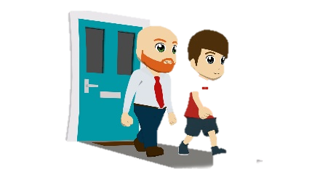
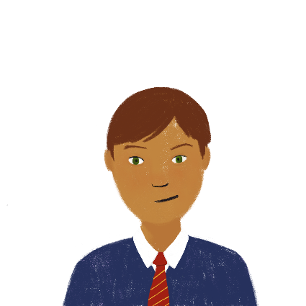
Present simple or continuous?
Present perfect or simple past?
écouter
Sam fait un podcast. Léa prend des notes en anglais. D’abord, choisis le(s) bon(s) verbe(s). Puis, traduis la phrase entière.
 | I celebrated / have celebrated my birthday in Brussels…
 | I visited / have visited the museum…
 | Léa left / has left the house…
 | I talked / have talked about the homework with my friends…
 | I started / have started my homework…
 | I borrowed / have borrowed some books from my sister…
 | I bought / have bought a new book…
 | We watched / have watched the film of this book…
1
2
3
4
5
6
7
8
Notes:
Timing: 8 minutes
Aim: Aural recognition of sentences in the French perfect tense. French to English translation with a focus on choosing the most suitable English past tense as an equivalent to the French perfect tense.
Procedure:
1. Click the number trigger to play the audio for each sentence. Partial English translations (with the time phrases obscured) are given.
2. Students listen to the French and decide based on the time phrases they hear whether the English translation must be in the simple past, or could be in either the simple past or present perfect. Draw attention to fact that the French tense is the same throughout, so it will not help them to listen to the verb form. Remind students that they must use the simple past if hear exactly when the event took place.
3. Click to reveal answers.
4. As a secondary task, students listen to the audio for a second time and complete the English sentences by adding the time phrases.
5. See next slide for suggested complete translations.
Transcript:
J’ai célébré mon anniversaire à Bruxelles l’année dernière.
J’ai visité le musée plusieurs fois.
Léa a déjà quitté la maison.
J’ai parlé des devoirs avec mes amis hier.
J’ai enfin commencé mes devoirs.
J’ai emprunté des livres de ma sœur plusieurs fois.
J’ai acheté un nouveau livre le mois dernier.
Nous avons regardé le film de ce livre la semaine dernière.
Word frequency of cognates used (1 is the most frequent word in French): verbe [>5000], podcast [>5000]
Source: Londsale, D., & Le Bras, Y. (2009). A Frequency Dictionary of French: Core vocabulary for learners London: Routledge.

Slide 32
Present simple or continuous?
Present perfect or simple past?
écouter
I celebrated my birthday in Brussels last year.
I visited / have visited the museum several times.
Léa already left / has already left the house.
I talked about the homework with my friends yesterday.
I finally started / have finally started my homework.
I borrowed / have borrowed some books from my sister several times.
I bought a new book last month.
We watched the film of this book last week.
Notes:
Suggested French – English translations to the previous activity.
J’ai célébré mon anniversaire à Bruxelles l’année dernière.
J’ai voyagé en France plusieurs fois.
Léa a déjà quitté la maison.
J’ai parlé des devoirs avec mes amis hier.
J’ai enfin commencé mes devoirs.
J’ai emprunté des livres de ma sœur plusieurs fois.
J’ai acheté un nouveau livre le mois dernier.
Nous avons regardé le film de ce livre la semaine dernière.

Slide 33
Present simple or continuous?
Ce sont les vacances !
écrire
Remember! To form the perfect tense in French, we use the short form of avoir + past participle.
Traduis ces phrases.
1. The holidays have already started! We are going to the beach today.
Les vacances ont déjà commencé ! Nous allons à la plage aujourd'hui.
2. I have always spent the holidays abroad. So, we are staying at home this year.
J'ai toujours passé les vacances à l'étranger. Nous restons à la maison cette année alors.
3. Sophie has travelled to Spain several times. She always takes the plane.
Sophie a voyagé en Espagne plusieurs fois. Elle prend toujours l’avion.
4. We talked about her experience yesterday. She likes describing the Spanish community.
Nous avons parlé de son expérience hier. Elle aime décrire la communauté espagnole.
Notes:
Timing: 8 minutes
Aim: Written production of sentences in the French perfect tense. Recognising that French uses one tense to express two meanings, whereas English has a tense for each meaning. Positioning of adverbs.
Procedure:
1. Students translate the full sentences.
2. Click to reveal answers
3. There are four more sentences on the following slide.

Slide 34
Present simple or continuous?
Ce sont les vacances !
écrire
Remember! To form the perfect tense in French, we use the short form of avoir + past participle.
Traduis ces phrases.
5. Antoine has finally left the house. He has to feed Sophie’s cat.
Antoine a enfin quitté la maison. Il doit nourrir le chat de Sophie.
6. I visited the local museum last Wednesday. I really like all the information!
J'ai visité le musée local mercredi dernier. J'aime bien toutes les informations !
7. And I bought a new shirt last Friday. But it’s a bit big!
Et j'ai acheté une nouvelle chemise vendredi dernier. Mais c'est un peu grand !
8. I started my homework yesterday. I have to finish a task today.
J'ai commencé mes devoirs hier. Je dois finir une tâche aujourd'hui.
Notes:
Continuation of the previous activity.

Slide 35
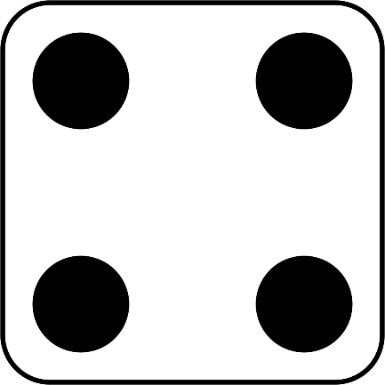
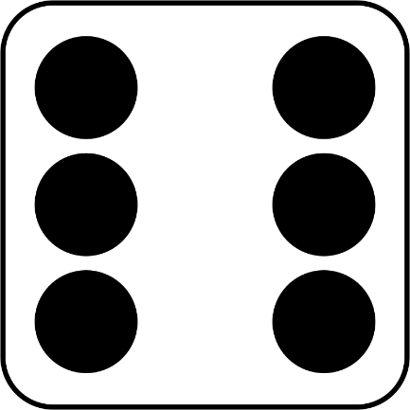
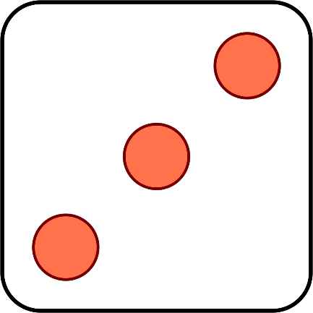
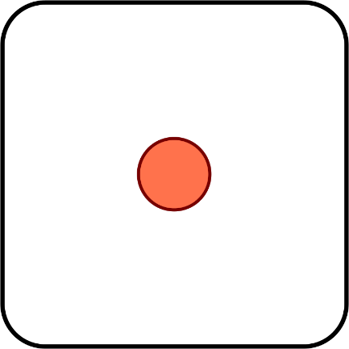
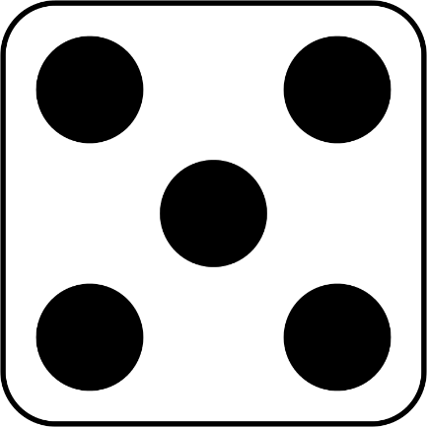
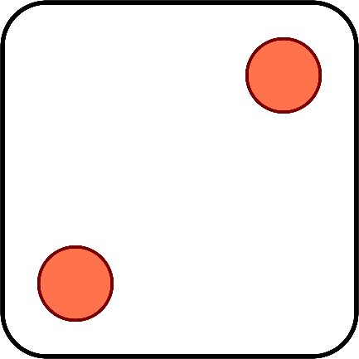
À vous de jouer !
Translate your partner’s sentence into English!
parler
Tense:
When did it happen:
Remember! If you know exactly when something happened, use the simple past in English.
1, 3, 5 = au présent
2, 4, 6 = au passé
1, 3, 5 = à un moment précis
2, 4, 6 = à un moment imprécis
verbes | à un moment précis | à un moment imprécis
commencer (je) | la semaine dernière | déjà
acheter (tu) | en ce moment | enfin
expliquer (il) | hier | toujours
emprunter (on) | maintenant | souvent
quitter (nous) | le 1 novembre | plusieurs fois
faire (vous) | jeudi dernier
dire (elles)
manger (Amir)
Notes:
Timing: 5 minutes
Aim: Oral production of sentences in the French perfect tense with a focus on adverb placement. Oral translation French – English.
Procedure:
1. Click to ‘roll’ the dice.
2. Students use the numbers shown on the two dice to randomly select the tense (first) and the type of adverb (second), according to the key. The first dice roll tells them whether they need to make a sentence in the past or present. The second dice roll tells them whether they need to make a sentence with an adverb indicating a specified or non-specified point in time.
3. Students use one verb (and a complement of their choice) from the first column and one adverb from the relevant adverb column.
4. Listening student translates what their partner says into English, paying attention to the tense used.
5. The student should back-translate what they heard to check whether their partner made a sentence with the correct English tense.
6. Click again to move on to the next pair of numbers.
Word frequency of cognates used (1 is the most frequent word in French): précis [643], imprécis [>5000]
Source: Londsale, D., & Le Bras, Y. (2009). A Frequency Dictionary of French: Core vocabulary for learners London: Routledge.

Slide 36
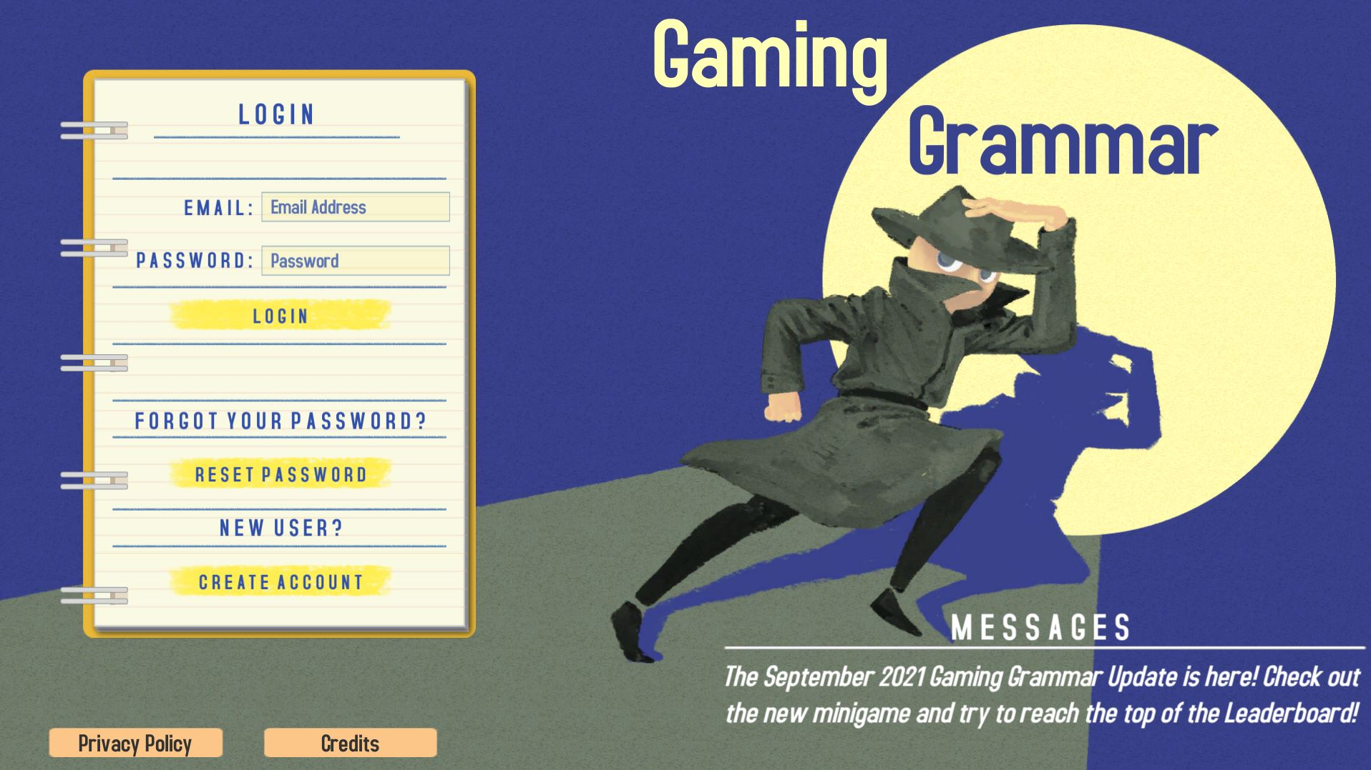
Gaming Grammar
Gaming Grammar
Relevant mini game(s):
Verbs: 1st person present & past tense (Verb agreement (past))
Verbs: 3rd person present & past tense (Verb agreement (past))
To have and to be: 1st person and 3rd person singular
Notes:
This slide links to Gaming Grammar login screen. The appropriate mission can then be selected from the menu page.
Students will progress through the game at their own rate; teachers should use the teacher interface to check progress. This will help to inform future lesson planning.

Slide 37
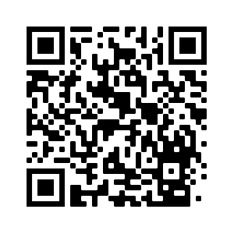
Devoirs
Vocabulary Learning Homework (Y8, Term 3.2, Week 6)
Quizlet link: Y8 Term 3.2 Week 6
Quizlet QR code:
In addition, revisit: Y8 Term 3.1 Week 6
Y8 Term 2.2 Week 3
Notes:
Use this slide to set the homework

