Slide 1
Phonics
SSC /äu/
Y7 German
Term 2.1 - Week 2
Author name(s): Inge Alferink / Rachel Hawkes
Date updated: 07/02/2020

Slide 2
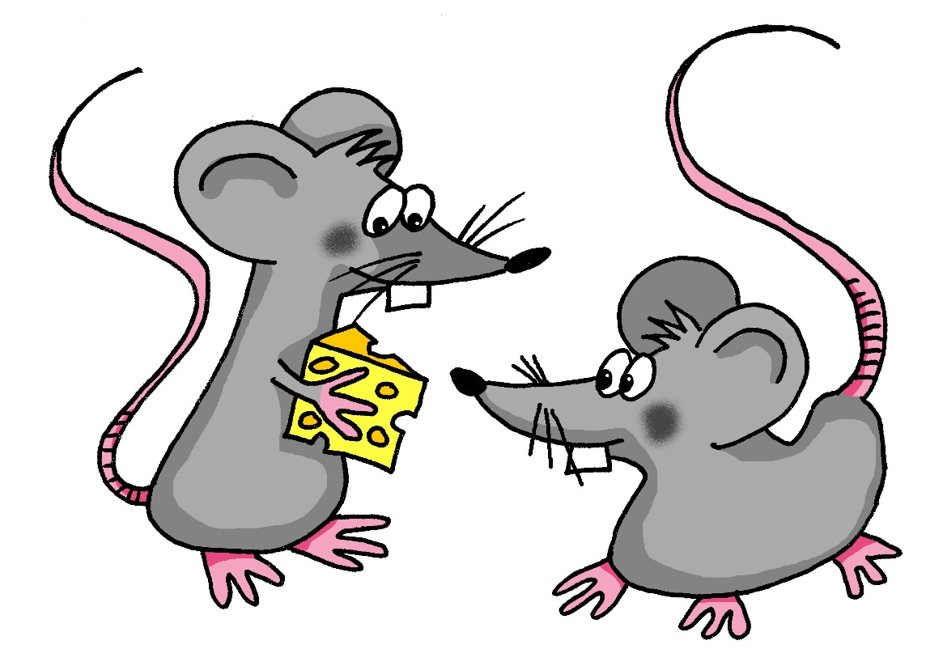
äu
Mäuse
Notes:
Introduce and elicit the pronunciation of the individual SSC ‘äu’ and then present and practise the pronunciation of the source word ‘Mäuse’.
A possible gesture for this would be to mime whiskers, holding your fingers up to the side of your mouth.

Slide 3
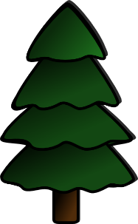
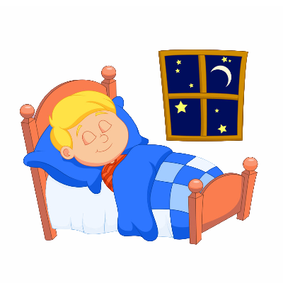
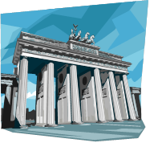
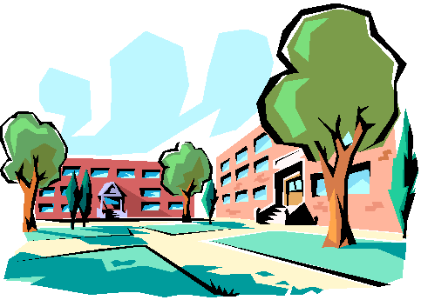
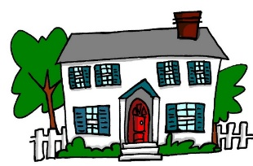
äu
häufig
Bäume
Mäuse
träumen
Gebäude
Häuser
Notes:
Introduce and elicit the pronunciation of the individual SSC ‘äu’ and then the source word again (with gesture, if using). Then present and elicit the pronunciation of the five cluster words. The cluster words have been chosen for their high-frequency, from a range of word classes, with the SSC (where possible) positioned within a variety of syllables within the words(e.g. initial, 2nd, final etc..) and additionally, we have tried to use words that build cumulatively on previously taught SSCs (see the Phonics Teaching Sequence document) and do not include new SSCs. Where new SSCs are used, they are often consonants which have a similar symbol-sound correspondence in English.
Word frequency rankings (1 is the most common word in German): Mäuse [3757]; Bäume [994] häufig [432]; träumen [1907]; Häuser [159]; Gebäude[1202]. Source: Jones, R.L. & Tschirner, E. (2006). A frequency dictionary of German: core vocabulary for learners. Routledge
Note: Four of these cluster words are plural. Draw students’ attention to these and elicit the singular forms from them. Bäume → der Baum (students met this word in the O Tannenbaum lesson before Christmas) Häuser → das Haus (students met Haus in 1.1.5 and revisited it last week in 2.1.1) - it is another example of the plural rule they saw last lesson (Männer, Wörter, Bücher) Mäuser → die Maus (students have not met this word, but may be able to deduce its singular form by working in reverse to remove the ending -e and the umlaut, to arrive at the cognate ‘Maus’. This models a very important comprehension strategy. Gebäude → This is a new word for students. Tell them that it is das Gebäude AND die Gebäude and elicit from them that this means that the plural and singular forms of this word (building/buildings) are the same.

Slide 4
äu
häufig
Bäume
Mäuse
träumen
Gebäude
Häuser
Notes:
With sound and no pictures to focus all attention on the sound-symbol correspondence.
Word frequency rankings (1 is the most common word in German): Mäuse [3757]; Bäume [994] häufig [432]; träumen [1907]; Häuser [159]; Gebäude[1202]. Source: Jones, R.L. & Tschirner, E. (2006). A frequency dictionary of German: core vocabulary for learners. Routledge

Slide 5
äu
häufig
Bäume
Mäuse
träumen
Gebäude
Häuser
Notes:
Without sound to elicit production from students.
Word frequency rankings (1 is the most common word in German): Mäuse [3757]; Bäume [994] häufig [432]; träumen [1907]; Häuser [159]; Gebäude[1202]. Source: Jones, R.L. & Tschirner, E. (2006). A frequency dictionary of German: core vocabulary for learners. Routledge

