Slide 1
Examples
Examples
production
Interpreting tasks (speaking)
Notes:
7.1.1.1
Speaking activity
Timing: 10 minutes
Aim: to use sentences with ‘estoy’ and ‘está’ in oral production
Procedure:
See separate set of cards (word doc) Students play the game as described below:
1 Separate the cards into two piles – verbs and cities.
2 Partner A picks a verb and then a city, says the Spanish sentence. 3 Partner B translates into English. 4 Players then swap roles. If pairs time themselves, they can then repeat the activity to see how quickly they can complete all the sentences and translations. With each new game, different sentences will be generated.
Note: Students could make these cards themselves i.e. fold A4 paper so it makes 12 rectangles - write 'I' x 3, he/she x 3, (this will be a cue/prompt to recall the correct verb in Spanish), then 6 cities that they remember. They could all do this so that they have 24 playing cards in total, when put together. This is good practice for spelling / memory / sounding out city names as they write them.

Slide 2
Partenaire A
parler / écrire
lire
Translate these sentences. Then say them to your partner. Your partner must understand what you say, so take care.
He studies _____________________ 5) They (f) eat ____________________
They (m) play __________________ 6) He wears _______________________
They (m) sing __________________ 7) She gives _______________________
She listens ______________________ 8) They (f) walk ____________________
Notes:
7.1.2.6
Timing: 12 minutes (to model, conduct and give feedback on the activity: 9 slides)
Aim: to practise receptive and productive knowledge of third person singular and plural of –er verbs in present tense.
Procedure:
Each student receives a set of 8 sentences plus a picture response sheet for use when listening.
Students take around four minutes to write the French for their set of 8 verbs. At this point, teachers should circulate to check for written accuracy.
Once each pair have written their sentences, they then take it in turns to say their sentences to their partner.
The listener ticks the correct image on their response sheet, writing the verb form underneath the picture.
Partners should compare immediately after each item, rather than waiting until the end of the whole activity (students would have to find a way of keeping their forthcoming answers covered up, with an ex. book, sheet of paper etc.), This would make the feedback immediate to help strengthen the link between pronunciation, verb form and meaning.

Slide 3
Partenaire B
parler / écrire
lire
Translate these sentences. Then say them to your partner. Your partner must understand what you say, so take care.
They (f) sing __________________ 5) She studies _____________________
He listens _____________________ 6) She wears ______________________
They (m) eat _________________ 7) They (m) give ___________________
4) They (f) play __________________ 8) He walks ________________________
Notes:
Partner B’s verb set.

Slide 4
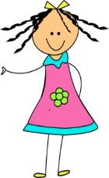
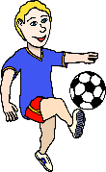
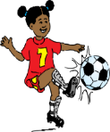
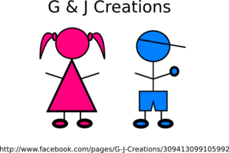
Partenaire B
écouter / écrire
lire
Listen to your partner, tick the correct picture, write the French then compare:
1) 5)
2) 6)
3) 7)
4) 8)
Notes:
Partner B’s response sheet

Slide 5
Partenaire A
écouter / écrire
Listen to your partner, tick the correct picture, write the French then compare:
1) 5)
2) 6)
3) 7)
4) 8)
Notes:
Partner A’s response sheet

Slide 6
Exemple :
écouter / écrire
Partenaire A
Partenaire B
eg)
1)
She listens
______________
__Elle écoute__
elle écoute
Notes:
Teachers could use this slide to model the instructions to the class.

Slide 7
Exemple :
parler / écrire
Partenaire A
Partenaire B
They (m) sing
_______________
1)
eg)
ils chantent
ils chantent
Notes:
Again, this could be used to model the instruction, this time with 3rd person plural. This is a valuable step to illustrate how the listener will need to think really carefully about singular and plural.

Slide 8
Réponses B :
écouter / écrire
Listen to your partner, tick the correct picture, write the French then compare:
1) 5)
2) 6)
3) 7)
4) 8)
Notes:
Partner B Answers
Teachers could elicit the spoken form from the students, then the animated circle appears to show the correct answer.
He studies / il étudie
They (m) play / ils jouent
They (m) sing / ils chantent
She listens / elle écoute
They (f) eat / elles mangent
He wears / il porte
She gives / elle donne
They (f) walk / elles marchent

Slide 9
Réponses A :
écouter / écrire
Listen to your partner, tick the correct picture, write the French then compare:
1) 5)
2) 6)
3) 7)
4) 8)
Notes:
Partner A Answers
They (f) sing / elles chantent
He listens / il écoute
They (m) eat / ils mangent
They (f) play / elles jouent
She studies / elle étudie
She wears / elle porte
They (m) give / ils donnent
He walks / il marche

Slide 10
Réponses :
parler / écrire
Partenaire A
Partenaire B
He studies _____________________
They (m) play __________________
They (m) sing __________________
She listens _____________________
They (f) eat _____________________
He wears ______________________
She gives ______________________
They (f) walk ___________________
They (f) sing ___________________
He listens _____________________
They (m) eat __________________
They (f) play___________________
She studies ____________________
She wears _____________________
They (m) give __________________
He walks ______________________
il étudie
ils jouent
ils chantent
elle écoute
elles mangent
il porte
elle donne
elles marchent
elles chantent
il écoute
ils mangent
elles jouent
elle étudie
elle porte
ils donnent
il marche
Notes:
Written answers.

Slide 11
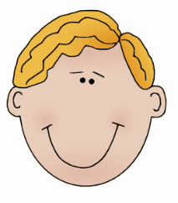
Qui fait quoi ?
parler / écouter / écrire
Parternaire B
Listen to your partner. Who does what?
Write the English under the correct image.
Translate these sentences into French:
The dog plays outside.
The teachers speak English.
The girls eat at school.
The dogs play in the sand.
The girl eats lunch.
The teacher speaks French.
Notes:
7.1.2.6
Partner B’s prompt sheet
Worked example here:
Partner A says: ‘Le garçon étudie l’histoire.’
Partner B finds the picture of one boy (singular) and writes in English next to the picture ‘studies History’.
Partners then swap roles completing this step for all 6 pictures.
At the end of the activity:
Partner B then writes the French for the full sentence underneath the picture: ‘Le garçon étudie l’histoire,’ says it back to their partner in French to practise pronunciation and checks his/her written French version against the original written French version that his/her partner wrote at the start to check if the verb endings match.

Slide 12
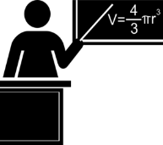
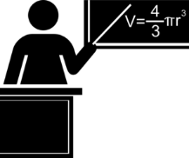
Activity sheet
Partenaire A
Partenaire B
plays outside
play in the sand
studies history
study at home
Le chien joue dehors.
Les chiens jouent dans le sable.
Le garçon étudie l’histoire.
Les garçons étudient à la masion.
eat at school
eat at home
prepares the fruit
prepare lunch
Les filles mangent à l’école.
La fille mange à la maison.
Les mères préparent le déjeuner.
La mère prépare le fruit.
speaks French
speak English
listen to the radio
listens to the girl
Le professeur parle français.
Les professeurs parlent anglais.
Les médecins écoutent la radio.
Le médecin écoute la fille.
Notes:
7.1.2.6
Answer slide
Final slide with French and English of all 12 sentences for checking.
This is what students’ sheets will look like on completion of the activity.

Slide 13
Vocabulaire
parler
Il y a quoi? Parle en français. Écris en anglais!
Exemple:
Partenaire A
Say there are these things il y a ... | Write here what your partner says there is
1) | 1)
Partner A écrit…
a computer
a boy
Il y a un ordinateur.
Partenaire B
Say there are these things il y a ... | Write here what your partner says there is
1) | 1)
Partner B écrit…
a boy
a computer
Il y a un garçon.
Notes:
7.2.1.1
Timing: 10 minutes
Aim: This example shows how the speaking task is intended to work. The stages are animated to support the teacher in modelling the task.
Procedure:
1. The students alternate in saying what is on their prompt sheets and writing what their partner has just said.
2. The full task (with answers animated) is displayed on the next slide.

Slide 14
Réponses - Partenaire A
parler
Il y a quoi? Parle en français. Écris en anglais!
Say there are these things il y a ... | Write here what your partner says there is
1) | 1)
2) | 2)
3) | 3)
4) | 4)
5) | 5)
6) | 6)
7) | 7)
8) | 8)
what Partner B said
a computer
a boy
un garçon
a house
four cars
quatre voitures
twelve cars
two girls
deux filles
five boys
seven computers
sept ordinateurs
three shops
nine people
neuf personnes
ten men
five shops
cinq magasins
two people
a window
a window
four girls
two houses
deux maisons
Notes:
7.2.1.1
ANSWERS for Partner A N.B. This slide should not be displayed during the activity!
Aim: This is to keep all students involved, and to provide additional whole class practice.
Procedure:
1. Answers are animated. English appears first, then the French.
2. Teacher elicits English from Partners A, and French from Partners B, either chorally or individually, as preferred.
Note: the left hand column is greyed out to help students focus on the correct part of their sheet.

Slide 15
Réponses - Partenaire A
parler
Il y a quoi? Parle en français. Écris en anglais!
Say there are these things il y a ... | Write here what your partner says there is
1) | 1)
2) | 2)
3) | 3)
4) | 4)
5) | 5)
6) | 6)
7) | 7)
8) | 8)
what Partner A said
a boy
a computer
un ordinateur
four cars
a house
une maison
two girls
twelve cars
douze voitures
seven computers
five boys
cinq garçons
nine people
three shops
trois magasins
five shops
ten men
dix hommes
a window
two people
deux personnes
two houses
four girls
quatre filles

Slide 16
Je suis quoi?
Remember!
le, la, les the
un, une, des – a
écouter / parler (1/2)
Je fais mes devoirs et je travaille bien en classe. Je suis quoi?
Tu es … tu es une école?
Non … c’est un adjectif.
Ah, ah! Tu es sage !
Oui, c’est ça! Je suis sage !
Notes:
7.2.2.1 (6 slides)
This example slide prepares students for the vocabulary revisit task that follows.
1/ Students read Amir’s question and try to think of a suitable answer. They may guess étudiant(e), intelligent(e) etc.
2/ Teacher brings up a possible answer, une école, and the partial sentence ‘___ ___ une école?’ Teacher to point to the use of the indefinite article, here. It sounds more natural to ask ‘Are you a school?’ than ‘Are you the school?’ Students may need a reminder about changing from definite to indefinite article before they begin.
3/ Ask students to guess the missing words. They may need a reminder about the conjugation of être.
4/ Reveal answer on click.
5/ Bring up the third speech bubble. Draw attention to the French interjection ‘ah, ah !’
6/ Bring up solution. Check understanding of ‘c’est ça !’

Slide 17
Je suis quoi?
écouter / parler (1/2)
que
le frère
rester à la maison
normalement
la raison
demander
la sœur
strict(e)
jeune
l’exemple
montrer
penser
sage
parler
l’école
ouvert(e)
le parent
Notes:
Vocabulary revisit using the Je suis quoi? role cards, which can be found on the portal alongside this resource.
Here, Partner A reads the sentences on their role card. Partner B listens and answers ‘Tu es…’ followed by one of the words on the board.
Before beginning the activity, the teacher should check that students are comfortable with changing definite articles to indefinite articles.
(Partenaire A)
1) Je suis un enfant et je suis une fille. Je suis quoi? (la sœur -> une sœur)
2) Je suis un modèle. Je suis quoi? (l’exemple -> un exemple)
3) J’ai quatre enfants. Je suis quoi? (le parent -> un parent)
4) J’aime les règles. Je suis quoi? (strict(e))
5) Il y a des ordinateurs, des professeurs et un tableau ici. Je suis quoi? (l’école-> une école)

Slide 18
Je suis quoi? (réponses)
écouter / parler
Je suis un enfant et je suis une fille. Je suis quoi? Je suis ... une sœur!
Je suis un modèle. Je suis quoi? Je suis ... un exemple!
J’ai quatre enfants. Je suis quoi? Je suis ... un parent!
J’aime les règles. Je suis quoi? Je suis ... strict(e)!
Il y a des ordinateurs, des professeurs et un tableau ici. Je suis quoi? Je suis ... une école!
Remember!
If you are a female person, add an –e to the adjective.
Notes:
Answers revealed on clicks.

Slide 19
Je fais quoi?
écouter / parler (2/2)
Remember!
The verb ends in –e when talking about yourself …
And in –es when talking to someone else
Je trouve une solution !
Je fais quoi?
Tu penses?
___ ___
Oui, c’est ça ! Je pense !
Je trouve une solution ! – I’m finding a solution! Je fais quoi? What am I doing?
Tu penses? – Are you thinking? Je pense. – I’m thinking.
All verbs are in the present continuous because the actions are happening now.
_____________________________
_____________________________
_____________________________
Notes:
This example slide prepares students for the vocabulary revisit task that follows.
1/ Students read Léa’s question and try to think of a suitable answer in the tu form. They may need a reminder about second person singular verb ending. Students may guess tu donnes, tu parles etc.
2/ Teacher brings up a possible answer, tu penses, and asks students how Léa would confirm this in the je form. What changes about the verb? Answer revealed on click.
3/ Teacher now brings up the questions and answers in the dialogue, and asks students to think about how they might translate these into English. Do they need present simple or continuous here? Why?

Slide 20
Je fais quoi?
écouter / parler (2/2)
que
le frère
rester à la maison
normalement
la raison
demander
la sœur
strict(e)
jeune
l’exemple
montrer
penser
sage
parler
l’école
ouvert(e)
le parent
Notes:
Vocabulary revisit using the Je fais quoi? role cards, which can be found on the portal alongside this resource.
Here, Partner B reads the sentences on their role card. Partner A listens and answers ‘Tu …’ followed by one of the verbs on the board in the second person singular.
Before beginning the activity, the teacher should check that students are comfortable with verb forms in the first and second person singular.
Prompts (Partenaire B)
1) J’ai une question pour le professeur. Je fais quoi? (demander -> je demande)
2) Je suis en conversation avec mes amis. Je fais quoi? (parler -> je parle)
3) J’ai une idée ! Je fais quoi? (penser -> je pense)
4) Je suis dans mon lit en ce moment. Je fais quoi? (rester à la maison -> reste à la maison)
5) Je donne une photo à Paul. Je fais quoi? (montrer -> montre)

Slide 21
Je fais quoi? (réponses)
écouter / parler (2/2)
J’ai une question pour le professeur. Je fais quoi? Je ... demande!
Je suis en conversation avec mes amis. Je fais quoi? Je... parle!
J’ai une idée ! Je fais quoi? Je... pense!
Je suis dans mon lit en ce moment. Je fais quoi? Je ... reste à la maison!
Je donne une photo à Paul. Je fais quoi? Je ... montre!
Notes:
Answers revealed on clicks.

Slide 22
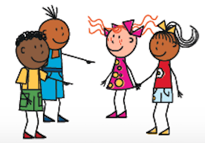
Qui va où ?
parler
Qui va où ?
Qui va où ? Partenaire A & B
Partenaire A & B
Use the pictures to make up a sentence about where he (il) or she (elle) is going, or they (il/elle) are going. Say the sentence to your partner, who has to translate it into English. Swap roles. Repeat four times.
Léa’s
il
ils
Amir’s
elle
elles
Notes:
7.2.2.4
Timing: 5 minutes
Aim: Paired speaking activity to practice production and recognition of forms of aller in third person singular and plural together with the correct use of the preposition ‘à’, ‘en’ and ‘chez’ plus destination vocabulary as previously presented.
Procedure:
This speaking activity requires students to work in pairs, one generating a French sentence using the pictures for inspiration, which the other will translate into English.
Partners alternate roles each time, each producing and translating a total of five sentences.

Slide 23
Qui va où ?
écrire
Qui va où ?
Qui va où ?
Use the pictures to make up six sentences: two about where he (il) is going, two about where she (elle) is going, and two about where they (ils/elles) are going. Write the sentences down and give them to your partner, who has to write them in English.
Do the same for your partner’s sentences.
Léa’s
il
ils
Amir’s
elle
elles
Notes:
7.2.2.4
Optional written production task. (This could be set as an additional homework activity – omitting the pair work element.)
Timing: 10 minutes
Aim: Written production practice of forms of aller in third person singular and plural together with the correct use of the preposition ‘à’, ‘en’ and ‘chez’ plus destination vocabulary as previously presented.
Procedure:
Students should create six sentences in French, using the pictures for inspiration.
Two sentences should use the subject pronoun ‘il’, two more should use the subject pronoun ‘elle’, and the remaining two should use ‘ils’ or ‘elles’.
Students should hand their French sentences to their partner, who will then write a translation of each sentence in English. This is reciprocated.

Slide 24
Vrai ou faux ?
Vrai ou faux ?
parler
 |  | oui / non | vrai / faux
1) | __________: tu es content(e) aujourd’hui.
2) | __________: tu as un animal.
3) | __________: tu aimes la couleur rouge.
4) | __________: tu regardes un film le week-end.
5) | __________: tu écoutes la musique rock.
6) | __________: tu chantes bien.
7) | __________: tu manges un fruit chaque jour.
8) | __________: tu marches à l’école.
Notes:
7.3.1.1
Timing: 10 minutes
Aim: Oral production and aural comprehension of questions and answers.
Procedure:
In this speaking activity, students have to guess each others’ answers to a set of questions, then ask them the question to find out if their guess was correct.
The questions can be written out before speaking if the group would benefit from the extra support and processing time.
This could be done in several ways:
In groups (ideally of 8): students write 1-8 and the name of a different group member for each statement, and predict their answer by writing ‘oui’ / ‘non’. They then take turns to ask each other the questions, marking ‘vrai’ if their guess was correct and ‘faux’ if not. One point for each correct guess.
In pairs: students simply guess their partner’s answer to each question and ask each other the questions to check.
4. The next slide includes a more challenging version of this task, where the statements are written in the 3rd person, so students must change the verb form as well as the word order – delete as necessary.
Frequency rankings (1 is the most frequent word in French):
musique [1139], week-end [2475], rock [4081]
Source: Londsale, D., & Le Bras, Y. (2009). A Frequency Dictionary of French: Core vocabulary for learners London: Routledge.

Slide 25
Habiter à Alger
Habiter à Alger
écrire
Amir écrit à Abdel. Lis la réponse d’Abdel. Amir dit quoi ? Écris les questions.
>> RE : Habiter à Alger, c’est comment ?
Salut Amir,
Oui, [1] j’aime habiter à Alger ! [2] J’aime étudier à l’université, et [3] j’aime mes professeurs. Souvent, [4] je parle français en classe. [5] Je travaille aussi, et [6] je sors chaque week-end. [7] Oui, j’aime devenir adulte. Rarement, [8] je vais à l’étranger. [9] Je prends la voiture. [10] Je reviens en France, mais c’est cher !
Abdel
Objet : Habiter à Alger, c’est comment ?
Salut Abdel,
[1] Aimes-tu habiter à Alger ?
[2] Aimes-tu étudier à l’université ?
[3] Aimes-tu tes professeurs ?
[4] Parles-tu français en classe ?
[5] Travailles-tu aussi ?
[6] Sors-tu chaque week-end ?
[7] Aimes-tu devenir adulte ?
[8] Vas-tu à l’étranger ?
[9] Prends-tu la voiture?
[10] Reviens-tu en France ?
Notes:
7.3.1.2
Timing: 10 minutes
Aim: Written production of one- and two-verb inversion questions.
Procedure:
Students write 1-10 and write a question for each statement in bold.
Answers appear on clicks.
Word frequency of cognates used (1 is the most frequent word in French): adulte [1580]
Source: Londsale, D., & Le Bras, Y. (2009). A Frequency Dictionary of French: Core vocabulary for learners London: Routledge.

Slide 26
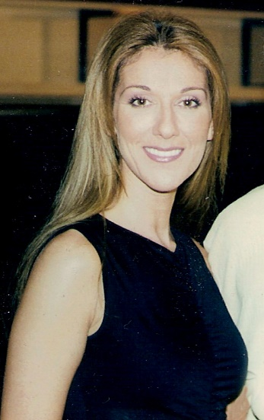
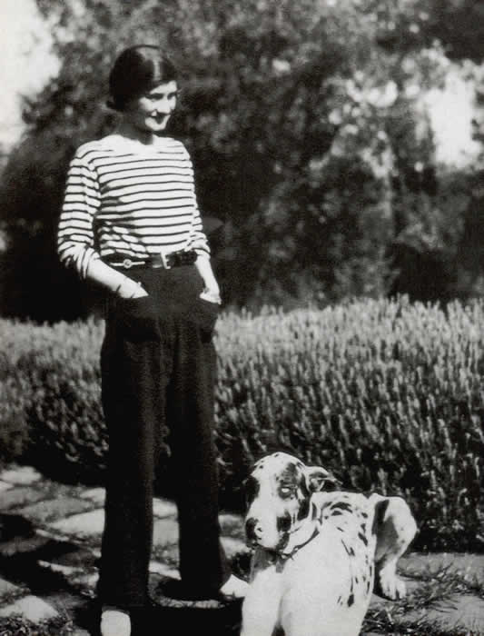
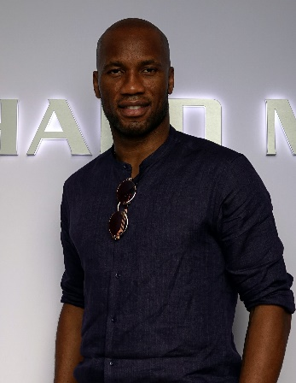
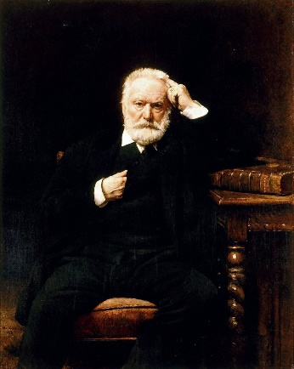
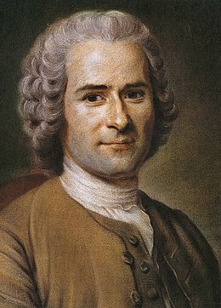
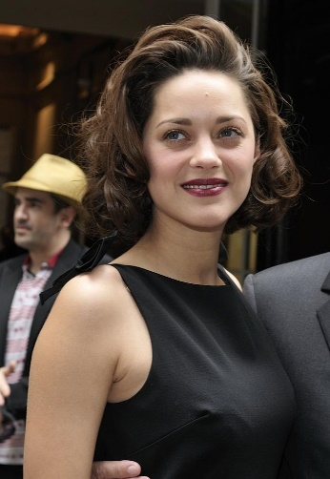
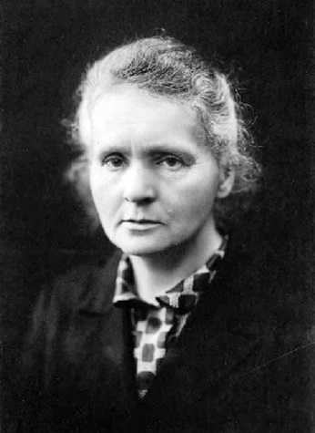
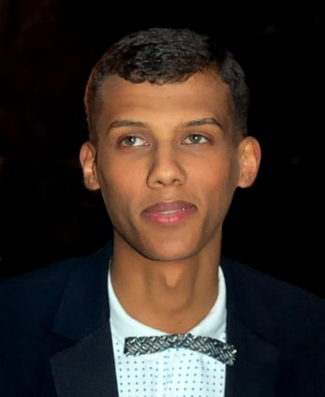
Qui fait quoi ?
Qui fait quoi ?
Exemple
Coco Chanel est-elle française ?
écouter / parler
Fais des questions avec:
être
venir
habiter
travailler
aimer
créer
changer
gagner
jouer
écrire
étudier
chanter
parler
…
Coco Chanel
Didier Drogba
Victor Hugo
Céline Dion
Jean-Jacques
Rousseau
Marion Cotillard
Marie Curie
Stromae
Notes:
7.3.1.2
Timing: 8 minutes
Aim: Oral production of subject repetition in inversion questions
Procedure:
Students ask yes/no questions in the 3rd person to try and recall as many facts as possible about the figures.
Having printed the bios single-sided (see 7.2.2.5 resource), distribute page 1 (the top row on this slide) to Partner A, and page 2 (the bottom row on this slide) to Partner B. Partner A asks a yes/no question about one of Partner B’s famous francophones. Partner B responds ‘oui’ if the question matches the information in the bio, or ‘non’ if it contradicts the bio, or if the information is not given in the bio. Swap roles after each question, moving onto a different celebrity each time. Each correct guess gets 1 point.
The level of difficulty can be varied according to the needs of the class, eg:
Students work purely from guesswork / their memory of the figures from 7.2.2.5.
Students have a limited amount of time to read the other partner’s bios (without taking notes) before the questioning stage.
Students have a limited amount of time to read the bios and take notes before the questioning stage.
4. The questioning stage could also be carried out in different ways, eg:
In groups, with two or more students sharing the ‘Partner A’ / ‘Partner B’ role.
In teams, with teams of students asking questions to the teacher and competing for points.
As a class, with all students asking questions to the teacher, non-competitively, to recall as much information as possible.
Images from: https://fr.wikipedia.org/

Slide 27
Elle est comment? Il est comment?
Il/Elle est comment ?
écrire / parler / écouter
Student A: Dis une description de l’artiste.
Exemples :
✓ + manger des carottes → Elle mange des carottes.
✗ + regarder la télé → Elle ne regarde pas la télé.
_________________________
_________________________
Student B: Ecoute, coche (✓) et écris la description. Exemples :
✓ + manger des carottes → Elle mange des carottes.
✗ + regarder la télé → Elle ne regarde pas la télé.
1. | manger des carottes | ✓ |  | Elle mange des carottes.
2. | regarder la télé |  | ✓ | Elle ne regarde pas la télé.
Notes:
7.3.1.4
In-class version (NB: a home-learning version of this activity can be found on slides 51-52).
Timing: 10 minutes
Aim: Oral production and aural comprehension of affirmative and negative sentences.
Procedure:
1. Print copies of the accompanying worksheet for this task, which can be found on the portal alongside this resource. Print once, cut widthways. Contents = two grids for describing, two grids for asking/writing. One top grid and one bottom grid for each student.
2. Student A says the appropriate positive or negative sentence in the 3rd person singular from the cues/phrases in the infinitive. Teacher can use this slide to practise eliciting sentences from a positive and negative prompt.
3. Student B listens, and ticks the correct information (i.e. puts a ✓ for affirmative and a ✗ for negative statements) and transcribes what Student A says. At more advanced levels, student B can transcribe the sentence in full. 4. Continue until all phrases are completed.
5. Swap roles.
6. Peer-correct answers.
7. Teacher displays whole sentence for whole class correction.
Word frequency of cognates used (1 is the most frequent word in French): sexisme [>5000]
Source: Londsale, D., & Le Bras, Y. (2009). A Frequency Dictionary of French: Core vocabulary for learners London: Routledge.
Disclaimer: all facts true to our knowledge, source: Wikipedia.fr

Slide 28
Elle est comment? Il est comment?
Il/Elle est comment ?
écouter / parler
Gims
Angèle
Elle est chanteuse.
Elle n’est pas française.
Elle vient de l’étranger.
Elle a un frère.
Elle est sur Instagram.
Elle n’aime pas le sexisme.
Elle travaille en France.
Elle est jeune.
Elle ne chante pas en Angleterre.
Il est chanteur.
Il chante le rap.
Il n’est pas jeune.
Il parle français.
Il n’est pas français.
Il n’habite pas à Londres.
Il habite à Paris.
Il écoute Eminem.
Il crée des vêtements.
Notes:
Answers to activity

Slide 29
Elle est comment? Il est comment?
parler
Il/Elle est comment ?
Check your pronunciation by clicking on the arrows.
Avec la liste de verbes, dis une description de l’artiste.
Exemples :
✓ + manger des carottes → Elle mange des carottes.
✗ + regarder la télé → Elle ne regarde pas la télé.
✓ être chanteuse
✗ être française
✓ venir de l’étranger
✓ avoir un frère
✓ être sur Instagram
✗ aimer le sexisme
✓ travailler en France
✓ être jeune
✗ chanter en Angleterre
Elle est chanteuse.
Elle n’est pas française.
Elle vient de l’étranger.
Elle a un frère.
Elle est sur Instagram.
Elle n’aime pas le sexisme.
Elle travaille en France.
Elle est jeune.
Elle ne chante pas en Angleterre.
Elle ne chante pas en Angleterre
Notes:
Home-learning version (NB: an in-class version of this activity can be found on slides 49-50).
Transcript:
Elle est chanteuse.
Elle n’est pas française.
Elle vient de l’étranger.
Elle a un frère.
Elle est sur Instagram.
Elle n’aime pas le sexisme.
Elle travaille en France.
Elle est jeune.
Elle ne chante pas en Angleterre.

Slide 30
Parlez en français!
Parlez en français !
écouter / parler
Écoute ton/ta partenaire. Coche la description correcte ou écris la description en anglais.
Use the correct form of the adjective in French (masculine/feminine) in the correct position (before/after the noun).
e.g. C’est une matière facile.
[easy subject]
Notes:
7.3.1.6
Timing: 10 minutes for 6 slides
Aim: Oral and written production of sentences containing pre- and post-nominal adjectives in masculine and feminine forms.
Procedure:
1. Print and distribute the role cards and answer grids, available as a separate document on the NCELP Resource Portal. NB: The more challenging version removes the noun and adjective prompts from the answer grid.
2. Use this slide to model the speaking task.
3. Explain that students will take turns to describe what is in each box on their role card. The listening students ticks (or sketches/describes in words, if using the more challenging version) what they imagine the box to contain on their response sheet.
4. Peer-correction by comparing answer sheets.
5. Students use the notes they have taken to write full sentences about what appears on their partners’ cards. Suggested answers are displayed on the following slides.
N.B. in this task it has been impossible to make the grammar, in terms of the position of the adjective, task-essential (i.e. students can put the adjective before or after the noun and meanings will still be successfully conveyed). Teachers should circulate and listen in, offering feedback to prompt students to correct their adjectival placement as necessary.
Word frequency of cognates used in task instructions (1 is the most frequent word in French): description [2779], correct [2617]
Source: Londsale, D., & Le Bras, Y. (2009). A Frequency Dictionary of French: Core vocabulary for learners London: Routledge.

Slide 31
Parlez en français!
Parlez en français ! (A)
parler
A
1
2
3
Hahaha
[new building]
[intelligent girl]
[funny teacher]
5
[good question]
4
6
[beautiful idea]
[interesting subject]
Notes:
DO NOT DISPLAY. There is a student worksheet for this activity, which can be downloaded from the NCELP Resource Portal and printed out.
Home learning – the audio for each complete French sentence is accessible upon clicking the button.
Transcript
1. C’est un nouveau bâtiment.
2. C’est une fille intelligente.
3. C’est un professeur drôle.
4. C’est une belle idée.
5. C’est une matière intéressante.
6. C’est une bonne question.

Slide 32
Parlez en français!
Parlez en français ! (B)
parler
B
1
2
3
[beautiful building]
[new girl]
[interesting teacher]
[funny question]
4
5
6
Hahaha
[intelligent idea]
[good subject]
Notes:
DO NOT DISPLAY. There is a student worksheet for this activity, which can be downloaded from the NCELP Resource Portal and printed out.
Students have to describe what is in each box – their partner has to specify what they say, on one of the response sheets which follows. This is Partner B’s card. Two answer grids – an easier and a more difficult one – follow on the next two sides.
Home learning – the audio for each complete French sentence is accessible upon clicking the button.
Transcript
1. C’est un beau bâtiment.
2. C’est une nouvelle fille.
3. C’est un professeur intéressant.
4. C’est une idée intelligente.
5. C’est une bonne matière.
6. C’est une question drôle.

Slide 33
Veux-tu faire ça?
parler / écouter
Tu veux faire une activité avec un(e) ami(e). Va-t-il / va-t-elle dire oui ou non ?
Fais des questions et donne des réponses avec un(e) partenaire.
Exemple 1:
A: Veux-tu regarder la télé ensemble ?
B: Oui, je veux regarder la télé ensemble !
Questions
Réponses
→ 2 points
Exemple 2:
A: Veux-tu regarder la télé ensemble ?
B: Peut-être… Tu dois encore demander demain !
Partenaire A
Partenaire B
→ 1 point
Exemple 3:
A: Veux-tu regarder la télé ensemble ?
B: Désolé(e), je ne veux pas regarder la télé. Je dois faire le ménage !
→ 0 points
Notes:
7.3.2.6
NB: This is the in-class version (a self-study version of this activity can be found on the following slide).
NB: A less challenging, structured speaking exercise can be found on slides 43-44.
Timing: 8 minutes
Aim: This paired speaking activity consolidates the lesson’s work on modal verbs in questions and negative sentences, in the context of making, accepting and refusing invitations.
Procedure:
1/ Print cards and divide into two piles: questions / answers. Shuffle each pile and place face down.
2/ Partner A takes a question card and asks a question using vouloir + the verb phrase on the prompt.
3/ Partner B takes an answer card. If "oui", reply using vouloir + verb phrase from the question. If "peut-être", reply using devoir + verb phrase on the prompt. If "désolé(e)", reply using ne pas vouloir + verb phrase from the question, followed by devoir + verb phrase on the prompt (see examples on the slide). In other words, oui cards contain an acceptance, peut-être cards contain a condition, désolé(e) cards contain a rejection and an excuse.
4/ Partner B gives the answer card to Partner A. They swap roles.
5/ At the end, each partner tallies up the marks from the answer cards they have been given: oui (2 points), peut-être (1 point) and désolé(e) (0 points). The partner with the most points (ie the most acceptances) wins!

Slide 34
Veux-tu faire ça?
parler / écouter
Tu veux faire une activité avec un(e) ami(e). Va-t-il / va-t-elle dire oui ou non ?
Écoute ton/ta partenaire. Fais des questions (Q) et donne des réponses (R).
Exemple 1:
A: Veux-tu regarder la télé ensemble ?
B: Oui, je veux regarder la télé ensemble !
Exemple 2:
A: Veux-tu regarder la télé ensemble ?
B: Peut-être… Tu dois demander encore demain !
Exemple 3:
A: Veux-tu regarder la télé ensemble ?
B: Désolé(e), je ne veux pas regarder la télé. Je dois faire le ménage !
Notes:
NB: This is the self-study version (an in-class version of this activity can be found on the previous slide).
NB: A less challenging, structured speaking exercise can be found on slides 43-44.
Example conversations to prepare for the task on the following slide.

