Slide 1
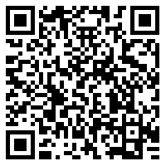
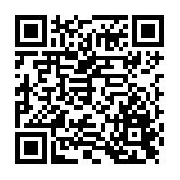
Hausaufgaben
Vocabulary Learning Homework (Y9, Term 3.1 Week 1)
Audio file
Audio file QR code:
Student worksheet
Quizlet link
Quizlet QR code:
In addition, revisit: Term 1.2 Week 1
Term 2.1 Week 5
Notes:
Use this slide to set homework. Student worksheet answers:

