Slide 1
What is it? Existential
Definite articles: the words for ‘the’
SSC [e:] and [ɛ]
Y7 German
Term 1.1- Week 2 - Lesson 3
Rachel Hawkes
Artwork: Steve Clarke
Date updated: 15/12/21
Notes:
Artwork by Steve Clarke. All additional pictures selected are available under a Creative Common license; no attribution required.
Learning outcomes (lesson 1):
Introduction of SSC [e:] and [ɛ] (long and short ‘e’)
Consolidation of definite articles (singular): der, die, das
Word frequency (1 is the most frequent word in German):
7.1.1.2 (introduce) sagen, sagt [40] was?[38] Klasse [961] Mann [121] Paar [241] Tag [111] falsch [524] richtig [177] oder [35] ja1 [45] nein [148] nicht [11] Ist das klar? [n/a]
Source: Jones, R.L. & Tschirner, E. (2019). A frequency dictionary of German: core vocabulary for learners. Routledge

Slide 2
e
geben
Notes:
Timing: 1 minute
Aim: To introduce/consolidate [] SSC [ei]
Procedure: 1. Present the letter(s) and say the [ei] sound first, on its own. Students repeat it with you. 2. Bring up the word ”frei” on its own, say it, students repeat it, so that they have the opportunity to focus all of their attention on the connection between the written word and its sound.
3. A possible gesture for this would be [to stretch both arms up in the air (pointing outwards slightly to make a Y shape with your body), and smile!]
4. Roll back the animations and work through 1-3 again, but this time, dropping your voice completely to listen carefully to the students saying the [ei] sound, pronouncing ”frei” and, if using, doing the gesture. Word frequency (1 is the most frequent word in German): frei [318] Source: Jones, R.L. & Tschirner, E. (2006). A frequency dictionary of German: core vocabulary for learners. Routledge

Slide 3
e
geben
Notes:
With sound and no pictures to focus all attention on the sound-symbol correspondence.

Slide 4
e
geben
Notes:
Without sound to elicit pronunciation (without first hearing the teacher).
Teacher to elicit pronunciation by asking “Wie sagt man…”

Slide 5
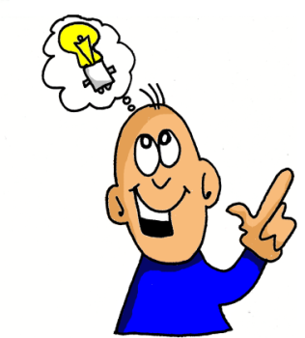
e
mehr
Leben
geben
sehen
Idee
Meer
Notes:
Timing: 1 minute
Aim: To introduce/consolidate SSC [e]
Procedure:
Introduce and elicit the pronunciation of the individual SSC [e] and then the source word again ‘geben’ (with gesture, if using).
Then present and elicit the pronunciation of the five cluster words.
The cluster words have been chosen for their high-frequency, from a range of word classes, with the SSC (where possible) positioned within a variety of syllables within the words (e.g. initial, 2nd, final etc.). Additionally, we have tried to use words that build cumulatively on previously taught SSCs (see the Phonics Teaching Sequence document) and do not include new SSCs. Where new SSCs are used, they are often consonants which have a similar symbol-sound correspondence in English.
Word frequency (1 is the most frequent word in German): geben [57]; mehr [58] Leben [220]; sehen [81]; Meer [977]; Idee [641].
Source: Jones, R.L. & Tschirner, E. (2006). A frequency dictionary of German: core vocabulary for learners. Routledge

Slide 6
e
mehr
Leben
geben
sehen
Idee
Meer
Notes:
With sound and no pictures to focus all attention on the sound-symbol correspondence.

Slide 7
e
mehr
Leben
geben
sehen
Idee
Meer
Notes:
Without sound to elicit pronunciation (without first hearing the teacher).
Teacher to elicit pronunciation by asking “Wie sagt man…”

Slide 8
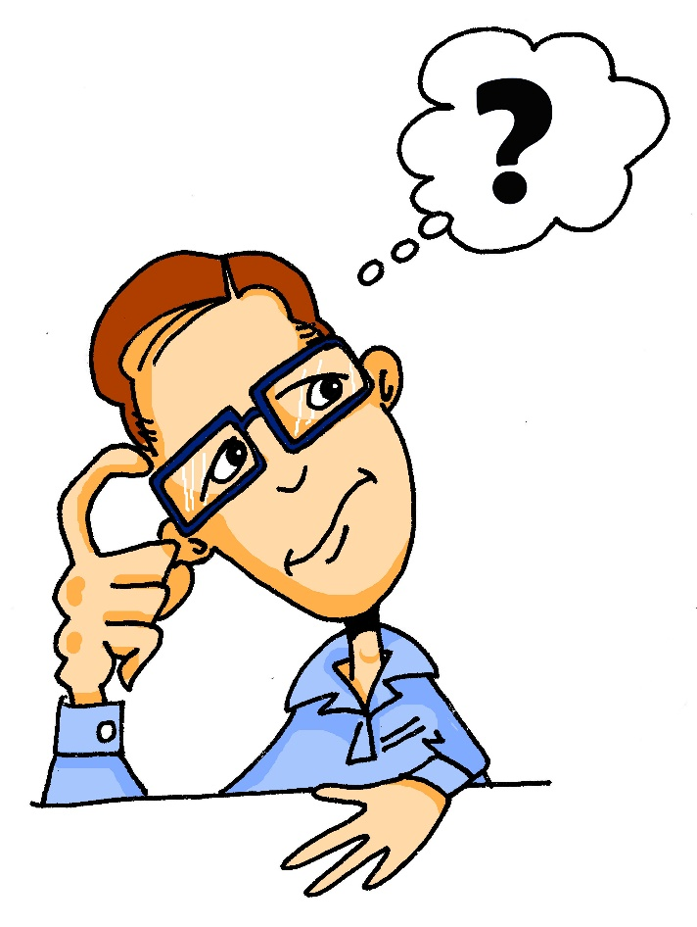
e
denken
Notes:
Timing: 1 minute
Aim: To introduce/consolidate SSC [e]
Procedure: 1. Present the letter(s) and say the [e] sound first, on its own. Students repeat it with you. 2. Bring up the word ”denken” on its own, say it, students repeat it, so that they have the opportunity to focus all of their attention on the connection between the written word and its sound.
3. A possible gesture for this would be to put your index finger to your temple and look thoughtful!
4. Roll back the animations and work through 1-3 again, but this time, dropping your voice completely to listen carefully to the students saying the [e] sound, pronouncing ”denken” and, if using, doing the gesture. Word frequency (1 is the most frequent word in German): denken [124] Source: Jones, R.L. & Tschirner, E. (2006). A frequency dictionary of German: core vocabulary for learners. Routledge

Slide 9
e
denken
Notes:
With sound and no pictures to focus all attention on the sound-symbol correspondence.

Slide 10
e
denken
Notes:
Without sound to elicit pronunciation (without first hearing the teacher).
Teacher to elicit pronunciation by asking “Wie sagt man…”

Slide 11
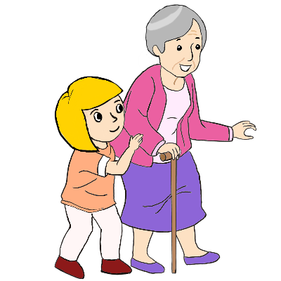
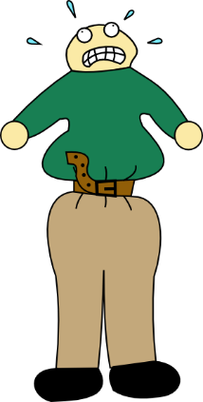
e
besser
Ende
denken
helfen
eng
Bett
Notes:
Timing: 2 minutes
Aim: To introduce/consolidate SSC [e]
Procedure:
Introduce and elicit the pronunciation of the individual SSC [e] and then the source word again ‘denken’ (with gesture, if using).
Then present and elicit the pronunciation of the five cluster words.
The cluster words have been chosen for their high-frequency, from a range of word classes, with the SSC (where possible) positioned within a variety of syllables within the words (e.g. initial, 2nd, final etc.). Additionally, we have tried to use words that build cumulatively on previously taught SSCs (see the Phonics Teaching Sequence document) and do not include new SSCs. Where new SSCs are used, they are often consonants which have a similar symbol-sound correspondence in English.
Word frequency (1 is the most frequent word in German): denken [124]; besser [231] Ende [204]; helfen [406]; Bett [654]; eng [591].
Source: Jones, R.L. & Tschirner, E. (2006). A frequency dictionary of German: core vocabulary for learners. Routledge

Slide 12
e
besser
Ende
denken
helfen
eng
Bett
Notes:
With sound and no pictures to focus all attention on the sound-symbol correspondence.

Slide 13
e
besser
Ende
denken
helfen
eng
Bett
Notes:
Without sound to elicit pronunciation (without first hearing the teacher).
Teacher to elicit pronunciation by asking “Wie sagt man…”

Slide 14
Phonetik
hören
Lang oder kurz?
 | geben | denken
1
Leben
2
Bett
3
besser
4
Ende
Notes:
Timing: 4 minutes Aim: To provide practice in distinguishing between lond and short vowel ‘e’ sounds Procedure: 1. Click on the audio buttons to play words.
2. Students listen and tick the appropriate column, according to wheter the vowel sound is short or long.
3. Click to animate the answers.
Transcript:
Leben
Bett
besser
Ende
Word frequency (1 is the most frequent word in German): Leben [220]; besser [231] Ende [204]; Bett [654] Source: Jones, R.L. & Tschirner, E. (2006). A frequency dictionary of German: core vocabulary for learners. Routledge

Slide 15
Grammatik
sprechen
der, die oder das?
60
die Flasche
der Mann
der Tisch
die Tafel
das Heft
das Fenster
das Paar
die Klasse
der Tag
0
LOS!
Notes:
Timing: 5 minutes Aim: To practise recall of the gender of the nouns presented last week (including phonics cluster words), by providing the definite article for each. Procedure: 1. Click on LOS!’ to start the one-minute timer.
2. Students have a minute to try to recall the obscured definites articles with a partner.
3. Teacher asks 'Was ist das?' Students respond.
4. Teacher models: ‘David sagt, das ist der Tag. Ist das richtig? Ja? Nein?’ and so on, until all answers are checked.
5. Click to reveal the answers in sequence (left-hand column from top to bottom, then right-hand column).
Word frequency (1 is the most frequent word in German): die Flasche [1762] das Fenster [634] das Heft [3598] die Tafel [3660] der Tisch [494] die Klasse [961] der Mann [121] das Paar [241] der Tag [111] Source: Jones, R.L. & Tschirner, E. (2011). A frequency dictionary of German: core vocabulary for learners. Routledge

Slide 16
Vokabeln
hören
Wie schreibt man das? Und auf Englisch?
 | sagen | to say, tell
 | sagt | says, tells
 | was? | what?
 | die Klasse | class
 | der Mann | man
 | das Paar | pair
 | der Tag | day
1
2
3
4
5
6
7
Notes:
Timing: 10 minutes (both slides)
Aim: To practise understanding the vocabulary for this week in the oral modality.
Note: Students in Y8 pre-learn vocabulary on Quizlet, additionally completing several tasks. This activity provides an additional step; listening and understanding the new vocabulary.
Procedure: 1. Click to hear the word in German. 2. Write down the meaning in English. 3. Click to check answers.
4. Vocabulary items 8-14 are on the following slide. Transcript: 1. sagen
2. sagt
3. was?
4. die Klasse
5. der Mann
6. das Paar
7. der Tag

Slide 17
Vokabeln
hören
Wie schreibt man das? Und auf Englisch?
 | falsch | false, wrong
 | richtig | right, correct
 | nicht | not
 | oder | or
 | ja | yes
 | nein | no
8
9
10
11
12
13
Notes:
Continued from previous slide.
Procedure: 1. Click to hear the word in German. 2. Write down the meaning in English. 3. Click to check answers. Transcript: 8. falsch
9. richtig
10. nicht
11. oder
12. ja
13. nein

Slide 18
Vokabeln - der, die oder das?
sprechen
Klasse
Tag
Flasche
Tisch
Mann
Paar
Tafel
Fenster
Heft
m
nt
f
Notes:
Timing: 5 minutes
Aim: To revise gender and word knowledge. Procedure: 1. The 9 nouns from Weeks 1 and 2 appear on separate mouse clicks. Say the word (chorally) with its definite article. 2. On second click, the noun moves into the ‘appropriately gendered’ mouth.

Slide 19
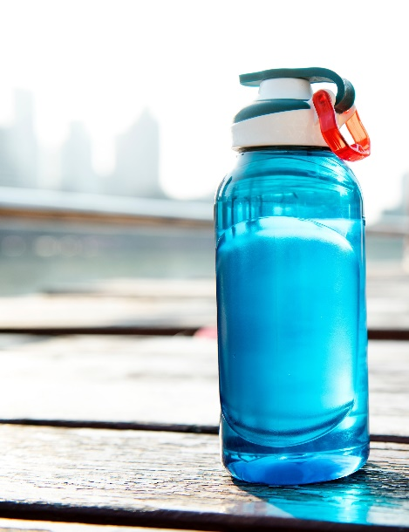
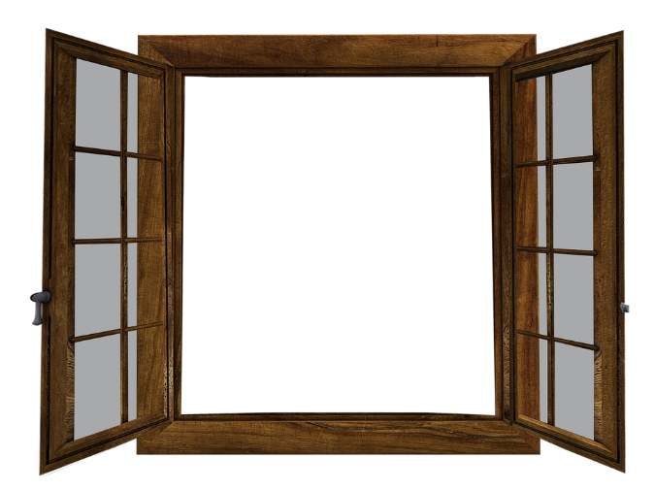
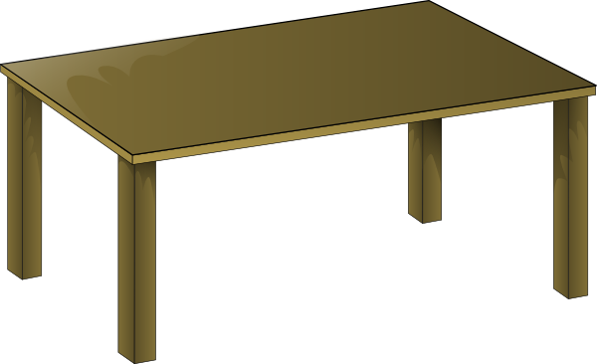
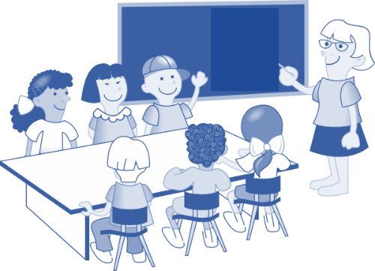
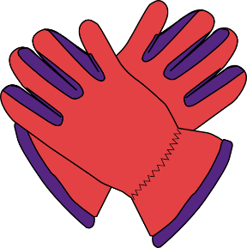
Vokabeln - der, die oder das?
sprechen
m
nt
f
Notes:
Timing: 5 minutes
Aim: To revise gender and word knowledge, this time the picture also prompting recall of the word itself. Procedure: 1. Pictures representing the 9 nouns from Weeks 1 and 2 appear on separate mouse clicks. Say the word (chorally) with its definite article. 2. On second click, the noun moves into the ‘appropriately gendered’ mouth.

Slide 20
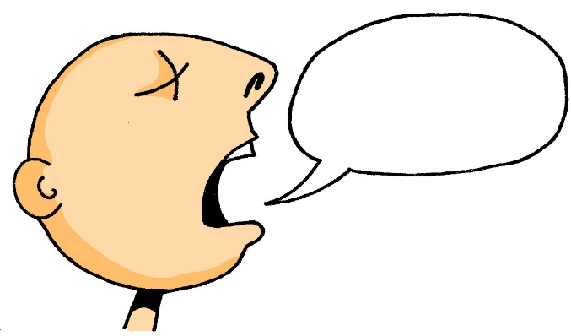
sagen
[to say / tell| saying / telling]
sagt
[says / tells | is saying / telling]
Notes:
Timing: 3 minutes for sequence of six verb slides
Aim: To introduce the verb sagen more explicitly.
Note: Sagen is one of the 25 most frequently used verbs in German. All 25 most frequent verbs will be introduced early on using the same format. Both long form (infinitive) and short form (3rd person singular) are introduced in order to familiarise students with various forms of the same verb.
Procedure:
Bring up the word sagen on its own, say it, students repeat it, and remind them of the phonics. Draw attention to the long ‘a’ sound.
Try to elicit the meaning from the students. Students have had explicit teaching that the present tense in German communicates two different present tense meanings in English. This reinforces that learning. Emphasise the two meanings for the short form, reminding students that German only has one form and does not have a direct equivalent of the grammar for ‘is + ing’, the continuous form (as covered later in the scheme of work).
Bring up the picture, and if using gestures, a possible gesture for this would be to mime speech coming out of your mouth, opening your mouth and drawing your hand away quickly away from you. Then bring up the English translations. Emphasise the two meanings for the infinitive.
Bring up the short form sagt, say it, students repeat it. Draw attention to the long ‘a’ sound.
Try to elicit the meaning from the students. Emphasise the two meanings for the short form.

Slide 21
sagen
[to say / tell| saying / telling]
sagt
[says / tells | is saying / telling]
Notes:
Cycle through the long and short form again.

Slide 22
sagt
[says / tells | is saying / telling]
Der Mann sagt nichts.
[The man says | is saying nothing.]
Notes:
Introduce the short form in a sentence.

Slide 23
sagen
[to say / tell | saying /telling]
Der Mann kann nichts sagen.
[The man can say nothing.]
Notes:
Introduce the long form in a sentence.

Slide 24
sagt
[says / tells| is saying / telling]
sagt
Der Mann ____ nichts.
[The man says | is saying nothing.]
Notes:
Cycle through the short form in context again.

Slide 25
sagen
[to say / tell | saying / telling]
sagen
Der Mann kann nichts_______.
[The man can say nothing.]
Notes:
Cycle through the long form in context again.

Slide 26
Vokabeln
lesen
was?
what?
Notes:
Timing: 2 minutes (all four ‘was?’ slides) Aim: To introduce the question word ‘was?’. Procedure: 1. Click on the mouse to bring up the word ‘was?’ – students repeat.
2. Bring up the meaning.
Word frequency (1 is the most frequent word in German): was [39] Source: Jones, R.L. & Tschirner, E. (2011). A frequency dictionary of German: core vocabulary for learners. Routledge

Slide 27
Vokabeln
sprechen
was?
what?
Notes:
Procedure: 1. Click on the mouse to bring up the word ‘was?’ – students repeat.
2. Elicit the meaning, then click to confirm.
Word frequency (1 is the most frequent word in German): was [39] Source: Jones, R.L. & Tschirner, E. (2011). A frequency dictionary of German: core vocabulary for learners. Routledge

Slide 28
Vokabeln
schreiben
was?
what?
Was denkst du?
[What do you think?]
Notes:
Procedure: 1. Click on the mouse to bring up the word ‘was?’ – students repeat.
2. Bring up the meaning.
3. Bring up the context sentence, and its meaning.
Word frequency (1 is the most frequent word in German): was [39] Source: Jones, R.L. & Tschirner, E. (2011). A frequency dictionary of German: core vocabulary for learners. Routledge

Slide 29
Vokabeln
Grammatik
was?
what?
____ denkst du?
Was
[What do you think?]
Notes:
Procedure: 1. Click on the mouse to bring up the word ‘was?’ – students repeat.
2. Elicit the meaning, then click to confirm.
3. Bring up the context sentence, and elicit its meaning, then click to confirm.
Word frequency (1 is the most frequent word in German): was [39] Source: Jones, R.L. & Tschirner, E. (2011). A frequency dictionary of German: core vocabulary for learners. Routledge

Slide 30
Was ist nicht mehr da? [1/4]
sprechen
die Flasche
das Fenster
der Tisch
die Tafel
das Heft
der Tag
Notes:
Timing: 5 minutes (all four slides) Aim: To practise recall of the vocabulary introduced last week and this week, using a ‘Kim’s game’ memory activity. Procedure: 1. Allow students to see the words on the slide long enough to attempt to memorise them.
2. Click to make all words disappear and then all but one reappear.
3. Students try to name the missing item.
4. Click to confirm the answer.
Answer: der Tisch Word frequency (1 is the most frequent word in German): das Fenster [634] die Flasche [1762] das Heft [3598] die Tafel [3660] der Tag [108] der Tisch [494] Source: Jones, R.L. & Tschirner, E. (2011). A frequency dictionary of German: core vocabulary for learners. Routledge

Slide 31
Was ist nicht mehr da? [2/4]
sprechen
die Flasche
das Fenster
der Tisch
die Tafel
das Heft
der Tag
Notes:
As previous slide.
Answer: das Heft Word frequency (1 is the most frequent word in German): das Fenster [634] die Flasche [1762] das Heft [3598] die Tafel [3660] der Tag [108] der Tisch [494] Source: Jones, R.L. & Tschirner, E. (2011). A frequency dictionary of German: core vocabulary for learners. Routledge

Slide 32
Was ist nicht mehr da? [3/4]
sprechen
die Flasche
das Fenster
der Tisch
die Tafel
das Heft
der Tag
Notes:
As previous slide.
Answer: das Fenster Word frequency (1 is the most frequent word in German): das Fenster [634] die Flasche [1762] das Heft [3598] die Tafel [3660] der Tag [108] der Tisch [494] Source: Jones, R.L. & Tschirner, E. (2011). A frequency dictionary of German: core vocabulary for learners. Routledge

Slide 33
Was ist nicht mehr da? [4/4]
sprechen
die Flasche
das Fenster
der Tisch
die Tafel
das Heft
der Tag
Notes:
As previous slide.
Answer: die Tafel Word frequency (1 is the most frequent word in German): das Fenster 634 die Flasche [1762] das Heft [3598] die Tafel [3660] der Tag [108] der Tisch [494] Source: Jones, R.L. & Tschirner, E. (2011). A frequency dictionary of German: core vocabulary for learners. Routledge

Slide 34
Was ist nicht mehr da? [1/4]
sprechen
Notes:
Timing: 5 minutes (all four slides) Aim: To practise recall of the vocabulary introduced last week and this week, using a variation of ‘Kim’s game’ in which the words are replaced by pictures, and with three additional nouns. Procedure: 1. Allow students to see the pictures on the slide long enough to attempt to memorise them.
2. Click to make all pictures disappear and then all but one reappear.
3. Students try to name the missing item.
4. Click to confirm the answer.
Answer: das Paar Word frequency (1 is the most frequent word in German): das Fenster [634] die Flasche [1762] das Heft [3598] die Klasse [619] der Mann [131] das Paar [284] die Tafel [3660] der Tag [108] der Tisch [494] Source: Jones, R.L. & Tschirner, E. (2011). A frequency dictionary of German: core vocabulary for learners. Routledge

Slide 35
Was ist nicht mehr da? [2/4]
sprechen
Notes:
As previous slide.
Answer: die Tafel Word frequency (1 is the most frequent word in German): das Fenster [634] die Flasche [1762] das Heft [3598] die Klasse [619] der Mann [131] das Paar [284] die Tafel [3660] der Tag [108] der Tisch [494] Source: Jones, R.L. & Tschirner, E. (2011). A frequency dictionary of German: core vocabulary for learners. Routledge

Slide 36
Was ist nicht mehr da? [3/4]
sprechen
Notes:
As previous slide.
Answer: die Klasse Word frequency (1 is the most frequent word in German): das Fenster [634] die Flasche [1762] das Heft [3598] die Klasse [619] der Mann [131] das Paar [284] die Tafel [3660] der Tag [108] der Tisch [494] Source: Jones, R.L. & Tschirner, E. (2011). A frequency dictionary of German: core vocabulary for learners. Routledge

Slide 37
Was ist nicht mehr da? [4/4]
sprechen
Notes:
As previous slide.
Answer: der Tag Word frequency (1 is the most frequent word in German): das Fenster [634] die Flasche [1762] das Heft [3598] die Klasse [619] der Mann [131] das Paar [284] die Tafel [3660] der Tag [108] der Tisch [494] Source: Jones, R.L. & Tschirner, E. (2011). A frequency dictionary of German: core vocabulary for learners. Routledge

Slide 38
What is it? Existential
Definite articles: the words for ‘the’
SSC [e:] and [ɛ]
Y7 German
Term 1.1- Week 2 - Lesson 4
Rachel Hawkes
Artwork: Steve Clarke
Date updated: 15/12/21
Notes:
Artwork by Steve Clarke. All additional pictures selected are available under a Creative Common license; no attribution required.
Learning outcomes (lesson 1):
Consolidation of SSC [e:] and [ɛ] (long and short ‘e’)
Consolidation of definite articles (singular): der, die, das
Word frequency (1 is the most frequent word in German):
7.1.1.2 (introduce) sagen, sagt [40] was?[38] Klasse [961] Mann [121] Paar [241] Tag [111] falsch [524] richtig [177] oder [35] ja1 [45] nein [148] nicht [11] Ist das klar? [n/a]
Source: Jones, R.L. & Tschirner, E. (2019). A frequency dictionary of German: core vocabulary for learners. Routledge

Slide 39
Phonetik
hören
Lang oder kurz?
 | lang | kurz
1
Idee
A
E
2
eng
3
Paar
4
danke
5
Gast
6
sehen
Notes:
Timing: 5 minutes Aim: To provide practice in distinguishing between lond and short vowel ‘e’ and ‘a’ sounds Procedure: 1. Click on the audio buttons to play words.
2. Students listen and tick the appropriate column, according to wheter the vowel sound is short or long.
3. Click to animate the answers.
Transcript:
Idee
eng
Paar
danke
Gast
sehen
Word frequency (1 is the most frequent word in German): Leben [220]; besser [231] Ende [204]; Bett [654] Source: Jones, R.L. & Tschirner, E. (2006). A frequency dictionary of German: core vocabulary for learners. Routledge

Slide 40
e
geben
Notes:
Without sound to elicit pronunciation (without first hearing the teacher).
Teacher to elicit pronunciation by asking “Wie sagt man…”

Slide 41
e
mehr
Leben
geben
sehen
Idee
Meer
Notes:
Without sound to elicit pronunciation (without first hearing the teacher).
Teacher to elicit pronunciation by asking “Wie sagt man…”

Slide 42
e
denken
Notes:
Without sound to elicit pronunciation (without first hearing the teacher).
Teacher to elicit pronunciation by asking “Wie sagt man…”

Slide 43
e
besser
Ende
denken
helfen
eng
Bett
Notes:
Without sound to elicit pronunciation (without first hearing the teacher).
Teacher to elicit pronunciation by asking “Wie sagt man…”

Slide 44
sein
[to be| being]
ist
[is]
Notes:
Timing: 3 minutes for sequence of six verbs
Aim: To introduce the verb sein more explicitly.
Note: Sein is one of the 25 most frequently used verbs in German. All 25 most frequent verbs will be introduced early on using the same format. Both long form (infinitive) and short form (3rd person singular) are introduced in order to familiarise students with various forms of the same verb.
Procedure
Bring up the word sein on its own, say it, students repeat it, and remind them of the phonics. Draw attention to the [ei] sound.
Try to elicit the meaning from the students.
2. Bring up the English translations. Emphasise the two meanings for the infinitive.
3. Bring up the short form ist, say it, students repeat it.
4. Try to elicit the meaning from the students. They know ‘ist’ already, but it’s important that they connect ‘is’ and ‘be’, ‘ist’ and ‘sein’. These verbs are so irregular in English and German that many students will not know that ‘is’ and ‘be’ are connected. It’s important to establish and reinforce this, often.

Slide 45
sein
[to be| being]
ist
[is]
Notes:
Cycle through the long and short form again.

Slide 46
ist
[is]
Hannah ist intelligent.
[Hannah is intelligent.]
Notes:
Introduce the long form in a sentence.

Slide 47
sein
[to be| being]
Hannah kann intelligent sein.
[Hannah can be inteligent.]
Notes:
Introduce the short form in a sentence.

Slide 48
ist
[is]
ist
Hannah __ intelligent.
[Hannah is intelligent.]
Notes:
Cycle through the short form in context again.

Slide 49
sein
[to be| being]
Hannah kann intelligent ____.
sein
[Hannah can be intelligent.]
Notes:
Cycle through the long form in context again.

Slide 50
Was ist die Ausnahme? [1/6]
sprechen
das Heft
die Flasche
das Paar
das Fenster
Notes:
Timing: 6 minutes (all six slides) Aim: To practise recall of the vocabulary introduced this week and last week. Procedure: 1. Students know ‘was’ ‘ist’ and ‘die’. They don’t know ‘Ausnahme’. Ensure the meaning is clear. Tell them the English meaning.
2. Explain that each set of four words has an odd one out. The reasons are mixed bringing together the various things students have learnt so far. For example, the set might be 3 neuter words and one masculine or 3 long vowel words and one short vowel one.
3. Teacher asks 'Was ist die Ausnahme?' Students respond. Teacher models: ‘David sagt, das ist der Tag. Ist das richtig? Ja? Nein?’, and so on, until all answers are checked.
This also revisits richtig / falsch / ja / nein / oder.
Answer: die Flasche (3 neuter nouns + 1 feminine) Word frequency (1 is the most frequent word in German): das Fenster [634] die Flasche [1762] das Heft [3598] die Klasse [619] der Mann [131] das Paar [284] die Tafel [3660] der Tag [108] der Tisch [494] Source: Jones, R.L. & Tschirner, E. (2011). A frequency dictionary of German: core vocabulary for learners. Routledge

Slide 51
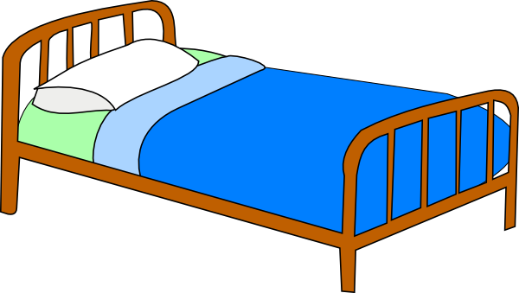
Was ist die Ausnahme? [2/6]
sprechen
besser
denken
das Bett
die Idee
Notes:
As previous slide.
Answer: die Idee (2 short e + one long e)
Word frequency (1 is the most frequent word in German): das Fenster [634] die Flasche [1762] das Heft [3598] die Klasse [619] der Mann [131] das Paar [284] die Tafel [3660] der Tag [108] der Tisch [494] Source: Jones, R.L. & Tschirner, E. (2011). A frequency dictionary of German: core vocabulary for learners. Routledge

Slide 52
Was ist die Ausnahme? [3/6]
sprechen
der Tisch
der Tag
die Tafel
der Mann
Notes:
As previous slide.
Answer: die Tafel (3 masculine nouns + one feminine) Word frequency (1 is the most frequent word in German): das Fenster [634] die Flasche [1762] das Heft [3598] die Klasse [619] der Mann [131] das Paar [284] die Tafel [3660] der Tag [108] der Tisch [494] Source: Jones, R.L. & Tschirner, E. (2011). A frequency dictionary of German: core vocabulary for learners. Routledge

Slide 53
Was ist die Ausnahme? [4/6]
sprechen
was?
denken
sagen
geben
Notes:
As previous slide.
Answer: was? (3 verbs and a question word) Word frequency (1 is the most frequent word in German): das Fenster [634] die Flasche [1762] das Heft [3598] die Klasse [619] der Mann [131] das Paar [284] die Tafel [3660] der Tag [108] der Tisch [494] Source: Jones, R.L. & Tschirner, E. (2011). A frequency dictionary of German: core vocabulary for learners. Routledge

Slide 54
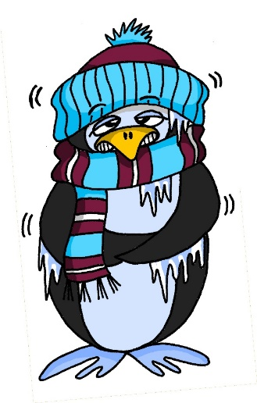
Was ist die Ausnahme? [5/6]
sprechen
geben
das Paar
kalt
die Idee
Inge Alferink / Rachel Hawkes
Notes:
As previous slide.
Answer: kalt (3 long vowels and a short one – mixed a and e) Word frequency (1 is the most frequent word in German): das Fenster [634] die Flasche [1762] das Heft [3598] die Klasse [619] der Mann [131] das Paar [284] die Tafel [3660] der Tag [108] der Tisch [494] Source: Jones, R.L. & Tschirner, E. (2011). A frequency dictionary of German: core vocabulary for learners. Routledge

Slide 55
Was is die Ausnahme? [6/6]
sprechen
der Tag
die Klasse
die Flasche
die Tafel
Notes:
As previous slide.
Answer: der Tag (3 feminine nouns + masculine one)
Word frequency (1 is the most frequent word in German): das Fenster [634] die Flasche [1762] das Heft [3598] die Klasse [619] der Mann [131] das Paar [284] die Tafel [3660] der Tag [108] der Tisch [494] Source: Jones, R.L. & Tschirner, E. (2011). A frequency dictionary of German: core vocabulary for learners. Routledge

Slide 56
Vokabeln
lesen
sagen
Tag
richtig
falsch
Mann
Ist das klar?
Paar
man
yes
class
false,
wrong
not
no
pair
day
right, correct
says,
tells
to say, tell
or
Is that clear?
what?
sagt
was?
ja
nein
Klasse
oder
nicht
Notes:
Timing: 4 minutes
Aim: To practise recognition and cued productive oral recall of this week’s vocabulary set.
Procedure:
1. Students supply the German for the word which appears in English. The aim is to be able to give the German before the teacher counts drei – zwei – eins.
Notes:
1. The activity can be repeated, clicking faster through the animations to increase speed of recall.
2. Teachers may wish to give students 30 seconds to look at the German words before showing the English prompts.

Slide 57
Phonetik/ Vokabeln
sprechen / hören
Arbeite mit einem Partner / einer Partnerin.
Person A liest fünf Wörter vor. You can try to read the words fast!
Person B sagt die Wörter auf Englisch.
Beispiel:
Person A sagt:
Person B sagt:
der Tag, richtig, sagt, was?, ja
day, right, correct, says/tells, what?; yes
Notes:
Timing: 3 mins (three slides)
Aim: to gain confidence in reading aloud and practising long and short [a] in particular, whilst the listening student practises aural comprehension of vocabulary from this week’s sets. Note: as far as possible words with the SSCs long and short [a] have been grouped together.
Procedure:
Student B turns away from the board.
Student A reads out five of the words in this week’s vocabulary set.
Student B listens and says the English meanings of the words, in the same order as they were said in German.
Students swap roles.

Slide 58
Phonetik/ Vokabeln
sprechen / hören
Person A liest fünf Wörter vor. You can try to read the words fast!
Person B sagt die Wörter auf Englisch.
Person A sagt:
der Mann, die Klasse, falsch, was?, nicht
Person B sagt:
man, class, false/wrong, what?, not
Notes:
[1/2] Procedure:
Student B turns away from the board.
Student A reads out five of the words in this week’s vocabulary as they appear on the board, on a click.
Student B listens and says the English meanings of the words, in the same order as they were said in German. 4. Student turns back to the board to check his/her answers.
5. Move to next slide to swap roles.

Slide 59
Phonetik/ Vokabeln
sprechen / hören
Person B liest fünf Wörter vor. You can try to read the words fast!
Person A sagt die Wörter auf Englisch.
Person B sagt:
to say/tell, day, pair, yes, is that clear?
Person A sagt:
sagen, der Tag, das Paar, ja, ist das klar?
Notes:
[2/2]

Slide 60
Grammatik
hören / schreiben
Wo ist das Fenster?
Das ist richtig.
Was denkst du?
Das ist falsch.
Die Flasche ist da.
Ist die Tafel hier oder da?
1
2
3
4
5
6
Notes:
Timing: 10 minutes Aim: Transcription exercise bringing together the phonics, vocabulary and grammar taught thus far.
Note: A lot of the activities so far have used isolated words. This activity puts the vocabulary they have learnt in context. It also focuses the students’ attention on spelling of the words. This leads into the next activity where we discuss the various aspects of ‘knowing a word’.
Procedure: 1. Play the audio recording of the sentences. Click the number to repeat the sentence as many times as needed.
2. Students write the sentences down.
3. Discuss the answers. For each item ask a student to read what they have written. Play the recording again and then show the written version.
Transcript: 1. Wo ist das Fenster?
2. Das ist richtig.
3. Was denkst du?
4. Das ist falsch.
5. Die Flasche ist da.
6. Ist die Tafel hier oder da? Word frequency (1 is the most frequent word in German): denken [124] ist [3] die Flasche [1762] das Fenster [634] die Tafel [3660] da [35] hier [71] wo? [94] der, die, das [1] was?[39] falsch [638] richtig [211] oder [30] Source: Jones, R.L. & Tschirner, E. (2011). A frequency dictionary of German: core vocabulary for learners. Routledge

Slide 61
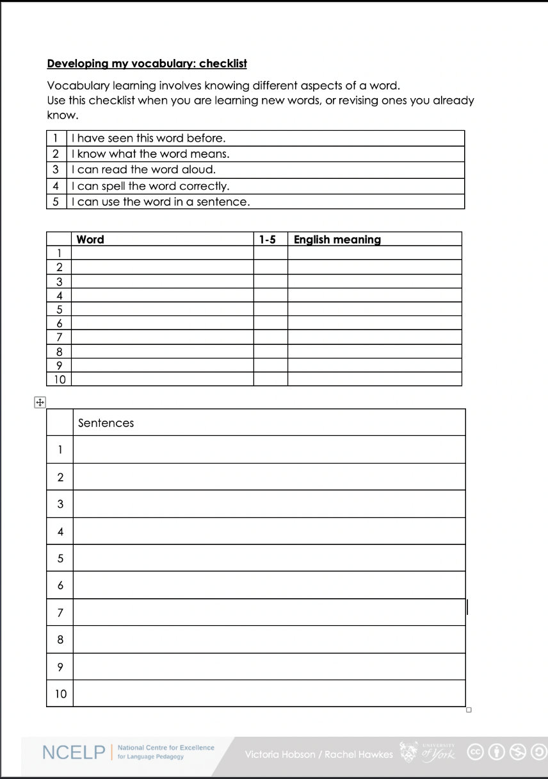
Vokabeln
schreiben
Was denkst du?
1. I have seen this word before.
2. I know what the word means.
3. I can read the word aloud.
4. I can spell the word correctly.
5. I can use the word in a sentence.
6. For nouns, I know the gender and the correct word for ‘the’
Notes:
Timing: 12 minutes Aim: To discuss with students what it means to know a word, and to encourage them to reflect on their depth of learning of new vocabulary on a regular basis. Procedure: 1. Elicit meaning of ‘Was denkst du?’ from the students.
2. Teacher talks students through the checklist. Vocabulary learning involves knowing different aspects of a word. Students can use this checklist to check what they know when they are learning new words, or revising ones they already know. The next slide presents all the vocabulary for week 1 and 2.
3. For each word the checklist asks students to asses which of the numbered statements apply.
4. Students then translate the word and try to use it in a sentence.
5. We suggest giving students a print out of the template they can refer to throughout the year. A word template is available on the NCELP resource portal:
https://resources.ncelp.org/concern/resources/gf06g264k?locale=en

Slide 62
Vokabeln
schreiben
sein | die Flasche | sagen | das Paar | nicht
das Fenster | wo? | was? | die Klasse | oder
das Heft | hier | sagt | richtig | ja
der Tisch | da | der Tag | falsch | nein
die Tafel | der, die, das | der Mann | ist
Notes:
Timing: 5 minutes Aim: To encourage students to reflect on the depth of their vocabulary learning.
Procedure: 1. Use this slide in conjunction with the previous one to encourage students to reflect on the depth of their vocabulary learning.
Word frequency (1 is the most frequent word in German): Vocabulary for Week 1
sein [3] ist [3] das Heft [3594] das Fenster [634] der Tisch [492] die Tafel [3656] die Flasche [1758] wo? [94] hier [71] da [35] der, die, das [1]
Vocabulary for Week 2
sagen [46] sagt [46] was?[39] der Tag [108] der Mann [131] das Paar [284] die Klasse [619] richtig [211] falsch [638] nicht [12] oder [30] ja [27] nein [120]
Source: Jones, R.L. & Tschirner, E. (2011). A frequency dictionary of German: core vocabulary for learners. Routledge

Slide 63
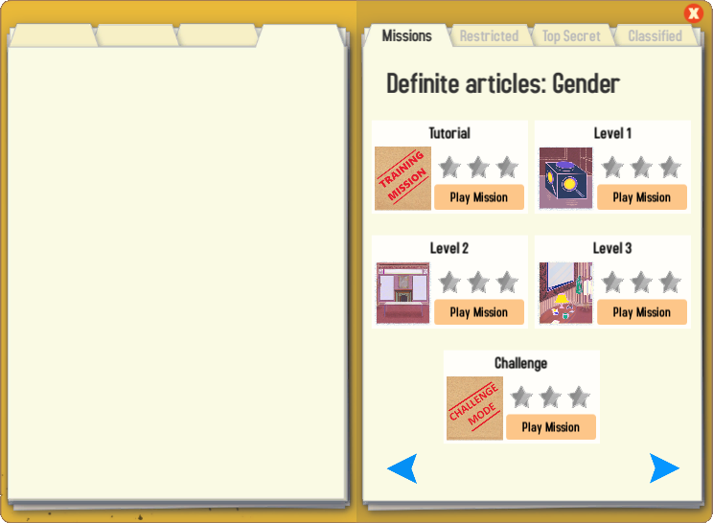
Gaming Grammar
Try the following Gaming Grammar missions to practise:

Slide 64
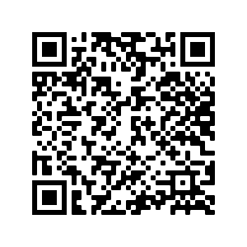
Hausaufgaben
Vocabulary Learning Homework (Y7, Term 1.1, Week 3)
Audio file
Audio file QR code:
Student worksheet
Quizlet link
Notes:
Use this slide to set the homework.

