Slide 1
Spanish phonics collection
SSCs [v], [b]
Victoria Hobson / Amanda Izquierdo / Nick Avery/
Rachel Hawkes
Artwork: Mark Davies
Date updated: 10 / 08 / 22
Notes:
Artwork by Mark Davies. All additional pictures selected are available under a Creative Commons license, no attribution required.

Slide 2
SSCs [v], [b]
fonética
Introduction

Slide 3
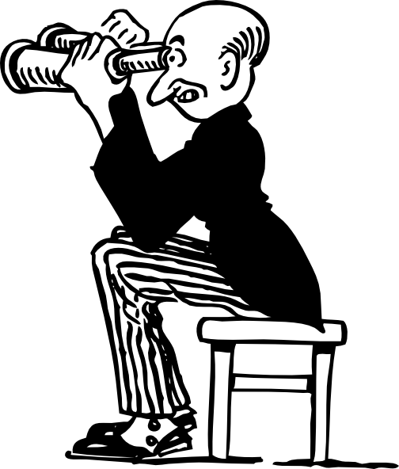
v
ver
Notes:
Introduce and elicit the pronunciation of the individual SSC ‘V’ and then present and practise the pronunciation of the source word ‘ver’.
A possible gesture for this source word would be to pretend to look through binoculars, as in the picture above

Slide 4
v
ver
Notes:
Repeat the sound and elicit the source word.

Slide 5
v
ver
Notes:
Repeat the sound and elicit the source word.

Slide 6
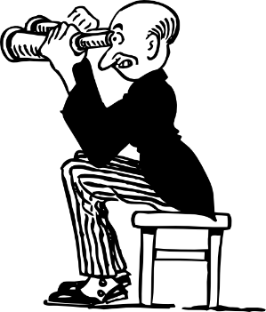
v
verdad
verano
verde
joven
ver
vivir
[to live]
Notes:
Introduce and elicit the pronunciation of the individual SSC ‘gi’ and then the source word again (with gesture, if using). Then present and elicit the pronunciation of the five cluster words.
The cluster words have been chosen for their high-frequency, from a range of word classes, with the SSC (where possible) positioned within a variety of syllables within the words (e.g. initial, 2nd, final etc.). Additionally, we have tried to use words that build cumulatively on previously taught SSCs (see the Phonics Teaching Sequence document) and do not include new SSCs. Where new SSCs are used, they are often consonants which have a similar symbol-sound correspondence in English.

Slide 7
v
verdad
verano
verde
joven
ver
vivir
Notes:
Without the images, students focus this time again closely on the SSC and the cluster words.

Slide 8
v
verdad
verano
verde
joven
ver
vivir
Notes:
Without the images or sound, students have to pronounce the words themselves.

Slide 9
b
celebrar
Notes:
Introduce and elicit the pronunciation of the individual SSC ‘b’ and then present and practise the pronunciation of the source word ‘celebrar’.
A possible gesture for this source word would be to put your hands above your ahead and dance/jump

Slide 10
b
celebrar
Notes:
Repeat the sound and elicit the source word.

Slide 11
b
celebrar
Notes:
Repeat the sound and elicit the source word.

Slide 12
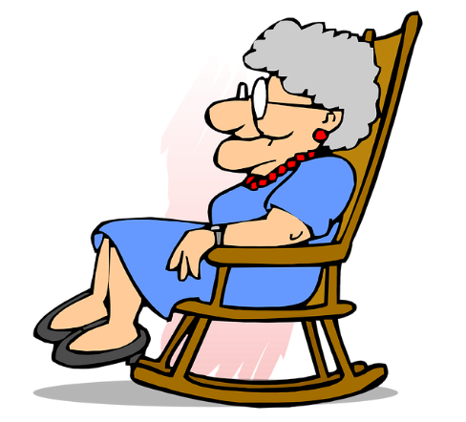
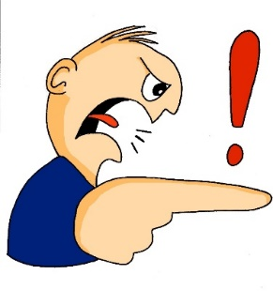
b
abuela
bonito
[pretty]
saber
deber
celebrar
[to know]
bastante
[quite]
Notes:
Introduce and elicit the pronunciation of the individual SSC ‘b’ and then the source word again (with gesture, if using). Then present and elicit the pronunciation of the five cluster words.
The cluster words have been chosen for their high-frequency, from a range of word classes, with the SSC (where possible) positioned within a variety of syllables within the words (e.g. initial, 2nd, final etc.). Additionally, we have tried to use words that build cumulatively on previously taught SSCs (see the Phonics Teaching Sequence document) and do not include new SSCs. Where new SSCs are used, they are often consonants which have a similar symbol-sound correspondence in English.

Slide 13
b
abuela
bonito
saber
deber
celebrar
bastante
Notes:
Without the images, students focus this time again closely on the SSC and the cluster words.

Slide 14
b
abuela
bonito
saber
deber
celebrar
bastante
Notes:
Without the images or sound, students have to pronounce the words themselves.

Slide 15
Escucha y lee. Es ¿‘v’ o ‘b’?
escuchar
A
B
C
jo__en
v
v
cele__rar
__erdad
b
D
E
F
__erde
b
b
v
__astante
de__er
G
H
I
b
a__uela
v
sa__er
_i_ir
b
v
Notes:
Timing: 3 minutes
Aim: Listening activity to provide input to help establish the sound-spelling connection.
Note that the audio will not help students to distinguish ‘b’ from ‘v’; the audio is simply provided for reinforcement. Students need to recall the spelling of each word.
Procedure:
Teachers click the letter button to play the recording of the word.
Students write the missing letter.
See next slide for a variation of this activity (where students have to write full word).

Slide 16
¿‘v’ o ‘b’?
escuchar
celebrar
verdad
joven
A
B
C
bastante
deber
verde
D
E
F
abuela
vivir
saber
G
H
I
Notes:
Variation activity to the previous slide
Timing: 3 minutes
Aim: Listening activity to provide input to help establish the sound-spelling connection.
Note that the audio will not help students to distinguish ‘b’ from ‘v’; the audio is simply provided for reinforcement. Students need to recall the spelling of each word.
Procedure
1. Teachers click the letter button to play the recording. Students listen and write the full word.

Slide 17
Identifica la palabra correcta.
deber
hablar
vivir
verde
[to know]
1
2
3
4
[young]
5
6
[to live]
joven
verdad
7
8
[quite]
9
[must]
saber
bastante
celebrar
abuela
Notes:
Timing: 3 minutes
Aim: Having focused on the sound-spelling correspondence, students now focus on the meaning of the words used for practice.
Procedure:
1. The teacher says the number (either in numerical or random order, to challenge students more). Students have to search the options around the edge of the box to decide which is the corresponding word. Teachers should pause for several seconds to allow students to search, then elicit the Spanish word from students in chorus.
Notes:
To allow for flexibility in the order of numbers, the answers have not been animated.

Slide 18
Escucha y completa la frase.
escuchar / escribir
Luego escribe la frase en inglés.
Quiere _______ la _________.
1
saber
verdad
5
Da una bolsa a la señora en la tienda.
Es ___________ grande.
bastante
S/he wants to know the truth.
S/he gives a bag to the lady in the shop. It’s quite big.
celebrar
2
Quiero __________ mi cumpleaños lejos de aquí.
6
Doy películas a una amiga, Sara.
¡______ películas con Sara es maravilloso!
I want to celebrate my birthday far (away) from here.
Ver
I give films to a friend, Sara.
Seeing / watching films with Sara is marvellous!
Verde
3
¿Qué color quieres? ¿_______?
What colour do you want? Green?
4
abuela
¿Das unas cosas a la _________?
mi = my
cumpleaños = birthday
Do you give some things to grandma?
Notes:
Timing: 8 minutes
Aim: This activity integrates grammar, vocabulary and phonics revision.
Procedure:
Phonics: Students first have to listen and write the missing word, which contains either the ‘b’ or ‘v’ SSC. The 7 missing words were used for phonics practice in lesson 1.
Grammar and vocabulary: After writing the missing words, students have to translate the sentence. Each one contains DAR and QUERER in 1st, 2nd or 3rd person singular. These two verbs are revisited in the current lesson, both for receptive and then productive practice. Vocabulary is also revisited from various earlier weeks. ‘Lejos’, ‘tienda’, ‘cosa’ and ‘bolsa’ are from the two vocabulary sets revisited this week (1.1.7 and 1.2.5) in the SoW.

Slide 19
SSCs [v], [b]
fonética
Consolidation [1]

Slide 20
v
ver
Notes:
Recap and elicit the pronunciation of the individual SSC ‘V’ and then present and practise the pronunciation of the source word ‘ver’.
A possible gesture for this source word would be to pretend to look through binoculars, as in the picture above.

Slide 21
v
ver
Notes:
Repeat the sound and elicit the source word.

Slide 22
v
ver
Notes:
Elicit the sound and the source word.

Slide 23
v
verdad
verano
verde
joven
ver
vivir
[to live]
Notes:
Estimated time (slides 2-7): 2 minutes
Introduce and elicit the pronunciation of the individual SSC ‘v’ and then the source word again (with gesture, if using). Then present and elicit the pronunciation of the five cluster words.
The cluster words have been chosen for their high-frequency, from a range of word classes, with the SSC (where possible) positioned within a variety of syllables within the words(e.g. initial, 2nd, final etc..) and additionally, we have tried to use words that build cumulatively on previously taught SSCs (see the Phonics Teaching Sequence document) and do not include new SSCs. Where new SSCs are used, they are often consonants which have a similar symbol-sound correspondence in English.
The word ‘verano’ has been added as a cluster word in addition to those already introduced in 2.1.1

Slide 24
v
verdad
verano
verde
joven
ver
vivir
Notes:
Without the images, students focus this time again closely on the SSC and the cluster words.

Slide 25
v
verdad
verano
verde
joven
ver
vivir
Notes:
Without the images or sound, students have to pronounce the words themselves.

Slide 26
b
celebrar
Notes:
Introduce and elicit the pronunciation of the individual SSC ‘b’ and then present and practise the pronunciation of the source word ‘celebrar’.
A possible gesture for this source word would be to put your hands above your ahead and dance/jump.

Slide 27
b
celebrar
Notes:
Repeat the sound and elicit the source word.

Slide 28
b
celebrar
Notes:
Elicit the sound and the source word.

Slide 29
b
abuela
bonito
[pretty]
saber
deber
celebrar
[to know]
bastante
[quite]
Notes:
Introduce and elicit the pronunciation of the individual SSC ‘b’ and then the source word again (with gesture, if using). Then present and elicit the pronunciation of the five cluster words.
The cluster words have been chosen for their high-frequency, from a range of word classes, with the SSC (where possible) positioned within a variety of syllables within the words (e.g. initial, 2nd, final etc..) and additionally, we have tried to use words that build cumulatively on previously taught SSCs (see the Phonics Teaching Sequence document) and do not include new SSCs. Where new SSCs are used, they are often consonants which have a similar symbol-sound correspondence in English.
The words ‘bonito’ and ‘deber’ have been added as cluster words in addition to those already introduced in 2.1.1

Slide 30
b
abuela
bonito
saber
deber
celebrar
bastante
Notes:
Without the images, students focus this time again closely on the SSC and the cluster words.

Slide 31
b
abuela
bonito
saber
deber
celebrar
bastante
Notes:
Without the images or sound, students have to pronounce the words themselves.

Slide 32
¿‘v’ o ‘b’?
Escucha. Completa las palabras con ‘v’ o ‘b’.
escuchar
El verde es un color bastante bonito.
Es verdad, İmi abuela no es joven!
Celebramos el aniversario en Barcelona.
İVivir en Valencia en verano debe ser excelente!
Ver gatos verdes en Benidorm no es normal!
1
Green is quite a pretty colour.
2
It’s true, my grandma isn’t young!
3
We celebrate the anniversary in Barcelona.
4
Living in Valencia in summer must be excellent!
5
Seeing green cats in Benidorm is not normal!
Notes:
There are two versions of this activity. Either do the activity on slide 14 or the one on slide 15.
Timing: 5 minutes
Aim: to reinforce the fact that one sound may correspond to two spellings, and to recall vocabulary.
Procedure:
Students write the missing letter. Although audio is provided for this activity (click the number button for the recording), this is simply to provide further input to help establish the sound-spelling connection, since [v] and [b] sound the same.
Students can also be asked to give the meanings of the sentences in English before moving on. English translations appear on a mouse click.
Notes:
The next slide offers a variation of this activity where students have to write full word if more challenge is required.

Slide 33
Escucha y completa las frases.
escuchar
El verde es un color bastante bonito.
Es verdad, İmi abuela no es joven!
Celebramos el aniversario en Barcelona.
İVivir en Valencia en verano debe ser excelente!
Ver gatos verdes en Benidorm no es normal!
1
Green is quite a pretty colour.
2
It’s true, my grandma isn’t young or pretty!
3
We celebrate the anniversary in Barcelona.
4
Living in Valencia in summer must be excellent !
5
Seeing green cats in Benidorm is not normal!
Notes:
ALTERNATIVE ACTIVITY – either do this one or the exercise on the previous slide
Procedure:
As on the previous slide, except that students listen and write the full word. This offers a greater level of challenge.

Slide 34
Lee las frases con una pareja.
hablar
El verde es un color bastante bonito.
Es verdad, İmi abuela no es joven!
Celebramos el aniversario en Barcelona.
İVivir en Valencia en verano debe ser excelente!
Ver gatos verdes en Benidorm no es normal!
1.
2.
3.
4.
5.
Notes:
Timing: 3 minutes
Aim: speaking practice using the SSCs [v] and [b]
Procedure:
In pairs students take turns reading aloud these tongue twisters while the teacher circulates to monitor pronunciation.
Students can also be asked to give the meanings of the sentences in English before moving on. English translations appear on a mouse click.

Slide 35
v
ver
Notes:
Recap and elicit the pronunciation of the individual SSC ‘V’ and then present and practise the pronunciation of the source word ‘ver’.
A possible gesture for this source word would be to pretend to look through binoculars, as in the picture above.

Slide 36
b
celebrar
Notes:
Introduce and elicit the pronunciation of the individual SSC ‘b’ and then present and practise the pronunciation of the source word ‘celebrar’.
A possible gesture for this source word would be to put your hands above your ahead and dance/jump.

Slide 37
hablar
hablar
a veces | nervioso | blanco | nueve | bueno | verde | barco | aburrido
revista | basura | viernes | bonito | llevar | dibujo | vista | abrir
buscar | lavar | barco | viajar | recibir | barato | vaso | bicicleta
vacaciones | bolígrafo | vivir | libro | botella | ventana | beber | árbol
sometimes
nervous
white
nine
good
green
bank
boring
magazine
rubbish
Friday
pretty
to wear
drawing
view
to open
to look for
to wash
boat
to travel
to receive
cheap
glass
bike
holidays
pen
to live
book
bottle
window
to drink
tree
Notes:
Estimated time: 7 minutes
Aim: speaking practice with the [v] and [b] SSCs.
Procedure:
This is a game of pairs. Students have to find a matching pair of words according to the SSC ‘b’ or ‘v’ that they have in common (e.g. bueno + libro / vaso + revista).
Teachers could run this:
1a) as a whole class activity where students volunteer answers or
1b) as a team game. Depending on the ability of the group, ‘lifelines’ could be used, such as three (for example) opportunities for students to use reference material (e.g. dictionaries or their exercise books).
or
2) in pairs/groups (a sort of pelmanism activity).
This could be done after the teacher models this with the whole class (as above) or pairs could go straight into it to challenge higher attaining groups.
Each pair/group of students would receive a set of the cards with the Spanish on one side and the English on the other (available as a Word doc). Students should lay the cards down on the desk with the English word facing up. Students take it in turns. Person A says the Spanish for a word then turns over the card to see if is correct. If correct the student chooses a matching word with the same SSC, again saying the word in Spanish and then turning over the card to reveal the answer. If a match is made, student A keeps the pair. If a match is not made, student A turns the cards back over and leaves the cards where they are. Whether correct or incorrect, play passes to person B, taking it in turns to find a match. The player with the most pairs at the end wins.
Differentiation:
If teachers feel that their students need preparation time ahead of this activity, students could be asked to look back through their exercise/vocab books (in pairs or groups of 4) and identify all the words they have learnt up to now that contain a ’b’ or a ‘v.’ If literacy would be a barrier here, teachers could use the flashcards provided as a word document with the English on one side and Spanish on the other. Students in pairs/groups could quickly classify them into ‘v’ or ‘b’ and spend 2 minutes testing each other Sp→Eng then Eng → Sp to embed the meanings and reinforce the sound spelling correspondence in order to have a greater chance of succeeding with the task described above.
Notes:
These are not the source/cluster words but rather previously taught vocabulary from vocab sets up to 3.2.4.

Slide 38
SSCs [v], [b]
fonética
Consolidation [2]

Slide 39
Fonética
escuchar / escribir
En español la [b] y la [v] tienen la misma pronunciación.
Escucha las frases y escribe las palabras, ¿es con b o con v?
 | palabras con b | palabras con v | ¿Qué significa la frase en inglés?
In English, we might also say here ‘You take advantage of…’.
1
billetes
olvidó
enviar
S/he forgot to send the tickets.
aprovechas
vacaciones
You make the most of the holidays to travel.
2
viajar
3
bebidas
vende
veinte
S/he sells twenty drinks.
4
debo
saber
verdad
I must know the truth.
S/he is going to see his/her girlfriend on the trip.
5
va
ver
novia
viaje
6
rabia
lluvia
verano
The rain in summer is infuriating.
Notes:
Phonics Timing: 6 minutes
Aim: to consolidate understanding of SSCs [b] & [v] and to consolidate understanding of vocabulary (as there is no juxtaposition of SSCs, previously taught vocabulary is used in this activity).
Procedure: 1. Students listen to each recording and write the words with the sounds [b] and [v] in the corresponding column. 2. Students listen again and write the meaning of the full sentence in English.
Transcript:
Olvidó enviar los billetes.
Aprovechas las vacaciones para viajar.
Vende veinte bebidas.
Debo saber la verdad.
Va a ver a su novia en el viaje.
La lluvia en verano da rabia.
Note: an additional translation is provided for ‘aprovechar’. The word has so far only been taught as ‘make the most of’, but in this context it would work well with ‘take advantage of’.

Slide 40
hablar / escuchar
Fonética
Trabajamos en parejas.
El estudiante A lee las palabras en la lista.
El estudiante B escribe las palabras en la columna correcta.
Ejemplo:
verdad
Estudiante A habla:
Estudiante B escribe la palabra:
1 | verdad
 | b | v
1
verdad
Notes:
Timing: 5 mins
Aim: to practise SSCs [b] and [v] in paired speaking and listening
Procedure:
Student A reads out the words on the list, one by one.
Student B listens and writes them down in the correct column depending on their spelling.
Students swap roles.
To check understanding, teachers can ask for oral translation of the words into English during feedback.

Slide 41
hablar / escuchar
Fonética
Estudiante A
 | Lee las palabras en la lista
1 | vida
2 | besar
3 | levantar
4 | abierto
5 | nuevo
6 | beber
7 | vivir
8 | móvil
 | b | v
1
2
3
4
5
6
7
8
Notes:
Speaking cards

Slide 42
hablar / escuchar
Fonética
Estudiante B
 | Lee las palabras en la lista
1 | recibir
2 | llave
3 | barrio
4 | abril
5 | abrir
6 | vergüenza
7 | diecinueve
8 | billete
 | b | v
1
2
3
4
5
6
7
8
Notes:
Speaking cards

Slide 43
hablar / escuchar
Fonética
Estudiante A - Solución
 | Lee las palabras en la lista
1 | vida
2 | besar
3 | levantar
4 | abierto
5 | nuevo
6 | beber
7 | vivir
8 | móvil
 | b | v
1
2
3
4
5
6
7
8
recibir
llave
barrio
abril
abrir
vergüenza
diecinueve
billete
Notes:
ANSWER SLIDE

Slide 44
hablar / escuchar
Fonética
Estudiante B - Solución
 | Lee las palabras en la lista
1 | recibir
2 | llave
3 | barrio
4 | abril
5 | abrir
6 | vergüenza
7 | diecinueve
8 | billete
 | b | v
1
2
3
4
5
6
7
8
vida
besar
levantar
abierto
nuevo
beber
vivir
móvil
Notes:
ANSWER SLIDE

Slide 45
SSCs [v], [b]
fonética
Consolidation [3]

Slide 46
Recuerda que la letra ‘b’ y la letra ‘v’ tienen la misma pronunciación en español. Escucha las palabras:
escuchar
1
grave
2
gobierno
Escucha las frases. Marca cada vez que hay una ‘b’ o una ‘v.’ Luego, escribe la frase en español.
 | ¿cuántas veces? v/b | Frases
jóvenes
ver
1
Las chicas __________ quieren __________ un partido.
2
buscando
aventuras
bosque
Está ____________ ____________ en el __________.
3
viajando
barco
través
Estoy __________ en _________ a _______ del Mar Mediterráneo.
Envía
botella
4
__________ un mensaje en una __________.
5
grabar
vídeo
boda
Quiere __________ un __________ de la __________.
Notes:
Timing: 5 minutes
Aim: to recognise the sound for letters ‘b’ and ‘v’.
Procedure:
Students listen to each phrase contaning the letters ‘b’ and ‘v’ and tally the number of times they hear the sound.
Students listen to each phrase again and write the missing words.
Teacher shows the answers one by one.
Transcript:
Las chicas jóvenes quieren ver un partido.
Está buscando aventuras en el bosque.
Está viajando en barco a través del Mar Mediterráneo.
Envía un mensaje en una botella.
Quiere grabar un vídeo de la boda.

Slide 47
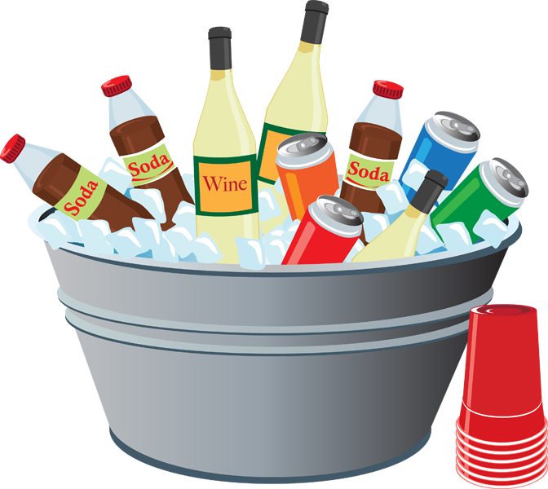
Un mensaje
hablar / escuchar / escribir
Persona A: Lee el texto a tu compañero.
Persona B: Sin mirar la pizarra*, escucha y escribe cada palabra con [b] o [v].
*board
Persona A
Persona B
Hola Luis. ¿Cómo estáis tu y tu hermana? Vosotros vais a venir a mi casa este sábado para la fiesta, ¿verdad? ¡Tenemos bastante comida y bebidas para todos en el barrio!
Hola Diego. Estamos bien, gracias. Ayer vimos la última película de Icíar Bollaín ¡Es muy buena! Sí, vamos a ir a la fiesta. También quiero invitar a mi novia. ¡Baila genial!
Notes:
[1/2]
Timing: 5 minutes
Aim: a paired read aloud and transcription task to practise oral production and recognition of words containing the SSCs [v] and [b] at text level.
Procedure:
1. Ask the students to read the instructions and check their understanding. At this point, advise student B to turn away from the board.
2. Click to bring up the text for student A.
3. Student A reads the text to student B who writes all the words containing SSC [v] or [b] .
4. Click again to hide the text that was just used.
5. Students then swap roles.
6. Teachers can use the answer slide (next slide) to bring the activity to a close. Elicit the meanings of the target words in English.
7. Teachers may also want to ask students to consider the meanings of the texts as a whole before moving on. Give pairs a minute per text and then take feedback.
Frequency of unknown vocabulary:
pizarra [>5000]

Slide 48
Solución
hablar / escuchar / escribir
Persona A
Persona B
vosotros
bastante
bien
invitar
vais
bebidas
vimos
novia
venir
barrio
Bollaín
baila
sábado
buena
verdad
vamos
Notes:
[2/2]
Answer slide.

