Slide 1
Spanish phonics collection
SSCs [l], [ll]
Nick Avery / Victoria Hobson / Rachel Hawkes / Jack Peacock
Date updated: 12 / 02 / 21
Notes:
Artwork by Mark Davies. All additional pictures selected are available under a Creative Commons license, no attribution required.

Slide 2
SSCs [l], [ll]
fonética
Introduction

Slide 3
l
libro
Notes:
Timing: 1 minute
Aim: To introduce/consolidate SSC [l]
Procedure: 1. Present the letter(s) and say the [l] sound first, on its own. Students repeat it with you. 2. Bring up the word ”libro” on its own, say it, students repeat it, so that they have the opportunity to focus all of their attention on the connection between the written word and its sound.
3. A possible gesture for this would be to open an imaginary book. 4. Roll back the animations and work through 1-3 again, but this time, dropping your voice completely to listen carefully to the students saying the [l] sound, pronouncing ”libro” and, if using, doing the gesture.
Word frequency (1 is the most frequent word in Spanish):
libro [230] Source: Davies, M. & Davies, K. (2018). A frequency dictionary of Spanish: Core vocabulary for learners (2nd ed.). Routledge: London

Slide 4
l
salir
palabra
lista
libro
luz
luego
[then]
Notes:
Timing: 2 minutes
Aim: To introduce/consolidate SSC [l]
Procedure:
Introduce and elicit the pronunciation of the individual SSC [l] and then the source word again ‘libro’ (with gesture, if using).
Then present and elicit the pronunciation of the five cluster words.
The cluster words have been chosen for their high-frequency, from a range of word classes, with the SSC (where possible) positioned within a variety of syllables within the words (e.g. initial, 2nd, final etc.). Additionally, we have tried to use words that build cumulatively on previously taught SSCs (see the Phonics Teaching Sequence document) and do not include new SSCs. Where new SSCs are used, they are often consonants which have a similar symbol-sound correspondence in English.
Word frequency (1 is the most frequent word in Spanish): libro [230]; salir [114]; lista [1189]; luego [150]; palabra [192]; luz [278] Source: Davies, M. & Davies, K. (2018). A frequency dictionary of Spanish: Core vocabulary for learners (2nd ed.). Routledge: London

Slide 5
l
salir
palabra
lista
libro
luz
luego
Notes:
Without the images, students focus this time again closely on the SSC and the cluster words.

Slide 6
l
salir
palabra
lista
libro
luz
luego
Notes:
Without the images or sound, students have to pronounce the words themselves.

Slide 7
ll
llamar
Notes:
Timing: 1 minute
Aim: To introduce/consolidate SSC [ll]
Procedure: 1. Present the letter(s) and say the [ll] sound first, on its own. Students repeat it with you. 2. Bring up the word ”llamar” on its own, say it, students repeat it, so that they have the opportunity to focus all of their attention on the connection between the written word and its sound.
3. A possible gesture for this would be to bring an imaginary phone to your ear. 4. Roll back the animations and work through 1-3 again, but this time, dropping your voice completely to listen carefully to the students saying the [ll] sound, pronouncing ”llamar” and, if using, doing the gesture.
Word frequency (1 is the most frequent word in Spanish): llamar [122] Source: Davies, M. & Davies, K. (2018). A frequency dictionary of Spanish: Core vocabulary for learners (2nd ed.). Routledge: London

Slide 8
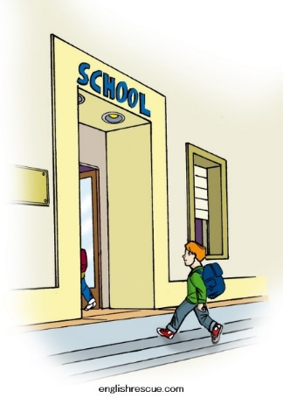
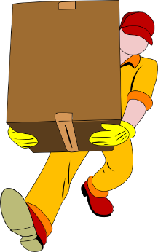
ll
llegar
llave
© www.englishrescue.com
llamar
llevar
amarillo
ella
Notes:
Timing: 2 minutes
Aim: To introduce/consolidate SSC [ll]
Procedure:
Introduce and elicit the pronunciation of the individual SSC [ll] and then the source word again ‘llamar’ (with gesture, if using).
Then present and elicit the pronunciation of the five cluster words.
The cluster words have been chosen for their high-frequency, from a range of word classes, with the SSC (where possible) positioned within a variety of syllables within the words (e.g. initial, 2nd, final etc.). Additionally, we have tried to use words that build cumulatively on previously taught SSCs (see the Phonics Teaching Sequence document) and do not include new SSCs. Where new SSCs are used, they are often consonants which have a similar symbol-sound correspondence in English.
Word frequency (1 is the most frequent word in Spanish): llamar [122]; llegar [75]; llevar [101]; llave [1853]; amarillo [1381] Source: Davies, M. & Davies, K. (2018). A frequency dictionary of Spanish: Core vocabulary for learners (2nd ed.). Routledge: London

Slide 9
ll
llegar
llave
llamar
llevar
amarillo
ella
Notes:
Without the images, students focus this time again closely on the SSC and the cluster words.

Slide 10
ll
llegar
llave
llamar
llevar
amarillo
ella
Notes:
Without the images or sound, students have to pronounce the words themselves.

Slide 11
Fonética
leer / hablar
60
ella
salir
llamar
Segundos
llevar
lista
amarillo
luz
0
palabra
INICIO
Notes:
Phonics practice activity (we recommend doing either this or the next activity)
Timing: 1 minute
Aim: to gain confidence and fluency in saying words with [l] and [ll]
Procedure:
1. Pupils say the words alternately out loud with a partner, building up speed, over 1 minute’s intensive practice.
2. Pupils call in any order they like, but are not allowed to repeat the one they said in their last turn. 3. Teacher can circulate to listen into their SSC knowledge.
Click on INICIO to start a one minute timer on the screen.
Word frequency (1 is the most frequent word in Spanish): salir [114]; lista [1189]; palabra [192]; luz [278]; llamar [122]; llevar [101]; ella [72]; amarillo [1381]
Source: Davies, M. & Davies, K. (2018). A frequency dictionary of Spanish: Core vocabulary for learners (2nd ed.). Routledge: London

Slide 12
Fonética
leer / hablar
60
ella
salir
llamar
Segundos
llevar
lista
amarillo
0
palabra
luz
INICIO
Notes:
OPTIONAL
Phonics practice activity: alphabetical read aloud
Timing: 1 minute
Aim: to gain confidence and fluency in saying words with [l] and [ll]
Procedure:
1. Individually (but all at once) pupils read out the words but in alphabetical order. They keep going for one minute.
2. Teacher can circulate to listen into their SSC knowledge.
Word frequency (1 is the most frequent word in Spanish): salir [114]; lista [1189]; palabra [192]; luz [278]; llamar [122]; llevar [101]; ella [72]; amarillo [1381]
Source: Davies, M. & Davies, K. (2018). A frequency dictionary of Spanish: Core vocabulary for learners (2nd ed.). Routledge: London

Slide 13
Fonética
leer / escribir
palabra
lista
llave
libro
llamar
© www.englishrescue.com
llegar
Notes:
Timing: 3 minutes
Aim: to correctly use SSCs [l] and [ll]
Procedure:
1. This can be done as a whole-class activity, or individually/in pairs.
2. The target SSC (L/ LL) is obscured in each word.
3. The teacher can say the word and ask students to write the missing letter(s).
4. To challenge students more, ask students to try to remember which source/cluster words with L and LL don’t appear here (e.g. amarillo, llevar, ella, luz, salir, luego), making sure to check their spelling and to also have students say them aloud.
5. Check understanding of the meanings of the words
Word frequency (1 is the most frequent word in Spanish): llamar [122]; llegar [75]; llave [1853]; libro [230]; lista [1189]; palabra [192]
Source: Davies, M. & Davies, K. (2018). A frequency dictionary of Spanish: Core vocabulary for learners (2nd ed.). Routledge: London

Slide 14
SSCs [l], [ll]
fonética
Consolidation [1]

Slide 15
ll
llegar
llave
© www.englishrescue.com
llamar
llevar
amarillo
ella
Notes:
Introduce and elicit the pronunciation of the individual SSC ‘LL’ and then the source word again (with gesture, if using). Then present and elicit the pronunciation of the five cluster words.
The cluster words have been chosen for their high-frequency, from a range of word classes, with the SSC (where possible) positioned within a variety of syllables within the words(e.g. initial, 2nd, final etc..) and additionally, we have tried to use words that build cumulatively on previously taught SSCs (see the Phonics Teaching Sequence document) and do not include new SSCs. Where new SSCs are used, they are often consonants which have a similar symbol-sound correspondence in English.

Slide 16
ll
llegar
llave
llamar
llevar
amarillo
ella
Notes:
Without the images, students focus this time again closely on the SSC and the cluster words.

Slide 17
ll
llegar
llave
llamar
llevar
amarillo
ella
Notes:
Without the images or sound, students have to pronounce the words themselves.

Slide 18
l
salir
palabra
lista
libro
luz
luego
[then]
Notes:
Introduce and elicit the pronunciation of the individual SSC ‘L’ and then the source word again (with gesture, if using). Then present and elicit the pronunciation of the five cluster words.
The cluster words have been chosen for their high-frequency, from a range of word classes, with the SSC (where possible) positioned within a variety of syllables within the words(e.g. initial, 2nd, final etc..) and additionally, we have tried to use words that build cumulatively on previously taught SSCs (see the Phonics Teaching Sequence document) and do not include new SSCs. Where new SSCs are used, they are often consonants which have a similar symbol-sound correspondence in English.

Slide 19
l
salir
palabra
lista
libro
luz
luego
Notes:
Without the images, students focus this time again closely on the SSC and the cluster words.

Slide 20
l
salir
palabra
lista
libro
luz
luego
Notes:
Without the images or sound, students have to pronounce the words themselves.

Slide 21
Escucha y completa las frases.
¿Qué tipo de palabra(s) es/son?
¿Las palabras tienen [L] o [LL]?
¿Cómo se dice en inglés?
nombre
nombre
pronombre
1
Es normal llamar por la mañana.
verbo
adjetivo
verbo
It’s normal to call in the morning.
2
¿Dónde está la luz? ¡Está muy oscuro aquí!
Where’s the light? It’s very dark here!
3
La persona sólo da libros amarillos a los chicos.
The person only gives yellow books to the boys.
4
¿Cómo está? … ¿Quién, ella? Está bien.
¿How is s/he? … Who, her? She’s well/fine.
5
¿Tienes una lista de películas nuevas?
Do you have a list of new films?
6
Salir los lunes por la noche no es normal.
Going out on Monday nights isn’t normal.
Notes:
Timing: 6 minutes
Aims: to practise distinguishing between SSCs [ll] and [l]; to also improve word class recognition.
Procedure:
Ask students to write the missing word. Teachers click the number button to play the recording, and then click to show the missing words.
Then ask students to give the English translation of the sentence, and click to go through the answers.
Finally, students need to work out the word class of the phonics word from the options in the top right. Teachers click for the answers to be revealed.
There is an alternative to this activity on the next slide.
Notes:
All words included in this activity are previously taught vocabulary items or phonics words. ‘Normal’ [1000] is a cognate.
Weeks in which vocabulary items were taught:
mañana, noche – 2.1.4; dónde, está – 1.1.1; cómo, muy – 1.1.2; aquí, chico – 1.2.3; oscuro – 2.2.5; profesor/a – 1.2.2; sólo, amarillo – 2.1.3; da, a – 1.2.7; quién, bien – 1.1.6; tienes, nuevo – 1.1.4; película – 1.2.6; lunes – 2.2.3; no – 1.2.1

Slide 22
Escucha y completa las frases.
¿Qué tipo de palabra(s) es/son?
¿Las palabras tienen [L] o [LL]?
¿Cómo se dice en inglés?
nombre
nombre
pronombre
1
Es normal llamar por la mañana.
verbo
adjetivo
verbo
It’s normal to call in the morning.
2
¿Dónde está la luz? ¡Está muy oscuro aquí!
Where’s the light? It’s very dark here!
3
La persona sólo da libros amarillos a los chicos.
The person only gives yellow books to the boys.
4
¿Cómo está? … ¿Quién, ella? Está bien.
¿How is s/he? … Who, her? She’s well/fine.
5
¿Tienes una lista de películas nuevas?
Do you have a list of new films?
6
Salir los lunes por la noche no es normal.
Going out on Monday nights isn’t normal.
Notes:
Timing: 8 minutes
Notes:
This is the same as the previous slide apart from instead of writing the one word with either [ll] or [l], students transcribe the whole sentence. The other two parts to this activity (translation and word type recognition) are the same.

Slide 23
Escucha y escribe las palabras en la columna correcta. Luego, escribe también la palabra en inglés.
escuchar
[L] |  | [LL]
español | inglés | español | inglés
listo
ready
llave
key
letra
letter
botella
bottle
regalo
gift
llamar
to call, calling
tranquilo
calm
amarillo
yellow
julio
July
paella
paella
iglesia
church
caballo
horse
Notes:
Timing: 4 minutes
Aim: to help students practise distinguishing between between the SSCs revisited this week, [LL] and [L].
Procedure:
Students listen to the recording and write down the words in the corresponding column. Then, students can write the meaning in English.
Play the recording by clicking on the speaker button. The recording can be paused if needed.
Click to show the show the answers which appear in the order in which words are said in the audio recording. The translations are then revealed by clicking after all the Spanish words have been revealed.
Notes
All words included in this activity are previously taught vocabulary items or phonics words. ‘Paella’ is a word that might be challenging. It has appeared in one activity in 2.2.3.
Weeks in which vocabulary items were taught:
listo [1684] – 1.1.2; letra [977]– 1.1.4; regalo [1986]– 1.2.7; iglesia [437]– 1.2.5; tranquilo [1073] – 1.1.2; julio [659]– 3.1.1; llave– SCC 1.1.4 and 3.1.3; botella [1878]– 1.1.5; llamar – SCC 1.1.4 and 3.1.3; amarillo [1381]– 2.1.3; caballo [907] – 1.1.5

Slide 24
SSCs [l], [ll]
fonética
Consolidation [2]

Slide 25
Fonética
escuchar / escribir
Escucha y escribe la palabra. ¿Es ‘l’ o ‘ll’? Luego, escribe la frase en inglés.
palabras
lista
largas
1
Las _________ en la _____ son ______.
The words on the list are long.
llevar
amarillos
I want to wear yellow shoes.
2
Quiero_______ zapatos __________ .
She is going to go out, then she is going to dance.
3
Ella
salir
luego
bailar
____ va a ____, ______ va a ______.
4
llegar
llaves
Es importante ______ con las ______ .
It is important to arrive with the keys.
luz
leer
libro
I need light (in order) to read my book.
5
Necesito ___ para _____ mi _____ .
6
llamar
¿Cuándo puedes _______?
When can you call?
Notes:
Timing: 7 mins.
Aim: to accurately spell words that contain SSCs [l] and [ll]. Audio is provided to reinforce the sound of the SSC and to give a cue for correct spelling.
Procedure:
1. Students listen and write the missing words.
2. The teacher goes through the answers for each sentence, one by one, including eliciting the English meanings.
3. For additional reinforcement, the teacher can play the audio again each time so that students can listen and read at the same time.
Note: This sentence level transcription task includes some known words and some less familiar cluster words from Year 7 that were only used for phonics practice. As such, it is a hybrid phonics/vocabulary practice task.
Transcript:
Las palabras en la lista son largas.
Quiero llevar zapatos amarillos.
Ella va a salir, luego va a bailar.
Es importante llegar con las llaves.
Necesito luz para leer mi libro.
¿Cuándo puedes llamar?

Slide 26
La llama amarilla llega tarde por la lluvia y no tiene llave. Llama a las otras llamas, pero no están. ¿Por qué las otras llamas no llevan la llave a la llama amarilla?
hablar
La llama amarilla
1
2
3
Notes:
A tonguetwister
Timing: 5 mins
Aim: to gain confidence in practising the SSC [ll] in sentences
Procedure:
The teacher first asks students to read the short text and think about what it means.
The teacher reads the text aloud in fragments, eliciting the meanings from students. Note that all words have been previously taught as vocabulary items or used for phonics practice. ‘Llama’ (animal) is a cognate.
Students then practise saying the sentence in pairs, at increasing speed.
The teacher can challenge students to listen to a native speaker read the text at three different speeds (1=slow; 3=very fast). Each time, students can be challenged to say it at the same speed.
Note: the personal ‘a’ is used with the verb ‘llamar’. This will be unfamiliar to students. However, it doesn’t need to be dwelt on; students are likely to still understand the sentence without knowing why it is used here.

Slide 27
SSCs [l], [ll]
fonética
Consolidation [3]

Slide 28
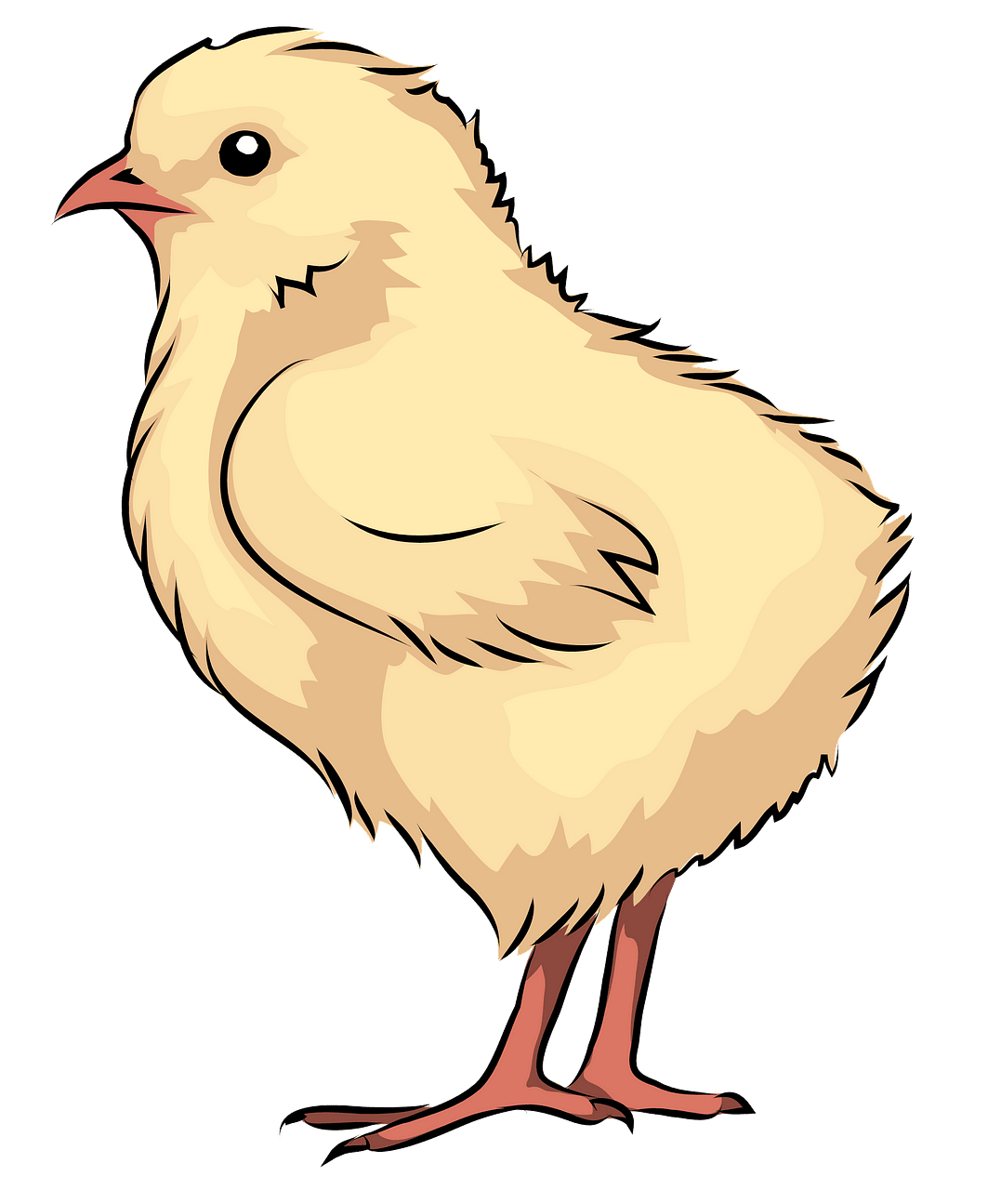
Fonética
escuchar / escribir
[ice lolly]
Remember:
‘l’ sounds like this:
1
A
polo
‘ll’sounds like this:
2
B
pollo
Lucía está hablando sobre cómo su familia celebra días especiales. Escucha y marca: ¿cuántas veces escuchas “l” y cuántas veces escuchas “ll”?
 | ¿Cuántas veces? | Las palabras
‘l’
‘ll’
9
relación,
abuelos,
celebramos,
leche,
plato,
pelota,
tranquilas,
colina,
sala
5
pollo,
estrella,
calles,
castillo,
batallas
Notes:
Timing: 5 minutes
Aim: to differentiate sounds for ‘l’ and ‘ll’.
Procedure:
After listening to the recordings modelling both sounds, students listen to the recording once and tally how many times they hear ‘l’ and how many times they hear ‘ll’.
Students listen to the recording one more time to try and write down all the words including ‘l’ or ‘ll’.
Answers can be shown one by one.
Transcript:
Tenemos una buena relación con mis tíos y mis abuelos, así que muchas veces celebramos fiestas en casa. A veces mi padre cocina pollo y mi tía prepara arroz con leche, ¡es su plato estrella!
Después de comer jugamos con una pelota en calles tranquilas. También corremos hasta un castillo que está en una colina y organizamos batallas, mientras que mis padres descansan en nuestra sala.
Notes:
Note that this audio text practises and revisits this week’s vocabulary.

Slide 29
İUn minuto!
hablar
familiar
malo
billete
60
allí
colocar
castillo
actual
Segundos
colegio
sala
llorar
llamar
llegada
realizar
relación
lluvia
0
lleno
INICIO
Notes:
Timing: 4 minutes.
Aim: for students to consolidate their pronunciation of words that contain SSCs ‘ll’ and ‘l’ in a choral alphabetical read aloud task.
Procedure:
Click on ‘Inicio’ to set the timer to count one minute.
Individually at their own pace (but all together at once) students read aloud the words in alphabetical order.They keep going for one minute.
Teachers can circulate to listen to students’ SSC knowledge.
As the final activity, students should write the English for as many of the words as they can to reinforce their meanings. Students could first have a minute individually, then team up with a partner to see if they can achieve translations for all 16 words. The answers are provided on the following slide.

