Slide 1
Spanish phonics collection
SSCs [ga], [go], [gu]
Nick Avery / Rachel Hawkes /St. James’ Hub Teachers / Victoria Hobson / Amanda Izquierdo
Artwork: Mark Davies
Date updated: 05 / 08 / 22
Notes:
Artwork by Mark Davies. All additional pictures selected are available under a Creative Commons license, no attribution required.

Slide 2
SSCs [ga], [go], [gu]
fonética
Introduction

Slide 3
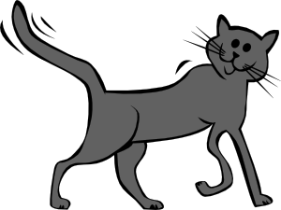
ga
regalo
jugar
gato
ganar
amiga
lugar
[place]
Notes:
Introduce and elicit the pronunciation of the individual SSC ‘ga’ and then the source word again (with gesture, if using). Then present and elicit the pronunciation of the five cluster words.
The cluster words have been chosen for their high-frequency, from a range of word classes, with the SSC (where possible) positioned within a variety of syllables within the words (e.g. initial, 2nd, final etc.). Additionally, we have tried to use words that build cumulatively on previously taught SSCs (see the Phonics Teaching Sequence document) and do not include new SSCs. Where new SSCs are used, they are often consonants which have a similar symbol-sound correspondence in English.

Slide 4
ga
regalo
jugar
gato
ganar
amiga
lugar
Notes:
Without the images, students focus this time again closely on the SSC and the cluster words.

Slide 5
ga
regalo
jugar
gato
ganar
amiga
lugar
Notes:
Without the images or sound, students have to pronounce the words themselves.

Slide 6
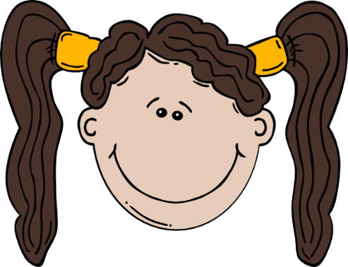
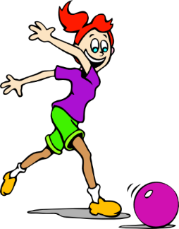
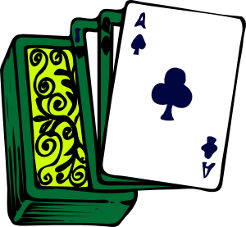
go
domingo
largo
SUNDAY
gol
juego (n)
conmigo
[with me]
algo
[something]
Notes:
Introduce and elicit the pronunciation of the individual SSC ‘go’ and then the source word again (with gesture, if using). Then present and elicit the pronunciation of the five cluster words.
The cluster words have been chosen for their high-frequency, from a range of word classes, with the SSC (where possible) positioned within a variety of syllables within the words (e.g. initial, 2nd, final etc.). Additionally, we have tried to use words that build cumulatively on previously taught SSCs (see the Phonics Teaching Sequence document) and do not include new SSCs. Where new SSCs are used, they are often consonants which have a similar symbol-sound correspondence in English.

Slide 7
go
domingo
largo
gol
juego (n)
conmigo
algo
Notes:
Without the images, students focus this time again closely on the SSC and the cluster words.

Slide 8
go
domingo
largo
gol
juego (n)
conmigo
algo
Notes:
Without the images or sound, students have to pronounce the words themselves.

Slide 9
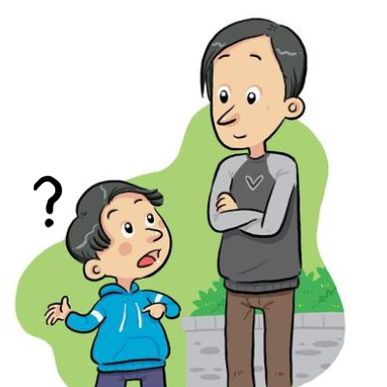
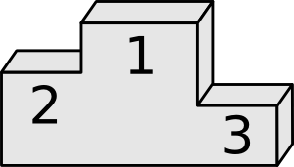
gu
¡mucho gusto!
segundo
preguntar
Notes:
Introduce and elicit the pronunciation of the individual SSC ‘gu’ and then the source word again (with gesture, if using). Then present and elicit the pronunciation of the five cluster words.
The cluster words have been chosen for their high-frequency, from a range of word classes, with the SSC (where possible) positioned within a variety of syllables within the words (e.g. initial, 2nd, final etc.). Additionally, we have tried to use words that build cumulatively on previously taught SSCs (see the Phonics Teaching Sequence document) and do not include new SSCs. Where new SSCs are used, they are often consonants which have a similar symbol-sound correspondence in English.

Slide 10
gu
¡mucho gusto!
segundo
preguntar
Notes:
Without the images, students focus this time again closely on the SSC and the cluster words.

Slide 11
gu
¡mucho gusto!
segundo
preguntar
Notes:
Without the images or sound, students have to pronounce the words themselves.

Slide 12
escuchar / escribir
Escucha.
Marca ‘GA’, ‘GO’ o ‘GU’.
Escucha otra vez.
Escribe la palabra.
 | GA | GO | GU
¿Cómo se dice en inglés?
go
1
conmi___
with me
se___ro
gu
sure, safe
2
go
3
___l
goal
ga
4
__to
cat
pre___ntar
5
gu
to ask
se___ndo
second
6
gu
ami__
7
ga
(female) friend
__nar
8
ga
to win
go
9
lar__
long
lu___r
10
ga
place
Notes:
Phonics practice activity
See the next slide for a variation of this activity.
Timing: 7 minutes
Aim: to practise mapping sound to spelling for the SSCs [ga], [go] and [gu]
Procedure:
1. Students write 1-10.
2. Students listen. For each item, they write ‘ga’, ‘go’ or ‘gu’.
3. Afterwards, students translate the words into English.
Notes: These are high-frequency words that some students will acquire incidentally. They are not automatically counted within the core expected learning of 360 words in Y7 (though some will be introduced as vocabulary items). The additional challenge of translating into English shouldn’t be seen as a test, but as an additional opportunity.
Transcript:
Conmigo
Seguro
Gol
Gato
Preguntar
Segundo
Amiga
Ganar
Largo
Lugar
Word frequency (1 is the most frequent word in Spanish): ganar [295]; gato [1728]; amiga [1172]; gol [2069]; conmigo [1256]; largo [1755]; preguntar [219]; segundo [223]; seguro [407]; lugar [144]
Source: Davies, M. & Davies, K. (2018). A frequency dictionary of Spanish: Core vocabulary for learners (2nd ed.). Routledge: London

Slide 13
escuchar / escribir
Escucha.
Marca ‘GA’, ‘GO’ o ‘GU’.
Escucha otra vez.
Escribe la palabra.
 | GA | GO | GU
¿Cómo se dice en inglés?
1
conmigo
with me
seguro
sure, safe
2
3
gol
goal
4
gato
cat
5
preguntar
to ask
6
segundo
second
7
amiga
(female) friend
8
ganar
to win
9
largo
long
10
lugar
place
Notes:
Variation: students have to write the whole word.
Transcript:
Conmigo
Seguro
Gol
Gato
Preguntar
Segundo
Amiga
Ganar
Largo
Lugar
Word frequency (1 is the most frequent word in Spanish): ganar [295]; gato [1728]; amiga [1172]; gol [2069]; conmigo [1256]; largo [1755]; preguntar [219]; segundo [223]; seguro [407]; lugar [144]
Source: Davies, M. & Davies, K. (2018). A frequency dictionary of Spanish: Core vocabulary for learners (2nd ed.). Routledge: London

Slide 14
Fonética
escuchar / hablar
¿Qué escuchas? ‘GA’, ‘GO’ o ‘GU’?
GU
1
Pregunta mucho en clase.
S/he asks a lot in class.
Notes:
Phonics practice
Timing: 5 minutes
Aim: to practise ‘listening out’ for the target SSC and understanding the source/cluster word in context
Procedure:
1. Students first listen and decide which target SSC(s) they hear.
2. They are then shown the sentence. Before showing its translation, try to elicit it from students.
Word frequency (1 is the most frequent word in Spanish): ganar [295]; gato [1728]; amiga [1172]; gol [2069]; conmigo [1256]; preguntar [219]; segundo [223]; seguro [407]
Source: Davies, M. & Davies, K. (2018). A frequency dictionary of Spanish: Core vocabulary for learners (2nd ed.). Routledge: London

Slide 15
¿Qué escuchas? ‘GA’, ‘GU’ o ‘GA’ y ‘GU’?
2
GA y GU
No quiero un gato. Estoy seguro.
I don’t want a cat. I’m sure.

Slide 16
¿Qué escuchas? ‘GA’, ‘GO’ o ‘GA’ y ‘GO’?
3
GA y GO
Una amiga estudia conmigo.
A (female) friend studies with me.

Slide 17
¿Qué escuchas? ‘GA’, ‘GO’ o ‘GA’ y ‘GO’?
GA y GO
4
¡Gol! ¡Gana el Real Madrid!
Goal! Real Madrid win!

Slide 18
¿Qué escuchas? ‘GA’, ‘GU’ o ‘GA’ y ‘GU’?
GU
5
‘B’ es la segunda letra.
‘B’ is the second letter.

Slide 19
SSCs [ga], [go], [gu]
fonética
Consolidation [1]

Slide 20
ga
regalo
jugar
gato
ganar
amiga
lugar
[place]
Notes:
Introduce and elicit the pronunciation of the individual SSC ‘ga’ and then the source word again (with gesture, if using). Then present and elicit the pronunciation of the five cluster words.
The cluster words have been chosen for their high-frequency, from a range of word classes, with the SSC (where possible) positioned within a variety of syllables within the words(e.g. initial, 2nd, final etc..) and additionally, we have tried to use words that build cumulatively on previously taught SSCs (see the Phonics Teaching Sequence document) and do not include new SSCs. Where new SSCs are used, they are often consonants which have a similar symbol-sound correspondence in English.

Slide 21
ga
regalo
jugar
gato
ganar
amiga
lugar
Notes:
Without the images, students focus this time again closely on the SSC and the cluster words.

Slide 22
ga
regalo
jugar
gato
ganar
amiga
lugar
Notes:
Without the images or sound, students have to pronounce the words themselves.

Slide 23
go
domingo
largo
SUNDAY
gol
juego (n)
conmigo
[with me]
algo
[something]
Notes:
Introduce and elicit the pronunciation of the individual SSC ‘go’ and then the source word again (with gesture, if using). Then present and elicit the pronunciation of the five cluster words.
The cluster words have been chosen for their high-frequency, from a range of word classes, with the SSC (where possible) positioned within a variety of syllables within the words(e.g. initial, 2nd, final etc..) and additionally, we have tried to use words that build cumulatively on previously taught SSCs (see the Phonics Teaching Sequence document) and do not include new SSCs. Where new SSCs are used, they are often consonants which have a similar symbol-sound correspondence in English.

Slide 24
go
domingo
largo
gol
juego (n)
conmigo
algo
Notes:
Without the images, students focus this time again closely on the SSC and the cluster words.

Slide 25
go
domingo
largo
gol
juego (n)
conmigo
algo
Notes:
Without the images or sound, students have to pronounce the words themselves.

Slide 26
gu
segundo
seguro
[sure, certain]
preguntar
Notes:
Without the images, students focus this time again closely on the SSC and the cluster words.

Slide 27
gu
segundo
seguro
preguntar
Notes:
Introduce and elicit the pronunciation of the individual SSC ‘gu’ and then the source word again (with gesture, if using). Then present and elicit the pronunciation of the five cluster words.
The cluster words have been chosen for their high-frequency, from a range of word classes, with the SSC (where possible) positioned within a variety of syllables within the words(e.g. initial, 2nd, final etc..) and additionally, we have tried to use words that build cumulatively on previously taught SSCs (see the Phonics Teaching Sequence document) and do not include new SSCs. Where new SSCs are used, they are often consonants which have a similar symbol-sound correspondence in English.

Slide 28
gu
segundo
seguro
preguntar
Notes:
Without the images or sound, students have to pronounce the words themselves.

Slide 29
İTres segundos!
hablar / escuchar
jugar
domingo
amiga
largo
seguro
regalo
conmigo
preguntar
gato
juego
segundo
lugar
gol
ganar
algo
Notes:
Timing: 3 minutes
Aim: to revise SSCs [ga], [go] and [gu]
Procedure:
1. This is a paired read aloud task. Teachers will need to print one sheet per pair, and then distribute to the students before explaining the activity.
2. Each student uses a different colour to play. Student A says one of the words and student B has 3 seconds to locate it and circle/highlight with their colour. If the student takes longer than 3 seconds student A can steal the point.
Teachers may need to think about student pairings to ensure friendly competition.
Notes:
Slides 11-12 (answers on slide 13) provide a few activities for further phonics practice. Teachers can do them all or select the most appropriate for their classes. In addition to previously taught source and cluster words, this set of words includes previously taught vocabulary items with the target SSC ‘ga’: jugar (2.2.2), amiga (1.1.6), lugar (2.1.3), regalo (1.2.7)

Slide 30
İUn minuto!
hablar
jugar
domingo
60
amiga
largo
seguro
regalo
conmigo
preguntar
Segundos
gato
juego
segundo
lugar
gol
0
ganar
algo
INICIO
Notes:
Timing: 4 minutes
Aim: to revise SSCs [ga], [go] and [gu]
Procedure:
This is a choral alphabetical read aloud – the teacher sets the 60-second timer going (click on ‘inicio’). Individually (but all together at once) students read out the words in alphabetical order. They keep going for one minute. Challenge – translate into English orally with partner. Teachers can circulate to listen to students’ SSC knowledge and recall of English.
As the final activity, students should write the English for as many of the words as they can to reinforce their meanings. Students could have a minute individually then team up with a partner to see if they can achieve translations for all 15 words. The answers are provided on slide 13.

Slide 31
¿Qué significan las palabras?
jugar
?
conmigo
?
to play, playing
with me
amiga
?
?
female friend
juego
game
regalo
?
present
gol
goal
?
gato
cat
?
algo
?
something
place
lugar
?
preguntar
?
to ask, asking
to win, winning
ganar
?
seguro
sure, certain
?
domingo
?
Sunday
second
segundo
?
largo
long
?
Notes:
Timing: 2 minutes
Aim: to revise the meaning of the words used in these phonics activities on the previous slides.
Procedure:
1. Click on the box with ‘?’ to reveal the answer for each word. In this way, answers can be volunteered in any order.

Slide 32
¿GA, GO o GU?
escuchar
Escucha.
Escucha otra vez.
Marca ‘GA’, ‘GO’ o ‘GU’.
Escribe las palabras.
 | GA | GO | GU
¿Cómo se dice en inglés?
1
gol
gana
goal
wins
segundo
lugar
second
place
2
3
jugar
domingos
playing
Sunday
4
regalo
pregunta
present
asks
algo
something
5
gato
cat
Notes:
Timing: 5 minutes
Aim: listening exercise to practise recognising the SSCs [ga], [go], and [gu].
Procedure:
1. Click the number button to play the recording. Students draw the grid and then listen. They tick the boxes for the SSCs that they hear in the sentence. Tell students that there will be more than one SSC per sentence.
2. Then click to go through the answers.
3. Click to reveal a second part to the activity, requiring students to write the words including the [ga], [go], or [gu] SSCs that they hear in Spanish. Then click to go through the answers.
4. Finally students translate those Spanish words into English, this could be either written or done orally, with the answers revealed by clicking.
Transcript
1) ¡Gol! Gana el Barça.
2) En segundo lugar es el Real Madrid.
3) Jugar los domingos es fantástico.
4) ¿Cual es el regalo?, pregunta Daniel.
5) Tener un gato es algo muy especial.
Notes:
Answers are animated to support differentiation. Some students will simply focus on listening out for the correct SSC the first time they listen, while others will be able to also write the words with the target SSCs as they go.
Students could be asked to give the English meaning of the whole sentence.

Slide 33
¿GA, GO o GU?
hablar
İGol! Gana el Barça.
1
Goal! Barca wins!
Notes:
OPTIONAL
Timing: 2 minutes (for slides 43-47)
Aim: Further practice with [ga], [go] and [gu] SSCs
Procedure:
Here, for further sentence level practice, the same sentences appear with target SSCs missing. Students have to read the sentence aloud in chorus, recalling the missing SSCs as they read aloud. The missing SSCs are revealed by clicking.
Students can be asked if they can give the whole translation of the sentence in English.
Audio is also included here for reinforcement of the pronunciation, if needed, by clicking on the number button.
Repeat the process for each slide.
Note: alternatively, the audio can be played first so that students transcribe the missing SSCs.

Slide 34
¿GA, GO o GU?
hablar
En segundo lugar es el Real Madrid.
2
In second place is Real Madrid.

Slide 35
¿GA, GO o GU?
hablar
Jugar los domingos es fantástico.
3
Playing on Sundays is fantastic.

Slide 36
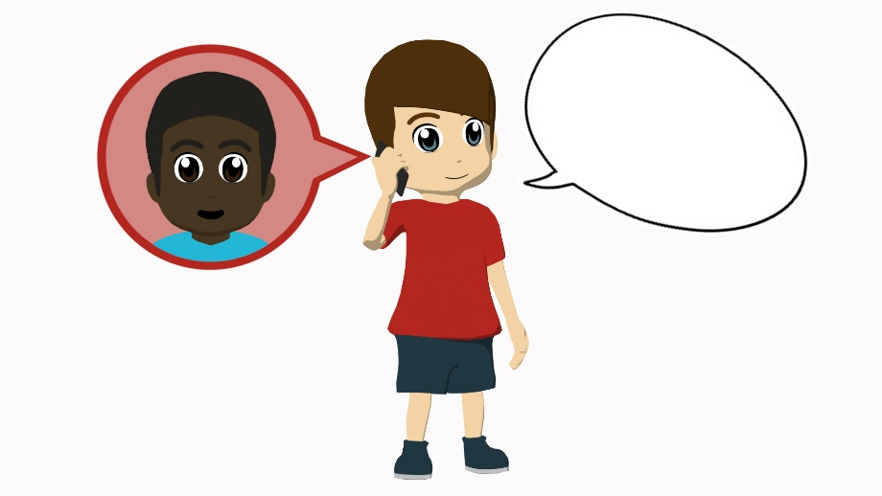
¿GA, GO o GU?
hablar
¿Cuál es el regalo?, pregunta Daniel.
4
“Which is the present?” asks Daniel.

Slide 37
¿GA, GO o GU?
hablar
Tener un gato es algo muy especial.
5
Having a cat is something very special.

Slide 38
SSCs [ga], [go], [gu]
fonética
Consolidation [2]

Slide 39
Fonética
escuchar / escribir
¡Atención! No conoces las palabras en el audio.
Escucha las palabras. ¿Escuchas [ga], [go] o [gu]?
Marca la columna correcta.
Luego escucha otra vez. Intenta escribir la palabra en español.
 | [ga] | [go] | [gu]
 | Palabras en español | Palabras en inglés
1
2
3
4
5
6
7
8
1
riesgo
risk
2
orgullo
pride
3
griego
Greek
4
pagar
to pay, paying
5
figura
figure
6
garantizar
to guarantee, guaranteeing
7
enemigo
enemy
8
seguridad
security, safety
Notes:
Phonics Timing: 6 minutes.
Aim: to consolidate understanding of the SSCs [ga], [go], [gu].
Procedure: 1. Students listen to each word. 2. Students tick the correct column depending on the sound they hear.
3. Students listen to each word again and try to write it down correctly.
Transcription:
riesgo.
orgullo.
griego.
pagar.
figura.
garantizar.
enemigo.
seguridad.
Note: these words have not been previously taught. The aim is not to rely on word knowledge and to focus on SSC knowledge instead.
Frequency of unknown/glossed words:
pagar [377]; riesgo [877]; enemigo [1066]; griego [1417]; garantizar [1615]; seguridad [538]; orgullo [2156]; figura [632]

Slide 40
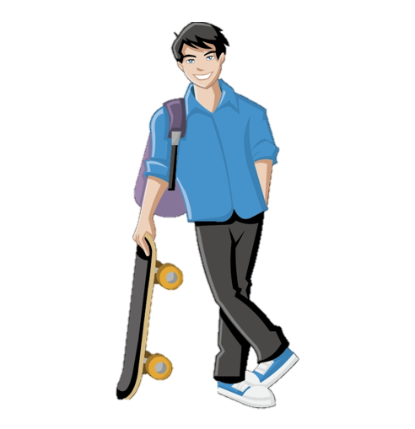
El jugador guapo jugó el domingo pero no ganó porque organizó el juego en un lugar antiguo sin agua. ¿Pregunto al jugador guapo si tiene vergüenza?
hablar
El jugador guapo
1
2
3
Notes:
A tonguetwister
Timing: 4 mins
Aim: to gain confidence in producing the SSCs [ga], [go], [gu] orally in sentences
Procedure:
The teacher first asks students to read the short text and think about what it means.
The teacher reads the text aloud in fragments, eliciting the meanings from students. Note that all words have been previously taught as vocabulary items or used for phonics practice.
Students then practise saying the sentence in pairs, at increasing speed.
The teacher can have students listen to a native speaker read the text at three different speeds (1=slow; 3=very fast). Each time, students can be challenged to say it at the same speed.
Notes:
In several cases, the SSC [gu] is followed by a strong vowel to create a diphthong. It may be worth asking students why this happens (answer=because [u] is a weak vowel and weak vowels combine with a strong vowel to make a single syllable) and how many examples of this they can identify (answer=3, guapo, antiguo, agua).
This slide could alternatively be used for an SSC tallying activity, where students count the number of times they hear the target SSCs. The text itself would need to be covered/removed during the activity.
To focus on meaning, students could work on the text as a dictation (running, paired or student-led) or be asked to write a written translation of the text displayed on the board. Students could also write alternative versions of it, adding other known words with the SSCs [go], [ga] and gu] (see the SoW for ideas of which known words could be used).

Slide 41
SSCs [gui] vs [gi], [gue] vs [ge]
fonética
Consolidation [3]

Slide 42
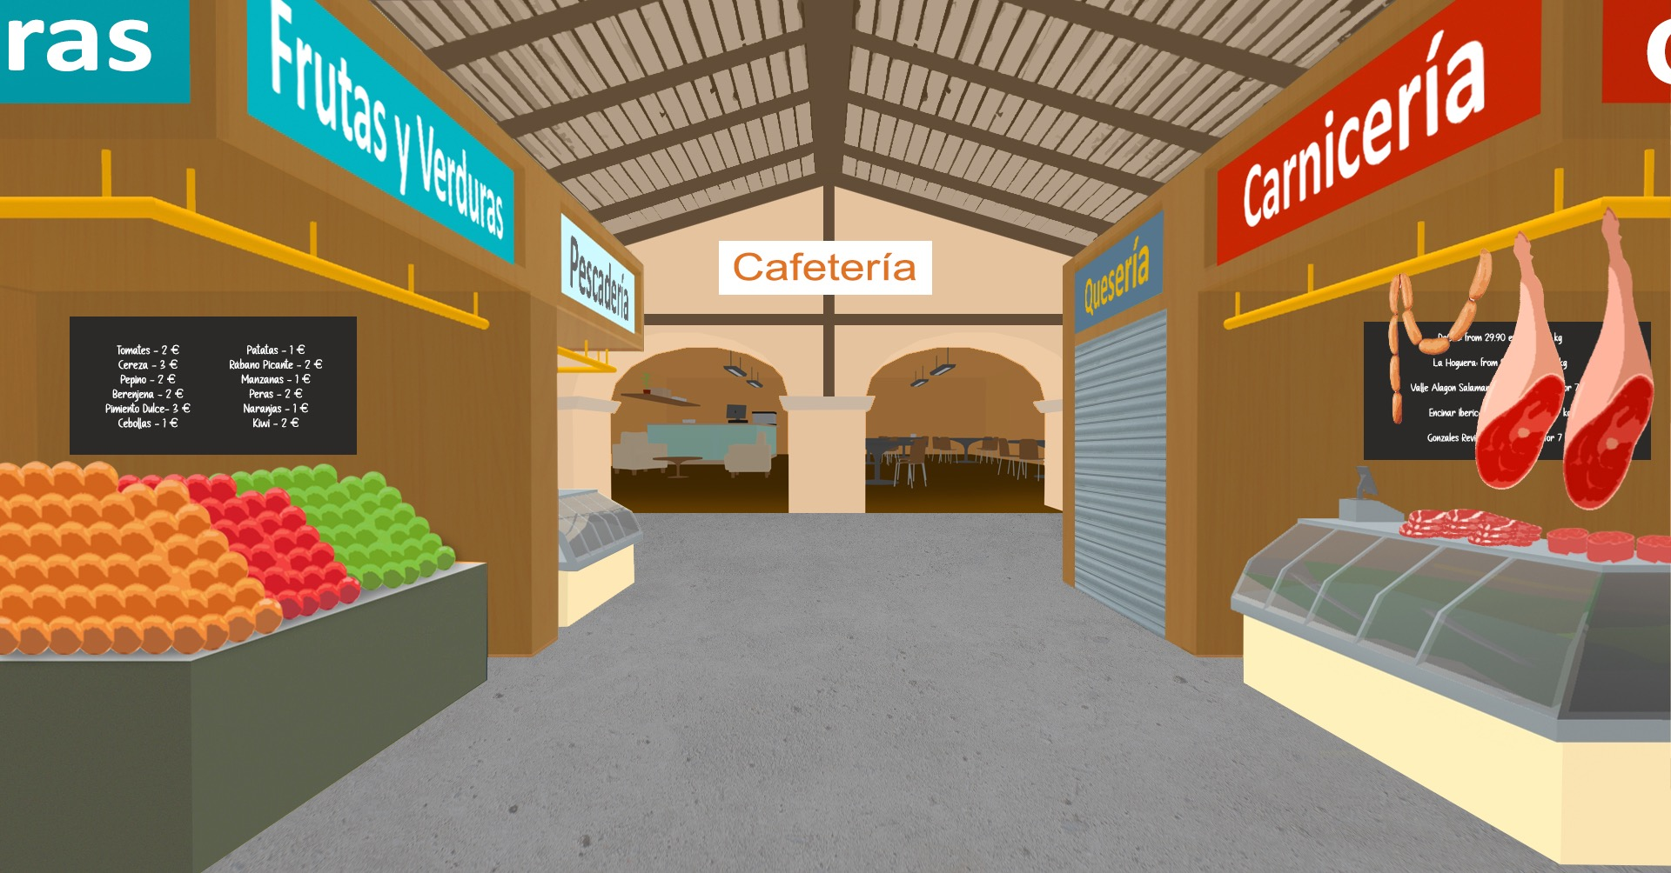
leer / escuchar/ hablar
Fonética
Remember, the ‘j’ in ‘ja’, ‘jo’ and ‘ju’ and the ‘g’ in ‘ga’, ‘go’ and ‘gu’ are pronounced differently. Listen and compare:
‘ja’, ‘jo’, ‘ju’
1
‘ga’, ‘go’, ‘gu’
2
Lee el texto con tu pareja. ¡Intenta pronunciar las palabras correctamente! Luego, piensa: ¿qué significa?
“Creo que es esencial mejorar la salud del planeta. Yo, por ejemplo, siempre elijo productos en vidrio porque son más seguros para el medioambiente. Es más justo*, sin embargo tengo que pagar un poco más. También traigo siempre mis propias bolsas cuando vengo al mercado. Además, sigo los consejos de mi profesor y guardo las hojas* con apuntes* viejos para hacer dibujos o las pongo en la papelera de reciclaje*. Finalmente, recojo basura todos los jueves con mi amigo José. Me gusta porque trabajamos juntos para dejar las calles limpias”.
*justo = just, fair *hoja = sheet *apuntes = notes *papelera de reciclaje = recycle bin
Notes:
Timing: 5 minutes
Aim: to gain confidence in producing the SSCs [ja], [jo], [ju] and [ga], [go], [gu] in context.
Procedure:
Students listen to the recordings modelling the SSCs.
Then, they read the text out loud in pairs, paying attention to the pronunciation of the words with the SSCs in question (in bold).
Finally, students try to translate the text orally. This could be done in pairs or as a whole group activity.
Frequency of unknown words and cognates:
justo [1511]; hoja; [916]; apunte [4865]; papelera [>5000]; reciclaje [>5000]

Slide 43
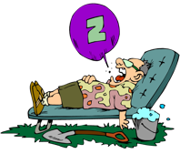
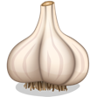
leer / escuchar/ hablar
Fonética
¿Qué palabra escuchas? Marca la opción correcta.
a) jota
b) gota
4
bajo
vago
1
[J (letter)]
[drop]
[lazy]
2
a) gusto
b) justo
5
paga
paja
[taste]
[fair, just]
[straw]
[jug]
3
ajo
hago
[garlic]
6
a) jarra
b) garra
[claw]
Notes:
Timing: 3 minutes
Aim: to gain confidence in identifying and producing the SSCs [ja], [jo], [ju] and [ga], [go], [gu] in minimal pairs.
Procedure:
Students listen to each recording and decide which is the word they hear.
Teacher shows the answers.
Students can repeat the activity in pairs: student A will pronounce one word in each pair from 1 to 3 and student B needs to say which is the word that student A has pronounced. Then, they swap roles for the next 3 pairs of words.
Transcript:
jota
gusto
ajo
vago
paja
garra
Frequency of unknown words and cognates:
jota [>5000]; gota [2391]; aguar [>5000]; ajuar [>5000]; ajo [>5000]; vago [3636]; paja [3876]; jarra [>5000]; garra [4958]

