Slide 1
Spanish phonics collection
SSCs [ca], [co], [cu]
Amanda Izquierdo / Nick Avery /
Rachel Hawkes/ Jack Peacock
Artwork: Mark Davies
Date updated: 07 / 07 / 22
Notes:
Artwork by Mark Davies. All additional pictures selected are available under a Creative Commons license, no attribution required.

Slide 2
SSCs [ca], [co], [cu]
fonética
Introduction

Slide 3
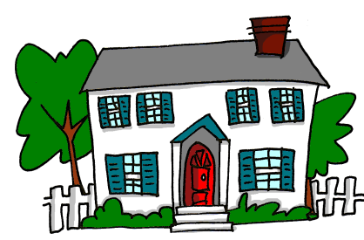
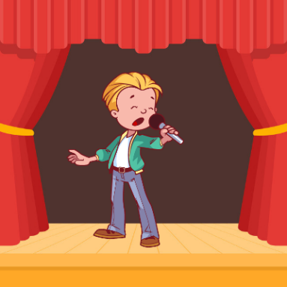
ca
CA
cantar
[street]
calle
casa
Notes:
Timing: 2 minutes
Aim: To introduce SSC [ca]
Procedure:
Introduce and elicit the pronunciation of the individual SSC [ca] and then the source word again ‘casa’ (with gesture, if using).
Then present and elicit the pronunciation of the two cluster words.
The cluster words have been chosen for their high-frequency, from a range of word classes, with the SSC (where possible) positioned within a variety of syllables within the words (e.g. initial, 2nd, final etc.). Additionally, we have tried to use words that build cumulatively on previously taught SSCs (see the Phonics Teaching Sequence document) and do not include new SSCs. Where new SSCs are used, they are often consonants which have a similar symbol-sound correspondence in English.
Word frequency (1 is the most frequent word in Spanish): casa [106], cantar [717], calle [269] Source: Davies, M. & Davies, K. (2018). A frequency dictionary of Spanish: Core vocabulary for learners (2nd ed.). Routledge: London

Slide 4
ca
CA
cantar
calle
casa
Notes:
Without the images, students focus this time again closely on the SSC and the cluster words.

Slide 5
ca
CA
cantar
calle
casa
Notes:
Without the images or sound, students have to pronounce the words themselves.

Slide 6
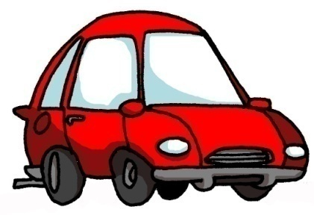
co
CO
con
coche
[with]
comer
Notes:
Timing: 2 minutes
Aim: To introduce SSC [co]
Procedure:
Introduce and elicit the pronunciation of the individual SSC [co] and then the source word again ‘comer’ (with gesture, if using).
Then present and elicit the pronunciation of the two cluster words.
The cluster words have been chosen for their high-frequency, from a range of word classes, with the SSC (where possible) positioned within a variety of syllables within the words (e.g. initial, 2nd, final etc.). Additionally, we have tried to use words that build cumulatively on previously taught SSCs (see the Phonics Teaching Sequence document) and do not include new SSCs. Where new SSCs are used, they are often consonants which have a similar symbol-sound correspondence in English.
Word frequency (1 is the most frequent word in Spanish): comer [347], con [14], coche [1190] Source: Davies, M. & Davies, K. (2018). A frequency dictionary of Spanish: Core vocabulary for learners (2nd ed.). Routledge: London

Slide 7
co
CO
con
coche
comer
Notes:
Without the images, students focus this time again closely on the SSC and the cluster words.

Slide 8
co
CO
con
coche
comer
Notes:
Without the images or sound, students have to pronounce the words themselves.

Slide 9
cu
CU
cultura
escuchar
documento
Notes:
Timing: 2 minutes
Aim: To introduce SSC [cu]
Procedure:
Introduce and elicit the pronunciation of the individual SSC [cu] and then the source word again ‘escuchar’ (with gesture, if using).
Then present and elicit the pronunciation of the two cluster words.
The cluster words have been chosen for their high-frequency, from a range of word classes, with the SSC (where possible) positioned within a variety of syllables within the words (e.g. initial, 2nd, final etc.). Additionally, we have tried to use words that build cumulatively on previously taught SSCs (see the Phonics Teaching Sequence document) and do not include new SSCs. Where new SSCs are used, they are often consonants which have a similar symbol-sound correspondence in English.
Word frequency (1 is the most frequent word in Spanish): escuchar [281], cultura [469], documento [996] Source: Davies, M. & Davies, K. (2018). A frequency dictionary of Spanish: Core vocabulary for learners (2nd ed.). Routledge: London

Slide 10
cu
CU
cultura
escuchar
documento
Notes:
Without the images, students focus this time again closely on the SSC and the cluster words.

Slide 11
cu
CU
cultura
escuchar
documento
Notes:
Without the images or sound, students have to pronounce the words themselves.

Slide 12
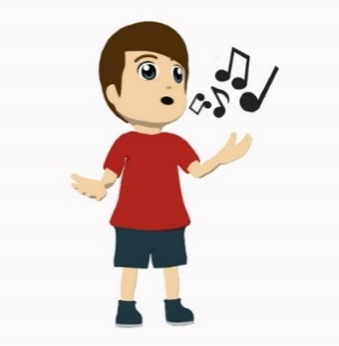
escuchar / escribir
coche
1
A)
casa
B)
comer
cultura
2
casa
3
C)
cultura
D)
coche
comer
4
cantar
5
E)
cantar
F)
calle
calle
6
[street]
Notes:
Two-part phonics task: dictation / word-picture matching
Timing: 6 minutes
Aim: to strengthen understanding of the sound-spelling correspondence for [ca], [co] and [cu]
Procedure:
1. First, the teacher plays the audio (click on the orange action buttons) and the students write the words. Then check answers.
2. Then students say the word aloud that corresponds to the picture. (This could be done chorally as a group, with the teacher pointing to the pictures to elicit the correct word).
Transcript:
Coche
Cultura
Casa
Comer
Cantar
Calle
Word frequency (1 is the most frequent word in Spanish): casa [106], cantar [717], calle [269], comer [347], coche [1190], cultura [469]
Source: Davies, M. & Davies, K. (2018). A frequency dictionary of Spanish: Core vocabulary for learners (2nd ed.). Routledge: London

Slide 13
Fonética
leer / hablar
calle
60
cultura
cantar
escuchar
Segundos
casa
coche
comer
con
0
documento
INICIO
Notes:
Phonics practice activity: Pairwork ‘tennis’
Timing: 1 minute
Aim: to practise with SSCs [ca], [co], [cu] at speed
Procedure:
1. Click on INICIO to start a one minute timer on the screen.
2. Pupils say the words alternately out loud with a partner, building up speed, over 1 minute’s intensive practice.
3. They call in any order they like, pupils are not allowed to repeat the one they said in their last turn.
4. Teacher can circulate to listen into their SSC knowledge.
Word frequency (1 is the most frequent word in Spanish): casa [106], cantar [717], calle [269], comer [347], con [14], coche [1190], escuchar [281], cultura [469], documento [996]
Source: Davies, M. & Davies, K. (2018). A frequency dictionary of Spanish: Core vocabulary for learners (2nd ed.). Routledge: London

Slide 14
SSCs [ca], [co], [cu]
fonética
Consolidation [1]

Slide 15
ca
campo
cara
cambiar
casa
cantar
calle
£
$
[street]
Nick Avery
Notes:
[1/9]
Timing: 3 minutes
Introduce and elicit the pronunciation of the individual SSC ‘ca’ and then the source word again (with gesture, if using). Then present and elicit the pronunciation of the five cluster words.
The cluster words have been chosen for their high-frequency, from a range of word classes, with the SSC (where possible) positioned within a variety of syllables within the words (e.g. initial, 2nd, final etc.). Additionally, we have tried to use words that build cumulatively on previously taught SSCs (see the Phonics Teaching Sequence document) and do not include new SSCs. Where new SSCs are used, they are often consonants which have a similar symbol-sound correspondence in English.

Slide 16
ca
campo
cara
cambiar
casa
cantar
calle
Nick Avery
Notes:
[2/9]
Timing: 3 minutes
Without the images, students focus this time again closely on the SSC and the cluster words.

Slide 17
ca
campo
cara
cambiar
casa
cantar
calle
Nick Avery
Notes:
[3/9]
Timing: 3 minutes
Without the images or sound, students have to pronounce the words themselves.

Slide 18
co
costa
coche
blanco
comer
con
Con ketchup
¿cómo?
[how…?]
Nick Avery
Notes:
[4/9]
Timing: 3 minutes
Introduce and elicit the pronunciation of the individual SSC ‘co’ and then the source word again (with gesture, if using). Then present and elicit the pronunciation of the five cluster words.
The cluster words have been chosen for their high-frequency, from a range of word classes, with the SSC (where possible) positioned within a variety of syllables within the words (e.g. initial, 2nd, final etc.). Additionally, we have tried to use words that build cumulatively on previously taught SSCs (see the Phonics Teaching Sequence document) and do not include new SSCs. Where new SSCs are used, they are often consonants which have a similar symbol-sound correspondence in English.
Teachers whose students have been also been taught French may wish to use the word ‘coche’ to also highlight the difference between the ‘ch’ in Spanish, and the softer ‘ch’ in French (as in ‘chat’)

Slide 19
co
costa
coche
blanco
comer
con
¿cómo?
Nick Avery
Notes:
[5/9]
Timing: 3 minutes
Without the images, students focus this time again closely on the SSC and the cluster words.

Slide 20
co
costa
coche
blanco
comer
con
¿cómo?
Nick Avery
Notes:
[6/9]
Timing: 3 minutes
Without the images or sound, students have to pronounce the words themselves.

Slide 21
cu
cultura
cuatro
cuerpo
escuchar
cuadro
escuela
Nick Avery
Notes:
[7/9]
Timing: 3 minutes
Introduce and elicit the pronunciation of the individual SSC ‘cu’ and then the source word again (with gesture, if using). Then present and elicit the pronunciation of the five cluster words.
The cluster words have been chosen for their high-frequency, from a range of word classes, with the SSC (where possible) positioned within a variety of syllables within the words (e.g. initial, 2nd, final etc.). Additionally, we have tried to use words that build cumulatively on previously taught SSCs (see the Phonics Teaching Sequence document) and do not include new SSCs. Where new SSCs are used, they are often consonants which have a similar symbol-sound correspondence in English.

Slide 22
cu
cultura
cuatro
cuerpo
escuchar
cuadro
escuela
Nick Avery
Notes:
[8/9]
Timing: 3 minutes
Without the images, students focus this time again closely on the SSC and the cluster words.

Slide 23
cu
cultura
cuatro
cuerpo
escuchar
cuadro
escuela
Nick Avery
Notes:
[9/9]
Timing: 3 minutes
Without the images or sound, students have to pronounce the words themselves.

Slide 24
escuchar / escribir
Escucha.
Marca ‘CA’, ‘CO’ o ‘CU’.
Escucha otra vez.
Escribe la palabra.
 | CA | CO | CU
¿Cómo se dice en inglés?
1
comida
food
2
película
film
3
cantar
to sing, singing
4
artístico
artistic
5
campo
countryside
6
periódico
newspaper
7
escuchar
to listen, listening
8
correcto
correct
9
cultura
culture
10
descansar
to rest, resting
Notes:
Phonics and vocabulary Timing: 5 minutes.
Aim: to recognise SSCs [ca], [co, [cu] and transcribe words with them
Procedure:
Students listen to each recording and tick the correct column depending on the sound they hear.
Students listen again and write the word in Spanish.
Students write the meaning of the word in English.
Note: These are all words that students have already learnt in previous lessons. Therefore, students will not only be revisiting the SSCs [ca], [co] and [cu], but also recalling previously taught vocabulary.

Slide 25
¿Qué escuchas? ¿[CA], [CO] o [CU]?
1
CO
Doy libros a un compañero.
I give books to a classmate.
Notes:
[1/5]
Timing: 7 minutes.
Aim: to practise this week’s phonics at sentence-level.
Procedure:
Students listen and decide if they hear ‘ca’, ‘co’ or ‘cu’.
Teacher shows the sentence and tries to elicit its translation.
Note: A number of words from this week’s revisited vocabulary sets are included in these sentences.

Slide 26
¿Qué escuchas? ¿[CA], [CO] o [CU]?
2
CO
La madre quiere un coche blanco.
The mother wants a white car.
Notes:
[2/5]

Slide 27
¿Qué escuchas? ¿[CA], [CO] o [CU]?
3
CO y CA
La hermana pasa tiempo con un amigo en la calle.
The sister spends time with a male friend in the street.
Notes:
[3/5]

Slide 28
¿Qué escuchas? ¿[CA], [CO] o [CU]?
4
CA y CO
Cantar solo puede ser complicado.
Singing alone can be complicated.
Notes:
[4/5]

Slide 29
¿Qué escuchas? ¿[CA], [CO] o [CU]?
5
CA y CU
Caminamos juntos a la escuela. Es la cultura aquí.
We walk together to school. It’s the culture here.
Notes:
[5/5]

Slide 30
SSCs [ca], [co], [cu]
fonética
Consolidation [2]

Slide 31
Fonética
escuchar / escribir
Escucha y escribe la palabra. ¿Es ‘ca’, ‘co’ o ‘cu’?
Luego, escribe la frase en inglés.
casa
calle
1
Hay una ______ azul en mi ______.
There is a blue house on my street.
escuchar
música
concierto
I want to listen to music in / at a concert.
2
Quiero __________ ________ en un __________.
coche
cerca
banco
3
Mi _______ está ______ del _______ .
My car is near the bank.
cantar
con
It is fun to sing with friends.
4
Es divertido _______ ____ amigos.
cultura
documentos
Estudio ________ y _____________ antiguos en clase.
I study culture and old documents in class.
5
comprar
Quiero _________ el ________ ________ .
6
caballo
blanco
I want to buy the white horse.
Notes:
Timing: 8 minutes
Aim: to consolidate understanding of the SSCs [ca], [co] and [cu] and of the words used to practise them.
Procedure:
1. Students listen to audio and write the missing words.
2. Students then translate the sentence into English.
3. The teacher checks answers. It may be helpful to highlight how ‘en’ can translate into English as ‘in’ or ‘at’ in item 2.
Transcript:
Hay una casa azul en mi calle.
Quiero escuchar música en un concierto.
Mi coche está cerca del banco.
Es divertido cantar con amigos.
Estudio cultura y documentos antiguos en clase.
Quiero comprar el caballo blanco.
Vocabulary from revisited sets:
8.1.1.2: concierto [1456]

Slide 32
Fonética
escuchar / escribir
Escucha y escribe la palabra. ¿Es ‘ca’, ‘co’ o ‘cu’?
Luego, escribe la frase en inglés.
1
Hay una casa azul en mi calle.
There is a blue house on my street.
Quiero escuchar música en un concierto.
I want to listen to music in / at a concert.
2
3
Mi coche está cerca del banco.
My car is near the bank.
4
Es divertido cantar con amigos.
It is fun to sing with friends.
Estudio cultura y documentos antiguos en clase.
I study culture and old documents in class.
5
6
Quiero comprar el caballo blanco.
I want to buy the white horse.
Notes:
VARIATION
Students listen to the full sentence. This may be more suitable, depending on the ability of the group.
See slide 2 for aims, procedure and transcript.

Slide 33
İUn minuto!
hablar
canción
blanco
escuela
campo
concierto
escuchar
calle
comprar
documento
en cambio
coche
cultura
caballo
coger
cubrir
cantar
costo
cuatro
Notes:
Timing: 2-4 minutes.
Aim: for students to consolidate their pronunciation of words that contain SSCs ‘ca’, ‘co’ and ‘cu’ in a choral alphabetical read aloud task.
Procedure:
Set a stopwatch or timer to count one minute.
Individually at their own pace (but all together at once) students read aloud the words in alphabetical order. They keep going for one minute.
Teachers can circulate to listen to students’ SSC knowledge.
As the final activity, students should write the English for as many of the words as they can to reinforce their meanings. Students could first have a minute individually, then team up with a partner to see if they can achieve translations for all 18 words. The answers are provided on the following slide.
Note: ‘En cambio’ will have been met during the pre-learning activities for homework before this lesson. However, its meaning may need to be reintroduced as part of the activity.
Vocabulary from revisited sets:
8.1.1.2: concierto [1456]; cantar [717]; coger [1001]; canción [982]
8.1.1.7: costo [1707]; cubrir [611]

Slide 34
¿Qué significan las palabras?
comprar
?
to buy, buying
car
coche
?
canción
?
song
to take, taking
coger
?
campo
?
countryside
costo
cost
?
calle
?
street
escuela
?
school
en cambio
?
however
cultura
?
culture
caballo
?
horse
cubrir
?
to cover, covering
cantar
?
to sing, singing
cuatro
?
four
blanco
?
white
escuchar
?
to listen, listening
concierto
?
concert
documento
document
?
Notes:
Timing: 1 minute
Aim: to check understanding of the words from the previous phonics activity. Some of these will have been learnt incidentally, through phonics practice, while others are previously taught vocabulary items.
Procedure:
Click on the box with ‘?’ to reveal the answer for each word. Answers can be volunteered in any order.
Vocabulary from revisited sets:
8.1.1.2: concierto [1456]; cantar [717]; coger [1001]; canción [982]
8.1.1.7: costo [1707]; cubrir [611]

Slide 35
SSCs [ca], [co], [cu]
fonética
Consolidation [3]

Slide 36
Fonética
leer
Lee una versión corta del texto con tu pareja. Intenta pronunciar las palabras con ‘ca’, ‘co’ y ‘cu’ correctamente.
El viernes catorce de septiembre celebramos el festival de lenguas. Aquí en la escuela todo cambió. Los profesores saludaron a los chicos y chicas en aléman. También los profesores cambiaron el menú de nuestro comedor*. A las dos, en clase, buscamos información sobre bebidas de otras culturas en nuestros ordenadores mientras que los profesores encontraron un lugar para hacer un salon de té* inglés. A las cuatro cantamos en nuestro idioma favorita.
*el salón de té = tearoom
*el comedor = dining hall
Notes:
Timing: 3 minutes
Aim: to practise pronunciation of the SSCs [ca], [co] and [cu].
Procedure:
Students read the short text with a partner or in chorus as a whole class, focusing on pronunciation of the SSCs [ca], [co] and [cu].
Frequency of unknown words and cognates:
menú [4112]; té [2552]; version [1057]; salón [1722]; favorito [2360]

Slide 37
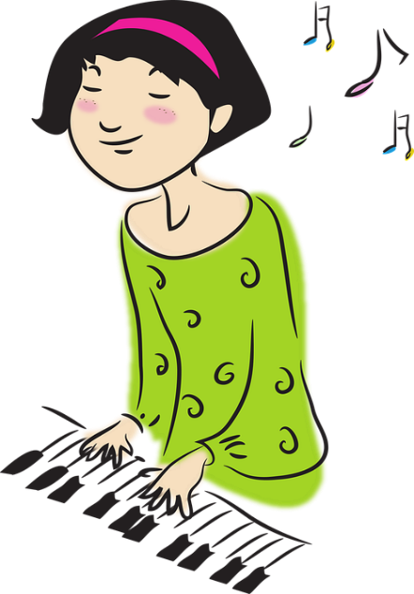
Fonética
hablar / escuchar
Pronuncia las palabras en español. ¿Cuál es la SSC?
CA
¿Cómo se dice ‘I am hot’ en español?
[heat]
[letter]
[to play, playing [instrument]]
Tengo calor.
calor
carta
tocar
Notes:
[Slide 1/3] Timing: 2 minutes Aim: to recall vocabulary, say it out loud and spot the SSC that the three words have in common. Procedure: 1. Students work alone or in pairs to recall the three Spanish words and identify the SSC that they have in common. 2. Click to reveal the SSC and again to reveal each of the three words. A recording of the word will play on each click.
ANSWERS:
1. calor
2. carta
3. tocar

Slide 38
Fonética
hablar / escuchar
Pronuncia las palabras en español. ¿Cuál es la SSC?
CO
[mail]
[glass, drink]
[I pick up, am picking up]
correo
copa
recojo
Notes:
[Slide 2/3]
ANSWERS:
1. correo
2. copa
3. recojo

Slide 39
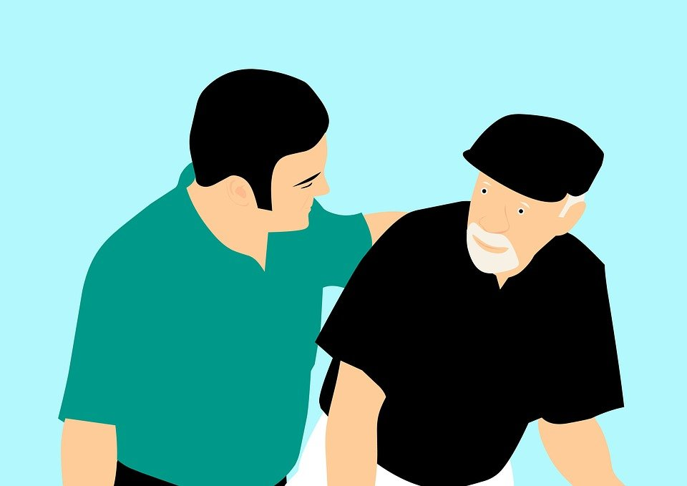
Fonética
hablar / escuchar
Pronuncia las palabras en español. ¿Cuál es la SSC?
CU
[to cover, covering]
[to look after, looking after]
cuatro
cubrir
cuidar
Notes:
[Slide 3/3]
ANSWERS:
1. cuatro
2. cubrir
3. cuidar

