Slide 1
Spanish phonics collection
SSC [qui]
Nick Avery / Rachel Hawkes / Amanda Izquierdo
Artwork: Mark Davies
Date updated: 04 / 08 / 22
Notes:
Artwork by Mark Davies. All additional pictures selected are available under a Creative Commons license, no attribution required.

Slide 2
SSC [qui]
fonética
Introduction

Slide 3
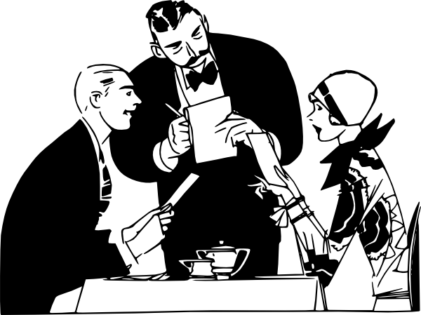
qui
quiero
Nick Avery
Notes:
Introduce and elicit the pronunciation of the individual SSC ‘qui’ and then present and practise the pronunciation of the source word ‘quiero’.
A possible gesture for this source word would be to fold hands over your heart, and then move the right hand away from the body.

Slide 4
qui
quiero
Nick Avery
Notes:
Repeat the sound and elicit the source word.

Slide 5
qui
quiero
Nick Avery
Notes:
Without sound to elicit pronunciation (without first hearing the teacher).

Slide 6
qui
izquierda
tranquilo
[calm]
quiero
[I want]
quince
¿quién?
equipo
[team]
Notes:
Timing: 2 minutes
Aim: To introduce/consolidate SSC [qui]
Procedure:
Introduce and elicit the pronunciation of the individual SSC [qui] and then the source word again ‘quiero’ (with gesture, if using).
Then present and elicit the pronunciation of the five cluster words.
The cluster words have been chosen for their high-frequency, from a range of word classes, with the SSC (where possible) positioned within a variety of syllables within the words (e.g. initial, 2nd, final etc.). Additionally, we have tried to use words that build cumulatively on previously taught SSCs (see the Phonics Teaching Sequence document) and do not include new SSCs. Where new SSCs are used, they are often consonants which have a similar symbol-sound correspondence in English.
Word frequency (1 is the most frequent word in Spanish): quiero [>5000]; izquierda [1352]; quince [1215]; equipo [373]; tranquilo [1073]; ¿quién? [289] Source: Davies, M. & Davies, K. (2018). A frequency dictionary of Spanish: Core vocabulary for learners (2nd ed.). Routledge: London

Slide 7
qui
izquierda
tranquilo
quiero
[I want…]
quince
¿quién?
equipo
Notes:
Without the images, students focus this time again closely on the SSC and the cluster words.

Slide 8
qui
izquierda
tranquilo
quiero
[I want…]
quince
¿quién?
equipo
Notes:
Without the images or sound, students have to pronounce the words themselves.

Slide 9
escuchar / escribir
Escucha.
Marca ‘QUE’ o ‘QUI’.
 | QUE | QUI
¿Cómo se dice en inglés?
por____
Escucha otra vez.
1
que
because
Escribe la palabra.
qui
calm, tranquil
2
tran___lo
¿___én?
who?
3
qui
par____
park
4
que
___nce
fifteen
5
qui
qui
I want
6
___ero
____rer
to want
7
que
qué
what?
8
¿____?
e___po
team
9
qui
que
to meet up
10
____dar
Notes:
Timing: 8 minutes
Aim: to practise mapping sound to spelling for SSCs [que] and [qui]
Procedure:
1. Students listen to audio.
2. Students tick ‘que’ or ‘qui’.
3. They then write the missing letters themselves and the English translation.
Note: Make sure that students remember the accent when writing ‘¿qué?’.
These are high-frequency words that some students will acquire incidentally, but are not counted within the core expected learning of 360 words in Y7. Students should therefore not think of the additional challenge of translating into English as a test, but as an additional opportunity.
Transcript:
Porque
Tranquilo
Quién
Parque
Quince
Quiero
Querer
Qué
Equipo
Quedar
Word frequency (1 is the most frequent word in Spanish): querer [58]; quince [1215]; equipo [373]; quién [289]; tranquilo [1073]; qué [50]; porque [40]; parque [1354]; quedar [100]
Source: Davies, M. & Davies, K. (2018). A frequency dictionary of Spanish: Core vocabulary for learners (2nd ed.). Routledge: London

Slide 10
escuchar / escribir
Escucha.
Marca ‘QUE’ o ‘QUI’.
 | QUE | QUI
¿Cómo se dice en inglés?
porque
because
Escucha otra vez.
1
Escribe la palabra.
2
tranquilo
calm, tranquil
3
¿quién?
who?
4
parque
park
5
quince
fifteen
6
quiero
I want
7
querer
to want
8
¿qué?
what?
9
equipo
team
10
quedar
to meet up
Notes:
Variation. Students have to write the whole word.
Word frequency (1 is the most frequent word in Spanish): querer [58]; quince [1215]; equipo [373]; quién [289]; tranquilo [1073]; qué [50]; porque [40]; parque [1354]; quedar [100]
Source: Davies, M. & Davies, K. (2018). A frequency dictionary of Spanish: Core vocabulary for learners (2nd ed.). Routledge: London

Slide 11
Fonética
escuchar / hablar
¿Qué escuchas? ‘QUI’, ‘QUE’ o ‘QUI’ y ‘QUE’?
QUI y QUE
1
Quiero estar en un parque.
I want to be in a park.
Notes:
Phonics practice activity
Timing: 6 minutes (slides 7-12)
Aim: to practise mapping sound to spelling with [que] and [qui]
Procedure:
1. Students first listen and decide if they hear ‘qui’, ‘que’ or both.
2. Then click to bring up the sentence
3. Teacher asks students for the translation and clicks again to bring it up.
Transcript:
1. Quiero estar en un parque.

Slide 12
Fonética
escuchar / hablar
¿Qué escuchas? ‘QUI’, ‘QUE’ o ‘QUI’ y ‘QUE’?
2
QUI y QUE
¿Qué necesitas? ¿Un equipo?
What do you need? A team?
Notes:
Transcript:
¿Qué necesitas? ¿Un equipo?

Slide 13
Fonética
escuchar / hablar
¿Qué escuchas? ‘QUI’, ‘QUE’ o ‘QUI’ y ‘QUE’?
3
QUI y QUE
Estudio español porque quiero hablar.
I study Spanish because I want to speak.
Notes:
Transcript:
Estudio español porque quiero hablar.

Slide 14
Fonética
escuchar / hablar
¿Qué escuchas? ‘QUI’, ‘QUE’ o ‘QUI’ y ‘QUE’?
QUI
4
¿Quince equipos? ¡Es mucho!
Fifteen teams? That’s a lot!
Notes:
Transcript:
¿Quince equipos? ¡Es mucho!

Slide 15
Fonética
escuchar / hablar
¿Qué escuchas? ‘QUI’, ‘QUE’ o ‘QUI’ y ‘QUE’?
QUI
5
¿Quién tiene un gato? ¡Quiero uno!
Who has a cat? I want one!
Notes:
Transcript:
¿Quién tiene un gato? ¡Quiero uno!

Slide 16
Fonética
leer / hablar
¿quién?
porque
casa
pequeño
tranquilo
querer
cama
quiero
cantar
calle
¿qué?
quince
caminar
parque
equipo
Notes:
Phonics activity (in pairs)
Timing: 7 minutes
Aim: to practise saying words with SSCs [que] and [qui]
Procedure:
There are 5 words for each of 3 SSCs (QUE, QUI, CA):
Start with all cards face down. Student A and B take turns to turn over one card at time.
The student turning over the card says the word aloud each time they turn one over.
S/he then puts the card into one of three piles: 1) QUE 2) QUI 3) CA
There is only one pile for each SSC (it is a pile shared by each pair). The student who adds the 4th card in any category wins!
Notes:
Printer-friendly version of these cards also available in Word document.
These cards contain phonics practice words for this and two previous weeks in NCELP SoW, with the addition of ‘caminar’ and ‘cama’, included to provide additional decoding practice.
Word frequency (1 is the most frequent word in Spanish): querer [58]; quince [1215]; equipo [373]; quién [289]; tranquilo [1073]; qué [50]; porque [40]; parque [1354]; pequeño [202]; cama [609]; casa [106]; cantar [717]; calle [269]; caminar [514]
Source: Davies, M. & Davies, K. (2018). A frequency dictionary of Spanish: Core vocabulary for learners (2nd ed.). Routledge: London

Slide 17
SSC [qui]
fonética
Consolidation [1]

Slide 18
qui
quiero
Notes:
Introduce and elicit the pronunciation of the individual SSC ‘qui’ and then present and practise the pronunciation of the source word ‘quiero’.
A possible gesture for this source word would be to fold hands over your heart, and then move the right hand away from the body.

Slide 19
qui
quiero
Notes:
Repeat the sound and elicit the source word.

Slide 20
qui
quiero
Notes:
Repeat the sound and elicit the source word.

Slide 21
qui
izquierda
tranquilo
quiero
[I want…]
quince
¿quién?
equipo
Notes:
Introduce and elicit the pronunciation of the individual SSC ‘qui’ and then the source word again (with gesture, if using). Then present and elicit the pronunciation of the five cluster words.
The cluster words have been chosen for their high-frequency, from a range of word classes, with the SSC (where possible) positioned within a variety of syllables within the words (e.g. initial, 2nd, final etc.). Additionally, we have tried to use words that build cumulatively on previously taught SSCs (see the Phonics Teaching Sequence document) and do not include new SSCs. Where new SSCs are used, they are often consonants which have a similar symbol-sound correspondence in English.

Slide 22
qui
izquierda
tranquilo
quiero
quince
¿quién?
equipo
Notes:
Without the images, students focus this time again closely on the SSC and the cluster words.

Slide 23
qui
izquierda
tranquilo
quiero
quince
¿quién?
equipo
Notes:
Without the images or sound, students have to pronounce the words themselves.

Slide 24
Escucha las frases.
How many times can you hear ‘qui’?
Escucha otra vez y escribe la frase. ¿Qué significa?
Frase | ¿Qué significa?
 | 1 | 2 | 3
El equipo está en el estadio a la izquierda del aeropuerto.
The team is in the stadium to the left of the airport.
1
¿Quién quiere viajar en avión por la noche?
Who wants to travel by plane at night?
2
¿Cuándo hago quince dibujos de deberes?
When do I do fifteen drawings for homework?
3
4
Quieren estar tranquilos aquí en la estación.
They want to be calm here at the station.
5
Estamos en el este pero el oeste está a la izquierda.
We are in the east but the west is on the left.
Note. el estadio = stadium; el avión = plane
Notes:
Timing: 8 minutes
Aim: to practise recognising and spelling SSC ‘qui’.
Procedure:
Teachers click on the number buttons to play the recordings.
Students listen and tally how many [qui] SSCs they hear in each recording and tick the appropriate column.
Answers are shown by clicking in order.
In the second part of the activity, students need to listen and transcribe the Spanish sentence, before then translating it. Teachers click to show this second grid. Teachers may need to play the recording several times.
Transcript:
El equipo está en el estadio, a la izquierda del aeropuerto;
¿Quién quiere viajar en avión por la noche?
¿Cuándo hago quince dibujos de deberes?
Quieren estar tranquilos aquí en la estación;
Estamos en el este pero el oeste está a la izquierda;
Notes:
All of the phonics source and cluster words have been used, here, plus some of the vocabulary to be revisited this week has been used: T2.2 Week 4:
estamos [estar-21]; oeste [2416]; este [>5000*]; estación [1404]; tren [1488]
T2.1 Week 4:
¿cuándo? [57]; hago [26]; deberes [2187]; dibujo [1726]; noche [164]; de [2];

Slide 25
SSC [qui]
fonética
Consolidation [2]

Slide 26
Fonética
escuchar / escribir
Escucha las frases. Escribe las palabras con [qui] en la primera columna y las palabras con [que] en la segunda columna.
Luego escribe el significado de las palabras en inglés.
 | [qui]
[que]
español
inglés
español
inglés
1
esquina
corner
quedó
[he] met up
2
quitó
[s/he] took off, removed
3
quince
fifteen
así que
paquete
so
packet
quieren
they want
4
quizás
maybe
tranquilo
calm
5
quinta
fifth
¿por qué?
why?
6
ataque
attack
equipo
izquierda
team
left
Notes:
Phonics and vocabulary Timing: 5 minutes.
Aim: To revisit SSC [qui] and contrast it with [que]. To also revisit previously taught vocabulary.
Procedure: 1. Students listen to each sentence.
2. Students write down the words with [qui] in the first column and the words with [que] in the second column.
3. Students write the meaning of known words in English. The meaning of unknown words is already given in the table. The meanings of these unknown words may be learnt incidentally.
Note: Unknown words are included to ensure that SSC knowledge is needed to accurately spell some of the words. Other target words have been used in earlier phonics and/or vocabulary activities, so the task is also a chance to consolidate understanding of the meaning of these words.
Transcript:
¿El inglés quedó con Lucía en la esquina?
¿Quién quitó la comida de la mesa?
El costo de un paquete es quince euros, así que compré dos.
Quizás quieren pasar un fin de semana tranquilo.
¿Por qué no subiste la quinta montaña a pie?
El equipo empieza el ataque por la izquierda.
Frequency of unknown/glossed words:
quinto [1586]; esquina [1536]; ataque [1116]; paquete [2325]

Slide 27
Vocabulario
escuchar
Escucha y completa las frases.
Did the English person (m) meet up with Lucía
1
______________________________________________on the corner?
Who
the food
the table
2
_______ took __________off___________?
The cost of a
is
so I bought two
3
_______________packet_____fifteen euros, __________________.
4
Maybe they want to have a calm/quiet weekend.
______________________________________________________.
Why didn’t you go up
mountain on foot
5
______________________the fifth____________________?
The team starts
on/up the left
6
________________the attack_______________.
Notes:
Vocabulary Timing: 4 minutes.
Aim: to focus on other vocabulary items from the sentences used in the previous task.
Procedure:
1. Students listen to the sentences and complete them. The meanings of previously untaught words is given.
Transcript:
El inglés quedó con Lucía en la esquina?
¿Quién quitó la comida de la mesa?
El costo de un paquete es quince euros, así que compré dos.
Quizás quieren pasar un fin de semana tranquilo.
¿Por qué no subiste la quinta montaña a pie?
El equipo empieza el ataque por la izquierda.

Slide 28
Fonética
hablar
1
2
3
esquina
querer
quinto
4
5
6
7
quedar
paquete
quince
ataque
8
9
10
pequeño
izquierda
máquina
Notes:
A game of pairs (whole-class activity)
Timing: 7 minutes (slides 16-17)
Aim: Students match words based on the SSC [que] and [qui].
Procedure:
1. The teacher selects a number by clicking on it.
2. Students say the word in choral response.
3. The teacher selects a second number by clicking on it.
4. Students say the word in choral response.
5. If a match is made i.e., both words have the same SSC (either [qui] or [que]), the teacher leaves the text box with the words visible on the board.
6. If a match is not made, the teacher clicks on the text box and the number will reappear, covering back up the word.
7. Some students will begin to memorize where matches could be made. Teachers could encourage students to give the numbers but making sure that students say the target word as well.
Students then play in pairs (see next slide for student cards, also available as a Word document.)
Notes:
The words selected for the activity are a mix of known and unknown words. Some words were only seen in the phonics activity in lesson 1 of this sequence (paquete, quinto, esquina, ataque, máquina). The meanings of these high-frequency words may be learnt incidentally. Others are part of the core vocabulary learnt in the SoW (querer, quedar, quince, pequeño, izquierda).
Teachers could also consider asking students about the word classes of these words (and of those seen in the next activity), if desired. This would build on the word class recognition activity in lesson 1.

Slide 29
Fonética
hablar
esquina
querer
quinto
quedar
paquete
quince
ataque
pequeño
izquierda
máquina
Notes:
Follow-up pair work
Aim: to continue focusing on SSCs [que] and [qui], this time in follow-up pair-work
Procedure:
These are the same word cards as those used for the pairs game on the previous slide. They are also available as a Word doc with the resource.
Students begin with all the cards facing down. They have to turn two over per go to find a pair (pelmansim). They say each word aloud when they turn over the card.
Students keep the pair if a match is made or turn the cards back over if a match is not made.
Students take it in turns. The player with the most pairs wins.
The teacher should circulate during the activity to ensure students are saying the word at the same time as turning the card over.

Slide 30
SSC [qui]
fonética
Consolidation [3]

Slide 31
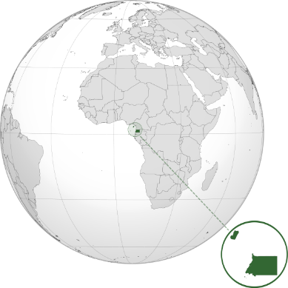
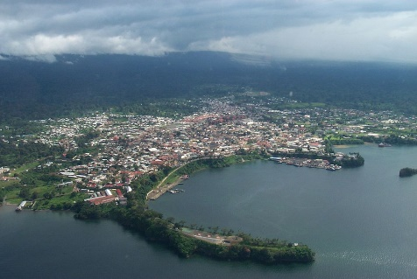
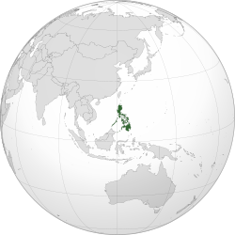
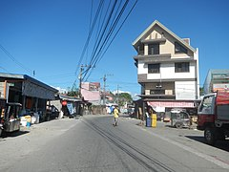
¿De dónde eres? ¿De dónde sois?
Escucha las preguntas.
¿Es ‘eres’ o ‘sois’?
escuchar
También escribe ‘qui’ o ‘gui’, según el lugar.
one ‘you’
more than one ‘you’
Zipaquirá
1
Zipa _ _ _ rá
Guinea Ecuatorial
2
_ _ _ nea Ecuatorial
3
I _ _ _ tos
Iquitos
Guinea Ecuatorial en el este de África era parte del imperio español hasta el 1968.
Guayaquil
4
Guaya _ _ _ l
Arequipa
5
Are _ _ _ pa
San _ _ _ llermo
6
San Guillermo
Bar _ _ _ simeto
7
Barquisimeto
San Guillermo es un pueblo en las Filipinas.
El país era parte del imperio español hasta 1898.
Monguí
8
Mon _ _ _
Notes:
Timing: 7 minutes
Aim:
to practise connecting ‘eres’ and ‘sois’ to their meanings (listening activity)
to practise aural recognition of SSCs [qui] and [gui]
Procedure:
Click to bring up the instructions.
Click the orange button to play the audio for the first time.
Click to reveal each answer and give feedback.
Play the audio again. This time, students write down ‘qui’ or ‘gui’, depending on the place name.
Click to reveal the answers to the second part of the activity.
Notes:
i. to challenge more able students, ask them to transcribe the whole word (the slide can easily be adapted to remove the gapped words).
ii. Spanish remains an official language of Ecuatorial Guinea today (in addition to French and Portuguese). 87.7% of the population speak Spanish as a first or second language (source: https://cvc.cervantes.es/lengua/anuario/anuario_06-07/pdf/paises_08.pdf)
iii. Spanish is a ‘recognised’ language in the Phillipines, meaning that it is “promoted on a voluntary and optional basis”. The official languages are English and Filipino. The country was named “Felipinas” after Philip II of Spain in 1542 and has a number of Spanish place names. Sources: http://republicact.com/widget/provision/340 and https://www.uni-due.de/SVE/VARS_Philippines.htm#:~:text=The%20Philippines%20are%20named%20after,them%20after%20its%20then%20king.
Transcript:
¿Sois de Zipaquirá?
¿Eres de Guinea Ecuatorial?
¿Sois de Iquito?
¿Sois de Guayaqui?
¿Eres de Arequi?
¿Sois de San Guillermo?
¿Eres de Barquisimeto?
¿Eres de Monguí?
Pictures licensed under CC licenses:
Equatorial Guinea map from Wikipedia https://commons.wikimedia.org/wiki/File:GNQ_orthographic.svg by Addicted04 This file is licensed under the Creative Commons Attribution-Share Alike 3.0 Unported license.
Photo https://commons.wikimedia.org/wiki/File:Malabo_a_13-oct-01.jpg
Phillipines map from Wikipedia https://commons.wikimedia.org/wiki/File:PHL_orthographic.svg by Addicted04This file is licensed under the Creative Commons Attribution-Share Alike 3.0 Unported license.
Photo https://commons.wikimedia.org/wiki/File:7560San_Guillermo_Capaoay,_San_Jacinto,_Pangasinan_30.jpg This file is made available under the Creative Commons CC0 1.0 Universal Public Domain Dedication.

