Slide 1
Spanish phonics collection
SSCs [gue], [gui]
Nick Avery / Rachel Hawkes / Amanda Izquierdo
Artwork: Mark Davies
Date updated: 06 / 09 / 22
Notes:
Artwork by Mark Davies. All additional pictures selected are available under a Creative Commons license, no attribution required.

Slide 2
SSCs [gue], [gui]
fonética
Introduction

Slide 3
seguir
[to follow |following]
The e in the stem changes to i in all forms except nosotros (‘we’) and vosotros (‘you pl.’).
sigue
[follows | is following]
sigo
The u from the stem is omitted in the ‘I’ form.
[follow | am following]
Notes:
Timing: 4 minutes for sequence of eight slides
Aim: to introduce the verb seguir more explicitly. The long form (infinitive), short form (3rd person singular) and 1st person singular are introduced in order to familiarise students with various forms of the same verb and exemplify the spelling changes.
Procedure
Bring up the word seguir on its own, say it, students repeat it, and remind them of the phonics [gu].
Elicit the meaning from the students. Students have had explicit teaching that the present tense in Spanish communicates two different present tense meanings in English. This reinforces that learning. Emphasise the two meanings for the short form. Later in their learning, students will be taught the Spanish present continuous, but it is important that they know both English meanings for the Spanish present simple, as it is often used to express ongoing events.
Bring up the picture, and, if using gestures, a possible gesture would be to use both the forefinger and middle finger of each hand to mine two sets of legs walking, one following the other.
Then bring up the English translations. Emphasise the two meanings for the infinitive.
Bring up the first short form sigue, say it, students repeat it. Draw attention to different pronunciation of [e] vs [i].
Bring up the second short form sigo, say it, students repeat it. Draw attention to different pronunciation of [e] vs [i].
Try to elicit the meaning from the students. Emphasise the two meanings for the short forms.
Bring up the info bubble to introduce the stem-change. NB: This is not a grammar point that students are expected to produce at this stage and will not feature in any NCELP tests. It is showcased here for awareness and passive understanding only.
Bring up the speech bubble to draw students’ attention to the spelling change in first person singular.

Slide 4
SSCs [gue], [gui]
fonética
Consolidation [1]

Slide 5
Spelling changes for –ar verbs in the preterite: using the verb ending ‘-gué’
gramática
As you know, some verbs in Spanish end in –ar.
To talk about ‘I’ for completed events in the past with –ar verbs ending in -car, remove ‘-ar’ and add _____ .
qué
practicar
practiqué
atacar
ataqué
Ejemplos:
(to practise)
(I practised)
(to attack)
(I attacked)
However, for –ar verbs ending in ‘-gar’, remove –gar and add –gué.
Ejemplos:
jugar
jugué
llegar
llegué
(to play)
(I played)
(to arrive)
(I arrived)
As the infinitive has a hard ‘g’, it needs to keep the same sound in the past tense. If the ‘g’ didn’t change to ‘gu’, the verb ending would be a soft [ge] sound.
Notes:
Timing: 2 minutes
Aim: recap the 1st person singular ending –qué and introduce the new verb ending –gué. These endings are based on the need for the verbs to maintain the correct pronunciation.
Procedure:
1. Remind students of the rule for forming the 1st person singular preterite form of –ar verbs ending in –car. Ask students what the verb ending is, which will be revealed with a click.
2. Click to show examples of regular ‘car’ verbs using new ‘car’ verbs from the top 2000 most frequent words. Click again to show the conjugated verb and again to show the translation. This allows teachers to ask students for the correct form of the verb and its meaning. These are both cognates, and their meanings are given.
3. Click to show the rule for ‘gar’ verbs.
4. Click again to show examples of the rule. ‘Jugar’ and ‘llegar’ verbs are both known vocabulary items.
5. Click to show the explanation for this spelling change. This is an opportunity to revisit the ‘soft’ [ge] SSC and juxtapose it with [gué].
Frequency of unknown words (1 is the most common word in Spanish)
practicar [1495]; atacar [1504]

Slide 6
Lucía describe el fin de semana pasado. Escucha. ¿Cuántas veces escuchas verbos en –é, –qué o –gué? Escribe las palabras.
escuchar / escribir
é
qué
gué
¿Qué palabras escuchas?
é
qué
gué
desayuné
quité
gané
saqué
practiqué
busqué
identifiqué
jugué
pagué
llegué
*quitar la mesa – to clear the table
*pagar – to pay
Notes:
Slide 1/2
Timing: 8 minutes (slides 24-5)
Aim: to identify how frequently the three SSCs occur in the text.
Procedure:
Students copy the tally grids into their books for this. Click on the ‘play’ button (top right) of the audio player to begin.
The first (and second) time they listen, they just tally how many times they hear the three SSCs.
Students listen again. They write the words that they hear with these SSCs. It may be necessary to replay the audio multiple times to give students the chance to complete all three boxes. There isn’t a problem with this – it is more likely to support errorless learning (see NCELP phonics rationale document (https://resources.ncelp.org/concern/parent/kd17cs85f/file_sets/sn009x76k).
Notes:
This fully readable text (i.e., a text that includes 100% or near to 100% previously taught language) could also be used for a dictation.
Transcript:
Text (77 words): Un día muy lleno
El sábado pasado, desayuné temprano y quité la mesa después. Me gusta la música, entonces saqué mi guitarra y practiqué casi toda la mañana. Después, busqué mi balón de fútbol y jugué en el parque con Hugo. ¡Yo gané cinco a cuatro! Por la tarde pagué unos billetes de autobús para un viaje a Sevilla, luego identifiqué unos lugares para visitar. Llegué a casa con sueño después de un día muy lleno.
Word frequency of unknown words/cognates (1 is the most frequent word in Spanish): identificar [1080]; pagar [377]

Slide 7
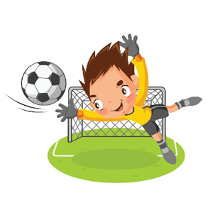
Lee el párrafo a tu compañero. Cambia el infinitivo del verbo a la forma correcta del ‘yo’ en el pasado.
hablar
El sábado pasado, [desayunar] temprano y [quitar] la mesa después. Me gusta la música, entonces [sacar] mi guitarra y [practicar] casi toda la mañana. Después, [buscar] mi balón de fútbol y [jugar] en el parque con Hugo. ¡Yo [ganar] cinco a cuatro! Por la tarde [pagar] unos billetes de autobús para un viaje a Sevilla, luego [identificar] unos lugares para visitar. [Llegar] a casa con sueño después de un día muy lleno.
desayuné
quité
saqué
practiqué
busqué
jugué
billetes
gané
pagué
identifiqué
Llegué
Notes:
Slide 2/2
Aim: pronunciation and fluency practice, with a specific focus on recognising verbs that require –qué and –gué in the preterite, and pronouncing these correctly.
Procedure:
1. Students work in pairs and take it in turns to read out the passage to their partner. They need to convert the verbs in bold in the infinitive into the ‘I’ form of the preterite. This is the same passage as the previous exercise. It could be worth doing the first verb (desayuné) in class, or asking which verbs are going to need the [qué] or [gué] endings before starting the activity.
2. The other student should then read the passage out.
3. The teacher can then go through the entire text with students, reading out individual sentences. Clicking will reveal the conjugated verb.
Notes: a native speaker from mainland Spain commented that she personally would use ‘ocupado’ (un día muy ocupado), but was aware that in other parts of Spain and in Latin American countries, ‘lleno’ is used.
If desired, the text could also also be translated as an extension activity.
Word frequency of unknown words/cognates (1 is the most frequent word in Spanish): identificar [1080]; pagar [377]

Slide 8
SSCs [gue], [gui]
fonética
Consolidation [2]

Slide 9
Fonética
escuchar / escribir
–qué
Remember: to mean ‘I’ in the preterite, infinitives ending in –car take the ending ______ and verbs ending in –gar take the ending ______.
–gué
 | ¿Escuchas ‘qué’ o ‘gué?
Verbos en infinitivo | ¿Qué significan?
sacar
jugar
publicar
buscar
llegar
pagar
practicar
tocar
1
q u é
to take out, taking out
sa _ _ _
g u é
to play, playing
2
ju _ _ _
3
q u é
to post, to publish
publi _ _ _
bus _ _ _
to look for, looking for
4
q u é
5
g u é
to arrive, arriving
lle _ _ _
6
g u é
to pay, paying
pa _ _ _
q u é
7
practi _ _ _
to practise, practising
to _ _ _
to touch, touching
8
q u é
Notes:
Timing: 5 minutes
Aim: to consolidate aural recognition of the –qué and –gué endings for 1st person singular verbs in the past tense; to understand the meanings of these verbs in their infinitive form.
Procedure:
Click the number buttons to play the recordings. Students listen to each word and complete the spelling with –gué or –qué accordingly. The answers are then shown by clicking.
Students then write the meaning of the verbs in the infinitive. Items 7 and 8 are unknown words (though practicar is a near-cognate), so the meanings are given upfront.
Transcript:
saqué
jugué
publiqué
busqué
llegué
pagué
practiqué
toqué
Frequency of unknown words or cognates (1 is the most frequent word in Spanish):
practicar [1595]; tocar [327]

Slide 10
Un recuerdo de la Tomatina
escuchar / escribir / hablar
El año pasado, Diego fue a Buñol para celebrar la Tomatina.
Comparte un recuerdo. Escucha y completa el texto.
El año pasado fui al pueblo de Buñol para celebrar La Tomatina. _______ un partido de fútbol por la mañana, así que _______ por la tarde. _________ en una calle lejos del centro. ________ unos tomates y caminé hasta la plaza para quedar con un amigo. Lo _________ sin éxito, pero *de repente, alguien me tiró un tomate: ¡mi amigo! En ese instante, empezó la guerra de tomates…
Jugué
llegué
Aparqué
Saqué
busqué
*de repente – all of a sudden
*en ese instante – at that moment
Notes:
Timing: 8 minutes
Aim: to improve accuracy of transcription of –ar verbs in the 1st person preterite, with endings –qué and –gué; to then practise oral production and retrieval of these words.
Procedure:
Draw students’ attention to the title. ‘Recuerdo’ is an unfamiliar word, so its meaning will need to be given upfront.
Students listen and write the missing verbs, which either end in –qué or –gué.
During feedback, check understanding of the text by eliciting oral translation into English or a preferred method.
Students can then practise reading the text aloud to one another, focusing on accurate oral production of the five verbs in orange.
As a final step, students read the text aloud, again in pairs, this time retrieving the verbs from memory (see next slide).
Note: a gloss is not given for ‘aparcar’ as this would give away the answer to the question.
Frequency of unknown words/cognates:
repente [1805]; recuerdo [771]; instante [992]; aparcar [>5000]

Slide 11
Un recuerdo de la Tomatina
hablar
El año pasado fui al pueblo de Buñol para celebrar La Tomatina. [I played] un partido de fútbol por la mañana, así que [I arrived] por la tarde. [I parked] en una calle lejos del centro. [I took out]
unos tomates y caminé hasta la plaza para quedar con un amigo. Lo [I looked for] sin éxito, pero *de repente, alguien me tiró un tomate: ¡mi amigo! En ese instante, empezó la guerra de tomates…
*de repente – all of a sudden
*en ese instante – at that moment
*aparcar – to park (e.g. a car)
Notes:
Slide 2/2
See previous slide for instructions.

Slide 12
SSCs [gue], [gui]
fonética
Consolidation [3]

Slide 13
Fonética
leer / escuchar
Lee y escucha este mensaje de Daniel sobre las tradiciones durante la Navidad. Escribe las palabras que faltan: ¿escuchas gue, ge, gui o gi?
El último día de 1) ________ en diciembre 2) ______________ hacemos una 3) __________ en clase. Normalmente también
4) ____________ 5) _________ para repartir a los niños porque es bueno ser 6) ___________ y así es un día 7) _________ para todos.
Luego aprendemos cómo la 8) _______ celebra la Navidad en otros países. Mi compañero 9) ________ es 10) ___________ y dice que allí 11) _______ figuras con forma de personas y las tiran a unas 12) __________.
*guirnalda = wreath
*hoguera = bonfire
*mágico = magic
*argentino = Argentinian
*juguete = toy
*generoso = generous
colegio
generalmente
guirnalda
recogemos
juguetes
generosos
mágico
gente
Miguel
argentino
cogen
hogueras.
Notes:
Timing: 7 minutes.
Aim: to practise written recall (either receptive or productive) of 12 words which contain the SSCs [gue], [ge], [gui] and [gi]
Procedure: 1. Students read and listen to the message and try to fill in the gaps.
2. Teacher reveals the answers with further clicks.
3. Students are encouraged to discuss the meaning of the text orally.
Transcript:
El último día de colegio en diciembre generalmente hacemos una guirnalda en clase. Luego aprendemos cómo la gente celebra la Navidad en otros países. Mi compañero Miguel es argentino y dice que allí cogen figuras con forma de personas y las tiran a unas hogueras. Normalmente también recogemos juguetes para repartir a los niños porque es bueno ser generosos y así es un día mágico para todos.
Notes:
More information about the Argentinian tradition of burning figures can be found here: https://es.wikipedia.org/wiki/Quema_de_mu%C3%B1ecos_de_fin_de_a%C3%B1o
Word frequency (1 is the most frequent word in Spanish):
guirnalda [>5000]; hoguera [>5000]; mágico [2518]; argentino [1032]; juguete [3162]; generoso [3193]

Slide 14
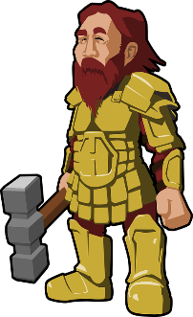
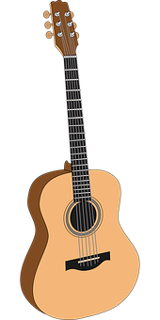
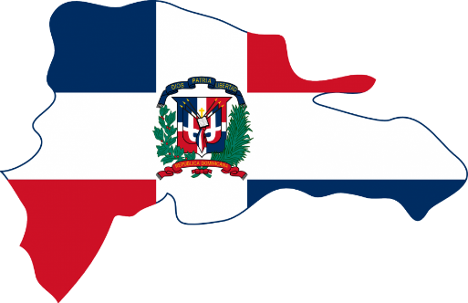
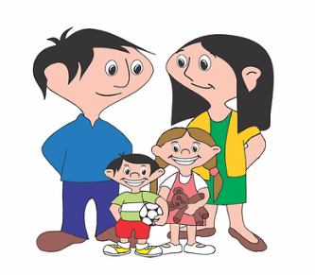
Miguel, el *guerrero portugués, toca la guitarra y baila merengue. Ángel de Gerona usa *poderes mágicos en el colegio para pasar las páginas. Generalmente, la gente de Argentina es genial, inteligente y generosa.
*guerrero = warrior
*poder = power
hablar
Tongue twisters
1
2
3
El merengue es un tipo de música para bailar de la República Dominicana.
1
2
3
1
2
3
Notes:
A tonguetwister
Timing: 5 mins
Aim: to gain confidence in practising the SSCs [gue] / [ge] vs [gui] / [gi] in sentences
Procedure:
The teacher first asks students to read the short text and think about what it means.
The teacher reads the text aloud in fragments, eliciting the meanings from students. A number of new words are included.
Students then practise saying the sentence in pairs, at increasing speed.
The teacher can challenge students to listen to a native speaker read the text at three different speeds (1=slow; 3=very fast). Each time, students can be challenged to say it at the same speed.
Notes:
The teacher can show a brief definition of ‘merengue’ with one click, and it will disappear with a further click.
Frequency rankings of unknown words and cognates (1 is the most common word in Spanish):
guerrero [2648]; merengue [>5000]; poder [352]; generoso [3193]
Source: Davies, M. & Davies, K. (2018). A frequency dictionary of Spanish: Core vocabulary for learners (2nd ed.). Routledge: London

Slide 15
SSCs [gue], [gui]
fonética
Consolidation [4]

Slide 16
Talking about the past Verb endings ‘-qué’ and ‘-gué’
gramática / fonética
Sometimes the spelling of –ar verbs changes in the past.
This is due to their pronunciation!
Normally, we just add‘-é’ to a stem to refer to ‘I’ in the past (preterite).
However, for –ar verbs ending in ‘-car’, we remove –car and add –qué.
Ejemplos:
sacar
saqué
buscar
busqué
(to take out)
(I took out)
(to look for)
(I looked for)
For –ar verbs ending in ‘-gar’, we remove –gar and add –gué.
Ejemplos:
llegar
llegué
pagar
pagué
(to arrive)
(I arrived)
(to pay)
(I paid)
Notes:
Timing: 2 minutes
Aims:
to recap the formation of the 1st person singular ending for verbs ending in ‘-car’ and ‘-gar’
to understand the reason for this (the need for the verbs to maintain the correct pronunciation)
Procedure:
Remind students of the rule for forming the 1st person singular preterite form of regular ‘-ar’ verbs. Ask students what the verb ending is, which will be revealed with a click.
Click again to show the two rules and examples for each. This is an opportunity to revisit the ‘soft’ [ce] and [ge] SSCs and juxtapose it with the [qué] and [gué] SSC.

Slide 17
Lucía y su tío participaron en un evento para ayudar a la organización benéfica Médicos Sin Fronteras. Escucha. ¿Qué hizo Lucía sola? Y, ¿qué hizo con su tío?
escuchar
-é
 | Lucía (‘I’) | Lucía y el tío (‘we’)
soporté
1
mandé
2
3
-qué
-gué
4
practiqué
jugué
5
busqué
pagué
6
saqué
llegué
7
8
*la organización benéfica = charity
*recaudar dinero = to raise money
Notes:
Timing: 7 minutes
Aim:
to practise connecting the verb endings –é and –amos with their endings
to accurately transcribe verbs with spelling changes in 1st person singular preterite (qué, gué)
Procedure:
Go through the task context and instructions with students.
Students listen to each sentence. The first time they can just note whether it refers to Daniel or Lucía and Daniel.
Play the audio again. This time they should transcribe the words in the 1st person singular preterite.
Check the answers with students. Elicit oral translations of each sentence to check understanding.
Transcript:
Logramos recaudar dinero para la organización Médicos sin Fronteras.
Caminamos bastante rápido.
Practiqué deporte. Jugué al fútbol con un chico de Alemania, Markus.
Busqué un lugar para dormir. Pagué treinta euros por la habitación.
No sé cómo soporté el mal tiempo. Llegué al hotel con agua en los zapatos.
Echamos de menos a la familia.
Logramos terminar el camino en diez días.
Saqué muchas fotos y las mandé a mamá.
Frequency of unknown words/cognates (1 is the most frequent word in Spanish):
benéfico [>5000]; recaudar [>5000], sencillo [1084]

Slide 18
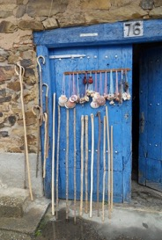
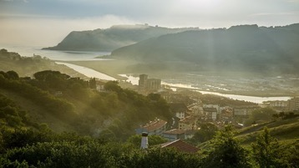
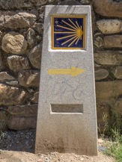
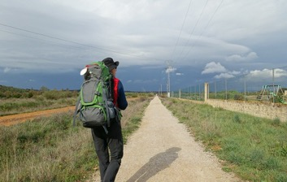
Un evento para ayudar a una organización benéfica
*recaudar = to raise *enseguida = straight away *sencillo = simple
leer / escuchar
1
5
En febrero mi tío me invitó a hacer el Camino de Santiago para *recaudar dinero para Médicos sin Fronteras. Esta organización benéfica trabaja en países pobres o lugares donde hay una crisis humana. iAcepté *enseguida!
Pasamos dos semanas especiales. ¡Qué aventura! Caminamos 100 kilómetros a través de Asturias y Galicia hasta Santiago de Compostela. Yo llevé todas mis cosas en una bolsa grande. Me acuerdo que un día caminamos veinte kilómetros a un pueblo precioso donde saqué fotos. Allí encontramos un hostal muy *sencillo para pasar la noche. Cenamos con una familia de Alemania y yo jugué al fútbol con su hijo, Markus.
El día siguiente hizo mal tiempo. iNo sé cómo soporté la lluvia! Llegué al próximo hostal con agua en los zapatos y eché de menos a mi familia. Sin embargo, con el apoyo de mi tío, logré terminar el camino dos días después.
2
6
3
7
4
8
Notes:
Timing: 8 minutes
Aim:
to help students to connect the spoken and written forms of the language more securely
to consolidate vocabulary and grammar knowledge by eliciting suggested changes to the text.
Procedure: Click on the audio button to play the text. Read and listen.
Note: There is a full version of the audio top right with a player. Alternatively the audio is in 8 sections with a pause just after the words 1-7 below, to facilitate easy stop/start.
To support segmentation (identifying boundaries between words), stop the audio and ask students to say: a) the next word b) the previous word
In addition, to develop understanding, vocabulary and grammar knowledge, pause at key points and ask students to suggest an alternative word that could replace the next word. This is a chance to draw on previously taught grammar and vocabulary knowledge. Students will need to think about the kinds of words they can use in context, depending on where the audio stops. Words in bold below are those after which the audio stops.
I: En febrero mi tío me invitó a hacer el Camino de Santiago para recaudar dinero para … [una organización, MSF, any infinitive]
II: … …Médicos sin Fronteras. Esta organización benéfica trabaja … [con personas pobres, en lugares/países donde hay problemas/guerra…]
III: …en países pobres o lugares donde hay una crisis humana. iAcepté enseguida! Pasamos dos semanas especiales. ¡Qué aventura! Caminamos 100 kilometros a través de Asturias y Galicia hasta Santiago de Compostela.Yo .... [any verb in 1st person singular preterite]
IV: … llevé todas mis cosas en una bolsa grande. Me acuerdo que un día caminamos veinte kilómetros a un pueblo … [an appropriate adjective, que se llama +name, cerca de, en las moñtanas , adjective e.g., precioso, bonito, pequeño]
V: … precioso donde saqué fotos. Allí encontramos … [any noun that works in context]
VI: … un hostal muy sencillo para pasar la noche. Cenamos con una familia de Alemania y yo jugué al fútbol con su hijo, Markus. El día siguiente hizo mal tiempo. iNo sé cómo soporté la lluvia! Llegué … [adverb or time marker e.g. temprano, tarde, por la tarde; preposition ‘a’ + place; time phrase e.g. a las ocho]
VII: al próximo hostal con agua en los zapatos y eché de menos a la familia. Sin embargo, con el apoyo de mi tío, logré… [any infinitive]
VIII: terminar el camino dos días después.
Frequency of unknown words/cognates (1 is the most frequent word in Spanish):
recaudar [>5000], crisis [871], enseguida [1070], sencillo [1084], hostal [>5000]; benéfico [>5000]

Slide 19
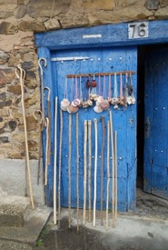
Un evento para recaudar dinero para Médicos sin Fronteras
*recaudar = to raise *enseguida = straight away
*el hostal = hostel *sencillo = simple
escribir
En febrero mi tío me invitó a hacer el Camino de Santiago para recaudar dinero para Médicos sin Fronteras. Esta organización benéfica trabaja en países pobres o lugares donde hay una crisis humana. iAcepté enseguida!
Pasamos dos semanas especiales. ¡Qué aventura! _[We walked]_ 100 kilómetros a través de Asturias y Galicia hasta Santiago de Compostela. Yo _[carried all my things]_ en una bolsa grande. Me acuerdo que un día caminamos veinte kilómetros a un pueblo precioso donde [I took photos]. Allí __[we found a hostel]__ muy *sencillo para pasar la noche. Cenamos con una familia de Alemania y yo _[I played football]_ con su hijo, Markus.
El día siguiente hizo mal tiempo. iNo sé cómo soporté la lluvia! [I arrived at the __[next hostel]__ con agua en los zapatos y _____[I missed the family]____. Sin embargo, con el apoyo de mi tío, [I managed to finish] dos días después.
Caminamos
Llevé todas mis cosas
saqué fotos
encontramos un hostal
jugué al fútbol
Llegué al
próximo hostal
eché de menos a la familia
logré terminar
Notes:
Timing: 8 minutes
Aim: to practise written production of the relevant verb endings (-é, -amos) and vocabulary
Procedure:
Display the gapped text.
Students write the missing words (they need not copy the text). It is enough just to write, e.g., 1. Caminamos.
Click to reveal each missing set of words.
Frequency of unknown words/cognates (1 is the most frequent word in Spanish):
recaudar [>5000], crisis [871], enseguida [1070], sencillo [1084], hostal [>5000]; benéfico [>5000]

Slide 20
Un evento para recaudar dinero para Médicos sin Fronteras
*recaudar = to raise *enseguida = straight away
*el hostal = hostel *sencillo = simple
escribir
En febrero mi tío me invitó a hacer el Camino de Santiago para recaudar dinero para Médicos sin Fronteras. Esta organización benéfica trabaja en países pobres o lugares donde hay una crisis humana. iAcepté enseguida!
Pasamos dos semanas especiales. ¡Qué aventura!
__[We walked 100km through/across Asturias and Galícia]__
hasta Santiago de Compostela. _[I carried all my things in a big bag]_.
Me acuerdo que un día caminamos veinte kilómetros a un pueblo precioso.
__[There we found a very simple hostal to spend the night]_.
[We had dinner with a family from Germany] y yo jugué al fútbol con su hijo.
El día siguiente hizo mal tiempo. iNo sé cómo soporté la lluvia!
_[I arrived at the next hostel with wáter in my shoes and I missed my family]_.
Sin embargo, [with the support of my uncle, I managed to finish, two days after.]
Caminamos 100 kilómetros a través de Asturias y Galicia
(Yo) llevé todas mis cosas en una bolsa grande.
Allí encontramos un hostal muy *sencillo para pasar la noche.
Cenamos con una familia de Alemania
Llegué al próximo hostal con agua en mis zapatos y eché de menos a mi familia.
con el apoyo de mi tío, logré terminar dos días después.
Notes:
VARIATION
This time students complete the text by writing longer phrases and sentences. This activity may be more suitable for a higher ability group.

Slide 21
hablar / escuchar
Habla de la experiencia de hacer el Camino de Santiago
Persona A habla: lee las frases en inglés. Debe decir las frases en español con verbos en el pasado que terminan en (-é, -gué, -qué o –amos), según la persona.
Persona B escucha: marca ‘I’ (é, -gué, -qué) o ‘we’ (-amos) y escribe la actividad en inglés.
Llevé una bolsa grande.
Ejemplo:
Persona B
Persona A
¿Quién? |  | la actividad
 | we | (en inglés)
1) I carried a big bag.
I
carried a big bag
Notes:
Timing: 12 minutes
Aims:
to produce and understand sentences the 1st person singular and the 1st person plural for the preterite tense
to produce and understand verbs with stem changes –gué and -qué
Procedure:
Student A looks at their card and translates the sentences into English, focusing on using the correct verb ending (-é, -gué,-qué or amos), depending on the person on the prompt card (‘I’ or ‘we’)
Student B notes down who their partner is talking about and translates the plan/activity into English.
Students swap roles.
The cards are shown on the next two slides which should not be shown during the activity.
Answers are shown on the slide after that for both students.

Slide 22
Persona A
 | ¿Quién? |  | la actividad
 | I | we | (en inglés)
1
2
3
4
5
6
I invited some friends to participate.
We swam in a river one afternoon.
I missed the family.
We managed to walk quite far.
I took lots of photos.
I didn’t pay for the hostel.
Notes:
DO NOT SHOW DURING ACTIVITY
Target answers:
Invité a unos amigos a participar.
Nadamos en un río una tarde.
Eché de menos a mi familia.
Logramos caminar muy lejos.
Saqué muchas fotos.
No pagué el hostal.

Slide 23
Persona B
 | ¿Quién? |  | la actividad
 | I | we | (en inglés)
1
2
3
4
5
6
I accepted the challenge*.
We couldn’t stand the sun after 11 o’clock.
We carried our clothes in a bag.
I missed England.
I looked for a present for my mum.
I played tennis against my friend.
*challenge = el desafío
*challenge = el desafío
Notes:
DO NOT SHOW DURING ACTIVITY
Target answers:
Acepté el desafío.
No sorportamos el sol después de las once.
Llevamos nuestra ropa en una bolsa.
Eché de menos Inglaterra.
Busqué un regalo para mi madre.
Jugué al tenis contra mi amigo.

Slide 24
Respuestas
Persona A
Persona B
 | ¿Quién? |  | la actividad
 | I | we | (en inglés)
1
2
3
4
5
6
 | ¿Quién? |  | la actividad
 | I | we | (en inglés)
1
2
3
4
5
6
invited friends to participate
accepted the challenge
couldn’t stand the sun
swam in a river
carried clothes in a bag
missed family
managed to walk quite far
missed England
looked for a present for Mum
took lots of photos
played tennis against my friend
didn’t pay for the hostel
Notes:
SHOW DURING FEEDBACK

Slide 25
SSCs [gue], [gui]
fonética
Consolidation [5]

Slide 26
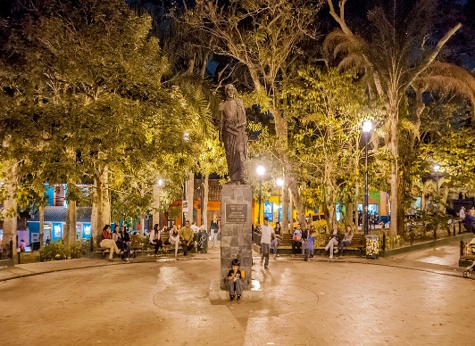
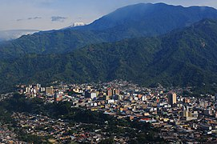
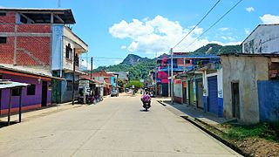
Lugares del mundo de habla hispana Lee la palabra. ¿Es ‘que’ o ‘gue’?
*el estado = state
fonética
Magangué
1
Guerrero
6
(Pueblo de Colombia)
(Estado* de México)
Quevedo
2
Querétaro
7
(Ciudad de Ecuador)
(Ciudad de México)
Los Teques, Venezuela
Ibagué
3
Rurrenabaque
8
(Ciudad de Colombia)
(Pueblo de Bolivia)
San Miguel
4
Ibagué, Colombia
Los Teques
9
(Ciudad de El Salvador)
(Ciudad de Venezuela)
Iquique
5
San Pablo Guelatao
10
(Ciudad de Chile)
(Pueblo de México)
Rurrenabaque, Bolivia
Notes:
Timing: 3 minutes
Aim:
i) to consolidate the SSCs ‘que’ and ‘gue’ in oral production
ii) to introduce students to some places that they will learn about during the lesson
Procedure:
Give students one minute to talk to a partner about how they would say the different words.
Click to make a prompt flash (it will flash 5 times in quick succession). This happens in random order to keep students on their toes.
Students say the word in chorus.
Then give students one further minute to practise in pairs under time pressure. One student says a word with the SSC ‘gue’ and the other must then say any other word, as quickly as possible, with the SSC ‘que’.
Note: orange action buttons with embedded audio are provided for additional support, if required. Click the button once to hear the place name.
Frequency of unknown words and cognates:
estado [271]
Pictures licensed under CC licenses:
Ibagué – photo from Wikimedia Commons https://commons.wikimedia.org/wiki/File:Ibagu%C3%A9.jpg by Gobernación del Tolima, licensed under Creative Commons Attribution-Share Alike 4.0 International license.
Rurrenabaque – photo from Wikimedia Commons https://commons.wikimedia.org/wiki/File:Rurrenabaque_Calle_Aniceto_Arce.JPG by Milton Lopez, licensed under Creative Commons Attribution-Share Alike 4.0 International license.
Los Teques – photo from Wikimedia Commons https://commons.wikimedia.org/wiki/File:Bol%C3%ADvar_Square_in_Los_Teques_2.jpg by Wilfredor, licensed under the Creative Commons CC0 1.0 Universal Public Domain Dedication .

Slide 27
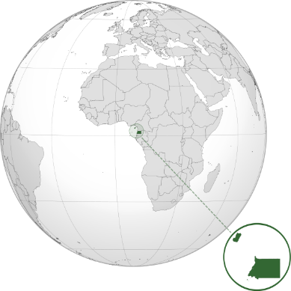
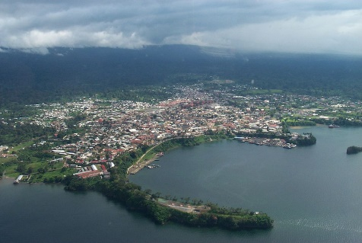
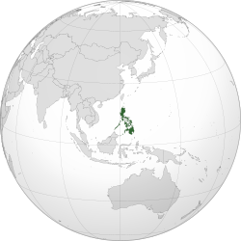
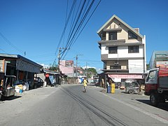
¿De dónde eres? ¿De dónde sois?
Escucha las preguntas.
¿Es ‘eres’ o ‘sois’?
escuchar
También escribe ‘qui’ o ‘gui’, según el lugar.
one ‘you’
more than one ‘you’
Zipaquirá
1
Zipa _ _ _ rá
Guinea Ecuatorial
2
_ _ _ nea Ecuatorial
3
I _ _ _ tos
Iquitos
Guinea Ecuatorial en el este de África era parte del imperio español hasta el 1968.
Guayaquil
4
Guaya _ _ _ l
Arequipa
5
Are _ _ _ pa
San _ _ _ llermo
6
San Guillermo
Bar _ _ _ simeto
7
Barquisimeto
San Guillermo es un pueblo en las Filipinas.
El país era parte del imperio español hasta 1898.
Monguí
8
Mon _ _ _
Notes:
Timing: 7 minutes
Aim:
to practise connecting ‘eres’ and ‘sois’ to their meanings (listening activity)
to practise aural recognition of SSCs [qui] and [gui]
Procedure:
Click to bring up the instructions.
Click the orange button to play the audio for the first time.
Click to reveal each answer and give feedback.
Play the audio again. This time, students write down ‘qui’ or ‘gui’, depending on the place name.
Click to reveal the answers to the second part of the activity.
Notes:
i. to challenge more able students, ask them to transcribe the whole word (the slide can easily be adapted to remove the gapped words).
ii. Spanish remains an official language of Ecuatorial Guinea today (in addition to French and Portuguese). 87.7% of the population speak Spanish as a first or second language (source: https://cvc.cervantes.es/lengua/anuario/anuario_06-07/pdf/paises_08.pdf)
iii. Spanish is a ‘recognised’ language in the Phillipines, meaning that it is “promoted on a voluntary and optional basis”. The official languages are English and Filipino. The country was named “Felipinas” after Philip II of Spain in 1542 and has a number of Spanish place names. Sources: http://republicact.com/widget/provision/340 and https://www.uni-due.de/SVE/VARS_Philippines.htm#:~:text=The%20Philippines%20are%20named%20after,them%20after%20its%20then%20king.
Transcript:
¿Sois de Zipaquirá?
¿Eres de Guinea Ecuatorial?
¿Sois de Iquito?
¿Sois de Guayaqui?
¿Eres de Arequi?
¿Sois de San Guillermo?
¿Eres de Barquisimeto?
¿Eres de Monguí?
Pictures licensed under CC licenses:
Equatorial Guinea map from Wikipedia https://commons.wikimedia.org/wiki/File:GNQ_orthographic.svg by Addicted04 This file is licensed under the Creative Commons Attribution-Share Alike 3.0 Unported license.
Photo https://commons.wikimedia.org/wiki/File:Malabo_a_13-oct-01.jpg
Phillipines map from Wikipedia https://commons.wikimedia.org/wiki/File:PHL_orthographic.svg by Addicted04This file is licensed under the Creative Commons Attribution-Share Alike 3.0 Unported license.
Photo https://commons.wikimedia.org/wiki/File:7560San_Guillermo_Capaoay,_San_Jacinto,_Pangasinan_30.jpg This file is made available under the Creative Commons CC0 1.0 Universal Public Domain Dedication.

Slide 28
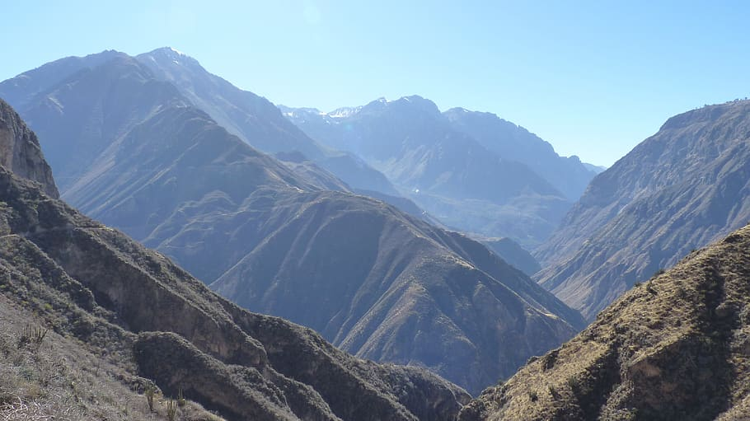
hablar / escuchar
¿De dónde eres? ¿De dónde sois?
Persona A: use your cards to say where you’re from. Use ‘soy’ (I am) or ‘somos’ (we are).
Persona B: listen carefully. Circle one person for ‘I am’ and two people for ‘we are’.
Then ask your partner for information about the city. Use these three questions:
¿Dónde está?
¿Cómo es?
¿Qué hay (allí)?
Somos de Arequipa.
¿Dónde está?
Un ejemplo:
Persona A:
En el sur de Perú.
Persona B:
1
1. Arequipa
Say: ‘We’re from Arequipa’
Other info
Write 2 or 3 details
in the south of Peru
in the south of Peru
_____________________
pretty
_____________________
there is a canyon* nearby
_________________________
*canyon = el cañon
El cañon cerca de Arequipa
Notes:
Note: there are two options for the final speaking and listening activity:
1) Slide 28: an activity where students practise producing ‘soy’ vs ‘somos’ and also ask for and give information about Latin American cities.
2) Slide 33: a ‘who am I’ style activity where students practise giving statements with ‘soy’ and ‘somos’ and producing questions with ‘eres’ and ‘sois’.
Option #1
Timing: 10 minutes
Aim:
to practise giving statements with ‘soy’ and ‘somos’
to practise asking three previously taught questions
to consolidate a range of vocabulary
Procedure:
Person A orally translates the statement on the prompt card into Spanish (e.g. Somos de Arequipa). This will involve ‘soy’ or ‘somos’, depending on the prompt.
Student B listens and circles one person if for ‘soy’ (I am) and two people for ‘somos’ (we are).
Student B then asks Student A for more information. Any of the three questions suggested on this slide could be used.
Student A listens and gives information as a suitable response. The information on Student A’s card will always refer to where the place is, what it’s like and what there is.
Note: glosses are given to the speaker for a number of country names. Although these country names have not been previously taught as vocabulary, they have been used in this lesson and in others, so students may well already be familiar with them. They are also all cognates, so we can expect the listener to be able to write them down accurately (even if unfamiliar with the country).
Picture source:
https://www.piqsels.com/da/public-domain-photo-jlths (photos released under CC0 public domain license)
Frequency of unknown words and cognates:
pesquero [>5000]; surf [>5000] selva [2768]; iguana [>5000]; cañon [>5000]; puerto [1077]

Slide 29
Persona A
Persona A
hablar
1
2
3
Say: ‘I’m from Querétaro’
Say: ‘We’re from San Guillermo’
Say: ‘I am from Monguí’
in the centre of Mexico*
in the centre of Colombia*
quite famous
in the Philippines*
pretty, traditional town
there are beautiful buildings
small town
there are mountains nearby
there aren’t many people
*México = Mexico
*Filipinas = Philippines
*Colombia = Colombia
4
5
6
Say: ‘I am from Iquitos’
Say: ‘We are from San Miguel’
Say: ‘We’re from Guayaquil’
in the north of Peru
in the south of El Salvador*.
on the coast of Ecuador*
it’s hot there
interesting place
big city next to a river
there is a famous river nearby
there is a carnaval every November
there is a park with iguanas*
*Peru = Perú
*El Salvador = El Salvador
*Ecuador; *iguana = iguana
Notes:
Persona A – Prompt cards (speaking)
(DO NOT DISPLAY DURING ACTIVITY)

Slide 30
Persona B
Persona B
7
8
9
Say: We’re from Magangué
Say: We’re from Los Teques
Say: I’m from Equatorial Guinea*
in the north of Colombia*
in the north of Venezuela*
in Africa
an interesting country
big town
small city
it used to be a port*
there are lots of tall buildings
there are people who also speak French
*Colombia *el puerto = port
*Venezuela = Venezuela
*Guinea Ecuatorial *África
10
11
12
Say: We’re from Iquique
Say: I’m from Rurrenabaque
Say: We’re from Guerrero
in the north of Chile
in the north of Bolivia*
in the south of Mexico
small city with little rain
it is very hot there
it is famous for its beaches
there are buildings by (‘next to’) the sea
there is a lot of nature nearby
there are also many mountains
*Chile = Chile
*Bolivia = Bolivia
*México = Mexico
Notes:
Persona B – Prompt cards (speaking)
(DO NOT DISPLAY DURING ACTIVITY)

Slide 31
Persona B
Persona B
1. Querétaro
2. San Guillermo
3. Monguí
Circle the correct picture.
Circle the correct picture.
Circle the correct picture.
Write 2 or 3 details
Write 2 or 3 details
Write 2 or 3 details
in the centre of Mexico
_____________________
in the Philippines
in the centre of Colombia
_____________________
_____________________
quite famous
_________________________
small town
pretty, traditional town
_________________________
_________________________
beautiful buildings
not many people
_________________________
_________________________
mountains nearby
_________________________
4. Iquitos
5. San Miguel
6. Guayaquil
Circle the correct picture.
Circle the correct picture.
Circle the correct picture.
Write 2 or 3 details
Write 2 or 3 details
Write 2 or 3 details
in north of Peru
_____________________
in south of El Salvador
on the coast - Ecuador
_____________________
_____________________
it’s hot there
_________________________
interesting place
_________________________
big city next to a river
_________________________
famous river nearby
_________________________
Carnaval every November
park with iguanas
_________________________
_________________________
Notes:
Persona B – Answer cards (listening)
(DO NOT DISPLAY DURING ACTIVITY)

Slide 32
Persona A
Persona A
7. Magangué
8. Los Teques
9. Guinea Ecuatorial
Circle the correct picture.
Circle the correct picture.
Circle the correct picture.
Write 2 or 3 details
Write 2 or 3 details
Write 2 or 3 details
in north of Colombia
_____________________
in north of Venezuela
_____________________
in Africa
_____________________
big town
__________________
puerto = port
small city
an interesting country
_________________________
_________________________
used to be a port
__________________
lots of tall buildings
people who speak French
_________________________
_________________________
10. Iguique
11. Rurrenabaque
12. Guerrero
Circle the correct picture.
Circle the correct picture.
Circle the correct picture.
Write 2 or 3 details
Write 2 or 3 details
Write 2 or 3 details
in the north of Chile
in the north of Bolivia
_____________________
_____________________
in south of Mexico
_____________________
small city with little rain
_________________________
very hot
_________________________
famous for its beaches
_________________________
buildings by the sea
_________________________
a lot of nature nearby
_________________________
many mountains
_________________________
Notes:
Persona A – Answer cards (listening)
(DO NOT DISPLAY DURING ACTIVITY)

Slide 33
hablar / escuchar
¿Quién soy / somos?
Use your cards to
give statements using ‘soy’ (I am) and ‘somos’ (we are).
ask questions using ‘eres’ (you are) and ‘sois’ (you both are)
Un ejemplo:
Somos de Guayaquil.
Mmm... ¿Sois Francisco y Elena?
No, prueba otra vez.
¿Sois Jorge y Alejandra?
iSí!
Persona A:
Persona B:
Say it in Spanish, but don’t say the names!
Did you hear ‘somos’ or ‘soy’?
Look at your options and ask your partner who it might be, using ‘¿Eres…?’ or ‘¿Sois…?’
Then, answer your partner’s question(s). Answer ‘sí’ or ‘intenta otra vez’.
1. We are from Guayaquil.
a) Francisco
c) Jorge
(Jorge y Alejandra)
b) Francisco y Elena
d) Jorge y Alejandra
Notes:
Option #2
Timing: 10 minutes
Aim:
to practise asking questions with ‘eres’ and ‘sois’
to practise giving statements with ‘soy’ and ‘somos’
Procedure:
Person A reads aloud the question on their prompt card. This will either have to produce ‘somos’ or ‘soy’, depending on the prompt.
Student B listens and decides which options on his/her card might be correct. There will be two answers that are potentially correct.
Student B asks ‘¿eres…?’ or ‘¿sois…?’ and the name(s) that s/he thinks might be correct.
Student A listens, looks at his/her card and either confirms (‘sí’) or says try again (‘intenta otra vez’).

Slide 34
Persona A
Say the sentence in Spanish, but don’t say the names below it!
Did you hear ‘somos’ or ‘soy’?
Look at your options and ask your partner who it might be, using ‘¿Eres…?’ or ‘¿Sois…?’
Your partner will ask you questions to find out who is speaking.
1a) Francisco
1c) Jorge
1. We are from Guayaquil.
(Jorge y Alejandra)
1b) Francisco y Elena
1d) Jorge y Alejandra
2a) David
2c) Mariel
2. We are from Magangué.
(Jorge y Elena)
2b)Mariel y Alejandra
2d) Jorge y Elena
3. I am from Los Teques.
3a) Pablo
3c) David
(Pablo)
3b) Mariel y Elena
3d) Jorge y Alejandra
4. I am from San Pablo Guelatao.
4a) David
4c) Alejandra
(David)
4b) Francisco y Elena
4d) Mariel y ELena
5a) Elena
5c) Mariel
5. We are from Iquitos.
(Mariel y Elena)
5b) Mariel y Elena
5d) Alejandra y David
Notes:
Persona A – prompt cards and answer cards
(Do not display during activity)

Slide 35
Persona B
Did you hear ‘somos’ or ‘soy’?
Look at your options and ask your partner who it might be, using ‘¿Eres…?’ or ‘¿Sois…?’
Say the sentence in Spanish, but don’t say the names below it!
Your partner will ask you questions to find out who is speaking.
1a) Francisco
1c) Jorge
1. I am from Guinea Ecuatorial.
1b) Francisco y Elena
1d) Jorge y Alejandra
(Francisco)
2a) David
2c) Mariel
2. We are from Guerrero.
2b)Mariel y Alejandra
2d) Jorge y Elena
(Mariel y Alejandra)
3a) Pablo
3c) David
3. We are from Iquitos.
3b) Mariel y Elena
3d) Jorge y Alejandra
(Mariel y Elena)
4a) David
4c) Alejandra
4. I am from San Guillermo.
4b) Francisco y Elena
4d) Mariel y Elena
(David)
5a) Elena
5c) Mariel
5. I am from San Miguel.
5b) Mariel y Elena
5d) Alejandra y David
(Mariel)
Notes:
Persona B – prompt cards and answer cards
(Do not display during activity)

